Slide 1
Linear Least Squares Regression
AIML for Engineers
Levent Burak Kara, Kevin Ferguson, Daniel Emerson

Slide 2
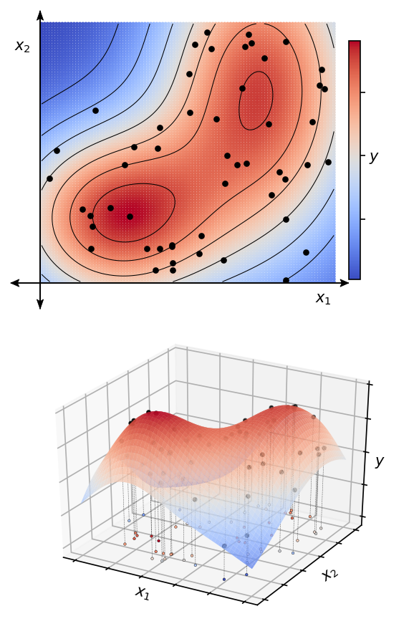
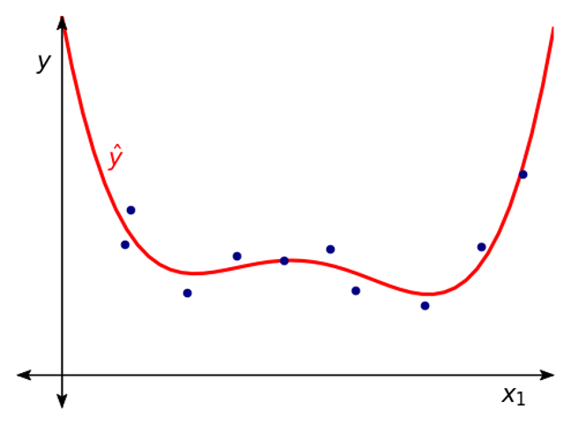
Overview
2D regression
Input x: data points at which measurements are taken
Output y: measured values (responses) at the measurement points x
Goal: find a function ŷ that best describes y
1D regression
Fatigue life
Extrusion head angle

Slide 3
Ontology
Pre-training
Attention mechanisms
Transfer learning
Regression
Dimensionality
Reduction
Semi-supervised learning
Ensemble methods
Convolutional Networks
Large language models
Supervised
Unsupervised
Contrastive learning
Deep learning
Neural Networks
Classification
AIML
Clustering
PCA
Active learning
Autoencoders
Generative Adversarial Networks
Self
supervised
Reinforcement
learning
Policy learning
Physics Informed Neural Nets
Reinforce
Actor-critic

Slide 4
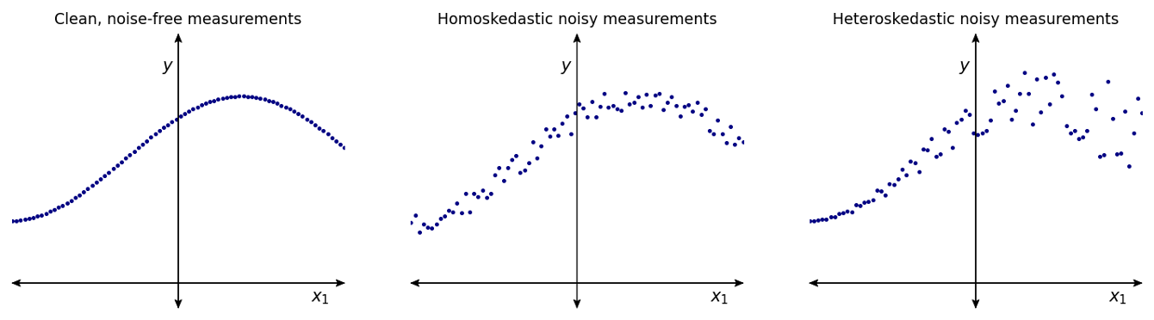
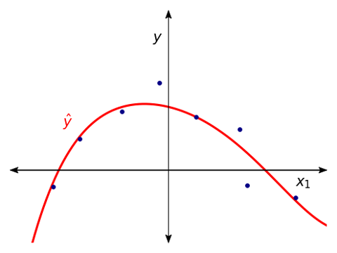
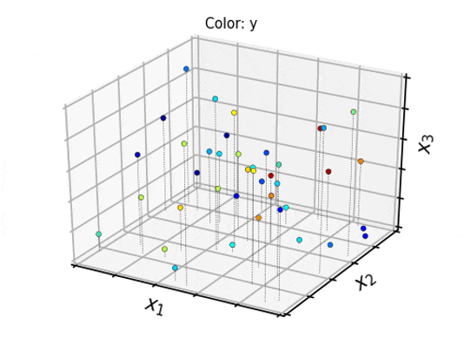
Overview
Data can be noisy:
Data can be low or high dimensional:
1D because only one input feature x = {x₁}
3D because three input features x = {x₁,x₂,x₃}

Slide 5
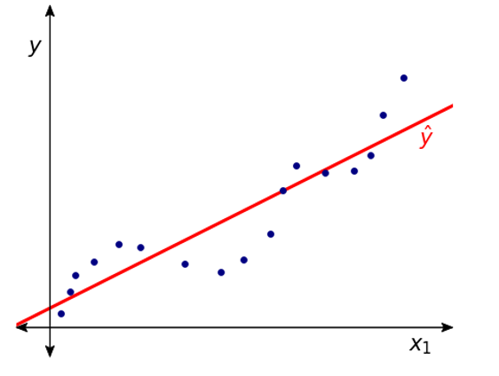
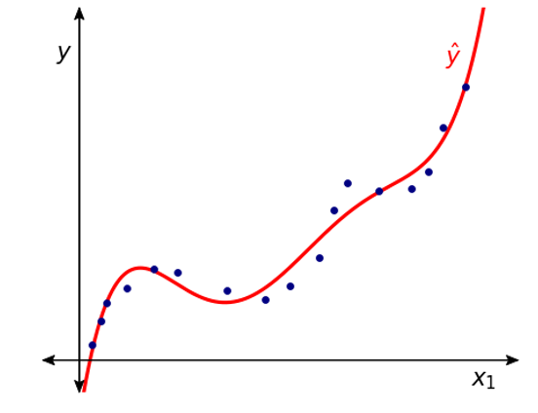
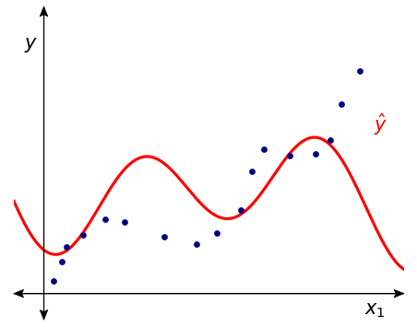
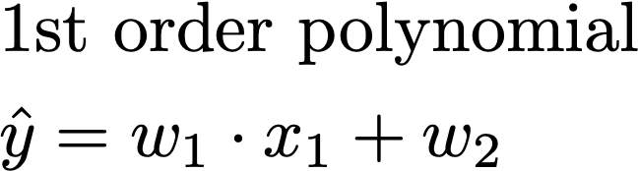
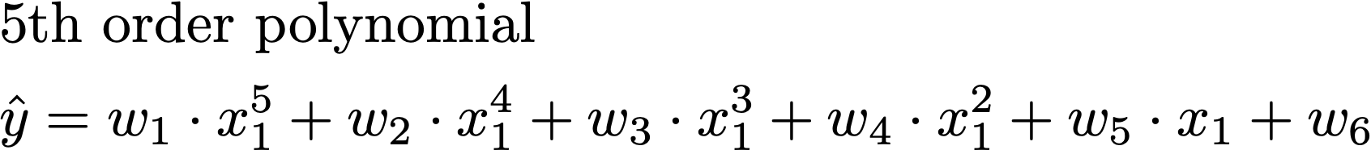
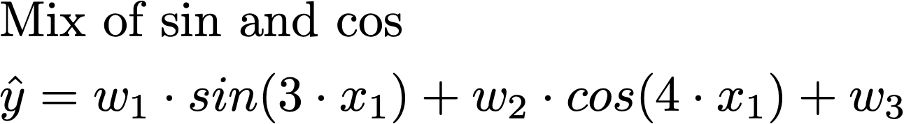
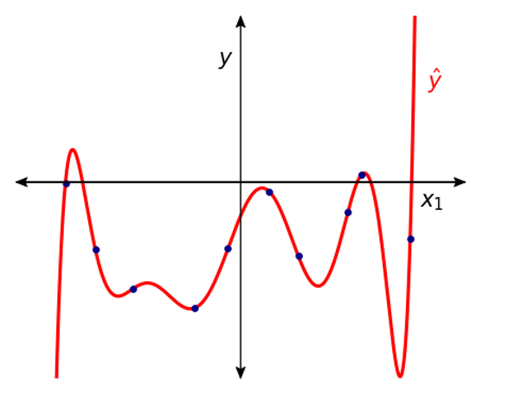
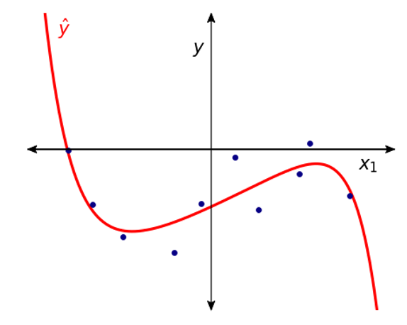
Overview
We can choose to fit simple of complex functions:
We can control “smoothness” through regularization:

Slide 6
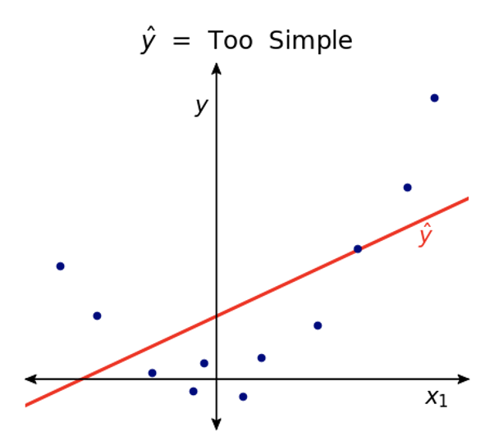
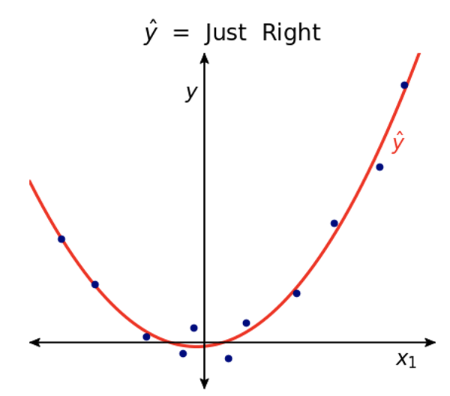
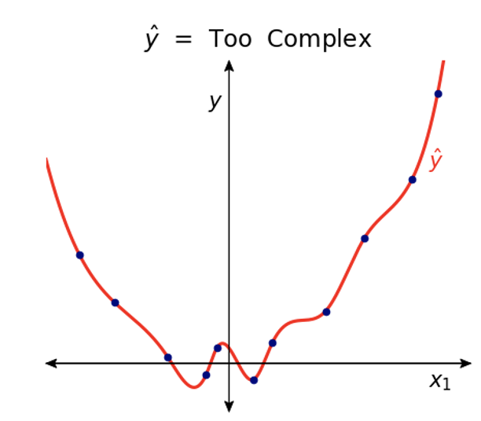
Overview
Overall criterion for a “good fit”: How well are you going to predict future data drawn from the same distribution?

Slide 7
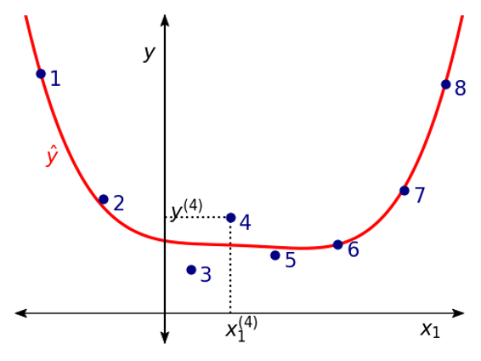
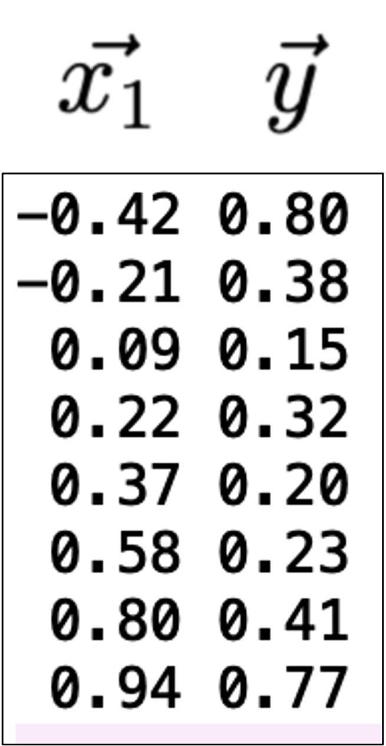
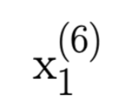
Nomenclature
Data point index
Input: x₁ = {x₁⁽¹⁾, x₁⁽²⁾, x₁⁽³⁾, … , x₁⁽⁸⁾}
Output y = {y⁽¹⁾, y⁽²⁾, y⁽³⁾, … , y⁽⁸⁾}
n = 8, number of data points
d = 1, dimensionality of input
The only feature we have here is x₁, and it contains 8 data points
Data in a txt file. This is what a typical file might look like
Dimension index

Slide 8
Approach
Pick the form of the function to be regressed (fitted) → ŷ
Write out all the equations
Establish an objective function to minimize
Solve the minimization problem to optimize w

Slide 9
Approach
Pick the form of the function to be regressed (fitted) → ŷ
Let’s use a 3rd order polynomial (cubic) function for ŷ
Unknowns: Model parameters. w = {w₁, w₂, w₃, w₄}. We need to find these.
Knowns: Features. There is one original feature: x₁ but using what is called feature expansion, our model is additionally using three new features {x₁³, x₁²,1}. These are generally non-linear variants of the original feature(s). When all is said and done, we have 4 total features: {x₁³, x₁², x₁, 1}. Everything about these is known/computable from the data given to us.
Important note: In LLS, ŷ will always be a linear function of the unknown parameters w. This is why it is called linear least squares regression, regardless of the form of the function we use (linear, quadratic, cubic, sin etc.)
We could have chosen a different model:
Note: this model is still linear in w. It has three parameters {w₁, w₂, w₃} to be computed. It has three total features {sin(3.1x₁), cos(4.2x₁), 1}, expanded from the original single feature x₁.
In general, domain experts may need to help with the choice of the fitted function.

Slide 10
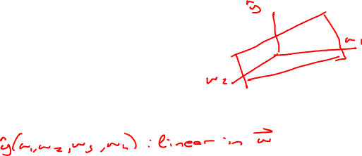
Approach

Slide 11
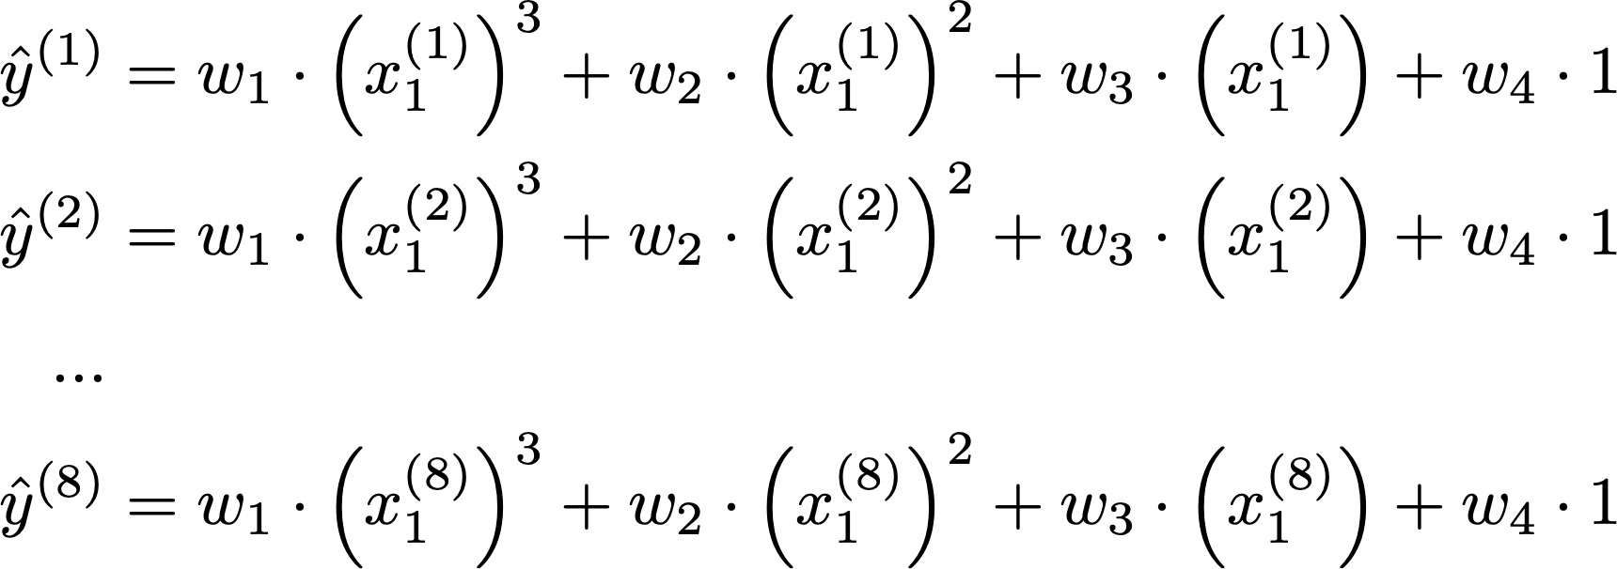
Approach
(2) Write out all of the equations (assuming we are proceeding with the cubic model)

Slide 12
Approach
(2) Write out all of the equations (assuming we are proceeding with the cubic model)

Slide 13
Approach
(2) Write out all of the equations (assuming we are proceeding with the cubic model)

Slide 14
Approach
(2) Write out all of the equations (assuming we are proceeding with the cubic model)

Slide 15
Approach
(2) Write out all of the equations (assuming we are proceeding with the cubic model)

Slide 16
Approach
(2) Write out all of the equations (assuming we are proceeding with the cubic model)

Slide 17
Approach
(2) Write out all of the equations (assuming we are proceeding with the cubic model)

Slide 18
Approach
(2) Write out all of the equations (assuming we are proceeding with the cubic model)

Slide 19
Approach
(2) Write out all of the equations (assuming we are proceeding with the cubic model)

Slide 20
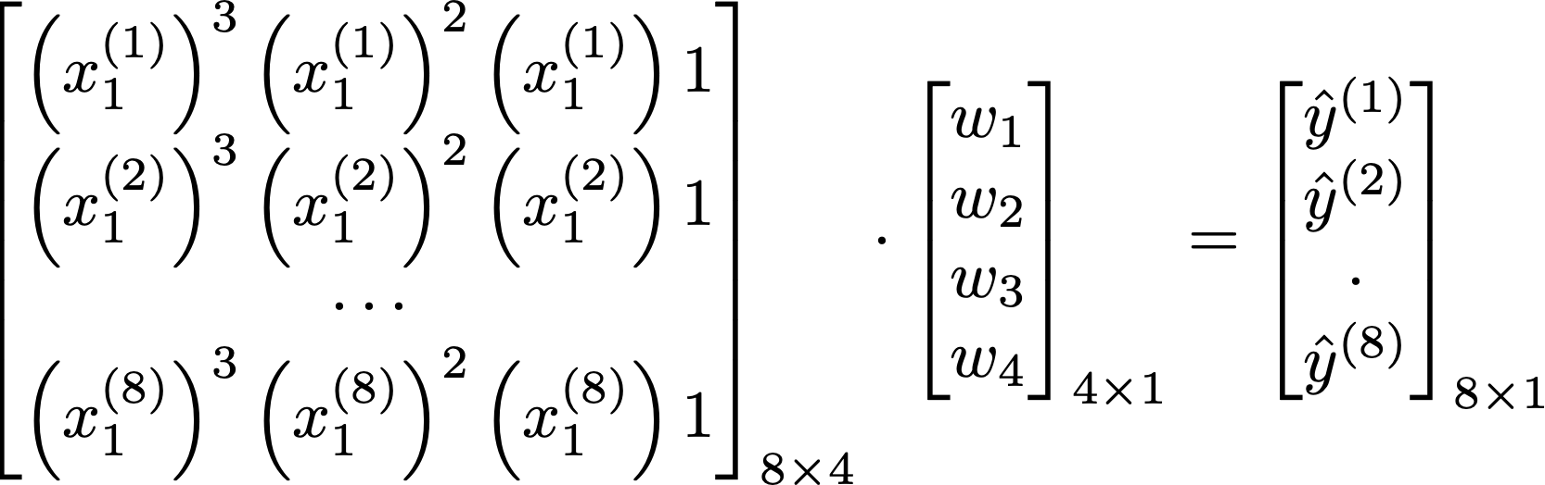
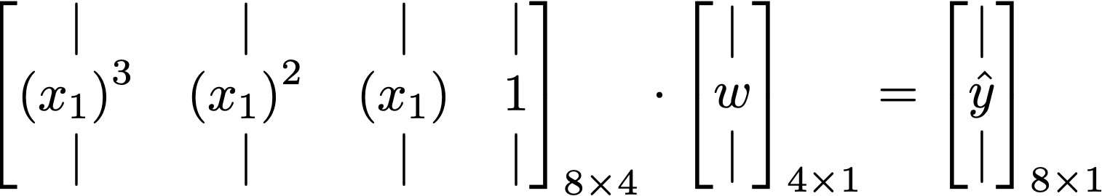
Approach
(2) Write out all of the equations (assuming we are proceeding with the cubic model)
The above can be compactly written as:
Even more compactly:

Slide 21

Approach
Note: there are usually more equations (data points = 8) than unknowns (4)
- We must have an over-constrained (or at worst, properly constrained) set of equations
- Otherwise (i.e., short and wide X matrix), the system of equations will be under-constrained and hence infinitely many solutions will exist.
Known
Unknown
Unknown
Tall and skinny matrix

Slide 22
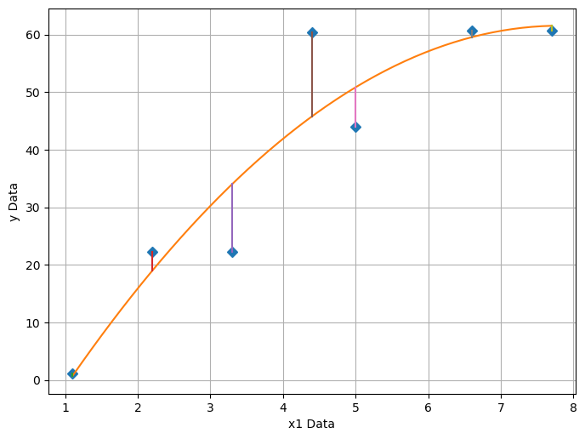
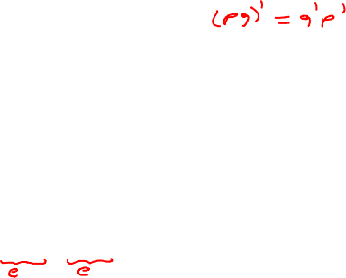
Approach
(3) Establish an objective function to minimize
Known
Unknown
Unknown
Known
Approach: Minimize the difference between ŷ and y. Define error e = ŷ - y. Note that e is a function of w
Minimize the squared magnitude of e by finding the best w*: ‖e‖ = e’e

Slide 23
Break

Slide 24
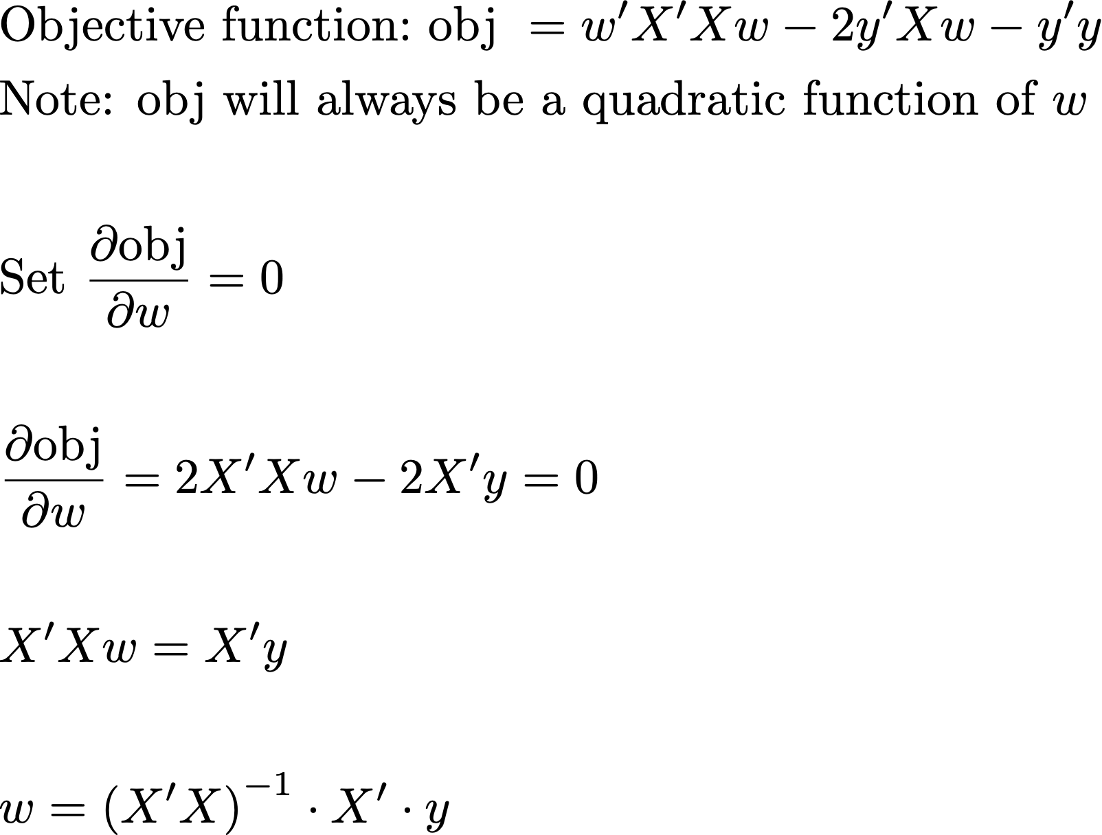
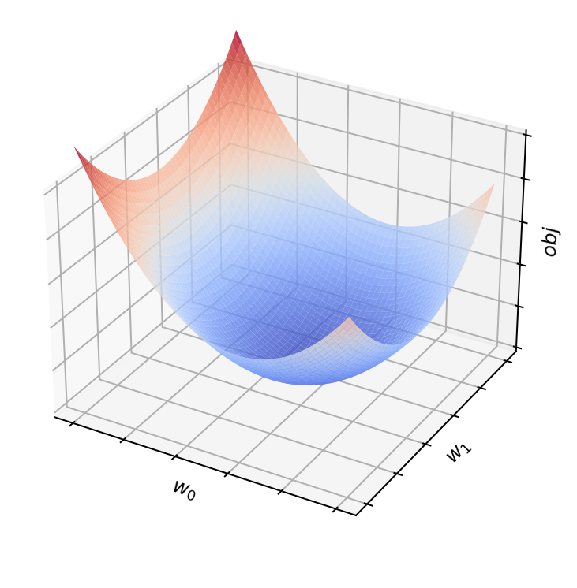
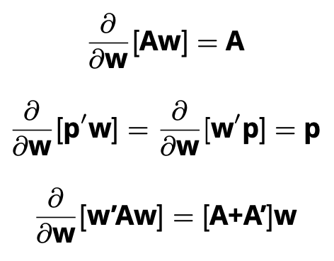
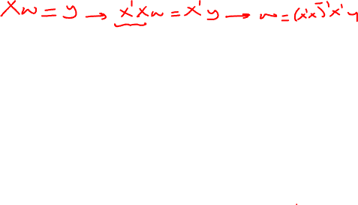
Approach
(4) Solve the minimization problem to find the optimized w*
Obj is a quadratic function of w
Closed form solution to the best (optimal) model parameters

Slide 25
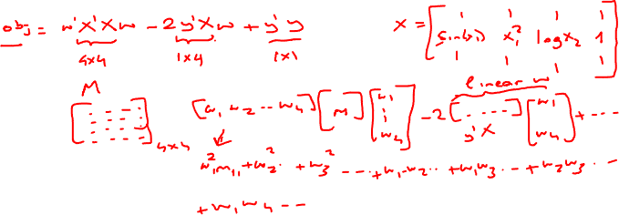
Why quadratic?

Slide 26
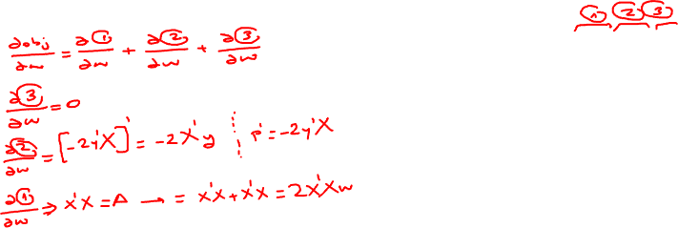
Approach

Slide 27
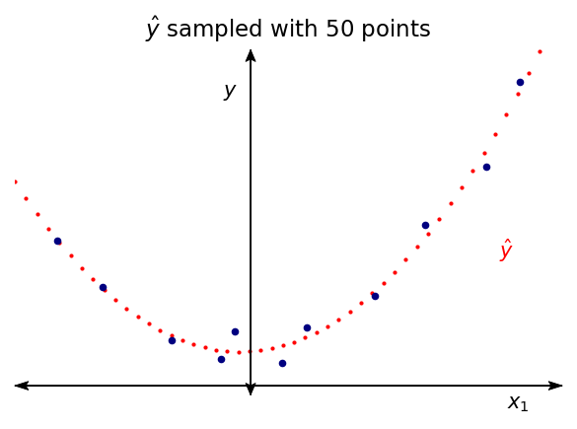
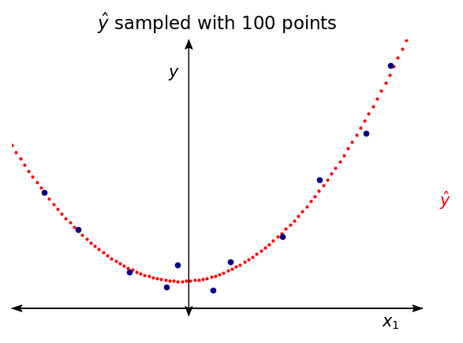
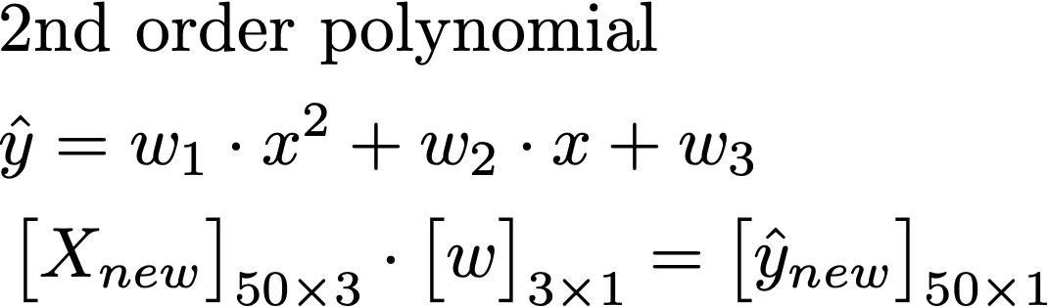
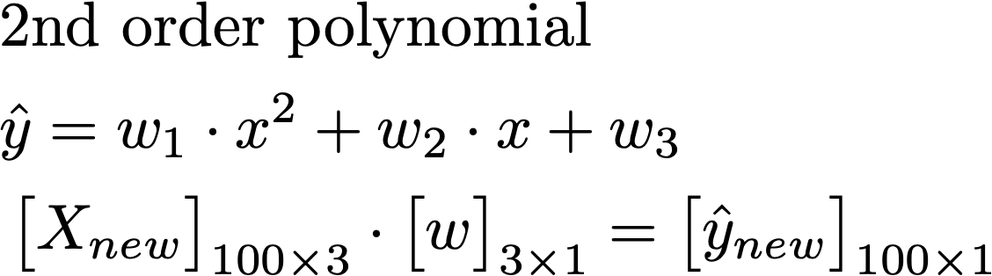
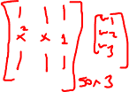
Trained Model
How do we use our model? Now that you have determined (optimized) your model parameters, you can sample from it as you wish!

Slide 28
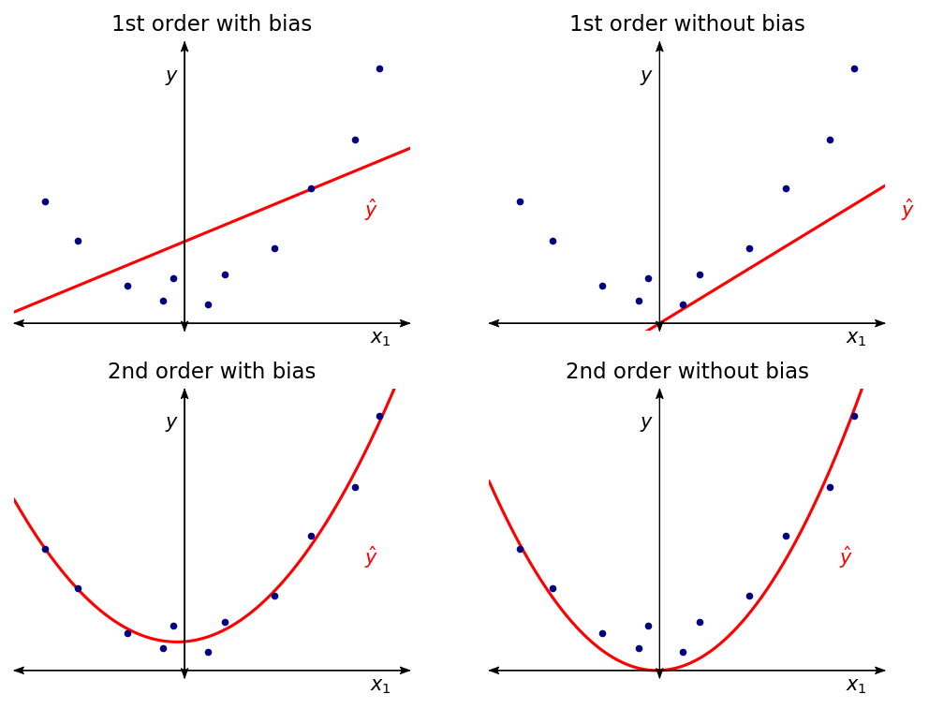
Model Bias
What happens without the bias term? The fitted model is forced to pass through the origin. This might be unnecessarily constraining in certain cases, while it might be desirable in others

Slide 29
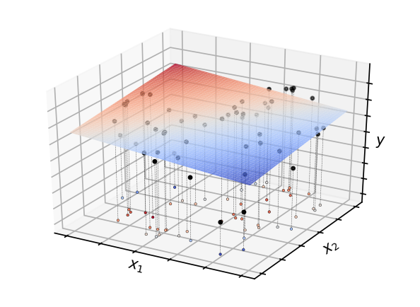
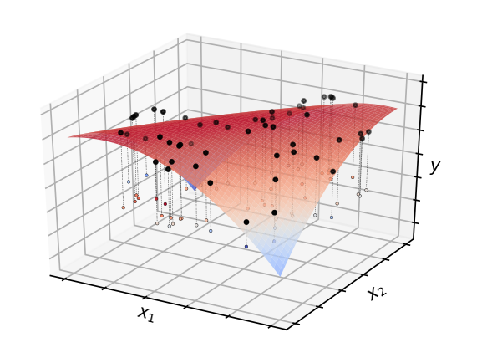
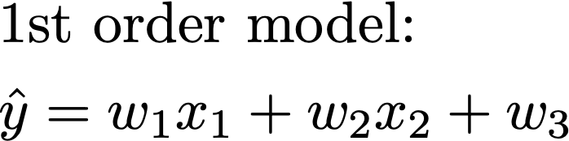
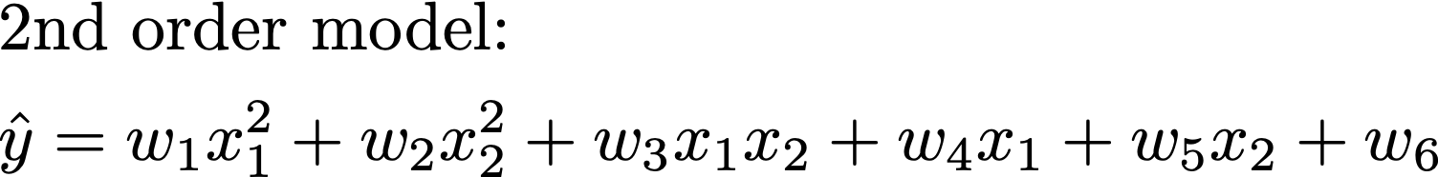
LLS in 2D Input Space
Underlying original function is a mixture of two Gaussians. 60 black points sampled from this function for training our models

