Slide 1
Linear Least Squares Regression
Iterative solvers, Regularization
AIML for Engineers
Levent Burak Kara, Kevin Ferguson, Daniel Emerson

Slide 2
Iterative Solvers
Remember: w* = (X’X)⁻¹ X’ y
If it is a complex model with many model parameters, inverting (X’X) can be problematic.
This is because the size of X’X is dXd where d is the number of model parameters
We can use various iterative methods to overcome this challenge, including:
Factorization methods: Cholesky decomposition, QR decomposition, SVD
Newton’s method
Gradient descent
In this course, we will study Gradient Descent

Slide 3
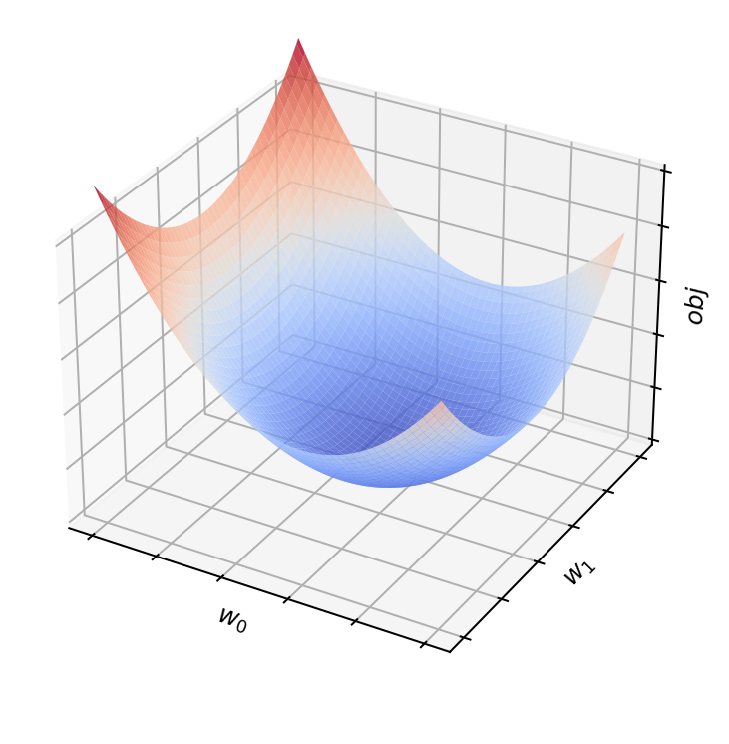
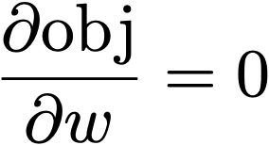

Gradient Descent for LLS
Remember our minimization problem, and how we arrived at the solution
Obj is quadratic in w:
w’X’Xw is the quadratic term in w
2y’Xw is the linear term in w
y’y is the constant term in w (does not affect optima)
Closed-form solution:
Obj is a quadratic function of w

Slide 4
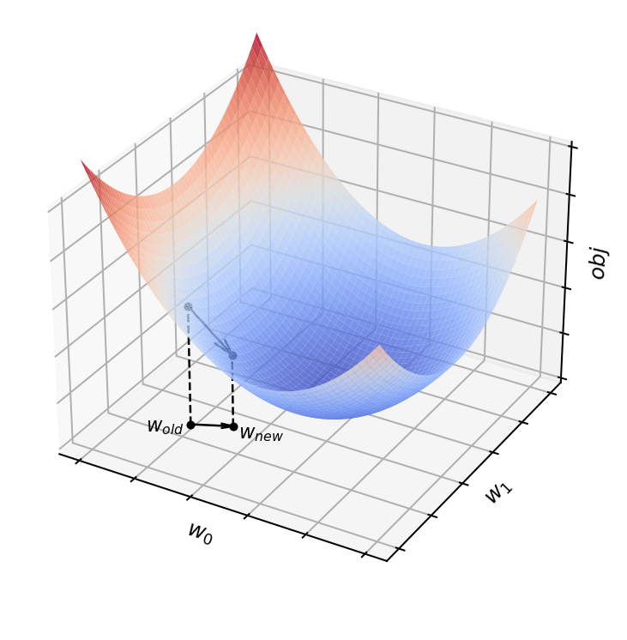
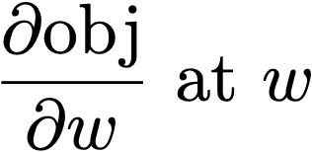
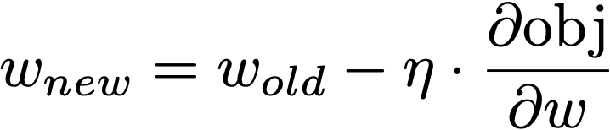
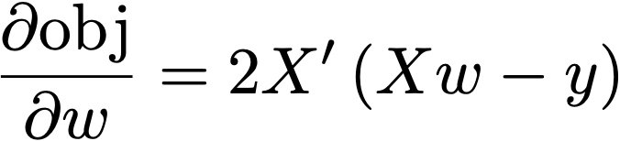
Gradient Descent for LLS
We can use gradient descent as follows:
Start at an initial w
Compute
η is the learning rate. Highly problem dependent, but if you have no better idea, choose η=0.05
Error vector e, between current model and training points
From calculus:
Gradient Descent
Update rule:

Slide 5
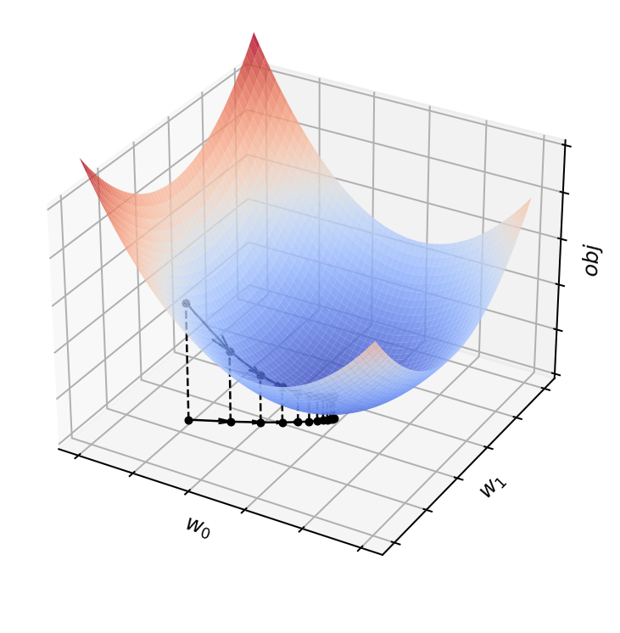
Gradient Descent for LLS
If found, is w* guaranteed to be the global optimum?
Yes, because the obj function is quadratic in w.
It has only one global minimum and is convex everywhere (no other local minima)
What is the impact of η?
If small, may take too long to converge
If large, may oscillate around the global minimum, without truly converging.
Tip: You can start with large η, then iteratively make it smaller
Gradient Descent

Slide 6
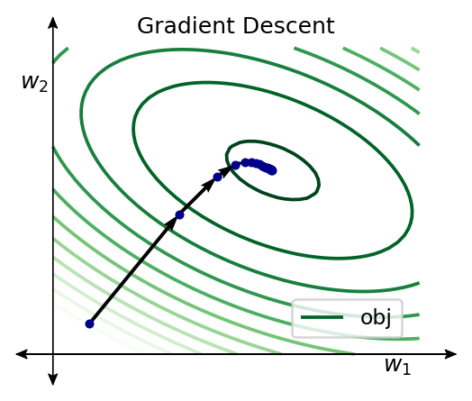
Stochastic Gradient Descent
Gradient descent uses the entire training data X and the corresponding y.
During GD iterations, it may be expensive to compute the gradient using the entire data set: 2 X’ (Xw-y)
X: nxd, w: dx1, y: nx1
n is the number of data points
d is the number of model parameters

Slide 7
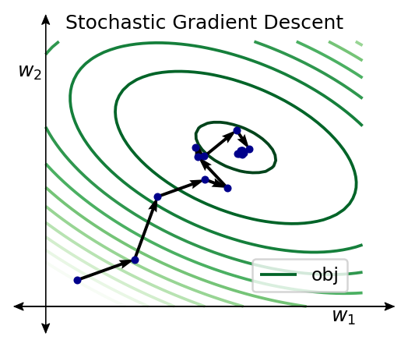
Stochastic Gradient Descent
Gradient descent uses the entire training data X and the corresponding y.
During GD iterations, it may be expensive to compute the gradient using the entire data set: 2 X’ (Xw-y)
X: nxd, w: dx1, y: nx1
n is the number of data points
d is the number of model parameters
Idea: Can we compute the gradient using a single data point?
Yes. This is called stochastic gradient descent.
At a given w, this does not represent the true gradient. Instead it is a very rough approximation. However, in each iteration, if you randomly change the data point that informs GD, you will obtain a noisy the following.

Slide 8
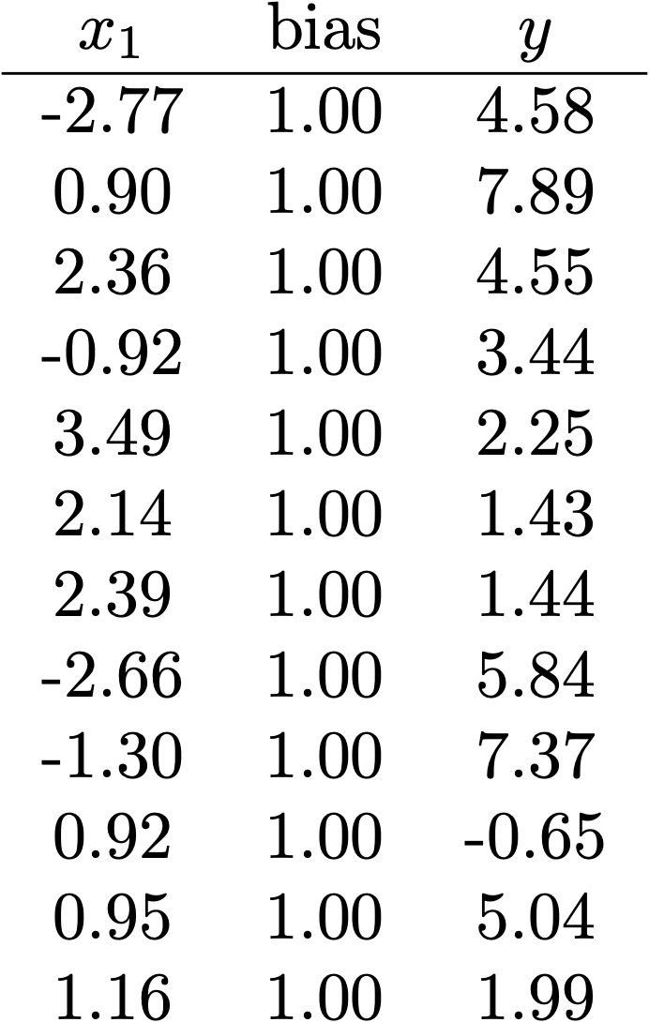






Regular (full batch) Gradient Descent
In regular Gradient descent:
Note: regardless of the number of data points, w is always dimension dx1

Slide 9


Stochastic Gradient Descent
In Stochastic Gradient descent:
Iter 1
Iter 3
Where the gradient is computed w.r.t a single randomly chosen data point
Iter 2

Slide 10



Batch Gradient Descent
Batch gradient descent falls between standard gradient descent and stochastic gradient descent.
We pick a random subset of the data (batch) at each iteration and compute the update as before
In this example b = 6
If b = 1, we have stochastic gradient descent
If b = n, we have standard gradient descent

Slide 11
Advantages of SGD and Batch GD
In each iteration, gradients are calculated using a much smaller set of training points.
Matrix multiplications become less demanding especially when the training set size (n) and the model complexity (d) are large
It is a noisier but potentially faster way of approaching w*. It is certainly much more memory efficient.

Slide 12

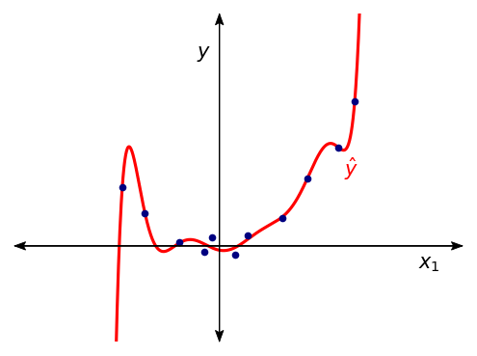
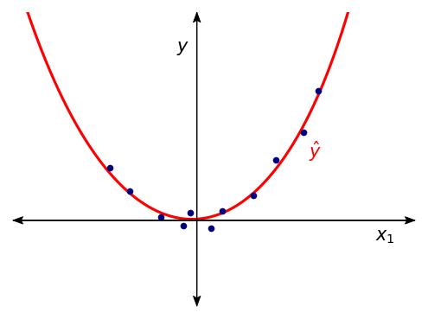
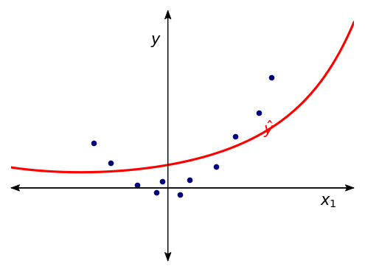
LLS with Regularization
L2 regularizer
Notes:
In this slide, I would like to have three plots like this. I want the middle one to be the ‘best’ level of regularization. The right one should be over regularized, so the curve should look overly flat. The left side one should with no regularization.

Slide 13
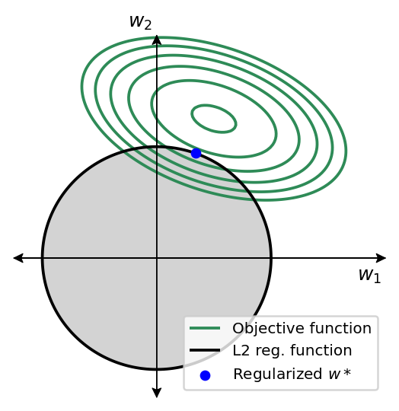
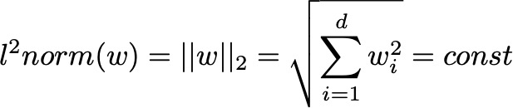
LLS with L2 Regularization
Also referred to as either ridge regularization
Aims to minimize the L2 norm of w (square length of w)
Adds positive values to the diagonal of the matrix X’X which improves the matrix condition
Simple closed form

Slide 14
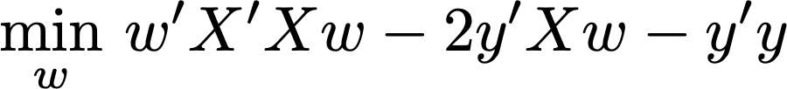


LLS with L2 Regularization
Also referred to as either ridge regularization
Aims to minimize the L2 norm of w (square length of w)
Adds positive values to the diagonal of the matrix X’X which improves the matrix condition
Simple closed form
Our previous objective function:
LLS closed form:
With L2 regularization we have:
LLS w/ L2 regularization closed form:
Note: we do not want to regularize the bias term so we use the modified identity matrix I_{m} to mask out the effect of regularization on w₀

Slide 15
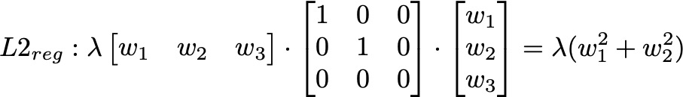

LLS with L2 Regularization - Example
Our objective function for LLS with L2 regularization:
Consider a 3DOF model with w = [w₁,w₂,w₃].
The L2 regularization (excluding the bias term w₃):

Slide 16
LLS with Regularization
L2 regularizer

Slide 17
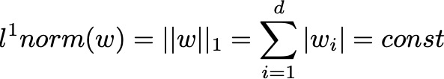
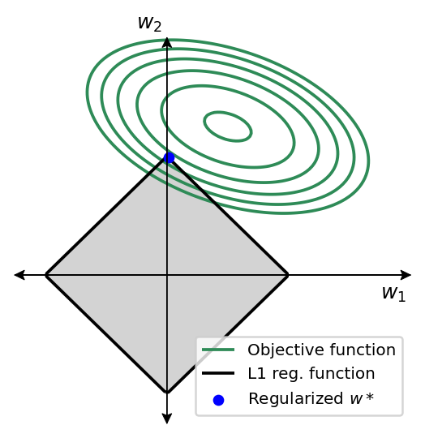
Other Regularization Techniques
L1 regularization
Also known as Lasso regularization (Least absolute shrinkage and selection operator)
Useful when we want to enforce sparsity on w, i.e., only a few nonzero model parameters
Useful for automatic feature selection

Slide 18
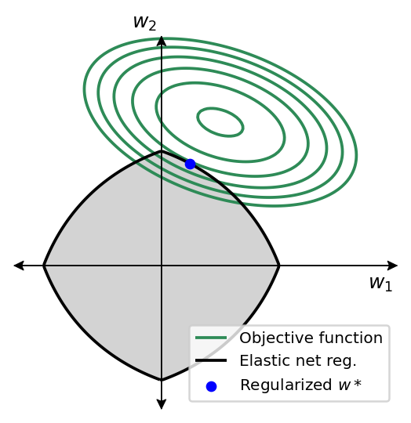
Other Regularization Techniques
L1 regularization
Also known as Lasso regularization (Least absolute shrinkage and selection operator)
Useful when we want to enforce sparsity on w, i.e., only a few nonzero model parameters
Useful for automatic feature selection
Elastic-net regularization
A weighted combination of L1 and L2 regularization

