Slide 1
Fundamentals of Web Media Technology
Module 18

Slide 2
Lecture Overview
Advanced jQuery | Events | Animation

Slide 3
Lecture Overview
TOPIC | OBJECTIVES
jQuery | Advanced | Events | click() | keypress() | on()
jQuery | Advanced | Effects | Basic |Custom | Fades | Slides

Slide 4
jQuery Events
Making things interactive

Slide 5
3 Most Common jQuery Events
click()
keypress()
on()

Slide 6
click()
jQuery’s click() is a quick and easy way to
add a click listener to element(s).
$(CSS Element).click(function() {
// code to do something interactive
});
anonymous callback function

Slide 7
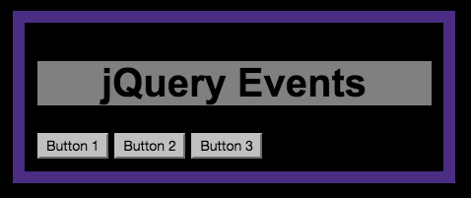

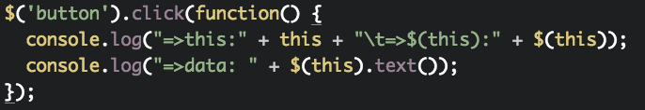
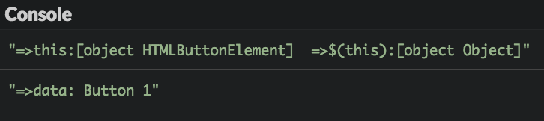
jQuery Event | click()

Slide 8
keypress()
jQuery’s keypress() is a way to
add a listener to user input keystrokes.
$(CSS Element).keypress(function(e) {
// code to process a single key code
});

Slide 9
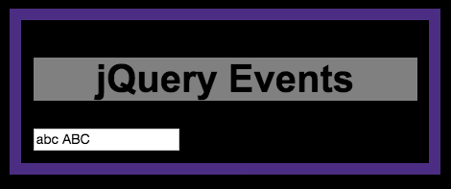

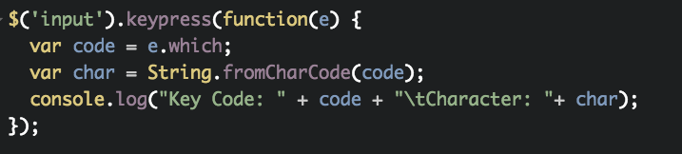
keypress()
"Key Code: 97 Character: a"
"Key Code: 98 Character: b"
"Key Code: 99 Character: c"
"Key Code: 32 Character: "
"Key Code: 65 Character: A"
"Key Code: 66 Character: B"
"Key Code: 67 Character: C"

Slide 10
on()
jQuery’s on() is similar to addEventListenter()
It provides a way to specify the type of an event.
$('button').on('click', function() {
// code to process a click
});
$('input').on('keypress', function() {
// code to process a keypress
});

Slide 11
on()
jQuery’s on() is similar to addEventListenter()
It provides a way to specify the type of an event.
$('li').on('mouseover', function() {
// code to process mouse entry
});
$('li').on('mouseleave', function() {
// code to process mouse exit
});

Slide 12
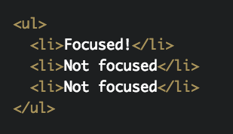
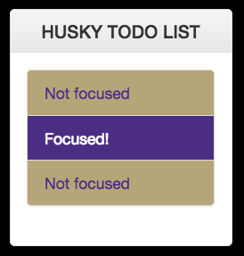
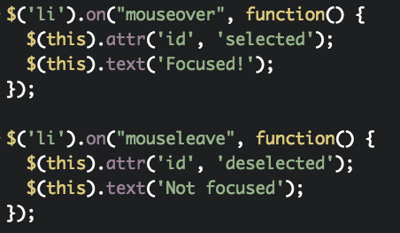
on()

Slide 13
Why use on()?
jQuery’s click() and on('click',...) both get the job done, but there is a subtle difference.
click() only applies to existing elements
on() applies to all potential future elements.

Slide 14
jQuery Effects
Livening up your objects

Slide 15
jQuery Effect Categories
Basics (3)
Custom (10)
.hide()
.show()
.toggle()
.animate()
...
.stop()
Fading (4)
Sliding (3)
.fadeIn()
.fadeOut()
.fadeTo()
.fadeToggle()
.slideDown()
.slideToggle()
.slideUp()

Slide 16
fadeOut()
Fading matched elements to transparent.
$('li').click(function() {
console.log("$(this):" + $(this));
$(this).fadeOut( 2000, function() {
console.log("fadeout complete!")
});
});

Slide 17
RECAP
Review of today’s lecture

Slide 18
Homework
Keep working on your portfolio.
Study chapters on Ajax and JSON

Slide 19
Code Lab 18
LAB | NAME | INSTRUCTIONS
18a | keylist.html keylist.css keylist.js | Using a state machine design pattern and keypress() create a website that can capture user keyboard input. Each time the user types in something and hits <enter> a new TODO list item will be added to the panel. Using click() add a reset button that clears the list.
18b | fader.html fader.css fader.js | Using the provided files for experimenting with panels of jQuery Effects, observe how the FadeOut works and then finish the panel for the other 3 fading effects.

Slide 20
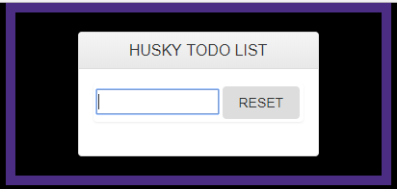
Lab 18a
Each time the user types a TODO item, and hits <enter>,
a new TODO list item will be added to the panel.

Slide 21
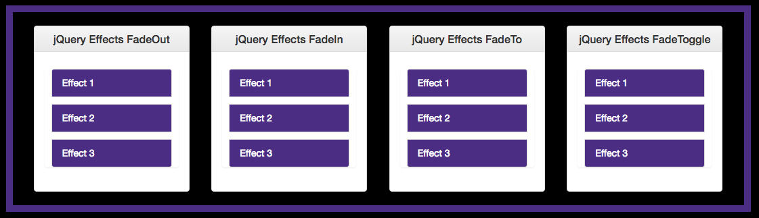
Lab 18b

