Slide 1

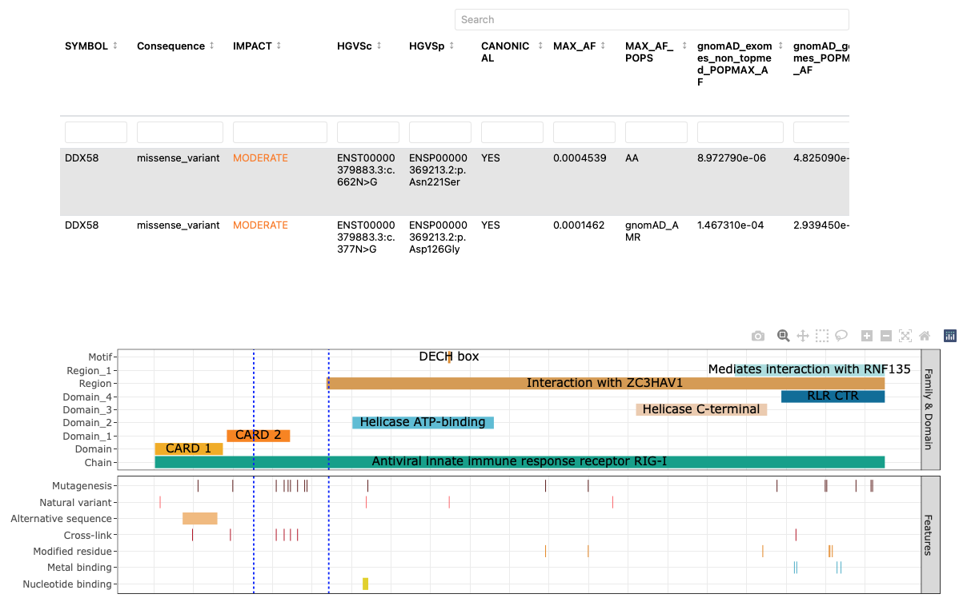
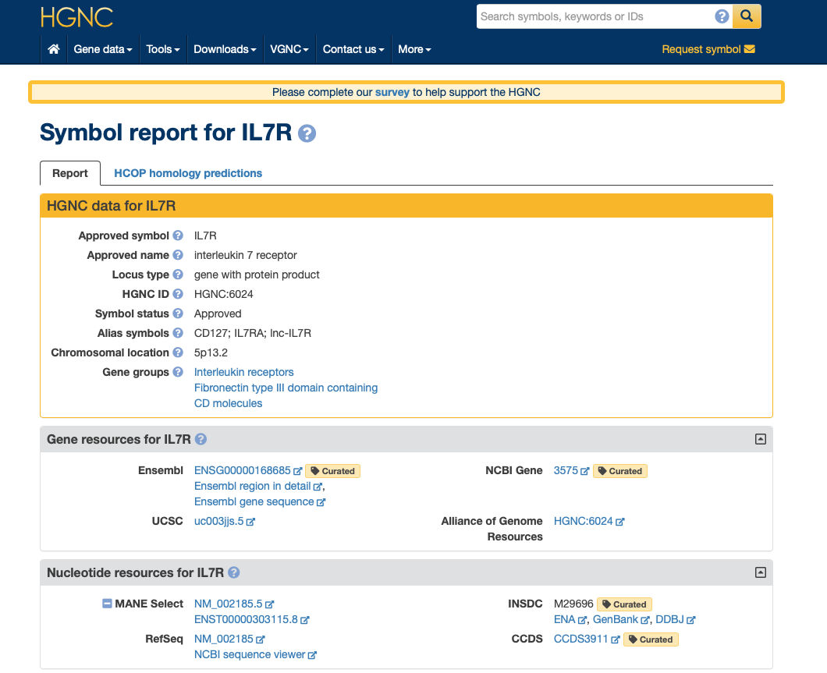
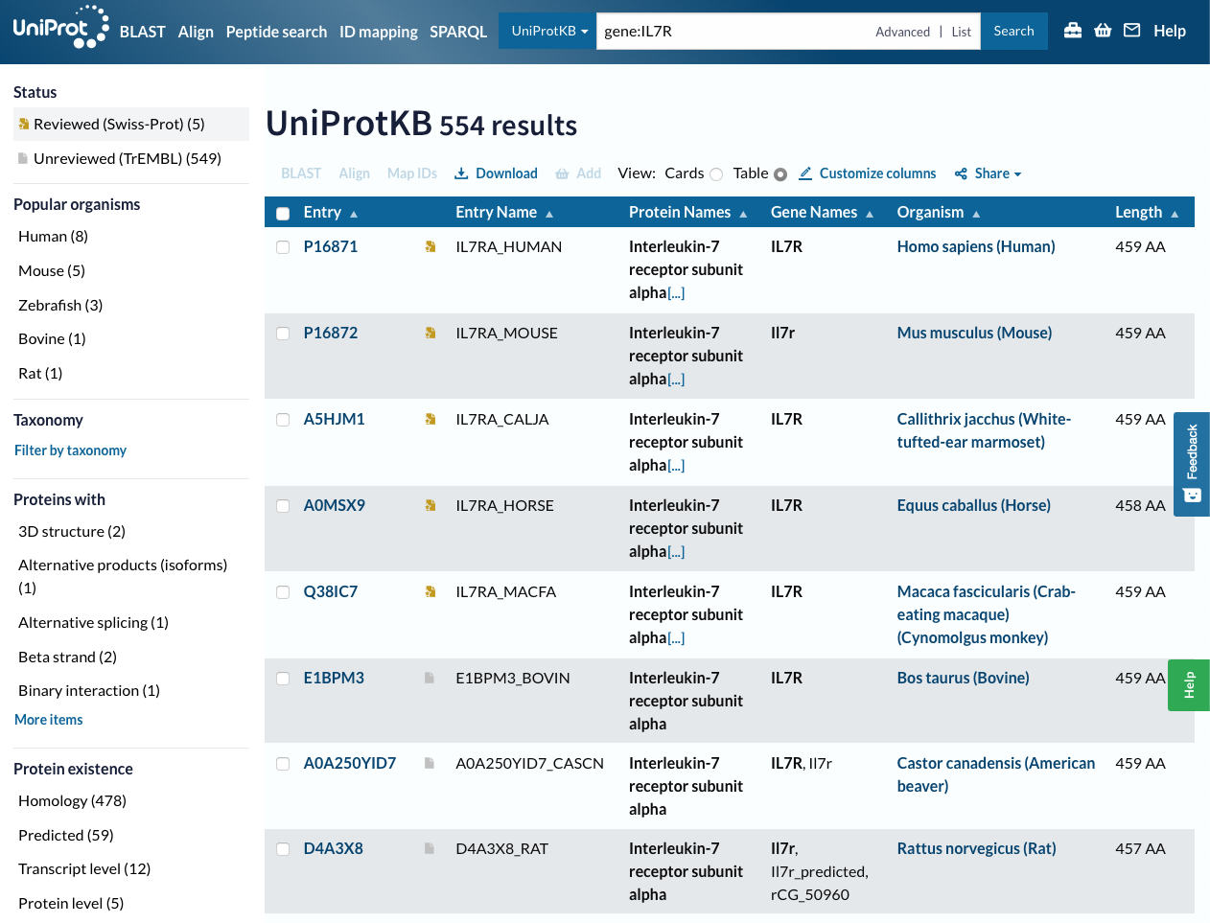
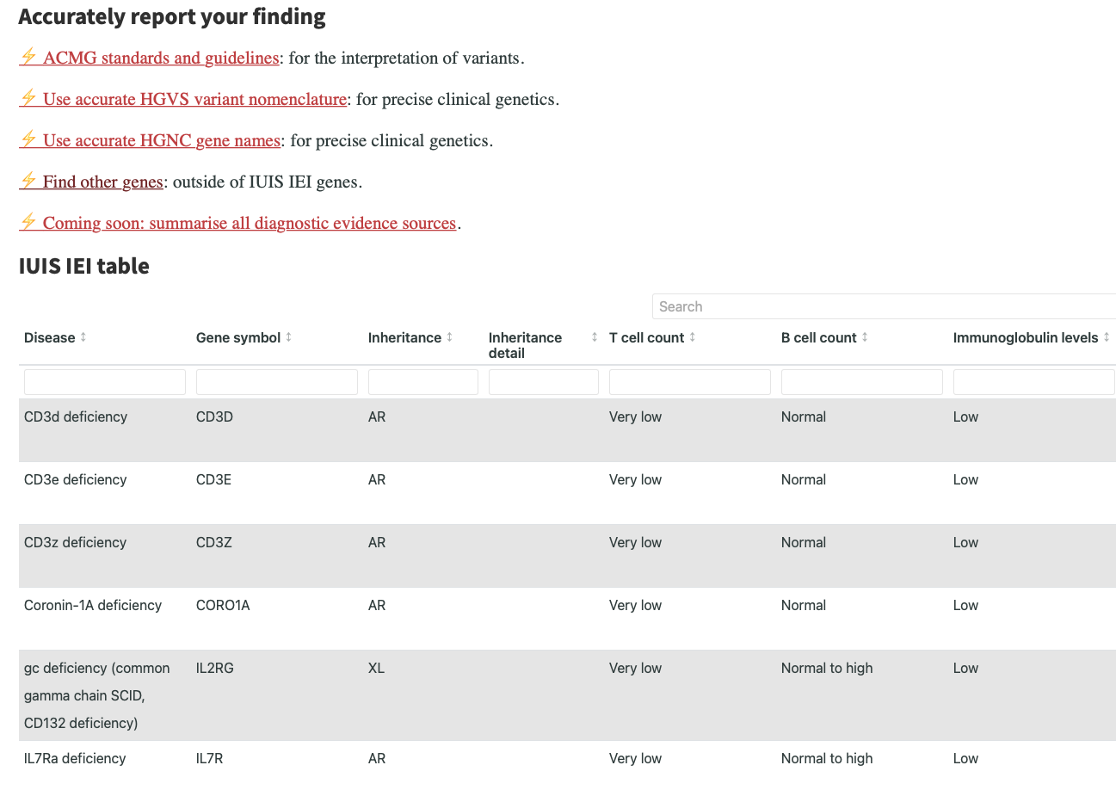
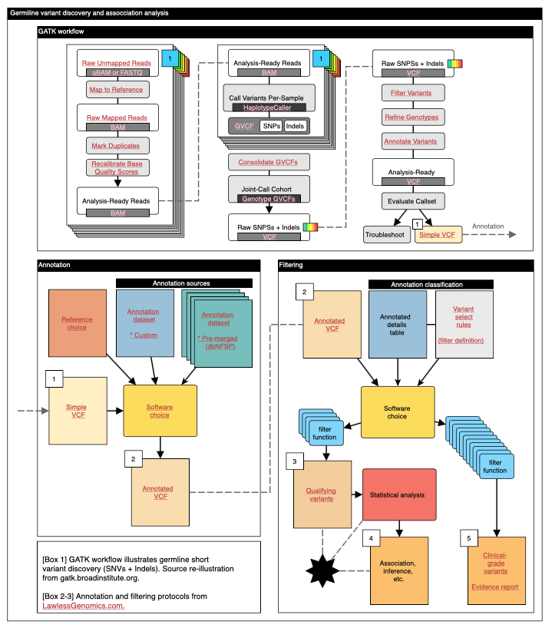
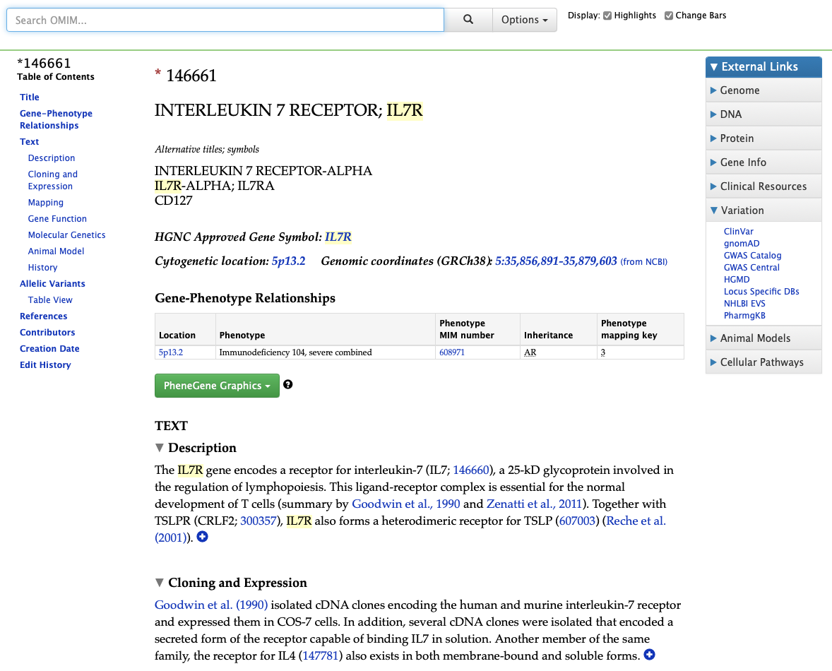
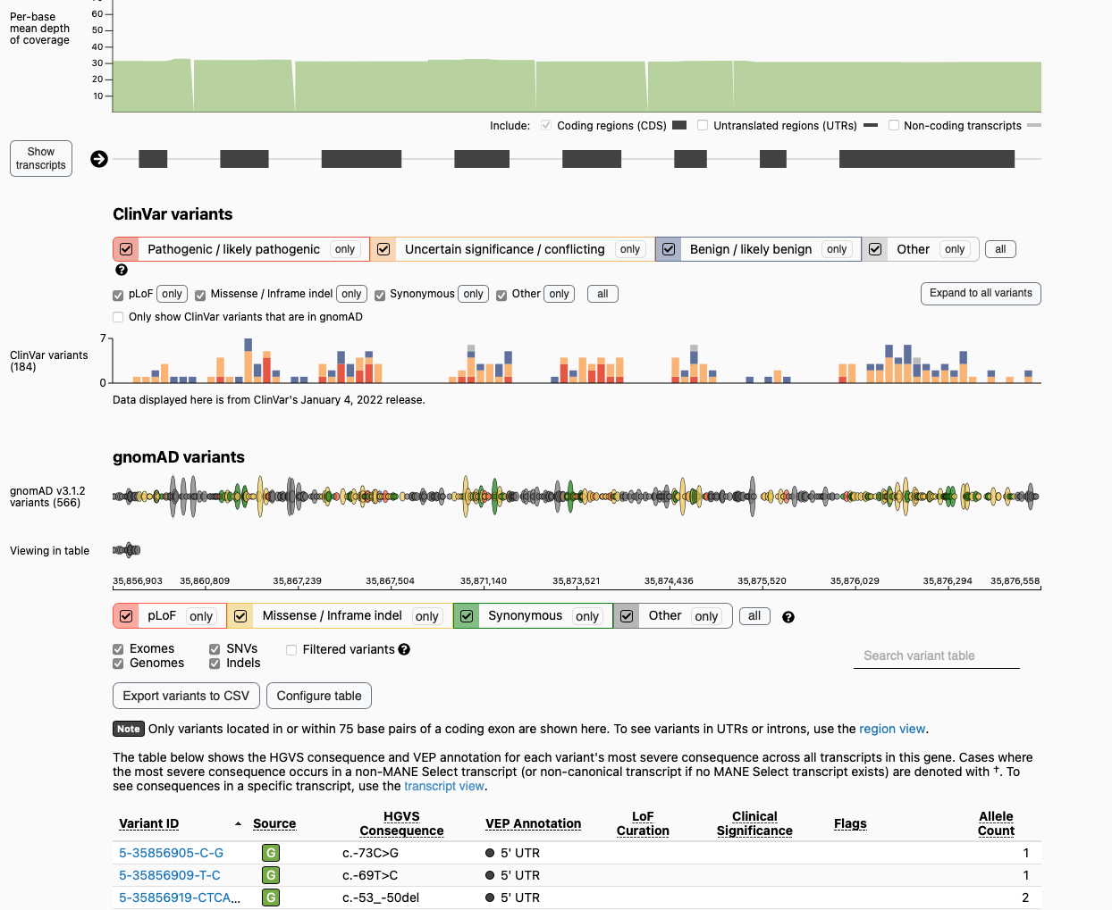
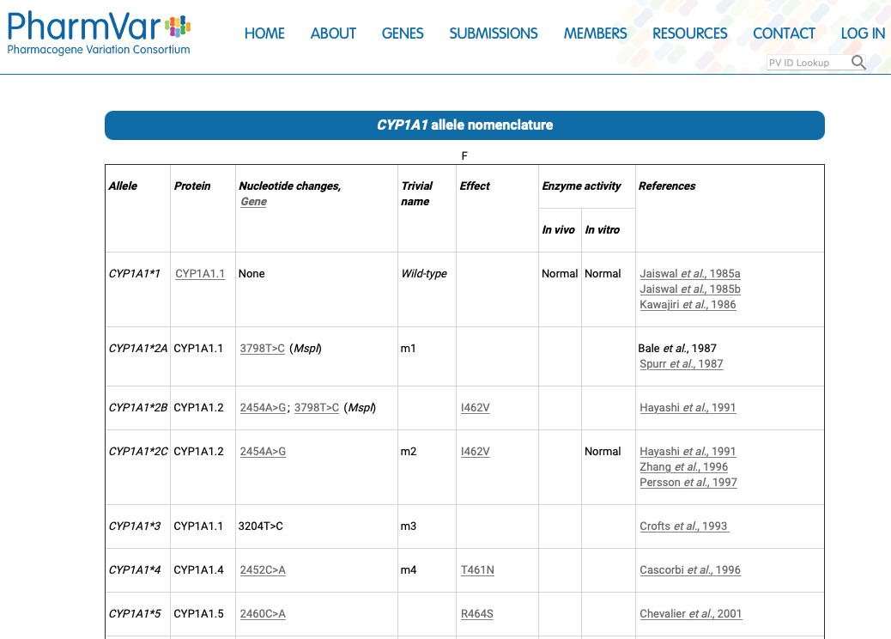
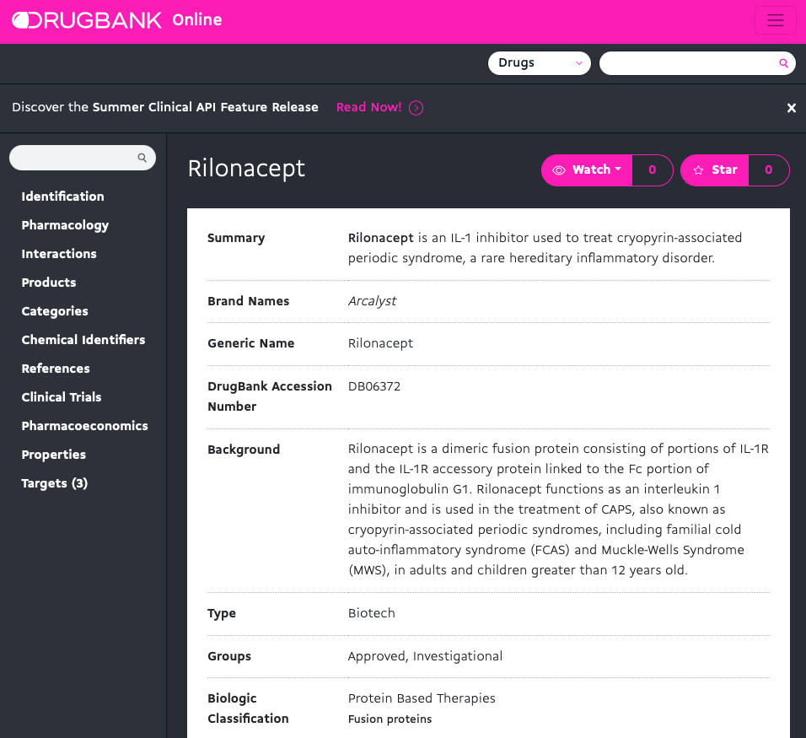
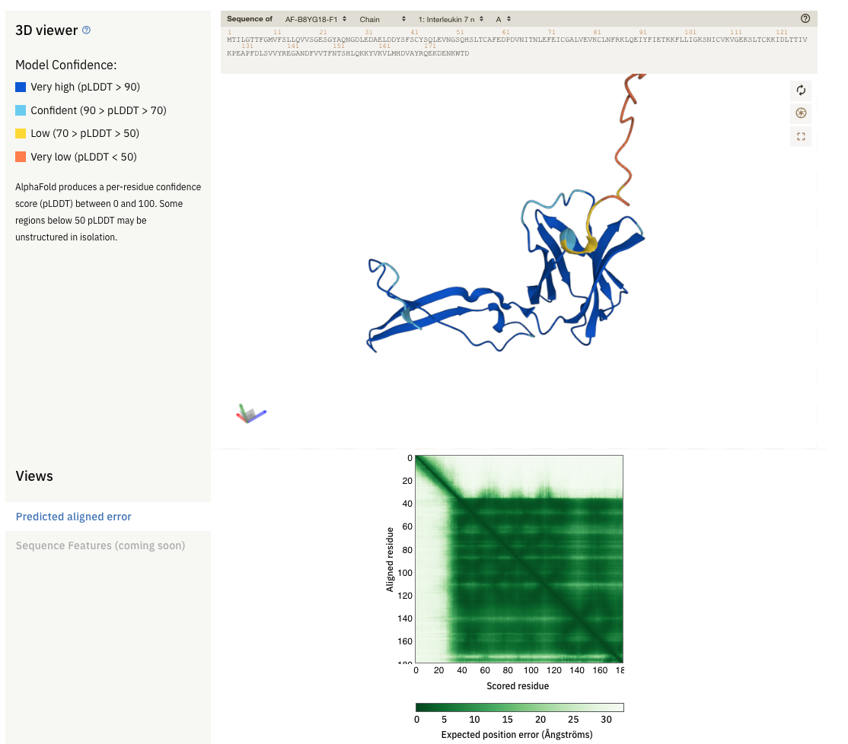
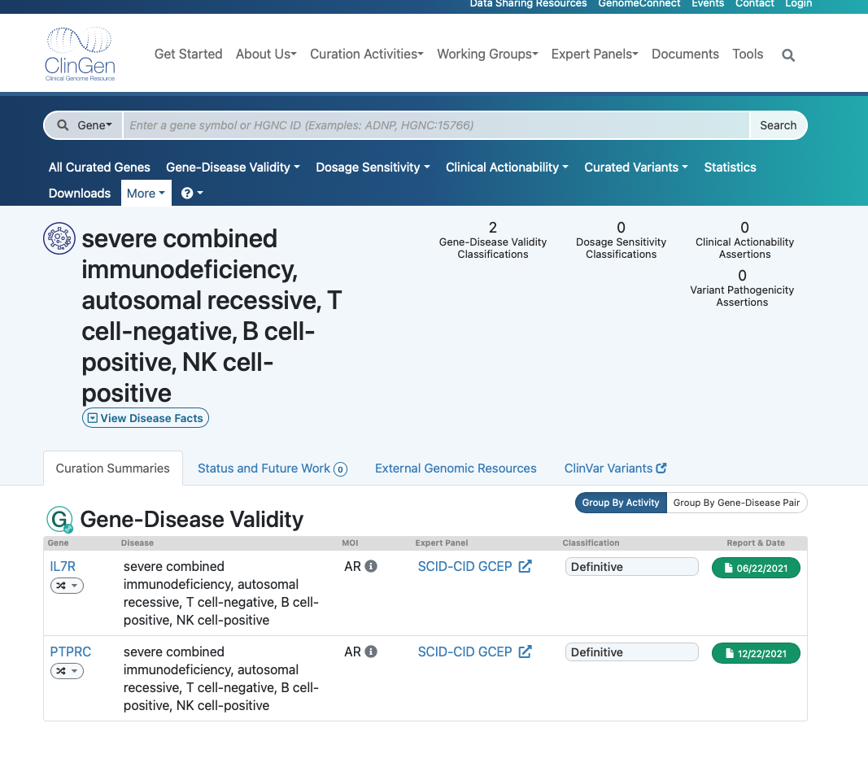
LawlessGenomics
Evidence Builder
Best practices in genomic analysis
to convert complex problems into
robust, simple, actionable results.
Analysis protocol & sources
Evidence sources
Evidence assignment
Interpretation criteria
Simplified report
5
Protocol
Evidence source
1
Report
2
Protocol
Evidence source
Was the correct method used ?
How was it done ?
What does each step do ?
Analysis browser.
Query report to access evidence sources.
HGNC
UniProt
3
OMIM
GnomAD
4
PharmVar
DrugBank
Alpha fold
ClinGen
many more
Notes:
Here is how we solve the problem.
An intricate analysis protocol and diagnosis, that folds down into a simple, single, concise report.
For any possible question, we can simply click what one we want to see.
We are provided with all of the source material and methods to explain why it is the most reliable data.

