Slide 1

Genomic discovery

Slide 2
A patient walks into hospital.
The doctors says:
"We were expecting you.
"Yesterday we diagnosed your illness and have prepared your treatment plan."
Notes:
Appeals to authority hinders reliability.
How many civilisations have failed because when the people shout: “Why is it this way ?” the leaders respond: “Because we say so”.

Slide 3
“Why is it this way?”
“Because we say so”
Notes:
Appeals to authority hinders reliability.
How many civilisations have failed because when the people shout: “Why is it this way ?” the leaders respond: “Because we say so”.

Slide 4
Our doctor is an expert knowledge curator.
Provide medical diagnosis
that is evidence-based.
Notes:
Historically, doctors would test and learn. Their knowledge and experience is used to diagnose and treat based on deductive reasoning.
Next, as libraries grew, as the internet to hold, doctors had to rely less on memory and intuition and more on recorded facts.
Tomorrow, no individual or team of doctors will outcompete their statistically-robust computational counterparts.
However, that does not mean the doctor will disappear. It just means their role evolves (as it has always done through the ages).

Slide 5
How can I trust medicine from an algorithm ?
Video clip: 1992 “Computers can not
replace AT&T switchboard operators.”
Notes:
When we are unfamiliar with something new, we can underestimate how, significant, positive, and inevitable a change it can be.
When we go to the bank, we don’t expect the bank teller to give their opinion of what they think our bank balance is.
We want the standardised calculating program to do it.
When we have a disease, wouldn’t the best solution be to tally every piece of existing information and rank the probabilities accurately; to provide the most likely diagnosis and treatment, and supply multiple alternatives and backups?
Instead, we hope that the doctor will do this very same job but manually.
We hope that the doctor knows about all of the evidence sources, how reliable each is, and that they have no reason to dismiss pertinent facts based on a whim.

Slide 6
Case study
A patient has a severe illness.
The doctor can provide a treatment.
How can the doctor be sure ?
The doctor states the facts :
Notes:
These are the statements that can be made by a doctor today.
Generally, the evidence supporting each claim exists and no opposing evidence is found to argue against the fact.
However, today the evidence-reporting chain is poorly standardised and unreliable.

Slide 7
Case study
We can explain your illness.
Due to a variant in your DNA,
your immune systems is often overactive.
This causes inflammation and pain.
We know the mechanism because of
existing scientific evidence.
Notes:
These are the statements that can be made by a doctor today.
Generally, the evidence supporting each claim exists and no opposing evidence is found to argue against the fact.
However, today the evidence-reporting chain is poorly standardised and unreliable.

Slide 8
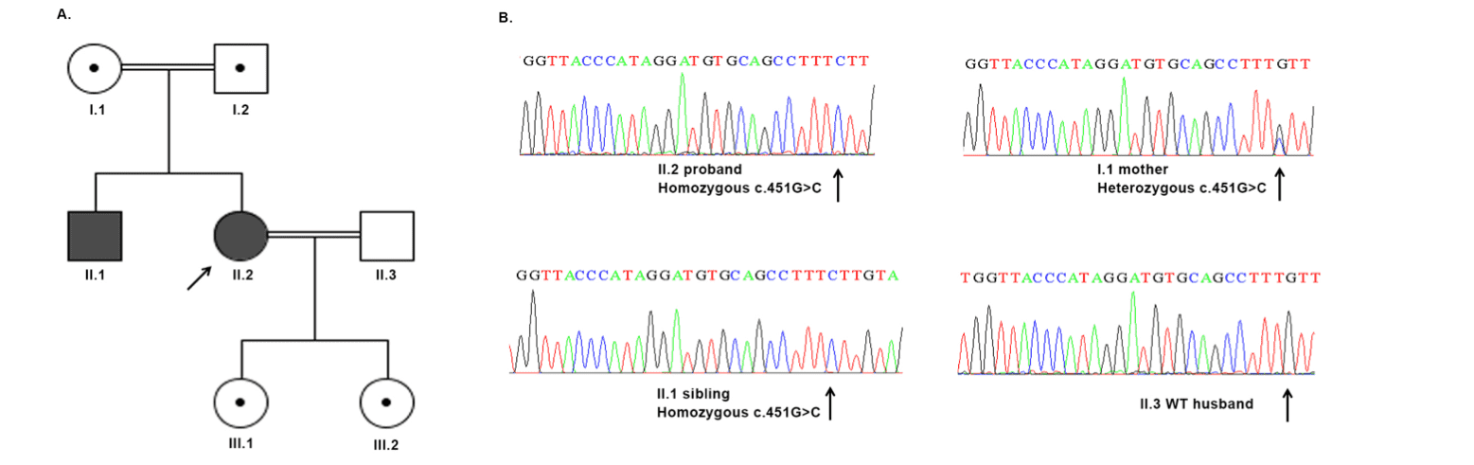
We can explain your illness.
Due to a variant in your DNA,
your immune systems is often overactive.
This causes inflammation and pain.
We know the mechanism because of
existing scientific evidence.
Notes:
This is what we want.
Trust but verify.

Slide 9
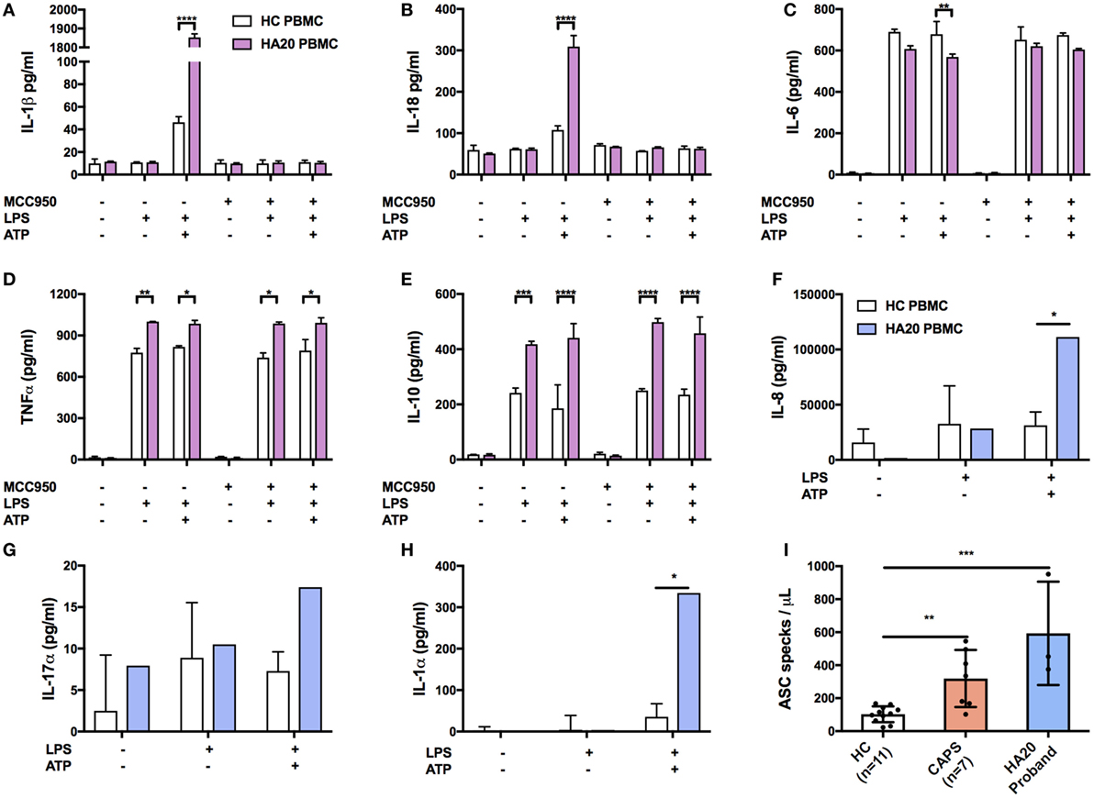
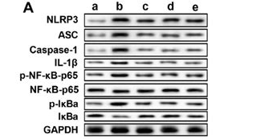
We can explain your illness.
Due to a variant in your DNA,
your immune systems is often overactive.
This causes inflammation and pain.
We know the mechanism because of
existing scientific evidence.
Notes:
This is what we want.
Trust but verify.
For every discovery the sum of evidence and methods are only a touch away.

Slide 10
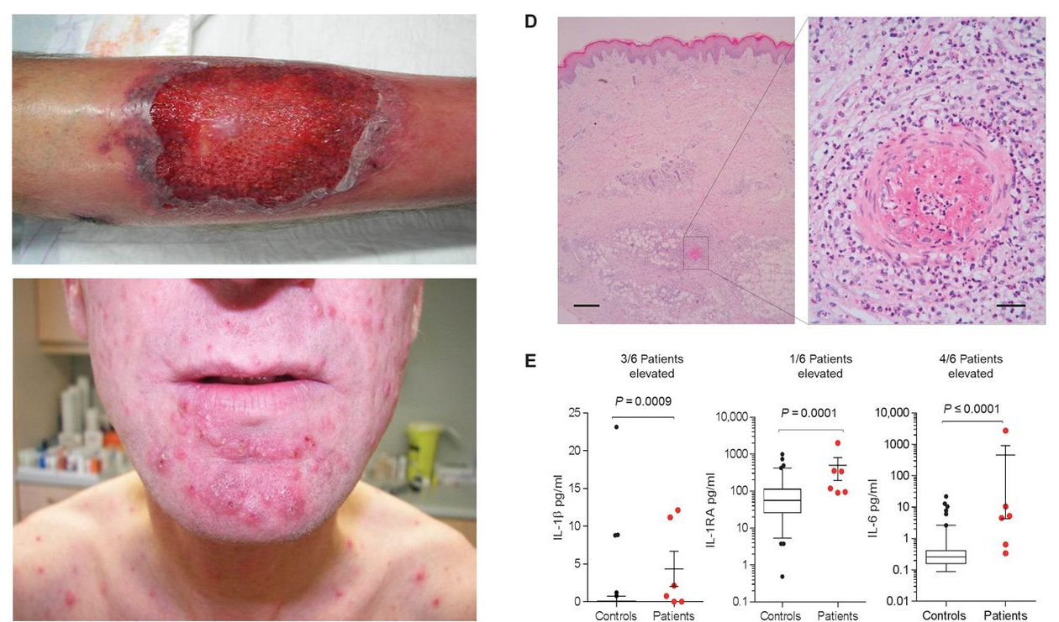
We can explain your illness.
Due to a variant in your DNA,
your immune systems is often overactive.
This causes inflammation and pain.
We know the mechanism because of
existing scientific evidence.
Notes:
This is what we want.
Trust but verify.
For every discovery the sum of evidence and methods are only a touch away.

Slide 11
We can explain your illness.
Due to a variant in your DNA,
your immune systems is often overactive.
This causes inflammation and pain.
We know the mechanism because of
existing scientific evidence.
?
Notes:
This is what we want.
Trust but verify.
For every discovery the sum of evidence and methods are only a touch away.

Slide 12
Evidence builder
Controls intricate analysis protocols.
Generates actionable diagnosis.
Folds down into a simple, single, concise report.
Notes:
This is what we want.
Trust but verify.
For every discovery the sum of evidence and methods are only a touch away.

Slide 13
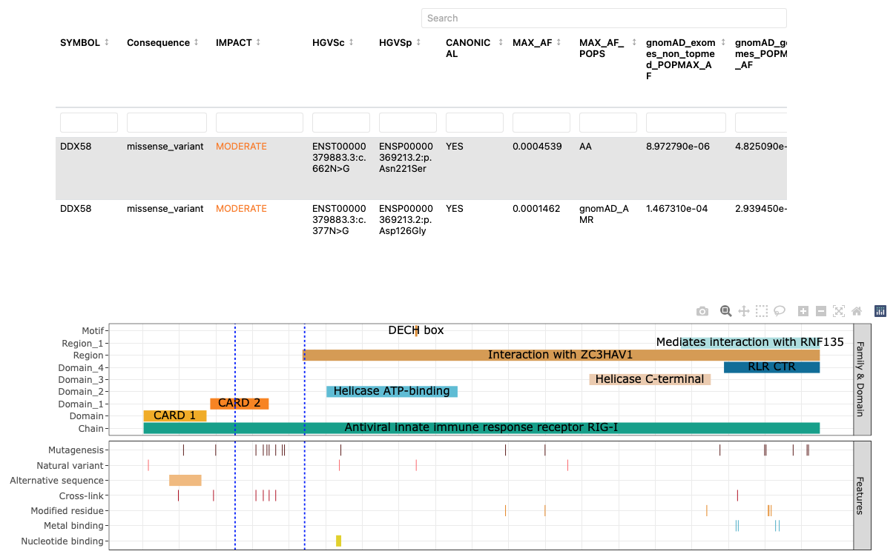
Protocol
Evidence source
Simple report
Notes:
Here is how we solve the problem.
An intricate analysis protocol and diagnosis, that folds down into a simple, single, concise report.
For any possible question, we can simply click what one we want to see.
We are provided with all of the source material and methods to explain why it is the most reliable data.

Slide 14
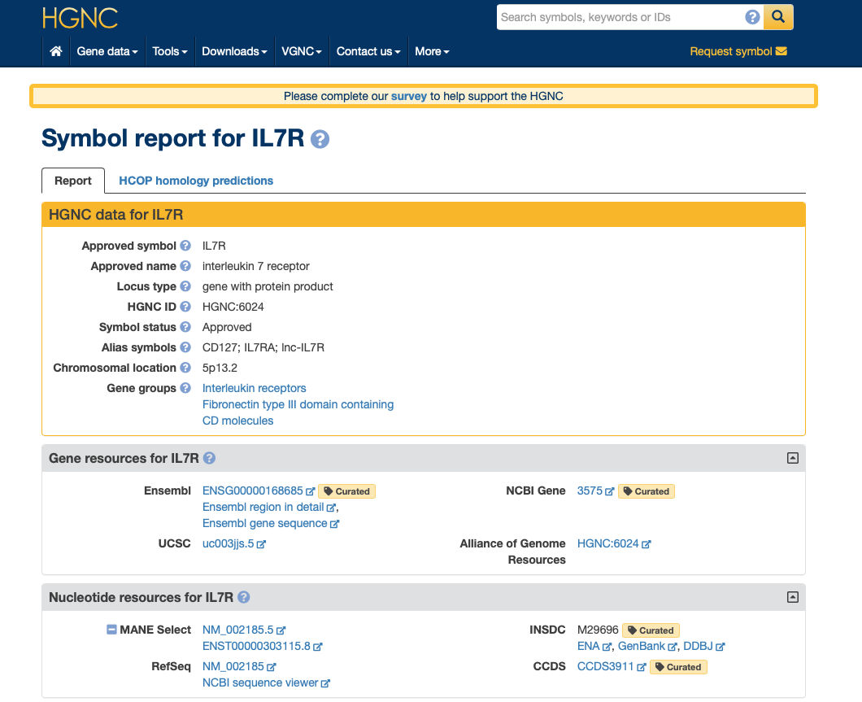
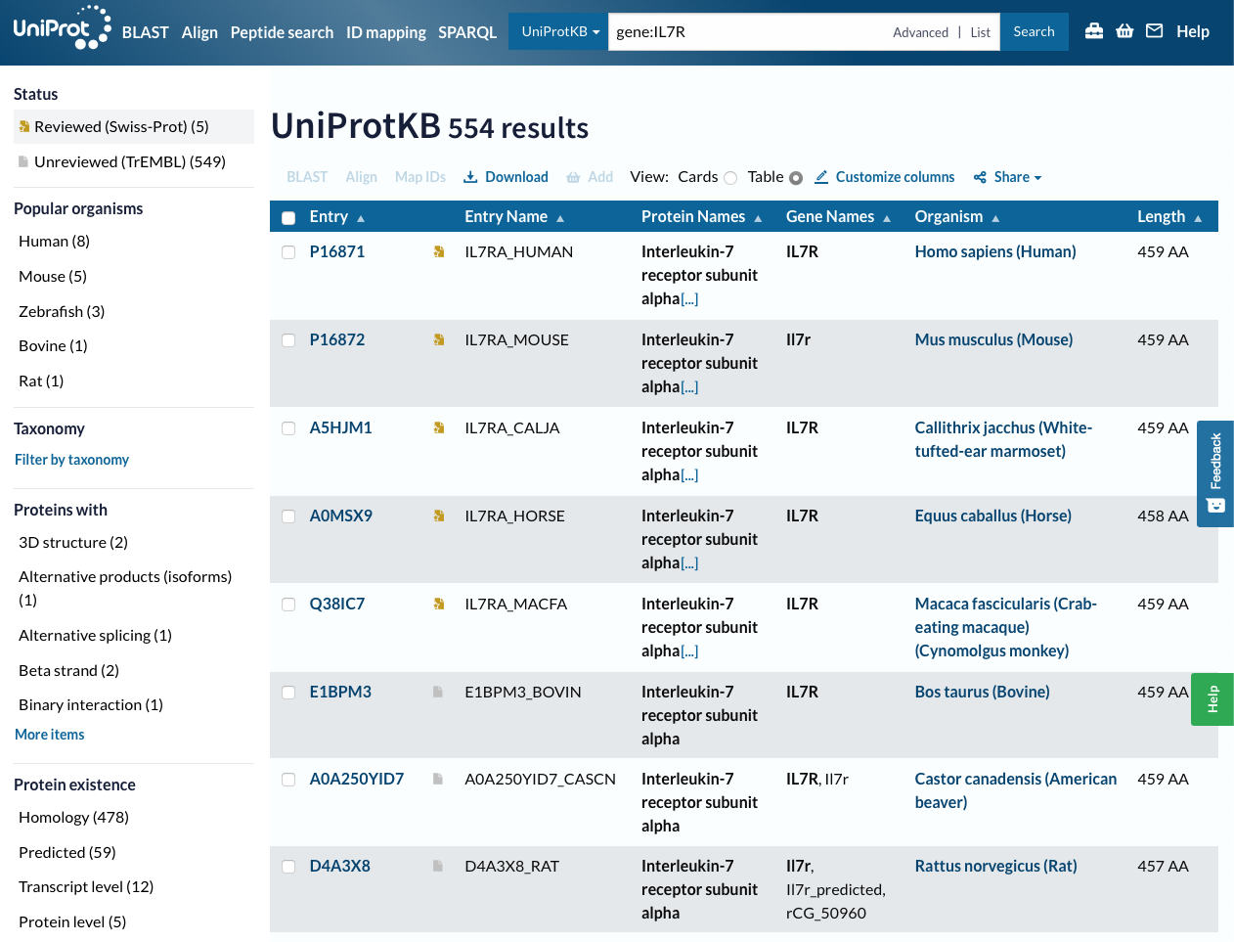
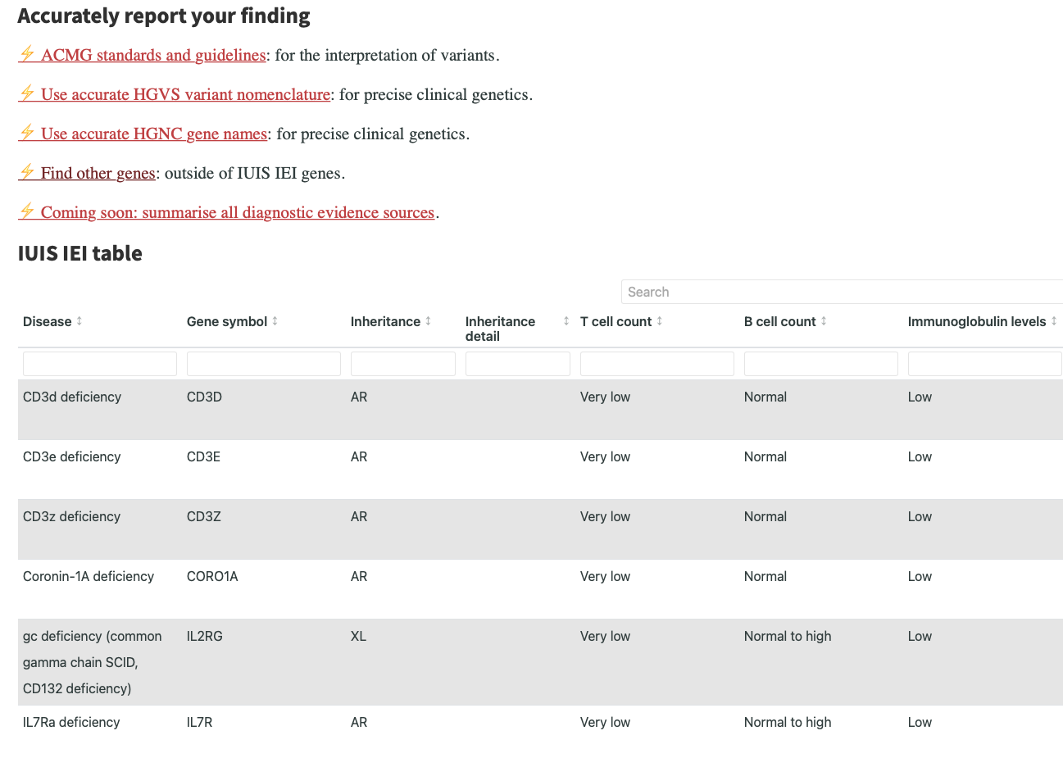
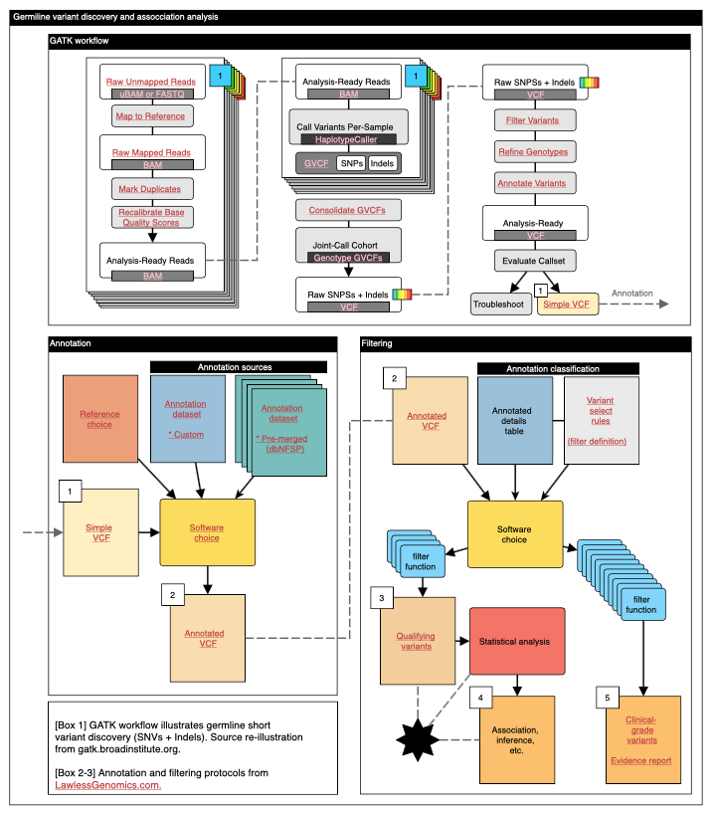
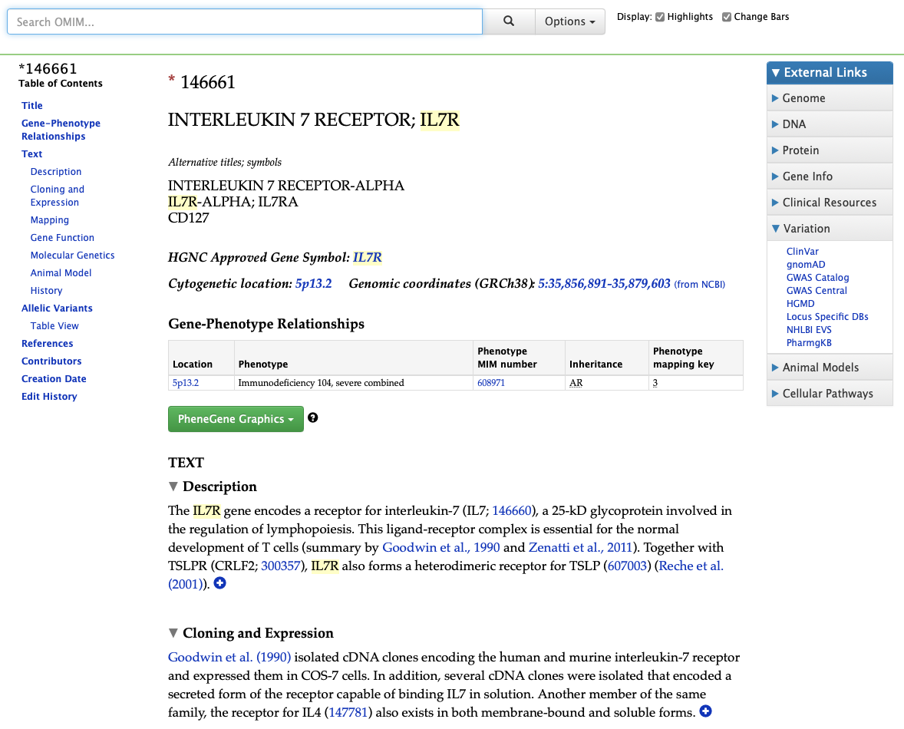
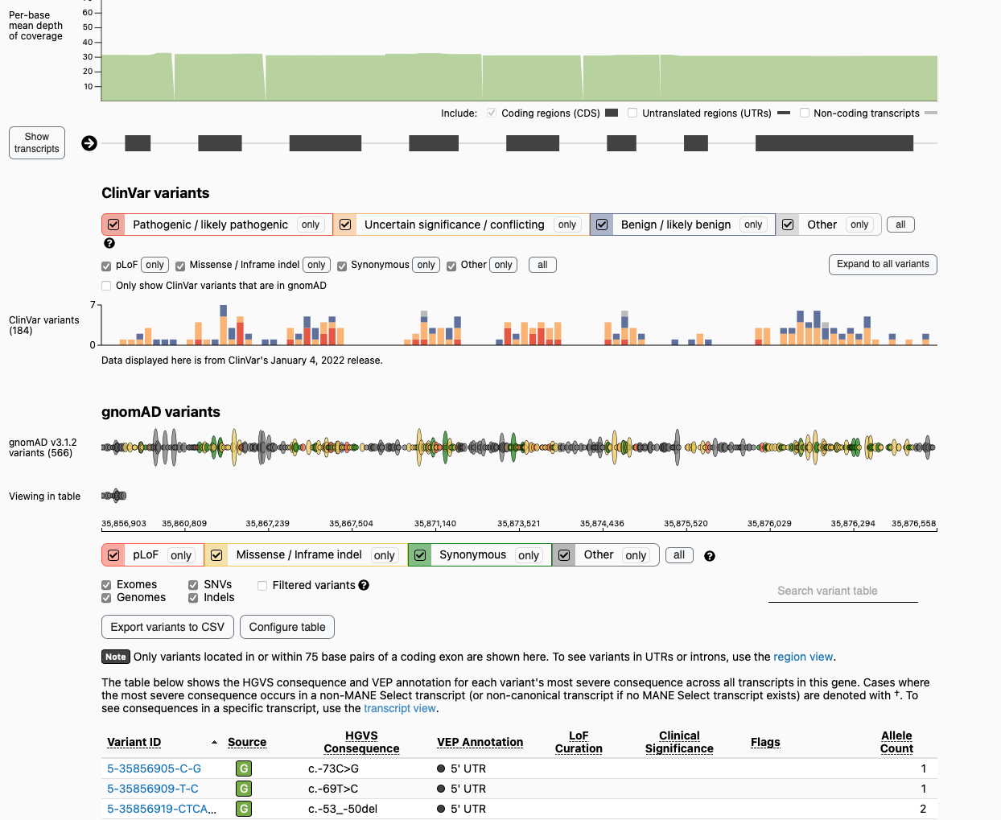
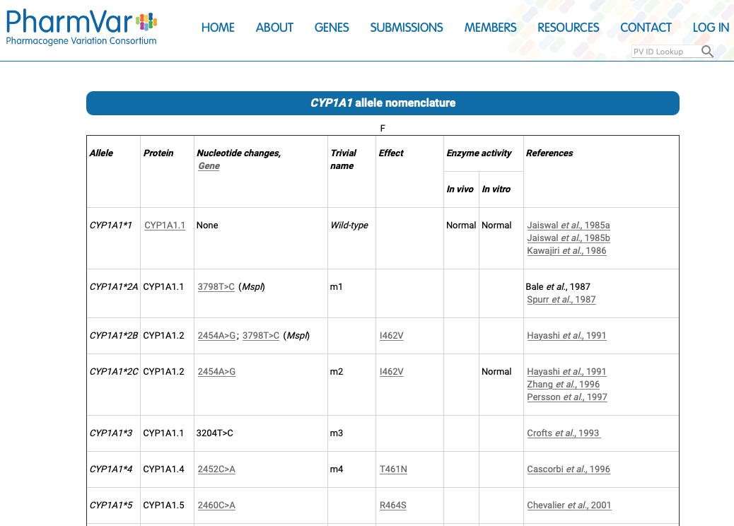
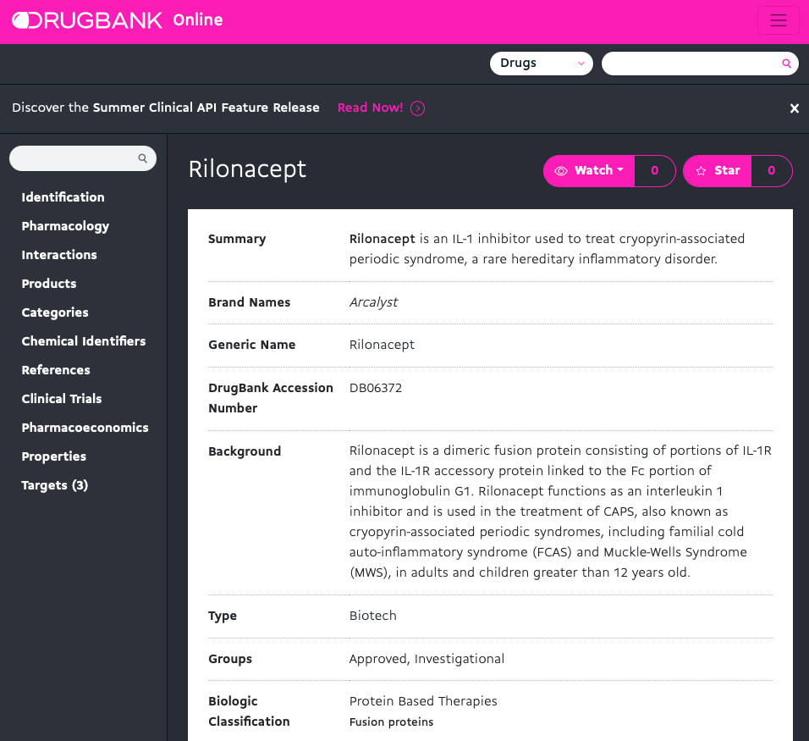
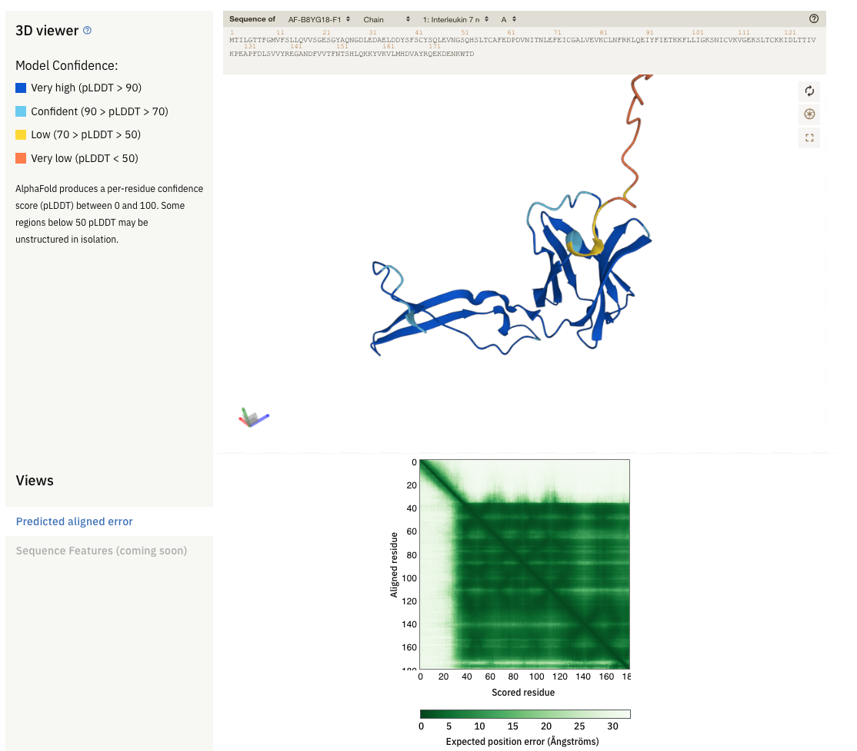
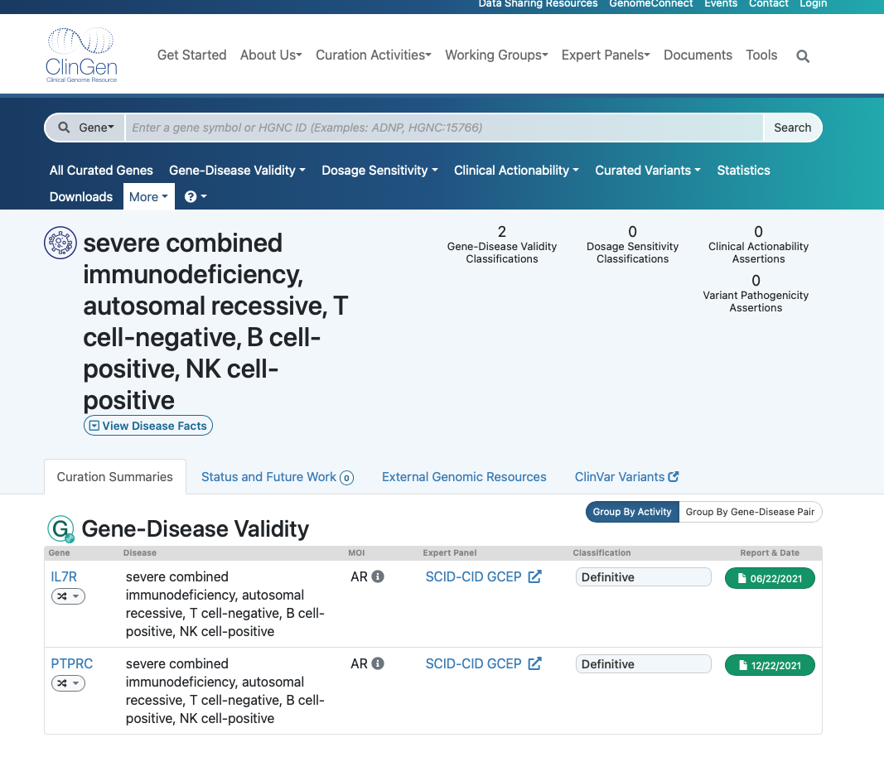
Protocol
Evidence source
Was the correct method used ?
How was it done ?
What does each step do ?
Analysis browser.
Query report to access evidence sources.
HGNC
UniProt
OMIM
GnomAD
PharmVar
DrugBank
Alpha fold
ClinGen
many more
Link: example protocol page
Link: example evidence page
Notes:
Here is how we solve the problem.
An intricate analysis protocol and diagnosis, that folds down into a simple, single, concise report.
For any possible question, we can simply click what one we want to see.
We are provided with all of the source material and methods to explain why it is the most reliable data.

Slide 15
When you have an efficient tool
you open new doors.
Clinical diagnosis is a
simple application example.

Slide 16
Every step
For every genetics-based application,
there are key critical factors:
1. Accurate application of protocols.
2. Easy protocol substitution.
3. Ensure that all relevant evidence has been assessed.
4. Summarize actionable results.
5. Provide a chain of custody for analysis and interpretation.

Slide 17
Every step
Drug development and regulation
Genomic-based discovery
Genomic medicine
Every field
Pharmaceutical industry
Personalised medicine
Biomedical sciences

Slide 18
Examples in use
Personalized medicine
Science Translational Medicine. Familial autoinflammation with neutrophilic dermatosis reveals a regulatory mechanism of pyrin activation. 10.1126/scitranslmed.aaf1471 S.L. Masters, et al.
Frontiers in Immunology. A case of AOSD caused by a novel splicing mutation in TNFAIP3 successfully treated with tocilizumab. 10.3389/fimmu.2018.01527 D. Lawless, et al.
Blood. Germline TET2 Loss-Of-Function Causes Childhood Immunodeficiency and Lymphoma. 10.1182/blood.2020005844 J. Spegarova, and D. Lawless, et al.
JACI-D-22-00926 (in-press) Prevalence of CFTR variants in PID patients with bronchiectasis - an important modifying co-factor. D. Lawless, et al.
Viral epidemiology
medRxiv. Viral genetic determinants of prolonged respiratory syncytial virus infection among infants in a healthy term birth cohort. 10.1101/2022.06.22.22276752 D. Lawless, et al.
Pharmacogenomic discovery pipeline
Pharmacogenomics for personal medicine – x8 EPFL MSc projects (2019-2022) for Health 2030 initiative.

Slide 19
Who would take a prototype today ?
Personalized medicine
Swiss Personalized Health Network
Health 2030, Swiss Hospitals
Clinical genetics Blueprint Genetics, US
Dante labs, Italy
Sophia genetics, Swsiss, US
BGI, China
Genomics England, UK
Pharma
Novartis, Roche, Genentech, J&J, etc.
Notes:
The current best practices are extremely poor
https://www.nature.com/articles/s41431-020-0579-y

