Slide 1
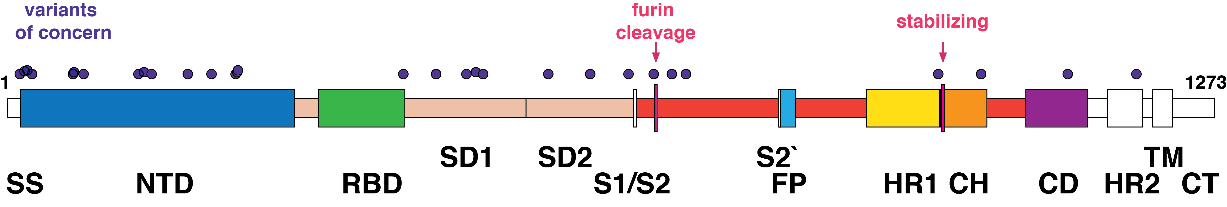
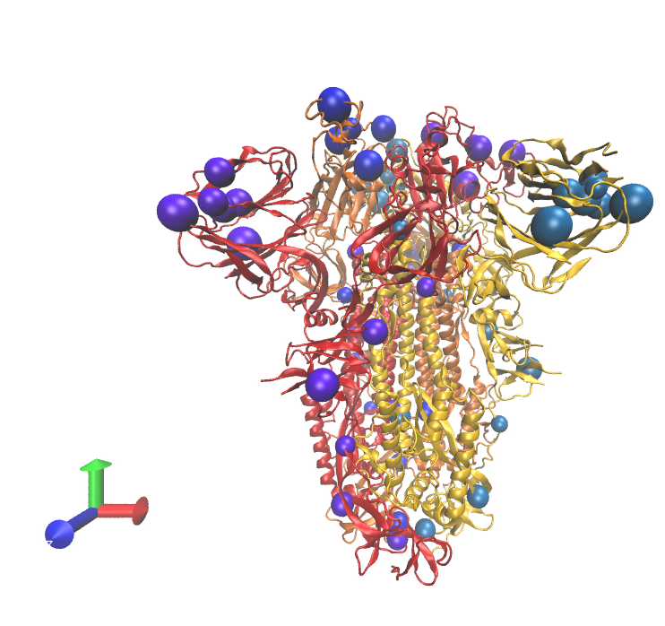
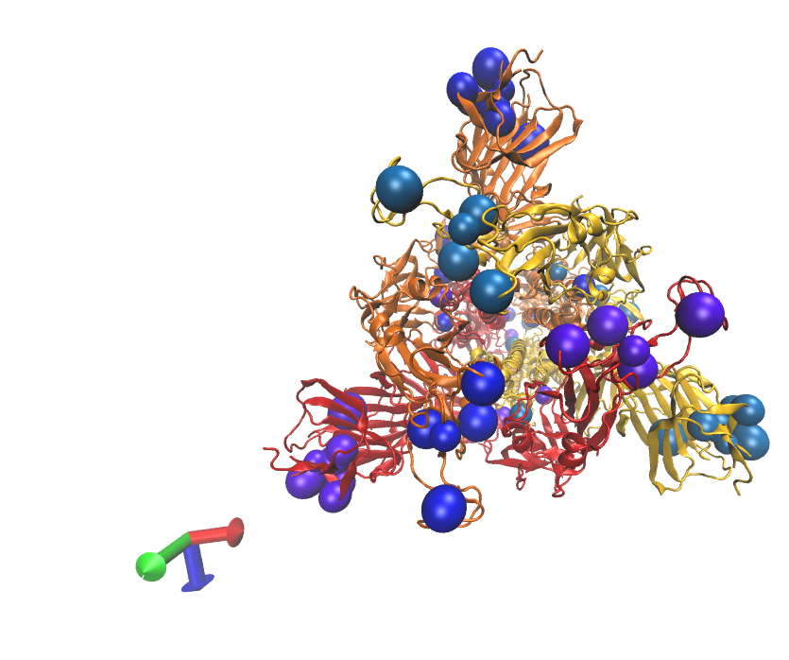
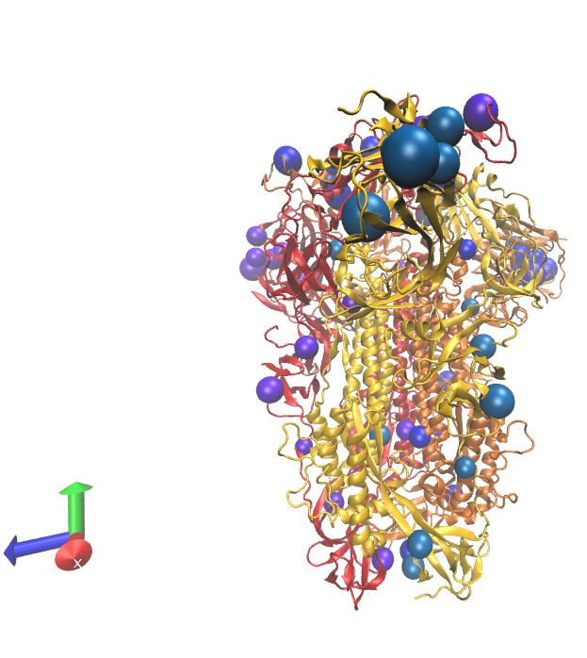

Alignment of vaccine genetic sequences & SARS-CoV-2 variants-of-concern (VoC)
Protein domains
Spike glycoprotein with VoC positions
Vaccine genetics and delivery summarized
mRNA-1273 Moderna
Genetics: p.(Lys986_Val987delinsProPro) - stabilizing x2 (PP)
Delivery: Lipid-nanoparticle
mRNA-1273.351 Moderna
Genetics: p.(Lys986_Val987delinsProPro) - stabilizing x2 (PP)
Genetics: Variants from strain B.1.351; L18F, D80A, D215G,
242-244del, R246I, K417N, E484K, N501Y, D614G, A701V
Delivery: Lipid-nanoparticle
mRNA-1273.211 Moderna
A 1:1 mix of mRNA-1273 and mRNA-1273.351
BNT162b2 Pfizer/BioNTech
Genetics: p.(Lys986_Val987delinsProPro) - stabilizing x2 (PP)
Delivery: Lipid-nanoparticle
Ad26.COV2-S Janssen/Johnson & Johnson
Genetics: p.[Arg682Ser;p.Arg685Gln] - furin cleavage x2 (SRAG)
Genetics: p.(Lys986_Val987delinsProPro) - stabilizing x2 (PP)
Delivery: Adenovirus vector (Ad26)
NVX-CoV2373 Novavax
Genetics: p.[Arg682_Arg683delinsGlnGln;Arg685Gln] - furin cleavage x3 (GGAG)
Genetics: p.(Lys986_Val987delinsProPro) - stabilizing x2 (PP)
Delivery: Lipid-nanoparticle, baculovirus expression cultured in Sf9
Sputnik V Gamaleya Research Inst
Genetics: “unmodified” full-length S-protein
Genetics: No reference sequence found
Delivery: Adenovirus vectors (Ad26 dose 1) and (Ad5 dose 2)
CVnCoV Curevac
Genetics: p.(Lys986_Val987delinsProPro) - stabilizing x2 (PP)
Delivery: Lipid nanoparticle-encapsulated mRNA.
AZD1222 AstraZeneca
Genetics: Unmodified S protein, ref MN908947
Delivery: Adenovirus vector (ChAdOx1).
AZD2816 modified MN908947 with variants from B.1.351 AstraZeneca
Genetics: Unmodified S protein, ref MN908947
Genetics: Variants from strain B.1.351; 18F, D80A, D215G,
242-243del, K417N, E484K, N501Y, D614G, A701V.
Delivery: Adenovirus vector (ChAdOx1).
sarscov2variants.com

