Slide 1
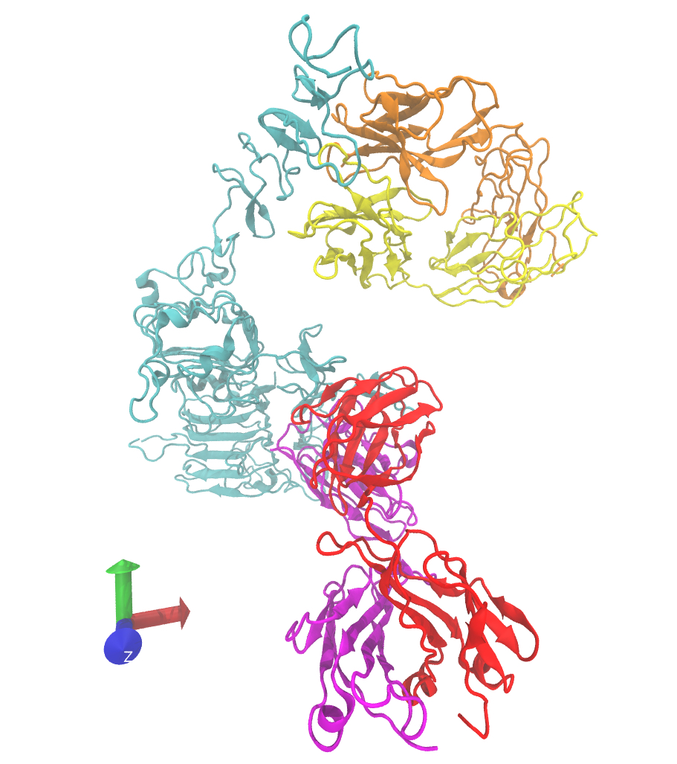
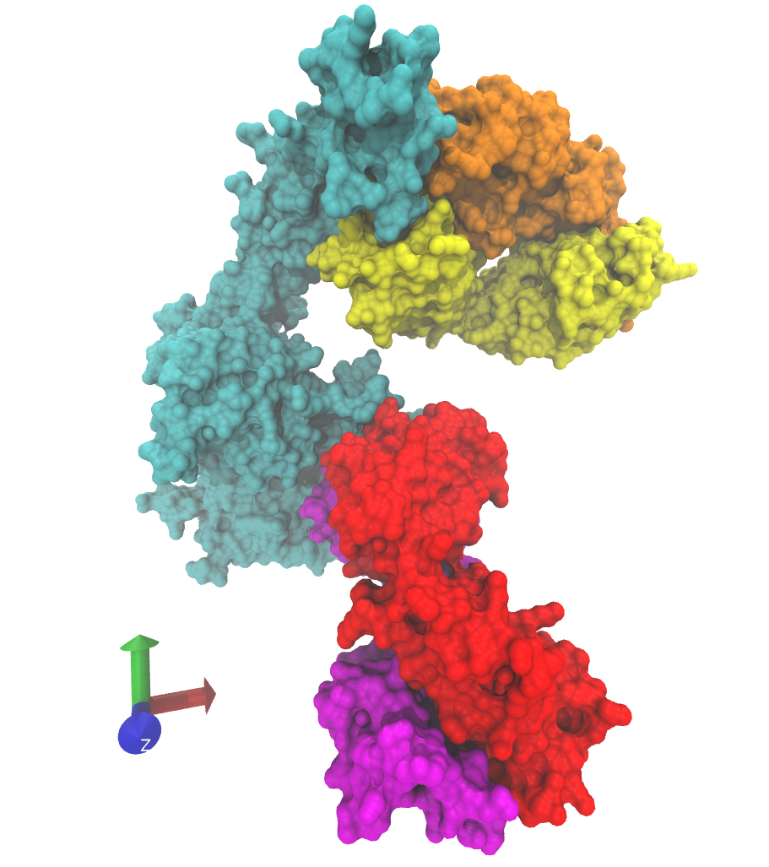
A
B
Pertuzumab
Pertuzumab
HER2
HER2
Trastuzumab
Trastuzumab

