Slide 1
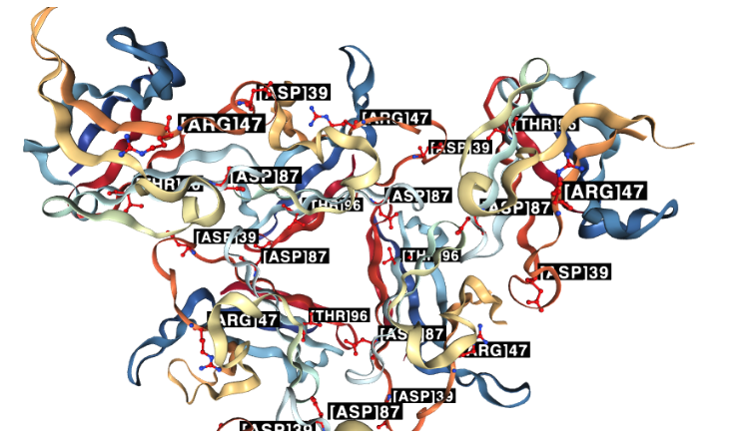
(A)
(B)
Engines
(x 22)
(x 25 criteria)
(x 160 db)
(C)
(D)
Genes
(x 72)
SIRPG
(3 pathways)
(x3 db)
LILRA5
FCGR3A
Pathway interpretation
Variant effect
TREM2
Evidence type
Position
Structure
Notes:
Figure
ACMGuru_post_ppi/ACMGuru_post_ppi_MCL_ID_22_586_836_patch1.pdf (note patch1 used for better font size)
ACMGuru_post_ppi/ACMGuru_post_ppi_MCL_ID_22_586_836_patch1.pdf (note patch1 used for better font size)
(C) ACMGuru_post_ppi/ACMGuru_post_ppi_MCL_ID_22_586_836_evidence_plots_without_filter.pdf
(D) ACMGuru_post_ppi_uniprotr/uniprotr_p_goi_pathway_ID...
(D) ACMGuru_post_ppi_uniprotr/uniprotr_p_kr_pathway_ID...

