Slide 1

Reference Points 101
Robyn Forrest and Tim Barrett
Nov 15 and 22, 2022
Technical Expertise in Stock Assessment (TESA) Webinar

Slide 2
Objectives
This webinar comes after the 2021 joint TESA/National Operational Guidelines (NOG) Taskforce workshop on “Limit Reference Points and the Fish Stocks Provisions”.
Feedback from the workshop indicated a desire for more training in the theory and calculation of reference points.
This webinar tries to address this gap by focusing on the more technical aspects of calculating reference points.
Participants are invited to review the materials from the 2021 workshop for a deeper dive into considerations for selecting LRPs
https://github.com/TESA-workshops/LRP
The proceedings from the 2021 workshop will be published as a DFO Technical Report

Slide 3
Objectives
Explore some of the practical aspects (and challenges) of calculating reference points. By the end of the webinars, participants should have:
An understanding of the concept of equilibrium as it relates to reference points;
An understanding of calculation of equilibrium reference points based on B₀, MSY, and the spawning potential ratio (SPR);
Awareness of non-equilibrium reference points (e.g., minimum historical biomass, index-based approaches, dynamic B₀); and
Awareness of some approaches for data-limited stocks.
Lecture material will be supported by R code, provided

Slide 4
Exercises
Five exercises are provided with the source code written in Rmarkdown.
The exercises can be downloaded from github:
https://github.com/TESA-workshops/LRP
Or shared as a zip file
We will provide a demonstration and some guidance on using Rmarkdown during this session
We will complete some of the exercises as a group and the remaining exercises can be completed on your own before the second session (Nov 22)

Slide 5
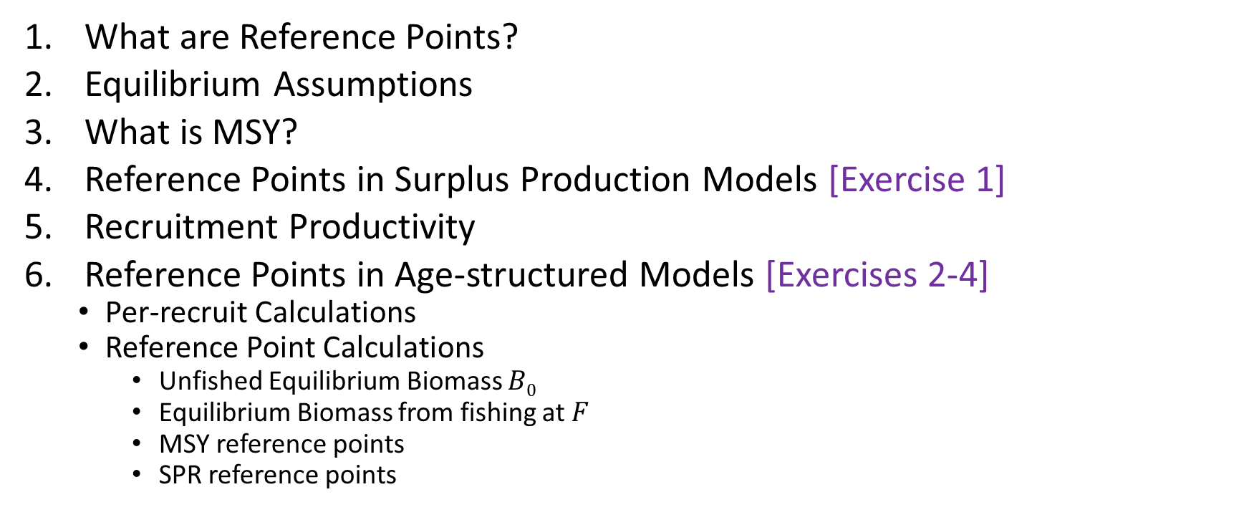
Outline – Day 1
What are Reference Points?
Equilibrium Assumptions
What is MSY?
Reference Points in Surplus Production Models [Exercise 1]
Recruitment Productivity
Reference Points in Age-structured Models [Exercises 2-4]
Per-recruit Calculations
Reference Point Calculations
Unfished Equilibrium Biomass $B0$
Equilibrium Biomass from fishing at $F$
MSY reference points
SPR reference points

Slide 6

Outline – Day 1 (hide)
For discussion Thursday afternoon
What are Reference Points? Robyn
Equilibrium Assumptions Robyn
What is MSY? Robyn
Reference Points in Surplus Production Models Tim
[Exercise 1] Tim
Recruitment Productivity Robyn
Reference Points in Age-structured Models Tim
Per-recruit Calculations Tim
Reference Point Calculations Tim
Unfished Equilibrium Biomass $B0$ Tim
Equilibrium Biomass from fishing at $F$ Tim
MSY reference points Tim
[Exercise 2] Tim
SPR reference points Robyn
[Exercise 4] Robyn

Slide 7
Outline – Day 2 (Hide)
SPR (if not covered on Day 1)
Time-varying parameters and choosing time periods for equilibrium estimates [Exercise 5]
Non-equilibrium ref pts
What is dynamic B0?
Historical and index-based
Approaches for data-limited stocks
Approaches using multiple models
Multiple OMs in MSE

Slide 8
1. What are Reference Points?

Slide 9

What are reference points?
“Reference points are operational or measurable benchmarks that identify targets to be achieved on average, limits to be avoided, or triggers to initiate specific management responses.
A fishery is expected to approach or fluctuate around a target reference point, to have a very high probability [e.g., at least 90%] of not violating a limit reference point, and to have trigger reference points [Operational Control Points] and planned management responses that achieve these two outcomes.”

Slide 10

What are reference points?
“Fisheries management is a decision making process which includes uncertainties. When providing advice to fisheries managers, it is not sufficient to merely describe the uncertainties but we should also predict the consequences of the possible management measures; this involves the concept of risk.”
Reference points are components of objectives for the fishery, against which consequences are evaluated.

Slide 11

What are reference points?
Objectives generally consist of three elements:
Target or limit
Desired probability of reaching target or breaching limit (risk tolerance)
Time-frame to achieve objective
E.g., Avoid the limit reference point with 95% probability over 10 years
Performance metrics are developed based on the objectives, which are used to measure the consequences of management actions, e.g.,
P(Biomass < LRP) over 10 years
Objectives are developed by multiple parties and there are typically multiple objectives
Need to consider trade-offs

Slide 12
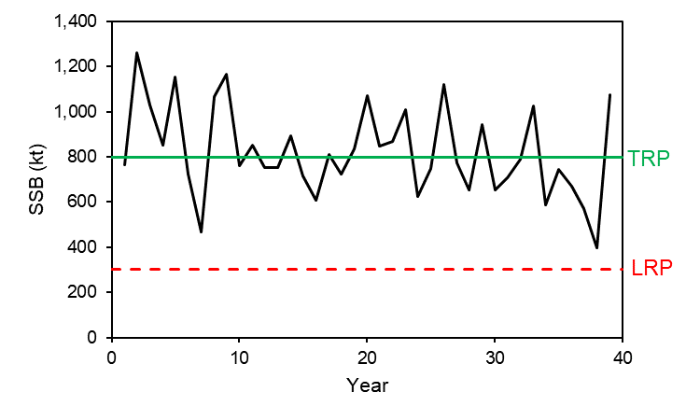
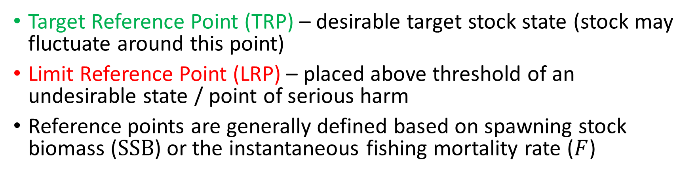
What are reference points?
Target Reference Point (TRP) – desirable target stock state (stock may fluctuate around this point)
Limit Reference Point (LRP) – placed above threshold of an undesirable state / point of serious harm
Reference points are generally defined based on spawning stock biomass ($SSB$) or the instantaneous fishing mortality rate ($F$)

Slide 13
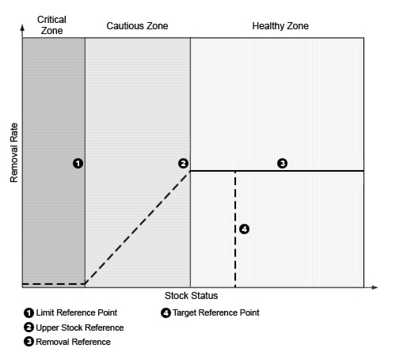
DFO: Reference Points (PA Framework)
A general fishery decision-making framework (DFO 2009) for implementing harvest strategies that incorporate the precautionary approach
Includes reference points and stock status zones
https://www.dfo-mpo.gc.ca/reports-rapports/regs/sff-cpd/precaution-back-fiche-eng.htm

Slide 14
DFO: Reference Points (PA Framework)
LRP: “represents the stock level below which there is a high probability that the stock’s productivity is so impaired that serious harm will occur”
“At this stock status level, there may also be resultant impacts to the ecosystem, associated species and a long-term loss of fishing opportunities”
The LRP is defined by DFO Science through a CSAS peer-review process

Slide 15
DFO: Reference Points (PA Framework)
USR – “a level below which removals must be progressively reduced so the LRP can be avoided” and can be “a target reference point”
“USR is defined by resource management, in consultation with [partners and] stakeholders and with advice and input from DFO Science”

Slide 16
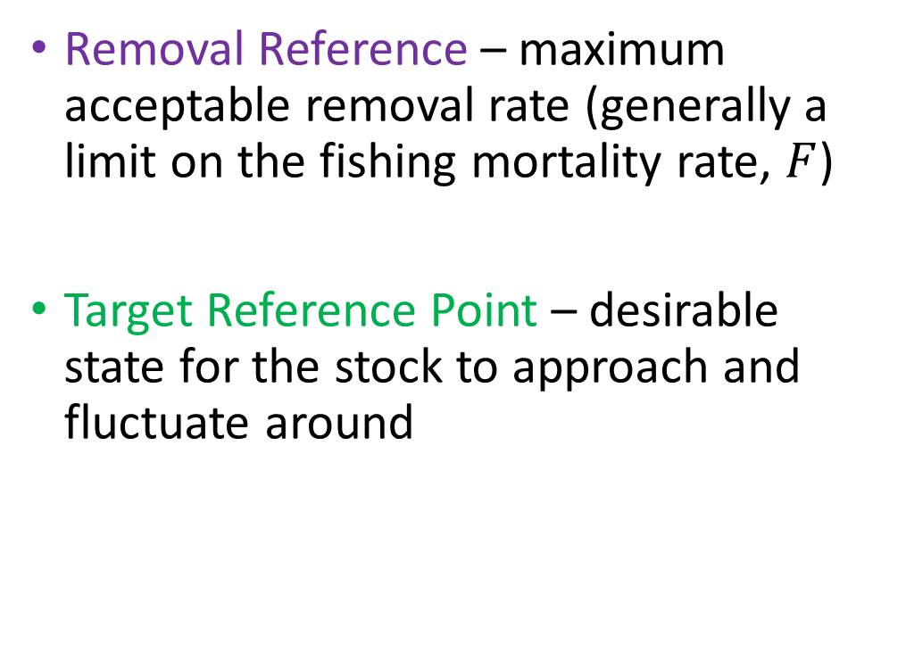
DFO: Reference Points (PA Framework)
Removal Reference – maximum acceptable removal rate (generally a limit on the fishing mortality rate, $F$)
Target Reference Point – desirable state for the stock to approach and fluctuate around

Slide 17
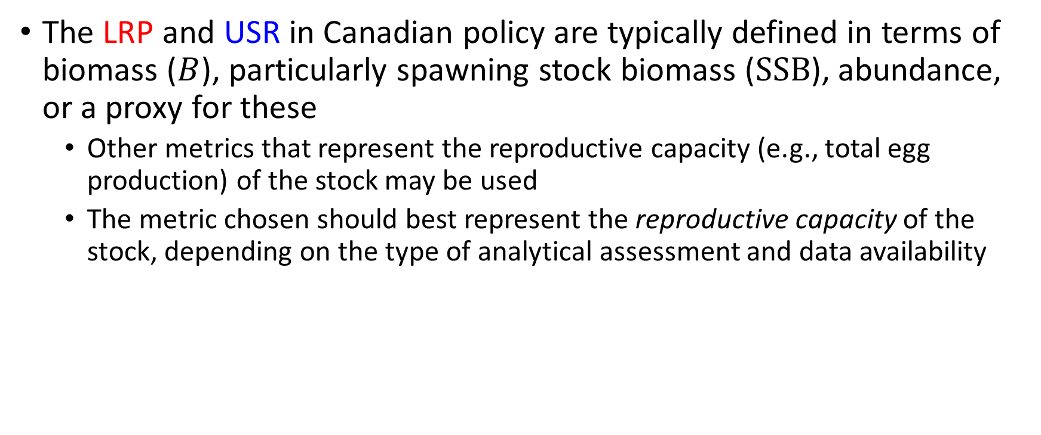
DFO: Reference Points (PA Framework)
The LRP and USR in Canadian policy are typically defined in terms of biomass ($B$), particularly spawning stock biomass ($SSB$), abundance, or a proxy for these
Other metrics that represent the reproductive capacity (e.g., total egg production) of the stock may be used
The metric chosen should best represent the reproductive capacity of the stock, depending on the type of analytical assessment and data availability

Slide 18
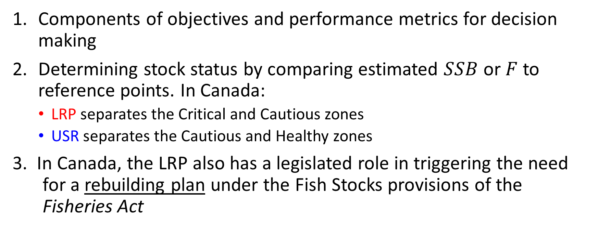
Roles of Reference Points
Components of objectives and performance metrics for decision making
Determining stock status by comparing estimated $SSB$ or $F$ to reference points. In Canada:
LRP separates the Critical and Cautious zones
USR separates the Cautious and Healthy zones
3. In Canada, the LRP also has a legislated role in triggering the need for a rebuilding plan under the Fish Stocks provisions of the Fisheries Act

Slide 19
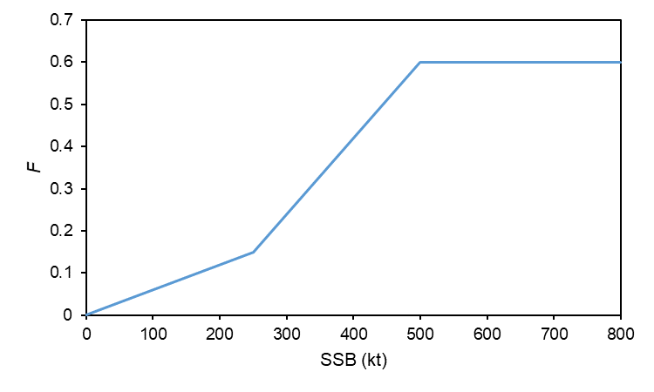
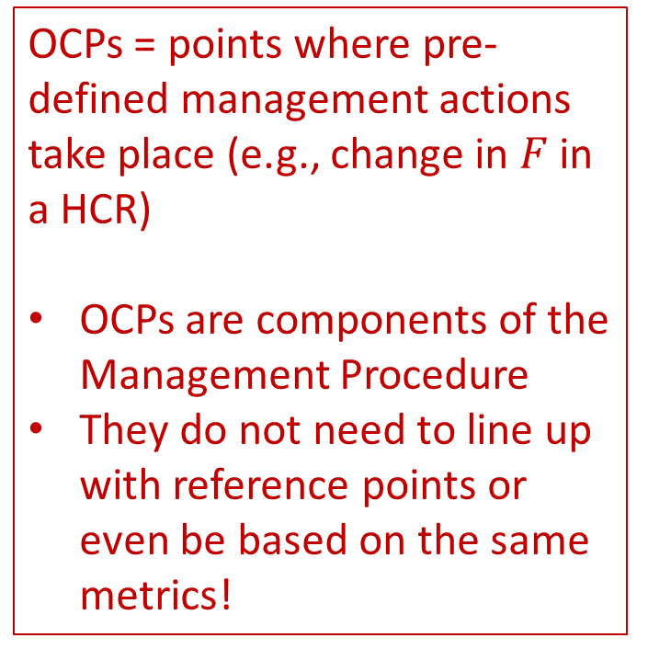
Roles of Reference Points
Can be and are often used as triggers (operational control points) in harvest control rules (HCRs)
OCPs = points where pre-defined management actions take place (e.g., change in $F$ in a HCR)
OCPs are components of the Management Procedure
They do not need to line up with reference points or even be based on the same metrics!

Slide 20
Reference points in stock assessment
Science Fisheries Management First Nations Stakeholders
Green bar = Easier*
Red bar = Hard!
Objectives
Priors on model parameters
Population and fishery dynamics
Observation models
Likelihood
Posterior parameter estimates
Reference
points
We are here
Performance metrics
*Arguably
DATA

Slide 21
2. Equilibrium Assumptions

Slide 22
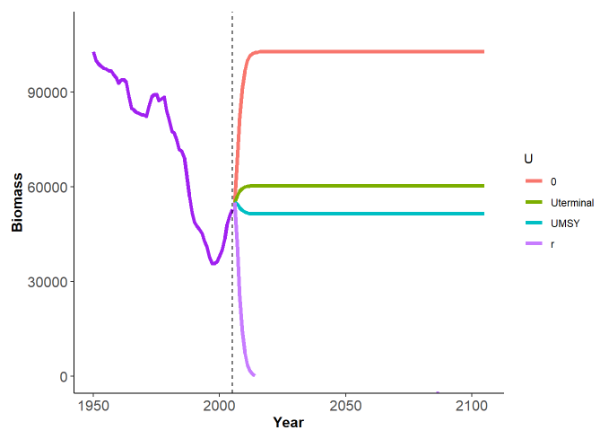
Equilibrium reference points
Many common reference points are based on equilibrium (or steady state) assumptions
These include reference points based on:
Maximum Sustainable Yield (MSY)
Unfished Spawning Biomass (B₀ or SSB₀)
The Spawning Potential Ratio (SPR)

Slide 23
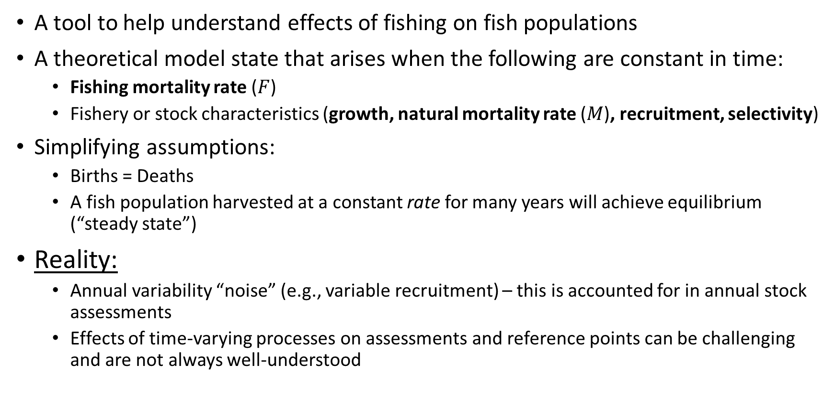
What is Equilibrium?
A tool to help understand effects of fishing on fish populations
A theoretical model state that arises when the following are constant in time:
Fishing mortality rate ($F$)
Fishery or stock characteristics (growth, natural mortality rate ($M$), recruitment, selectivity)
Simplifying assumptions:
Births = Deaths
A fish population harvested at a constant rate for many years will achieve equilibrium (“steady state”)
Reality:
Annual variability “noise” (e.g., variable recruitment) – this is accounted for in annual stock assessments
Effects of time-varying processes on assessments and reference points can be challenging and are not always well-understood

Slide 24
What is Equilibrium?
The equilibrium assumptions inherent in the calculation of reference points will be demonstrated when we get to Exercise 1

Slide 25
3. What is MSY?

Slide 26
Maximum Sustainable Yield (MSY)
We begin by exploring yield in a simple surplus production model
We then define the theoretical concept of MSY
In later sections we explore MSY in age-structured models

Slide 27

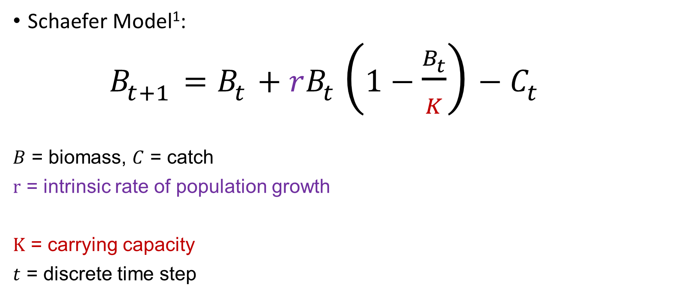
Surplus Production Models
Schaefer Model¹:
$B_{t+1}=B_{t}+rB_{t}\left(1−\frac{B_{t}}{K}\right)−C_{t}$
$B$ = biomass, $C$ = catch
$r$ = intrinsic rate of population growth
$K$ = carrying capacity
$t$ = discrete time step
Combined effects of recruitment, growth, and M in a single parameter $r$
Maximum population size, “unfished biomass”
1. Schaefer, M.B. 1954. Some aspects of the dynamics of the populations important to the management of the commercial marine fisheries. Inter-American Tropical Tuna Commission, 1: 27-56.

Slide 28

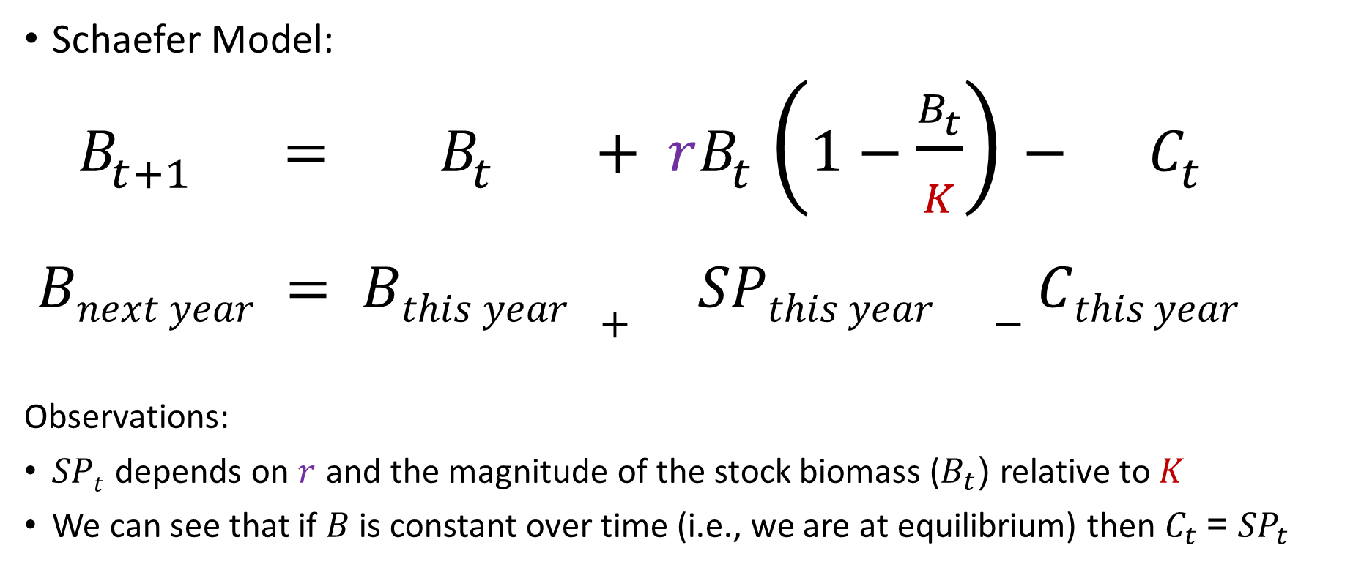
Surplus Production (SP) Models
$${SP}_{t}$$
Schaefer Model:
$B_{t+1} = B_{t} + rB_{t}\left(1−\frac{B_{t}}{K}\right)− C_{t}$
$$Bnext year = Bthis year + SPthis year −Cthis year$$
Observations:
$SPt$ depends on $r$ and the magnitude of the stock biomass ($B_{t}$) relative to $K$
We can see that if $B$ is constant over time (i.e., we are at equilibrium) then ${C_{t} \text{= }SP}_{t}$

Slide 29
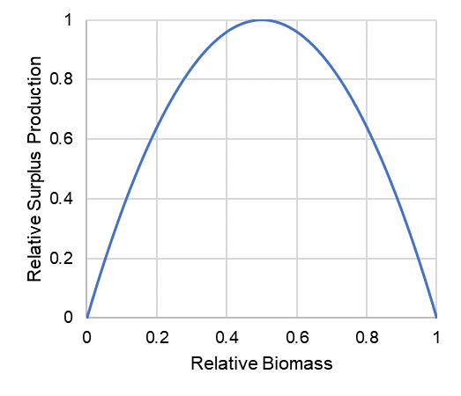
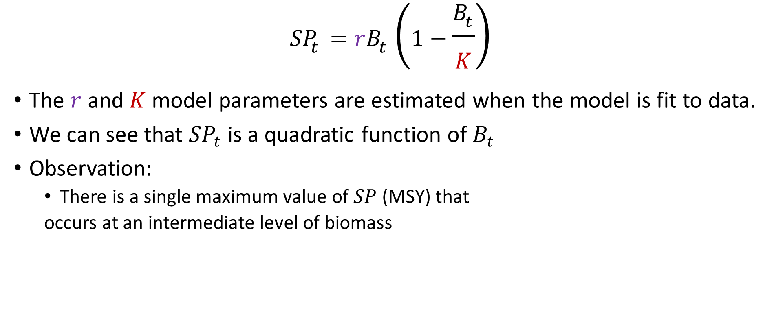
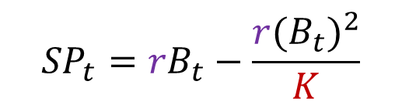
Surplus Production Curve
$${SP}_{t}=rB_{t}\left(1−\frac{B_{t}}{K}\right)$$
The $r$ and $K$ model parameters are estimated when the model is fit to data.
We can see that ${SP}_{t}$ is a quadratic function of $B_{t}$
Observation:
There is a single maximum value of $SP$ (MSY) that
occurs at an intermediate level of biomass
$${SP}_{t}=rB_{t}−\frac{r{{(B}_{t})}^{2}}{K}$$

Slide 30
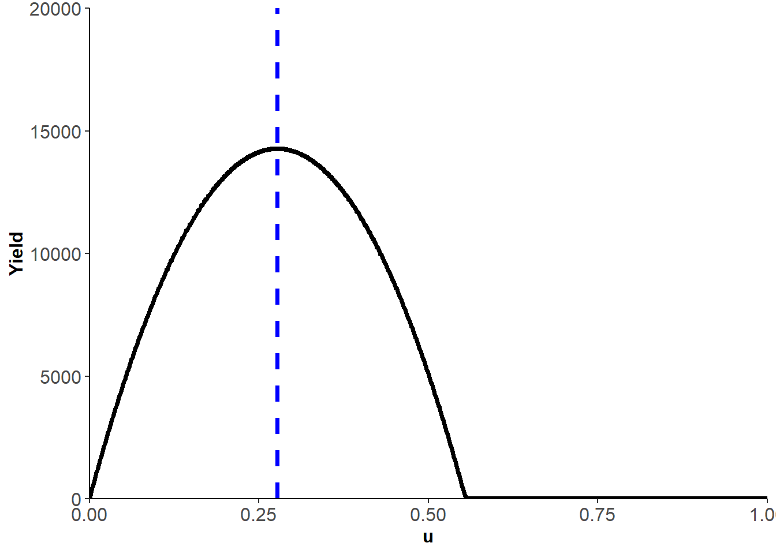

MSY Theory
MSY = maximum long-term yield that the stock can produce, given constant life history and selectivity parameters (i.e., equilibrium conditions).
MSY occurs at an intermediate harvest rate ($u$) between $u=0$ and a $u$ that crashes the stock, and at a biomass below carrying capacity $K$.
Example yield curve:
MSY

Slide 31
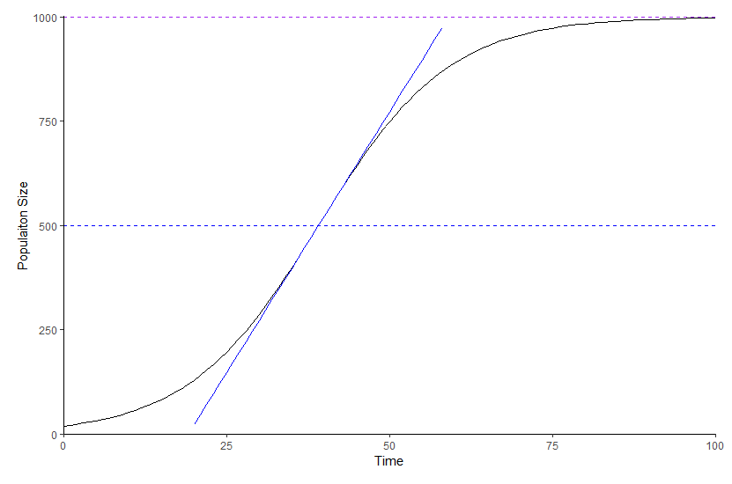


MSY Theory
Theory: with increasing long-term $F$, the abundance and mean age of a population decreases and the per-capita growth rate of the population increases as a result of reduced competition or similar effects as the biomass reduces from carrying capacity $K$ to $B$_{MSY}
Carrying capacity $K$
Theory:
The population growth rate is zero at carrying capacity
As population size is reduced below carry capacity, the population growth rate increases (due to available resources, decreased competition)
Maximum population growth rate occurs at an intermediate population size
The population “growth” could be harvested as surplus production
Maximum population
growth rate
B_{MSY}

Slide 32
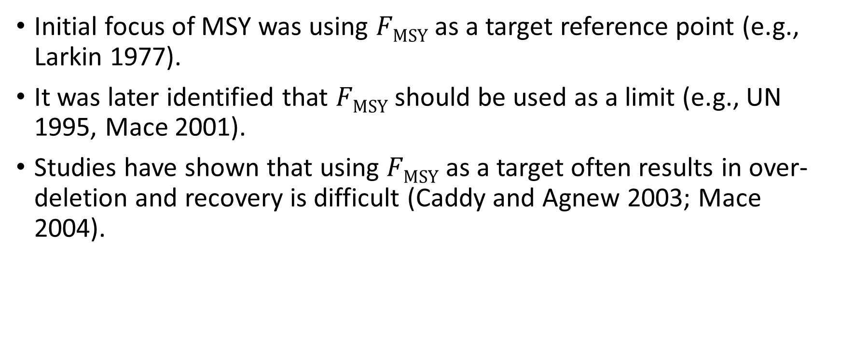
MSY as target/limit Need to think more about this slide … Canadian policy identifies Bmsy as target. The distinctions are maybe too subtle for here. Hiding slide for now. Note Larkin wrote “Epitaph for MSY” he wasn’t advocating for it as a target.
Initial focus of MSY was using $FMSY$ as a target reference point (e.g., Larkin 1977).
It was later identified that $FMSY$ should be used as a limit (e.g., UN 1995, Mace 2001).
Studies have shown that using $FMSY$ as a target often results in over-deletion and recovery is difficult (Caddy and Agnew 2003; Mace 2004).

Slide 33
MSY as target/limit
The concept of MSY has been the global standard for sustainable fisheries for decades (Sainsbury 2008; Cadrin 2012) and is included in many international agreements, e.g.,
Straddling Fish Stocks and Highly Migratory Fish Stocks Agreement (UN 1995)
European Union Common Fisheries Policy (EU 2013)
and national laws, e.g.,
US Magnuson-Stevens Fishery Conservation and Management Act (2007)

Slide 34
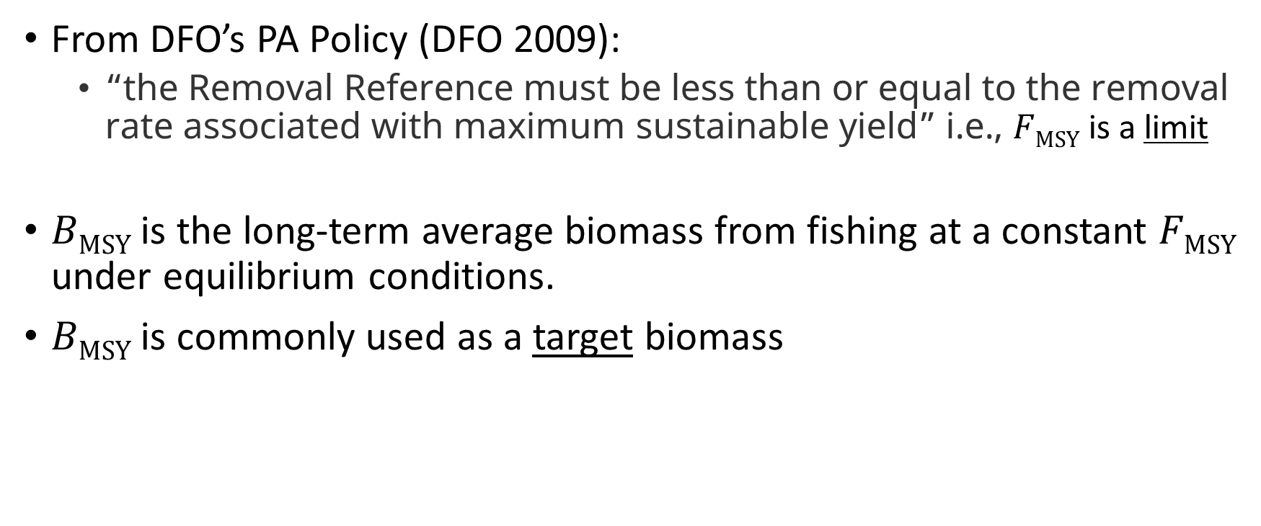
MSY in Canadian Policy
From DFO’s PA Policy (DFO 2009):
“the Removal Reference must be less than or equal to the removal rate associated with maximum sustainable yield” i.e., $FMSY$ is a limit
$BMSY$ is the long-term average biomass from fishing at a constant $FMSY$ under equilibrium conditions.
$BMSY$ is commonly used as a target biomass

Slide 35
References
Caddy, J.F. and Agnew, D.J. 2003. Recovery plans for depleted stocks: an overview of global experience. ICES CM 2003.
Cadrin, S.X. 2012. Unintended consequences of MSY proxies for defining overfishing. ICES Evolution of management frameworks to prevent overfishing. ICES CM 2012/L:23.
EU (European Union). 2013. European Union: Common fisheries policy.
Larkin, P.A. 1977. An epitaph for the concept of maximum sustained yield. Transactions American Fisheries Society 106: 1‐11.
Mace, P.M. 2001. A new role for MSY in single-species and ecosystem approaches to fisheries stock assessment and management. Fish and Fisheries, 2, 2-32.
Mace, P.M. 2004. In defence of fisheries scientists, single-species models and other scapegoats: confronting the real problems: Perspectives on eco-system-based approaches to the management of marine resources. Marine Ecology Progress Series 274: 285-291
Magnuson-Stevens Fishery Conservation and Management Act. 2007. Management Reauthorization Act of 2006. Public Law 109–479. US Congress, Washington, DC. 91 pp.
Sainsbury, K. 2008. Best Practice Reference Points for Australian Fisheries. Australian Fisheries Management Authority Report R2001/0999.
UN (United Nations). 1995. Agreement for the implementation of the provisions of the United Nations Convention on the Law of the Sea of 10 December, 1982 relating to the conservation and management of straddling fish stocks and highly migratory fish stocks. UN Rome, Italy.

Slide 36
4. Reference Points in Surplus Production Models

Slide 37

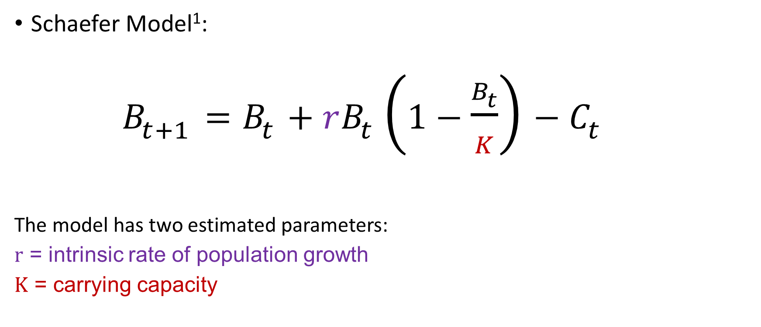
Reference points from the Schaefer Model¹
$${SP}_{t}$$
Schaefer Model¹:
$B_{t+1}=B_{t}+rB_{t}\left(1−\frac{B_{t}}{K}\right)−C_{t}$
The model has two estimated parameters:
$r$ = intrinsic rate of population growth
$K$ = carrying capacity
Hilborn R. and Walters, C.J. 1992. Quantitative fisheries stock assessment: choice, dynamics and uncertainty. Chapman and Hall, New York. 570 pp.

Slide 38

Reference points from the Schaefer Model
Our reference point calculations depend on the model parameters $r$and $K$
We can derive formulas for:
$BMSY$
$MSY$
$UMSY$ = harvest rate at $MSY$

Slide 39



$BMSY$ from the Schaefer Model
${SP}_{t}=rB_{t}\left(1−\frac{B_{t}}{K}\right)$ What stock biomass maximizes production?
$\frac{d\left({SP}_{t}\right)}{d\left(B_{t}\right)} = r−$ $\frac{{2rB}_{t}}{K}=0$
${2rB}_{t}$ $=rK$
$B_{t} =$ $\frac{K}{2}$ ($B_{MSY}$)
$$BMSY = K/2$$

Slide 40



$MSY$ from the Schaefer Model
${SP}_{t}=rB_{t}\left(1−\frac{B_{t}}{K}\right)$ What is the maximum ${SP}_{t}$?
Evaluate ${SP}_{t}$ at $B_{t}$= $\frac{K}{2}$
${SP}_{t}=r\frac{K}{2}\left(1−\frac{K/2}{K}\right)$ $=$ $\frac{rK}{4}=MSY$
$MSY= \frac{rK}{4}$
$$BMSY = K/2$$

Slide 41


$UMSY$ from the Schaefer Model
${SP}_{t}=rB_{t}\left(1−\frac{B_{t}}{K}\right)$ What is the harvest rate at MSY?
$\frac{MSY}{B_{MSY}}=$ $\frac{rK/4}{K/2}=$ $\frac{r}{2}=$ $UMSY$
$MSY= \frac{rK}{4}$
$$BMSY = K/2$$

Slide 42



Reference points from the Schaefer Model¹
$MSY= \frac{rK}{4}$
$B_{MSY}=$ $\frac{K}{2}$
MSY $=$ $\frac{rK}{4}$
$U_{MSY}=$ $\frac{r}{2}$
$$BMSY = K/2$$
For three-parameter models with non-symmetrical yield curves (e.g., Fox, Pella-Tomlinson), see 1.
Hilborn R. and Walters, C.J. 1992. Quantitative fisheries stock assessment: choice, dynamics and uncertainty. Chapman and Hall, New York. 570 pp.

Slide 43
Exercise 1
Let’s fit a SP model and calculate reference points in R

Slide 44
5. Recruitment Productivity

Slide 45
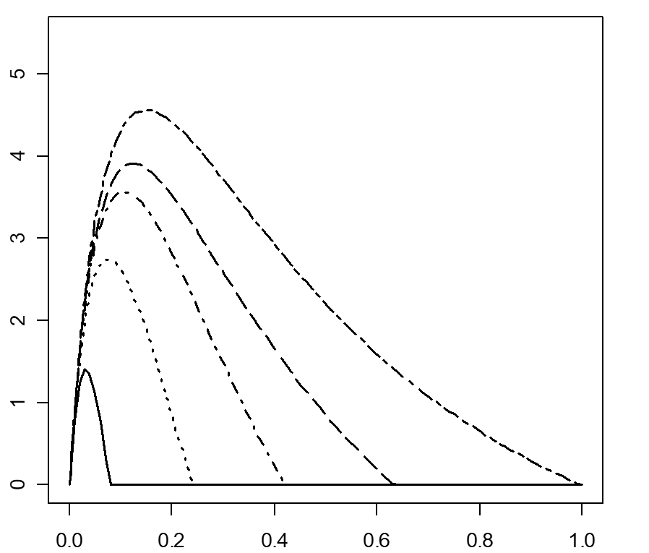
The productivity of a fish stock is the key determinant of how hard it can be fished sustainably
Therefore productivity is the key determinant of reference points
Yield
F
Confirm axis labels and change to black font

Slide 46

Productivity
In surplus production models the productivity is captured in a composite parameter ($r$ = intrinsic rate of population growth)
Age-structured models represent different components of productivity separately

Slide 47








Productivity is a composite function of:
Growth of individuals
Natural mortality rate ($M$)
Recruitment (survival of juveniles)
Notes:
MYERS:Stock-recruitment data are much like Hobbes’ view of primitive man: Nasty, brutish and short (outliers, bias, short time series)
Productivity is the fundamental determinant of a fish population’s resilience to fishing
Productivity determines important reference points for management
Estimation of recruitment productivity parameters a principal concern in stock assessment

Slide 48
Density dependence in juvenile survival (recruitment compensation)
In many animal populations, the juvenile survival rate improves as population size is reduced. This can be due to:
Reduced competition for resources in smaller populations;
Territorial behaviour at larger population sizes;
Reduced predation risk (foraging arena theory).
Notes:
Mechanism for recruitment productivity

Slide 49
Density dependence in juvenile survival
Foraging arena theory
As density increases, fewer safe refuges
More individuals must feed in unsafe areas
As density increases, rate of juvenile survival decreases
Number of survivors similar across wide range of stock sizes
Source: Walters and Juanes 1993
Walters, C.J. and Juanes, F. 1993. Recruitment limitation as a consequence of natural selection for use of restricted feeding habitats and predation risk taking by juvenile fishes. Can. J. Fish. Aquat. Sci. 50(10): 2058-2070.
Walters, C.J. and Korman, J. 1999. Linking recruitment to trophic factors: revisiting the Beverton−Holt recruitment model from a life history and multispecies perspective. Rev. Fish. Biol. Fish. 9, 187–202.
Walters, C.J. and Martell, S.J.D. 2004. Fisheries Ecology and Management. Princeton University Press, Princeton, 399 pp.

Slide 50
Linear density dependence in juvenile natural mortality predicts asymptotic stock-recruit relationships
M = M₀ + M₁N
dN/dt = -MN_{t} = -(M₀ + M₁N_{t})N_{t}
Integrate this to find N_{t+1}
The resulting equation is of the form of the Beverton-Holt SRR*
Slope = M₁
Number of recruits N _{t+1}
Juvenile mortality M
M₀
Numbers N
Numbers N
Beverton, R.J.H. and Holt, S.J. 1957. On the dynamics of exploited fish populations. Fisheries Investment Series 2, Vol. 19. U.K. Min. Agriculture & Fisheries, London.
Walters, C.J. and Korman, J. 1999. Linking recruitment to trophic factors: revisiting the Beverton−Holt recruitment model from a life history and multispecies perspective. Rev. Fish. Biol. Fish. 9, 187–202.
*Walters, C.J. and Martell, S.J.D. 2004. Fisheries Ecology and Management. Princeton University Press, Princeton, pp. 128 - 132.
Notes:
Flat stock recruit relationships seem to be ubiquitous in fish populations (Myers database) www.mscs.dal.ca/~myers/welcome.html
JUVENILES
1. M = M0 + M1N
2. dN/dt = -MNt = (M0 + M1Nt)Nt
3. Integrate 2 to get Nt+1
4. Gives equation of Beverton-Holt form

Slide 51
Recruitment compensation (Beverton-Holt SRR)
α is the maximum juvenile survival rate (max Recruits per Egg)
R₀
Recruits (R)
The values of α and β are unit-dependent. Commonly in models for iteroparous species, we express recruitment productivity as unitless ratio.
β is a “scaling” parameter representing density-dependent effects
Eggs (E)
E₀
Notes:
Assume compensatory relationship between stock size and juvenile survival
Alpha maximum juvenile survival rate
Biologically meaningful – emerges from risk-sensitive foraging behaviour of juvenile fish at different densities
More resources available at lower density
Alpha not comparable among species
Usually standardised to CR or Steepness
Compensation ratio represents maximum possible improvement in juvenile survival as stock size is reduced by fishing
ALPHA and CR commonly stated as the principal determinant of sustainable harvest rate
In this thesis I quantify the relative effects of CR and other parameters on Umsy
Goodyear, C.P. 1977. Assessing the impact of power plant mortality on the compensatory reserve of fish populations. In: Proceedings of the Conference on Assessing the Effects of Power Plant Induced Mortality on Fish Populations, Gatlinburg, Tennessee, 3–6 May 1997. Pergamon Press, New York. pp. 186–195.
α = recruit survival rate at very low stock size
β = 1/maximum recruits as E →∞

Slide 52
Recruitment compensation (Beverton-Holt SRR)
Compensation ratio = i/ii = αE₀/R₀ = αφ_{E0}
We’ll see later that φ_{E0} is a function of the stock’s growth, maturity and natural mortality
(i) Slope = α = maximum survival rate
R₀
Recruits (R)
(ii) Slope = R₀ /E₀ = unfished survival
Eggs (E)
E₀
Goodyear, C.P. 1977. Assessing the impact of power plant mortality on the compensatory reserve of fish populations. In: Proceedings of the Conference on Assessing the Effects of Power Plant Induced Mortality on Fish Populations, Gatlinburg, Tennessee. Pergamon Press, New York. pp. 186–195.
Myers, R. A., Bowen, K.G. and Barrowman, N.J. 1999. Maximum reproductive rate of fish at low population sizes. Canadian Journal of Fisheries and Aquatic Sciences 56, 2404-2419 (CR=â).
Notes:
Assume compensatory relationship between stock size and juvenile survival
Alpha maximum juvenile survival rate
Biologically meaningful – emerges from risk-sensitive foraging behaviour of juvenile fish at different densities
More resources available at lower density
Alpha not comparable among species
Usually standardised to CR or Steepness
Compensation ratio represents maximum possible improvement in juvenile survival as stock size is reduced by fishing
ALPHA and CR commonly stated as the principal determinant of sustainable harvest rate
In this thesis I quantify the relative effects of CR and other parameters on Umsy
Goodyear, C.P. 1977. Assessing the impact of power plant mortality on the compensatory reserve of fish populations. In: Proceedings of the Conference on Assessing the Effects of Power Plant Induced Mortality on Fish Populations, Gatlinburg, Tennessee, 3–6 May 1997. Pergamon Press, New York. pp. 186–195.
α = recruit survival rate at very low stock size
β = 1/maximum recruits as E →∞

Slide 53
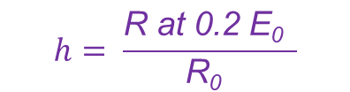
Recruitment compensation (Beverton-Holt SRR)
Steepness (h) is the ratio of the recruitment when spawning biomass is 20% of unfished to the unfished recruitment (ratio of the horizontal lines)
$$h= \frac{\text{R} \text{at}\text{ 0.2 }\text{E}\text{0} }{\text{R}\text{0} }$$
R₀
In all these models and in fisheries stock assessment in general, we assume spawning biomass is a proxy for number of eggs
Recruits (R)
R at 0.2 E₀
My suggestions added in purple. Please review and change to black if accepted
0.2 E₀
Eggs (E)
E₀
Mace P.M. and Doonan, I.J. 1988. A generalized bioeconomic simulation model for fish population dynamics. N.Z. Fish. Assess. Res. Doc. 88/4.
Notes:
Assume compensatory relationship between stock size and juvenile survival
Alpha maximum juvenile survival rate
Biologically meaningful – emerges from risk-sensitive foraging behaviour of juvenile fish at different densities
More resources available at lower density
Alpha not comparable among species
Usually standardised to CR or Steepness
Compensation ratio represents maximum possible improvement in juvenile survival as stock size is reduced by fishing
ALPHA and CR commonly stated as the principal determinant of sustainable harvest rate
In this thesis I quantify the relative effects of CR and other parameters on Umsy
Goodyear, C.P. 1977. Assessing the impact of power plant mortality on the compensatory reserve of fish populations. In: Proceedings of the Conference on Assessing the Effects of Power Plant Induced Mortality on Fish Populations, Gatlinburg, Tennessee, 3–6 May 1997. Pergamon Press, New York. pp. 186–195.
α = recruit survival rate at very low stock size
β = 1/maximum recruits as E →∞

Slide 54
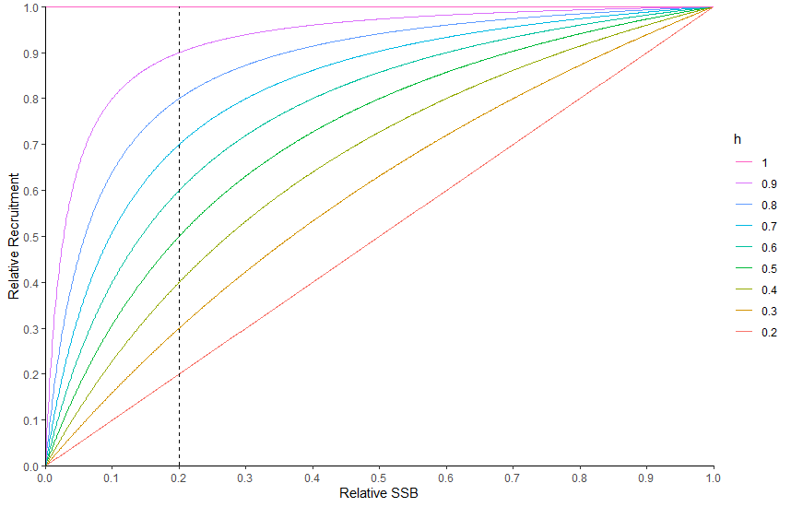


Steepness (h)
$h$ is a measure of the resilience of recruitment to decreases in SSB from $SSB0$
Ranges from 0.2 to 1
$h$ = 1 (constant recruitment)
$h$ = 0.2 (linear increase in recruits)
$h$ = relative recruitment at relative SSB = 0.2

Slide 55
Steepness and CR are analytically related
Compensation ratio (CR) =
αφ_{E0} (for BH and Ricker SRRs)
Steepness (h) =
(BH)
(Ricker)
Steepness is a widely used parameter in fisheries stock assessment. It has strong effects on the modeled fish population’s resilience to fishing and its reference points. It is very hard to estimate. Commonly, practitioners must use an informative prior.

Slide 56
6. Reference Points in Age-structured Models

Slide 57

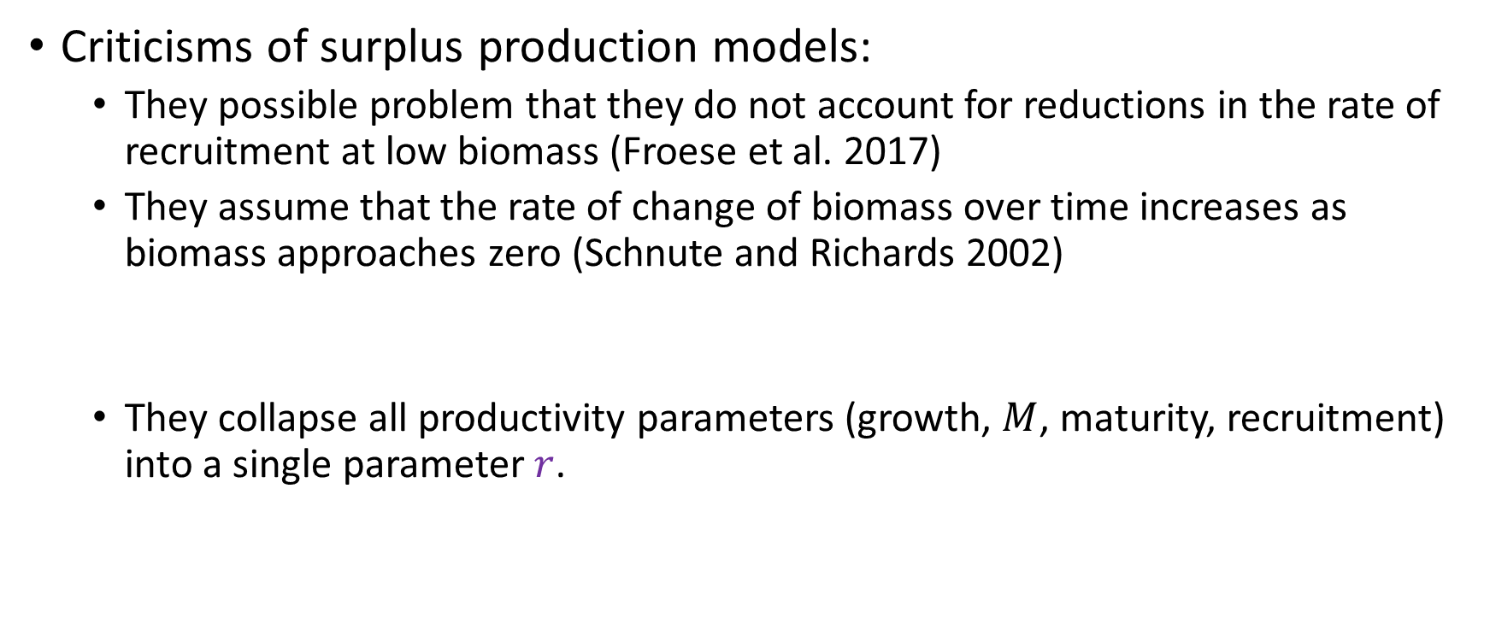
Limitations of Surplus Production Models
Criticisms of surplus production models:
They possible problem that they do not account for reductions in the rate of recruitment at low biomass (Froese et al. 2017)
They assume that the rate of change of biomass over time increases as biomass approaches zero (Schnute and Richards 2002)
They collapse all productivity parameters (growth, $M$, maturity, recruitment) into a single parameter $r$.
Addressed using a stock-recruitment relationship
Addressed using an age-structured model that accounts for:
weight-at-age, $M$-at-age, maturity-at-age, recruitment

Slide 58
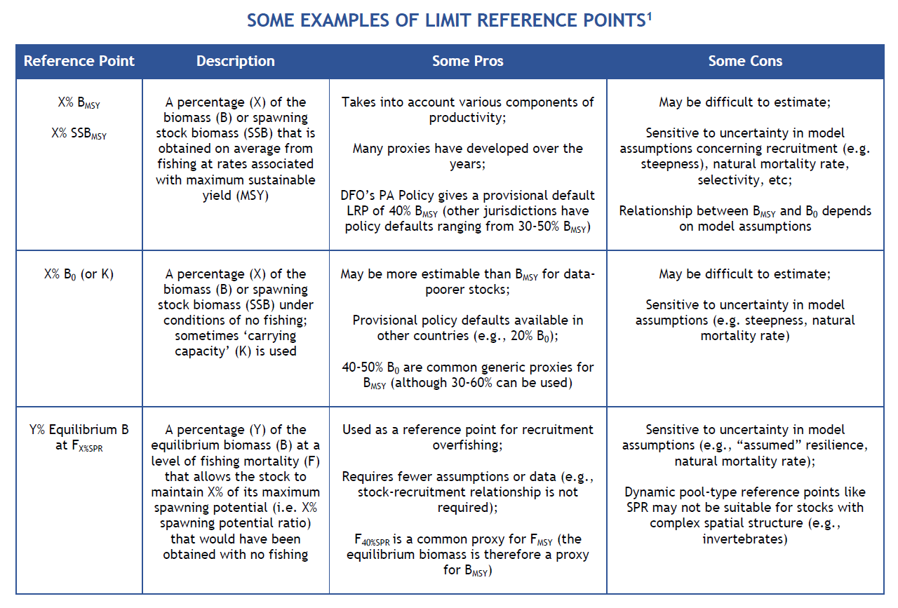


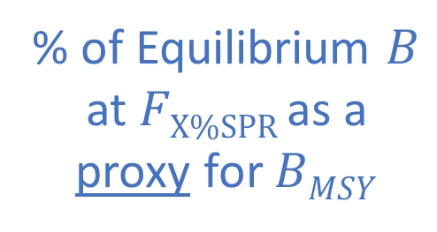
Examples of Limit Reference Points
$$\text{\% }\text{of} BMSY$$
% of $B0$
% of Equilibrium $B$ at $FX\%SPR$as a
proxy for $BMSY$
1 Adapted from Pew Charitable Trusts (2016) Reference Points: Measuring Success in Fisheries Management. 8 pp.

Slide 59

Some Equilibrium Reference Points
We will explore the calculations for an age-structured model:
$B0$
$FMSY$and $BMSY$
$FX\%SPR$ and the equilibrium $B$ from fishing at $FX\%SPR$

Slide 60
Per-recruit Calculations

Slide 61
Per-recruit Calculations
Mortality Rates
Survivorship
SSB-per-recruit (or Eggs-per-recruit)
Yield-per-recruit (YPR)

Slide 62
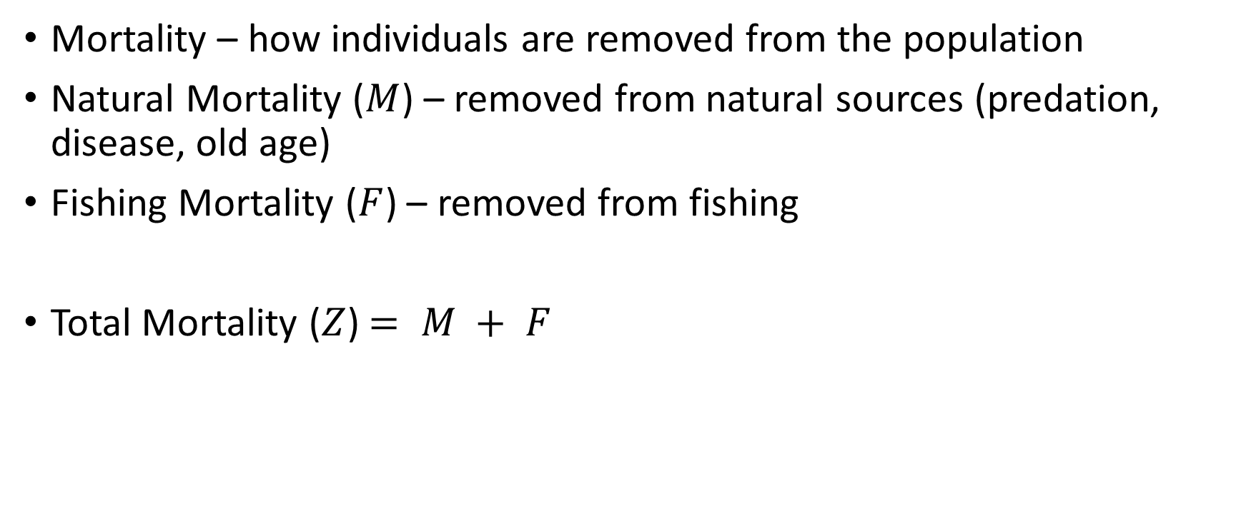
Per-Recruit Calculations 1. Mortality Rates
Mortality – how individuals are removed from the population
Natural Mortality ($M$) – removed from natural sources (predation, disease, old age)
Fishing Mortality ($F$) – removed from fishing
Total Mortality ($Z$) $= M + F$

Slide 63


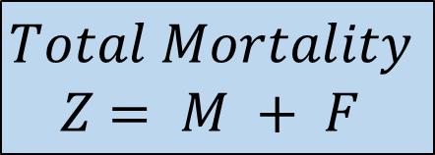

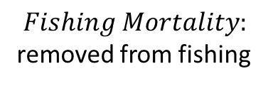
Per-Recruit Calculations 1. Mortality Rates
$Mortality$: how individuals are removed from the population
$Natural Mortality$: removed from natural sources (predation, disease, old age)
$$M$$
$$F$$
$$Fishing Mortality:$$
removed from fishing
$$Total Mortality$$
$Z$ $= M + F$

Slide 64
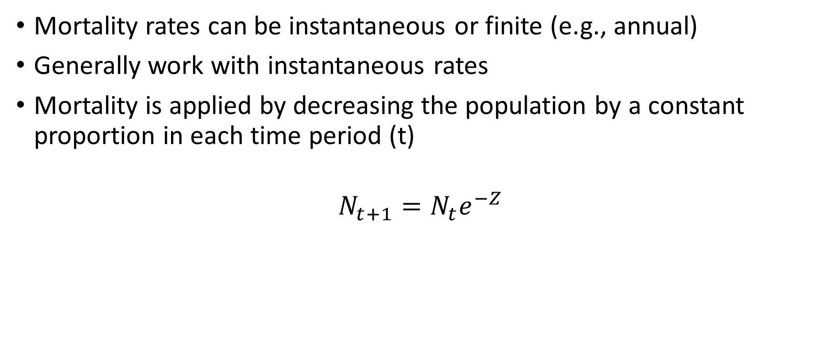
Per-Recruit Reference Points 1. Mortality Rates
Mortality rates can be instantaneous or finite (e.g., annual)
Generally work with instantaneous rates
Mortality is applied by decreasing the population by a constant proportion in each time period (t)
$$N_{t+1}=N_{t}e^{−Z}$$

Slide 65
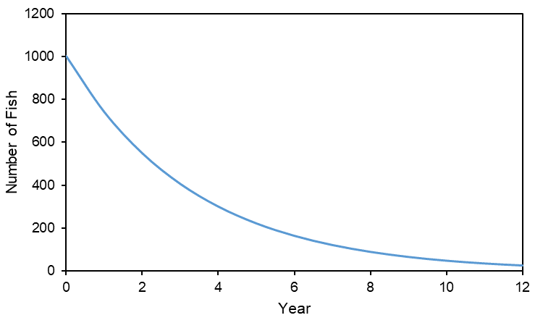

Per-Recruit Calculations 1. Mortality Rates
Example: $Z=0.3$, start with 1000 recruits at age 0 and track this cohort over time
$$N_{t+1}=N_{t}e^{−Z}$$

Slide 66
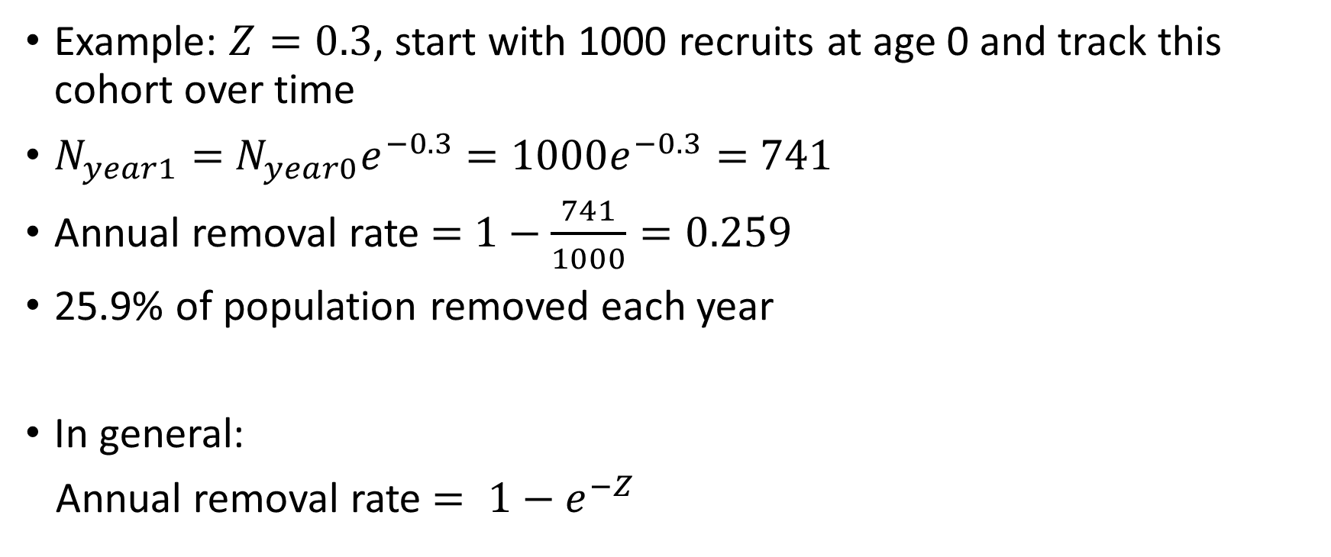
Per-Recruit Calculations 1. Mortality Rates
Example: $Z=0.3$, start with 1000 recruits at age 0 and track this cohort over time
$N_{year1}=$ $N_{year0}e^{−0.3}$ $=1000e^{−0.3}=$ $741$
Annual removal rate $=$ $1−\frac{741}{1000}=0.259$
25.9% of population removed each year
In general:
Annual removal rate $= 1−e^{−Z}$

Slide 67
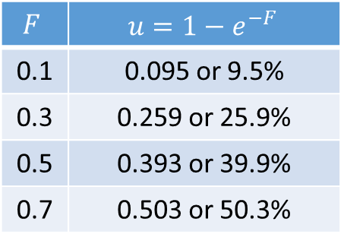

Per-Recruit Calculations 1. Mortality Rates
Harvest rate (or exploitation rate $u$) is the annual proportional change in numbers of fish for a given instantaneous fishing mortality rate ($F$)
Sometimes expressed as a percentage (%)
$$F$$ | $$u=1−e^{−F}$$
0.1 | 0.095 or 9.5%
0.3 | 0.259 or 25.9%
0.5 | 0.393 or 39.9%
0.7 | 0.503 or 50.3%

Slide 68
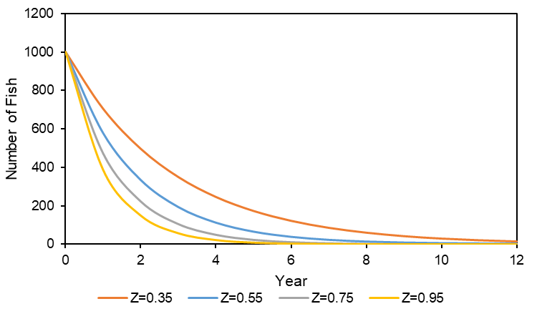

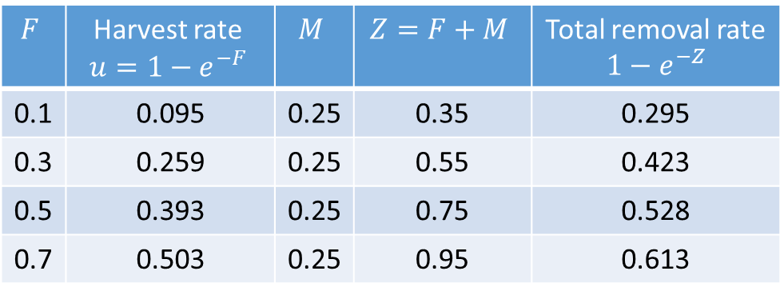
Per-Recruit Calculations 1. Mortality Rates
Add $M=0.25$and calculate total removal rate ($Z=M+F$)
$$F$$ | Harvest rate $$u=1−e^{−F}$$ | $$M$$ | $$Z=F+M$$ | Total removal rate $1−e^{−Z}$
0.1 | 0.095 | 0.25 | 0.35 | 0.295
0.3 | 0.259 | 0.25 | 0.55 | 0.423
0.5 | 0.393 | 0.25 | 0.75 | 0.528
0.7 | 0.503 | 0.25 | 0.95 | 0.613

Slide 69
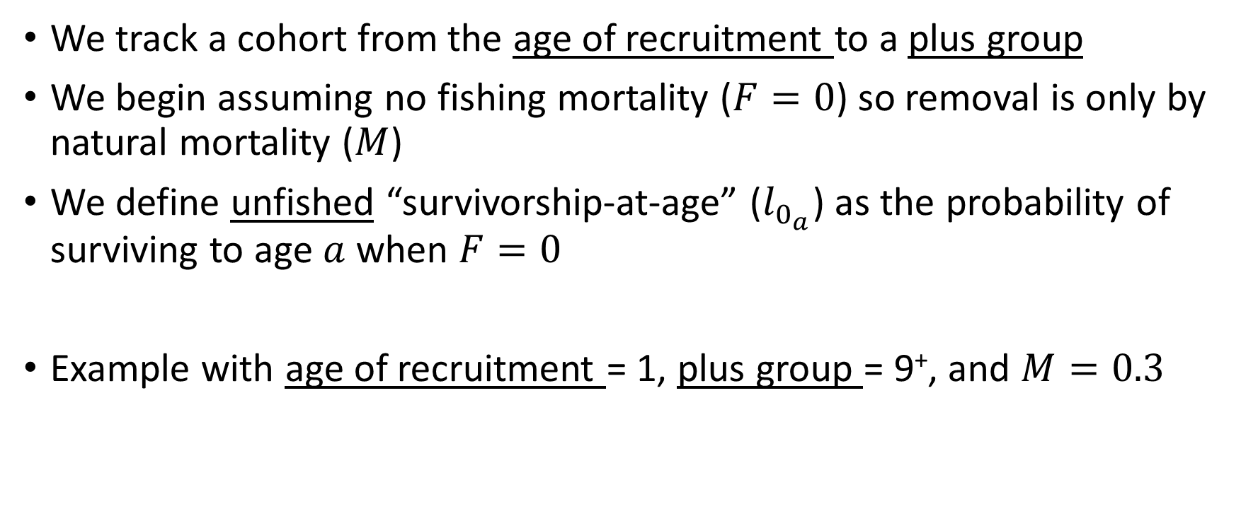
Per-Recruit Calculations 2. Survivorship
We track a cohort from the age of recruitment to a plus group
We begin assuming no fishing mortality ($F=0$) so removal is only by natural mortality ($M$)
We define unfished “survivorship-at-age” ($l_{0_{a}}$) as the probability of surviving to age $a$ when $F=0$
Example with age of recruitment = 1, plus group = 9⁺, and $M=0.3$

Slide 70



Per-Recruit Calculations 2. Unfished Survivorship
age 1 = age of recruitment
For $M=0.3$
$l_{0_{a=1}}=P\left(surviving to age 1\right)=1$
$l_{0_{a=2}}=P\left(surviving to age 2\right)=1×e^{−M}=e^{−0.3}$
$l_{0_{a=3}}=P\left(surviving to age 3\right)=1$ $×e^{−M}×e^{−M}=e^{−2(0.3)}$
$l_{0_{a=4}}=P\left(surviving to age 4\right)=1 ×e^{−M}×e^{−M}×e^{−M}=e^{−3(0.3)}$
$l_{0_{a=a}}=e^{− \left(a−1\right)M}$

Slide 71


Per-Recruit Calculations 2. Unfished Survivorship
$l_{a=9^{+}}=P\left(surviving to at least age 9 \right)=$ $e^{−8M}$ + $e^{−9M}$ + $e^{−10M}$ + …
$l_{a=9^{+}}=$ $e^{−8M}\left(1+ e^{−M}+\text{ (}e^{−M}\text{)}\text{2 }+\text{ (}e^{−M}\text{)}\text{3 }+\text{ …} \right)$
$l_{a=9^{+}}=$ $e^{−8M}\frac{1}{1−e^{M}}$

Slide 72

Per-Recruit Calculations 2. Unfished Survivorship
Unfished survivorship-at-age
$$l_{0_{a}}=\left\{\begin{matrix}1, a =a_{rec} \\ l_{0_{a−1}}e^{−(M_{a−1}+Fv_{a−1})},a_{rec}< a<a_{max} \\ \frac{l_{0_{a−1}}e^{−(M_{a−1}+Fv_{a−1})}}{1−e^{−(M_{a}+Fv_{a})}},a= a_{max}\end{matrix}\right.$$

Slide 73






Per-Recruit Calculations 2. Survivorship
Survivorship when we add fishing mortality ($F$):
$$l_{a}=\left\{\begin{matrix}1, a =a_{rec} \\ l_{a−1}e^{−(M_{a−1}+Fv_{a−1})},a_{rec}< a<a_{max} \\ \frac{l_{a−1}e^{−(M_{a−1}+Fv_{a−1})}}{1−e^{−(M_{a}+Fv_{a})}},a= a_{max}\end{matrix}\right.$$
The total mortality at-age depends on the vulnerability-at-age

Slide 74


Per-Recruit Calculations 3. Unfished SSB-per-Recruit
Equilibrium unfished SSB-per-recruit ($φ_{E0}$)
subscript $E$ because we assume that SSB is a proxy for eggs produced
subscript $0$ represents unfished ($F=0$) state
$φ_{E0}=$SSB produced on average by each recruit over its lifetime, considering survival, growth, and maturity
Sum over all ages:
P(survives to age $a$) × weight-at-age $a$ × P(mature-at-age $a$)
$$φ_{E0}=\sum_{{a=a}_{rec}}^{a_{max}}{l_{0_{a}}w_{a}m_{a}}$$

Slide 75



Per-Recruit Calculations 3. SSB-per-Recruit
Equilibrium SSB-per-recruit ($φ_{F}$) = SSB produced on average by each recruit over its lifetime, considering survival, growth, and maturity
Sum over all ages:
P(survives to age $a$) × weight-at-age $a$ × P(mature-at-age $a$)
Survivorship now includes $F$
$$φ_{F}=\sum_{{a=a}_{rec}}^{a_{max}}{l_{a}w_{a}m_{a}}$$

Slide 76


Per-Recruit Calculations 3. Eggs-per-Recruit
If we knew fecundity-at-age, we could calculate eggs-per-recruit
Equilibrium eggs-per-recruit ($φ_{F}$)
Sum over all ages:
P(survives to age $a$) × Relative fecundity-at-age $a$× weight-at-age $a$ × P(mature-at-age $a$)
Eggs/unit body weight
$$φ_{F}=\sum_{a=a_{rec}}^{a_{max}}{l_{a}{f_{a}w}_{a}m_{a}}$$

Slide 77

Per-Recruit Calculations 3. SSB-per-Recruit or Eggs-per-Recruit
We generally do not know relative fecundity and assume that SSB is proportional to fecundity
See recent paper from Marshall et al. (2021) if you’re interested in understanding the implications of the assumption that SSB is proportional to fecundity.

Slide 78

Per-Recruit Reference Points 4. Yield-per-Recruit (YPR)
YPR-at-age is the expected life-time yield per fish recruited into the stock at a specified age
We begin the introduction to YPR by defining total biomass removed-per-recruit:
$B$ removed-per-recruit at age $a$= biomass-per-recruit at age $a$× total removal rate
from fishing and natural mortality
$B \text{r}\text{emov}\text{ed}\text{−}\text{per}\text{−}\text{recruit} \text{at} \text{age} a=l_{a}w_{a}$($1−e^{−\left(M_{a}+Fv_{a}\right)}$)

Slide 79


Per-Recruit Reference Points 4. Yield-per-Recruit (YPR)
The yield is the biomass removed from $F$ and excludes the biomass removed from $M$
YPR-at-age $a$is therefore the proportion of $B \text{r}\text{emoved}\text{−}\text{per}\text{−}\text{recruit} \text{at} \text{age} a$that is due to fishing
$B \text{r}\text{emov}\text{ed}\text{−}\text{per}\text{−}\text{recruit} \text{at} \text{age} a=l_{a}w_{a}$($1−e^{−\left(M_{a}+Fv_{a}\right)}$)
${YPR}_{a}=l_{a}w_{a}$($1−e^{−(M_{a}+{Fv}_{a})}$) $\frac{Fv_{a}}{M_{a}+{Fv}_{a}}$

Slide 80



Per-Recruit Reference Points 4. Yield-per-Recruit (YPR)
$YPR=$Sum over all ages:
${YPR}_{a}=l_{a}w_{a}$($1−e^{−(M_{a}+{Fv}_{a})}$) $\frac{Fv_{a}}{M_{a}+{Fv}_{a}}$
$${YPR}_{F}=\sum_{a=a_{rec}}^{a_{max}}{l_{a}w_{a}\left(1−e^{−(M_{a}+{Fv}_{a})}\right)\frac{{Fv}_{a}}{M_{a}+{Fv}_{a}}}$$

Slide 81

Next step: Yield-per-Recruit → Yield
Yield = $YPR ×number of recruits$
We saw how to calculate yield-per-recruit
We already know how to calculate $YPR$ for various $F$
Now we just need to know how the number of recruits change with changes with $F$
This is where stock-recruitment relationships enter the reference point calculations

Slide 82
Reference Point Calculations

Slide 83


Data Requirements for Reference Points for Age- Structured Models
SRR
(R₀, h, and φ₀) or (α and β)
Growth
(weight-at-age)
Maturity
MSY reference points
Per-recruit calculations
$$M$$
$F$ and Selectivity

Slide 84

Reference Points
Unfished Equilibrium Biomass $B0$
Equilibrium Biomass when fishing at $F$
MSY reference points
SPR reference points

Slide 85





Reference Points 1. Unfished Equilibrium Biomass $B0$
$B_{0}$ is the equilibrium unfished biomass, here we will use SSB
${SSB}_{0}$ is estimated from two pieces of information
the unfished SSB-per-recruit ($φ_{E0}$)
the SRR (here we will use the BH SRR)
Example SRR
$$φ_{E0}=\sum_{{a=a}_{rec}}^{a_{max}}{l_{0_{a}}w_{a}m_{a}}$$
Survivorship-at-age (depends on $M$)
weight-at-age
maturity-at-age

Slide 86



Reference Points 1. Unfished Equilibrium Biomass $B0$
We can calculate $φ_{E0}=\frac{{SSB}_{0}}{R_{0}}$
The point (${SSB}_{0}$, $R_{0}$) lies on the SRR so we know:
$R_{0}=\frac{α{SSB}_{0}}{1+β{SSB}_{0}}$
$$φ_{E0}=\sum_{{a=a}_{rec}}^{a_{max}}{l_{0_{a}}w_{a}m_{a}}$$
We have 2 equations and two unknowns ($R_{0}$ and ${SSB}_{0}$)

Slide 87






Reference Points 1. Unfished Equilibrium Biomass $B0$
Equation 1: $φ_{E0}=\frac{{SSB}_{0}}{R_{0}}$ $R_{0}=\frac{{SSB}_{0}}{φ_{0}}$
Equation 2: $R_{0}=\frac{α{SSB}_{0}}{1+β{SSB}_{0}}$
$\frac{{SSB}_{0}}{φ_{0}}=$ $\frac{α{SSB}_{0}}{1+β{SSB}_{0}}$
$\frac{1}{φ_{0}}=$ $\frac{α}{1+β{SSB}_{0}}$
$$1+β{SSB}_{0}=αφ_{0}$$
${SSB}_{0}=$ $\frac{αφ_{E0}−1}{β}$
Equation 3
$B_{0}$ therefore depends on:
SRR parameters $α$ and $β$
$φ_{E0}$ (determined by $M$, $weight$-$at$-$age$, and $maturity$-$at$-$age$)

Slide 88




Reference Points 1. Unfished Equilibrium Biomass $B0$
${SSB}_{0}$ occurs at the intersection of the SRR and a line through the origin with slope $1/φ_{E0}$
Note the inverse of $φ_{E0}$ is $R0/SSB0$ and $R0$ = the unfished equilibrium recruitment
Line with slope $1/φ_{E0}$
$$(SSB0,R0)$$

Slide 89

Reference Points 2. Equilibrium Biomass and Recruitment
To calculate $B_{0}$we needed the SSB-per-recruit and the SRR
To calculate an equilibrium biomass from fishing at a constant specified $F$ (e.g., $B_{MSY}$) we will also use SSB-per-recruit and the SRR
When $F$ increases from 0, the SSB-per-recruit ($φ_{F}$) decreases from the unfished $φ_{E0}$

Slide 90




Reference Points 2. Equilibrium Biomass and Recruitment
A line with slope 1/$φ_{F}$ that represents the recruits per spawning biomass ($RF$/$SSBF$) is steeper than 1/$φ_{E0}$
($SSB0$,$R0$)
Line with slope $1/φ_{F}$
Line with slope $1/φ_{E0}$

Slide 91


Reference Points 2. Equilibrium Biomass and Recruitment
A line with slope 1/$φ_{F}$ that represents the recruits per spawning biomass ($RF$/$SSBF$) is steeper than 1/$φ_{E0}$
This line intersects the SRR at a lower biomass ($SSBF$) than $SSB0$
($SSBF$,$RF$)
($SSB0$,$R0$)
Line with slope $1/φ_{F}$
Line with slope $1/φ_{E0}$

Slide 92


Reference Points 2. Equilibrium Biomass and Recruitment
The equilibrium SSB at $F$is $SSBF$
The equilibrium recruitment at $F$is $RF$
$SSBF$ and $RF$ can be calculated for any $F$
($SSBF$,$RF$)
($SSB0$,$R0$)
Line with slope $1/φ_{F}$
Line with slope $1/φ_{E0}$

Slide 93


Reference Points 2. Equilibrium Biomass and Recruitment
The equilibrium SSB ($SSBF$) for $φ_{F}$ from Equation 3 is: ${SSB}_{F}=$ $\frac{αφ_{F}−1}{β}$
The equilibrium recruitment ($RF$) for $φ_{F}$ from Equation 1 is: $R_{F}=\frac{{SSB}_{F}}{φ_{F}}$
Now that we can calculate the equilibrium SSB for any $F$, we can calculate the MSY reference points

Slide 94



Reference Points 3. MSY
Equilibrium MSY reference points can be determined from calculating:
Yield = YPR × Equilibrium Recruitment, and
Equilibrium SSB
over a range of $F$ values using the formulas presented on previous slides.

Slide 95

Reference Points 3. MSY
$FMSY \text{= }\text{Fishing} \text{mortality} \text{rate} \text{that} \text{results} \text{in} \text{maximum} \text{yield} \text{over} \text{the} \text{long} \text{term}$
$MSY\text{ = }\text{the} \text{largest} \text{catch} \text{(}\text{yield}\text{) }\text{that} \text{can} \text{be} \text{continuously} \text{removed} \text{from} \text{the} \text{stock} \text{assuming} \text{constant} \text{environmental} \text{conditions}\text{ (}\text{equilibrium}\text{)}$
$BMSY$ = average long-term biomass (SSB) from fishing at a constant $FMSY$ over the long term

Slide 96





Reference Points 3. MSY
$YieldF = YPRF × RF$
$FMSY$: calculate yield for various $F$ and identify the $F$ where yield is at its maximum
Equilibrium Yield at a specified $F$
Yield-per-recruit at a specified $F$
Equilibrium Recruitment at a specified $F$
$$F_{MSY}$$

Slide 97



Reference Points 3. MSY
$MSY=$ yield at $FMSY$
${SSB}_{MSY}=$ equilibrium biomass at $FMSY$
MSY
$${SSB}_{MSY}$$
$$F_{MSY}$$
$$F_{MSY}$$

Slide 98
Exercise 2 and 3
Let’s explore these calculations in R in Exercise 2
Exercise 3 can be done on your own prior to the Nov 22 session

Slide 99

Reference Points 4. Spawning Potential Ratio (SPR)
${SPR}_{F}=\frac{φ_{F}}{φ_{E0}}$
$φ_{F}$ = SSB-per-recruit when fishing at $F=F$
$φ_{E0}$ = unfished SSB-per-recruit (i.e., $F=0$)
Reference points based on SPR and independent of the SRR and are common proxies for $FMSY$ and $SSBMSY$

Slide 100


Reference Points 4. Spawning Potential Ratio (SPR)
${SPR}_{F}$ decreases with increasing $F$
An example SPR vs. $F$ curve is plotted below where $F40\%SPR$ is identified as the $F$ that results in 40% SPR.
40%SPR

Slide 101

Reference Points 4. Spawning Potential Ratio (SPR)
F_{X%SPR} represents the F that results in X% of $φ$₀
Value of SPR as a proxy for F_{MSY} depends on productivity
Biomass reference points
B_{MSY} proxy = equilibrium biomass from fishing at F_{X%SPR}
An assumption about the equilibrium biomass from fishing at F_{X%SPR} is needed
Productivity | r | F_{MSY} ≈ F_{X%SPR}
Very Low | -* | F_{≥50%}
Low | <0.14 | F_{45%}
Medium | 0.14-0.35 | F_{40%}
High | >0.35 | F_{30%}
*Defined based on M < 0.1 and age-at-maturation > 15 years
NZ Ministry of Fisheries Operational Guidelines (MF 2011)

Slide 102
Exercise 4
Let’s explore the SPR calculations in R

Slide 103
End day 1 – move SPR to day 2 if we run out of time.

Slide 104
7. Approaches for Data-limited Stocks
I think this should be a very gentle introduction to what options are available?

Slide 105
Approaches for Data-limited Stocks
Methods:
Empirical, theoretical, and historical proxies for B₀ and B_{MSY}
Catch-only methods: can provide estimates of B relative to B₀ and B_{MSY}
they have generally been used to estimate global trends in stock status and not for stock assessment
Closed-loop simulation approaches: an alternative to using empirical proxies or methods that rely on strong model assumptions or priors

Slide 106


Theoretical Proxies for B_{MSY}
Per-recruit models: Spawning Potential Ratio (SPR)
$F$ reference point: $FX\%SPR$ represents the $F$ that results in $X$% of unfished SSB-pre-recruit
$FX\%SPR$is a common proxy for $FMSY$
Value of SPR as a proxy for $FMSY$ depends on productivity
Biomass reference point:
$BMSY$ proxy = equilibrium B from fishing at $FX\%SPR$
Productivity | $$r$$ | $FMSY$ ≈ $FX\%SPR$
Very Low | -* | F_{≥50%}
Low | <0.14 | F_{45%}
Medium | 0.14-0.35 | F_{40%}
High | >0.35 | F_{30%}
*Defined based on M < 0.1 and age-at-maturation > 15 years
NZ Ministry of Fisheries (2011)

Slide 107

Theoretical Proxies for F_{MSY}
Other F_{MSY} proxies:
$Fmax$= $F$ that maximizes YPR (not recommended)
$F0 1$ = $F$ where slope of YPR curve is 10% of the slope at the origin
Sensitive to assumptions about growth and $M$
Not recommended without understanding how well it relates to $FMSY$ (Mace 2001)
$FMSY$ = $M$ or a proportion of $M$
$0.87M$ meta-analysis (Zhou et al. 2012)
$0.5M$ pelagic species (Patterson 1992)
Biomass reference points = equilibrium B from fishing at $F$
.

Slide 108

Historical, Empirical, or Other Proxies for B₀ and B_{MSY}
$BMSY$ proxy, defined by
the mean or median value of an indicator over a historical time period when the indicator is high and catches are high; or
the mean or median value of an indicator over a productive period.
$B0$ proxy, defined by
the mean/median (or maximum) value of the indicator over a historical time period reflecting the beginning of exploitation.
LRPs based on a historical low biomass state:
from which the stock recovered to above average levels;
or that is agreed by managers and resource users to be an undesirable state to avoid.

Slide 109
Catch-only Approaches
Assume Catch is proportional to Abundance
Have been developed primarily to assess the global status of unassessed stocks (e.g., Costello et al. 2012; Kleisner et al. 2013; Palomares et al. 2020)
Recent reviews of data-limited methods have evaluated the performance of catch-only methods to estimate stock status (Carruthers et al. 2014; Free et al. 2020; Sharma et al., 2021; Ovando et al. 2022).
Performance evaluated on data rich stocks and simulated stocks
Catch-only methods:
produced biased and imprecise estimates of stock status
have been developed primarily to assess the global status of unassessed stocks

Slide 110

Closed-loop Simulation
Process that involves evaluating performance of MPs through simulation to assess trade-offs among multiple fishery and conservation objectives.
“Management Strategy Evaluation” – CLS is the technical modeling component of MSE.

Slide 111
Closed-loop Simulation
Data-limited context, CLS approach is an alternative to using empirical proxies that may not capture bias and uncertainty in estimated stock status.
CLS approach can provide sustainable catch advice consistent with the PA Policy and in compliance with the FSP, when stock status cannot be well estimated using traditional methods.
The application of a data-limited CLS framework to provide management advice has been demonstrated for groundfish in BC (Anderson et al. 2021).

Slide 112
8. Approaches using Multiple Models
I think this should be a very gentle introduction to what options are available?

Slide 113
Stock Status from Multiple Models
Model averaging (ensemble approach)
100% weight on one model (model selection);
equal weighting;
tactical weighting (e.g., based on expert opinion or historical performance);
weighting based on model probabilities (e.g., Bayes factors);
weighting based on information theoretic values (e.g., AIC); or
weighting based on predictive ability
Empirical Approaches
Reference points based on empirical indicators

Slide 114
Something on multiple OMs in MSE

