Slide 1

Reference Points 101
Robyn Forrest and Tim Barrett
Nov 15 and 22, 2022
Technical Expertise in Stock Assessment (TESA) Webinar

Slide 2
Objectives
This webinar comes after the 2021 joint TESA/National Operational Guidelines (NOG) Taskforce workshop on “Limit Reference Points and the Fish Stocks Provisions”.
Feedback from the workshop indicated a desire for more training in the theory and calculation of reference points.
This webinar tries to address this gap by focusing on the more technical aspects of calculating reference points.
Participants are invited to review the materials from the 2021 workshop for a deeper dive into considerations for selecting LRPs
https://github.com/TESA-workshops/LRP
The proceedings from the 2021 workshop will be published as a DFO Technical Report

Slide 3
Objectives
This webinar will allow participants to explore some of the practical aspects (and challenges) of calculating reference points. By the end of the webinars, participants should have:
an understanding of the concept of equilibrium as it relates to reference points;
an understanding of calculation of equilibrium reference points based on B₀, MSY, and the spawning potential ratio (SPR);
awareness of non-equilibrium reference points (e.g., minimum historical biomass, index-based approaches, dynamic B₀); and
awareness of some approaches for data-limited stocks.
Lecture material will be supported by R code, which we will provide

Slide 4
Exercises
Our introduction to reference points includes reference point calculations in R.
5 exercises are provided with the source code in R markdown.
The exercises can be downloaded from github:
https://github.com/TESA-workshops/LRP
We will provide a demonstration in Rstudio and some guidance on using Rmarkdown during this session.
We will complete some of the exercises as a group in this session and the remaining exercises can be completed on your own before the second session (Nov 22)

Slide 5
Exercises
A note about the exercises
How to get and use them etc
I think we should demo them partly in the course
Expectation that people will have tried them in the week between webinars

Slide 6
Outline – Should follow the exercises and also refer to them. Save last two points for the second session (they have no exercises)
Introduction to reference points
Background on fish stock productivity
Equilibrium assumptions
Background on MSY
Reference points in surplus production models [Exercise 1]
Reference points in age-structured models [Exercises 2-5]
Approaches for data-limited stocks
Approaches using multiple models

Slide 7
1. What are Reference Points?

Slide 8
Risk-based decision-making
How do we make decisions in fisheries?
Inherent uncertainties
Role of reference points as objectives in risk-based decision making
Objective
P(achieving objective)
Time-frame
RF add comments from ARK about reference points need to be embedded in decision making system

Slide 9
What are reference points?
General definition
A bit of background (see Sainsbury 2008 and Caddy papers from the 90s)
Probably already covered this in the LRP WPs

Slide 10
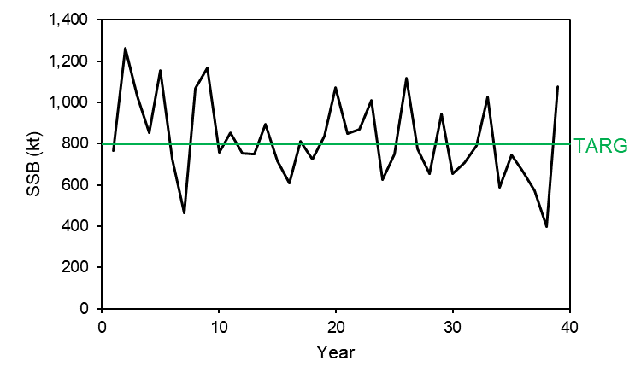
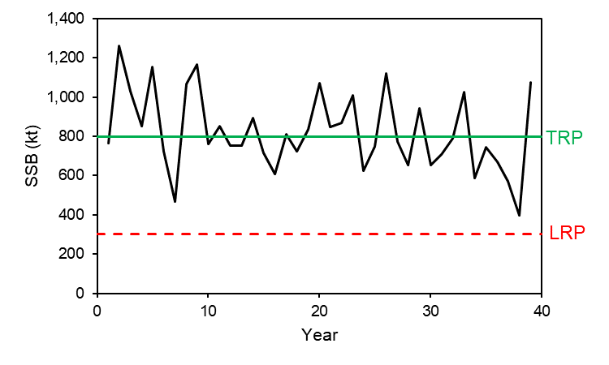
Reference Points
Target Reference Point (TRP) – desirable target stock state (stock may fluctuate around this point)
Limit Reference Point (LRP) – placed above threshold of an undesirable state / point of serious harm
Reference points are generally defined based on spawning stock biomass (SSB) or the instantaneous fishing mortality rate (F)

Slide 11
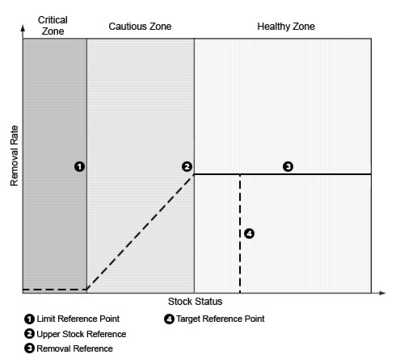
DFO: Reference Points (PA Framework)
A general fishery decision-making framework (DFO 2009) for implementing harvest strategies that incorporate the precautionary approach
Includes reference points and stock status zones

Slide 12
DFO: Reference Points (PA Framework)
LRP: “represents the stock level below which there is a high probability that the stock’s productivity is so impaired that serious harm will occur”
“At this stock status level, there may also be resultant impacts to the ecosystem, associated species and a long-term loss of fishing opportunities”
The LRP is defined by DFO Science through a CSAS peer-review process

Slide 13
DFO: Reference Points (PA Framework)
USR – “a level below which removals must be progressively reduced so the LRP can be avoided” OR “a target reference point”
“USR is defined by resource management, in consultation with stakeholders and with advice and input from DFO Science”

Slide 14
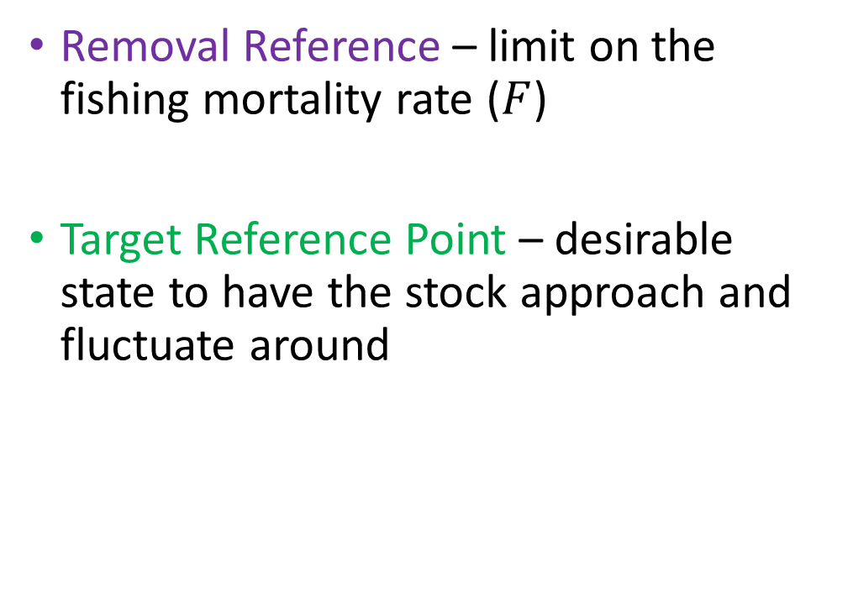
DFO: Reference Points (PA Framework)
Removal Reference – limit on the fishing mortality rate ($F$)
Target Reference Point – desirable state to have the stock approach and fluctuate around

Slide 15
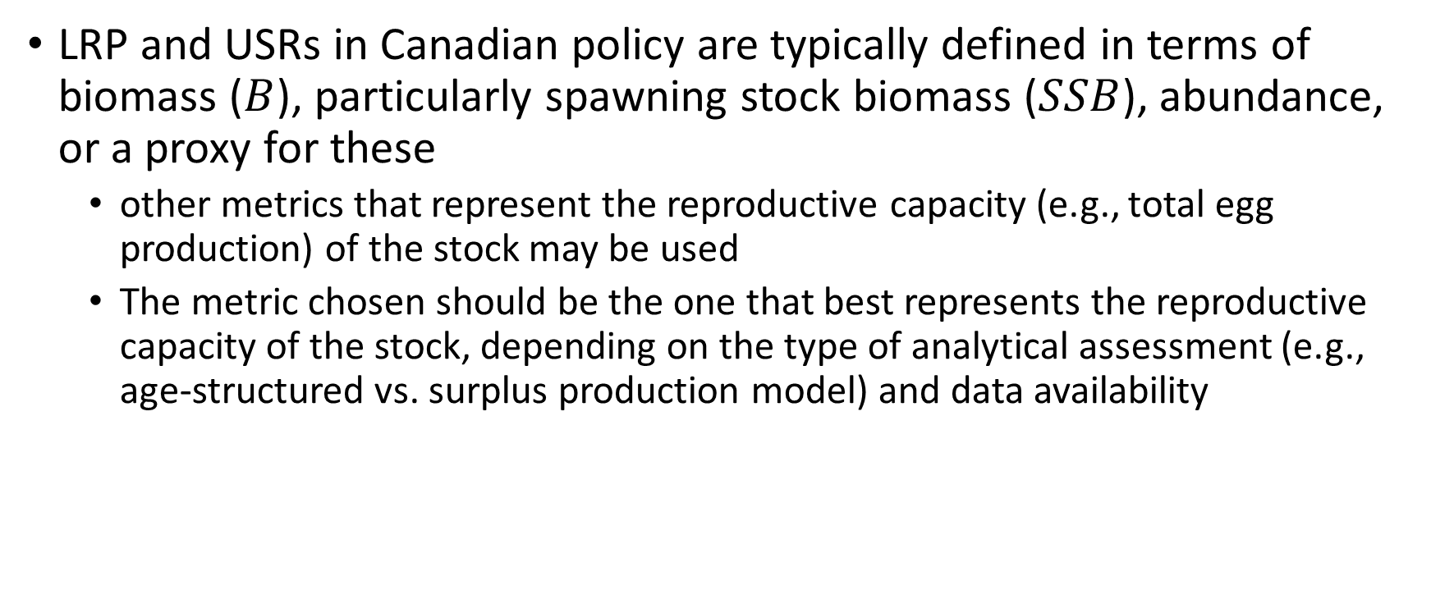
DFO: Reference Points (PA Framework)
LRP and USRs in Canadian policy are typically defined in terms of biomass ($B$), particularly spawning stock biomass ($SSB$), abundance, or a proxy for these
other metrics that represent the reproductive capacity (e.g., total egg production) of the stock may be used
The metric chosen should be the one that best represents the reproductive capacity of the stock, depending on the type of analytical assessment (e.g., age-structured vs. surplus production model) and data availability

Slide 16
Roles of Reference Points
Components of objectives and performance metrics for decision making
Determining stock status by comparing estimated SSB or F to reference points
LRP separates the critical and cautious zones
USR separates the cautious and healthy zones

Slide 17
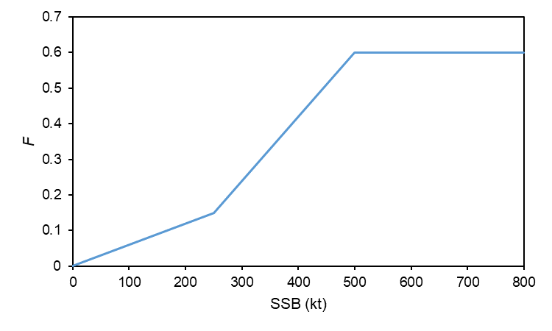
Roles of Reference Points
Can be and are often used as operational control points in harvest control rules (HCRs)
The LRP also has a legislated role in triggering the need for a rebuilding plan under the Fish Stocks Provisions
OCPs = points where pre-defined management actions take place (e.g., change in F in a HCR)

Slide 18
2. Equilibrium Assumptions

Slide 19
What is Equilibrium?
A tool to help understand effects of fishing on fish populations
A theoretical model state that arises when the following are constant in time:
Fishing mortality (F)
Fishery or stock characteristics (growth, natural mortality (M), recruitment, selectivity)
Simplifying assumptions:
Births = Deaths
A fish population harvested at a constant rate for many years will achieve equilibrium (“steady state”)
Reality:
Annual variability “noise” (e.g., variable recruitment) – this is accounted for in annual stock assessments
Effects of time-varying processes on assessments and reference points can be challenging and are not always well-understood

Slide 20
A couple of slides from the exercises (Ex 1 and 2)

Slide 21
3. What is MSY?

Slide 22
Maximum Sustainable Yield (MSY)
Intro to Schaefer model and some graphics from Ex 1

Slide 23
Maximum Sustainable Yield (MSY)
We begin by exploring yield in a simple surplus production model
We then define the theoretical concept of maximum sustainable yield
We then move to exploring yield in age-structured models (Section 6)

Slide 24

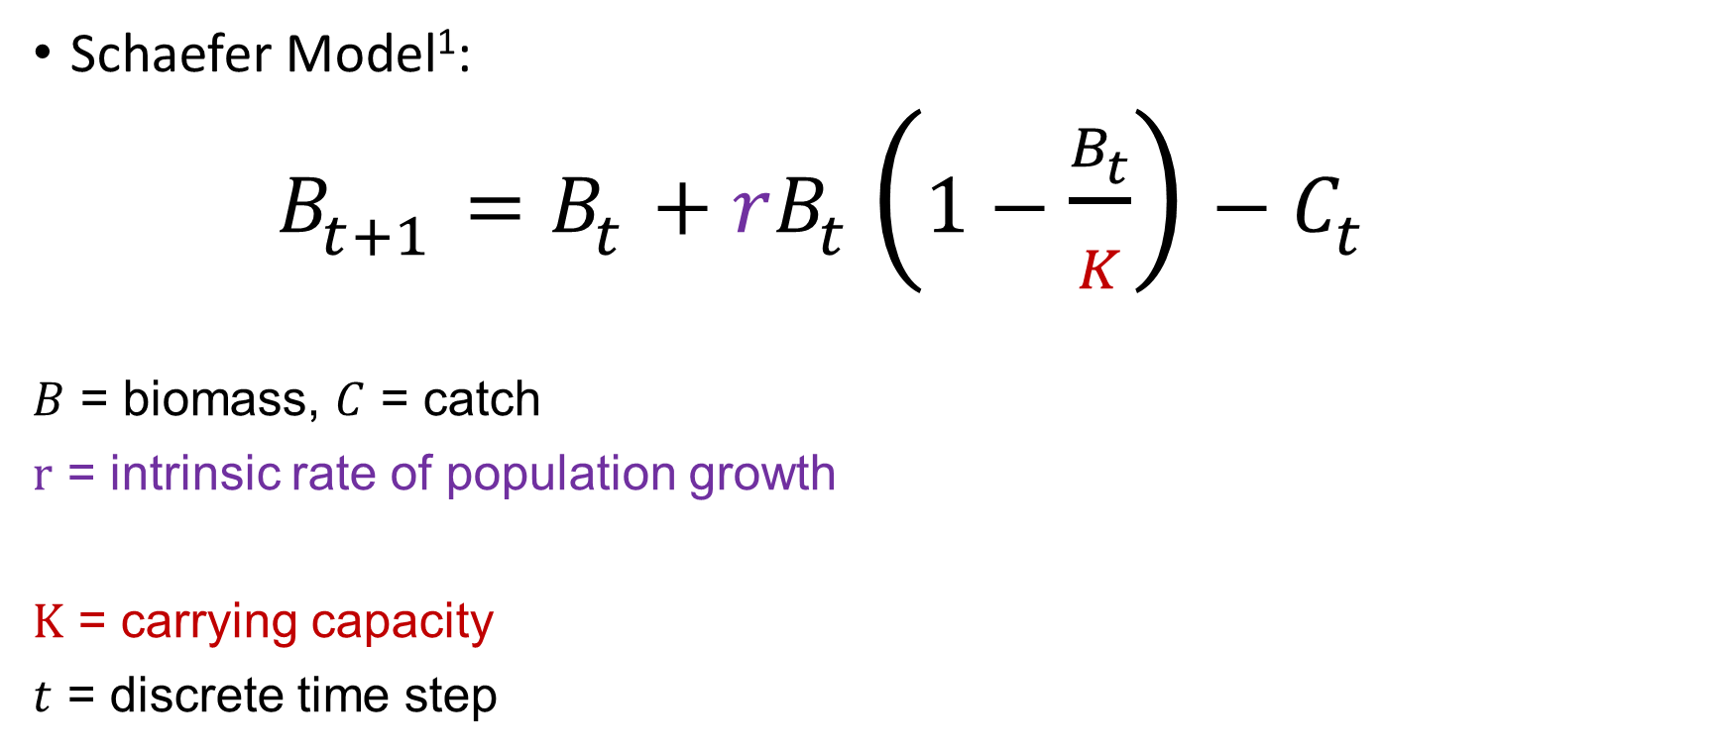
Surplus Production Models
Schaefer Model¹:
$B_{t+1}=B_{t}+rB_{t}\left(1−\frac{B_{t}}{K}\right)−C_{t}$
$B$ = biomass, $C$ = catch
$r$ = intrinsic rate of population growth
$K$ = carrying capacity
$t$ = discrete time step
Combined effects of recruitment, growth, and M in a single parameter $r$
Maximum population size, “unfished biomass”
1. Schaefer, M.B. 1954. Some aspects of the dynamics of the populations important to the management of the commercial marine fisheries. Inter-American Tropical Tuna Commission, 1: 27-56.

Slide 25

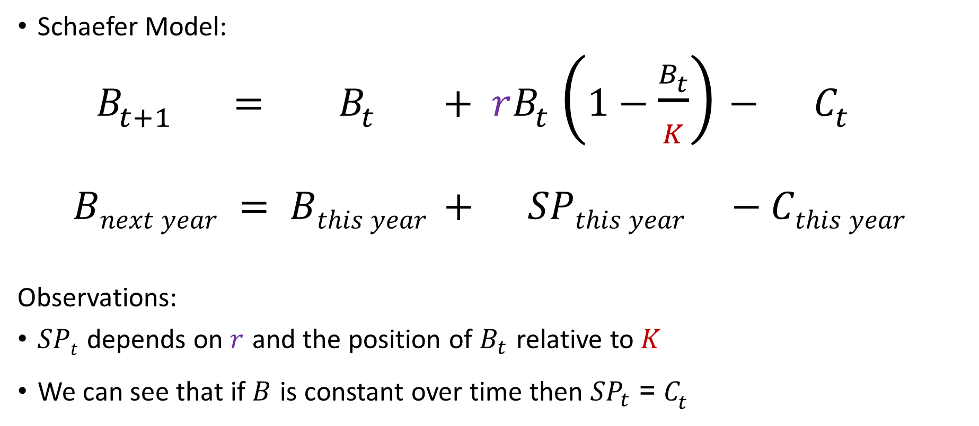
Surplus Production (SP) Models
$${SP}_{t}$$
Schaefer Model:
$B_{t+1} = B_{t} + rB_{t}\left(1−\frac{B_{t}}{K}\right)− C_{t}$
$Bnext year = Bthis year + SPthis year −Cthis year$
Observations:
$SPt$ depends on $r$ and the position of $B_{t}$ relative to $K$
We can see that if $B$ is constant over time then ${SP}_{t}$ = $C_{t}$

Slide 26
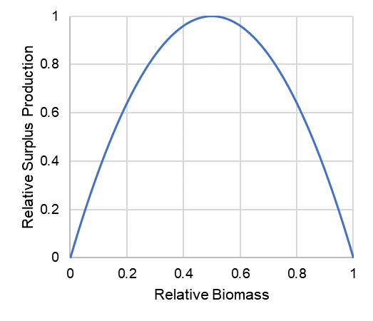
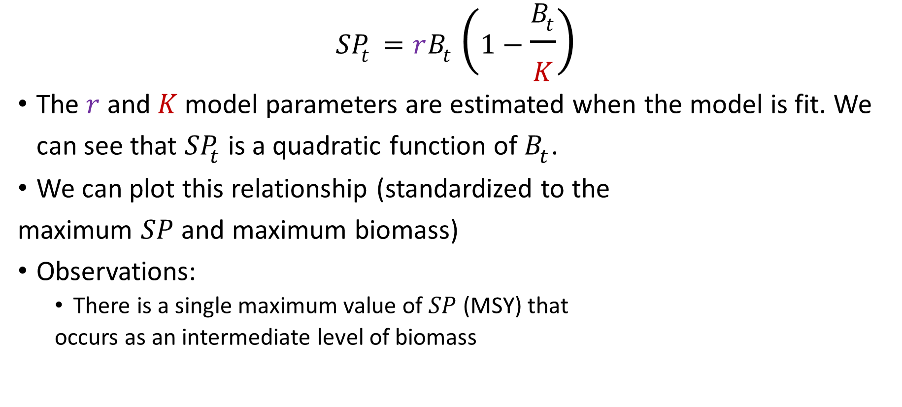
Surplus Production Curve
$${SP}_{t}=rB_{t}\left(1−\frac{B_{t}}{K}\right)$$
The $r$ and $K$ model parameters are estimated when the model is fit. We can see that ${SP}_{t}$ is a quadratic function of $B_{t}$.
We can plot this relationship (standardized to the
maximum $SP$ and maximum biomass)
Observations:
There is a single maximum value of $SP$ (MSY) that
occurs as an intermediate level of biomass

Slide 27
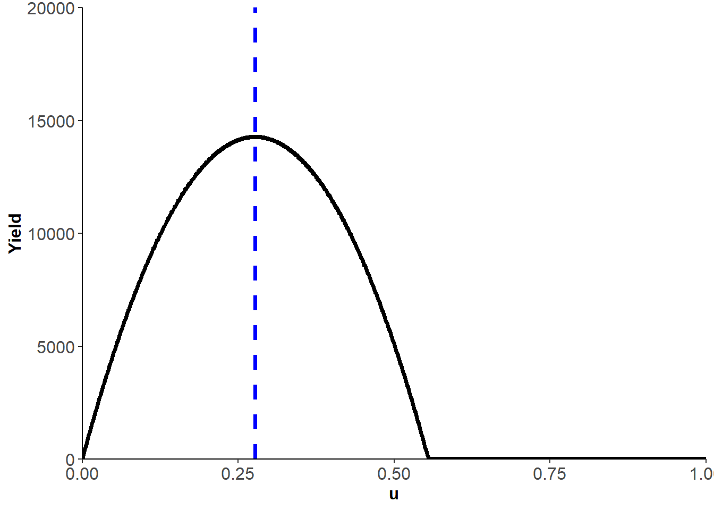

MSY Theory
MSY = maximum long-term yield that the stock can produce, given constant life history and selectivity parameters (i.e., equilibrium conditions).
MSY occurs at an intermediate harvest rate ($u$) between $u=0$ and a $u$ that crashes the stock, and at a biomass below carrying capacity $K$.
Example yield curve:
MSY

Slide 28
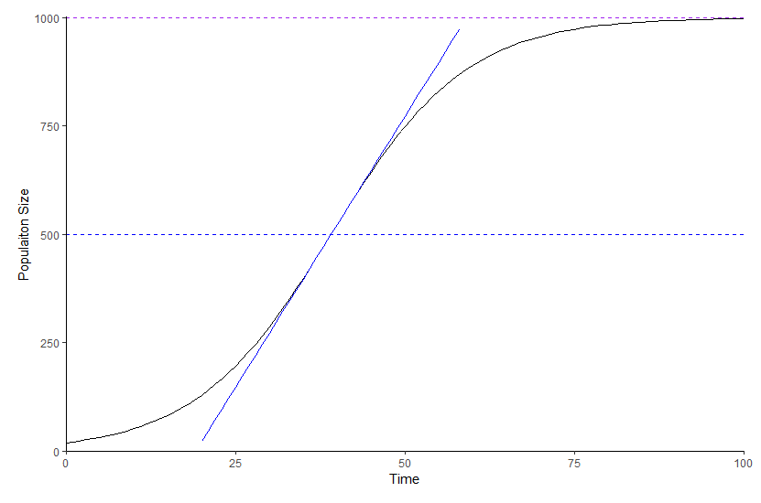


MSY Theory
Theory: with increasing long-term $F$, the abundance and mean age of a population decreases and the per-capita growth rate of the population increases as a result of reduced competition or similar effects as the biomass reduces from $K$ to $B$_{MSY}
Carrying capacity $K$
Maximum population
growth rate

Slide 29
Notes on MSY as target/limit
Links to papers and/or ref to Ex 1
Tim to add text from WP2 (e.g., Larkin paper)

Slide 30
4. Reference Points in Surplus Production Models

Slide 31
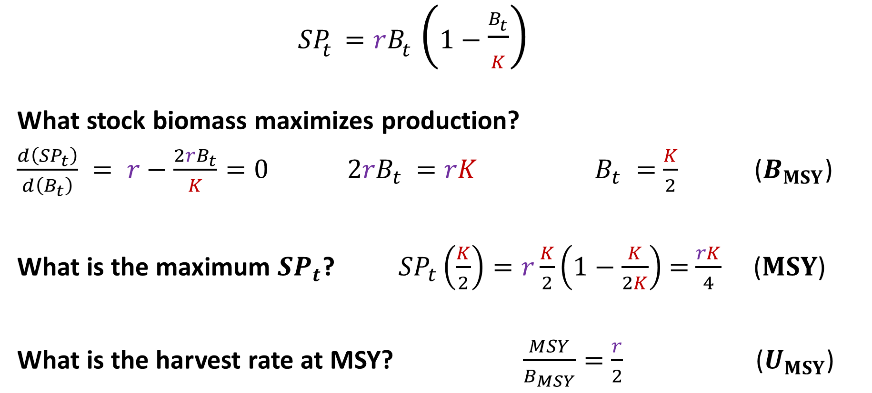


Reference points
MSY = $\frac{rK}{4}$
${SP}_{t}=rB_{t}\left(1−\frac{B_{t}}{K}\right)$
What stock biomass maximizes production?
$\frac{d\left({SP}_{t}\right)}{d\left(B_{t}\right)} = r−$ $\frac{{2rB}_{t}}{K}=0$ ${2rB}_{t}$ $=rK$ $B_{t} =$ $\frac{K}{2}$ ($B_{MSY}$)
What is the maximum ${SP}_{t}$? ${SP}_{t}\left(\frac{K}{2}\right)=r\frac{K}{2}\left(1−\frac{K}{2K}\right)$ $=$ $\frac{rK}{4}$ ($MSY$)
What is the harvest rate at MSY? $\frac{MSY}{B_{MSY}}=$ $\frac{r}{2}$ ($U_{MSY}$)
Tim to break up into 3 slides
B_{MSY} = $0.5K$

Slide 32


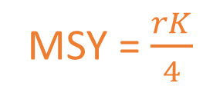
Reference points from the Schaefer Model¹
MSY = $\frac{rK}{4}$
$B_{MSY}=$ $\frac{K}{2}$
MSY $=$ $\frac{rK}{4}$
$U_{MSY}=$ $\frac{r}{2}$
For three-parameter models with non-symmetrical yield curves (e.g., Fox, Pella-Tomlinson), see 1.
B_{MSY} = $0.5K$
Hilborn R. and Walters, C.J. 1992. Quantitative fisheries stock assessment: choice, dynamics and uncertainty. Chapman and Hall, New York. 570 pp.

Slide 33
Go to Ex 1

Slide 34
5. Fish Stock Productivity

Slide 35
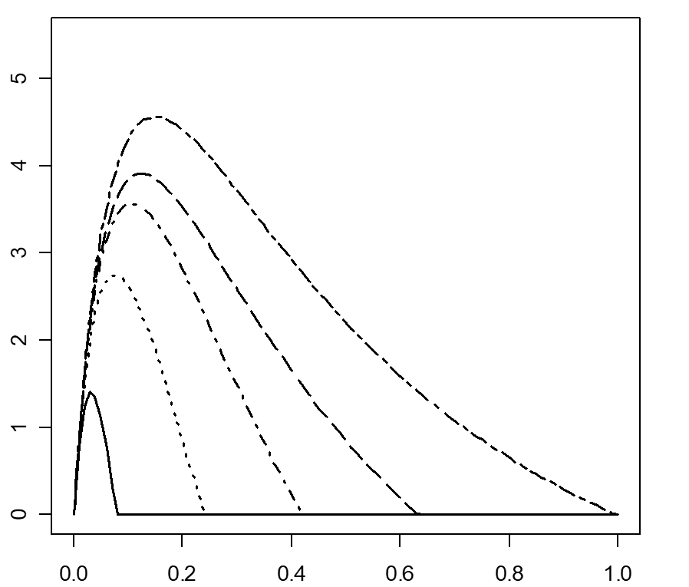
The productivity of a fish stock is the key determinant of how hard it can be fished sustainably
Therefore productivity is the key determinant of reference points

Slide 36







Productivity is a composite function of:
Growth of individuals
Natural mortality rate
Recruitment (survival of juveniles)
Notes:
MYERS:Stock-recruitment data are much like Hobbes’ view of primitive man: Nasty, brutish and short (outliers, bias, short time series)
Productivity is the fundamental determinant of a fish population’s resilience to fishing
Productivity determines important reference points for management
Estimation of recruitment productivity parameters a principal concern in stock assessment

Slide 37
Density dependence in juvenile survival (recruitment compensation)
In many animal populations, the juvenile survival rate improves as population size is reduced. This can be due to:
Reduced competition for resources in smaller populations;
Territorial behaviour at larger population sizes;
Reduced predation risk (foraging arena theory).
Notes:
Mechanism for recruitment productivity

Slide 38
Density dependence in juvenile survival
Foraging arena theory
As density increases, fewer safe refuges
More individuals must feed in unsafe areas
As density increases, rate of juvenile survival decreases
Number of survivors similar across wide range of stock sizes
Source: Walters and Juanes 1993
Walters, C.J. and Juanes, F. 1993. Recruitment limitation as a consequence of natural selection for use of restricted feeding habitats and predation risk taking by juvenile fishes. Can. J. Fish. Aquat. Sci. 50(10): 2058-2070.
Walters, C.J. and Korman, J. 1999. Linking recruitment to trophic factors: revisiting the Beverton−Holt recruitment model from a life history and multispecies perspective. Rev. Fish. Biol. Fish. 9, 187–202.
Walters, C.J. and Martell, S.J.D. 2004. Fisheries Ecology and Management. Princeton University Press, Princeton, 399 pp.

Slide 39
Linear density dependence in juvenile natural mortality predicts asymptotic stock-recruit relationships
M = M₀ + M₁N
dN/dt = -MN_{t} = -(M₀ + M₁N_{t})N_{t}
Integrate this to find N_{t+1}
The resulting equation is of the form of the Beverton-Holt SRR*
Slope = M₁
Number of recruits N _{t+1}
Juvenile mortality M
M₀
Numbers N
Numbers N
Beverton, R.J.H. and Holt, S.J. 1957. On the dynamics of exploited fish populations. Fisheries Investment Series 2, Vol. 19. U.K. Min. Agriculture & Fisheries, London.
Walters, C.J. and Korman, J. 1999. Linking recruitment to trophic factors: revisiting the Beverton−Holt recruitment model from a life history and multispecies perspective. Rev. Fish. Biol. Fish. 9, 187–202.
*Walters, C.J. and Martell, S.J.D. 2004. Fisheries Ecology and Management. Princeton University Press, Princeton, pp. 128 - 132.
Notes:
Flat stock recruit relationships seem to be ubiquitous in fish populations (Myers database) www.mscs.dal.ca/~myers/welcome.html
JUVENILES
1. M = M0 + M1N
2. dN/dt = -MNt = (M0 + M1Nt)Nt
3. Integrate 2 to get Nt+1
4. Gives equation of Beverton-Holt form

Slide 40
Recruitment compensation (Beverton-Holt SRR)
α is the maximum juvenile survival rate (max Recruits per Egg)
R₀
Recruits (R)
The values of α and β are unit-dependent. Commonly in models for iteroparous species, we express recruitment productivity as unitless ratio.
β is a “scaling” parameter representing density-dependent effects
Eggs (E)
E₀
Notes:
Assume compensatory relationship between stock size and juvenile survival
Alpha maximum juvenile survival rate
Biologically meaningful – emerges from risk-sensitive foraging behaviour of juvenile fish at different densities
More resources available at lower density
Alpha not comparable among species
Usually standardised to CR or Steepness
Compensation ratio represents maximum possible improvement in juvenile survival as stock size is reduced by fishing
ALPHA and CR commonly stated as the principal determinant of sustainable harvest rate
In this thesis I quantify the relative effects of CR and other parameters on Umsy
Goodyear, C.P. 1977. Assessing the impact of power plant mortality on the compensatory reserve of fish populations. In: Proceedings of the Conference on Assessing the Effects of Power Plant Induced Mortality on Fish Populations, Gatlinburg, Tennessee, 3–6 May 1997. Pergamon Press, New York. pp. 186–195.
α = recruit survival rate at very low stock size
β = 1/maximum recruits as E →∞

Slide 41
Recruitment compensation (Beverton-Holt SRR)
Compensation ratio = i/ii = αE₀/R₀ = αφ_{E0}
We’ll see later that φ_{E0} is a function of the stock’s growth, maturity and natural mortality
(i) Slope = α = maximum survival rate
R₀
Recruits (R)
(ii) Slope = R₀ /E₀ = unfished survival
Eggs (E)
E₀
Goodyear, C.P. 1977. Assessing the impact of power plant mortality on the compensatory reserve of fish populations. In: Proceedings of the Conference on Assessing the Effects of Power Plant Induced Mortality on Fish Populations, Gatlinburg, Tennessee. Pergamon Press, New York. pp. 186–195.
Myers, R. A., Bowen, K.G. and Barrowman, N.J. 1999. Maximum reproductive rate of fish at low population sizes. Canadian Journal of Fisheries and Aquatic Sciences 56, 2404-2419 (CR=â).
Notes:
Assume compensatory relationship between stock size and juvenile survival
Alpha maximum juvenile survival rate
Biologically meaningful – emerges from risk-sensitive foraging behaviour of juvenile fish at different densities
More resources available at lower density
Alpha not comparable among species
Usually standardised to CR or Steepness
Compensation ratio represents maximum possible improvement in juvenile survival as stock size is reduced by fishing
ALPHA and CR commonly stated as the principal determinant of sustainable harvest rate
In this thesis I quantify the relative effects of CR and other parameters on Umsy
Goodyear, C.P. 1977. Assessing the impact of power plant mortality on the compensatory reserve of fish populations. In: Proceedings of the Conference on Assessing the Effects of Power Plant Induced Mortality on Fish Populations, Gatlinburg, Tennessee, 3–6 May 1997. Pergamon Press, New York. pp. 186–195.
α = recruit survival rate at very low stock size
β = 1/maximum recruits as E →∞

Slide 42
Recruitment compensation (Beverton-Holt SRR)
Steepness (h) is the recruitment when spawning biomass is 20% of unfished (ratio of the horizontal lines)
R₀
In all these models and in fisheries stock assessment in general, we assume spawning biomass is a proxy for number of eggs
Recruits (R)
0.2 E₀
Eggs (E)
E₀
Mace P.M. and Doonan, I.J. 1988. A generalized bioeconomic simulation model for fish population dynamics. N.Z. Fish. Assess. Res. Doc. 88/4.
Notes:
Assume compensatory relationship between stock size and juvenile survival
Alpha maximum juvenile survival rate
Biologically meaningful – emerges from risk-sensitive foraging behaviour of juvenile fish at different densities
More resources available at lower density
Alpha not comparable among species
Usually standardised to CR or Steepness
Compensation ratio represents maximum possible improvement in juvenile survival as stock size is reduced by fishing
ALPHA and CR commonly stated as the principal determinant of sustainable harvest rate
In this thesis I quantify the relative effects of CR and other parameters on Umsy
Goodyear, C.P. 1977. Assessing the impact of power plant mortality on the compensatory reserve of fish populations. In: Proceedings of the Conference on Assessing the Effects of Power Plant Induced Mortality on Fish Populations, Gatlinburg, Tennessee, 3–6 May 1997. Pergamon Press, New York. pp. 186–195.
α = recruit survival rate at very low stock size
β = 1/maximum recruits as E →∞

Slide 43
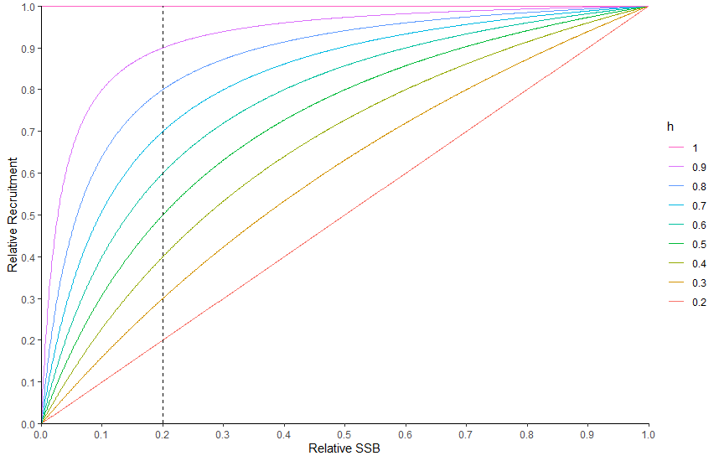

Steepness (h) – copied from later section
$h$ is a measure of the resilience of recruitment to decreases in SSB from $SSB0$
Ranges from 0.2 to 1
$h$ = 1 (constant recruitment)
$h$ = 0.2 (linear increase in recruits )

Slide 44
Steepness and CR are analytically related
Compensation ratio (CR) =
αφ_{E0} (for BH and Ricker SRRs)
Steepness (h) =
(BH)
(Ricker)
Steepness is a widely used parameter in fisheries stock assessment. It has strong effects on the modeled fish population’s resilience to fishing and its reference points. It is very hard to estimate. Commonly, practitioners must use an informative prior.

Slide 45
6. Reference Points in Age-structured Models

Slide 46
Something on limitations of biomass dynamic models
Why do we want to consider age structure?

Slide 47
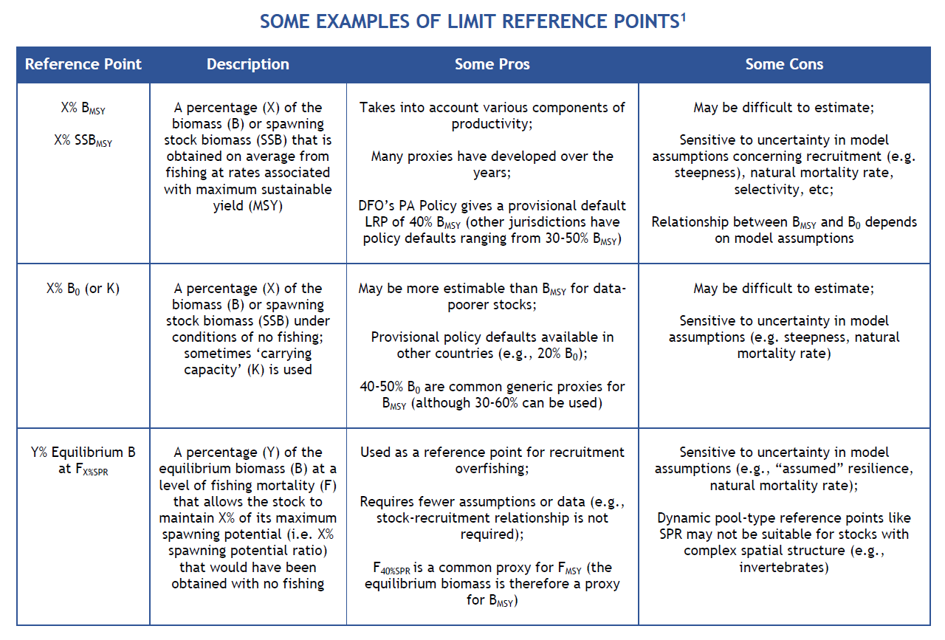
Examples of Limit Reference Points
B_{MSY}
% of B₀ as a proxy for B_{MSY}
% of Equilibrium B at F_{X%SPR} as a
proxy for B_{MSY}
1 Adapted from Pew Charitable Trusts (2016) Reference Points: Measuring Success in Fisheries Management. 8 pp.

Slide 48

Some Equilibrium Reference Points
Calculations for an age-structured model:
$FMSY \text{and} SSBMSY$
$SSB0$
$SSB$ at $FX\%SPR$

Slide 49
Per Recruit Calculations

Slide 50
Per-Recruit Calculations [Concepts]
Mortality Rates
Survivorship
SSB-per-recruit (or eggs-per-recruit)
Spawning potential ratio (SPR)
Yield-per-recruit (YPR)

Slide 51
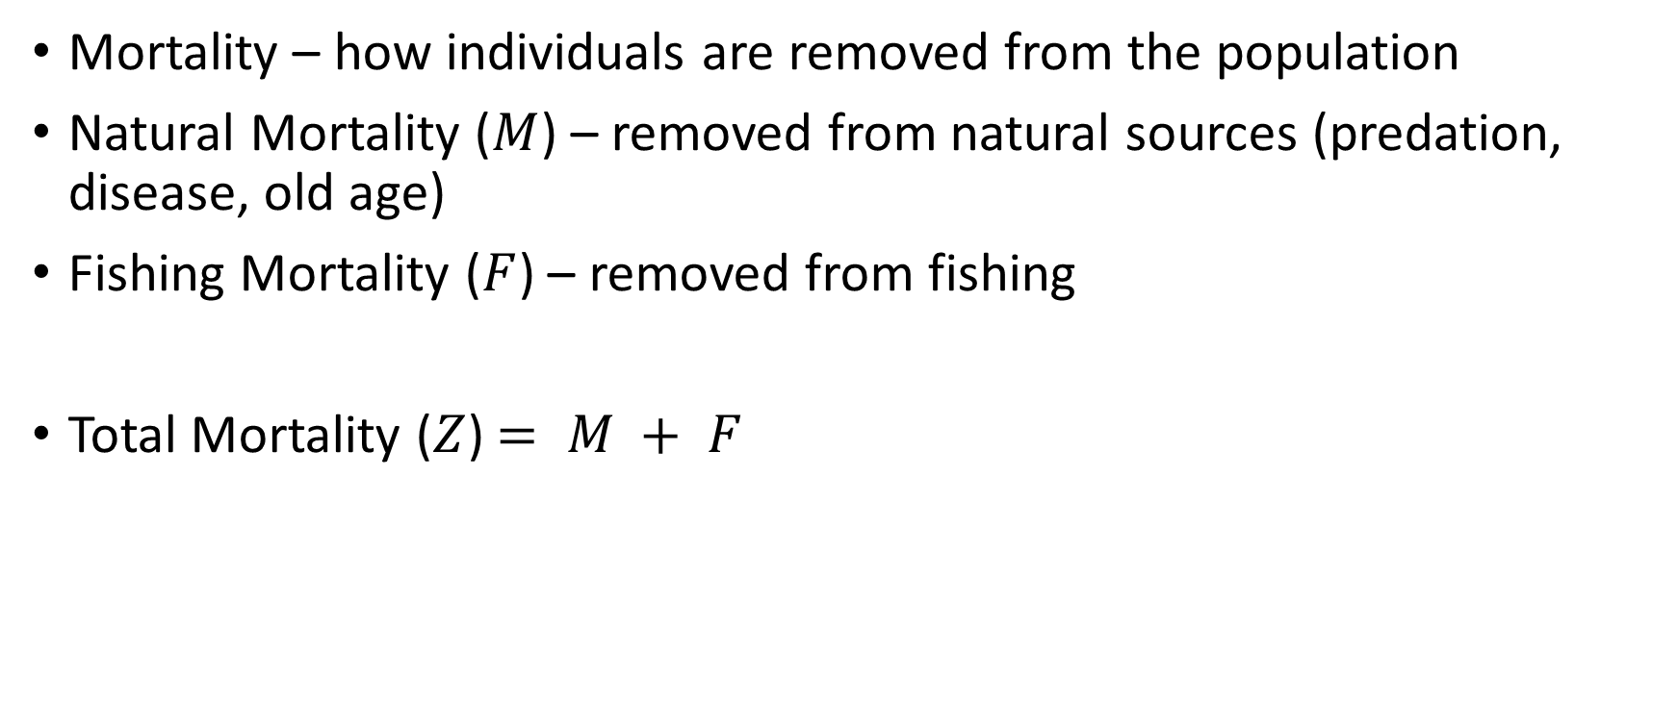
Per-Recruit Calculations 1. Mortality Rates
Mortality – how individuals are removed from the population
Natural Mortality ($M$) – removed from natural sources (predation, disease, old age)
Fishing Mortality ($F$) – removed from fishing
Total Mortality ($Z$) $= M + F$

Slide 52


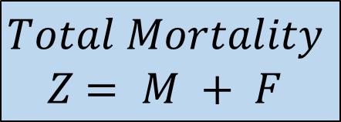


Per-Recruit Calculations 1. Mortality Rates
$Mortality$: how individuals are removed
$Natural Mortality$: removed from natural sources (predation, disease, old age)
$$M$$
$$F$$
$$Fishing Mortality:$$
removed from fishing
$$Total Mortality$$
$Z$ $= M + F$

Slide 53
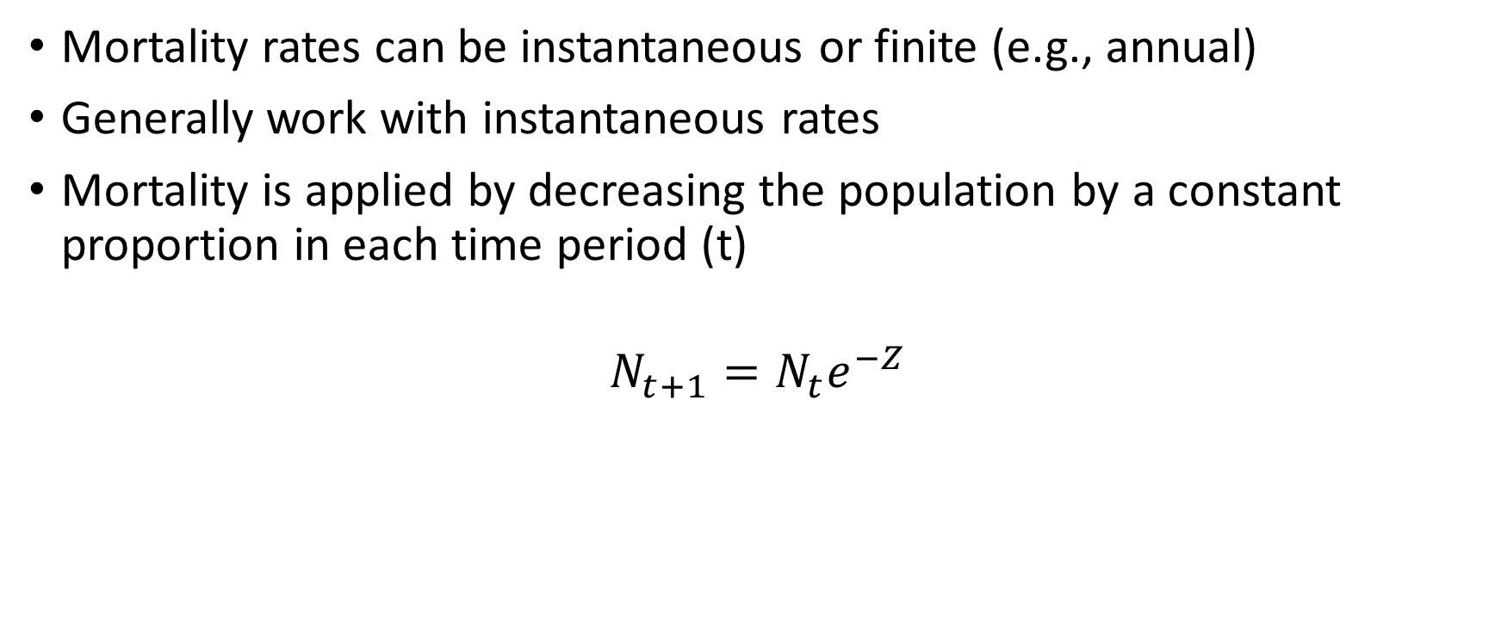
Per-Recruit Reference Points 1. Mortality Rates
Mortality rates can be instantaneous or finite (e.g., annual)
Generally work with instantaneous rates
Mortality is applied by decreasing the population by a constant proportion in each time period (t)
$$N_{t+1}=N_{t}e^{−Z}$$

Slide 54
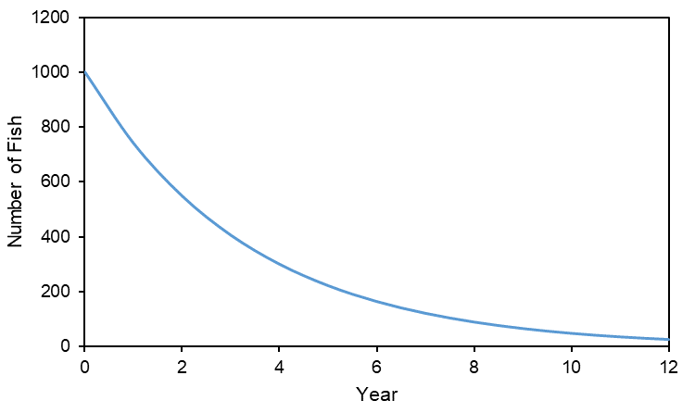

Per-Recruit Calculations 1. Mortality Rates
Example: $Z = 0.3$, start with 1000 recruits at age 0 and track this cohort over time
$$N_{t+1}=N_{t}e^{−Z}$$

Slide 55
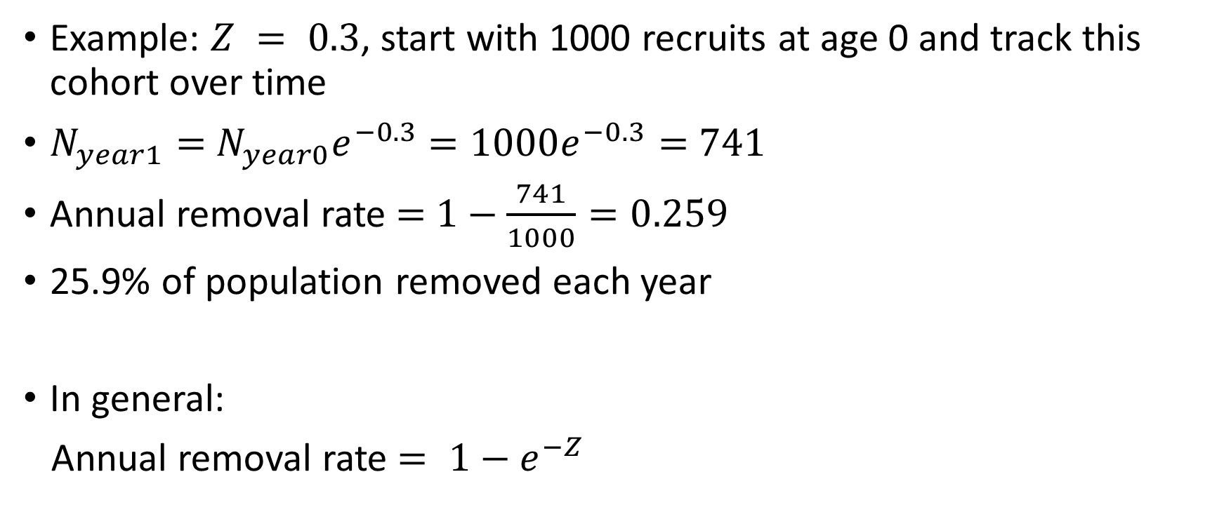
Per-Recruit Calculations 1. Mortality Rates
Example: $Z = 0.3$, start with 1000 recruits at age 0 and track this cohort over time
$N_{year1}=$ $N_{year0}e^{−0.3}$ $=1000e^{−0.3}=$ $741$
Annual removal rate $=$ $1−\frac{741}{1000}=0.259$
25.9% of population removed each year
In general:
Annual removal rate $= 1−e^{−Z}$

Slide 56
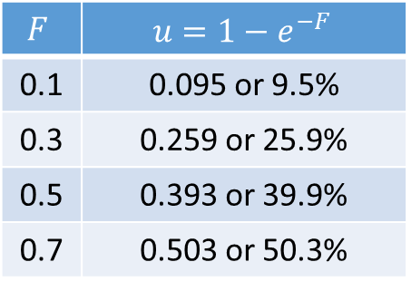

Per-Recruit Reference Points 1. Mortality Rates
Harvest rate (or exploitation rate $u$) is the annual proportional change in numbers of fish for a given instantaneous fishing mortality rate ($F$)
Sometimes expressed as a percentage (%)
$$F$$ | $$u=1−e^{−F}$$
0.1 | 0.095 or 9.5%
0.3 | 0.259 or 25.9%
0.5 | 0.393 or 39.9%
0.7 | 0.503 or 50.3%

Slide 57
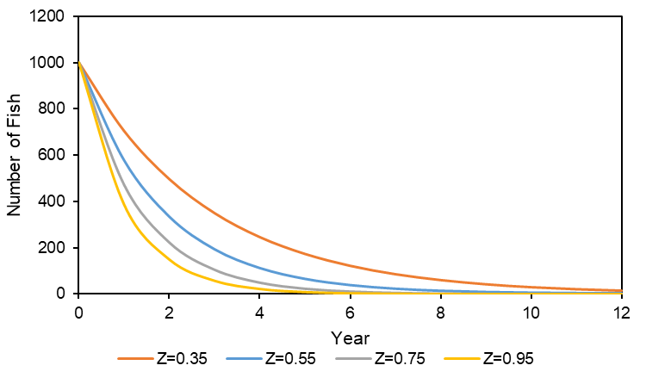

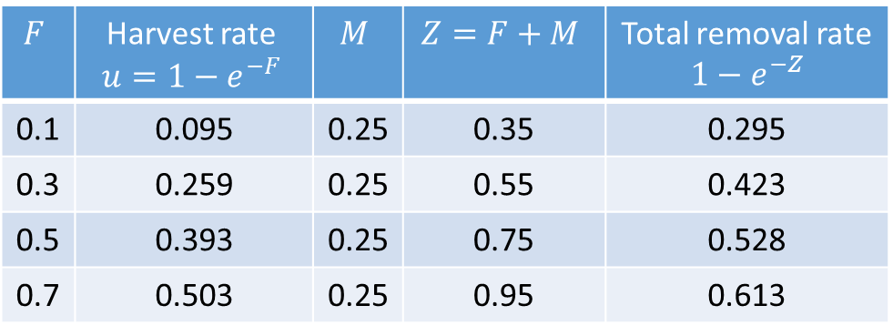
Per-Recruit Calculations 1. Mortality Rates
Add $M = 0.25$and calculate total removal rate ($Z=M+F$)
$$F$$ | Harvest rate $$u=1−e^{−F}$$ | $$M$$ | $$Z=F+M$$ | Total removal rate $1−e^{−Z}$
0.1 | 0.095 | 0.25 | 0.35 | 0.295
0.3 | 0.259 | 0.25 | 0.55 | 0.423
0.5 | 0.393 | 0.25 | 0.75 | 0.528
0.7 | 0.503 | 0.25 | 0.95 | 0.613

Slide 58
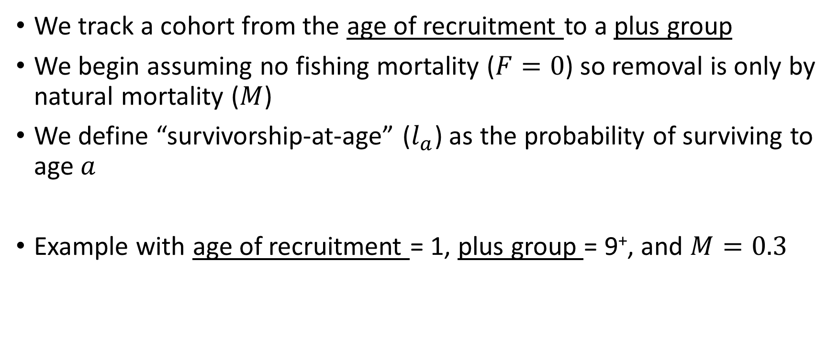
Per-Recruit Calculations 2. Survivorship
We track a cohort from the age of recruitment to a plus group
We begin assuming no fishing mortality ($F=0$) so removal is only by natural mortality ($M$)
We define “survivorship-at-age” ($l_{a}$) as the probability of surviving to age $a$
Example with age of recruitment = 1, plus group = 9⁺, and $M=0.3$

Slide 59
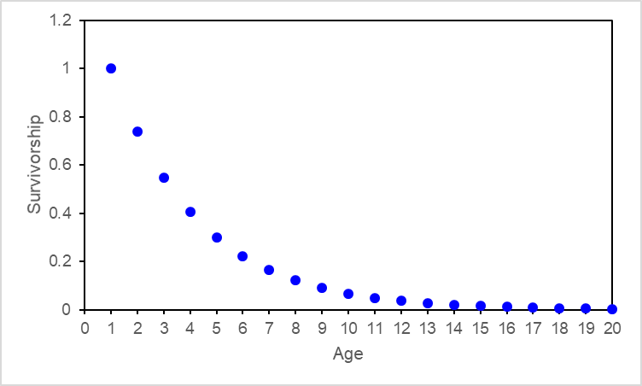
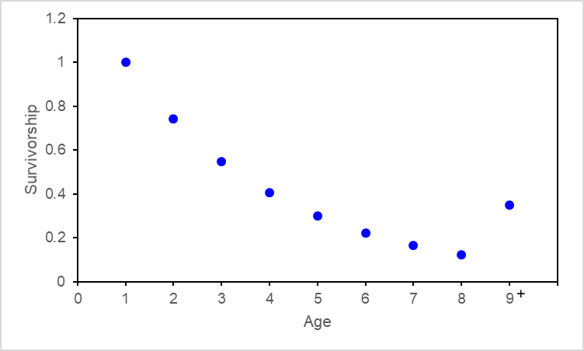

Per-Recruit Calculations 2. Survivorship
age 1 = age of recruitment
For $Z=0.3$
$l_{a=1}=P\left(surviving to age 1\right)=1$
$l_{a=2}=P\left(surviving to age 2\right)=1×e^{−Z}=e^{−0.3}$
$l_{a=3}=P\left(surviving to age 3\right)=1$ $×e^{−Z}×e^{−Z}=e^{−2(0.3)}$
$l_{a=4}=P\left(surviving to age 4\right)=1 ×e^{−Z}×e^{−Z}×e^{−Z}=e^{−3(0.3)}$
$l_{a=a}=e^{− \left(a−1\right)M}$

Slide 60
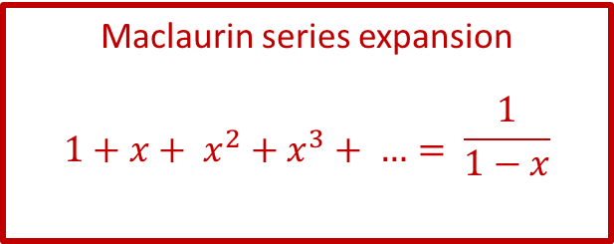
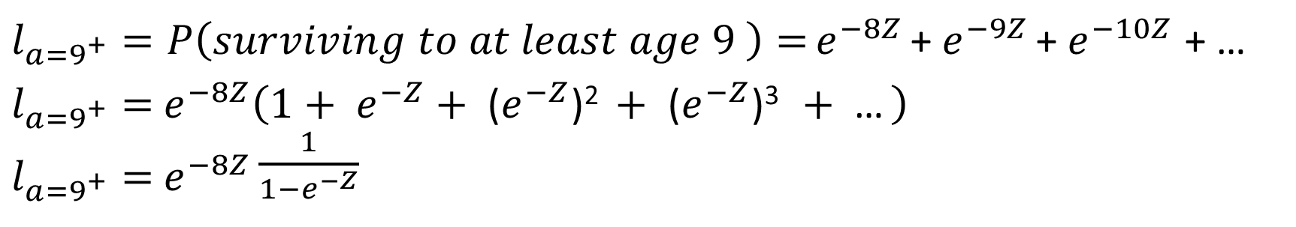
Per-Recruit Calculations 2. Survivorship
$l_{a=9^{+}}=P\left(surviving to at least age 9 \right)=$ $e^{−8Z}$ + $e^{−9Z}$ + $e^{−10Z}$ + …
$l_{a=9^{+}}=$ $e^{−8Z}\left(1+ e^{−Z}+\text{ (}e^{−Z}\text{)}\text{2 }+\text{ (}e^{−Z}\text{)}\text{3 }+\text{ …} \right)$
$l_{a=9^{+}}=$ $e^{−8Z}\frac{1}{1−e^{−Z}}$

Slide 61
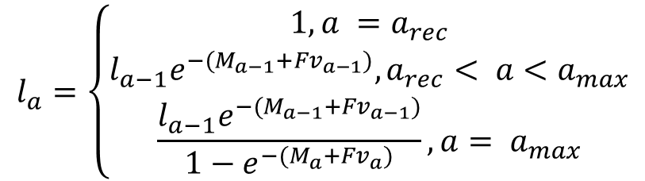
Per-Recruit Calculations 2. Survivorship
In general:
$$l_{a}=\left\{\begin{matrix}1, a =a_{rec} \\ l_{a−1}e^{−(M_{a−1}+Fv_{a−1})},a_{rec}< a<a_{max} \\ \frac{l_{a−1}e^{−(M_{a−1}+Fv_{a−1})}}{1−e^{−(M_{a}+Fv_{a})}},a= a_{max}\end{matrix}\right.$$

Slide 62
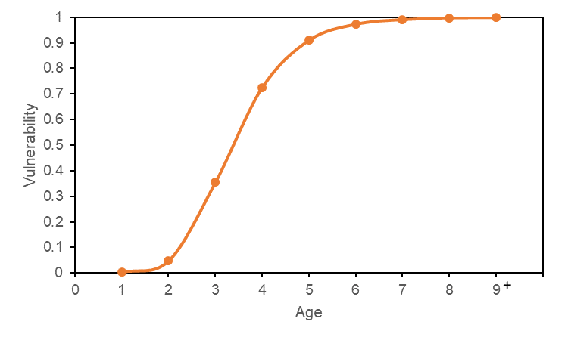
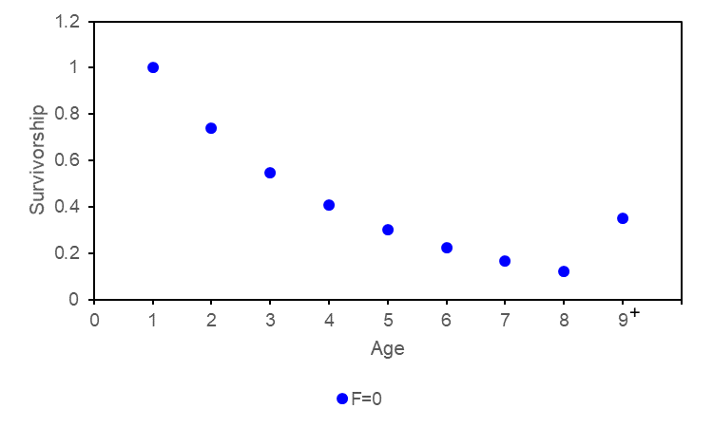
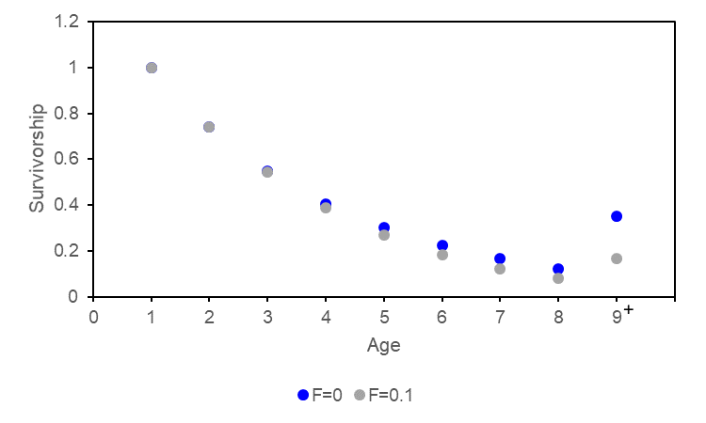
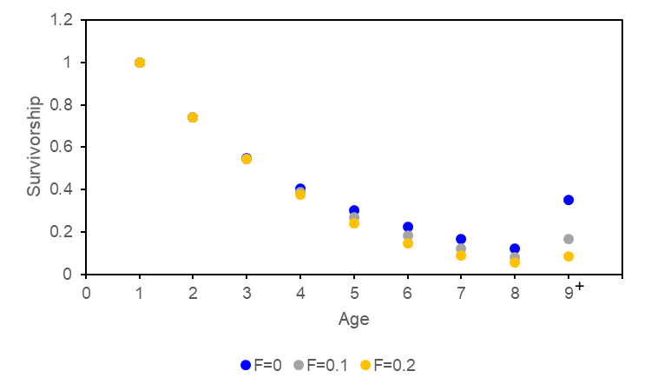
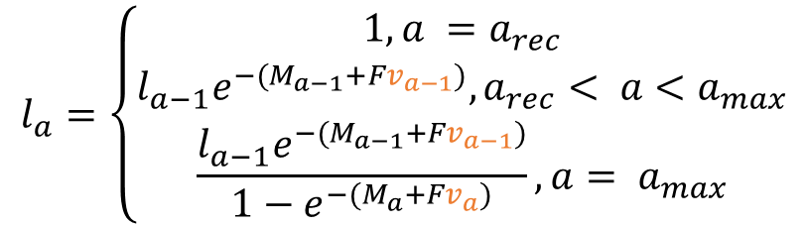
Per-Recruit Calculations 2. Survivorship
In general:
$$l_{a}=\left\{\begin{matrix}1, a =a_{rec} \\ l_{a−1}e^{−(M_{a−1}+Fv_{a−1})},a_{rec}< a<a_{max} \\ \frac{l_{a−1}e^{−(M_{a−1}+Fv_{a−1})}}{1−e^{−(M_{a}+Fv_{a})}},a= a_{max}\end{matrix}\right.$$
The total mortality at-age depends on the vulnerability-at-age

Slide 63


Per-Recruit Calculations 3. SSB-per-Recruit
Equilibrium SSB-per-recruit ($φ_{F}$) = SSB produced on average by each recruit over its lifetime, considering survival, growth, and maturity
Sum over all ages:
P(survives to age $a$) × weight-at-age $a$ × P(mature-at-age $a$)
$$φ_{F}=\sum_{{a=a}_{rec}}^{a_{max}}{l_{a}w_{a}m_{a}}$$

Slide 64

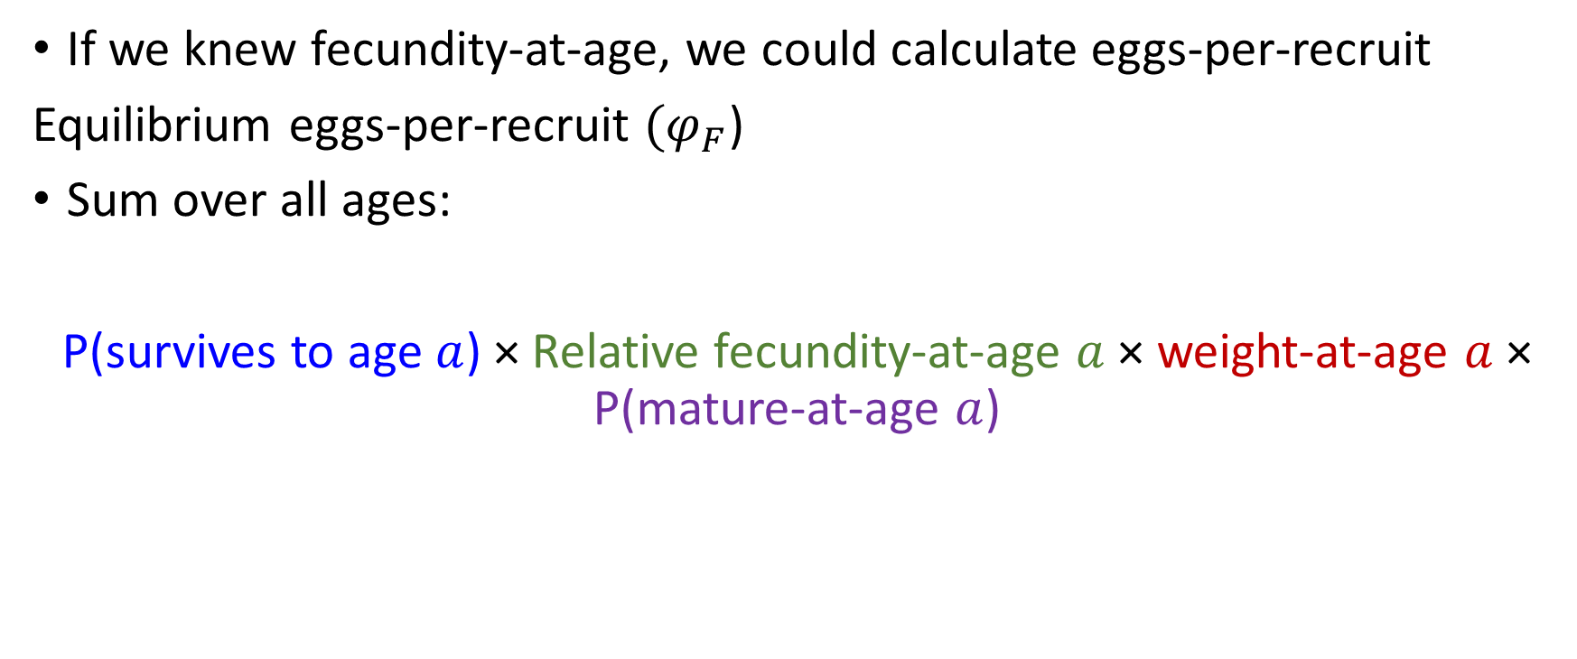
Per-Recruit Calculations 3. Eggs-per-Recruit
If we knew fecundity-at-age, we could calculate eggs-per-recruit
Equilibrium eggs-per-recruit ($φ_{F}$)
Sum over all ages:
P(survives to age $a$) × Relative fecundity-at-age $a$× weight-at-age $a$ × P(mature-at-age $a$)
Eggs/unit body weight
$$φ_{F}=\sum_{a=a_{rec}}^{a_{max}}{l_{a}{f_{a}w}_{a}m_{a}}$$

Slide 65

Per-Recruit Calculations 3. SSB-per-Recruit or Eggs-per-Recruit
We generally do not know relative fecundity and assume that SSB is proportional to fecundity
See recent paper from Marshall et al. (2021) if you’re interested in understanding the implications of the assumption that SSB is proportional to fecundity.

Slide 66
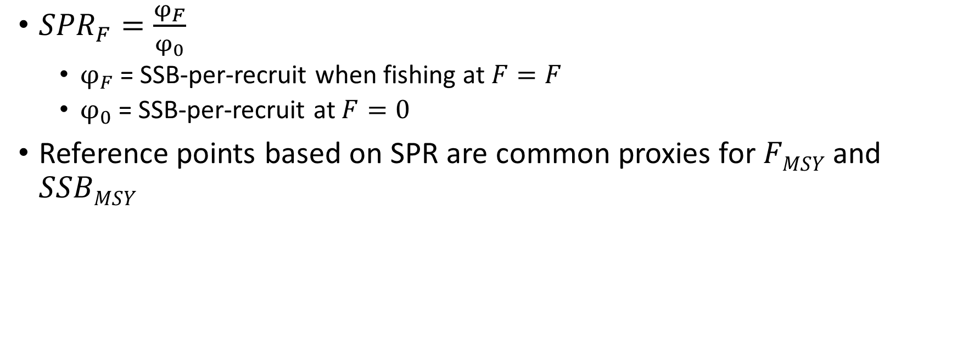
Per-Recruit Reference Points 4. Spawning Potential Ratio (SPR)
${SPR}_{F}=\frac{φ_{F}}{φ_{0}}$
$φ_{F}$ = SSB-per-recruit when fishing at $F=F$
$φ_{0}$ = SSB-per-recruit at $F=0$
Reference points based on SPR are common proxies for $FMSY$ and $SSBMSY$

Slide 67


Per-Recruit Reference Points 4. Spawning Potential Ratio (SPR)
${SPR}_{F}$ decreases with increasing $F$
And example SPR vs $F$ curve is plotted below where $F40\%SPR$ is identified as the F that results in 40% SPR.
40%SPR

Slide 68


Per-Recruit Reference Points 5. Yield-per-Recruit (YPR)
YPR-at-age is the expected life-time yield per fish recruited into the stock at a specified age
Removals-per-recruit at age $a$= biomass-per-recruit at age $a$× total removal rate
YPR at age $a$= biomass-per-recruit at age $a$× proportion of total removal rate that is due to fishing
from fishing and natural mortality
$\text{Removals}\text{−}\text{per}\text{−}\text{recruit} \text{at} \text{age} a=l_{a}w_{a}$($1−e^{−\left(M_{a}+Fv_{a}\right)}$)
${YPR}_{a}=l_{a}w_{a}$($1−e^{−(M_{a}+{Fv}_{a})}$) $\frac{Fv_{a}}{M_{a}+{Fv}_{a}}$

Slide 69



Per-Recruit Reference Points 5. Yield-per-Recruit (YPR)
$YPR=$Sum over all ages:
${YPR}_{a}=l_{a}w_{a}$($1−e^{−(M_{a}+{Fv}_{a})}$) $\frac{Fv_{a}}{M_{a}+{Fv}_{a}}$
$${YPR}_{F}=\sum_{a=a_{rec}}^{a_{max}}{l_{a}w_{a}\left(1−e^{−(M_{a}+{Fv}_{a})}\right)\frac{{Fv}_{a}}{M_{a}+{Fv}_{a}}}$$

Slide 70



Per-Recruit Reference Points 5. Yield-per-Recruit (YPR)
Can be calculated over a range of $F$ values to estimate $F_{max}$
$F_{max}= F$corresponding to the maximum $YPR$
$$F_{max}$$

Slide 71
MSY Reference Points: Calculations

Slide 72

Yield-per-Recruit → Yield
Yield = $YPR ×number of recruits$
We already know how to calculate $YPR$ for various $F$
Now we need to know how $R$ changes with $F$
Stock Recruitment Relationships

Slide 73
Data Requirements for Reference Points for Age- Structured Models
Need to introduce stock recruitment relationships
RF will do this in productivity section – move some of the next slides up
SRR
(R₀ and h) or (a and b)
Growth
(weight-at-age)
Maturity
MSY reference points
Per-recruit reference points
Natural Mortality
Selectivity

Slide 74

MSY Reference Points [Concepts]
Stock Recruitment Relationships (SRR)
Unfished Equilibrium Biomass $SSB0$
MSY

Slide 75



MSY Reference Points 1. Stock Recruitment Relationships
Beverton-Holt
$$R(B)=\frac{aB }{1+bB}$$
Tim to remove SRR slides
asymptotic recruitment$Rmax=\frac{a}{b}$

Slide 76


MSY Reference Points 1. Stock Recruitment Relationships
Ricker
$$R(B)=αB e^{−βB}$$
R_{max}
Recruitment declines at high SSB

Slide 77





MSY Reference Points 1. Stock Recruitment Relationships
Focus on Beverton-Holt
Alternative parameterization
$$R(B)=\frac{aB }{1+bB}$$
$$R(B)=\frac{\text{4}R_{0}hB }{\left(1−h\right)R_{0}φ_{0}+\left(5h−1\right)B}$$
$$h= \frac{aφ_{0}}{4+aφ_{0}}$$
h = steepness
$$R_{0}= \frac{1}{b}\left(a−\frac{1}{φ_{0}}\right)$$
$R_{0}$ = equilibrium unfished recruitment

Slide 78








MSY Reference Points 1. Stock Recruitment Relationships
Steepness ($h$) = proportion of equilibrium unfished recruitment produced by 20% of unfished equilibrium SSB (i.e., 0.2 ${SSB}_{0}$)
$$R(B)=\frac{\text{4}R_{0}hB }{\left(1−h\right)R_{0}φ_{0}+\left(5h−1\right)B}$$
$$h=\frac{R_{0.2{SSB}_{0}}}{R_{0}}$$
$$R0$$
$$R0.2SSB0$$
$$0.2SSB0$$
$$SSB0$$

Slide 79

MSY Reference Points 1. Stock Recruitment Relationships
$h$ is a measure of the resilience of recruitment to decreases in SSB from $SSB0$
$h$ ranges from 0.2 to 1
$h$ = 1 (recruits do not decline as
SSB declines from $SSB0$)
$h$ = 0.2 (recruits decline linearly
as SSB declines from $SSB0$)

Slide 80


MSY Reference Points 2. ${SSB}_{0}$
${SSB}_{0}$ is the equilibrium unfished biomass
${SSB}_{0}$ is estimated from the unfished SSB-per-recruit ($φ_{0}$) and the SRR
We can calculate $φ_{0}=\sum_{a=a_{rec}}^{a_{max}}{l_{a}w_{a}m_{a}}$ and we know:
$φ_{0}=\frac{{SSB}_{0}}{R_{0}}$ (1)
The point (${SSB}_{0}$, $R_{0}$) lies on the SRR so we know:
$R_{0}=\frac{a{SSB}_{0}}{1+b{SSB}_{0}}$ (2)
We have 2 equations and two unknowns ($R_{0}$ and ${SSB}_{0}$)

Slide 81





MSY Reference Points 2. ${SSB}_{0}$
Equation 1: $φ_{0}=\frac{{SSB}_{0}}{R_{0}}$ $R_{0}=\frac{{SSB}_{0}}{φ_{0}}$
Equation 2: $R_{0}=\frac{a{SSB}_{0}}{1+b{SSB}_{0}}$
${SSB}_{0}$ therefore depends on the SRR parameters $a$ and $b$ and $φ_{0}$ (determined by $M$, $weight$-$at$-$age$, and $maturity$-$at$-$age$)
$\frac{{SSB}_{0}}{φ_{0}}=$ $\frac{a{SSB}_{0}}{1+b{SSB}_{0}}$
$\frac{1}{φ_{0}}=$ $\frac{a}{1+b{SSB}_{0}}$
$$1+b{SSB}_{0}=aφ_{0}$$
${SSB}_{0}=$ $\frac{aφ_{0}−1}{b}$
(Equation 3)

Slide 82



MSY Reference Points 2. ${SSB}_{0}$
${SSB}_{0}$ occurs at the intersection of the SRR and a line through the origin with slope $1/φ_{0}$
Note the inverse of $φ_{0}$ is $R0/SSB0$
Line with slope $1/φ_{0}$
$$(SSB0,R0)$$

Slide 83

MSY Reference Points 1. Stock Recruitment Relationships
When $F=0$ the SSB-per-recruit is $φ_{0}$
When $F$ increases from 0, the SSB-per-recruit ($φ_{F}$) decreases from the unfished $φ_{0}$
The equilibrium SSB for $φ_{F}$ from Equation 3 is: ${SSB}_{F}=$ $\frac{aφ_{F}−1}{b}$
The equilibrium recruitment for $φ_{F}$ from Equation 1 is: $R_{F}=\frac{{SSB}_{F}}{φ_{F}}$

Slide 84



MSY Reference Points 1. Stock Recruitment Relationships
When $F$ is applied, the equilibrium recruitment and equilibrium SSB “slide down” the SRR from ($SSB0$,$R0$). Example stock: $F$ = 0.34
At $F$ = 0.34 the SSB-per-recruit decreases to $φ_{F=0.34}$
Equilibrium recruitment: $R_{F=0.34}$at $φ_{F=0.34}$
Equilibrium SSB: ${SSB}_{F=0.34}$at $φ_{F=0.34}$
($SSBF$,$RF$)
($SSB0$,$R0$)

Slide 85

MSY Reference Points 2. MSY
MSY: the largest catch that can be continuously removed from the stock assuming constant environmental conditions
Reference points are based on $F_{MSY}$
${SSB}_{MSY}$ is the long-term average (equilibrium) SSB from fishing at a constant$F_{MSY}$
Carrying capacity
Theory:
population growth rate is zero at carrying capacity
as population size is reduced below carry capacity, the population growth rate increases (due to available resources, decreased competition)
Maximum population growth rate occurs at an intermediate population size
The population “growth” is harvested as surplus production
Maximum population
growth rate

Slide 86

MSY Reference Points 2. MSY
MSY: the largest catch that can be continuously removed from the stock assuming constant environmental conditions
Reference points are based on $F_{MSY}$
${SSB}_{MSY}$ is the long-term average (equilibrium) SSB from fishing at a constant$F_{MSY}$
Carrying capacity
Maximum population
growth rate

Slide 87



MSY Reference Points 2. MSY
Equilibrium MSY reference points can be determined by calculating yield and the equilibrium SSB over a range of $F$ values using the formulas presented on pervious slides.

Slide 88

MSY Reference Points 2. MSY
$FMSY \text{= }\text{Fishing} \text{mortality} \text{rate} \text{that} \text{results} \text{in} \text{maximum} \text{yield} \text{over} \text{the} \text{long} \text{term}$
$MSY\text{ = }\text{the} \text{largest} \text{catch} \text{(}\text{yield}\text{) }\text{that} \text{can} \text{be} \text{continuously} \text{removed} \text{from} \text{the} \text{stock} \text{assuming} \text{constant} \text{environmental} \text{conditions}\text{ (}\text{equilibrium}\text{)}$
$BMSY$ = average long-term biomass (SSB) from fishing at a constant $FMSY$ over the long term

Slide 89









MSY Reference Point: $SSBMSY$
$YieldF = YPRF × RF$
Calculate Yield for various $F$ and identify $F$ where yield is at its maximum
Equilibrium Yield at a specified $F$
Yield-per-recruit at a specified $F$
Equilibrium Recruitment at a specified $F$
MSY
$${SSB}_{0}$$
$${SSB}_{MSY}$$
$$F_{MSY}$$
$$F_{MSY}$$

Slide 90
7. Approaches for Data-limited Stocks
I think this should be a very gentle introduction to what options are available?

Slide 91
Approaches for Data-limited Stocks
Methods:
Empirical, theoretical, and historical proxies for B₀ and B_{MSY}
Catch-only methods: can provide estimates of B relative to B₀ and B_{MSY}
they have generally been used to estimate global trends in stock status and not for stock assessment
Closed-loop simulation approaches: an alternative to using empirical proxies or methods that rely on strong model assumptions or priors

Slide 92


Theoretical Proxies for B_{MSY}
Per-recruit models: Spawning Potential Ratio (SPR)
$F$ reference point: $FX\%SPR$ represents the $F$ that results in $X$% of unfished SSB-pre-recruit
$FX\%SPR$is a common proxy for $FMSY$
Value of SPR as a proxy for $FMSY$ depends on productivity
Biomass reference point:
$BMSY$ proxy = equilibrium B from fishing at $FX\%SPR$
Productivity | $$r$$ | $FMSY$ ≈ $FX\%SPR$
Very Low | -* | F_{≥50%}
Low | <0.14 | F_{45%}
Medium | 0.14-0.35 | F_{40%}
High | >0.35 | F_{30%}
*Defined based on M < 0.1 and age-at-maturation > 15 years
NZ Ministry of Fisheries (2011)

Slide 93

Theoretical Proxies for F_{MSY}
Other F_{MSY} proxies:
$Fmax$= $F$ that maximizes YPR (not recommended)
$F0 1$ = $F$ where slope of YPR curve is 10% of the slope at the origin
Sensitive to assumptions about growth and $M$
Not recommended without understanding how well it relates to $FMSY$ (Mace 2001)
$FMSY$ = $M$ or a proportion of $M$
$0.87M$ meta-analysis (Zhou et al. 2012)
$0.5M$ pelagic species (Patterson 1992)
Biomass reference points = equilibrium B from fishing at $F$
.

Slide 94

Historical, Empirical, or Other Proxies for B₀ and B_{MSY}
$BMSY$ proxy, defined by
the mean or median value of an indicator over a historical time period when the indicator is high and catches are high; or
the mean or median value of an indicator over a productive period.
$B0$ proxy, defined by
the mean/median (or maximum) value of the indicator over a historical time period reflecting the beginning of exploitation.
LRPs based on a historical low biomass state:
from which the stock recovered to above average levels;
or that is agreed by managers and resource users to be an undesirable state to avoid.

Slide 95
Catch-only Approaches
Assume Catch is proportional to Abundance
Have been developed primarily to assess the global status of unassessed stocks (e.g., Costello et al. 2012; Kleisner et al. 2013; Palomares et al. 2020)
Recent reviews of data-limited methods have evaluated the performance of catch-only methods to estimate stock status (Carruthers et al. 2014; Free et al. 2020; Sharma et al., 2021; Ovando et al. 2022).
Performance evaluated on data rich stocks and simulated stocks
Catch-only methods:
produced biased and imprecise estimates of stock status
have been developed primarily to assess the global status of unassessed stocks

Slide 96

Closed-loop Simulation
Process that involves evaluating performance of MPs through simulation to assess trade-offs among multiple fishery and conservation objectives.
“Management Strategy Evaluation” – CLS is the technical modeling component of MSE.

Slide 97
Closed-loop Simulation
Data-limited context, CLS approach is an alternative to using empirical proxies that may not capture bias and uncertainty in estimated stock status.
CLS approach can provide sustainable catch advice consistent with the PA Policy and in compliance with the FSP, when stock status cannot be well estimated using traditional methods.
The application of a data-limited CLS framework to provide management advice has been demonstrated for groundfish in BC (Anderson et al. 2021).

Slide 98
8. Approaches using Multiple Models
I think this should be a very gentle introduction to what options are available?

Slide 99
Stock Status from Multiple Models
Model averaging (ensemble approach)
100% weight on one model (model selection);
equal weighting;
tactical weighting (e.g., based on expert opinion or historical performance);
weighting based on model probabilities (e.g., Bayes factors);
weighting based on information theoretic values (e.g., AIC); or
weighting based on predictive ability
Empirical Approaches
Reference points based on empirical indicators

Slide 100
Something on multiple OMs in MSE

