Slide 1

Reference Points 101
Robyn Forrest and Tim Barrett
Nov 15 and 22, 2022

Slide 2
Objectives
This webinar will allow participants to explore some of the practical aspects (and challenges) of selecting LRPs. By the end of the webinars, participants should have:
an understanding of the concept of equilibrium as it relates to reference points;
an understanding of calculation of equilibrium reference points based on B₀, MSY, and the spawning potential ratio (SPR);
awareness of non-equilibrium reference points (e.g., minimum historical biomass, index-based approaches, dynamic B₀); and
awareness of approaches for developing reference points for data-limited stocks.

Slide 3
Outline
Introduction to reference points
Background on fish stock productivity
Equilibrium assumptions
Background on MSY
Reference points in surplus production models
Reference points in age-structured models
Approaches for data-limited stocks
Approaches using multiple models

Slide 4
1. Introduction – Reference Points

Slide 5
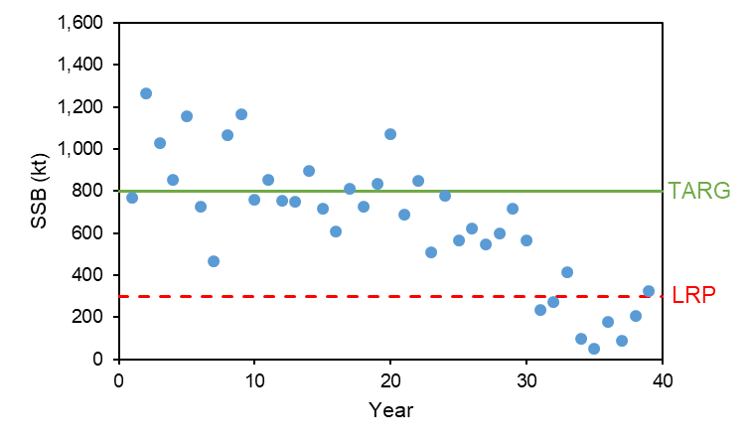
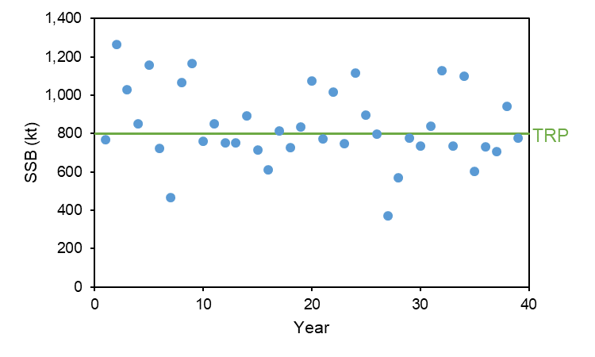
Reference Points
Target Reference Point (TRP) – desirable state to have the stock approach and fluctuate around
Limit Reference Point (LRP) – threshold to an undesirable state
Reference points are generally defined based on spawning stock biomass (SSB) or the instantaneous fishing mortality rate (F)

Slide 6
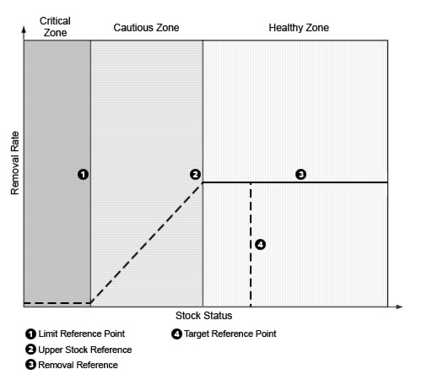
DFO: Reference Points (PA Framework)
A general fishery decision-making framework (DFO 2009) for implementing harvest strategies that incorporate the precautionary approach
Includes reference points and stock status zones

Slide 7
DFO: Reference Points (PA Framework)
LRP: “represents the stock level below which there is a high probability that the stock’s productivity is so impaired that serious harm will occur”
“At this stock status level, there may also be resultant impacts to the ecosystem, associated species and a long-term loss of fishing opportunities”
The LRP is defined by DFO Science through a CSAS peer-review process

Slide 8
DFO: Reference Points (PA Framework)
USR – “a level below which removals must be progressively reduced so the LRP can be avoided” OR “a target reference point”
“USR is defined by resource management, in consultation with stakeholders and with advice and input from DFO Science”

Slide 9
DFO: Reference Points (PA Framework)
Removal Reference – limit on the fishing mortality rate (F)
Target Reference Point – desirable state to have the stock approach and fluctuate around

Slide 10
Roles of Reference Points
Used to determine stock status by comparing estimated SSB or F to reference points
LRP separates the critical and cautious zones
USR separates the cautious and healthy zones
Used to define performance metrics that evaluate how well harvest strategies meet (measurable) management objectives
e.g., P(SSB > LRP)

Slide 11
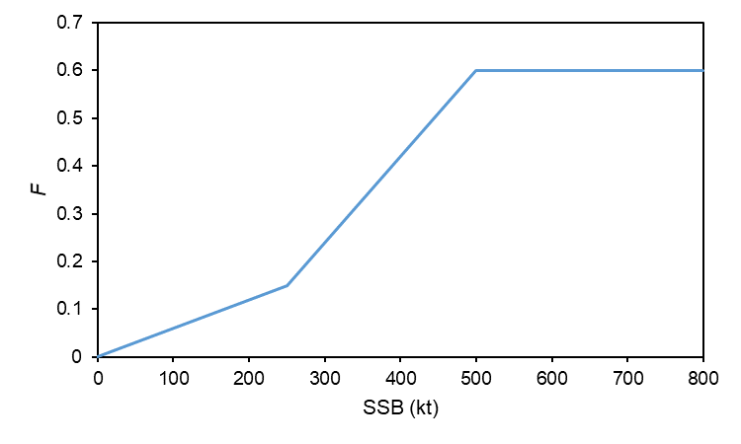
Roles of Reference Points
Can be and are often used as operational control points in harvest control rules (HCRs)
The LRP also has a legislated role in triggering the need for a rebuilding plan under the Fish Stocks Provisions
OCPs = points where pre-specified management actions take place (e.g., change in F in a HCR)

Slide 12
2. Background on Fish Stock Productivity

Slide 13
Steepness
A, b of BH SRR?

Slide 14
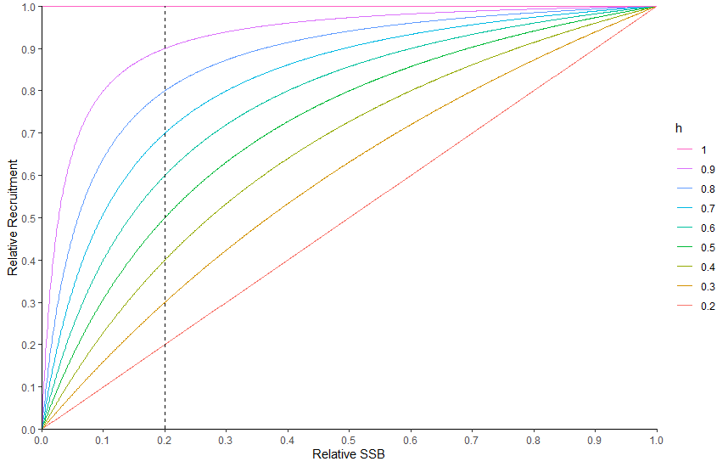

Copied from section 5
$h$ is a measure of the resilience of recruitment to decreases in SSB from $SSB0$
$h$ ranges from 0.2 to 1
$h$ = 1 (recruits do not decline as
SSB declines from $SSB0$)
$h$ = 0.2 (recruits decline linearly
as SSB declines from $SSB0$)

Slide 15
3. Equilibrium Assumptions

Slide 16
What is Equilibrium?
A theoretical model state that arises when the following are constant (do not change from year to year):
Fishing mortality (F)
Exploitation pattern (selectivity)
Fishery or stock characteristics (growth, natural mortality (M), recruitment)
Simplifying assumptions:
Births = Deaths
A fish population harvested at a constant rate for many years will achieve equilibrium (“steady state”)
A tool to help understand effects of fishing on fish populations
Reality:
Annual variability “noise” (e.g., variable recruitment) – this is accounted for in annual stock assessments
Effects of time-varying processes on assessments and reference points are challenging and not well-understood

Slide 17
4. Background on MSY

Slide 18
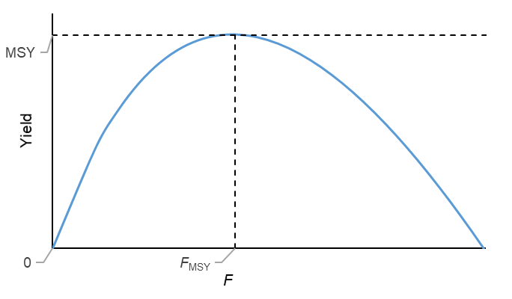
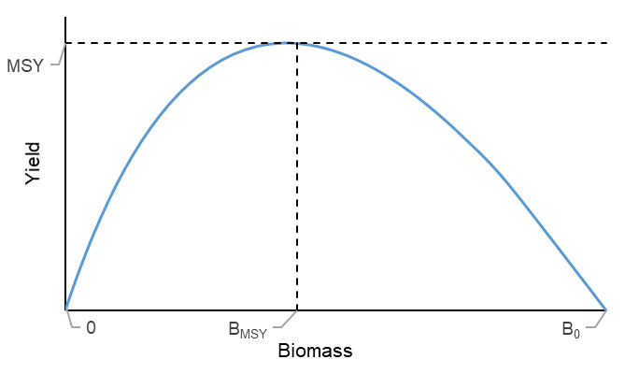
MSY
MSY: maximum long-term yield that the stock can produce, given constant life history and selectivity parameters.
MSY occurs at an intermediate level of F (between F = 0 and F_{crash}) and at a biomass below B₀.

Slide 19
MSY
MSY: maximum long-term yield that the stock can produce, given constant life history and selectivity parameters.
MSY occurs at an intermediate level of F (between F = 0 and F_{crash}) and at a biomass below B₀.
F_{MSY} = long-term F that results in MSY
B_{MSY} = average biomass from fishing at F_{MSY} over the long-term under equilibrium conditions

Slide 20
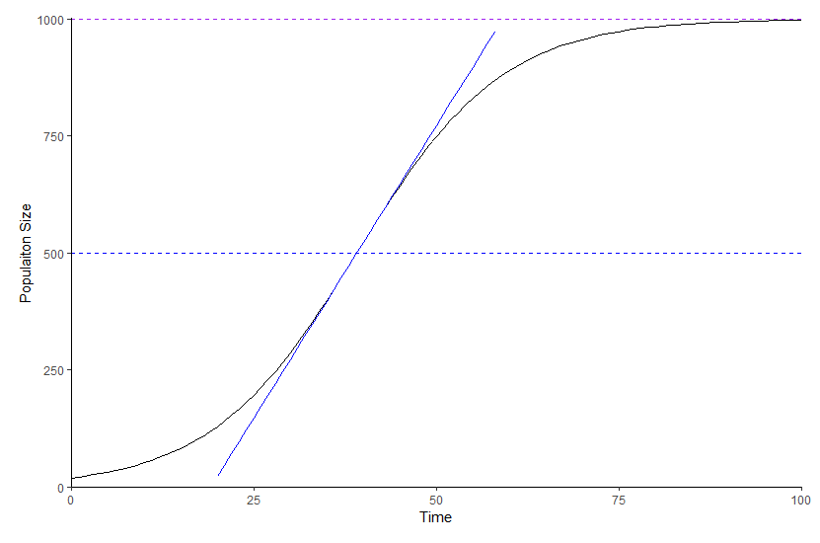
MSY
Theory: with increasing long-term F, the abundance and mean age of a population decreases and the per-capita growth rate of the population increases as a result of reduced competition or similar effects as the biomass reduces from K to B_{MSY}
Carrying capacity
Maximum population
growth rate

Slide 21
5. Reference Points in Surplus Production Models

Slide 22
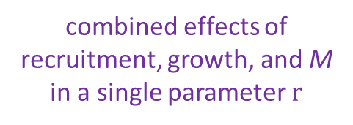

Surplus Production Models
Schaefer Model:
$B_{t+1}=B_{t}+rB_{t}\left(1−\frac{B_{t}}{K}\right)−C_{t}$
$B$ = biomass, $C$ = catch
$r$ = intrinsic rate of population growth
$K$ = carry capacity
$t$ = discrete time step
combined effects of recruitment, growth, and M in a single parameter $r$
Maximum population size, “unfished biomass”

Slide 23

Surplus Production Models
$${SP}_{t}$$
Schaefer Model:
$B_{t+1}=B_{t}+rB_{t}\left(1−\frac{B_{t}}{K}\right)−C_{t}$
$B$ next year = $B$biomass this year + Surplus Production ($SP$) this year – $C$ this year
$SP$ depends on population growth rate $r$ and position of $B_{t}$ relative to $K$

Slide 24
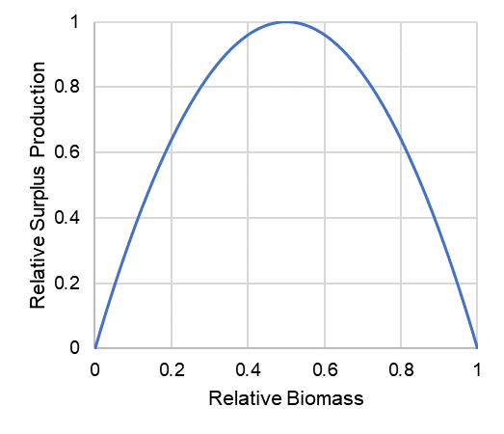
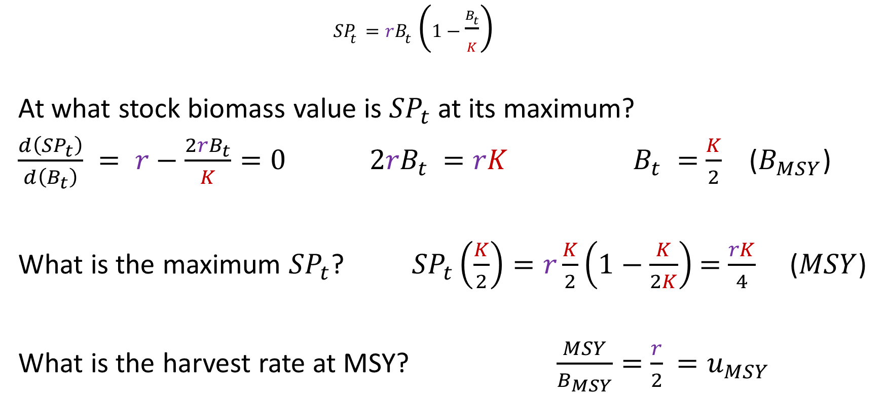


Surplus Production Models
MSY = $\frac{rK}{4}$
${SP}_{t}=rB_{t}\left(1−\frac{B_{t}}{K}\right)$
At what stock biomass value is ${SP}_{t}$ at its maximum?
$\frac{d\left({SP}_{t}\right)}{d\left(B_{t}\right)} = r−$ $\frac{{2rB}_{t}}{K}=0$ ${2rB}_{t}$ $=rK$ $B_{t} =$ $\frac{K}{2}$ ($B_{MSY}$)
What is the maximum ${SP}_{t}$? ${SP}_{t}\left(\frac{K}{2}\right)=r\frac{K}{2}\left(1−\frac{K}{2K}\right)$ $=$ $\frac{rK}{4}$ ($MSY$)
What is the harvest rate at MSY? $\frac{MSY}{B_{MSY}}=$ $\frac{r}{2}$ ${=u}_{MSY}$
B_{MSY} = $0.5K$

Slide 25




Surplus Production Models
Schaefer SP model:
2-parameter model ($r$ and $K$) with symmetric yield curve
More complex models (non-symmetrical yield curves)
Fox
Pella-Tomlinson
(see Hilborn and Walters 1992)
MSY = $\frac{rK}{4}$
$$K$$
B_{MSY} = $0.5K$

Slide 26
6. Reference Points in Age-structured Models

Slide 27
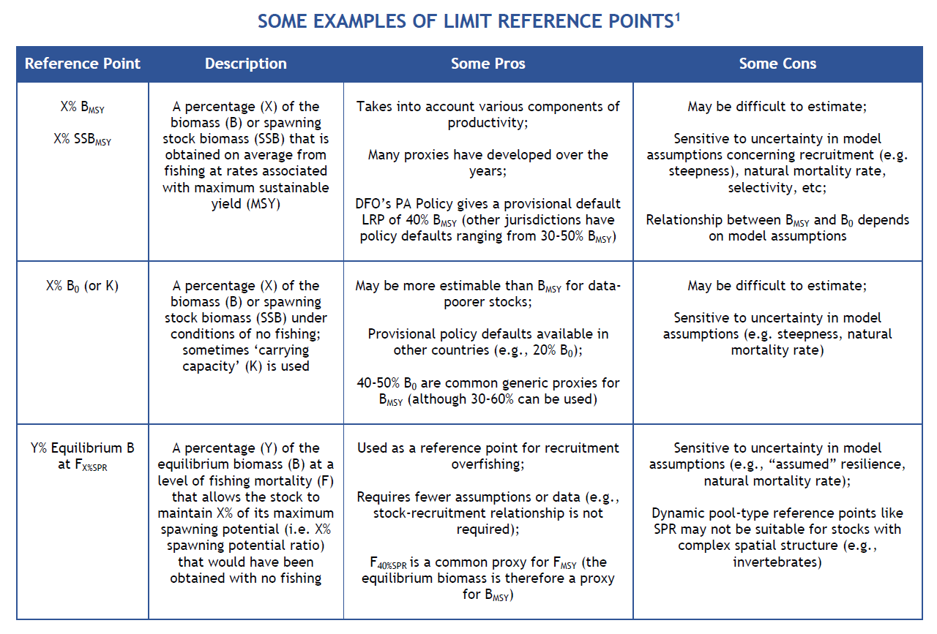
Examples of Limit Reference Points
B_{MSY}
% of B₀ as a proxy for B_{MSY}
% of Equilibrium B at F_{X%SPR} as a
proxy for B_{MSY}
1 Adapted from Pew Charitable Trusts (2016) Reference Points: Measuring Success in Fisheries Management. 8 pp.

Slide 28

Some Equilibrium Reference Points
Calculations for an age-structured model:
$FMSY \text{and} SSBMSY$
$SSB0$
$SSB$ at $FX\%SPR$

Slide 29
Per Recruit Reference Points: Calculations

Slide 30
Per-Recruit Reference Points [Concepts]
Mortality Rates
Survivorship
SSB-per-recruit (or eggs-per-recruit)
Spawning potential ratio (SPR)
Yield-per-recruit (YPR)

Slide 31
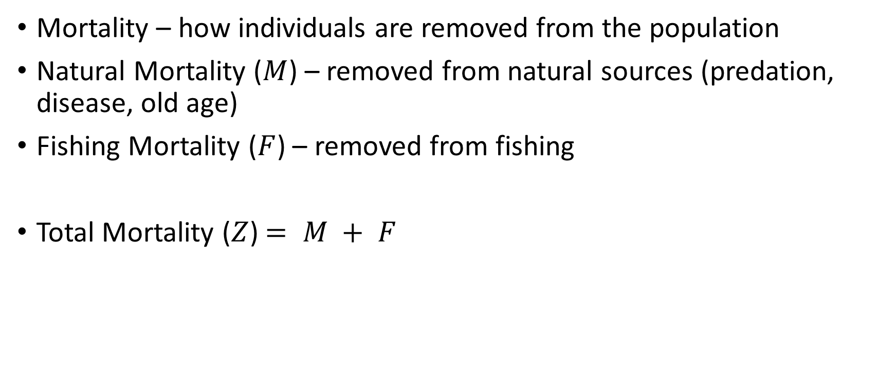
Per-Recruit Reference Points 1. Mortality Rates
Mortality – how individuals are removed from the population
Natural Mortality ($M$) – removed from natural sources (predation, disease, old age)
Fishing Mortality ($F$) – removed from fishing
Total Mortality ($Z$) $= M + F$

Slide 32


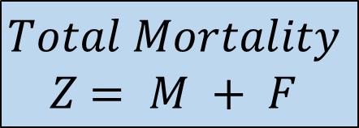

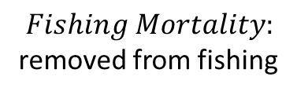
Per-Recruit Reference Points 1. Mortality Rates
$Mortality$: how individuals are removed
$Natural Mortality$: removed from natural sources (predation, disease, old age)
$$M$$
$$F$$
$$Fishing Mortality:$$
removed from fishing
$$Total Mortality$$
$Z$ $= M + F$

Slide 33
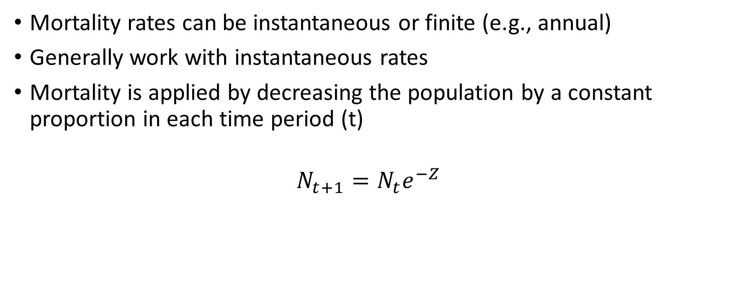
Per-Recruit Reference Points 1. Mortality Rates
Mortality rates can be instantaneous or finite (e.g., annual)
Generally work with instantaneous rates
Mortality is applied by decreasing the population by a constant proportion in each time period (t)
$$N_{t+1}=N_{t}e^{−Z}$$

Slide 34
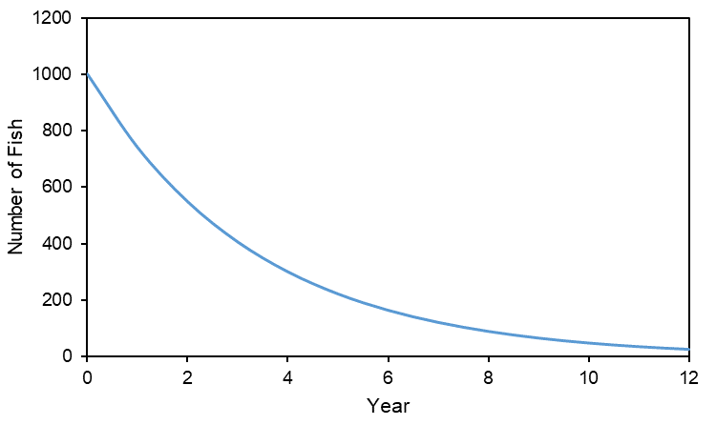

Per-Recruit Reference Points 1. Mortality Rates
Example: $Z = 0.3$, start with 1000 recruits at age 0 and track this cohort over time
$$N_{t+1}=N_{t}e^{−Z}$$

Slide 35
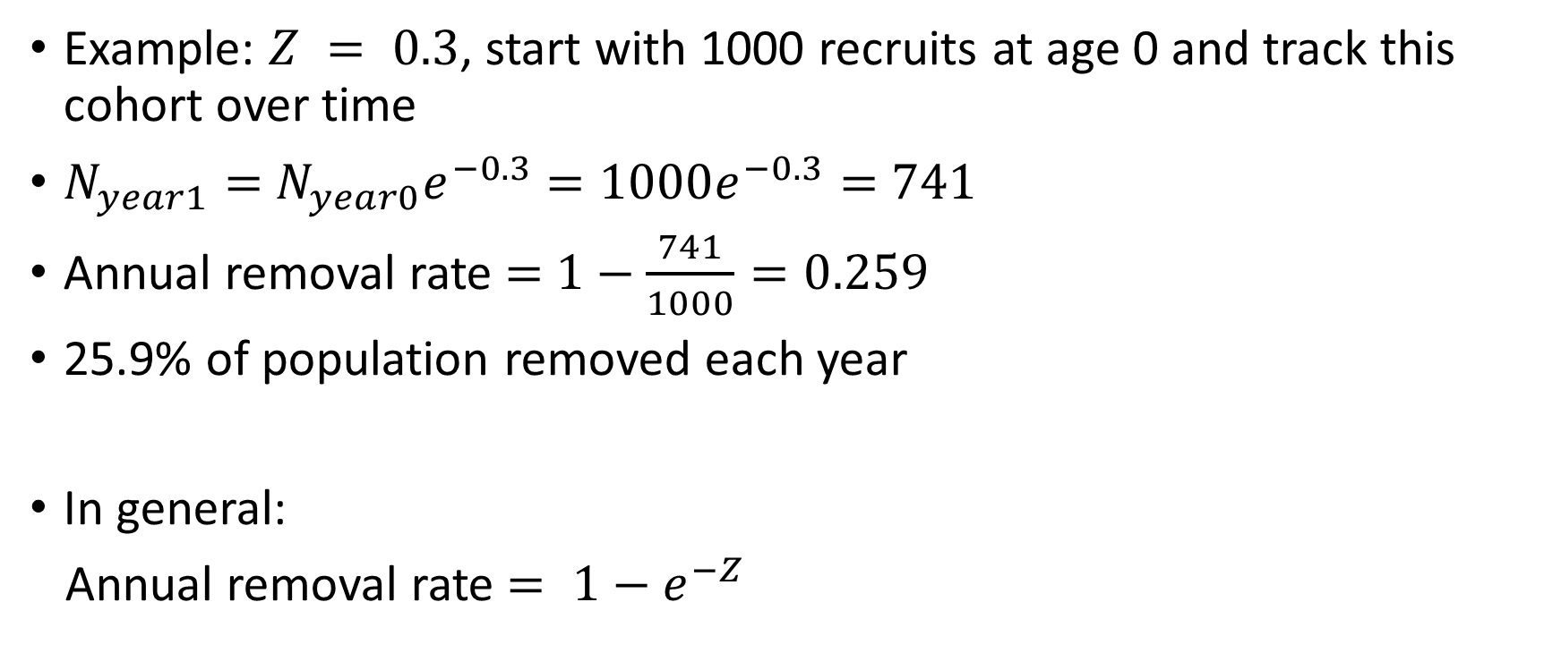
Per-Recruit Reference Points 1. Mortality Rates
Example: $Z = 0.3$, start with 1000 recruits at age 0 and track this cohort over time
$N_{year1}=$ $N_{year0}e^{−0.3}$ $=1000e^{−0.3}=$ $741$
Annual removal rate $=$ $1−\frac{741}{1000}=0.259$
25.9% of population removed each year
In general:
Annual removal rate $= 1−e^{−Z}$

Slide 36
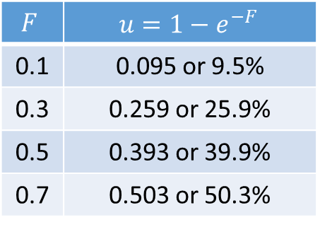

Per-Recruit Reference Points 1. Mortality Rates
Harvest rate (or exploitation rate $u$) is the annual proportional change in numbers of fish for a given instantaneous fishing mortality rate ($F$)
Sometimes expressed as a percentage (%)
$$F$$ | $$u=1−e^{−F}$$
0.1 | 0.095 or 9.5%
0.3 | 0.259 or 25.9%
0.5 | 0.393 or 39.9%
0.7 | 0.503 or 50.3%

Slide 37
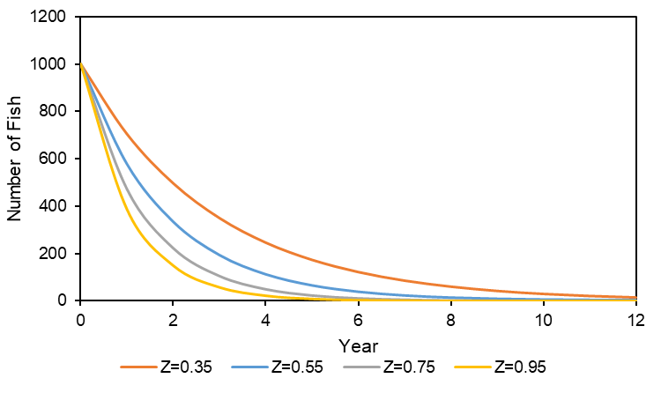

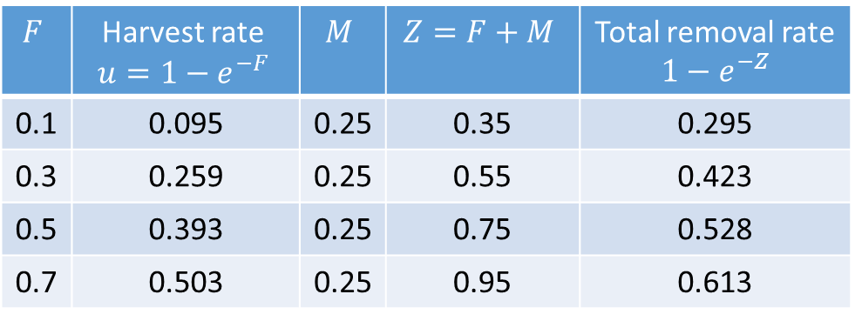
Per-Recruit Reference Points 1. Mortality Rates
Add $M = 0.25$and calculate total removal rate ($Z=M+F$)
$$F$$ | Harvest rate $$u=1−e^{−F}$$ | $$M$$ | $$Z=F+M$$ | Total removal rate $1−e^{−Z}$
0.1 | 0.095 | 0.25 | 0.35 | 0.295
0.3 | 0.259 | 0.25 | 0.55 | 0.423
0.5 | 0.393 | 0.25 | 0.75 | 0.528
0.7 | 0.503 | 0.25 | 0.95 | 0.613

Slide 38
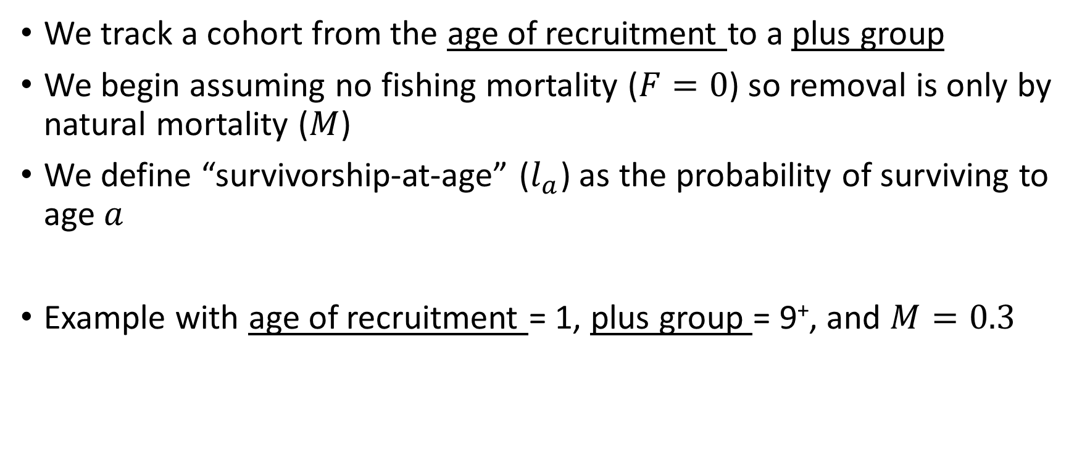
Per-Recruit Reference Points 2. Survivorship
We track a cohort from the age of recruitment to a plus group
We begin assuming no fishing mortality ($F=0$) so removal is only by natural mortality ($M$)
We define “survivorship-at-age” ($l_{a}$) as the probability of surviving to age $a$
Example with age of recruitment = 1, plus group = 9⁺, and $M=0.3$

Slide 39
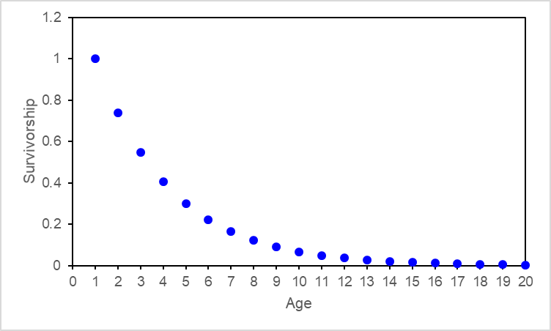
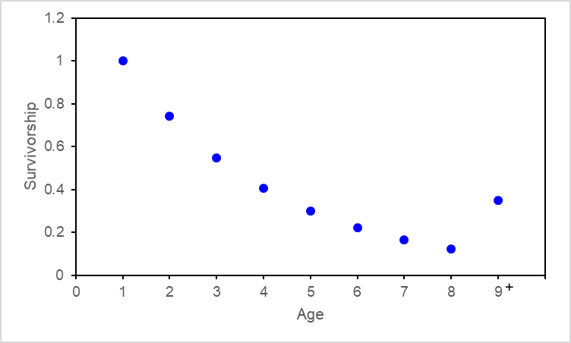

Per-Recruit Reference Points 2. Survivorship
age 1 = age of recruitment
For $Z=0.3$
$l_{a=1}=P\left(surviving to age 1\right)=1$
$l_{a=2}=P\left(surviving to age 2\right)=1×e^{−Z}=e^{−0.3}$
$l_{a=3}=P\left(surviving to age 3\right)=1$ $×e^{−Z}×e^{−Z}=e^{−2(0.3)}$
$l_{a=4}=P\left(surviving to age 4\right)=1 ×e^{−Z}×e^{−Z}×e^{−Z}=e^{−3(0.3)}$
$l_{a=a}=e^{− \left(a−1\right)M}$

Slide 40
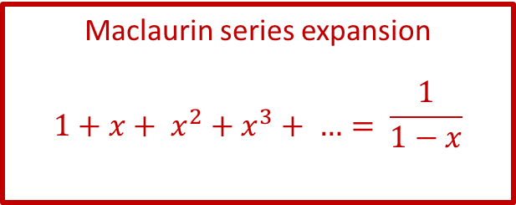
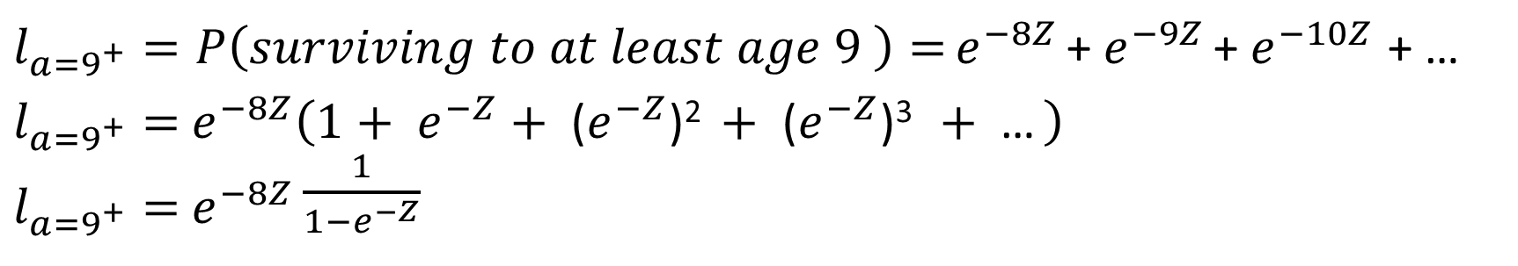
Per-Recruit Reference Points 2. Survivorship
$l_{a=9^{+}}=P\left(surviving to at least age 9 \right)=$ $e^{−8Z}$ + $e^{−9Z}$ + $e^{−10Z}$ + …
$l_{a=9^{+}}=$ $e^{−8Z}\left(1+ e^{−Z}+\text{ (}e^{−Z}\text{)}\text{2 }+\text{ (}e^{−Z}\text{)}\text{3 }+\text{ …} \right)$
$l_{a=9^{+}}=$ $e^{−8Z}\frac{1}{1−e^{−Z}}$

Slide 41
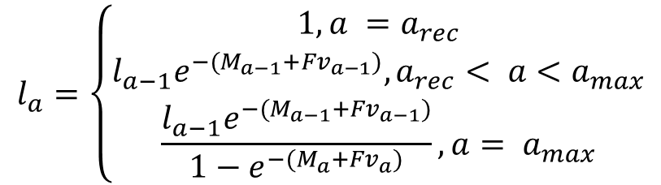
Per-Recruit Reference Points 2. Survivorship
In general:
$$l_{a}=\left\{\begin{matrix}1, a =a_{rec} \\ l_{a−1}e^{−(M_{a−1}+Fv_{a−1})},a_{rec}< a<a_{max} \\ \frac{l_{a−1}e^{−(M_{a−1}+Fv_{a−1})}}{1−e^{−(M_{a}+Fv_{a})}},a= a_{max}\end{matrix}\right.$$

Slide 42
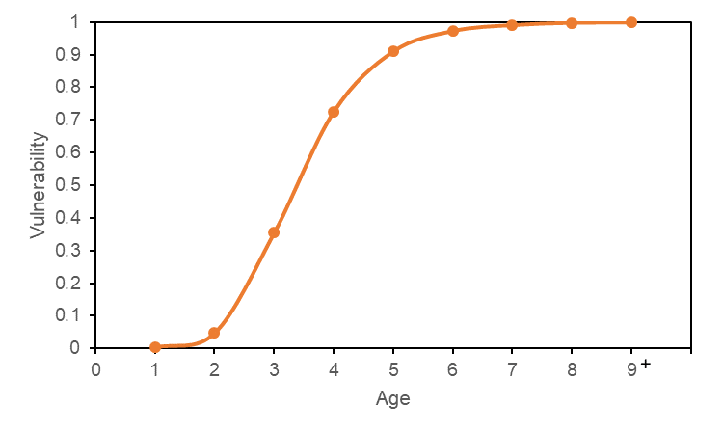
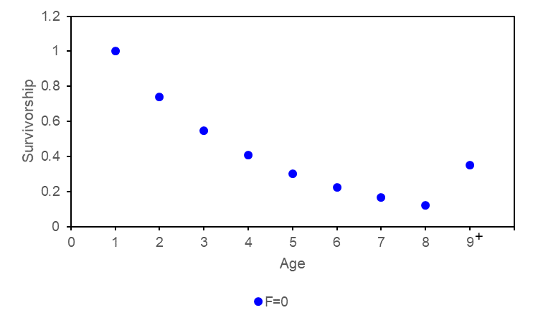
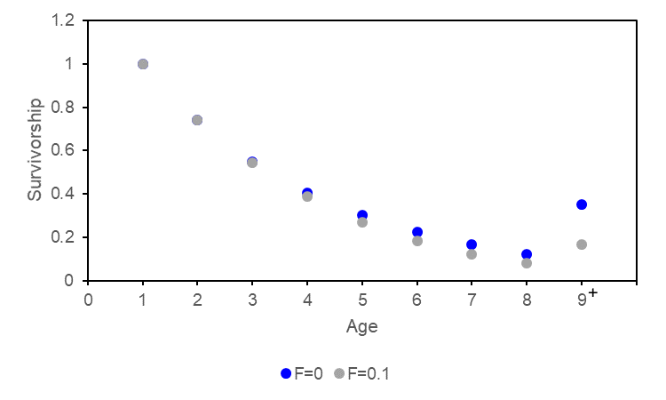
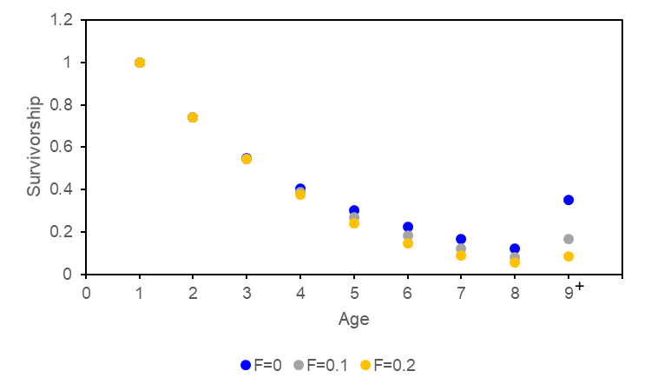
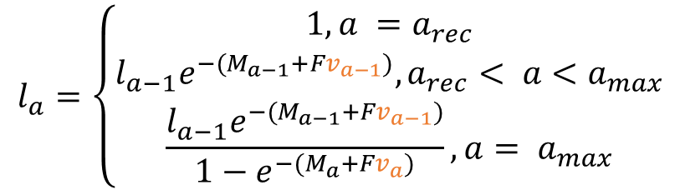
Per-Recruit Reference Points 2. Survivorship
In general:
$$l_{a}=\left\{\begin{matrix}1, a =a_{rec} \\ l_{a−1}e^{−(M_{a−1}+Fv_{a−1})},a_{rec}< a<a_{max} \\ \frac{l_{a−1}e^{−(M_{a−1}+Fv_{a−1})}}{1−e^{−(M_{a}+Fv_{a})}},a= a_{max}\end{matrix}\right.$$
The total mortality at-age depends on the vulnerability-at-age

Slide 43


Per-Recruit Reference Points 3. SSB-per-Recruit
Equilibrium SSB-per-recruit ($φ_{F}$) = SSB produced on average by each recruit over its lifetime, considering survival, growth, and maturity
Sum over all ages:
P(survives to age $a$) × weight-at-age $a$ × P(mature-at-age $a$)
$$φ_{F}=\sum_{{a=a}_{rec}}^{a_{max}}{l_{a}w_{a}m_{a}}$$

Slide 44

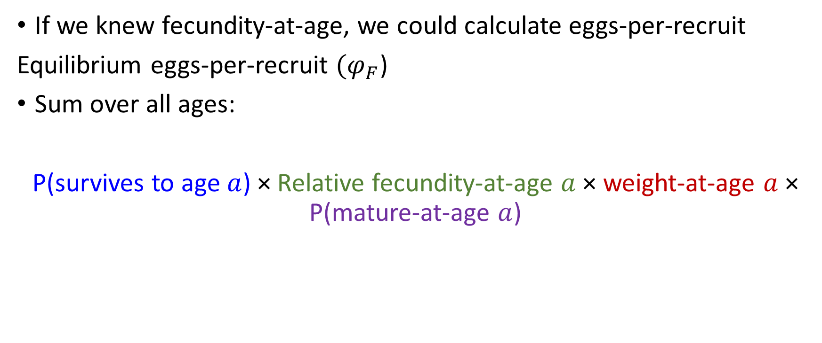
Per-Recruit Reference Points 3. Eggs-per-Recruit
If we knew fecundity-at-age, we could calculate eggs-per-recruit
Equilibrium eggs-per-recruit ($φ_{F}$)
Sum over all ages:
P(survives to age $a$) × Relative fecundity-at-age $a$× weight-at-age $a$ × P(mature-at-age $a$)
Eggs/unit body weight
$$φ_{F}=\sum_{a=a_{rec}}^{a_{max}}{l_{a}{f_{a}w}_{a}m_{a}}$$

Slide 45

Per-Recruit Reference Points 3. SSB-per-Recruit or Eggs-per-Recruit
We generally do not know relative fecundity and assume that SSB is proportional to fecundity
See recent paper from Marshall et al. (2021) if you’re interested in understanding the implications of the assumption that SSB is proportional to fecundity.

Slide 46
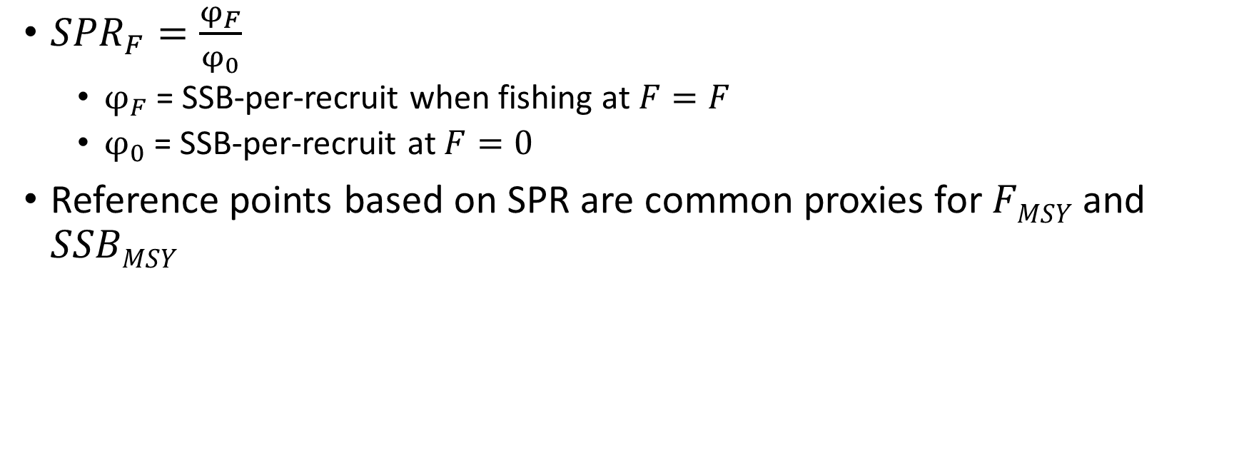
Per-Recruit Reference Points 4. Spawning Potential Ratio (SPR)
${SPR}_{F}=\frac{φ_{F}}{φ_{0}}$
$φ_{F}$ = SSB-per-recruit when fishing at $F=F$
$φ_{0}$ = SSB-per-recruit at $F=0$
Reference points based on SPR are common proxies for $FMSY$ and $SSBMSY$

Slide 47
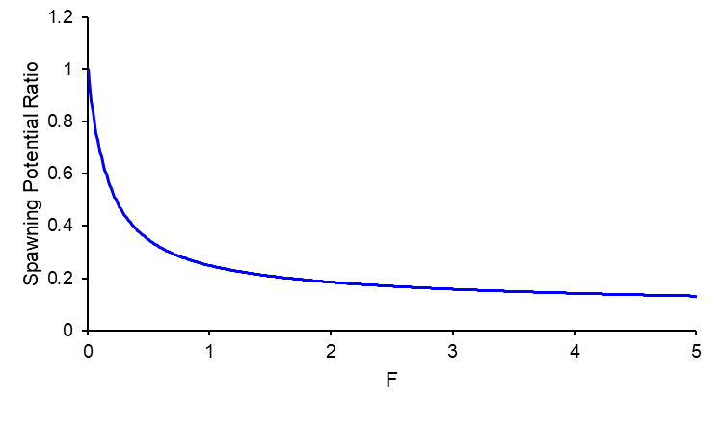
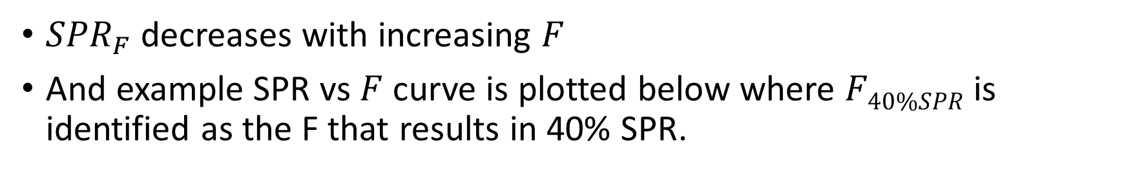
Per-Recruit Reference Points 4. Spawning Potential Ratio (SPR)
${SPR}_{F}$ decreases with increasing $F$
And example SPR vs $F$ curve is plotted below where $F40\%SPR$ is identified as the F that results in 40% SPR.
40%SPR

Slide 48
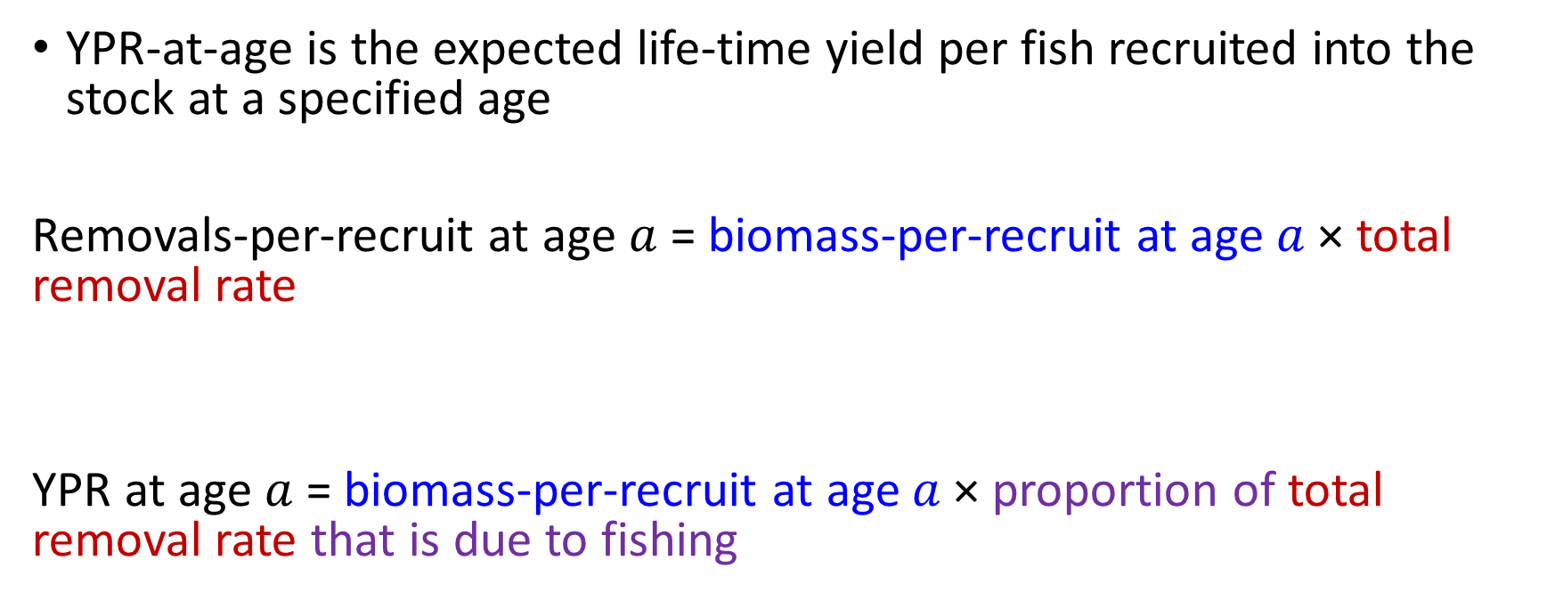

Per-Recruit Reference Points 5. Yield-per-Recruit (YPR)
YPR-at-age is the expected life-time yield per fish recruited into the stock at a specified age
Removals-per-recruit at age $a$= biomass-per-recruit at age $a$× total removal rate
YPR at age $a$= biomass-per-recruit at age $a$× proportion of total removal rate that is due to fishing
from fishing and natural mortality
$\text{Removals}\text{−}\text{per}\text{−}\text{recruit} \text{at} \text{age} a=l_{a}w_{a}$($1−e^{−\left(M_{a}+Fv_{a}\right)}$)
${YPR}_{a}=l_{a}w_{a}$($1−e^{−(M_{a}+{Fv}_{a})}$) $\frac{Fv_{a}}{M_{a}+{Fv}_{a}}$

Slide 49



Per-Recruit Reference Points 5. Yield-per-Recruit (YPR)
$YPR=$Sum over all ages:
${YPR}_{a}=l_{a}w_{a}$($1−e^{−(M_{a}+{Fv}_{a})}$) $\frac{Fv_{a}}{M_{a}+{Fv}_{a}}$
$${YPR}_{F}=\sum_{a=a_{rec}}^{a_{max}}{l_{a}w_{a}\left(1−e^{−(M_{a}+{Fv}_{a})}\right)\frac{{Fv}_{a}}{M_{a}+{Fv}_{a}}}$$

Slide 50



Per-Recruit Reference Points 5. Yield-per-Recruit (YPR)
Can be calculated over a range of $F$ values to estimate $F_{max}$
$F_{max}= F$corresponding to the maximum $YPR$
$$F_{max}$$

Slide 51
MSY Reference Points: Calculations

Slide 52

Yield-per-Recruit → Yield
Yield = $YPR ×number of recruits$
We already know how to calculate $YPR$ for various $F$
Now we need to know how $R$ changes with $F$
Stock Recruitment Relationships

Slide 53
Data Requirements for Reference Points for Age- Structured Models
Need to introduce stock recruitment relationships
SRR
(R₀ and h) or (a and b)
Growth
(weight-at-age)
Maturity
MSY reference points
Per-recruit reference points
Natural Mortality
Selectivity

Slide 54

MSY Reference Points [Concepts]
Stock Recruitment Relationships (SRR)
Unfished Equilibrium Biomass $SSB0$
MSY

Slide 55



MSY Reference Points 1. Stock Recruitment Relationships
Beverton-Holt
$$R(B)=\frac{aB }{1+bB}$$
asymptotic recruitment$Rmax=\frac{a}{b}$

Slide 56


MSY Reference Points 1. Stock Recruitment Relationships
Ricker
$$R(B)=αB e^{−βB}$$
R_{max}
Recruitment declines at high SSB

Slide 57





MSY Reference Points 1. Stock Recruitment Relationships
Focus on Beverton-Holt
Alternative parameterization
$$R(B)=\frac{aB }{1+bB}$$
$$R(B)=\frac{\text{4}R_{0}hB }{\left(1−h\right)R_{0}φ_{0}+\left(5h−1\right)B}$$
$$h= \frac{aφ_{0}}{4+aφ_{0}}$$
h = steepness
$$R_{0}= \frac{1}{b}\left(a−\frac{1}{φ_{0}}\right)$$
$R_{0}$ = equilibrium unfished recruitment

Slide 58








MSY Reference Points 1. Stock Recruitment Relationships
Steepness ($h$) = proportion of equilibrium unfished recruitment produced by 20% of unfished equilibrium SSB (i.e., 0.2 ${SSB}_{0}$)
$$R(B)=\frac{\text{4}R_{0}hB }{\left(1−h\right)R_{0}φ_{0}+\left(5h−1\right)B}$$
$$h=\frac{R_{0.2{SSB}_{0}}}{R_{0}}$$
$$R0$$
$$R0.2SSB0$$
$$0.2SSB0$$
$$SSB0$$

Slide 59
MSY Reference Points 1. Stock Recruitment Relationships
$h$ is a measure of the resilience of recruitment to decreases in SSB from $SSB0$
$h$ ranges from 0.2 to 1
$h$ = 1 (recruits do not decline as
SSB declines from $SSB0$)
$h$ = 0.2 (recruits decline linearly
as SSB declines from $SSB0$)

Slide 60


MSY Reference Points 2. ${SSB}_{0}$
${SSB}_{0}$ is the equilibrium unfished biomass
${SSB}_{0}$ is estimated from the unfished SSB-per-recruit ($φ_{0}$) and the SRR
We can calculate $φ_{0}=\sum_{a=a_{rec}}^{a_{max}}{l_{a}w_{a}m_{a}}$ and we know:
$φ_{0}=\frac{{SSB}_{0}}{R_{0}}$ (1)
The point (${SSB}_{0}$, $R_{0}$) lies on the SRR so we know:
$R_{0}=\frac{a{SSB}_{0}}{1+b{SSB}_{0}}$ (2)
We have 2 equations and two unknowns ($R_{0}$ and ${SSB}_{0}$)

Slide 61





MSY Reference Points 2. ${SSB}_{0}$
Equation 1: $φ_{0}=\frac{{SSB}_{0}}{R_{0}}$ $R_{0}=\frac{{SSB}_{0}}{φ_{0}}$
Equation 2: $R_{0}=\frac{a{SSB}_{0}}{1+b{SSB}_{0}}$
${SSB}_{0}$ therefore depends on the SRR parameters $a$ and $b$ and $φ_{0}$ (determined by $M$, $weight$-$at$-$age$, and $maturity$-$at$-$age$)
$\frac{{SSB}_{0}}{φ_{0}}=$ $\frac{a{SSB}_{0}}{1+b{SSB}_{0}}$
$\frac{1}{φ_{0}}=$ $\frac{a}{1+b{SSB}_{0}}$
$$1+b{SSB}_{0}=aφ_{0}$$
${SSB}_{0}=$ $\frac{aφ_{0}−1}{b}$
(Equation 3)

Slide 62



MSY Reference Points 2. ${SSB}_{0}$
${SSB}_{0}$ occurs at the intersection of the SRR and a line through the origin with slope $1/φ_{0}$
Note the inverse of $φ_{0}$ is $R0/SSB0$
Line with slope $1/φ_{0}$
$$(SSB0,R0)$$

Slide 63

MSY Reference Points 1. Stock Recruitment Relationships
When $F=0$ the SSB-per-recruit is $φ_{0}$
When $F$ increases from 0, the SSB-per-recruit ($φ_{F}$) decreases from the unfished $φ_{0}$
The equilibrium SSB for $φ_{F}$ from Equation 3 is: ${SSB}_{F}=$ $\frac{aφ_{F}−1}{b}$
The equilibrium recruitment for $φ_{F}$ from Equation 1 is: $R_{F}=\frac{{SSB}_{F}}{φ_{F}}$

Slide 64



MSY Reference Points 1. Stock Recruitment Relationships
When $F$ is applied, the equilibrium recruitment and equilibrium SSB “slide down” the SRR from ($SSB0$,$R0$). Example stock: $F$ = 0.34
At $F$ = 0.34 the SSB-per-recruit decreases to $φ_{F=0.34}$
Equilibrium recruitment: $R_{F=0.34}$at $φ_{F=0.34}$
Equilibrium SSB: ${SSB}_{F=0.34}$at $φ_{F=0.34}$
($SSBF$,$RF$)
($SSB0$,$R0$)

Slide 65

MSY Reference Points 2. MSY
MSY: the largest catch that can be continuously removed from the stock assuming constant environmental conditions
Reference points are based on $F_{MSY}$
${SSB}_{MSY}$ is the long-term average (equilibrium) SSB from fishing at a constant$F_{MSY}$
Carrying capacity
Theory:
population growth rate is zero at carrying capacity
as population size is reduced below carry capacity, the population growth rate increases (due to available resources, decreased competition)
Maximum population growth rate occurs at an intermediate population size
The population “growth” is harvested as surplus production
Maximum population
growth rate

Slide 66

MSY Reference Points 2. MSY
MSY: the largest catch that can be continuously removed from the stock assuming constant environmental conditions
Reference points are based on $F_{MSY}$
${SSB}_{MSY}$ is the long-term average (equilibrium) SSB from fishing at a constant$F_{MSY}$
Carrying capacity
Maximum population
growth rate

Slide 67



MSY Reference Points 2. MSY
Equilibrium MSY reference points can be determined by calculating yield and the equilibrium SSB over a range of $F$ values using the formulas presented on pervious slides.

Slide 68

MSY Reference Points 2. MSY
$FMSY \text{= }\text{Fishing} \text{mortality} \text{rate} \text{that} \text{results} \text{in} \text{maximum} \text{yield} \text{over} \text{the} \text{long} \text{term}$
$MSY\text{ = }\text{the} \text{largest} \text{catch} \text{(}\text{yield}\text{) }\text{that} \text{can} \text{be} \text{continuously} \text{removed} \text{from} \text{the} \text{stock} \text{assuming} \text{constant} \text{environmental} \text{conditions}\text{ (}\text{equilibrium}\text{)}$
$BMSY$ = average long-term biomass (SSB) from fishing at a constant $FMSY$ over the long term

Slide 69









MSY Reference Point: $SSBMSY$
$YieldF = YPRF × RF$
Calculate Yield for various $F$ and identify $F$ where yield is at its maximum
Equilibrium Yield at a specified $F$
Yield-per-recruit at a specified $F$
Equilibrium Recruitment at a specified $F$
MSY
$${SSB}_{0}$$
$${SSB}_{MSY}$$
$$F_{MSY}$$
$$F_{MSY}$$

Slide 70
7. Approaches for Data-limited Stocks
I think this should be a very gentle introduction to what options are available?

Slide 71
Approaches for Data-limited Stocks
Methods:
Empirical, theoretical, and historical proxies for B₀ and B_{MSY}
Catch-only methods: can provide estimates of B relative to B₀ and B_{MSY}
they have generally been used to estimate global trends in stock status and not for stock assessment
Closed-loop simulation approaches: an alternative to using empirical proxies or methods that rely on strong model assumptions or priors

Slide 72


Theoretical Proxies for B_{MSY}
Per-recruit models: Spawning Potential Ratio (SPR)
$F$ reference point: $FX\%SPR$ represents the $F$ that results in $X$% of unfished SSB-pre-recruit
$FX\%SPR$is a common proxy for $FMSY$
Value of SPR as a proxy for $FMSY$ depends on productivity
Biomass reference point:
$BMSY$ proxy = equilibrium B from fishing at $FX\%SPR$
Productivity | $$r$$ | $FMSY$ ≈ $FX\%SPR$
Very Low | -* | F_{≥50%}
Low | <0.14 | F_{45%}
Medium | 0.14-0.35 | F_{40%}
High | >0.35 | F_{30%}
*Defined based on M < 0.1 and age-at-maturation > 15 years
NZ Ministry of Fisheries (2011)

Slide 73

Theoretical Proxies for F_{MSY}
Other F_{MSY} proxies:
$Fmax$= $F$ that maximizes YPR (not recommended)
$F0 1$ = $F$ where slope of YPR curve is 10% of the slope at the origin
Sensitive to assumptions about growth and $M$
Not recommended without understanding how well it relates to $FMSY$ (Mace 2001)
$FMSY$ = $M$ or a proportion of $M$
$0.87M$ meta-analysis (Zhou et al. 2012)
$0.5M$ pelagic species (Patterson 1992)
Biomass reference points = equilibrium B from fishing at $F$
.

Slide 74

Historical, Empirical, or Other Proxies for B₀ and B_{MSY}
$BMSY$ proxy, defined by
the mean or median value of an indicator over a historical time period when the indicator is high and catches are high; or
the mean or median value of an indicator over a productive period.
$B0$ proxy, defined by
the mean/median (or maximum) value of the indicator over a historical time period reflecting the beginning of exploitation.
LRPs based on a historical low biomass state:
from which the stock recovered to above average levels;
or that is agreed by managers and resource users to be an undesirable state to avoid.

Slide 75
Catch-only Approaches
Assume Catch is proportional to Abundance
Have been developed primarily to assess the global status of unassessed stocks (e.g., Costello et al. 2012; Kleisner et al. 2013; Palomares et al. 2020)
Recent reviews of data-limited methods have evaluated the performance of catch-only methods to estimate stock status (Carruthers et al. 2014; Free et al. 2020; Sharma et al., 2021; Ovando et al. 2022).
Performance evaluated on data rich stocks and simulated stocks
Catch-only methods:
produced biased and imprecise estimates of stock status
have been developed primarily to assess the global status of unassessed stocks

Slide 76

Closed-loop Simulation
Process that involves evaluating performance of MPs through simulation to assess trade-offs among multiple fishery and conservation objectives.
“Management Strategy Evaluation” – CLS is the technical modeling component of MSE.

Slide 77
Closed-loop Simulation
Data-limited context, CLS approach is an alternative to using empirical proxies that may not capture bias and uncertainty in estimated stock status.
CLS approach can provide sustainable catch advice consistent with the PA Policy and in compliance with the FSP, when stock status cannot be well estimated using traditional methods.
The application of a data-limited CLS framework to provide management advice has been demonstrated for groundfish in BC (Anderson et al. 2021).

Slide 78
8. Approaches using Multiple Models
I think this should be a very gentle introduction to what options are available?

Slide 79
Stock Status from Multiple Models
Model averaging (ensemble approach)
100% weight on one model (model selection);
equal weighting;
tactical weighting (e.g., based on expert opinion or historical performance);
weighting based on model probabilities (e.g., Bayes factors);
weighting based on information theoretic values (e.g., AIC); or
weighting based on predictive ability
Empirical Approaches
Reference points based on empirical indicators

