Slide 1

The Omega Nannies Operating System
A PROPOSAL FOR OMEGA NANNIES
One private platform for families, nannies and the Omega team — built on the brand families already trust.
October 2026 · Working software, tested and ready for your accounts
Notes:
This is working software, not a mock-up. Every screen in this deck is a real screenshot of the platform running with synthetic demo data. It extends omeganannies.com — the website keeps doing marketing and enquiries; the platform runs everything after the enquiry.

Slide 2



Every placement, from enquiry to review, in one place
VISION
Families
Nannies
The Omega team
Find a vetted nanny, get a clear quote, pay safely and stay in touch — without chasing emails.
A professional home: offers to accept, today’s schedule, documents and a profile they control.
Vetting, matching, quotes, payments and reports — with every sensitive action recorded.
Founder-led care, run like a well-organised private office.
Notes:
Three audiences, one database. Each portal shows only what that person needs. The tone and look carry the existing Omega brand.

Slide 3
The website wins trust — then the work moves to inboxes
THE PROBLEM
What omeganannies.com does well today
What happens after the enquiry
Beautiful brand and founder story
17 nanny profiles with photos
Rates, FAQ and vetting promise
Enquiry form with POPIA consent
No accounts for families or nannies
Vetting and documents tracked by hand
No shared view of who is free — double-booking risk
Quotes, deposits and EFTs reconciled manually
Children’s details and IDs travel by email
Notes:
Left: what we found on the public site. Right: capabilities the site does not have. We did not assume anything about internal tools — these are gaps in what a family or nanny can do online today.

Slide 4
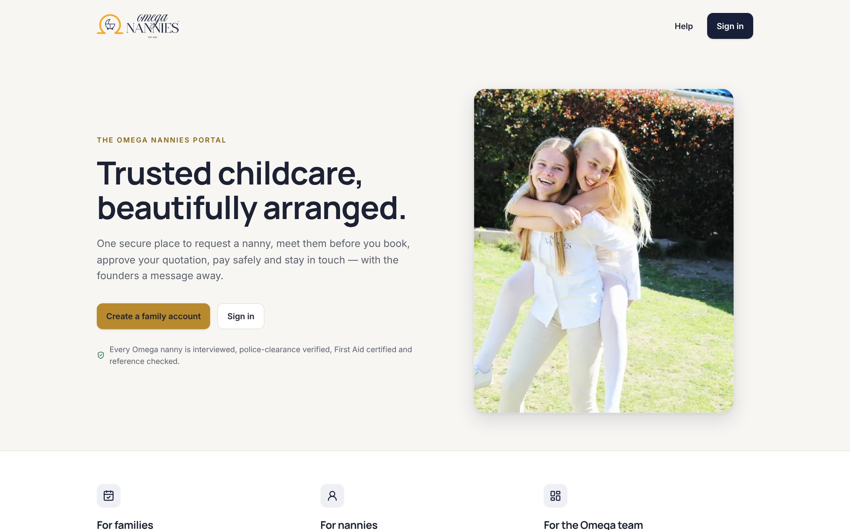
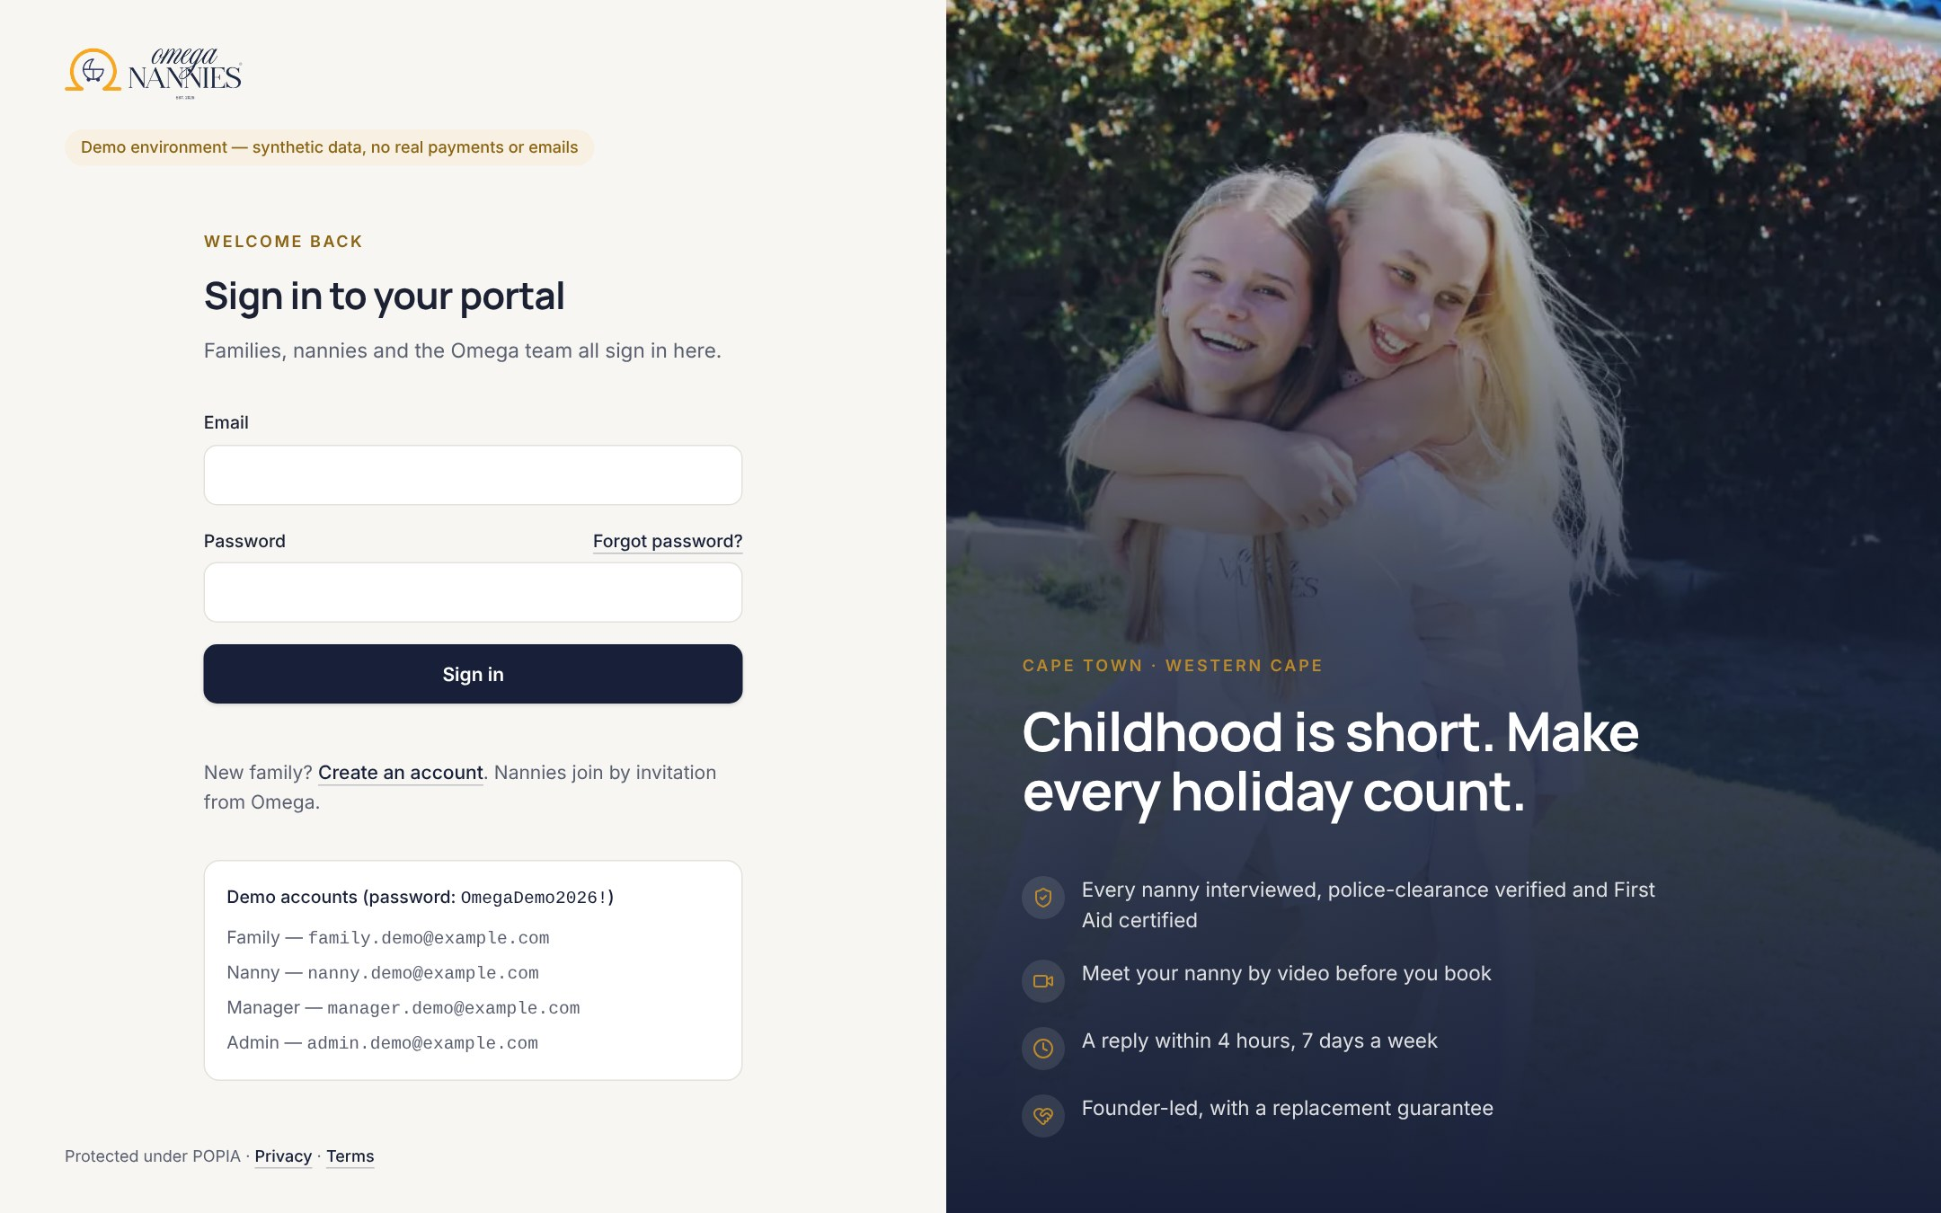
Calm, premium software that still feels like Omega
REDESIGNED EXPERIENCE
Landing page with Omega’s own photography and promise.
Sign-in for families, nannies and staff — one secure door.
Design system: Manrope + Inter typefaces (self-hosted), navy and gold from the brand, accessible contrast, icon navigation and a phone-first tab bar.
Notes:
The website's serif was kept for marketing; inside the app we use clean, highly legible type because figures and tables matter. Contrast meets WCAG AA — checked automatically on 33 pages.

Slide 5
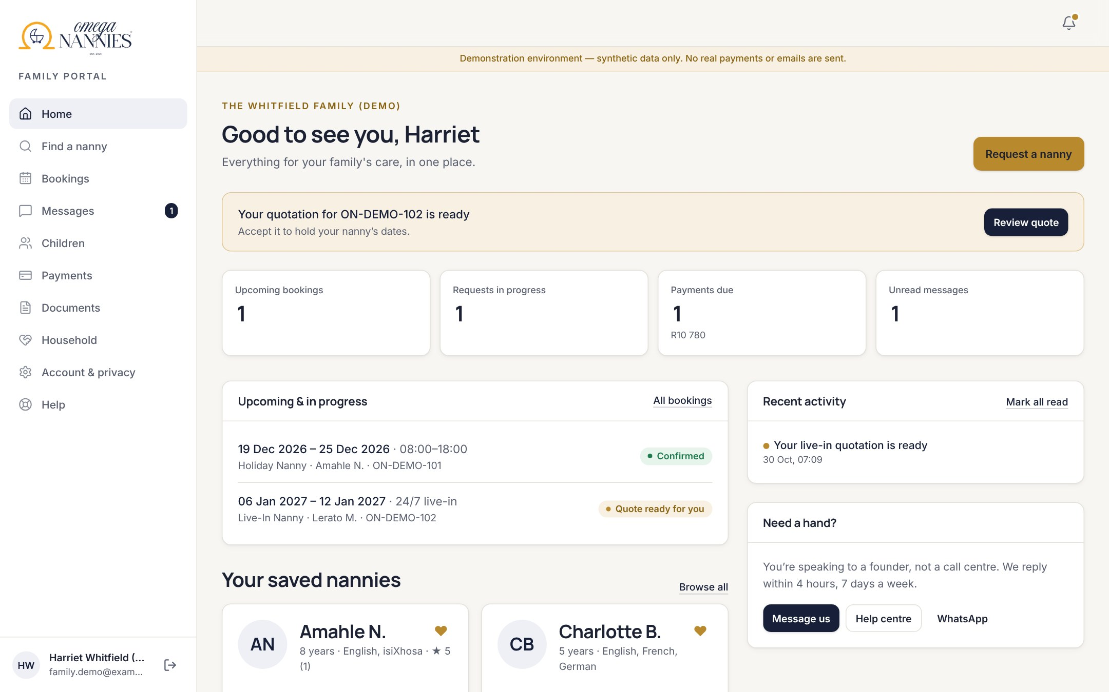




Families see their nanny, their quote and their next step
FAMILY PORTAL
Discover
Browse approved nannies, shortlist favourites, compare.
Request
Dates or set weekdays, live-in, driver, language and budget.
Quote & pay
Clear quote, deposit online, printable receipts.
Stay in touch
Messages and updates — no lost WhatsApps.
Notes:
The family home shows the quotation waiting for them, upcoming care, saved nannies and how to reach a founder.

Slide 6
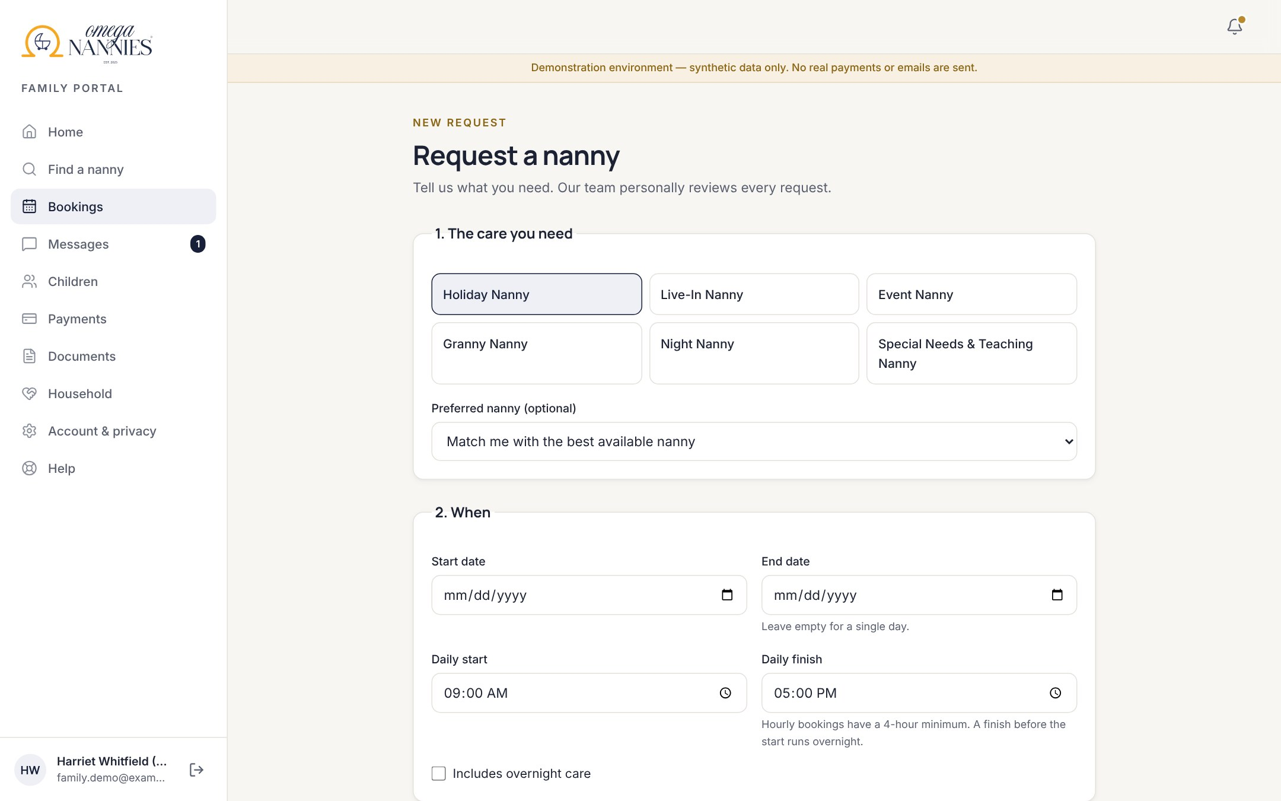
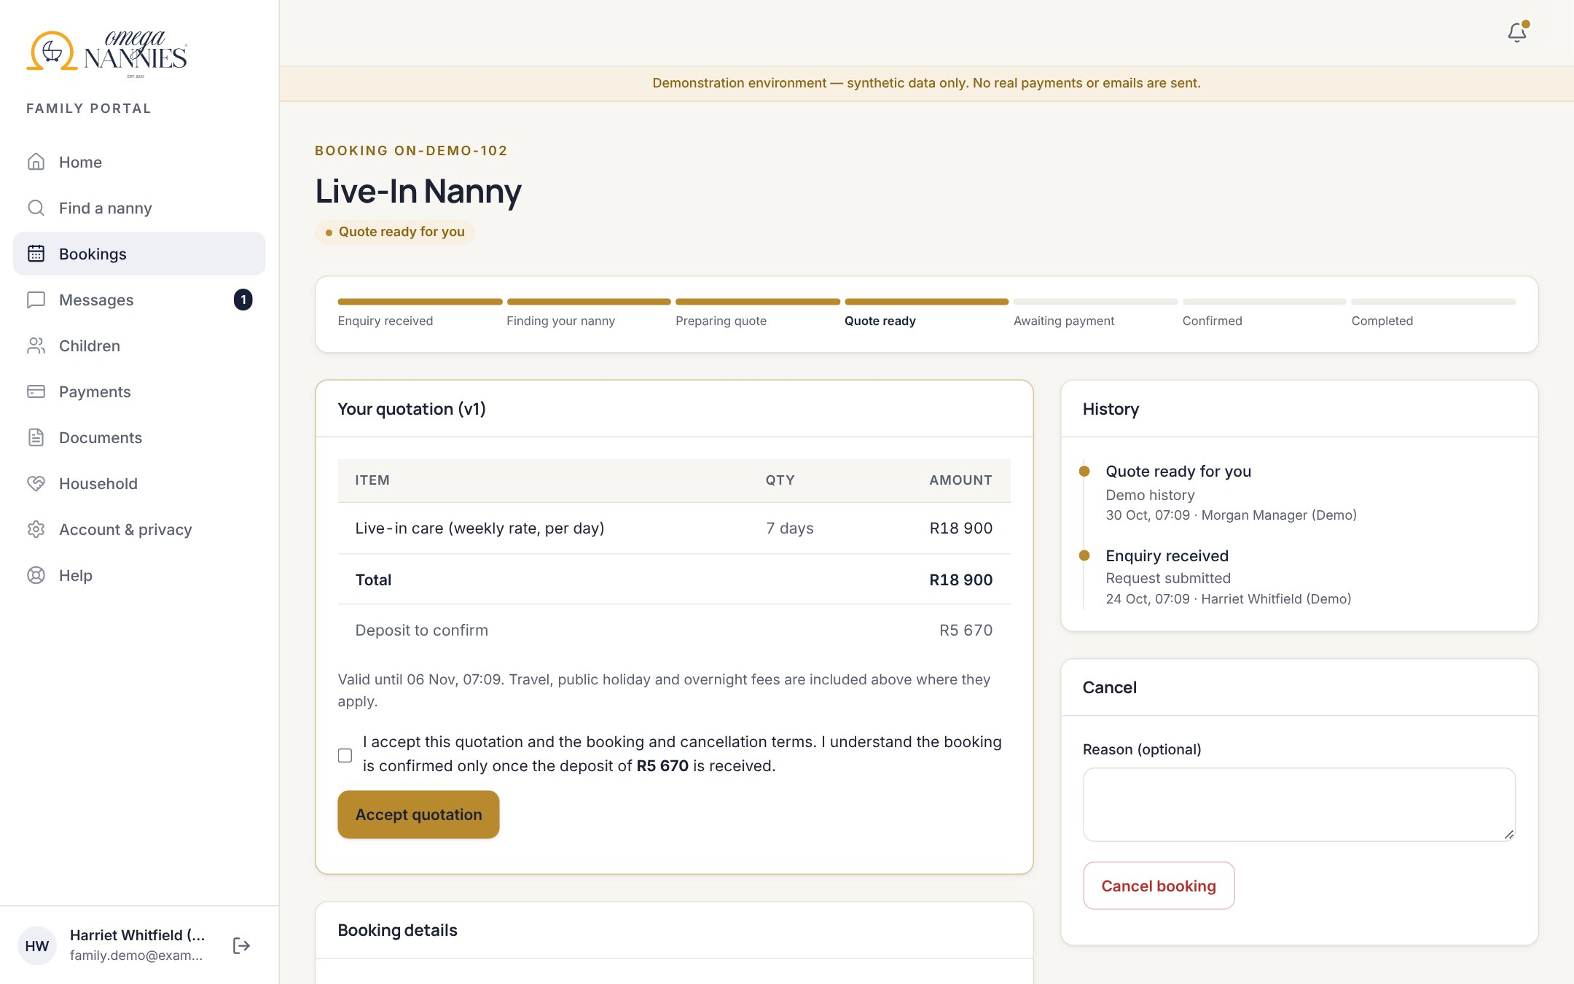
Requests that fit real family life
FAMILY PORTAL · BOOKING
Request: service, dates or chosen weekdays (e.g. Mon/Wed/Fri), times and extras.
Quote: itemised, priced from Omega’s price book; the nanny is held once the family accepts.
Notes:
Prices are computed on the server from a versioned price book, so no one can tamper with the amount. Confirmation happens only when the payment is verified.

Slide 7
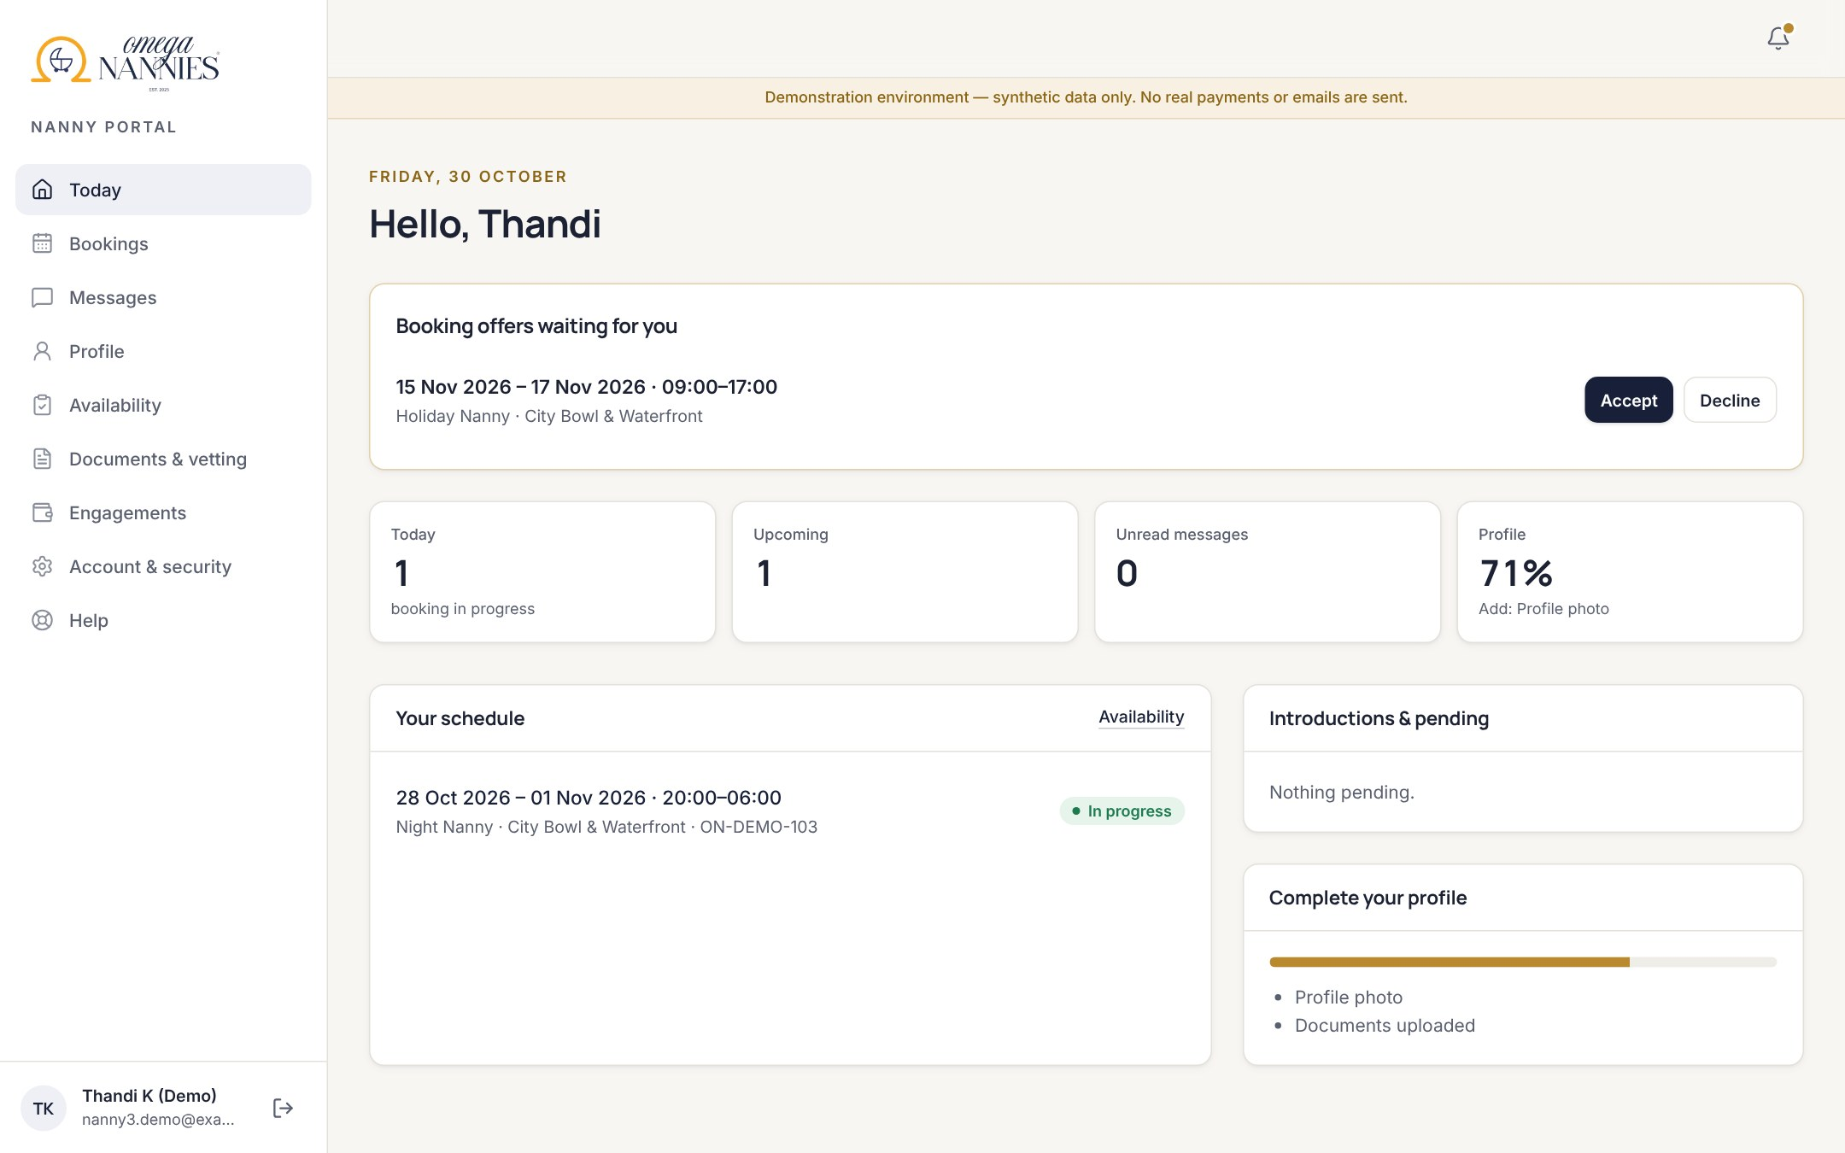
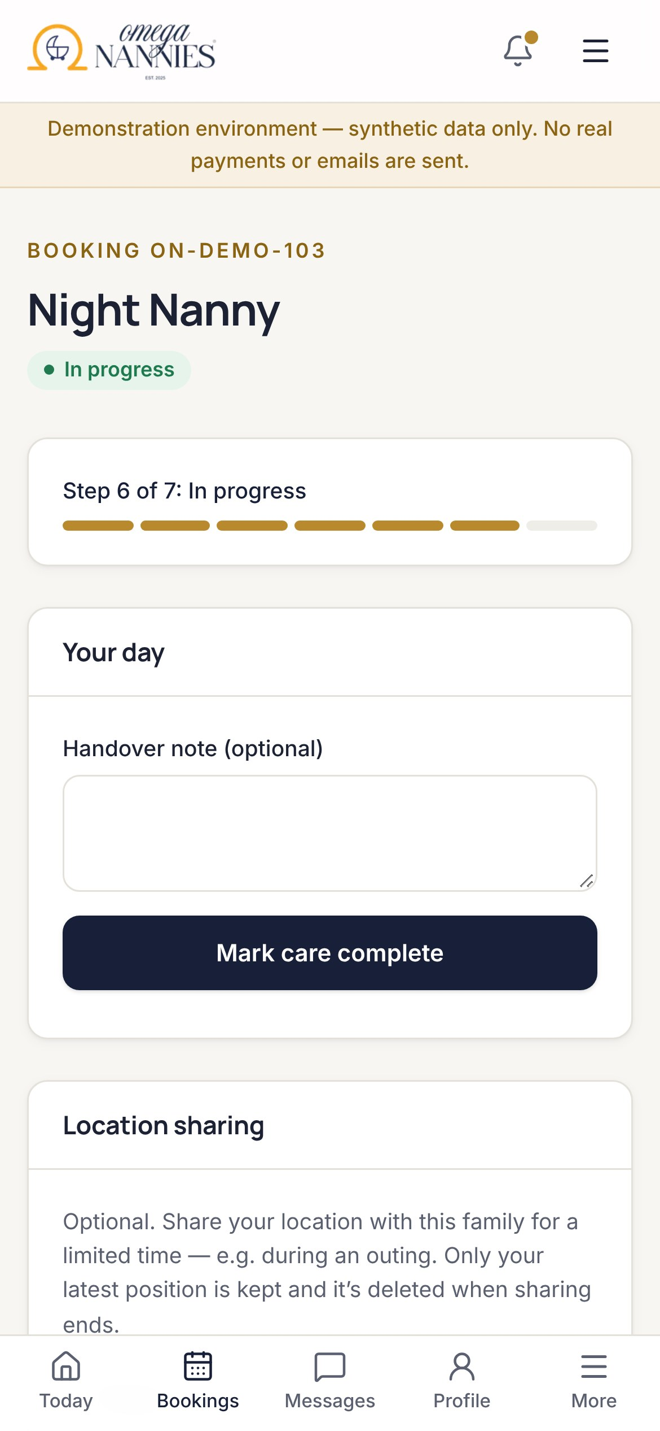



Nannies accept offers and run their day from their phone
NANNY PORTAL
Offers
Accept or decline — only the area is shown until accepted.
On the day
Check in, care notes, opt-in location sharing.
Documents
Upload ID, police clearance and first aid securely.
Notes:
Address and children's care notes appear only from the reveal point Omega chooses — on confirmation by default.

Slide 8
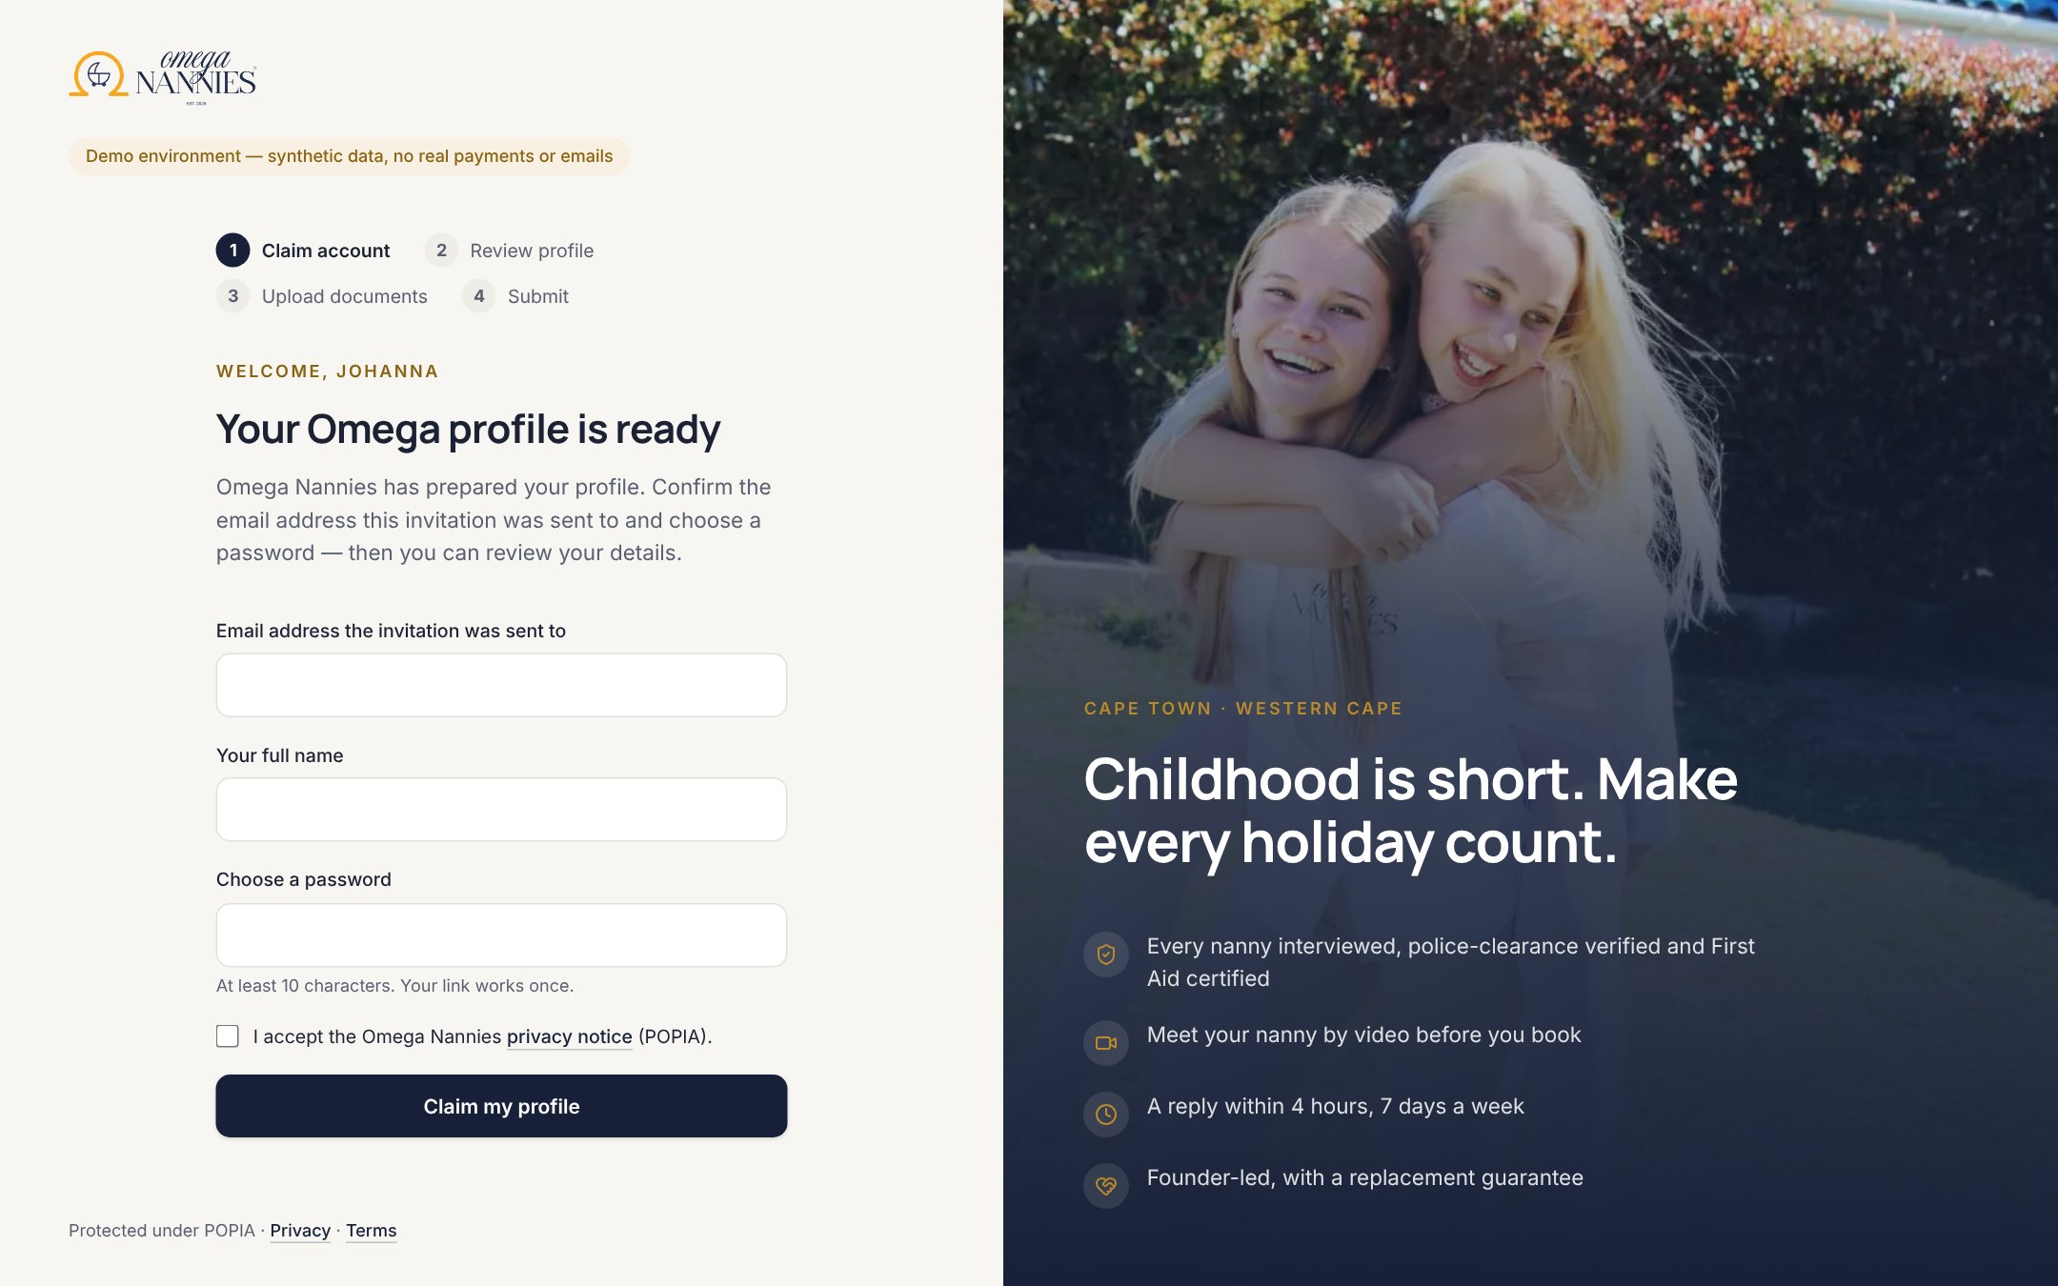
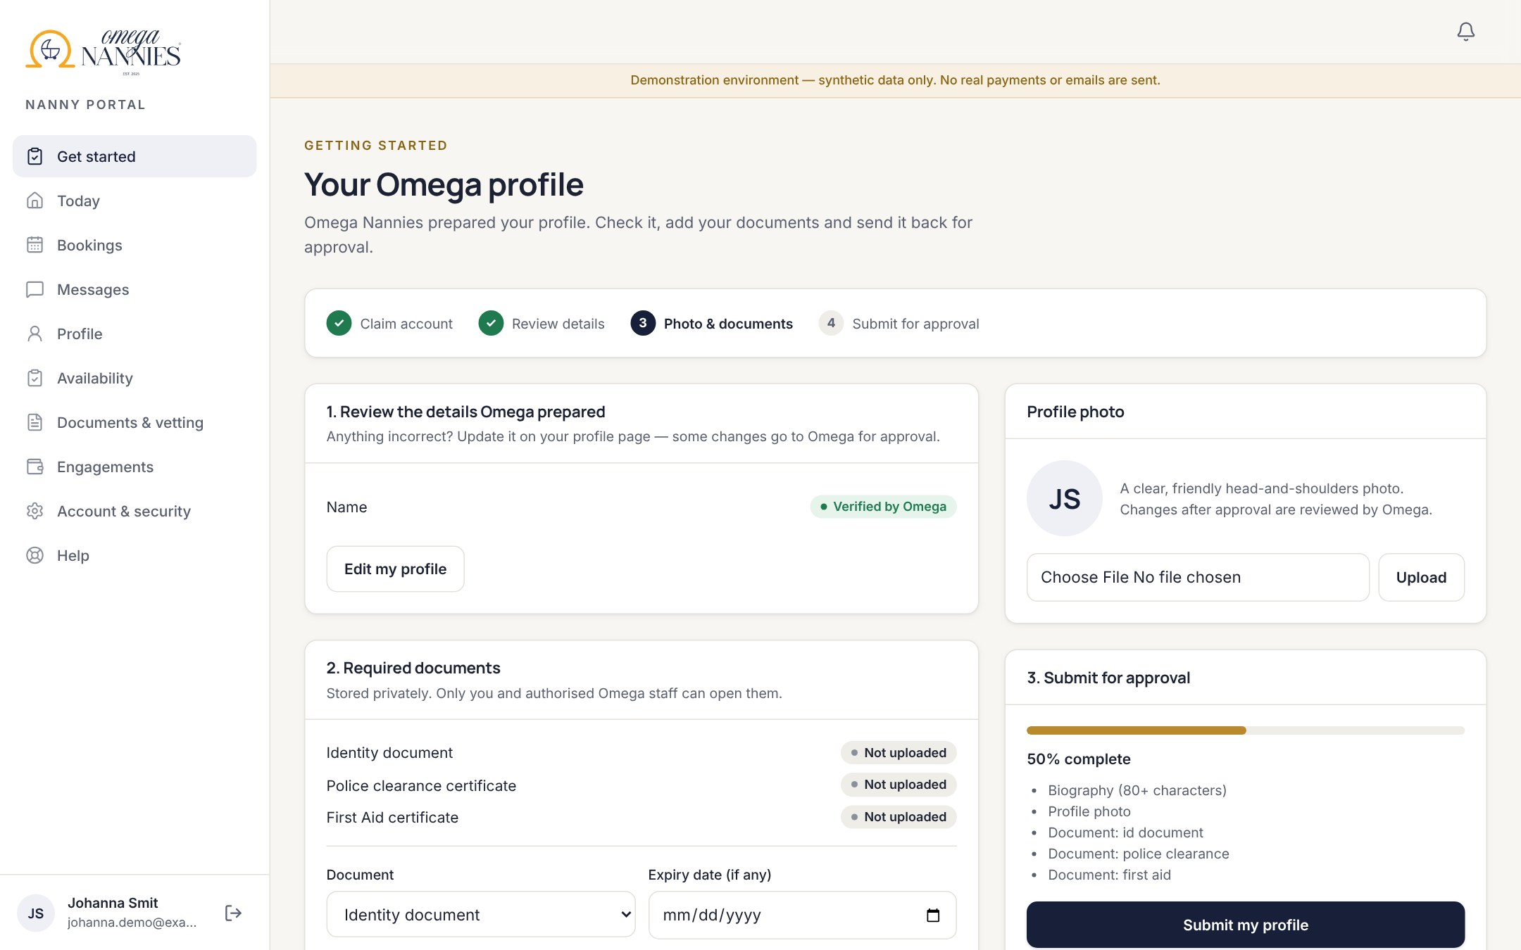
Profiles prepared by Omega, claimed securely by each nanny
ONBOARDING
1
2
3
4
5
Prepare
Create, import from the website, or CSV — no email needed
Invite
Single-use link, 7 days, revocable
Claim
Works only with the invited email
Onboard
Confirm details, upload documents and photo
Approve
5 checks + 3 documents, then publish
Tokens stored only as fingerprints
5 wrong attempts revoke the link
Two claims at once → exactly one account
Claiming never approves a nanny
Notes:
How claiming works: Omega prepares the profile; staff add an email and send an invitation; the nanny opens the one-time link, enters the same email, sets a password and accepts the privacy notice; then completes onboarding and submits. Only Omega can approve and publish.

Slide 9
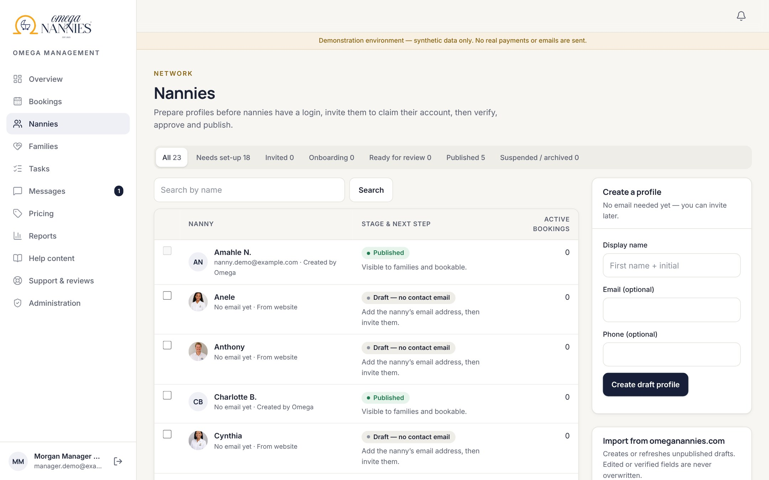
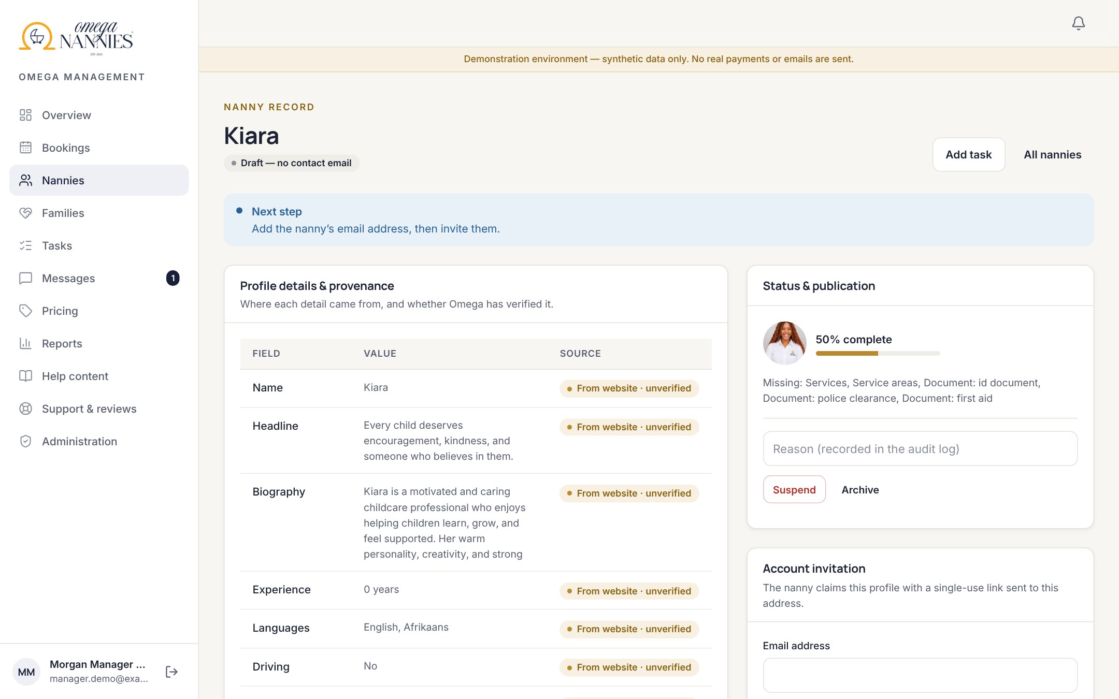
Every detail shows where it came from and who verified it
MANAGEMENT · NANNIES
Lifecycle board: needs set-up, invited, onboarding, ready for review, published.
Website imports arrive as unverified drafts. Edited or verified fields are never overwritten.
Notes:
We imported the 17 public profiles and photos from omeganannies.com as private drafts. Website claims such as 'police clearance' are never treated as verification — Omega records each check.

Slide 10
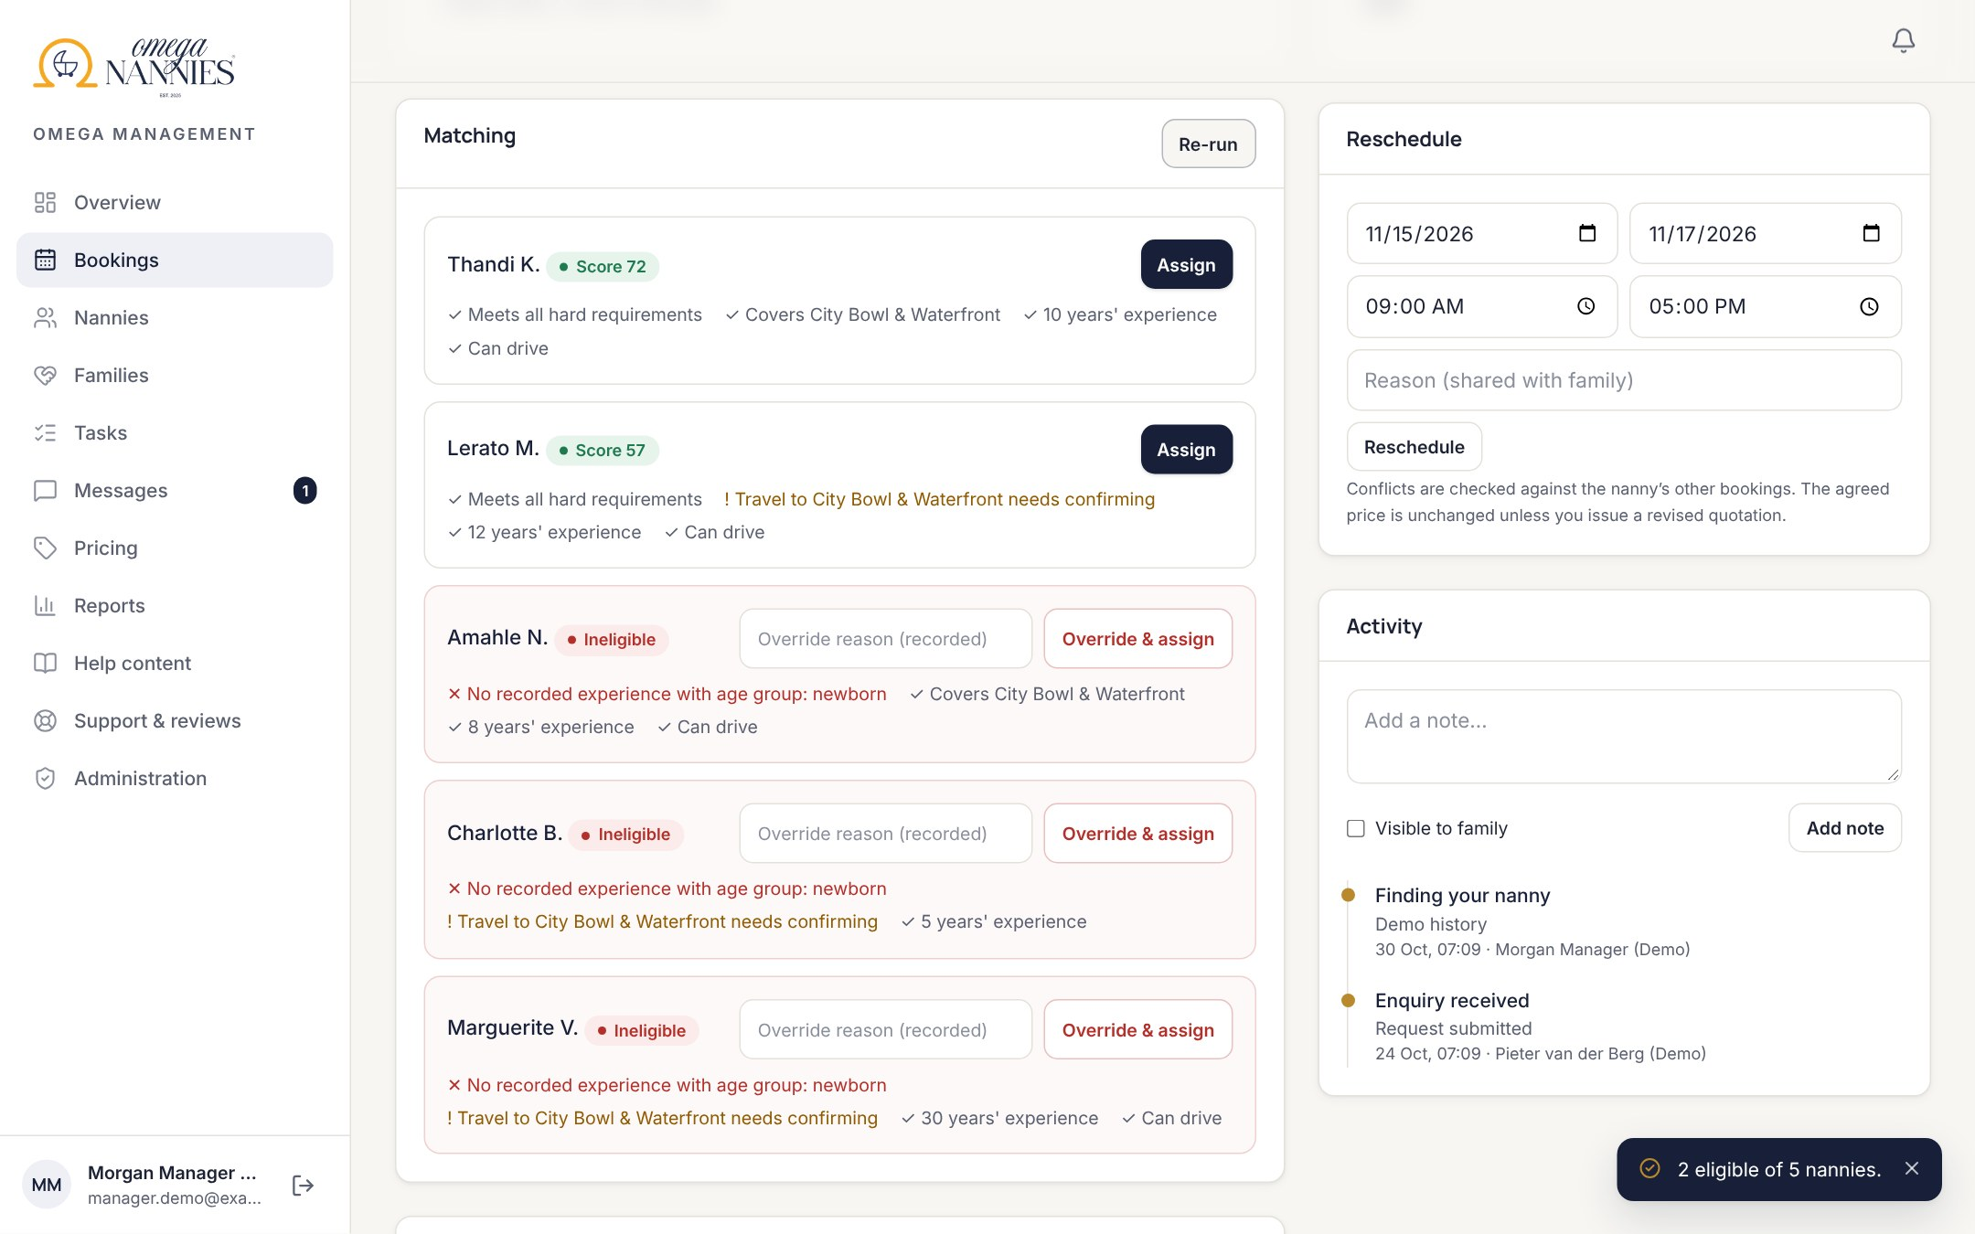
Recommendations with reasons — Omega makes the call
MANAGEMENT · MATCHING
Must-haves
Current vetting, service, children’s ages, languages, driving, no clashing booking or leave.
Preferences
Area, experience, requested nanny, past placements with the family.
Override
Staff can assign anyway — with a recorded reason.
Notes:
In this real example Amahle is marked ineligible because she has no recorded newborn experience — the reason is shown, and an override is possible but recorded.

Slide 11
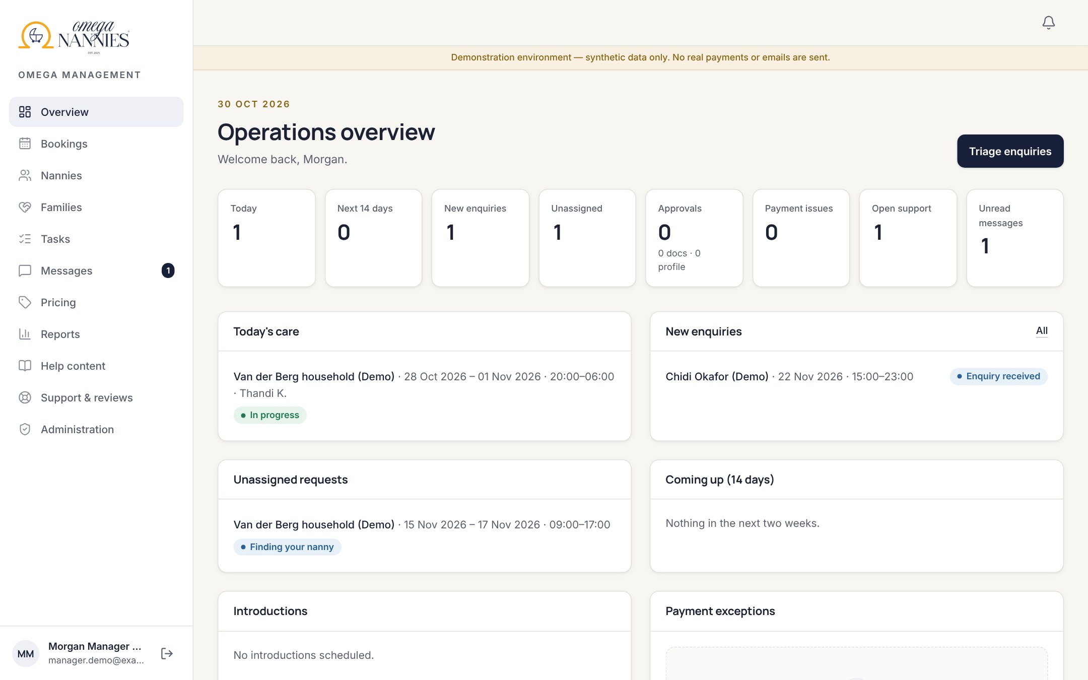
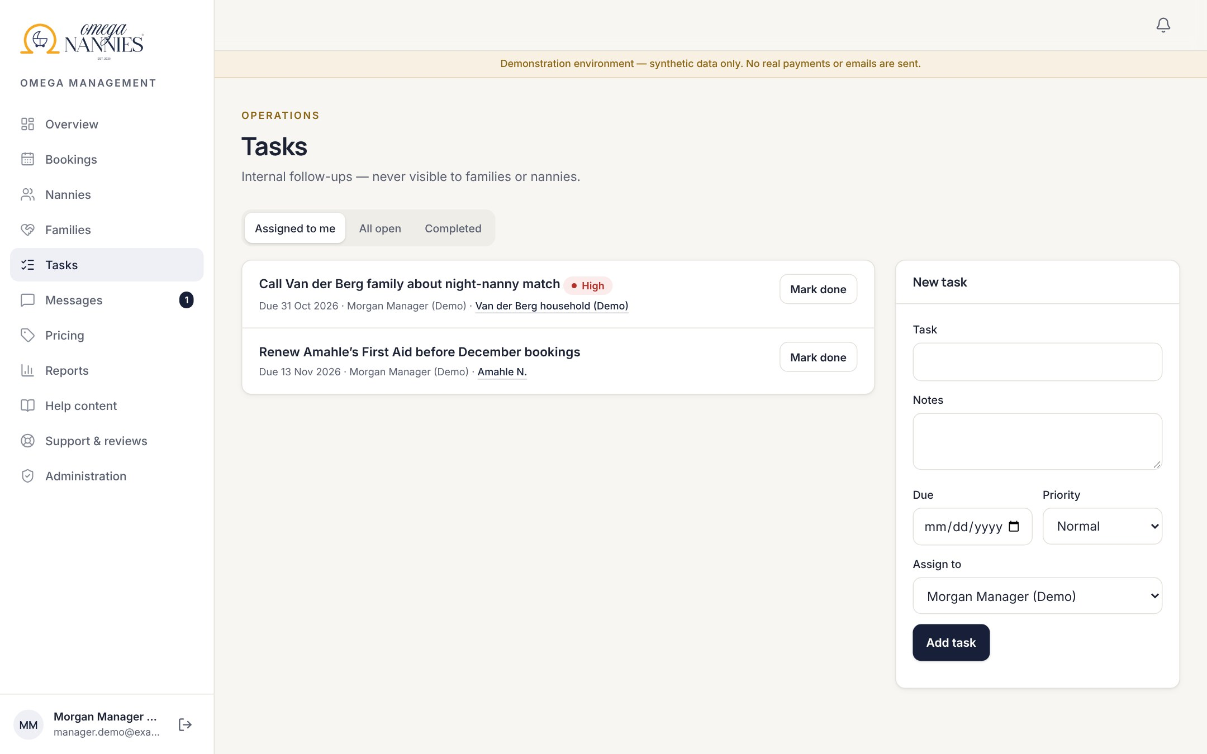
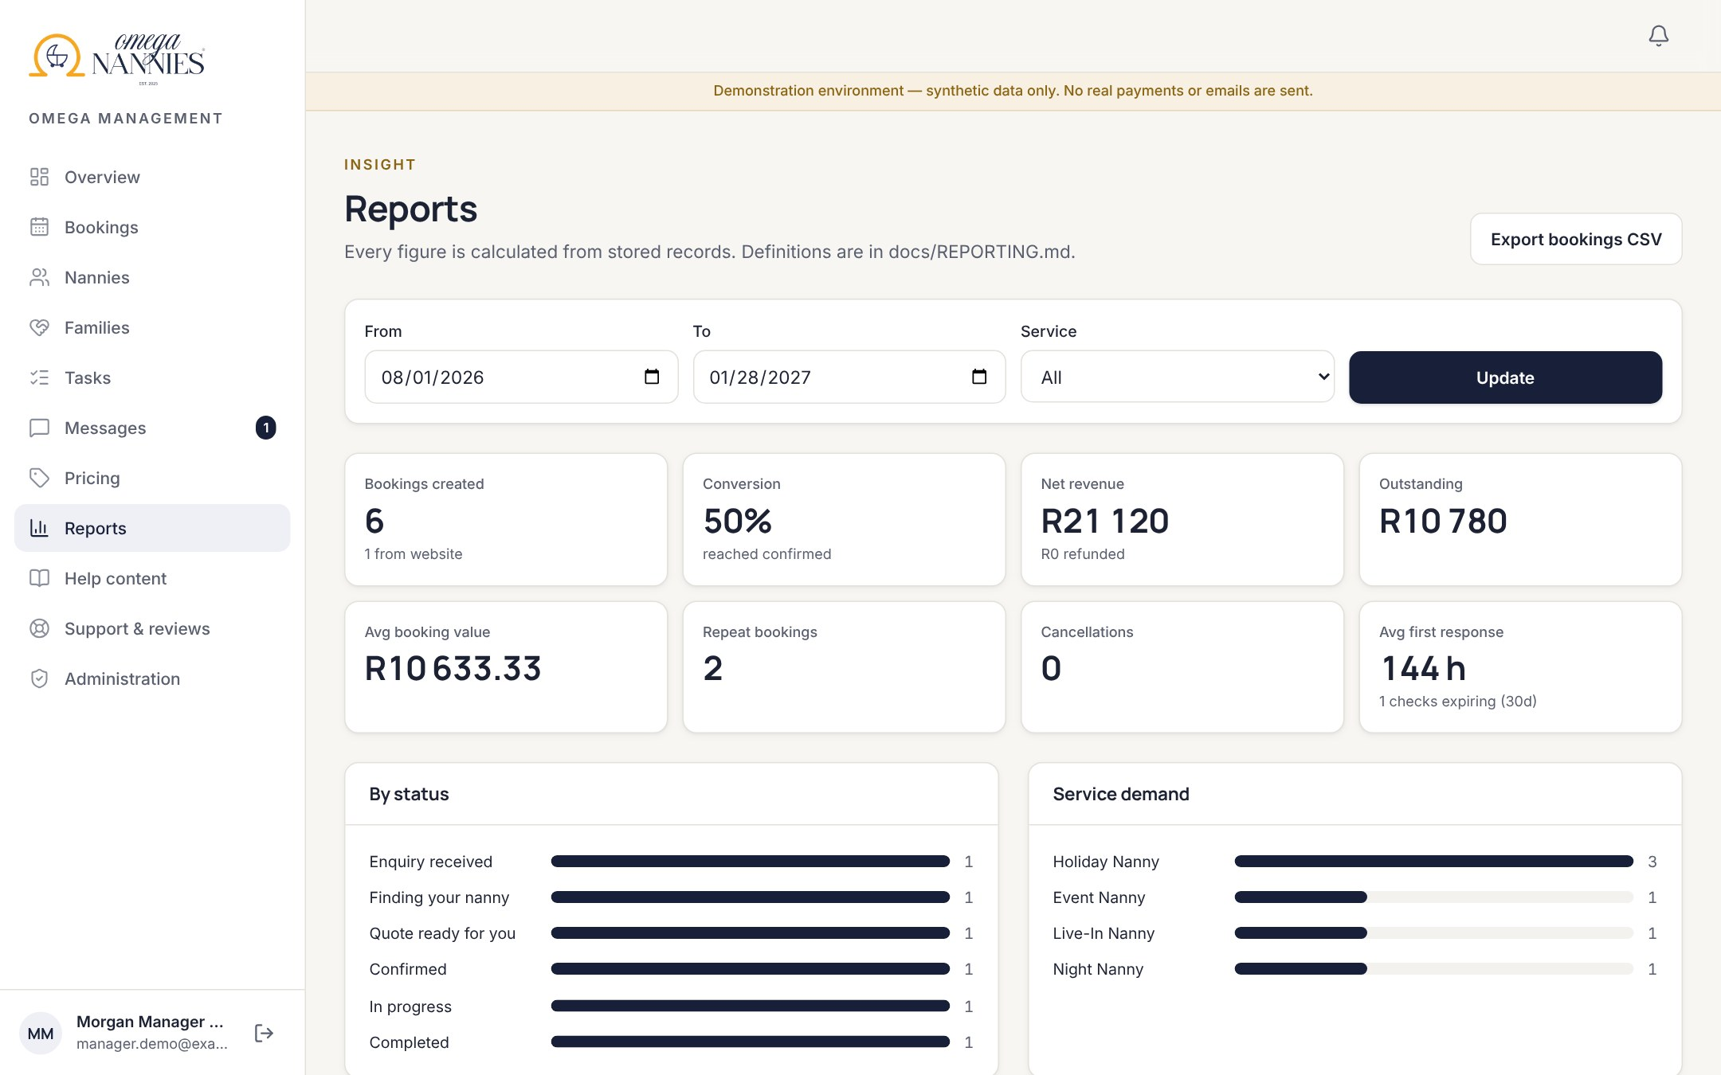
Queues, tasks and reports — nothing falls through
MANAGEMENT · DAY TO DAY
Overview: today’s care, new enquiries, approvals, payment exceptions.
Tasks: follow-ups, plus automatic flags for duplicate payments and unpaid holds.
Reports: conversion, revenue, outstanding, utilisation; CSV export.
Also included: versioned pricing · quotation builder · EFT recording and refunds · families and children records · help centre · support and review moderation · staff permissions · audit log.
Notes:
Report figures are calculated from stored records only; definitions are documented. Empty periods show empty states, never invented numbers.

Slide 12








SECURITY & PRIVACY
Built for a business that holds children’s data
Addresses private
Revealed to the nanny only from the point Omega sets.
Secure claiming
One-time, expiring, email-bound links.
Staff two-step sign-in
Mandatory for everyone in management.
Verified payments
Signed notices only; replays and duplicates caught.
No double-booking
The database refuses overlapping holds.
Private documents
Signed links; virus-scan hook; every view logged.
POPIA rights
Own-data export, corrections, account closure.
Everything audited
Approvals, overrides, payments and exports.
Each control is covered by automated tests that attempt the attack. A professional penetration test is still recommended before launch.
Notes:
Virus scanning needs a ClamAV service in production — until then uploads are clearly labelled 'not scanned'. We say that openly rather than claim it.

Slide 13
What is connected today — and what needs your accounts
INTEGRATIONS
Integration | What it does | Status | Needed to go live
omeganannies.com import | Brings public nanny profiles and photos in as private drafts | Working — 17 imported | Nothing
Website enquiries | Enquiry form posts securely into the platform | Built | Small change on the website + shared secret
PayFast | Card/EFT deposits and balances, verified notifications | Built & tested | Merchant account; one sandbox test
Email (Resend) | Invitations, confirmations, reminders | Built | API key + verified sending domain
Document storage | Private bucket for IDs and certificates | Built | Supabase project
Virus scanning | Scans every upload; infected files blocked | Built | ClamAV service
Calendar & help assistant | Nanny calendar feed; FAQ-grounded assistant | Working / optional | Optional AI key
No credentials were invented. Administration shows each integration’s real status.
Notes:
Green items work today. Amber items are built and tested in code but need Omega's own accounts — they are switched on by setting environment variables, not by more development.

Slide 14
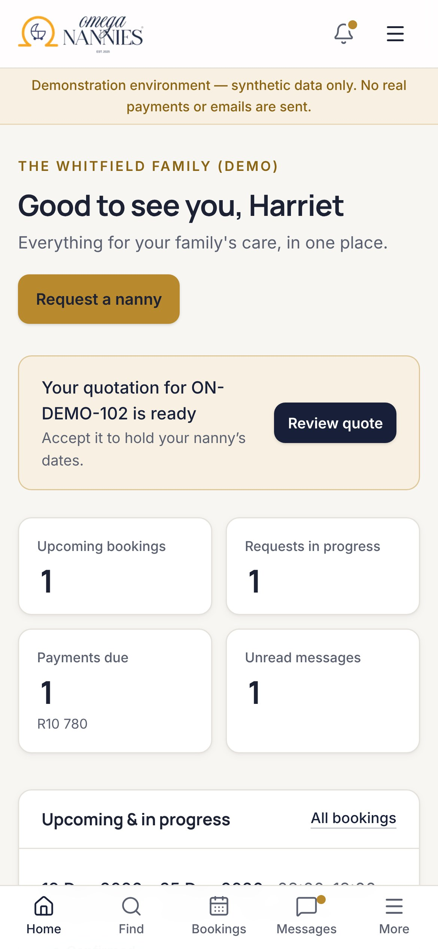
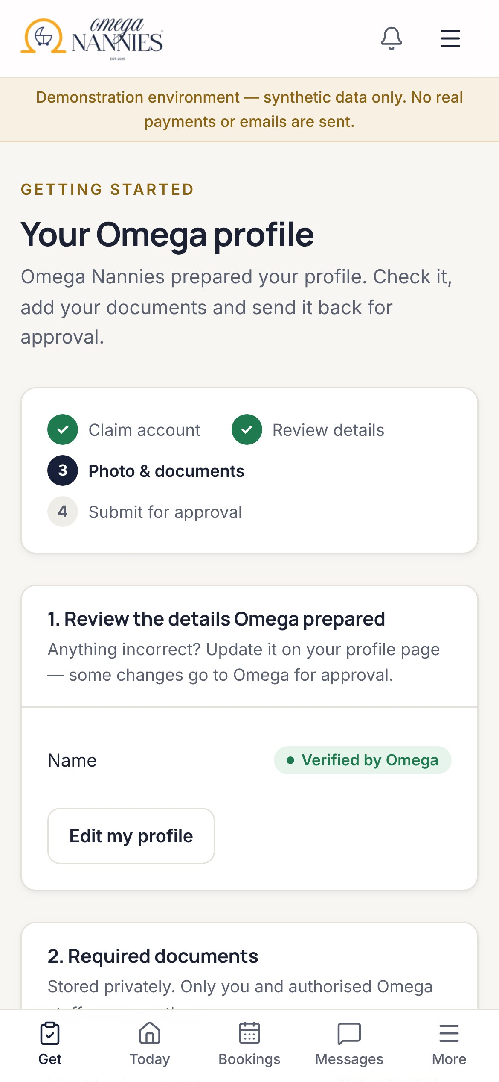



Works like an app on every phone — no app store needed
MOBILE & APP
Install to home screen
Progressive web app with Omega icon.
Phone-first navigation
Bottom tabs; key actions first.
Private by design offline
Only the app shell is cached — never personal data.
Notes:
Automated tests check there is no sideways scrolling on a Pixel 7 and run accessibility checks on mobile too.

Slide 15
Five audit cycles, every finding logged
QUALITY & HONESTY
5
audit cycles
53
findings logged
53/53
unit & integration tests
29/29
browser tests
Examples fixed: a second payment tab could double-count a deposit · forms lost typing after an error · unpaid holds could block a nanny indefinitely · low-contrast text · unsafe demo/live configuration.
Honest status: a tested release candidate, not yet live. It needs your PayFast, email, storage and hosting accounts, a virus scanner, a penetration test and a legal review of the privacy notice before real families use it.
Notes:
The full audit log, with evidence, root cause and the test guarding each fix, is in docs/AUDIT_LOG.md.

Slide 16






Room to grow — options, not commitments
FUTURE EXPANSION
Nanny payouts
Once the compensation model is agreed.
WhatsApp & SMS
Reminders where families already are.
Two-way calendar sync
Google and Apple calendars.
Referrals & loyalty
Reward the families who refer others.
New regions
Areas and pricing per region.
Deeper insight
Demand forecasting by season and area.
Notes:
None of these are built. They are natural next steps that the current data model supports.

Slide 17
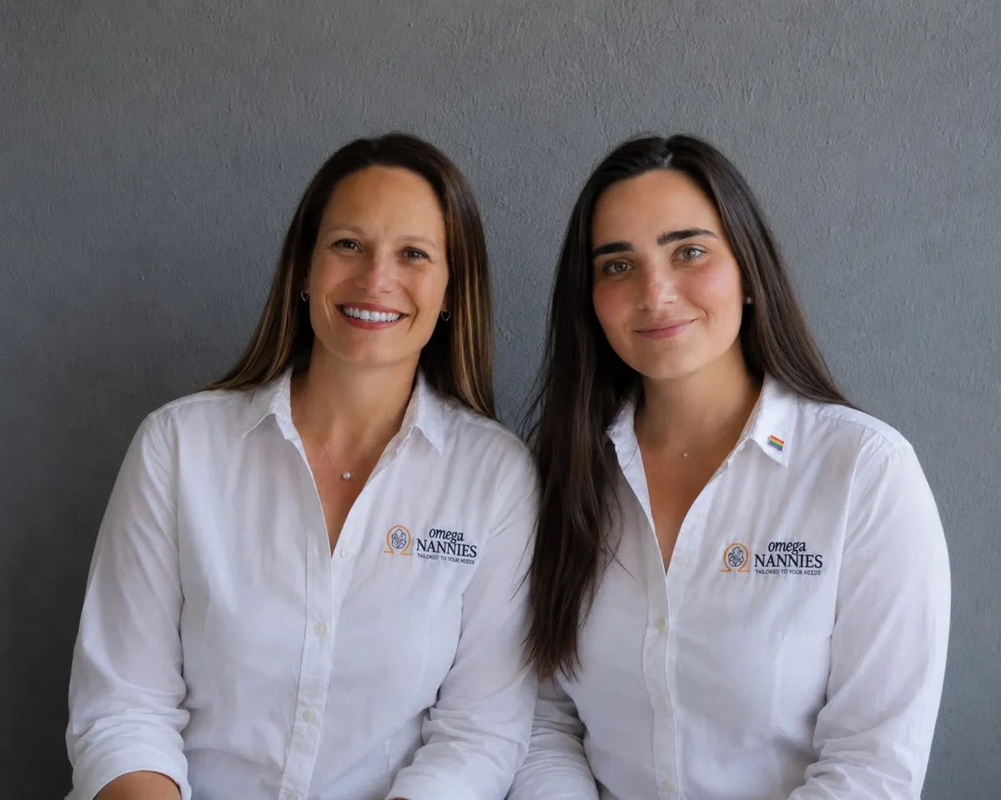
NEXT STEP
A two-week pilot to go live
1
Connect your accounts: hosting, PayFast, email, storage, virus scanning
2
Confirm rates, deposit, cancellation and refund policies
3
Review the 17 imported profiles and invite your nannies
4
Run three real bookings end to end in PayFast sandbox
5
Penetration test and privacy-notice review, then launch
The software is ready. What remains are your accounts, your decisions and two outside reviews.
Notes:
Recommended next action: a short working session to set up the accounts and agree the open business rules, then the pilot.

