Slide 1

The Omega Nannies Platform
THE NEXT VERSION · FOR OMEGA NANNIES
A guided way for families to find and request the right nanny — connected to your website, your calendars and your team.
October 2026 · Real screenshots of the working product, synthetic demo data
Notes:
Every screen in this deck is a screenshot of the real product running with synthetic demo data. Features that still need Omega's accounts or approval are marked as such.

Slide 2



Effortless for families, organised for Omega
PRODUCT VISION
Families
Nannies
The Omega team
Answer three questions, see who is free, shortlist, compare and send a request — on any phone.
Offers to accept, today’s schedule, documents and a profile that shows their real experience.
Requests arrive complete, with preferences and availability — plus live insight into the business.
Founder-led care, with software that feels as personal as the service.

Slide 3
One journey across your website and the portal
CONNECTED ECOSYSTEM
Payments
PayFast · verified notices
Omega portal
Family, Nanny and Management portals on one secure database. Safe redirects return each person to the right place.
omeganannies.com
Brand, services and trust. “Book now”, “Find a nanny” and login buttons link into the portal — tokens never travel in links.
Calendars
Google · Outlook (two-way)
Messages
Email · SMS · WhatsApp · in-app
The website keeps doing what it does well; the portal takes over from the first click on “Book”.

Slide 4
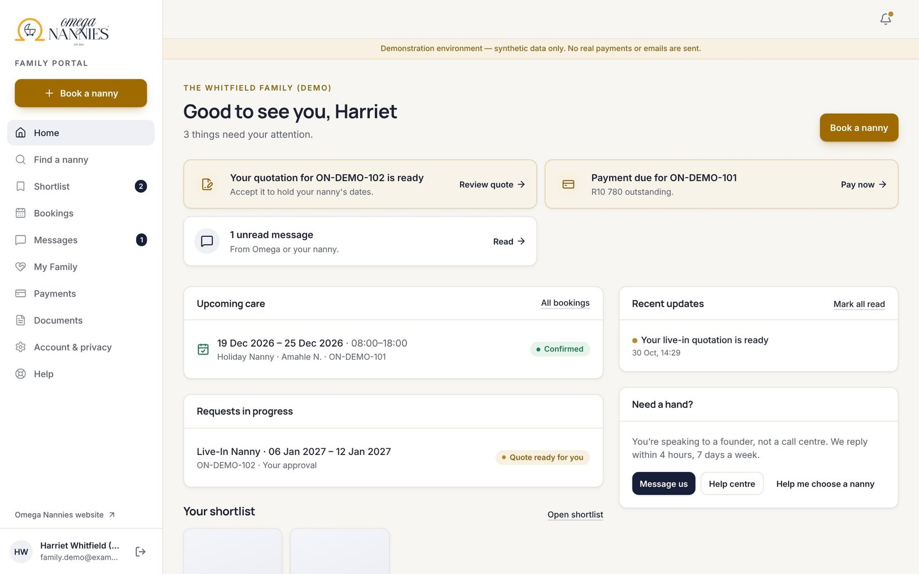



A home screen that shows what needs attention
FAMILY EXPERIENCE
Act on what matters
Quotes to approve, deposits due and unfinished requests come first.
Pick up where you left off
Booking answers are saved — continue on any device.
My Family
Household, children, addresses and members in one place.
One clear button
The brighter “Book a nanny” action is always one tap away.

Slide 5
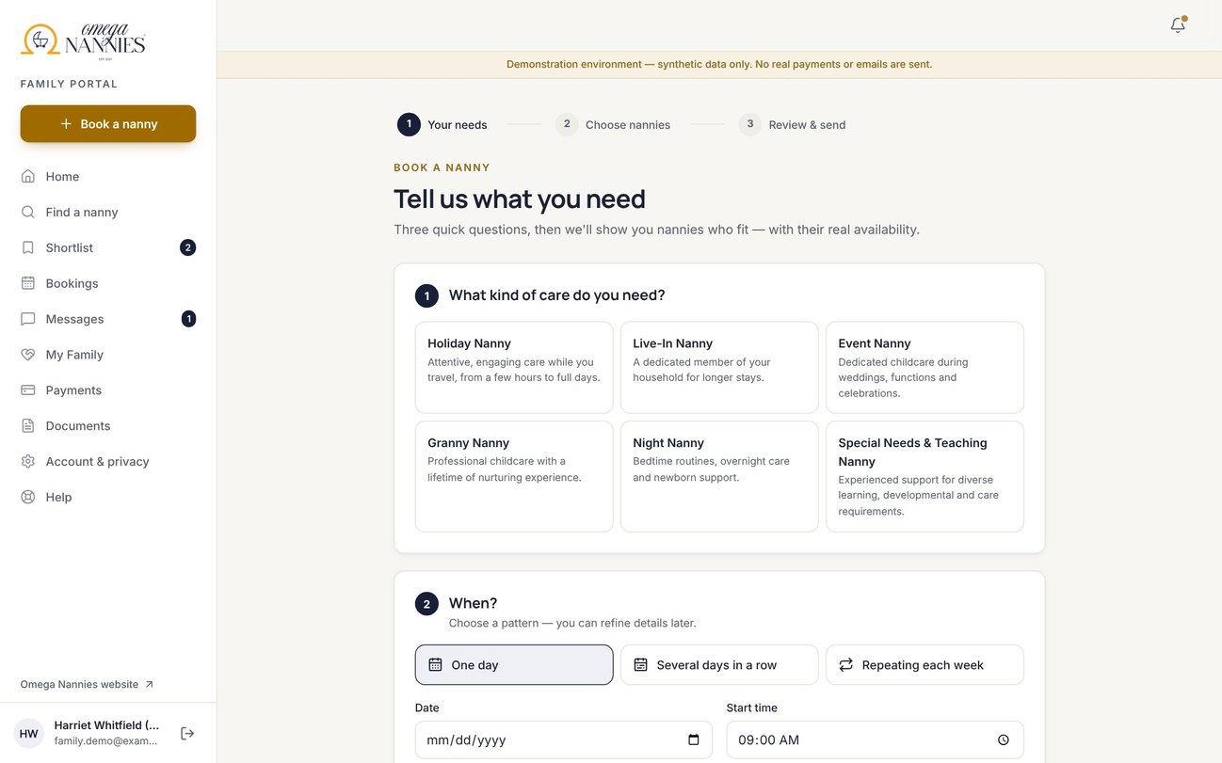
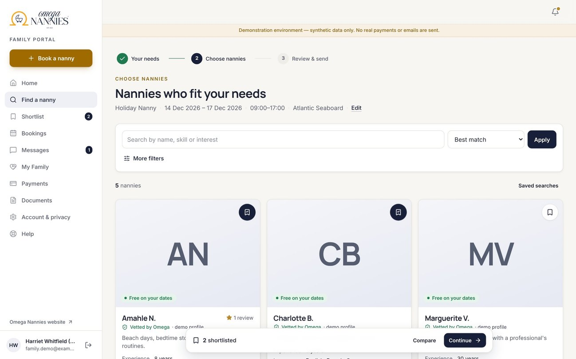
Three short steps instead of one long form
DISCOVERY & BOOKING JOURNEY
1
Your needs
Service, dates or weekly pattern, area and children — only relevant questions
2
Choose nannies
A photo-led grid with real availability for your dates
3
Review & send
Rank up to three preferences or ask Omega to choose
Requests are never auto-confirmed and nothing is charged until Omega quotes.

Slide 6
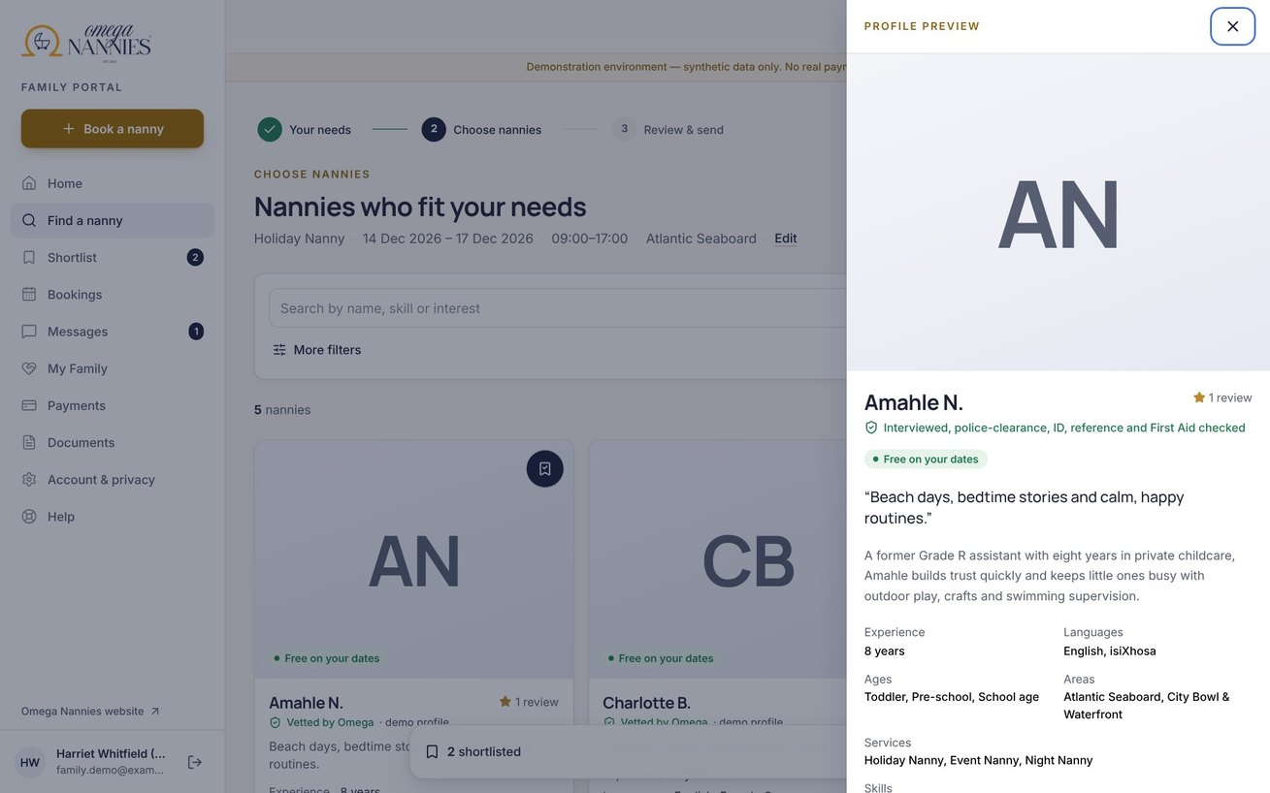
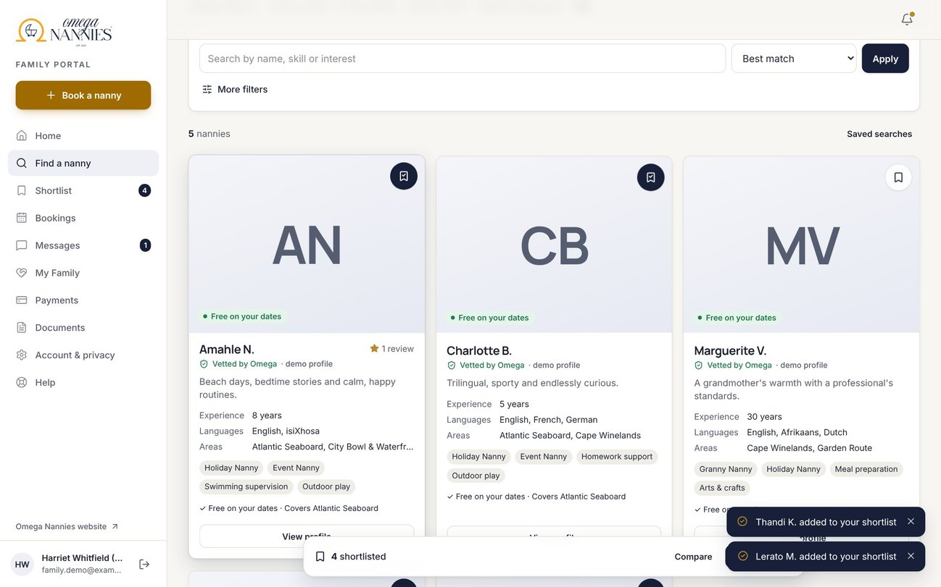
Look closer without losing your place
PROFILES & SHORTLISTING
Preview drawer: introduction, experience, availability — the grid, filters and page stay exactly as they were.
Bookmark to shortlist with instant confirmation; the shortlist is saved to the account across devices.

Slide 7
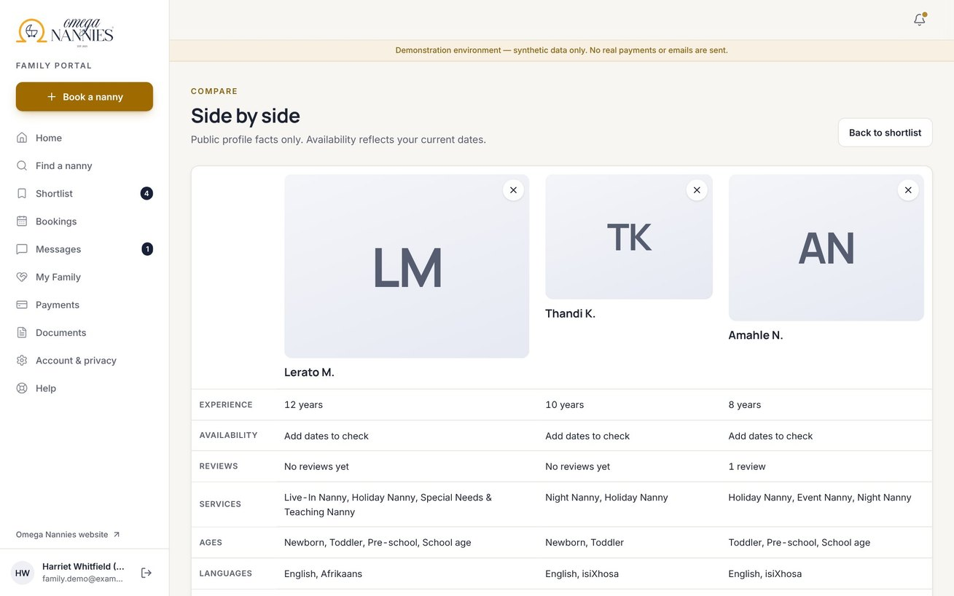
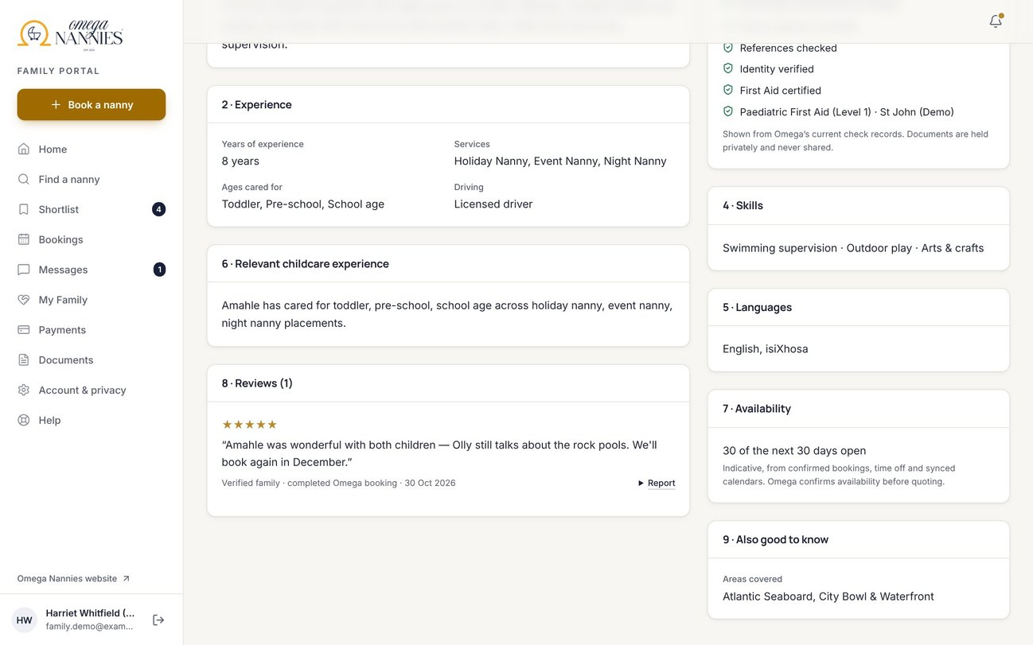
Side-by-side facts and genuine reviews only
COMPARISON & REVIEWS
Compare 2–4 nannies on experience, availability, languages, ages and reviews — no private data.
Reviews come only from completed Omega bookings, are moderated, and can be reported. Averages need 3+ reviews.

Slide 8
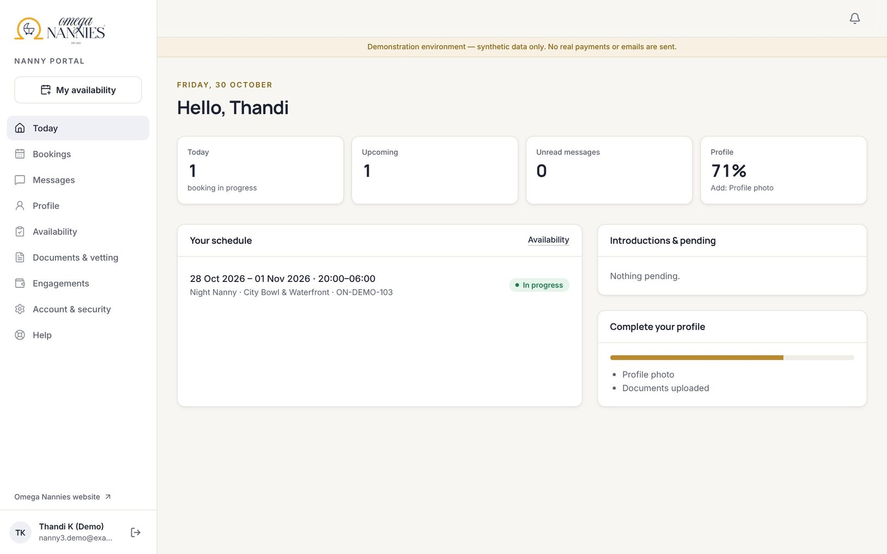
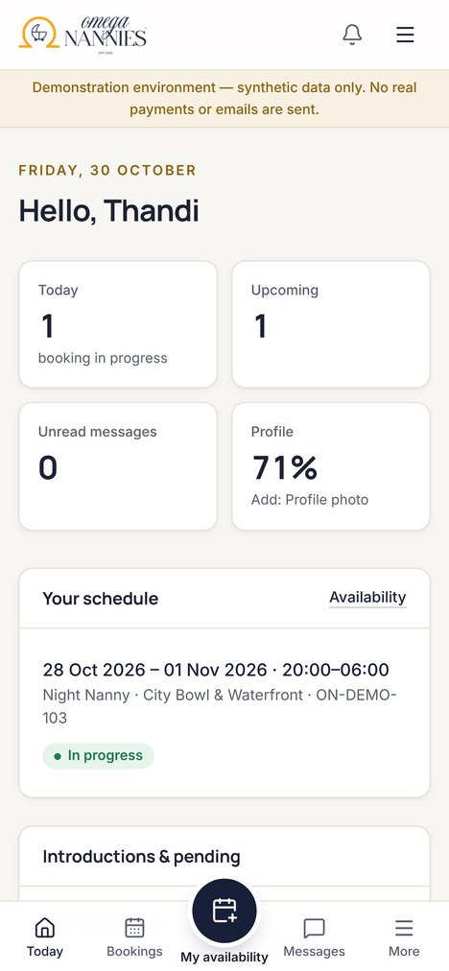


Nannies run their day from their phone
NANNY PORTAL
Offers
Accept or decline; area only until accepted.
Calendar
Bookings flow into their own calendar.

Slide 9
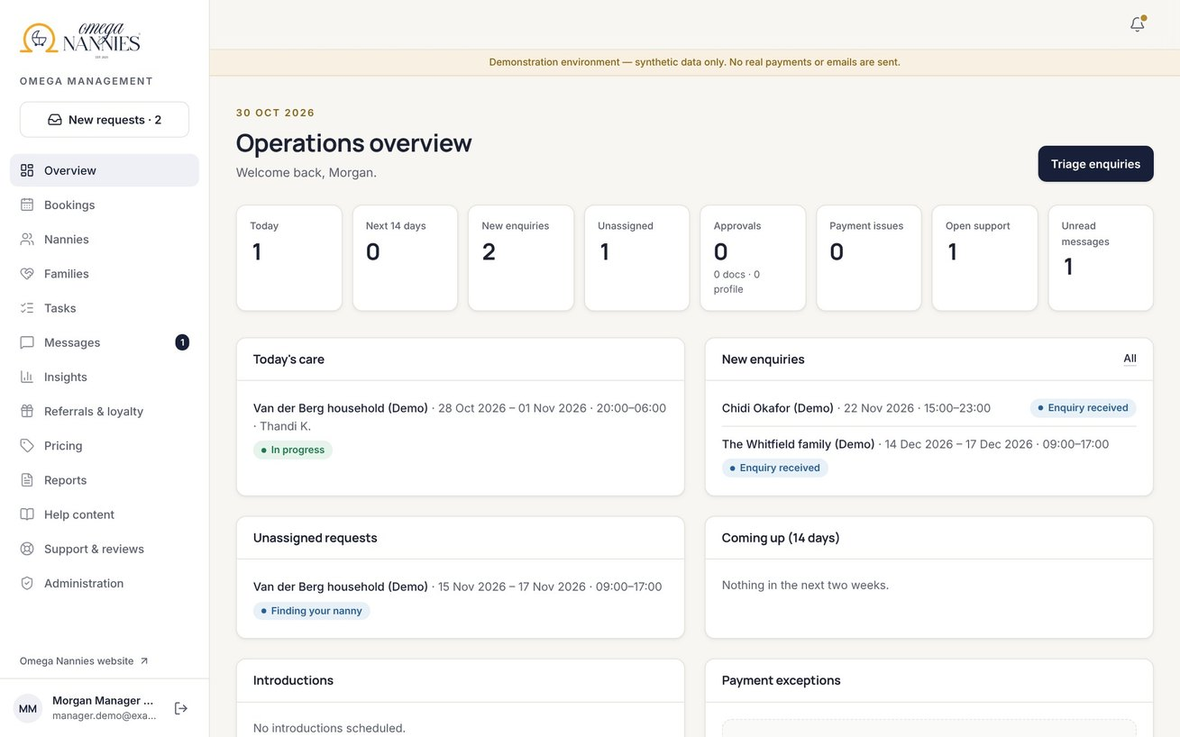
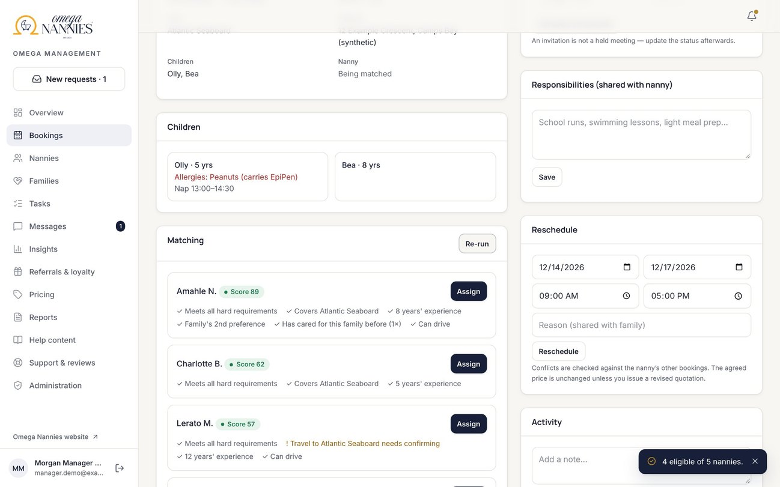
Requests arrive complete and explained
MANAGEMENT PORTAL
Overview queues: new requests, today’s care, approvals and payment exceptions.
Matching explains every recommendation — including the family’s 1st, 2nd and 3rd preference.

Slide 10
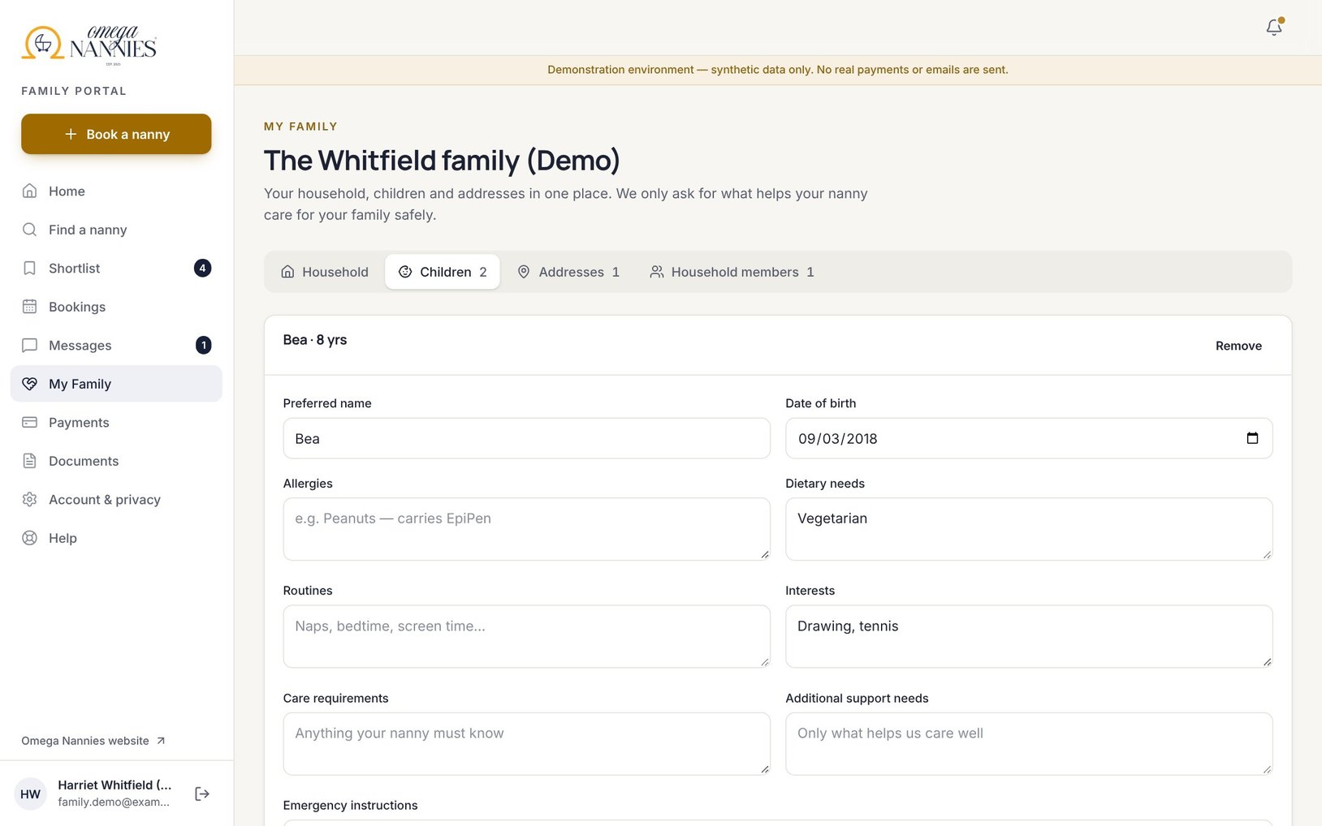



Everything about the family in one place
HOUSEHOLD & FAMILY MANAGEMENT
Household
Billing and the emergency contact.
Children
Routines, allergies and care notes — shared with the nanny only once confirmed.
Addresses
Never shown to a nanny before the reveal point Omega sets.
Members
Partners can see bookings; booking and paying are separate permissions.

Slide 11
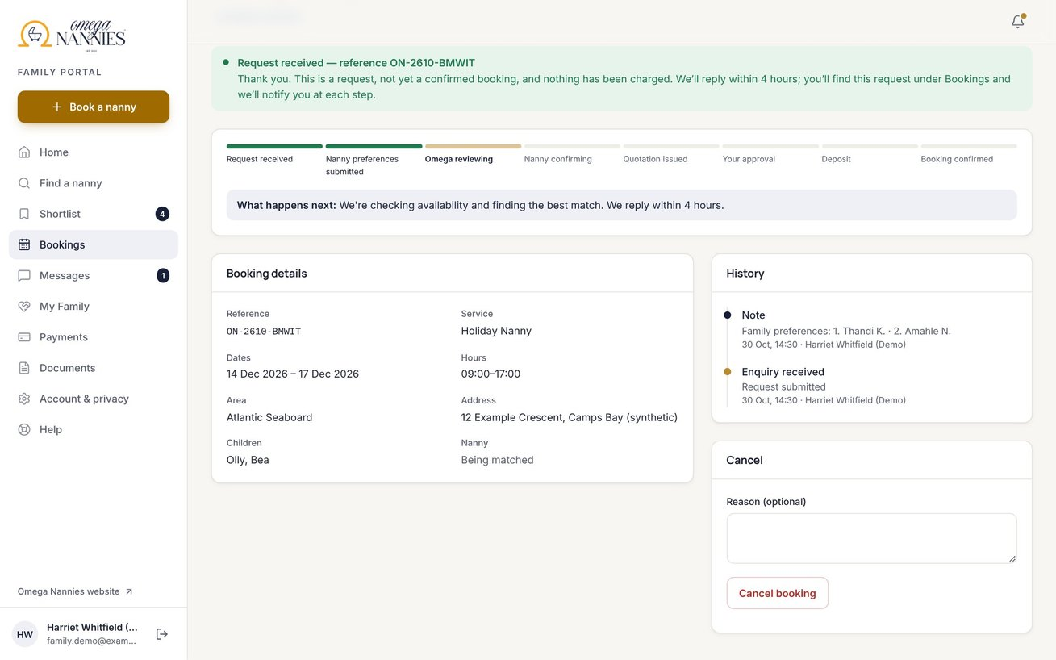
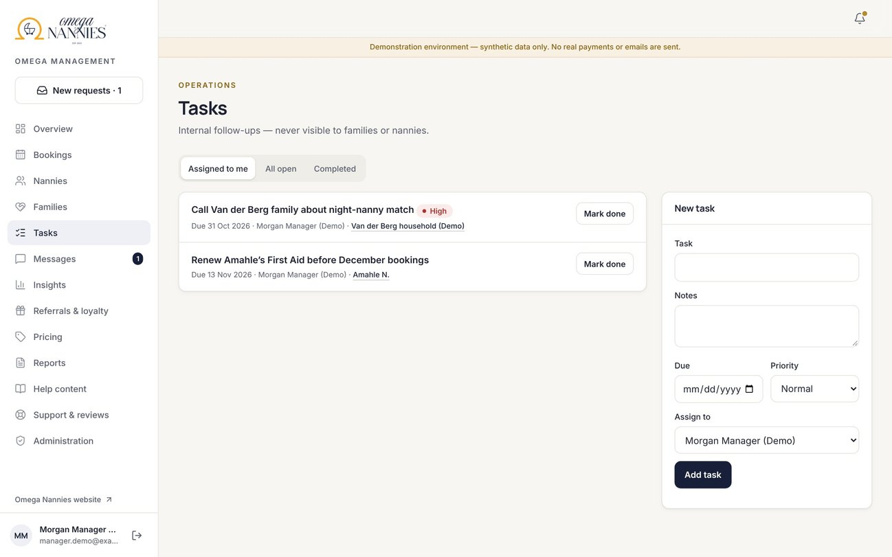
Everyone knows what happens next
BOOKING OPERATIONS
Progress comes from the real booking state, with a plain “what happens next”.
“Help me choose” creates a high-priority task; duplicate payments, unpaid holds and calendar conflicts do too.

Slide 12
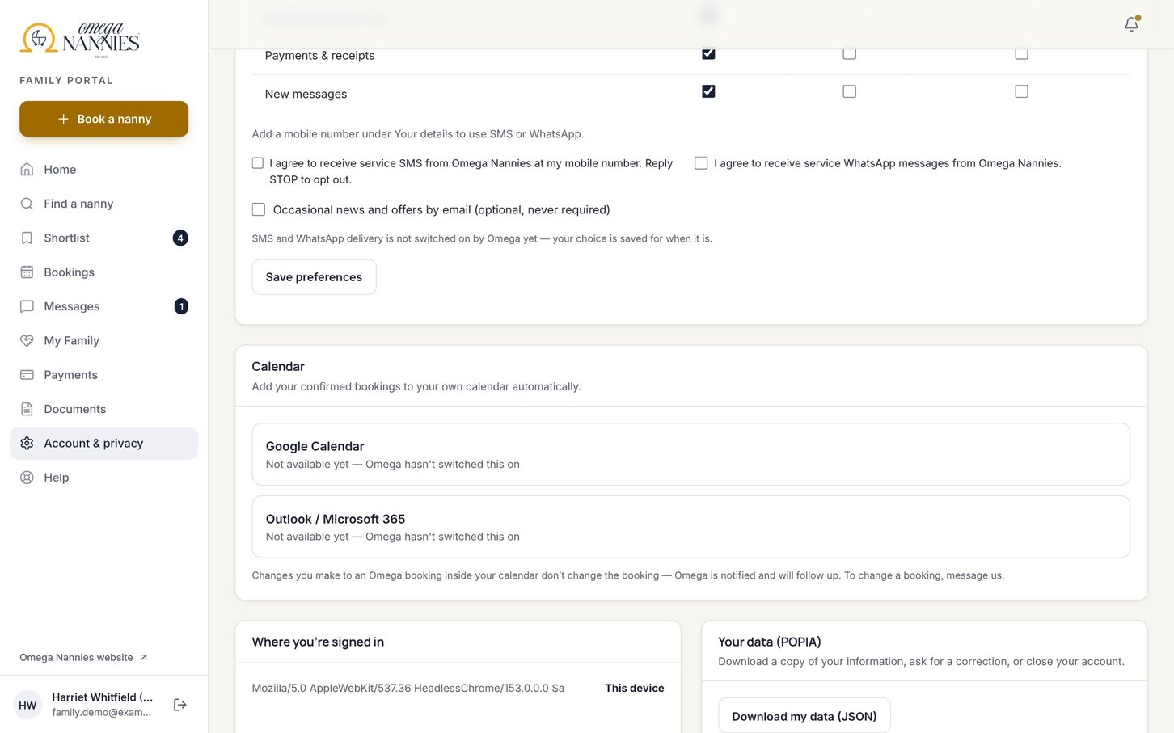



Two-way calendars, with Omega as the source of truth
CALENDAR SYNCHRONISATION
Out
Confirmed bookings appear in nanny and family calendars — one event per care day, never duplicated.
In
A nanny’s busy times protect availability — start and end only, never titles or details.
Conflicts
Outside edits never change a booking; Omega restores or reschedules.
Built & tested — needs Google / Microsoft app credentials

Slide 13
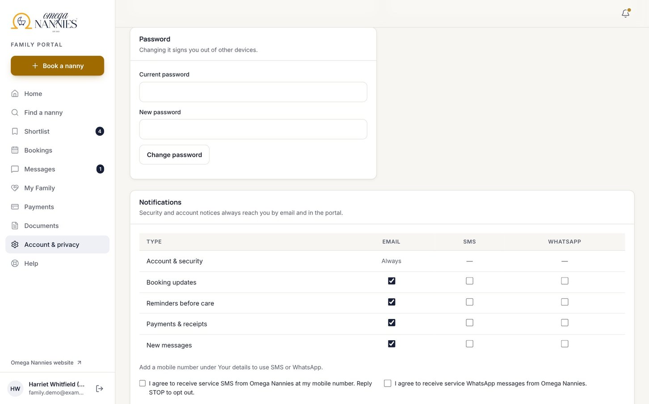


The right message, on the channel each person chose
MULTI-CHANNEL NOTIFICATIONS
Email & in-app
Every booking step, in short and reassuring language.
SMS & WhatsApp
Only with a mobile number and recorded consent; never addresses or child details.
Honest delivery
“Delivered” only when the provider confirms it; retries and history included.
Email built — SMS / WhatsApp need a Twilio account and approved WhatsApp templates

Slide 14
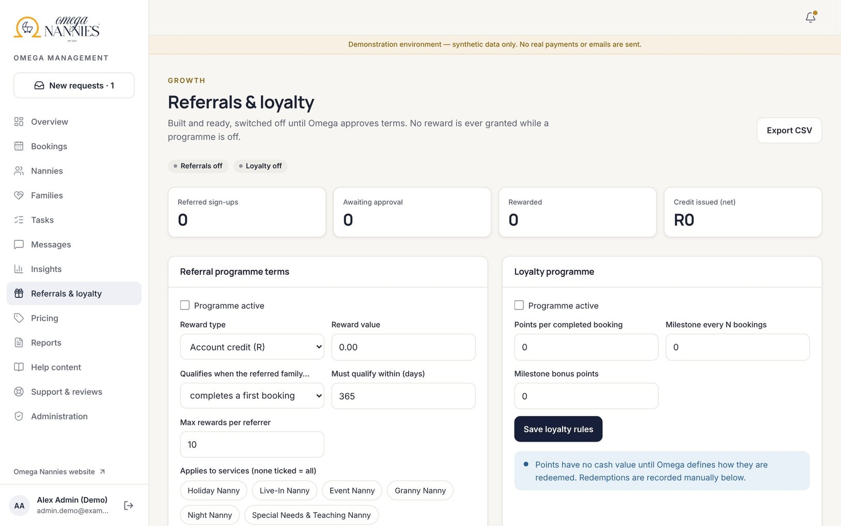


Ready to switch on when Omega approves the terms
REFERRALS & LOYALTY
Referral links
Unique codes, attribution and progress — referred families never named.
Your rules
Reward type and value, qualifying booking, expiry, limits and approval.
Fraud-aware ledger
Self-referrals blocked, suspicious sign-ups flagged, every change audited.
Inactive by default — no rewards until approved

Slide 15
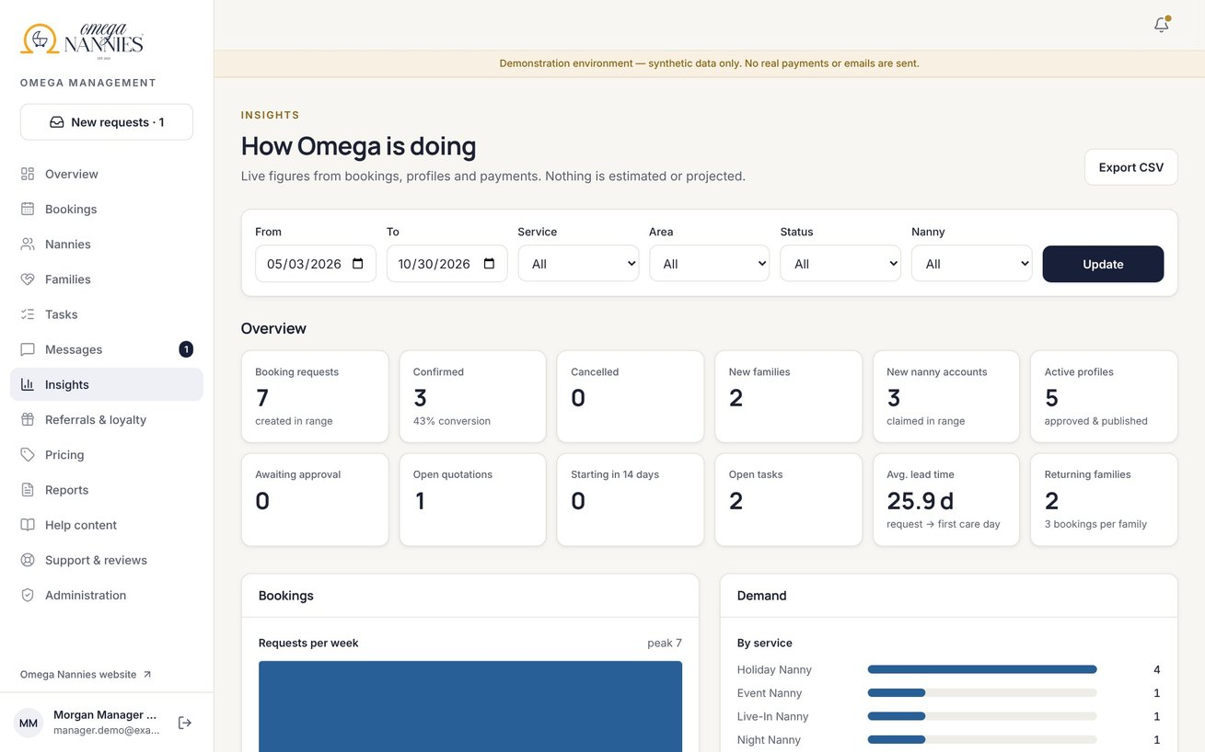
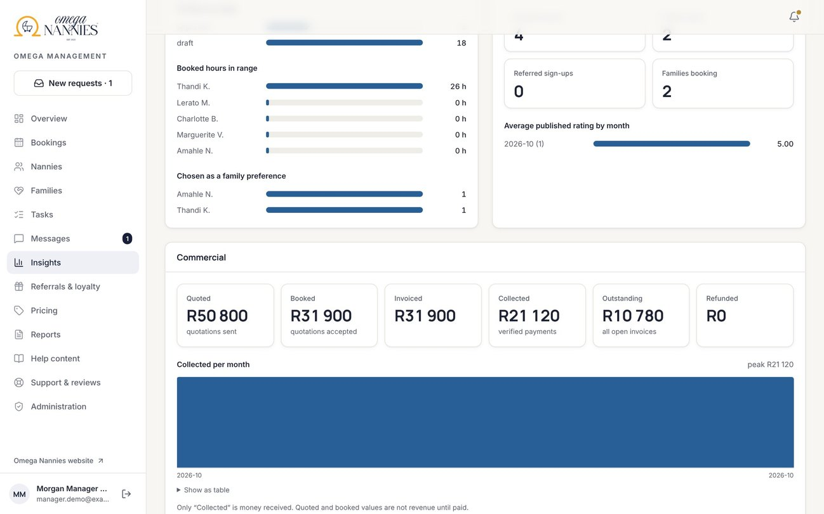
Genuine figures, filtered your way
MANAGEMENT INSIGHTS
Bookings, demand, nanny utilisation and family behaviour — filter by date, service, area, status or nanny.
Quoted, booked, invoiced, collected and outstanding are always separate. Only “collected” is money received.

Slide 16








SECURITY & PRIVACY
New features, the same protection
Addresses private
Area only during discovery; full address after confirmation.
Your data is yours
Shortlists, searches and views belong to one family only.
Tamper-proof requests
Preferences and prices re-checked on the server.
Calendar safety
Encrypted tokens, minimal permissions, verified webhooks.
Quiet messages
No addresses, child details or IDs in SMS or WhatsApp.
Safe links
Website links only land inside the portal; no tokens in URLs.
Honest ledgers
Rewards only from the server; balances can’t be edited by users.
POPIA
Own-data export now includes shortlists, searches and calendars.
Each control is covered by automated tests that attempt the misuse. A professional penetration test is still recommended before launch.

Slide 17
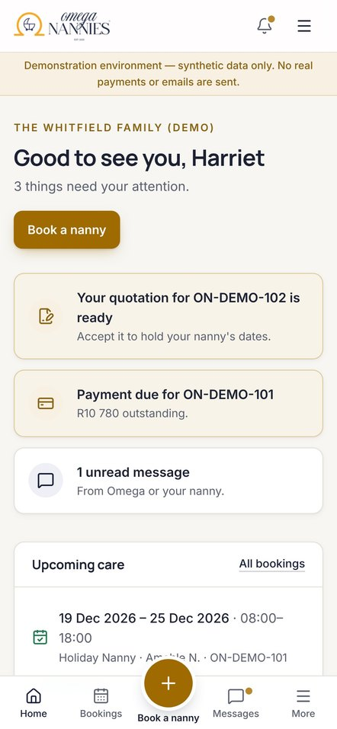
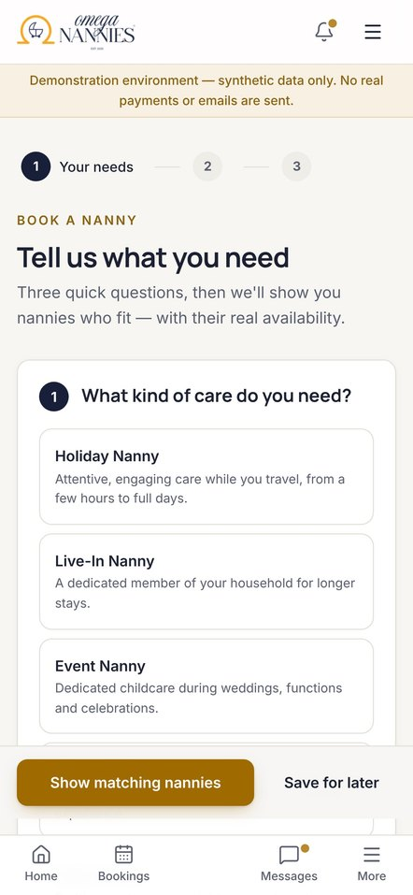
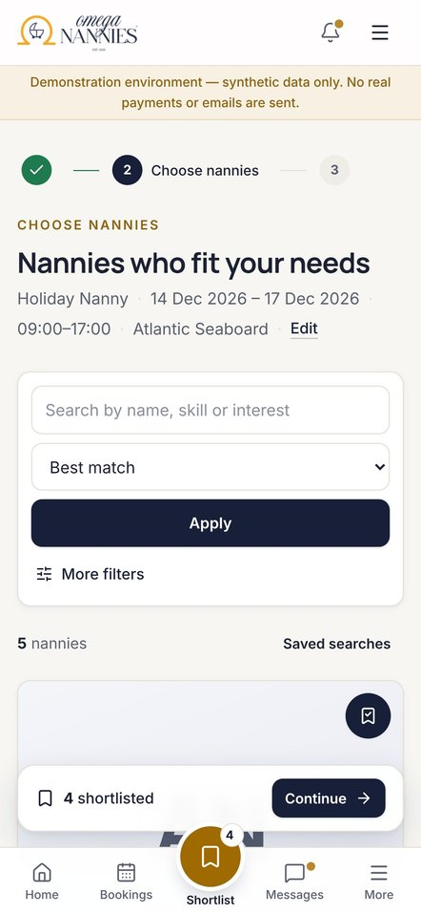
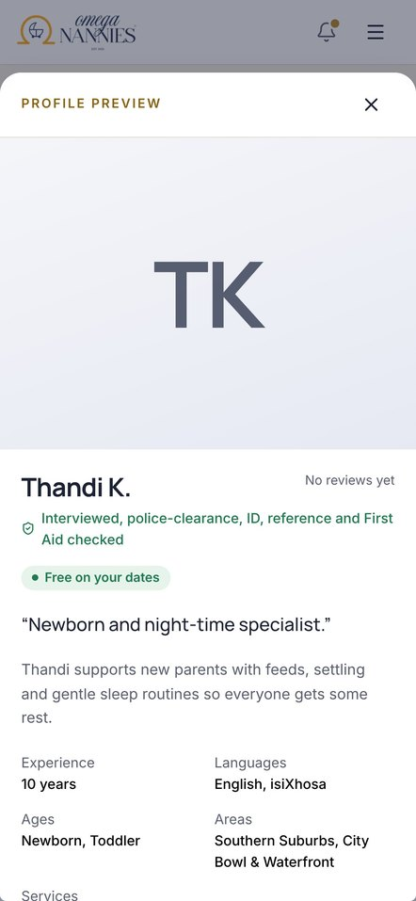

Built for one hand, on any phone
MOBILE EXPERIENCE
Centre action
“Book a nanny”, or the next step in context.
Installable
Home-screen app; never caches personal data.

Slide 18





Room to grow — options, not commitments
FUTURE OPPORTUNITIES
Nanny payouts
Once the compensation model is agreed.
Availability alerts
Opt-in alerts when a saved search has a free nanny.
New regions
Areas and pricing per region.
Richer profiles
Approved video introductions and photo galleries.
Languages
The portal in Afrikaans and isiXhosa.
Forecasting
Seasonal demand by area and service.

Slide 19

CLOSING VISION
Ready for your families
1
Connect accounts: hosting, PayFast, email, SMS/WhatsApp, calendars
2
Confirm rates, policies and referral terms
3
Invite your nannies to claim their profiles
4
Pilot with a few families end to end
5
Penetration test and privacy review, then launch
The product is built and tested. What remains are your accounts, your decisions and two outside reviews.
Notes:
Recommended next step: a working session to connect accounts and agree the open business rules, then a short pilot.

