Slide 1
Get On The Bus!!!
Dylan Nicolini
Western Mass Microsoft Technology Users Group

Slide 2
Bio
I have been developing software for over 10 years.
I work both as a freelance software architect / developer and as a fulltime contract developer.
Lately I’ve been focusing on architecting solutions on Microsoft Azure, Microsoft’s public cloud platform.
I graduated from CCSU with a B.S. in Computer Science and hold the Software Architecture Professional Certificate from the Software Engineering Institute (SEI) @ Carnegie Mellon University.
I currently havea BizSpark MSDN license under my company Kodah Technology Services, LLC.

Slide 3
Fly-Away Airlines
Fly-Away Airlines is a medium-sized airline that offers service within the United States.
In early 2012 they decided that they wanted to make their ticketing agency available online.
They did not have a large IT organization and lacked the knowledge and manpower for a large-scale enterprise application development effort.
Ultimately, they enlisted the help of Fly-Away Airlines employees that worked with the business to produce a web application to be used for online ticket purchasing.
Over time this application was modified to be more than an online ticketing hub.

Slide 4
Fly-Away Airlines
The application was modified to hold employee time tracking data, as well as serve as an internal extranet application.
This tripled the user base over night.
This application grew to serve as a key internal enterprise line of business application as well as an online ticketing agency.
The application becomes unresponsive to internal as well as external users during times of peak load.
This scalability issue is impacting the revenue streams of the business…
e.g. if no one can use the app…no one buys tickets…no one makes money.

Slide 5
Fly-Away Airlines Poc
The initial web application that was developed started as a proof-of-concept that evolved into a current production application.
The developers were new to Microsoft technologies and used the “get it to work” approach.
They attempted to use current relevant technologies but fell short in common design principles and practices.

Slide 6
Fly-Away Airlines Poc
The technology stack is as follows:
ASP.Net MVC Web Application
Uses ASP.Net Web API
KnockoutJS
Entity Framework
Code-first Database Design
LocalDB

Slide 7
Fly-Away Airlines Poc
Architectural Challenges:
A tightly coupled monolithic application.
There is no real separation of concerns or duties.
LocalDB lives in App_Data which makes the desire to achieve High Availability difficult.
All processes wait for completion in a Request / Response type pattern.
Although this isn’t wrong this is infringing on the company’s desire of a highly scalable application.

Slide 8
Fly-Away Airlines Poc
Lets see the code…

Slide 9
Fly-Away Airlines Re/architecture Effort
The Fly-Away Airlines executive team has recognized the need for a re-architecture of their flagship enterprise line-of-business application.
The company is looking to achieve a scalable solution that can scale up and down when needed to handle times of peak load.
Peak load is defined as times during the holiday months and the beginning and end of the month.
The company would like this solution to be cloud based, as they are not looking to purchase infrastructure and licenses.
They are hoping that using the cloud platform will cut down costs and overhead by only paying for what they are using at the current time.
They would like to take advantage of the support team through MSFT rather than hiring countless resources.

Slide 10
Fly-Away Airlines Quality Attributes
The architecture team has decided that scalability / availability, modifiability, performance and maintainability are the primary quality attributes that the business is looking to achieve.
These are defined as the primary business drivers.
The architecture team recommends using the Azure Public Cloud Platform offered by Microsoft.
The architecture team recommends the following architecture patterns to be used:
Command-Query Responsibility Segregation (CQRS)
Event-Sourcing (ES)
Eventual Consistency

Slide 11
Command – Query Responsibility Segregation

Slide 12
CQRS
What is CQRS?
CQRS stands for command-query responsibility segregation.
This is an application of the principle Command – Query Separation (CQS).
Simply stated in C#, to use CQS principles the following must be done:
If a method modifies data, it’s return type must be void.
If a method returns data, it must not modify the data when doing so.

Slide 13
CQRS
CQRS is a pattern that is followed that is an application of the CQS principle.
This pattern is the CQS principle on steroids.
Segregate operations that read data from operations that update data by using separate interfaces.
This pattern can maximize performance, scalability, and security; support evolution of the system over time through higher flexibility; and prevent update commands from causing merge conflicts at the domain level.
Database models are often times optimized for reading and writing.

Slide 14
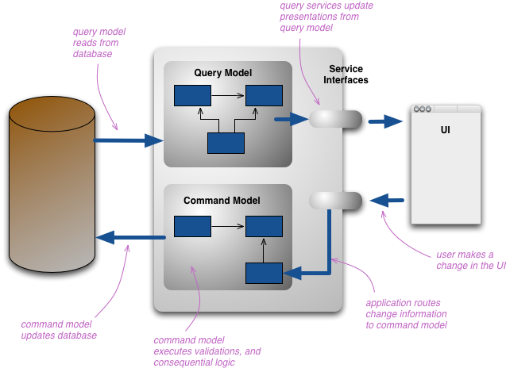
CQRS

Slide 15
Event Sourcing

Slide 16
ES
The Event Sourcing pattern defines an approach to handling operations on data that is driven by a sequence of events, each of which is recorded in an append-only store.
Application code sends a series of events that imperatively describe each action that has occurred on the data to the event store, where they are persisted. Each event represents a set of changes to the data (such as BookedFlight).
The events are persisted in an event store that acts as the source of truth or system of record (the authoritative data source for a given data element or piece of information) about the current state of the data.
The event store typically publishes these events so that consumers can be notified and can handle them if needed.
Consumers could, for example, initiate tasks that apply the operations in the events to other systems, or perform any other associated action that is required to complete the operation.

Slide 17
ES
Events are immutable and can be stored using an append-only operation.
The user interface, workflow, or process that initiated the action that produced the events can continue, and the tasks that handle the events can run in the background.
This, combined with the fact that there is no contention during the execution of transactions, can vastly improve performance and scalability for applications, especially for the presentation level or user interface.
Events are simple objects that describe some action that occurred, together with any associated data required to describe the action represented by the event.
Events do not directly update a data store; they are simply recorded for handling at the appropriate time. These factors can simplify implementation and management.

Slide 18
Eventual Consistency

Slide 19
Eventual Consistency
When splitting your read / write models data becomes inconsistent between the two.
There are many options that are available to update the data.
Infrastructure must be put in place to keep read models up to date as the data is changing. The notion must be communicated to the user that although the data is not updated in real-time, the data will eventually become consistent.
Event sourcing patterns work well for updating the Read model after the data is written.
Events are not the only method for updating data in the Read Model.
ETL patterns also can work quite nicely. An example of this is Change-Data-Capture (CDC) available through SQL Server.

Slide 20
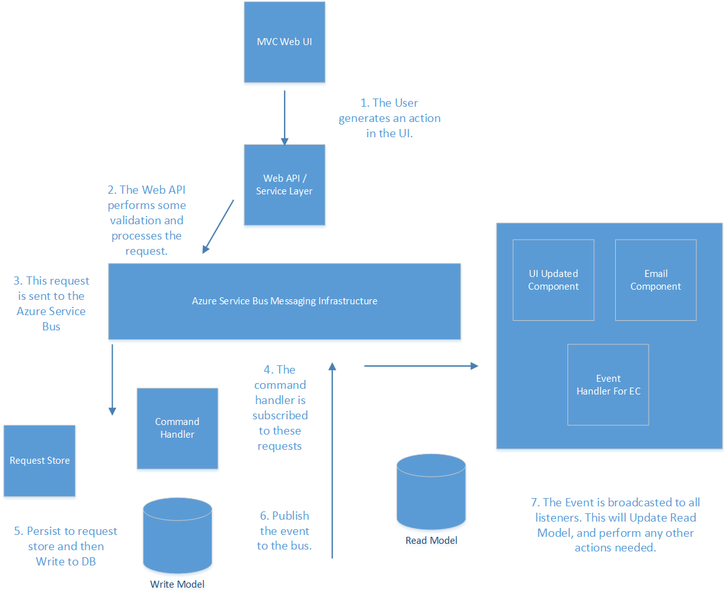
Fly-Away Airlines Architecture

Slide 21
Azure Service Bus

Slide 22
What is the Azure Service Bus?
The windows Azure Service Bus provides a hosted, secure, and widely available infrastructure for widespread communication, large-scale event distribution, naming and service publishing.
The service bus provides connectivity options for WCF and other service endpoints – including rest.
The service bus provides both “relayed” and “brokered” messaging capabilities.

Slide 23
Relayed Messaging Pattern
Supports direct one-way messaging.
Supports Request / Response messaging.
Supports Peer-to-peer messaging.

Slide 24
The Brokered Messaging Pattern
Provides durable, asynchronous messaging components.
The components include Queues, Topics, and Subscriptions.
These components support features such as publish – subscribe and temporal decoupling.
Temporal decoupling means that receivers do not have to be online at the same time.
The messaging infrastructure reliably stores messages until the receiving party is ready to receive them.

Slide 25
Why use Azure Service Bus Queues?
Using Azure Service Bus Queues allows us to create applications of Scale by giving us access to platform (PaaS) and infrastructure services (IaaS) on demand.
These are services that would otherwise be very expensive to implement due to the incredible overhead of platform and infrastructure management required.
Using Azure Service Bus Queues helps us to achieve the desired quality attributes found in enterprise-grade applications.

Slide 26
Quality Attributes
Scalability
Reduced Latency
Increased Reliability
Increased Modifiability / Loose Coupling

Slide 27
Scalability
The ability of a system to handle a growing amount of work in a capable manner or its ability to be enlarged to accommodate that growth.
Scale Up or Scale Out
Scaling Up is increasing the resources capacity within an existing node. E.g. More Ram, Faster Processor
Scale Out is increasing resources capacity by adding nodes.

Slide 28
How Can Azure Service Bus Queues Help Us to Scale Applications?
Welcome to the Queue-Centric Work Pattern.
This pattern is used for loose coupling of cloud based applications.
The queue-centric work pattern can be used when:
Work is done that is time consuming (high latency)
Work is done that requires an external service that might not always be available.
Work is done that is resource –intensive (high CPU utilization)
Work that would benefit from rate leveling. (Subject to sudden load bursts).

Slide 29
Queue – Centric Work Pattern

Slide 30
Azure Service Bus Demo
Lets see it work!!!

Slide 31
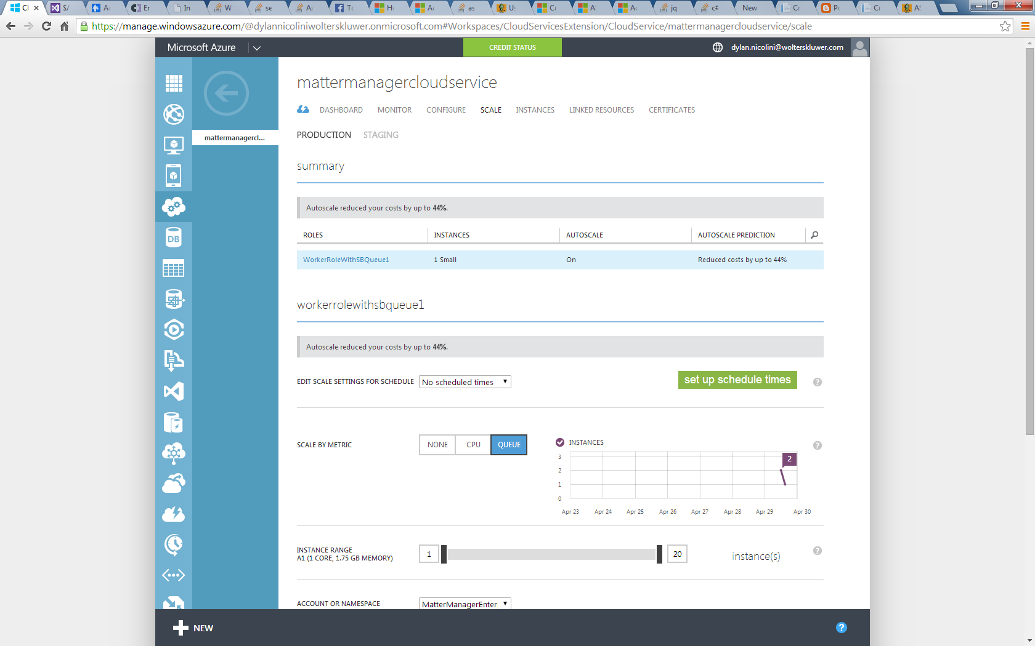
Auto Scaling

Slide 32
Questions?

Slide 33
References
http://www.asp.net/aspnet/overview/developing-apps-with-windows-azure/building-real-world-cloud-apps-with-windows-azure/queue-centric-work-pattern
https://leanpub.com/cqrs
http://msdn.microsoft.com/en-us/library/ee732537.aspx
http://msdn.microsoft.com/en-us/library/hh367519.aspx
http://view.officeapps.live.com/op/view.aspx?src=http%3a%2f%2fvideo.ch9.ms%2fsessions%2fbuild%2f2014%2f3-626.pptx
http://azure.microsoft.com/en-us/documentation/articles/cloud-services-how-to-scale/
http://www.codingthearchitecture.com/presentations/jdays2012-just-enough-software-architecture
https://www.macaw.nl/weblog/2013/5/setting-up-a-solution-with-mvc4-and-twitter-bootstrap
http://stackoverflow.com/questions/19618771/how-to-resolve-mvc4-twitter-bootstrap-project-fail-from-simple-nuget-installatio/20131339#20131339
https://www.simple-talk.com/cloud/cloud-data/an-introduction-to-windows-azure-service-bus-brokered-messaging/

