Slide 1
Final Project
Dylan Ordaz A01327199
José Eduardo Hernández A01732165
Agustín García Rodríguez A01378823

Slide 2


Introduction
In the following project a distributed database system will be developed with a graphical interface shown in the form of a web application running in a linux environment, for this it will make use of two DBMS, mysql and postgresql, however the user should not be able to distinguish from which place the information is obtained

Slide 3
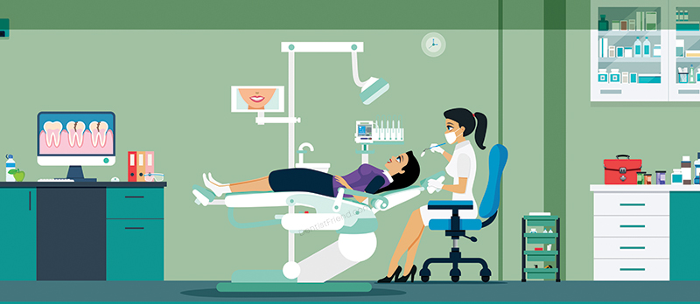
Problem definition
Our problem is obtained by thinking about the needs that a dental office may have as it grows, managing the information of a large number of patients, their types of treatment, the daily dates, the information of each of the dentists who work there, as well as payment information and various dental offices distributed in different locations. It’s believed that a database system can facilitate each of these processes, at the same time that we apply in a practical way the concepts seen throughout the course.

Slide 4

What are we going to do?
Parting from the problem definition, we decided to tackle the problem by creating a platform, especially in this project it will be directed to an administrator, in which it will contained the database with essential information of clients, dentist, consulting rooms, payments, etc.
By the other hand, this information will be represented in graphical way, which it will be a website page, here the administrator can have access to create, update,delete,or read all the data that has been stored.

Slide 5
Tools and way to develop the project
The project is developed based on the CRUD examples shown in the class, both from MySQL and PostgreSQL, which implies that tools such as PHP, HTML, CSS, Bootstrap will be used. The reason behind this is that none of the team members have sufficient experience in web development and given the limited time, it will not be possible for us to use other tools.
Likewise, we hope to use the project developed in the previous class as a base, since we believe that it can be very useful to have a part of the design already done.
Finally, it is important to note that we expect to run the project on a server that a team member has access to, but if the conditions are not met, the project will only run on localhost and on one computer at the same time.

Slide 6
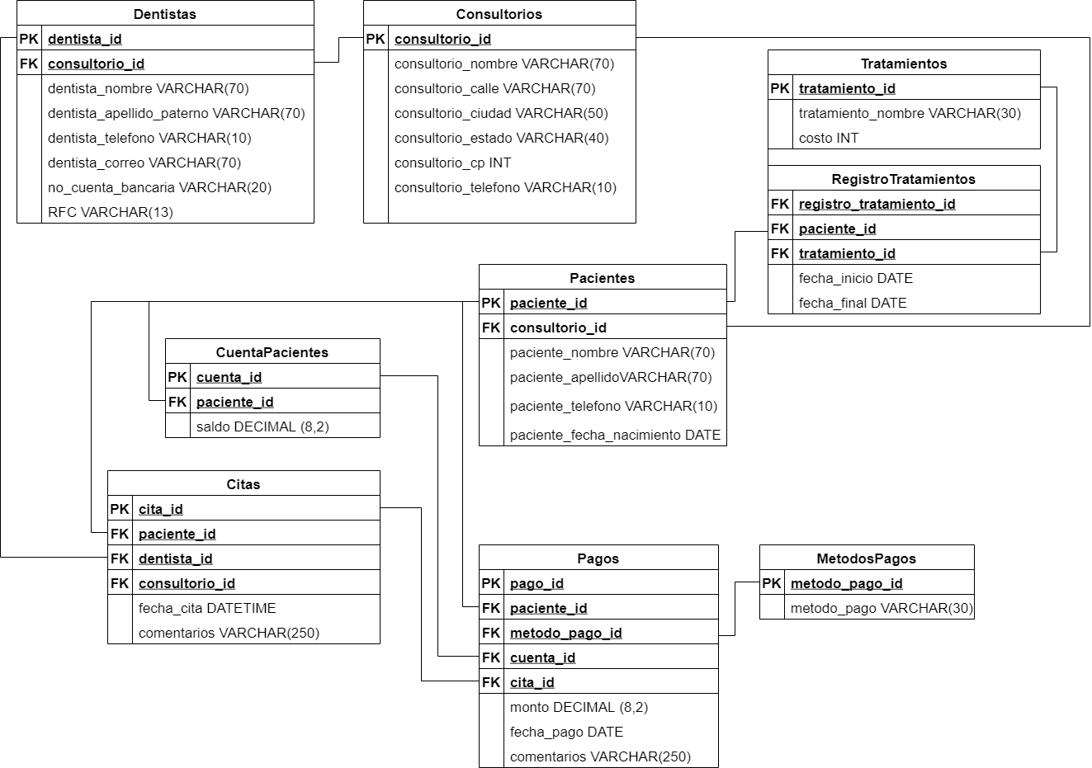
Diagram

Slide 7
Proposals
Implement one view: join some fields of tables CuentaPaciente, Patients and MetodosPago in one view to show the patient's account
Implement one transaction: Check if the dentist is available at the proposed time every time in managing appointments
Implement one trigger: When a patient registers to a new treatment, price is charged to the patient’s account.
Implement one stored procedure: You send the patient and the appointment and it returns the appointment information
Implement one function: Calculate the time left to an appointment.
Implement one check constraint: Check if pay amount is greater than 0 in the pagos table.
Partitions
Vertical:
Horizontal: The patients table will be divided according to the office assigned to them
Mixed: The dentist table will be partitioned with separate RFC and cuenta_bancaria fields to provide better security. and it will devided according to the office assigned

