Slide 1
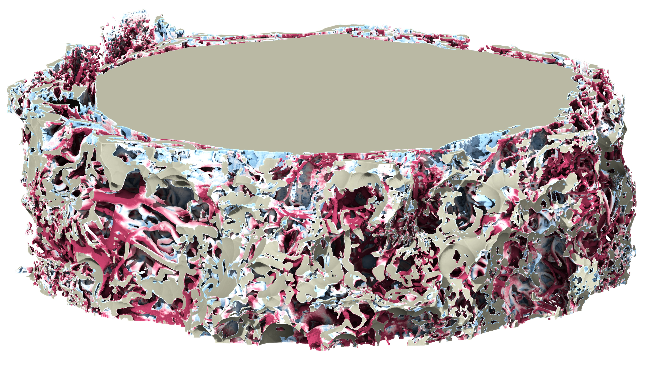
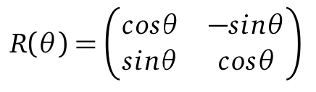
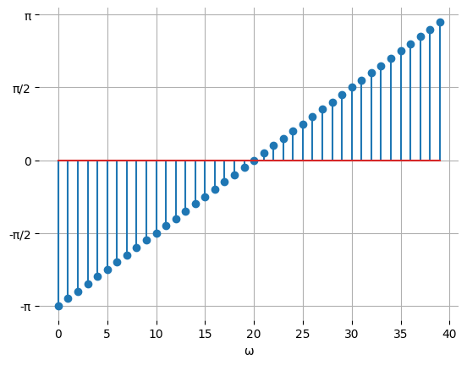
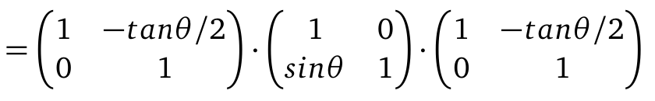
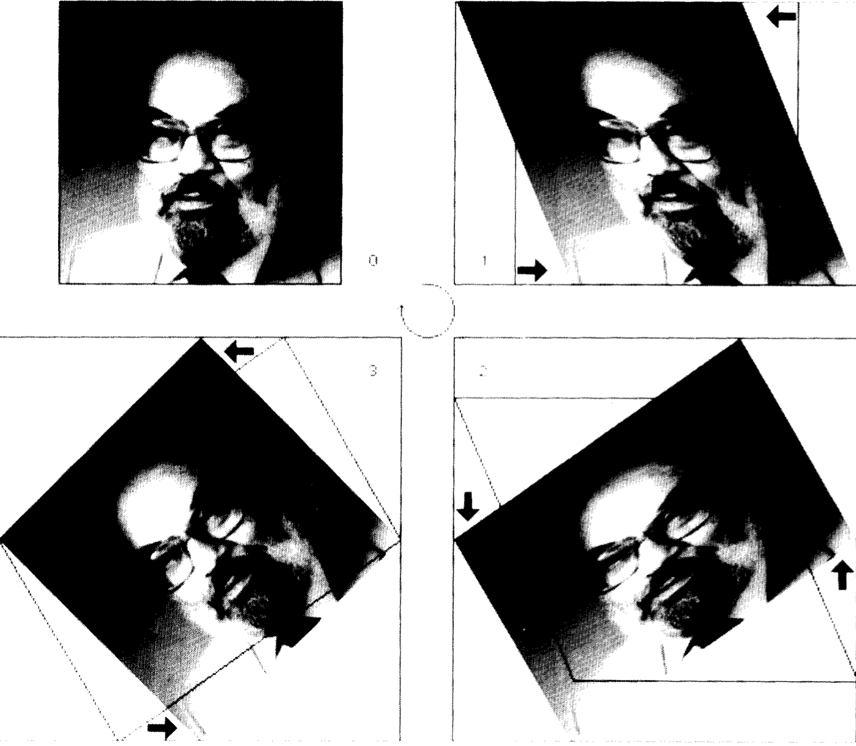

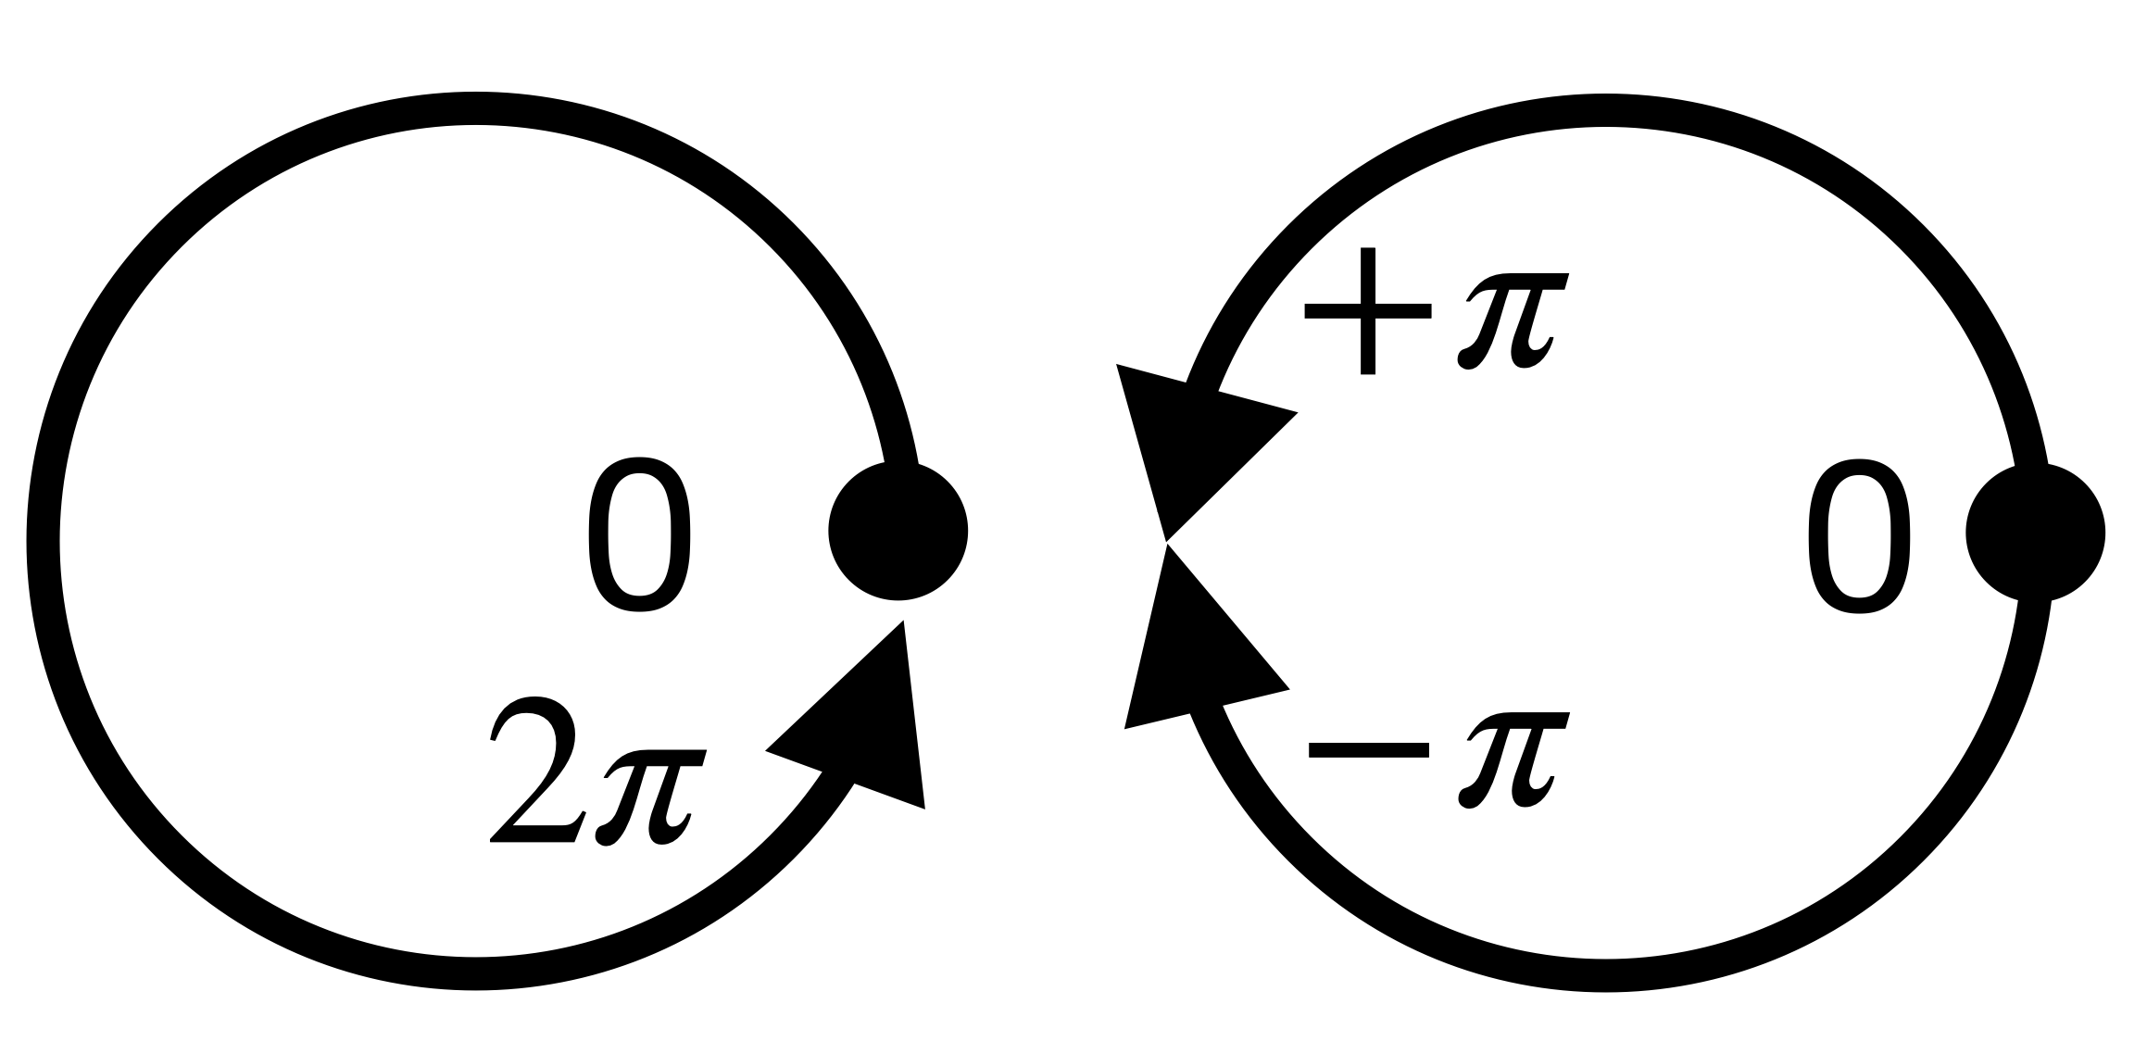

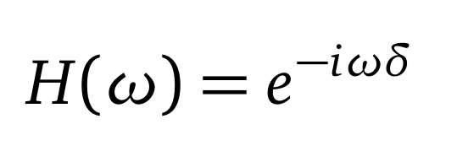
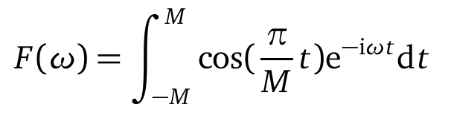
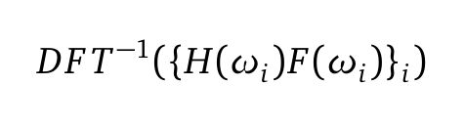
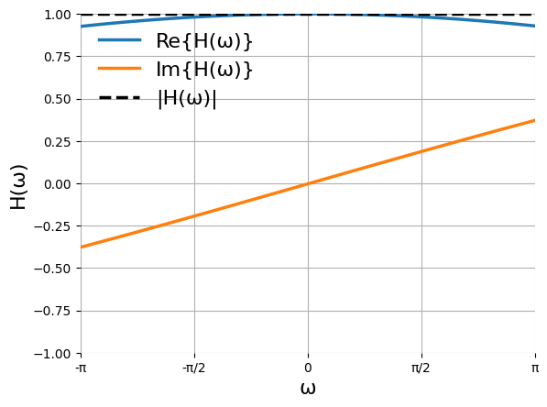
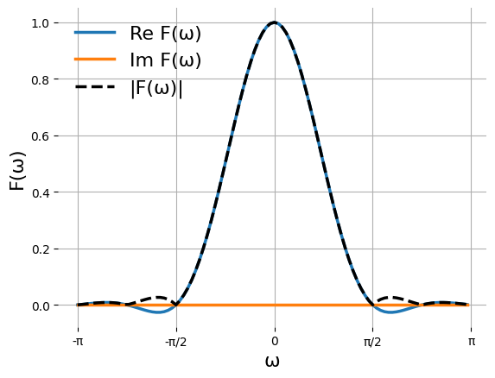
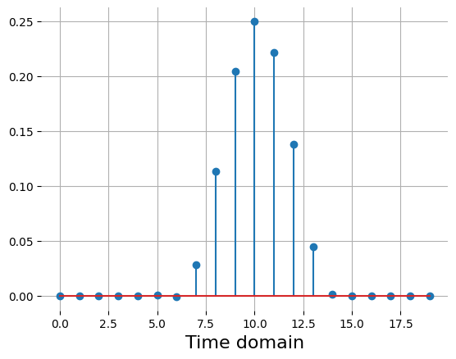
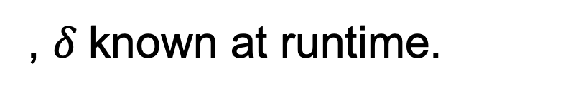
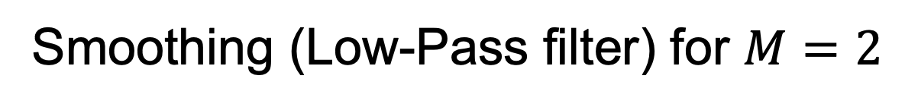

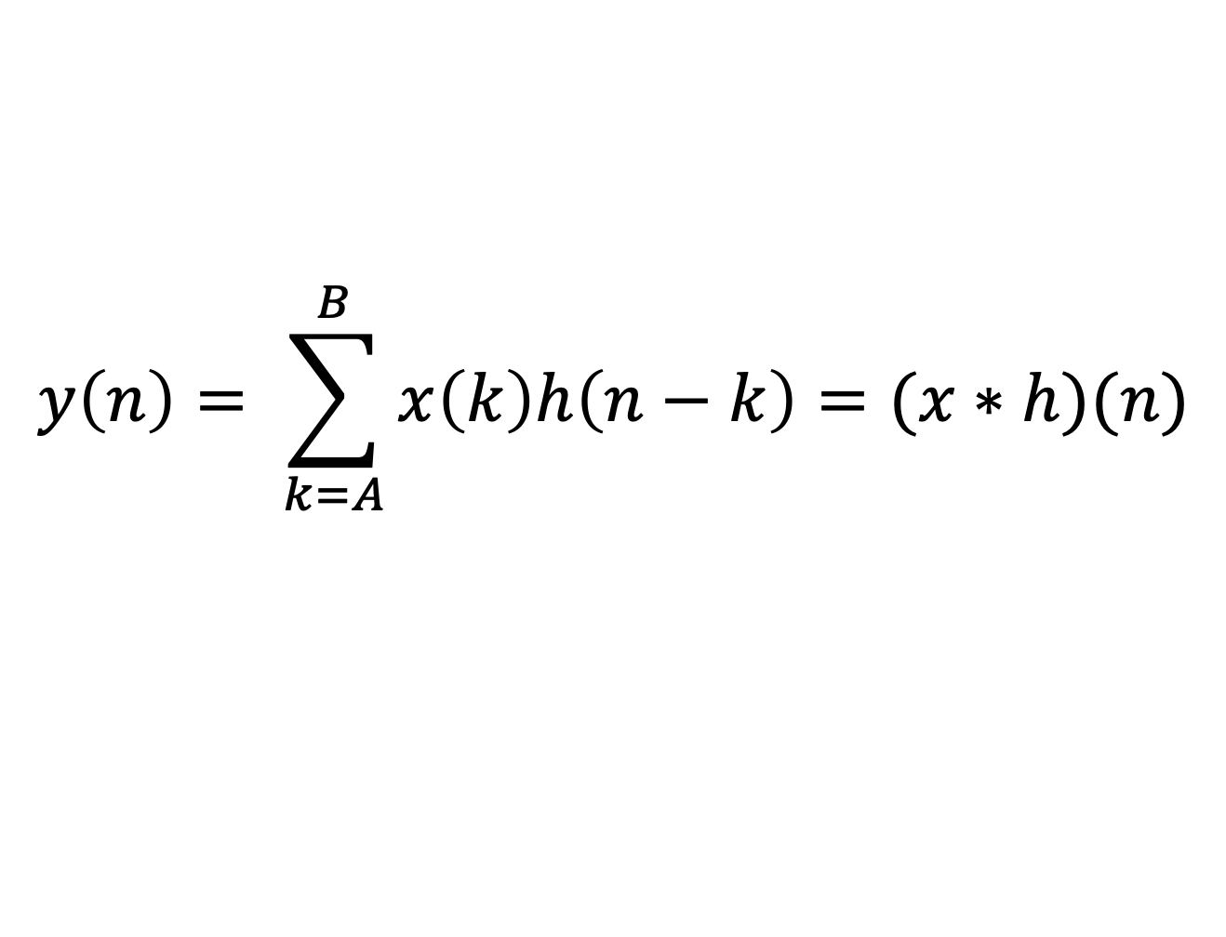
Rotation of Multidimensional Signals with Spectral Schemes
Student: Dylan Reid Ramelli
Advisor: Prof Rolf Krause
Co-Advisors: Dr Diego Rossinelli, Dr Patrick Zulian
Large-scale in-silico investigation of homeostasis in the subarachnoid space of the human optic nerve [Rossinelli et al. 2023, in-preparation]. Homeostasis is directly related with the interaction between the cerebrospinal fluid flow (not shown here) and the meningeal surface. Blue denotes poor levels of homeostasis , whereas red denotes sufficient material exchange between fluid and structure.
Light transport calculation
Design Strategies
Interpretation of frequencies
Light attenuation by massive ray casting.
Efficiency through volumetric rotations.
3D rotations as series of 2D rotations.
2D Rotations as 1D translations (!)
Favor local computational schemes.
Perform direct convolution:
$$y\left(n\right)= \sum_{k=A}^{B}{x\left(k\right)h\left(n−k\right)=(x∗h)(n)}$$
Compact filter support compared to original signal.
Ideal execution on superscalar architectures.
Exploiting spatiotemporal locality (data cache).
Dense Linear Algebra (data-level parallelism).
Scalable (thread-level parallelism).
[Convolution-Based Interpolation for Fast, High-Quality Rotation of Images, Unser et. al, 1995]
Own Contributions
, $δ$known at runtime.
Interpolant, translation by $δ=0.1234$
Smoothing (Low-Pass filter) for $M=2$
Combined (Cascaded) Impulse Response

