Slide 1
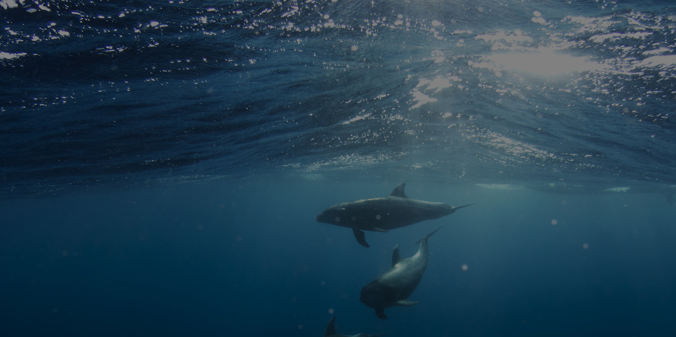
Intro To Python
Python Basics (#1)
The Open Project

Slide 2
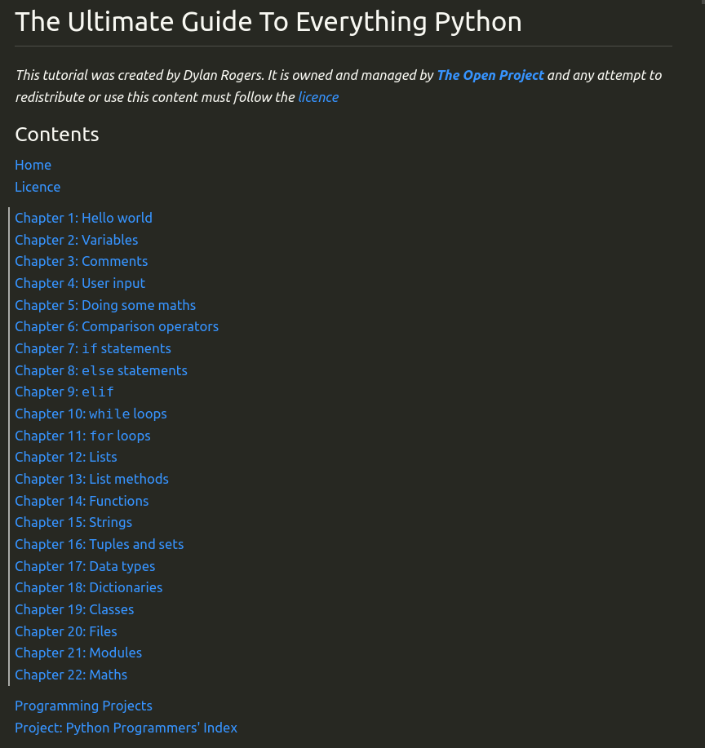
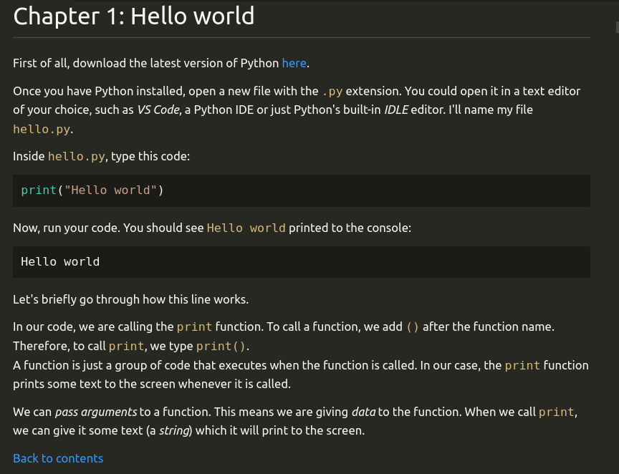
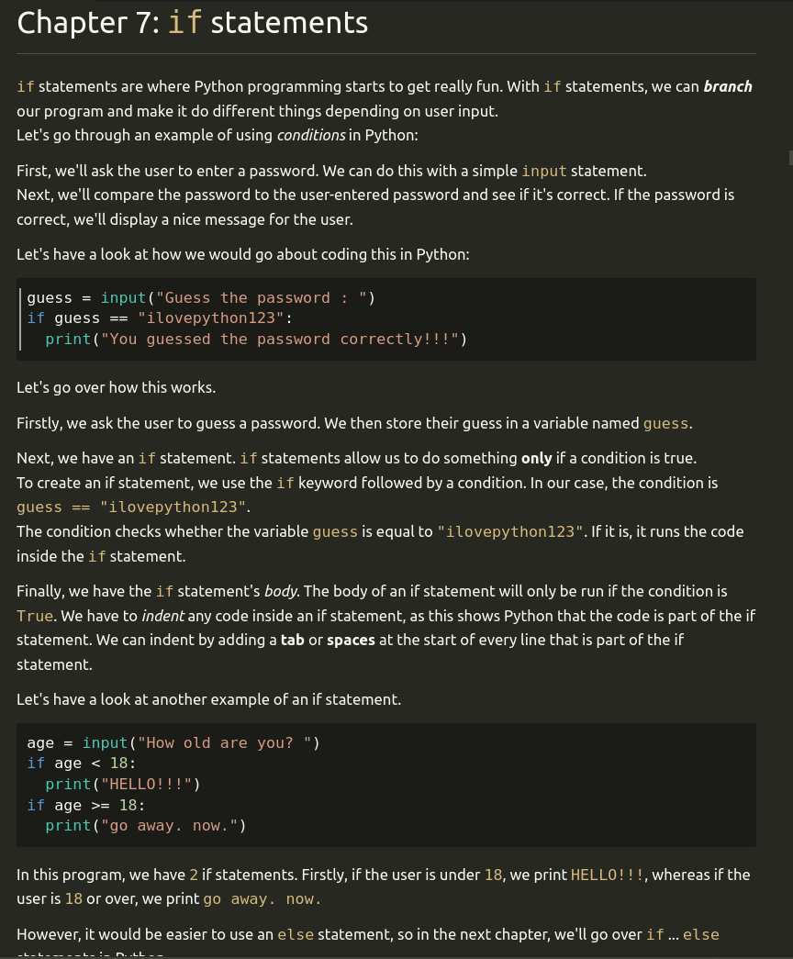
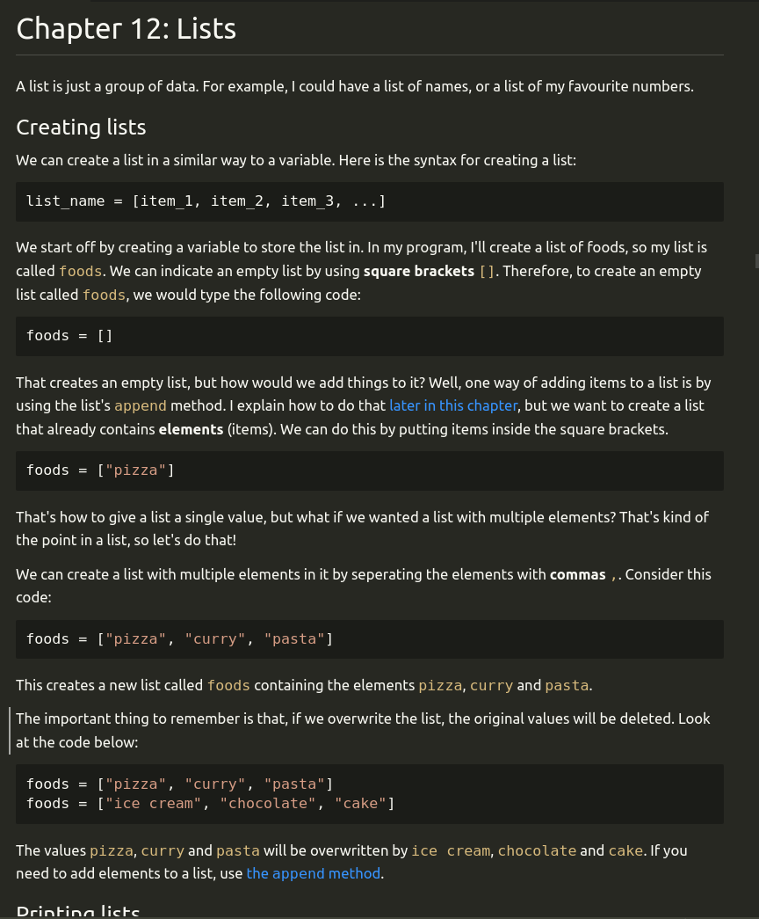
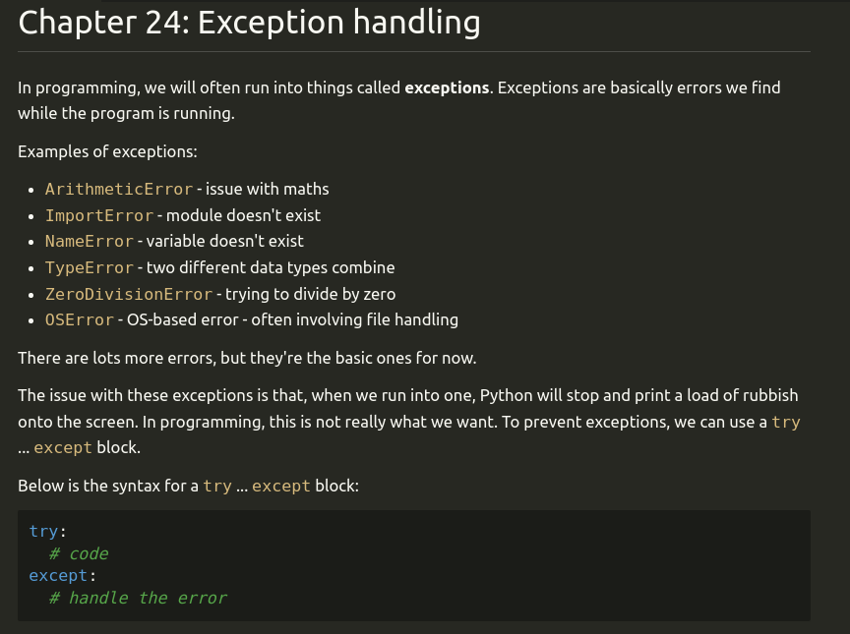
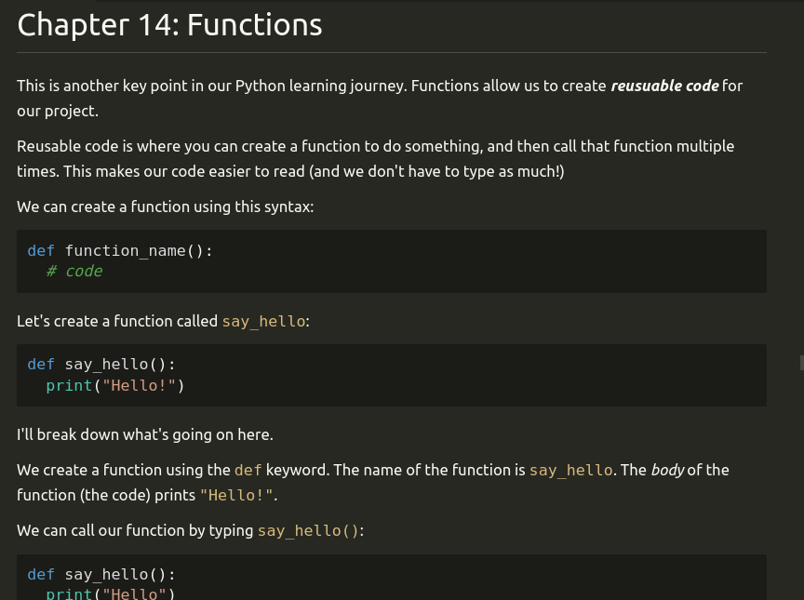
tHe DoCuMeNt!!!
The Open Project

Slide 3
tHe DoCuMeNt!!!
Hopefully it’ll stop me going on about something unimportant
The Open Project

Slide 4
tHe DoCuMeNt!!!
Hopefully it’ll stop me going on about something unimportant
Alternative tutorial – you can choose to watch the video or read the document
The Open Project

Slide 5
tHe DoCuMeNt!!!
Hopefully it’ll stop me going on about something unimportant
Alternative tutorial – you can choose to watch the video or read the document
Link in description (github.com/dylanrogers1)
The Open Project

Slide 6
tHe DoCuMeNt!!!
If you make tutorials like me:
The Open Project

Slide 7
tHe DoCuMeNt!!!
If you make tutorials like me:
Use the document to help you!
The Open Project

Slide 8
tHe DoCuMeNt!!!
If you make tutorials like me:
Use the document to help you!
You don’t have to scratch – use my document as a starting point!
The Open Project

Slide 9
tHe DoCuMeNt!!!
If you make tutorials like me:
Use the document to help you!
You don’t have to scratch – use my document as a starting point!
Read the licence on the document for more info!
The Open Project

Slide 10
tHe ScRiPt!!!
I really don’t have the ability to talk unscripted…
The Open Project

Slide 11
tHe ScRiPt!!!
I really don’t have the ability to talk unscripted…
So I’ve made scripts for all the videos!
The Open Project

Slide 12
tHe ScRiPt!!!
I really don’t have the ability to talk unscripted…
So I’ve made scripts for all the videos!
Hopefully this means I’ll get in twice the information in half the time!
The Open Project

Slide 13
tHe SuBtItLeS!!!
Finally… subtitles!
The Open Project

Slide 14
tHe SuBtItLeS!!!
Finally… subtitles!
I’m sure you know what subtitles are, so if you’d like to enable them, I’ve created custom subtitles so you don’t have to use YouTube’s awful automatic ones!
The Open Project

Slide 15
Hey, stop going on about the document that will stop you going on about things. I knew I should never have hired you.
Open
Project
Robot
(likes to tell people off)
The Open Project

Slide 16
Installing Python
The Open Project

Slide 17
Installing Python
First, let’s install Python!
The Open Project

Slide 18
Installing Python
First, let’s install Python!
Download it with the link in the description, or just install ‘python3’ using your package manager.
The Open Project

Slide 19
Installing Python
First, let’s install Python!
Download it with the link in the description, or just install ‘python3’ using your package manager.
Now open up a new ‘.py’ file, such as ‘hello.py’!
The Open Project

Slide 20
The Program
Finally, we’ve finished the boring stuff!
The Open Project

Slide 21
The Program
Finally, we’ve finished the boring stuff!
Copy the following code into your python file:
The Open Project

Slide 22
The Program
Finally, we’ve finished the boring stuff!
Copy the following code into your python file:
print("Hello world")
The Open Project

Slide 23
Running Our Program
There’s no point in a program that never runs, so let’s learn how to execute our program!
The Open Project

Slide 24
Running Our Program
There’s no point in a program that never runs, so let’s learn how to execute our program!
Open a terminal, navigate to the folder your file is in, then run the following command:
The Open Project

Slide 25
Running Our Program
There’s no point in a program that never runs, so let’s learn how to execute our program!
Open a terminal, navigate to the folder your file is in, then run the following command:
python3 hello.py
The Open Project

Slide 26
Running Our Program
There’s no point in a program that never runs, so let’s learn how to execute our program!
Open a terminal, navigate to the folder your file is in, then run the following command:
python3 hello.py
Note that on some devices - particularly Windows computers - `python3` is installed as `python` or `py`.
Try all three commands and use the one that works!
The Open Project

Slide 27
Output
When we run our code, we get the following output on the console:
Hello world
The Open Project

Slide 28
Explanation
Well come on, explain the code! What did I say about not explaining every single line? I’ll fire you!
Open
Project
Robot
(likes to tell people off)
The Open Project

Slide 29
Explanation
First, we call the print function, by typing print()
The Open Project

Slide 30
Explanation
First, we call the print function, by typing print()
Function – a block of code which runs when the function is called
The Open Project

Slide 31
Explanation
First, we call the print function, by typing print()
Function – a block of code which runs when the function is called
Inside the brackets, we pass the “Hello world” argument.
The Open Project

Slide 32
Explanation
First, we call the print function, by typing print()
Function – a block of code which runs when the function is called
Inside the brackets, we pass the “Hello world” argument.
“Hello world” is a string (text)
The Open Project

Slide 33
Thanks For Watching!
As always, thank you so much for watching this video – I really appreciate it!
New video out every weekend – Saturday 5pm GMT
If you found this video useful, please consider subscribing or liking the video!
Find the document here: https://github.com/dylanrogers1/learn
Watch the “Python Basics” playlist (link in description)
Thank you everyone for watching, I’ll see you in the next video!
The Open Project

Slide 34
Variables
Python Basics (#2)
The Open Project

Slide 35
What are variables?
The Open Project

Slide 36
What are variables?
Key part of every programming language
The Open Project

Slide 37
What are variables?
Key part of every programming language
Allow us to store data (information) for later
The Open Project

Slide 38
What are variables?
Key part of every programming language
Allow us to store data (information) for later
The Open Project

