Slide 1

Chapter 2
Introduction to Number Theory
Department of Computer Science
Kennesaw State University
Marietta, GA, USA
Notes:
Lecture slides prepared for “Cryptography and Network Security”, 7/e, by William Stallings, Chapter 2 – “Introduction to Number Theory”.

Slide 2
Outline
Review of Lecture 1
Divisibility
Greatest Common Divisor & Euclidean Algorithm
Modular Arithmetic

Slide 3
Lecture 01 Review
Why cryptography:
Information has much greater impact to greater population, information systems under constant attack, cryptocurrency, need to secure storage and transmission of information.
Computer Security:
Preserves integrity, gives availability and protects confidentiality
Cryptography standards documents:
X.800 OSI organization of security models - Security Attacks, Mechanisms and Services
RFC4949 – discusses attacks and other components of cryptography/analysis
Passive and Active Attacks (masquerade, DOS, Replay, Data Mod)
Private / Public Key, Symmetric/Asymmetric and the secure channel.

Slide 4
Divisibility
We say that a nonzero b divides a if a = mb for some m, where a, b, and m are integers
b divides a if there is no remainder on division
The notation b | a is commonly used to mean b divides a
If b | a we say that b is a divisor of a
The positive divisors of 24 are 1, 2, 3, 4, 6, 8, 12, and 24
13 | 182; - 5 | 30; 17 | 289; - 3 | 33; 17 | 0
Notes:
We say that a nonzero b divides a if a=mb for some m, where a, b, and m are integers. That is, b divides a if there is no remainder on division.
The notation b | a is commonly used to mean b divides a . Also, if b | a , we say that b is a divisor of a .

Slide 5
Properties of Divisibility
If a | 1, then a = ±1
If a | b and b | a, then a = ±b
Any b ≠ 0 divides 0
If a | b and b | c, then a | c
If b | g and b | h, then b | (mg + nh) for arbitrary integers m and n
11 | 66 and 66 | 198 = 11 | 198
Notes:
Subsequently, we will need some simple properties of divisibility for integers, which are as follows:
• If a|1, then a = ±1.
• If a|b and b|a, then a = ±b.
• Any b ≠ 0 divides 0.
• If a | b and b | c, then a | c
• If b|g and b|h, then b|(mg + nh) for arbitrary integers m and n.

Slide 6
Properties of Divisibility
To see this last point, note that:
If b | g , then g is of the form g = b * g₁ for some integer g₁
If b | h , then h is of the form h = b * h₁ for some integer h₁
So:
mg + nh = mbg₁ + nbh₁ = b * (mg₁ + nh₁ )
and therefore b divides mg + nh
This will be seen once again in
El-Gamal and Diffie-Hellman
b = 7; g = 14; h = 63; m = 3; n = 2
7 | 14 and 7 | 63.
To show 7 (3 * 14 + 2 * 63),
we have (3 * 14 + 2 * 63) = 7(3 * 2 + 2 * 9),
and it is obvious that 7 | (7(3 * 2 + 2 * 9)).
Notes:
To see this last point, note that
• If b | g , then g is of the form g = b * g₁ for some integer g₁ .
• If b | h , then h is of the form h = b * h₁ for some integer h₁ .
So
mg + nh = mbg₁ + nbh₁ = b * (mg₁ + nh₁ )
and therefore b divides mg + nh .

Slide 7

Division Algorithm
Given any positive integer n and any nonnegative integer a, if we divide a by n we get an integer quotient q and an integer remainder r that obey the following relationship:
a = qn + r 0 ≤ r < n;
is the largest integer less than or equal to x
Can also be noted as [0, n)
Where “[“ means includes endpoint, “(“ = excludes end point
Notes:
Given any positive integer n and any nonnegative integer a, if we divide a by n, we get an integer quotient q and an integer remainder r that obey the following relationship:
a = qn + r, 0 ≤ r < n; q = [a/n] which is referred to as the division algorithm.

Slide 8
Notes:
Figure 2.1a demonstrates that, given a and positive n, it is always possible to find q and r that satisfy the preceding relationship. Represent the integers on the number line; a will fall somewhere on that line (positive a is shown, a similar demonstration can be made for negative a). Starting at 0, proceed to n, 2n, up to qn such that qn ≤ a and (q + 1)n > a. The distance from qn to a is r, and we have found the unique values of q and r. The remainder r is often referred to as a residue .
For example:
a = 11; n = 7; 11 = 1 x 7 + 4; r = 4 q = 1
a = –11; n = 7; –11 = (–2) x 7 + 3; r = 3 q = –2
Figure 4.1b provides another example.

Slide 9
Greatest Common Divisor & Euclidean Algorithm
One of the basic techniques of number theory
Procedure for determining the greatest common divisor of two positive integers
Two integers are relatively prime if their only common positive integer factor is 1
Notes:
One of the basic techniques of number theory is the Euclidean algorithm, which
is a simple procedure for determining the greatest common divisor of two positive
integers. First, we need a simple definition: Two integers are relatively prime if their
only common positive integer factor is 1.

Slide 10
Greatest Common Divisor (GCD)
The greatest common divisor of a and b is the largest integer that divides both a and b
We can use the notation gcd(a,b) to mean the greatest common divisor of a and b
We also define gcd(0,0) = 0
Positive integer c is said to be the gcd of a and b if:
c is a divisor of both a and b
Any divisor of a and b is a divisor of c
An equivalent definition is:
gcd(a,b) = max[k, such that k | a and k | b]
This will be seen when generating pseudo-random
numbers
Notes:
Recall that nonzero b is defined to be a divisor of a if a = mb for some m , where a , b , and
m are integers. We will use the notation gcd(a , b ) to mean the greatest common divisor
of a and b . The greatest common divisor of a and b is the largest integer that divides
both a and b . We also define gcd(0, 0) = 0.
More formally, the positive integer c is said to be the greatest common divisor
of a and b if
1. c is a divisor of a and of b .
2. Any divisor of a and b is a divisor of c .
An equivalent definition is the following:
gcd(a , b ) = max[k , such that k | a and k | b ]

Slide 11
GCD
Because we require that the greatest common divisor be positive, gcd(a,b) = gcd(a,-b) = gcd(-a,b) = gcd(-a,-b)
In general, gcd(a,b) = gcd(| a |, | b |)
Also, because all nonzero integers divide 0, we have gcd(a,0) = | a |
We stated that two integers a and b are relatively prime if their only common positive integer factor is 1; this is equivalent to saying that a and b are relatively prime if gcd(a,b) = 1
gcd(60, 24) = gcd(60, - 24) = 12
Notice how negative numbers are handled
8 and 15 are relatively prime because the positive divisors of 8 are 1, 2, 4, and 8, and the positive divisors of 15 are 1, 3, 5, and 15. So 1 is the only integer on both lists.
Notes:
Because we require that the greatest common divisor be positive, gcd(a , b ) =
gcd(a , -b ) = gcd(-a , b ) = gcd(-a ,-b ). In general, gcd(a , b ) = gcd( | a | , | b | ).
Also, because all nonzero integers divide 0, we have gcd(a , 0) = a .
We stated that two integers a and b are relatively prime if their only common
positive integer factor is 1. This is equivalent to saying that a and b are relatively
prime if gcd(a , b ) = 1.

Slide 12
gcd(710, 310) = 10
gcd(310, 710) = 10
Notes:
We now describe an algorithm credited to Euclid for easily finding the greatest
common divisor of two integers (Figure 2.2). This algorithm has broad significance
in cryptography.

Slide 13
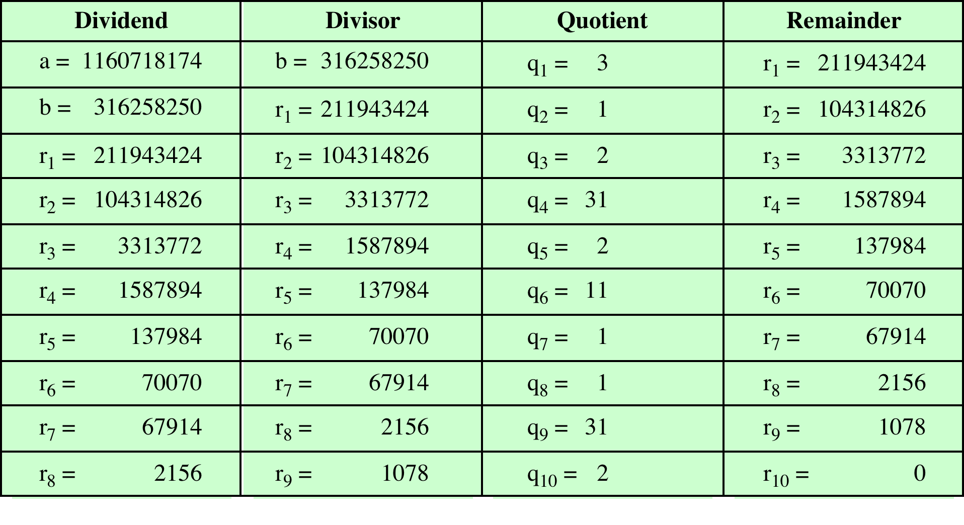
Table 2.1 Euclidean Algorithm Example
(This table can be found on page 30 in the textbook)
Notes:
In this example, we begin by dividing 1160718174 by 316258250, which gives 3
with a remainder of 211943424. Next we take 316258250 and divide it by 211943424.
The process continues until we get a remainder of 0, yielding a result of 1078.

Slide 14
Euclidean Algorithm
The gcd of two integers can be found by repeated application of the division algorithm, this is known as the Euclidean Algorithm. We repeatedly divide the divisor by the remainder until the remainder is 0. The gcd is the last non-zero remainder in this algorithm. The following example shows the algorithm.
Finding the gcd of 81 and 57 by the Euclidean Algorithm:

Slide 15
Modular Arithmetic
The modulus
If a is an integer and n is a positive integer, we define (a mod n) to be the remainder when a is divided by n; the integer n is called the modulus
Thus, for any integer a:
a = qn + r 0 ≤ r < n;
* n + ( a mod n)
11 mod 7 = 4; - 11 mod 7 = 3
Notes:
If a is an integer and n is a positive integer, we define a mod n to be the remainder
when a is divided by n . The integer n is called the modulus . Thus, for any integer a:
a = qn + r 0 ≤ r < n; q = [ a/ n]
a = [a/ n] * n + ( a mod n)

Slide 16
Modular Arithmetic
Congruent modulo n
Two integers a and b are said to be congruent modulo n if (a mod n) = (b mod n)
This is written as a b(mod n)
Note that if a 0(mod n), then n | a
73 4 (mod 23); 21 - 9 (mod 10)
Notes:
Two integers a and b are said to be congruent modulo n , if (a mod n ) =
(b mod n ). This is written as a K b (mod n ).²
Note that if a = 0 (mod n ), then n | a .

Slide 17
Properties of Congruences
Congruences have the following properties:
1. a b (mod n) if n|(a – b)
2. a b (mod n) implies b a (mod n)
3. a b (mod n) and b c (mod n) imply a c (mod n)
To demonstrate the first point, if n (a - b), then (a - b) = kn for some k
So we can write a = b + kn
Therefore, (a mod n) = (remainder when b + kn is divided by n) = (remainder when b is divided by n) = (b mod n)
23 = 8 (mod 5) because 23 - 8 = 15 = 5 * 3
- 11 = 5 (mod 8) because - 11 - 5 = - 16 = 8 * (- 2)
81 = 0 (mod 27) because 81 - 0 = 81 = 27 * 3
Notes:
Congruences have the following properties:
1. a = b (mod n) if n (a – b)
2. a = b (mod n) implies b = a (mod n)
3. a = b (mod n) and b = c (mod n) imply a = c (mod n)
To demonstrate the first point, if n (a - b), then (a - b) = kn for some k
So we can write a = b + kn
Therefore, (a mod n) = (remainder when b + kn is divided by n) = (remainder when b is divided by n) = (b mod n)

Slide 18
Modular Arithmetic Operations
Modular arithmetic exhibits the following properties:
1. [(a mod n) + (b mod n)] mod n = (a + b) mod n
2. [(a mod n) - (b mod n)] mod n = (a - b) mod n
3. [(a mod n) * (b mod n)] mod n = (a * b) mod n
We demonstrate the first property:
Define (a mod n) = r_{a} and (b mod n) = r_{b}. Then we can write a = r_{a} + jn for some integer j and b = r_{b} + kn for some integer k
Then:
(a + b) mod n = (ra + jn + rb + kn) mod n
= (ra + rb + (k + j)n) mod n
= (ra + rb) mod n
= [(a mod n) + (b mod n)] mod n
Notes:
Modular arithmetic exhibits the following properties:
1. [(a mod n) + (b mod n)] mod n = (a + b) mod n
2. [(a mod n) - (b mod n)] mod n = (a - b) mod n
3. [(a mod n) * (b mod n)] mod n = (a * b) mod n
We demonstrate the first property:
Define (a mod n) = r_{a} and (b mod n) = r_{b}. Then we can write a = r_{a} + jn for some integer j and b = r_{b} + kn for some integer k.
Then:
(a + b) mod n = (ra + jn + rb + kn) mod n
= (ra + rb + (k + j)n) mod n
= (ra + rb) mod n
= [(a mod n) + (b mod n)] mod n

Slide 19
Remaining Properties:
Examples of the three remaining properties:
11 mod 8 = 3; 15 mod 8 = 7
[(11 mod 8) + (15 mod 8)] mod 8 = 10 mod 8 = 2
(11 + 15) mod 8 = 26 mod 8 = 2
[(11 mod 8) - (15 mod 8)] mod 8 = - 4 mod 8 = 4
(11 - 15) mod 8 = - 4 mod 8 = 4
[(11 mod 8) * (15 mod 8)] mod 8 = 21 mod 8 = 5
(11 * 15) mod 8 = 165 mod 8 = 5
Notes:
The remaining properties are proven as easily. Here are examples of the three
properties.

Slide 20
What about Exponentiation
Can you find 11⁷ mod 13 ≡ ?

Slide 21
What about Exponentiation
Can you find 11⁷ mod 13 ≡ ?
11 mod 13 ≡ 11

Slide 22
What about Exponentiation
Can you find 11⁷ mod 13 ≡ ?
11 mod 13 ≡ 11
11² mod 13 ≡ 4

Slide 23
What about Exponentiation
Can you find 11⁷ mod 13 ≡ ?
11 mod 13 ≡ 11
11² mod 13 ≡ 4
(11² x 11²) mod 13 ≡ (4x4) mod 13 ≡ 3

Slide 24
What about Exponentiation
Can you find 11⁷ mod 13 ≡ ?
11 mod 13 ≡ 11
11² mod 13 ≡ 4
(11² x 11²) mod 13 ≡ (4x4) mod 13 ≡ 3
11⁷ mod 13 ≡ (11 x 11² x 11⁴) mod 13

Slide 25
What about Exponentiation
Can you find 11⁷ mod 13 ≡ ?
11 mod 13 ≡ 11
11² mod 13 ≡ 4
(11² x 11²) mod 13 ≡ (4x4) mod 13 ≡ 3
11⁷ mod 13 ≡ (11 x 11² x 11⁴) mod 13
(11 x 4 x 2) mod 13 ≡ 132 mod 13 ≡ 2
11⁷ mod 13 ≡ 2

