Slide 1
Course Prerequisites
A Demonstration of a Directed Graph
Presented by Dylan Sullins
For UMKC COMP-SCI 291
17 Nov. 2024

Slide 2
Introduction
Project
This project is a representation of course prerequisites through a directed graph, where each vertex is a course and each edge indicates that one course is a prerequisite for another.
Objectives
To model course dependencies using a directed graph
Find min. prereqs, max. prereqs, any circular dependencies
To implement the directed graph model in C++ with Qt

Slide 3
Methodology
Research Methodology
In order to ensure relevance, courses were selected from the University of Missouri – Kansas City 2024-2025 Course Catalog
Includes undergraduate computer science courses and all of their prerequisites
Implementation Methodology
Tools and Technologies
C++
Qt library for C++

Slide 4
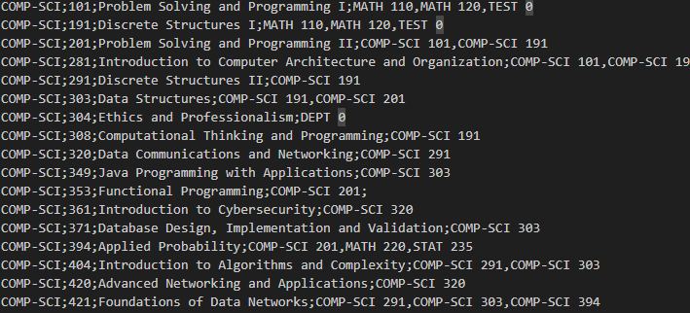
Data
Data Collection Method
Data for courses and prerequisites were obtained from the UMKC Catalog and manually compiled into a file.
Snippet of Catalog.dat file:

Slide 5
Implementation
Implementation Process:
Initial Course object construction in C++
Initial parameters: Category, Number, Name
Completion of Directed Graph
Vector of Course pointers stored in each Course object
Qt Implementation
Creation of CourseNode objects and map
Creation of directed edges
Hover highlighting

Slide 6
Implementation
Implementation Process:
Finding Min. and Max. Prerequisites
Recursively count the prerequisites of each course, including prerequisites of prerequisites
Find minimum and maximum prereqs, ignoring specific categories
(i.e. TEST, DEPT, JUNIOR, and NONE)

Slide 7
Results
Min. and Max. Prereqs:
Minimum with 0 Prerequisites:
COMP-SCI 424 Software Methods and Tools
Maximum with 12* Prerequisites:
COMP-SCI 421 Foundations of Data Networks

Slide 8
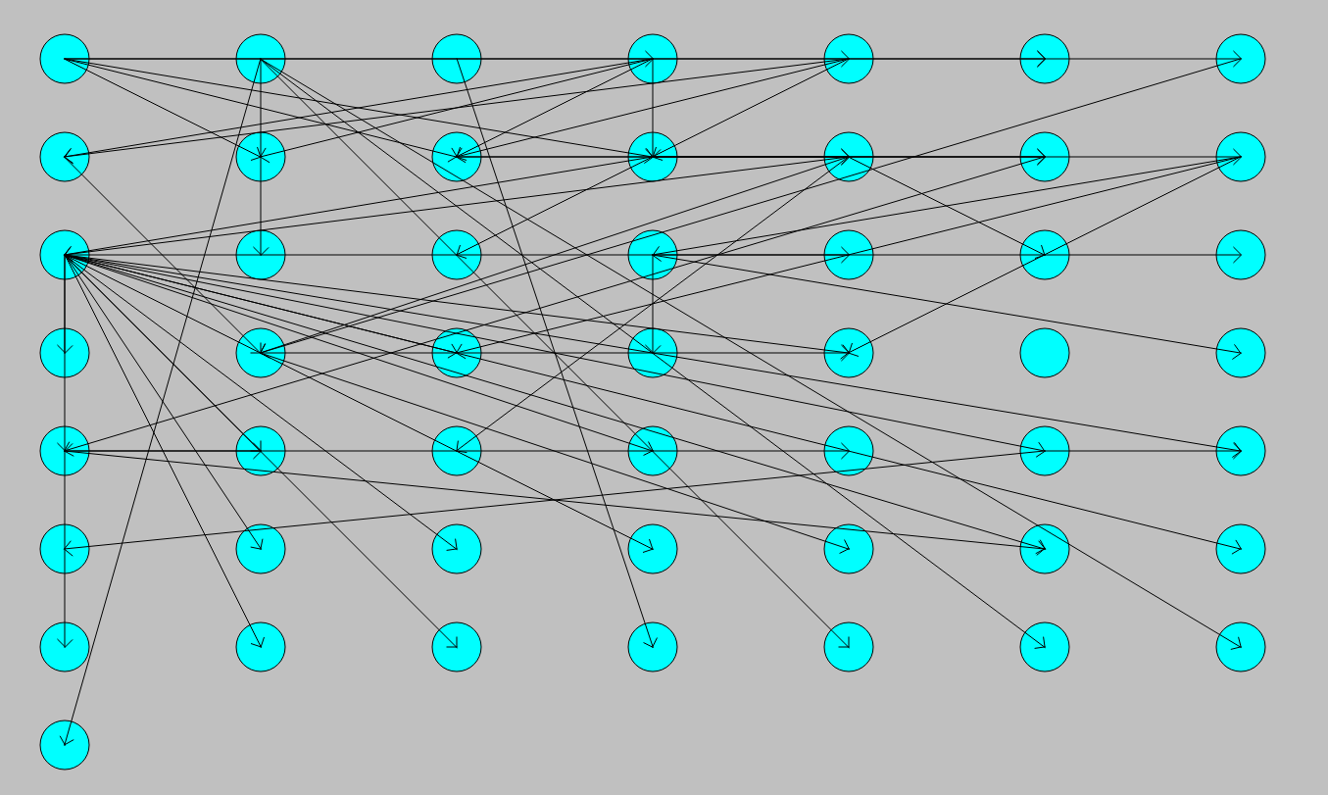
Results
Directed Graph:

Slide 9
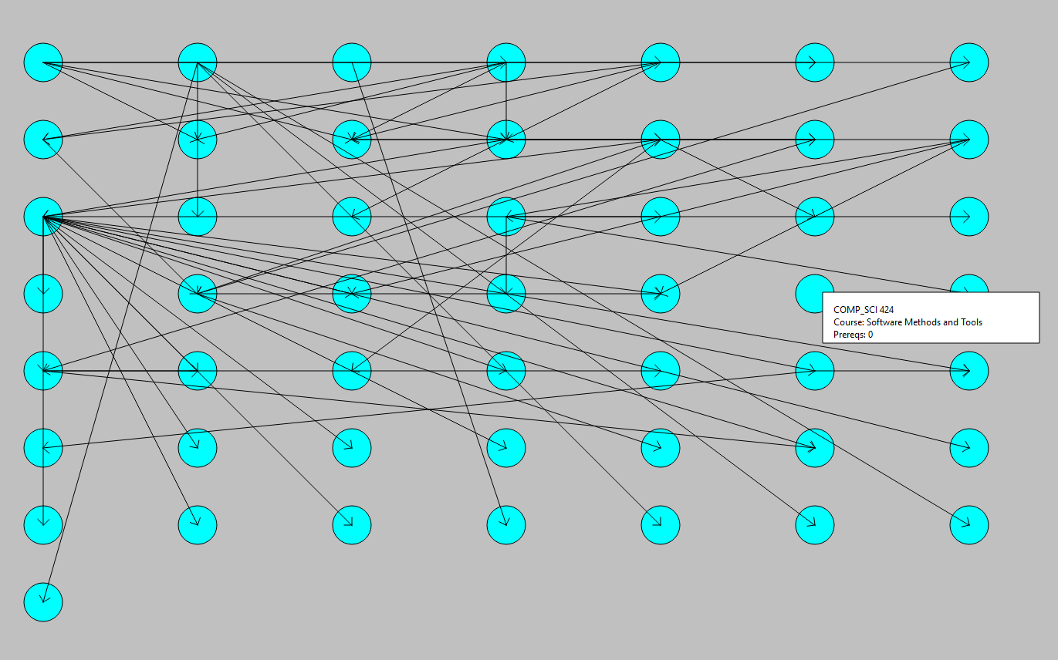
Results

Slide 10
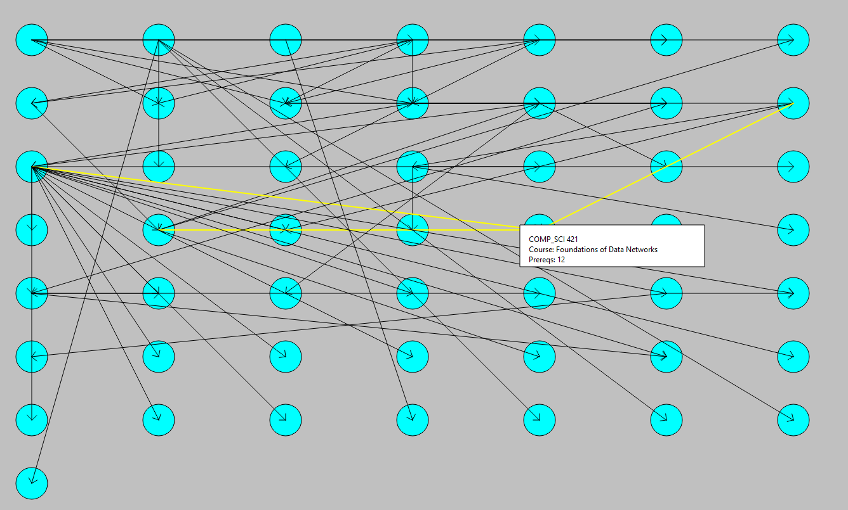
Results

Slide 11
Discussion of Results
Limitations
Small portion of courses selected
Inaccuracies when simplifying for directed graph model
No OR relationships, only AND relationships
Slightly affects maximum number of prerequisites
Possible prerequisites missing from catalog

Slide 12
Discussion of Results
Analysis
Higher-level (4XX) courses for both minimum and maximum
No circular dependencies

Slide 13
Conclusion
Project Objectives:
Modeled course dependencies using a directed graph
Found min. prereqs, max. prereqs, and no circular dependencies
Implemented the directed graph model in C++ with Qt
Future Work:
Project can be expanded to represent the entirety of the UMKC course catalog as a gargantuan directed graph, which could assist students in answering enrollment questions.
Design can be tweaked to be more visually appealing

Slide 14
Questions || Comments
?

Slide 15
References
University of Missouri-Kansas City 2024-2025 Academic Catalog, UMKC
https://catalog.umkc.edu/course-offerings/undergraduate/comp-sci/.
Accessed 16 Nov. 2024.
Source Code
https://github.com/DylanSullins/CS291Project.git

Slide 16
Thank You
!

