Slide 1


CprE Quantum Computing Hackathon
Quantum Random Number Generation
Group: Dylan Brehm, and Josh Deaton

Slide 2
Challenge Goal and Presentation Timeline
Probability Theory
Quantum Gate Formulation
Code
Results
Dylan Brehm and Josh Deaton

Slide 3



Probability Theory
Define the sample space for the measurement of a qubit
An ordered list representing a binary number can be made using a series of measurements
Define our decimal number as a number between 0 and 2^{N}-1
Dylan Brehm and Josh Deaton

Slide 4


Probability Theory
y
13
1 | 1 | 0 | 1
Dylan Brehm and Josh Deaton

Slide 5

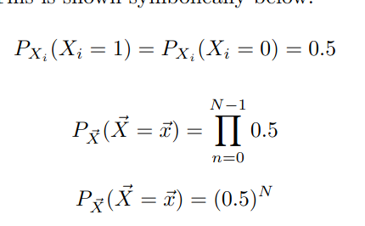
Probability Theory
Independence
Two assumptions are made
The Qubit measurements are independent
The probability of measuring a zero and a one are equal at 50%
Equal Qubit Probability
Dylan Brehm and Josh Deaton

Slide 6
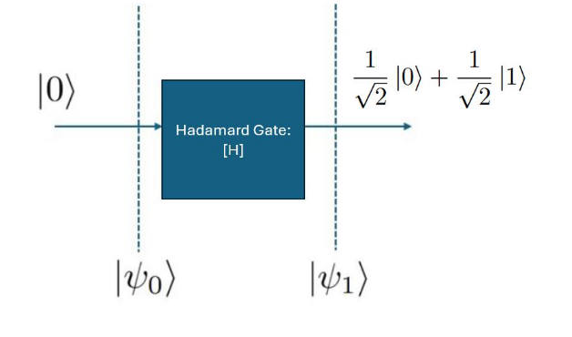
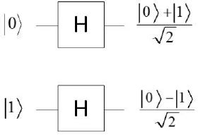
Implementation
Dylan Brehm and Josh Deaton

Slide 7
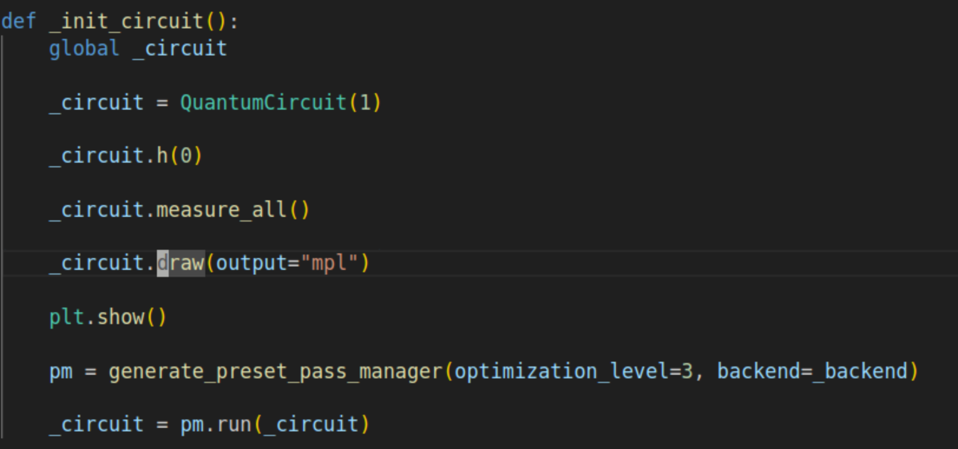
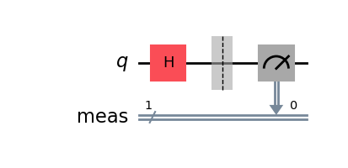
Implementation
By implementing a 1 qubit hadamard gate and measurement in qiskit the theoretical design has been created
Dylan Brehm and Josh Deaton

Slide 8
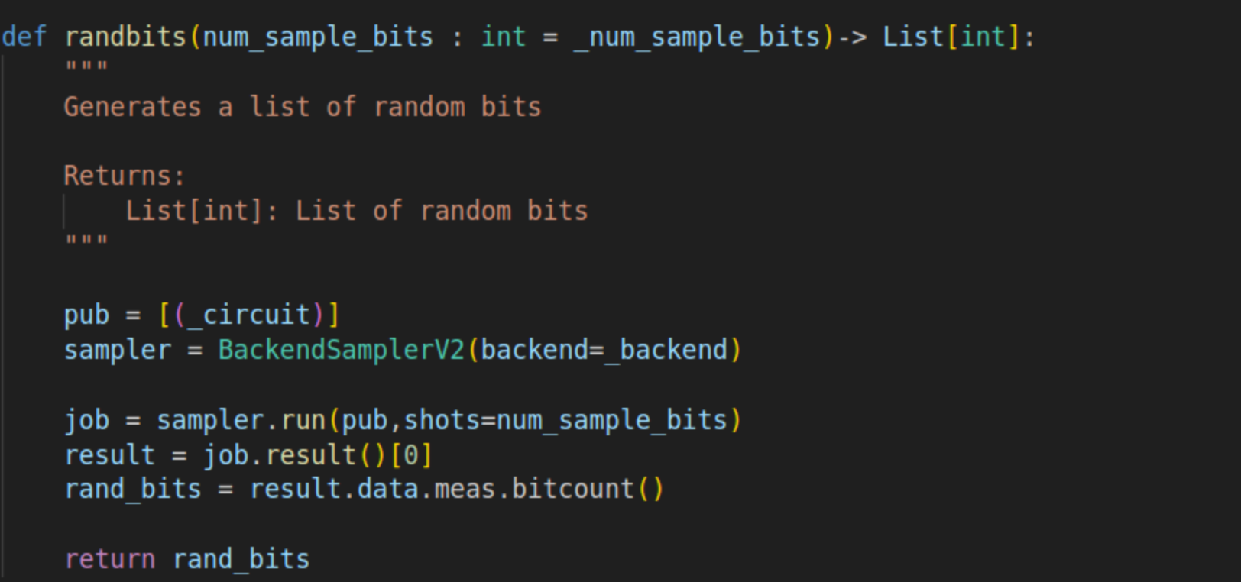
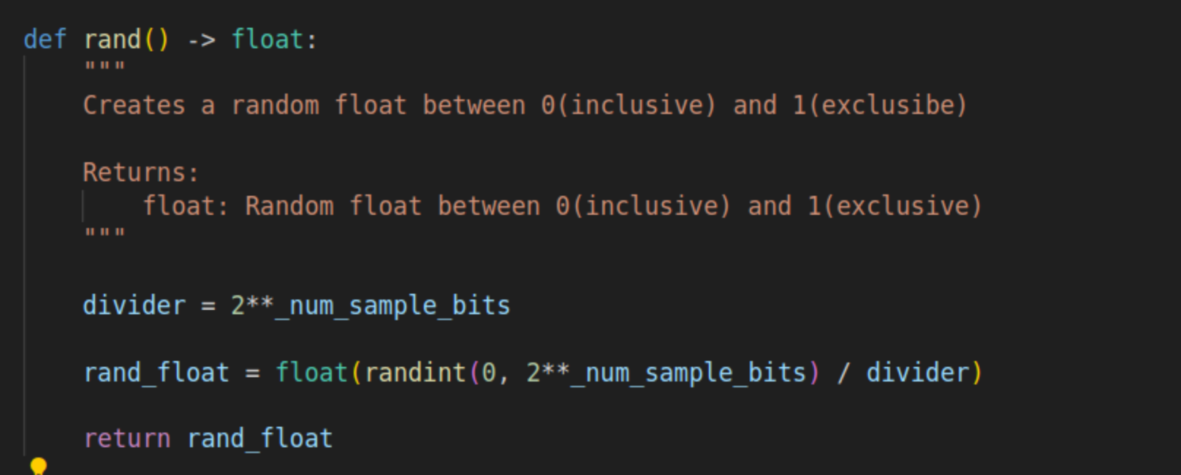
Implementation
A series of random bits can be generated by performing the sampler any number of times
For integer and double generation, a mapping can be performed from 2^64 possible values to the desired number of buckets.
Dylan Brehm and Josh Deaton

Slide 9
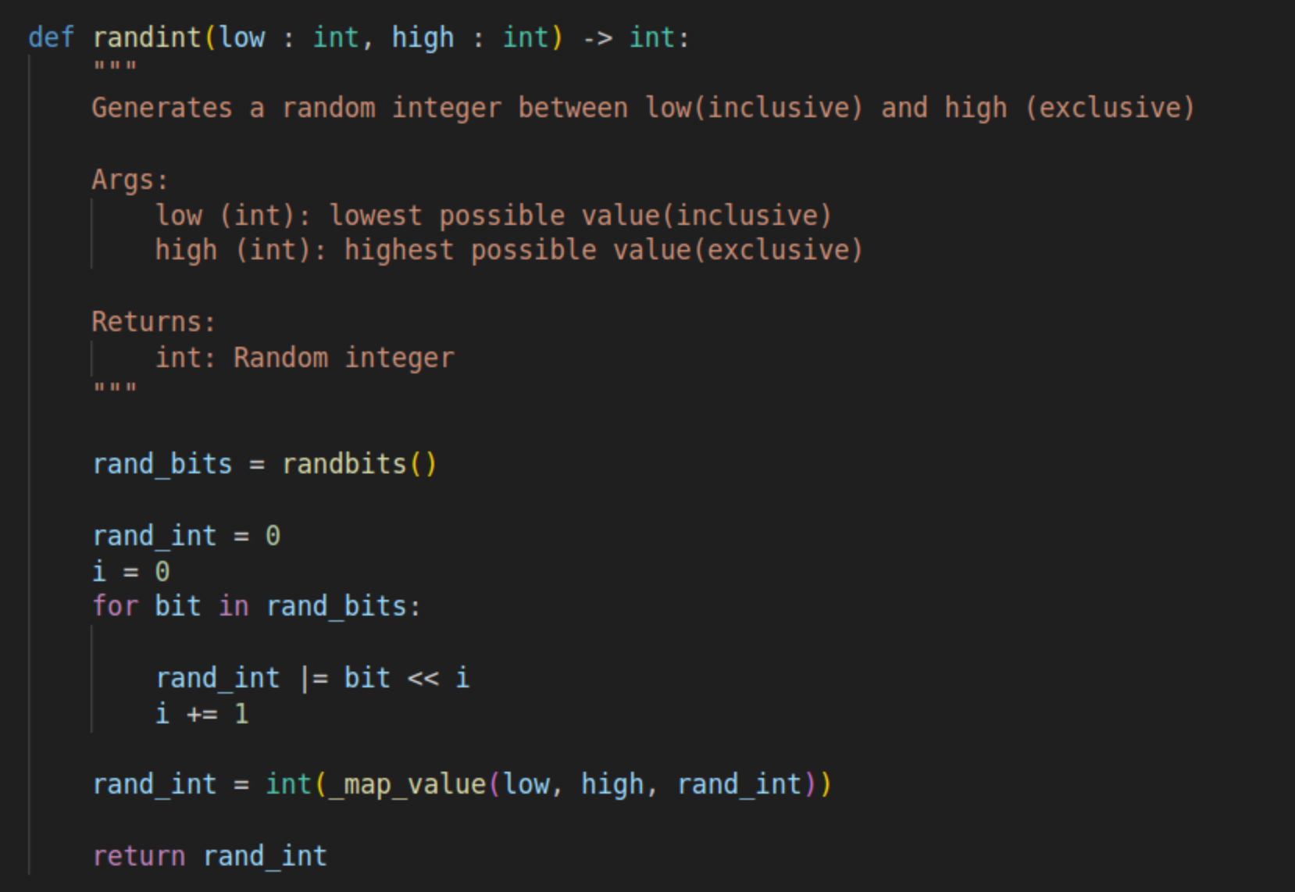
Implementation
The mapping can create a small error for non-factors of 2 as the 2^64 values is not evenly divided into the range
However, using 2^64 bits mitigates this. For example, a user requesting 2000 different values will have a max probability difference of ~5*10^-20. This is much less then the error introduced by the quantum computer itself.
Dylan Brehm and Josh Deaton

Slide 10
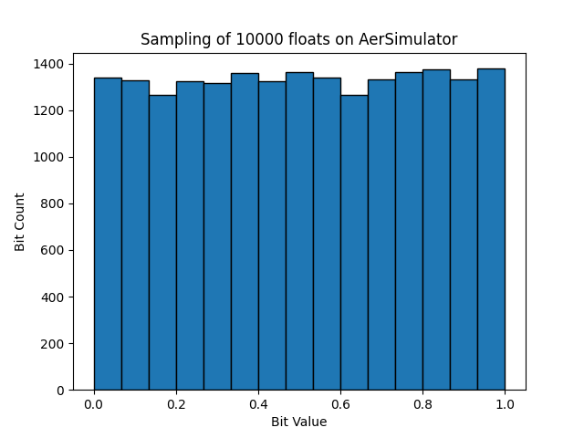
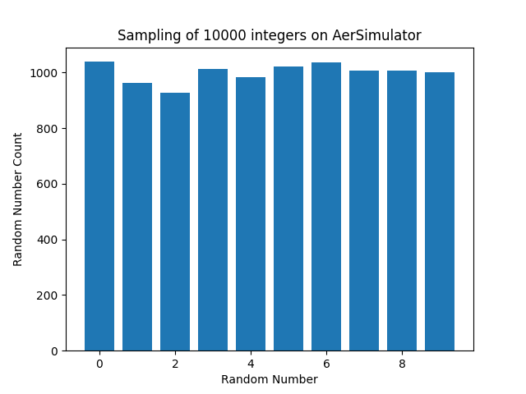
Simulation Results
Float Value
Dylan Brehm and Josh Deaton

Slide 11
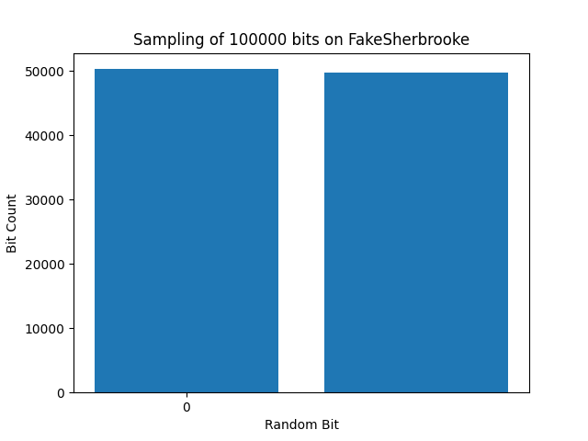
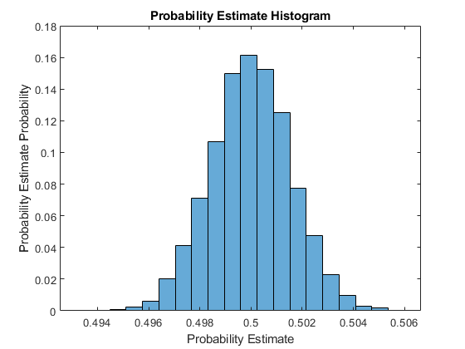
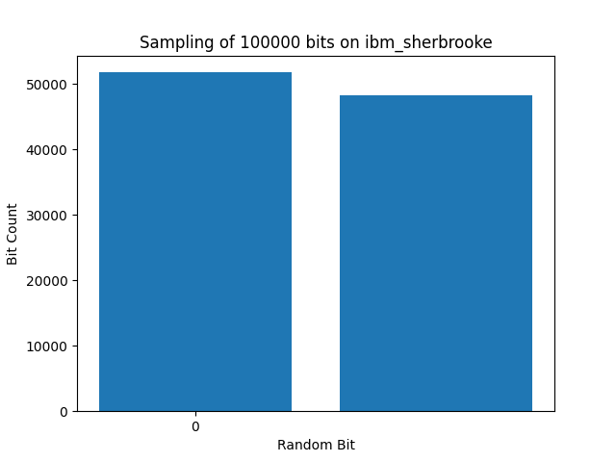
Hardware Results
Estimated probability of getting a 0 on hardware from 100000 samples is 51.7%
The histogram of probability estimates for 100000 sample experiments shows this is highly unlikely
There is error in the hadamard gate
Dylan Brehm and Josh Deaton

Slide 12
Conclusion
It was an enjoyable exercise in quantum computing that allowed us to work on our fundamentals in Qiskit and probability
After seeing our hardware results, it is clear that error mitigation is needed
It would be cool to test how small deviations from equal probability would affect our results
Optimization could be done in the qrand integer and float algorithm as only the bit results could be produced by the hardware in our allotted free 10 minutes
Dylan Brehm and Josh Deaton

Slide 13
Questions?
Dylan Brehm and Josh Deaton

