Slide 1

Publishing
real time Open Data

Slide 2

Are you sure you’re going to get there?

Slide 3
Research questions
How can we keep a cache for route planner up to date in a cost-efficient way for both Open Data publishers and consumers?
How can we consume real time Open Data updates in route planner algorithms in an efficient way?

Slide 4
Specifications
Implementation
Experiments
Conclusion

Slide 5



Goals
Informing commuters in real time
Alternatives based on real time data
Cost-efficient for publishers and users

Slide 6
Open Data
“Open Data is data that can be freely used, re-used and redistributed by anyone – subject only, at most, to the requirement to attribute and sharealike.”
opendatahandbook.org
Reducing maintenance and publication costs

Slide 7
Linked Connections

Slide 8
Specifications
Implementation
Experiments
Conclusion

Slide 9
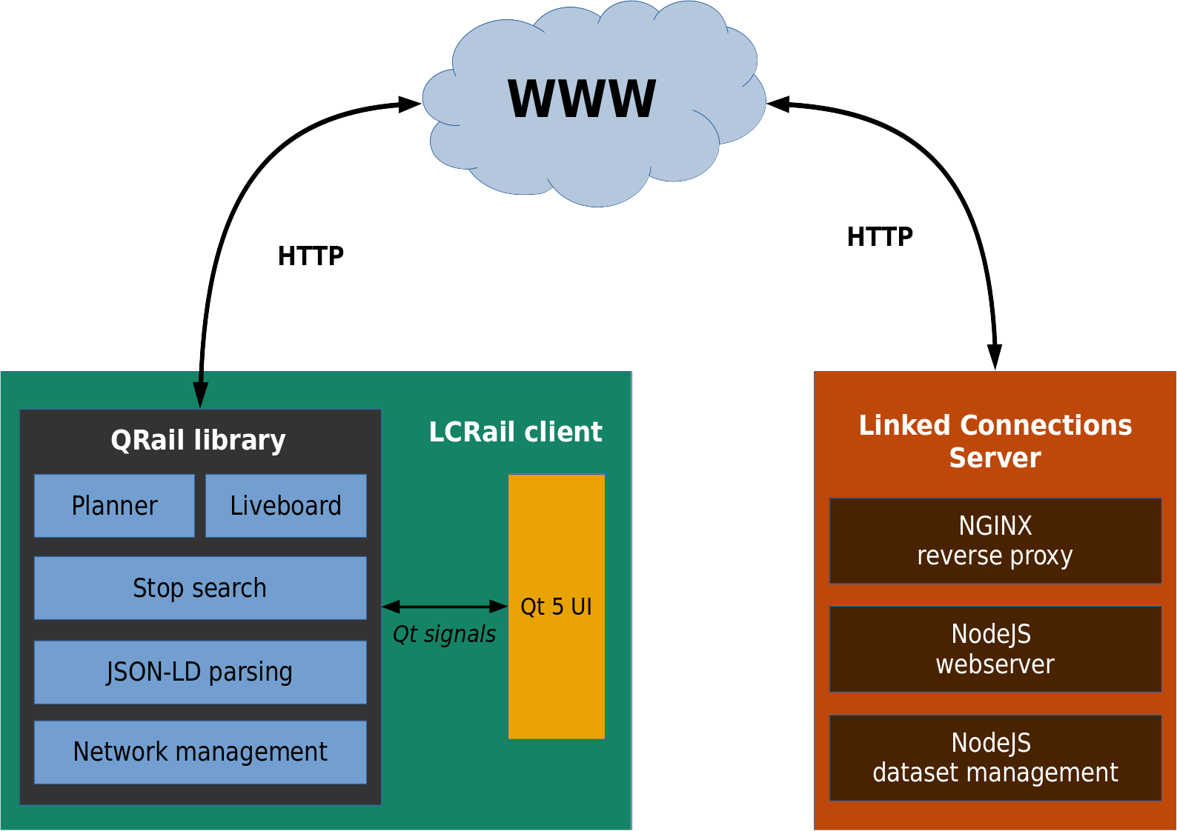
Architecture

Slide 10
Our improvements to Linked Connections
Gtfsrt2lc:Delays and cancellations added
Realtime resource: Added to the Linked Connections Server
Connection Scan Algorithm: rerouting support with real time updates
Liveboard algorithm: departing vehicles in a station with real time updates

Slide 11


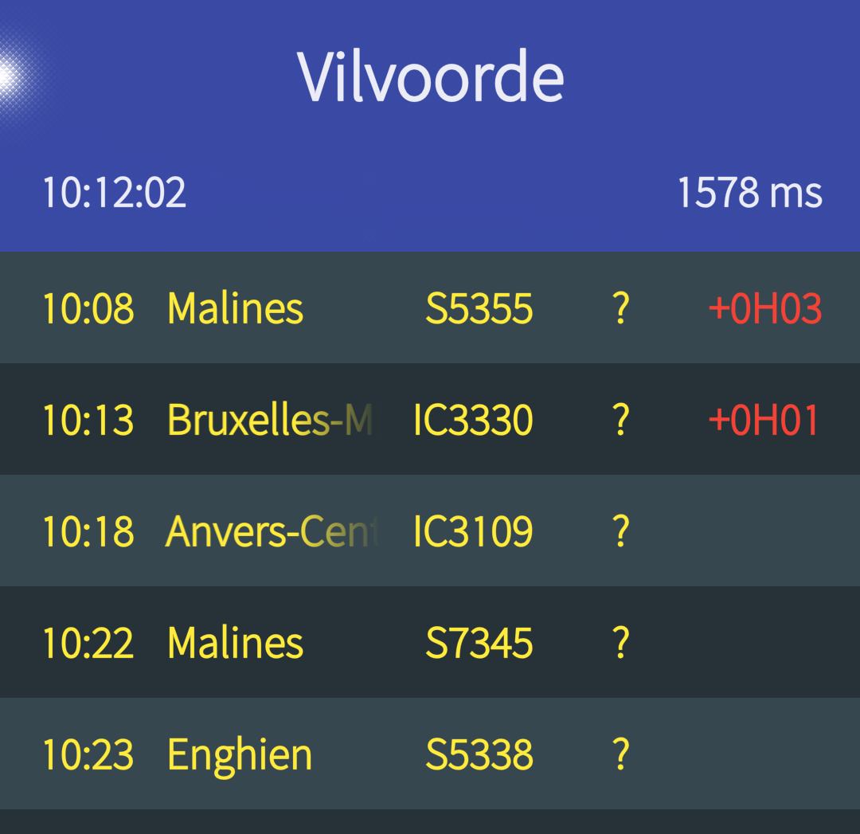
Adding a real time resource to Linked Connections
1. Publishing
of the real
time data
2. Efficiently using the real time data
3. Informing the user
Linked Connections Server
CSA & Liveboard
algorithms in QRail
LCRail
client

Slide 12
Format & transport protocol
HTTP | JSON
Supported by every Web client | Supported by every Web client
Readable by humans & machines | Readable by humans & machines
HTTP caching | Lightweight data format

Slide 13
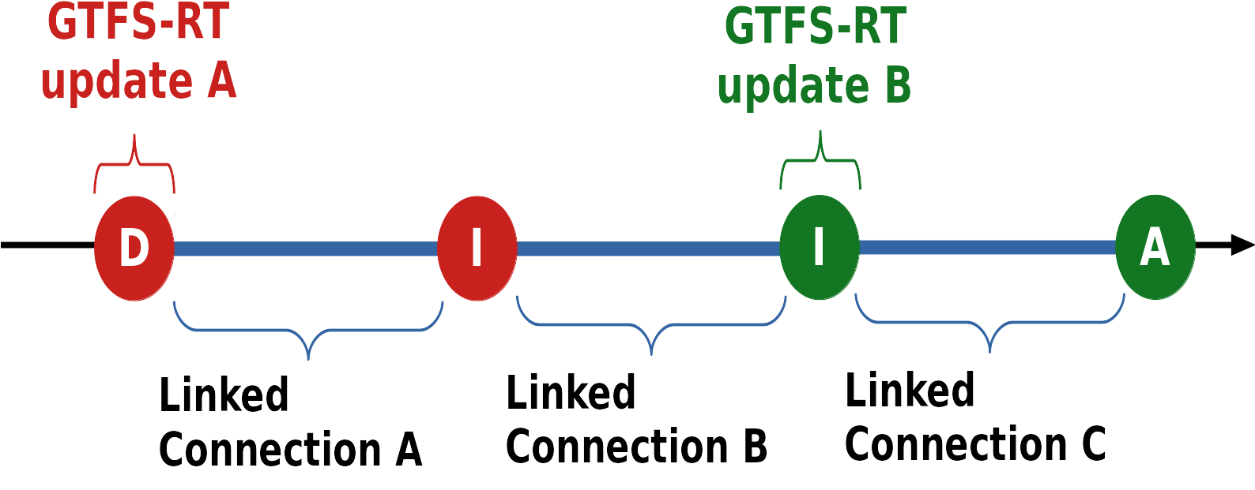
Gtfsrt2lc library
Completely rewrote the algorithm to convert the GTFS-RT data to Linked Connections
Previously, some delays were skipped
Added support for cancelled vehicles

Slide 14
Events Manager
Gtfsrt2lc library
Events Manager
Real time resource
Generates all events from the last X minutes
Publishes only new events
SOSA ontology
HTTP polling
SSE

Slide 15
Adding a real time resource to Linked Connections
1. Publishing
of the real
time data
2. Efficiently using the real time data
3. Informing the user
Linked Connections Server
CSA & Liveboard
algorithms in QRail
LCRail
client

Slide 16
Connection Scan Algorithm routing in QRail

Slide 17
Routing updates in QRail

Slide 18
Liveboard algorithm with updates in QRail

Slide 19
Adding a real time resource to Linked Connections
1. Publishing
of the real
time data
2. Efficiently using the real time data
3. Informing the user
Linked Connections Server
CSA & Liveboard
algorithms in QRail
LCRail
client

Slide 20
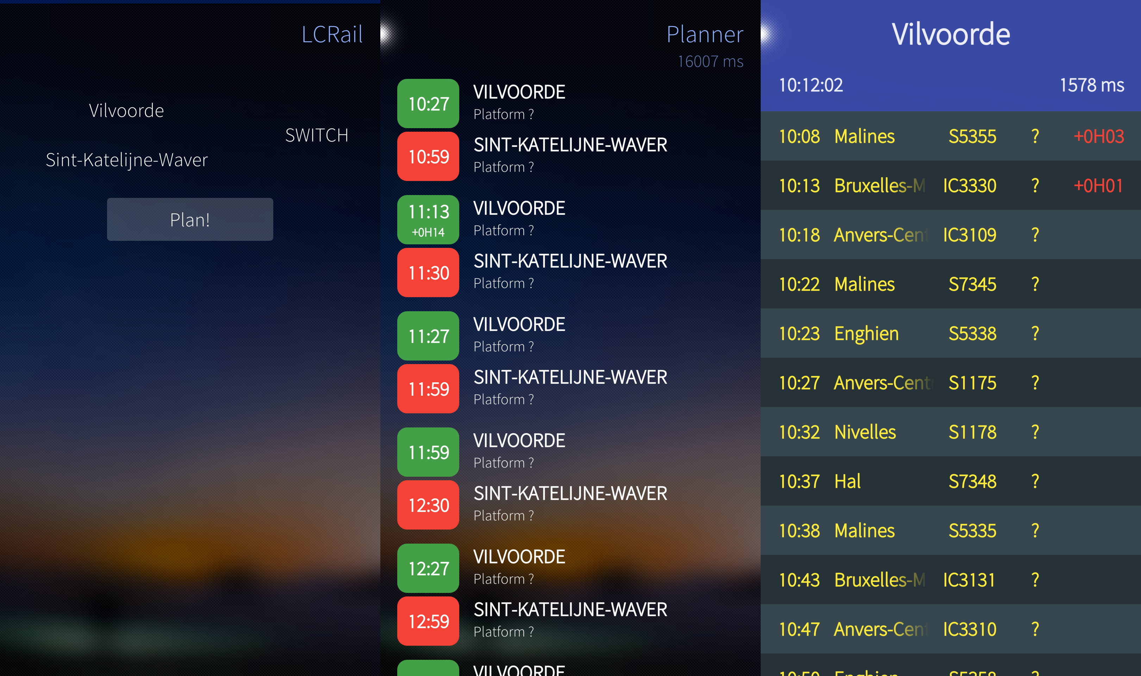
LCRail: informing the user

Slide 21
Specifications
Implementation
Experiments
Conclusion

Slide 22

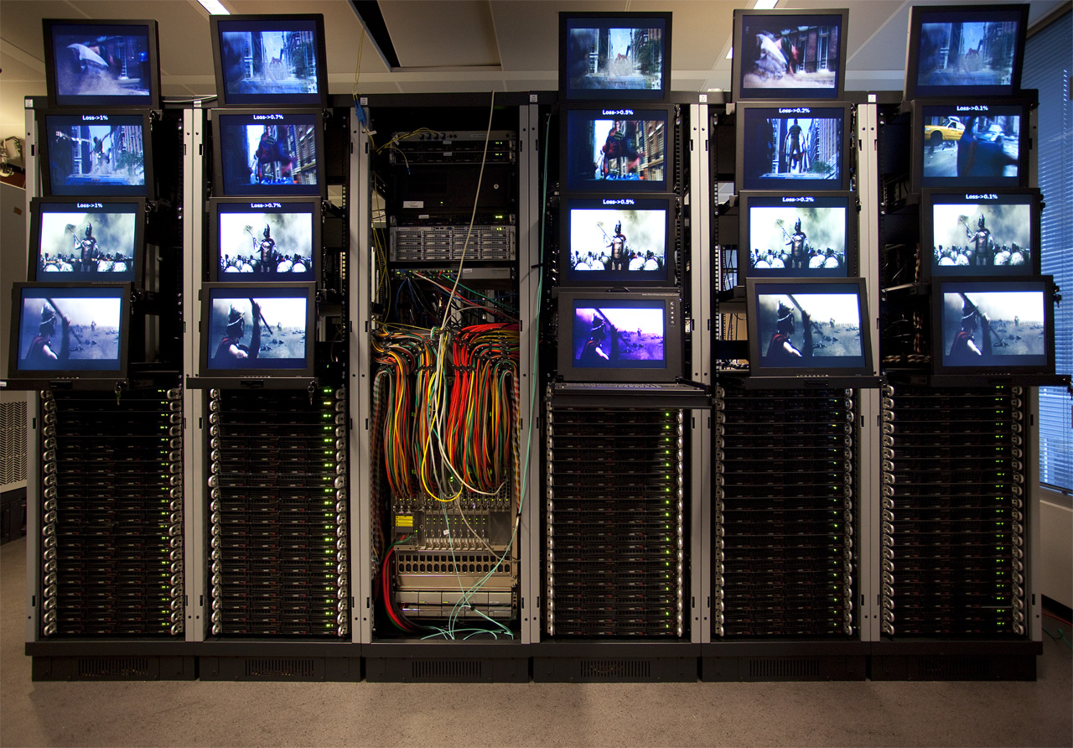

Test environment
Pushing vs polling experiment: Digital Ocean server & Virtual Wall clients
Processing of updates experiment: Digital Ocean server & Sailfish OS clients
Conditions: Each experiment ran for 30 minutes with a clean cache

Slide 23
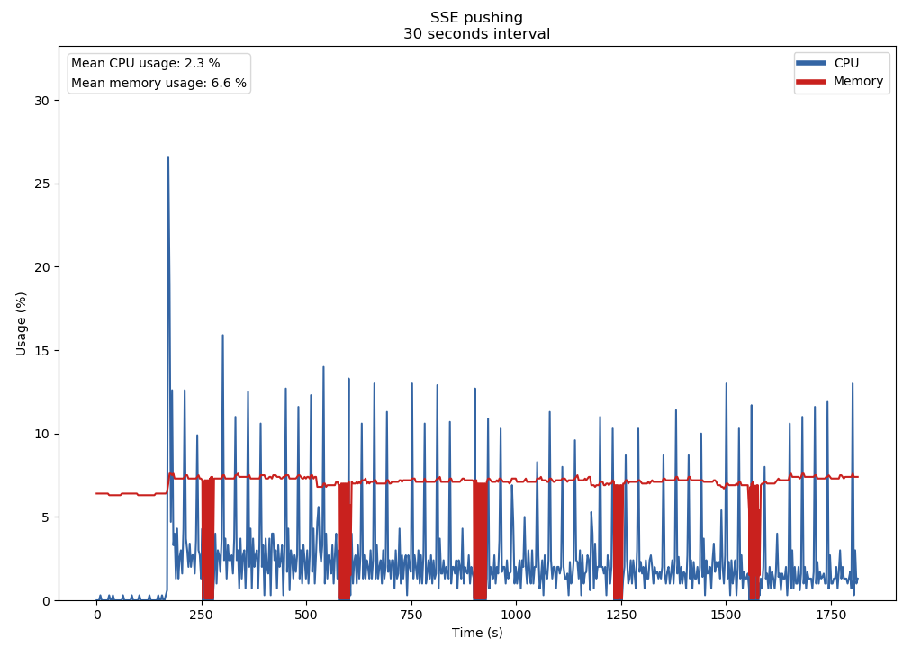
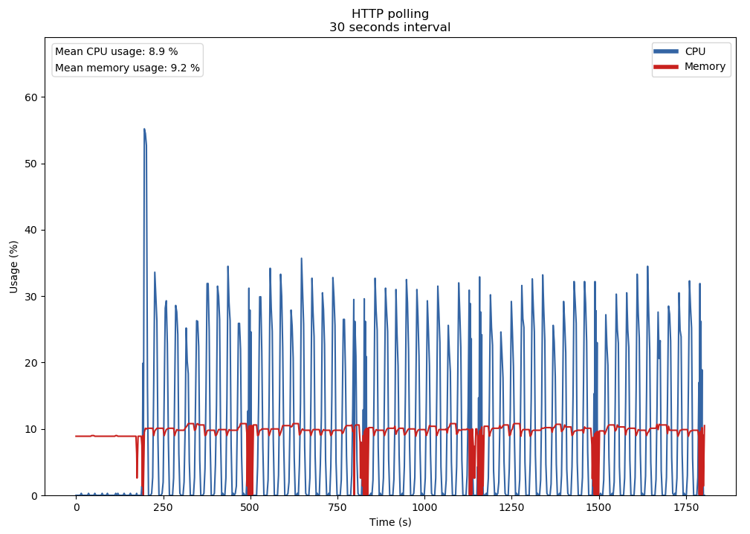
Pushing vs polling: CPU & RAM usage
SSE pushing
HTTP polling
35% peak, 8,9 % mean CPU usage
15% peak, 2,3 % mean CPU usage

Slide 24
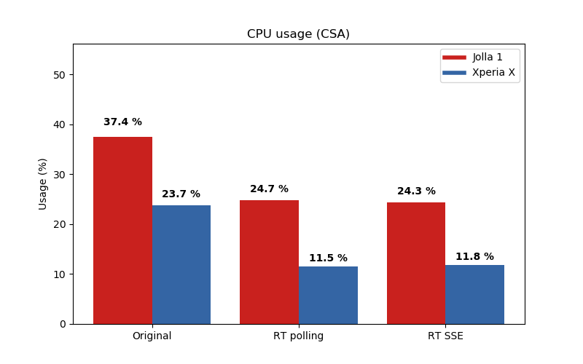
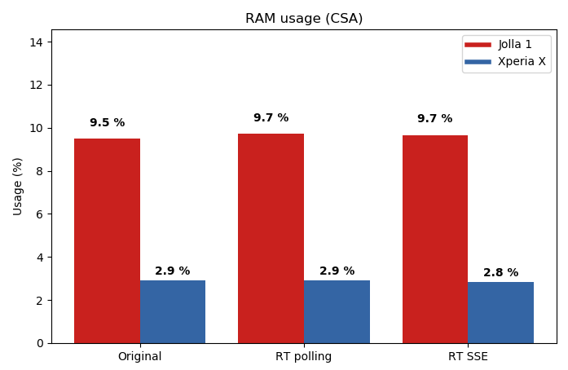
Processing of updates: CPU & RAM usage
Connection Scan Algorithm:
CPU usage
Connection Scan Algorithm:
RAM usage
RAM usage stays the same
Less CPU usage

Slide 25
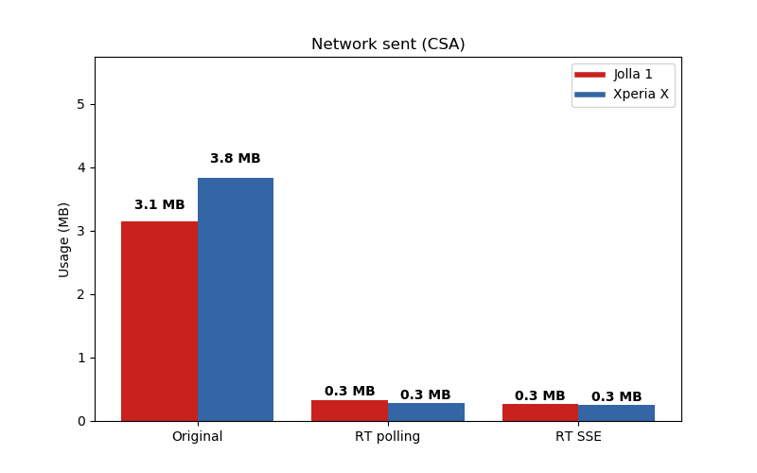
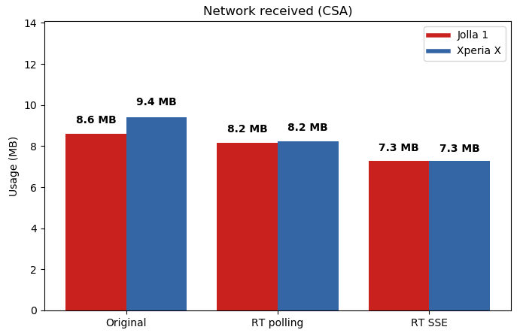
Processing of updates: bandwidth usage
Connection Scan Algorithm:
Bandwidth usage (sent)
Connection Scan Algorithm:
Bandwidth usage (received)
Less bandwidth usage

Slide 26
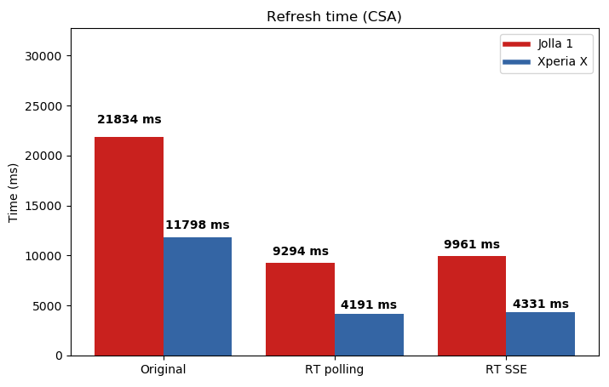
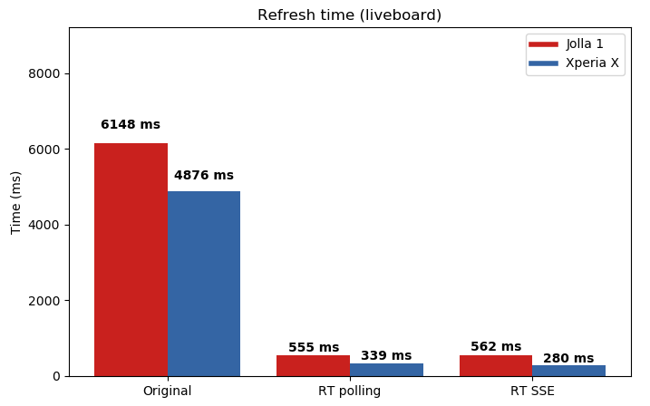
Processing of updates: User informed time
Connection Scan Algorithm:
User informed time
Liveboard algorithm:
User informed time

Slide 27
Demo: Connection Scan Algorithm in LCRail

Slide 28
Demo: Liveboard in LCRail

Slide 29
Specifications
Implementation
Experiments
Conclusion

Slide 30
How can we keep a cache for route planners up to date in a cost-efficient way for both Open Data publishers and consumers?
Pushing: Let the server push the data to the clients with SSE
Real time resource: Less bandwidth and processing power is needed
Updates only: Only process the changes to the data

Slide 31
How can we consume real time Open Data updates in route planner algorithms in an efficient way?
Real time data processing: Extra logic is needed
Updates only: Processing only the changes to the data, reduces the CPU and bandwidth usage
Faster computation: The user is informed faster about the changes to his or her trip

Slide 32
Achieved goals
Information: Notifications from LCRail keep the commuters informed in real time
Alternatives: Alternative routes are generated automatically for the commuters
Cost-efficient: Bandwidth and CPU usage is reduced with our real time resource

Slide 33
Thank you for your attention!
Are there any questions?

