Slide 1
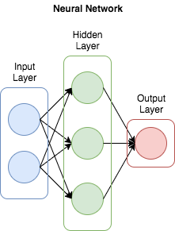

Creating 2 Neural Networks
Steps to Implement
Input = 50, Hidden = 25,Output = 1
Input = 100, Hidden = 50,Output = 1
The Code
A
Prepping the text data
Store Top Word 50 Words
Extracting process
Training the classifier
A
2
1
A
A
Messages
Messages
Spam
or
Ham
Spam
or
Ham

