Slide 1
How To Drive Your Server Like You Stole It: Data Compression
Hotsos 2018
Andy Weiss & Kirby Sand

Slide 2
Review of Data Blocks
block dump in hex
human readable
7FE32965FFF0 43415004 01012C4B 54415203 7D970601 [.PACK,...RAT...}]
0xe:pti[0] nrow=2 offs=0
0x12:pri[0] offs=0x1f91
0x14:pri[1] offs=0x1f89
block_row_dump:
tab 0, row 0, @0x1f91
tl: 7 fb: --H-FL-- lb: 0x1 cc: 1
col 0: [ 3] 52 41 54
tab 0, row 1, @0x1f89
tl: 8 fb: --H-FL-- lb: 0x1 cc: 1
col 0: [ 4] 50 41 43 4b
row directory
human friendly
Notes:
Big endian
This is a dump
Consider table definition and insert statement
Mention Ric talk (look at schedule)

Slide 3
Compression Types for Data Blocks
Basic
Deduplication within a data block
FREE !!
Advanced
Like basic but can be used for active tables
Not free ☹
HCC
Can only be used with an HCC supported platform
Notes:
Row store compress advanced (new name for oltp(new name for all operations))

Slide 4
Basic vs Advanced
Basic compresses only once during a direct path load
you have to recreate the blocks by moving the table
Advanced will automatically recompress blocks when they fill up with uncompressed data
Notes:
Updates kill compression, cant add/remove columns

Slide 5
Compressed Data Block
0x16:pti[0] nrow=1 offs=0
0x1a:pti[1] nrow=728 offs=1
0x1e:pri[0] offs=0x1f73
...
block_row_dump:
tab 0, row 0, @0x1f73
tl: 13 fb: --H-FL-- lb: 0x0 cc: 1
col 0: [10] 41 41 41 41 41 41 41 41 41 41
bindmp: 02 d8 d2 41 41 41 41 41 41 41 41 41 41
tab 1, row 0, @0x1f6f
tl: 4 fb: --H-FL-- lb: 0x0 cc: 1
col 0: [10] 41 41 41 41 41 41 41 41 41 41
bindmp: 2c 00 01 00
...
two tables
same column
different lengths

Slide 6
Multicolumn Tokens
block_row_dump:
tab 0, row 0, @0x1f5c
tl: 36 fb: --H-FL-- lb: 0x0 cc: 3
col 0: [10] 41 41 41 41 41 41 41 41 41 41
col 1: [10] 42 42 42 42 42 42 42 42 42 42
col 2: [10] 43 43 43 43 43 43 43 43 43 43
bindmp: 02 d0 03 d2 41 41 41 41 41 41 41 41 41 41 d2 42 42 42 42 42 42 42 42 42 42 d2 43 43 43 43 43 43 43 43 43 43
tab 1, row 0, @0x1f58
tl: 4 fb: --H-FL-- lb: 0x0 cc: 3
col 0: [10] 41 41 41 41 41 41 41 41 41 41
col 1: [10] 42 42 42 42 42 42 42 42 42 42
col 2: [10] 43 43 43 43 43 43 43 43 43 43
bindmp: 2c 00 01 00
One token for three columns

Slide 7
Finding Tokens
Bytes | Meaning
00 – c7 | Token byte
c9 - f9 | Length byte
fa + 2bytes | Multibyte length
fb + 2bytes | Multibyte token
Row Header
Column 1
Column 2
Column 3
bindmp: 2c 00 03 d0 32 4d 58 54 53 50 4d 4c 00 d0 32 57 55 51 54 49 42 53
Notes:
Add table for reference
Explain how col1 and col3 random to compress

Slide 8
Tokens all the way down
block_row_dump:
tab 0, row 0, @0x1f64
tl: 15 fb: --H-FL-- lb: 0x0 cc: 2
col 0: [10] 41 41 41 41 41 41 41 41 41 41
col 1: [10] 42 42 42 42 42 42 42 42 42 42
bindmp: 01 69 02 02 d2 42 42 42 42 42 42 42 42 42 42
...
tab 0, row 2, @0x1f73
tl: 13 fb: --H-FL-- lb: 0x0 cc: 1
col 0: [10] 41 41 41 41 41 41 41 41 41 41
bindmp: 00 02 d2 41 41 41 41 41 41 41 41 41 41
tab 1, row 0, @0x1f51
tl: 4 fb: --H-FL-- lb: 0x0 cc: 2
col 0: [10] 41 41 41 41 41 41 41 41 41 41
col 1: [10] 42 42 42 42 42 42 42 42 42 42
bindmp: 2c 00 01 00
Table 0 points
to itself
Table 1 still
the same
Notes:
Tolken table row header

Slide 9
Column Reordering
Column order
for this block
...
perm_9ir2[3]={ 0 2 1 }
...
block_row_dump:
tab 0, row 0, @0x1f67
tl: 25 fb: --H-FL-- lb: 0x0 cc: 2
col 0: [10] 41 41 41 41 41 41 41 41 41 41
col 1: [10] 42 42 42 42 42 42 42 42 42 42
bindmp: 01 d5 02 d2 41 41 41 41 41 41 41 41 41 41 d2 42 42 42 42 42 42 42 42 42 42
tab 1, row 0, @0x1f58
tl: 15 fb: --H-FL-- lb: 0x0 cc: 3
col 0: [10] 41 41 41 41 41 41 41 41 41 41
col 1: [10] 42 42 42 42 42 42 42 42 42 42
col 2: [10] 49 4a 4d 4f 52 4a 48 45 59 41
bindmp: 2c 00 02 00 d2 49 4a 4d 4f 52 4a 48 45 59 41
insert into creorder values('AAAAAAAAAA',
dbms_random.string('u',10),
'BBBBBBBBBB');
Notes:
This happens at the block level
When does it compress? Formula?

Slide 10
Better Buffer Cache
Notes:
no need to decompress in buffer cache

Slide 11
Experimental Matrix
We measured table size after turning the following knobs
Compression vs. No Compression
Compression while sorting data before inserts
Block Size (8K/16K/32K)
Separate vs. Combined Parent/Child Tables
Normalized vs. Demornalized data

Slide 12
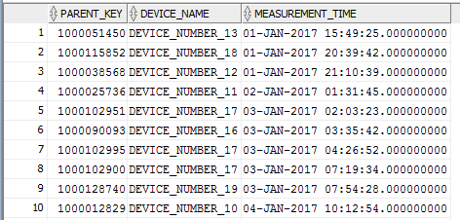
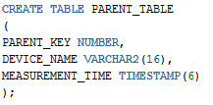
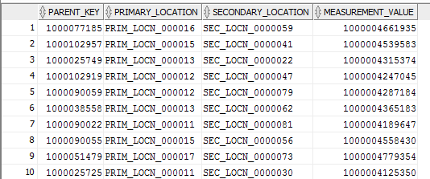
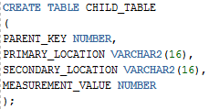
Example Data
Parent Table
Child Table

Slide 13
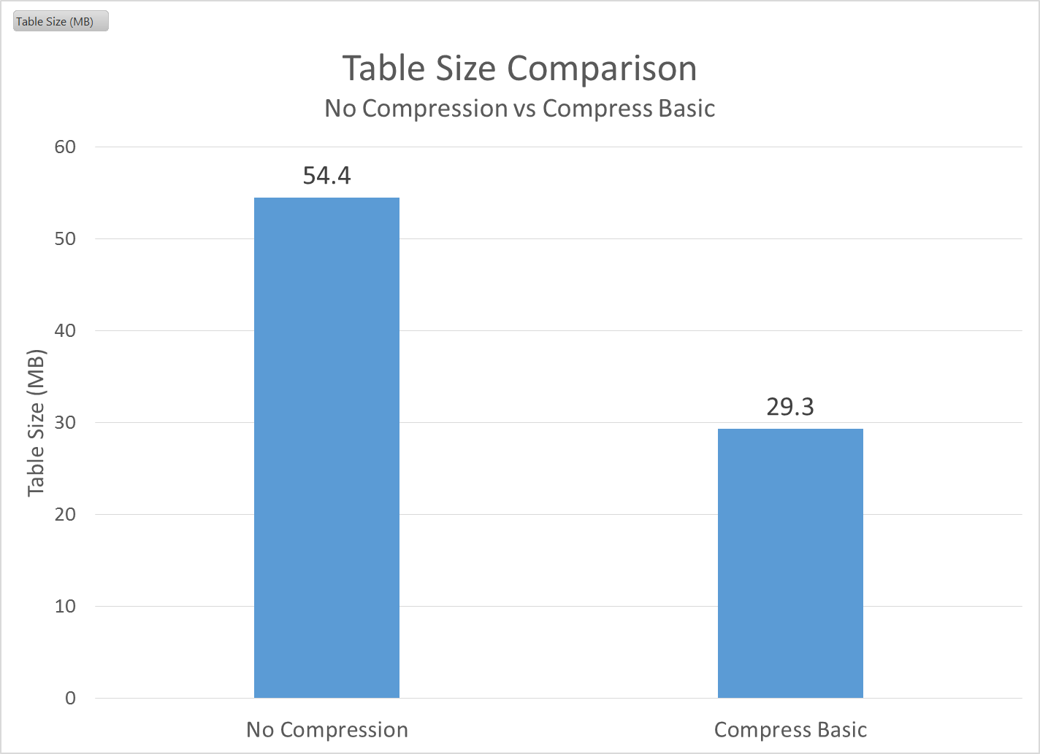
Compressed vs. Uncompressed
No surprise here, compression is good.
Default compression ratio = 1.86X
Now that we know how the Oracle block compression algorithm works, can we organize the data to make it even better?

Slide 14
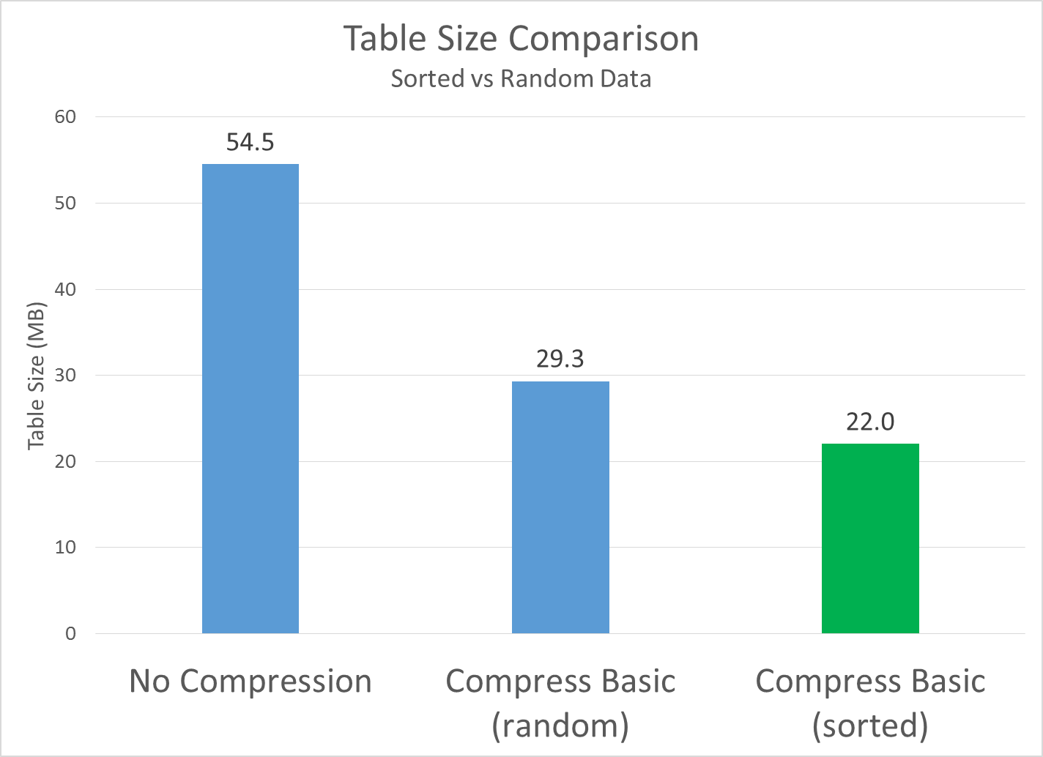
Sorted vs. Random Data
Wow, that’s a pretty big difference!
We know that at the block level Oracle creates tokens to replace the actual row values.
If we sort our rows before we insert them, starting with the lowest cardinality columns, we can guarantee to have a lot of repeat values.
We know that Oracle will rearrange columns in order to enable creating multi-column tokens
New compression ratio = 2.48X

Slide 15
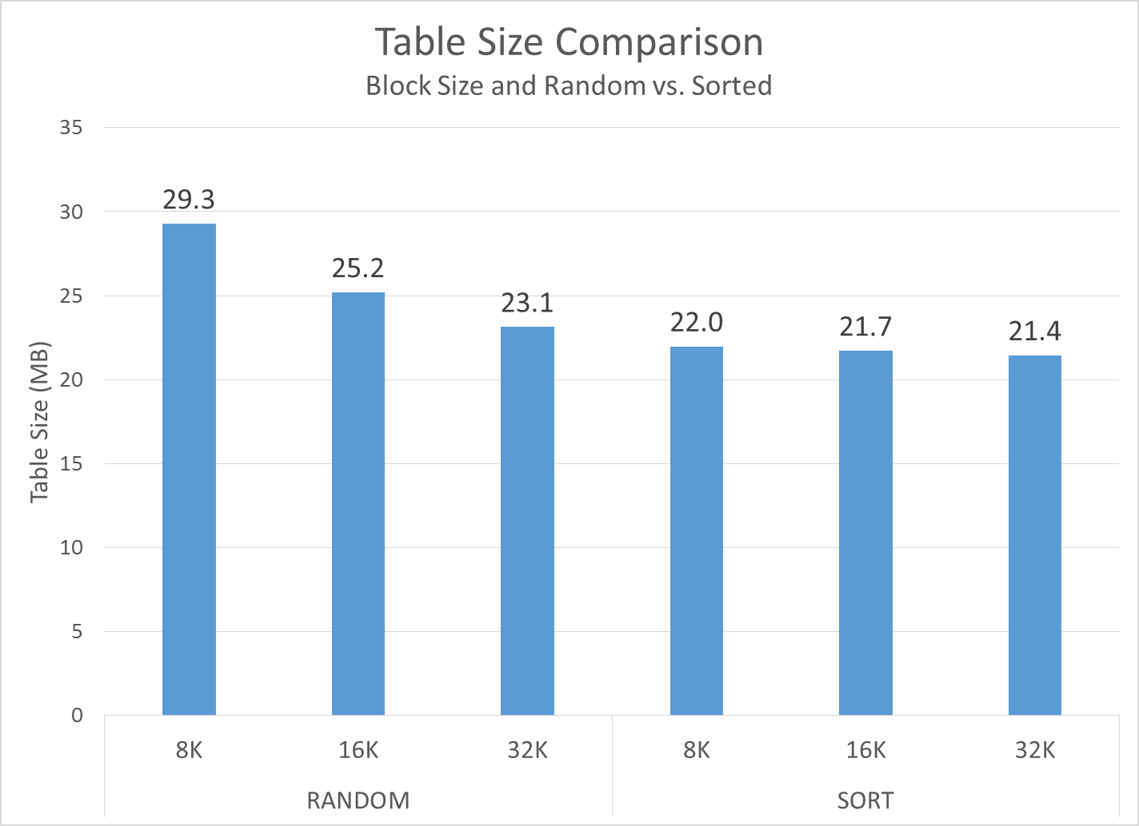
Block Size & Sorted vs. Random
Very Interesting results…
Block size really matters when you don’t sort the data before you insert.
32K is a lot better than 8K
When you sort the data, the effects of 32K blocks is much smaller.

Slide 16
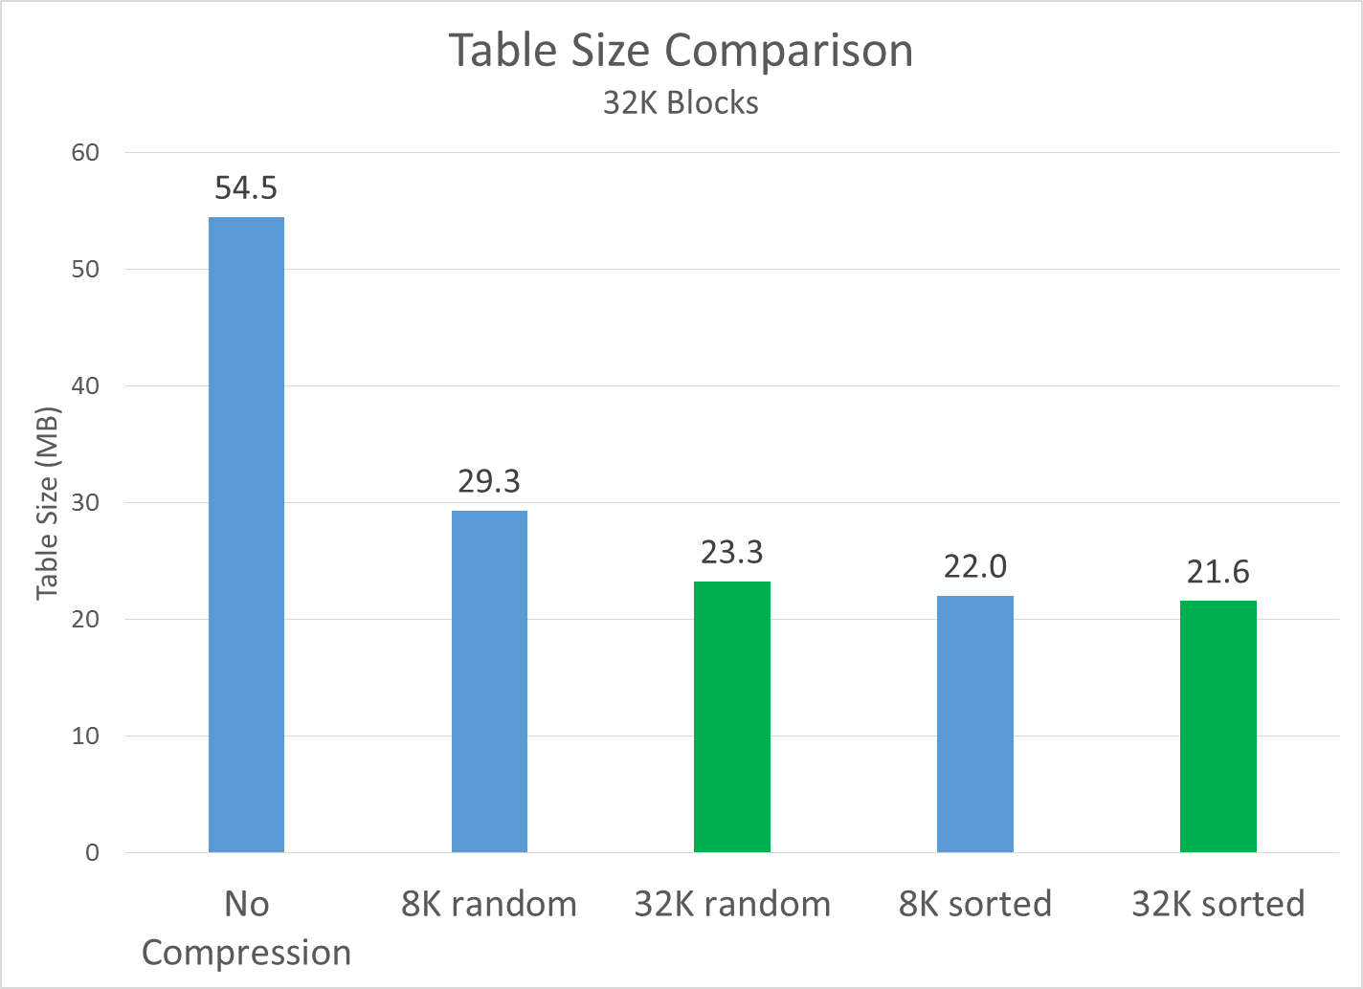
32K Blocks
If we use 32K blocks but don’t‘ sort:
Things still improve a lot compred to 8K random
Compression Ratio = 2.34X
If we use 32K blocks and we also sort:
Things improve only slightly relative to 8K sorted data
New compression ratio = 2.52X

Slide 17
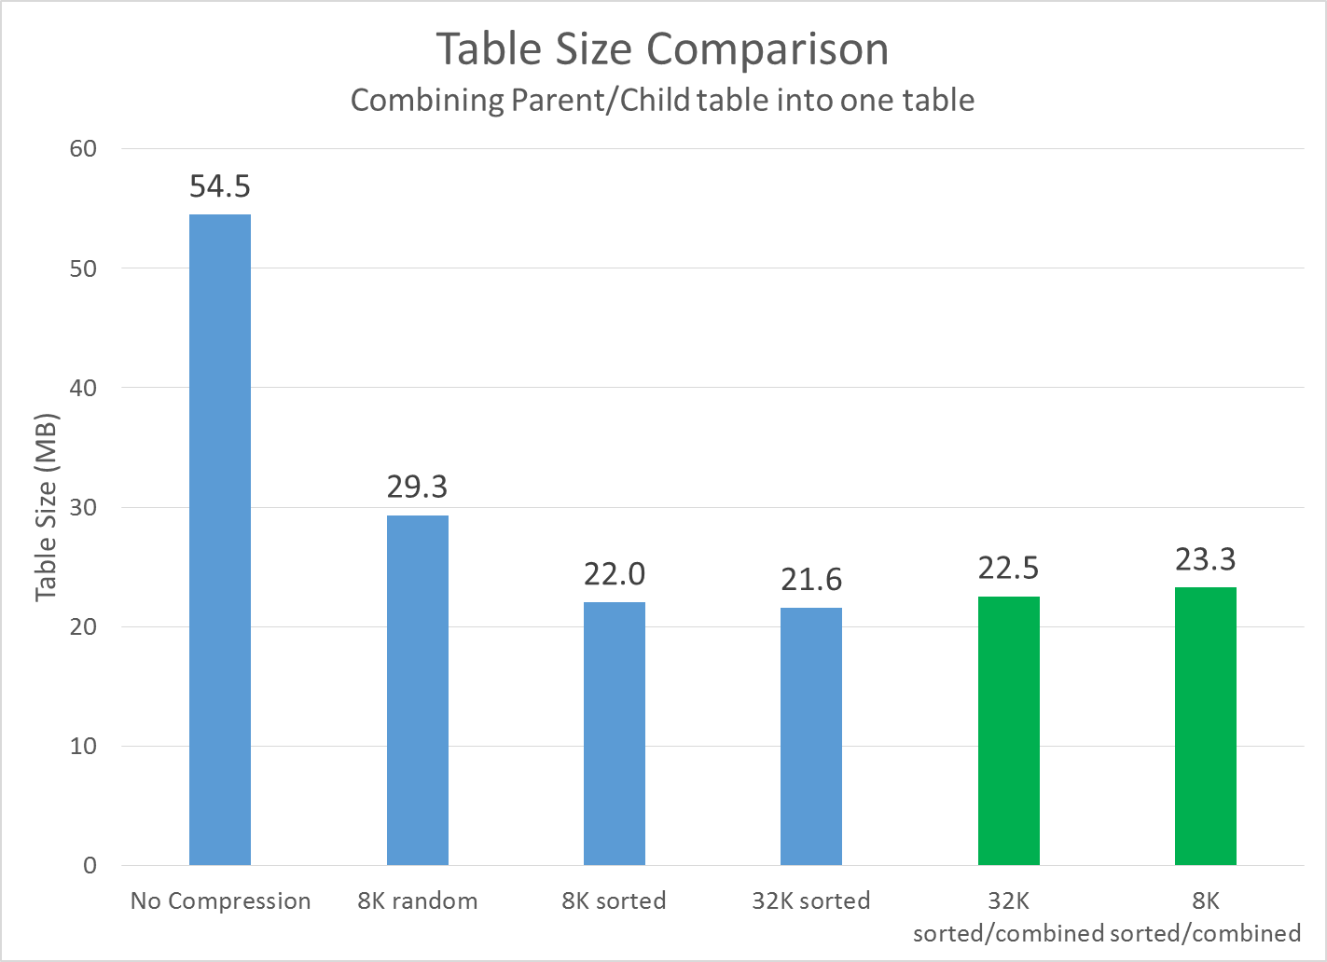
Combining Parent/Child Tables into One Table
It’s obvious, but you do pay a storage price if you combine your parent/child tables into one table.
In this example, that price is relatively small.
Your results may vary, but I almost always have to join my parent/child tables before I can run a query. Combining them into one table will greatly speed up query performance.
New compression ratio
32K = 2.42X
8K = 2.34X

Slide 18
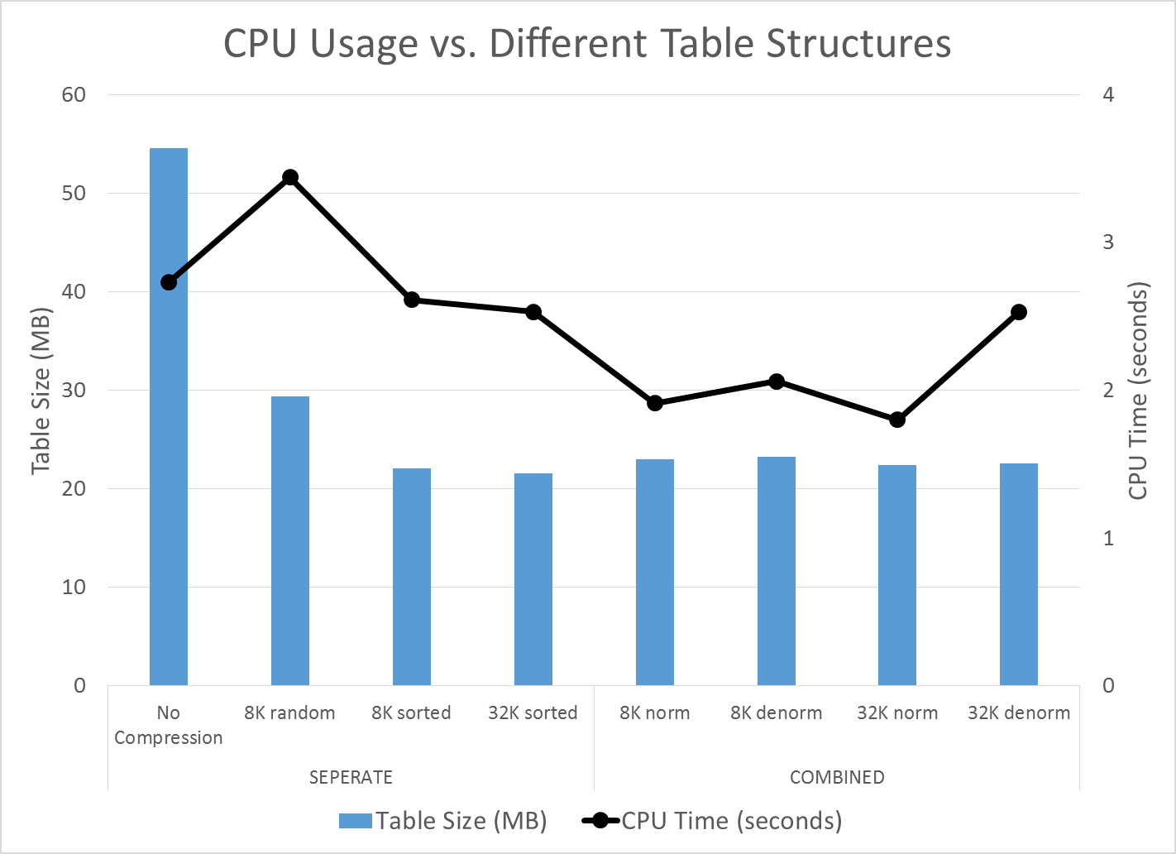
CPU Usage
Very interesting results…
Moving from uncompressed to compressed/random shows an increase in CPU usage. This is as expected as it requires CPU to decompress the block.
I was not expecting CPU usage for the compressed/sorted blocks to be better than nocompress.
Moving from separate tables to combined tables makes the CPU usage go down quite a bit. This also makes sense as you don’t need to do a join which costs CPU.
I was not expecting the normalized tables to require less CPU than the denormalized tables.
Normalized tables require a join with the reference tables.
*Used Snapper to gather CPU data

Slide 19
Conclusions
Compression is an absolute must as data volumes start to really grow.
Sorting your data can yield significant improvements on storage size.
There is a small price to pay for combining parent/child tables into one table.
There is a large improvement in query performance when these tables are combined.
Normalizing warehouse data may result in smaller storage requirements, but greatly increases the complexity of a system.
For my system I really wish we would have never started off doing this and I am strongly considering backing out of that decision.

Slide 20
Thank you
Hotsos!
OSU Computer Science Students
Alex Schultz
Dylan Davis
Trevor Hammock
All the great Oracle Bloggers

Slide 21
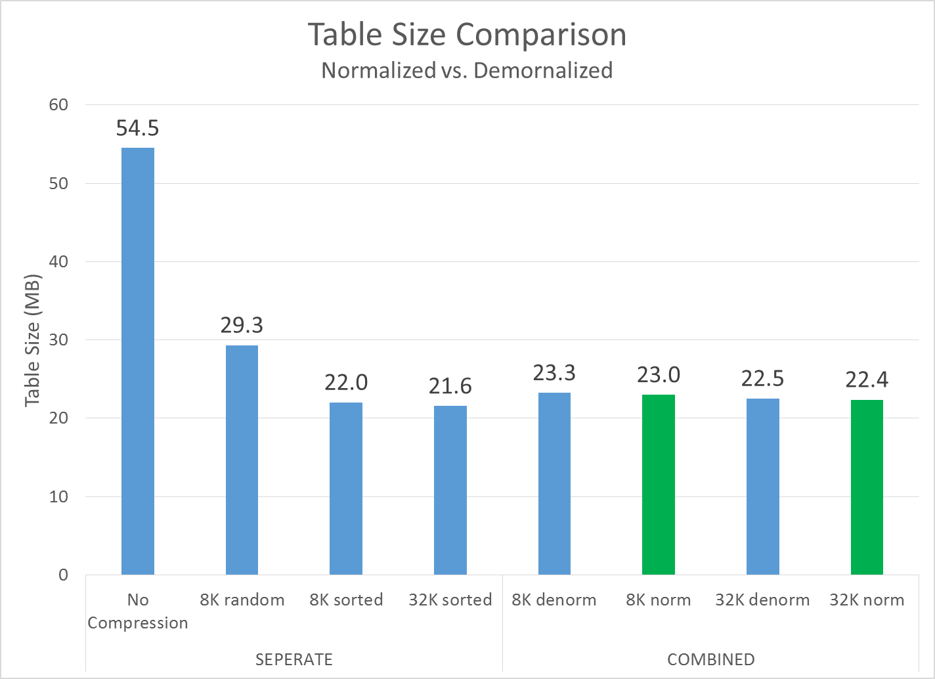
Normalized vs. Denormalized Tables
You can normalize your data and get some improvement in storage size.
In our case, when we say normalize what we’re really doing is storing static VARCHAR data as a number.
In a way, this is essentially what Oracle is doing for me with compression.
Not doing it would greatly simplify my system.

