Slide 1
How To Drive Your Server Like You Stole It: Data Compression
Hotsos 2018
Andy Weiss & Kirby Sand

Slide 2
Intro: Who Are We?
Kirby Sand (kirby.sand@hp.com)
Lead Analyst
Andy Weiss (andy.weiss@hp.com)
Senior DBA
Our System
Running Oracle 12.1
15TB Data Warehouse

Slide 3
Presentation Overview
Data Block Compression Options
basic vs. advanced
Block Compression Fundamentals
What’s going on under the hood
Experimental Results
Compression Ratio w/ Turning Various Knobs
CPU Usage
Conclusions/Future Work
Questions

Slide 4
Compression Types for Data Blocks
Basic
Deduplication within a data block
Basic compresses only once during a direct path load
PCTFREE 0
Included with EE
Advanced
Like basic but can be used for active tables
Advanced will automatically recompress blocks as they fill
PCTFREE 10
Advanced Compression option license
Hybrid Columnar Compression (HCC)
Can only be used with an HCC supported platform
Notes:
There are only a few choices for data block compression
Row store compress advanced (new name for oltp(new name for all operations))
With Basic compression you cannot add/remove columns.
Basic only compresses block during direct path load operations.
Updates kill compression, If there are inserts and updates the table will need to be rebuilt to recompress.
Direct load of unchanging data is best case.
Advanced recompresses blocks as they fill up.
[dba | all | user]_tables contains 2 columns COMPRESSION and COMPRESS_FOR that indicate if the tale is compresses and the compression type respectively.
Basic is what we are looking at:
- We can do most offline because our large raw tables are not directly accessed by the reporting layer.
- Easy to coordinate among analysts.
- We are archiving historic data that rarely changes.
Doc ID 1223705.1

Slide 5
Review of an Uncompressed Data Blocks
COL1
RAT
PACK
block dump in hex
human readable
7FE32965FFF0 43415004 01012C4B 54415203 7D970601 [.PACK,...RAT...}]
0xe:pti[0] nrow=2 offs=0
0x12:pri[0] offs=0x1f91
0x14:pri[1] offs=0x1f89
block_row_dump:
tab 0, row 0, @0x1f91
tl: 7 fb: --H-FL-- lb: 0x1 cc: 1
col 0: [ 3] 52 41 54
tab 0, row 1, @0x1f89
tl: 8 fb: --H-FL-- lb: 0x1 cc: 1
col 0: [ 4] 50 41 43 4b
row directory
human friendly
Notes:
This is a block dump
Mention Ric talk (on monday)
little endian
43415004 01012C4B 54415203
Becomes (for those of us that read left to right)
04504143 4b2c0101 03524154
Matches what we see in ‘block_row_dump’
04(length byte) 5041434b(PACK) 2c0101 (row header) 03(length byte) 514154 (RAT)
Important points
tl -> total length
rows and tables start at 0
pti -> table directory
pri -> row directory

Slide 6
Compressed Data Block
COL1
AAAAAAAAAA
AAAAAAAAAA
AAAAAAAAAA
0x16:pti[0] nrow=1 offs=0
0x1a:pti[1] nrow=728 offs=1
0x1e:pri[0] offs=0x1f73
...
block_row_dump:
tab 0, row 0, @0x1f73
tl: 13 fb: --H-FL-- lb: 0x0 cc: 1
col 0: [10] 41 41 41 41 41 41 41 41 41 41
bindmp: 02 d8 d2 41 41 41 41 41 41 41 41 41 41
tab 1, row 0, @0x1f6f
col tl: 4 fb: --H-FL-- lb: 0x0 cc: 1
0: [10] 41 41 41 41 41 41 41 41 41 41
bindmp: 2c 00 01 00
...
two tables
same column
different lengths
Notes:
Replace repeating column values with symbols stored in the same block
All or nothing for columns
- a column is compressed as a unit and each column in a row has one and only one symbol or length byte.
(( Where are the flag byte, lock byte, and column count for compressed blocks? ))
A couple of differences between the compressed block and the uncompressed one.
- First off, it doesn’t look like what I think of when I think compression.
I was thinking complicated algorithms that would render the data unreadable.
(( any chance the compression could be hidden by the dump mechanism? ))
But what I see here looks a lot like a regular block dump.
- The next thing to notice is that there are two tables listed in the table directory. As we see here, there are two ‘pti’ entries. Table 0 and table 1.
- There is also a new field included with each row, the binary dump.
(( show how binary dump matches hex dump? ))
You see that table 0, row 0 is 13 bytes and contains the actual row data.
But, if you look down here at table 1, row 0 is only 4 bytes.
So how can these rows contain the same data but have different column lengths? Well, it has to do with the way Oracle’s compression algorithm works.
It finds duplicate values at the column level and replaces them with symbols. These symbols are stored within the block In a special symbol table. Table 0 in the example. The actual value is then replaced with row number in the symbol table that represents the value.
If you look at table 1 row 0, here is the flag byte, lock byte, and column count then a 00. This directs you to table 0 row 0 which is where the actual value for the column is stored.

Slide 7
Not All Columns Are Compressed…
COL1 | COL2
AAAAAAAAAA | OZCQVLMUID
AAAAAAAAAA | HQJFWERAAS
AAAAAAAAAA | AUFLETNDIL
block_row_dump:
tab 0, row 0, @0x1f73
tl: 13 fb: --H-FL-- lb: 0x0 cc: 1
col 0: [10] 41 41 41 41 41 41 41 41 41 41
bindmp: 01 d7 d2 41 41 41 41 41 41 41 41 41 41
tab 1, row 0, @0x1f64
tl: 15 fb: --H-FL-- lb: 0x0 cc: 2
col 0: [10] 41 41 41 41 41 41 41 41 41 41
col 1: [10] 4f 5a 43 51 56 4c 4d 55 49 44
bindmp: 2c 00 02 00 d2 4f 5a 43 51 56 4c 4d 55 49 44
Notes:
Here is another compressed block. This time we notice that not all of the columns in the data table contain pointers to symbols.
By inserting values that we know were unique within the block, we can see that oracle seems to only create symbols for values that occur more than once.
This makes since because if the values only occurs once, it will take more bytes to store the data. The overhead for a symbols is at least 1 byte for the symbol, 2 bytes for a usage count, and 2 bytes for the symbol table row directory entry.
So we would need to save at least 5 bytes for compression to be worthwhile.
Another thing to note if your table does not contain enough data to fill up a block then it will not be compressed.
(( Only less than one block, or does this apply to the last block of the table? ))
I would like to also point your attention to what should be the length byte. This column is definitely not that long.
So how do you tell the difference between symbols and length bytes?

Slide 8
Finding Symbols
Bytes | Meaning
00 – c7 | Symbol byte
c8 - f9 | Length byte
fa + 2bytes | Multibyte length
fb + 2bytes | Multibyte symbol
COL1 | COL2 | COL3
D2MXTSPML | AAAAAAAAAA | D2WUQTIBS
Row Header
Column 1
Column 2
Column 3
bindmp: 2c 00 03 d0 32 4d 58 54 53 50 4d 4c 00 d0 32 57 55 51 54 49 42 53
Notes:
To do this test, Column 1 and column 3 are random values.
The symbol table works by overloading the length bytes. 0 - 199 are reserved for symbols. The length is calculated by adding 200 to the length, but the last 6 are reserved for special purposes which we will discuss as needed. We already know that FF is set aside for null.
So, what happens when we have a value whose length is greater than 50 or more than 199 symbols?
Well just as with an uncompressed block, they will need to be represented with multiple bytes. These are will be three bytes each, a special character to indicate what it is followed by two bytes for the value.
Here you can see the binary dump of a compressed row.

Slide 9
Multicolumn Symbols
COL1 | COL2 | COL3
AAAAAAAAAA | BBBBBBBBBB | CCCCCCCCCC
AAAAAAAAAA | BBBBBBBBBB | CCCCCCCCCC
block_row_dump:
tab 0, row 0, @0x1f5c
tl: 36 fb: --H-FL-- lb: 0x0 cc: 3
col 0: [10] 41 41 41 41 41 41 41 41 41 41
col 1: [10] 42 42 42 42 42 42 42 42 42 42
col 2: [10] 43 43 43 43 43 43 43 43 43 43
bindmp: 02 d0 03 d2 41 41 41 41 41 41 41 41 41 41 d2 42 42 42 42 42 42 42 42 42 42 d2 43 43 43 43 43 43 43 43 43 43
tab 1, row 0, @0x1f58
tl: 4 fb: --H-FL-- lb: 0x0 cc: 3
col 0: [10] 41 41 41 41 41 41 41 41 41 41
col 1: [10] 42 42 42 42 42 42 42 42 42 42
col 2: [10] 43 43 43 43 43 43 43 43 43 43
bindmp: 2c 00 01 00
One symbol for three columns
Notes:
So lets take a look at this block.
You see something strange happening with the row data. It looks just like the single column compressed row.
Because symbols are stored in a table and the symbol itself is just a rownumber, multiple columns can be replaced by a single symbol

Slide 10
Column Reordering
COL1 | COL2 | COL3
AAAAAAAAAA | IJMORJHEYA | BBBBBBBBBB
AAAAAAAAAA | HQJFWERAAS | BBBBBBBBBB
AAAAAAAAAA | AUFLETNDIL | BBBBBBBBBB
...
perm_9ir2[3]={ 0 2 1 }
...
block_row_dump:
tab 0, row 0, @0x1f67
tl: 25 fb: --H-FL-- lb: 0x0 cc: 2
col 0: [10] 41 41 41 41 41 41 41 41 41 41
col 1: [10] 42 42 42 42 42 42 42 42 42 42
bindmp: 01 d5 02 d2 41 41 41 41 41 41 41 41 41 41 d2 42 42 42 42 42 42 42 42 42 42
tab 1, row 0, @0x1f58
tl: 15 fb: --H-FL-- lb: 0x0 cc: 3
col 0: [10] 41 41 41 41 41 41 41 41 41 41
col 1: [10] 42 42 42 42 42 42 42 42 42 42
col 2: [10] 49 4a 4d 4f 52 4a 48 45 59 41
bindmp: 2c 00 02 00 d2 49 4a 4d 4f 52 4a 48 45 59 41
Column order
for this block
Notes:
This happens at the block level
In order to replace multiple columns with a single symbol, they must be contiguous.
Should we put columns with the most likelihood of a duplicate value first?
Should our column order be dictated by the cardinality?
Not really. The algorithm gives us the best of both worlds. Oracle will look at the data and reorder the columns to give us the best compression.
Because this compression happens at the block level, each block can have a different column order.
The permutation maps how to recreate the row in the column order specified during table creation. This does, however, limit you to only 1 permutation per block.

Slide 11
Symbols all the way down
COL1 | COL2
AAAAAAAAAA | BBBBBBBBBB
AAAAAAAAAA | BBBBBBBBBB
AAAAAAAAAA | CCCCCCCCCC
AAAAAAAAAA | CCCCCCCCCC
block_row_dump:
tab 0, row 0, @0x1f64
tl: 15 fb: --H-FL-- lb: 0x0 cc: 2
col 0: [10] 41 41 41 41 41 41 41 41 41 41
col 1: [10] 42 42 42 42 42 42 42 42 42 42
bindmp: 01 69 02 02 d2 42 42 42 42 42 42 42 42 42 42
...
tab 0, row 2, @0x1f73
tl: 13 fb: --H-FL-- lb: 0x0 cc: 1
col 0: [10] 41 41 41 41 41 41 41 41 41 41
bindmp: 00 02 d2 41 41 41 41 41 41 41 41 41 41
tab 1, row 0, @0x1f51
tl: 4 fb: --H-FL-- lb: 0x0 cc: 2
col 0: [10] 41 41 41 41 41 41 41 41 41 41
col 1: [10] 42 42 42 42 42 42 42 42 42 42
bindmp: 2c 00 01 00
Table 0 points
to itself
Table 1 still
the same
Notes:
Symbol rows can contain reference to other symbols within the block.
This is why length bytes are overloaded in the symbol table as well.
Unknowns:
Symbol table row header?
ITL and symbol table?

Slide 12
Better Buffer Cache
Blocks are read into the buffer cache in the compressed form.
The lower CPU and IO cost when dealing with compressed blocks.
Block level compression means minimal CPU cost to decompress data.
Notes:
no need to decompress in buffer cache
Blocks do not need to be decompressed when the are read from disk into the buffer cache. And it you think about it, if they were it would mean having to deal with variable block sizes in the cache.
Imagine a index rowid lookup. Without the need to decompress the block when it is loaded into the cache, you only need to pull the row and resolve any symbols. While this operation isn’t free, it is not nearly as intensive as having to uncompress all of the rows in a block before it could be read.
Also note that because the symbol is a row number, you can look up the offset in the row directory.

Slide 13
Compression summary
Compression is at the block level
Repeated values are replaced with symbols
Symbols can reference other symbols
Column values are atomic unit of compression
Oracle will reorder columns to optimize compression

Slide 14
Experimental Results

Slide 15
Problem Statement
Data Warehouse Environment
Industrial IoT system used for engineering analytics
Long Term Storage of Actively Used Tables
Rows are static. No updates, lots of bulk inserts
Following results from child table with 1M rows and parent table with 1250 rows.
Typical tables are 100M – 30B rows
Analytics Queries on Parent/Child Tables
Typically used to create intermediate aggregation tables

Slide 16
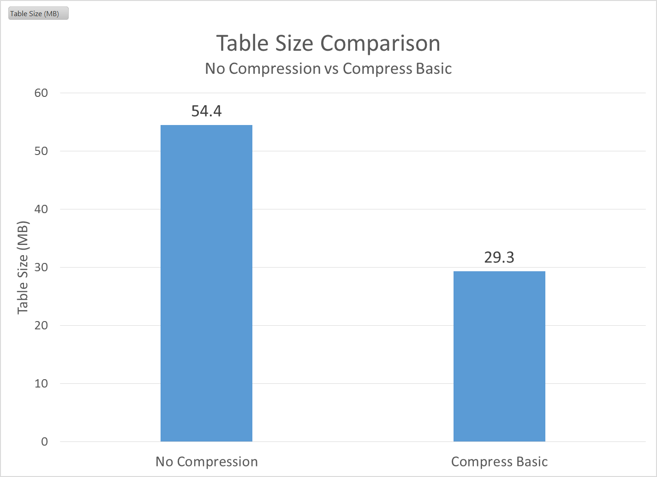
Compressed vs. Uncompressed
No surprise here, compression is good.
Default compression ratio = 1.86X
46% smaller
Now that we know how the Oracle data block compression algorithm works, what knobs can we turn to improve compression?

Slide 17
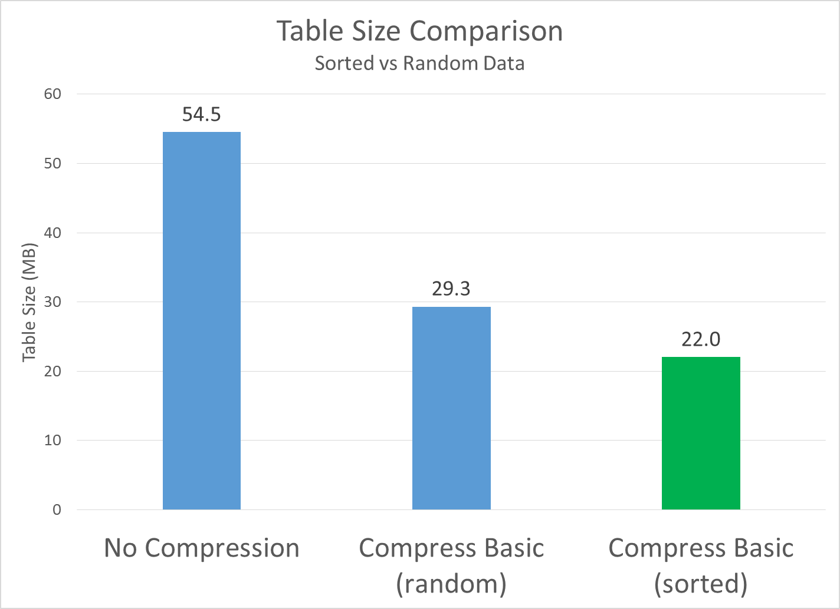
Sorted vs. Random Data
Wow, that’s a pretty big difference!
Data was sorted on lowest cardinality columns to highest.
We know that at the block level Oracle creates tokens to replace the actual row values.
If we sort our rows before we insert them, starting with the lowest cardinality columns, we can guarantee to have a lot of repeat values.
We know that Oracle will rearrange columns in order to enable creating multi-column symbols
New compression ratio = 2.48X
25% smaller than the unsorted tables

Slide 18
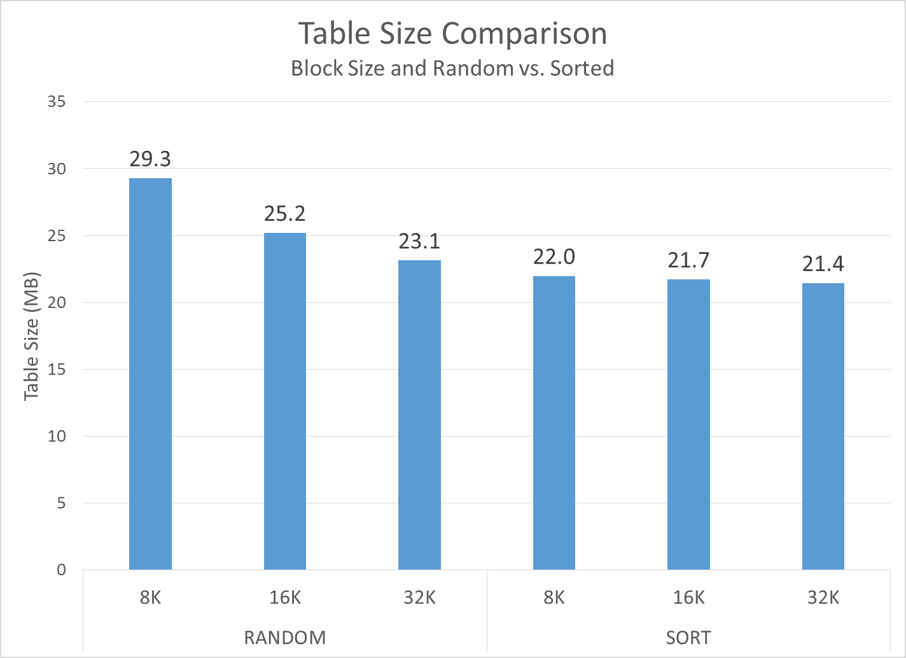
Block Size & Sorted vs. Random
Very Interesting results…
Block size strongly influences compression when data isn’t sorted.
32K is a lot better than 8K
When you sort the data, the benefit of 32K blocks is much smaller.

Slide 19
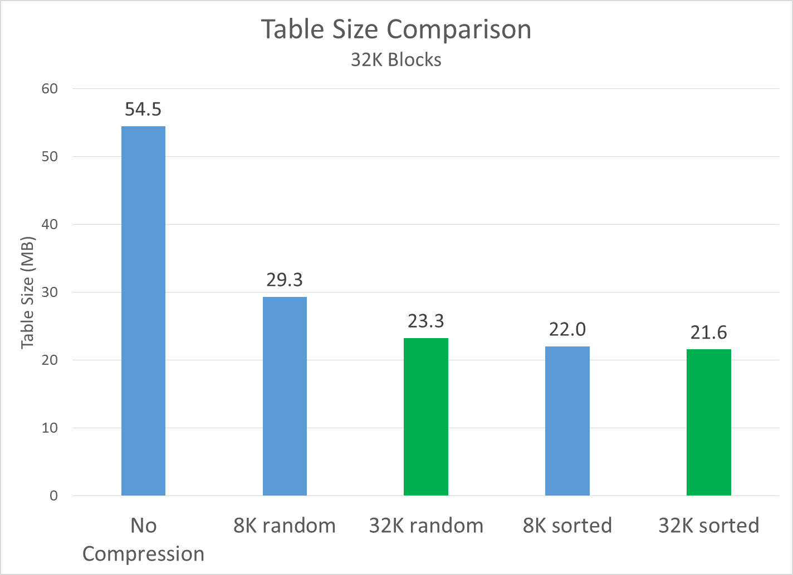
32K Blocks
If we use 32K blocks but don’t‘ sort:
Things still improve a lot compred to 8K random
Compression Ratio = 2.34X
If we use 32K blocks and we also sort:
Things improve only slightly relative to 8K sorted data
New compression ratio = 2.52X

Slide 20
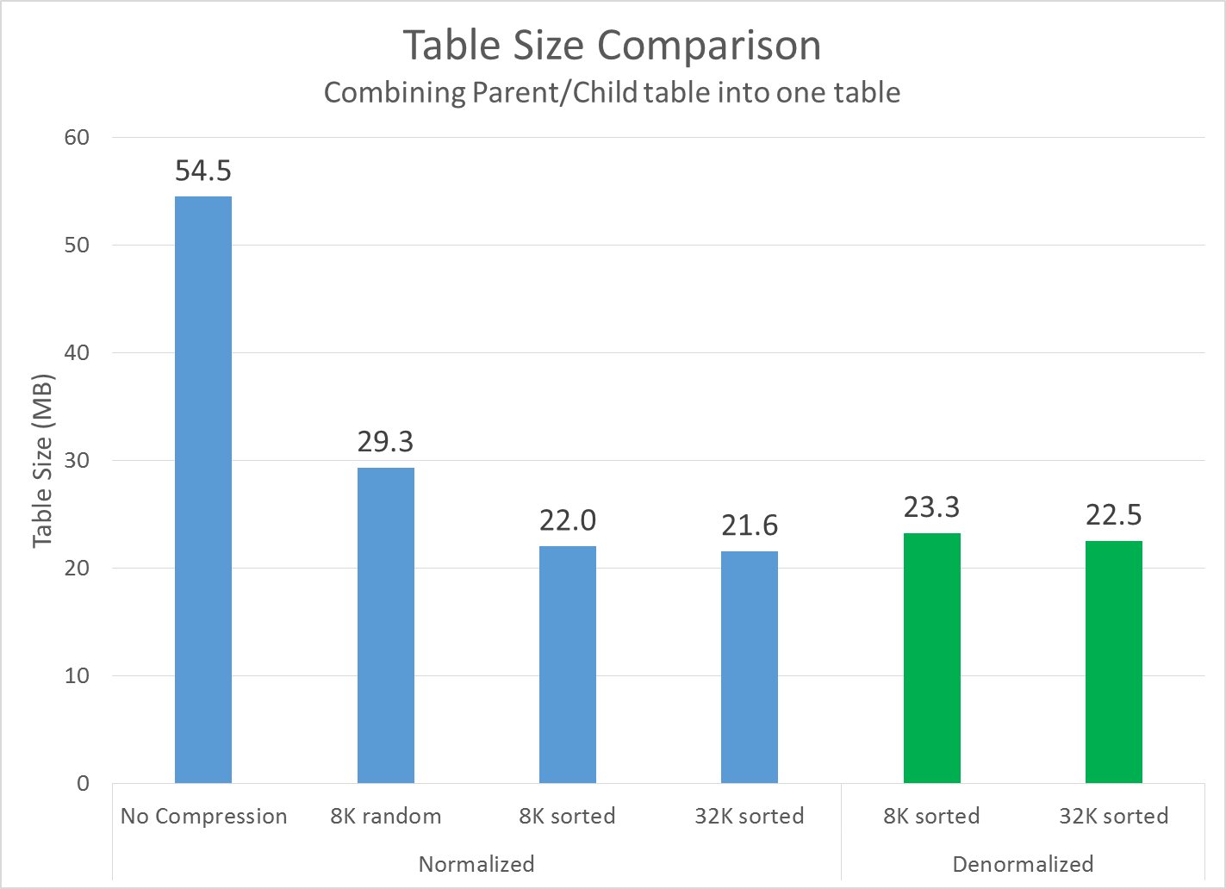
Denormalizing Parent/Child Tables into One Table
It’s obvious, but you do pay a storage price if you denormalize into a combined parent/child table.
In this example, that price is relatively small.
As your parent/child ratio increases this will be more costly
Your results may vary, but I almost always have to join my parent/child tables before I can run a query. Combining them into one table will greatly speed up query performance.
New compression ratio for denormalized tables
32K = 2.42X
8K = 2.34X

Slide 21
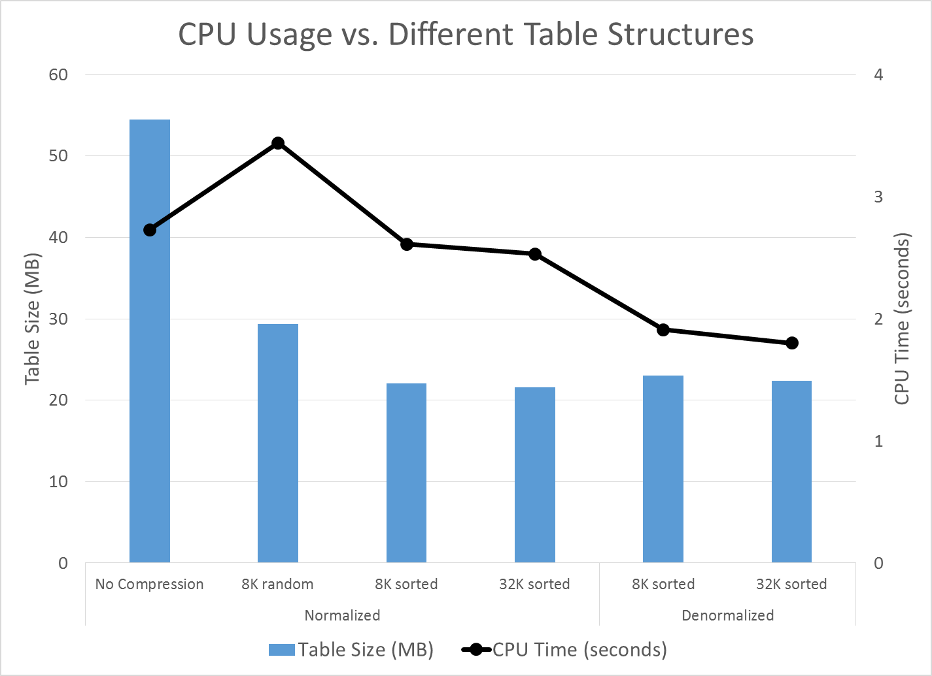
CPU Usage
Very interesting results…
Moving from uncompressed to compressed/random shows an increase in CPU usage. This is as expected as it requires CPU to decompress the block.
I was not expecting CPU usage for the compressed/sorted blocks to be better than nocompress.
Moving from separate tables to combined tables makes the CPU usage go down quite a bit. This also makes sense as you don’t need to do a join which costs CPU.
*Used Snapper to gather CPU data

Slide 22
Conclusions & Future Work
Conclusions
Compression is an absolute must as data volumes start to really grow.
Sorting your data can yield significant improvements on storage size.
Sorting columns lowest cardinality to highest cardinality was very effective using our test tables (25% improvement).
In our system, there is a small price to pay for denormalizing your data into a combined parent/child.
There is a large improvement in query performance when these tables are combined.
Future Work
Understand what happens on tables with lots of columns
Explore 32K blocks

Slide 23
Questions?

Slide 24
Thank you
Hotsos!
OSU Computer Science Students
Alex Schultz
Dylan Davis
Trevor Hammock
All the great Oracle Bloggers

