Slide 1
COMP 3711 Design and Analysis of Algorithms
Tutorial 1: Asymptotic Analysis

Slide 2
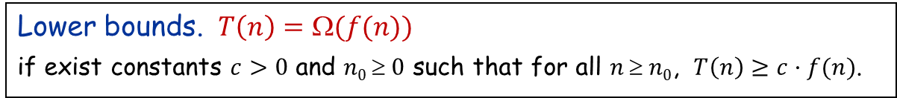
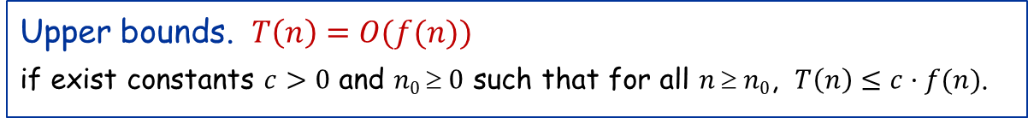

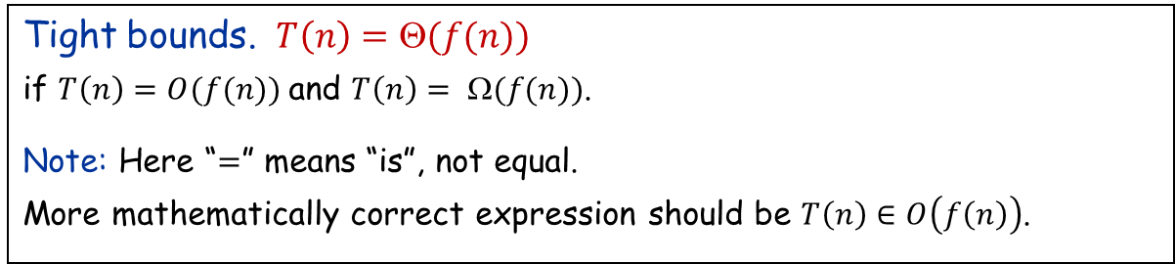
Asymptotic Notation: Quick Revision
Upper bounds. $T\left(n\right)=O(f(n))$
if exist constants $c>0$ and $n0  0$ such that for all $n  n0$, $T\left(n\right)≤c·f(n)$.
Lower bounds. $T\left(n\right)=Ω(f(n))$
if exist constants $c>0$ and $n0  0$ such that for all $n  n0$, $T\left(n\right)≥c·f(n)$.
Tight bounds. $T\left(n\right)=Θ(f(n))$
if $T\left(n\right)=O(f(n))$and $T\left(n\right)= Ω(f(n))$.
Note: Here “$=$” means “is”, not equal. More mathematically correct expression should be $T\left(n\right)∈O\left(f\left(n\right)\right)$.
constant < logarithmic < polynomial < exponential
${9999}^{{9999}^{9999}}$< $\log^{10}{n}$< $n^{0.1}$ < $n\log{n\text{< }n^{2}}$ < $2^{n}$

Slide 3
Some Basic Properties
If f$\left(n\right)=O(g\left(n\right))$ and $g\left(n\right)=O\left(h\left(n\right)\right) ⇒$ $f\left(n\right)=O(h\left(n\right))$
b) If f$\left(n\right)=Ω(g\left(n\right))$ and $g\left(n\right)=Ω\left(h\left(n\right)\right) ⇒$ $f\left(n\right)=Ω(h\left(n\right))$
If f$\left(n\right)=Θ(g\left(n\right))$ and $g\left(n\right)=Θ\left(h\left(n\right)\right) ⇒$ $f\left(n\right)=Θ(h\left(n\right))$
d) If f$\left(n\right)=O(h\left(n\right))$ and $g\left(n\right)=O\left(h\left(n\right)\right) ⇒$ $f\left(n\right)+g(n)=O(h\left(n\right))$
e) If f$\left(n\right)=Ω(h\left(n\right))$ and $g\left(n\right)=Ω\left(h\left(n\right)\right) ⇒$ $f\left(n\right)+g(n)=Ω(h\left(n\right))$
f) If f$\left(n\right)=Θ (h\left(n\right))$ and $g\left(n\right)=Θ\left(h\left(n\right)\right) ⇒$ $f\left(n\right)+g(n)=Θ(h\left(n\right))$
Prove by definition

Slide 4
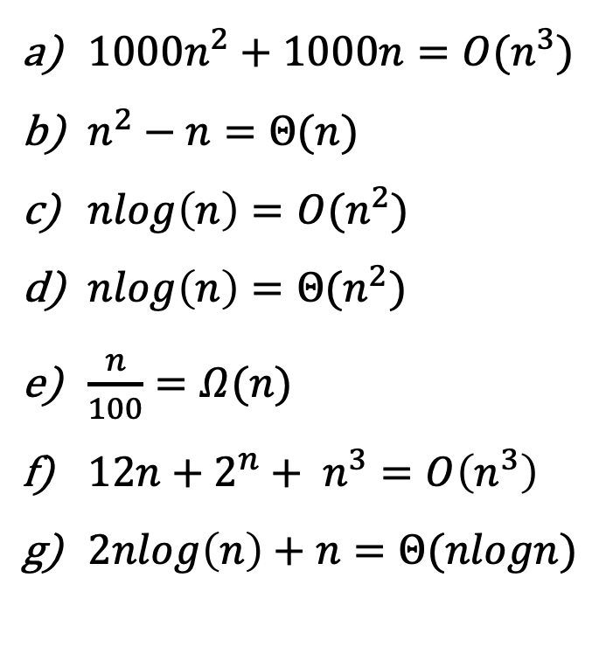
Question 1
For each of the following statements, answer whether the statement is true or false.
${1000n}^{2}+1000n=O(n^{3})$
$n^{2}−n=Θ(n)$
$nlog\left(n\right)=O(n^{2})$
$nlog\left(n\right)=Θ(n^{2})$
$\frac{n}{100}=Ω(n)$
$12n+2^{n}+ n^{3}=O\left(n^{3}\right)$
$2nlog\left(n\right)+n=Θ(nlogn)$
True
False
True
False
True
False
True

Slide 5

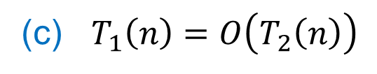
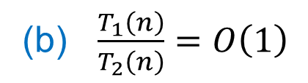
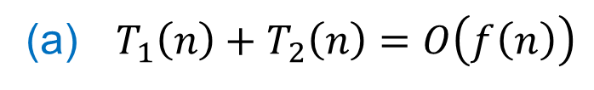
Question 2
﻿Suppose $T_{1}\left(n\right)=O\left(f\left(n\right)\right)$ and $T_{2}\left(n\right)=O\left(f\left(n\right)\right)$. Which of the following are true? Justify your answers.
(a) $T_{1}\left(n\right)+T_{2}\left(n\right)=O\left(f\left(n\right)\right)$
(b) $\frac{T_{1}\left(n\right)}{T_{2}\left(n\right)}=O\left(1\right)$
(c) $T_{1}\left(n\right)=O\left(T_{2}\left(n\right)\right)$

Slide 6

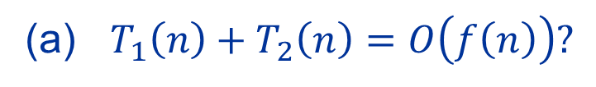
Question 2
Suppose $T_{1}\left(n\right)=O\left(f\left(n\right)\right)$ and $T_{2}\left(n\right)=O\left(f\left(n\right)\right)$.
Is the following true?
(a) $T_{1}\left(n\right)+T_{2}\left(n\right)=O\left(f\left(n\right)\right)?$
True.
This was just basic property (d).
Example
$T_{1}\left(n\right)={2n}^{4}+{3n}^{3}$ and $T_{2}\left(n\right)={5n}^{4}+{2n}^{2}$
$T_{1}\left(n\right)=O(n^{4})$ and $T_{2}\left(n\right)=O(n^{4})$
$⇒ T_{1}\left(n\right)+T_{2}\left(n\right)=O\left(n^{4}\right)$

Slide 7
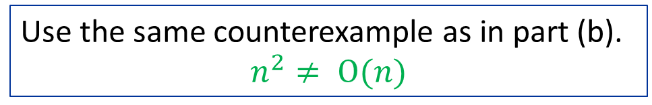
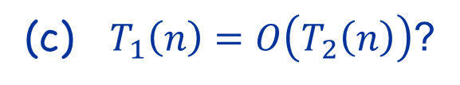
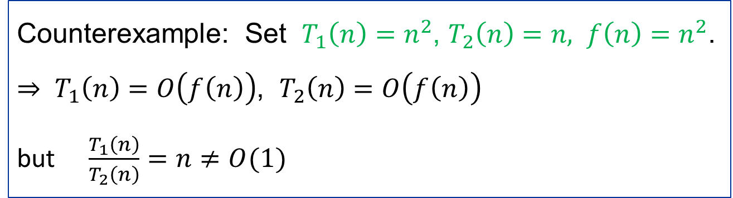

Question 2
Suppose $T_{1}\left(n\right)=O\left(f\left(n\right)\right)$ and $T_{2}\left(n\right)=O\left(f\left(n\right)\right)$.
Is the following true?
(b) $\frac{T_{1}\left(n\right)}{T_{2}\left(n\right)}=O\left(1\right)$?
False.
Counterexample: Set $T_{1}\left(n\right)=n^{2}$, $T_{2}\left(n\right)=n, f\left(n\right)=n^{2}$.
$⇒ T_{1}\left(n\right)=O\left(f\left(n\right)\right)$, $T_{2}\left(n\right)=O\left(f\left(n\right)\right)$
but $\frac{T_{1}\left(n\right)}{T_{2}\left(n\right)}=n≠O(1)$
(c) $T_{1}\left(n\right)=O\left(T_{2}\left(n\right)\right)$?
False.
Use the same counterexample as in part (b).
$$n^{2}≠ O(n)$$

Slide 8
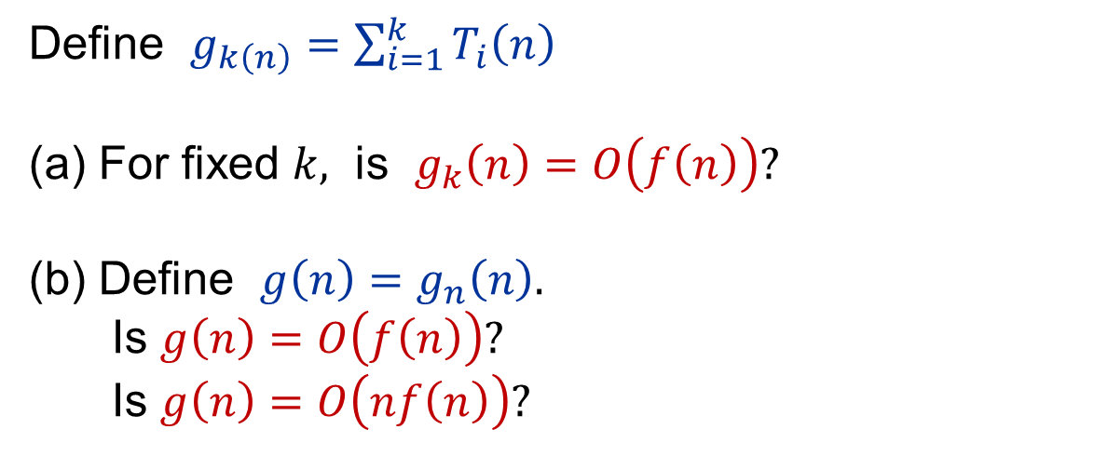
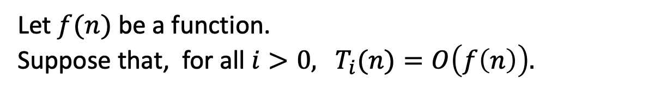
Question 3
Let $f(n)$ be a function. Suppose that, for all $i>0,$ $T_{i}(n)=O\left(f\left(n\right)\right).$
Define $g_{k\left(n\right)}=\sum_{i=1}^{k}{T_{i}\left(n\right)}$
For fixed $k,$ is $g_{k}\left(n\right)=O\left(f\left(n\right)\right)?$
Define $g\left(n\right)=g_{n}\left(n\right).$ Is $g\left(n\right)=O\left(f\left(n\right)\right)?$ Is $g\left(n\right)=O\left(nf\left(n\right)\right)?$

Slide 9

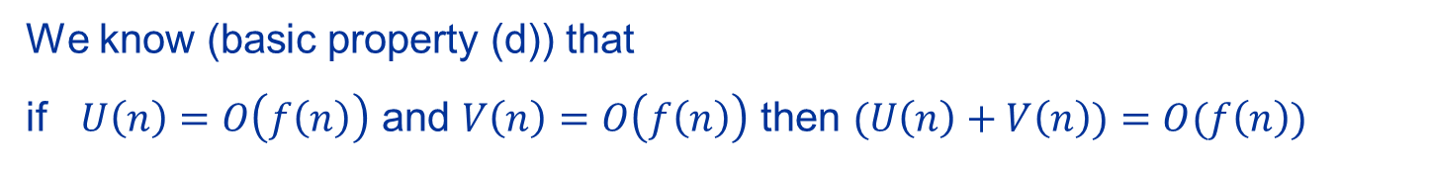



Question 3: (a)
(a)
For fixed $k,$ is $g_{k}\left(n\right)=O\left(f\left(n\right)\right)?$
Yes.
Recall $g_{k}(n)=\sum_{i=1}^{k}{T_{i}\left(n\right)}$where, for each $i,$ $T_{i}\left(n\right)=O\left(f\left(n\right)\right).$
We know (basic property (d)) that
if $U\left(n\right)=O\left(f\left(n\right)\right)$ and $V\left(n\right)=O\left(f\left(n\right)\right)$ then $(U\left(n\right)+V\left(n\right))=O(f\left(n\right))$
For fixed $k,$ is $g_{k}\left(n\right)=O\left(f\left(n\right)\right)?$
Then $g_{2}\left(n\right)=T_{1}\left(n\right)+T_{2}\left(n\right)=O\left(f\left(n\right)\right)$
Iterating, using induction, shows that, for FIXED k
$$g_{k}\left(n\right)=g_{k−1}\left(n\right)+T_{k}\left(n\right)=O(f\left(n\right))$$
$$U(n)$$
$$V(n)$$

Slide 10

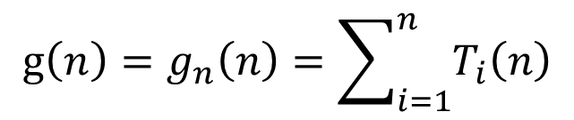
Question 3:
(b)
$g_{k}(n)=\sum_{i=1}^{k}{T_{i}\left(n\right)}$where, for each $i,$ $T_{i}\left(n\right)=O\left(f\left(n\right)\right).$
$$g\left(n\right)=g_{n}\left(n\right)=\sum_{i=1}^{n}{T_{i}\left(n\right)}$$
Even though we just saw that, for FIXED $k,$ $g_{k}\left(n\right)=O\left(f\left(n\right)\right),$
It is NOT true that $g\left(n\right)=O\left(f\left(n\right)\right)$ or even that $g\left(n\right)=O\left(nf\left(n\right)\right).$
We display a counterexample.

Slide 11
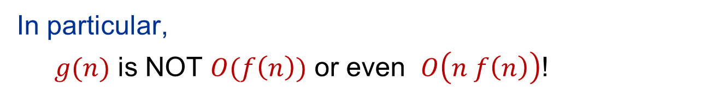
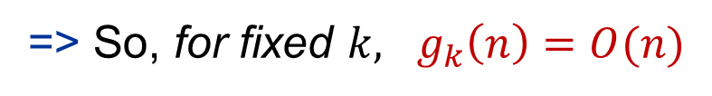


A Counterexample
Set $T_{i}\left(n\right)=i⋅n$, and $f\left(n\right)=n.$
=> $T_{i}\left(n\right)=O(f\left(n\right))$ for all FIXED $i≥1.$
=> $g_{k}\left(n\right)=\sum_{i=1}^{k}{T_{i}(n)}=\sum_{i=1}^{k}{i⋅n=}n\frac{k(k+1)}{2}$
=> $g_{k}\left(n\right)=c_{k}n$ where $c_{k}=\frac{k(k+1)}{2}$
Which we also know is true from part (a)
=> So, for fixed $k,$ $g_{k}\left(n\right)=O(n)$
But $g\left(n\right)=g_{n}\left(n\right)=n\frac{n(n+1)}{2}=Θ(n^{3})$
In particular,
$g(n)$ is NOT $O(f\left(n\right))$ or even $O\left(n f\left(n\right)\right)$!
$$O(n)$$
$$O(n^{2})$$

Slide 12
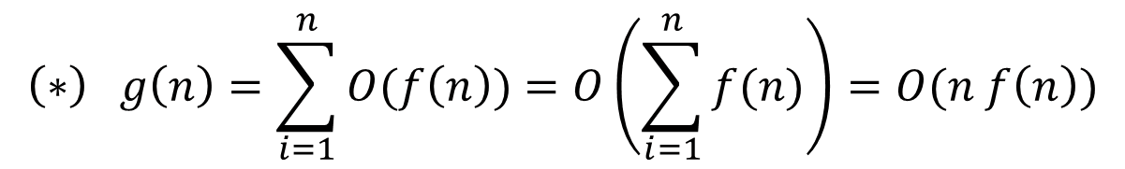
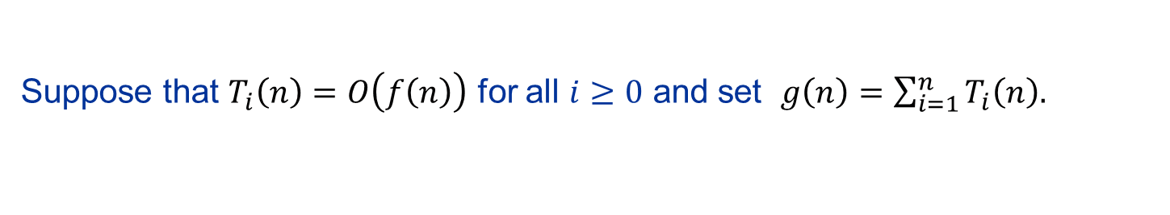
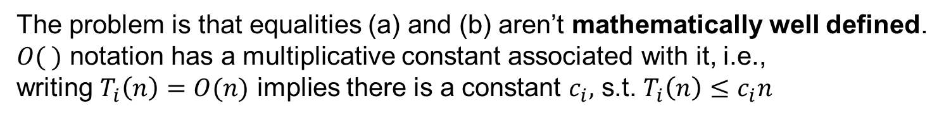

A Deeper Dive
Suppose that $T_{i}\left(n\right)=O\left(f\left(n\right)\right)$ for all $i≥0$ and set $g\left(n\right)=\sum_{i=1}^{n}{T_{i}\left(n\right).}$
$$\left(∗\right) g\left(n\right)=\sum_{i=1}^{n}{O(f\left(n\right))}=O\left(\sum_{i=1}^{n}{f(n)}\right)=O(n f\left(n\right))$$
(a)
(b)
IS NOT CORRECT. Why is this “proof” wrong?
Use the counterexample from previous page to unpack problem.
Set $T_{i}\left(n\right)=i⋅n$, and $f\left(n\right)=n.$
$$g\left(n\right)=Θ\left(n^{3}\right)≠O\left(n f\left(n\right)\right)=O(n^{2})$$
The problem is that equalities (a) and (b) aren’t mathematically well defined.
$O( )$ notation has a multiplicative constant associated with it, i.e., writing $T_{i}\left(n\right)=O(n)$ implies there is a constant $c_{i},$ s.t. $T_{i}\left(n\right)≤c_{i}n$
The way that (a) and (b) are written imply that all of the constants are the same. But they are NOT. $c_{i}=i,$ so the constants are increasing.

Slide 13

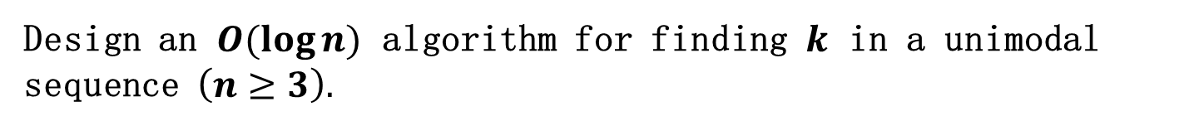

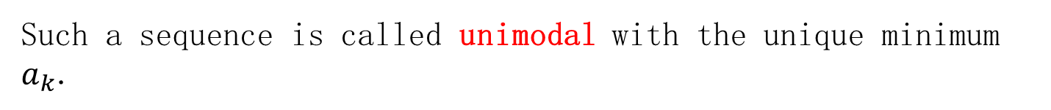
Question
Let $a_{1},a_{2},…,a_{n}$ be a sequence that has the following property:
There exists some $k$ such that
$$∀i :1≤i<k, a_{i}>a_{i+1};$$
$$∀i :k≤i<n, a_{i}<a_{i+1}$$
Such a sequence is called unimodal with the unique minimum $a_{k}$.
(The sequence goes down and then goes up, with minimum at $a_{k}$.)
Design an $O(\log{n})$ algorithm for finding $k$ in a unimodal sequence $\left(n≥3\right).$

Slide 14
Example
Example: $A= [ 10, 8, 6, 5, 25, 30, 40, 70, 90, 100]$
$A$ is unimodal with minimum $a_{4}=5$.

Slide 15
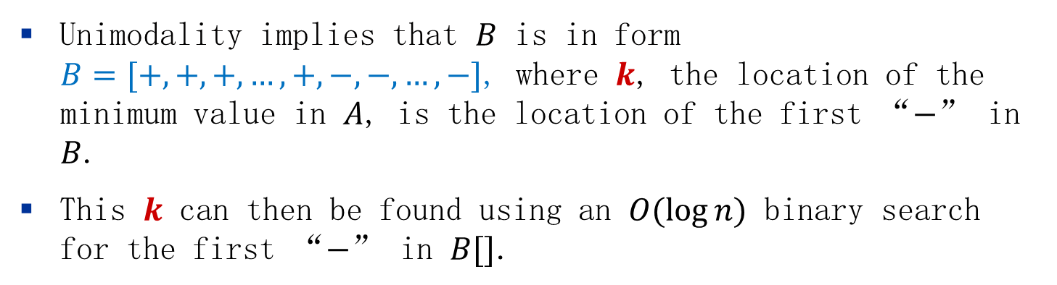
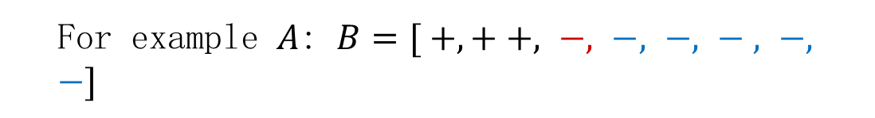
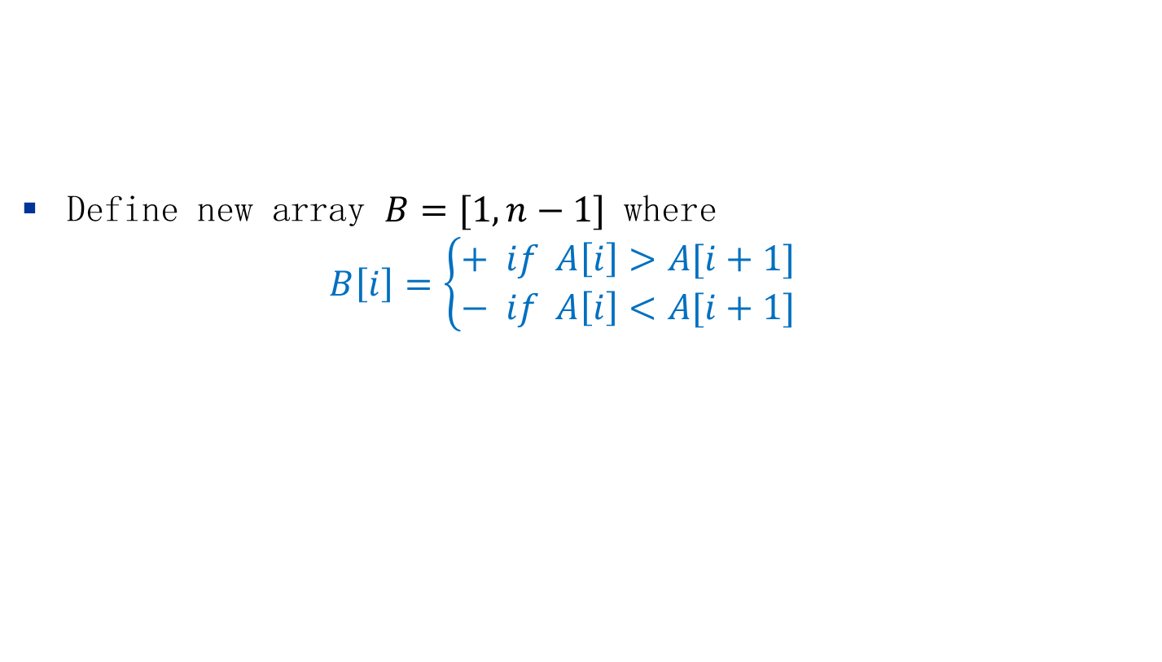
Solution
Example: $A= [ 10, 8, 6, 5, 25, 30, 40, 70, 90, 100]$
We can binary search for the transition point where the items stop decreasing and start increasing.
Define new array $B=[1,n−1]$ where
$$B\left[i\right]=\left\{\begin{aligned}+ if A\left[i\right]>A[i+1] \\ − if A\left[i\right]<A[i+1]\end{aligned}\right.$$
For example $A$: $B=[ +,+ +, −, −, −, − , −, −]$
Unimodality implies that $B$ is in form
$B=[+, +, +, …,+, −,−,…,−]$, where $k$, the location of the minimum value in $A$, is the location of the first “$−$” in $B$.
This $k$ can then be found using an $O(\log{n})$ binary search for the first “$−$” in $B[]$.

Slide 16
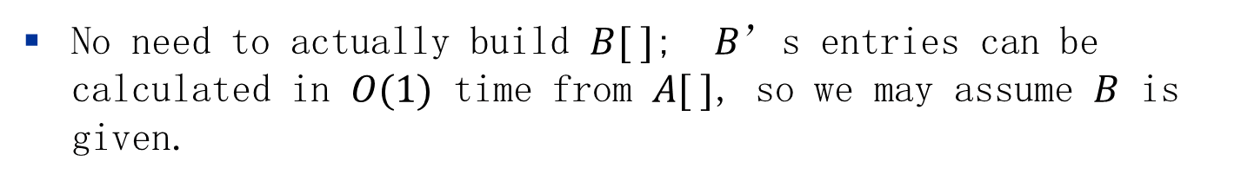
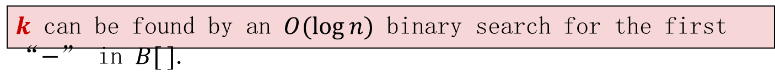
Solution
Example: $A= [ 10, 8, 6, 5, 25, 30, 40, 70, 90, 100]$
We can binary search for the transition point where the items stop decreasing and start increasing.
Define new array $B=[1,n−1]$ where
$$B\left[i\right]=\left\{\begin{aligned}+ if A\left[i\right]>A[i+1] \\ − if A\left[i\right]<A[i+1]\end{aligned}\right.$$
For example $A$: $B=[ +,+ +, −, −, −, − , −, −]$
$k$ can be found by an $O(\log{n})$ binary search for the first “$−$” in $B[ ]$.
No need to actually build $B[ ]$; $B$’s entries can be calculated in $O(1)$ time from $A[ ]$, so we may assume $B$ is given.

Slide 17
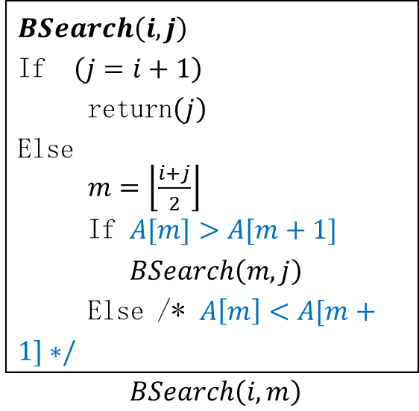
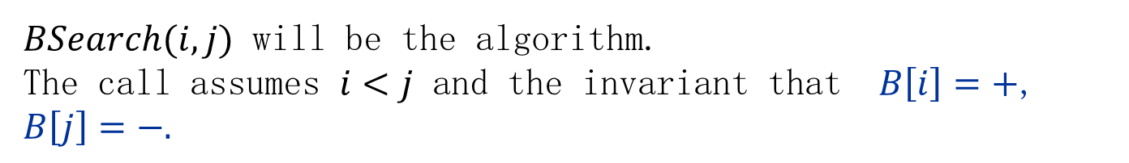
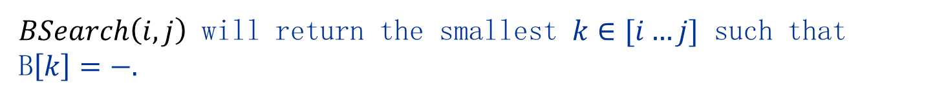
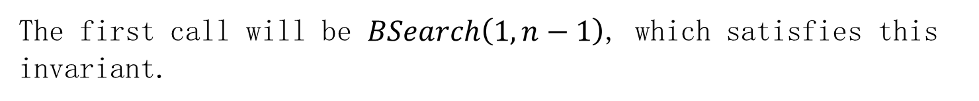
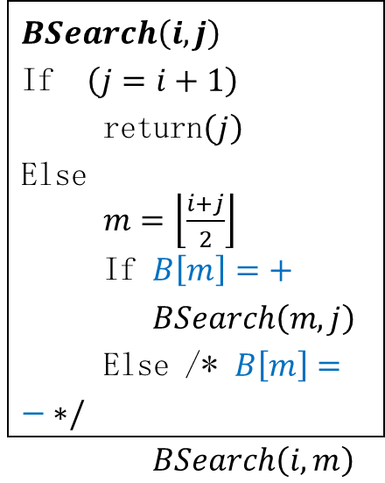
Solution: More Details
$BSearch(i,j)$ will be the algorithm. The call assumes $i<j$ and the invariant that $B\left[i\right]=+$, $B\left[j\right]=−.$
The first call will be $BSearch\left(1,n−1\right)$, which satisfies this invariant.
$BSearch\left(i,j\right)$ will return the smallest $k∈[i…j]$ such that B$\left[k\right]=−.$
Example: $B=[ +,+ +, −, −, −, − , −, −]$
$BSearch\left(i,j\right)$ If $\left(j=i+1\right)$ return$\left(j\right)$ Else $m=\left\lfloor \frac{i+j}{2}\right\rfloor$ If $B\left[m\right]=+$ $BSearch\left(m,j\right)$ Else /* $B\left[m\right]=− ∗/$ $BSearch\left(i,m\right)$
$BSearch\left(i,j\right)$ If $\left(j=i+1\right)$ return$\left(j\right)$ Else $m=\left\lfloor \frac{i+j}{2}\right\rfloor$ If $A[m]>A[m+1]$ $BSearch\left(m,j\right)$ Else /* $A\left[m\right]<A[m+1]∗/$ $BSearch\left(i,m\right)$
or

