Slide 1
COMP3711: Design and Analysis of Algorithms
Tutorial 2: D&C, Sorting

Slide 2
Divide-and-Conquer Revision: Binary search
Main idea of D&C: Solve a problem of size n by breaking it into one or more smaller problems of size less than n. Solve the smaller problems recursively and combine their solutions, to solve the large problem
Idea of binary search : Set q $←$ middle of the array. If x = A[q], return q. If x < A[q], search A[1..q-1]. If x > A[q], search A[q+1..n]

Slide 3
Finding a “fixed point”

Slide 4
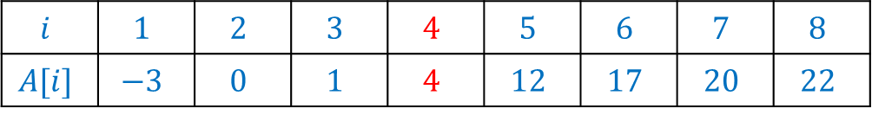
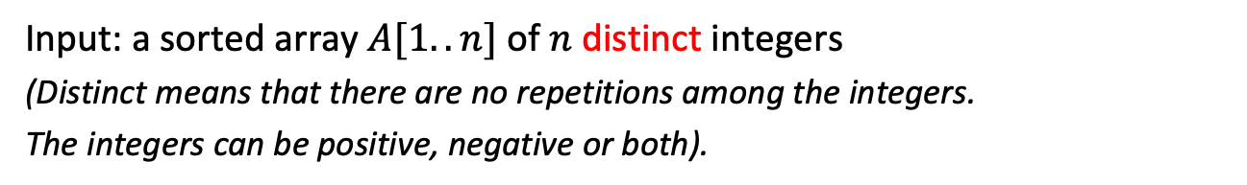
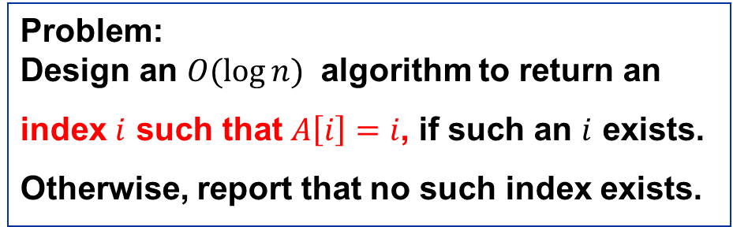
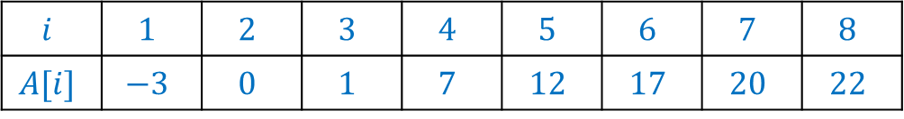
Question
Input: a sorted array $A[1..n]$ of $n$ distinct integers (Distinct means that there are no repetitions among the integers. The integers can be positive, negative or both).
Problem: Design an $O(\log{n})$ algorithm to return an
index $i$ such that $A\left[i\right]=i$, if such an $i$ exists.
Otherwise, report that no such index exists.
As an example, in the array immediately below, the algorithm returns 4
$$i$$ | $$1$$ | $$2$$ | $$3$$ | $$4$$ | $$5$$ | $$6$$ | $$7$$ | $$8$$
$$A[i]$$ | $$−3$$ | $$0$$ | $$1$$ | $$4$$ | $$12$$ | $$17$$ | $$20$$ | $$22$$
while in the array below, the algorithm returns that no such index exists.
$$i$$ | $$1$$ | $$2$$ | $$3$$ | $$4$$ | $$5$$ | $$6$$ | $$7$$ | $$8$$
$$A[i]$$ | $$−3$$ | $$0$$ | $$1$$ | $$7$$ | $$12$$ | $$17$$ | $$20$$ | $$22$$

Slide 5

Solution
The main observation is that
(*) If $A\left[m\right]>m$, then $A\left[i\right]>i$ for all $i>m$.
Follows directly from facts that the array is sorted and all integers are distinct.
More specifically, those two facts imply that
$A\left[m+1\right]≥A\left[m\right]+1$.
So, if $A\left[m\right]>m$ => $A\left[m+1\right]≥A\left[m\right]+1>m+1$
Statement (*) follows by mathematical induction.
A similar proof shows that
(**) If $A[m]<m$, then $A[i]<i$ for all $i<m$.

Slide 6
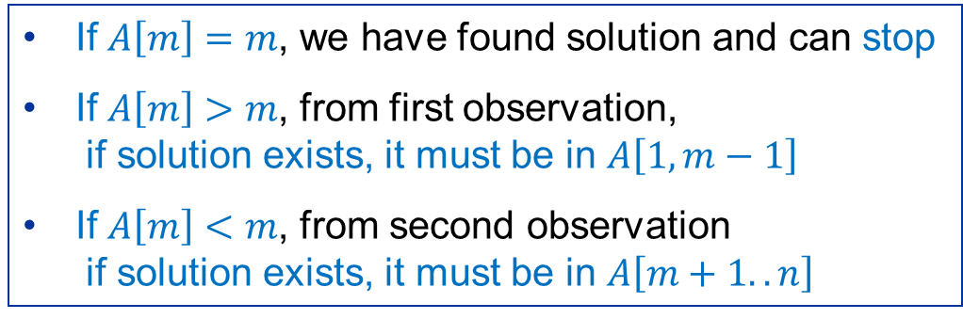
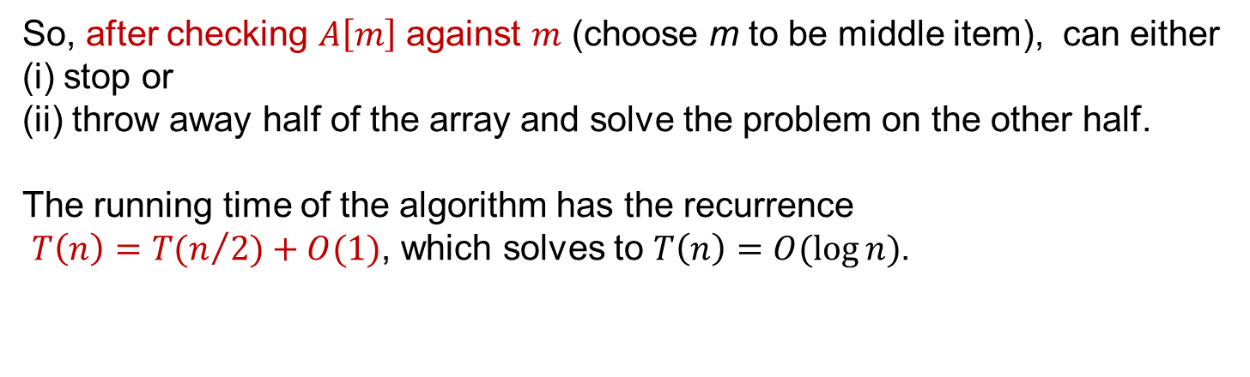
Solution
Use observations that
(*) If $A\left[m\right]>m$, then $A\left[i\right]>i$ for all $i>m$.
(**) If $A[m]<m$, then $A[i]<i$ for all $i<m$.
If $A\left[m\right]=m$, we have found solution and can stop
If $A\left[m\right]>m$, from first observation, if solution exists, it must be in $A\left[1,m−1\right]$
If $A\left[m\right]<m$, from second observation if solution exists, it must be in $A\left[m+1..n\right]$
So, after checking $A\left[m\right]$ against $m$ (choose m to be middle item), can either (i) stop or (ii) throw away half of the array and solve the problem on the other half.
The running time of the algorithm has the recurrence $T\left(n\right)=T(n/{2)+O(1)}$, which solves to $T\left(n\right)=O(\log{n})$.

Slide 7
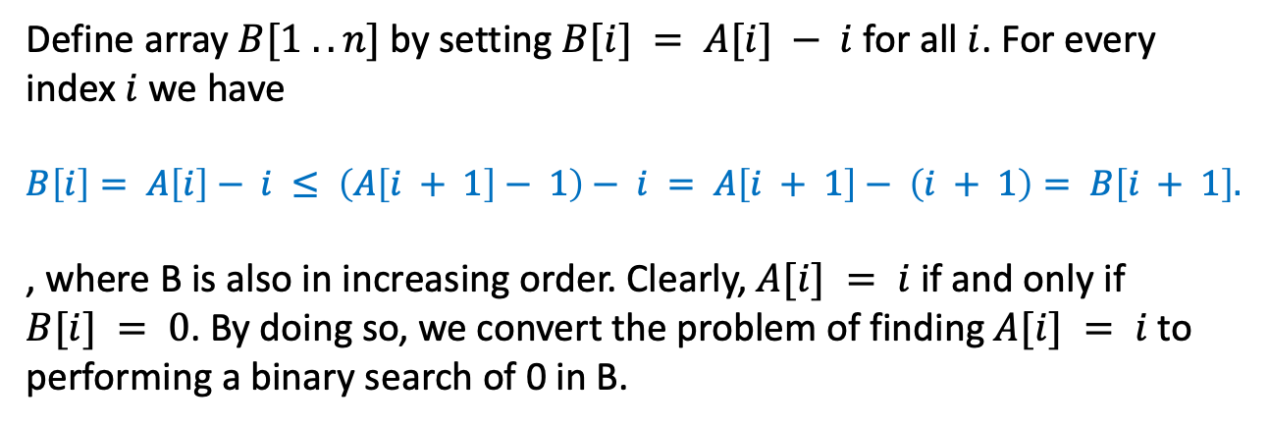
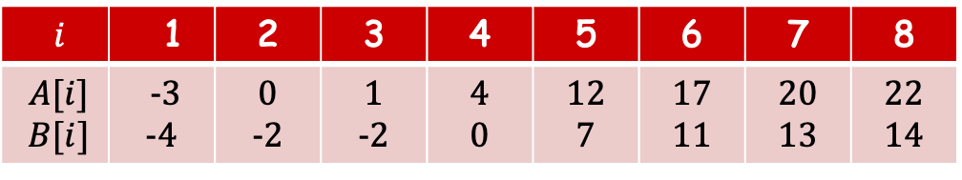
Solution from another perspective
Define array $B[1 .. n]$by setting $B[i] = A[i] − i$for all $i$. For every index $i$ we have
$$B\left[i\right]= A\left[i\right]− i ≤ \left(A\left[i + 1\right]− 1\right)− i = A\left[i + 1\right]− \left(i + 1\right)= B\left[i + 1\right].$$
, where B is also in increasing order. Clearly, $A[i] = i$ if and only if $B[i] = 0$. By doing so, we convert the problem of finding $A[i] = i$to performing a binary search of 0 in B.
$i$ | 1 | 2 | 3 | 4 | 5 | 6 | 7 | 8
$$A[i]$$ $B[i]$ | -3 -4 | 0 -2 | 1 -2 | 4 0 | 12 7 | 17 11 | 20 13 | 22 14

Slide 8
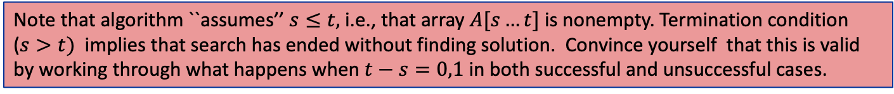
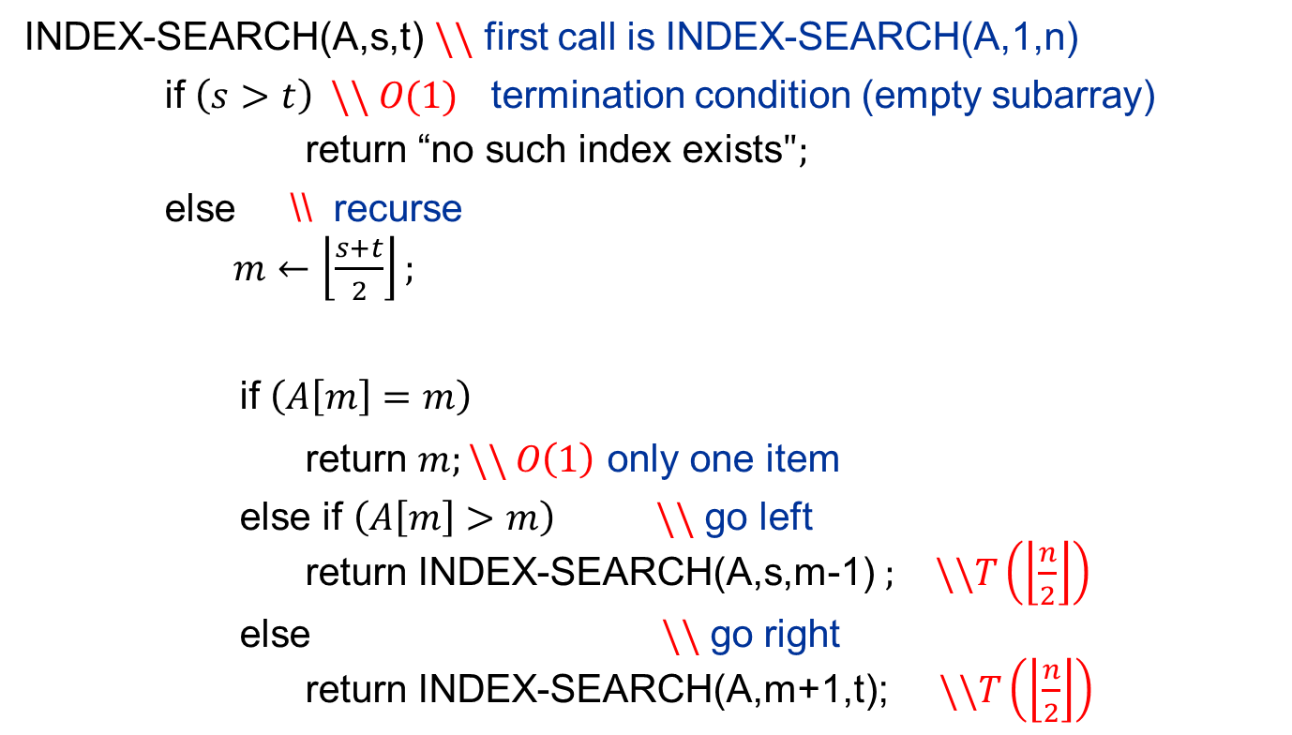
Solution (Code)
INDEX-SEARCH(A,s,t) $\backslash \backslash$ first call is INDEX-SEARCH(A,1,n)
if $\left(s>t\right) \backslash \backslash O(1)$ termination condition (empty subarray)
return “no such index exists$";$
else \\ recurse
$m←\left\lfloor \frac{s+t}{2}\right\rfloor ;$
if $\left(A\left[m\right]=m\right)$
return $m;\backslash \backslash O\left(1\right)$ only one item
else if $\left(A\left[m\right]>m\right)$ $\backslash \backslash$ go left
return INDEX-SEARCH(A,s,m-1) $; \backslash \backslash T\left(\left\lfloor \frac{n}{2}\right\rfloor \right)$
else $\backslash \backslash$ go right
return INDEX-SEARCH(A,m+1,t); $\backslash \backslash T\left(\left\lfloor \frac{n}{2}\right\rfloor \right)$
Note that algorithm ``assumes’’ $s≤t,$ i.e., that array $A[s…t]$ is nonempty. Termination condition ($s>t)$ implies that search has ended without finding solution. Convince yourself that this is valid by working through what happens when $t−s=0,1$ in both successful and unsuccessful cases.

Slide 9
Minimum of the wave

Slide 10
Outline
You are given an array A of size n. A starts with A[1] = 0, increases to maximum, then decrease to the minimum, and increases again and finally get back to A[n] = 0.
Describe a D&Q algorithm to find the minimum of the array. Assume all numbers in A are distinct, some are positive, and some are negative.
Some example for A: = [0; 2; 5; 8; 4; 3; 1;-3;-5;-2; 0] is such an array but
A: = [0; 3;-2; 6;-3; 0] is not

Slide 11
Index | 1 | 2 | 3 | 4 | 5 | 6 | 7 | 8 | 9 | 10 | 11 | 12
Value | 0 | 2 | 5 | 8 | 4 | 3 | 1 | -3 | -5 | -2 | -1 | 0
The strategy:
Find the midpoint of the array, we can split the array into two subarray.
Given the status of the midpoint, find the minimum of one of two small subarray.
Recursively search the subarray until we get the result.

Slide 12
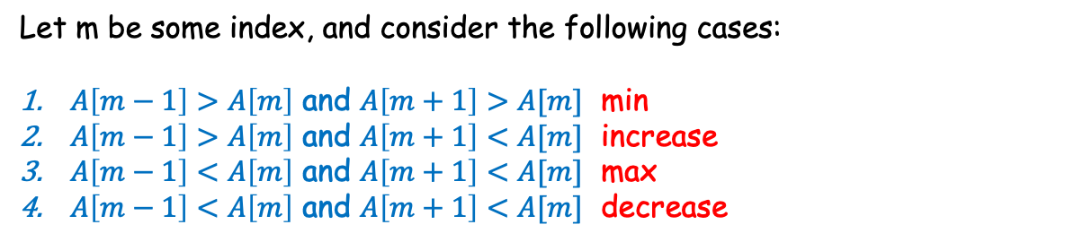
Index | 1 | 2 | 3 | 4 | 5 | 6 | 7 | 8 | 9 | 10 | 11 | 12
Value | 0 | 2 | 5 | 8 | 4 | 3 | 1 | -3 | -5 | -2 | -1 | 0
Let m be some index, and consider the following cases:
$A\left[m−1\right]>A\left[m\right]$ and $A\left[m+1\right]>A[m]$ min
$A\left[m−1\right]>A\left[m\right]$ and $A\left[m+1\right]<A[m]$ increase
$A\left[m−1\right]<A\left[m\right]$ and $A\left[m+1\right]<A[m]$ max
$A\left[m−1\right]<A\left[m\right]$ and $A\left[m+1\right]<A[m]$ decrease

Slide 13
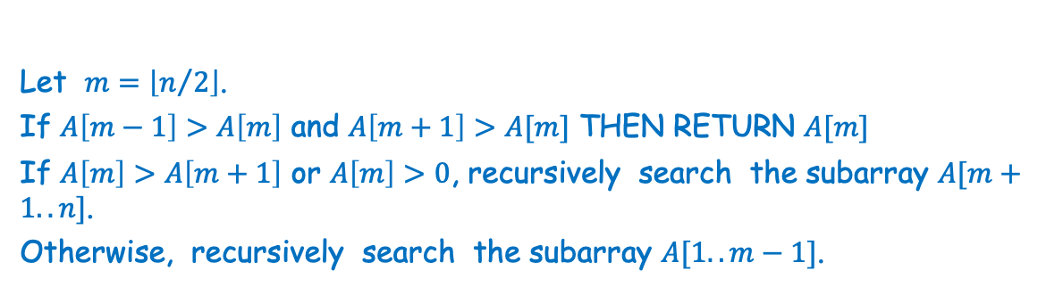
Let $m=\left\lfloor n/2\right\rfloor$.
If $A\left[m−1\right]>A\left[m\right]$ and $A\left[m+1\right]>A[m]$ THEN RETURN $A[m]$
If $A\left[m\right]>A\left[m+1\right]$ or $A\left[m\right]>0$, recursively search the subarray $A[m+1..n]$.
Otherwise, recursively search the subarray $A[1..m−1]$.
Running time on Recurrence: T(n) = T(n/2), which is O(logn)

Slide 14
Using Black Box Median Algorithms

Slide 15

Black-box means that you can call the algorithm and use its result, but can’t peer inside of it.

Slide 16

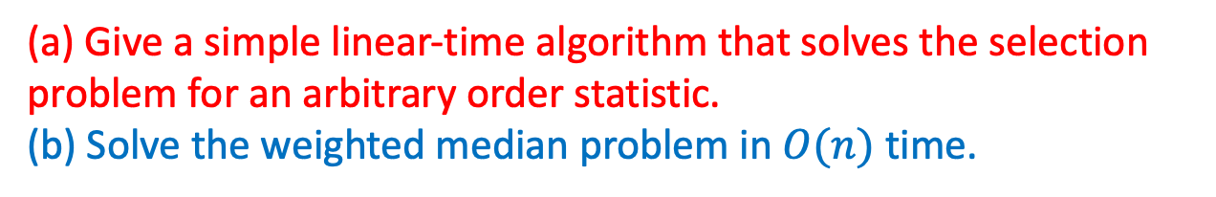
Outline
(a) Give a simple linear-time algorithm that solves the selection problem for an arbitrary order statistic.
(b) Solve the weighted median problem in $O(n)$ time.

Slide 17



(a) Give a simple linear-time algorithm that solves the selection problem for an arbitrary order statistic.
Solution: Modify the randomized selection algorithm so that it is deterministic. At every step, instead of choosing the pivot at random from the current subarray, it uses the O(n) median finding algorithm to find the median and then uses the median as pivot.
At each step, the algorithm will reduce the size of the array in which it is searching by at least one- half so the running time satisfies

Slide 18
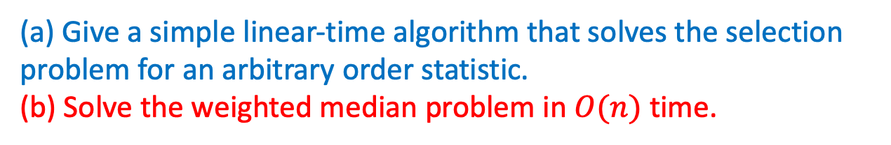
Outline
(a) Give a simple linear-time algorithm that solves the selection problem for an arbitrary order statistic.
(b) Solve the weighted median problem in $O(n)$ time.

Slide 19






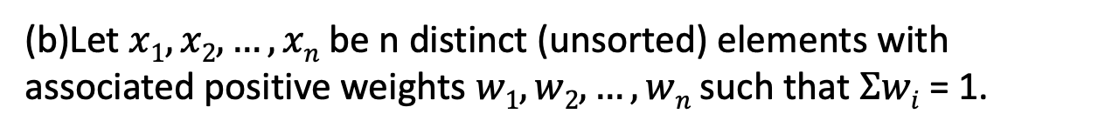
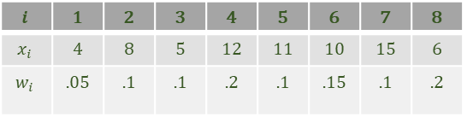
(b)Let $x1, x2, …, xn$be n distinct (unsorted) elements with associated positive weights $w1, w2, …, wn$such that $Σwi$ = 1.
Example:
 | 1 | 2 | 3 | 4 | 5 | 6 | 7 | 8
 | 4 | 8 | 5 | 12 | 11 | 10 | 15 | 6
 | .05 | .1 | .1 | .2 | .1 | .15 | .1 | .2

Slide 20
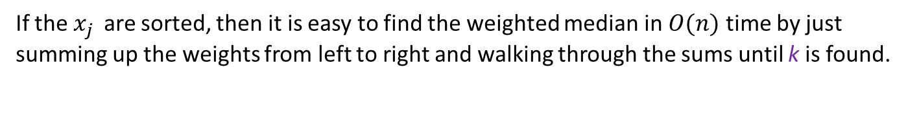
(b)Let $x1, x2, …, xn$be n distinct (unsorted) elements with associated positive weights $w1, w2, …, wn$such that $Σwi$ = 1.
Show that if the items are not sorted you can still solve the problem in linear time using the linear –time black box median finding algorithm as a subroutine.
Intuition: We will develop a linear time test (using the black box) that reduces the size of the problem by a half each step. This immediately implies a linear time algorithm

Slide 21
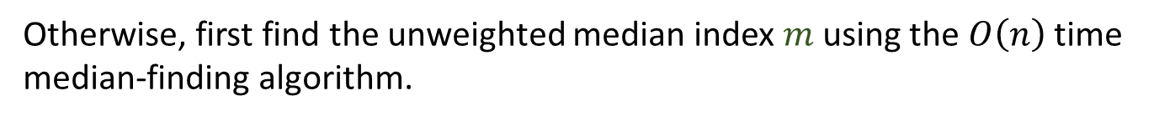


Major observation is

Slide 22
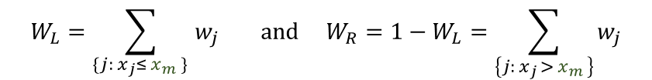






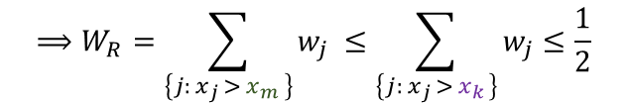
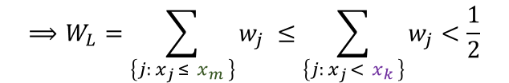

Observation:
Proof:

Slide 23
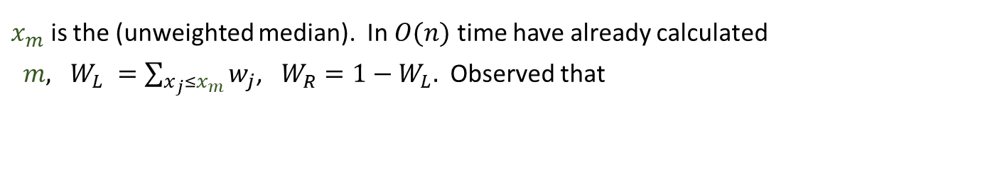


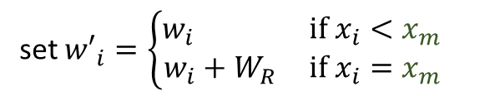



From observation, none of the removed items were solution to the weighted median problem.

