Slide 1
The Spread of epidemics
Author: Marcin Jędrzejczyk
Supervisor: Dr hab. inż. Jarosław Wąs

Slide 2
Epidemic
„A widespread occurrence of an infectious disease in a community at a particular time.”[Oxford Dictionary Online]
Examples:
1346-1353 -„Black death”(bubonic plague) in Europe
1918-1919 – „Spanish Flu”
World War 1 casualities – 22 – 24 million
Spanish Flu casualities – 40 – 50 million (current estimates say 50 – 100 million)

Slide 3
Reasons for epidemics simulations
To better understand how epidemic behave in time
To predict how quickly it spreads depending on many factors (recovery rate, vaccination rate, virulence of epidemic, movement factor)
To picture how vaccination affect disease spreading and confirms that herd immunity is important

Slide 4
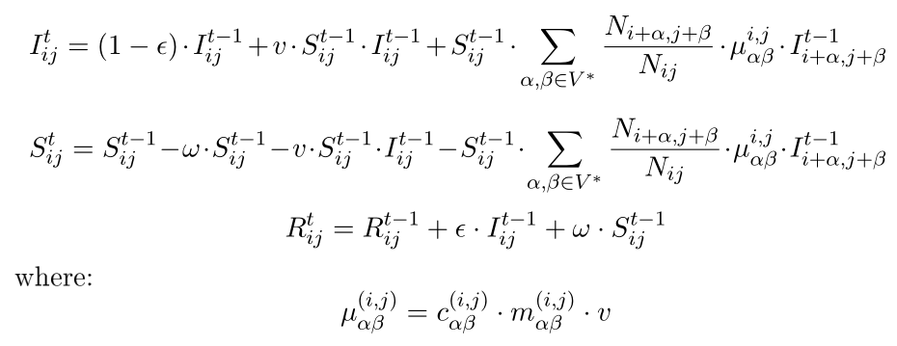
Models
SIR
SIS
SEIR
SEIRS
S – suspectible
I – infected
R – recovered
E – exposed

Slide 5
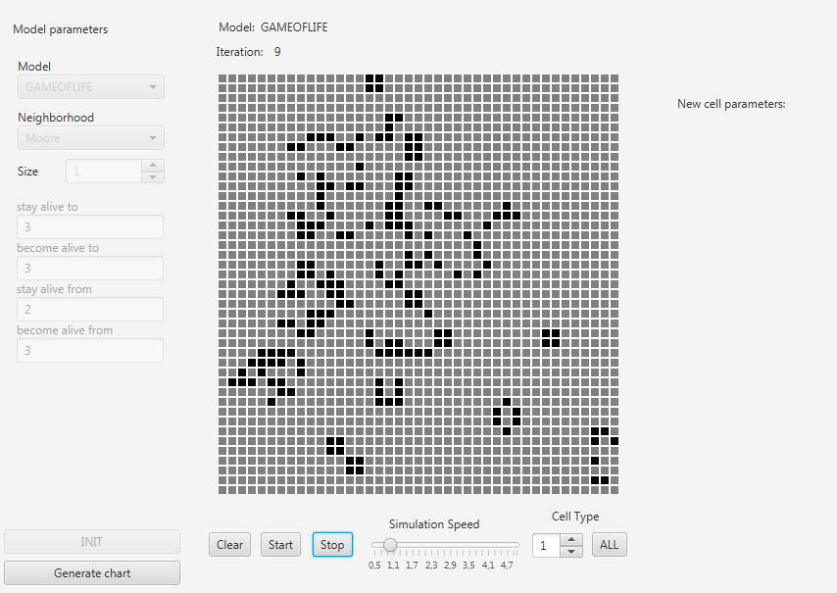
Program

Slide 6
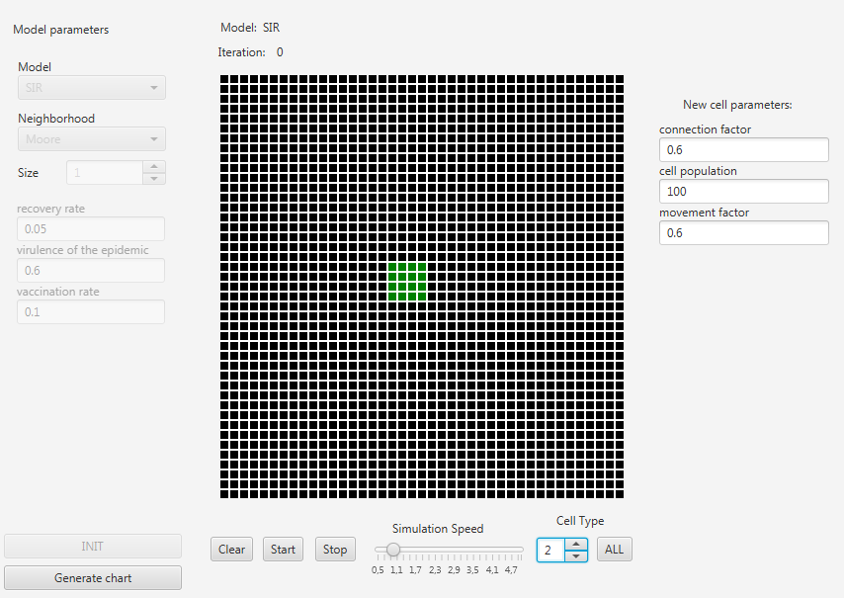

Slide 7
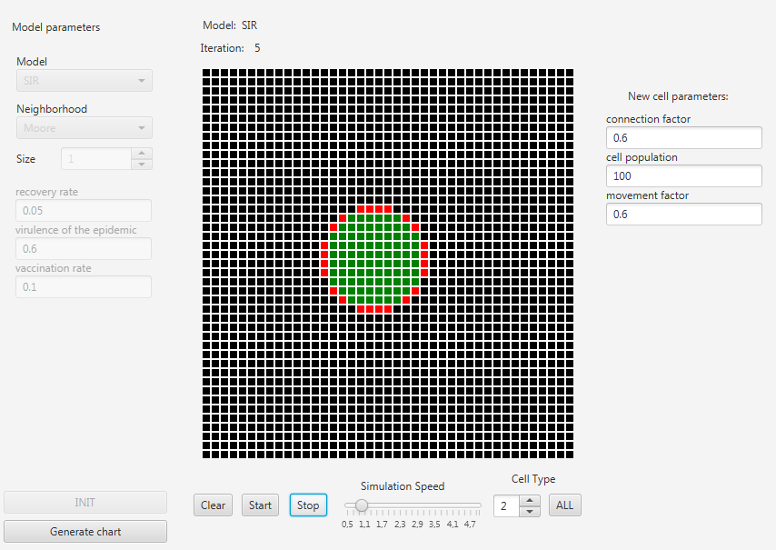

Slide 8
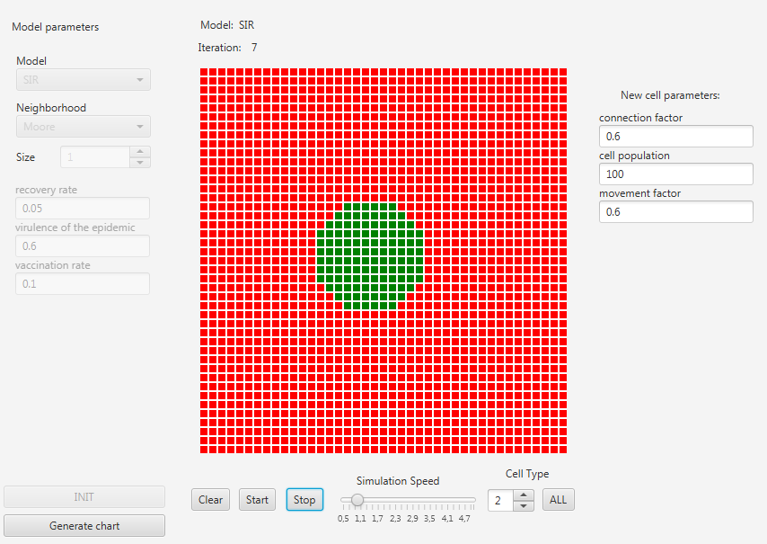

Slide 9
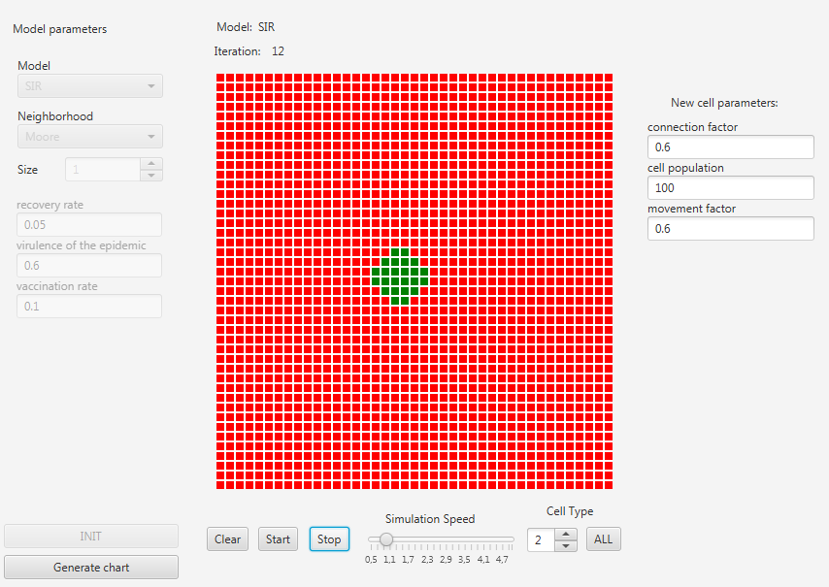

Slide 10
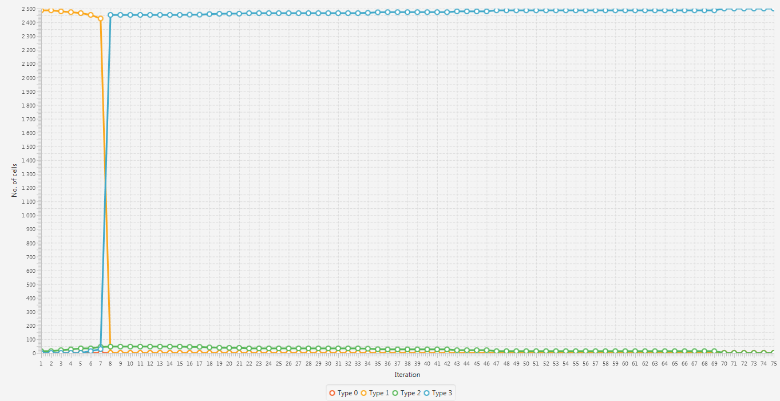

Slide 11
THANK YOU FOR YOUR ATTENTION

