Slide 1

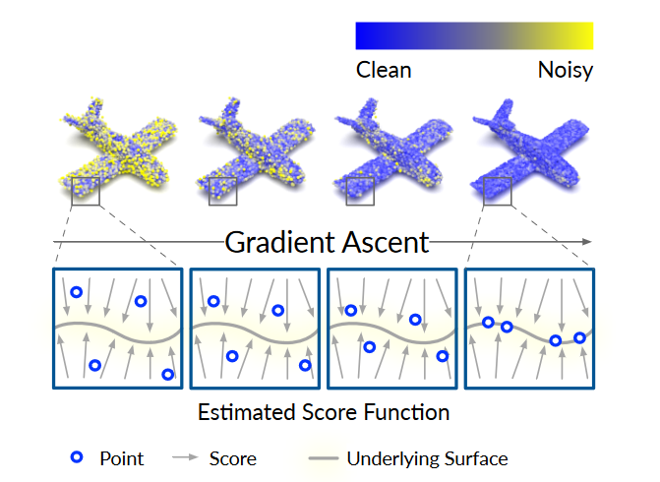

Slide 2
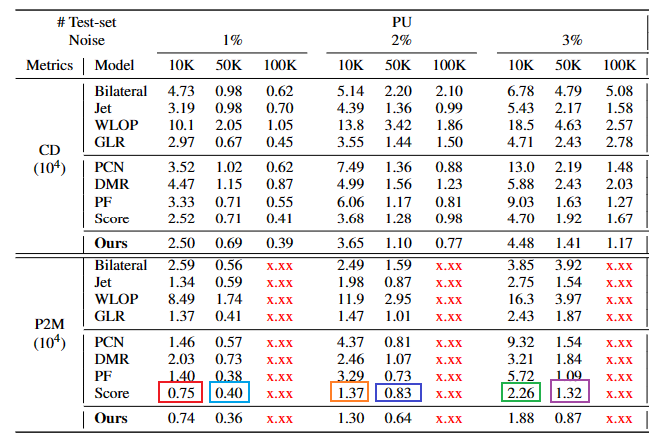
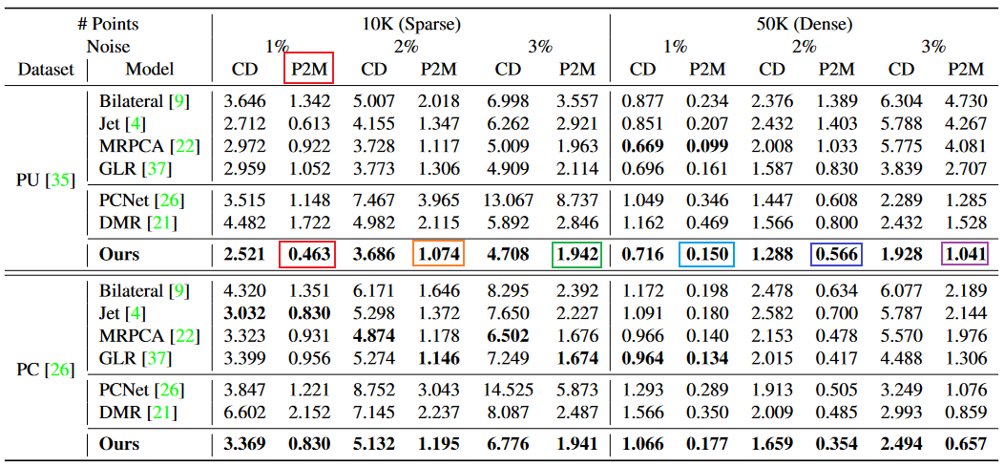
3.369 | 1.708 | 5.132 | 2.522

Slide 3
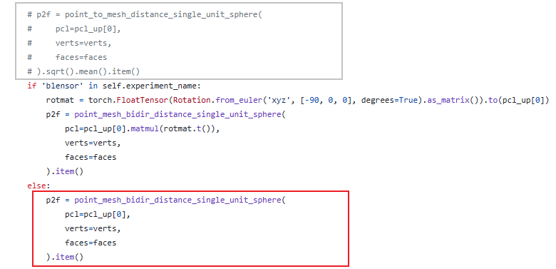
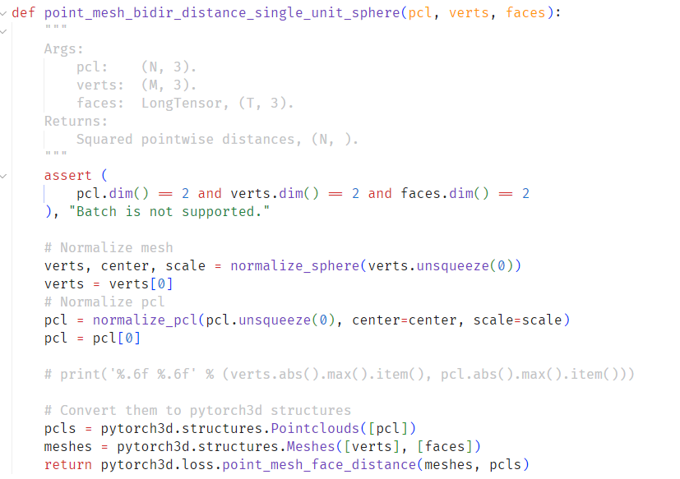

Slide 4
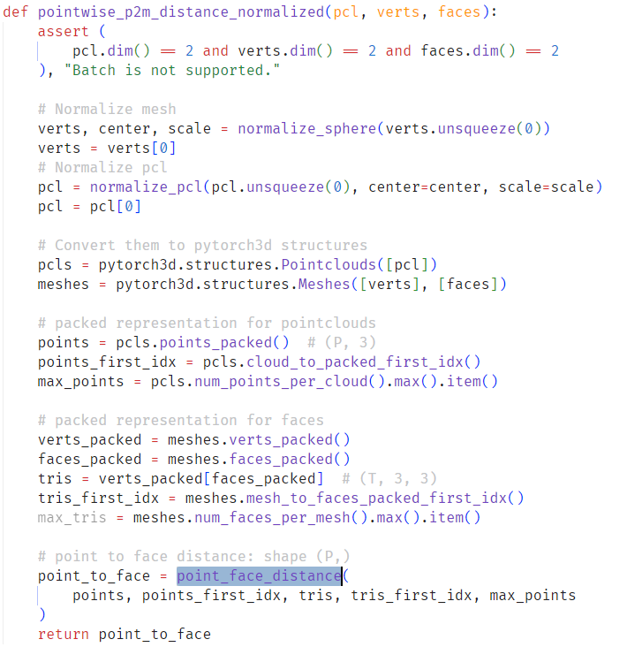
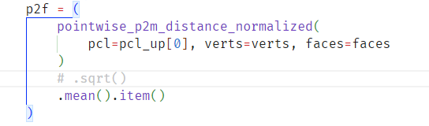

Slide 5
 | 10 1% | 10 2% | 10 3% | 50 1% | 50 2% | 50 3% | 100 1% | 100 2% | 100 3%
16 128 35 | 0.0002514 | 0.0003666 | 0.0004488 | 0.0000698 | 0.0001106 | 0.0001413 | 0.0000400 | 0.0000771 | 0.0001179
32 256 3 | 0.0002466 | 0.0003585 | 0.0004325 | 0.0000718 | 0.0001136 | 0.0001574 | 0.0000387 | 0.0000682 | 0.0001051
32 512 3 | 0.0002550 | 0.0003640 | 0.0004370 | 0.0000718 | 0.0001142 | 0.0001632 | 0.0000381 | 0.0000734 | 0.0001202
32 128 35 | 0.0002400 | 0.0003507 | 0.0004298 | 0.0000679 | 0.0001077 | 0.0001434 | 0.0000379 | 0.0000743 | 0.0001171
32 256 35 | 0.0002397 |  | 0.0004314 | 0.0000679 |  | 0.0001473 | 0.0000372 |  | 0.0001096
IterPFN | 0.0002056 | 0.0003043 |  | 0.0000605 | 0.0000803 | 0.0001970 | 0.0000322
 | 10 1% | 10 2% | 10 3% | 50 1% | 50 2% | 50 3% | 100 1% | 100 2% | 100 3%
16 128 35 | 0.0000235 | 0.0000557 | 0.0000965 | 0.0000092 | 0.0000333 | 0.0000440 | 0.0000072 | 0.0000340 | 0.0000545
32 256 3 | 0.0000209 | 0.0000507 | 0.0000842 | 0.0000100 | 0.0000332 | 0.0000476 | 0.0000061 | 0.0000328 | 0.0000450
32 512 3 | 0.0000247 | 0.0000531 | 0.0000866 | 0.0000100 | 0.0000340 | 0.0000526 | 0.0000057 | 0.0000332 | 0.0000526
32 128 35 | 0.0000180 | 0.0000479 | 0.0000849 | 0.0000080 | 0.0000308 | 0.0000430 | 0.0000056 | 0.0000304 | 0.0000522
32 256 35 | 0.0000176 |  | 0.0000833 | 0.0000079 |  | 0.0000438 | 0.0000053 |  | 0.0000465
IterPFN

Slide 6
 | 10 1% | 10 2% | 10 3% | 50 1% | 50 2% | 50 3% | 100 1% | 100 2% | 100 3%
16 128 35 | 0.0002514 | 0.0003666 | 0.0004488 | 0.0000698 | 0.0001106 | 0.0001413 | 0.0000400 | 0.0000771 | 0.0001179
32 256 35 | 0.0002397 |  | 0.0004314 | 0.0000679 |  | 0.0001473 | 0.0000372 |  | 0.0001096
B-dgcnn 14 | 0.0002596 | 0.0003735 | 0.0004337 | 0.0000691 | 0.0000953 | 0.0001245 | 0.0000389 | 0.0000566 | 0.0001041
B-dgcnn 20 | 0.0002339 | 0.0003314 | 0.0004046 | 0.0000646 | 0.0000993 | 0.0001489 | 0.0000373 | 0.0000750 | 0.0001969
Bdg121 14 | 0.0002332 | 0.0003350 | 0.0004201 | 0.0000642 | 0.0001043 | 0.0001554 | 0.0000365 | 0.0000847 | 0.0002432
Bd212 5 14 | 0.0002372 | 0.0003390 | 0.0004224 | 0.0000653 | 0.0001127 | 0.0001733 | 0.0000392 | 0.0001041 | 0.0002785
IterPFN | 0.0002056 | 0.0003043 | 0.0004242 | 0.0000605 | 0.0000803 | 0.0001970 | 0.0000322 | 0.0000553 | 0.0001918
 | 10 1% | 10 2% | 10 3% | 50 1% | 50 2% | 50 3% | 100 1% | 100 2% | 100 3%
16 128 35 | 0.0000235 | 0.0000557 | 0.0000965 | 0.0000092 | 0.0000333 | 0.0000440 | 0.0000072 | 0.0000340 | 0.0000545
32 256 35 | 0.0000176 |  | 0.0000833 | 0.0000079 |  | 0.0000438 | 0.0000053 |  | 0.0000465
B-dgcnn 14 |  |  | 0.0000767 | 0.0000078 | 0.0000205 | 0.0000394 | 0.0000056 | 0.0000163 | 0.0000403
B-dgcnn 20 | 0.0000145 | 0.0000373 | 0.0000716 | 0.0000060 | 0.0000259 | 0.0000497 | 0.0000052 | 0.0000306 | 0.0001014
Bdg121 14 | 0.0000142 | 0.0000396 | 0.0000811 | 0.0000059 | 0.0000295 | 0.0000553 | 0.0000048 | 0.0000378 | 0.0001418
Bd212 5 14 | 0.0000162 | 0.0000419 | 0.0000841 | 0.0000066 | 0.0000354 | 0.0000689 | 0.0000066 | 0.0000524 | 0.0001698
IterPFN | 0.0000074 | 0.0000214 | 0.0000781 | 0.0000036 | 0.0000117 | 0.0000844 | 0.0000022 | 0.0000151 | 0.0001517

Slide 7
 | 10 1% | 10 2% | 10 3% | 50 1% | 50 2% | 50 3% | 100 1% | 100 2% | 100 3%
16 128 35 | 0.0002514 | 0.0003666 | 0.0004488 | 0.0000698 | 0.0001106 | 0.0001413 | 0.0000400 | 0.0000771 | 0.0001179
32 256 35 | 0.0002397 |  | 0.0004314 | 0.0000679 |  | 0.0001473 | 0.0000372 |  | 0.0001096
B-dgcnn 14 | 0.0002410 | 0.0003444 | 0.0004093 | 0.0000648 | 0.0000953 | 0.0001362 | 0.0000365 | 0.0000657 | 0.0001702
B-dgcnn 20 | 0.0002339 | 0.0003314 | 0.0004046 | 0.0000646 | 0.0000993 | 0.0001489 | 0.0000373 | 0.0000750 | 0.0001969
Bdg121 14 | 0.0002332 | 0.0003350 | 0.0004201 | 0.0000642 | 0.0001043 | 0.0001554 | 0.0000365 | 0.0000847 | 0.0002432
Bd212 5 14 | 0.0002372 | 0.0003390 | 0.0004224 | 0.0000653 | 0.0001127 | 0.0001733
IterPFN | 0.0002056 | 0.0003043 | 0.0004242 | 0.0000605 | 0.0000803 | 0.0001970 | 0.0000322 | 0.0000553 | 0.0001918
 | 10 1% | 10 2% | 10 3% | 50 1% | 50 2% | 50 3% | 100 1% | 100 2% | 100 3%
16 128 35 | 0.0000235 | 0.0000557 | 0.0000965 | 0.0000092 | 0.0000333 | 0.0000440 | 0.0000072 | 0.0000340 | 0.0000545
32 256 35 | 0.0000176 |  | 0.0000833 | 0.0000079 |  | 0.0000438 | 0.0000053 |  | 0.0000465
B-dgcnn 14 | 0.0000177 | 0.0000422 | 0.0000705 | 0.0000060 | 0.0000228 | 0.0000397 | 0.0000047 | 0.0000238 | 0.0001036
B-dgcnn 20 | 0.0000145 | 0.0000373 | 0.0000716 | 0.0000060 | 0.0000259 | 0.0000497 | 0.0000052 | 0.0000306 | 0.0001014
Bdg121 14 | 0.0000142 | 0.0000396 | 0.0000811 | 0.0000059 | 0.0000295 | 0.0000553 | 0.0000048 | 0.0000378 | 0.0001418
Bd212 5 14 | 0.0000162 | 0.0000419 | 0.0000841 | 0.0000066 | 0.0000354 | 0.0000689
IterPFN | 0.0000074 | 0.0000214 | 0.0000781 | 0.0000036 | 0.0000117 | 0.0000844 | 0.0000022 | 0.0000151 | 0.0001517

Slide 8
 | 10 1% | 10 2% | 10 3% | 50 1% | 50 2% | 50 3% | 100 1% | 100 2% | 100 3%
16 128 35 | 0.0002514 | 0.0003666 | 0.0004488 | 0.0000698 | 0.0001106 | 0.0001413 | 0.0000400 | 0.0000771 | 0.0001179
32 256 35 | 0.0002397 |  | 0.0004314 | 0.0000679 |  | 0.0001473 | 0.0000372 |  | 0.0001096
orgB20 20 | 0.0002446 | 0.0003578 | 0.0004370 | 0.0000668 | 0.0001077 | 0.0001461 | 0.0000382 | 0.0000783 | 0.0001136
o256B20 20 | 0.0002557 | 0.0003597 | 0.0004345 | 0.0000715 | 0.0001115 | 0.0001538 | 0.0000388 | 0.0000735 | 0.0001123
Mlp256 2 2 | 0.0002394 | 0.0003521 | 0.0004423 | 0.0000694 | 0.0001088 | 0.0001817 | 0.0000415 | 0.0000784 | 0.0001448
IterPFN | 0.0002056 | 0.0003043 | 0.0004242 | 0.0000605 | 0.0000803 | 0.0001970 | 0.0000322 | 0.0000553 | 0.0002580
 | 10 1% | 10 2% | 10 3% | 50 1% | 50 2% | 50 3% | 100 1% | 100 2% | 100 3%
16 128 35 | 0.0000235 | 0.0000557 | 0.0000965 | 0.0000092 | 0.0000333 | 0.0000440 | 0.0000072 | 0.0000340 | 0.0000545
32 256 35 | 0.0000176 |  | 0.0000833 | 0.0000079 |  | 0.0000438 | 0.0000053 |  | 0.0000465
32 20 20 | 0.0000203 | 0.0000508 | 0.0000879 | 0.0000075 | 0.0000309 | 0.0000438 | 0.0000060 | 0.0000336 | 0.0000507
3225620 20 | 0.0000254 | 0.0000513 | 0.0000866 | 0.0000098 | 0.0000327 | 0.0000468 | 0.0000062 | 0.0000295 | 0.0000469
Mlp256 2 2 | 0.0000175 | 0.0000482 | 0.0000910 | 0.0000086 | 0.0000321 | 0.0000853 | 0.0000076 | 0.0000336 | 0.0000730
IterPFN | 0.0000074 | 0.0000214 | 0.0000781 | 0.0000036 | 0.0000117 | 0.0000844 | 0.0000022 | 0.0000151 | 0.0001517

Slide 9





















$$n×in$$
$$n×k×d$$
$$n×k×c$$
$$n×k×(c+d)$$
$$n×k×c$$
$$n×k×(2c+d)$$
$$n×k×(Lc+d)$$
$$n×\left(Lc+d\right)$$
$$knn$$
Linear
=
ReLU
=
$$iter…$$
Max Pool
$$Edge$$
$$Feature$$
ReLU
Linear
$$Dense EdgeConv$$
$$n×3$$
$$n×l$$
$$n×\left(Lc+d\right)$$
$$n×l$$
$$n×\left(Lc+d\right)$$
$$n×\left(Lc+d\right)$$
Linear
ReLU
$$iter…$$
$$Dense EdgeConv$$
Linear
$$Dense EdgeConv$$
Notes:
Denoise iteration
Patch -> 1000
New EdgeConv cat

Slide 10
















$$n×out×k$$
$$n×h×k$$
Conv1d
$$n×h_{0}×k$$
$$n×out×k$$
$$n×out×k$$
Conv1d
+
Conv1d
ReLU
ReLU
BN
$$n×in×d$$
BN
$$ResnetBlock$$
$$n×\left(d+z\right)×k$$
$$n×h×k$$
$$n×h×k$$
$$n×k×d$$
$$n×z$$
Conv1d
ReLU
$$ResnetBlock$$
$$iter…$$
Conv1d
$$ResnetBlock$$
BN
$$n×k×d$$

Slide 11
 | 10 1% | 10 2% | 10 3% | 50 1% | 50 2% | 50 3% | 100 1% | 100 2% | 100 3%
16 128 35 | 0.0002514 | 0.0003666 | 0.0004488 | 0.0000698 | 0.0001106 | 0.0001413 | 0.0000400 | 0.0000771 | 0.0001179
w/o sigma | 0.0002448 | 0.0003586 | 0.0004513 | 0.0000686 | 0.0001121 | 0.0001407 | 0.0000404 | 0.0000861 | 0.0001219
B-dgcnn 14 | 0.0002410 | 0.0003444 | 0.0004093 | 0.0000648 | 0.0000953 | 0.0001362 | 0.0000365 | 0.0000657 | 0.0001702
 | 0.0002329 | 0.0003322 | 0.0003992 | 0.0000639 | 0.0000943 | 0.0001341
IterPFN | 0.0002056 | 0.0003043 | 0.0004242 | 0.0000605 | 0.0000803 | 0.0001970 | 0.0000322 | 0.0000553 | 0.0001918
 | 10 1% | 10 2% | 10 3% | 50 1% | 50 2% | 50 3% | 100 1% | 100 2% | 100 3%
16 128 35 | 0.0000235 | 0.0000557 | 0.0000965 | 0.0000092 | 0.0000333 | 0.0000440 | 0.0000072 | 0.0000340 | 0.0000545
w/o sigma | 0.0000211 | 0.0000532 | 0.0001013 | 0.0000087 | 0.0000347 | 0.0000465 | 0.0000075 | 0.0000396 | 0.0000609
B-dgcnn 14 | 0.0000177 | 0.0000422 | 0.0000705 | 0.0000060 | 0.0000228 | 0.0000397 | 0.0000047 | 0.0000238 | 0.0001036
 | 0.0000146 | 0.0000367 | 0.0000661 | 0.0000056 | 0.0000221 | 0.0000398
IterPFN | 0.0000074 | 0.0000214 | 0.0000781 | 0.0000036 | 0.0000117 | 0.0000844 | 0.0000022 | 0.0000151 | 0.0001517
Notes:
Test 23
Test our [0,2.5]

Slide 12








$$n×3$$
$$n×l$$
$$n×\left(Lc+d\right)$$
$$n×l$$
$$n×\left(Lc+d\right)$$
$$n×\left(Lc+d\right)$$
$$n×I\left(Lc+d\right)$$
Linear
ReLU
$$iter…$$
=
$$Dense EdgeConv$$
Linear
$$Dense EdgeConv$$
 | 10 1% | 10 2% | 10 3% | 50 1% | 50 2% | 50 3% | 100 1% | 100 2% | 100 3%
16 128 35 | 0.0000235 | 0.0000557 | 0.0000965 | 0.0000092 | 0.0000333 | 0.0000440 | 0.0000072 | 0.0000340 | 0.0000545
B-dgcnn 14 | 0.0000177 | 0.0000422 | 0.0000705 | 0.0000060 | 0.0000228 | 0.0000397 | 0.0000047 | 0.0000238 | 0.0001036
Add Cat
IterPFN | 0.0000074 | 0.0000214 | 0.0000781 | 0.0000036 | 0.0000117 | 0.0000844 | 0.0000022 | 0.0000151 | 0.0001517
Notes:
Denoise iteration
Patch -> 1000
New EdgeConv cat

Slide 13
 | 10 1% | 10 2% | 10 3% | 50 1% | 50 2% | 50 3% | 100 1% | 100 2% | 100 3%
16 128 35 | 0.0002514 | 0.0003666 | 0.0004488 | 0.0000698 | 0.0001106 | 0.0001413 | 0.0000400 | 0.0000771 | 0.0001179
w/ Patch | 0.0002552 | 0.0003720 | 0.0004559 | 0.0000704 | 0.0001146
B-dgcnn 14 | 0.0002410 | 0.0003444 | 0.0004093 | 0.0000648 | 0.0000953 | 0.0001362 | 0.0000365 | 0.0000657 | 0.0001702
IterPFN | 0.0002056 | 0.0003043 | 0.0004242 | 0.0000605 | 0.0000803 | 0.0001970 | 0.0000322 | 0.0000553 | 0.0001918
 | 10 1% | 10 2% | 10 3% | 50 1% | 50 2% | 50 3% | 100 1% | 100 2% | 100 3%
16 128 35 | 0.0000235 | 0.0000557 | 0.0000965 | 0.0000092 | 0.0000333 | 0.0000440 | 0.0000072 | 0.0000340 | 0.0000545
w/ Patch | 0.0000254 | 0.0000580 | 0.0000999 | 0.0000094 | 0.0000362
B-dgcnn 14 | 0.0000177 | 0.0000422 | 0.0000705 | 0.0000060 | 0.0000228 | 0.0000397 | 0.0000047 | 0.0000238 | 0.0001036
IterPFN | 0.0000074 | 0.0000214 | 0.0000781 | 0.0000036 | 0.0000117 | 0.0000844 | 0.0000022 | 0.0000151 | 0.0001517
Notes:
Test 23 PCDNF
Test DDIM mult noise
Train Patch 1000
Train our [0, 2.5]

Slide 14
 | 10 1% | 10 2% | 10 3% | 50 1% | 50 2% | 50 3% | 100 1% | 100 2% | 100 3%
16 128 35 | 0.0002514 | 0.0003666 | 0.0004488 | 0.0000698 | 0.0001106 | 0.0001413 | 0.0000400 | 0.0000771 | 0.0001179
w/o sigma | 0.0002448 | 0.0003586 | 0.0004513 | 0.0000686 | 0.0001121 | 0.0001407 | 0.0000404 | 0.0000861 | 0.0001219
 | 0.0002522 | 0.0003722 | 0.0004551 | 0.0000713 | 0.0001138
B-dgcnn 14 | 0.0002410 | 0.0003444 | 0.0004093 | 0.0000648 | 0.0000953 | 0.0001362 | 0.0000365 | 0.0000657 | 0.0001702
IterPFN | 0.0002056 | 0.0003043 | 0.0004242 | 0.0000605 | 0.0000803 | 0.0001970 | 0.0000322 | 0.0000553 | 0.0001918
 | 10 1% | 10 2% | 10 3% | 50 1% | 50 2% | 50 3% | 100 1% | 100 2% | 100 3%
16 128 35 | 0.0000235 | 0.0000557 | 0.0000965 | 0.0000092 | 0.0000333 | 0.0000440 | 0.0000072 | 0.0000340 | 0.0000545
w/o sigma | 0.0000211 | 0.0000532 | 0.0001013 | 0.0000087 | 0.0000347 | 0.0000465 | 0.0000075 | 0.0000396 | 0.0000609
 | 0.0000239 | 0.0000577 | 0.0000972 | 0.0000098 | 0.0000329
B-dgcnn 14 | 0.0000177 | 0.0000422 | 0.0000705 | 0.0000060 | 0.0000228 | 0.0000397 | 0.0000047 | 0.0000238 | 0.0001036
IterPFN | 0.0000074 | 0.0000214 | 0.0000781 | 0.0000036 | 0.0000117 | 0.0000844 | 0.0000022 | 0.0000151 | 0.0001517

Slide 15
 | 10 1% | 10 2% | 10 3% | 50 1% | 50 2% | 50 3% | 100 1% | 100 2% | 100 3%
16 128 35 | 0.0002514 | 0.0003666 | 0.0004488 | 0.0000698 | 0.0001106 | 0.0001413 | 0.0000400 | 0.0000771 | 0.0001179
w/o sigma | 0.0002448 | 0.0003586 | 0.0004513 | 0.0000686 | 0.0001121 | 0.0001407 | 0.0000404 | 0.0000861 | 0.0001219
B-dgcnn 14 | 0.0002410 | 0.0003444 | 0.0004093 | 0.0000648 | 0.0000953 | 0.0001362 | 0.0000365 | 0.0000657 | 0.0001702
 | 0.0002329 | 0.0003322 | 0.0003992 | 0.0000639 | 0.0000943 | 0.0001341
PSR | 0.0002421 | 0.0003437 | 0.0004165 | 0.0000649 | 0.0001026 | 0.0001394 | 0.0000362 | 0.0000619 | 0.0001059
PCDNF | 0.0008617 | 0.0009457 | 0.0010382 | 0.0000809 | 0.0001368 | 0.0001799 | 0.0000421 | 0.0000748 | 0.0001037
IterPFN | 0.0002056 | 0.0003043 | 0.0004242 | 0.0000605 | 0.0000803 | 0.0001970 | 0.0000322 | 0.0000553 | 0.0001918
 | 10 1% | 10 2% | 10 3% | 50 1% | 50 2% | 50 3% | 100 1% | 100 2% | 100 3%
16 128 35 | 0.0000235 | 0.0000557 | 0.0000965 | 0.0000092 | 0.0000333 | 0.0000440 | 0.0000072 | 0.0000340 | 0.0000545
w/o sigma | 0.0000211 | 0.0000532 | 0.0001013 | 0.0000087 | 0.0000347 | 0.0000465 | 0.0000075 | 0.0000396 | 0.0000609
B-dgcnn 14 | 0.0000177 | 0.0000422 | 0.0000705 | 0.0000060 | 0.0000228 | 0.0000397 | 0.0000047 | 0.0000238 | 0.0001036
 | 0.0000146 | 0.0000367 | 0.0000661 | 0.0000056 | 0.0000221 | 0.0000398
PSR | 0.0000118 | 0.0000327 | 0.0000566 | 0.0000049 | 0.0000201 | 0.0000337 | 0.0000037 | 0.0000148 | 0.0000371
PCDNF |  |  |  |  |  | 0.0000665 | 0.0000082 | 0.0000269 | 0.0000452
IterPFN | 0.0000074 | 0.0000214 | 0.0000781 | 0.0000036 | 0.0000117 | 0.0000844 | 0.0000022 | 0.0000151 | 0.0001517
Notes:
Test 23
Test our [0,2.5]

Slide 16
CD | 10 1% | 10 2% | 10 3% | 50 1% | 50 2% | 50 3% | 100 1% | 100 2% | 100 3%
16 128 35 | 0.0002514 | 0.0003666 | 0.0004488 | 0.0000698 | 0.0001106 | 0.0001413 | 0.0000400 | 0.0000771 | 0.0001179
w/o sigma | 0.0002448 | 0.0003586 | 0.0004513 | 0.0000686 | 0.0001121 | 0.0001407 | 0.0000404 | 0.0000861 | 0.0001219
B-dg 10 | 0.0002329 | 0.0003322 | 0.0003992 | 0.0000639 | 0.0000943 | 0.0001341
B-dg 20 | 0.0002298 | 0.0003262 | 0.0004058 | 0.0000631 | 0.0001002 | 0.0001540
PSR | 0.0002421 | 0.0003437 | 0.0004165 | 0.0000649 | 0.0001026 | 0.0001394 | 0.0000362 | 0.0000619 | 0.0001059
PCDNF | 0.0008617 | 0.0009457 | 0.0010382 | 0.0000809 | 0.0001368 | 0.0001799 | 0.0000421 | 0.0000748 | 0.0001037
IterPFN | 0.0002056 | 0.0003043 | 0.0004242 | 0.0000605 | 0.0000803 | 0.0001970 | 0.0000322 | 0.0000553 | 0.0001918
 | 10 1% | 10 2% | 10 3% | 50 1% | 50 2% | 50 3% | 100 1% | 100 2% | 100 3%
16 128 35 | 0.0000235 | 0.0000557 | 0.0000965 | 0.0000092 | 0.0000333 | 0.0000440 | 0.0000072 | 0.0000340 | 0.0000545
w/o sigma | 0.0000211 | 0.0000532 | 0.0001013 | 0.0000087 | 0.0000347 | 0.0000465 | 0.0000075 | 0.0000396 | 0.0000609
B-dgcnn 14 | 0.0000146 | 0.0000367 | 0.0000661 | 0.0000056 | 0.0000221 | 0.0000398
B-dg 20 | 0.0000131 | 0.0000343 | 0.0000707 | 0.0000053 | 0.0000261 | 0.000053
PSR | 0.0000118 | 0.0000327 | 0.0000566 | 0.0000049 | 0.0000201 | 0.0000337 | 0.0000037 | 0.0000148 | 0.0000371
PCDNF |  |  |  |  |  | 0.0000665 | 0.0000082 | 0.0000269 | 0.0000452
IterPFN | 0.0000074 | 0.0000214 | 0.0000781 | 0.0000036 | 0.0000117 | 0.0000844 | 0.0000022 | 0.0000151 | 0.0001517
Notes:
Test 23
Test our [0,2.5]

Slide 17















Random Point
Random Patch
$$∀pos∈x^{t}$$
$$∀pos∈x^{t}$$
$$∀pos∈x^{t}$$
$$∀pos∈x^{t}$$
$$<$$
$$P=kNN(pos,x^{t},k)$$
$$<$$
$$P=kNN(pos,x^{t},k)$$
$$s_{θ}(pos,F)$$
$$s_{θ}(pos,F)$$
$$s_{θ}(P,F)$$
$$s_{θ}(P,F)$$
$$0.81$$
$$1.52$$
$$1.31$$

Slide 19










$$n×3$$
$$n×l$$
$$n×\left(Lc+d\right)$$
$$n×l$$
$$n×\left(Lc+d\right)$$
$$n×\left(Lc+d\right)$$
$$n×I\left(Lc+d\right)$$
Linear
ReLU
$$iter…$$
=
$$Dense EdgeConv$$
Linear
$$Dense EdgeConv$$
$$0.85$$
$$σ_{t}∈(0,2.5\%]$$
50 1% | 50 2% | 50 3%
0.0000635 | 0.0000952 | 0.0001493

Slide 20
P2M w/ Edge distance
P2M w/o Edge distance
Point-wise P2M distance
Point 2 Face distance
Point 2 Face distance
Point 2 Face distance
Face 2 Point distance
Face 2 Point distance
Point 2 Edge distance
Edge 2 Point distance
CD

Slide 21
AnisoGauss
CD | 10 1% | 10 2% | 10 3% | 50 1% | 50 2% | 50 3% | 100 1% | 100 2% | 100 3%
org | 0.0002461 | 0.0003661 | 0.0004561 | 0.0000692 | 0.0001115 | 0.0001557
new+DDIM | 0.0002276 | 0.0003320 | 0.0004051 | 0.0000634 | 0.0000953 | 0.0001459
PSR | 0.0002377 | 0.0003427 | 0.0004192 | 0.0000646 | 0.0001035 | 0.0001507 | 0.0000366 | 0.0000634 | 0.0001248
P2M | 10 1% | 10 2% | 10 3% | 50 1% | 50 2% | 50 3% | 100 1% | 100 2% | 100 3%
org | 0.0000771 | 0.0001331 | 0.0001983 | 0.0000365 | 0.0000660 | 0.0001007
new+DDIM | 0.0000644 | 0.0001070 | 0.0001586 | 0.0000325 | 0.0000537 | 0.0000949
PSR | 0.0000615 | 0.0001132 | 0.0001704 | 0.0000328 | 0.0000602 | 0.0000954 | 0.0000293 | 0.0000478 | 0.0000919
Laplacian
CD | 10 1% | 10 2% | 10 3% | 50 1% | 50 2% | 50 3% | 100 1% | 100 2% | 100 3%
org | 0.0002902 | 0.0004164 | 0.0005677 | 0.0000807 | 0.0001377 | 0.0001794
new+DDIM | 0.0002656 | 0.0003727 | 0.0004968 | 0.0000703 | 0.0001235 | 0.0001812
PSR | 0.0002745 | 0.0003897 | 0.0004945 | 0.0000733 | 0.0001247 | 0.0001822 | 0.0000417 | 0.0000786 | 0.0001591
P2M | 10 1% | 10 2% | 10 3% | 50 1% | 50 2% | 50 3% | 100 1% | 100 2% | 100 3%
org | 0.0000954 | 0.0001689 | 0.0002889 | 0.0000441 | 0.0000868 | 0.0001196
new+DDIM | 0.0000776 | 0.0001345 | 0.0002292 | 0.0000368 | 0.0000755 | 0.0001201
PSR | 0.0000784 | 0.0001502 | 0.0002311 | 0.0000385 | 0.0000763 | 0.0001160 | 0.0000329 | 0.0000567 | 0.0001141
Notes:
Test 23
Test our [0,2.5]

Slide 22
Uni-Direction
CD | 10 1% | 10 2% | 10 3% | 50 1% | 50 2% | 50 3% | 100 1% | 100 2% | 100 3%
org | 0.0001210 | 0.0002205 | 0.0002916 | 0.0000428 | 0.0000694 | 0.0000972
new+DDIM | 0.0001123 | 0.0002027 | 0.0002626 | 0.0000426 | 0.0000640 | 0.0000991
PSR | 0.0001383 | 0.0002218 | 0.0002811 | 0.0000635 | 0.0000808 | 0.0001059 | 0.0000565 | 0.0000593 | 0.0000798
P2M | 10 1% | 10 2% | 10 3% | 50 1% | 50 2% | 50 3% | 100 1% | 100 2% | 100 3%
org | 0.0000559 | 0.0000798 | 0.0001135 | 0.0000292 | 0.0000420 | 0.0000624
new+DDIM | 0.0000504 | 0.0000683 | 0.0000953 | 0.0000296 | 0.0000397 | 0.0000647
PSR | 0.0000511 | 0.0000689 | 0.0000973 | 0.0000358 | 0.0000442 | 0.0000615 | 0.0000416 | 0.0000432 | 0.0000581
UniformBall
CD | 10 1% | 10 2% | 10 3% | 50 1% | 50 2% | 50 3% | 100 1% | 100 2% | 100 3%
org | 0.0001033 | 0.0002470 | 0.0003138 | 0.0000491 | 0.0000670 | 0.0000954
new+DDIM | 0.0000961 | 0.0002312 | 0.0002901 | 0.0000498 | 0.0000622 | 0.0000768
PSR | 0.0001226 | 0.0002407 | 0.0002955 | 0.0000497 | 0.0000636 | 0.0000918 | 0.0000287 | 0.0000375 | 0.0000802
P2M | 10 1% | 10 2% | 10 3% | 50 1% | 50 2% | 50 3% | 100 1% | 100 2% | 100 3%
org | 0.0000525 | 0.0000724 | 0.0000964 | 0.0000277 | 0.0000346 | 0.0000547
new+DDIM | 0.0000480 | 0.0000610 | 0.0000773 | 0.0000283 | 0.0000312 | 0.0000417
PSR | 0.0000484 | 0.0000612 | 0.0000759 | 0.0000268 | 0.0000310 | 0.0000491 | 0.0000252 | 0.0000293 | 0.0000586
Notes:
Test 23
Test our [0,2.5]

Slide 23
Discrete
CD | 10 1% | 10 2% | 10 3% | 50 1% | 50 2% | 50 3% | 100 1% | 100 2% | 100 3%
org | 0.0001003 | 0.0002060 | 0.0002501 | 0.0000399 | 0.0000535 | 0.0000697
new+DDIM | 0.0000926 | 0.0001889 | 0.0002202 | 0.0000401 | 0.0000490 | 0.0000616
PSR | 0.0001177 | 0.0001999 | 0.0002353 | 0.0000422 | 0.0000516 | 0.0000760 | 0.0000253 | 0.0000318 | 0.0000733
P2M | 10 1% | 10 2% | 10 3% | 50 1% | 50 2% | 50 3% | 100 1% | 100 2% | 100 3%
org | 0.0000519 | 0.0000699 | 0.0000909 | 0.0000276 | 0.0000340 | 0.0000449
new+DDIM | 0.0000473 | 0.0000595 | 0.0000725 | 0.0000283 | 0.0000312 | 0.0000410
PSR | 0.0000473 | 0.0000587 | 0.0000752 | 0.0000279 | 0.0000308 | 0.0000458 | 0.0000254 | 0.0000287 | 0.0000552
Notes:
Test 23
Test our [0,2.5]

Slide 24
CD | 10 1% | 10 2% | 10 3% | 50 1% | 50 2% | 50 3% | 100 1% | 100 2% | 100 3%
RandPoint | 0.0002330 |  | 0.0003993 | 0.0000639 |  | 0.0001341
RandPoint | 0.0002436 |  | 0.0004048 | 0.0000661 |  | 0.0001242
Xt-xT 4 | 0.0002440 |  | 0.0004059 | 0.0000662 |  | 0.0001216
Xt-xT 1 | 0.000238 |  | 0.0004005 | 0.0000656 |  | 0.0001231
Xt-xt 4 | 0.0002438 |  | 0.0004049 | 0.0000661 |  | 0.0001225
Xt-xt 1 | 0.0002389 |  | 0.0003997 | 0.0000655 |  | 0.0001250
Patch | 0.0002333 |  | 0.0004183 | 0.0000650 |  | 0.0001784
PatchtT | 0.0002429 |  | 0.0004112 | 0.0000660 |  | 0.0001589
P2M | 10 1% | 10 2% | 10 3% | 50 1% | 50 2% | 50 3% | 100 1% | 100 2% | 100 3%
RandPoint | 0.0000146 |  | 0.0000661 | 0.0000056 |  | 0.0000398
RandPoint | 0.0000196 |  | 0.0000656 | 0.0000065 |  | 0.0000406
Xt-xT | 0.0000198 |  | 0.0000654 | 0.0000065 |  | 0.0000376
Xt-xT 1 | 0.0000174 |  | 0.0000633 | 0.0000062 |  | 0.0000388
Xt-xt 4 | 0.0000197 |  | 0.0000651 | 0.0000065 |  | 0.0000388
Xt-xt 1 | 0.0000174 |  | 0.0000633 | 0.0000062 |  | 0.0000408
Patch | 0.0000148 |  | 0.0000745 | 0.0000060 |  | 0.0000812
PatchtT | 0.0000194 |  | 0.0000680 | 0.0000064 |  | 0.0000635
Notes:
Test 23
Test our [0,2.5]

Slide 25
CD | 10 1% | 10 2% | 10 3% | 50 1% | 50 2% | 50 3% | 100 1% | 100 2% | 100 3%
Rpoint | 0.0002356 |  | 0.0004033 | 0.0000635
Rpatch | 0.0002381 |  | 0.0004106 | 0.0000631
P2M | 10 1% | 10 2% | 10 3% | 50 1% | 50 2% | 50 3% | 100 1% | 100 2% | 100 3%
Rpoint | 0.0000370 |  | 0.0001237 | 0.0000075
Rpatch | 0.0000394 |  | 0.0001309 | 0.0000074
Notes:
Test 23
Test our [0,2.5]

Slide 26
 | 10 1% | 10 2% | 10 3% | 50 1% | 50 2% | 50 3% | 100 1% | 100 2% | 100 3%
16 128 35 | 0.0002514 | 0.0003666 | 0.0004488 | 0.0000698 | 0.0001106 | 0.0001413 | 0.0000400 | 0.0000771 | 0.0001179
Xt-xt | 0.0002537 |  | 0.0004499 | 0.0000703 |  | 0.0001524
Xm-xm | 0.0002529 |  | 0.0004501 | 0.0000702 |  | 0.0001530
Xt-xT | 0.0002542 |  | 0.0004526 | 0.0000715 |  | 0.0001533
 | 10 1% | 10 2% | 10 3% | 50 1% | 50 2% | 50 3% | 100 1% | 100 2% | 100 3%
16 128 35 | 0.0000235 | 0.0000557 | 0.0000965 | 0.0000092 | 0.0000333 | 0.0000440 | 0.0000072 | 0.0000340 | 0.0000545
 | 0.0000254 |  | 0.0000951 | 0.0000091 |  | 0.0000605
 | 0.0000251 |  | 0.0000956 | 0.0000091 |  | 0.0000613
 | 0.0000256 |  | 0.0000965 | 0.0000096 |  | 0.0000603
Notes:
Test 23
Test our [0,2.5]

Slide 27
CD | 10 1% | 10 2% | 10 3% | 50 1% | 50 2% | 50 3% | 100 1% | 100 2% | 100 3%
1135 | 0.0002292 | 0.0003262 | 0.0003849 | 0.0000617 | 0.0000836 | 0.0001225 | 0.0000333 | 0.0000527 | 0.0001222
1135 2 | 0.0002282 | 0.0003247 | 0.0003843 | 0.0000611 | 0.0000829 | 0.0001280 | 0.0000329 | 0.0000546 | 0.0001433
1158
 |  |  |  |  |  |  |  | 0.00005223 | 0.0001197
 |  |  |  |  |  |  |  | 0.00005420 | 0.0001410
IterPFN | 0.0002056 | 0.0003043 | 0.0004242 | 0.0000605 | 0.0000803 | 0.0001970 | 0.0000322 | 0.0000553 | 0.0001918
PSR | 0.0002421 | 0.0003437 | 0.0004165 | 0.0000649 | 0.0001026 | 0.0001394 | 0.0000362 | 0.0000619 | 0.0001059
 | 10 1% | 10 2% | 10 3% | 50 1% | 50 2% | 50 3% | 100 1% | 100 2% | 100 3%
1135 | 0.0000128 | 0.0000336 | 0.0000569 | 0.0000044 | 0.0000149 | 0.0000393 | 0.0000029 | 0.0000142 | 0.0000628
1135 2 | 0.0000123 | 0.0000330 | 0.0000571 | 0.0000042 | 0.0000148 | 0.0000435 | 0.0000027 | 0.0000157 | 0.0000772
1158
 |  |  |  |  |  |  |  | 0.0000140 | 0.0000615
 |  |  |  |  |  |  |  | 0.0000156 | 0.0000764
IterPFN | 0.0000074 | 0.0000214 | 0.0000781 | 0.0000036 | 0.0000117 | 0.0000844 | 0.0000022 | 0.0000151 | 0.0001517
PSR | 0.0000118 | 0.0000327 | 0.0000566 | 0.0000049 | 0.0000201 | 0.0000337 | 0.0000037 | 0.0000148 | 0.0000371
Notes:
Test 23
Test our [0,2.5]

