Slide 1
CarRacing-v3 DQN
Dyllon Dunton

Slide 2
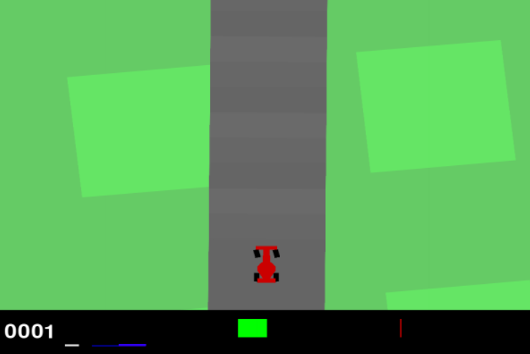
State Space
A top-down 96x96 RGB image of the car and racetrack
The generated track is random every episode.
Some indicators are shown at the bottom of the window

Slide 3
Action Space
Box([-1. 0. 0.], 1.0, (3,), float32)
Steering [-1,1] (Left to Right)
Gas [0,1]
Braking [0,1]
Could aggregate action space for a discrete option

Slide 4
Reward Function
The reward is -0.1 every frame and +1000/N for every track tile visited, where N is the total number of tiles visited in the track.
For example, if you have finished in 732 frames, your reward is 1000 - 0.1*732 = 926.8 points.
The episode finishes when all the tiles are visited. The car can also go outside the playfield - that is, far off the track, in which case it will receive -100 reward and die.

Slide 5
Deep Q-Learning Approach
Neural Network that takes in state image and outputs Q value for each of the possible actions
Difficult for continuous action space since you must approximate the 3-dimensional continuous actions (steering, gas, brake)
Argmax of the q-values is the action that is predicted to give the highest reward

Slide 6
Offline Training
Keep replay buffer of previous 300 epsilon greedy states (s,a,r,s’,t)
Each step of the episode take random 100 and train network given state to predict the q-value
Standard Bellman: Q(s,a) <- r + y*max(Q(s’a’))
DQN: loss = [Q_online(s,a) – (r + y*max(Q(s’a’))]^2
Keep separate online and target networks
Fit the online weights, and every so often, copy online weights to target

Slide 7
Inference Time
Simply use the online network to give q-values of each action given the state and take the arg-max for the optimal value
To implement rollout, run base policy from single lookahead and pick the action with highest reward.
I will test both and compare

