Slide 1




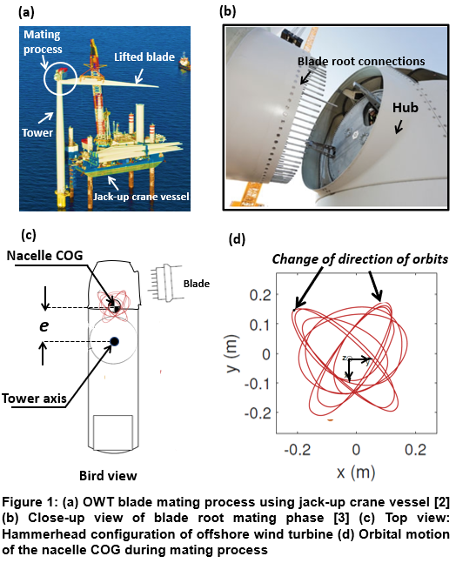
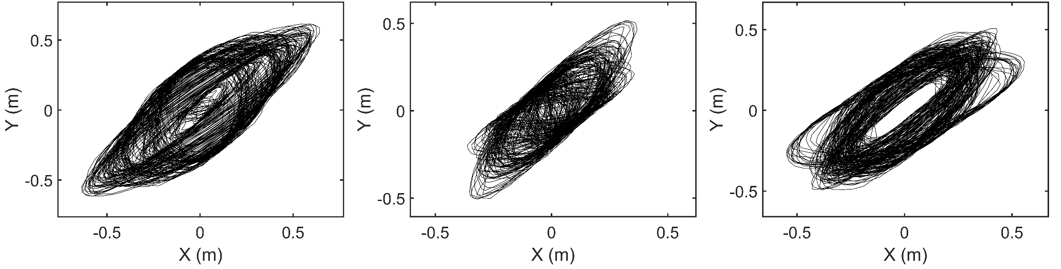
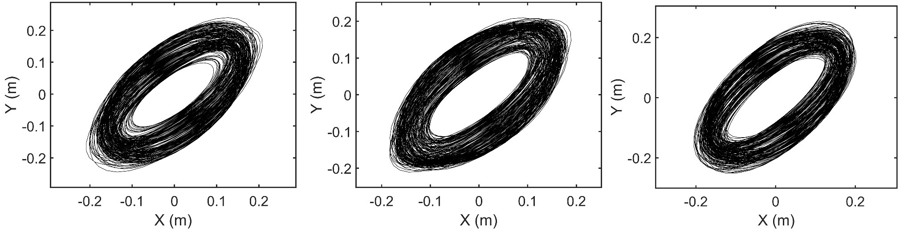
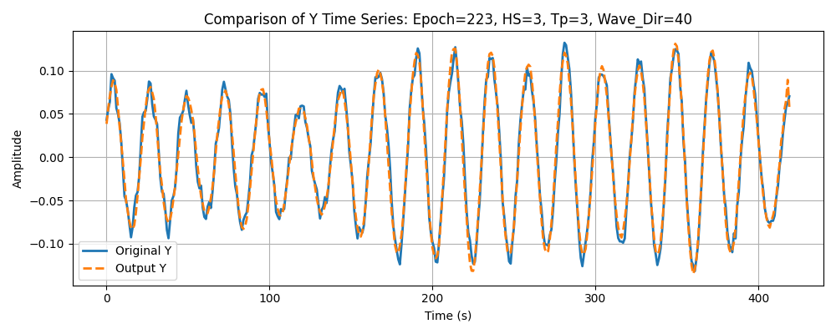
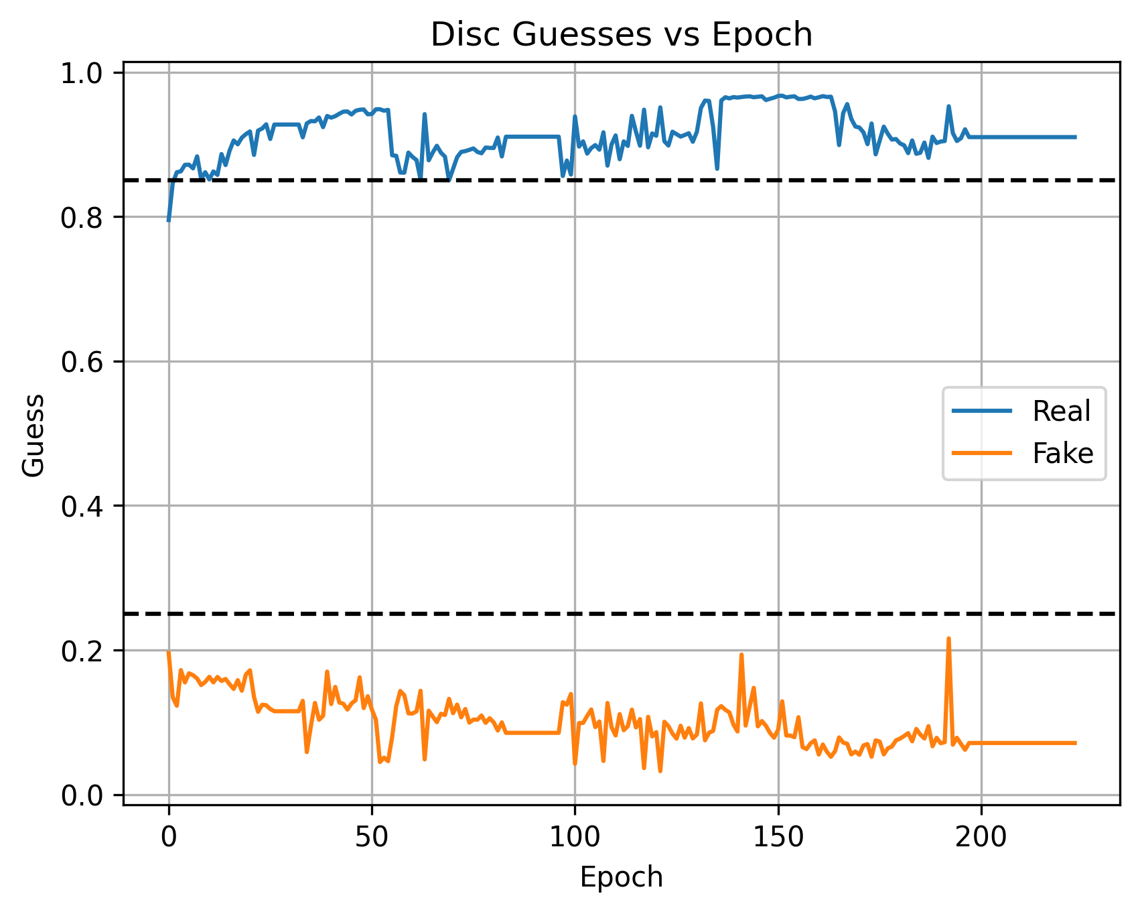
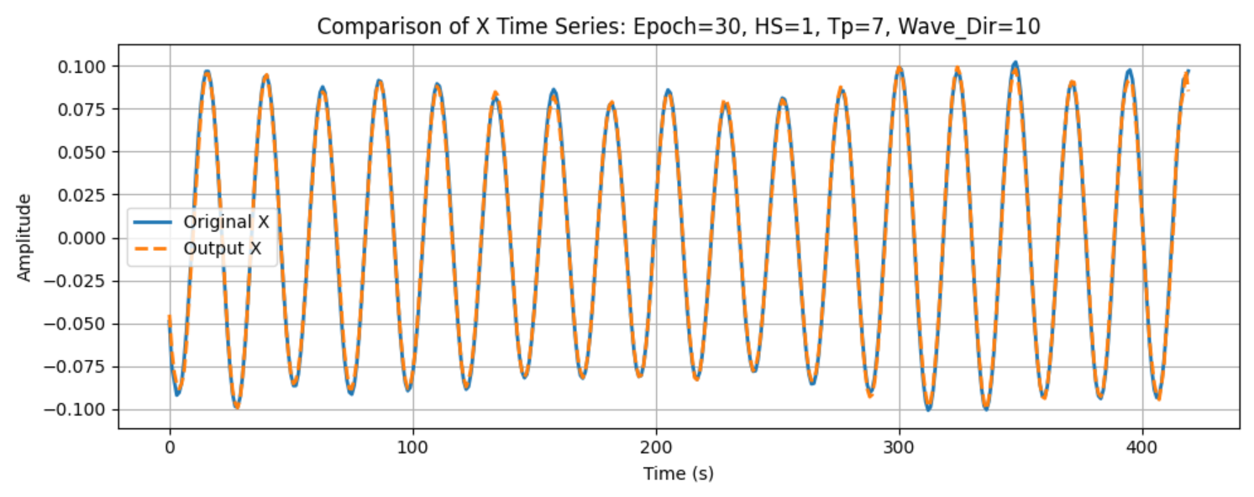
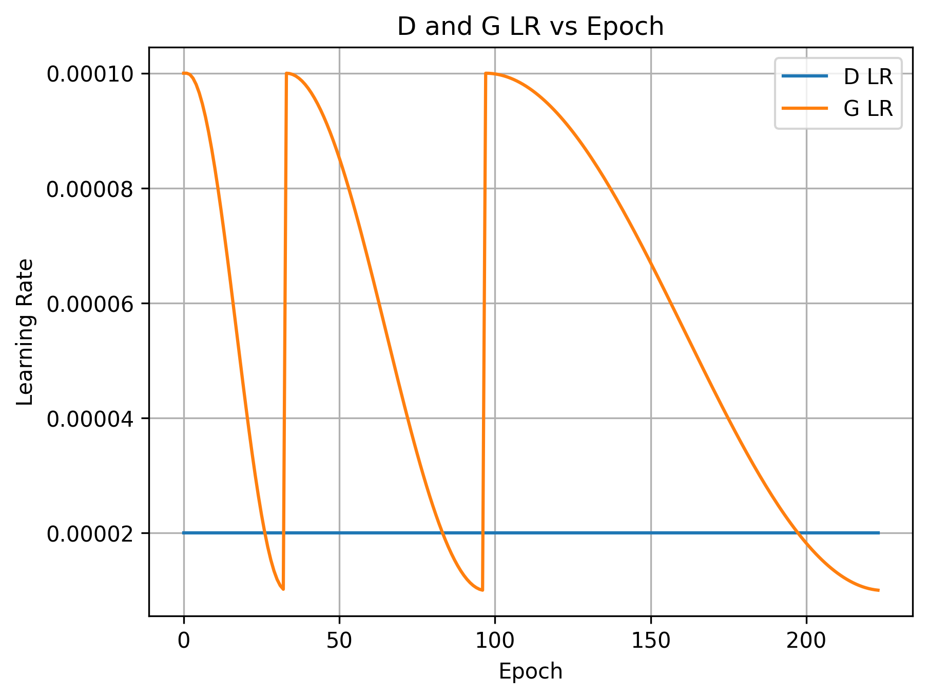
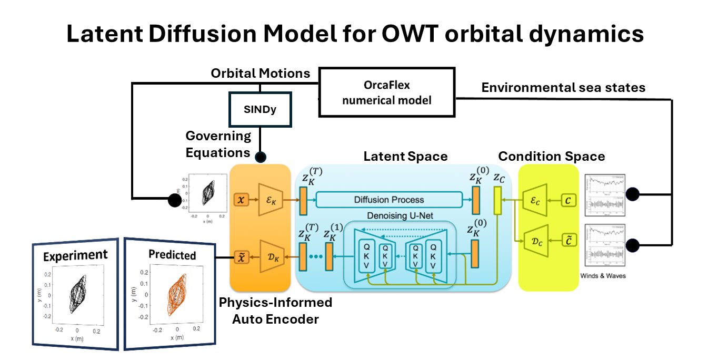
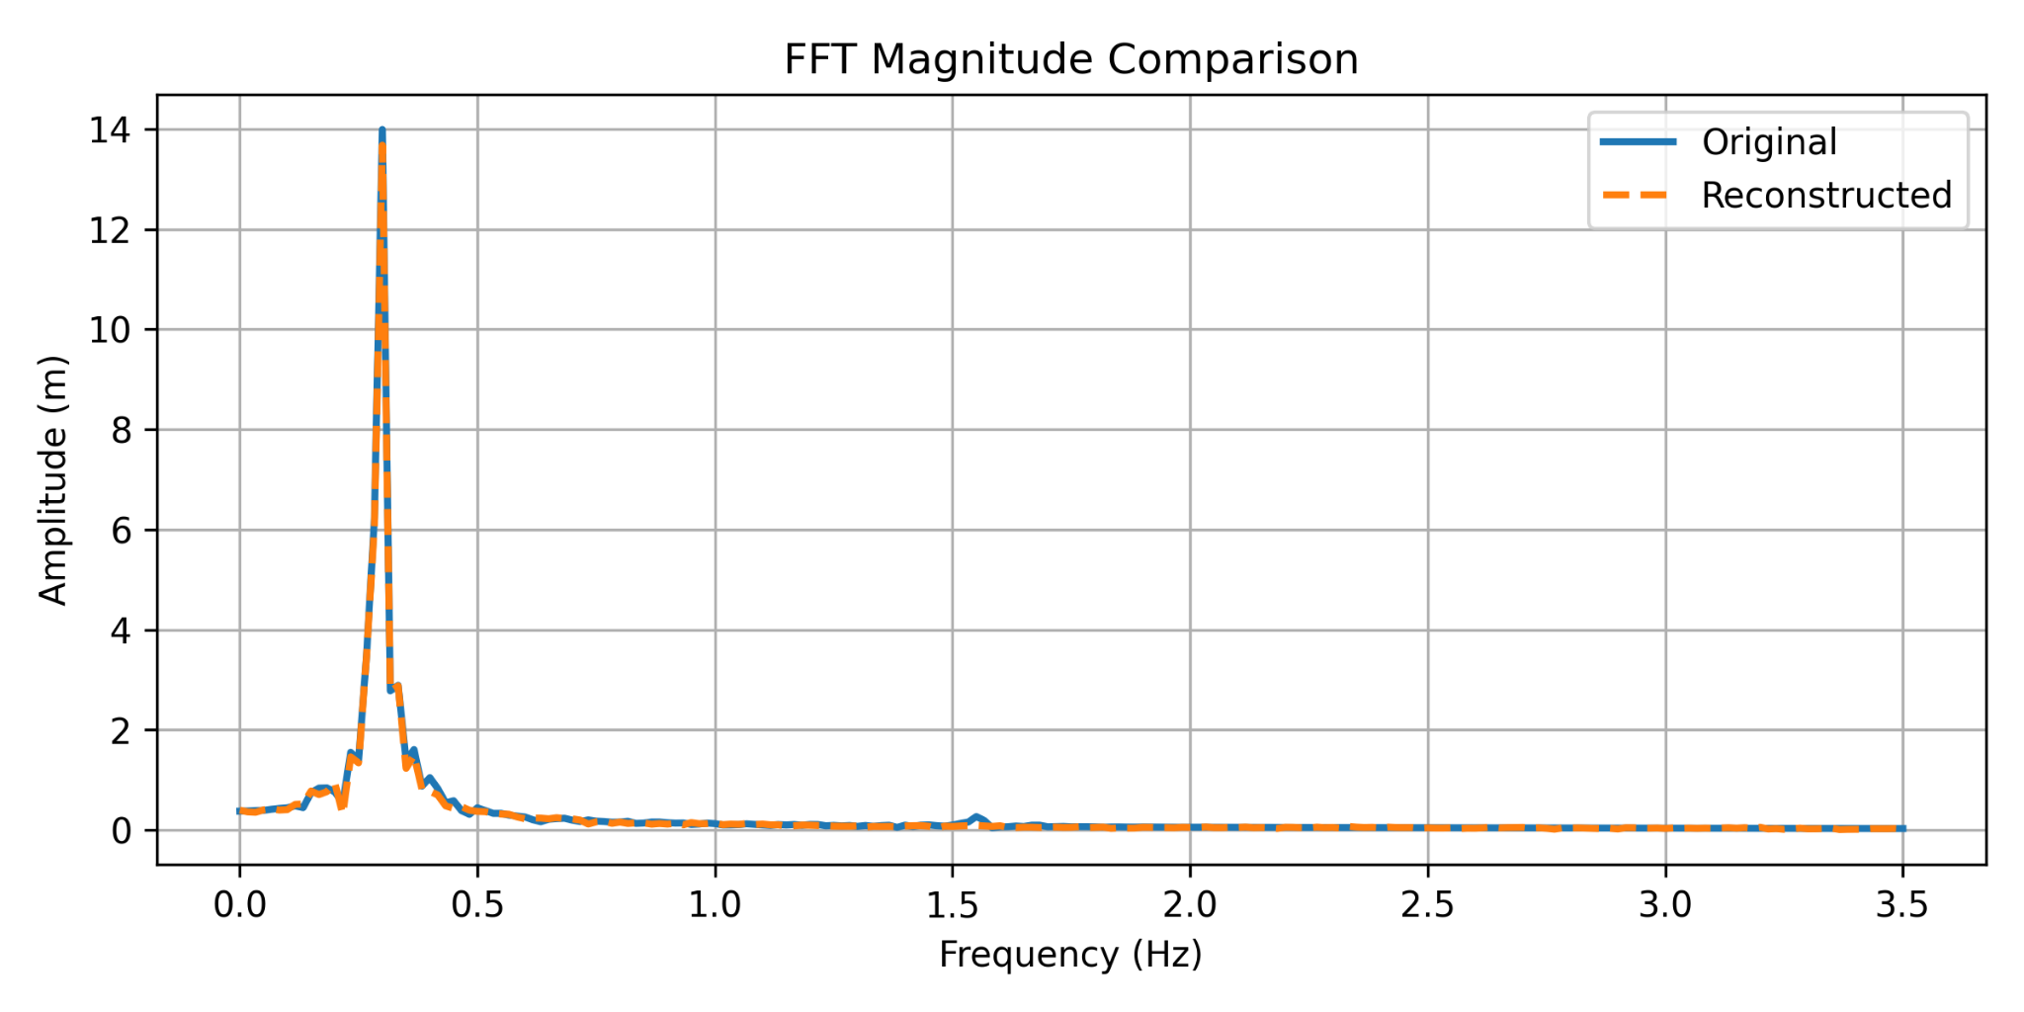
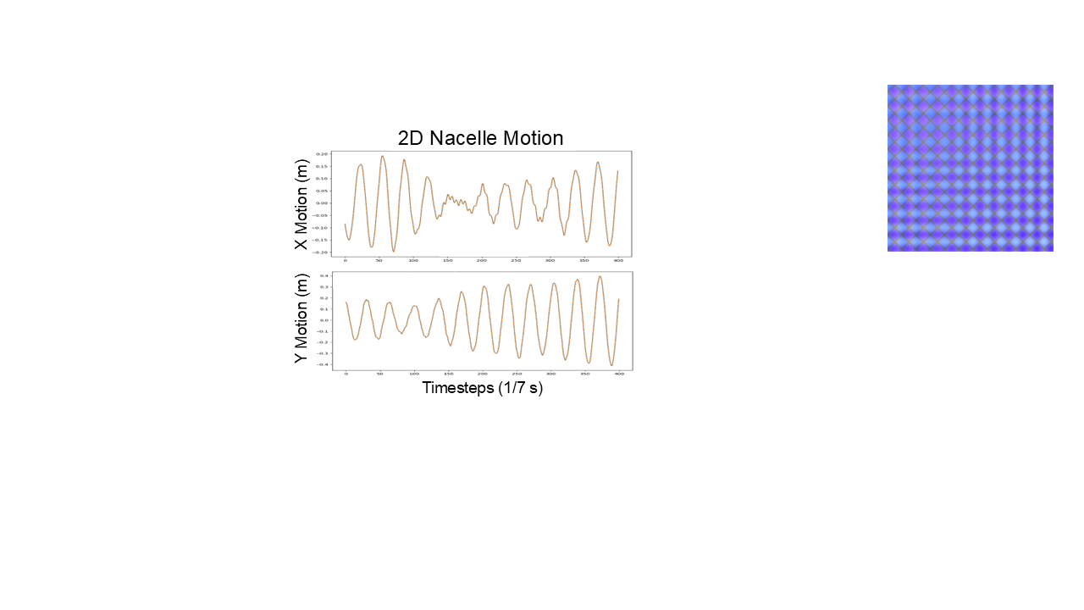

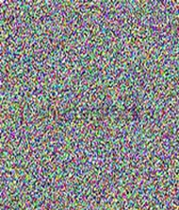
PINN with SINDy for Real-Time Prediction of Tower Top Motions During Offshore Wind Turbine Installation
IMECE 2025-173097
Saravanan Bhaskaran¹, Dyllon Dunton², Yifeng Zhu², Andrew Goupee¹, Amrit Verma (PI)¹
¹Department of Mechanical Engineering, ²Department of Electrical and Computer Engineering, University of Maine
IMECE Track 19-01
NSF Research Poster Competition
1. Objectives and Goals
4. Data and Results
This study presents a physics-informed AI model, leveraging Sparse Identification of Nonlinear Dynamical Systems (SINDy), to predict tower-top orbital motions in real-time across a wide range of sea states. By delivering fast, interpretable forecasts, the model underpins informed, time-critical decisions that improve safety and operational efficiency during offshore wind turbine blade installation.
A high-fidelity numerical model of the IEA 10 MW turbine was developed using OrcaFlex, which is a dynamic analysis tool for offshore systems. The tower and monopile were modeled as Timoshenko beams, and the nacelle as a rigid eccentric point mass, with blades and controllers excluded. Irregular-wave load cases spanned a full campaign of 7,440 simulations. The base grid combined significant wave heights (H_{s}) of 1, 2, and 3 meters with peak periods (T_{p}) of 3, 5, 7, and 9 seconds and wave directions (θ_{wv}) of 20, 30, 40, 50, 60, and 70 degrees, using 100 random seeds per combination (7,200 cases). This was augmented with additional directions at 10 and 80 degrees, using 10 seeds per combination (240 cases). Each simulation produced a 10-minute time series of nacelle motion in the fore-aft (X) and side-side (Y) directions, and the wave elevation was recorded for every case. Figure 4 shows representative orbital patterns across these sea states.
The first stage in developing the motion prediction framework involved training the physics-informed autoencoder (AE). Before training, Gramian Angular Summation Field (GASF) images were generated from nacelle motion time series and paired with their corresponding wave height and wave parameter data. The dataset was divided into balanced training and testing subsets as described in the Numerical Setup.
During training, the AE and discriminator were optimized in alternating steps. For each AE epoch, the discriminator was first trained on reconstructed GASF images using a logarithmic loss that increases when it confidently identifies real images as “1” and reconstructed images as “0.” Training continued until the discriminator average confidence exceeded 0.85 for real images and dropped below 0.25 for reconstructions, ensuring stable adversarial feedback (see Fig. 6)
The AE was then trained to minimize a weighted sum of seven losses - including reconstruction, time-series, spectral, latent regularization, adversarial, symmetry, and physics-informed terms. A Cosine Annealing with Warm Restarts [10] learning-rate schedule (Fig. 7) was applied to promote convergence and prevent overfitting. The AE was trained for 224 epochs without the physics term and fine-tuned for 32 epochs with the SINDy-based physics loss at a reduced learning rate. This staged process improved reconstruction fidelity and physical coherence, yielding accurate, reversible latent representations for subsequent LDM training.
2. Background
Offshore wind turbines are rapidly growing in size to increase energy output, but this introduces greater complexity during installation. Blade mating (Figure 1a–1b) is the most critical phase [1], requiring precise alignment while the turbine is in the hammerhead configuration (Figure 1c), with the monopile, transition piece, and nacelle already installed. Due to an offset between the tower axis and the nacelle center of gravity, wave-induced lateral motion generates torsional excitation about the tower axis. This coupling of lateral and longitudinal dynamics produces complex orbital motions at the tower top (Figure 1d), which can lead to collisions, delays, and safety risks during installation.
Figure 1: (a) OWT blade mating process using jack-up crane vessel [2] (b) Close-up view of blade root mating phase [3] (c) Top view: Hammerhead configuration of offshore wind turbine (d) Orbital motion of the nacelle COG during mating process
(b)
(c)
(d)
(e)
(f)
(a)
3. Numerical Setup
Figure 4: Examples of orbits obtained for a H_{s} of 3m, θ_{wv} of 45 degrees and a T_{p} of 3s (a,b and c) and 10s (d,e and f).
High-fidelity motion data for the offshore wind turbine system are generated using OrcaFlex [4], which serves as the physics-based foundation for model development. The hammerhead configuration of the International Energy Agency (IEA) 10 MW [5] turbine is modeled in OrcaFlex and the time-series responses of the nacelle motion in the fore-aft (FA) and side-side (SS) directions are extracted under a variety of irregular wave load cases and random seeds. To introduce physics-based guidance, sparse identification of non-linear dynamical systems (SINDy) [6] is employed to identify a parsimonious set of governing terms and derive a compact ordinary-differential equation that captures the dominant fore–aft/side–side coupling. This ODE is embedded in the training loop as an additional loss term, penalizing deviations between the learned latent dynamics and the physically consistent SINDy-derived equation. For a single load case—defined by fixed sea-state parameters —the tower-top dynamics are represented by a linear, second-order form with constant coefficients as shown in Eq.1 and Eq.2.
On the right-hand side, the external excitation is simplified from the “real” hydrodynamic force to a proportional term i.e., a scalar gain multiplying the measured free-surface elevation. This replaces detailed Morison-type or radiation–diffraction force models with an effective input that is (i) directly observable, (ii) low dimensional, and (iii) sufficiently correlated with tower-top response within the sea-state ranges of interest. Directionality is enforced by projecting the wave elevation onto the global axes. To accommodate multiple load cases spanning a range of sea states, this structure is generalized by replacing the constant coefficients with smooth, sea-state–parametric functions as shown in Eq.3
Time Series Comparison
Coefficients are first estimated for each sea state by fitting the single-case model and aggregating across seeds. They are then linearly regressed against the sea-state parameters—significant wave height (H_{s}), peak period (T_{p}), and wave direction (θ_{wv})—so that each coefficient becomes an explicit function of these variables. Adopting a linear-only dependence preserves interpretability, avoids unnecessary higher-order or coupling terms, and yields smoothly varying coefficients suitable for robust simulation and physics-informed learning.
The digital twin is implemented using a Latent Diffusion Model (LDM) (see Fig. 2) trained within a compressed latent space encoded by a physics-informed Autoencoder (AE) (see Fig. 3). Unlike conventional diffusion models that add noise to raw signals, this framework performs diffusion on reversible Gramian-encoded images derived from nacelle motion time series. This allows the network to generate realistic and physically consistent tower-top motion trajectories for offshore wind turbines.
Figure 6: Discriminator Guesses
Frequency Domain Comparison
Figure 7: AE and Discriminator learning rates
Table 1: Mean Absolute Error with and without PINN
Batch | Mean Absolute Error
Training | 3.76 mm
Training w/ PINN | 3.63 mm
Testing | 3.73 mm
Testing w/ PINN | 3.60 mm
Figure 2: Pipeline of latent diffusion model [7] that generates orbital motions influenced by external conditions such as wind and waves
The AE follows a U-Net–based [8] Physics-Informed Neural Network (PINN) architecture, trained to encode and reconstruct the Gramian Angular Summation Field (GASF) [9] representations of longitudinal and lateral motion. Each motion component is converted into a single GASF channel, where pixel values represent the sine of summed signal angles. The original time series can be exactly recovered by extracting and inverting the image diagonal after normalization to ±π/4 (corresponding to ±0.1 m displacement).
Figure 5: Comparison between reconstruction and original motion in both time and frequency domain
5. Conclusion
10. References
[1] Verma, A.S., Jiang, Z., Ren, Z., Gao, Z. and Vedvik, N.P., 2019. Energies, 12(10), p.1867.
[2]https://www.marinelog.com/offshore/renewables/grounded-wind-turbine-installation-barge-capsizes/
[3]https://www.power-technology.com/features/featureinpictures-longest-wind-turbine-rotor-blades.
[4] OrcaFlex ©, Version 11.4; Orcina: Ulverston, UK.
[5] Bortolotti, P., Tarres, H.C., Dykes, K., Merz, K., Sethuraman, L., Verelst, D. and Zahle, F., 2019. IEA Wind TCP Task 37: Systems engineering in wind energy- WP2.1 Reference wind turbines.
[6] Brunton, S.L., Proctor, J.L. and Kutz, J.N., 2016. Discovering governing equations from data by sparse identification of nonlinear dynamical systems. Proceedings of the national academy of sciences, 113(15), pp.3932-3937.
[7]https://milvus.io/ai-quick-reference/what-are-latent-diffusion-models-and-how-do-they-differ-from-pixelspace-diffusion
[8] Rombach, R., Blattmann, A., Lorenz, D., Esser, P., & Ommer, B., Proceedings of the IEEE/CVF Conference on Computer Vision and Pattern Recognition (CVPR), 2022, pp. 10684–10695.
[9] Z. Wang and T. Oates, arXiv preprint arXiv:1510.06104, 2015.
[10] I. Loshchilov and F. Hutter, “SGDR: Stochastic Gradient Descent with Warm Restarts,” International Conference on Learning Representations (ICLR), 2017. [Online].
The framework integrates physics-informed learning with a latent diffusion model to enable real-time prediction of offshore wind turbine nacelle motion.
A combination of GASF encoding, a PINN-based autoencoder, and a latent diffusion model ensures reversible data transformation and physical interpretability.
The inclusion of the SINDy-derived physics loss enforces agreement between generated motion trajectories and governing system dynamics.
The resulting model demonstrates a scalable foundation for developing physically consistent digital twins for complex, dynamic engineering systems.
E D
6. Future Studies
Figure 3: Autoencoder pipeline with reversible gramian field that compresses nacelle motion to a latent space
The next stage of development involves training and refining the full Latent Diffusion Model (LDM) to generate accurate nacelle motion predictions. This phase requires multiple rounds of tuning and optimization and is currently in progress.
Training of the AE minimizes a weighted sum of seven loss terms: image and time-series MSE, spectral (FFT) loss, latent-space regularization, adversarial consistency, symmetry and endpoint constraints, and a physics loss enforcing the SINDy-derived governing equation. The trained AE provides the reversible latent representation required for the LDM, which is subsequently trained to model the temporal evolution of the encoded nacelle motion distributions.
8. Acknowledgment
This research was funded by the U.S. National Science Foundation (NSF), Award No. 2343210 (CBET—Division of Chemical, Bioengineering, Environmental, and Transport Systems; Program Manager: Carole Read).
9. Publications
There are no publications on this research yet, as it is still in progress.

