Slide 1
Hybrid Observation Logic for
MAS
INPUT:
  Operator enters mission requirements (i.e. priority of the targets to be observed)
OUTPUT:
  Operator will be able continuously observe a target of interest
Features:
  The team of UAVs will be autonomuosly work together to observe/track a moving target (or group of targets)

Slide 2


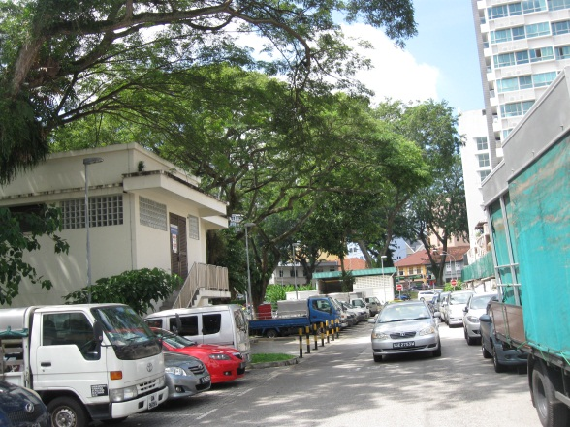
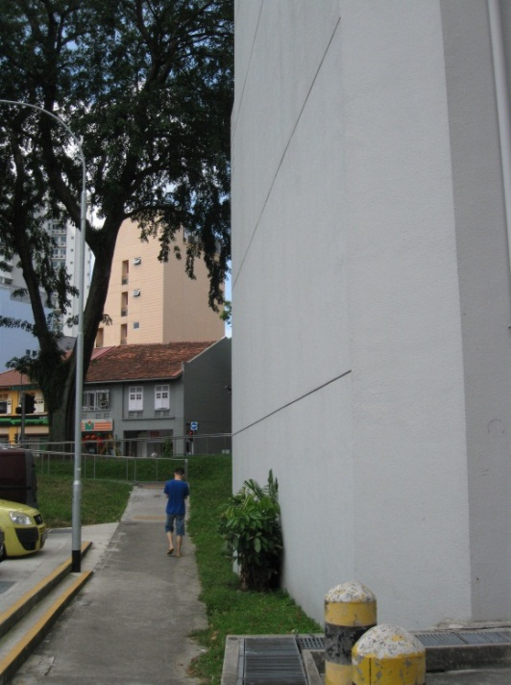
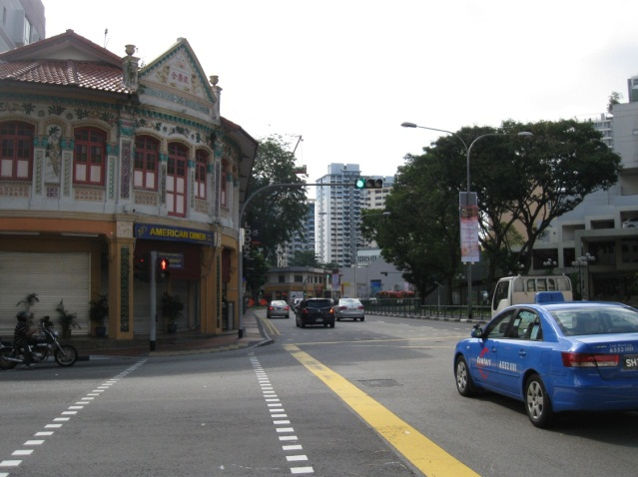
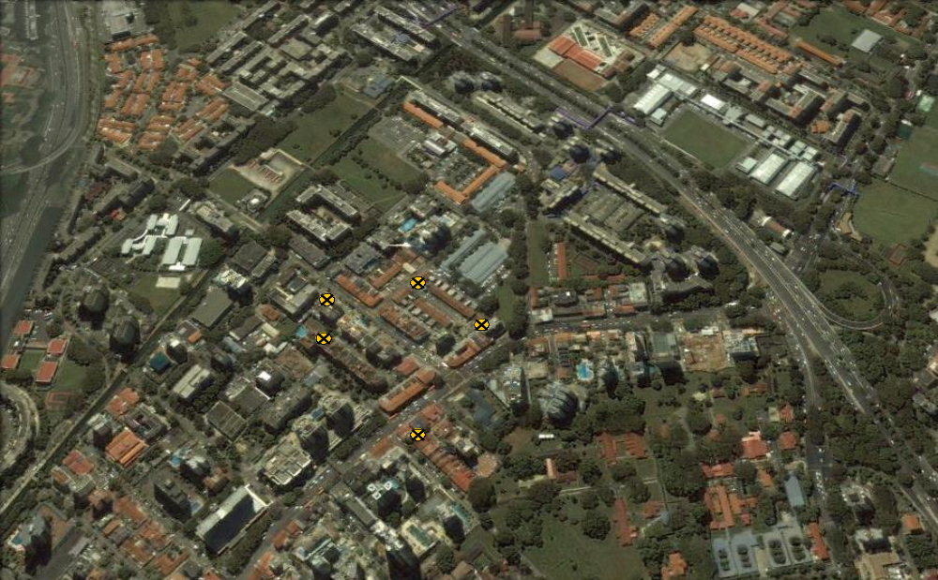
Cooperative Target Observation Logic

Slide 3
Operator Mode

Slide 4
  During Surveillance, given moving targets to observe, the coordination logic selects and pans the vehicle cameras to observe the targets

Slide 11


Slide 33
Lost target: Centralized approach

Slide 34
Lost target: if not find in next some small time interval, according to the last position of the target define a search area (in order to initiate the search and track algorithms with corresponding tasking)

Slide 35
Lost target: Hybrid approach---such situation never appear (inside of “perimeter”)!

Slide 53
The target moved out of “perimeter”

Slide 54
The target moved out of “perimeter”

Slide 55
The target moved out of “perimeter”

Slide 56
A vehicle will be deployed to a new point to find and then follow the target of interest

Slide 57
Summary
  Coordinates multiple UAVs to follow target;
  Deploys vehicle to new point if target goes out of view of all UAVs;
  Maintains surveillance;
  Dynamic re-scheduling if targets move out from “perimeter”.

