Slide 1
MX17 Resistive Micromegas — Detector Performance
Cosmic-bench characterisation at CEA Saclay and first reconstructed tracks at n_TOF EAR2
Prototype Detector 0 — how the detector you built performs
n_TOF X17 · prepared for the detector lab · June 2026 [add recipient / affiliation]

Slide 2
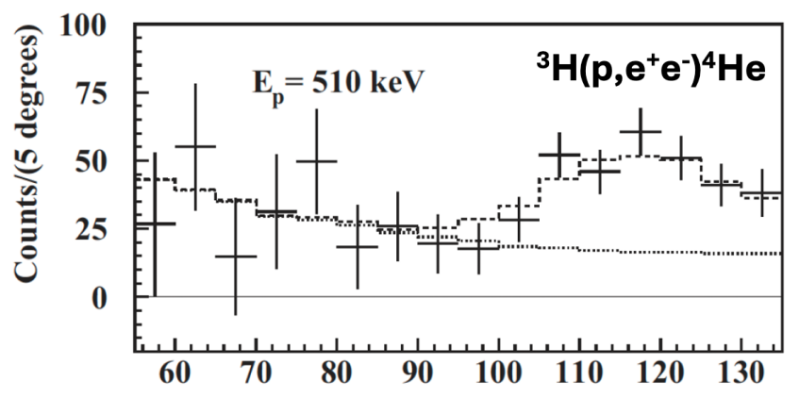
CONTEXT · ONE SLIDE
What these detectors are for
• The ATOMKI experiments report an excess of e⁺e⁻ pairs peaking near a 120° opening
  – angle — possibly a new ~17 MeV boson, the “X17”.
• n_TOF EAR2 can make an independent, complementary measurement using a ³He target:
  – n + ³He → ⁴He* → ⁴He + X17 → e⁺e⁻.
• The observable is the e⁺e⁻ opening angle → we must reconstruct the two tracks and the
  – angle between them, event by event.
• Our tool: four 40×40 cm resistive-strip Micromegas in µ-TPC mode (30 mm drift),
  – giving full 3-D track angles around the target.
• → The detector requirement is good efficiency to MIPs and good ANGULAR resolution.
ATOMKI: e⁺e⁻ excess near ~120° — the signature we aim to reconstruct.
The rest of this deck is about how the detector performs —
not the physics. Efficiency, spatial & angular resolution, tracking.
MX17 detector · Context

Slide 3
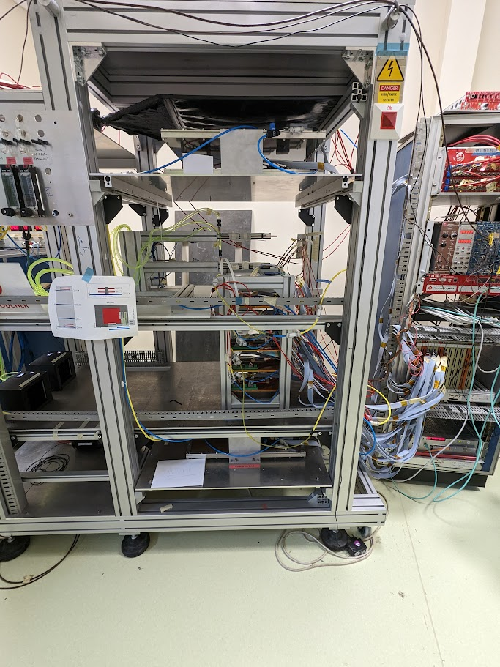
METHOD
Characterised on the cosmic test bench at CEA Saclay
• Prototype “Detector 0”: 40×40 cm resistive-strip Micromegas, 30 mm drift gap,
  – aluminium frame, Argon/Isobutane 95/5, DREAM readout.
• Mounted in a cosmic-muon telescope: 4 reference tracking detectors + 2 trigger
  – scintillators provide an external reference track (the M3 tracker).
• Cosmic muons (MIPs) cross all layers; we compare the MX17 reconstruction to the
  – reference track to extract efficiency, spatial resolution and angular resolution.
• µ-TPC mode: strip position + drift time → the 3rd coordinate, so a single detector
  – reconstructs a 3-D track segment and its angle.
• Reference tracker resolution ≈ 500 µm — it sets the floor on what we can measure.
Cosmic bench (side view).
MX17 detector · Method

Slide 4
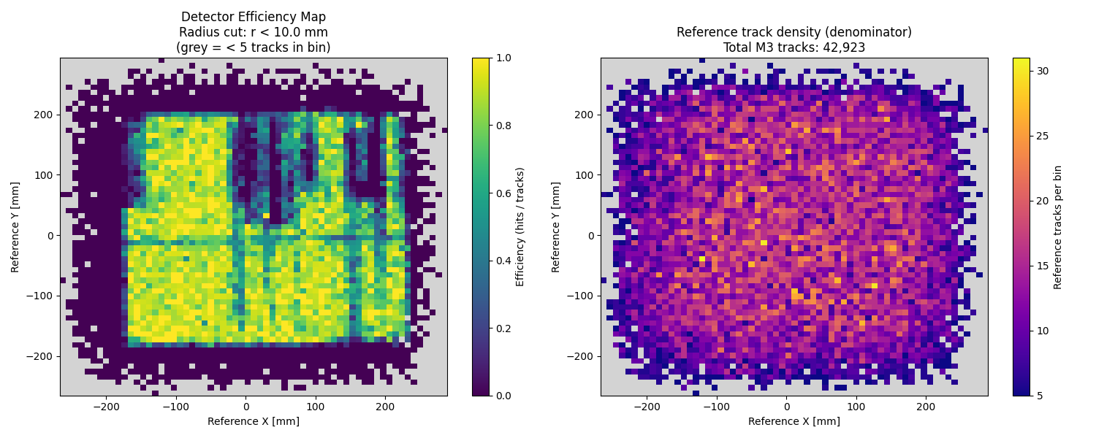
PERFORMANCE · EFFICIENCY
The detector is efficient
• Across most of the active area the detector is at or near
  – full efficiency to cosmic MIPs.
• The two understood dead features:
  – a band of broken resistive strips (no HV there);
  – the M4 connector edge not making contact.
• Both causes are identified and fixable in the next
  – detector iteration — not intrinsic to the design.
Per-bin efficiency = MX17 hits / reference tracks (left); reference-track density / exposure (right). 42,923 reference tracks.
Argon/Isobutane 95/5 · 30 mm drift · aluminium frame · cosmic bench @ CEA Saclay
MX17 detector · Performance

Slide 5
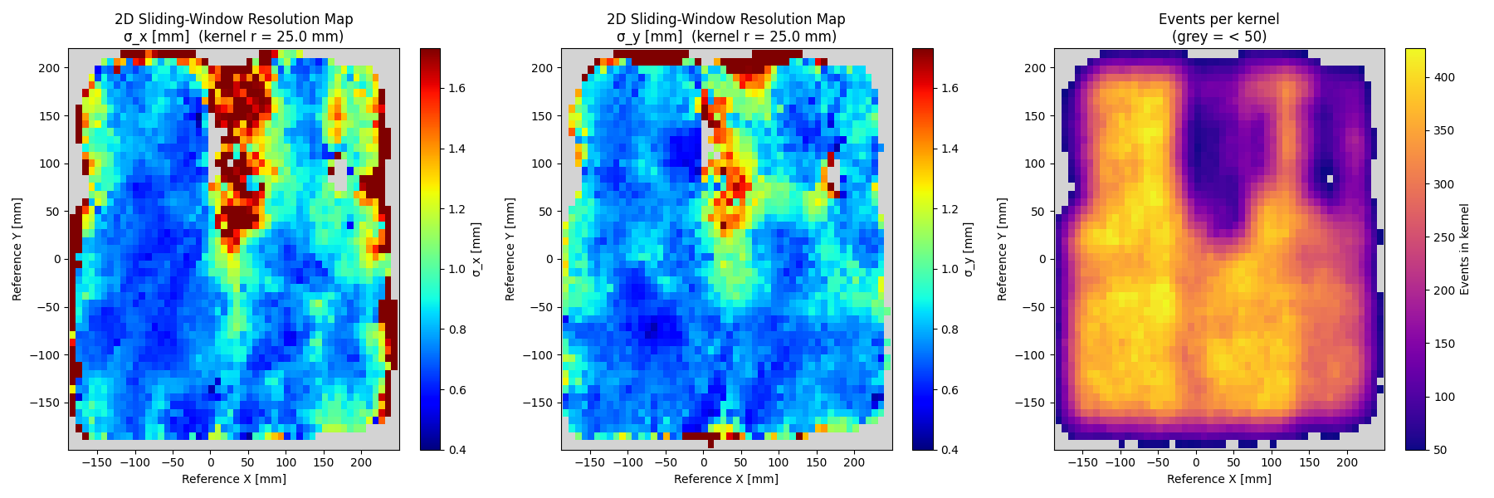
PERFORMANCE · SPATIAL
Spatial resolution ~500 µm
Sliding-window residual resolution maps in X and Y, and event statistics per bin.
• Residual width (MX17 − reference) is ~500 µm over most of the detector.
• The reference tracker itself only has ~500 µm resolution — so the measurement is
  – resolution-limited by the bench: the true detector resolution is at least this good,
  – probably better.
Argon/Isobutane 95/5 · 30 mm drift · aluminium frame · cosmic bench @ CEA Saclay
MX17 detector · Performance

Slide 6
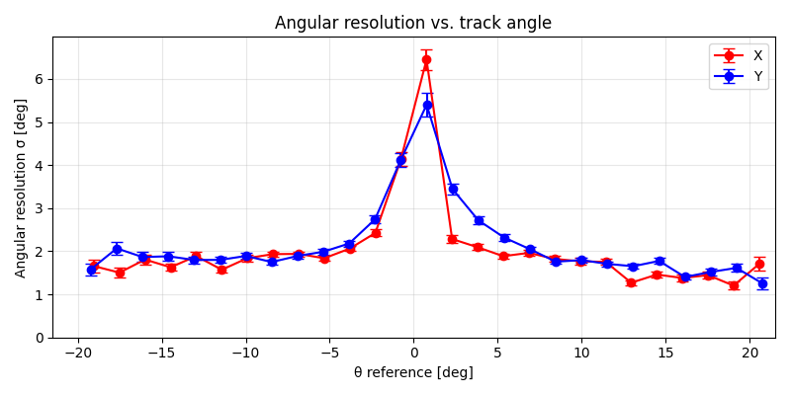
PERFORMANCE · ANGULAR
Angular resolution ~2° in µ-TPC mode
• Angular resolution ≈ 2° across most of the angular range.
• Worse only near 0° (tracks normal to the detector), where
  – the µ-TPC has no longitudinal lever arm — expected.
• This is the key number for the physics: the X17 signature
  – is a ~120° e⁺e⁻ pair, so few-degree per-track resolution
  – is what we need.
• Reconstruction algorithm not yet fully optimised — likely
  – room to improve further.
µ-TPC angular resolution σ vs reference track angle (X and Y projections).
Argon/Isobutane 95/5 · 30 mm drift · aluminium frame · cosmic bench @ CEA Saclay
MX17 detector · Performance

Slide 7
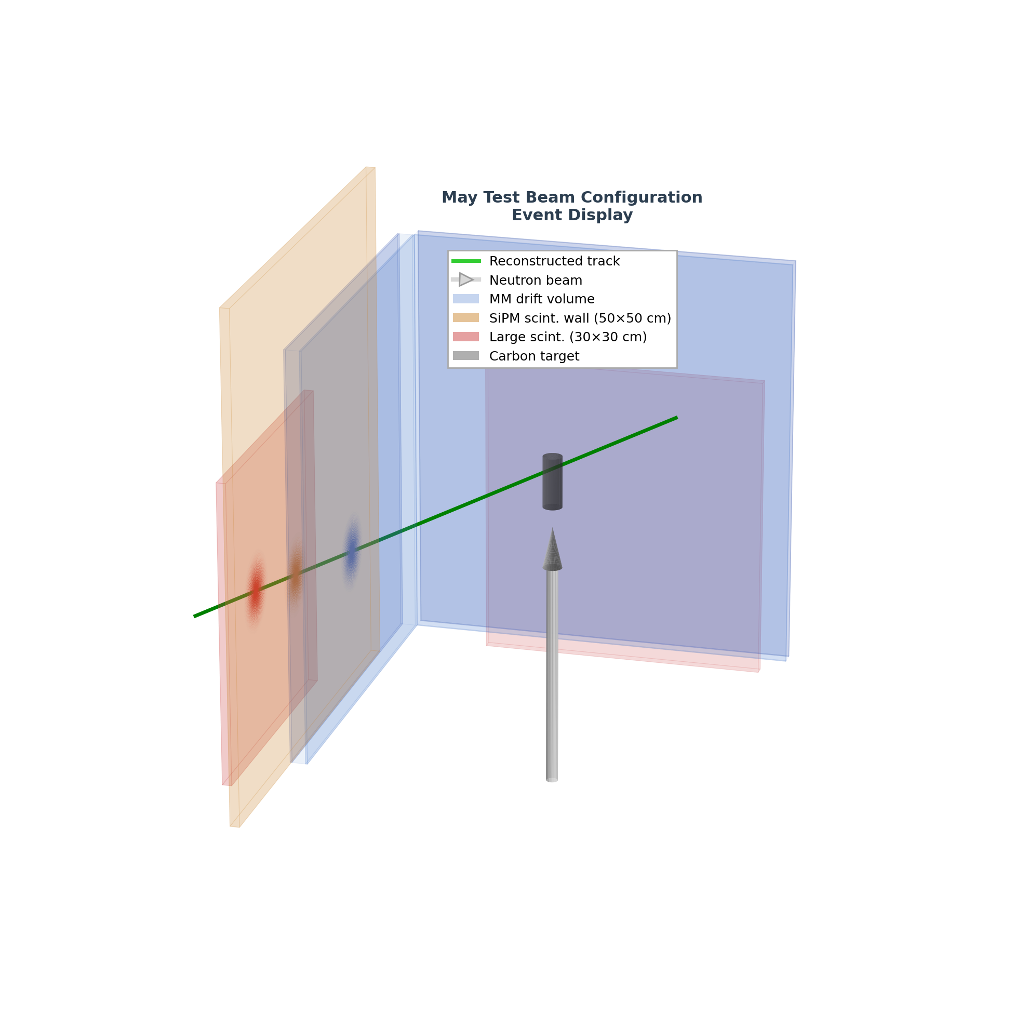
PERFORMANCE · IN BEAM
…and it reconstructs tracks in the n_TOF beam
• The same µ-TPC reconstruction works on real beam data at
  – n_TOF EAR2, not just on the bench.
• Single, well-separated tracks are cleanly reconstructed in
  – the low-occupancy (thermal-neutron) window.
• Strip hits + drift time give the 3-D track (green); it crosses
  – the Micromegas and continues toward the trigger scintillators.
• Confirms the detector behaves in the real experiment as it
  – did on the Saclay bench.
A reconstructed beam event in the n_TOF EAR2 setup (He/Ethane, 16 mm drift).
MX17 detector · In beam

Slide 8
BOTTOM LINE
Summary — the detector performs to spec
• Efficient to MIPs across the active area; the only dead regions have understood,
  – fixable causes (broken resistive strips, M4 connector contact).
• Spatial resolution ~500 µm — at the limit of what the reference bench can measure.
• Angular resolution ~2° in µ-TPC mode — the number that matters for the X17 e⁺e⁻ angle.
• Full 3-D track reconstruction demonstrated both on the cosmic bench and in the n_TOF beam.
• Reconstruction software not yet fully optimised → headroom on resolution.
• Clear, concrete improvements identified for the production batch (strip break, connector).
• Net: the detector you built does what the measurement needs.
MX17 detector · Summary

Slide 9
Backup
Reconstruction detail, more event displays, specs & next iteration

Slide 10
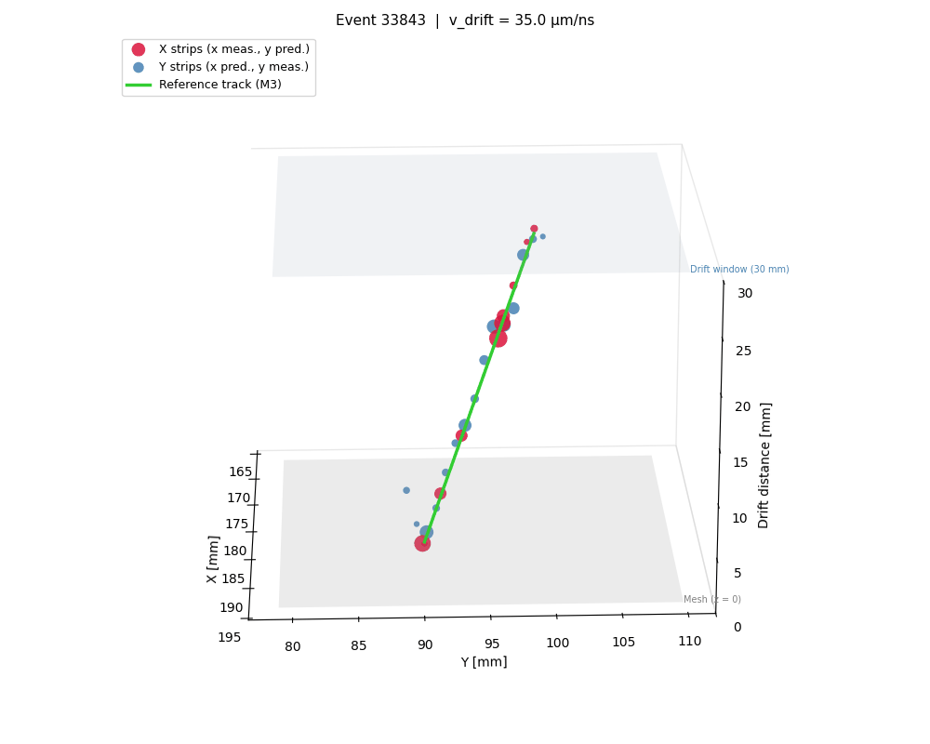
BACKUP · COSMIC BENCH
µ-TPC reconstruction — single cosmic event (3-D)
Event 33843. X-strip and Y-strip hits placed in the 30 mm drift window; the MX17 µ-TPC track sits on top of the reference track (M3) — good agreement.
Argon/Isobutane 95/5 · 30 mm drift · aluminium frame · cosmic bench @ CEA Saclay
MX17 detector · Backup

Slide 11
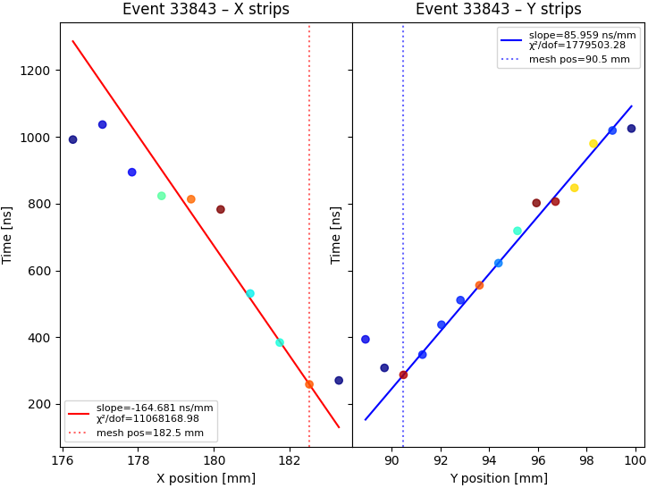
BACKUP · COSMIC BENCH
µ-TPC reconstruction — drift-time vs position fits
Same event: drift time vs X and Y strip position. The slope of each line is the projected track angle; the intercept locates the mesh crossing. This is the µ-TPC measurement.
Argon/Isobutane 95/5 · 30 mm drift · aluminium frame · cosmic bench @ CEA Saclay
MX17 detector · Backup

Slide 12
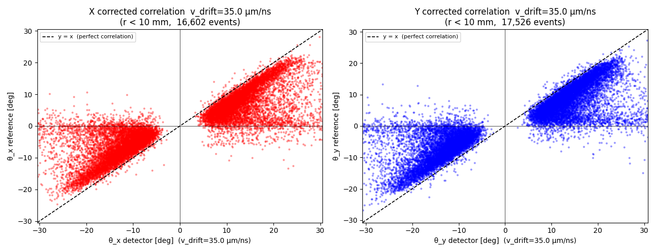
BACKUP · COSMIC BENCH
Reconstructed vs reference track angle
MX17 µ-TPC angle vs reference-tracker angle (X and Y), v_drift = 35 µm/ns. Clear correlation along y = x; the offset is under study (possible reconstruction/algorithmic effect).
Argon/Isobutane 95/5 · 30 mm drift · aluminium frame · cosmic bench @ CEA Saclay
MX17 detector · Backup

Slide 13
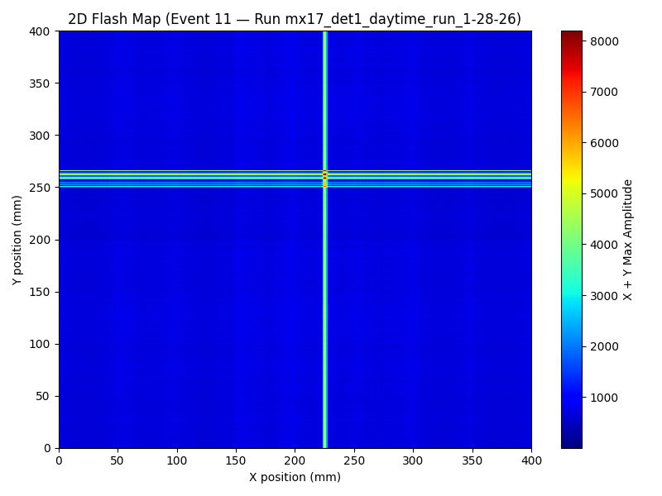
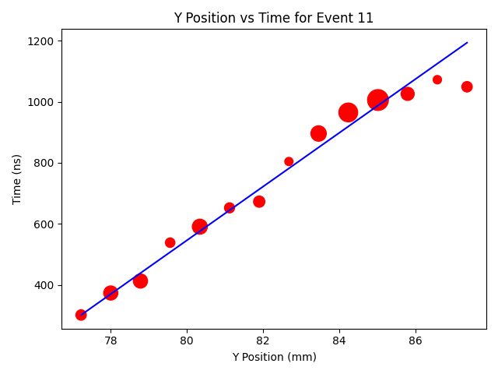
BACKUP · COSMIC BENCH
Detector is alive — a single cosmic muon
2-D hit map, single cosmic muon (Det-0 daytime run).
Y position vs drift time for the same muon — the straight µ-TPC line; marker size = pulse amplitude.
MX17 detector · Backup

Slide 14
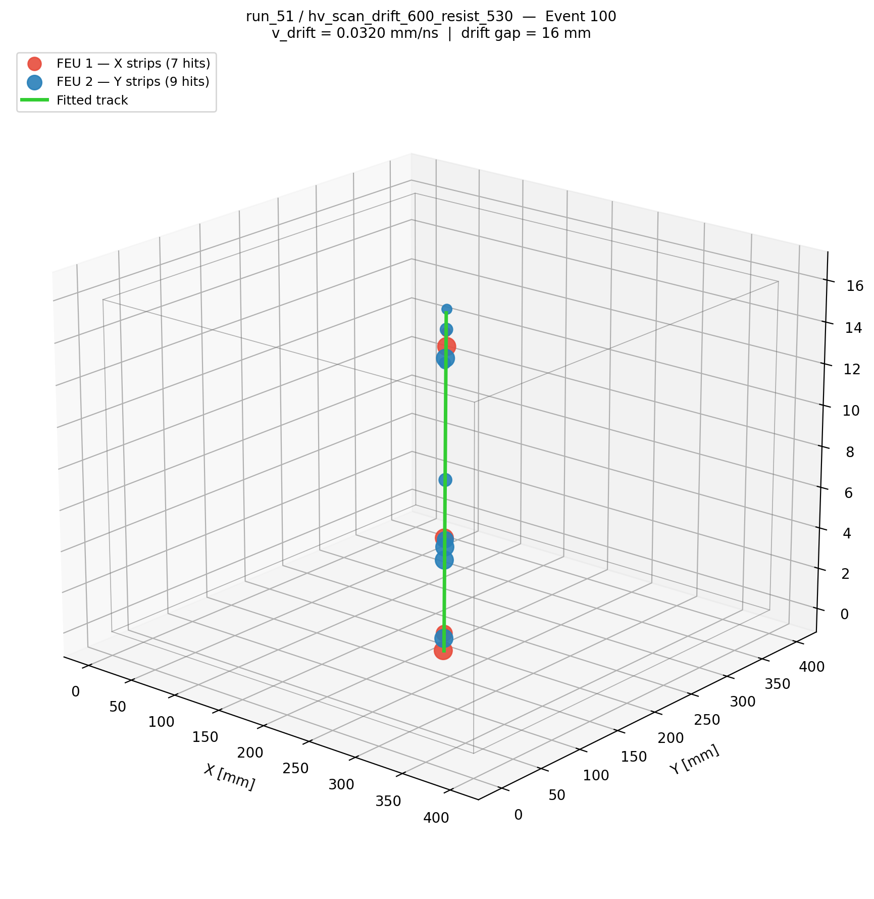
BACKUP · N_TOF EVENT DISPLAY
Beam event display — Micromegas strip hits (3-D)
Run 51, Event 100. FEU 1 X-strips (7 hits), FEU 2 Y-strips (9 hits) placed in 3-D from strip position and drift time (v_drift = 0.0320 mm/ns, 16 mm gap); green = fitted µ-TPC track.
MX17 detector · Backup

Slide 15
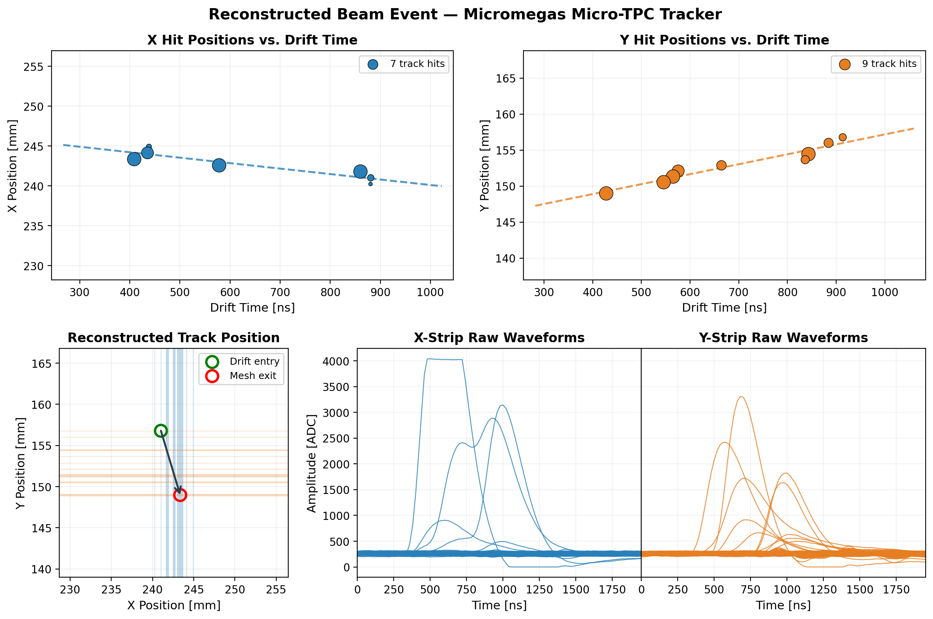
BACKUP · N_TOF EVENT DISPLAY
Beam event display — hit-vs-drift fits & raw waveforms
Same event. Top: X/Y hit position vs drift time (slope = µ-TPC angle). Bottom: reconstructed track position and the raw X/Y strip waveforms.
MX17 detector · Backup

Slide 16
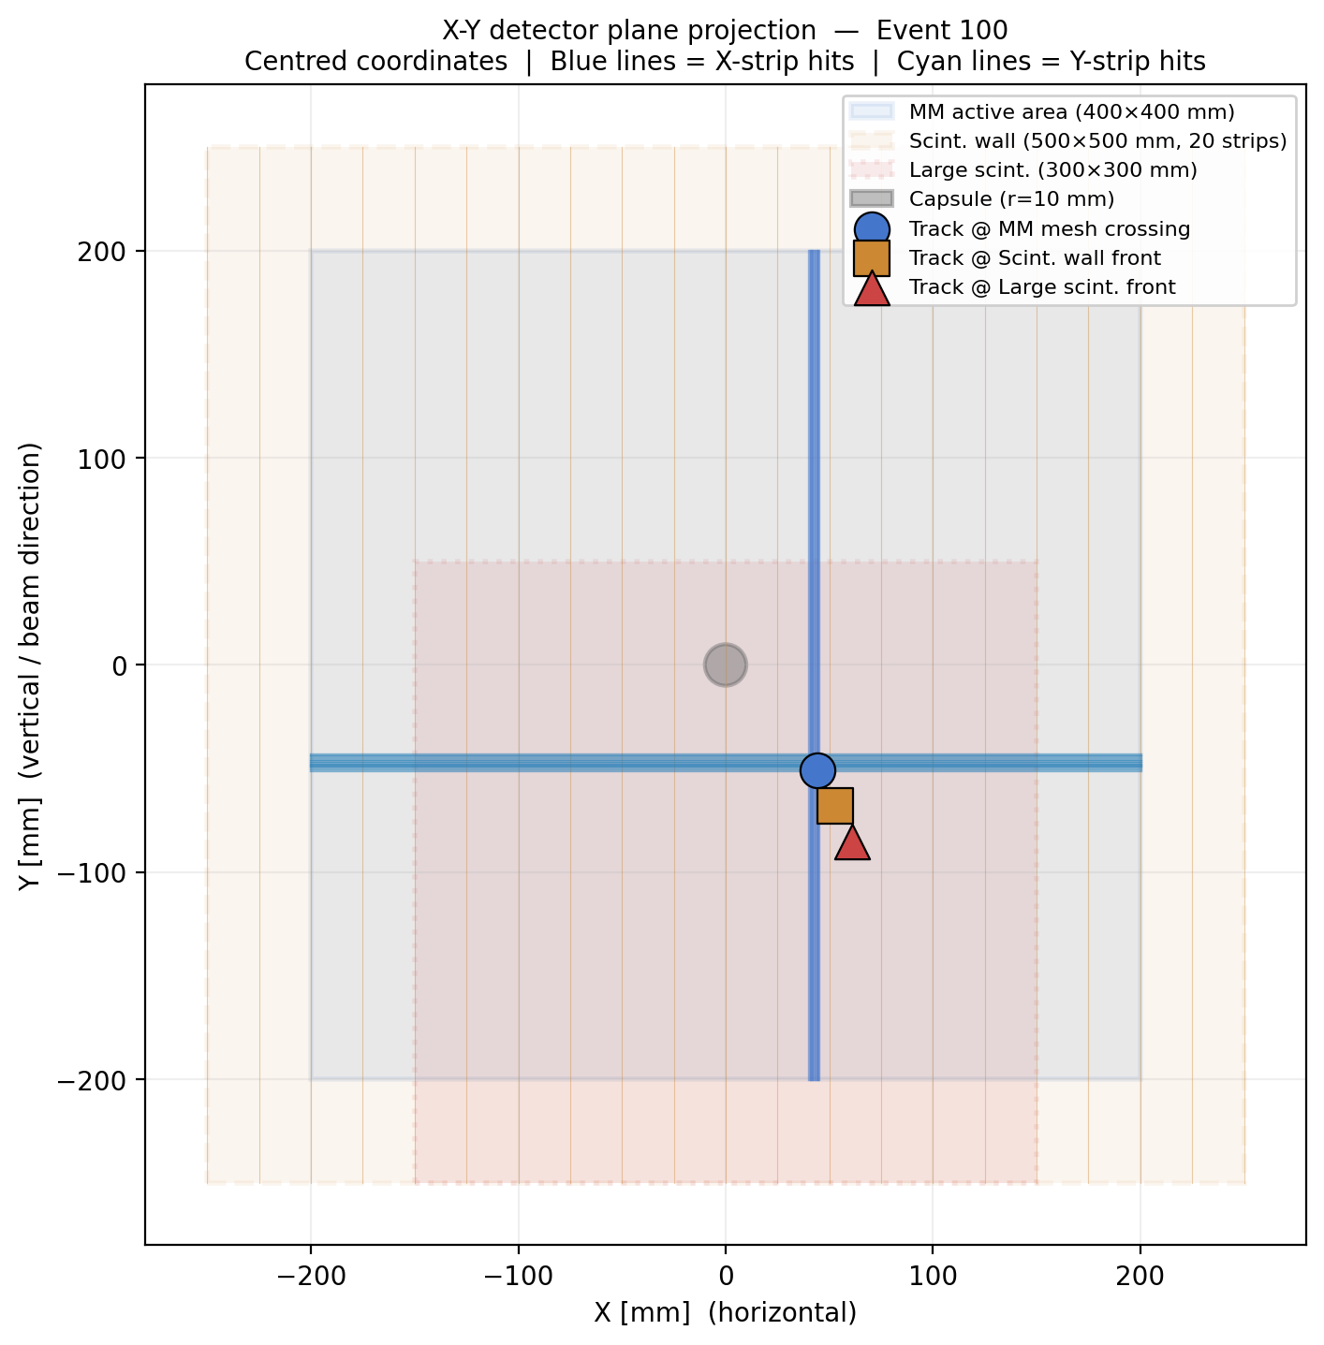
BACKUP · N_TOF EVENT DISPLAY
Beam event display — X–Y detector-plane projection
Same event projected on the detector plane: X/Y strip hits, MM active area, scintillators and capsule, with the track crossing points at each plane.
MX17 detector · Backup

Slide 17
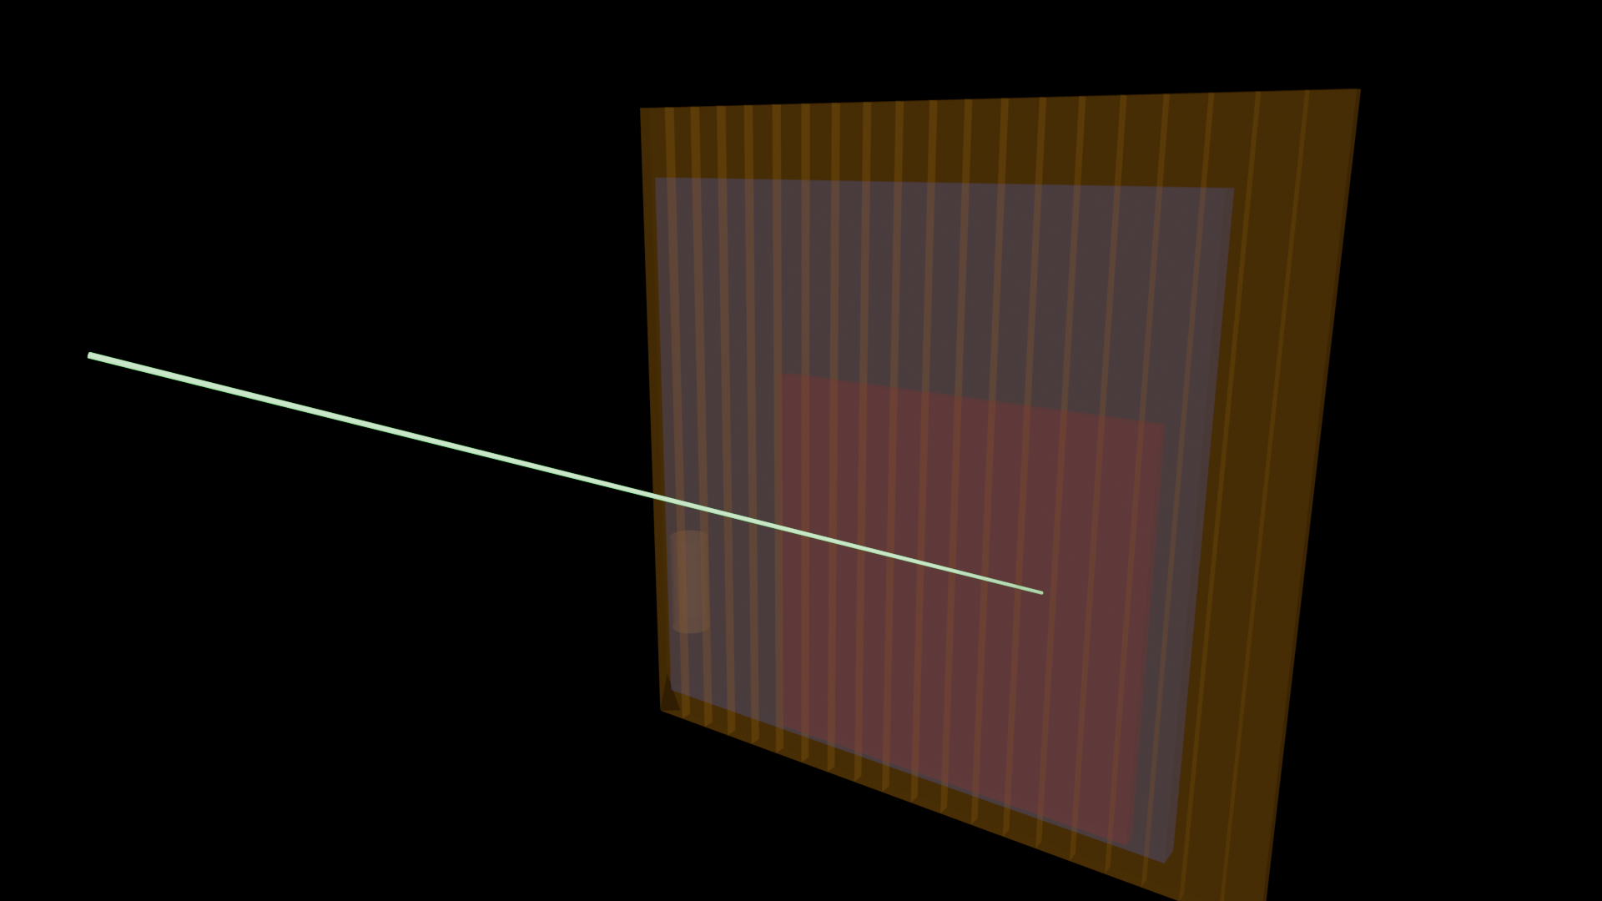
BACKUP · N_TOF EVENT DISPLAY
Beam event display — cinematic render
3-D render of the reconstructed track through the resistive Micromegas. A rotating animation is available (event_100_3d_geo_rotating.gif).
MX17 detector · Backup

Slide 18
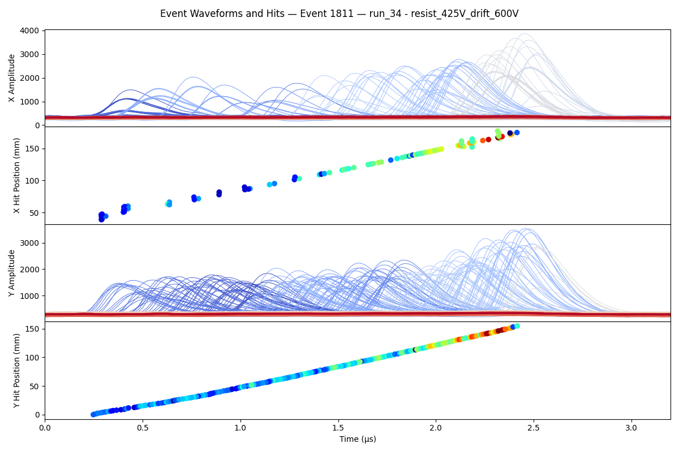
BACKUP · N_TOF
Isolated track in the n_TOF beam (thermal region)
He/Ethane, 30 mm drift, µ-TPC mode: a clean, well-separated track in the thermal-neutron window — naively exactly a single-track event (high dE/dx; particle ID uncertain).
MX17 detector · Backup

Slide 19
BACKUP · SPECS
Prototype Detector 0 — specifications
Parameter | Value
Type | Resistive-strip bulk Micromegas (MX17)
Active area | 40 × 40 cm
Drift gap | 30 mm (µ-TPC mode)
Frame | Aluminium (carbon frame also tested)
Readout | X & Y strips, DREAM front-end (FEU)
Bench gas | Argon/Isobutane 95/5
Reference tracker | M3 cosmic telescope, ~500 µm resolution
Cosmic statistics | ~43k reference tracks for efficiency/resolution maps
• Performance
• Efficiency: near-full over active area
• Spatial: ~500 µm (bench-limited)
• Angular: ~2° (µ-TPC)
MX17 detector · Backup

Slide 20
BACKUP · OUTLOOK
Known issues & fixes for the next iteration
Observation | Cause | Fix for production batch
Dead band in efficiency map | Broken resistive strips (no HV in region) | Improve resistive-strip QC / handling in fabrication
Dead edge in efficiency map | M4 connector edge not making contact | Connector seating / mechanical revision
σ(angle) larger near 0° | No µ-TPC lever arm at normal incidence | Intrinsic to µ-TPC; mitigated by geometry around target
Angle-correlation offset | Possible reconstruction/algorithm effect | Reconstruction software optimisation (in progress)
Bottom line: every observed limitation is either understood and fixable in fabrication, or a known µ-TPC property — none point to a problem with the detector concept. Four production detectors are planned for the July n_TOF run.
MX17 detector · Backup

