Slide 1
Searching for the X17 at n_TOF EAR2
February & May 2026 Beam Tests — Status, Results & What We Learned
Technical tests of the high-energy measurement against the gamma flash
n_TOF Collaboration · EAR2, CERN · Internal status — June 2026

Slide 2
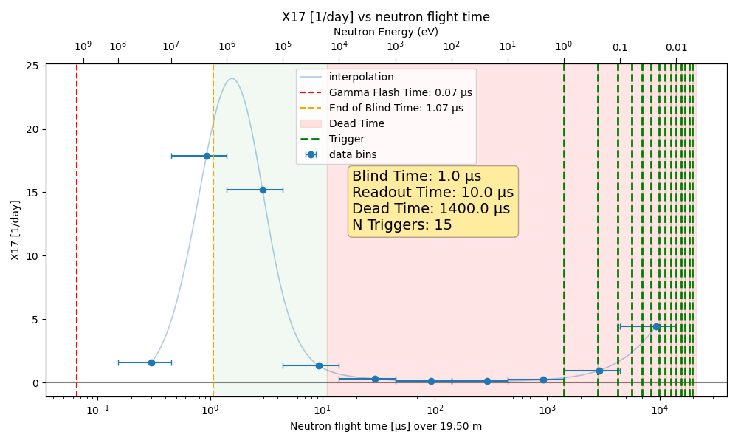
CONTEXT
The measurement and its central challenge
• Goal: search for the hypothetical X17 boson via the e⁺e⁻ pairs it would emit,
  – looking for a peak in the pair opening angle near 120°.
• EAR2 sits 20 m directly above the lead spallation target. Each PS proton bunch
  – on the target produces a broad neutron spectrum — ~80% of the expected X17 yield
  – is in the first ~10 µs (the ~1 MeV neutron region).
• The catch — the “gamma flash”: every relativistic particle from the bunch hitting
  – the lead target arrives in EAR2 essentially all at once.
• It dumps enormous charge in the Micromegas and saturates (“blinds”) the DREAM DAQ
  – exactly when the high-energy X17 signal would appear.
Expected X17 yield vs neutron flight time. Flash at t≈0; DREAM dead-time follows.
Feb & May were technical tests: can we survive the flash and still
be efficient to e⁺e⁻ tracks in the high-energy window?
n_TOF X17 · Context

Slide 3
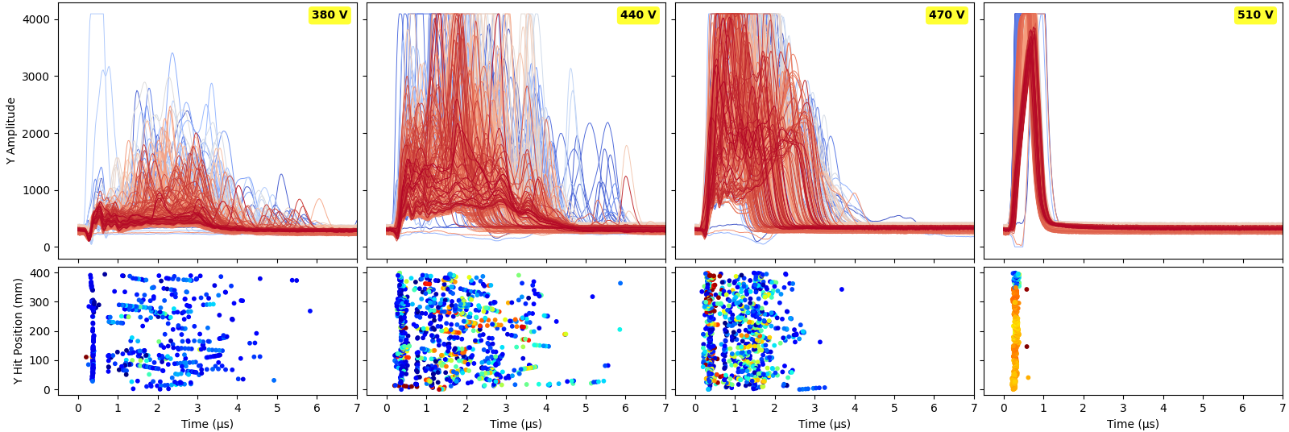
THE CORE PROBLEM
The gamma flash blinds the DREAM DAQ
Helium/Ethane, 30 mm drift. Raising resist HV (360→510 V): flash fills the readout, then ALL channels go flat — DREAM saturates for the full 10 µs window.
• At low HV the detector is not yet efficient to ~MeV electrons/positrons.
• As HV is raised toward efficiency, the flash charge grows until the DREAM front-end
  – locks at baseline and recovers only after the entire 10 µs readout window.
• Confirmed to be a DAQ limit (not the detector) — see backup: single MM strip read on
  – the n_TOF 1 GHz scope shows clear signals where DREAM reports nothing.
n_TOF X17 · Problem

Slide 4
February 2026
Single Micromegas + SiPM wall — first characterisation in the n_TOF beam

Slide 5
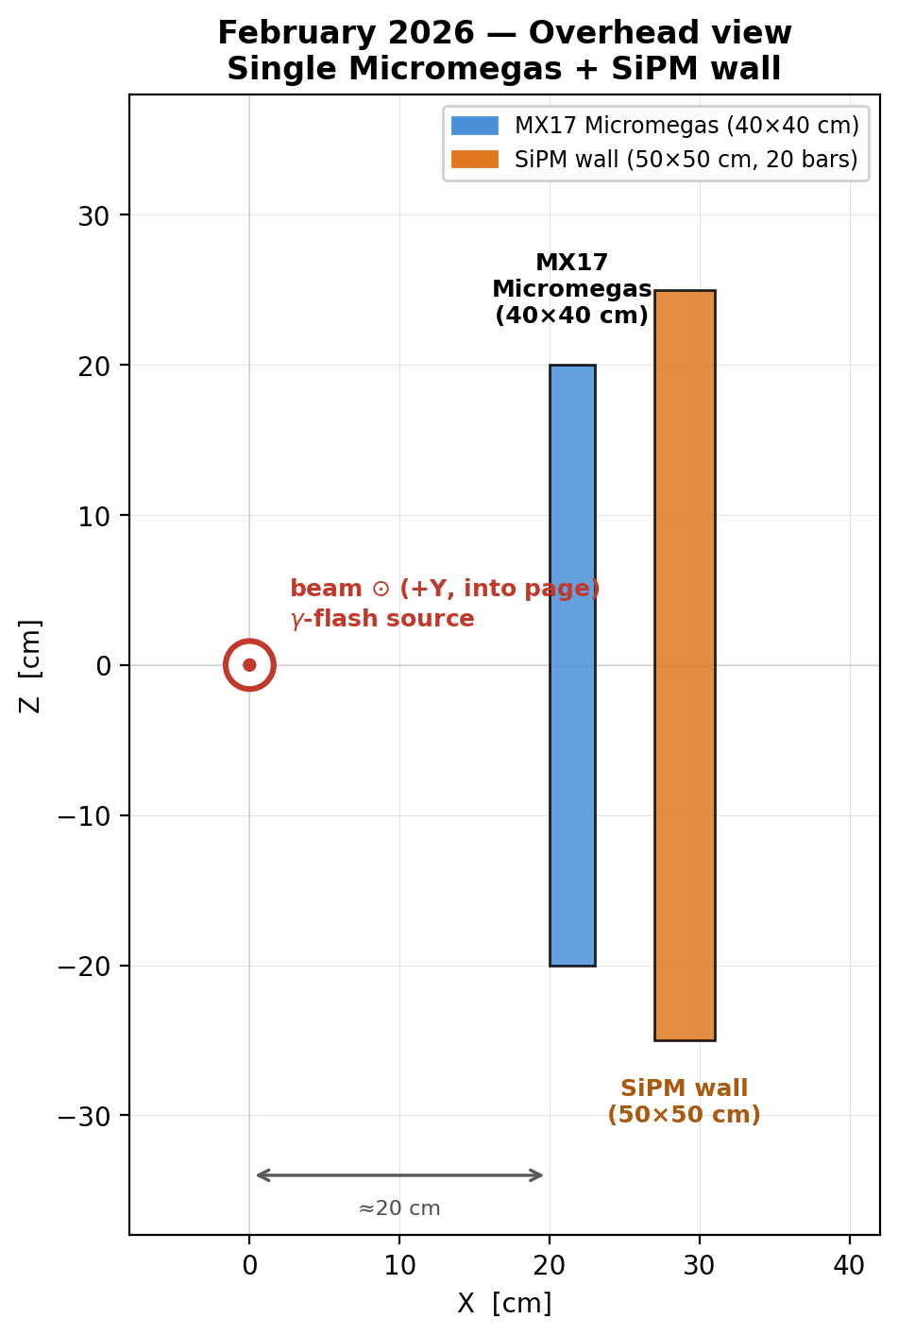
FEBRUARY · SETUP
February setup — overhead view
• One prototype MX17 resistive-strip Micromegas (40×40 cm) ~20 cm from the beam axis.
• One SiPM wall (50×50 cm, 20 × 2.5 cm bars) directly behind it.
• No ³He target — samples (empty, lead, B4C, carbon, Timepix) swapped on the beam line.
• Read out with the DREAM DAQ; PS-pickup trigger aligned just before the flash.
• Variables scanned: gas (Ar- and He-based), resist HV, drift gap (30 → 11 → 6 mm),
  – aluminium vs carbon frame.
• On beam ~1 month — the workhorse dataset for understanding the flash.
n_TOF X17 · February

Slide 6
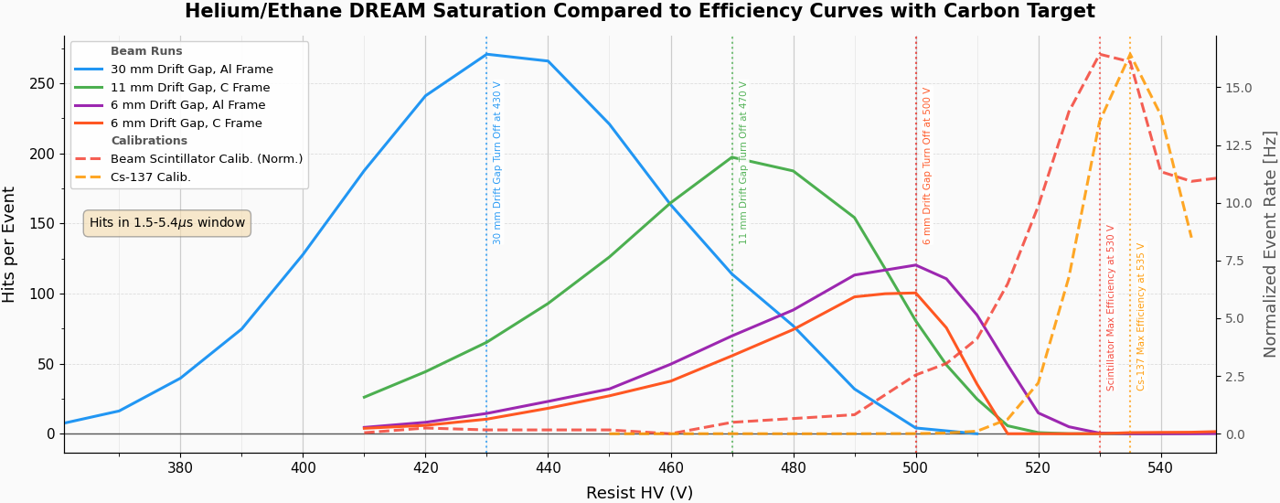
FEBRUARY · KEY RESULT
DREAM saturates BEFORE the detector is efficient
• Primary metric: mean strip hits/event vs resist HV,
  – in the ~1 MeV signal window (1.5–5.4 µs).
• Curve rises as the detector turns on, then collapses
  – to zero as the flash saturates DREAM.
• The collapse (“turn-off”) happens at LOWER HV than
  – the electron-efficiency plateau (Cs-137 & scint.).
• ⇒ No usable operating window for the high-energy
  – measurement in this configuration.
He/Ethane, empty carbon capsule. Solid: hits/event in the 1.5–5.4 µs signal window vs HV (rises, peaks, then →0 as DREAM saturates). Dashed: e⁻ efficiency calibrations.
n_TOF X17 · February

Slide 7
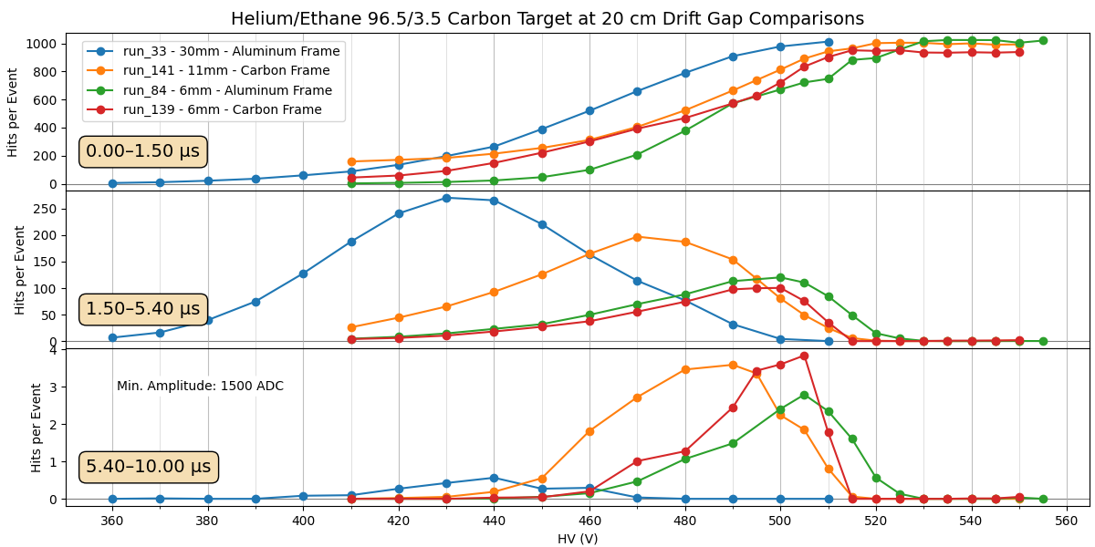
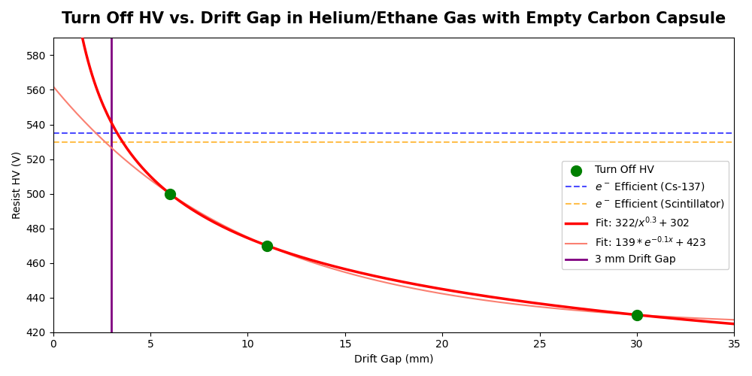
FEBRUARY · WHAT HELPED
Smaller drift gap → DREAM survives to higher HV
• Reducing the active volume (30 → 11 → 6 mm drift) lowers the flash charge integrated by DREAM,
  – so the turn-off shifts up: ~430 V (30 mm) → ~470 V (11 mm) → ~500 V (6 mm) in He/Ethane.
• Firm, repeatable conclusion. But extrapolation suggests we'd need ≲3 mm drift to reach efficiency —
  – not demonstrated, and not robust without a Saclay cosmic calibration in the same gas.
n_TOF X17 · February

Slide 8
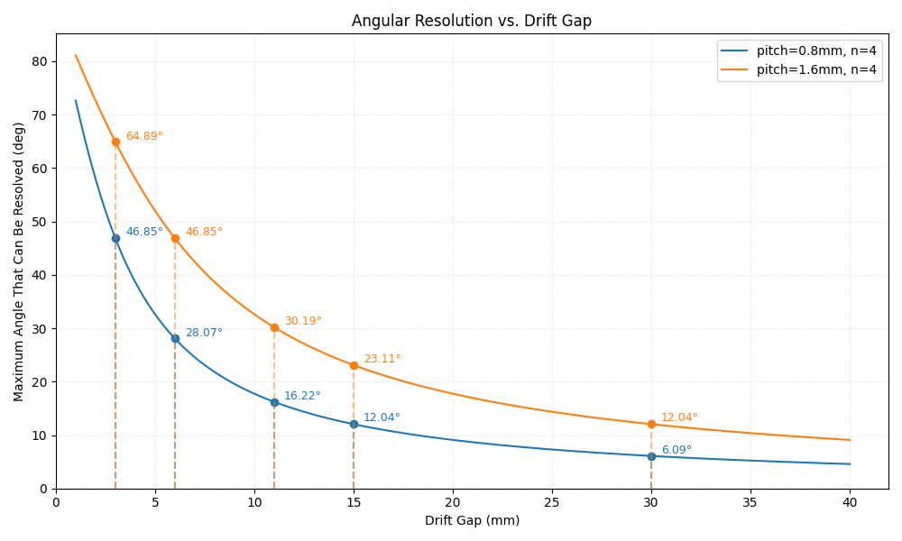
FEBRUARY · THE TRADE-OFF
…but smaller drift gap costs us the tracking
• The 30 mm gap enables µ-TPC mode: full 3-D track angle
  – reconstruction (≈2° resolution on the Saclay bench).
• Shrinking the gap to survive the flash sacrifices the
  – longitudinal lever arm → no 3-D angle, only projected hits
  – (“hit mode”).
• Fewer readout strips for July (channel budget) further
  – degrades the minimum resolvable angle.
• So: a flash-surviving config and a track-reconstructing
  – config pull in opposite directions.
Max resolvable opening angle vs drift gap (µ-TPC mode).
n_TOF X17 · February

Slide 9
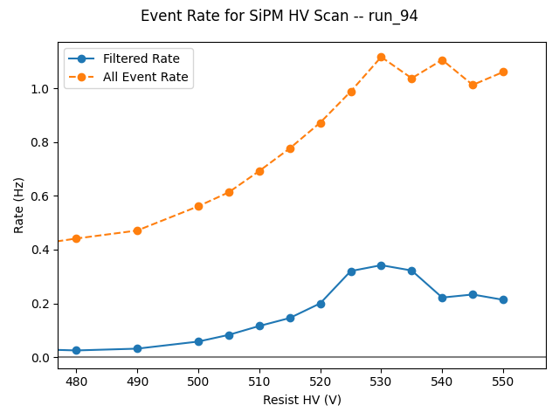
FEBRUARY · BEST CASE
Best case seen: a marginal window in He/Ethane at 6 mm
• With He/Ethane + 6 mm drift, the efficiency turn-on (~525 V)
  – and the DREAM turn-off (~520 V) very nearly overlap.
• Hints at a narrow ~515–530 V window where the detector may
  – be approaching efficiency while DREAM is not yet fully dead.
• Helium also brings high neutron sensitivity → large point-like
  – background in the same window.
• Encouraging but unproven; not a robust working point.
Run 94 — SiPM-coincidence beam scan, filtered vs all events.
n_TOF X17 · February

Slide 10
FEBRUARY · SUMMARY
February — what we understood
• Confirmed: the DREAM DAQ (not the detector) is the limiting element — it saturates from
  – the flash at operating HV and stays blind for the full readout window.
• All Argon-based gases saturate at or below the efficiency threshold → no window.
• Helium/Ethane survives the flash more cleanly, but is highly neutron-sensitive.
• Reducing the drift gap reliably buys HV headroom — but sacrifices µ-TPC tracking.
• Single-strip scope test proves signal exists in the DREAM-blind region.
• Carbon frame: only ~10–20% hit-rate reduction; not worth the complexity.
• Grounding the MX connector cards almost entirely removed flash-induced sinusoidal noise.
• Net: no demonstrated high-energy working point; clear levers and limits identified for May.
n_TOF X17 · February

Slide 11
May 2026
Two Micromegas at 90° — DAQ fixes, flash-mitigation attempts, thermal trigger

Slide 12
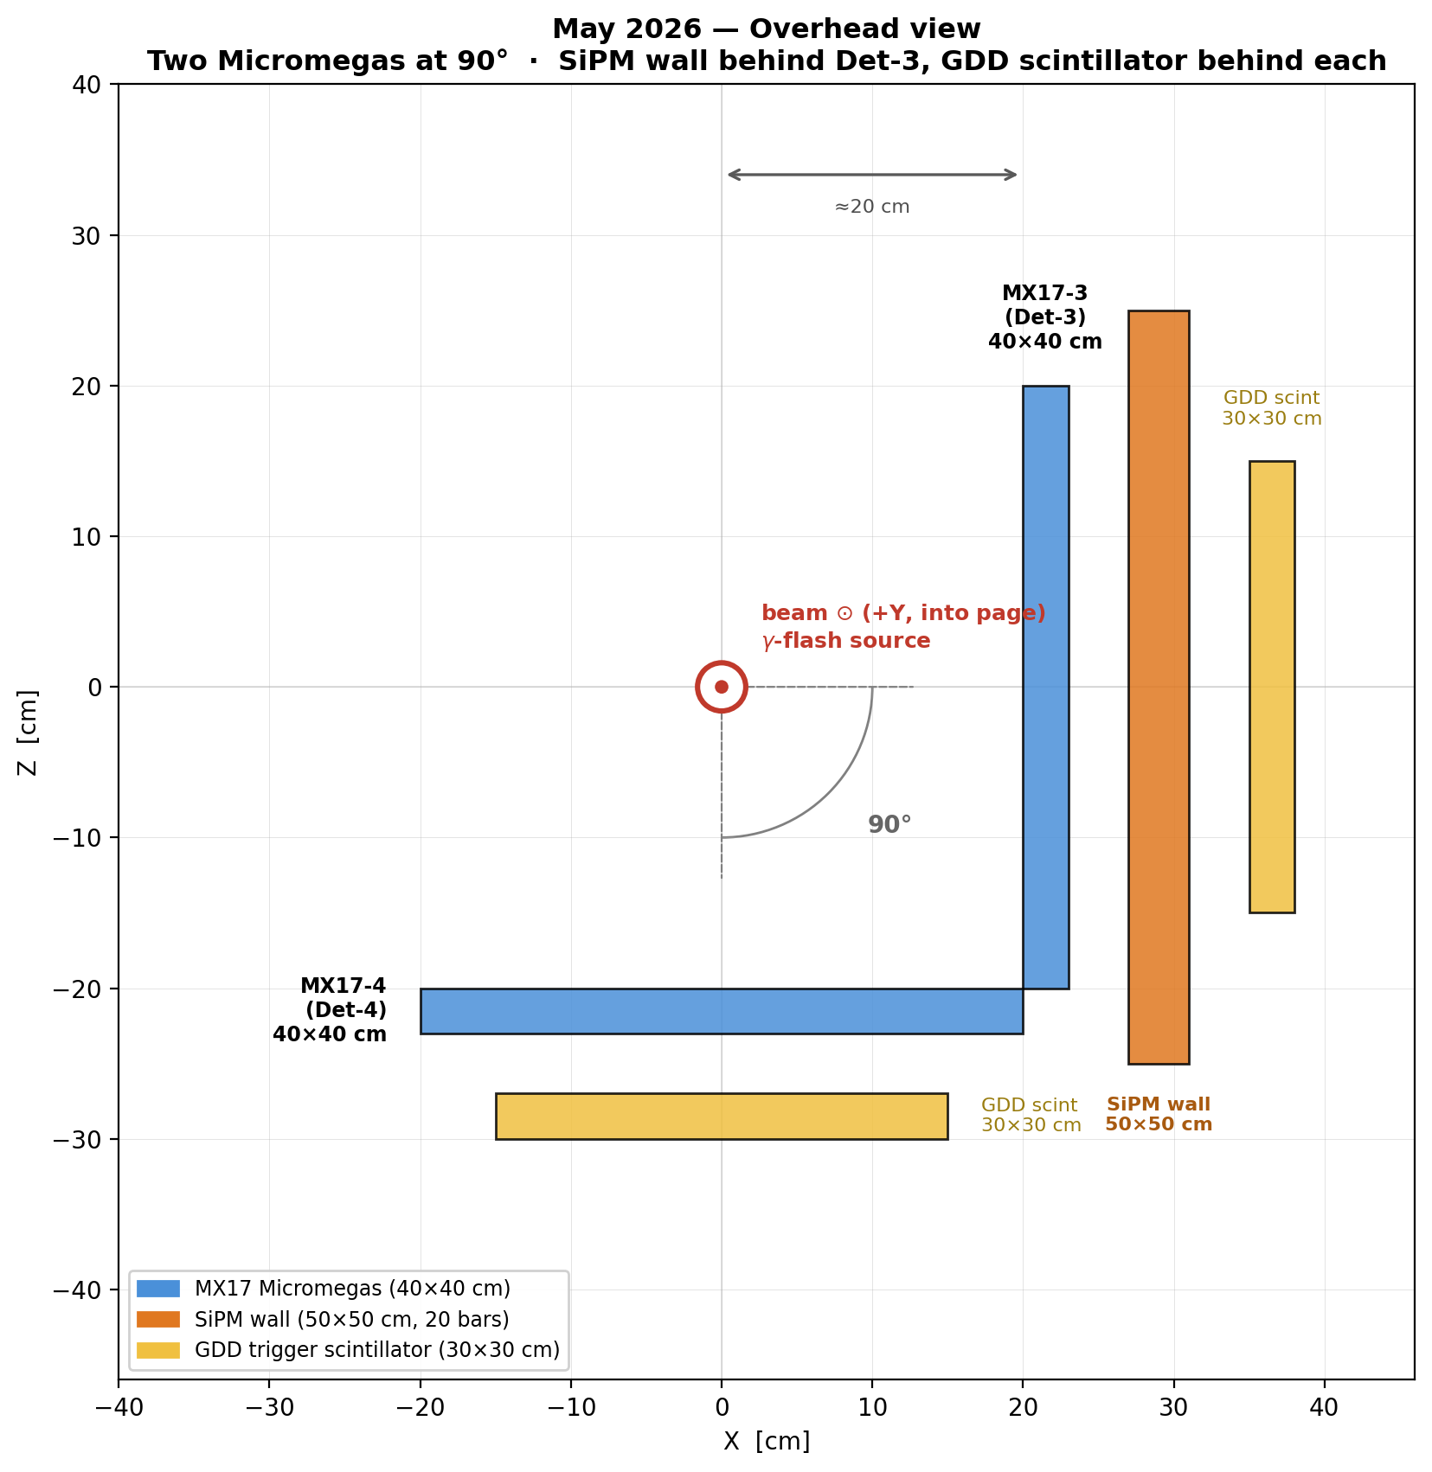
MAY · SETUP
May setup — overhead view
• Two MX17 Micromegas at 90° to each other, ~20 cm from the beam axis:
  – MX17-3 (Det-3): 16 mm drift, full M1 readout — the reliable detector.
  – MX17-4 (Det-4): 30 mm drift, multiplexed M2 — found largely inefficient.
• SiPM wall (50×50 cm) behind Det-3.
• One GDD trigger scintillator (30×30 cm) behind each detector.
• 6–18 May; four gas mixtures; scintillator-coincidence trigger commissioned
  – for the first time.
n_TOF X17 · May

Slide 13
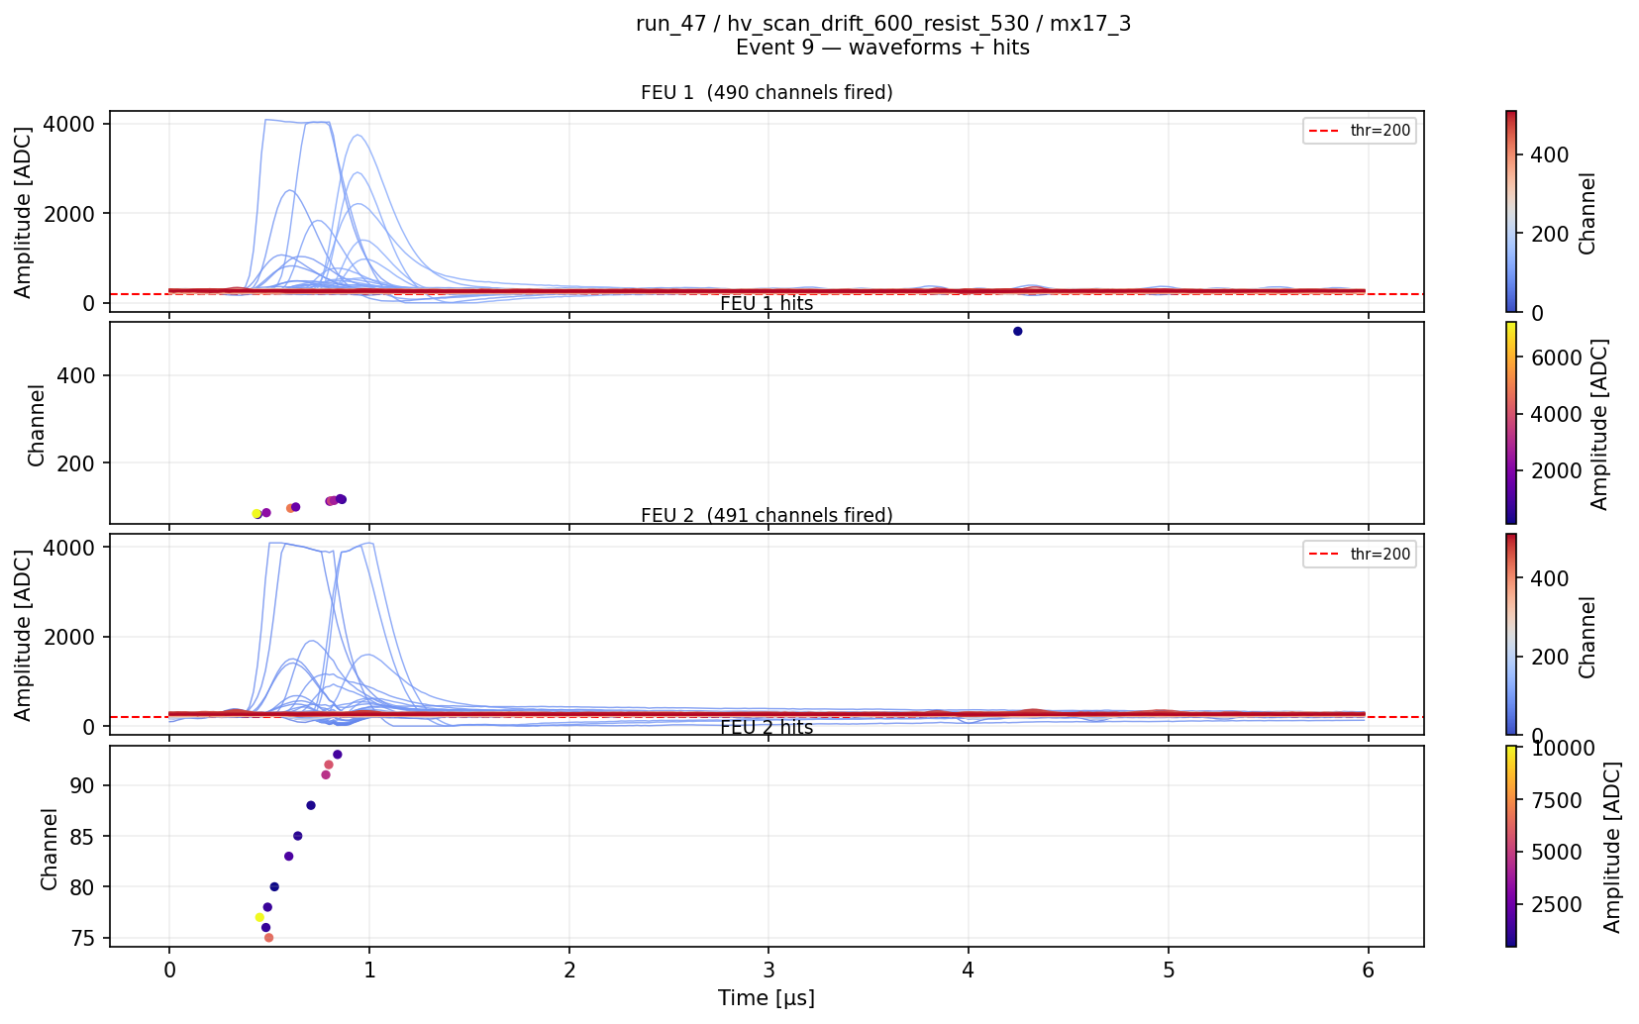
MAY · DAQ
Found & fixed: the DREAM “4096” lock-up
• First beam runs hit a show-stopper: random DREAM channels stuck at exactly 4096
  – (max ADC) for entire subruns.
• Diagnosed with Simone's noise generator + Irakli's hint to cut the sample count.
• A clean sweep (Runs 21–30) bracketed it: lock-up appears at ≳500 samples;
  – ≤450 samples → all channels behave.
• Adopted 450 samples = 9 µs window (20 ns/sample) as the standard.
• Likely a buffer/timing overflow in the DREAM ASIC at long readout length —
  – to be confirmed with Irakli (firmware fix vs hard limit).
• Consumed ~1.5 days of beam, but unblocked all subsequent running.
Cost the high-energy window 80 → 9 µs?
No — 450 samples still spans the
full ~1 MeV signal region.
Clean event readout after the fix (Ne/Iso).
n_TOF X17 · May

Slide 14
MAY · MITIGATION ATTEMPTS
Three flash-mitigation ideas — none worked out
Idea | What we tried | Outcome
2 mm Al plate | Shield Det-4 against low-energy X-rays in the flash | No effect — flash is dominated by MeV photons/electrons, not keV X-rays
Mesh charge injection | Inject positive charge on the floating mesh to cancel flash charge | Tentative early promise, but circuit killed by 400–800 V discharges from the resistive layer; could not iterate
Neon / Isobutane 95/5 | Lower-Z gas: predicted ‘goldilocks’ between Ar and He | Efficiency onset ~490 V, flash-survival peak ~420 V — ~70 V gap, not usable; neon also costly
Conclusion: no viable path to a high-energy measurement was demonstrated. The mesh-injection circuit is the only surviving concept, but needs a discharge-protected redesign. The high-energy measurement is not planned for July.
n_TOF X17 · May

Slide 15
MAY · THERMAL PATH
Pivot: commissioning the thermal-neutron trigger
• From 13 May, focus shifted to the thermal window (t > ~1 ms): low occupancy, clean topology,
  – no flash in the signal region — the ~20% of yield we can realistically reach.
• Trigger = SiPM wall (behind Det-3) in coincidence with the GDD scintillator behind it.
  – The coincidence rejects single Compton gammas and selects charged particles through both layers.
• Measured coincidence rates per PS pulse (after monostable correction):
Coincidence configuration | Non-flash triggers / PS pulse
Det-4 scint + Det-3 wall | ≈ 2.68
Det-3 scint + Det-3 wall | ≈ 6.87
Det-4 scint + Det-3 scint + Det-3 wall (3-way) | ≈ 0.11 (very rare)
• Sr-90 source test: the ~1 mm Al backing on the SiPM wall blocks 1–2 MeV electrons —
  – must be removed/replaced with thin foil for July.
• Lesson: NIM trigger logic must live inside EAR2 — the long cable run drops signals
  – below the N1081B 10 mV threshold.
n_TOF X17 · May

Slide 16
MAY · GAS STUDY
Four gases on beam — comparison
Gas | Op. V | Flash behaviour / notes
Ar/CF4 90/10 | ~635 V | February standard; flash saturation at op. V; early beam work
Ne/Iso 95/5 | ~490 V | No discharges on ramp (advantage); flash peak ~420 V → gap not useful; not viable
He/Eth 96.5/3.5 | ~515 V | Lower discharge rate; survives flash best; good thermal data; Feb calibration exists
Ar/CF4/Iso 88/10/2 | ~800 V | Very high V; heavy sparking on ramp; flash saturation confirmed (Feb benchmark)
July decision: an Argon/Isobutane mix — operating voltage similar to Ne/Iso, with the higher primary ionisation of an Argon-based gas for track quality. (Note: ZS mode was left on from Run 36 — all Ne/Iso, He/Eth, Ar/CF4/Iso data are zero-suppressed; analysis must account for it.)
n_TOF X17 · May

Slide 17
BOTTOM LINE
Summary — what these technical tests established
• These were technical tests, not physics runs — the question was feasibility of the
  – high-energy X17 measurement against the gamma flash.
• The DREAM DAQ saturates from the flash before the detector is efficient to e⁺e⁻ — confirmed
  – in both Feb and May, across all gases tested.
• Levers we quantified: smaller drift gap buys HV headroom (but kills tracking); He/Ethane
  – survives the flash best; reducing flash charge is the whole game.
• Mitigation ideas tried — Al shielding, mesh charge injection, neon gas — none gave a usable window.
• DAQ understood and hardened: 4096 lock-up fixed (450 samples); grounding, ZS, RunCtrl issues mapped.
• The thermal-neutron measurement is the viable path: coincidence trigger commissioned, ~3 triggers/pulse,
  – architecture for July substantially defined.
• July: full 4-detector + ³He-target run, targeting the thermal region.
n_TOF X17 · Summary

Slide 18
Backup
Supporting figures, tables and detail

Slide 19
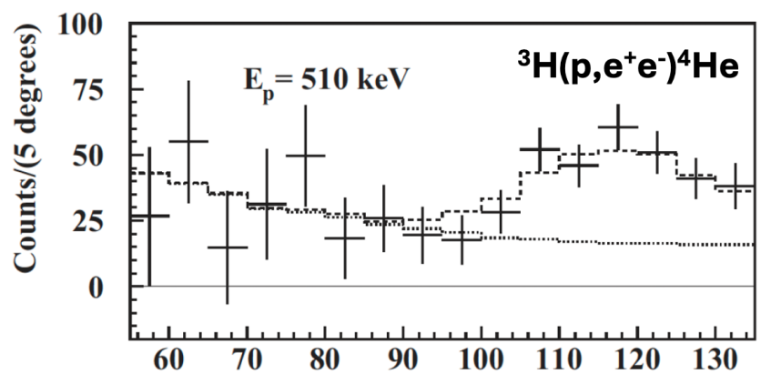
BACKUP · PHYSICS
Motivation — the ATOMKI X17 anomaly
ATOMKI: excess e⁺e⁻ pairs peaking near ~120° opening angle — consistent with a 17 MeV boson.
n_TOF X17 · Backup

Slide 20
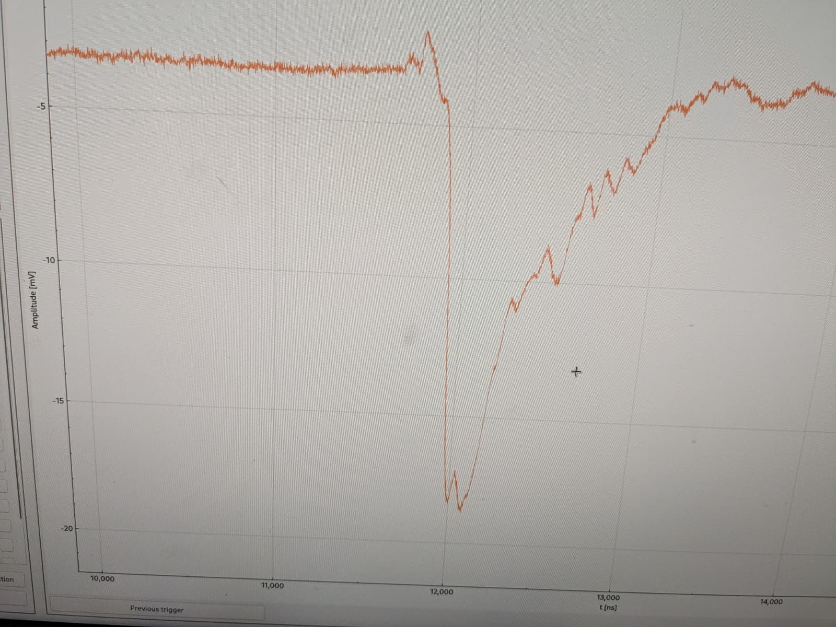
BACKUP · FLASH
Gamma flash on the n_TOF 1 GHz DAQ
Single MM strip on the n_TOF scope: ~ -15 mV, ~300 ns → ~90 pC/strip, already enough to saturate DREAM. Signals are visible here where DREAM reports nothing.
n_TOF X17 · Backup

Slide 21
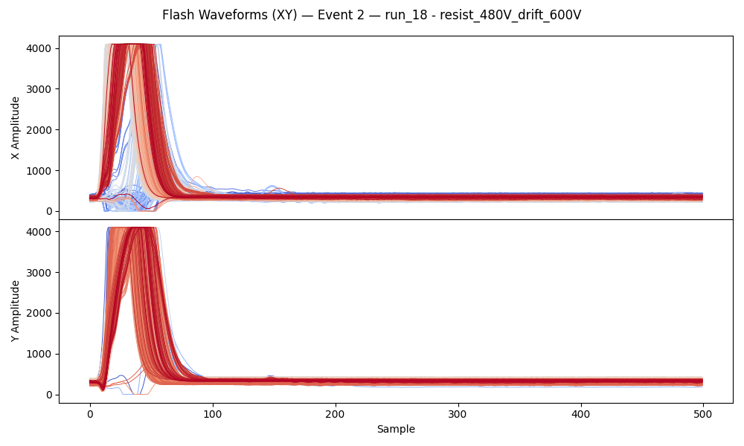
BACKUP · FLASH
Flash saturates all DREAM channels (waveforms)
Run 18, Ar/CF4/Iso. All X/Y channels driven to the 4096 rail by the flash, then flat baseline — no recovery within the readout window.
n_TOF X17 · Backup

Slide 22
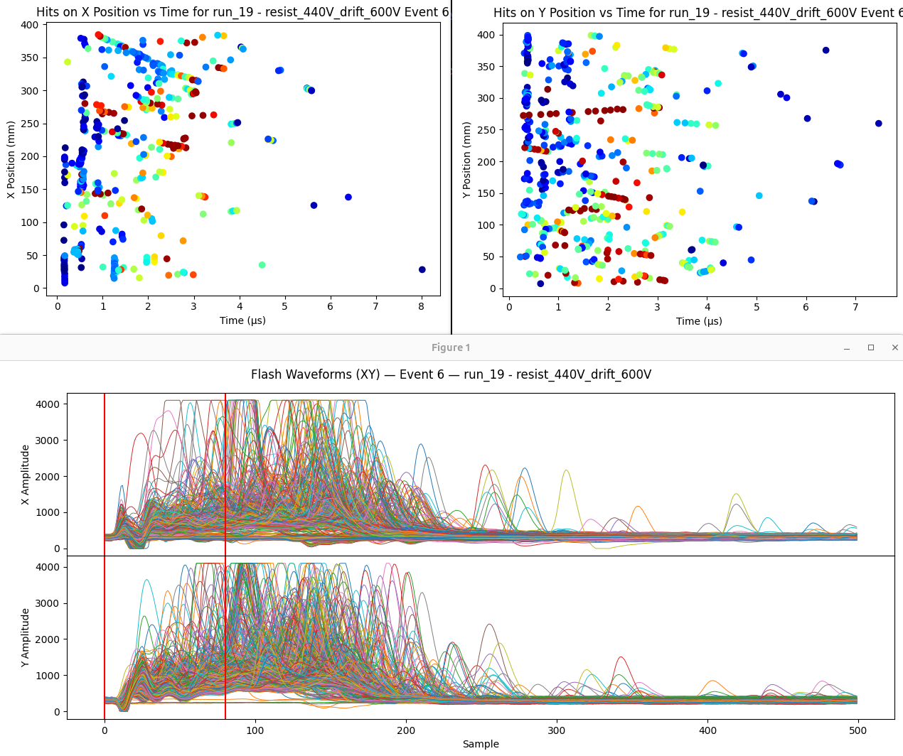
BACKUP · FLASH
High occupancy in the ~1 MeV neutron peak
Even when not fully saturated, the post-flash hit density makes individual e⁺e⁻ track reconstruction extremely hard (Helium gas).
n_TOF X17 · Backup

Slide 23
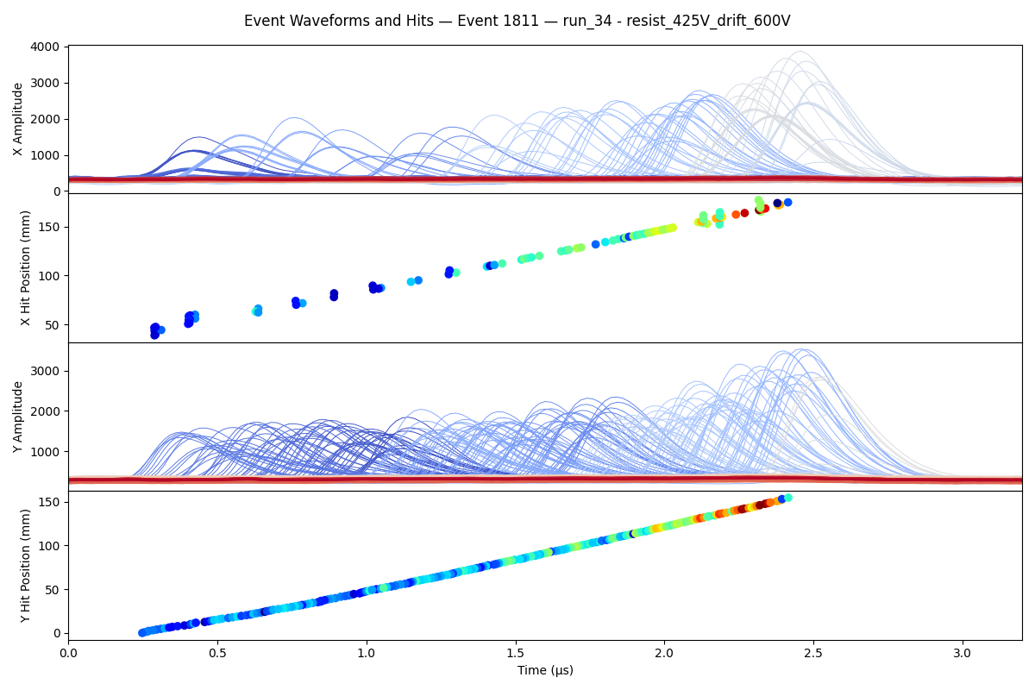
BACKUP · THERMAL
What we CAN see — isolated thermal-region track
He/Ethane, 30 mm drift, µ-TPC mode: a clean, well-separated track in the thermal window — exactly the regime targeted for July.
n_TOF X17 · Backup

Slide 24
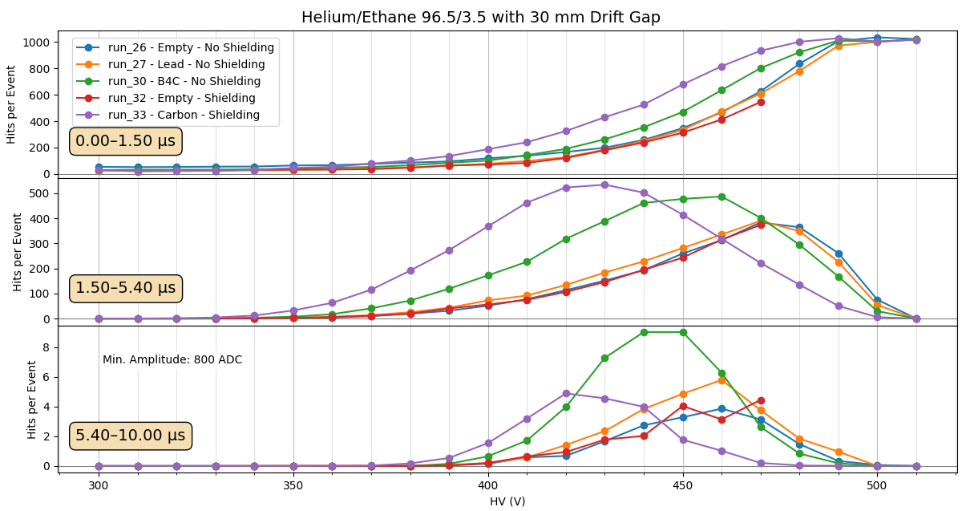
BACKUP · FEBRUARY
He/Ethane 30 mm — target comparison
Hits/event vs HV in three time windows for different samples. Carbon turns on/off earliest (more material → more scattering); B4C loudest at late times.
n_TOF X17 · Backup

Slide 25
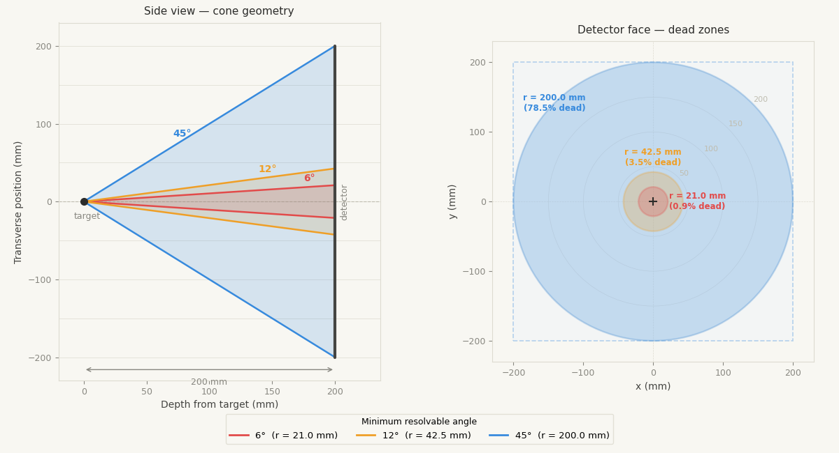
BACKUP · FEBRUARY
Cost of fewer strips / smaller acceptance
Geometry of minimum resolvable angle and dead-zone fractions for the readout/channel-budget trade-offs.
n_TOF X17 · Backup

Slide 26
BACKUP · MAY
Neon/Isobutane event display
Run 47, Ne/Iso, resist 530 V: waveforms + reconstructed hits. Neon shows cleaner low-energy tracks than Ar/CF4, but no usable flash window.
n_TOF X17 · Backup

Slide 27
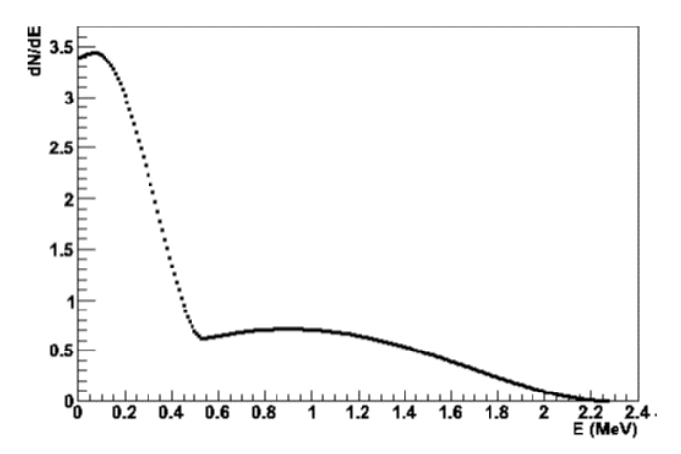
BACKUP · MAY
Sr-90 beta spectrum (source test)
Sr-90 endpoint ~2 MeV with substantial spectrum near 1 MeV — used to probe SiPM-wall material budget; the ~1 mm Al backing blocks these electrons.
n_TOF X17 · Backup

Slide 28
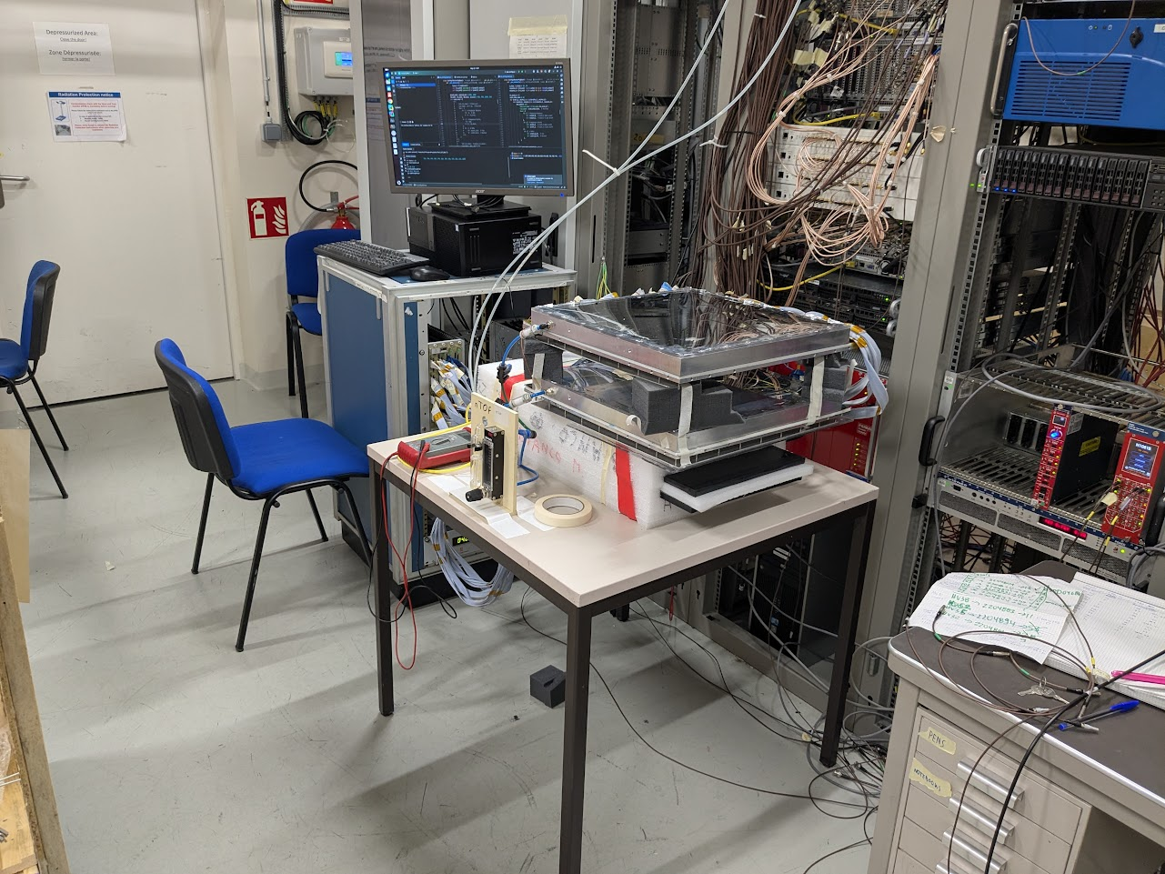
BACKUP · SETUP
EAR2 setup photograph
The MX17 detector and DREAM rack installed in EAR2.
n_TOF X17 · Backup

Slide 29
BACKUP · FEBRUARY
February — gases & samples tested
Gas mixture | Period | Key characteristics
Ar/CF4/Iso 88/10/2 | Feb 2–7, 9–11 | Strong flash saturation; op. V ~490 V; high spark rate
He/Ethane 96.5/3.5 | Feb 3–7, 20–Mar 2 | Survives flash at low HV; very neutron-sensitive; op. V ~500–540 V
Ar/CF4/CO2 45/40/15 | Feb 9–11 | Brief; op. V ~680–800 V; outside usable flash window
Ar/CF4 90/10 | Feb 10–16 | ± B4C target; op. V region incompatible with flash survival
Ar/CO2 70/30 | Feb 16–Mar 1 | Op. V ~680–720 V; saturation well below op. V
• Samples: empty / lead (gammas) / B4C (strong n absorber) / carbon (≈ July capsule) / Timepix.
• Drift gaps: 30 mm (µ-TPC) → 6 mm (Feb 18) → 11 mm (final days). Frame: aluminium → carbon (Feb 26).
• Feb 19: single-strip scope test conclusively pins the blindness on DREAM, not the detector.
n_TOF X17 · Backup

Slide 30
BACKUP · FEBRUARY
February — selected run summary
Run | Date | Gas | Target | Drift | Frame | Note
18 | Feb 3 | Ar/CF4/Iso | Timepix | 30 | Al | First detailed flash study
26 | Feb 4 | He/Eth | None | 30 | Al | Overnight HV scan
30 | Feb 5 | He/Eth | B4C | 30 | Al | B4C vs no-target
33 | Feb 6 | He/Eth | Carbon | 30 | Al | Carbon target scan
52–54 | Feb 11–12 | Ar/CF4 | None | 30 | Al | SiPM-triggered cosmics
71 | Feb 19 | Ar/CO2 | B4C | 6 | Al | 0 V vs 1000 V drift — 6 mm alive
97 | Feb 24 | He/Eth | Cs-137 | 6 | Al | Key efficiency calibration
136 | Feb 28 | He/Eth | Lead | 6 | Carbon | Al vs carbon frame (~10–20%)
143 | Mar 1 | He/Eth | Carbon | 11 | Carbon | Final 11 mm dataset
n_TOF X17 · Backup

Slide 31
BACKUP · MAY
May — issues identified
Issue | Status / action
DREAM 4096 lock-up at ≳470 samples | RESOLVED — limit to 450 samples (9 µs window)
Zero-suppression left on from Run 36 | All Ne/Iso, He/Eth, Ar/CF4/Iso data are ZS; reprocess with flag
Det-4 largely inefficient (M2 mux) | Physics analysis relies on Det-3 only
SiPM wall ~1 mm Al backing | Blocks 1–2 MeV e⁻; remove / thin-foil for July
NIM trigger outside EAR2 | Cable attenuation < N1081B threshold; move logic in-area
B4C target misaligned (Runs 35–44) | B4C data from those runs suspect
RunCtrl manual ‘G’ keypress | Needs software watchdog for overnight runs
Disk I/O bottleneck on DAQ PC | Clone OS to SSD before July
n_TOF X17 · Backup

Slide 32
BACKUP · OUTLOOK
July concept — thermal trigger architecture
• Full four-detector geometry around a pressurised ³He carbon capsule.
• Per side: SiPM wall (16/20 bars → 8 channels) summed & discriminated → one logic pulse.
• Coincide with the first layer of a new liquid-scintillator calorimeter (PMT readout) →
  – a “sector hit” that rejects single Compton gammas but accepts e⁺/e⁻.
• Singles = any one sector; Doubles = majority ≥2 (for a ~120° pair).
• Optional hardware PS-flash veto; scaledown to Doubles if singles rate too high.
• Liquid scintillator must contain up to 10 MeV e± within ~5 cm (GEANT4 to verify acceptance).
• Rate scaling vs empty-capsule ~3/pulse: area ×1.8, no Al ×~2, ³He fill ×2–3, four walls ×4
  – → O(50–200) singles/pulse; DREAM dead-time vs rate must be modelled to choose Singles vs Doubles.
n_TOF X17 · Backup

Slide 33
BACKUP · OUTLOOK
Roadmap to July
Period | Milestone | Key items
June 2026 | Production | Build 4 final MMs (30 mm, Al frame); upgrade/obtain DREAM FEUs & 64 cables; build liquid-scint modules & 3 more SiPM walls
June 2026 | DAQ & trigger | In-area NIM trigger (N1081B, veto); SSD clone; auto-ZS detection; RunCtrl watchdog; GEANT4 acceptance + dead-time model
July 2026 | Physics run | Four-detector thermal-region X17 search with ³He target
• Open detector-quality question: Det-4 inefficiency and Det-3 discharges — root cause before building the four.
n_TOF X17 · Backup

