Slide 1
The X17 search at n_TOF EAR2
Full Geant4 simulation: production, acceptance, and the path to a measurement Final July setup · expected results · the post-LS3 upgrade
D. Neff — 16 June 2026 | simulation + analysis: this repository (MX17_Full_Geant)
Notes:
Deck for INFN presentation of the July run plan + post-LS3 expectations, plus a broader set of simulation results. Section A (slides 2-5) is the INFN-requested core; Section B is supporting detail. All numbers from the full Geant4 campaign (5e8 neutrons, 1e7 pair events).

Slide 2
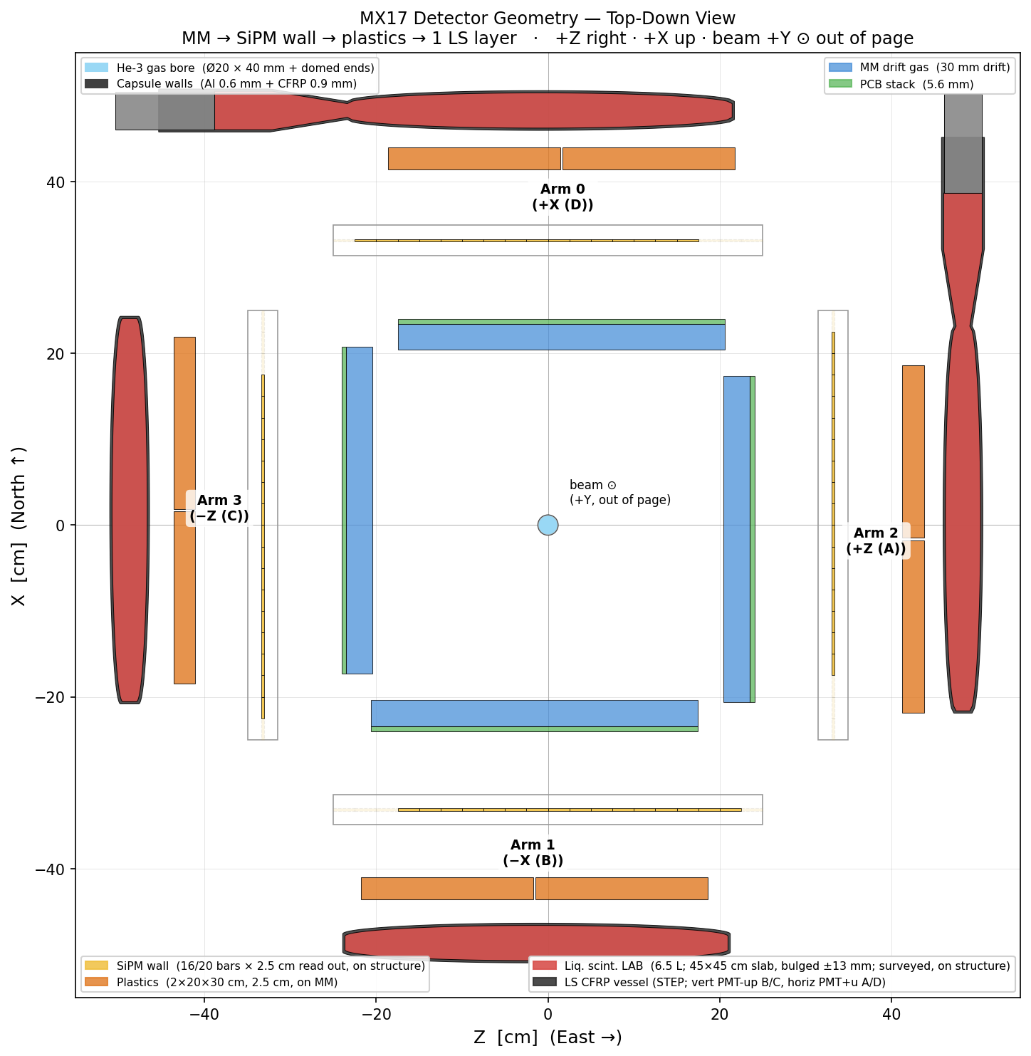
The experiment: a 4-arm e⁺ e⁻ pair spectrometer
³He(n,γ)⁴He* → (X17 or IPC) → e⁺ e⁻ ; measure the opening angle in 4 Micromegas + scintillator arms
Target
³He gas capsule, 500 bar, r = 10 mm, 60 mm on axis; thin Al (0.6 mm) + CFRP (0.9 mm) wall.
Tracking
4 Micromegas arms, front face ≈ 25 cm from the target, 30 mm drift gap — the e⁺ e⁻ directions.
Calorimetry / trigger
Liquid-scintillator + plastic layers per arm (assumed saturated/unusable for the high-energy measurement — tracking-only baseline).
The observable
X17 (m ≈ 17 MeV) makes a sharp opening-angle shoulder at θ ≈ 109°; the IPC continuum is the irreducible background.
Notes:
Geometry from scripts/plot_geometry.py (SimConfig defaults). Beam into the page. Production happens in the He-3 gas; the two leptons exit through the capsule wall (the dominant resolution limit, see later) and are tracked in the Micromegas. Calorimetry is conservatively treated as unusable at high energy, so the measurement rests on MM tracking only.

Slide 3
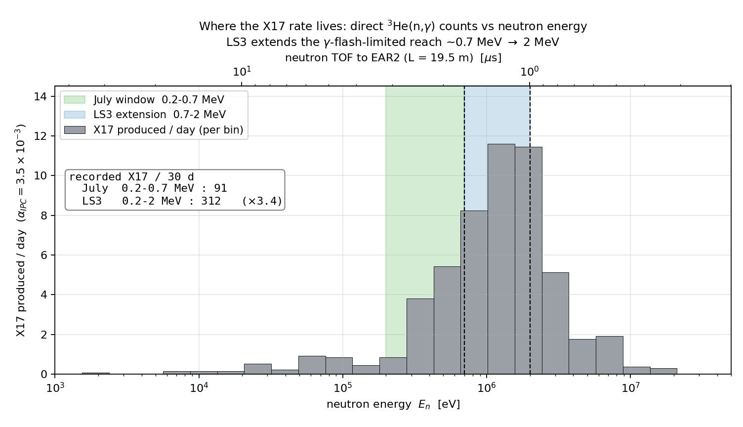
Production is settled — and it lives at MeV energies
Directly counted ³He(n,γ) from 5×10⁸ neutrons; the γ-flash sets the high-energy reach
Sub-keV is dead.
The gas is opaque to (n,p); radiative capture is capped at σₙγ/σₙₚ ≈ 10⁻⁸ → ~0.1 X17/day.
The MeV window is the measurement.
Above ~100 keV the gas is thin and the rate table is confirmed by Geant4 (within 10–70%). ~33 X17/day produced over the full range.
The γ-flash limits the reach.
Faster neutrons arrive sooner, closer to the flash. How early the detectors recover sets the max neutron energy — this is the LS3 lever.
Notes:
From docs/report/mev_note.tex + analysis/mev. The per-bin X17/day uses alpha_IPC = 3.5e-3. Green = July reach (0.2-0.7 MeV), blue = the extra reach LS3 buys (0.7-2 MeV). Top axis is neutron TOF to EAR2 at 19.5 m: 2 MeV = 1.0 us, 0.7 MeV = 1.7 us, 0.2 MeV = 3.2 us. Recorded X17 in 30 d: 64 (July) -> 220 (LS3).

Slide 4
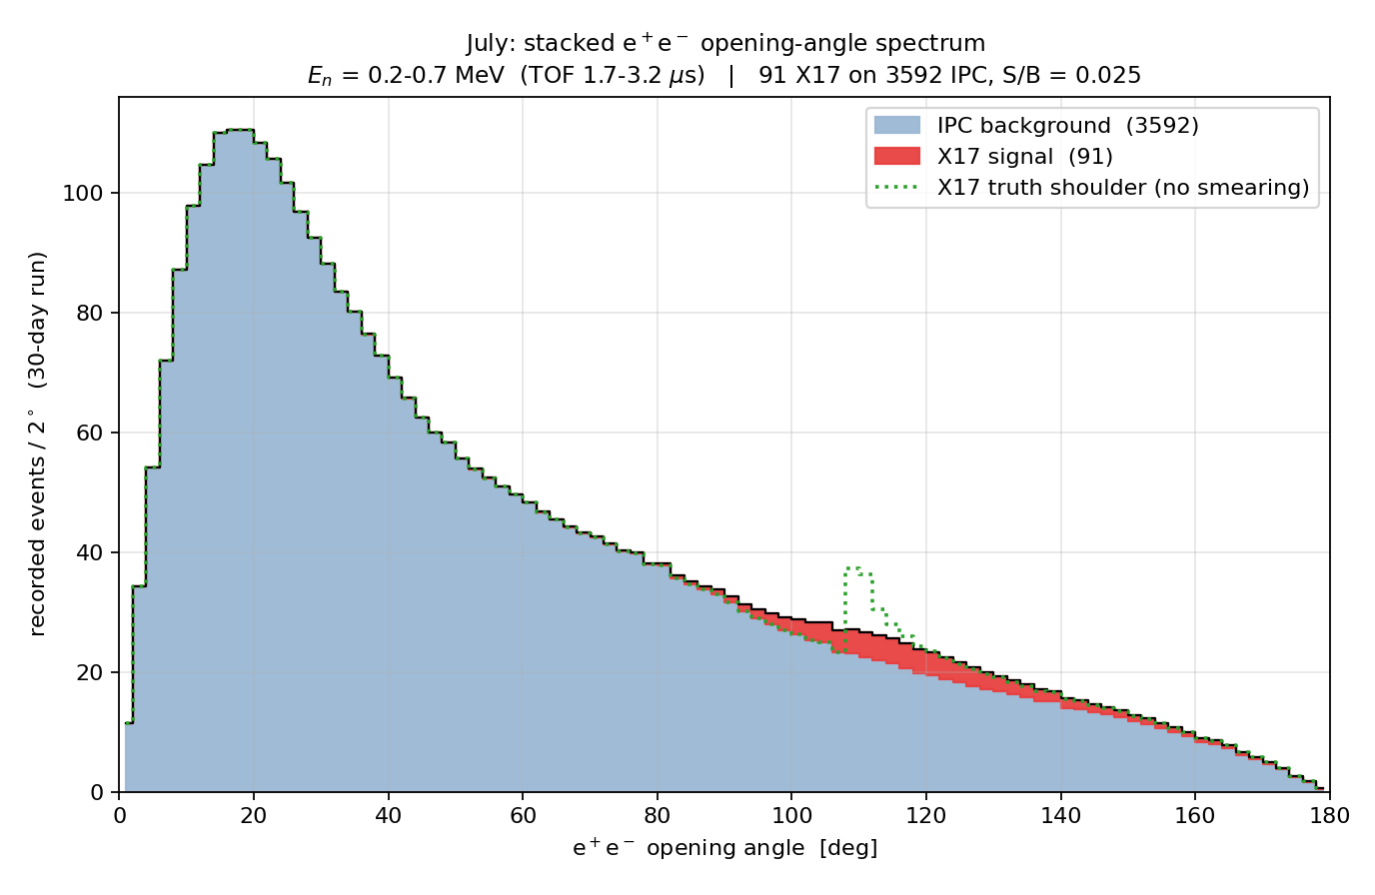
July run: expected result (optimistic scenario)
Window 0.2–0.7 MeV — conservative γ-flash recovery (detectors usable by ≈ 1.7 µs); 30-day run
≈ 91 X17 on ≈ 3 600 IPC
recorded in 30 days (S/B ≈ 0.021).
The peak is diluted, not visible by eye.
Capsule multiple scattering smears θ by σ68 ≈ 14°; the 109° shoulder (green dotted = truth) becomes a broad bump. The measurement is a template fit, not a cut-and-count.
Caveats / assumptions (separate box — delete before INFN if desired)
• Optimistic: best-estimator (target-centre chord) smearing; no pile-up, no γ-flash losses, no θ-dependent MM acceptance shaping.
• α_IPC = 3.5×10⁻³ (¹²C/⁸Be-anchored) and X17/IPC = 2.5% are assumed inputs (provenance pending). Table α = 2.1×10⁻³ would scale signal ×0.6 (→ ~38 X17).
• At-rest kinematics (shoulder shifts a few degrees with the Eₙ boost). MM-double acceptance 27.8% (X17) / 27.4% (IPC), nose-first (was 19.6/23.6 pre-flip).
Notes:
Conservative July choice: gamma-flash recovery only by ~1.7 us, so max neutron energy ~0.7 MeV (this 'energy cutoff' framing is how the collaboration thinks). 143 captures in the window -> 91 recorded X17 (nose-first acc.) / 3592 IPC over 30 days at alpha=3.5e-3 (nose-first acceptance). The caveat box is a separate shape: delete it for the INFN talk if desired. Figure: scripts/make_slides_figures.py.

Slide 5
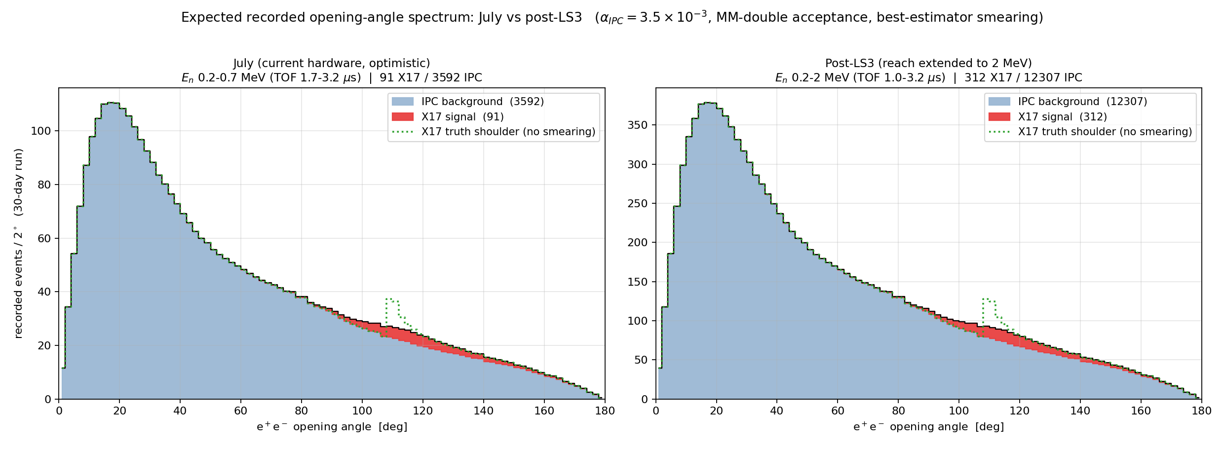
After LS3: extend the reach to 2 MeV neutrons
Faster γ-flash recovery (≈ 1.0 µs) → window 0.2–2 MeV; same analysis, ×3.4 the statistics
July 91 X17 → post-LS3 312 X17 recorded (30 d), on the same S/B ≈ 0.021.
Reaching 2 MeV neutrons (faster γ-flash recovery) adds the most productive energy decade. The spectrum shape is unchanged — the gain is purely statistical, which is exactly what a template fit converts into significance.
Notes:
LS3 goal stated by the collaboration: achieve neutron energy of at least 2 MeV. Same plot as July, window extended 0.7->2 MeV. Recorded X17 30 d: 312 vs 91 (x3.4). S/B identical (set by X17/IPC branching x acceptance ratio, window-independent). The decisive question remains the gamma-flash recovery time, measured on the real setup.

Slide 6
Supporting results
Production budget · the angular-resolution floor · the analysis strategy · the γ-dark E0 channel · backgrounds

Slide 7
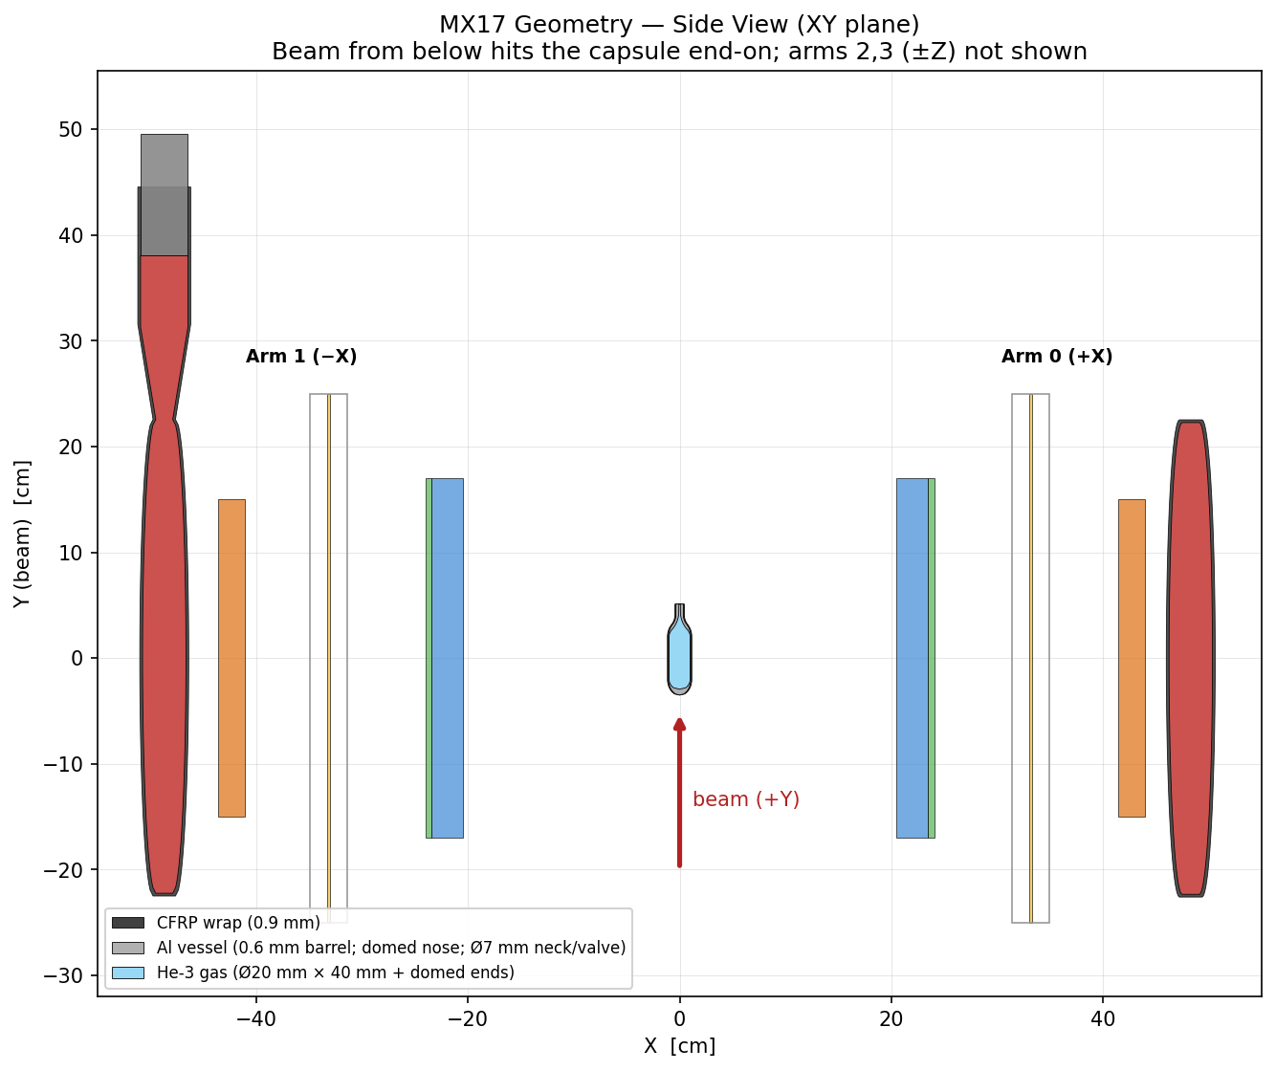
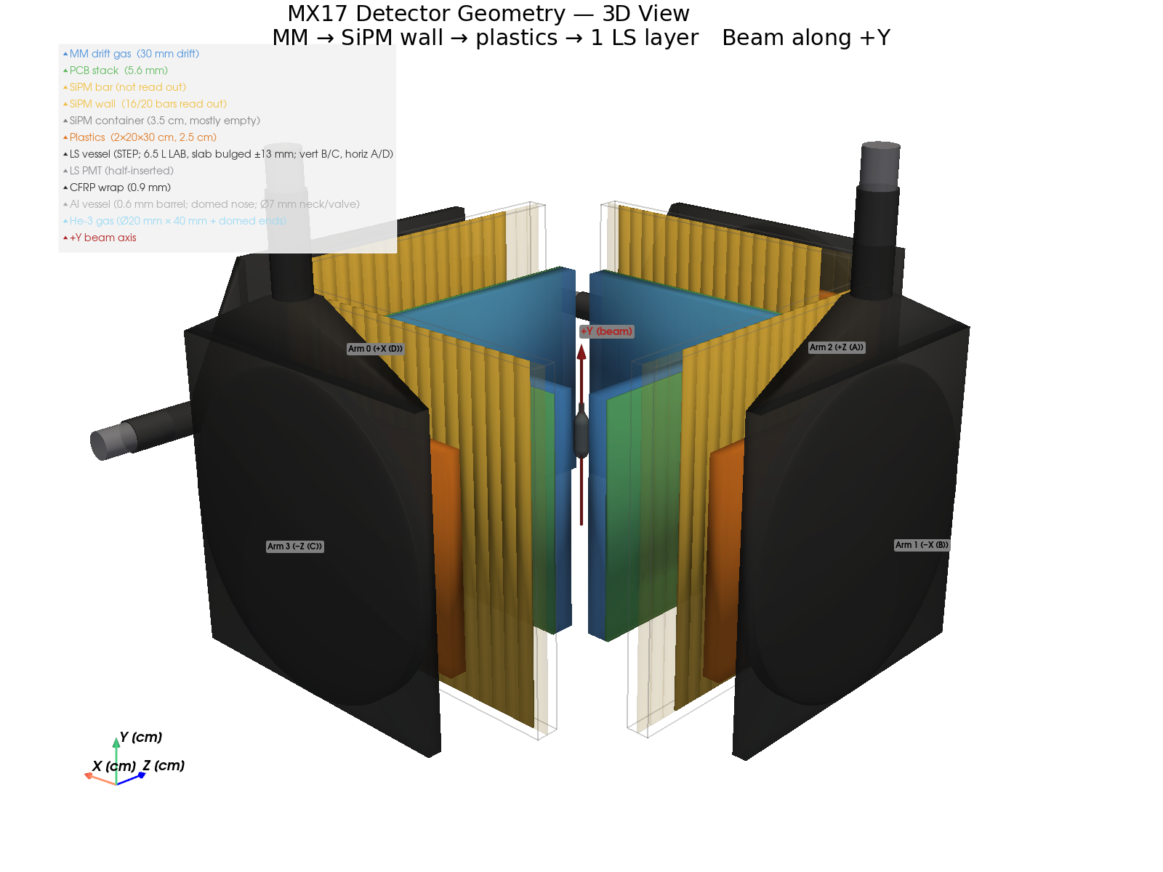
Detector geometry — side view and 3D
Companion views to the top-down layout: the ³He capsule shape, beam-end-on incidence, and the full 4-arm arrangement
Side view (XY): beam enters end-on along +Y into the capsule; arms 0/1 (±X) shown.
3D: 4 arms (±X, ±Z), each MM + scintillator stack around the target.
Notes:
Backup geometry slide (scripts/plot_geometry.py). Side view shows the capsule bottle profile (20 mm dia x 40 mm + domed ends, neck/valve on axis) and the beam hitting it end-on along +Y. The 3D isometric shows all four arms; arms 2,3 are along +/-Z (not shown in the side view).

Slide 8
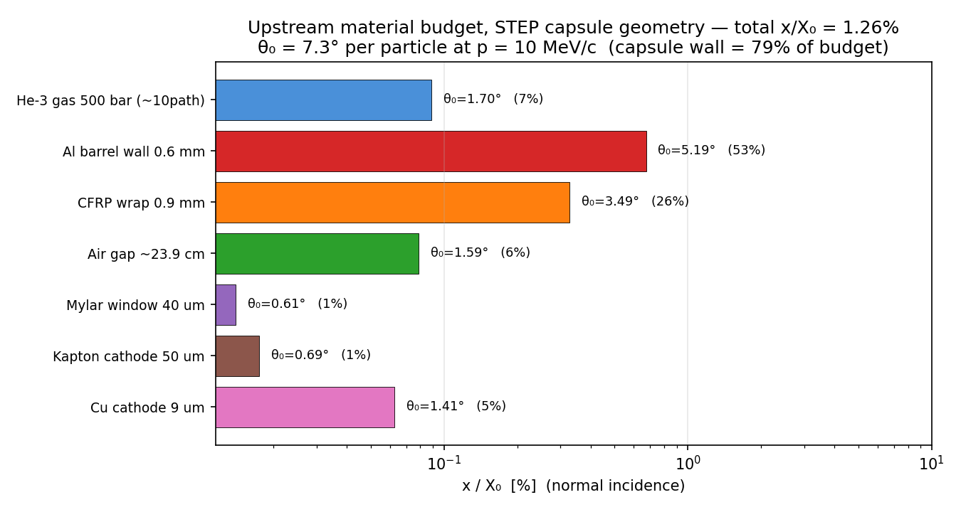
The angular resolution is hardware-frozen
Opening-angle resolution is set by multiple scattering in the capsule wall — no reconstruction can beat it
σ68(Δθ) ≈ 14.5°
full accepted spectrum (≈ 11.5–12.5° for symmetric pairs), even assuming a perfect vertex.
Why:
The 0.6 mm Al + 0.9 mm CFRP wall (~11 mm from the vertex) is 79% of the material budget. A scatter that early rotates the whole visible track.
Verdict:
All 7 reconstruction methods land within 2° of each other. The only hardware lever is an all-composite vessel (→ ~10°). The recovery path is statistical: fit the shape.
Notes:
From docs/angular_resolution/angular_resolution_note. Highland budget on the new STEP capsule. The vertex-constraint trick (target-centre chord) is already within 0.5 deg of the perfect-vertex oracle because the small target banks the gain. Detector spatial resolution costs <0.5 deg. This is the single most important hardware fact for the measurement.

Slide 9
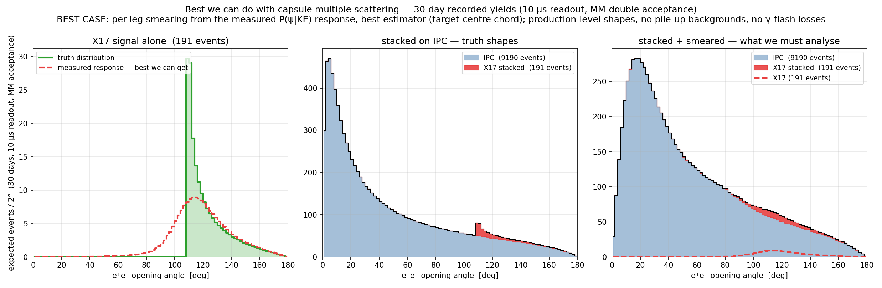
Why the analysis is a template fit, not a peak cut
Truth → stacked on IPC → both smeared: the shoulder washes out, but its shape is known to ~1% from 10⁷ simulated pairs
Cut-and-count on θ is dead (recorded S/B ≈ 0.02). What survives: a fit of the known smeared-signal template + the smooth IPC continuum, with resolution entering as dilution of statistical power rather than as a cliff. This is the natural go/no-go calculation.
Notes:
The 'money plot' from the angular note. Per-leg smearing drawn from the measured P(psi|KE) response (best estimator). Normalised to full-production 30-day recorded yields (191 X17 / 9190 IPC at alpha=2.1e-3). The middle vs right panels show the shoulder before/after smearing on the IPC continuum.

Slide 10
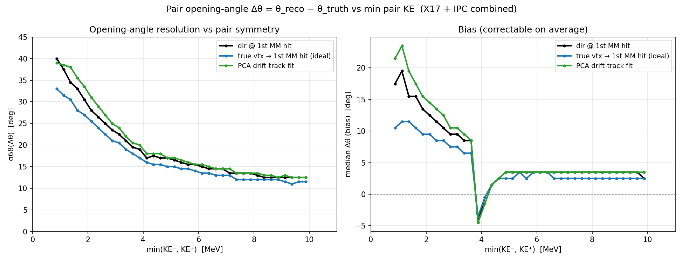
Resolution is a soft-track problem
σ68 vs pair symmetry, and the +bias (correctable in a response-matrix fit) — X17 is sharpest at its symmetric 109° shoulder
Below ~3 MeV a leg is directionless after the wall (σ68 → 40°); above ~8 MeV it plateaus at ~12°. X17 is sharpest at its symmetric 109° shoulder — the good news.
Notes:
X17 has KE- + KE+ ~ 19.6 MeV so one leg is always <= 9.8 MeV; the resolution is driven by the softer leg. MM-internal quality cuts (straightness, dE/dx) could reject soft legs and recover ~12.5 deg without a calorimeter -- the one open reconstruction study.

Slide 11
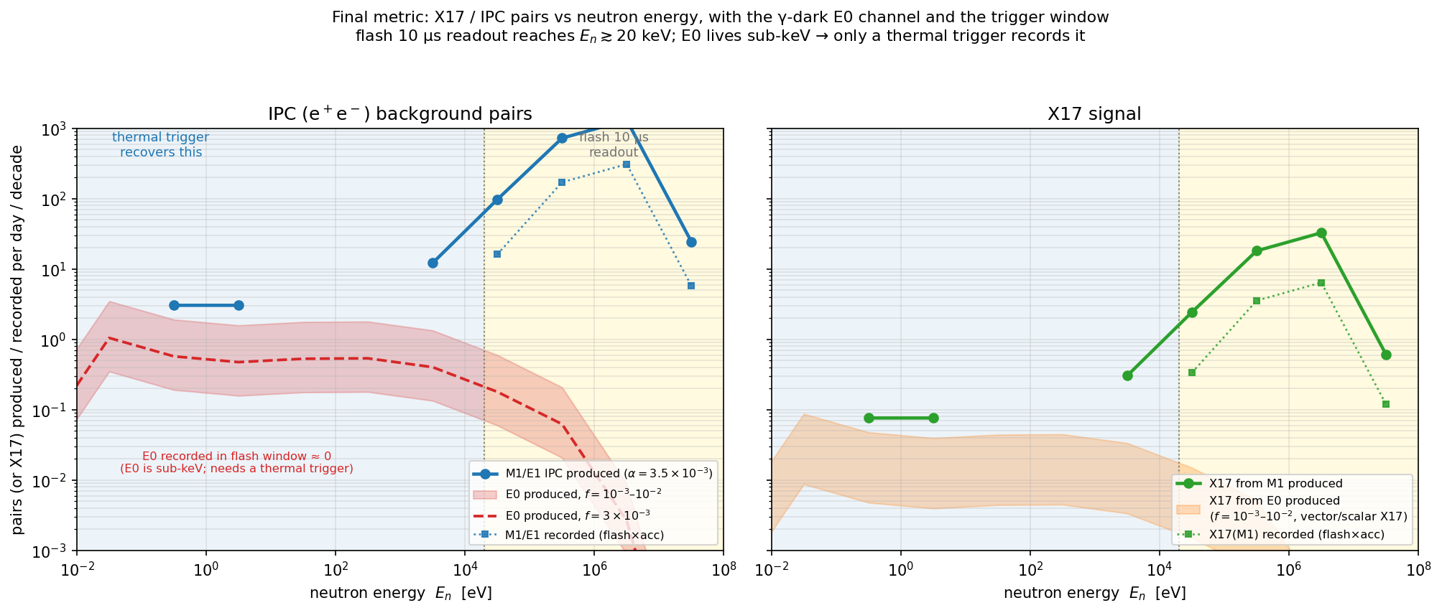
The γ-dark E0 channel: completeness, not a game-changer
0⁺→0⁺ captures make no photon but can make a massive X17 — yet the rate is tiny and sub-keV
E0 is real but small.
The 0⁺ doorway sits sub-keV, where the same 10⁻⁸ radiative branching that kills the thermal program applies — times f ≤ 10⁻².
The flash readout cannot see it.
Sub-keV → TOF > 45 µs → arrives after the window closes. Only a dedicated thermal trigger records it (≤ 0.06 X17/day).
So:
Leaving E0 out does not bias the baseline high-energy analysis. Worth adding to the generator for completeness only.
Notes:
From docs/report/e0_final_metric_note + e0_branch docs. Addresses Alberto's E0 question. Key physics: 0+->0+ is photon-dark because the photon is massless, but a massive vector/scalar X17 is allowed. The rate is bounded by the (tiny) E0 capture rate. Left panel: IPC background pairs/day; right: X17 signal. Gold/blue = thermal vs flash trigger regions.

Slide 12
Expected significance — a statistical ceiling, not the final CL
Profile-likelihood (template-fit) Asimov significance, with the IPC background shape & normalisation taken as exactly known
Scenario (30-day run) | Recorded S / B | Shape-fit Z (smeared, realistic) | Z if no smearing | Naïve S/√B (whole spectrum)
July · 0.2–0.7 MeV | 91 / 3 592 | 3.5 σ | 5.1 σ | 1.5
Post-LS3 · 0.2–2 MeV | 312 / 12 307 | 6.4 σ | 9.6 σ | 2.8
What IS in these numbers
Binned profile-likelihood ratio (Cowan et al. Asimov formula) — the rigorous form of “count in a region”, optimally weighted over all bins.
Same templates as slides 4–5: best-estimator (target-centre chord) capsule multiple-scattering smearing; α_IPC = 3.5×10⁻³, X17/IPC = 2.5%, nose-first MM-double acceptance.
Binning-independent: 2° and 8° (×4) bins agree to <1%.
Background normalisation can be floated from the θ ≲ 90° region (X17-free) to ~2% — negligible. The shape fit ~doubles the naïve whole-spectrum S/√B by weighting the high-θ shoulder.
⚠ Why this is a ceiling, not a confidence level (keep this box)
• The IPC angular SHAPE is assumed equal to the simulation truth; its uncertainty — which will dominate the real CL — is NOT propagated.
• Physics: a single E1 transition is assumed (probably fair, unquantified here).
• Detector/acceptance shape distortion is omitted: poor separation of near-collinear tracks (small θ), and finite active area shaping the catch probability for wide-angle pairs (large θ) — the signal region.
• With B ≈ 3 000–10 000, a few-% shape error in the high-θ signal region already rivals the statistical fluctuation — by post-LS3 the IPC shape, not statistics, sets the achievable CL.
• Read 3.5σ / 6.4σ as a best-case ceiling. A defensible CL needs the MEASURED IPC shape + full detector response folded in (open work).
Notes:
Significance projection (open item from the summary slide). Numbers from scripts/make_slides_figures.py templates fed through an Asimov binned profile-likelihood: Z = sqrt(2 sum[(s+b)ln(1+s/b)-s]). July smeared Z=2.64 (truth 3.94), LS3 smeared Z=4.89 (truth 7.29); 2deg vs 8deg binning agree to <1%; a best single theta-window cut-and-count gives ~2.5 / 4.7 sigma (the broad shoulder makes counting nearly as good as the full fit). CRITICAL CAVEAT (the red box): these assume the IPC angular shape equals MC truth. Not included: physics shape uncertainty (single-E1 assumption), and — emphasised by D.N. — detector / acceptance shape distortion: track-pair separation inefficiency at small opening angle, and active-area geometric acceptance falling off for wide-angle pairs (the signal region). These reshape the IPC template where the signal sits and will dominate the final CL. Do not quote these as a final confidence level.

Slide 13
Summary & status
Production is settled.
Full Geant4 (5×10⁸ neutrons) confirms the rate table where it is valid: ~33 X17/day produced, living at MeV energies. The sub-keV measurement is dead (self-shielding).
July (current hardware): ~91 recorded X17 / 30 d.
Window 0.2–0.7 MeV under a conservative γ-flash recovery; on ~3 600 IPC (S/B ≈ 0.025), nose-first. Extractable by a template fit, not a peak cut.
Post-LS3: ~312 recorded X17 / 30 d.
Reaching 2 MeV neutrons (×3.4 statistics). The decisive measurement is the real γ-flash recovery time.
The resolution is hardware-frozen at σ68 ≈ 14°.
Capsule wall MS; an all-composite vessel is the only lever. E0 is a completeness item, not a driver.
Open items:
α_IPC & X17/IPC provenance (Alberto); Eₙ-dependent generator kinematics; the template-fit significance projection; γ-flash recovery measurement.
Notes:
Wrap-up. The program is now an acceptance-and-backgrounds problem, not a production one. Next analysis step: wire the smeared templates into the fast-MC likelihood fit and quote expected significance vs run time.

Slide 14
Backup: factor-4 rebinned spectra
The slides 4–5 stacked spectra with 4 base bins merged into one (2° → 8° opening-angle bins) — same events, coarser binning.
Notes:
Backup versions of the slide 4 (July) and slide 5 (July vs LS3) stacked opening-angle spectra, rebinned by a factor of 4 (2 deg -> 8 deg bins) per collaborator request. Identical event samples, yields and normalisation as the main slides; only the histogram binning differs. 90 base bins are not divisible by 4, so the final 176-180 deg bin holds the 2 leftover base bins (negligible -- the distribution is empty there). Figures: scripts/make_slides_figures.py (rebin=4).

Slide 15
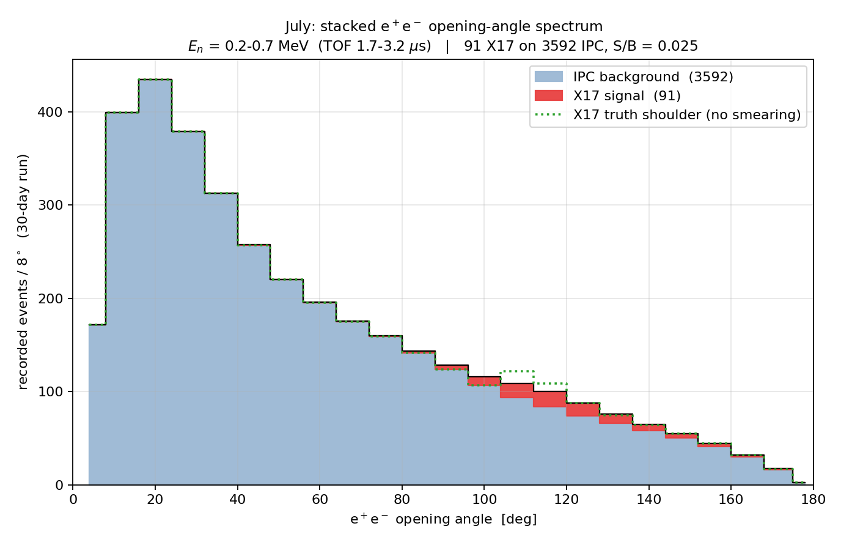
July run, rebinned ×4 (8° bins)
Same as slide 4 — window 0.2–0.7 MeV, 30-day run — with 4 base bins merged into one
≈ 91 X17 on ≈ 3 600 IPC
recorded in 30 days (S/B ≈ 0.021) — yields unchanged from slide 4.
Coarser binning, same statistics.
Merging 4 base bins (2° → 8°) smooths the per-bin fluctuations and makes the smeared 109° excess (red, over green-dotted truth) easier to read by eye — but it adds no information. Significance is set by the template fit, which is binning-independent.
Notes:
Backup rebinned (x4) twin of slide 4. Same recorded yields (91 X17 / 3592 IPC, S/B 0.025); only the display binning is coarser. Use to answer the collaborator's rebinning request; do not read a confidence level off the binning -- that comes from the template-fit / counting analysis (see notes).

Slide 16
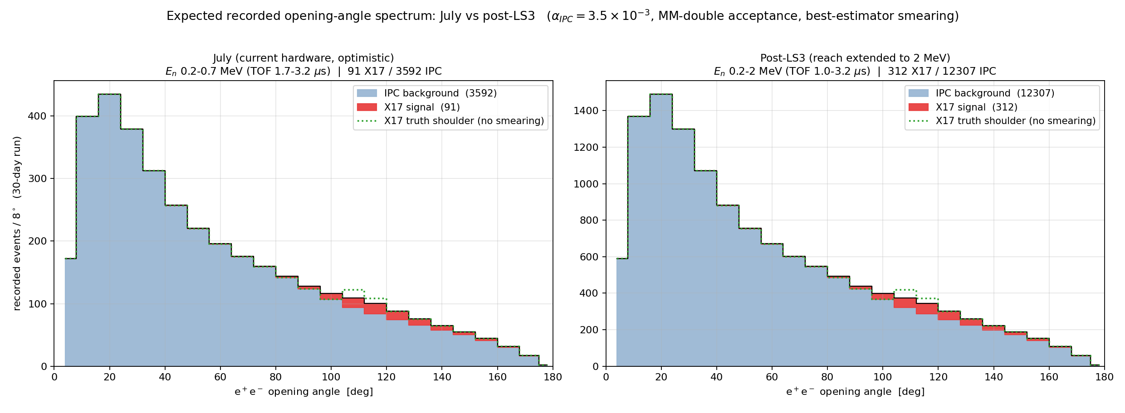
July vs post-LS3, rebinned ×4 (8° bins)
Same as slide 5 — the two windows side by side — with 4 base bins merged into one
July 91 X17 → post-LS3 312 X17 recorded (30 d), same S/B ≈ 0.021.
Rebinned ×4 (2° → 8°) for readability; the shape and yields are identical to slide 5. The post-LS3 gain is purely statistical.
Notes:
Backup rebinned (x4) twin of slide 5 (fig_stacked_compare_rebin4). Identical to slide 5 apart from the 8 deg display binning.

