Slide 1
MPGD 2026 · Applications
Large Area μTPC Micromegas for the X17 Search at n_TOF
Micromegas built at CEA Saclay for an X17 search at n_TOF’s EAR2 facility at CERN
Dylan Neff · MPGD 2026, Prague · 3 September 2026
Slides drafted with Claude Code (Anthropic)

Slide 2
Outline
1
The X17 particle and the n_TOF channel
2
Micromegas μTPC detectors
3
X17 search at n_TOF —
experimental setup
4
Experiment Summary and Early Results
D. Neff · MPGD 2026, Prague · 3 September 2026
2 / 25

Slide 3
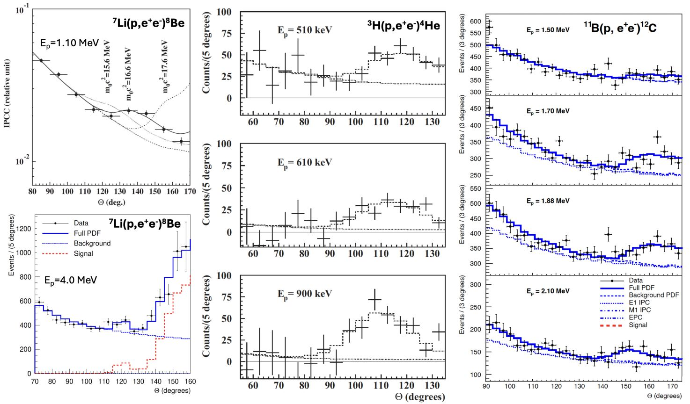
Motivation
A possible new boson at 17 MeV?
ATOMKI, 2016: an excess of e⁺e⁻ pairs at large opening angle, in three nuclear transitions
Consistent with a new particle: X17, ~17 MeV, decaying to e⁺e⁻
Can we make an independent measurement?
The same ⁴He* state, generated with neutrons + ³He?
A.J. Krasznahorkay et al., PRL 116, 042501 (2016) · PRC 104, 044003 (2021) · PRC 106, L061601 (2022)
D. Neff · MPGD 2026, Prague · 3 September 2026
3 / 25

Slide 4
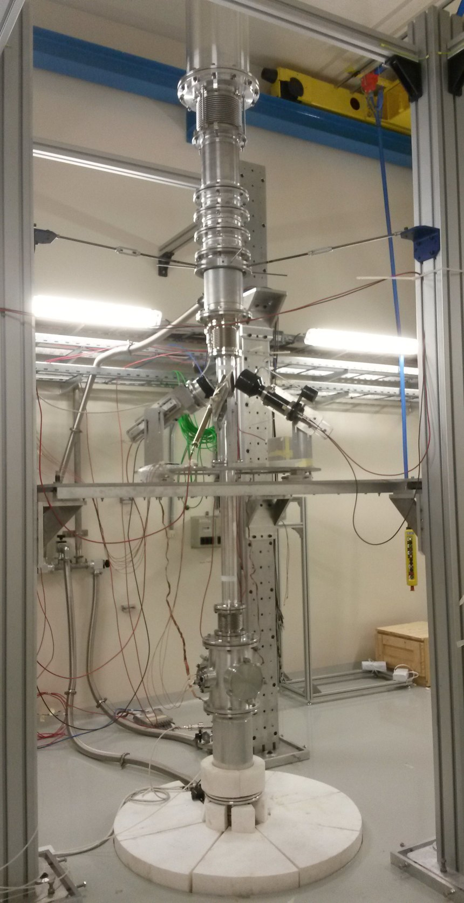
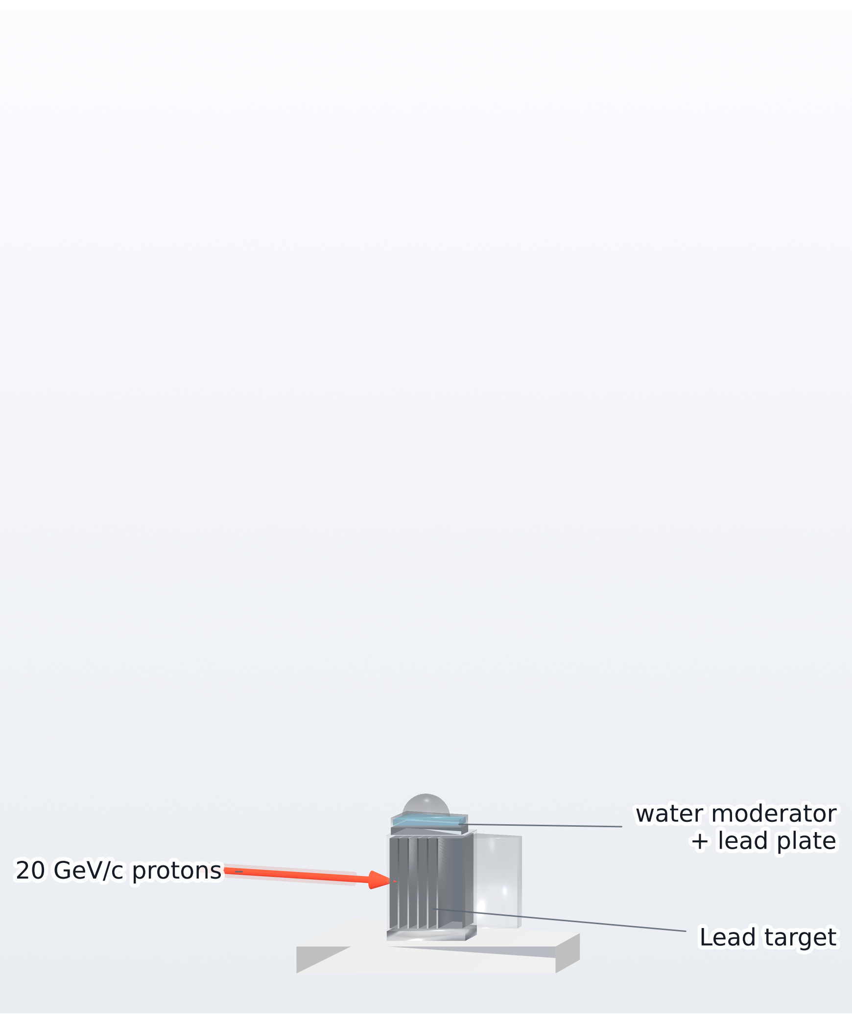
Motivation
n_TOF EAR2: a vertical neutron beam line at CERN
20 GeV/c PS protons hit a lead spallation target
The EAR2 hall — © CERN
In-house render · Weiß (2015), Pavon-Rodriguez (2025)
D. Neff · MPGD 2026, Prague · 3 September 2026
4.1 / 25

Slide 5
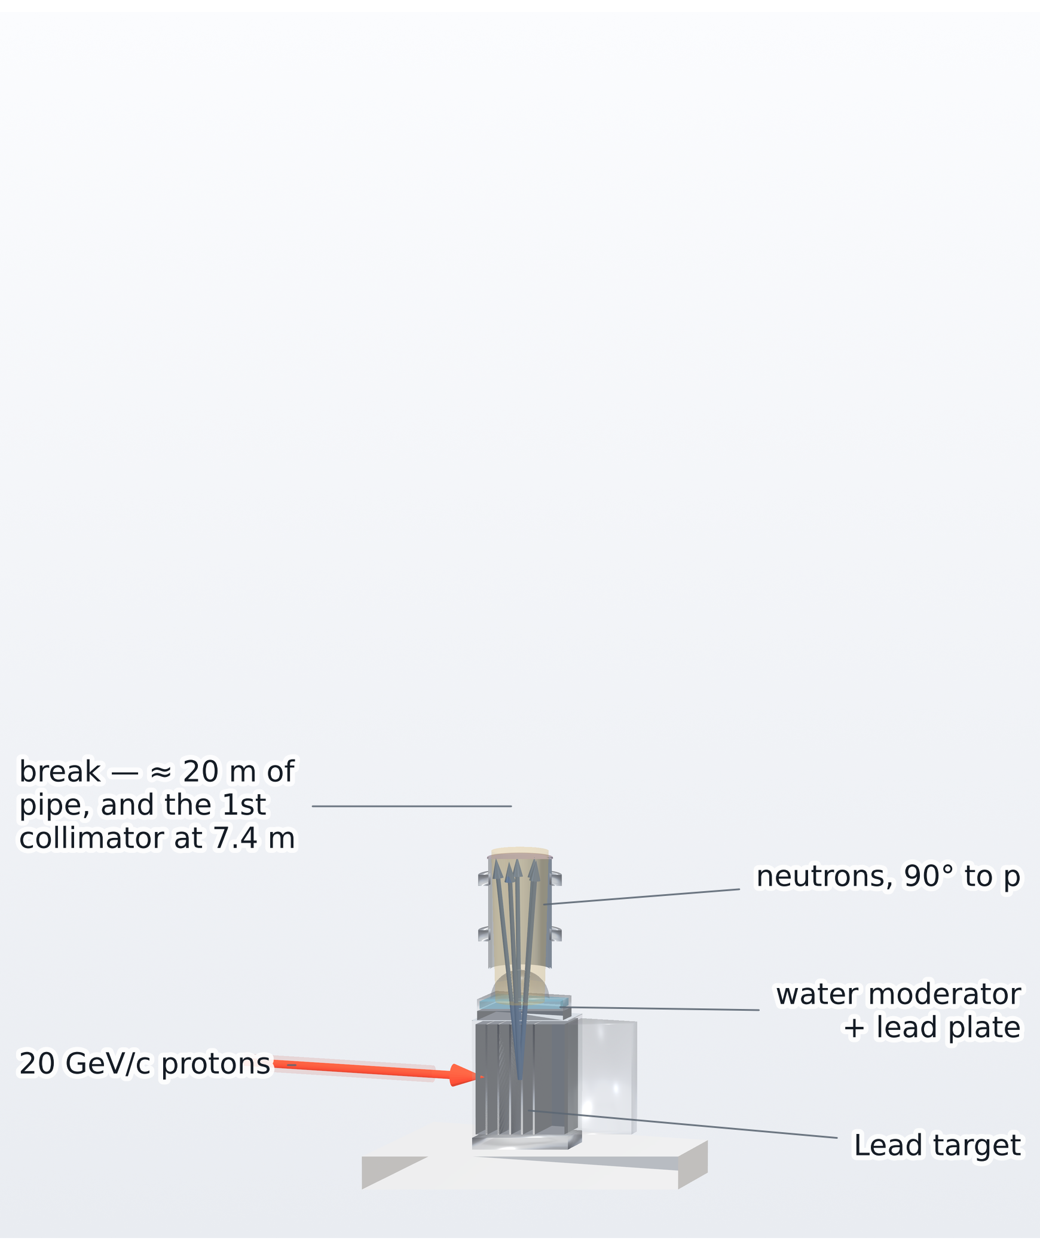
Motivation
n_TOF EAR2: a vertical neutron beam line at CERN
20 GeV/c PS protons hit a lead spallation target
Neutrons ejected at 90° climb ~20 m to EAR2
The EAR2 hall — © CERN
In-house render · Weiß (2015), Pavon-Rodriguez (2025)
D. Neff · MPGD 2026, Prague · 3 September 2026
4.2 / 25

Slide 6
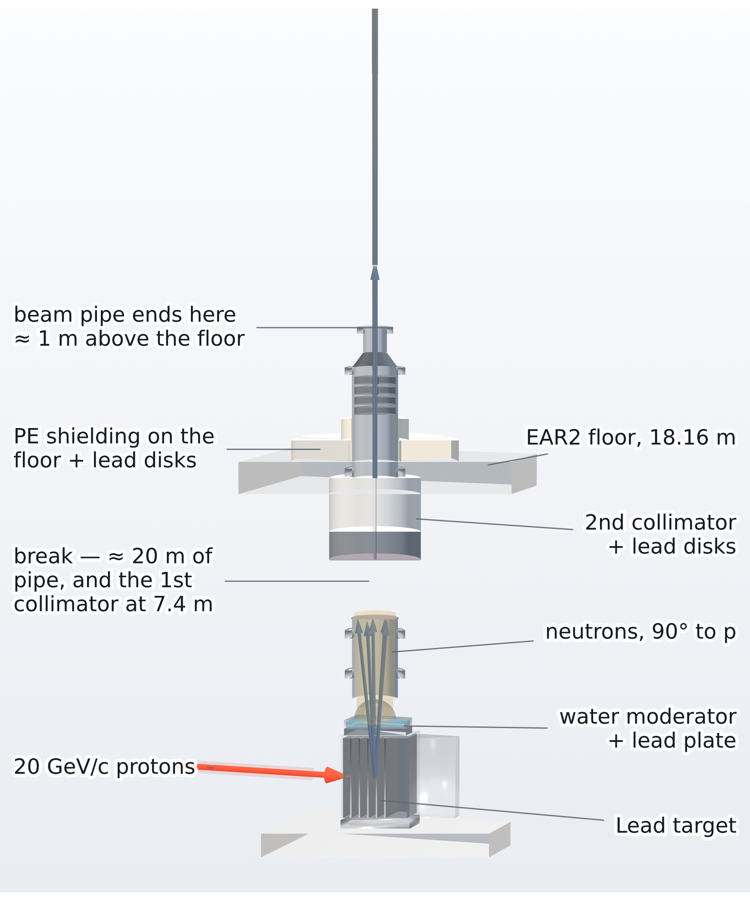
Motivation
n_TOF EAR2: a vertical neutron beam line at CERN
20 GeV/c PS protons hit a lead spallation target
Neutrons ejected at 90° climb ~20 m to EAR2
Collimated to a ≈3 cm pencil
The pipe ends: the beam crosses the hall in air
The EAR2 hall — © CERN
In-house render · Weiß (2015), Pavon-Rodriguez (2025)
D. Neff · MPGD 2026, Prague · 3 September 2026
4.3 / 25

Slide 7
Motivation
n_TOF EAR2: a vertical neutron beam line at CERN
20 GeV/c PS protons hit a lead spallation target
Neutrons ejected at 90° climb ~20 m to EAR2
Collimated to a ≈3 cm pencil
The pipe ends: the beam crosses the hall in air
Measurement station sits in that open beam
The highest instantaneous flux at n_TOF
The EAR2 hall — © CERN
In-house render · Weiß (2015), Pavon-Rodriguez (2025)
D. Neff · MPGD 2026, Prague · 3 September 2026
4.4 / 25

Slide 8
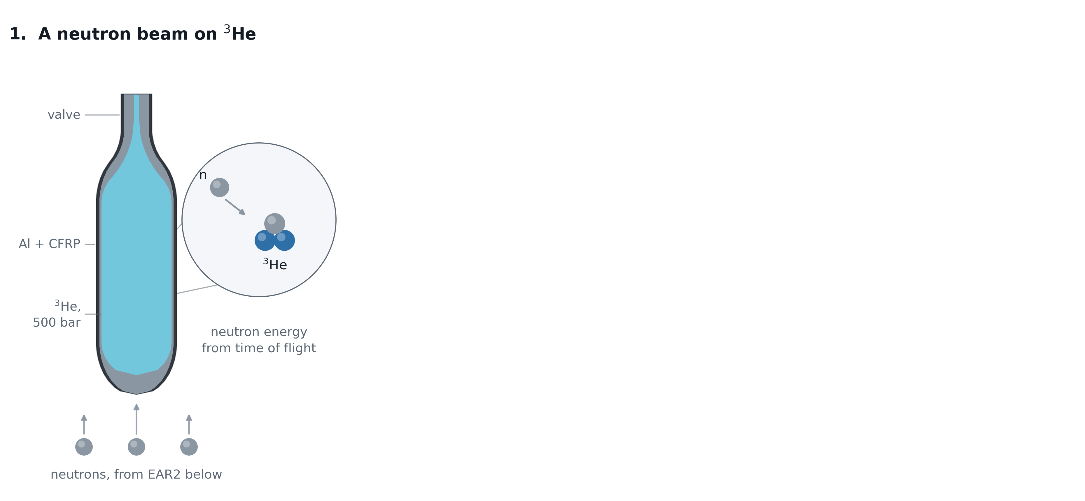
Motivation
Capture on ³He and how X17 could come out
D. Neff · MPGD 2026, Prague · 3 September 2026
5.1 / 25

Slide 9
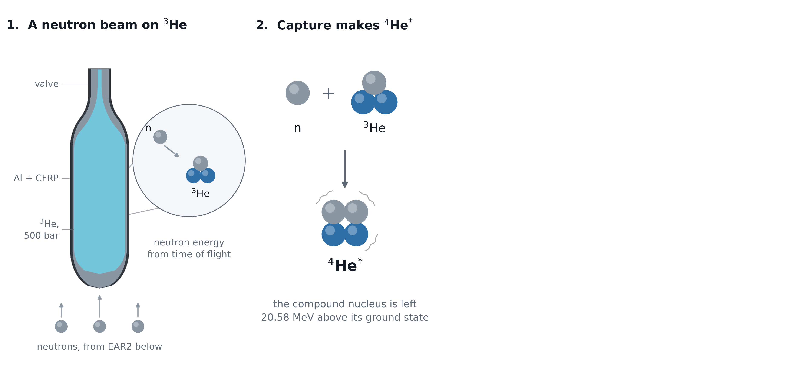
Motivation
Capture on ³He and how X17 could come out
D. Neff · MPGD 2026, Prague · 3 September 2026
5.2 / 25

Slide 10
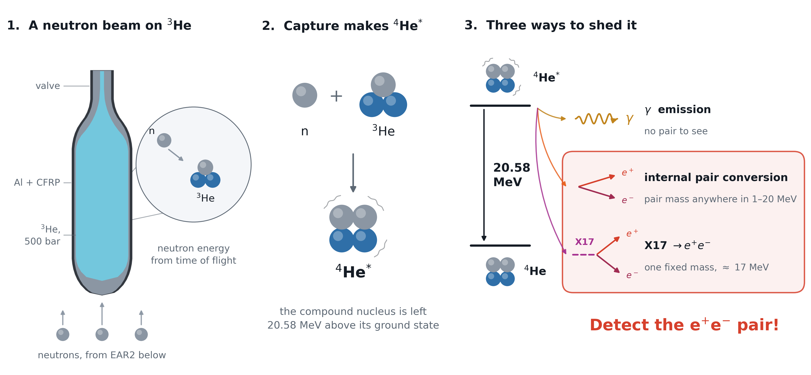
Motivation
Capture on ³He and how X17 could come out
?
D. Neff · MPGD 2026, Prague · 3 September 2026
5.3 / 25

Slide 11
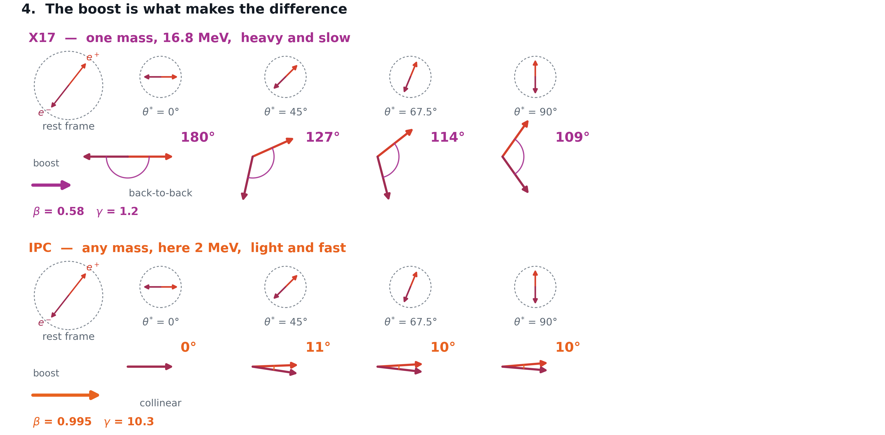
Motivation
The opening angle observable -- X17 moves slow
D. Neff · MPGD 2026, Prague · 3 September 2026
6.1 / 25

Slide 12
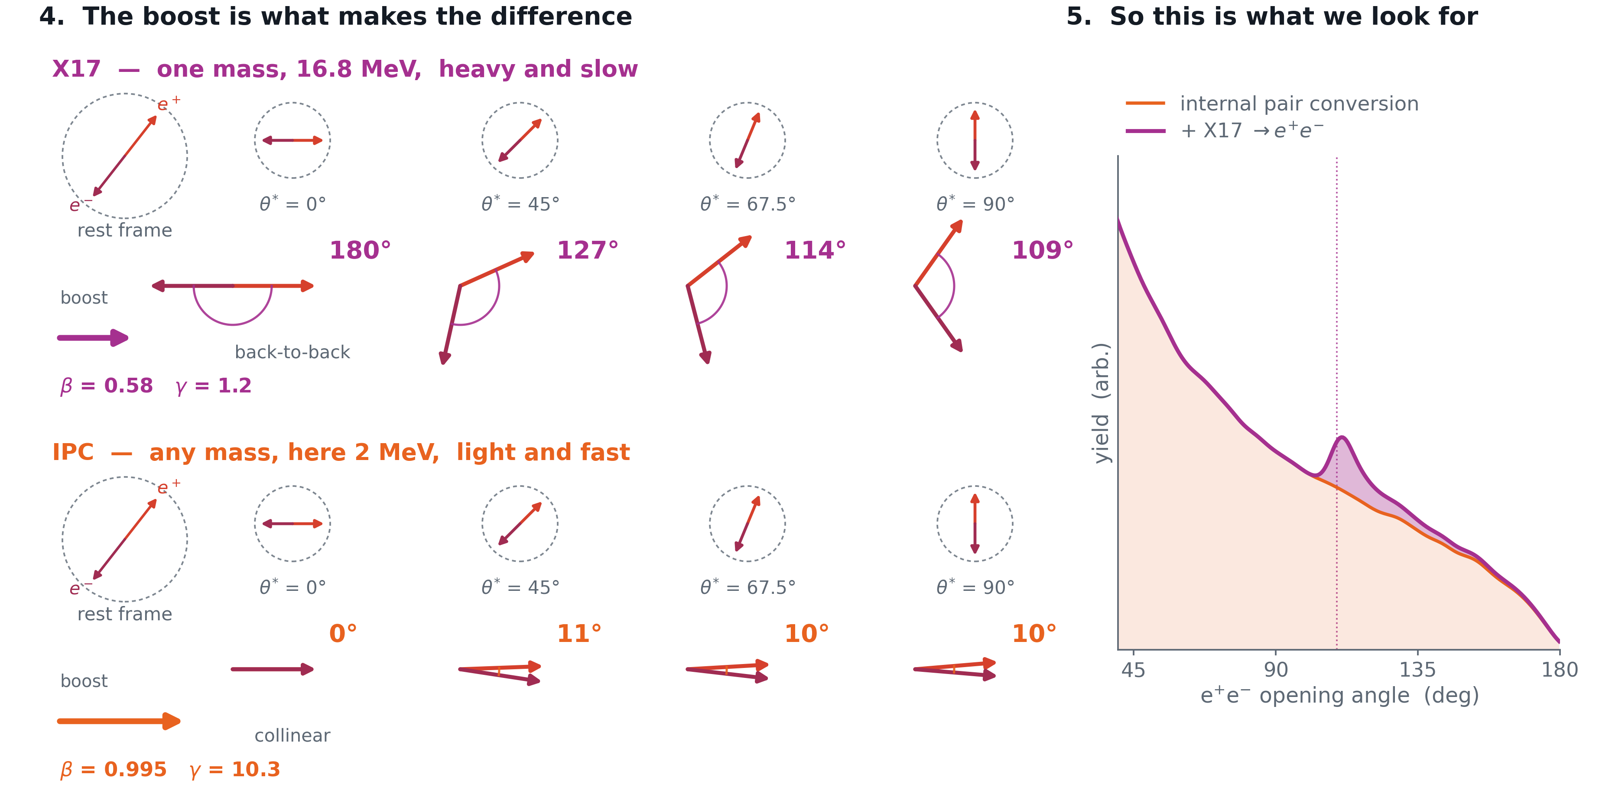
Motivation
The opening angle observable -- X17 moves slow
D. Neff · MPGD 2026, Prague · 3 September 2026
6.2 / 25

Slide 13
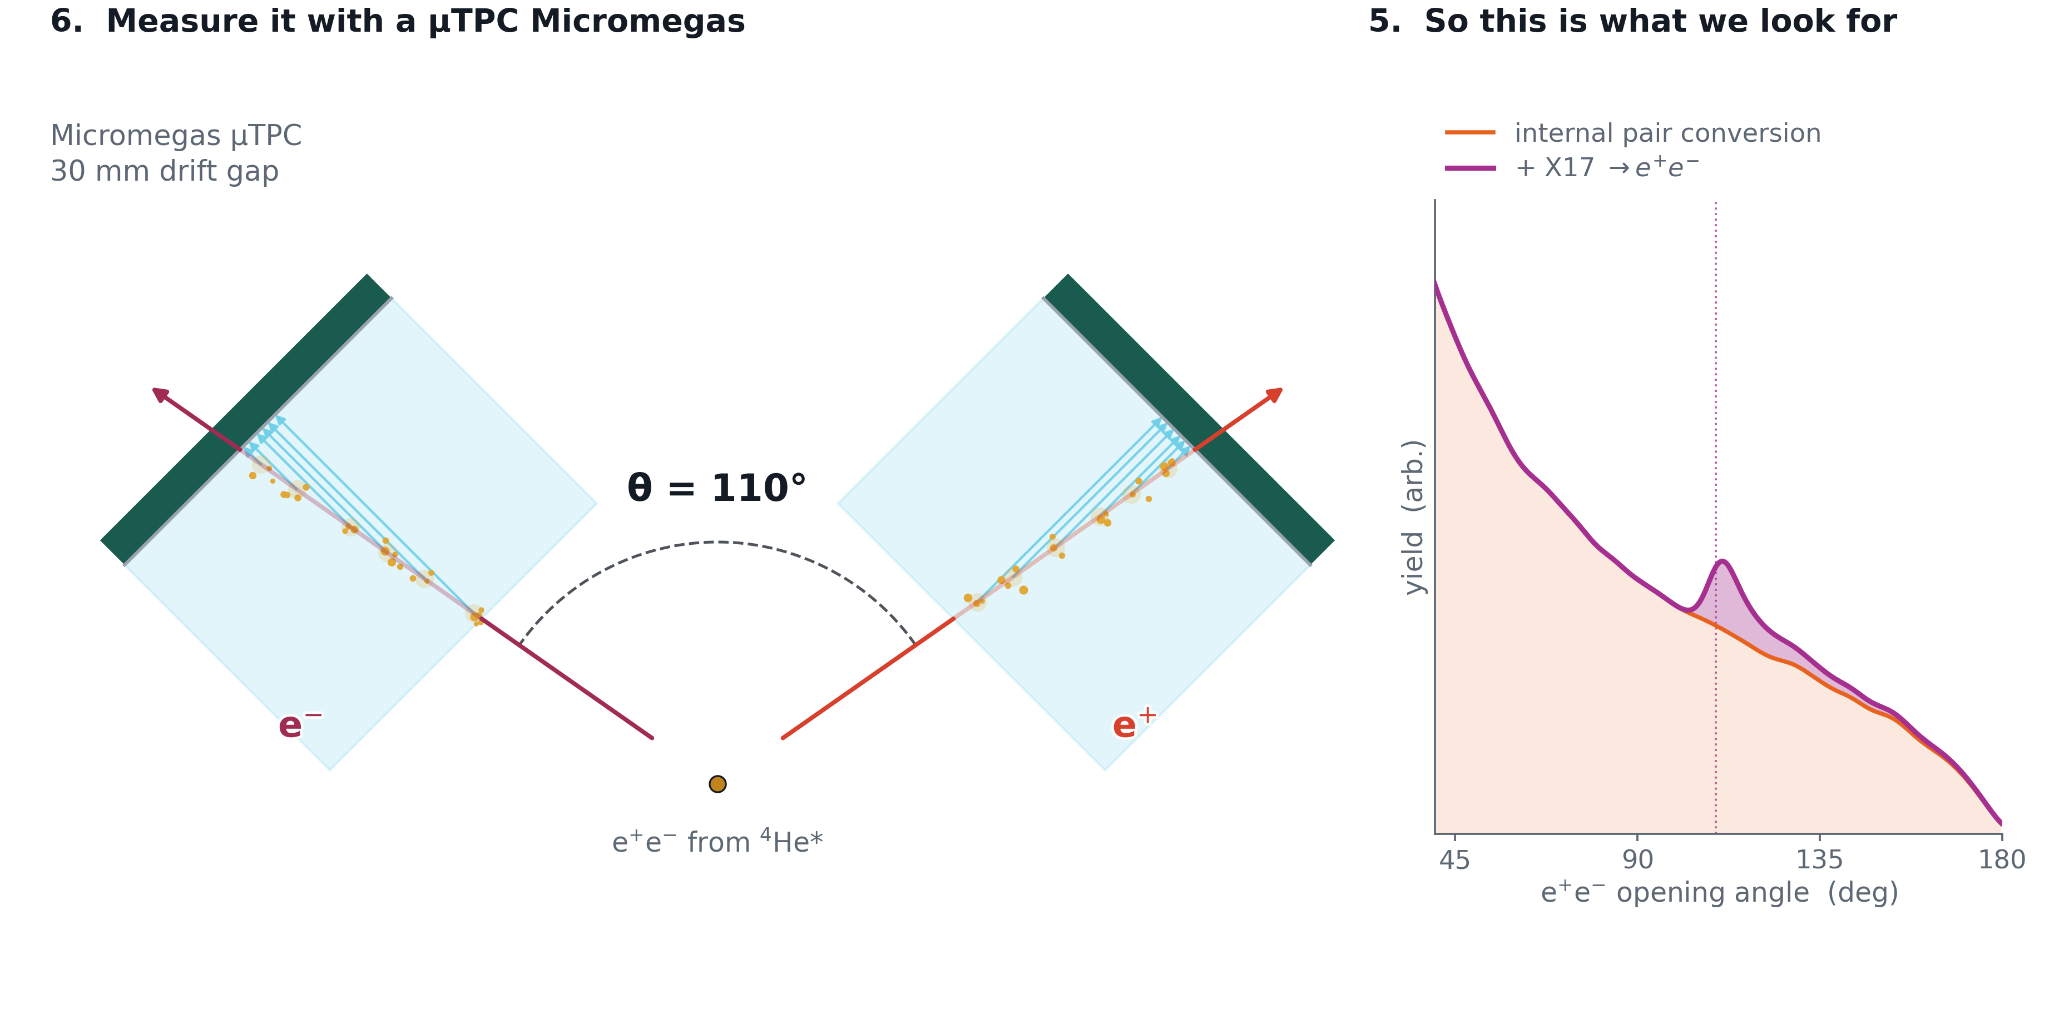
Motivation
The opening angle observable -- X17 moves slow
D. Neff · MPGD 2026, Prague · 3 September 2026
6.3 / 25

Slide 14
The Micromegas µTPC
A large-area resistive-strip detector, built to measure the opening angle of the pair.
D. Neff · MPGD 2026, Prague · 3 September 2026

Slide 15
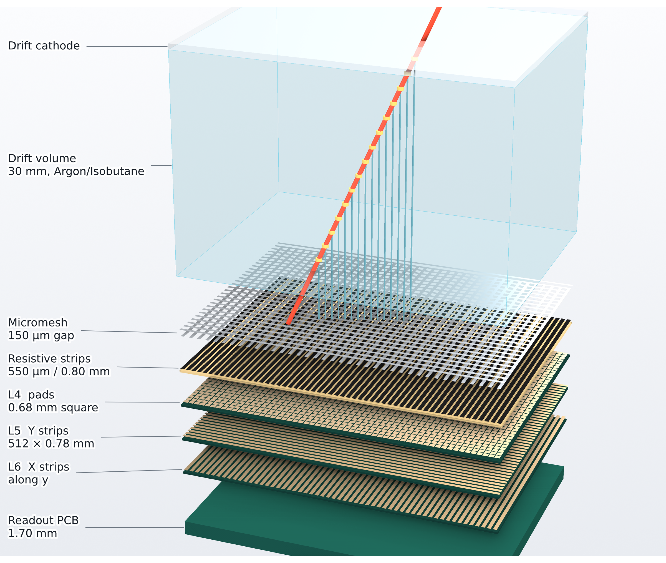
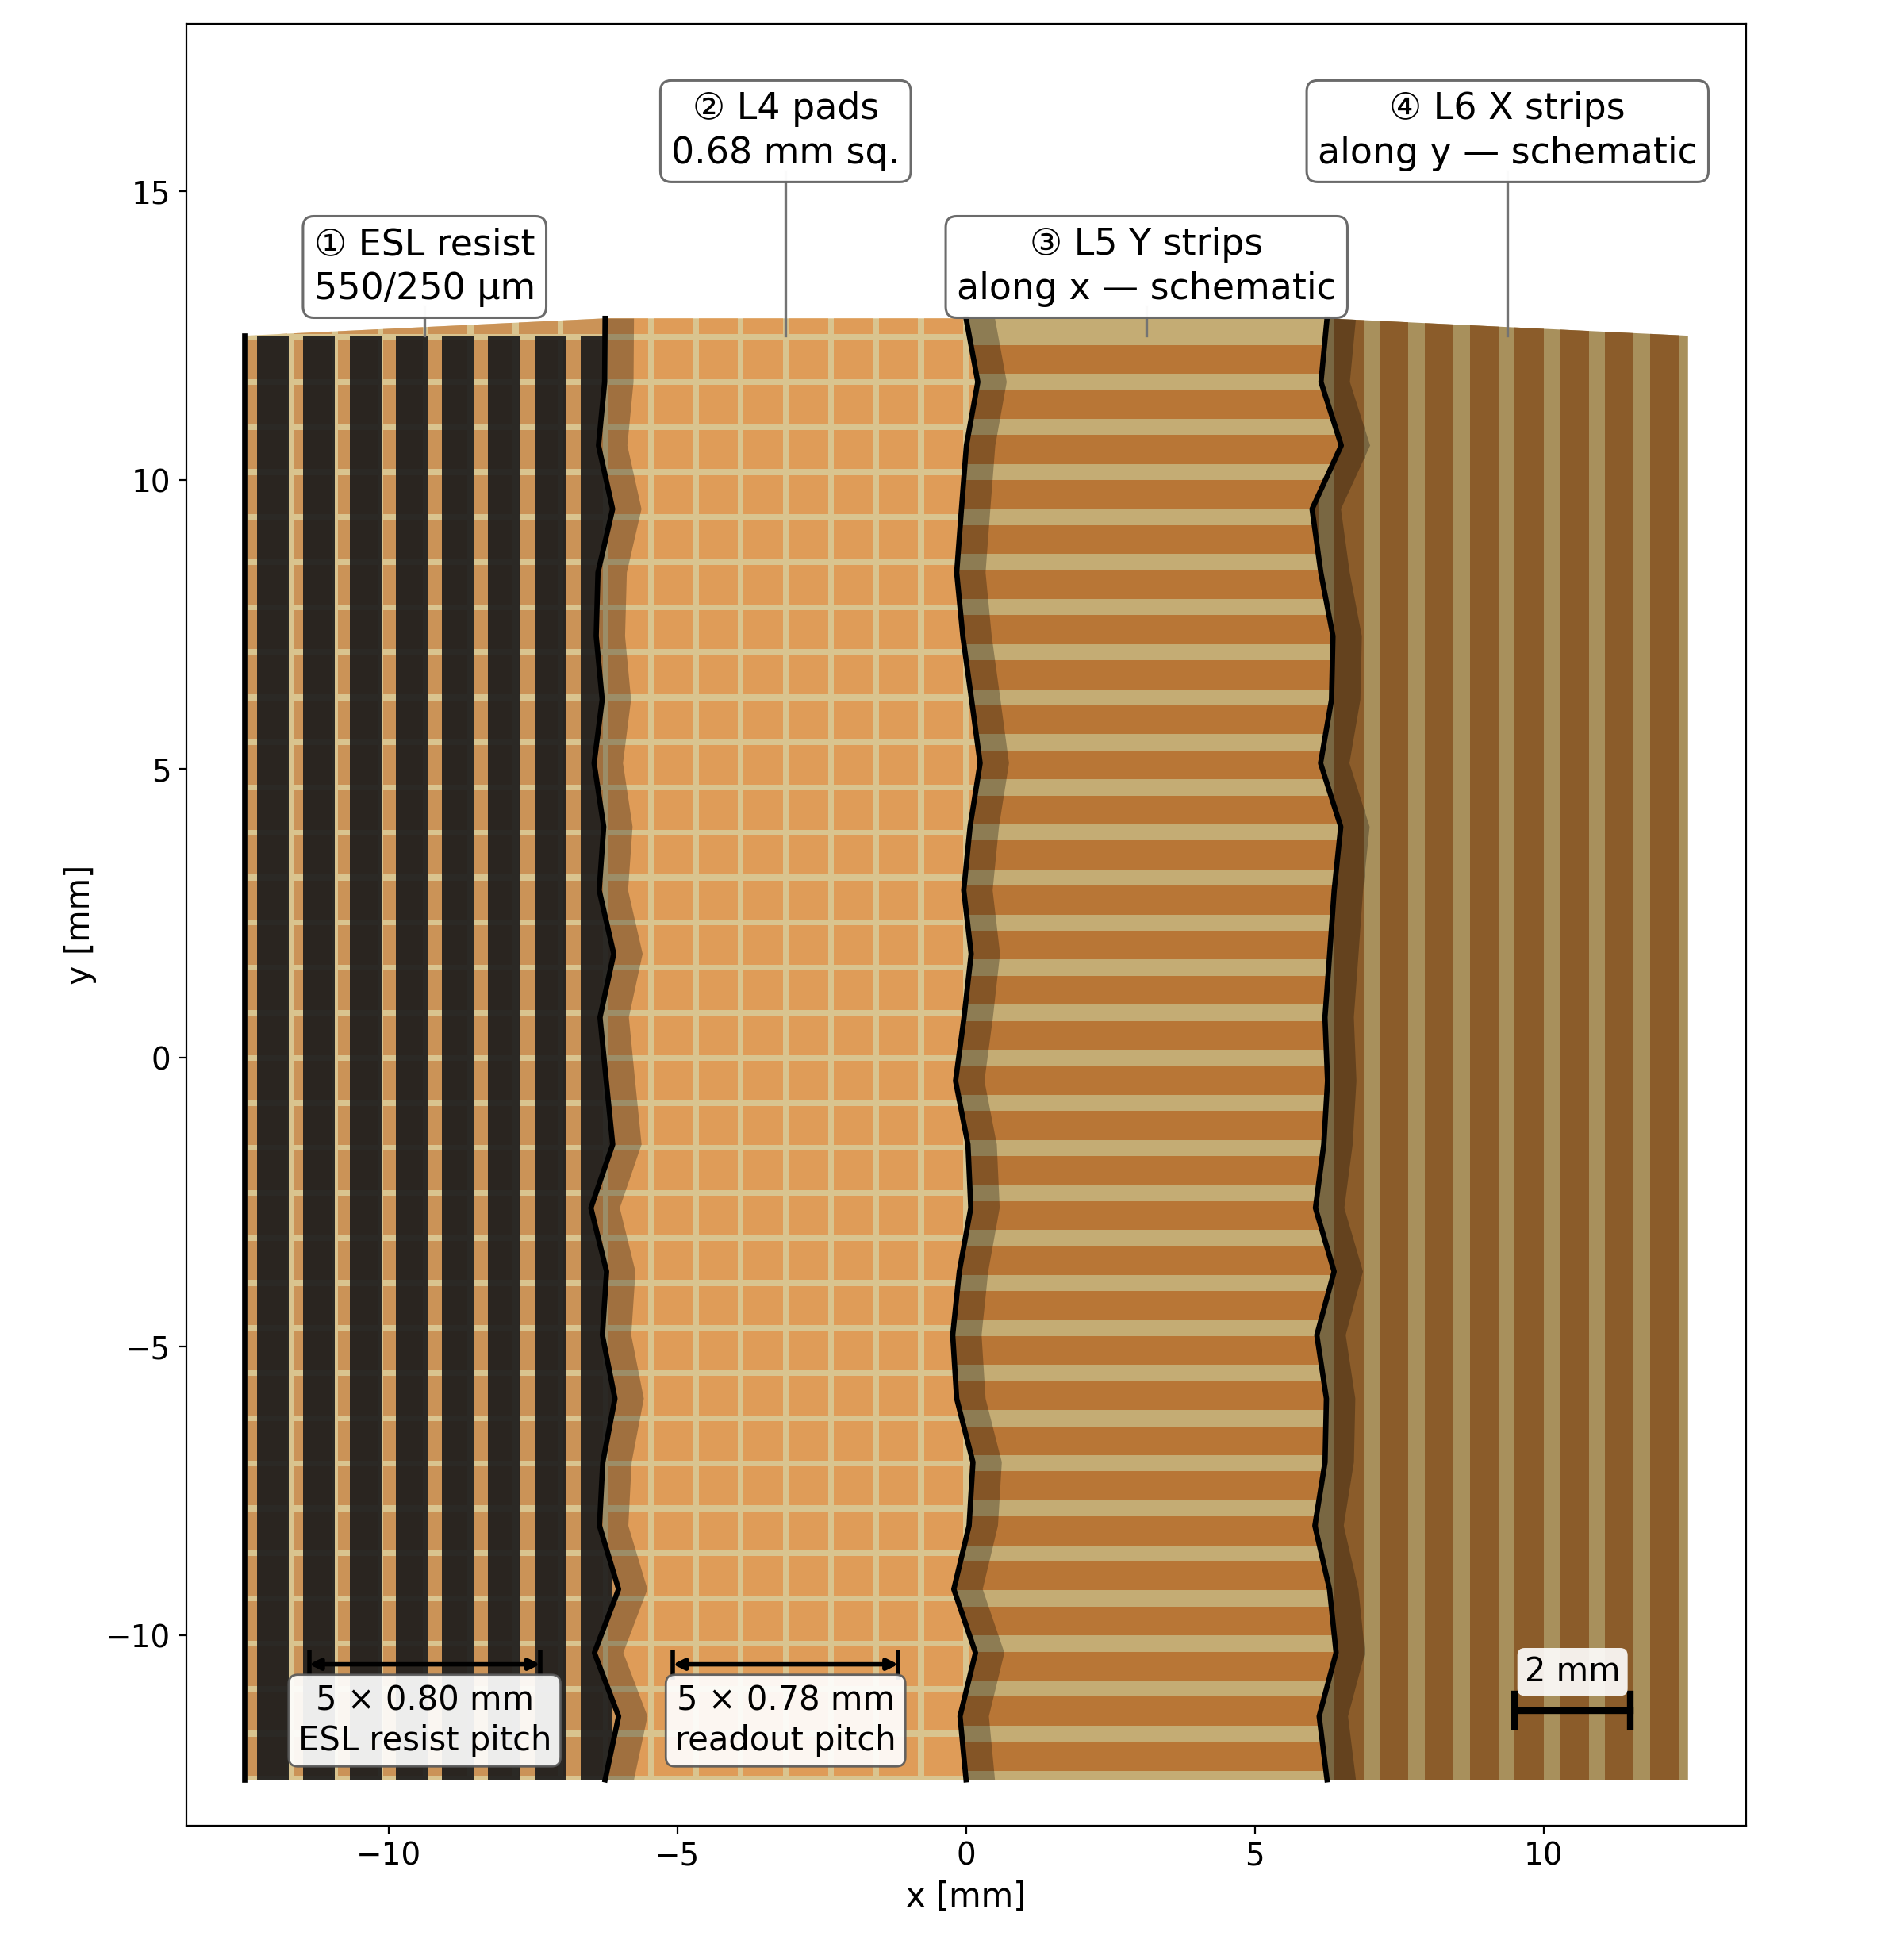
Designed & built at CEA Saclay by
Micromegas micro-TPC · Saclay
Stéphan Aune
The Micromegas μTPC design
One chamber, exploded along the drift axis
a 44 × 34 mm window at the real pitch
MX17 readout board, four layers peeled back
25 × 25 mm of the 470 mm board
D. Neff · MPGD 2026, Prague · 3 September 2026
7 / 25

Slide 16
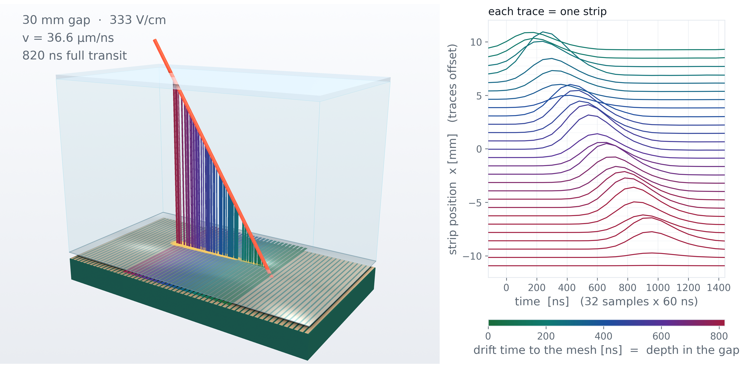
Designed & built at CEA Saclay by
Micromegas micro-TPC · Saclay
Stéphan Aune
Micro-TPC operation
Simulated event
D. Neff · MPGD 2026, Prague · 3 September 2026
8 / 25

Slide 17
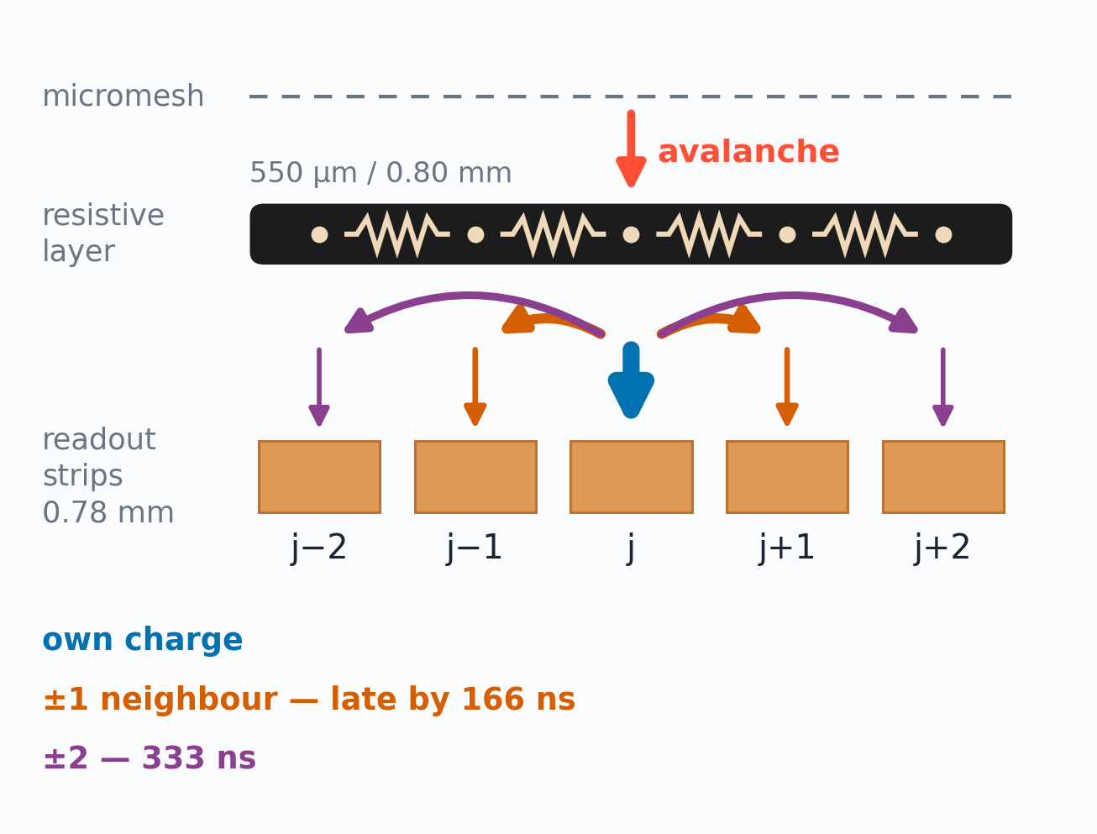
Method inspired by T2K ND280
Attié et al., NIM A 1056 (2023) 168534
Work in progress
Micromegas micro-TPC · Reconstruction
Resistive strips spread and delay charge
What happens on the resistive layer
Charge spreads through the resistive strips
A neighbor’s copy arrives late and dispersed
D. Neff · MPGD 2026, Prague · 3 September 2026
9.1 / 25

Slide 18
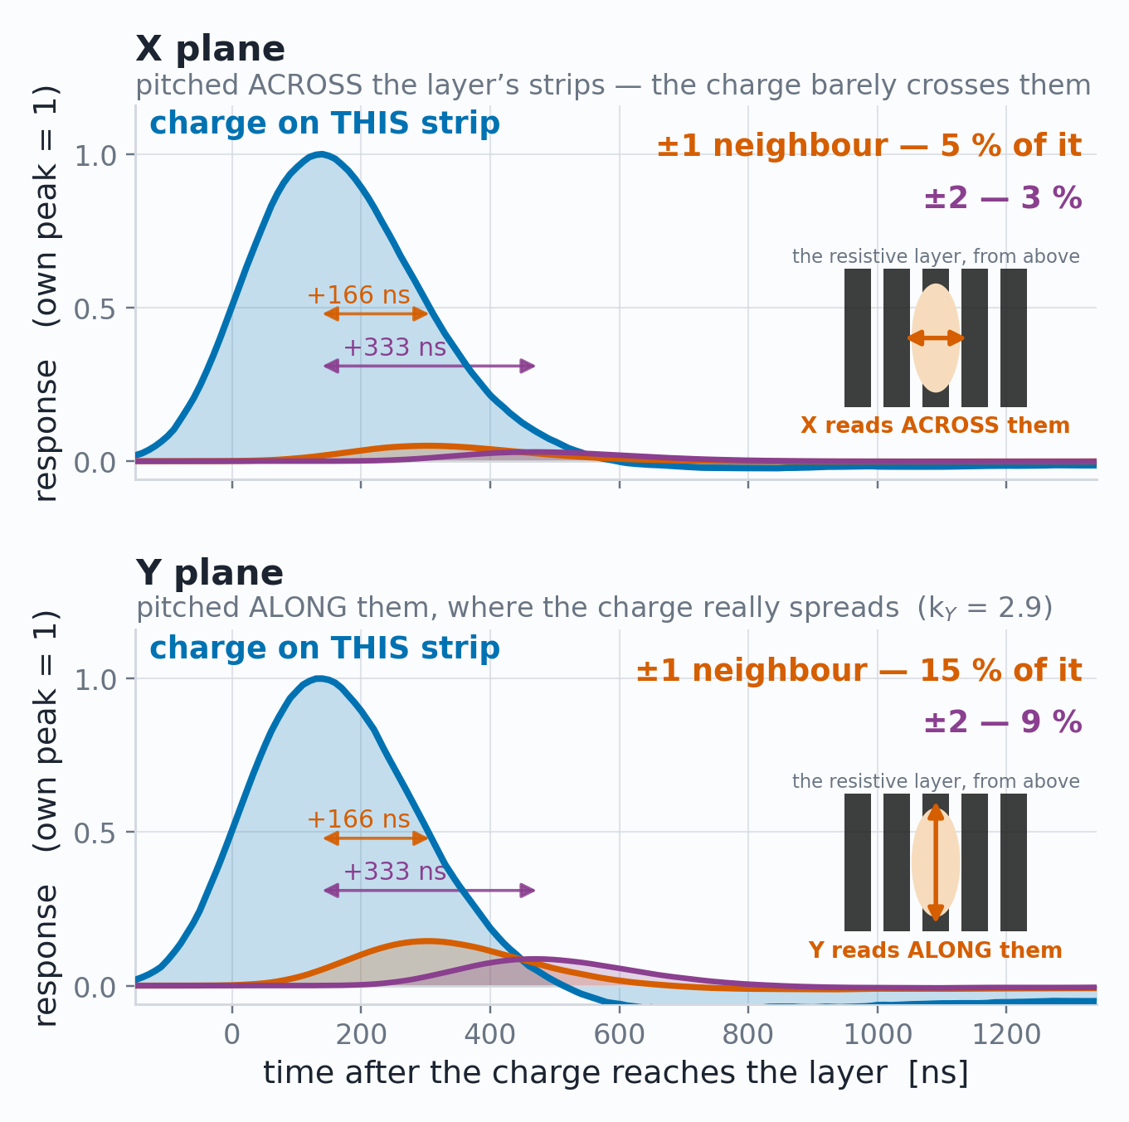
Method inspired by T2K ND280
Attié et al., NIM A 1056 (2023) 168534
Work in progress
Micromegas micro-TPC · Reconstruction
Resistive strips spread and delay charge
What happens on the resistive layer
Charge spreads through the resistive strips
A neighbor’s copy arrives late and dispersed
D. Neff · MPGD 2026, Prague · 3 September 2026
9.2 / 25

Slide 19
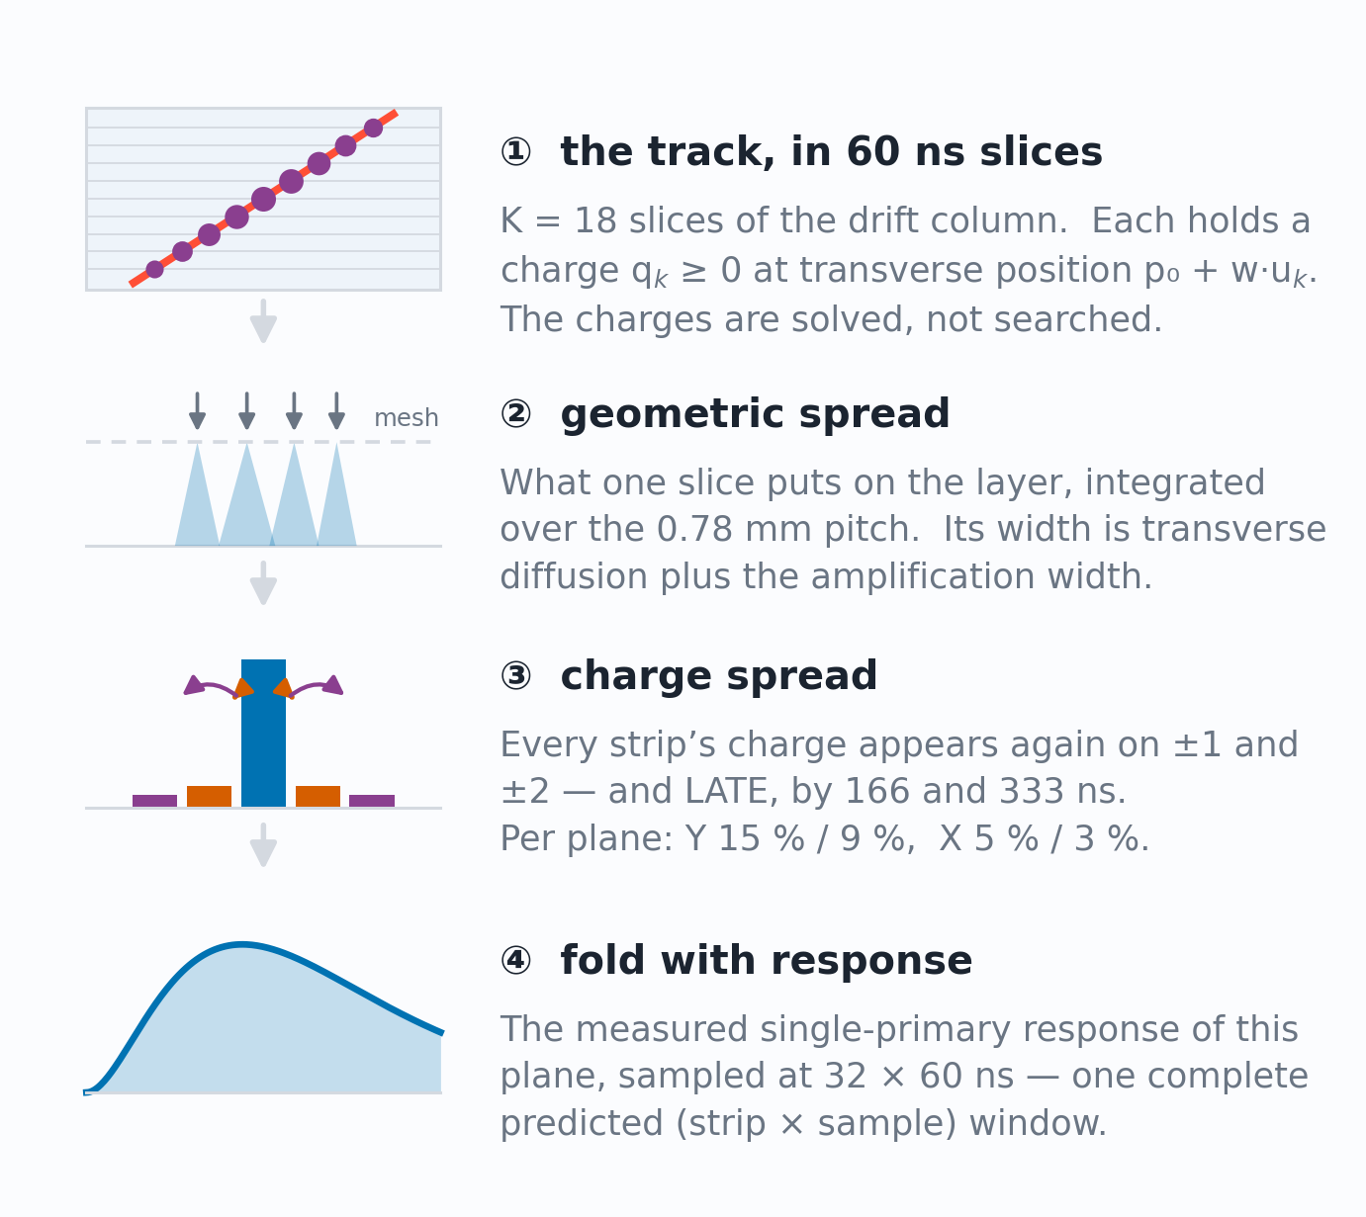
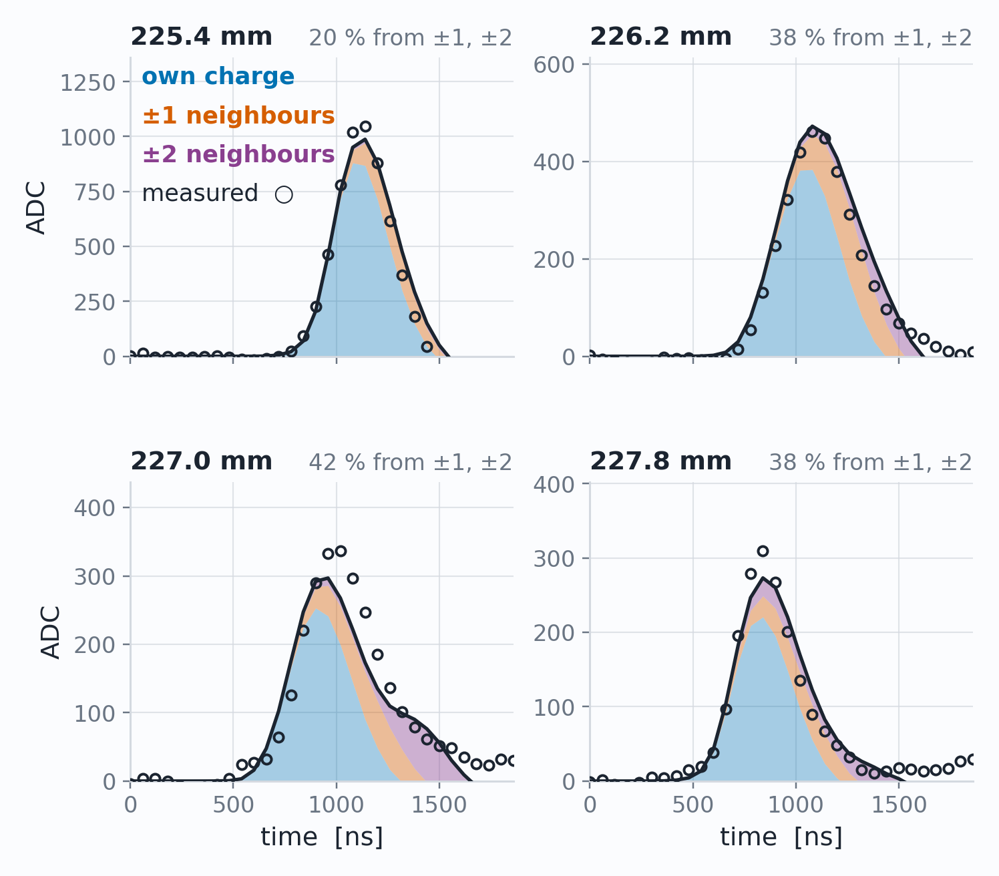
Method inspired by T2K ND280
Attié et al., NIM A 1056 (2023) 168534
Work in progress
Micromegas micro-TPC · Reconstruction
The forward fit: assume a track and predict every waveform
Three numbers are searched:
Mesh arrival position and time (p₀, t₀) and transverse speed (w)
v_{drift} enters once at the end: tan θ = w / v_{drift}
Four consecutive strips of one real muon event
D. Neff · MPGD 2026, Prague · 3 September 2026
10 / 25

Slide 20
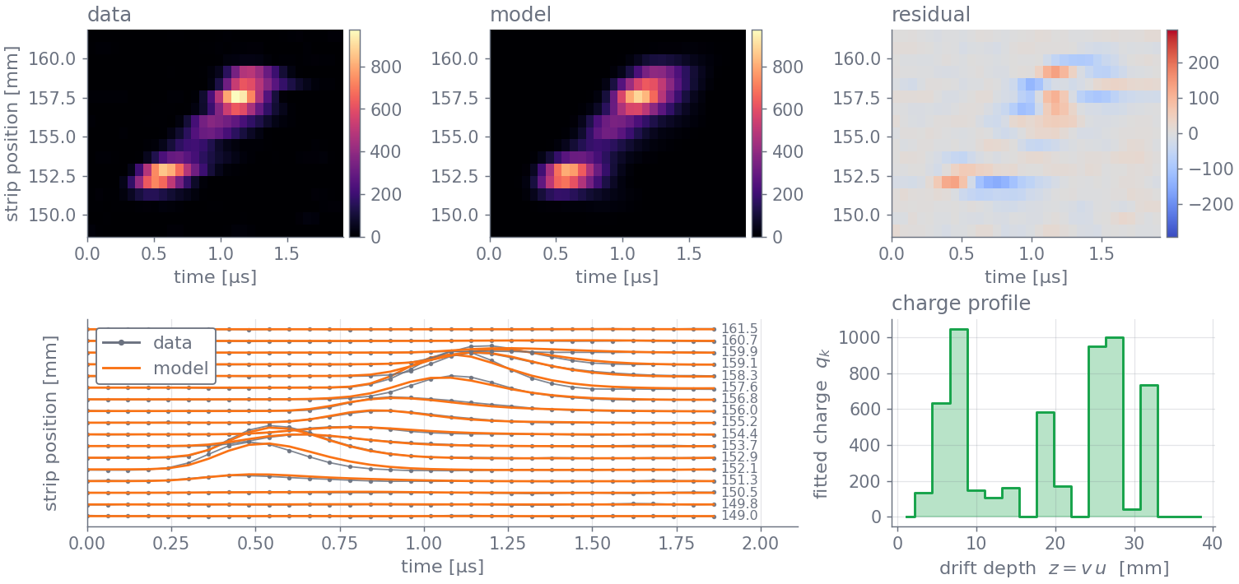
Work in progress
Micromegas micro-TPC · Reconstruction
One muon through the forward fit
D. Neff · MPGD 2026, Prague · 3 September 2026
11 / 25

Slide 21
Characterization
How well the chamber actually performs,
measured with cosmic muons.
D. Neff · MPGD 2026, Prague · 3 September 2026

Slide 22
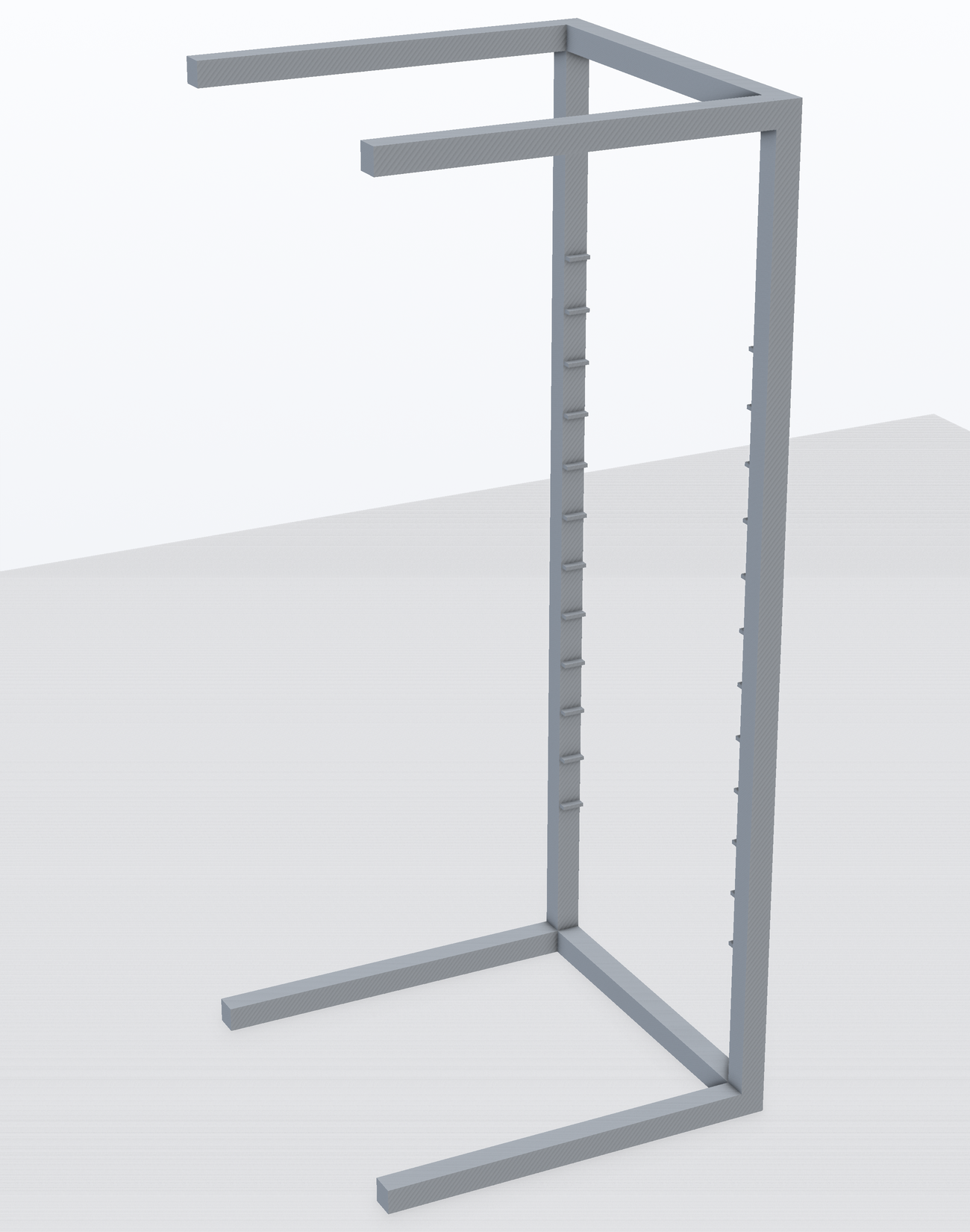
Characterization
Characterization on the Saclay cosmic bench
A cosmic muon fires the scintillators at the top and bottom of the stack.
Four reference Micromegas reconstruct its track; the two MX17 detectors under test sit in between.
D. Neff · MPGD 2026, Prague · 3 September 2026
12.1 / 25

Slide 23
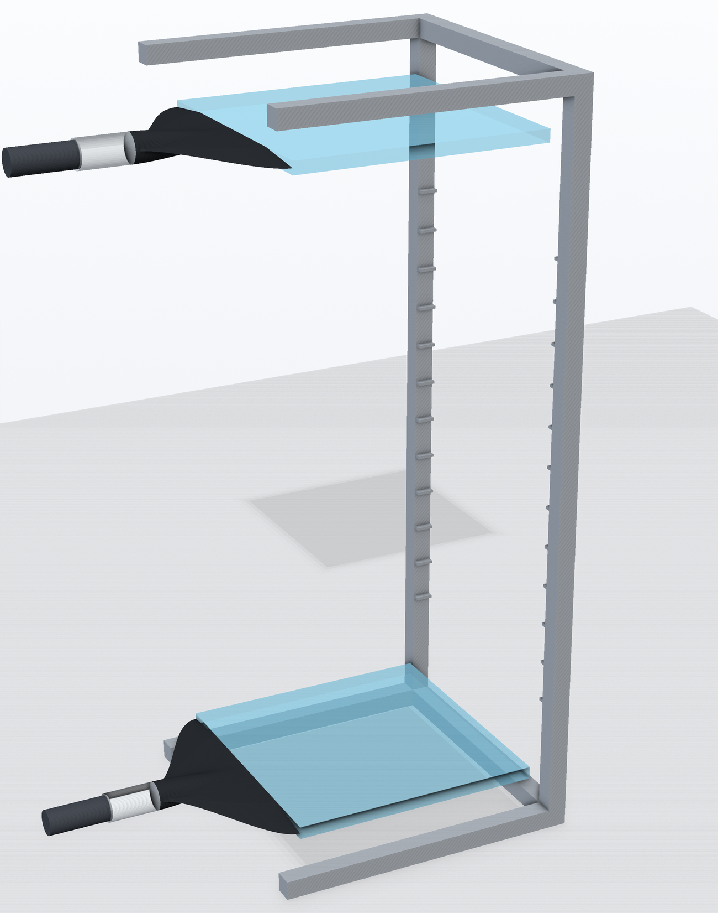
Characterization
Characterization on the Saclay cosmic bench
60 × 60 cm trigger scintillators, top and bottom
A cosmic muon fires the scintillators at the top and bottom of the stack.
Four reference Micromegas reconstruct its track; the two MX17 detectors under test sit in between.
D. Neff · MPGD 2026, Prague · 3 September 2026
12.2 / 25

Slide 24
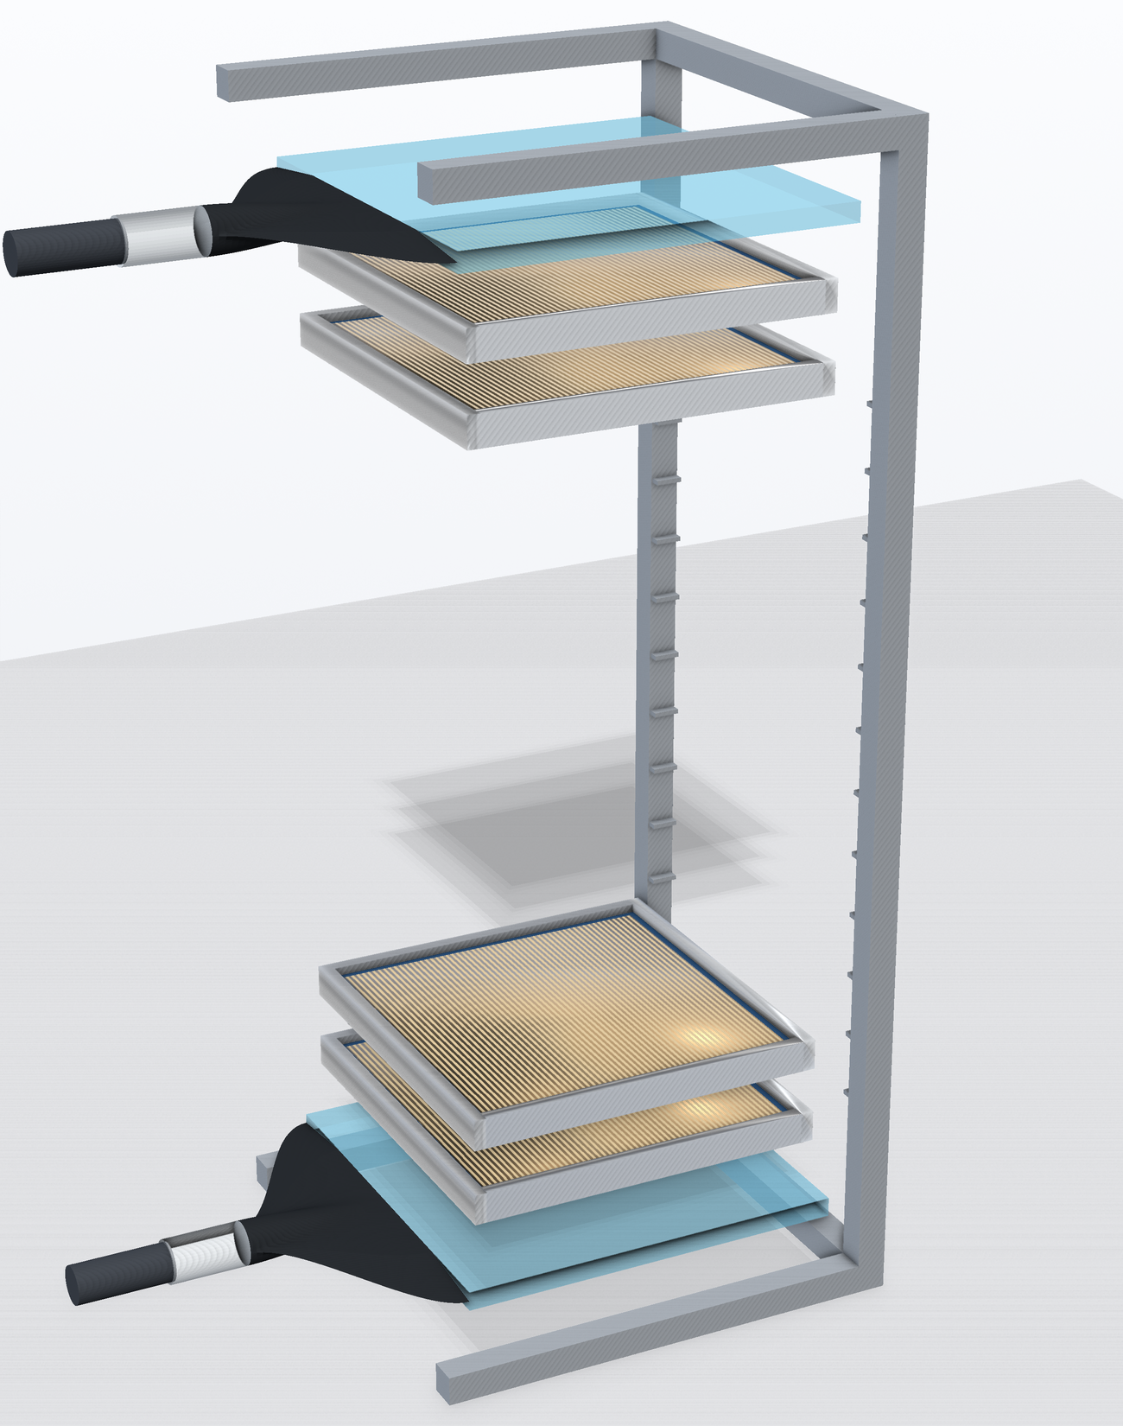
Characterization
Characterization on the Saclay cosmic bench
60 × 60 cm trigger scintillators, top and bottom
50 × 50 cm Micromegas reference trackers, four of them
A cosmic muon fires the scintillators at the top and bottom of the stack.
Four reference Micromegas reconstruct its track; the two MX17 detectors under test sit in between.
D. Neff · MPGD 2026, Prague · 3 September 2026
12.3 / 25

Slide 25
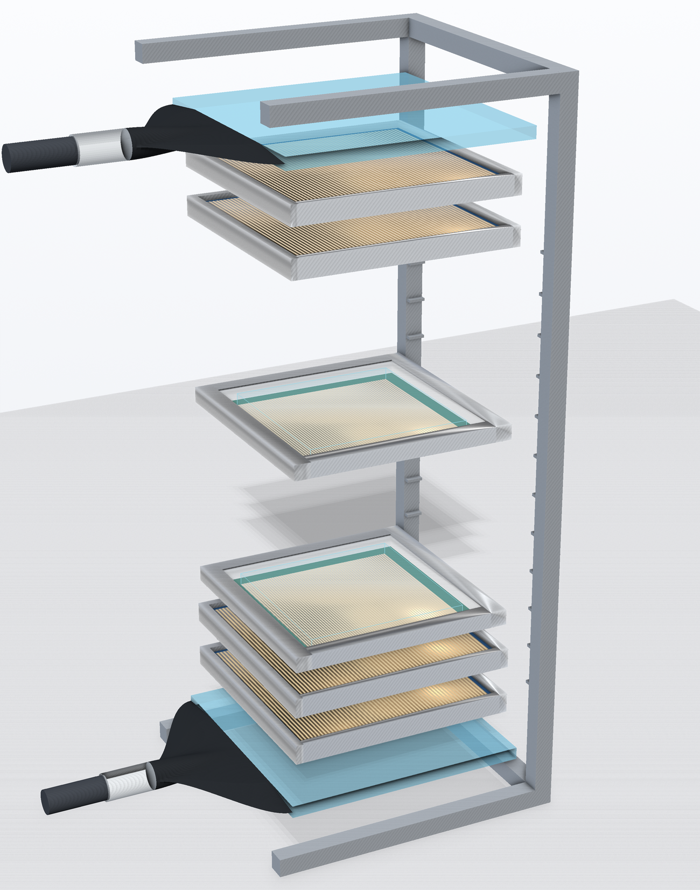
Characterization
Characterization on the Saclay cosmic bench
60 × 60 cm trigger scintillators, top and bottom
50 × 50 cm Micromegas reference trackers, four of them
A cosmic muon fires the scintillators at the top and bottom of the stack.
Four reference Micromegas reconstruct its track; the two MX17 detectors under test sit in between.
40 × 40 cm µTPC chambers — the ones being characterized
D. Neff · MPGD 2026, Prague · 3 September 2026
12.4 / 25

Slide 26
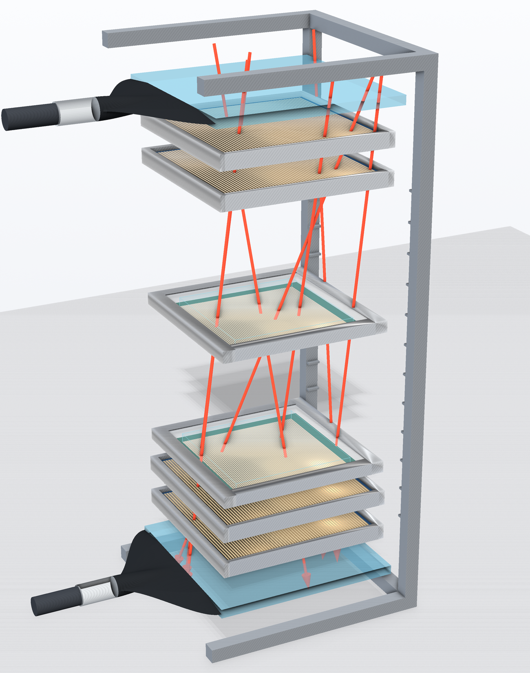
Characterization
Characterization on the Saclay cosmic bench
60 × 60 cm trigger scintillators, top and bottom
50 × 50 cm Micromegas reference trackers, four of them
A cosmic muon fires the scintillators at the top and bottom of the stack.
Four reference Micromegas reconstruct its track; the two MX17 detectors under test sit in between.
40 × 40 cm µTPC chambers — the ones being characterized
Cosmic muons — two slots measured at once, against the same reference
D. Neff · MPGD 2026, Prague · 3 September 2026
12.5 / 25

Slide 27
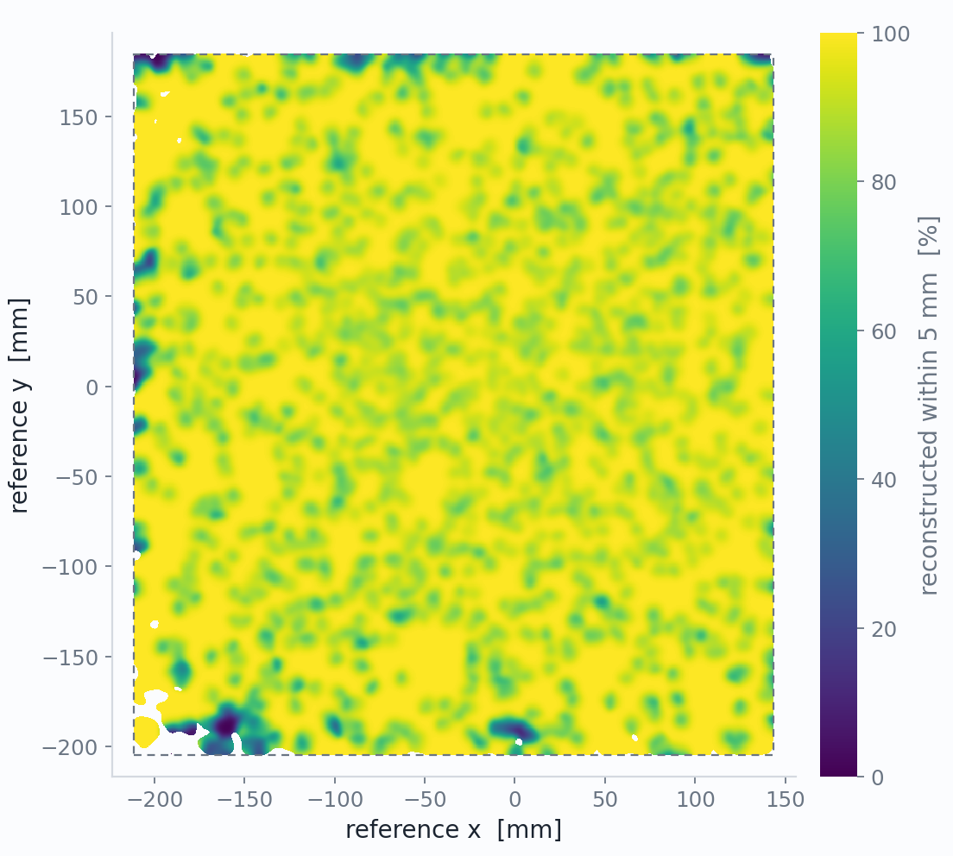
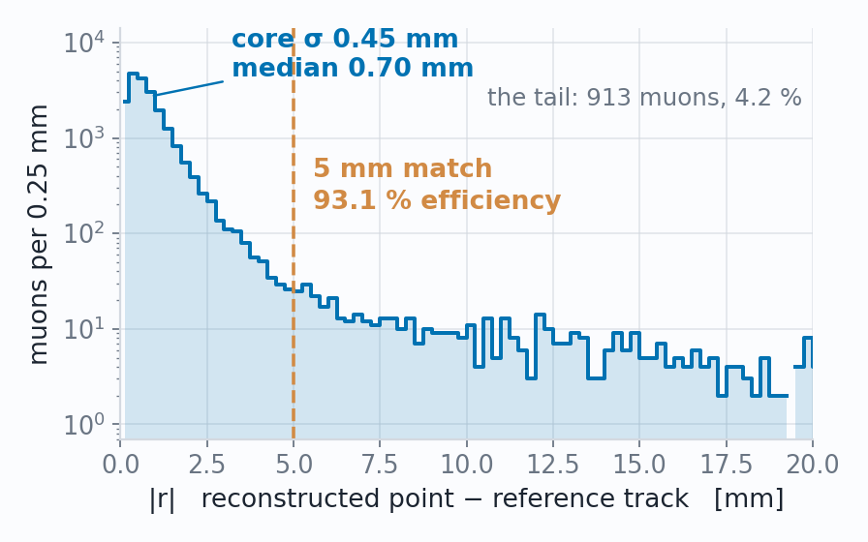
Work in progress
Characterization
Efficiency: 93% on the best chamber
Where every crossing muon goes
Flat across the chamber face
a circle swept over the face, 500 µm at a time
Reconstructed within 5 mm
93.1% 20,428
the efficiency
Detected, point >5 mm off
4.2% 913
the near-miss tail†
Discharged during the muon
2.6% 563
many strips fire uncorrelated with muon
Fired, no valid X+Y point
0.2% 46
Silent — no signal at all
0.01% 3
genuine blindness
WHY 0.45 mm
Reference trackers resolve to ~500 µm
D. Neff · MPGD 2026, Prague · 3 September 2026
13 / 25

Slide 28
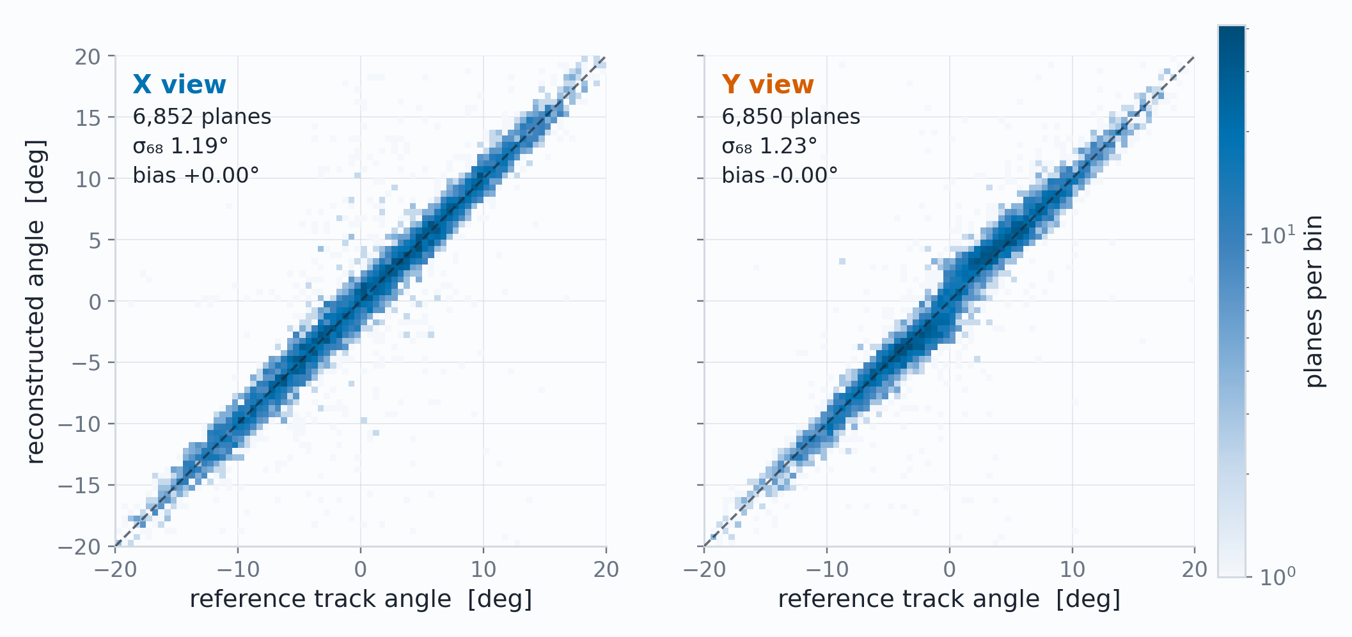
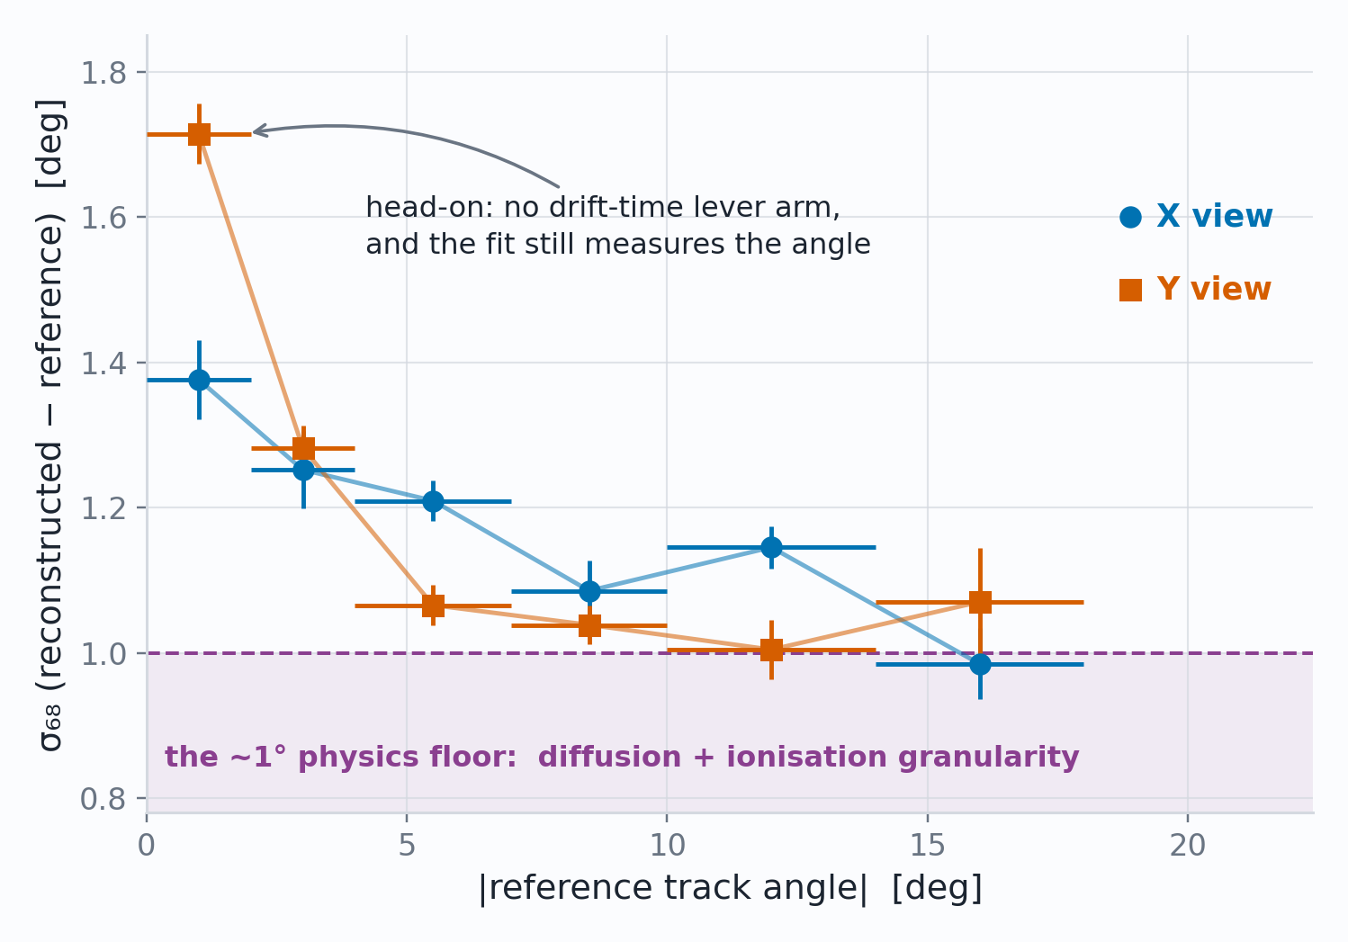
Work in progress
Characterization
Adequate angular, spatial and temporal resolution
Reconstructed against reference, per plane
Head on tracks reasonable and angled tracks approach physics floor
1.19 / 1.23°
180 µm
33 ns
angle per plane, X / Y (σ₆₈), bias < 0.1°
position at normal incidence, ±0.035 mm conservatively
plane-to-plane timing, ≈ 1.1 mm of drift
D. Neff · MPGD 2026, Prague · 3 September 2026
14 / 25

Slide 29
The n_TOF Search
Four of these chambers, on a high intensity neutron beam at EAR2.
D. Neff · MPGD 2026, Prague · 3 September 2026

Slide 30
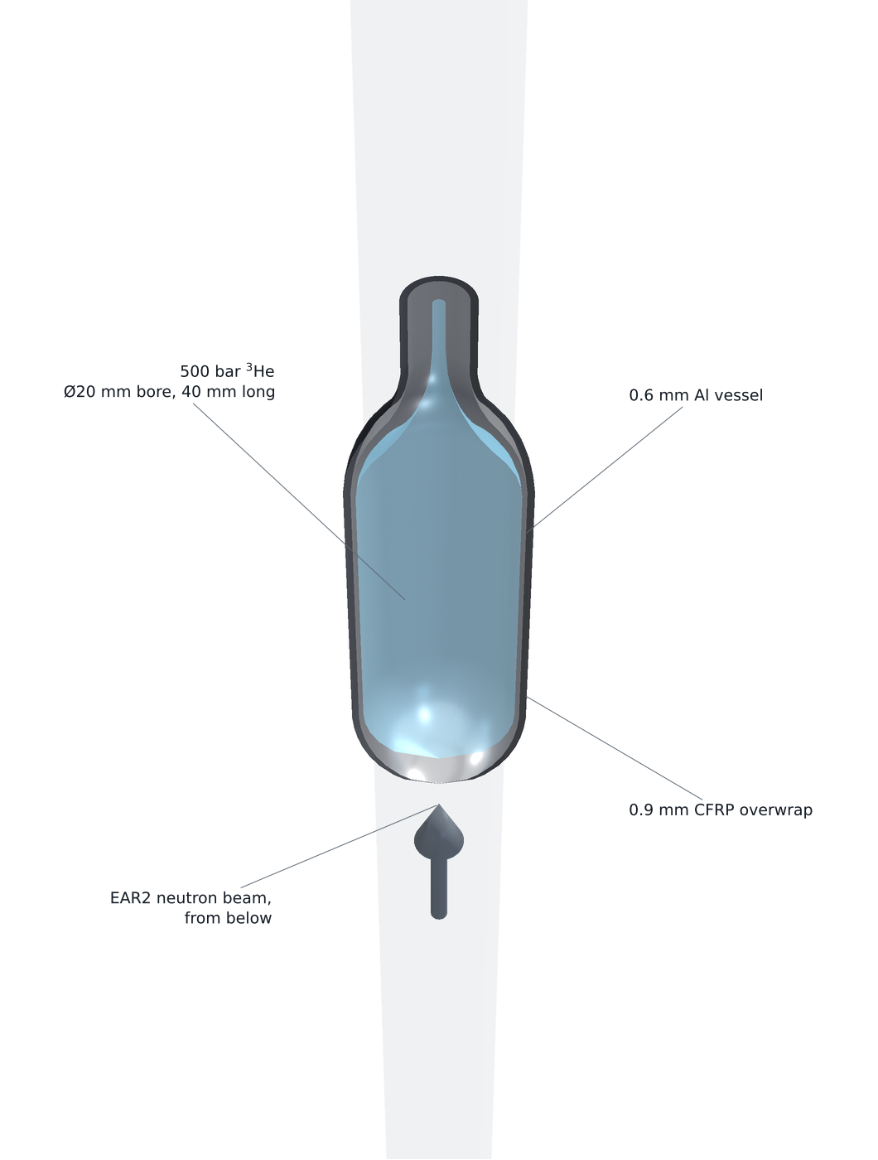
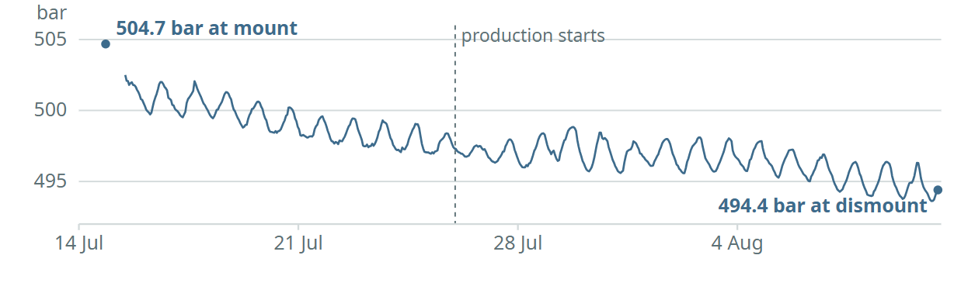
X17 search at n_TOF · Experimental setup
The vessel, as built: 500 bar of ³He in the beam
500 bar ³He
Ø20 mm bore,
40 mm long
0.6 mm Al
vessel
500 bar of ³He in as thin a capsule as we can build — least scattering on the way out, most interaction on the way in.
Ø20 mm bore, 40 mm of gas, domed both ends —
walls of 0.6 mm Al + 0.9 mm CFRP.
0.9 mm CFRP
overwrap
EAR2 neutron beam,
from below
D. Neff · MPGD 2026, Prague · 3 September 2026
15.1 / 25

Slide 31
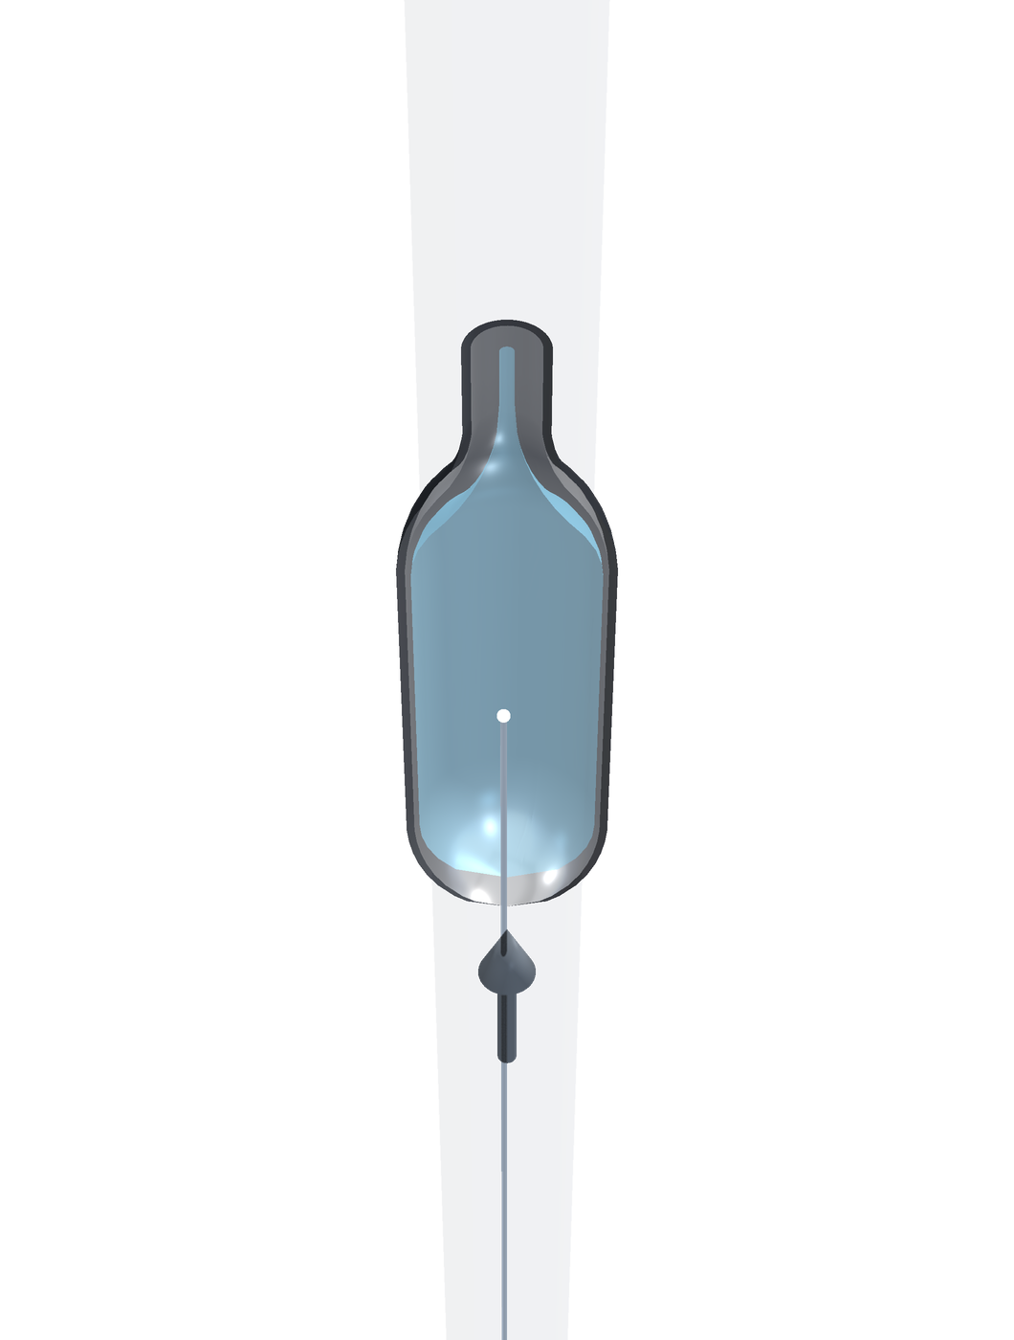
X17 search at n_TOF · Experimental setup
A neutron arrives
500 bar of ³He in as thin a capsule as we can build — least scattering on the way out, most interaction on the way in.
The neutron beam arrives from below and interacts in the ³He gas volume.
D. Neff · MPGD 2026, Prague · 3 September 2026
15.2 / 25

Slide 32
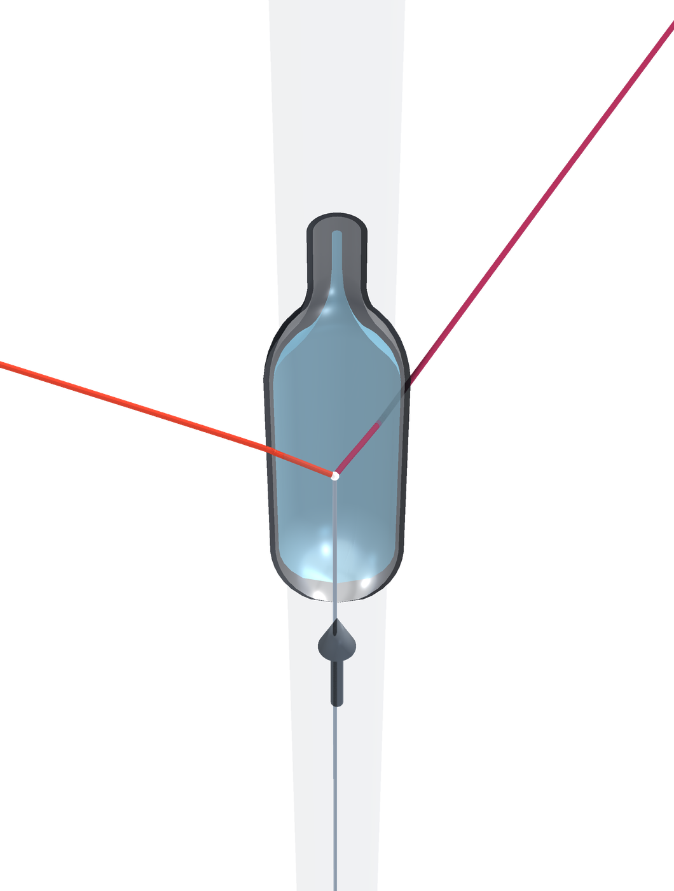
X17 search at n_TOF · Experimental setup
…and a pair leaves
500 bar of ³He in as thin a capsule as we can build — least scattering on the way out, most interaction on the way in.
The neutron beam arrives from below and interacts in the ³He gas volume.
Some probability of internal pair conversion — or of X17 → e⁺e⁻ — leaving the capsule, with some scattering in its wall.
e⁻
e⁺
neutron
beam
D. Neff · MPGD 2026, Prague · 3 September 2026
15.3 / 25

Slide 33
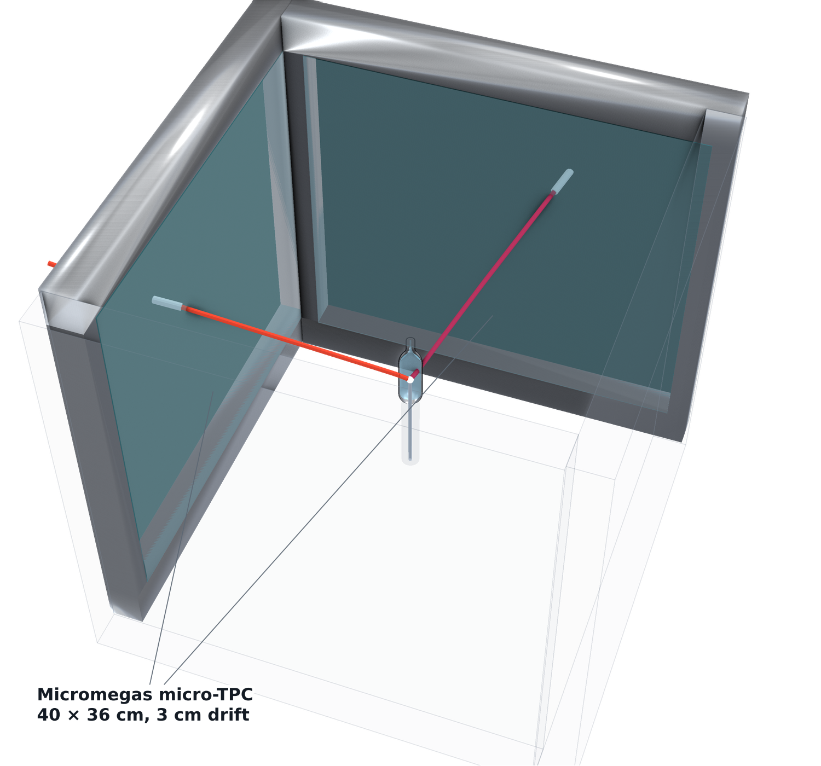
X17 search at n_TOF · Experimental setup
Now build something that can catch them
Reduce material budget until the track angles have been recorded with four Micromegas µTPCs
D. Neff · MPGD 2026, Prague · 3 September 2026
15.4 / 25

Slide 34
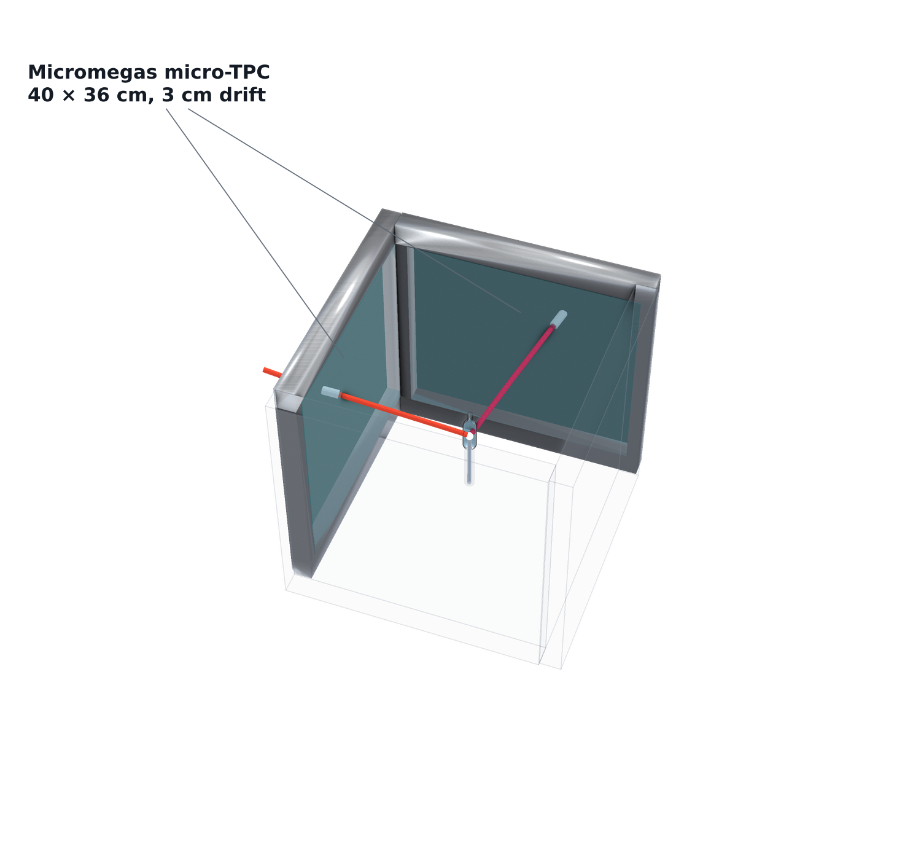
X17 search at n_TOF · Experimental setup
+ four Micromegas micro-TPCs
Reduce material budget until the track angles have been recorded with four Micromegas µTPCs
Need an external trigger for these trackers
D. Neff · MPGD 2026, Prague · 3 September 2026
15.5 / 25

Slide 35
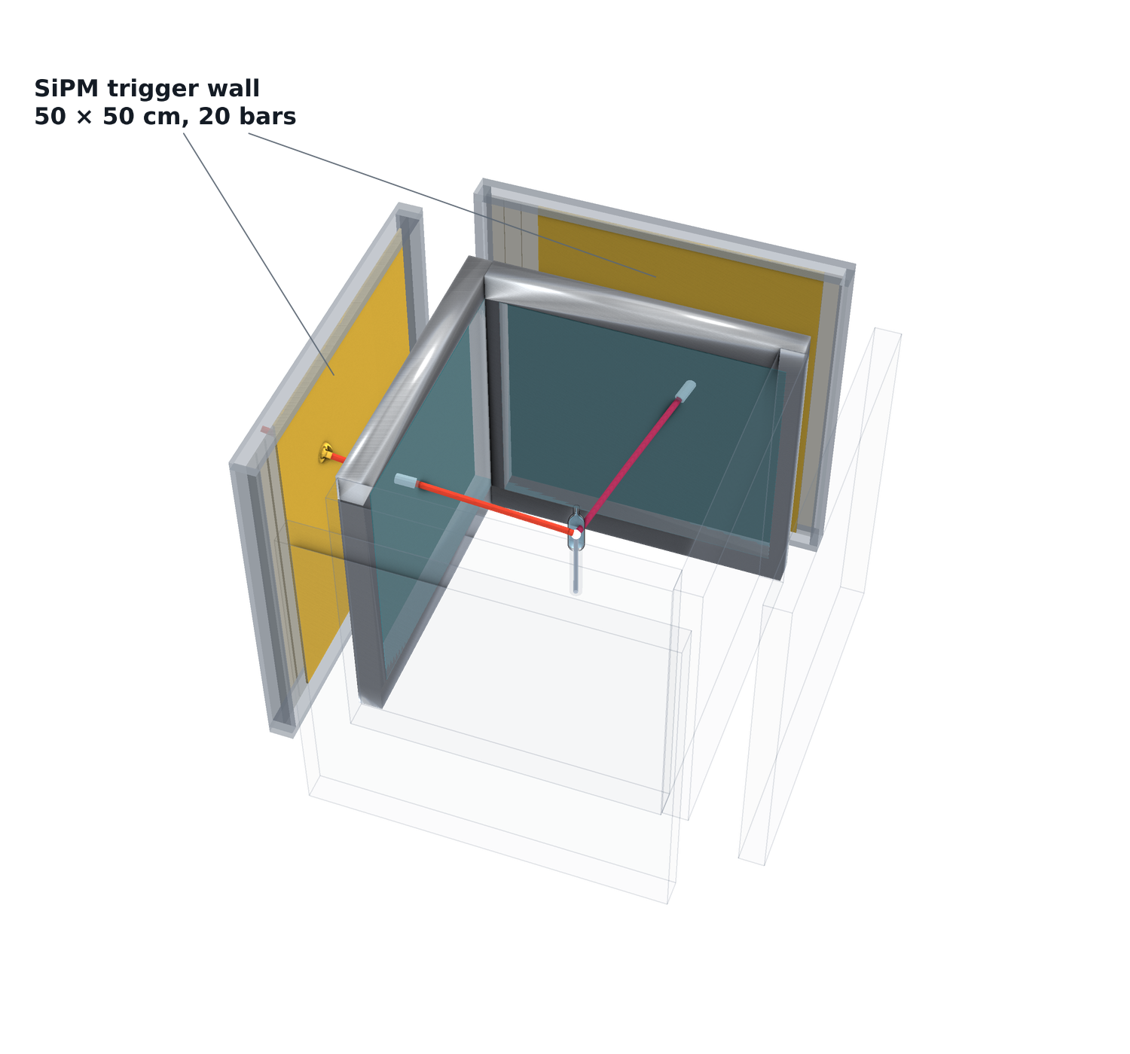
X17 search at n_TOF · Experimental setup
+ the SiPM trigger wall
Reduce material budget until the track angles have been recorded with four Micromegas µTPCs
Need an external trigger for these trackers
Thin vertical scintillator bars readout by SiPMs: register the hit without stopping the electron or the positron. Precise timing.
D. Neff · MPGD 2026, Prague · 3 September 2026
15.6 / 25

Slide 36
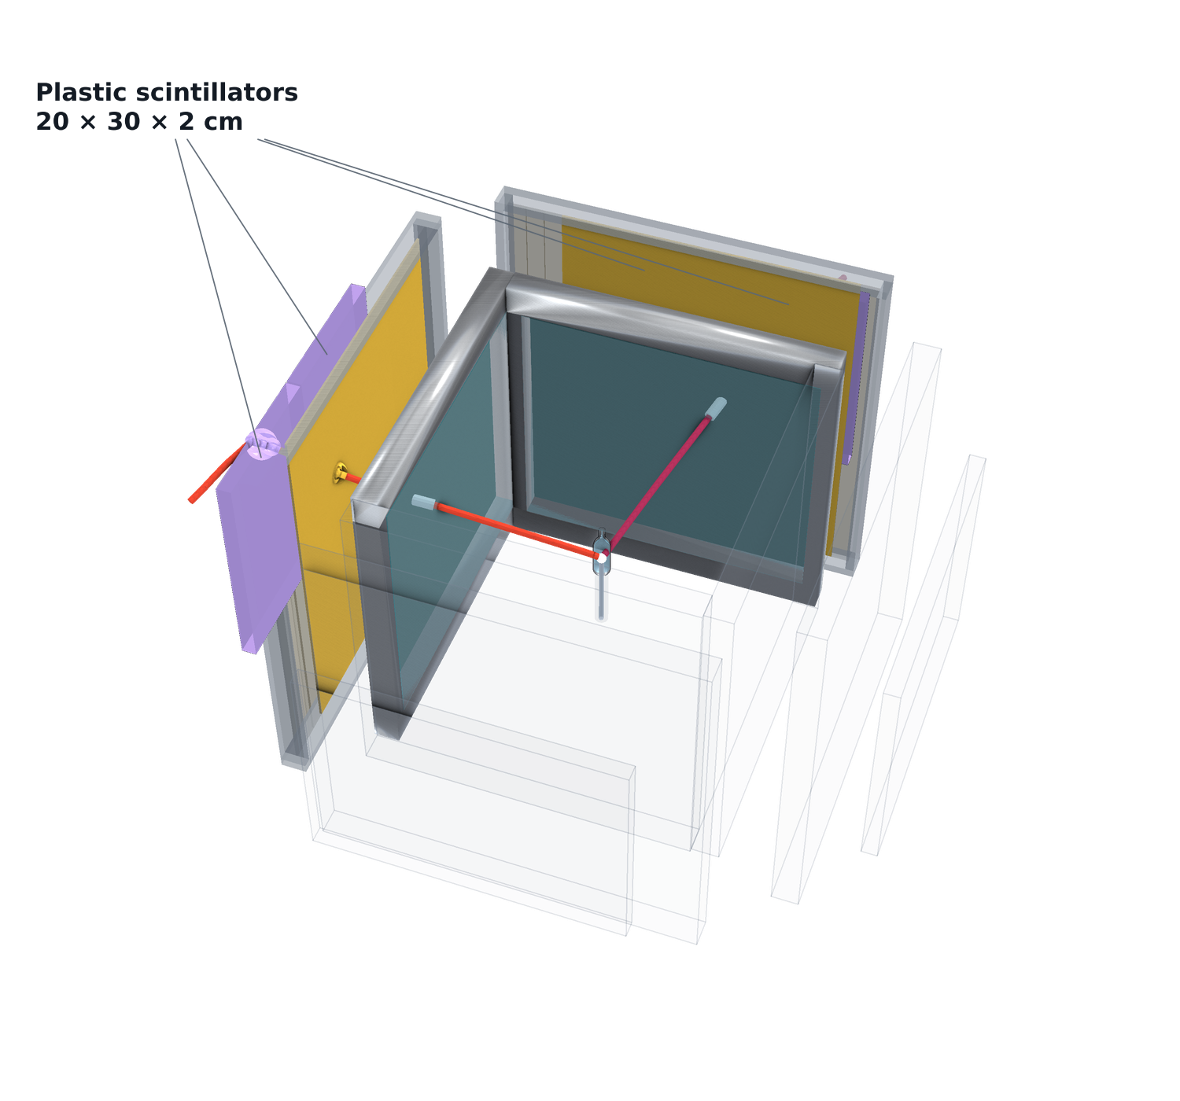
X17 search at n_TOF · Experimental setup
+ the plastic scintillators
Reduce material budget until the track angles have been recorded with four Micromegas µTPCs
Need an external trigger for these trackers
Thin vertical scintillator bars readout by SiPMs: register the hit without stopping the electron or the positron. Precise timing.
2cm thick plastic scintillators complete the coincidence with the trigger wall.
D. Neff · MPGD 2026, Prague · 3 September 2026
15.7 / 25

Slide 37
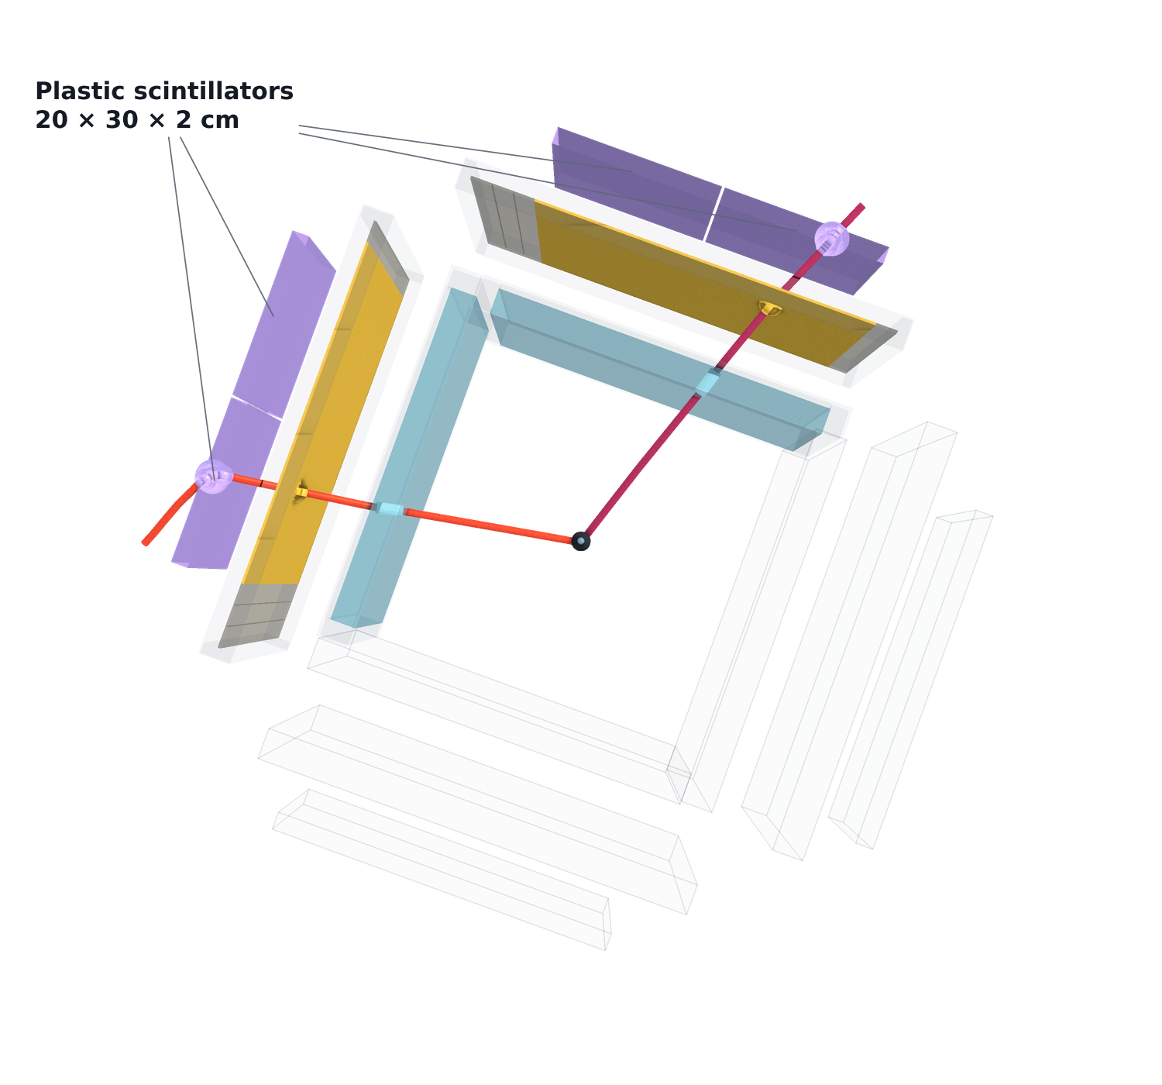
X17 search at n_TOF · Experimental setup
The same event from above — where the pair goes
Reduce material budget until the track angles have been recorded with four Micromegas µTPCs
Need an external trigger for these trackers
Thin vertical scintillator bars readout by SiPMs: register the hit without stopping the electron or the positron. Precise timing.
2cm thick plastic scintillators complete the coincidence with the trigger wall.
Also provides stopping for calorimetry
D. Neff · MPGD 2026, Prague · 3 September 2026
15.8 / 25

Slide 38
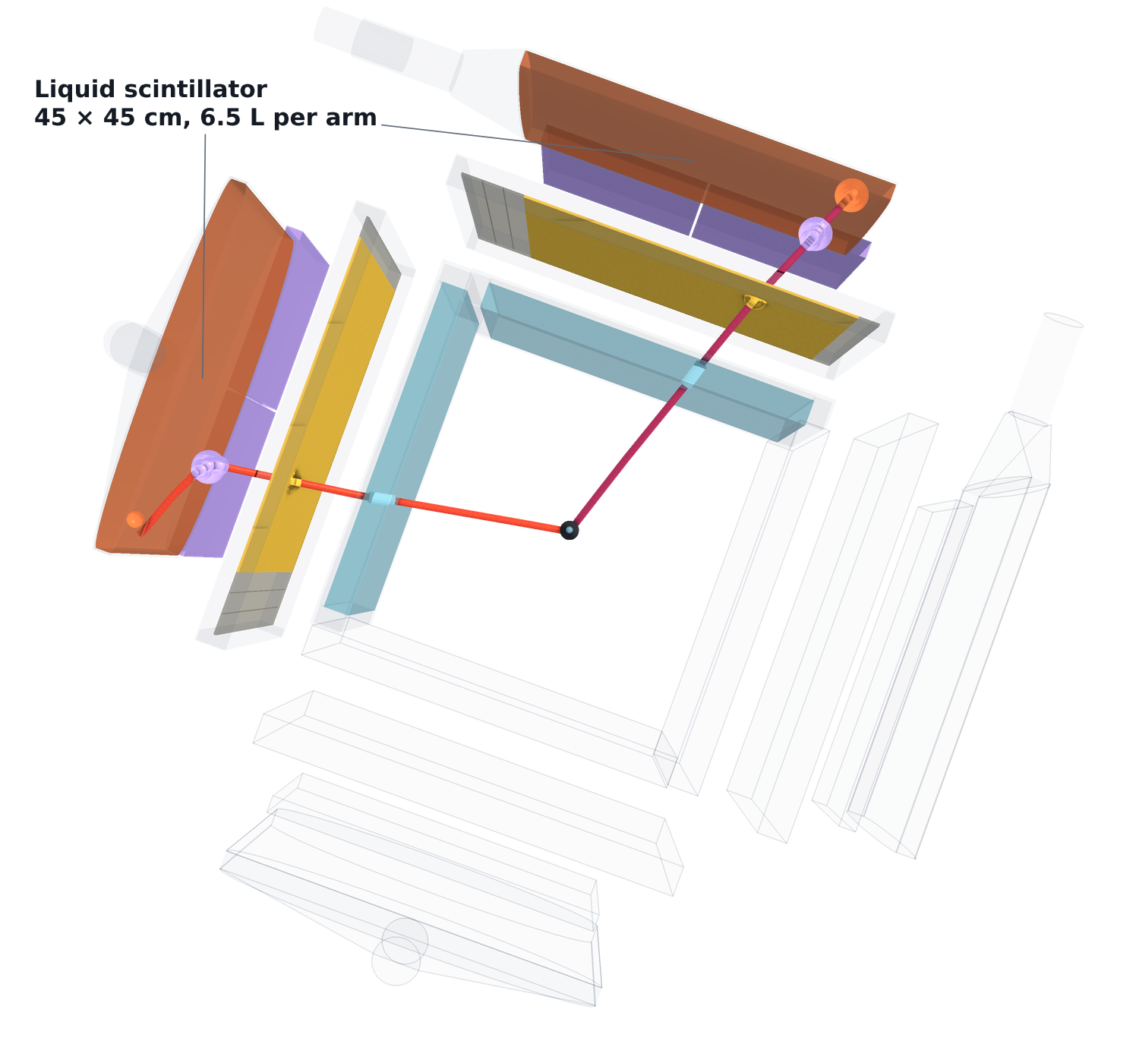
X17 search at n_TOF · Experimental setup
+ liquid-scintillator calorimetry — the full setup
Reduce material budget until the track angles have been recorded with four Micromegas µTPCs
Need an external trigger for these trackers
Thin vertical scintillator bars readout by SiPMs: register the hit without stopping the electron or the positron. Precise timing.
2cm thick plastic scintillators complete the coincidence with the trigger wall.
Also provides stopping for calorimetry
Add 2cm of liquid scintillator to stop the pair completely
D. Neff · MPGD 2026, Prague · 3 September 2026
15.9 / 25

Slide 39
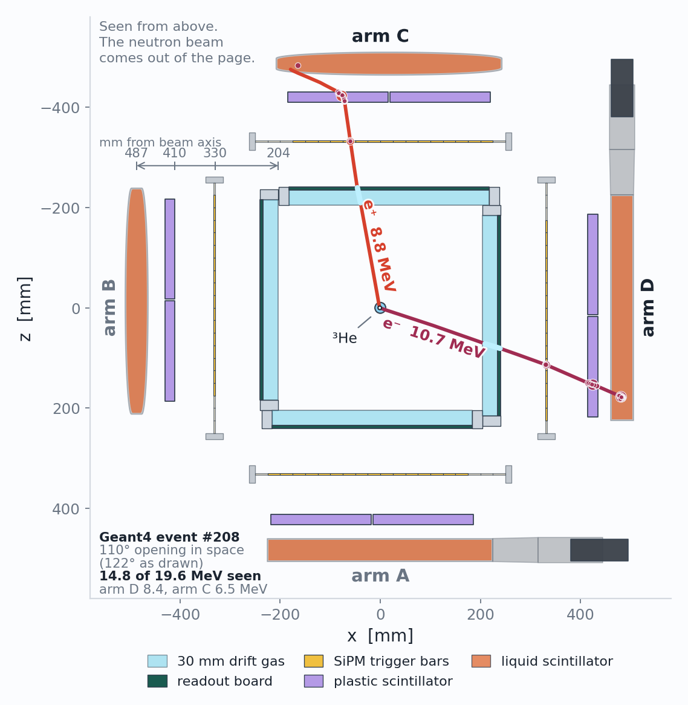
X17 search at n_TOF · Experimental setup
The same setup from above
Opening angle from the Micromegas, before anything else touches the pair.
Trigger and timing from the wall and the plastics.
Calorimetry from the full scintillator stack.
D. Neff · MPGD 2026, Prague · 3 September 2026
15.10 / 25

Slide 40
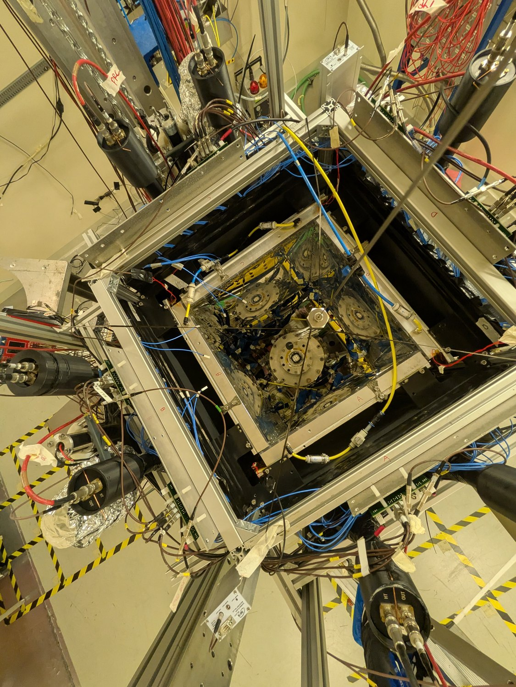
X17 search at n_TOF · Experimental setup
A look at the actual experiment – ran this July+August
Looking down into the station · n_TOF EAR2, 10 August 2026
D. Neff · MPGD 2026, Prague · 3 September 2026
16.1 / 25

Slide 41
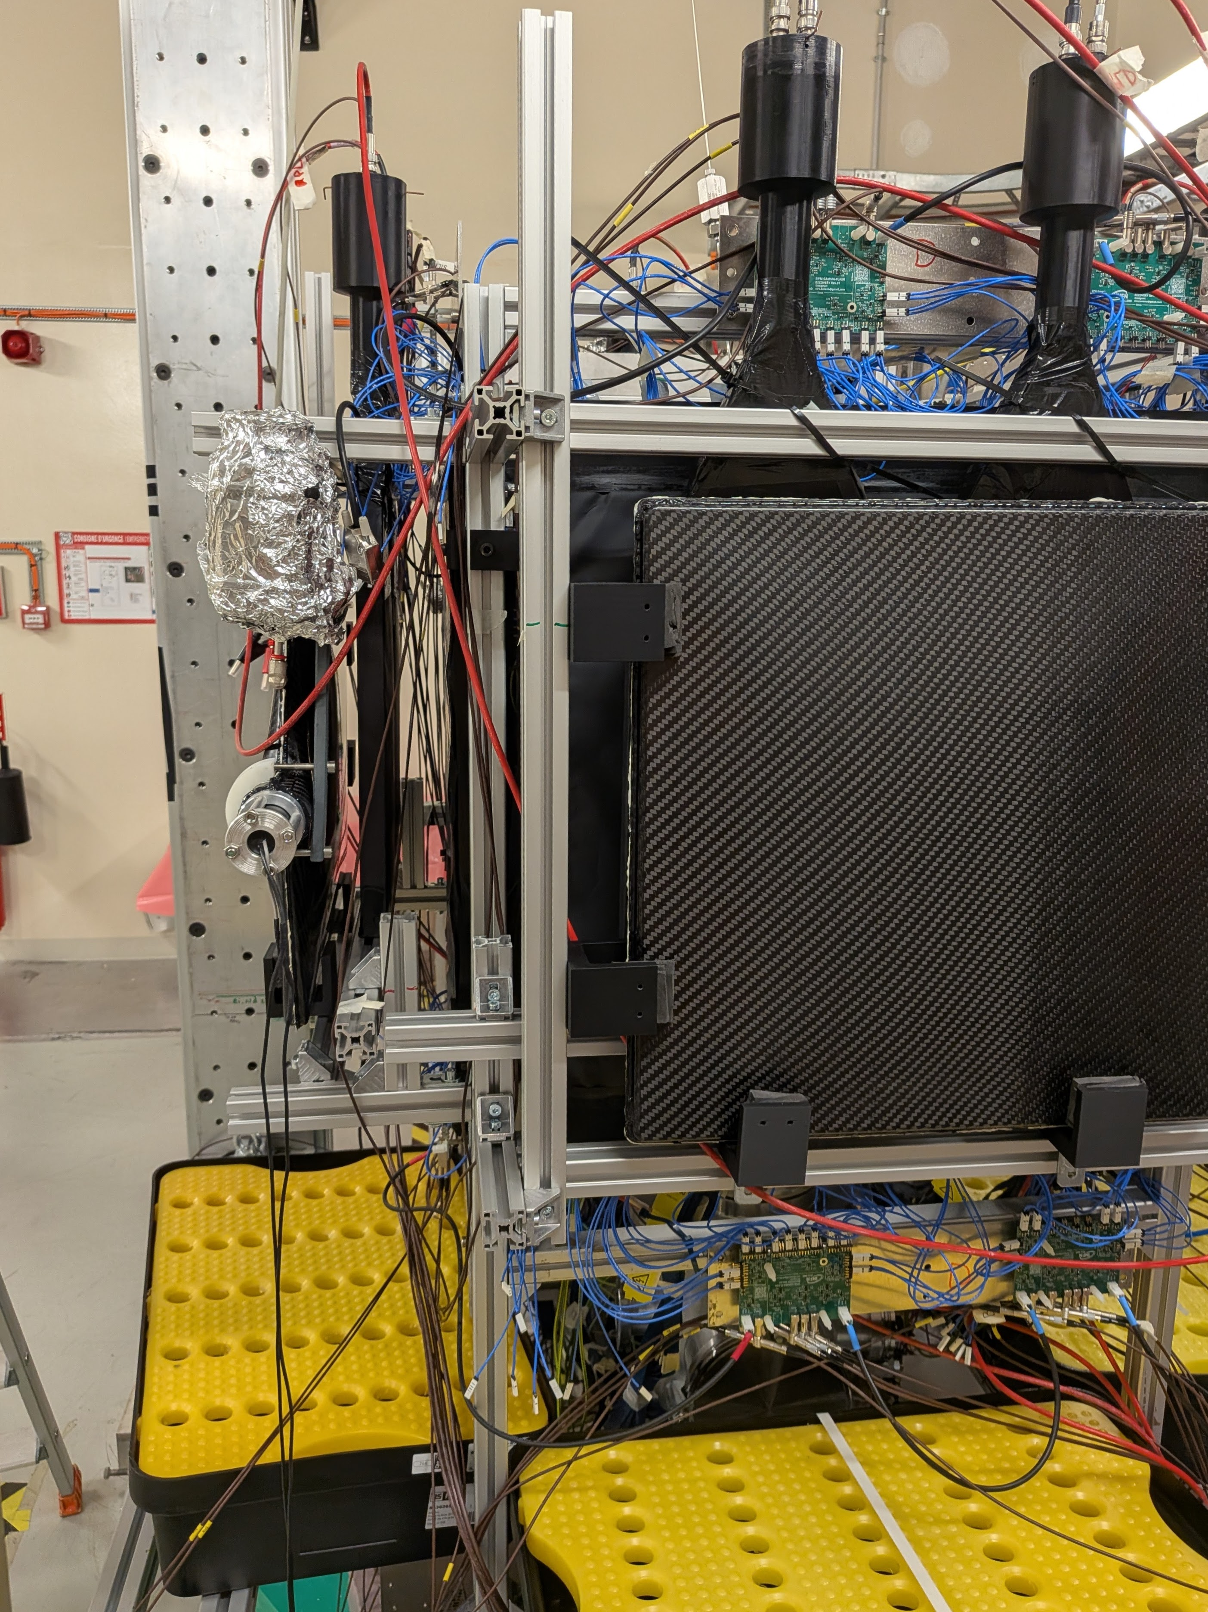
X17 search at n_TOF · Experimental setup
A look at the actual experiment – ran this July+August
Looking down into the station · n_TOF EAR2, 10 August 2026
One arm, from outside · n_TOF EAR2, 10 August 2026
D. Neff · MPGD 2026, Prague · 3 September 2026
16.2 / 25

Slide 42
Measurement Status
What the campaign actually recorded, and the problems we faced.
D. Neff · MPGD 2026, Prague · 3 September 2026

Slide 43
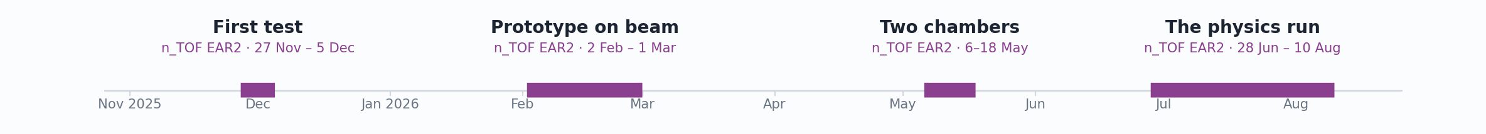
Status
Experiment timeline and statistics
D. Neff · MPGD 2026, Prague · 3 September 2026
17.1 / 25

Slide 44
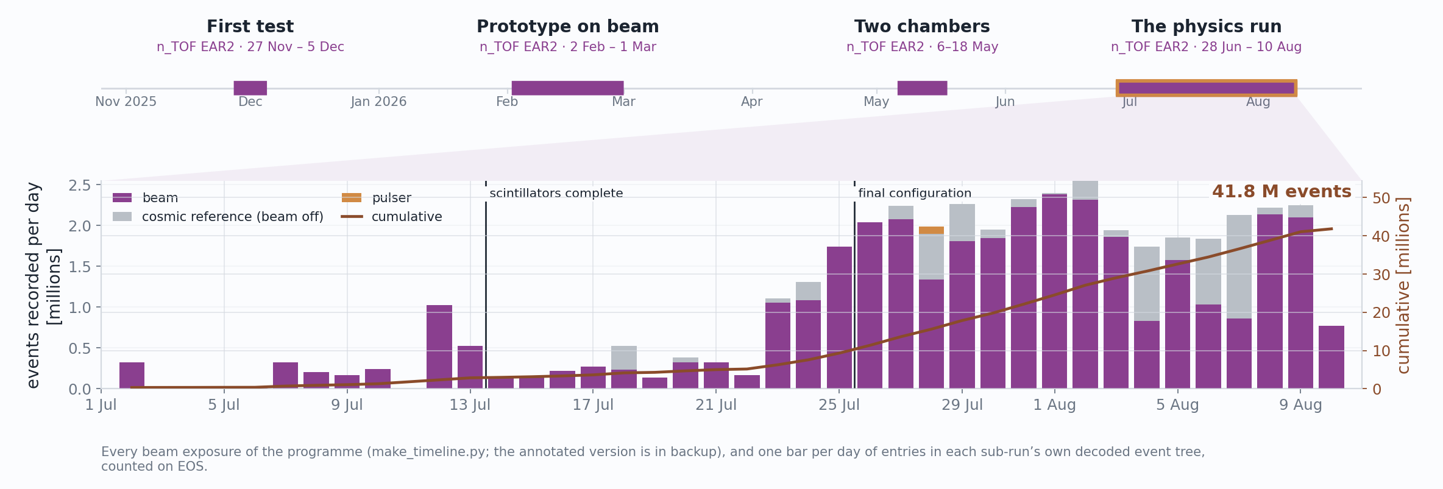
Status
Experiment timeline and statistics
D. Neff · MPGD 2026, Prague · 3 September 2026
17.2 / 25

Slide 45
Status
Experiment timeline and statistics
41.8 M
17.9 TB
436,373
events recorded — 35.9 M on beam, 5.8 M cosmic reference
on EOS, across 162 runs / 2,705 sub-runs
beam pulses on target over 44 days
D. Neff · MPGD 2026, Prague · 3 September 2026
17.3 / 25

Slide 46
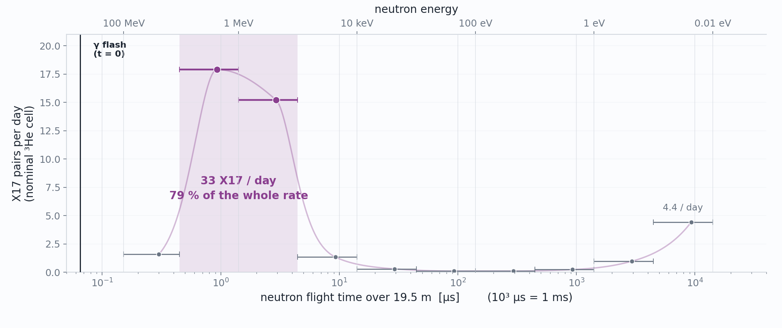
Status · What we came for
Almost all of the X17 rate is in the MeV
D. Neff · MPGD 2026, Prague · 3 September 2026
18 / 25

Slide 47
Status · The environment
Our read-out is DREAM — and the γ flash rails every channel of it
DREAM — Dead-timeless Read-out Electronics ASIC for Micromegas, developed at CEA Saclay and built for the CLAS12 Micromegas vertex tracker.
512 channels per front-end unit (8 ASICs × 64); two units per chamber, 1,024 channels for each MX17.
Every channel: a charge-sensitive preamplifier and shaper, full scale switchable 50–600 fC, into a switched-capacitor analogue memory.
Sampled here at 20 ns, digitized on an external trigger.
D. Neff · MPGD 2026, Prague · 3 September 2026
19.1 / 25

Slide 48
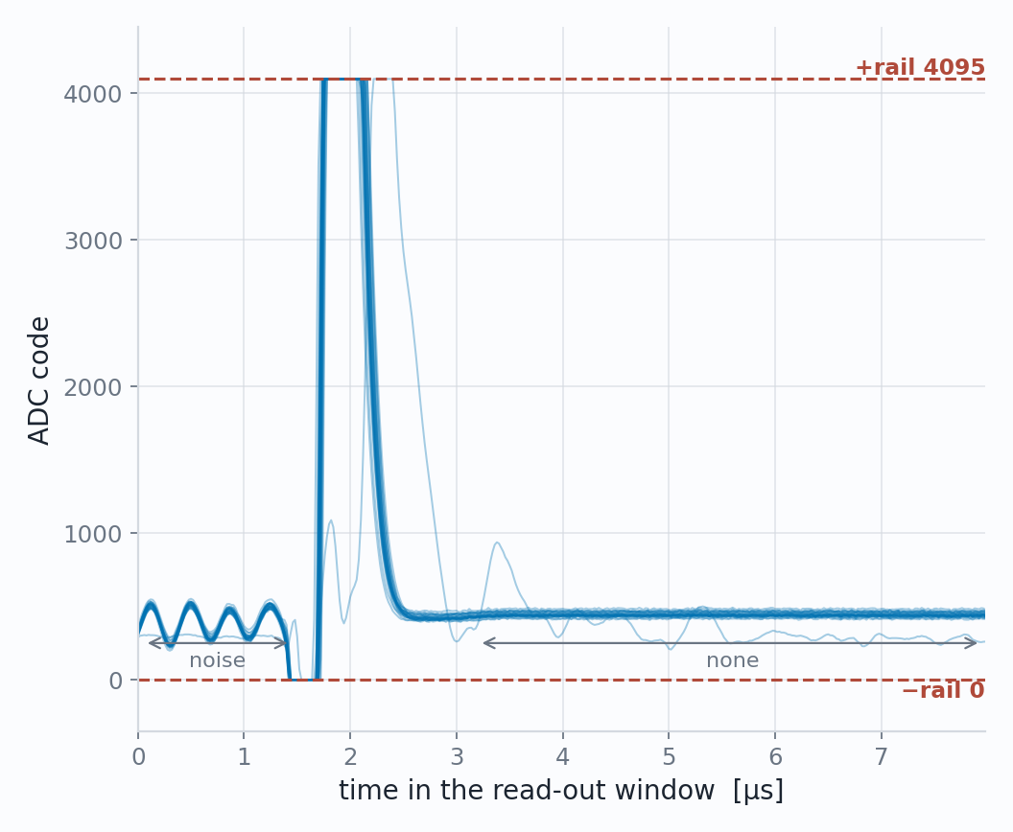
Status · The environment
Our read-out is DREAM — and the γ flash rails every channel of it
One flash, the 24 hottest strips
DREAM — Dead-timeless Read-out Electronics ASIC for Micromegas, developed at CEA Saclay and built for the CLAS12 Micromegas vertex tracker.
512 channels per front-end unit (8 ASICs × 64); two units per chamber, 1,024 channels for each MX17.
Every channel: a charge-sensitive preamplifier and shaper, full scale switchable 50–600 fC, into a switched-capacitor analogue memory.
Sampled here at 20 ns, digitized on an external trigger.
February 2026, the first prototype on beam: saturated — and saturated in a way that hides itself. The ADC rails to +4095, crosses to 0, and settles onto a flat baseline within ~3 µs.
D. Neff · MPGD 2026, Prague · 3 September 2026
19.2 / 25

Slide 49
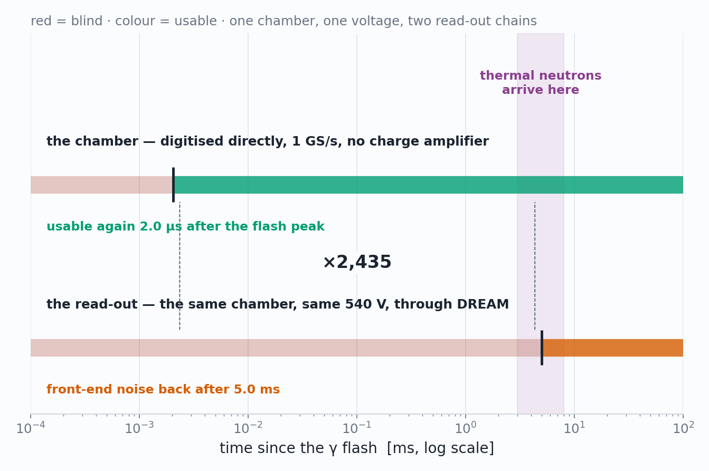
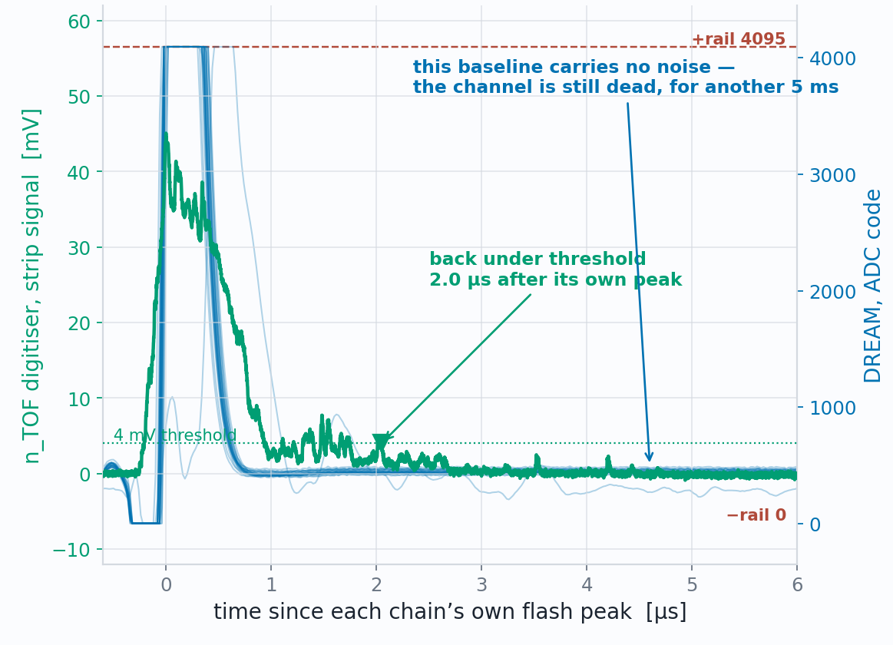
Status · The environment
The detector is fine. The DREAM DAQ is not.
When each DAQ is usable again
The same flash, seen by both DAQ
aligned on their own peaks
Detector A at 540V
D. Neff · MPGD 2026, Prague · 3 September 2026
20 / 25

Slide 50
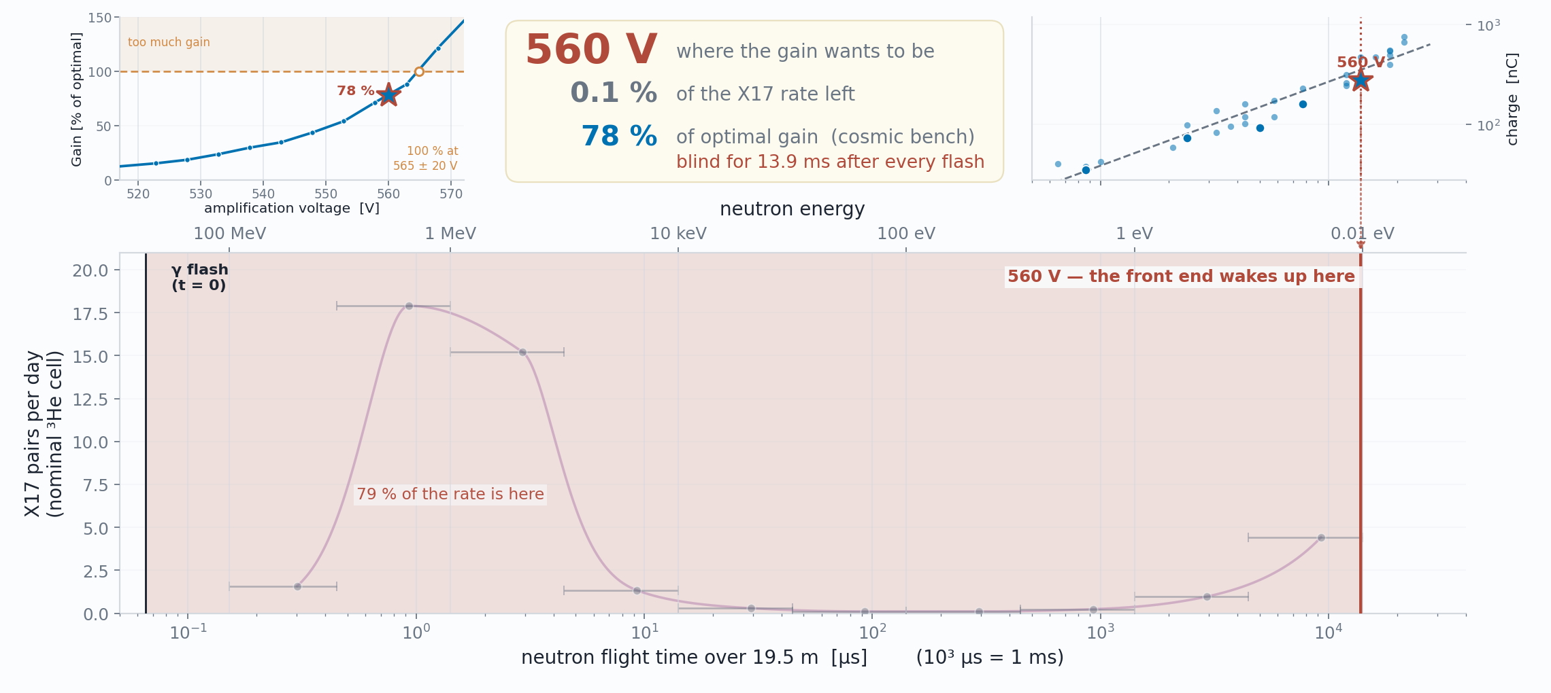
Status · The environment
Every volt of gain costs milliseconds of beam
D. Neff · MPGD 2026, Prague · 3 September 2026
21.1 / 25

Slide 51
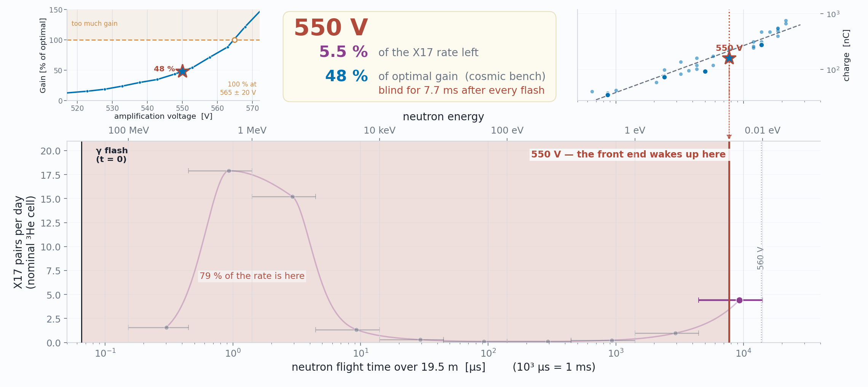
Status · The environment
Every volt of gain costs milliseconds of beam
D. Neff · MPGD 2026, Prague · 3 September 2026
21.2 / 25

Slide 52
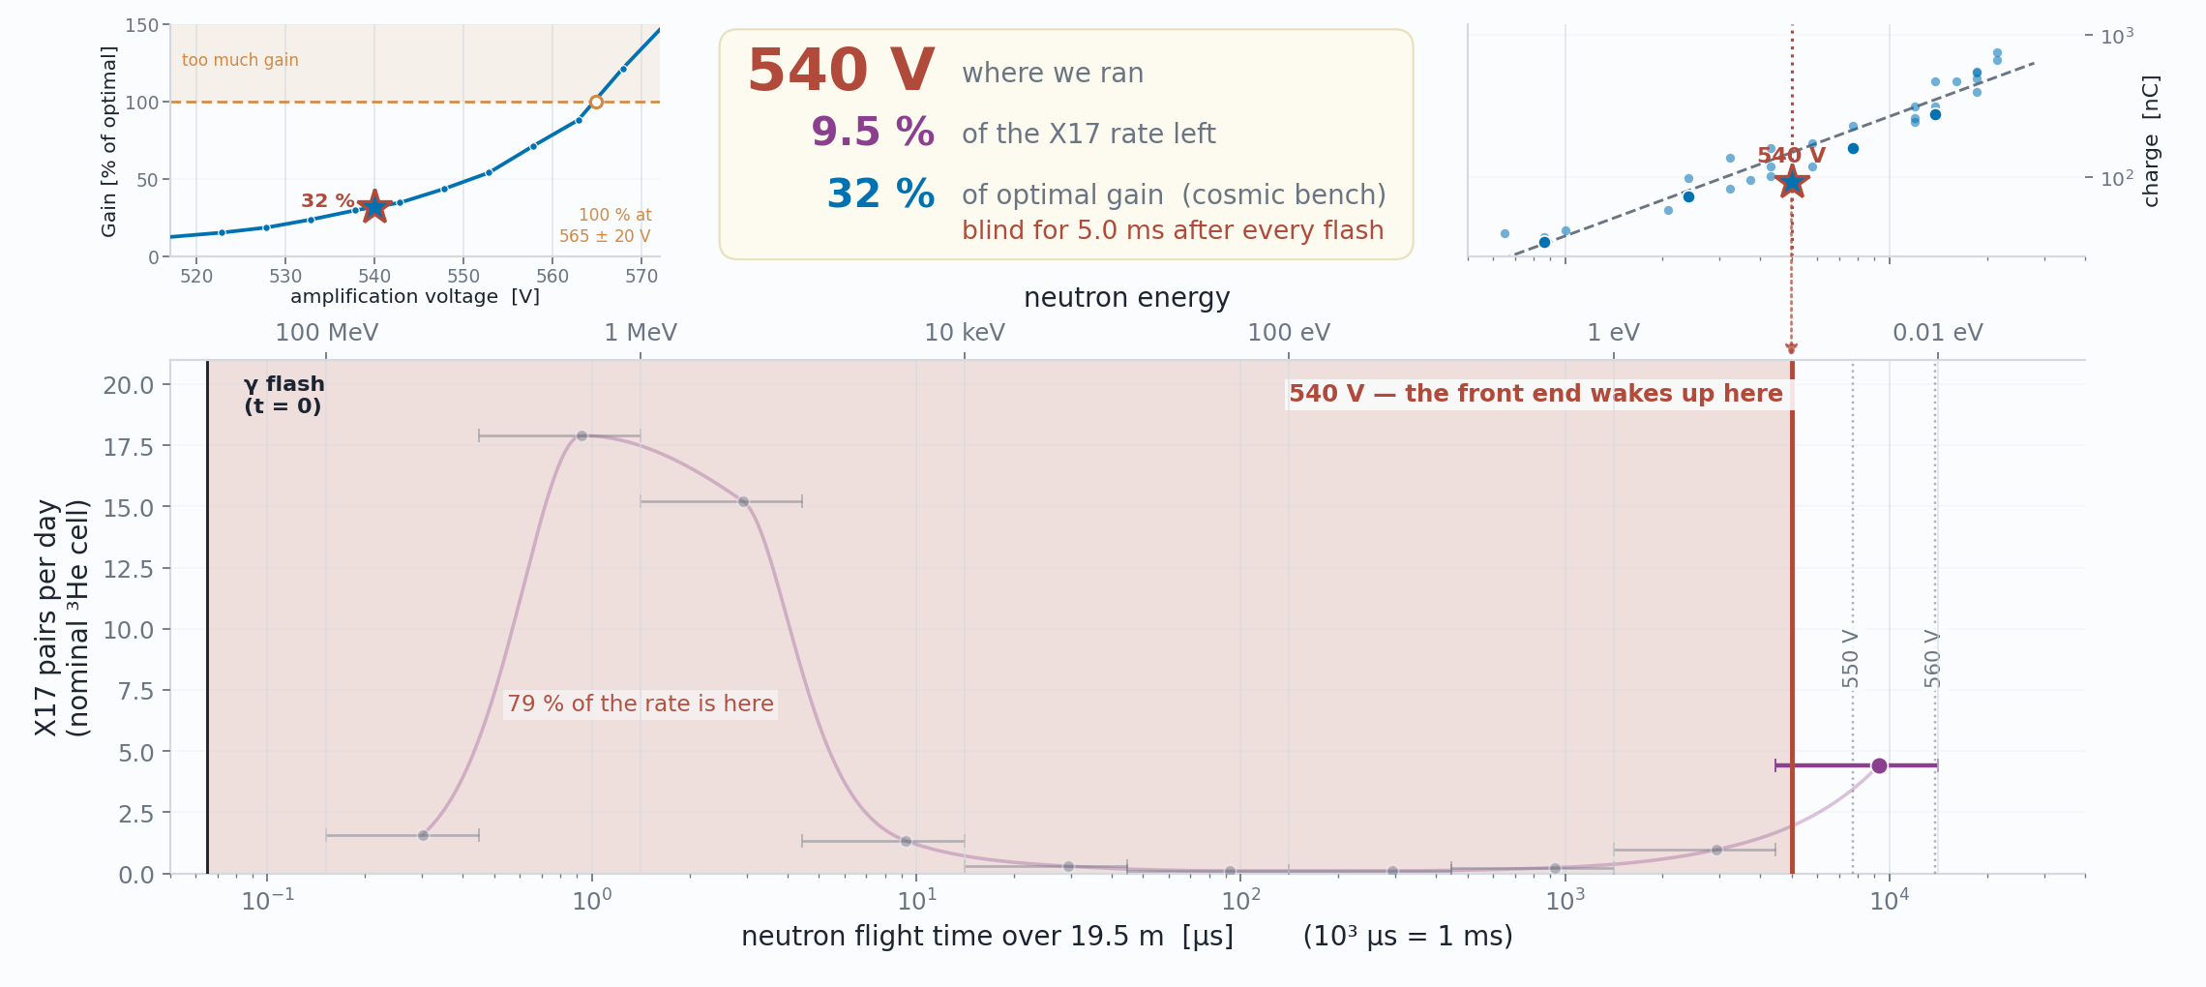
Status · The environment
Every volt of gain costs milliseconds of beam
D. Neff · MPGD 2026, Prague · 3 September 2026
21.3 / 25

Slide 53

Status · The environment
Every volt of gain costs milliseconds of beam
D. Neff · MPGD 2026, Prague · 3 September 2026
21.4 / 25

Slide 54

Status · The environment
Every volt of gain costs milliseconds of beam
D. Neff · MPGD 2026, Prague · 3 September 2026
21.5 / 25

Slide 55

WHAT WE RAN WITH
Status · The environment
Every volt of gain costs milliseconds of beam
D. Neff · MPGD 2026, Prague · 3 September 2026
21.6 / 25

Slide 56

Status · What we could measure
So we made a measurement at thermal energies
D. Neff · MPGD 2026, Prague · 3 September 2026
22 / 25

Slide 57

Work in progress
Status · Early Reconstruction Results
The angle a track arrives with says where it came from
D. Neff · MPGD 2026, Prague · 3 September 2026
23.1 / 25

Slide 58
Work in progress
Status · Early Reconstruction Results
The angle a track arrives with says where it came from
Correlation implies that tracks point back to capsule
D. Neff · MPGD 2026, Prague · 3 September 2026
23.2 / 25

Slide 59

Work in progress
Status · Early Reconstruction Results
Two opposing arms, seen from above – image of capsule
Capsule looks ~1 cm off-center, will confirm after careful detector/tracking calibration
Other two detector more problematic – working to recover
D. Neff · MPGD 2026, Prague · 3 September 2026
24 / 25

Slide 60

Summary
Summary and where we go from here
Constructed Micromegas µTPCs which measure charged track angle to ~1°
2026 X17 campaign at n_TOF EAR2 complete: 41.8 M events, 17.9 TB, 44 days
Thermal window recorded
Next steps for the analysis
D. Neff · MPGD 2026, Prague · 3 September 2026
25.1 / 25

Slide 61
Summary
Summary and where we go from here
thanks to:
n_TOF — the whole collaboration, and especially the local team, for making the measurement happen
EUROLABS — for the funding that made this experiment possible
CERN GDD & MPGD — for their indispensable support that enabled the measurement
CEA Saclay & Bulk Lab — for help building the detectors and supplying the DAQ
MPGD 2026 — for giving me the opportunity to present these results
Next steps for the analysis
Thank you! Questions?
D. Neff · MPGD 2026, Prague · 3 September 2026
25.2 / 25

Slide 62
Backup
D. Neff · MPGD 2026, Prague · 3 September 2026

Slide 63


Backup · Experimental setup
The setup to scale: top-down, and layer by layer
Pinwheel, to scale: opposing mylar faces 408.0 mm (B↔D) and 409.0 mm (C↔A)
The full stack in section — every layer depth from the mylar front face
Same geometry as the 3-D build-up, drawn as a measured section rather than a render: distances 2026-07-15, per-arm gaps and vessel placements 2026-07-17/18. The intermediate build states (+SiPM, +plastics) are setup_2_sipm.png / setup_3_plastic.png in assets/img/.
D. Neff · MPGD 2026, Prague · 3 September 2026
37 / 25

Slide 64

Backup · Reconstruction
The ~1° per-event scatter is physics, not fitting
The closure test | waveforms generated from the calibrated model with known tracks — real geometries, real charge profiles, real noise, real clipping — then fitted back. One knob: per-depth-bin transverse jitter of the charge centroid
jitter 0 | σ_{θ} 0.02° — electronics noise contributes essentially nothing
0.15 mm | 0.55°
0.30 mm | 1.05° — the scale diffusion + a few effective electrons per 2 mm of track + δ-rays actually give; reproduces the data exactly
0.50 mm | 1.77°
errors honest? | pull width 1.16 (X) / 1.13 (Y) — ~15 % optimistic, and χ²/dof genuinely ranks which fits to distrust
Full run, 6,852 / 6,850 reference-matched events, reference never in any fit: σ_{θ} = 1.16° / 1.13°, bias < 0.1°, flat across the angle range and sitting on the measured floor (middle, dashed); implied v flat to ~1.4 µm/ns (right)
So the per-event fit is extracting essentially all the information the detector geometry physically has — gains beyond ~1° come from ensemble averaging, not better fitters, which is why the reported errors carry a physics floor added in quadrature and the optimiser tolerances are deliberately loose. Ablations agree: dropping any single model refinement moves per-event σ by < 0.05°; what the refinements buy is ensemble physicality (implied-v flatness), the thing that cannot be tuned. Doc Part VII §41–43.
D. Neff · MPGD 2026, Prague · 3 September 2026
44 / 25

Slide 65
Backup · Characterization
The fleet, and what limits each chamber
det3 / det2 | Healthy. 100% of crossings fire; the whole residue is a 2.4–3.2% discharge coincidence and a 4.0–4.3% near-miss tail.
det6 / det7 | Discharge-limited — 22.3% / 37.4% of firing events are >50-strip discharges. Both ran at resist 495 V, above their measured optima (~480 / ~440 V): this is a chosen operating point, not a ceiling.
det4 | Gain-limited, and it is not blind: it produces a signal on 95.8% of crossings, but on 38.3% too few strips fire to form a valid X+Y point. Independently confirmed at the SPS: 62% of its area does not amplify.
Position core σ | 0.43–0.46 mm on det2/det3/det6, 0.56/0.62 mm on det4/det7 (radial) — on the good chambers the M3 reference contributes only ~10–20% of the variance.
det3
93.3%
det2
92.0%
det6
74.9%
det7
57.0%
det4
41.6%
Reconstructed within 5 mm of the M3 reference track (χ²<1.0 & NClus=4). One high-statistics sub-run per chamber, 3.7k–12.3k reference muons, waveform-first reconstruction, 2026-08-13 reprocessing.
Superseded 2026-07-14 values were 92.9 / 91.3 / 57.8 / 43.1 / 20.7%. The last three chambers gain 14–21 points from the matched-filter reprocessing of the raw waveforms — low-amplitude hits the previous analyzer never admitted — plus a further 0.4–4 points from reconstructing position from the waveforms instead of the strip hit times.
D. Neff · MPGD 2026, Prague · 3 September 2026
48 / 25

Slide 66

Backup · Operating in it
What we record, and when
Reconstructed tracks on beam data, joined event-by-event to the n_TOF scintillator stream. The turn-on at 1 ms is the DREAM gate, not the reconstruction; the bulk of everything we record sits in the first ~10 ms — the same interval the recovery map says the chambers are only partly alive in. That overlap is the experiment's central operational problem, stated in data.
D. Neff · MPGD 2026, Prague · 3 September 2026
69 / 25

Slide 67
Backup · Operating in it
The trigger lives in the thermal window — by design
Capture loves slow neutrons, and slow neutrons are late. Over ~20 m of flight path the thermal flux peaks at 5.3 ms — recorded, and reproduced by Geant4 in shape.
The trigger: per arm, the SiPM wall (any of 4 segments over ½ MIP) AND a plastic bar over 0.90 MIP, within 20 ns — a charged leg crossing the stack, not a γ.
Simulation says 96 % of those trigger legs are ²⁷Al-capture γs converting in the capsule wall — the trigger is dominated by the background the analysis has to beat.
Recorded trigger rate vs neutron arrival time, against Geant4 — the 5.3 ms thermal peak reproduces; the normalisation runs 2.1× high (per wall 1.1–2.6×), under investigation
D. Neff · MPGD 2026, Prague · 3 September 2026
70 / 25

Slide 68

Backup · Reconstruction
The tracks point back at the capsule
Waveform-first reconstruction on beam data, coloured by which SiPM wall segment fired — external position truth on a 100 mm granularity, on a lever arm the chamber knows nothing about. The four bundles are 251 mm apart at the wall and 9 mm apart at the target plane; shuffling the segment labels collapses that to 28 mm and 3.2 mm. Ensemble statement — the waist is a convergence of medians, not a per-track pointing resolution.
D. Neff · MPGD 2026, Prague · 3 September 2026
71 / 25

Slide 69

Backup · The campaign
Beam availability, day by day
Fraction of each day with protons on the n_TOF target, from the one-minute classification of the last beam-current transformer before the target (FTN.BCT477). Campaign mean 78.6 %; the 21.4 % without beam is the usual mix of PS supercycle sharing and machine stops — the logger’s attribution between the two is not reliable, so only the total is quoted. Colours are the three campaign phases; 10 August is a partial day (HV off 09:15).
D. Neff · MPGD 2026, Prague · 3 September 2026
73 / 25

Slide 70

Backup · Outlook
Next: from single tracks to pairs
What a signal is: two tracks in different arms, opening angle kinematically confined above 109°, total pair energy 19.6 MeV (slide 4). Everything in this talk exists to make that measurable.
The reconstruction is ready for the easy half: the forward fit now returns every candidate track, not just the winner — single-track output bit-identical, candidates shipped alongside. Two tracks merged closer than ~12 mm still fit as one bad-χ² compromise: the two-track forward model is the one designed-but-unbuilt piece.
The dataset is final and the search is offline: 41.8 M events on EOS, with the trigger dominated by Al-capture pairs — an enormous calibration sample for exactly this topology.
The bar the tracker has to clear: the Al background separates on total pair energy, which asks for σ(p)/p ≲ 30 % per lepton from scattering or range — the open MPGD question to leave the room with.
A real two-track event in one chamber (July scan run) — two track-grade lines in both planes, paired into 3-D. A demonstration, not a measurement: hits-basis, and the X↔Y pairing is two-fold ambiguous
D. Neff · MPGD 2026, Prague · 3 September 2026
76 / 25

