Slide 1
n_TOF Collaboration Meeting 2026
X17 Search in EAR2
Overview + Status of the July+August Run
Dylan Neff · n_TOF Collaboration Meeting, Athens · 1 October 2026
Slides and analysis built with Claude Code (Anthropic)

Slide 2
Outline
1
The X17 particle and the n_TOF channel
2
Micromegas TPC detectors
3
X17 search at n_TOF —
experimental setup
4
Experiment Summary and Early Results
D. Neff · n_TOF Collaboration Meeting, Athens · 1 October 2026
2 / 18

Slide 3
Outline
X17 particle and how to see it
Micromegas detectors
Expected statistics in EAR2
High energy tests in Feb + May --> DAQ saturation
Thermal statistics and measurement
D. Neff · n_TOF Collaboration Meeting, Athens · 1 October 2026
2 / 18

Slide 4
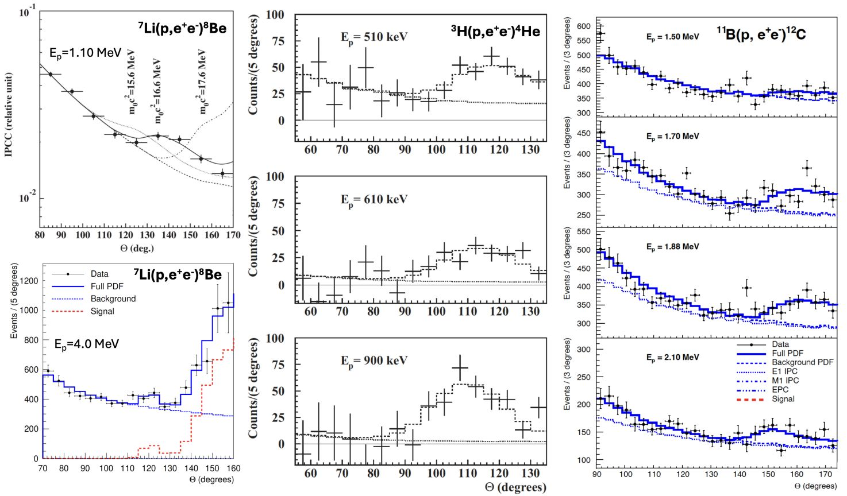
Motivation
A possible new boson at 17 MeV?
ATOMKI, 2016: an excess of e⁺e⁻ pairs at large opening angle, in three nuclear transitions
Consistent with a new particle: X17, ~17 MeV, decaying to e⁺e⁻
Can we make an independent measurement?
The same ⁴He* state, generated with neutrons + ³He?
A.J. Krasznahorkay et al., PRL 116, 042501 (2016) · PRC 104, 044003 (2021) · PRC 106, L061601 (2022)
D. Neff · n_TOF Collaboration Meeting, Athens · 1 October 2026
3 / 18

Slide 5
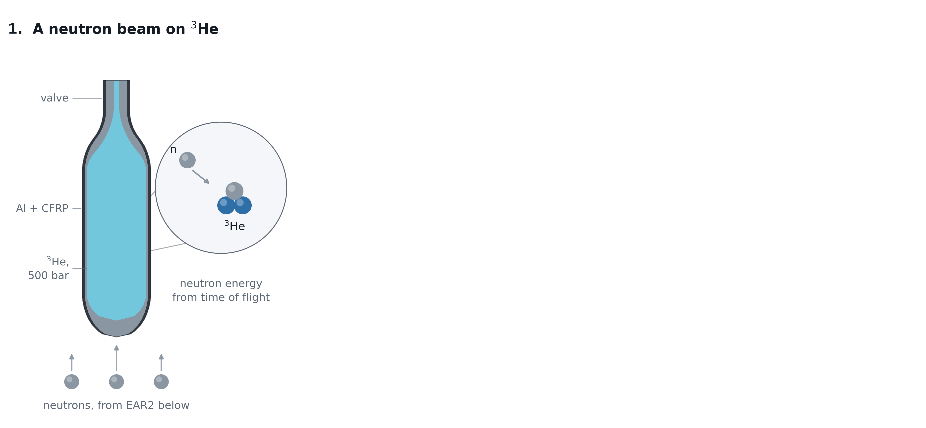
Motivation
Capture on ³He and how X17 could come out
D. Neff · n_TOF Collaboration Meeting, Athens · 1 October 2026
4.1 / 18

Slide 6
Motivation
Capture on ³He and how X17 could come out
D. Neff · n_TOF Collaboration Meeting, Athens · 1 October 2026
4.2 / 18

Slide 7
Motivation
Capture on ³He and how X17 could come out
?
D. Neff · n_TOF Collaboration Meeting, Athens · 1 October 2026
4.3 / 18

Slide 8
Motivation
The opening angle observable -- X17 moves slow
D. Neff · n_TOF Collaboration Meeting, Athens · 1 October 2026
5.1 / 18

Slide 9
Motivation
The opening angle observable -- X17 moves slow
D. Neff · n_TOF Collaboration Meeting, Athens · 1 October 2026
5.2 / 18

Slide 10
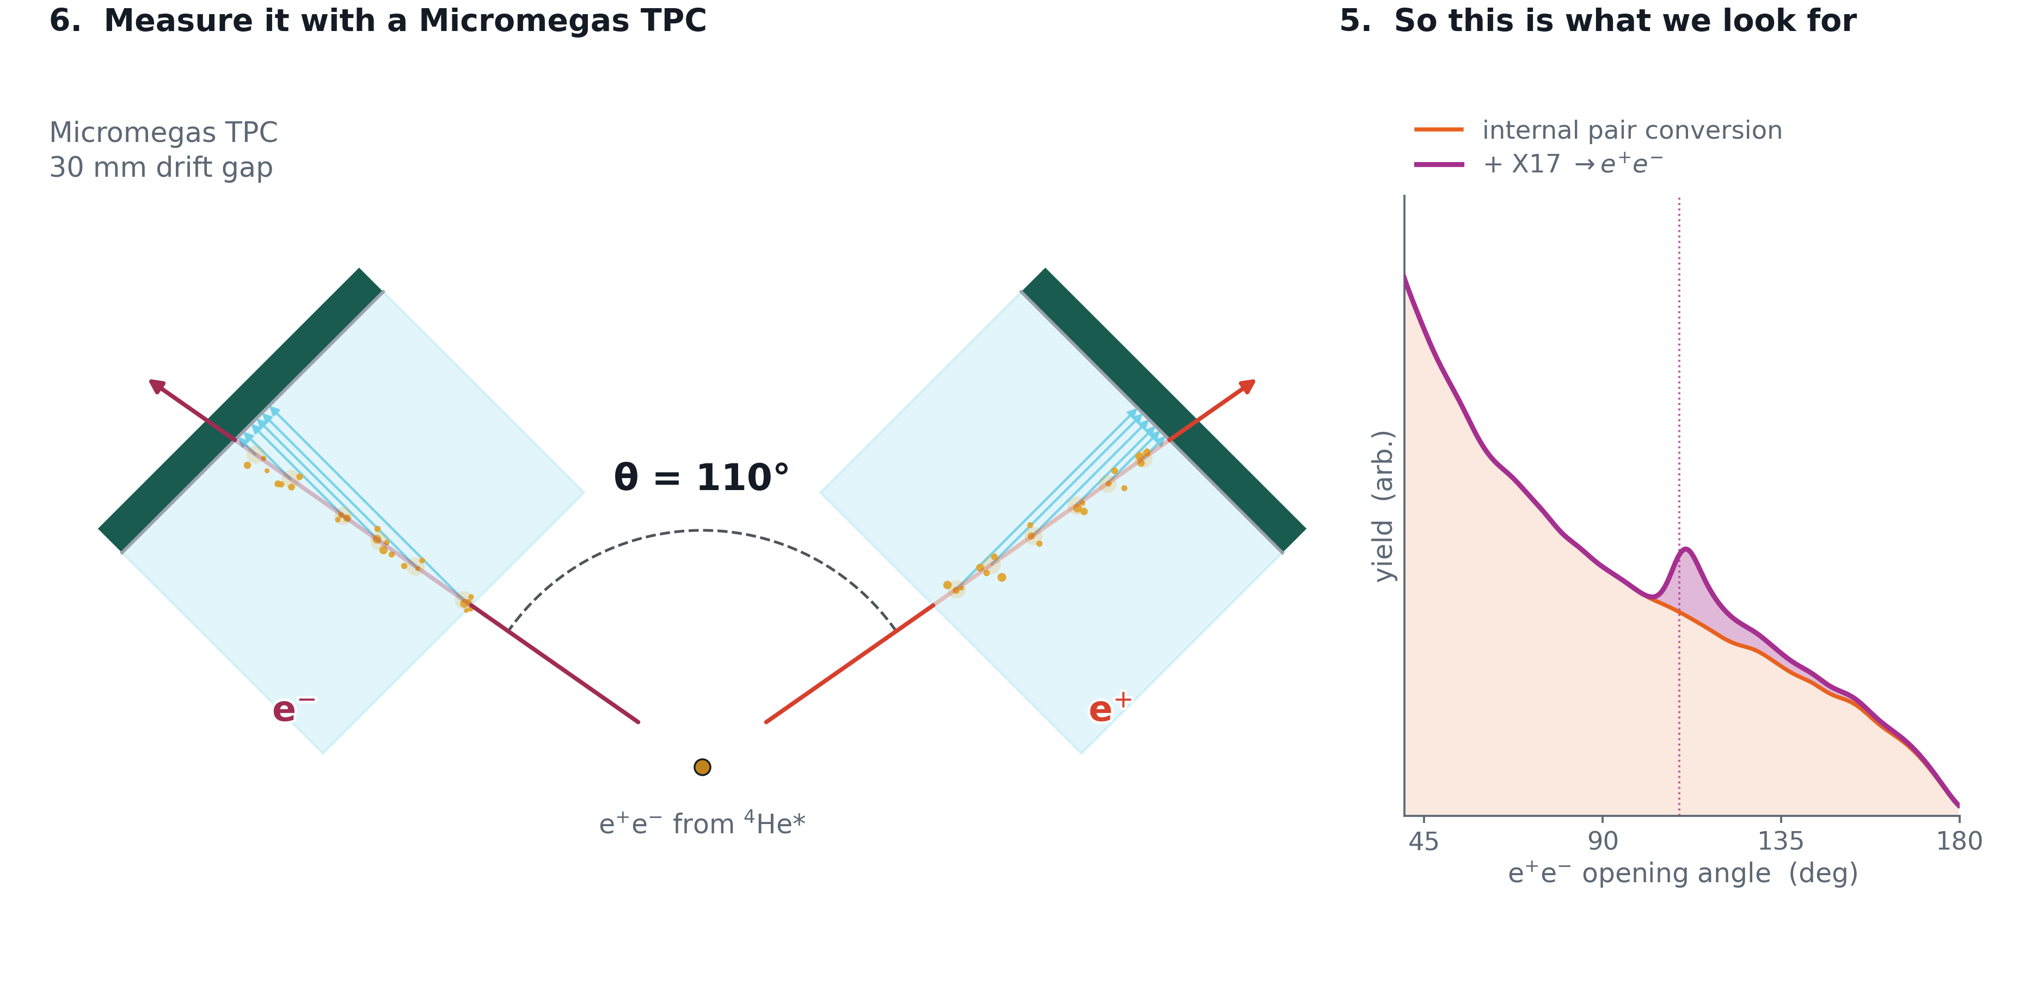
Motivation
The opening angle observable -- X17 moves slow
D. Neff · n_TOF Collaboration Meeting, Athens · 1 October 2026
5.3 / 18

Slide 11
The Micromegas Compact TPC
A large-area resistive-strip detector, built to measure the opening angle of the pair.
D. Neff · n_TOF Collaboration Meeting, Athens · 1 October 2026

Slide 12
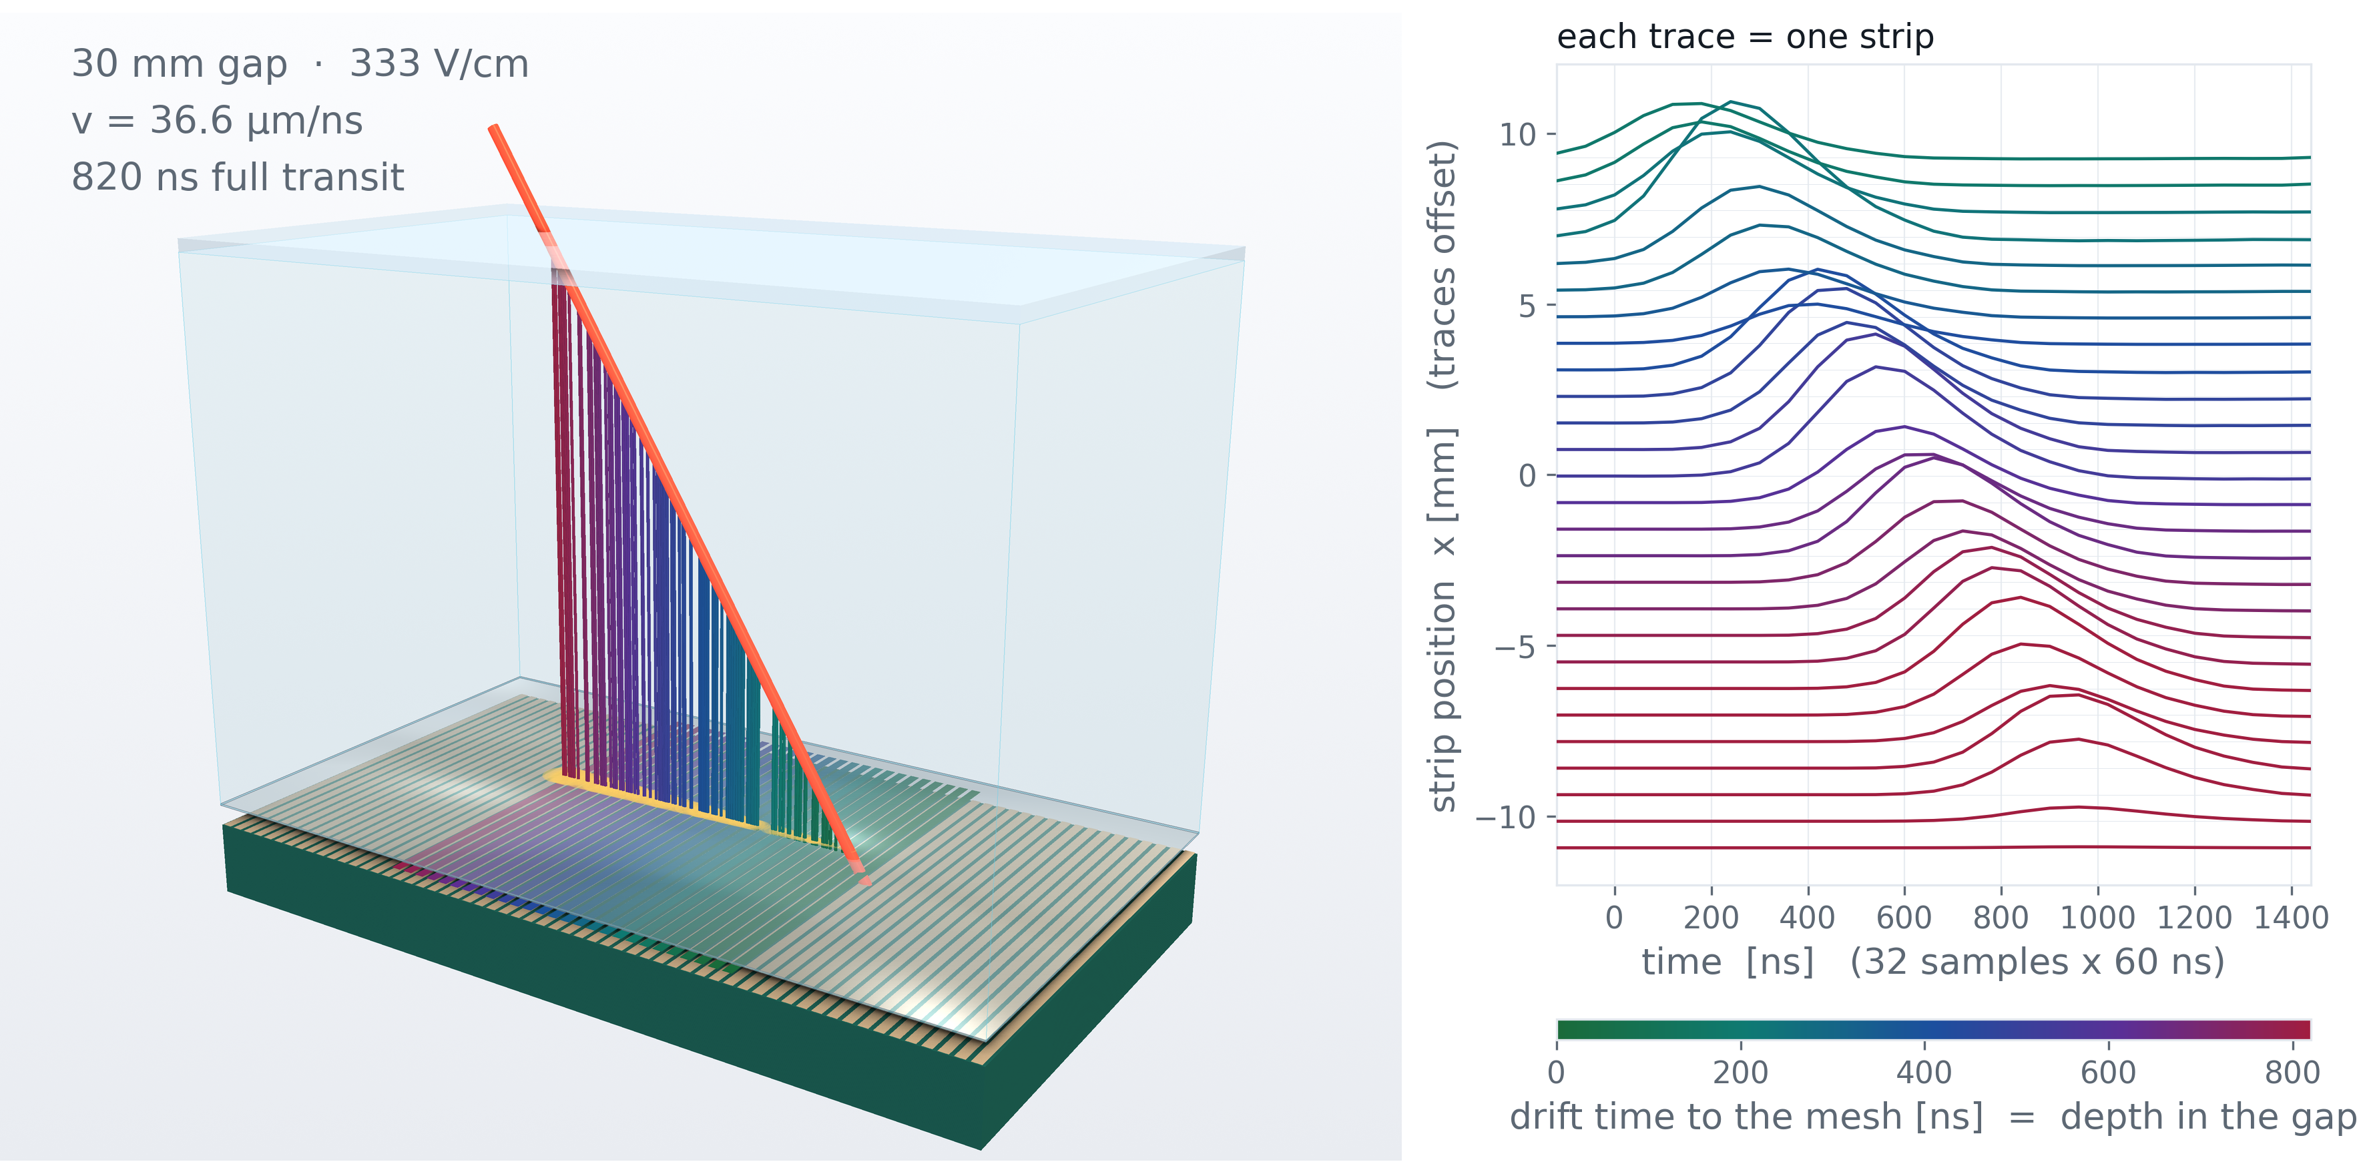
Designed & built at CEA Saclay by
Micromegas TPC · Saclay
Stéphan Aune
TPC operation
Simulated event
D. Neff · n_TOF Collaboration Meeting, Athens · 1 October 2026
6 / 18

Slide 13
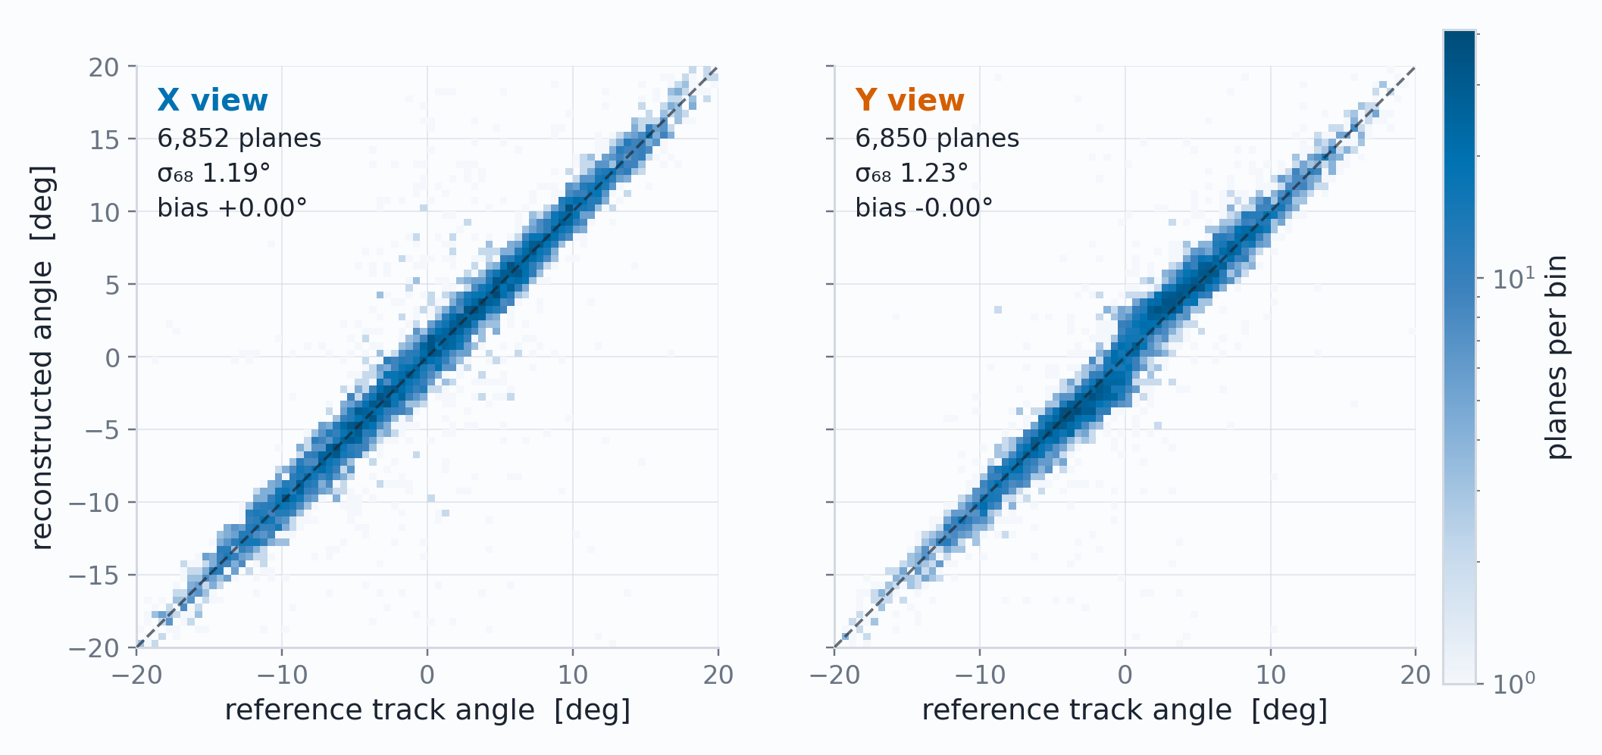
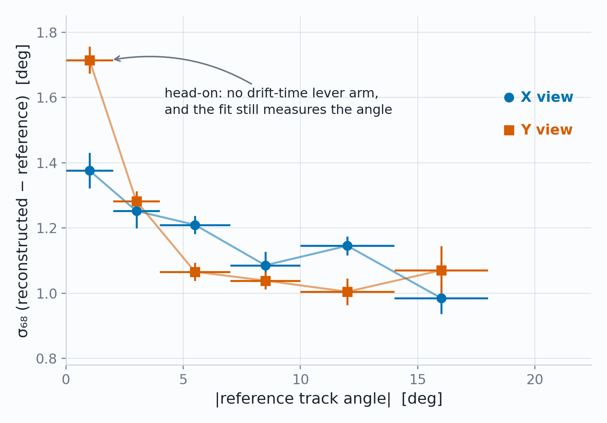
Work in progress
Characterization
Adequate angular, spatial and temporal resolution
Reconstructed against reference, per plane
Head on tracks reasonable and angled tracks approach 1°
1.19 / 1.23°
180 µm
33 ns
angle per plane, X / Y (σ₆₈), bias < 0.1°
position at normal incidence, ±0.035 mm conservatively
plane-to-plane timing, ≈ 1.1 mm of drift
D. Neff · n_TOF Collaboration Meeting, Athens · 1 October 2026
7 / 18

Slide 14
X17 in EAR2
Where should we look?
D. Neff · n_TOF Collaboration Meeting, Athens · 1 October 2026

Slide 15
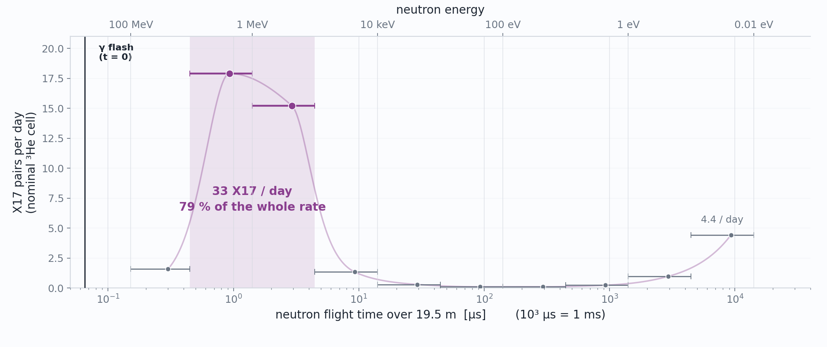
Status · What we came for
Almost all of the X17 rate is in the MeV
D. Neff · n_TOF Collaboration Meeting, Athens · 1 October 2026
11 / 18

Slide 16
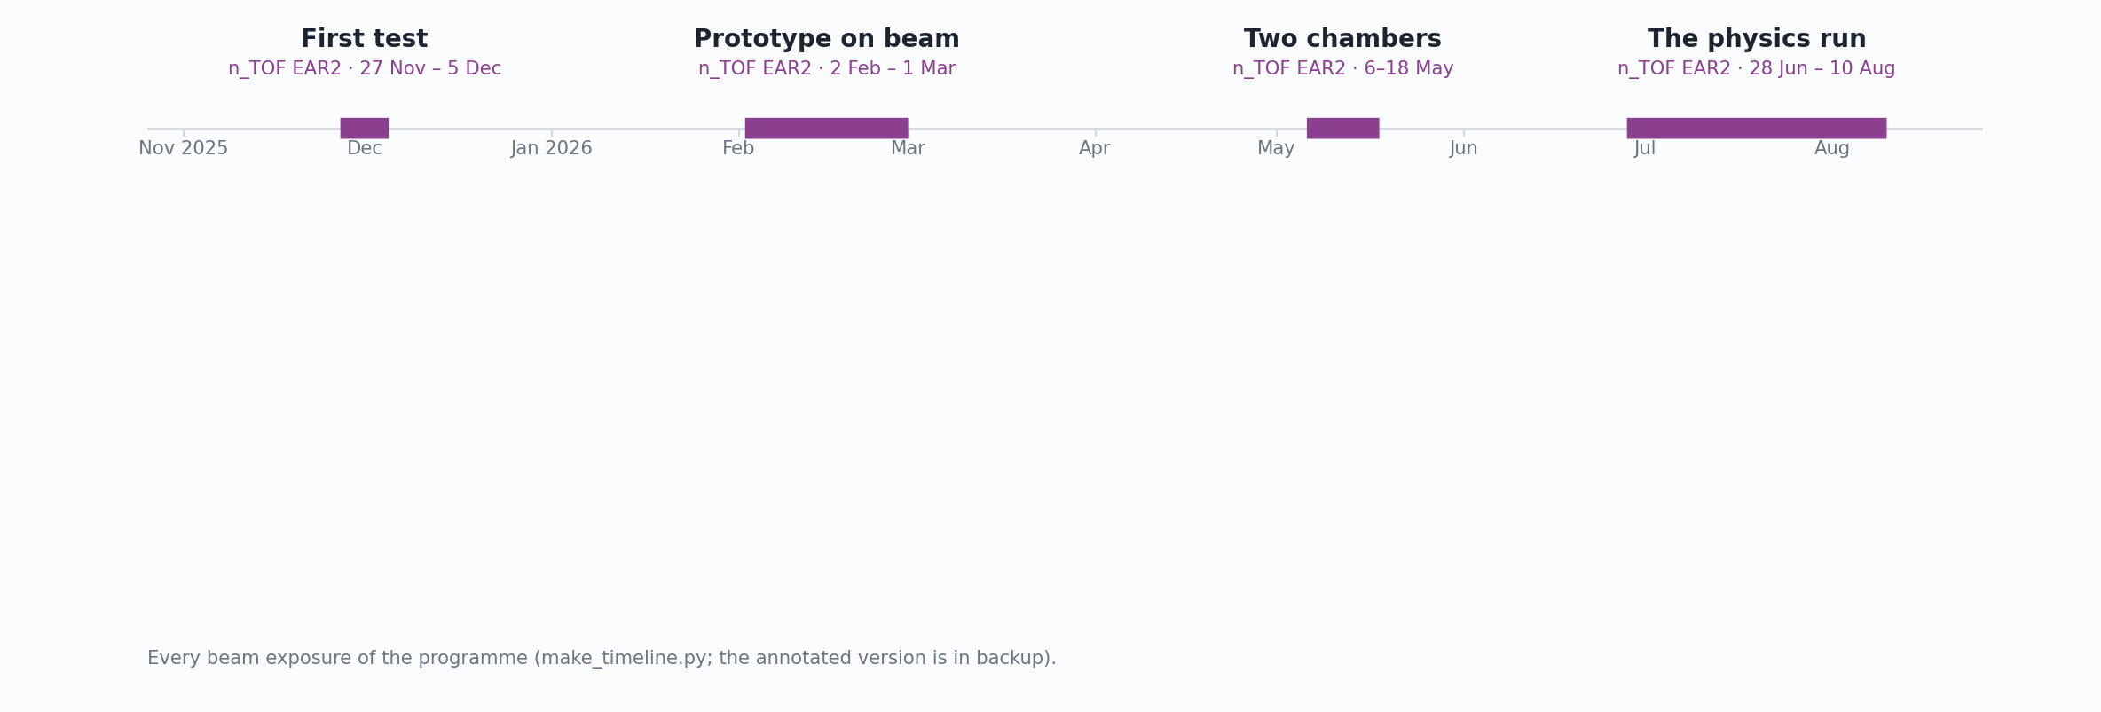
Status · What we came for
Almost all of the X17 rate is in the MeV
D. Neff · n_TOF Collaboration Meeting, Athens · 1 October 2026
11 / 18

Slide 17
Status · The environment
Problem: DREAM DAQ Can’t Handle Gamma Flash
DREAM — Dead-timeless Read-out Electronics ASIC for Micromegas, developed at CEA Saclay and built for the CLAS12 Micromegas vertex tracker.
512 channels per front-end unit (8 ASICs × 64); two units per chamber, 1,024 channels for each MX17.
Every channel: a charge-sensitive preamplifier and shaper, full scale switchable 50–600 fC, into a switched-capacitor analogue memory.
Sampled here at 20 ns, digitized on an external trigger.
D. Neff · n_TOF Collaboration Meeting, Athens · 1 October 2026
12.1 / 18

Slide 18
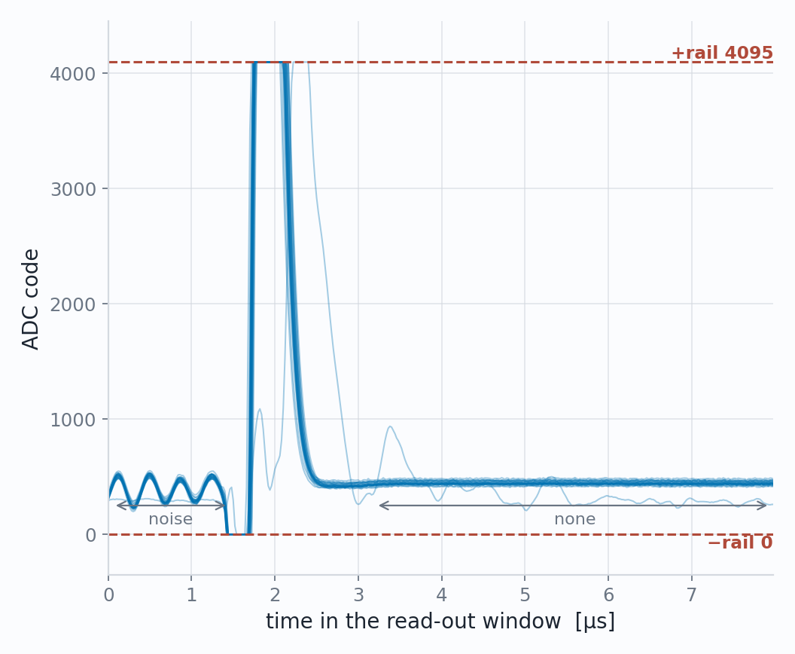
Status · The environment
Problem: DREAM DAQ Can’t Handle Gamma Flash
One flash, the 24 hottest strips
DREAM — Dead-timeless Read-out Electronics ASIC for Micromegas, developed at CEA Saclay and built for the CLAS12 Micromegas vertex tracker.
512 channels per front-end unit (8 ASICs × 64); two units per chamber, 1,024 channels for each MX17.
Every channel: a charge-sensitive preamplifier and shaper, full scale switchable 50–600 fC, into a switched-capacitor analogue memory.
Sampled here at 20 ns, digitized on an external trigger.
February 2026, the first prototype on beam: saturated — and saturated in a way that hides itself. The ADC rails to +4095, drops to 0, and settles onto a flat baseline within ~3 µs.
D. Neff · n_TOF Collaboration Meeting, Athens · 1 October 2026
12.2 / 18

Slide 19
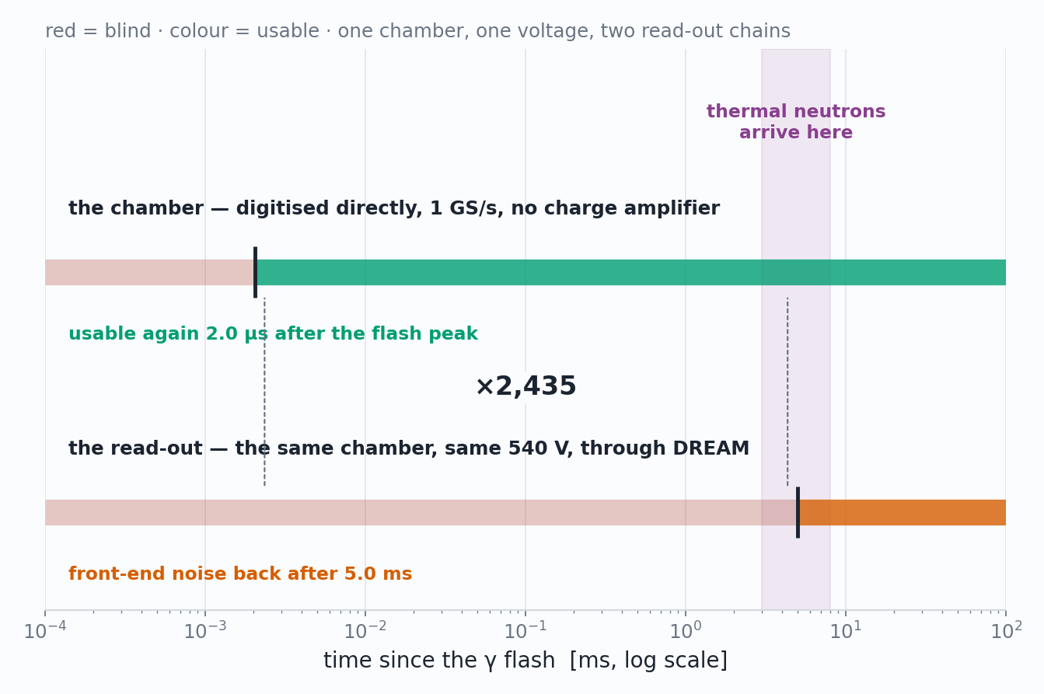
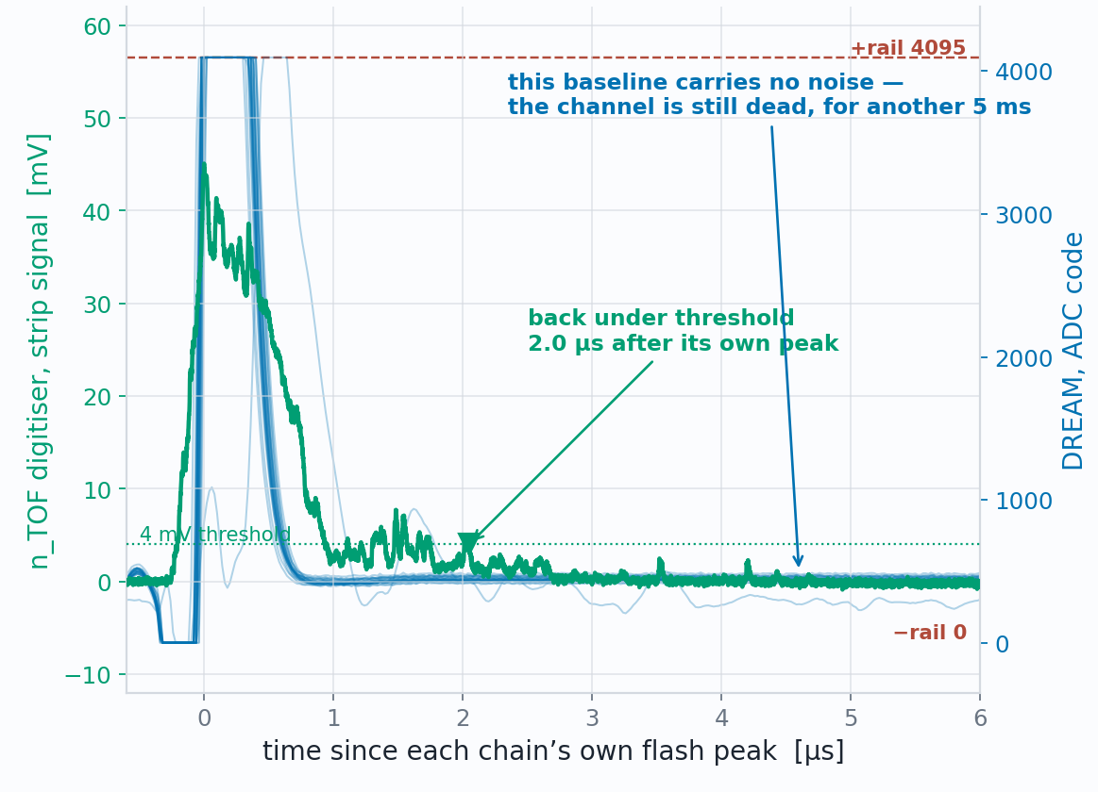
Status · The environment
The detector is fine. The DREAM DAQ is not.
When each DAQ is usable again
The same flash, seen by both DAQ
aligned on their own peaks
Detector A at 540V
D. Neff · n_TOF Collaboration Meeting, Athens · 1 October 2026
13 / 18

Slide 20
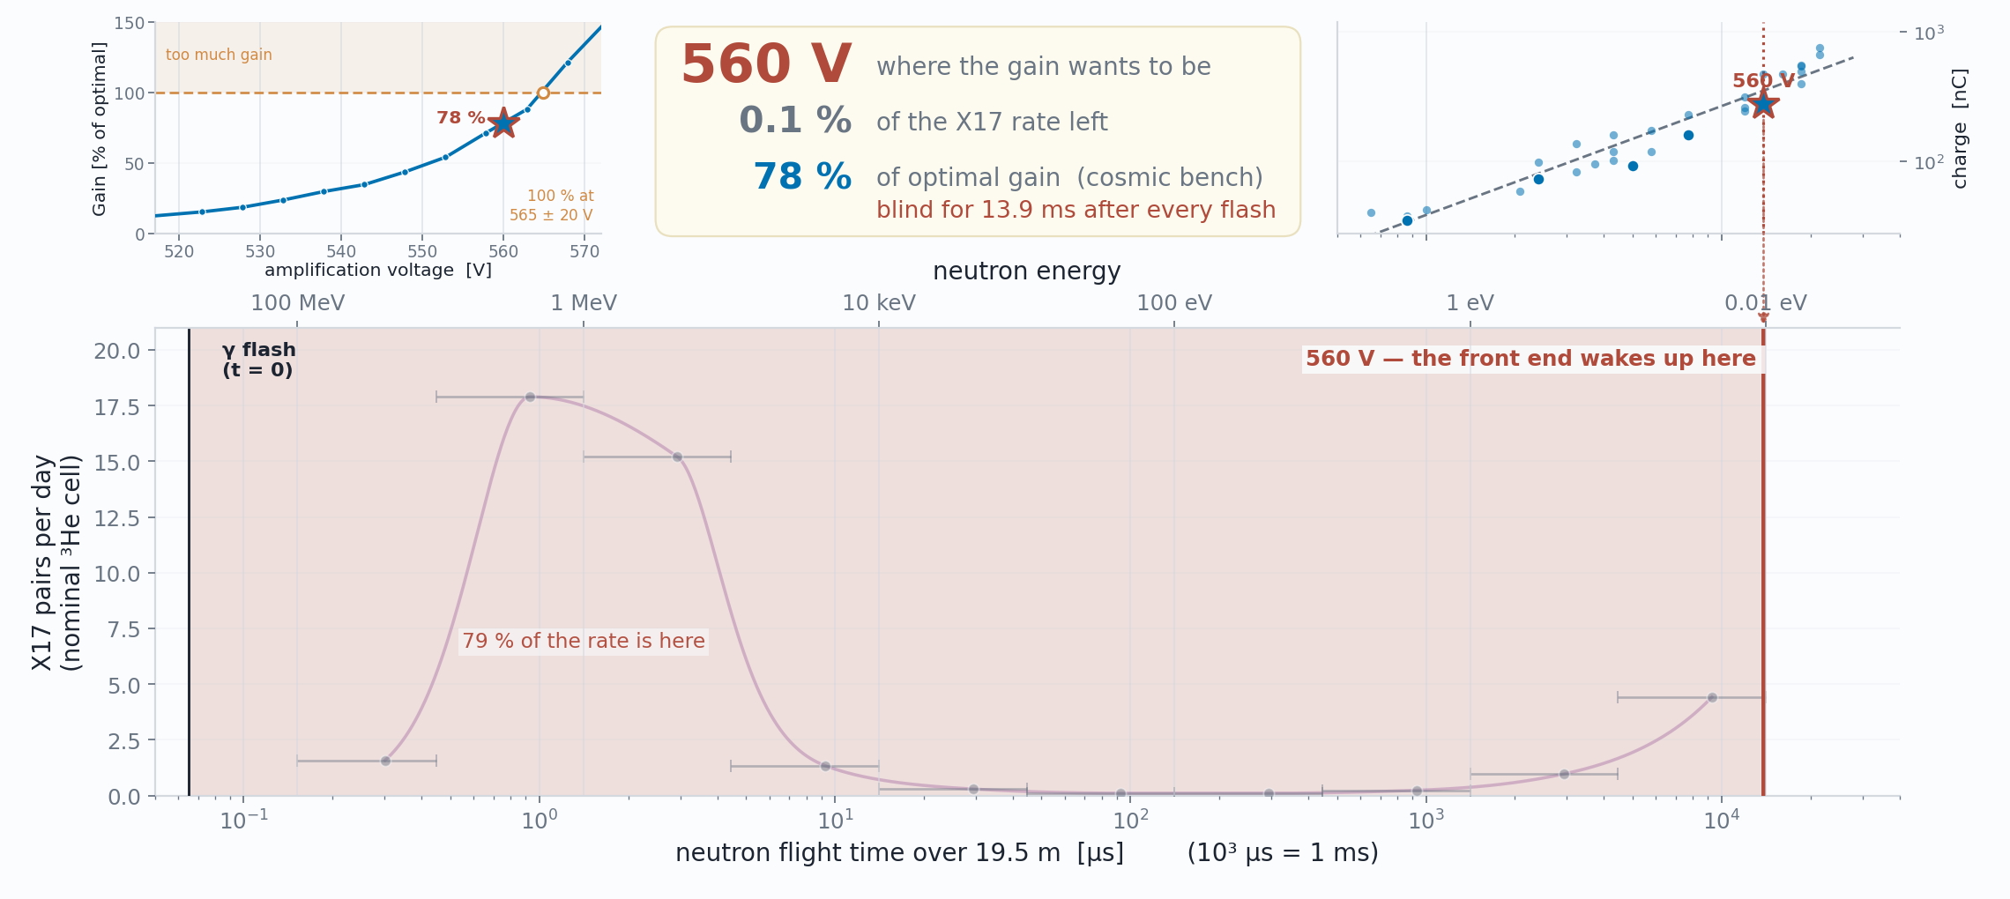
Status · The environment
Every volt of gain costs milliseconds of beam
D. Neff · n_TOF Collaboration Meeting, Athens · 1 October 2026
14.1 / 18

Slide 21
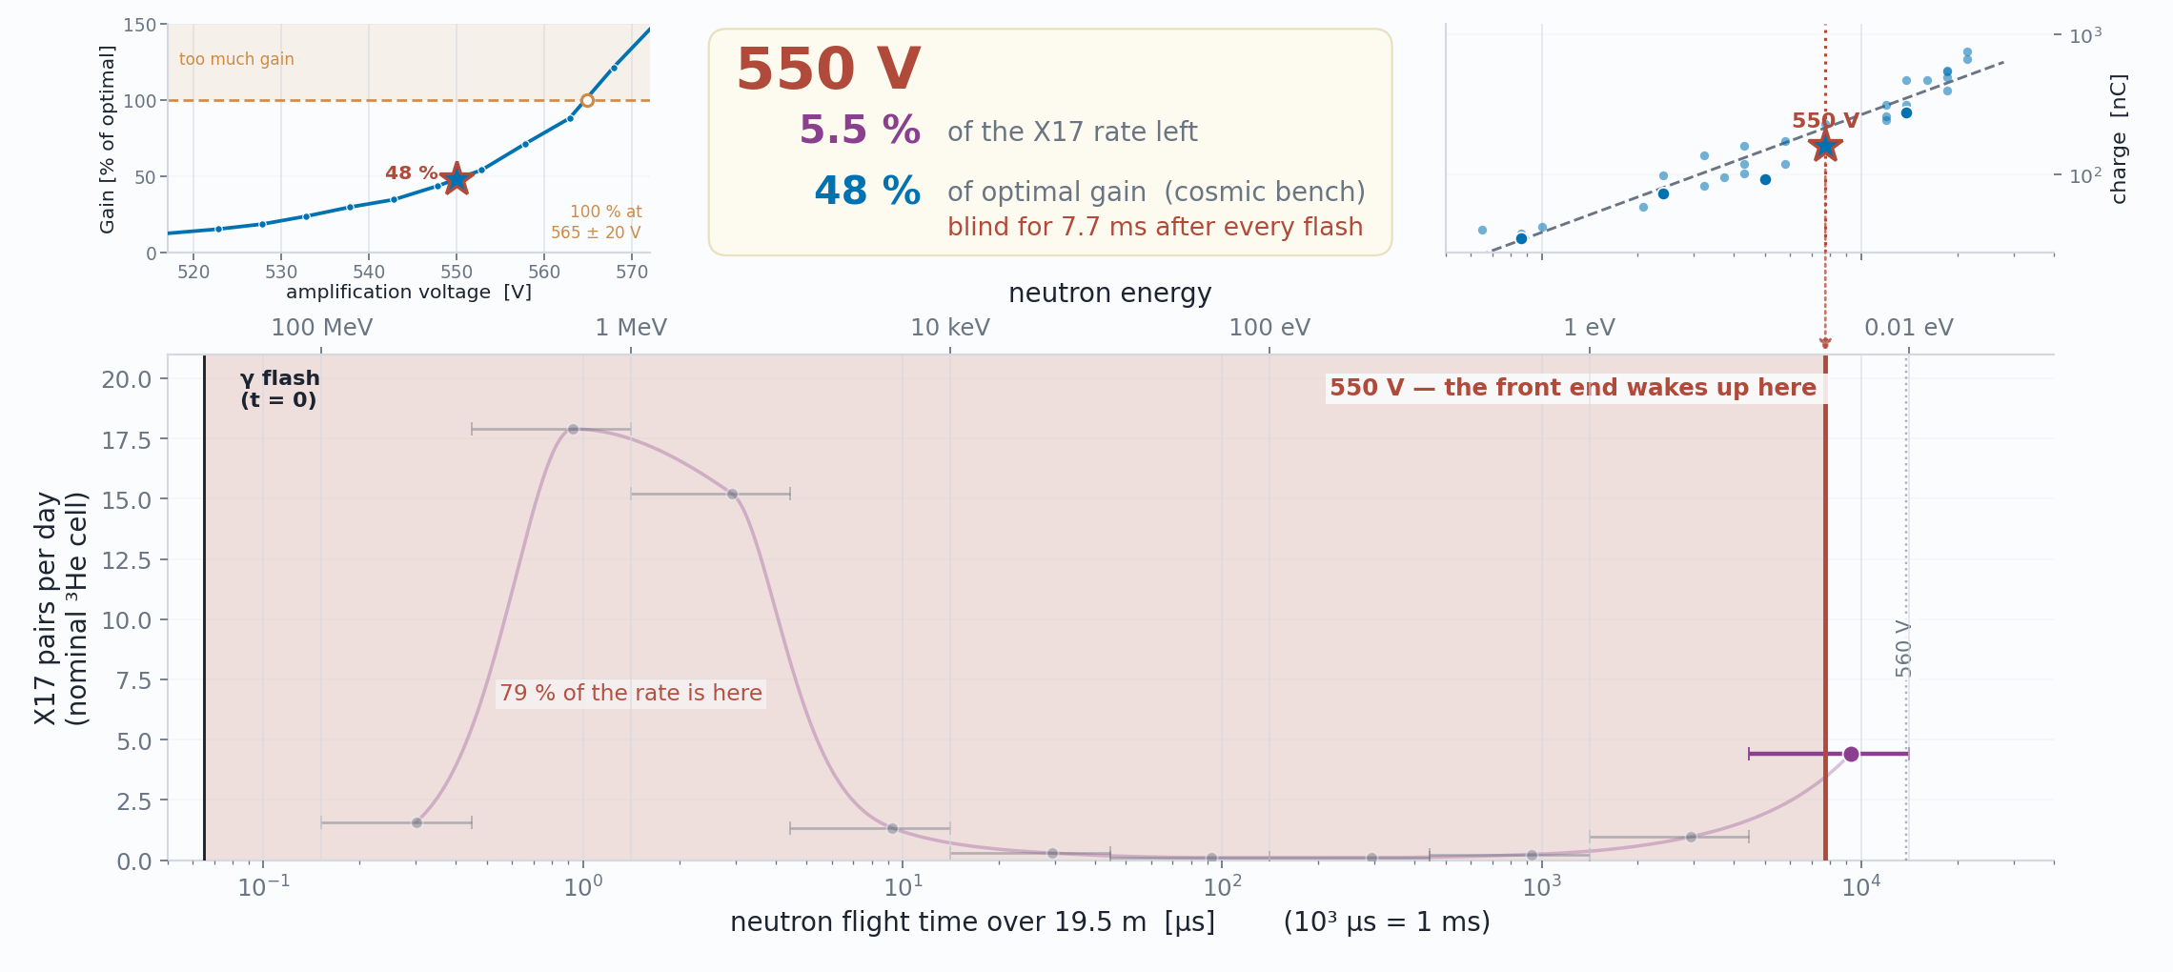
Status · The environment
Every volt of gain costs milliseconds of beam
D. Neff · n_TOF Collaboration Meeting, Athens · 1 October 2026
14.2 / 18

Slide 22
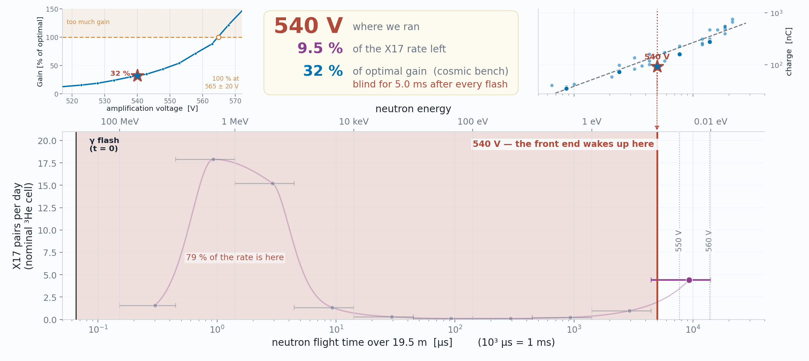
Status · The environment
Every volt of gain costs milliseconds of beam
D. Neff · n_TOF Collaboration Meeting, Athens · 1 October 2026
14.3 / 18

Slide 23
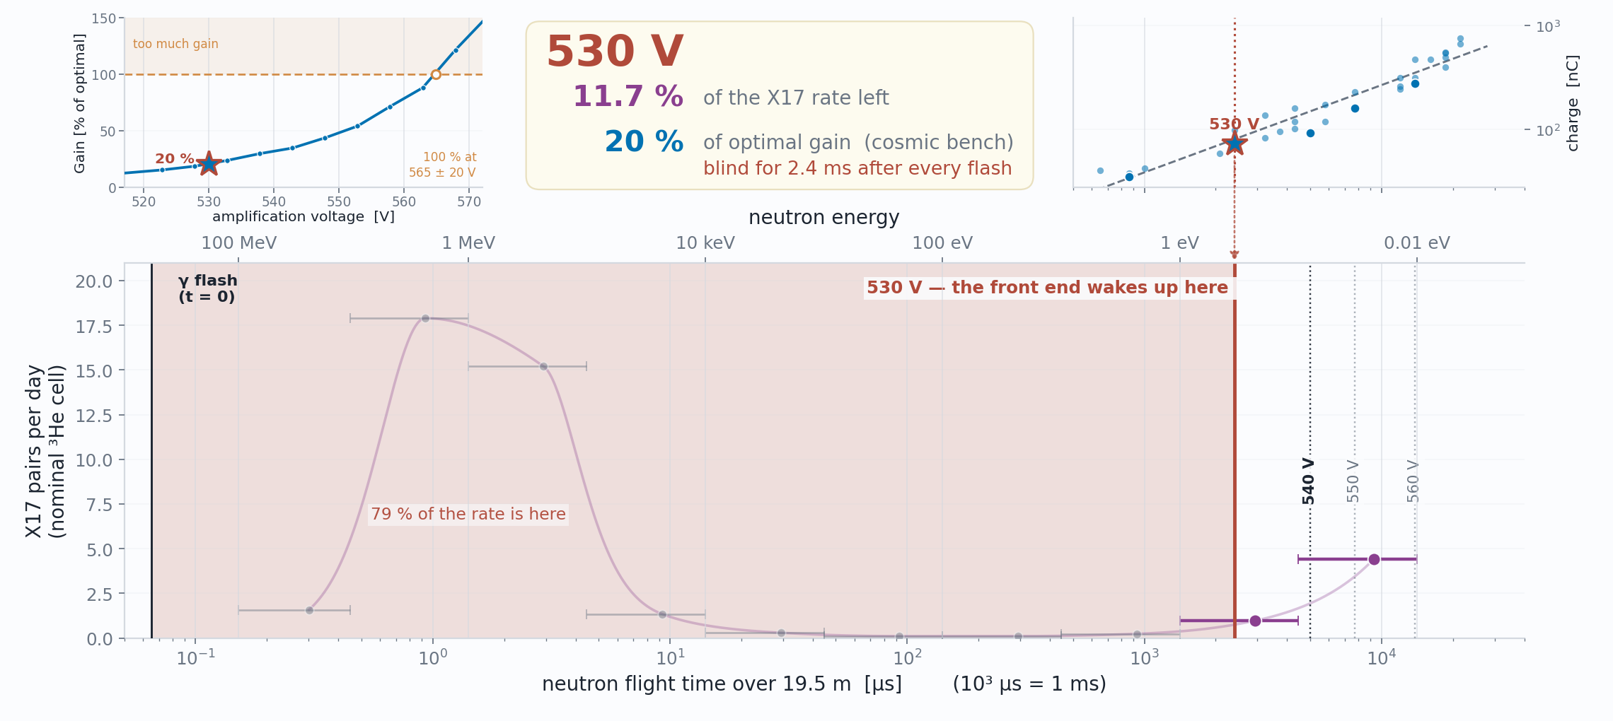
Status · The environment
Every volt of gain costs milliseconds of beam
D. Neff · n_TOF Collaboration Meeting, Athens · 1 October 2026
14.4 / 18

Slide 24
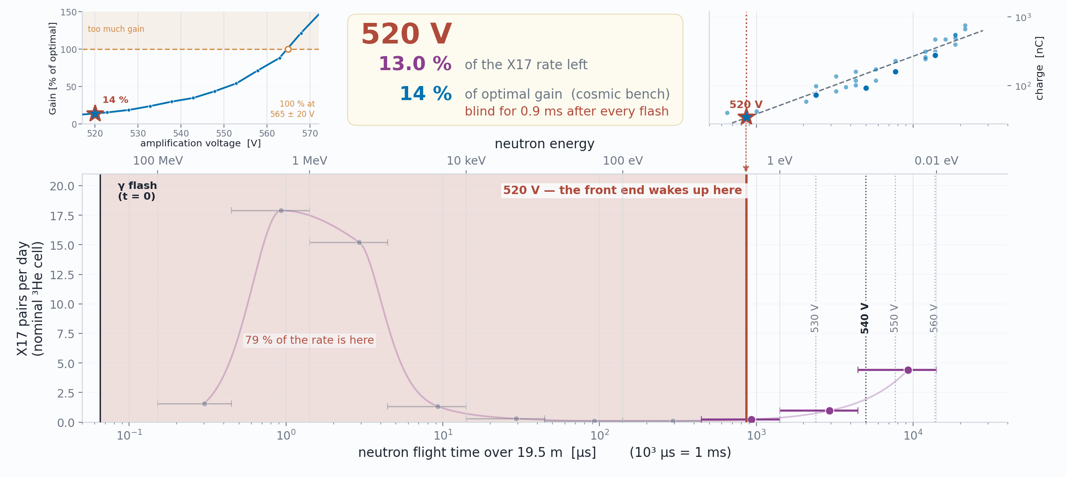
Status · The environment
Every volt of gain costs milliseconds of beam
D. Neff · n_TOF Collaboration Meeting, Athens · 1 October 2026
14.5 / 18

Slide 25
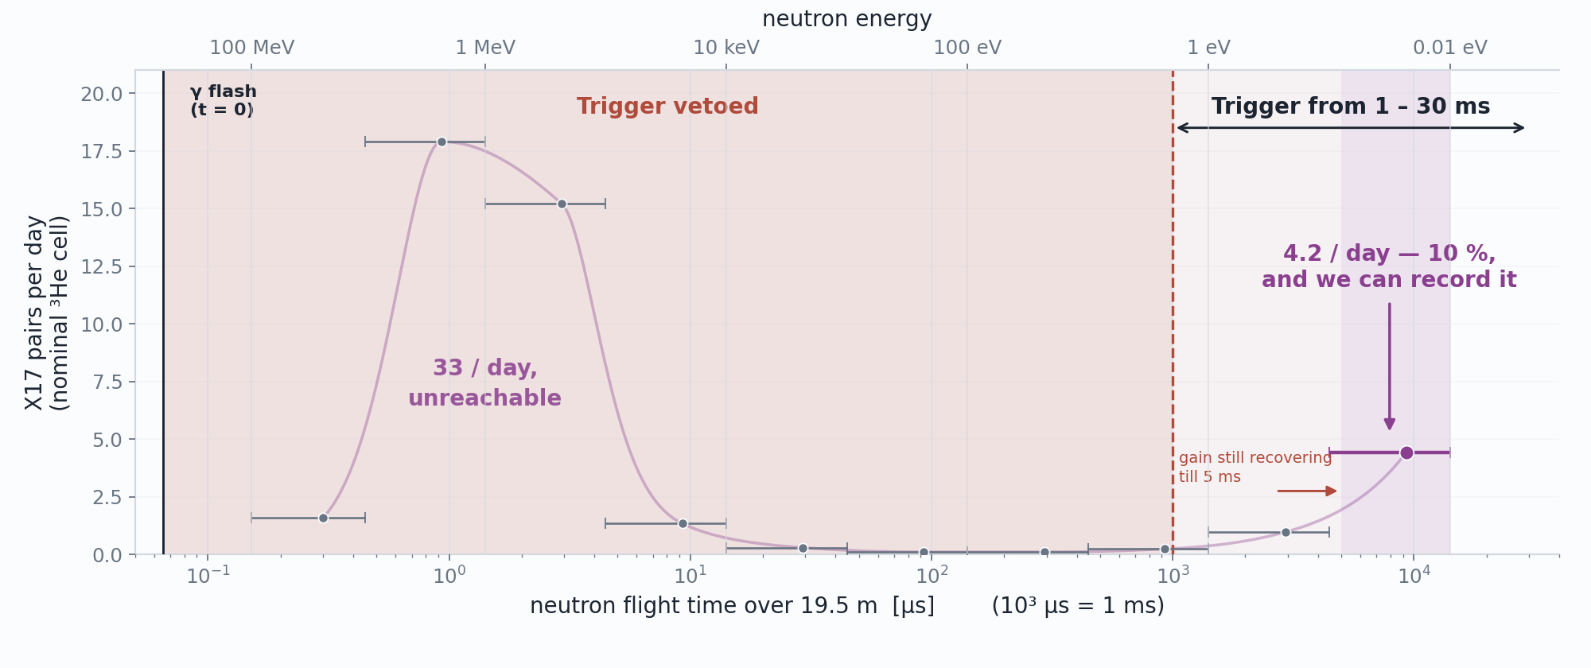
Status · What we could measure
Let’s make the measurement at thermals!
D. Neff · n_TOF Collaboration Meeting, Athens · 1 October 2026
15 / 18

Slide 26
Status · What we could measure
Let’s make the measurement at thermals!
Nothing we tried could recover high energy measurement before July.
Let’s take the statistics hit and measure at thermals!
D. Neff · n_TOF Collaboration Meeting, Athens · 1 October 2026
15 / 18

Slide 27
The Problem with Thermals
Statistics disapear
D. Neff · n_TOF Collaboration Meeting, Athens · 1 October 2026

Slide 28
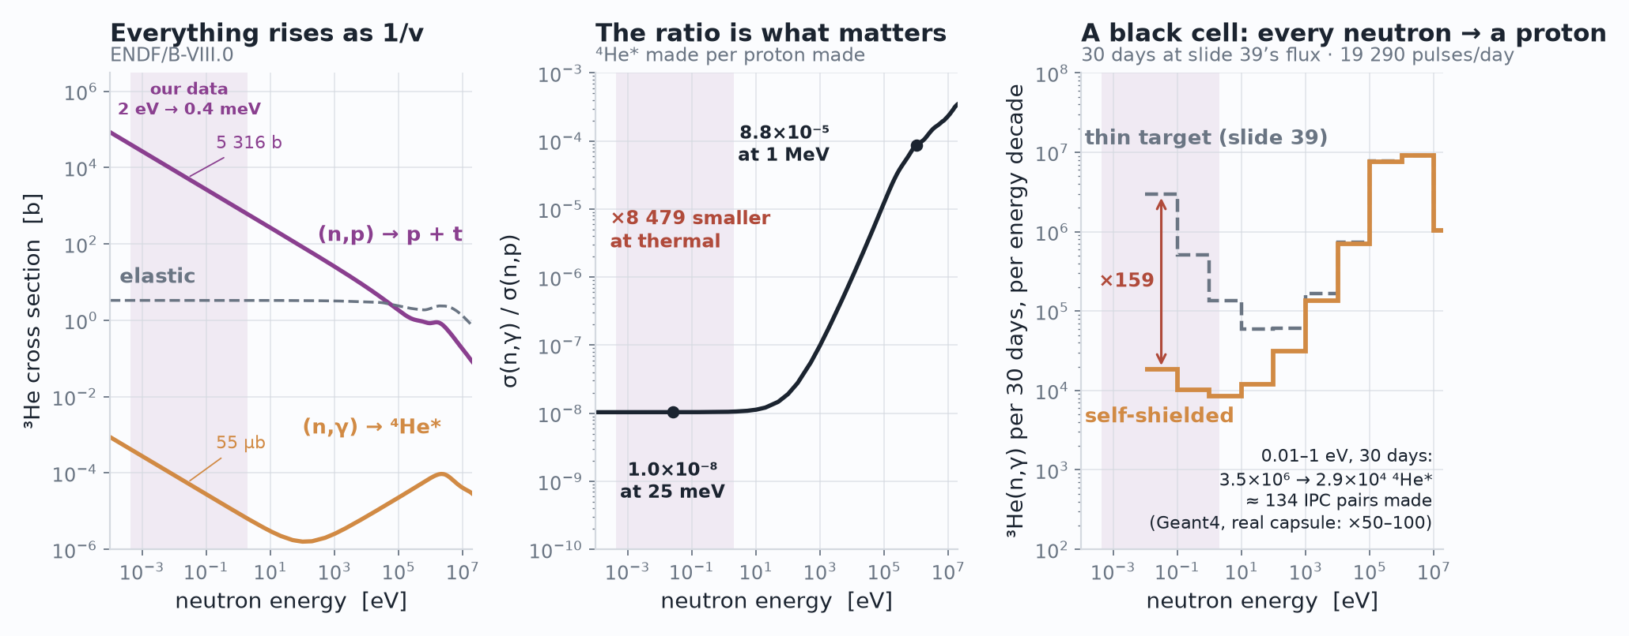
Status · What we could measure
Problem: (n, p) dominates!
D. Neff · n_TOF Collaboration Meeting, Athens · 1 October 2026
15 / 18

Slide 29
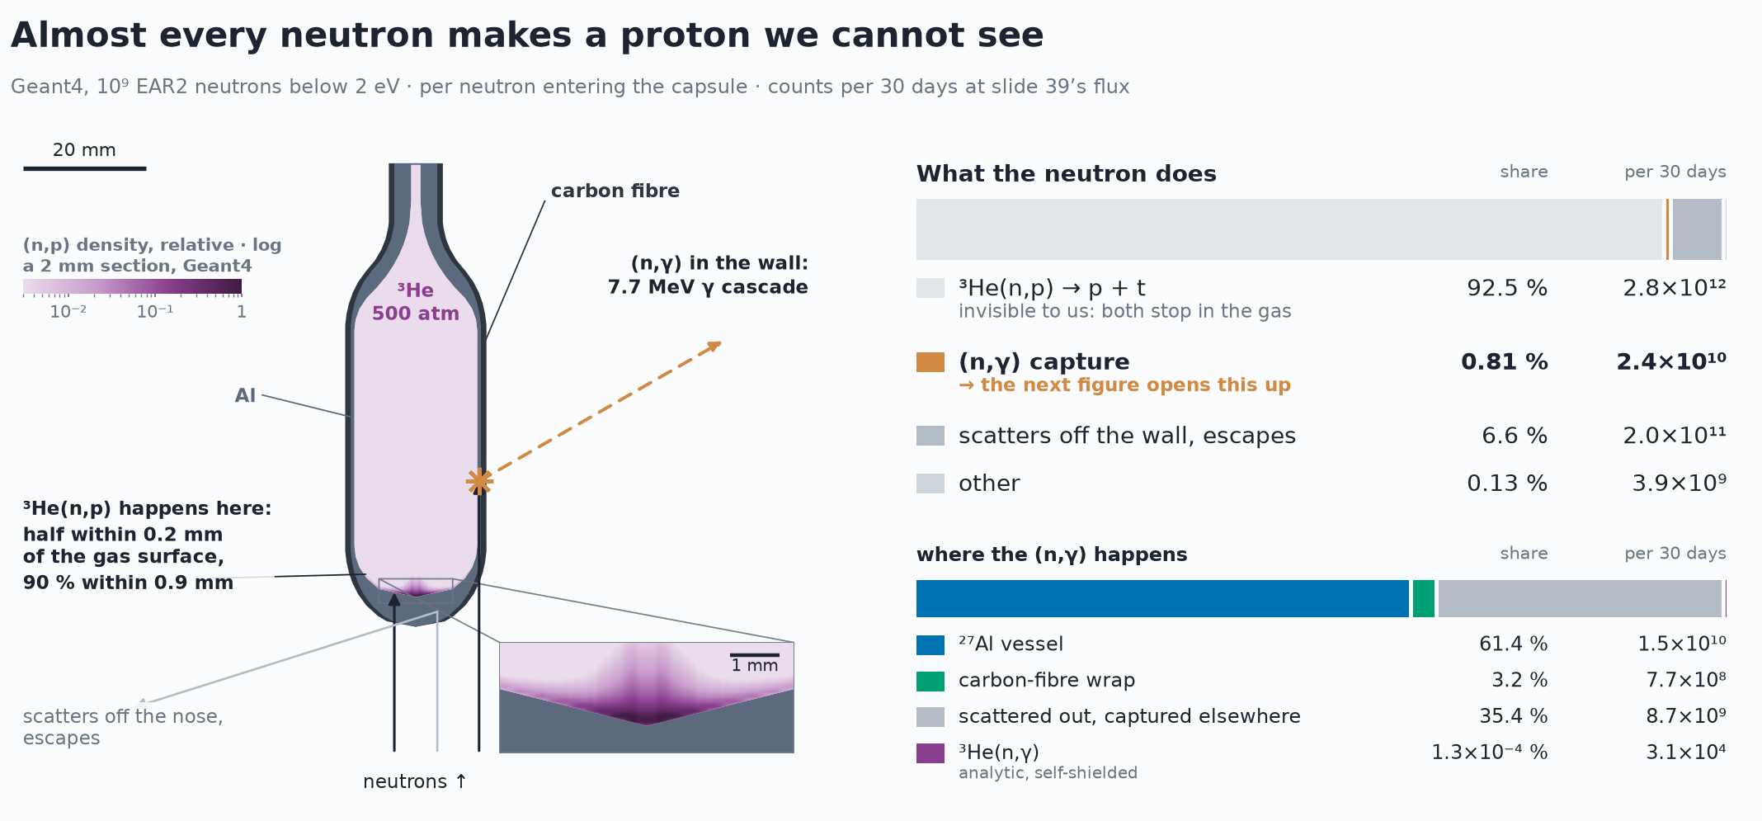
Status · What we could measure
Problem: (n, p) dominates! (n, γ) self-shielded!
Situation seems grim
Make the measurement we can
D. Neff · n_TOF Collaboration Meeting, Athens · 1 October 2026
15 / 18

Slide 30
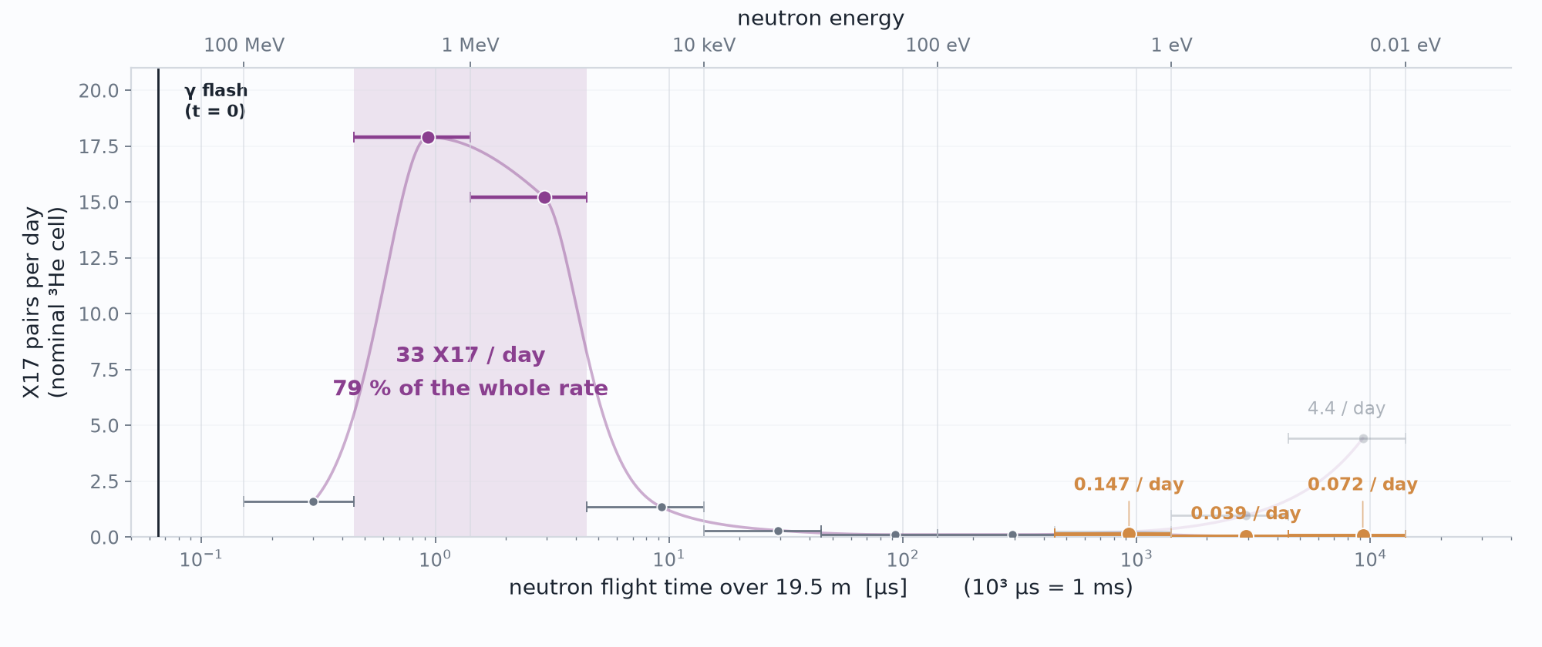
Status · What we could measure
Thermal Rate Lost
D. Neff · n_TOF Collaboration Meeting, Athens · 1 October 2026
15 / 18

Slide 31
The EAR2 Setup
An apparatus capable of detecting X17
D. Neff · n_TOF Collaboration Meeting, Athens · 1 October 2026

Slide 32
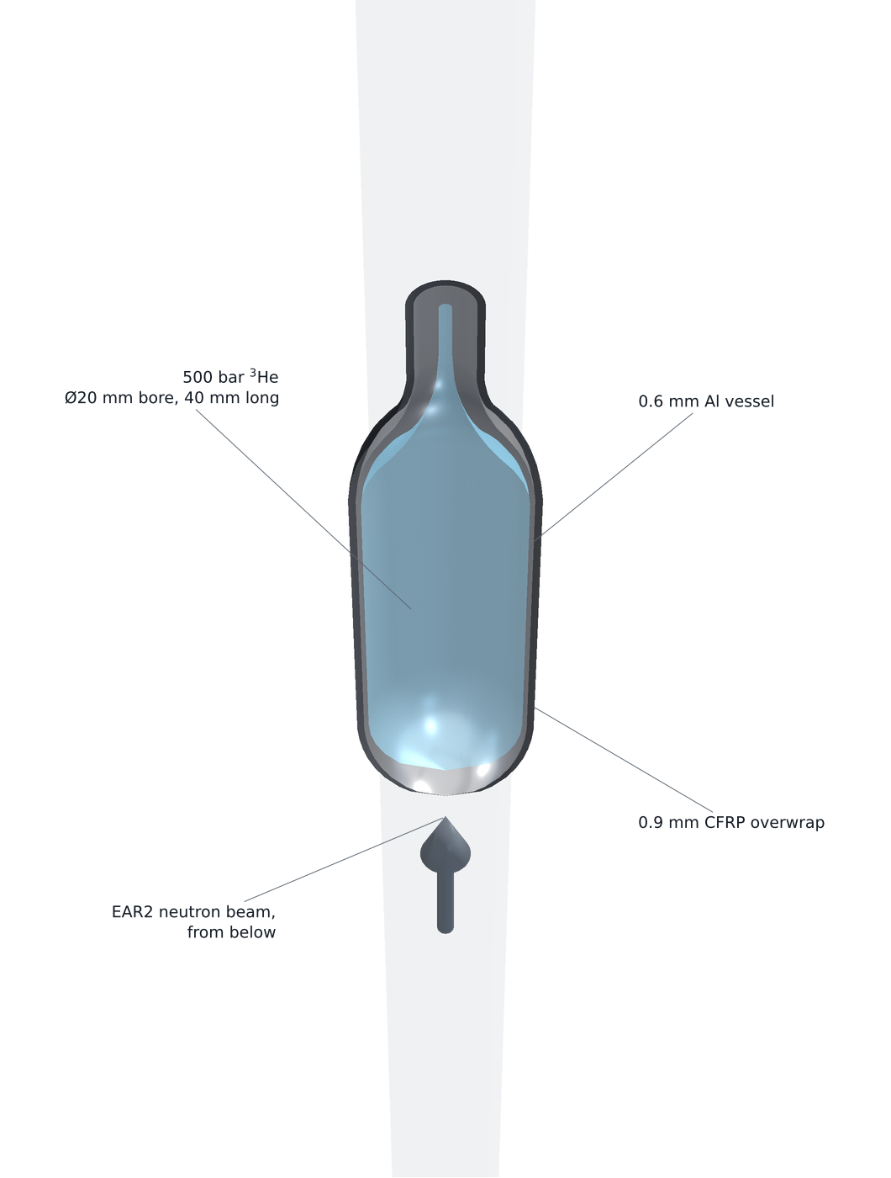
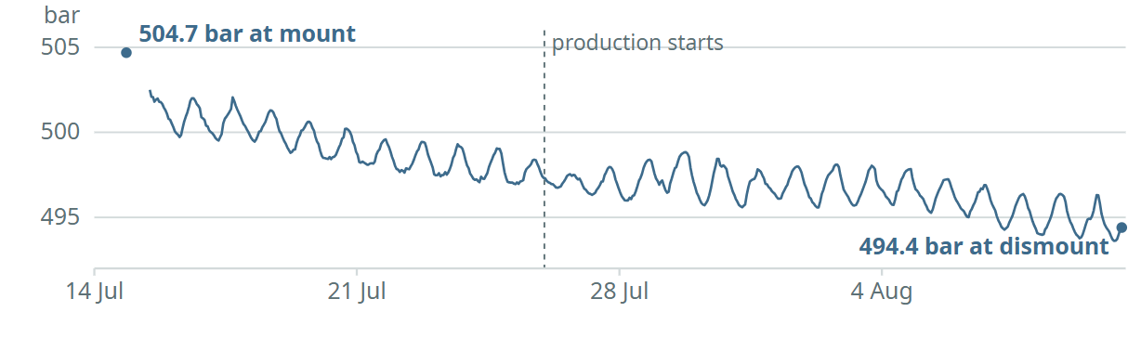
X17 search at n_TOF · Experimental setup
The vessel, as built: 500 bar of ³He in the beam
500 bar ³He
Ø20 mm bore,
40 mm long
0.6 mm Al
vessel
500 bar of ³He in as thin a capsule as we can build — least scattering on the way out, most interaction on the way in.
Ø20 mm bore, 40 mm of gas, domed both ends —
walls of 0.6 mm Al + 0.9 mm CFRP.
0.9 mm CFRP
overwrap
EAR2 neutron beam,
from below
D. Neff · n_TOF Collaboration Meeting, Athens · 1 October 2026
8.1 / 18

Slide 33
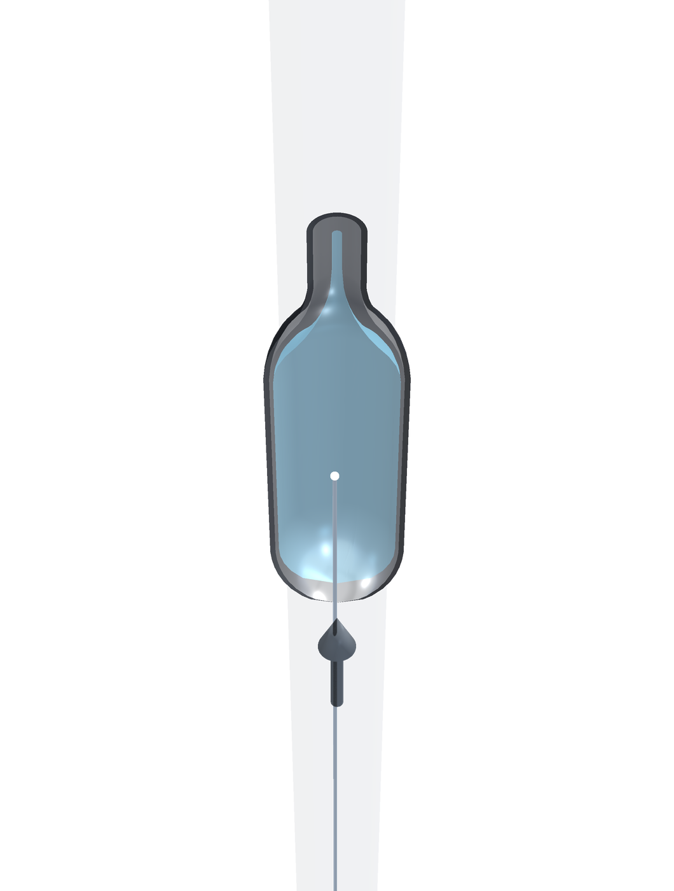
X17 search at n_TOF · Experimental setup
A neutron arrives
500 bar of ³He in as thin a capsule as we can build — least scattering on the way out, most interaction on the way in.
The neutron beam arrives from below and interacts in the ³He gas volume.
D. Neff · n_TOF Collaboration Meeting, Athens · 1 October 2026
8.2 / 18

Slide 34
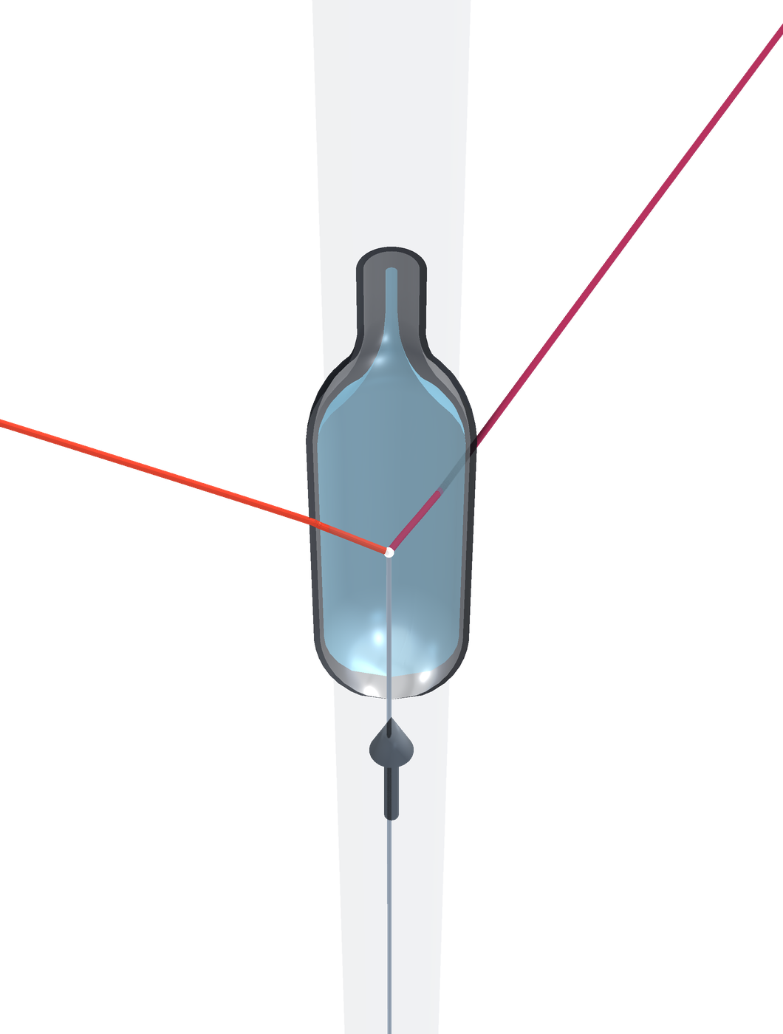
X17 search at n_TOF · Experimental setup
…and a pair leaves
500 bar of ³He in as thin a capsule as we can build — least scattering on the way out, most interaction on the way in.
The neutron beam arrives from below and interacts in the ³He gas volume.
Some probability of internal pair conversion — or of X17 → e⁺e⁻ — leaving the capsule, with some scattering in its wall.
e⁻
e⁺
neutron
beam
D. Neff · n_TOF Collaboration Meeting, Athens · 1 October 2026
8.3 / 18

Slide 35
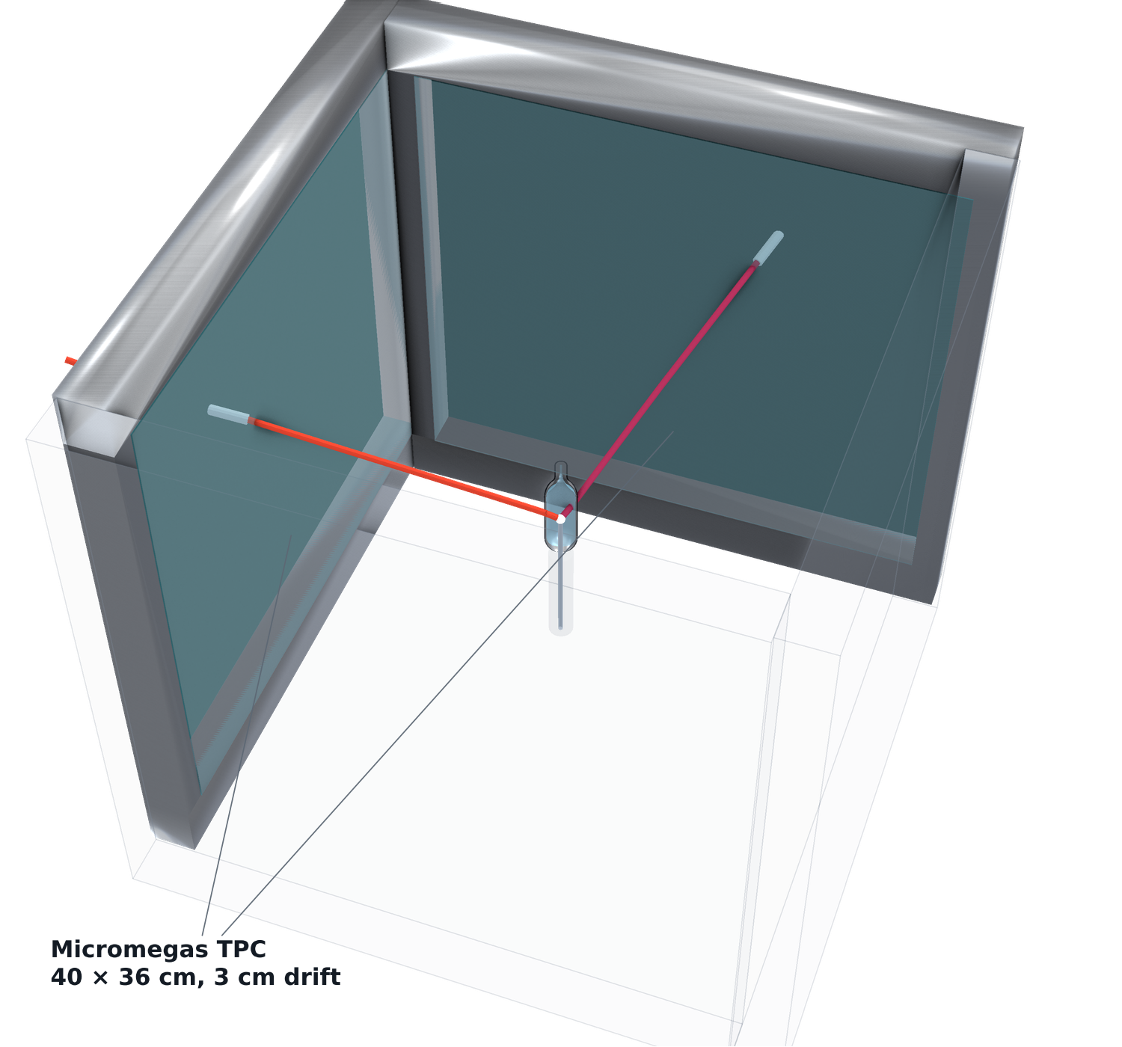
X17 search at n_TOF · Experimental setup
Now build something that can catch them
Reduce material budget until the track angles have been recorded with four Micromegas TPCs
D. Neff · n_TOF Collaboration Meeting, Athens · 1 October 2026
8.4 / 18

Slide 36
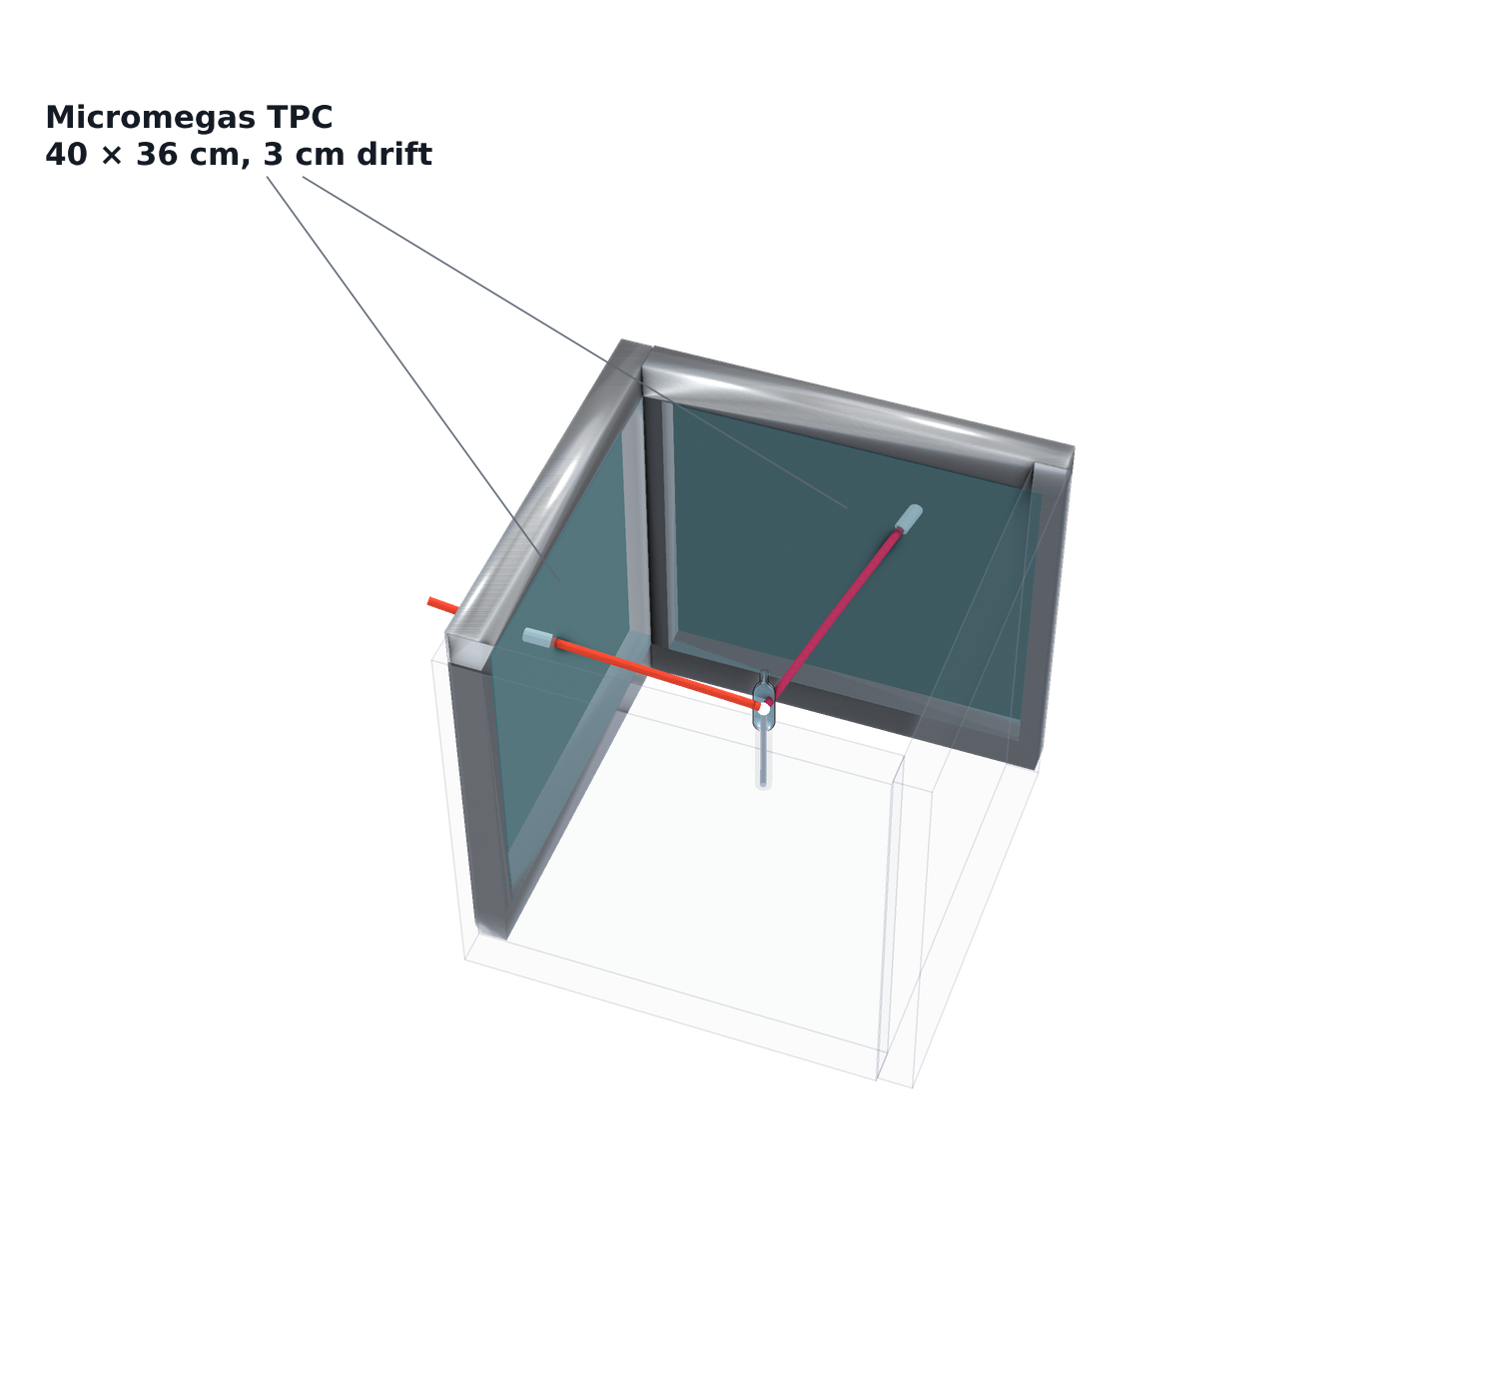
X17 search at n_TOF · Experimental setup
+ four Micromegas TPCs
Reduce material budget until the track angles have been recorded with four Micromegas TPCs
Need an external trigger for these trackers
D. Neff · n_TOF Collaboration Meeting, Athens · 1 October 2026
8.5 / 18

Slide 37
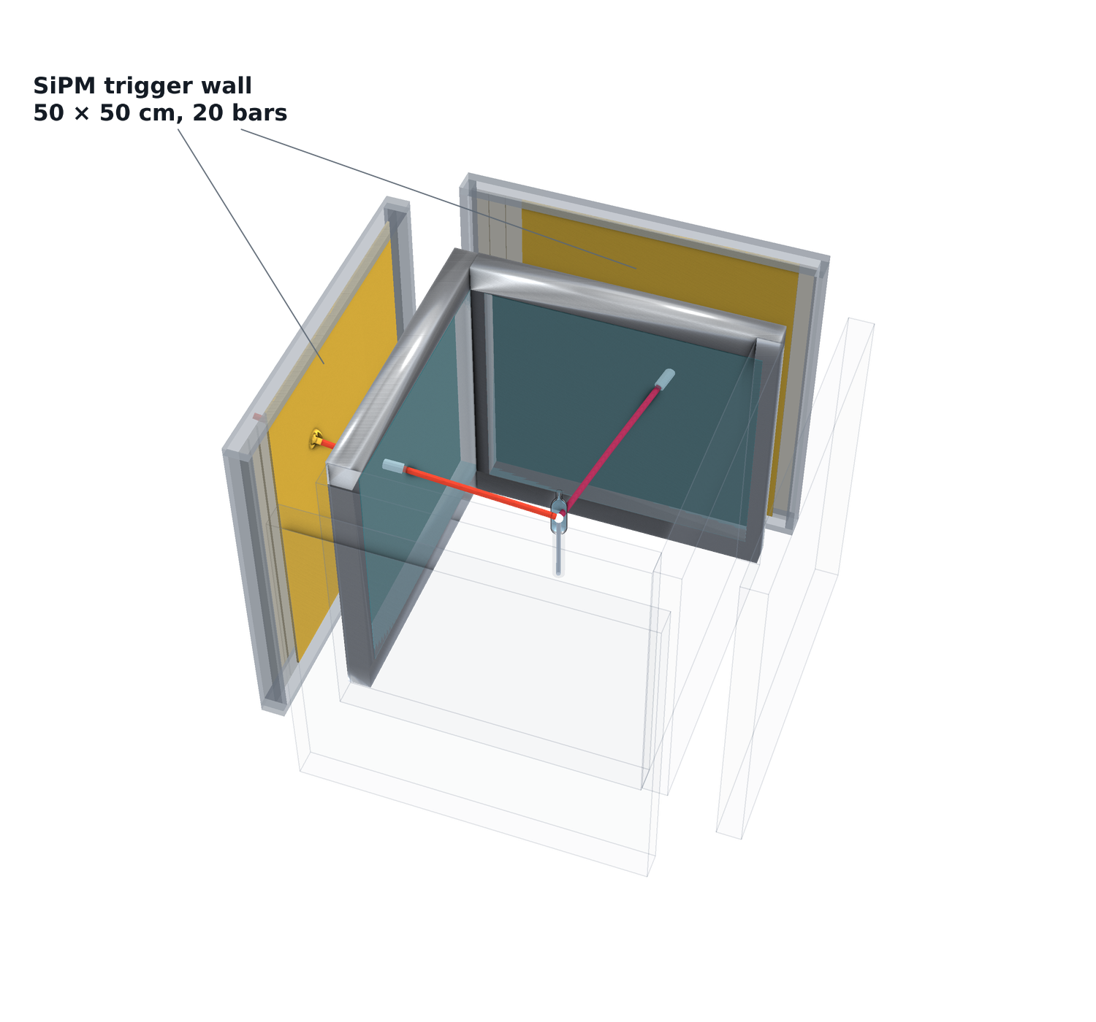
X17 search at n_TOF · Experimental setup
+ the SiPM trigger wall
Reduce material budget until the track angles have been recorded with four Micromegas TPCs
Need an external trigger for these trackers
Thin vertical scintillator bars readout by SiPMs: register the hit without stopping the electron or the positron. Precise timing.
D. Neff · n_TOF Collaboration Meeting, Athens · 1 October 2026
8.6 / 18

Slide 38
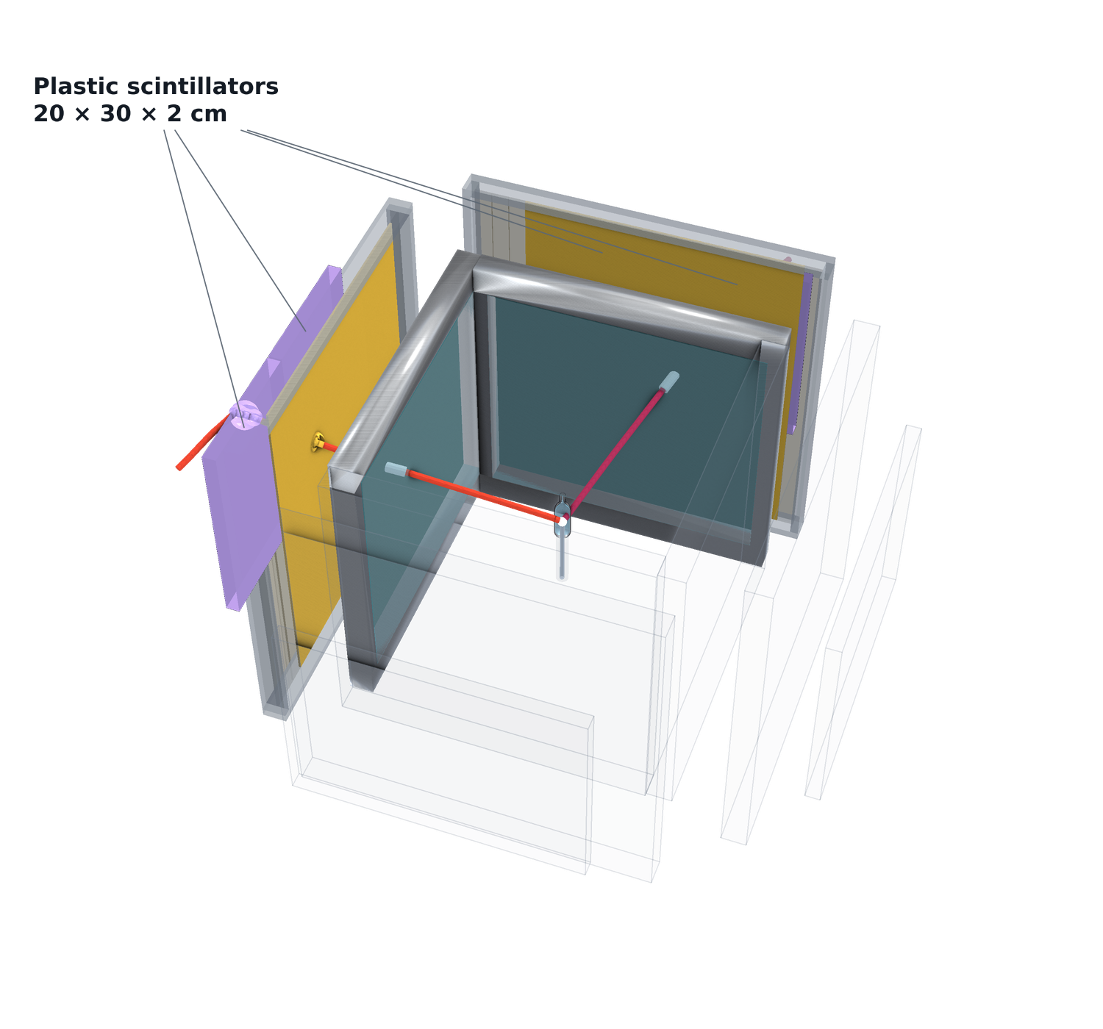
X17 search at n_TOF · Experimental setup
+ the plastic scintillators
Reduce material budget until the track angles have been recorded with four Micromegas TPCs
Need an external trigger for these trackers
Thin vertical scintillator bars readout by SiPMs: register the hit without stopping the electron or the positron. Precise timing.
2cm thick plastic scintillators complete the coincidence with the trigger wall.
D. Neff · n_TOF Collaboration Meeting, Athens · 1 October 2026
8.7 / 18

Slide 39
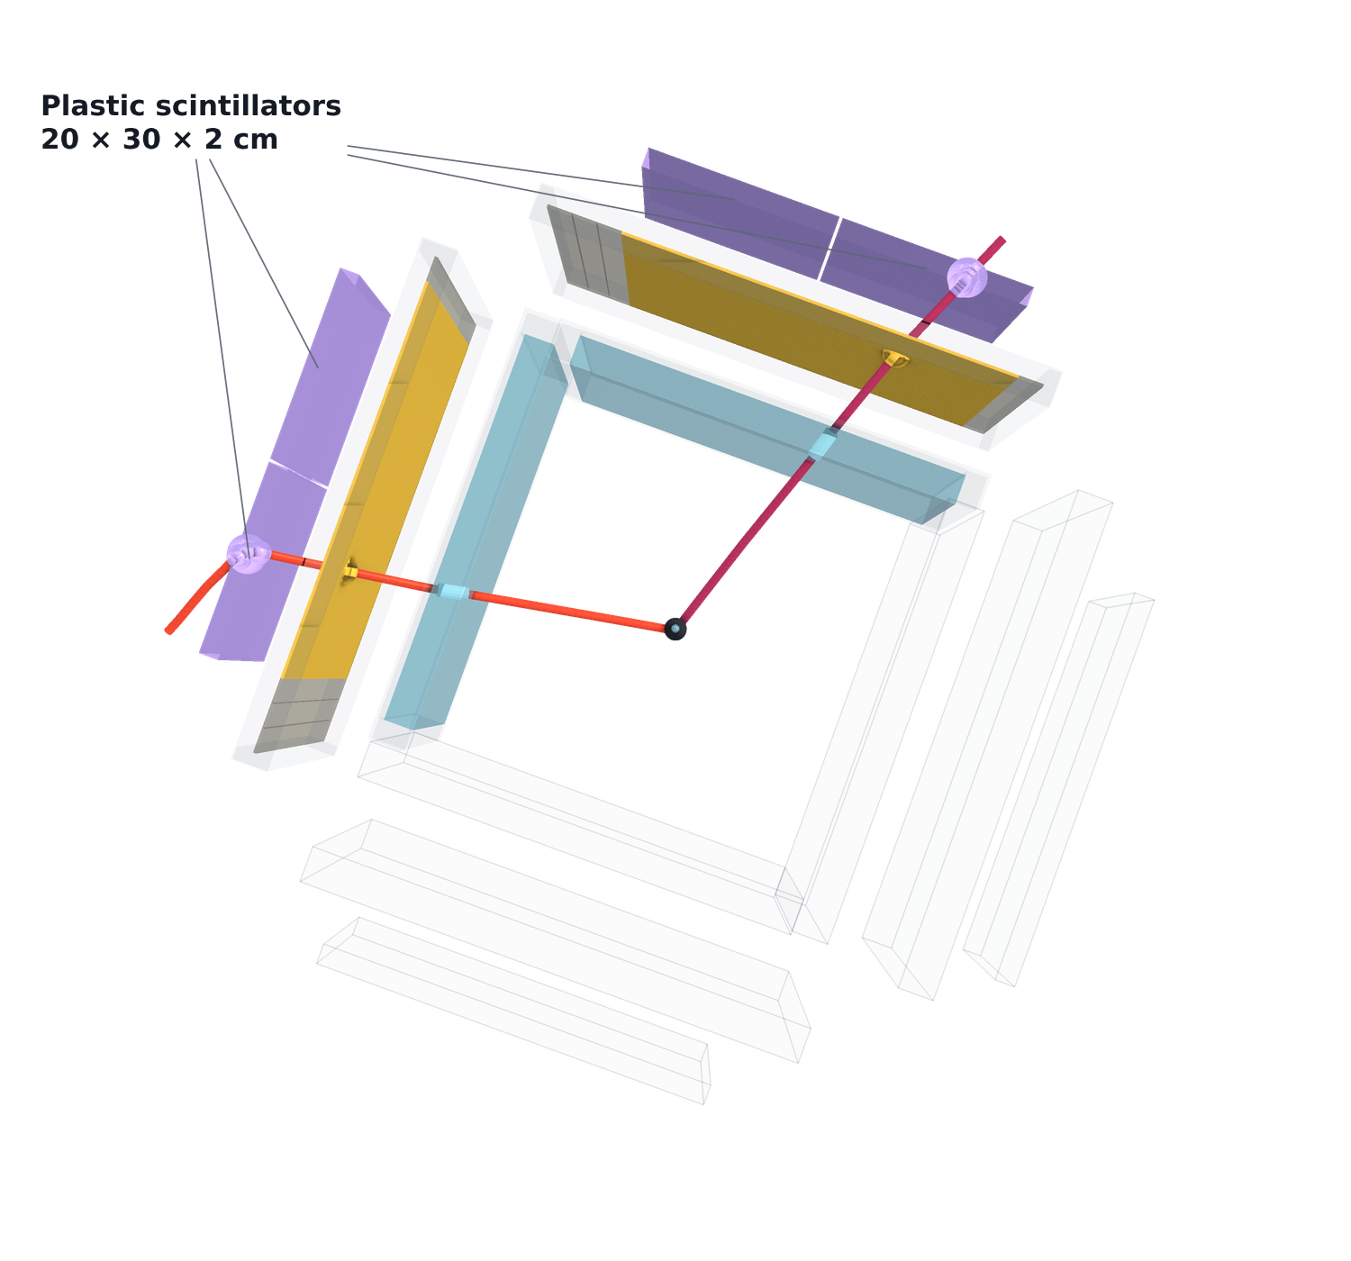
X17 search at n_TOF · Experimental setup
The same event from above — where the pair goes
Reduce material budget until the track angles have been recorded with four Micromegas TPCs
Need an external trigger for these trackers
Thin vertical scintillator bars readout by SiPMs: register the hit without stopping the electron or the positron. Precise timing.
2cm thick plastic scintillators complete the coincidence with the trigger wall.
Also provides stopping for calorimetry
D. Neff · n_TOF Collaboration Meeting, Athens · 1 October 2026
8.8 / 18

Slide 40
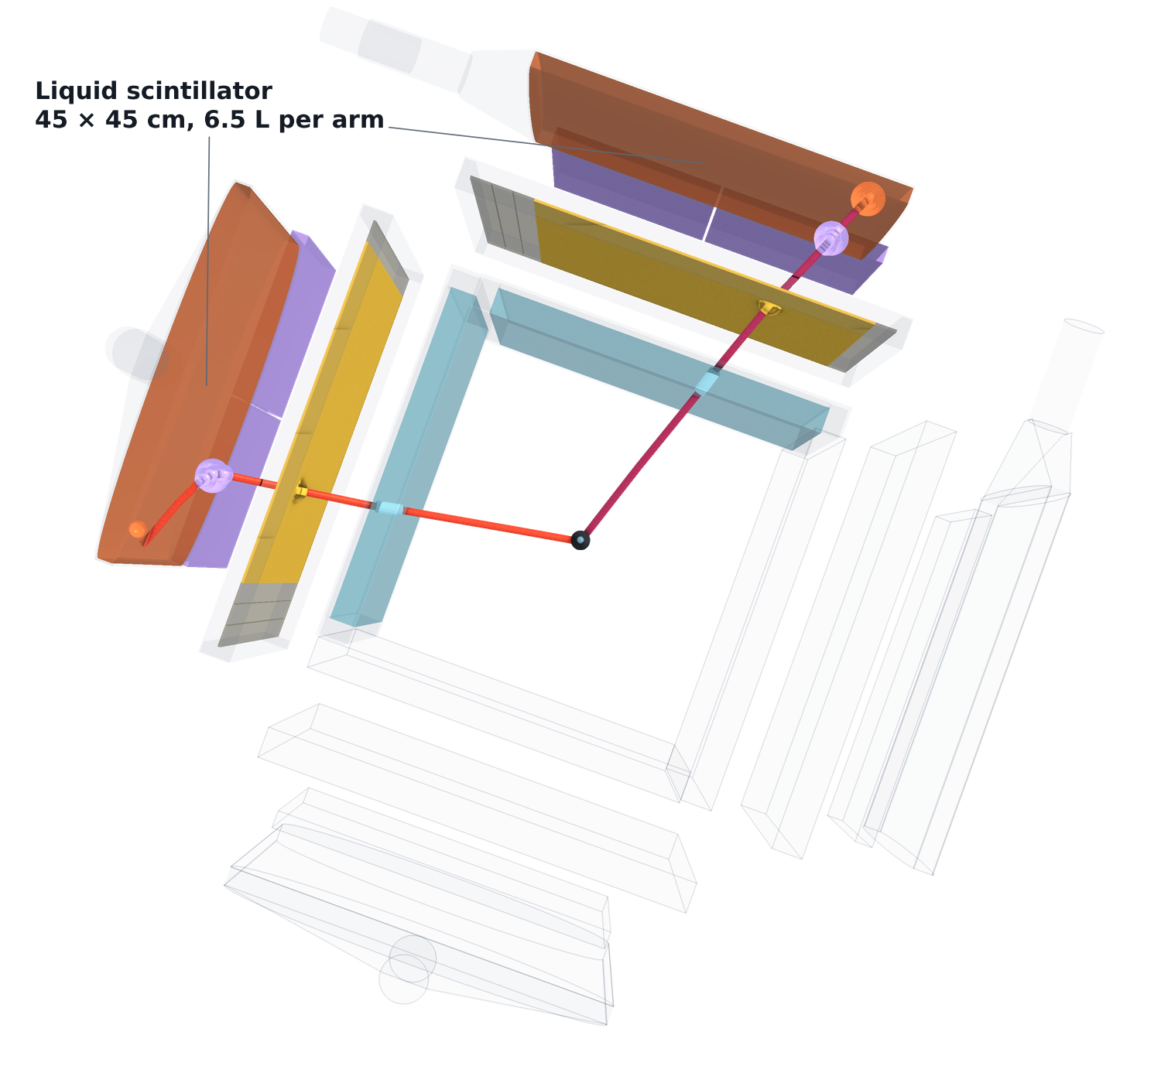
X17 search at n_TOF · Experimental setup
+ liquid-scintillator calorimetry — the full setup
Reduce material budget until the track angles have been recorded with four Micromegas TPCs
Need an external trigger for these trackers
Thin vertical scintillator bars readout by SiPMs: register the hit without stopping the electron or the positron. Precise timing.
2cm thick plastic scintillators complete the coincidence with the trigger wall.
Also provides stopping for calorimetry
Add 2cm of liquid scintillator to stop the pair completely
D. Neff · n_TOF Collaboration Meeting, Athens · 1 October 2026
8.9 / 18

Slide 41
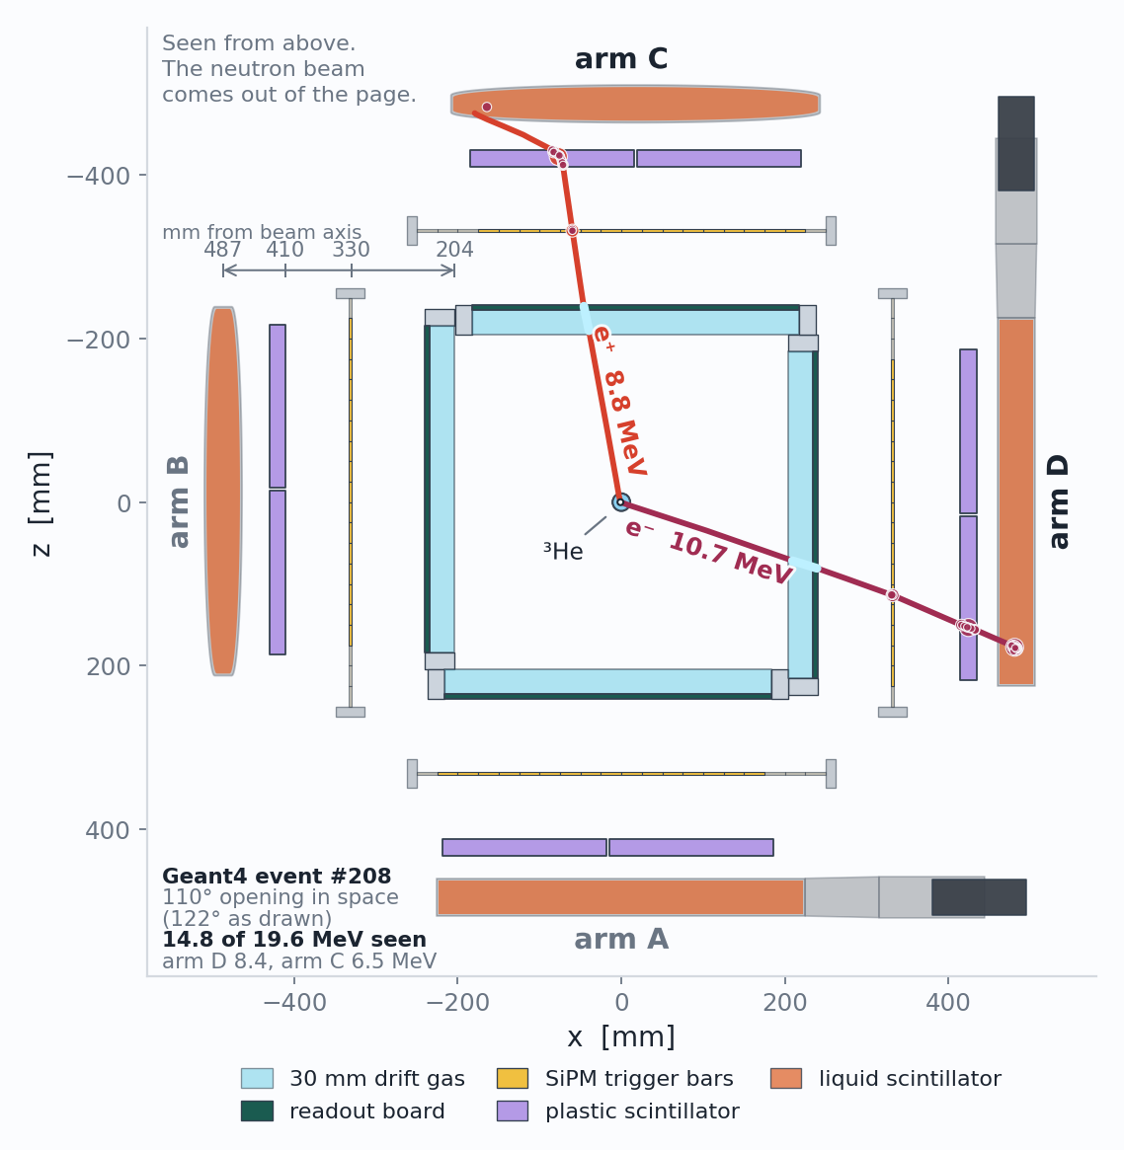
X17 search at n_TOF · Experimental setup
The same setup from above
Opening angle from the Micromegas, before anything else touches the pair.
Trigger and timing from the wall and the plastics.
Calorimetry from the full scintillator stack.
D. Neff · n_TOF Collaboration Meeting, Athens · 1 October 2026
8.10 / 18

Slide 42
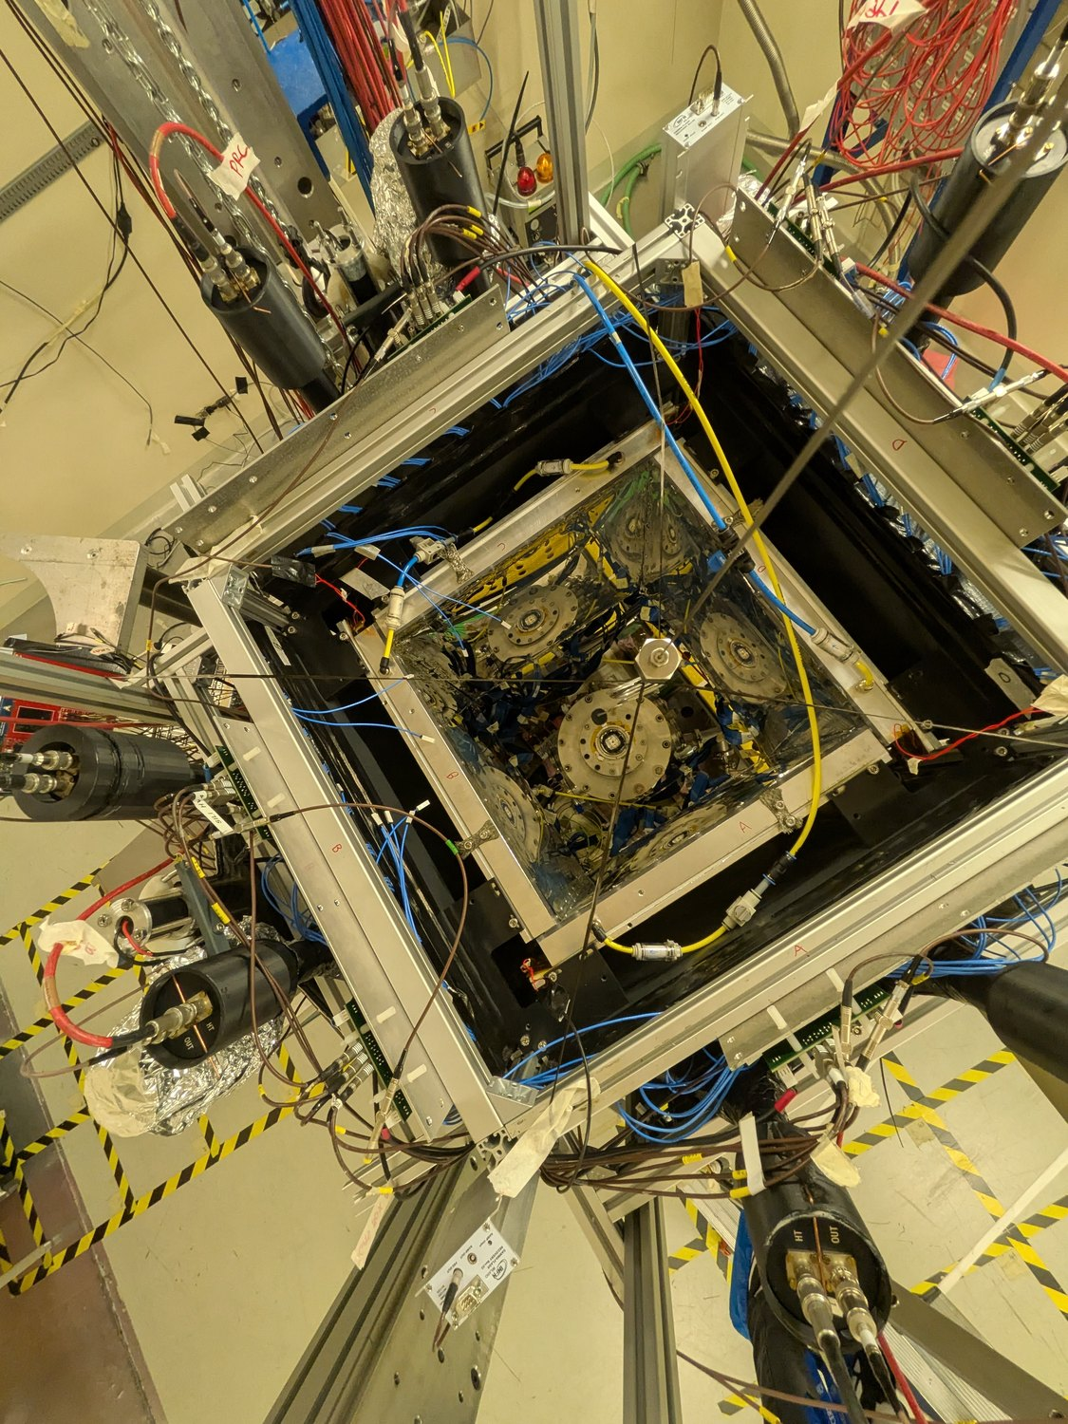
X17 search at n_TOF · Experimental setup
A look at the actual experiment – ran this July+August
Looking down into the station · n_TOF EAR2, 10 August 2026
D. Neff · n_TOF Collaboration Meeting, Athens · 1 October 2026
9.1 / 18

Slide 43
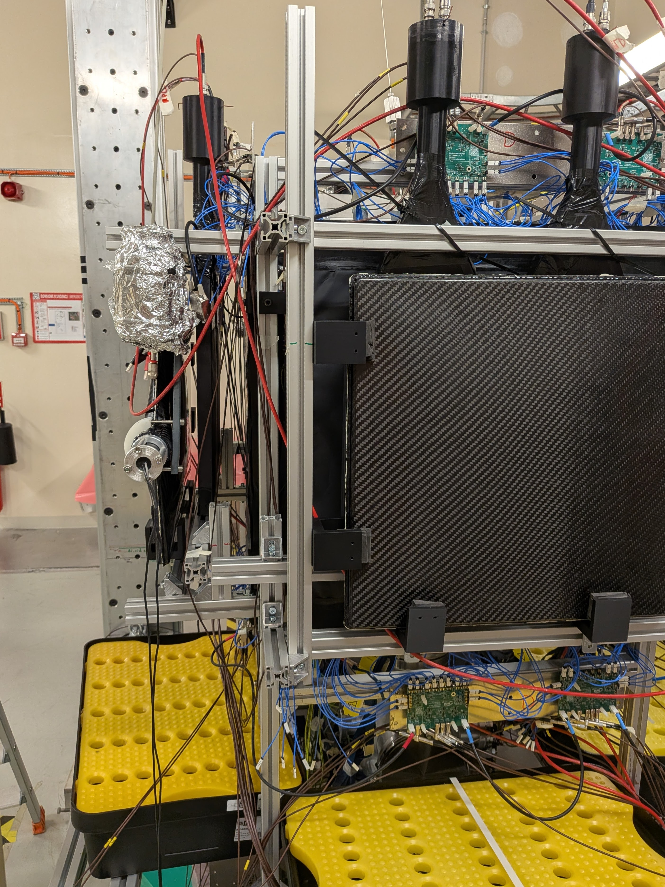
X17 search at n_TOF · Experimental setup
A look at the actual experiment – ran this July+August
Looking down into the station · n_TOF EAR2, 10 August 2026
One arm, from outside · n_TOF EAR2, 10 August 2026
D. Neff · n_TOF Collaboration Meeting, Athens · 1 October 2026
9.2 / 18

Slide 44
Measurement Status
What the campaign actually recorded, and the problems we faced.
D. Neff · n_TOF Collaboration Meeting, Athens · 1 October 2026

Slide 45
Status
Experiment timeline and statistics
D. Neff · n_TOF Collaboration Meeting, Athens · 1 October 2026
10.1 / 18

Slide 46
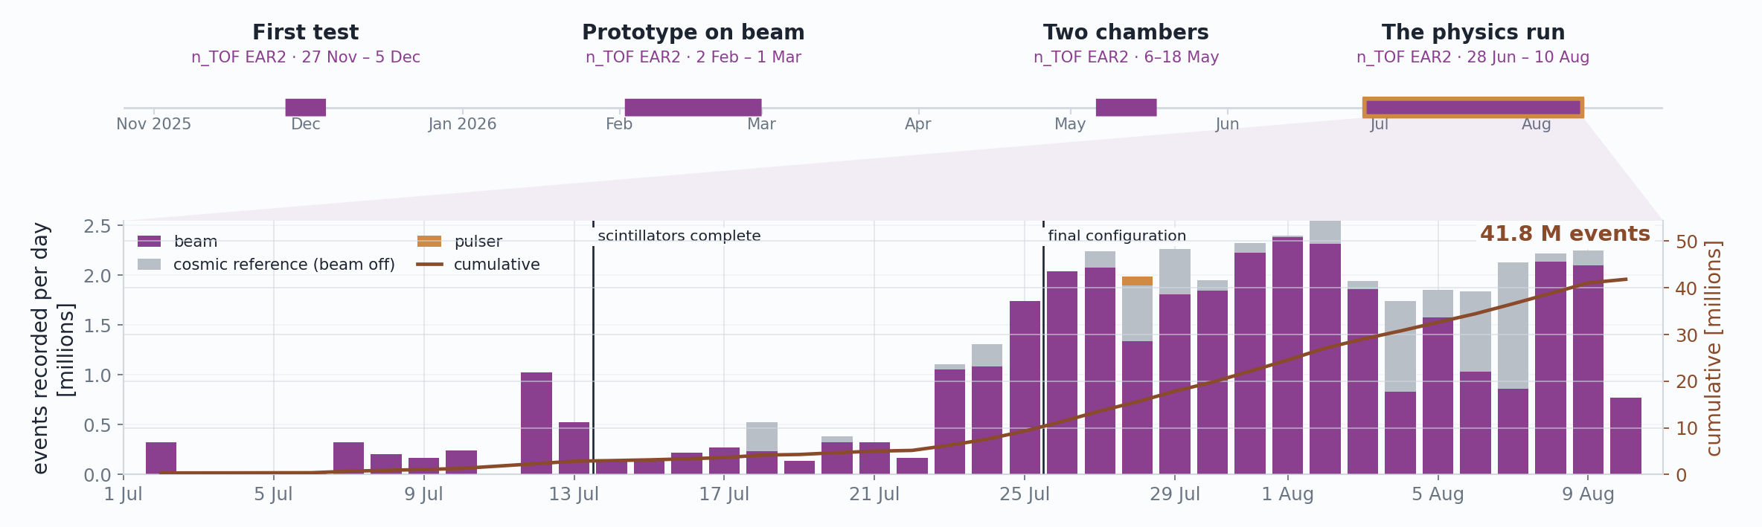
Status
Experiment timeline and statistics
41.8 M
17.9 TB
436,373
events recorded — 35.9 M on beam, 5.8 M cosmic reference
on EOS, across 162 runs / 2,705 sub-runs
beam pulses on target over 44 days
D. Neff · n_TOF Collaboration Meeting, Athens · 1 October 2026
10.2 / 18

Slide 47
Status · What we could measure
What we expect at thermals -- aluminum
Realized in July after running Geant4 simulation that 3He self-shields at thermal energies and actually aluminum capture will dominate e+e- production.
Unfortunately, we don’t expect to see X17 or even 3He IPC, but aluminum gamma → pair conversion
Show the simulation of where our expected e+e- come from at thermal energies. Mostly aluminum
Show 3He branching ratio vs neutron energy
Show e+e- source breakdown
D. Neff · n_TOF Collaboration Meeting, Athens · 1 October 2026
15 / 18

Slide 48
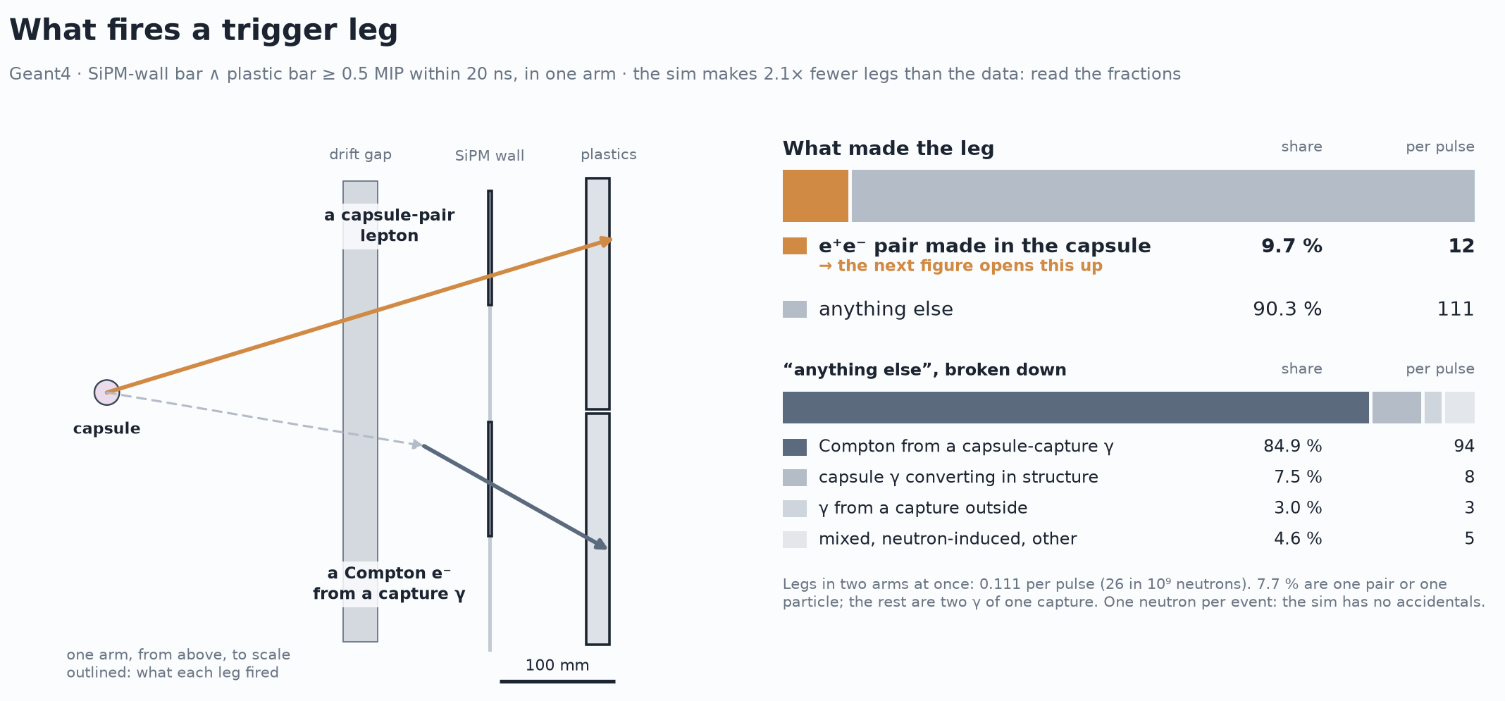
Status · What we could measure
What we expect at thermals -- aluminum
D. Neff · n_TOF Collaboration Meeting, Athens · 1 October 2026
15 / 18

Slide 49
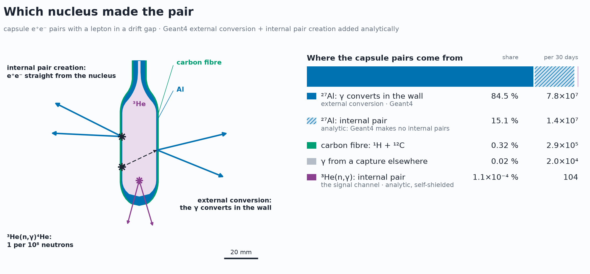
Status · What we could measure
What we expect at thermals -- aluminum
D. Neff · n_TOF Collaboration Meeting, Athens · 1 October 2026
15 / 18

Slide 50
Early Reconstruction
First attempts at track reconstruction
D. Neff · n_TOF Collaboration Meeting, Athens · 1 October 2026

Slide 51
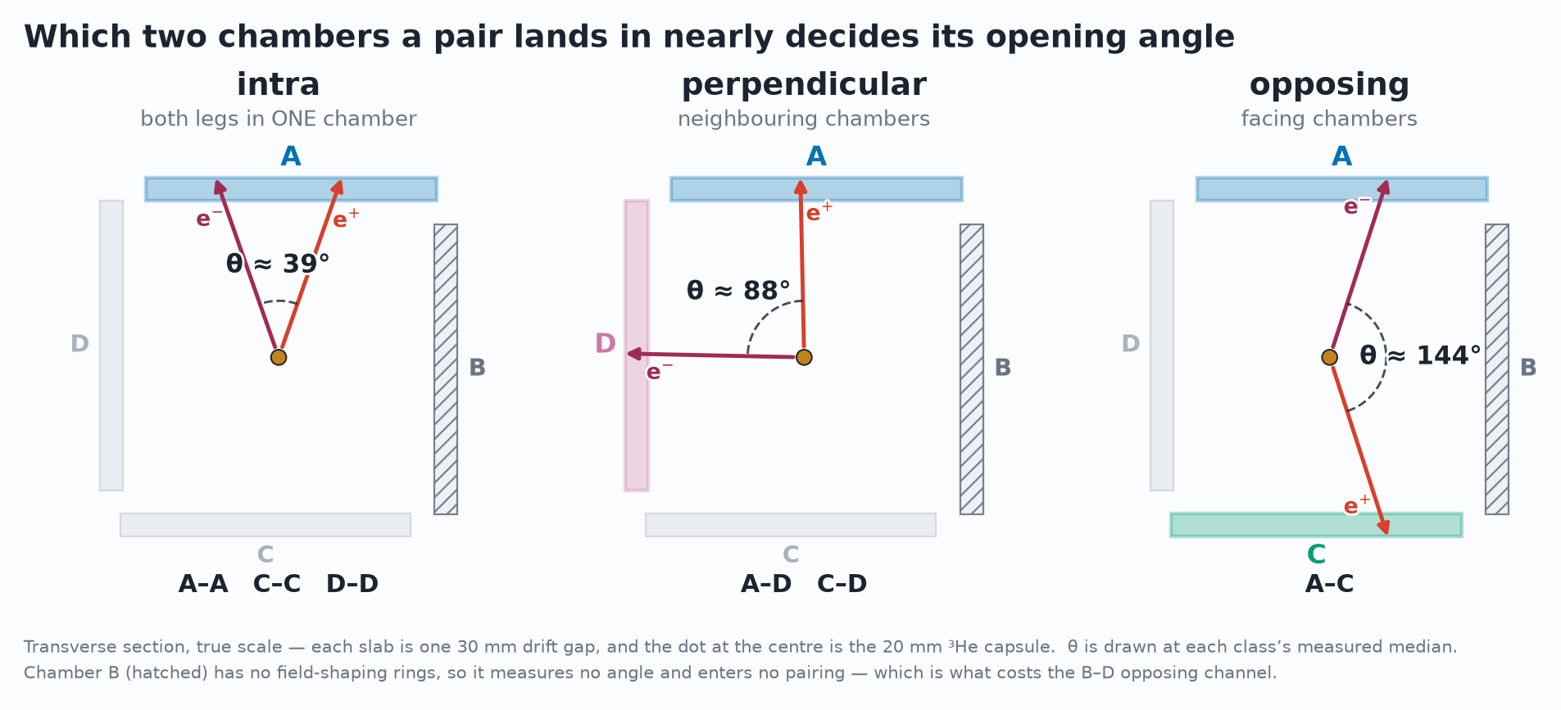
Work in progress
Status · Early Reconstruction Results
The angle a track arrives with says where it came from
D. Neff · n_TOF Collaboration Meeting, Athens · 1 October 2026
16.1 / 18

Slide 52
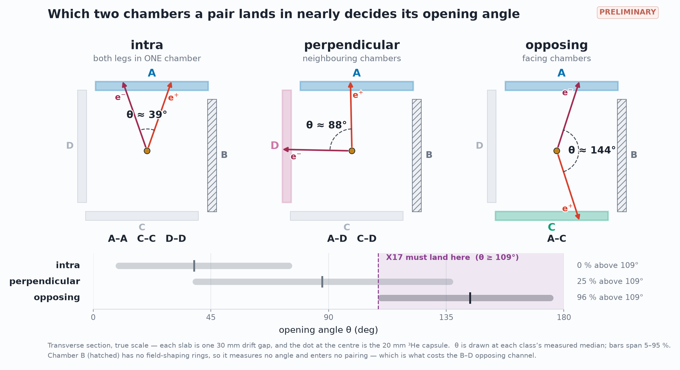
Work in progress
Status · Early Reconstruction Results
The angle a track arrives with says where it came from
D. Neff · n_TOF Collaboration Meeting, Athens · 1 October 2026
16.1 / 18

Slide 53
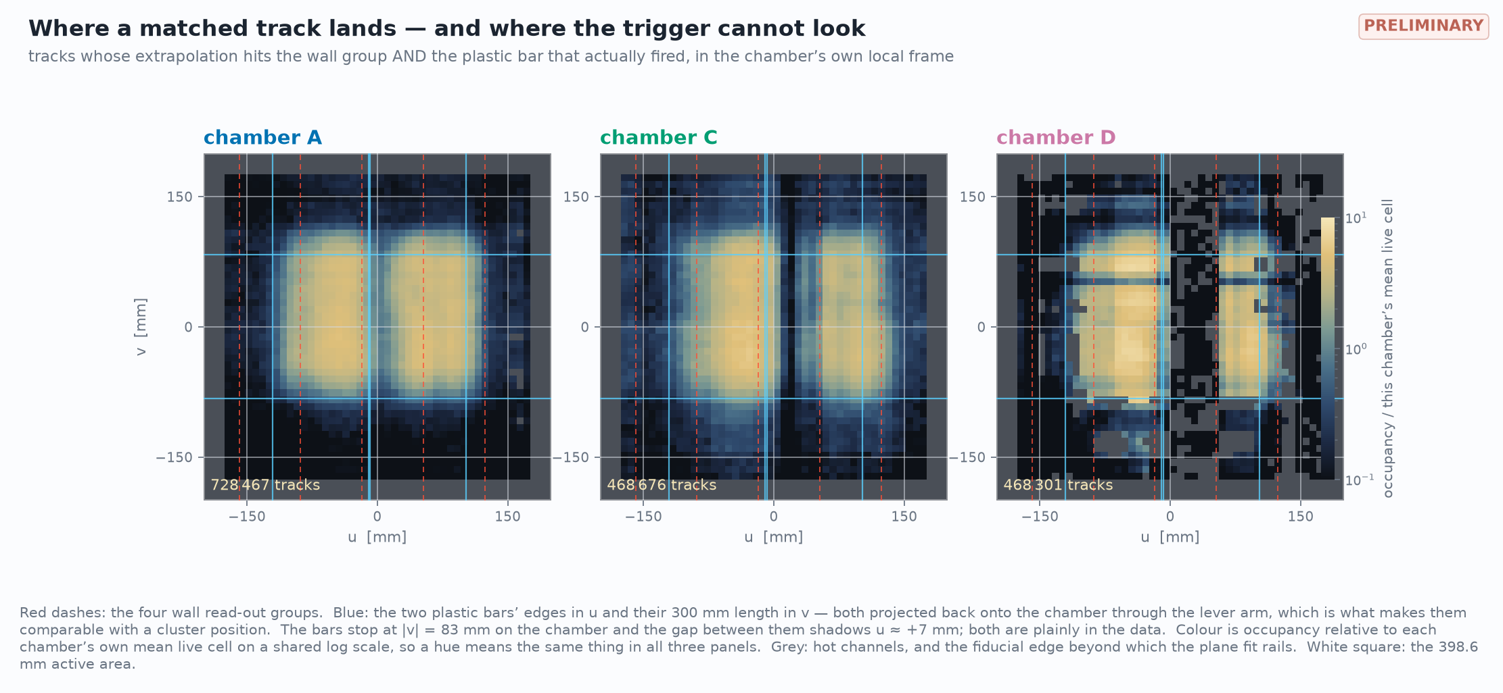
Work in progress
Status · Early Reconstruction Results
The angle a track arrives with says where it came from
D. Neff · n_TOF Collaboration Meeting, Athens · 1 October 2026
16.1 / 18

Slide 54
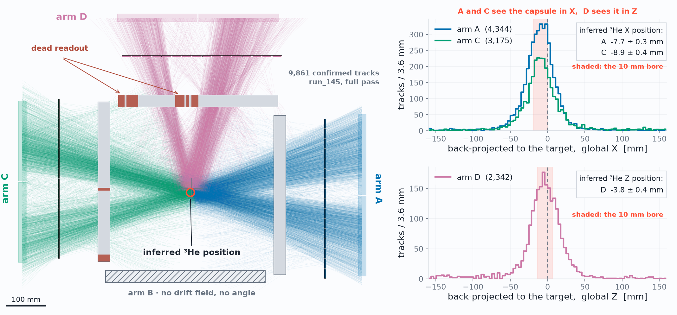
Work in progress
Status · Early Reconstruction Results
Two opposing arms, seen from above – image of capsule
Capsule ~1 cm
off-center in x
D. Neff · n_TOF Collaboration Meeting, Athens · 1 October 2026
17 / 18

Slide 55
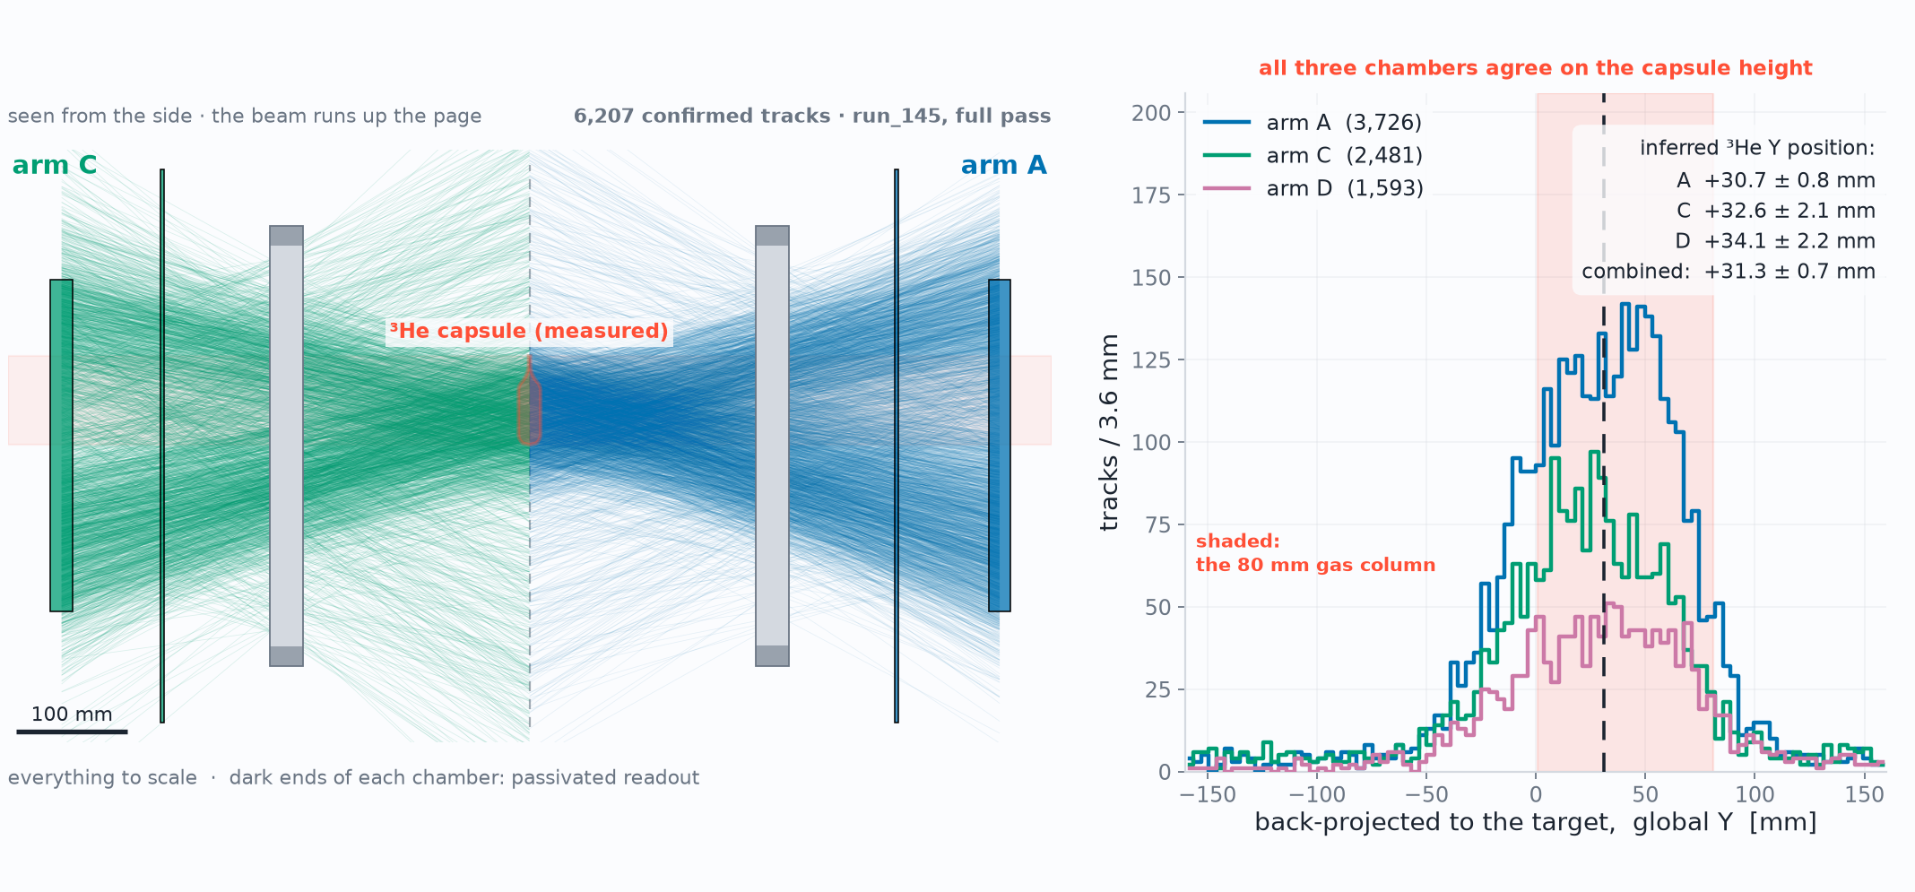
Work in progress
Status · Early Reconstruction Results
Two opposing arms, seen from above – image of capsule
Capsule ~3 cm
high in y
D. Neff · n_TOF Collaboration Meeting, Athens · 1 October 2026
17 / 18

Slide 56
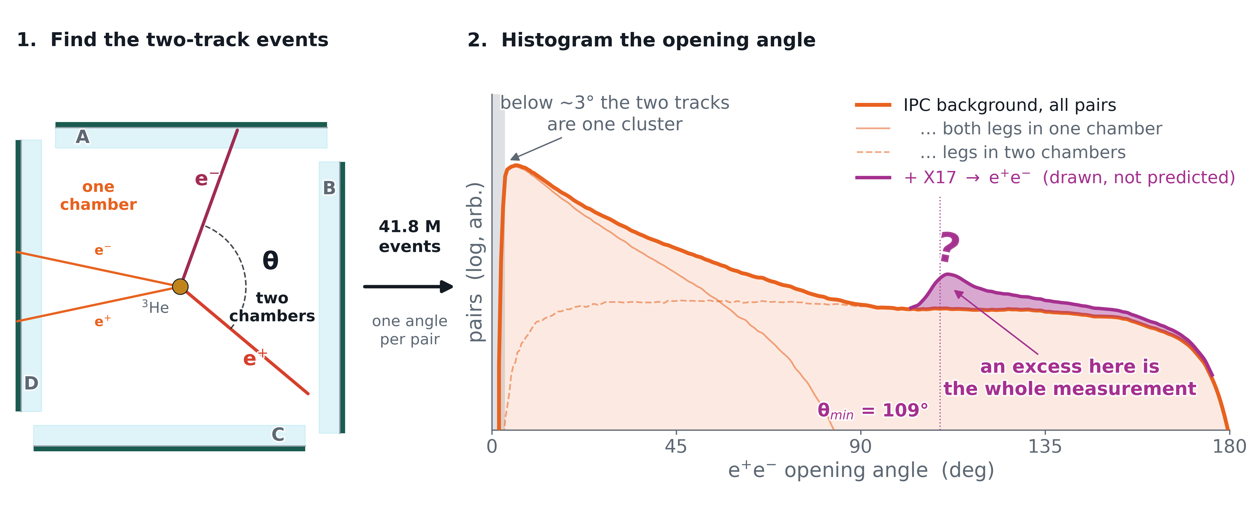
Summary
Summary and where we go from here
Constructed Micromegas TPCs which measure track angle to ~1°
2026 X17 campaign at n_TOF EAR2 complete: 41.8 M events, 17.9 TB, 44 days
Thermal window recorded
Next steps for the analysis
D. Neff · n_TOF Collaboration Meeting, Athens · 1 October 2026
18.1 / 18

Slide 57
Summary
Summary and where we go from here
Constructed Micromegas TPCs which measure track angle to ~1°
2026 X17 campaign at n_TOF EAR2 complete: 41.8 M events, 17.9 TB, 44 days
Thermal window recorded
Next steps for the analysis
Thank you! Questions?
D. Neff · n_TOF Collaboration Meeting, Athens · 1 October 2026
18.2 / 18

Slide 58
Summary
Conclusions
Weren’t able to make the viable high energy measurement
Backup plan to make thermal measurement was self-shielded
Measured Aluminum – Proof of concept
Next steps for the analysis
Thank you! Questions?
D. Neff · n_TOF Collaboration Meeting, Athens · 1 October 2026
18.2 / 18

Slide 59
Backup
D. Neff · n_TOF Collaboration Meeting, Athens · 1 October 2026

Slide 60
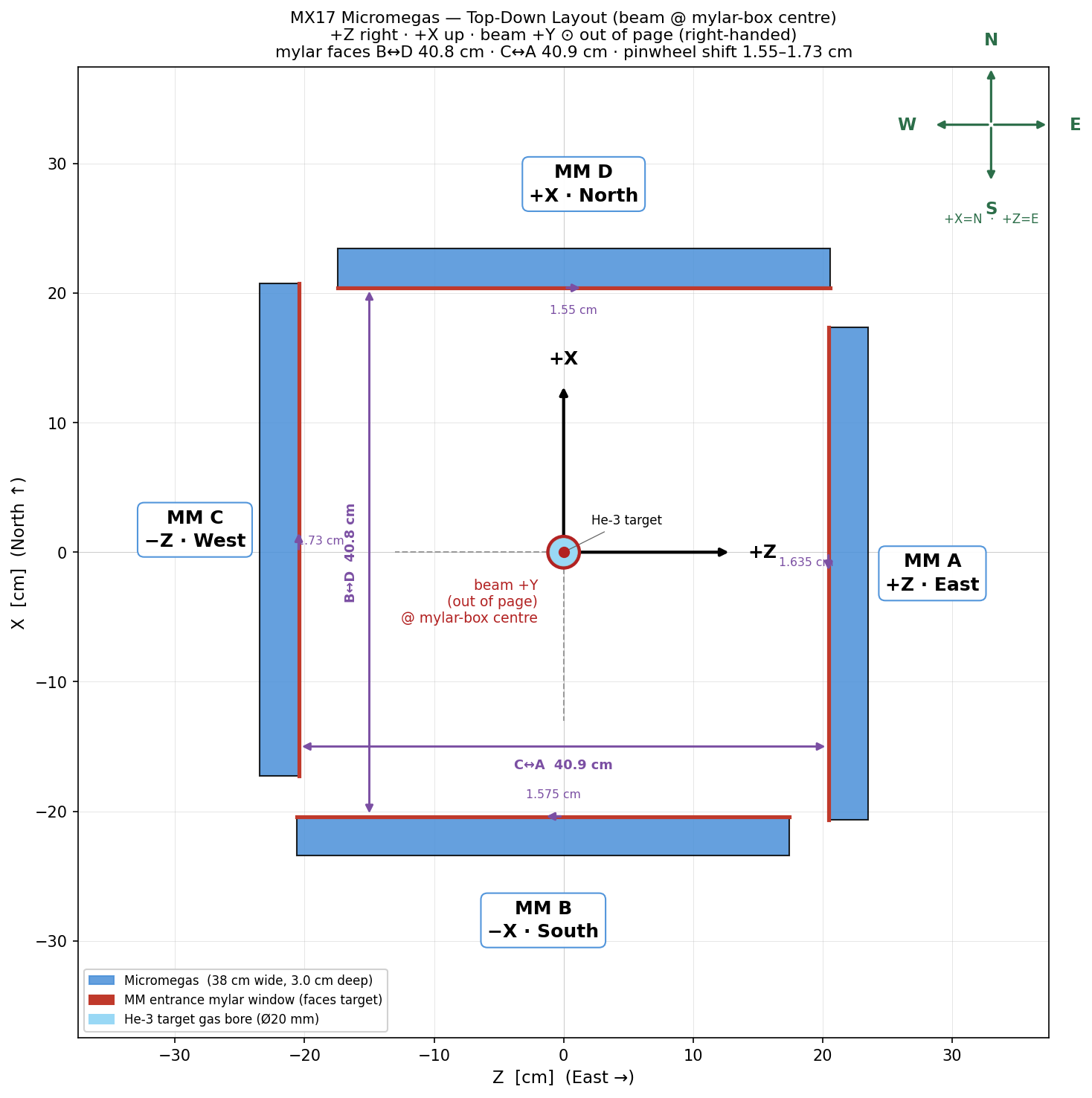
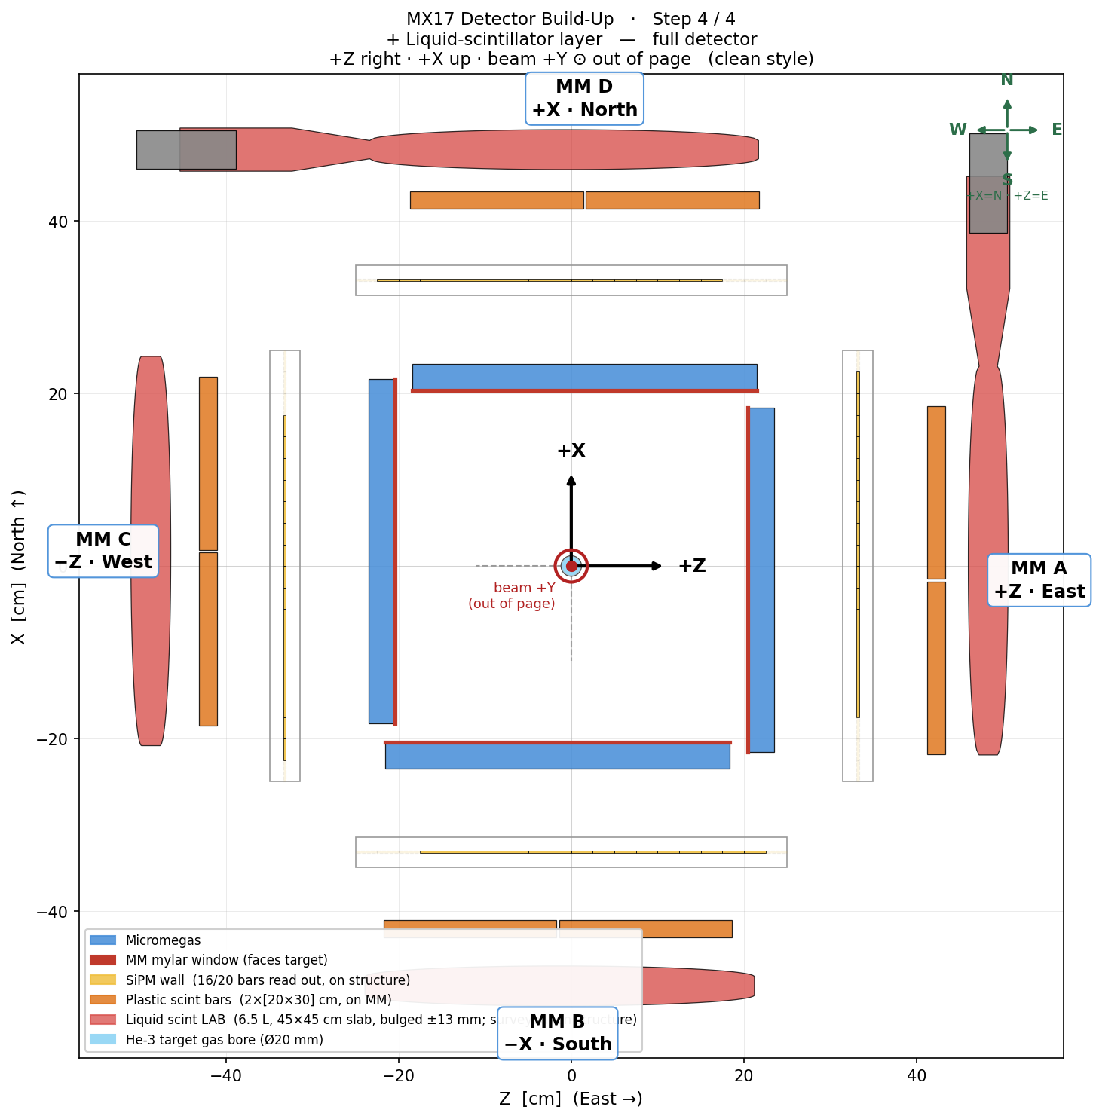
Backup · Experimental setup
The setup to scale: top-down, and layer by layer
Pinwheel, to scale: opposing mylar faces 408.0 mm (B↔D) and 409.0 mm (C↔A)
The full stack in section — every layer depth from the mylar front face
Same geometry as the 3-D build-up, drawn as a measured section rather than a render: distances 2026-07-15, per-arm gaps and vessel placements 2026-07-17/18. The intermediate build states (+SiPM, +plastics) are setup_2_sipm.png / setup_3_plastic.png in assets/img/.
D. Neff · n_TOF Collaboration Meeting, Athens · 1 October 2026
B1

Slide 61
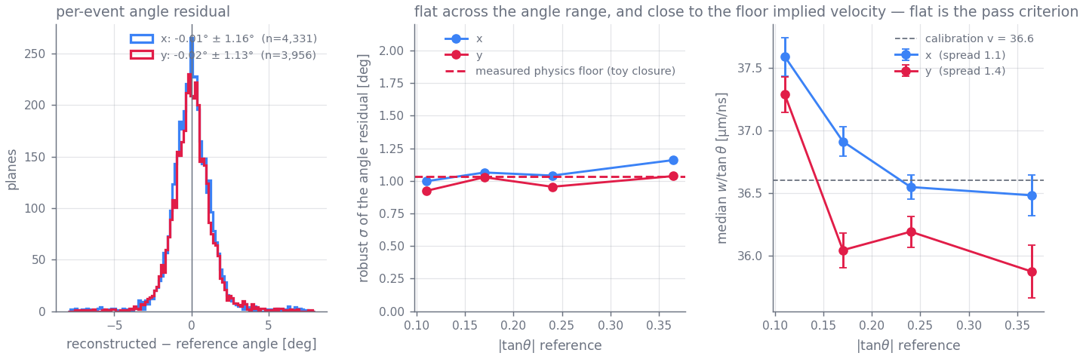
Backup · Reconstruction
The ~1° per-event scatter is physics, not fitting
The closure test | waveforms generated from the calibrated model with known tracks — real geometries, real charge profiles, real noise, real clipping — then fitted back. One knob: per-depth-bin transverse jitter of the charge centroid
jitter 0 | σ_{θ} 0.02° — electronics noise contributes essentially nothing
0.15 mm | 0.55°
0.30 mm | 1.05° — the scale diffusion + a few effective electrons per 2 mm of track + δ-rays actually give; reproduces the data exactly
0.50 mm | 1.77°
errors honest? | pull width 1.16 (X) / 1.13 (Y) — ~15 % optimistic, and χ²/dof genuinely ranks which fits to distrust
Full run, 6,852 / 6,850 reference-matched events, reference never in any fit: σ_{θ} = 1.16° / 1.13°, bias < 0.1°, flat across the angle range and sitting on the measured floor (middle, dashed); implied v flat to ~1.4 µm/ns (right)
So the per-event fit is extracting essentially all the information the detector geometry physically has — gains beyond ~1° come from ensemble averaging, not better fitters, which is why the reported errors carry a physics floor added in quadrature and the optimiser tolerances are deliberately loose. Ablations agree: dropping any single model refinement moves per-event σ by < 0.05°; what the refinements buy is ensemble physicality (implied-v flatness), the thing that cannot be tuned. Doc Part VII §41–43.
D. Neff · n_TOF Collaboration Meeting, Athens · 1 October 2026
B2

Slide 62
Backup · Characterization
The fleet, and what limits each chamber
det3 / det2 | Healthy. 100% of crossings fire; the whole residue is a 2.4–3.2% discharge coincidence and a 4.0–4.3% near-miss tail.
det6 / det7 | Discharge-limited — 22.3% / 37.4% of firing events are >50-strip discharges. Both ran at resist 495 V, above their measured optima (~480 / ~440 V): this is a chosen operating point, not a ceiling.
det4 | Gain-limited, and it is not blind: it produces a signal on 95.8% of crossings, but on 38.3% too few strips fire to form a valid X+Y point. Independently confirmed at the SPS: 62% of its area does not amplify.
Position core σ | 0.43–0.46 mm on det2/det3/det6, 0.56/0.62 mm on det4/det7 (radial) — on the good chambers the M3 reference contributes only ~10–20% of the variance.
det3
93.3%
det2
92.0%
det6
74.9%
det7
57.0%
det4
41.6%
Reconstructed within 5 mm of the M3 reference track (χ²<1.0 & NClus=4). One high-statistics sub-run per chamber, 3.7k–12.3k reference muons, waveform-first reconstruction, 2026-08-13 reprocessing.
Superseded 2026-07-14 values were 92.9 / 91.3 / 57.8 / 43.1 / 20.7%. The last three chambers gain 14–21 points from the matched-filter reprocessing of the raw waveforms — low-amplitude hits the previous analyzer never admitted — plus a further 0.4–4 points from reconstructing position from the waveforms instead of the strip hit times.
D. Neff · n_TOF Collaboration Meeting, Athens · 1 October 2026
B3

Slide 63
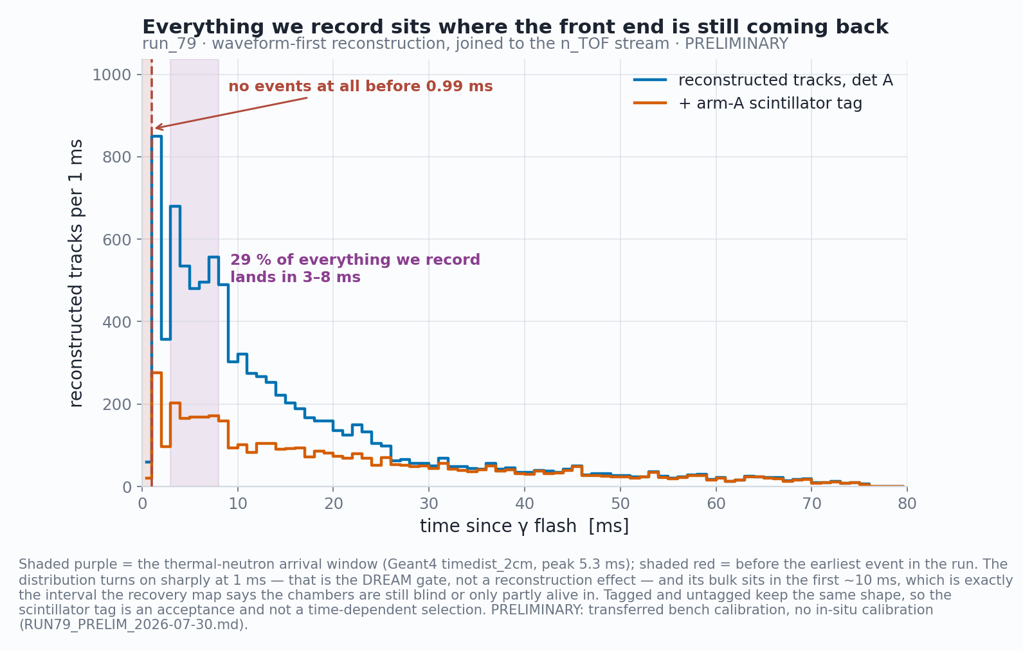
Backup · Operating in it
What we record, and when
Reconstructed tracks on beam data, joined event-by-event to the n_TOF scintillator stream. The turn-on at 1 ms is the DREAM gate, not the reconstruction; the bulk of everything we record sits in the first ~10 ms — the same interval the recovery map says the chambers are only partly alive in. That overlap is the experiment's central operational problem, stated in data.
D. Neff · n_TOF Collaboration Meeting, Athens · 1 October 2026
B4

Slide 64
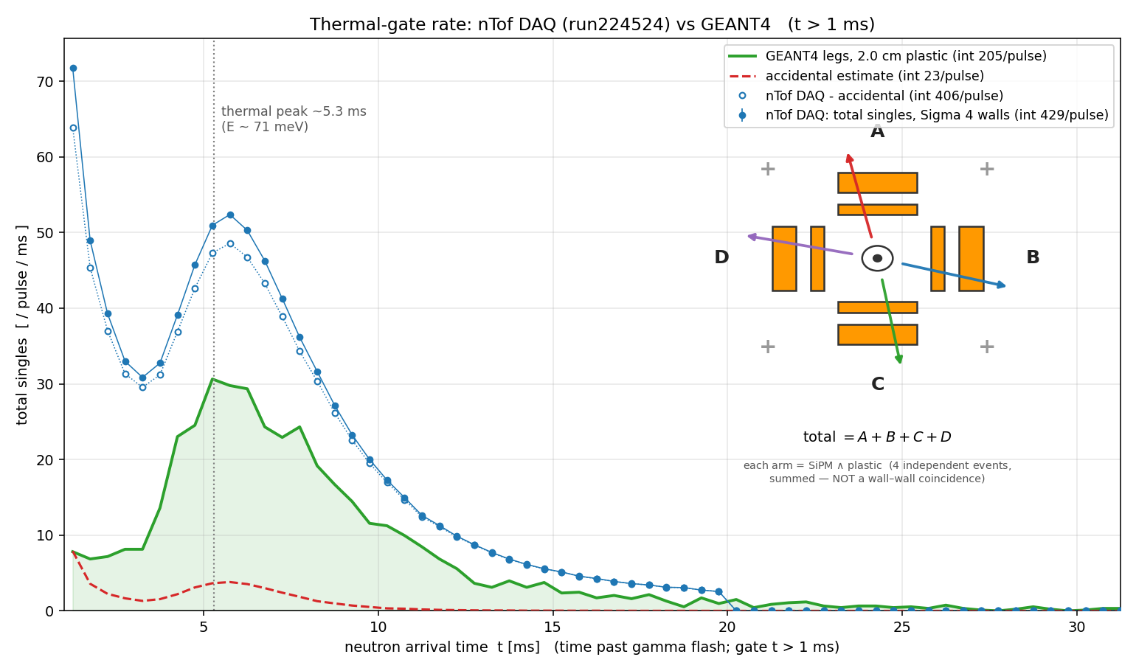
Backup · Operating in it
The trigger lives in the thermal window — by design
Capture loves slow neutrons, and slow neutrons are late. Over ~20 m of flight path the thermal flux peaks at 5.3 ms — recorded, and reproduced by Geant4 in shape.
The trigger: per arm, the SiPM wall (any of 4 segments over ½ MIP) AND a plastic bar over 0.90 MIP, within 20 ns — a charged leg crossing the stack, not a γ.
Simulation says 96 % of those trigger legs are ²⁷Al-capture γs converting in the capsule wall — the trigger is dominated by the background the analysis has to beat.
Recorded trigger rate vs neutron arrival time, against Geant4 — the 5.3 ms thermal peak reproduces; the normalisation runs 2.1× high (per wall 1.1–2.6×), under investigation
D. Neff · n_TOF Collaboration Meeting, Athens · 1 October 2026
B5

Slide 65
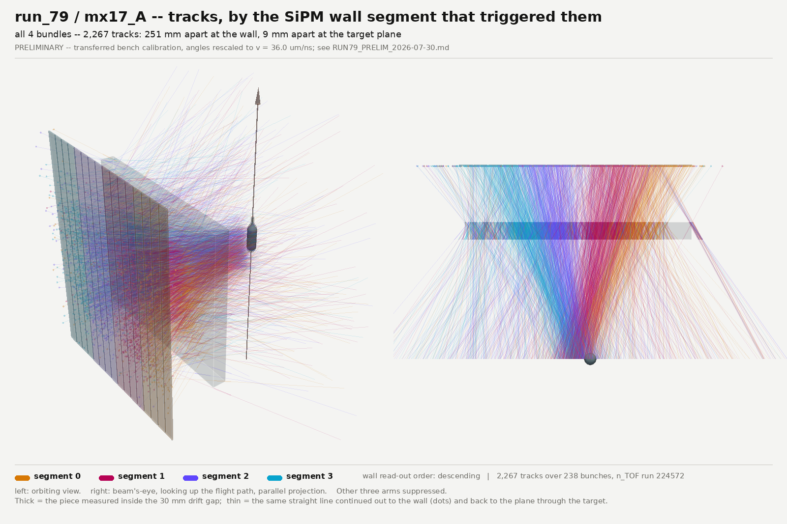
Backup · Reconstruction
The tracks point back at the capsule
Waveform-first reconstruction on beam data, coloured by which SiPM wall segment fired — external position truth on a 100 mm granularity, on a lever arm the chamber knows nothing about. The four bundles are 251 mm apart at the wall and 9 mm apart at the target plane; shuffling the segment labels collapses that to 28 mm and 3.2 mm. Ensemble statement — the waist is a convergence of medians, not a per-track pointing resolution.
D. Neff · n_TOF Collaboration Meeting, Athens · 1 October 2026
B6

Slide 66
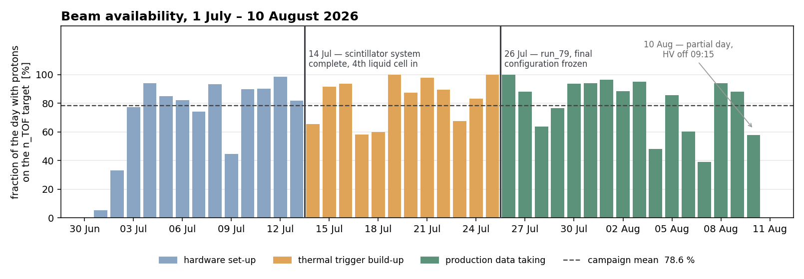
Backup · The campaign
Beam availability, day by day
Fraction of each day with protons on the n_TOF target, from the one-minute classification of the last beam-current transformer before the target (FTN.BCT477). Campaign mean 78.6 %; the 21.4 % without beam is the usual mix of PS supercycle sharing and machine stops — the logger’s attribution between the two is not reliable, so only the total is quoted. Colours are the three campaign phases; 10 August is a partial day (HV off 09:15).
D. Neff · n_TOF Collaboration Meeting, Athens · 1 October 2026
B7

Slide 67
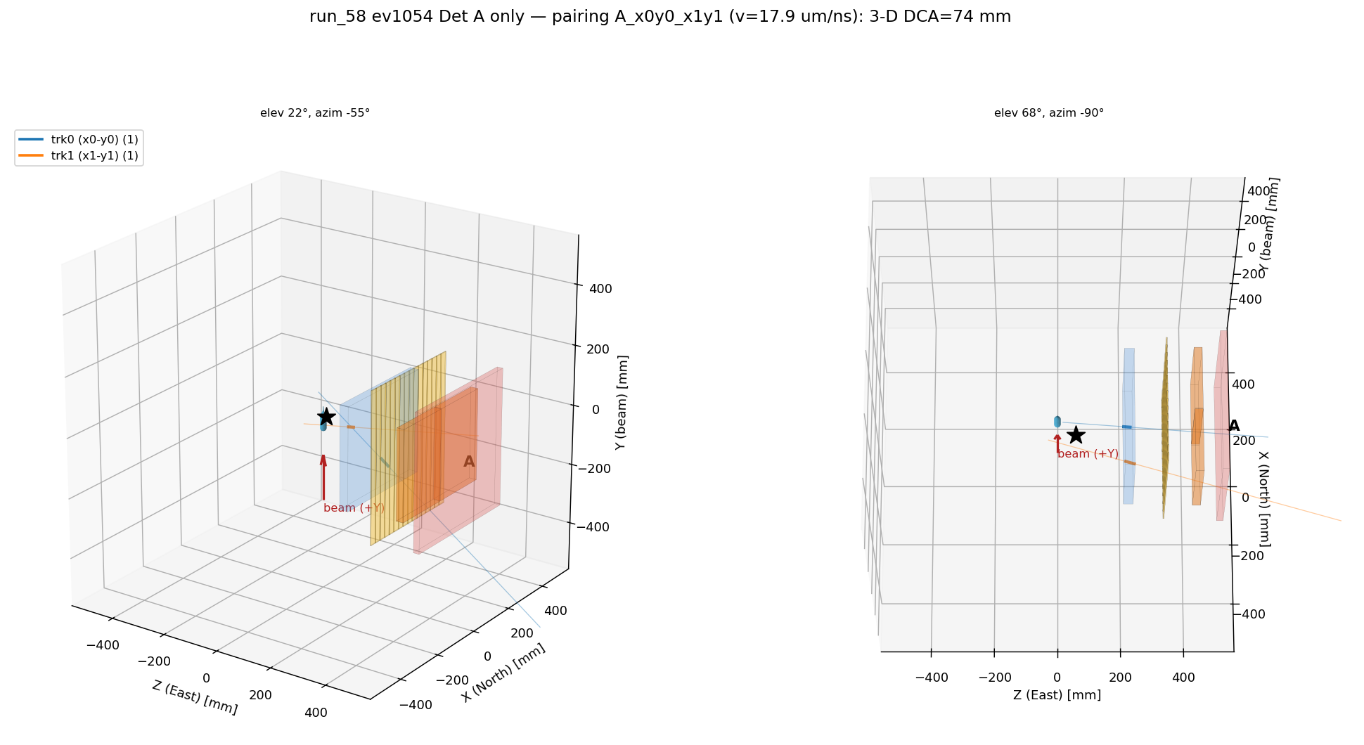
Backup · Outlook
Next: from single tracks to pairs
What a signal is: two tracks in different arms, opening angle kinematically confined above 109°, total pair energy 19.6 MeV (slide 4). Everything in this talk exists to make that measurable.
The reconstruction is ready for the easy half: the forward fit now returns every candidate track, not just the winner — single-track output bit-identical, candidates shipped alongside. Two tracks merged closer than ~12 mm still fit as one bad-χ² compromise: the two-track forward model is the one designed-but-unbuilt piece.
The dataset is final and the search is offline: 41.8 M events on EOS, with the trigger dominated by Al-capture pairs — an enormous calibration sample for exactly this topology.
The bar the tracker has to clear: the Al background separates on total pair energy, which asks for σ(p)/p ≲ 30 % per lepton from scattering or range — the open MPGD question to leave the room with.
A real two-track event in one chamber (July scan run) — two track-grade lines in both planes, paired into 3-D. A demonstration, not a measurement: hits-basis, and the X↔Y pairing is two-fold ambiguous
D. Neff · n_TOF Collaboration Meeting, Athens · 1 October 2026
B8

Slide 68


Motivation
n_TOF EAR2: a vertical neutron beam line at CERN
20 GeV/c PS protons hit a lead spallation target
The EAR2 hall — © CERN
In-house render · Weiß (2015), Pavon-Rodriguez (2025)
D. Neff · n_TOF Collaboration Meeting, Athens · 1 October 2026
B9

Slide 69

Motivation
n_TOF EAR2: a vertical neutron beam line at CERN
20 GeV/c PS protons hit a lead spallation target
Neutrons ejected at 90° climb ~20 m to EAR2
The EAR2 hall — © CERN
In-house render · Weiß (2015), Pavon-Rodriguez (2025)
D. Neff · n_TOF Collaboration Meeting, Athens · 1 October 2026
B10

Slide 70

Motivation
n_TOF EAR2: a vertical neutron beam line at CERN
20 GeV/c PS protons hit a lead spallation target
Neutrons ejected at 90° climb ~20 m to EAR2
Collimated to a ≈3 cm pencil
The pipe ends: the beam crosses the hall in air
The EAR2 hall — © CERN
In-house render · Weiß (2015), Pavon-Rodriguez (2025)
D. Neff · n_TOF Collaboration Meeting, Athens · 1 October 2026
B11

Slide 71

Motivation
n_TOF EAR2: a vertical neutron beam line at CERN
20 GeV/c PS protons hit a lead spallation target
Neutrons ejected at 90° climb ~20 m to EAR2
Collimated to a ≈3 cm pencil
The pipe ends: the beam crosses the hall in air
Measurement station sits in that open beam
The highest instantaneous flux at n_TOF
The EAR2 hall — © CERN
In-house render · Weiß (2015), Pavon-Rodriguez (2025)
D. Neff · n_TOF Collaboration Meeting, Athens · 1 October 2026
B12

Slide 72
The Micromegas Compact TPC
A large-area resistive-strip detector, built to measure the opening angle of the pair.
D. Neff · n_TOF Collaboration Meeting, Athens · 1 October 2026

Slide 73


Designed & built at CEA Saclay by
Micromegas TPC · Saclay
Stéphan Aune
The Micromegas compact TPC design
One chamber, exploded along the drift axis
a 44 × 34 mm window at the real pitch
MX17 readout board, four layers peeled back
25 × 25 mm of the 470 mm board
D. Neff · n_TOF Collaboration Meeting, Athens · 1 October 2026
B13

Slide 74
Designed & built at CEA Saclay by
Micromegas TPC · Saclay
Stéphan Aune
TPC operation
Simulated event
D. Neff · n_TOF Collaboration Meeting, Athens · 1 October 2026
B14

Slide 75

Method inspired by T2K ND280
Attié et al., NIM A 1056 (2023) 168534
Work in progress
Micromegas TPC · Reconstruction
Resistive strips spread and delay charge
What happens on the resistive layer
Charge spreads through the resistive strips
A neighbor’s copy arrives late and dispersed
D. Neff · n_TOF Collaboration Meeting, Athens · 1 October 2026
B15

Slide 76

Method inspired by T2K ND280
Attié et al., NIM A 1056 (2023) 168534
Work in progress
Micromegas TPC · Reconstruction
Resistive strips spread and delay charge
What happens on the resistive layer
Charge spreads through the resistive strips
A neighbor’s copy arrives late and dispersed
D. Neff · n_TOF Collaboration Meeting, Athens · 1 October 2026
B16

Slide 77


Method inspired by T2K ND280
Attié et al., NIM A 1056 (2023) 168534
Work in progress
Micromegas TPC · Reconstruction
The forward fit: assume a track and predict every waveform
Three numbers are searched:
Mesh arrival position and time (p₀, t₀) and transverse speed (w)
v_{drift} enters once at the end: tan θ = w / v_{drift}
Four consecutive strips of one real muon event
D. Neff · n_TOF Collaboration Meeting, Athens · 1 October 2026
B17

Slide 78

Work in progress
Micromegas TPC · Reconstruction
One muon through the forward fit
D. Neff · n_TOF Collaboration Meeting, Athens · 1 October 2026
B18

Slide 79
Characterization
How well the chamber actually performs,
measured with cosmic muons.
D. Neff · n_TOF Collaboration Meeting, Athens · 1 October 2026

Slide 80

Characterization
Characterization on the Saclay cosmic bench
A cosmic muon fires the scintillators at the top and bottom of the stack.
Four reference Micromegas reconstruct its track; the two MX17 detectors under test sit in between.
D. Neff · n_TOF Collaboration Meeting, Athens · 1 October 2026
B19

Slide 81

Characterization
Characterization on the Saclay cosmic bench
60 × 60 cm trigger scintillators, top and bottom
A cosmic muon fires the scintillators at the top and bottom of the stack.
Four reference Micromegas reconstruct its track; the two MX17 detectors under test sit in between.
D. Neff · n_TOF Collaboration Meeting, Athens · 1 October 2026
B20

Slide 82

Characterization
Characterization on the Saclay cosmic bench
60 × 60 cm trigger scintillators, top and bottom
50 × 50 cm Micromegas reference trackers, four of them
A cosmic muon fires the scintillators at the top and bottom of the stack.
Four reference Micromegas reconstruct its track; the two MX17 detectors under test sit in between.
D. Neff · n_TOF Collaboration Meeting, Athens · 1 October 2026
B21

Slide 83

Characterization
Characterization on the Saclay cosmic bench
60 × 60 cm trigger scintillators, top and bottom
50 × 50 cm Micromegas reference trackers, four of them
A cosmic muon fires the scintillators at the top and bottom of the stack.
Four reference Micromegas reconstruct its track; the two MX17 detectors under test sit in between.
40 × 40 cm TPC chambers — the ones being characterized
D. Neff · n_TOF Collaboration Meeting, Athens · 1 October 2026
B22

Slide 84

Characterization
Characterization on the Saclay cosmic bench
60 × 60 cm trigger scintillators, top and bottom
50 × 50 cm Micromegas reference trackers, four of them
A cosmic muon fires the scintillators at the top and bottom of the stack.
Four reference Micromegas reconstruct its track; the two MX17 detectors under test sit in between.
40 × 40 cm TPC chambers — the ones being characterized
Cosmic muons — two slots measured at once, against the same reference
D. Neff · n_TOF Collaboration Meeting, Athens · 1 October 2026
B23

Slide 85


Work in progress
Characterization
Efficiency: 93% on the best chamber
Where every crossing muon goes
Flat across the chamber face
a circle swept over the face, 500 µm at a time
Reconstructed within 5 mm
93.1% 20,428
the efficiency
Detected, point >5 mm off
4.2% 913
the near-miss tail†
Discharged during the muon
2.6% 563
many strips fire uncorrelated with muon
Fired, no valid X+Y point
0.2% 46
Silent — no signal at all
0.01% 3
genuine blindness
WHY 0.45 mm
Reference trackers resolve to ~500 µm
D. Neff · n_TOF Collaboration Meeting, Athens · 1 October 2026
B24

Slide 86
Work in progress
Characterization
Adequate angular, spatial and temporal resolution
Reconstructed against reference, per plane
Head on tracks reasonable and angled tracks approach 1°
1.19 / 1.23°
180 µm
33 ns
angle per plane, X / Y (σ₆₈), bias < 0.1°
position at normal incidence, ±0.035 mm conservatively
plane-to-plane timing, ≈ 1.1 mm of drift
D. Neff · n_TOF Collaboration Meeting, Athens · 1 October 2026
B25

Slide 87

Work in progress
Status · Early Reconstruction Results
The angle a track arrives with says where it came from
D. Neff · n_TOF Collaboration Meeting, Athens · 1 October 2026
16.1 / 18

Slide 88
Work in progress
Status · Early Reconstruction Results
The angle a track arrives with says where it came from
Correlation implies that tracks point back to capsule
D. Neff · n_TOF Collaboration Meeting, Athens · 1 October 2026
16.2 / 18

Slide 89

WHAT WE RAN WITH
Status · The environment
Every volt of gain costs milliseconds of beam
D. Neff · n_TOF Collaboration Meeting, Athens · 1 October 2026
14.6 / 18

Slide 90
Summary
Summary and where we go from here
thanks to:
n_TOF — the whole collaboration, and especially the local team, for making the measurement happen
EUROLABS — for the funding that made this experiment possible
CERN GDD & MPT — for their indispensable support that enabled the measurement
CEA Saclay & Bulk Lab — for help building the detectors and supplying the DAQ
MPGD 2026 — for giving me the opportunity to present these results
Next steps for the analysis
D. Neff · n_TOF Collaboration Meeting, Athens · 1 October 2026
18.2 / 18

