Slide 1
The MX17 Micromegas detectors under cosmic muons
Performance summary from the June 2026 cosmic test bench (Saclay)
• ~96 % muon detection efficiency in the chamber core
• 0.47 mm position resolution — better than the 0.78 mm strip pitch
• ~1.7° track angle and 33 ns event time from a single chamber (micro-TPC)
• Resistive spark protection verified: discharges self-quench, zero dead time
Preliminary — June 2026 cosmic-bench campaign. Speaker-note details on every slide.
Notes:
Five MX17 chambers (experiment labels A–E = serials mx17_3, _2, _6, _7, _4) were characterized identically with cosmic muons against an independent reference tracker. All numbers preliminary; position resolutions still include the reference telescope's small pointing error (conservative).

Slide 2
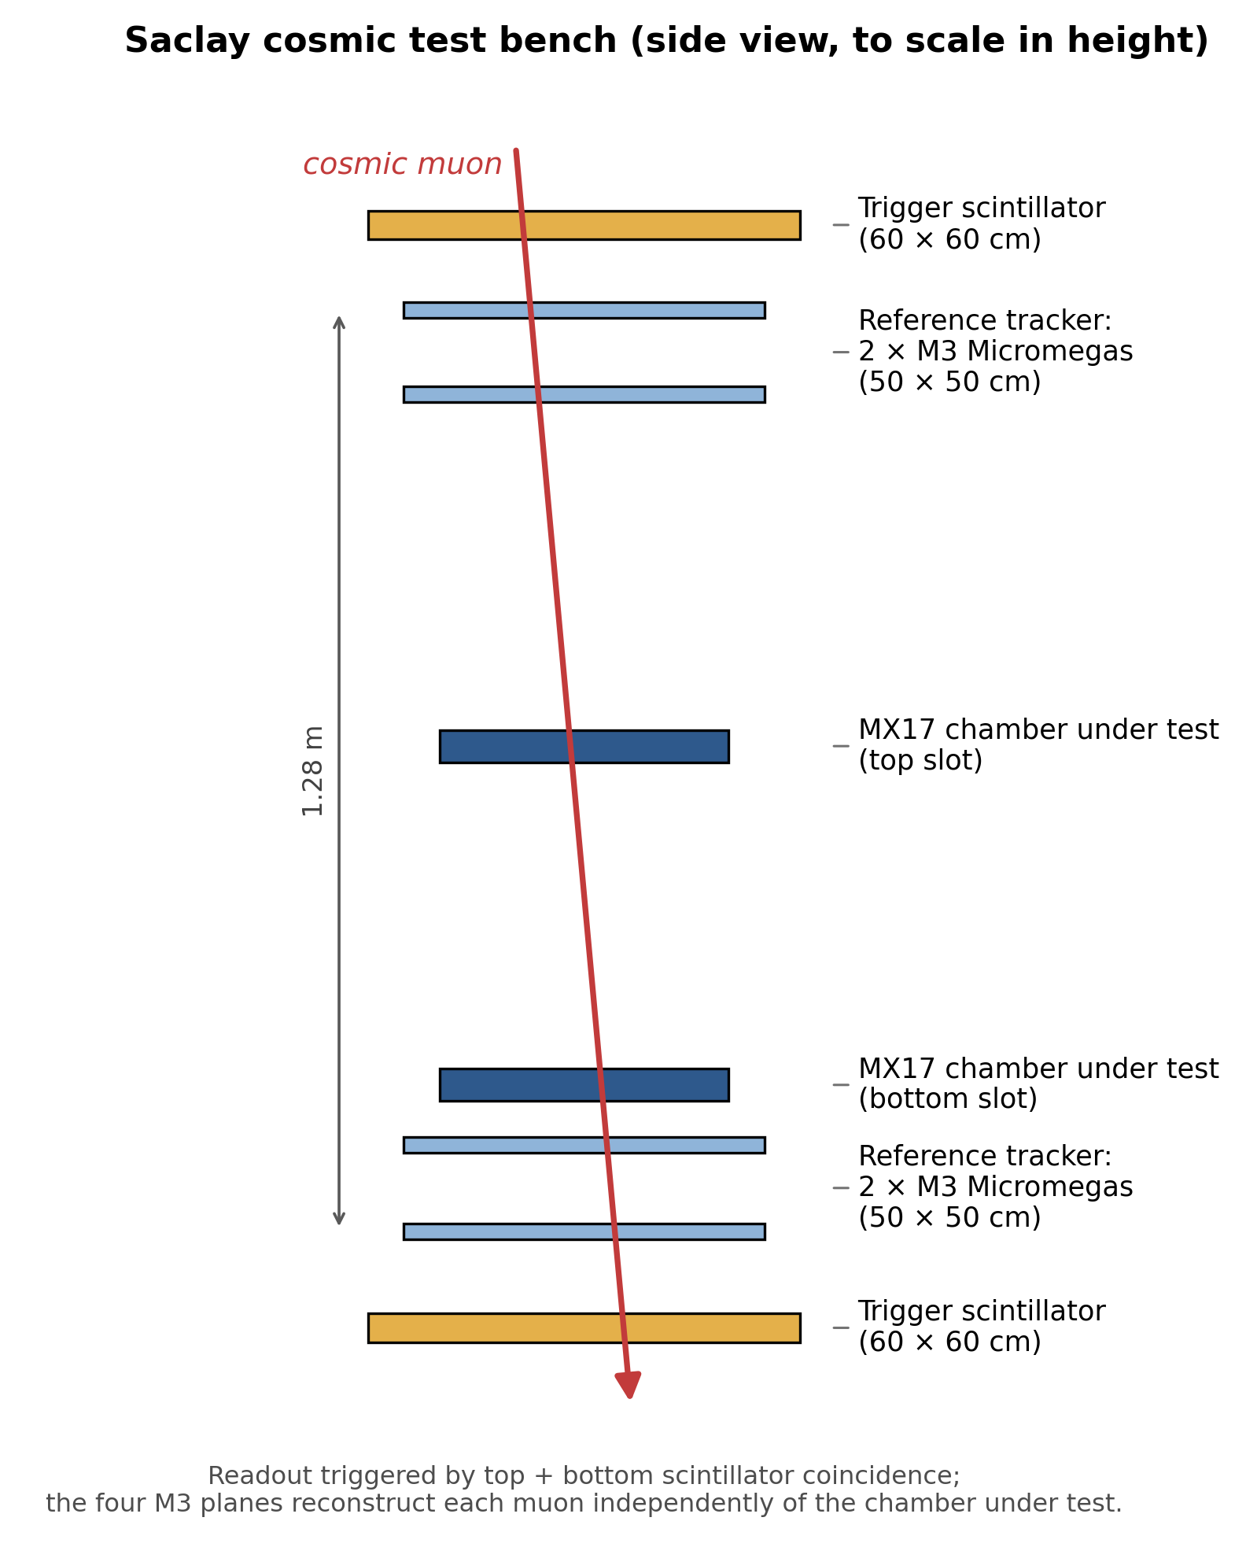
How they were tested: the cosmic bench
• Every muon is measured twice: by a reference telescope and by the chamber under test
• Trigger: scintillator-paddle coincidence (also the absolute time reference)
• Efficiency: reconstructed hit within 5 mm of the reference track — no hidden normalization
• 52,000 clean reference muons on the headline run; all 5 chambers, same method
• As operated: Ar/isobutane 95/5, drift 1000 V over 30 mm, amplification 440–490 V,
– DREAM readout: full waveform per strip, 60 ns sampling
Detector letters: A=mx17_3, B=mx17_2, C=mx17_6, D=mx17_7, E=mx17_4
Notes:
Bench stack (bottom to top, to scale): 60x60 cm trigger scintillator, two 50x50 cm M3 reference Micromegas, the two MX17 test slots, two more M3 planes, and the top 60x60 cm scintillator. The four M3 planes reconstruct each cosmic muon independently of the chamber under test; the scintillator coincidence (~5 ns) triggers readout and provides the absolute time reference. Efficiency = fraction of reference tracks with a reconstructed X+Y hit within 5 mm at the chamber plane; muons with no detector response stay in the denominator. Alignment converged sub-mm for every chamber.

Slide 3
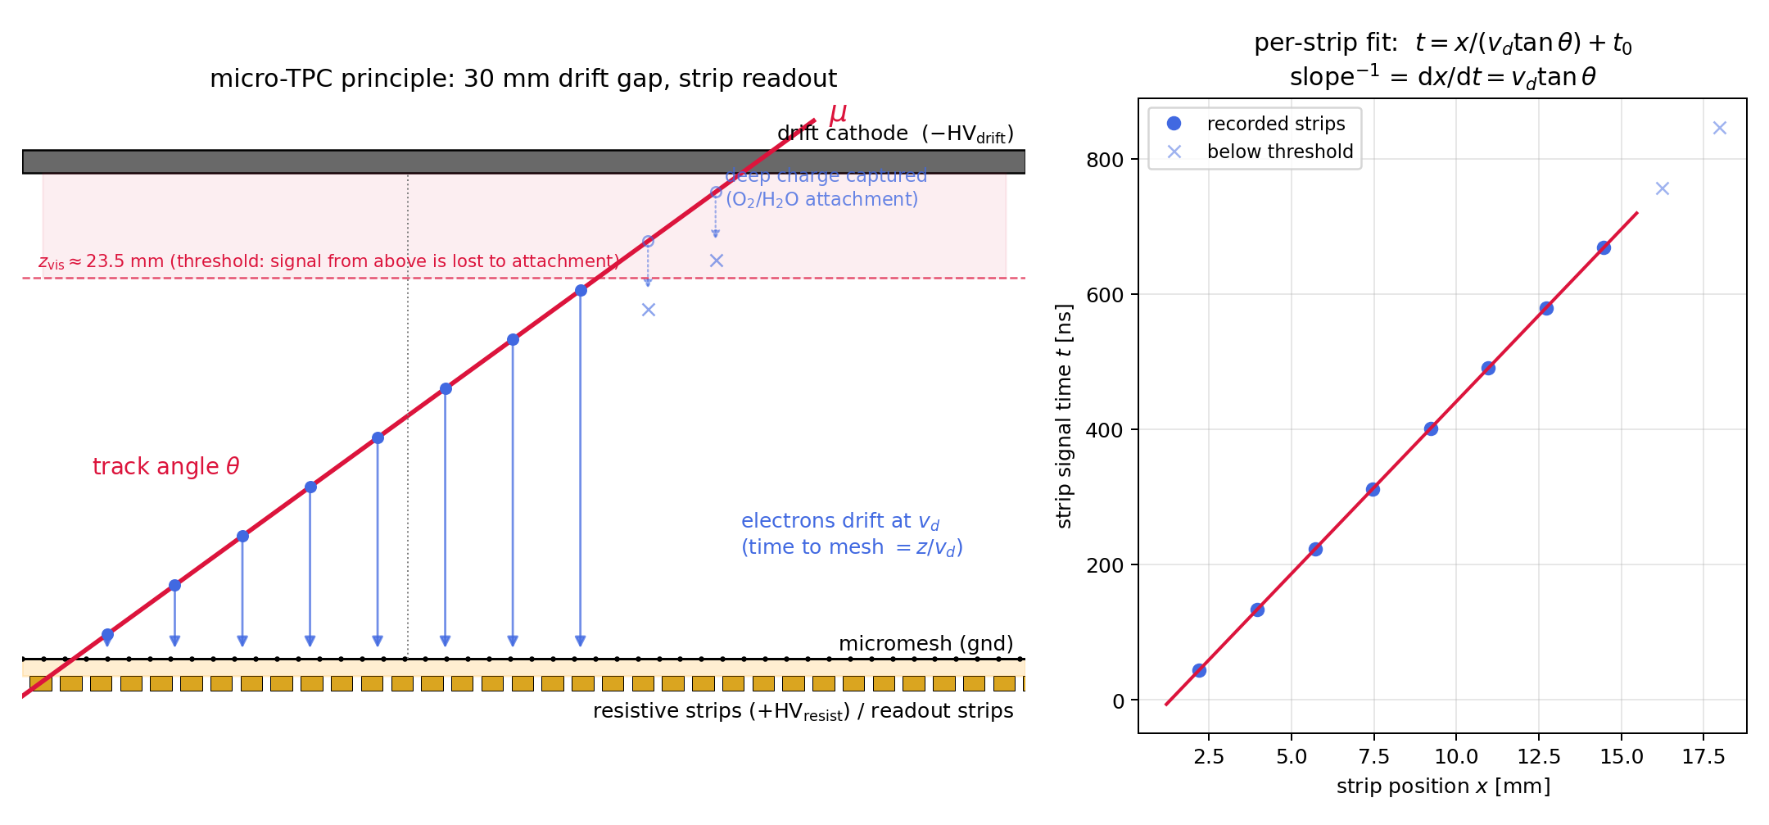
One 30 mm gap makes each chamber a tiny TPC
• Drift time = depth: 30 mm gap maps onto ~0.9 µs of arrival times
• Each fired strip gives a 3D point; the line fit gives the track angle
• A single chamber measures position, direction, and time
Notes:
Electrons freed deeper in the 30 mm drift gap arrive later at the mesh (drift velocity 34 µm/ns at the nominal field), so each strip's pulse time is a depth coordinate. A straight-line fit through (strip position, drift time) points gives the muon's angle from a single chamber — no external tracker. This 'micro-TPC' operation is what delivers the angular and timing performance on the next slides.

Slide 4
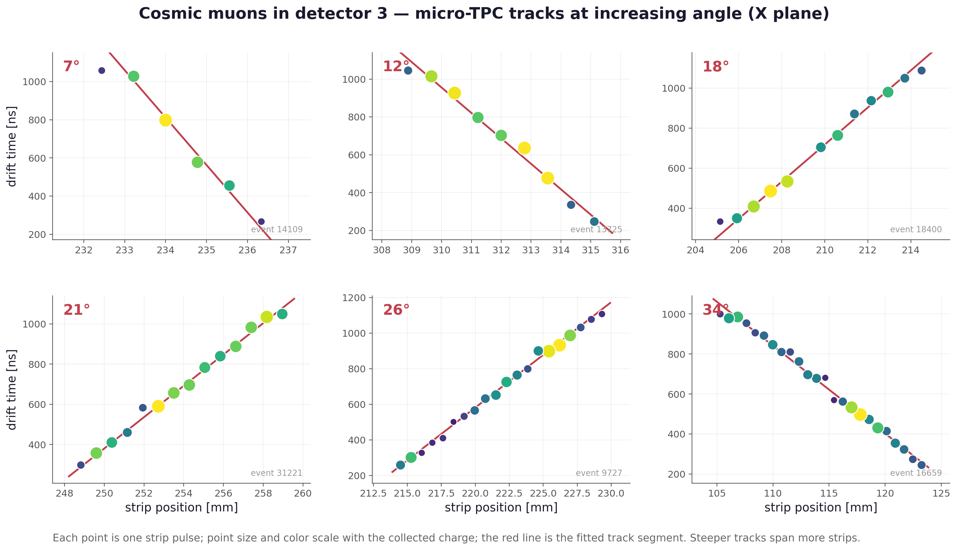
What a cosmic muon looks like in the chamber
Notes:
Real events from detector A, drawn from the raw data. Each marker is one strip signal at its strip position (horizontal) and drift time / depth (vertical), colored by pulse amplitude; the overlaid line is the track fitted from this chamber's own data. Individual per-event displays (X and Y planes, several angles) are in event_displays/ as separate PNG/PDF files.

Slide 5
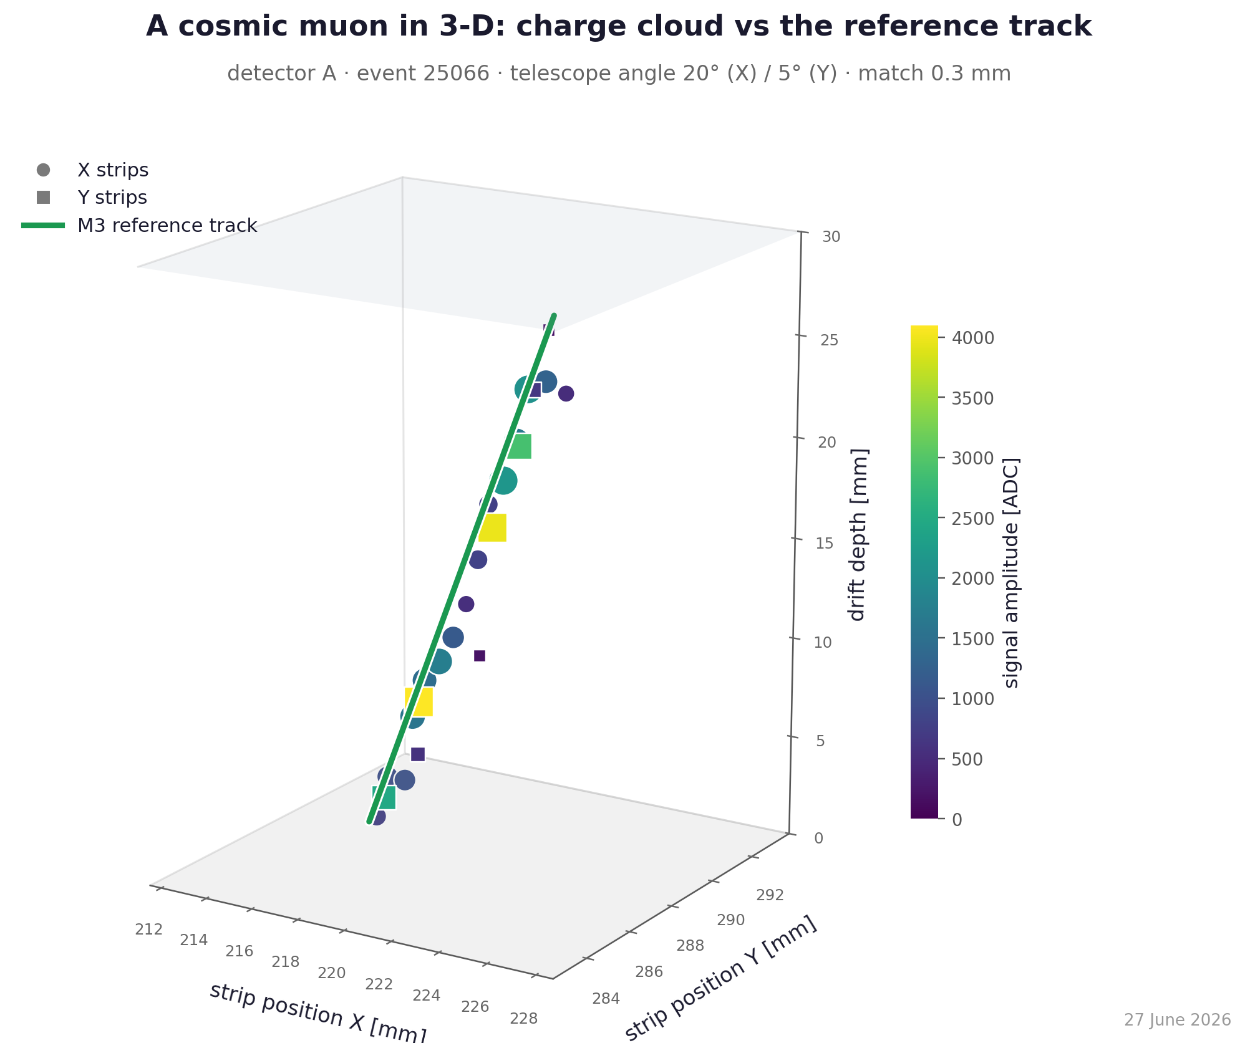
The same muon in 3-D — with the reference track through it
Detector A (mx17_3), event 25066 · reference track = M3 telescope, independent of the chamber
Notes:
Putting the X and Y strip planes together: each strip signal's drift time becomes a depth, so the charge cloud traces the muon's path through the 30 mm gas gap (circle = X plane, square = Y plane; color = amplitude). The green line is the INDEPENDENT M3 telescope track extrapolated into the chamber — it runs straight through the charge cloud (match 0.3 mm here), a direct 3-D check that both the reconstruction and the alignment are right. On resolution: across the full sample the chamber-vs-reference match is centered at zero (no misalignment: mean residual <10 um in both axes) with a 0.6-0.8 mm per-axis core, so a typical event sits ~0.8 mm off in 2-D radial distance (a positive quantity — that is just what 0.7 mm/axis looks like as a distance); the events shown here were picked near the tight end to show the geometry cleanly. Any fanning of the raw per-strip ladder away from the line with depth is the resistive-strip charge-sharing angle bias (removed before angles are quoted), not a position error. A 2x2 gallery across angles (figures/08) and turntable GIFs (event_displays_3d/) are in the package.

Slide 6
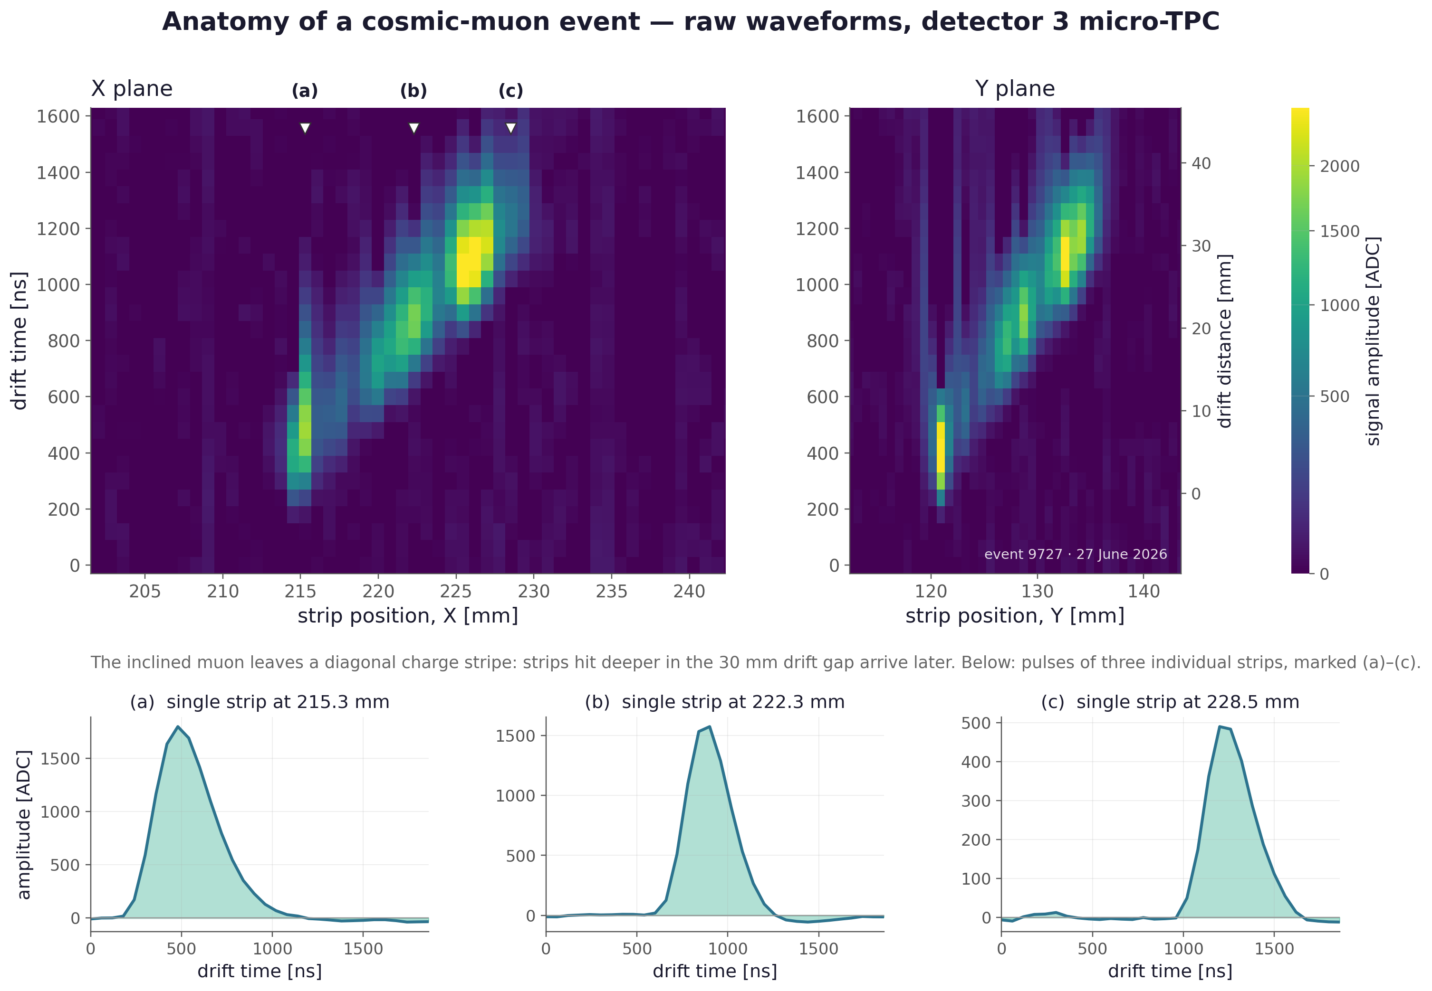
The raw signal: a muon crossing, as the electronics see it
Notes:
Raw DREAM waveforms for one inclined muon (pedestal and common-mode subtracted): the diagonal charge stripe across the channel-vs-time plane is the muon track; its slope is the drift-time ladder used for the angle measurement. This is the rawest possible view of the detector working.

Slide 7
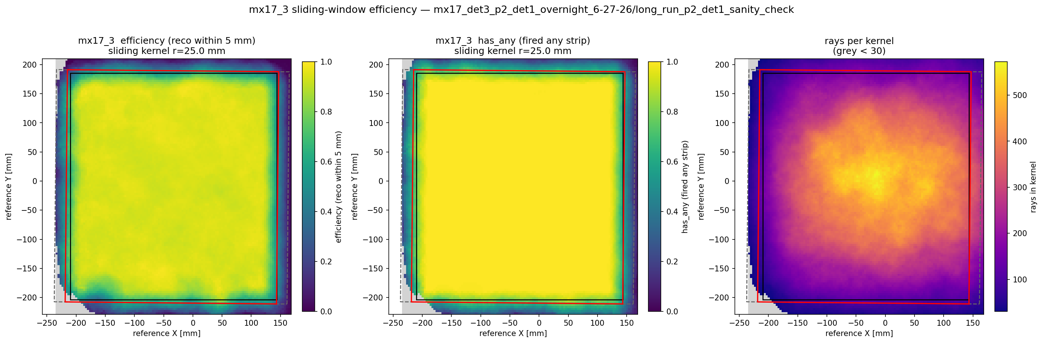
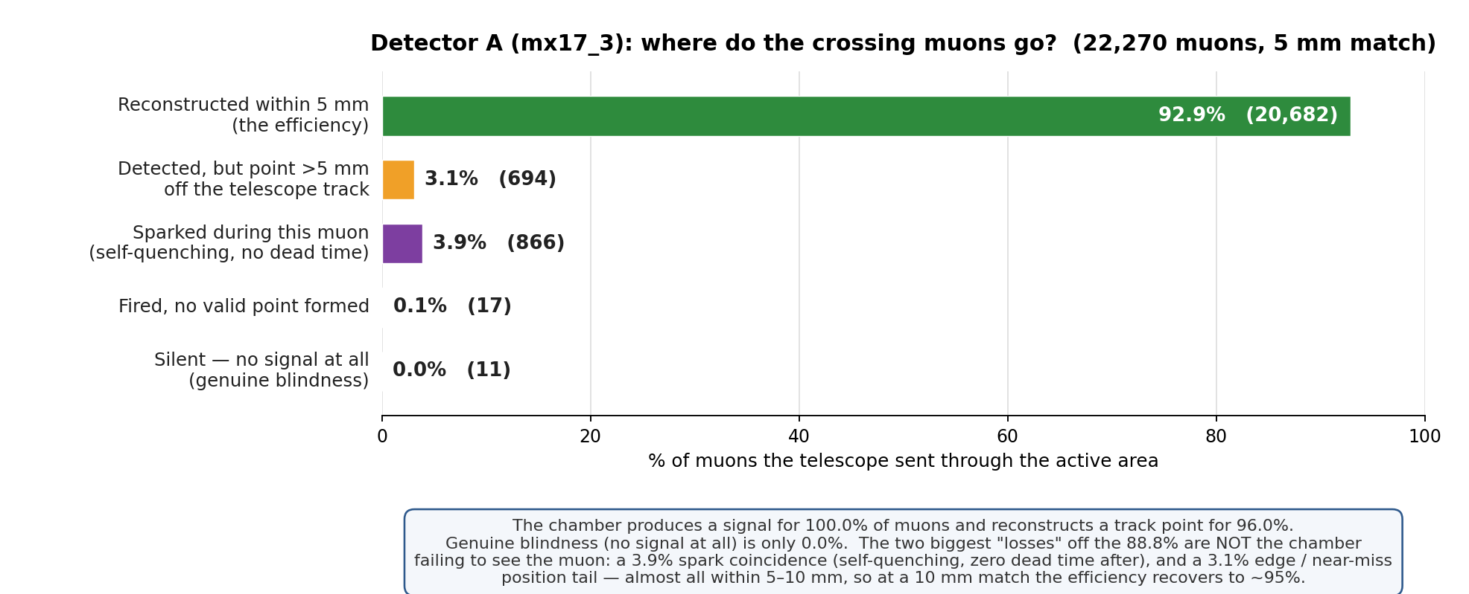
Efficiency: 92.9 % overall, ~96 % in the core, never blind
• 92.9 % within 5 mm over the full area; ~96 % in the core
• Signal on ~100 % of muons, a track point on 96.0 % — genuine blindness is ~0 %
• Loss = a spark coincidence (3.9 %) + an edge/near-miss position tail (3.1 %), not dead area
Detector A (mx17_3), weekend headline run, 490 V / 1000 V
Notes:
Detector A, 22.3k reference muons (2026-07-14 recipe: χ²<1.0, NClus=4): 92.9 ± 0.2 % reconstructed within 5 mm over the full active area — the operating number, with the 3.9 % in-spark coincidence folded in; ~96 % in the core (>25 mm from the frame — the outer band is the fringe-field region present in any bounded drift volume, pre-recipe-change figure). Crucially, the chamber produces a signal for essentially 100 % of muons and a track point for 96.0 % — genuine blindness is effectively 0 %. The loss off 92.9 % is a 3.9 % spark coincidence (self-quenching, no dead time after) plus a 3.1 % edge/near-miss position tail that sits just past the 5 mm cut — loosening the match recovers still more of it. Not dead area.

Slide 8
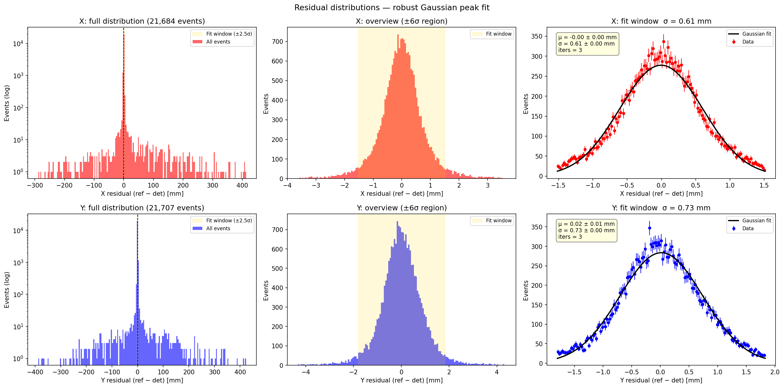
Position resolution: better than the strip pitch
• σ ≈ 0.47 mm at best — below the 0.78 mm strip pitch
• Resistive charge sharing = built-in analog interpolation between strips
• Telescope error still included → these are conservative numbers
Notes:
Residuals of detector A hits vs the reference telescope: Gaussian core σ = 0.61/0.73 mm (X/Y) on this run; the best position estimator reaches 0.47/0.54 mm for near-vertical muons — below the 0.78 mm strip pitch. Sub-pitch is possible because the resistive layer shares ~half the avalanche charge with neighbouring strips, acting as an analog interpolator: a deliberate design feature paying off. All values still include the telescope's own pointing error, so the true detector resolution is better.

Slide 9
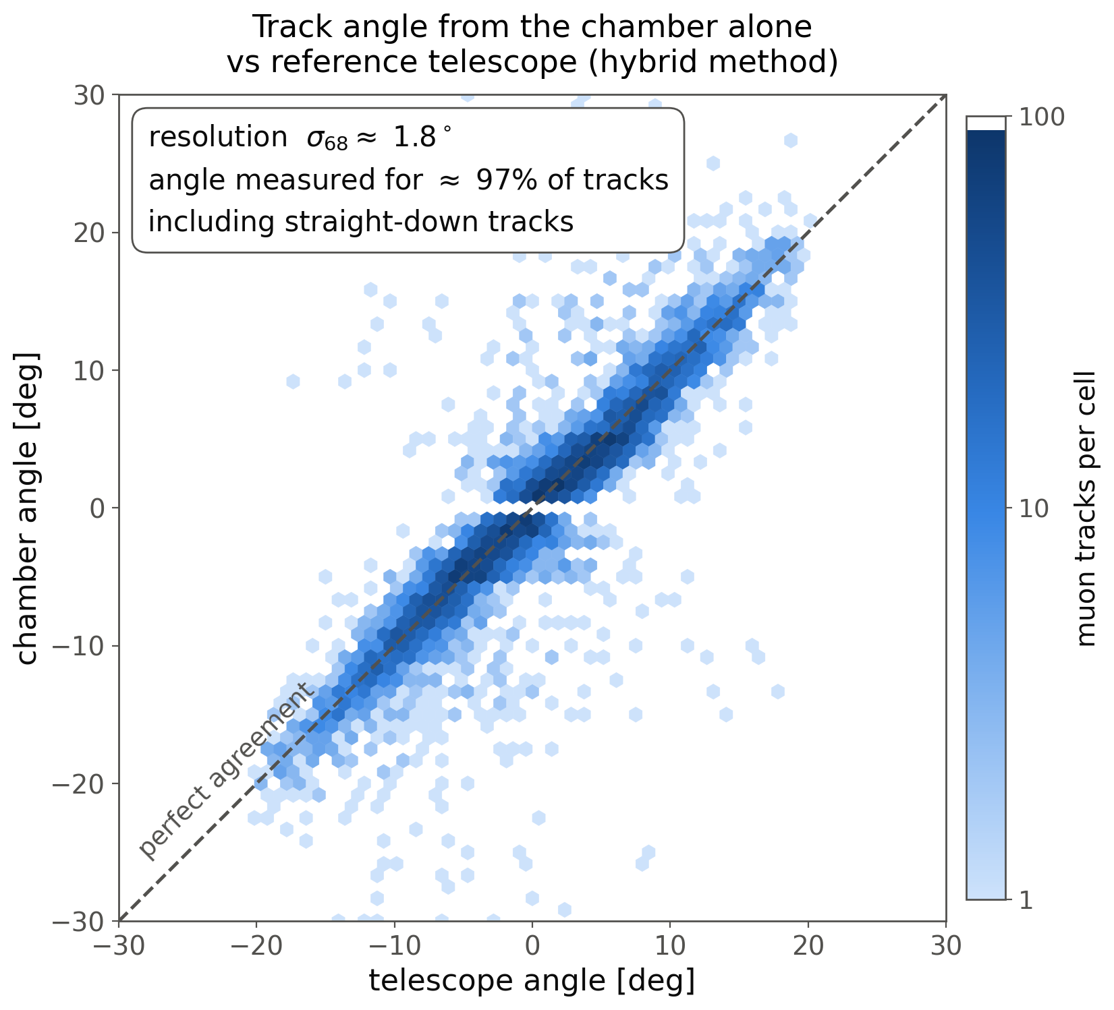
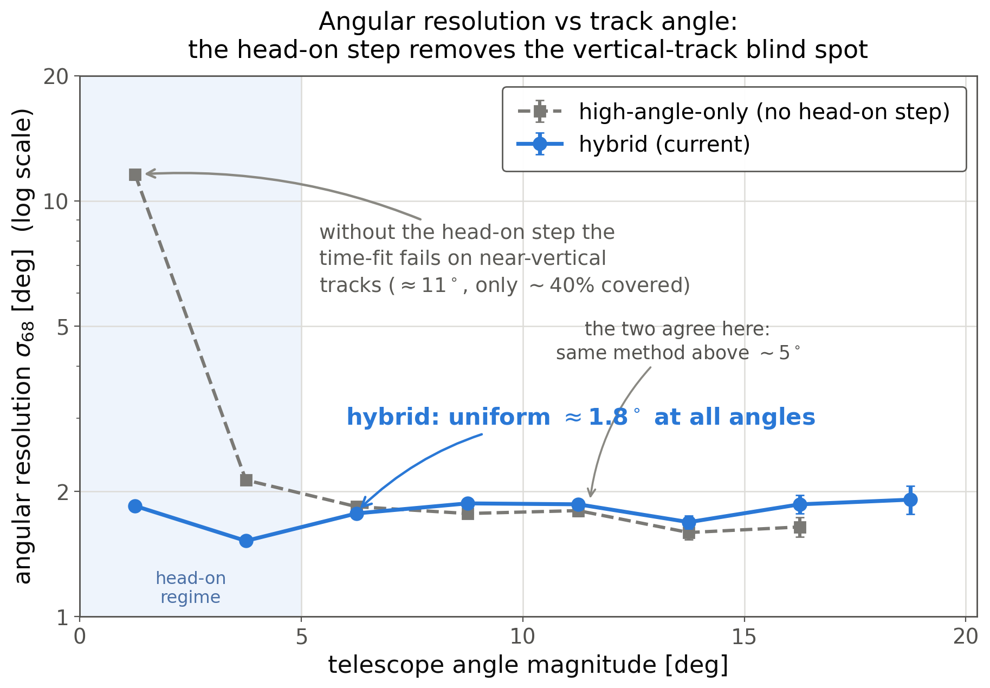
Track angle to ~1.7° — from one chamber alone, at every angle
• σ68 ≈ 1.7° per plane, uniform at ALL angles incl. head-on
• Bias only ~0.1°; 97–98 % of tracks usable
• Head-on step is what fixes near-vertical tracks (~5°→1.7°); the two agree above ~5°
• Transfers between chambers unchanged → design property
Notes:
Hybrid tracking (the current-best method): for inclined tracks the drift-time ladder (after the charge-sharing 'unsharing' correction); for near-vertical tracks — where the time ladder has no lever arm — the shape of the charge deposit itself. Result: uniform σ68 ≈ 1.7° at ALL angles (1.66° near-vertical, 1.84° plateau), 97–98 % of tracks usable, ~0.1° residual bias. Right plot is the honest ablation: the SAME method with the head-on step switched off ('high-angle-only') matches the hybrid above ~5° — it's the same estimator there — and only rises, to ~5°, on near-vertical tracks (where a drift-time fit has no lever arm and covers just ~51 % of them). The same reconstruction transferred untouched to detector B gives 2.7° vs 2.3° retrained — a design property, not tuning. Bonus: the fit also returns the drift velocity, so the chambers monitor their own gas in situ.

Slide 10
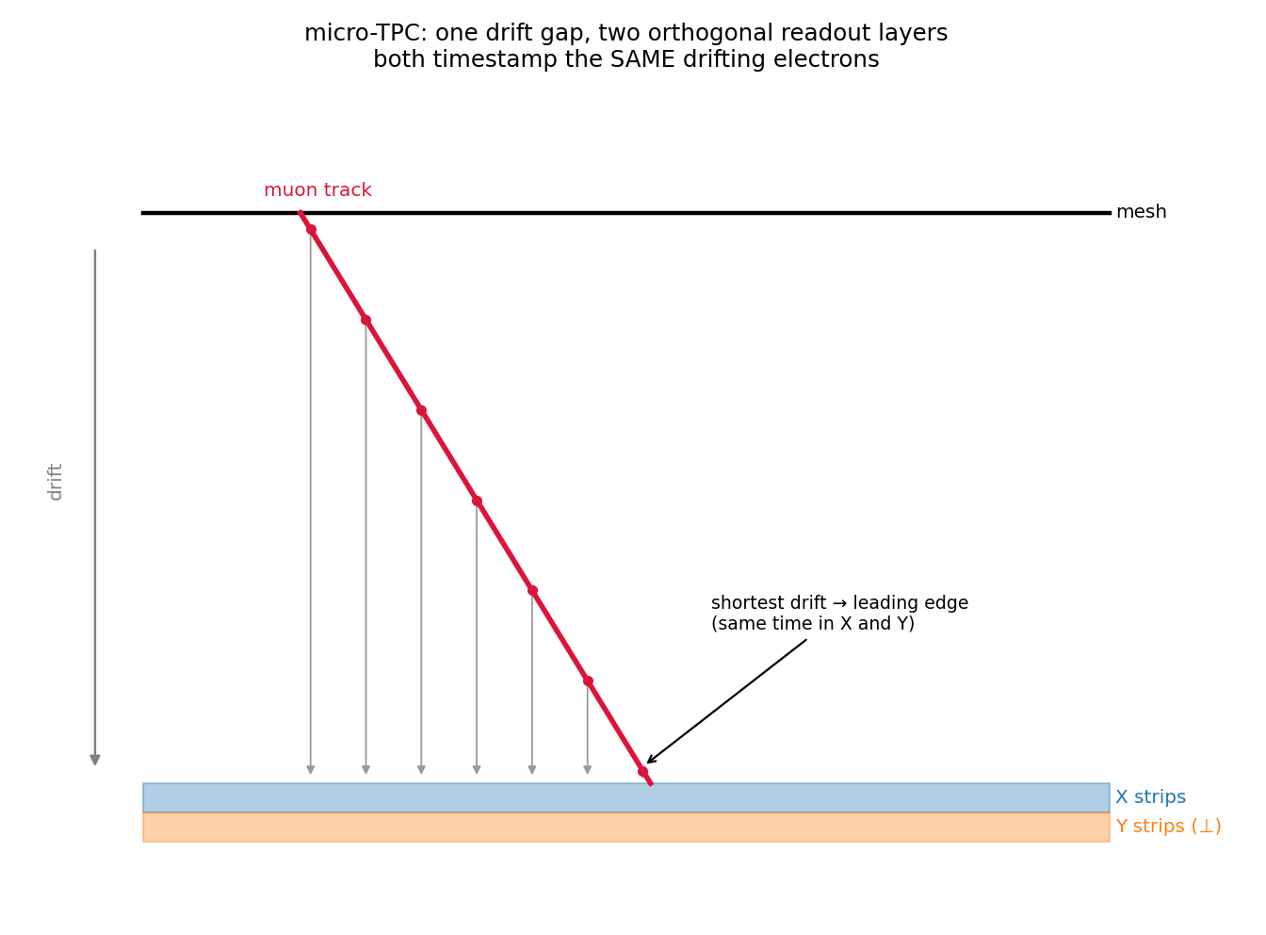
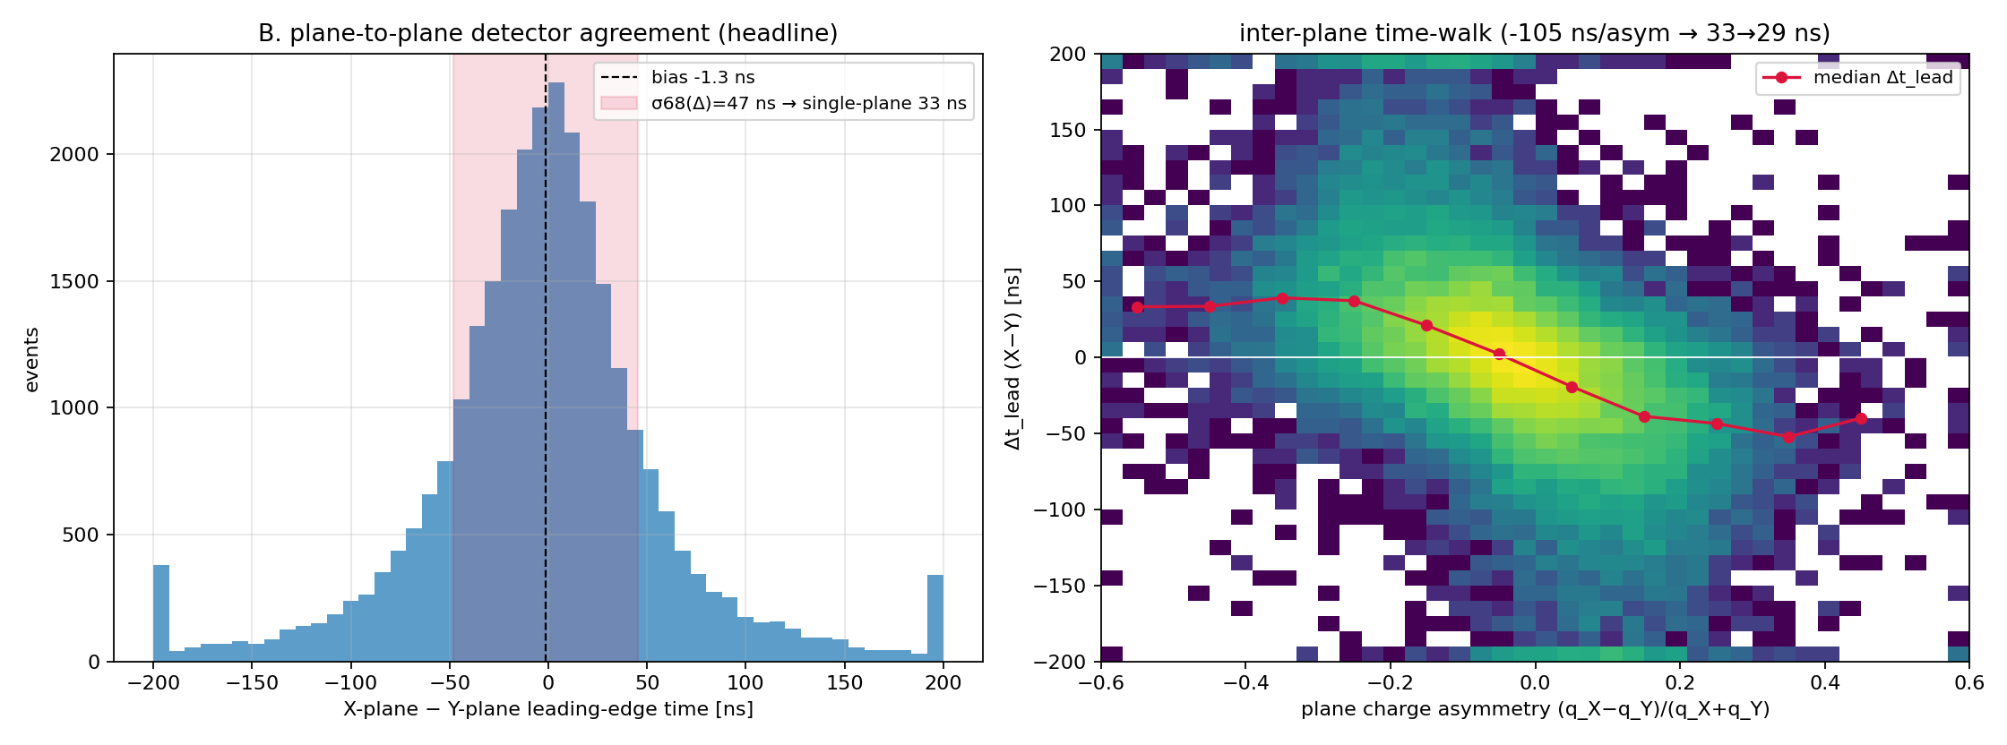
Event timing: 33 ns ≈ 1 mm of drift
• σt = 33 ns per plane (≈ 1 mm of drift); 29 ns after walk correction
• Measured telescope-free: two orthogonal layers time the same electrons
• Absolute event time vs trigger: σ68 = 37.7 ns
Notes:
The X and Y strip layers sit under one amplification stage and time the same drifting electrons, so their time difference is a pure self-measurement of the chamber's timing: σt = 33 ns per plane (29 ns after time-walk correction), ≈ 1 mm of drift — matching the transverse resolution, i.e. the chamber is not timing-limited. Against the scintillator trigger the absolute event time is σ68 = 37.7 ns, detector-dominated. Replicated on detector B within ~10 %.

Slide 11
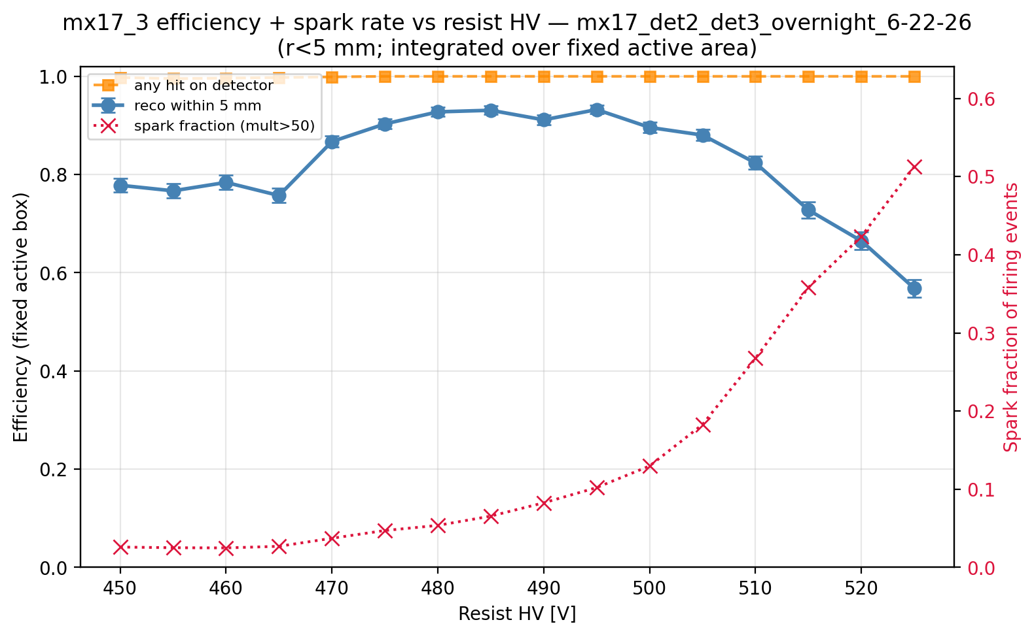
Operating point: a clean plateau, ended by sparks — not silence
• ~93 % plateau at 485–495 V (detectors A and B)
• Above plateau: sparks rise exactly where efficiency falls
• The chamber never goes silent — losses are discharge coincidences
• Per-chamber optima: 440–495 V
Notes:
Amplification-voltage scan of detector A (450–525 V, drift 1000 V): efficiency plateaus at ~93 % around 490–495 V then rolls off — while the fraction of events with any signal stays at ~100 % and the spark fraction (right axis) climbs sharply exactly where efficiency dies. High-HV loss is spark-induced reconstruction failure, not a quiet detector. Optima: A 490–495 V, B 485–490 V, C 480 V, D 440 V — chamber-to-chamber optima differ by ~50 V, so each chamber gets its own operating point.

Slide 12
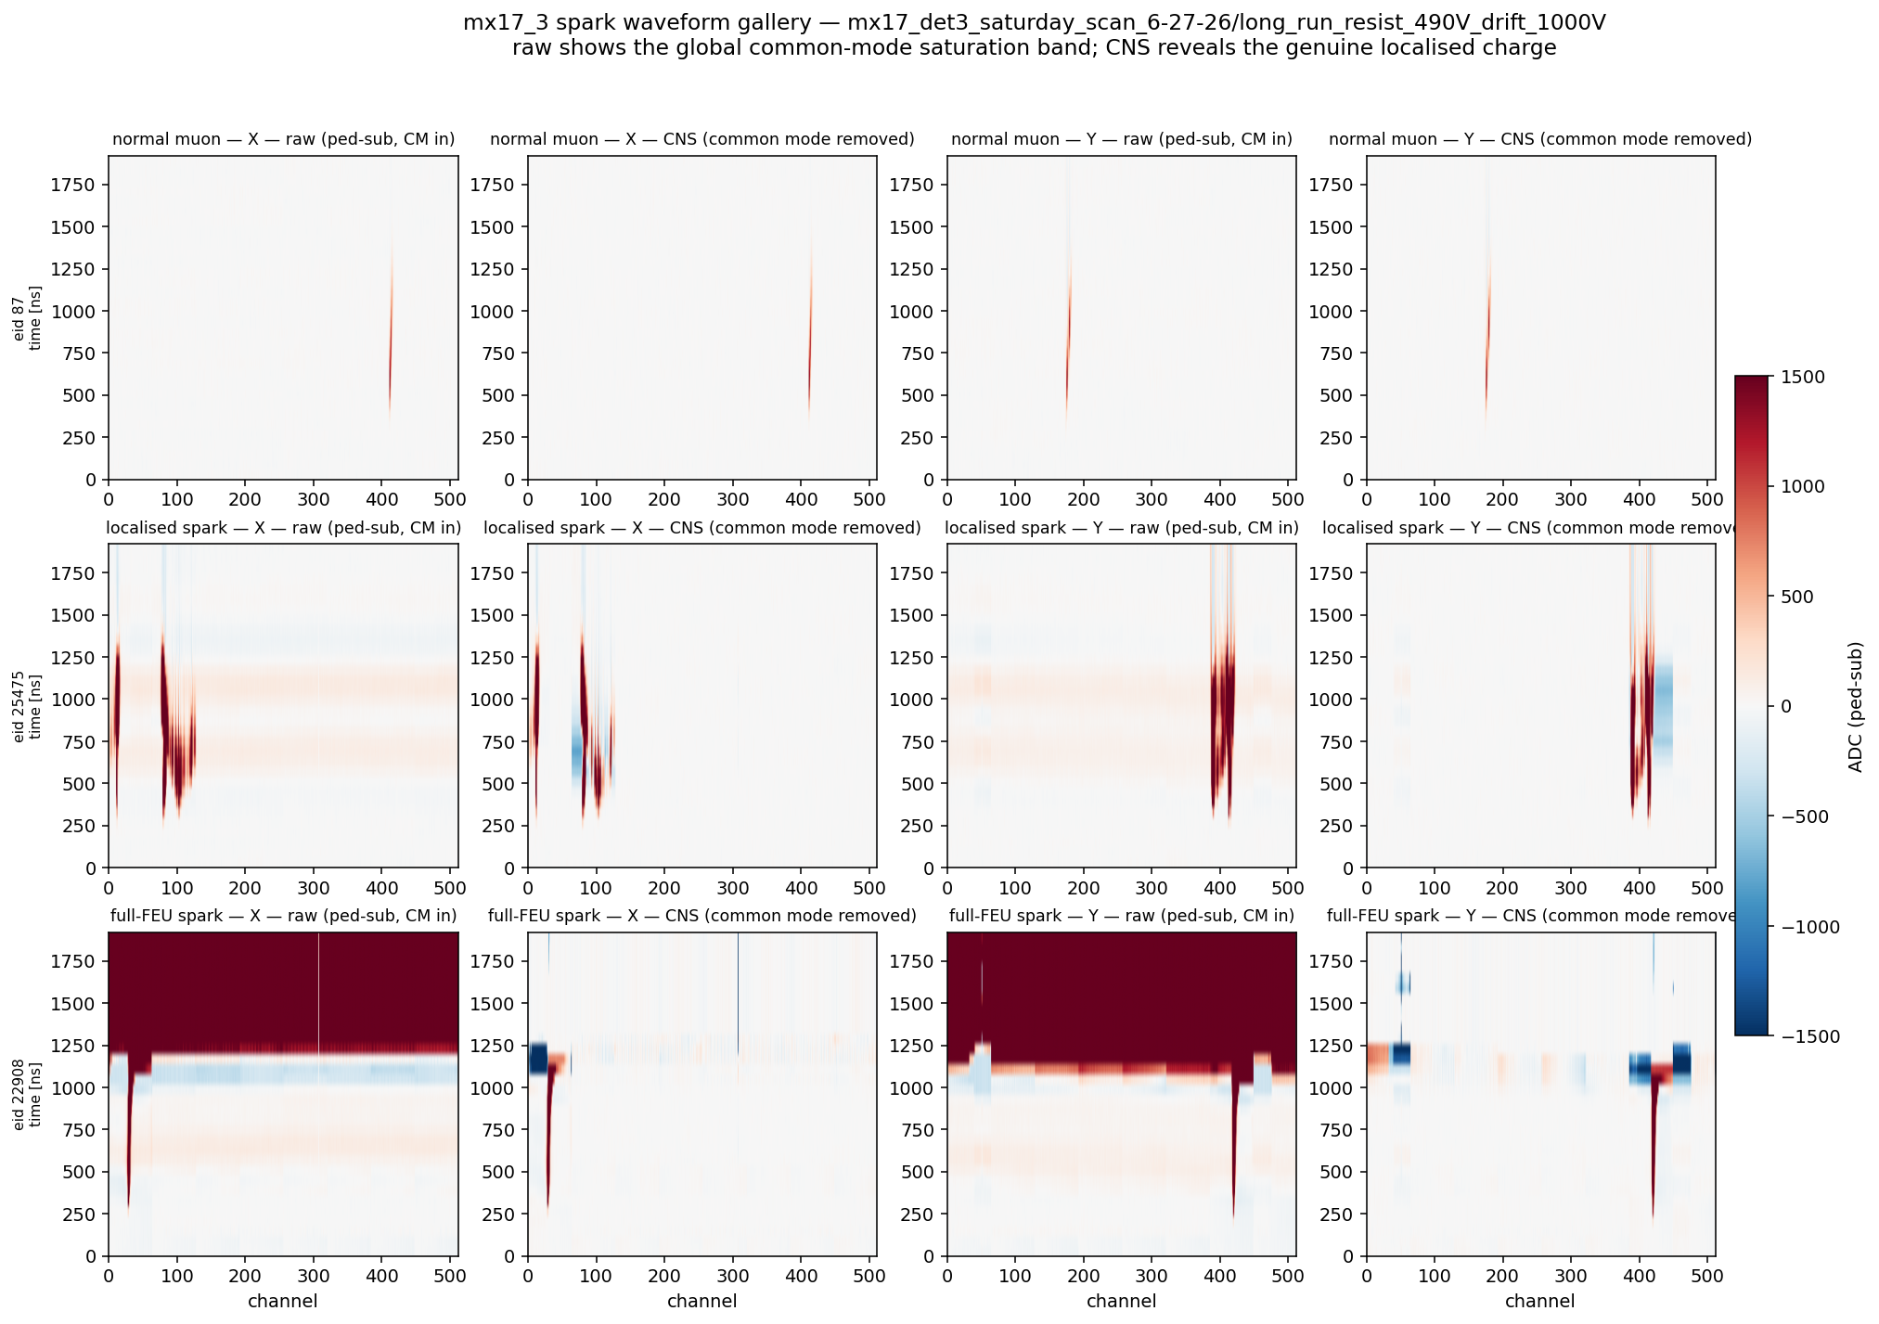
What a discharge really is: fast, global, self-quenching
• Global baseline step, over within 2 µs
• Not a streamer: onset simultaneous on all 512 channels
• Poisson, muon-induced (4×), edge-seeded
• Alternative figure: event_displays/event_display_spark
Notes:
Raw waveforms: a spark is a fast common-mode baseline step across the whole front-end that recovers within the 1.9 µs readout window (94 % fully recovered); the genuine localized charge is confined to ~40–56 strips at one edge. It is NOT a propagating streamer — the onset is simultaneous across all 512 channels. This is the resistive-Micromegas spark-protection signature seen directly in raw data. Sparks are Poisson in time (0.33 Hz at A's operating point — random, no bursts), mostly muon-induced (4× enhancement), and edge-seeded.

Slide 13
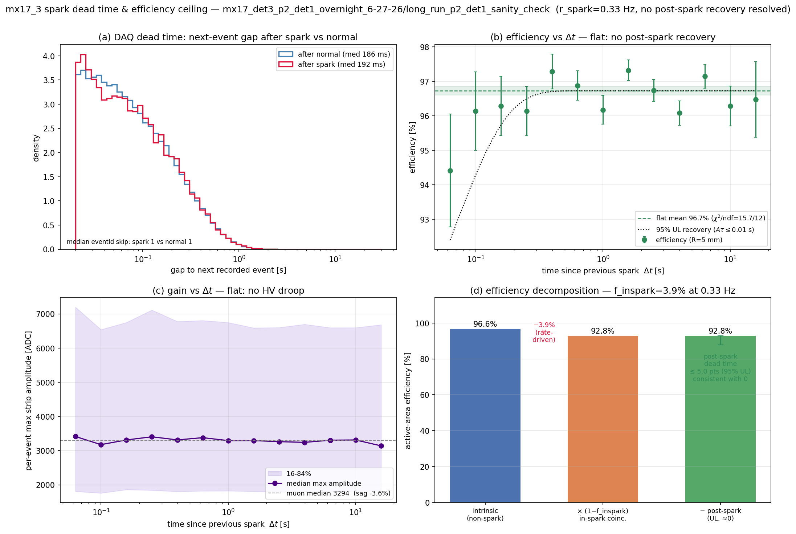
…and it costs no dead time at all
• Efficiency flat vs time-since-spark (χ²/ndf ≈ 1)
• Gas gain flat too — no HV droop, no recovery transient
• Only cost: the crossing that coincides with the spark (3.9 % at A)
Notes:
The dead-time null measurement on detector A (and D): DAQ event spacing after a spark is unchanged; reconstruction efficiency AND gas gain are flat vs time since the previous spark. The only spark-related loss is the muon that coincides with the discharge itself — already inside the quoted efficiency. The resistive protection scheme imposes no recovery-time ceiling on operation. For a construction talk this is the strongest single message: the protection design works, verified down to the raw waveforms.

Slide 14
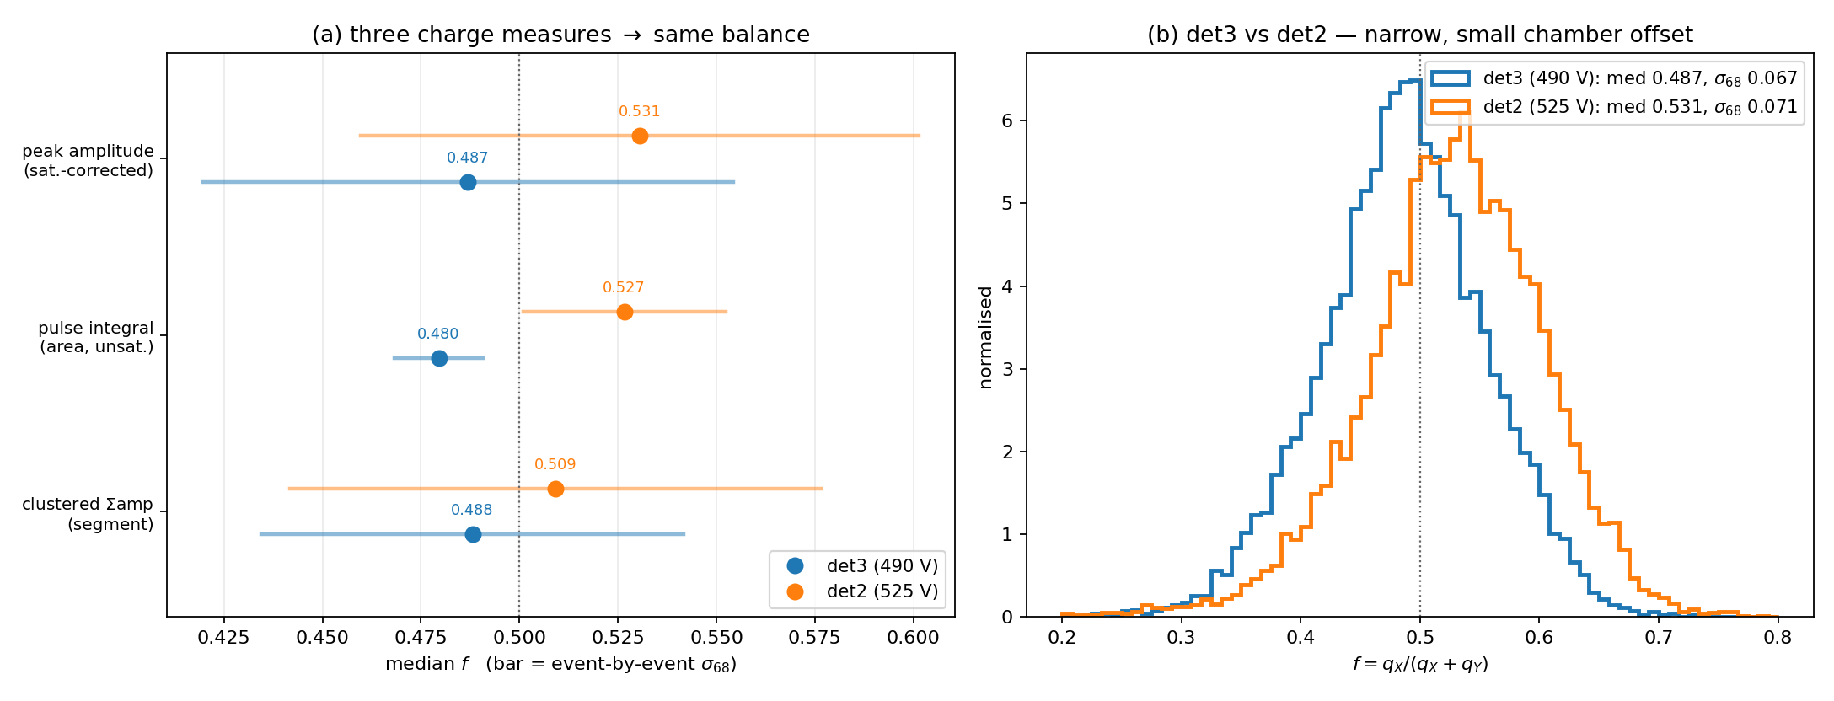
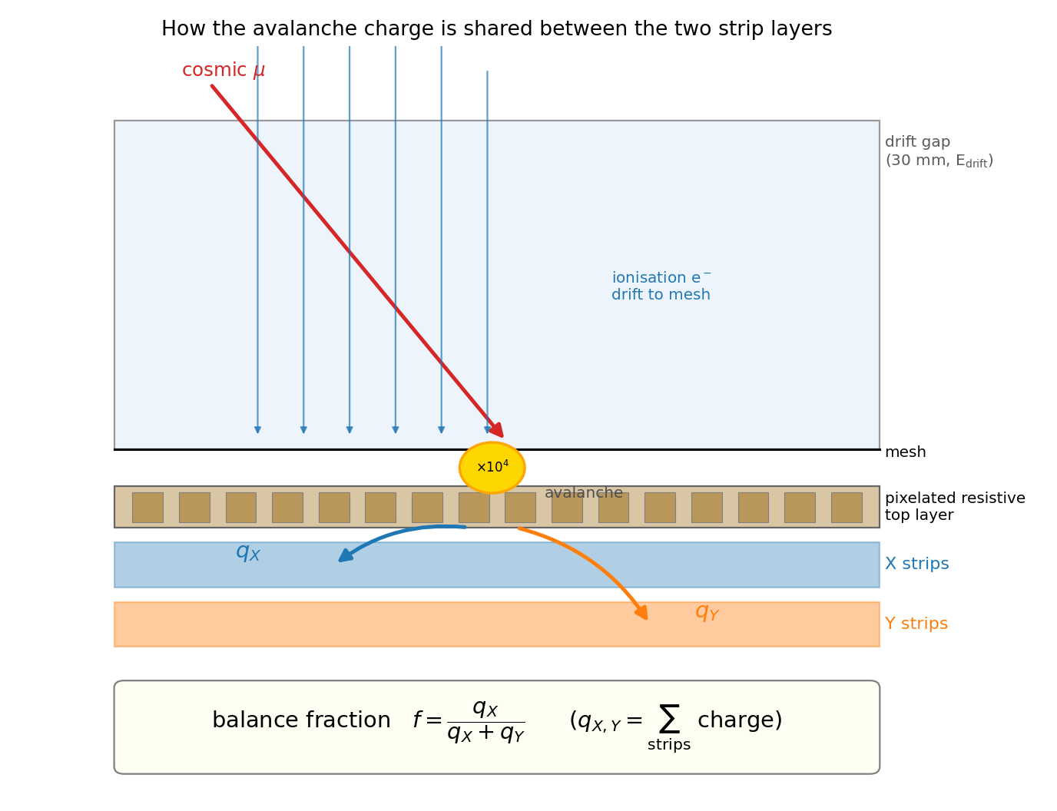
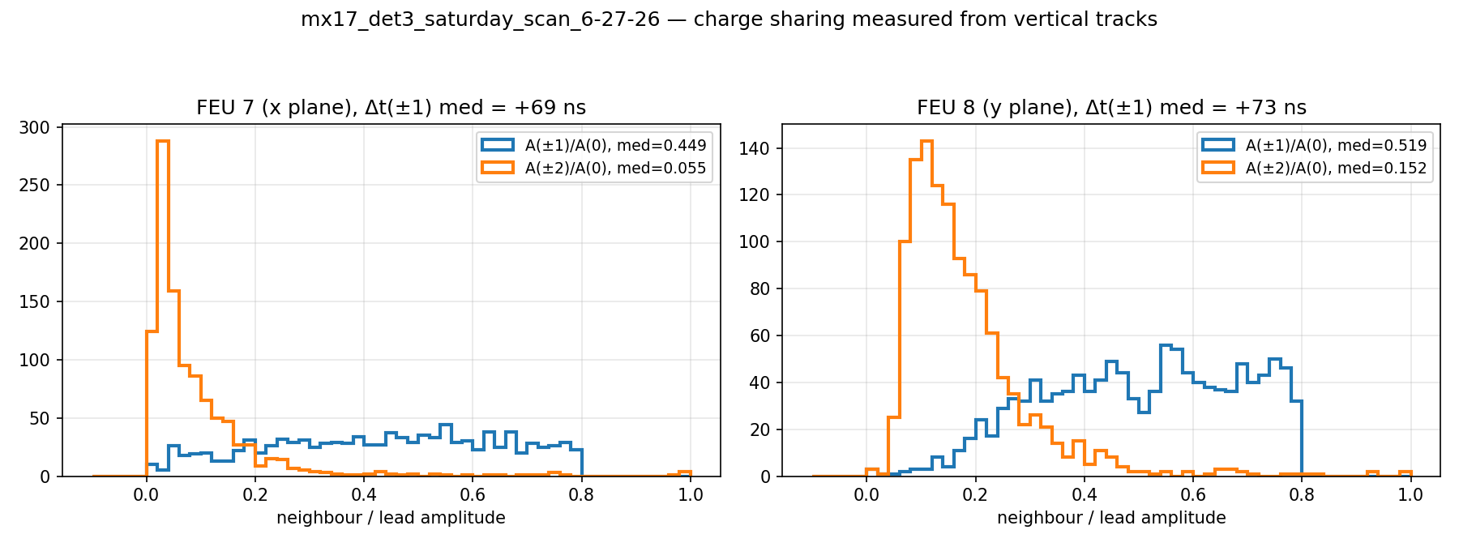
Two construction choices, validated in data
Pixel-layer charge balance (left schematic, top right) and resistive strip-to-strip sharing (bottom right)
Notes:
Left: the pixelated resistive top layer routes avalanche charge to both strip layers — measured: X/Y charge split narrow (σ68 ≈ 0.07), centred at 0.491 (A) / 0.534 (B), constant across position and angle; X–Y charge correlation r ≈ 0.84–0.89. The ~0.04 chamber-to-chamber offset is an assembly-level effect; the constancy is the design metric. Right: resistive charge sharing measured from vertical tracks — first neighbour carries ~45–52 % with ~70 ns delay, identical on both chambers measured → a design property. It must be corrected for timing ('unsharing'), and it is exactly what buys sub-pitch position resolution.

Slide 15
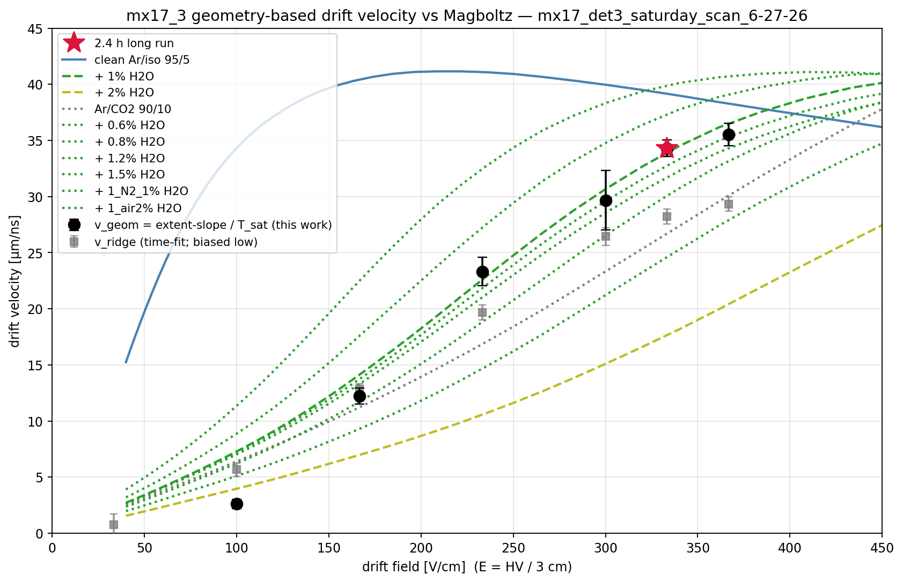
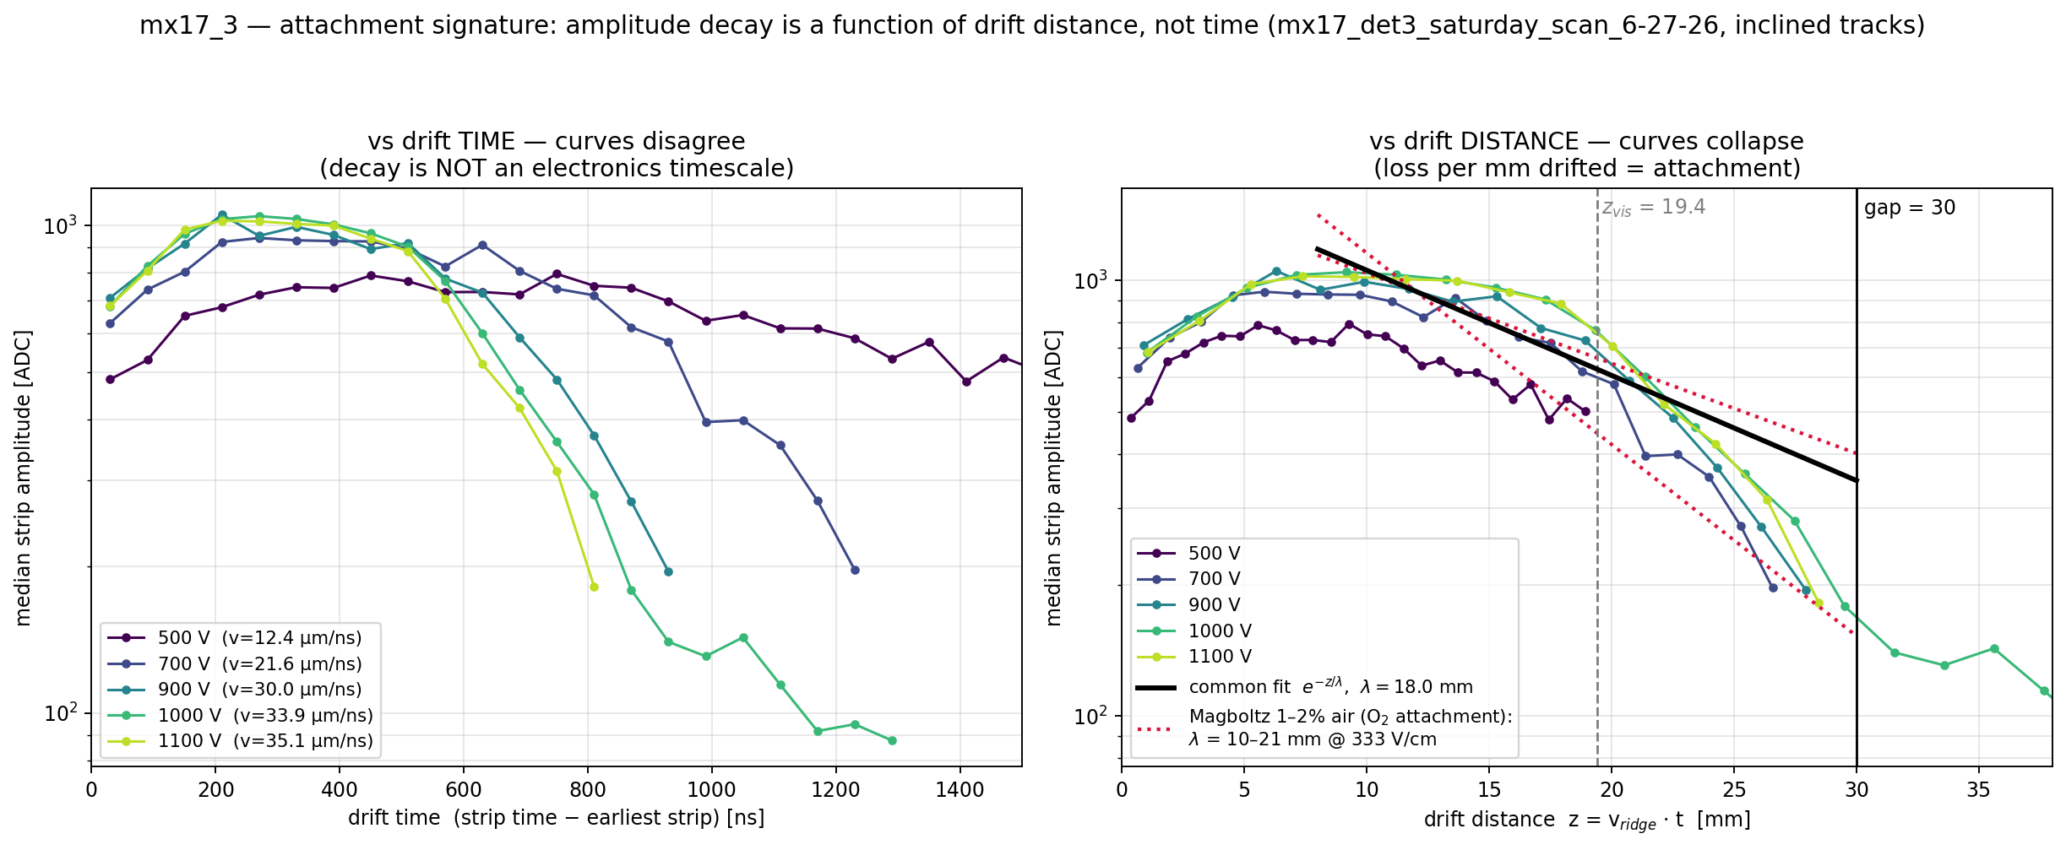
The gas talks: drift velocity and attachment as built-in monitors
Water sets the drift speed; oxygen sets the attachment — both measured from the muon data themselves
Notes:
Left: measured drift velocity vs field matches simulation (Magboltz) for Ar/iso 95/5 with ~1 % water — the chambers identify their own gas condition from data (detector A visibly dried from >3 % to ~1 % H2O over the week). Right: signal amplitude decays with drift DISTANCE, not time — curves at all drift voltages collapse onto one exponential (λ ≈ 18 mm), the fingerprint of electron attachment on oxygen from ~1 % air. Lesson for construction/operation: gas tightness and flushing matter — water sets the speed, oxygen eats the signal — and both are monitorable in situ.

Slide 16
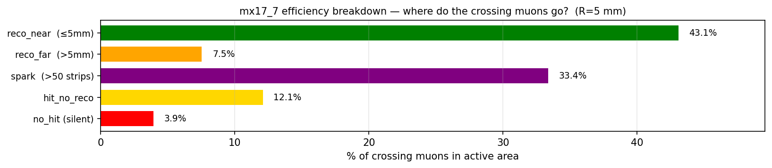
The five chambers, honestly compared
Det | Serial | Efficiency | Position σ | Angle σ68* | Spark | Verdict
A | mx17_3 | 92.9 % | 0.47 mm | 1.7° | 3.9 % | Best performer
B | mx17_2 | 91.3 % | 0.46 mm | 2.3° | 5.0 % | Healthy
C | mx17_6 | 57.8 % | 0.45 mm | 3.9° † | 23.0 % | Spark-limited (op. point)
D | mx17_7 | 43.1 % | 0.59 mm | 3.4° | 33.4 % | Spark-limited (op. point)
E | mx17_4 | 20.7 % | 0.67 mm | 2.6° | 3.2 % | Gain-limited
• A & B excellent and mutually consistent
• C & D: great cores, June op. point past spark optimum
• E: fires on ~70 % of muons — gain issue, not dead
Efficiency within 5 mm of reference track, full active area; position σ includes the telescope. *Angle = hybrid tracking |θ|<5° σ68 (holdout), now fleet-wide. †C low-angle-only: X-plane has no drift-time structure (board-C mesh defect), plateau omitted
Notes:
Identical method on all five (2026-07-14 recipe). A and B: excellent — high uniform efficiency at sub-mm resolution, and everywhere both were probed deeply they agree (evidence the performance is the design, not luck). C and D reconstruct with the same sub-mm quality when they fire (C's 0.45 mm core is the best in the fleet) but ran at 23–33 % spark fraction at their June operating points — an operating-point effect, recoverable, not broken chambers. E fires on ~70 % of muons but its clusters are too small to reconstruct (gas gain issue — HV/threshold/gas — not a dead detector). Bottom bars: A's loss budget vs D's — same 'fires on everything' behaviour, very different discharge cost.

Slide 17
Detector A at a glance — specification sheet
Quantity | Value | Notes
Active area | ~40 × 40 cm² | 512 strips × 0.78 mm, per coordinate
Strip pitch | 0.78 mm | both coordinates (X and Y)
Drift gap | 30 mm | micro-TPC mode, drift field ≈ 330 V/cm
Gas | Ar/iC₄H₁₀ 95/5 | atmospheric, flushed
Drift velocity | 34 ± 1.5 µm/ns | measured; matches Magboltz (~1 % H₂O)
Detection efficiency | 92.9 % | within 5 mm; spark-free 96.6 %, core ~96 %
Muons giving any signal | ≈ 100 % | chamber essentially never blind (≈0 % silent)
Position resolution | 0.44 – 0.47 mm | sub-pitch (pitch 0.78 mm); incl. telescope
Angular resolution | ≈ 1.7° | hybrid tracking, all angles; bias ≈0.1°
Time resolution | 33 ns (≈ 1 mm drift) | telescope-free, inter-plane method
Charge sharing | 45 – 52 % to neighbour | design property; enables sub-pitch
Spark rate (at optimum) | 3.9 % of crossings | self-quenching; zero measurable dead time
Detector A (mx17_3), 490 V / 1000 V. All values preliminary; measured against reference muon tracks.
Notes:
A one-page reference for the reference chamber (mx17_3) at its June operating point (amplification 490 V, drift 1000 V). Every number is measured against independently reconstructed cosmic-muon reference tracks. Efficiency is the operating value (in-spark coincidences folded in): spark-free it is 96.6 %, and ~96 % in the core away from the fringe-field edge. Position and angle include the reference telescope's own error, so they are conservative. Full provenance and the fine print are in report/main.pdf.

Slide 18
Per-detector characteristics — the five chambers
Det | Serial | Efficiency (≤5 mm) | Position σ | Angle σ68* | Spark (% cross.) | Amp HV (optimum) | Verdict
A | mx17_3 | 92.9 % | 0.47 mm | 1.7° | 3.9 % | 490–495 V | Best performer
B | mx17_2 | 91.3 % | 0.46 mm | 2.3° | 5.0 % | 485–490 V | Healthy
C | mx17_6 | 57.8 % | 0.45 mm | 3.9° † | 23.0 % | 480 V | Spark-limited (op. pt.)
D | mx17_7 | 43.1 % | 0.59 mm | 3.4° | 33.4 % | 440 V | Spark-limited (op. pt.)
E | mx17_4 | 20.7 % | 0.67 mm | 2.6° | 3.2 % | — | Gain-limited
• A & B: excellent and mutually consistent (design, not luck)
• C & D: best-in-fleet cores (C 0.45 mm) — June op. point past the spark optimum
• E: fires on ~70 % of muons — gain issue, recoverable, not a dead chamber
*Angle = hybrid tracking |θ|<5° σ68 (holdout), fleet-wide. †C low-angle-only: X-plane has no drift-time structure (board-C mesh defect), plateau omitted. C/D drift 700 V; A/B drift 1000 V.
Notes:
The same measurements on all five chambers, at their best June runs (2026-07-14 recipe). A and B (drift 1000 V) are the healthy reference pair; C and D (drift 700 V) reconstruct with the same sub-mm quality when they fire but lost 23–33 % of crossings to sparking at their June operating points — an operating-point effect, not broken chambers. E fires on ~70 % of muons but its clusters are too small to reconstruct (gas-gain issue). Efficiency is within 5 mm of the reference track over the full active area; position σ includes the telescope; angle σ68 is the hybrid tracker (|θ|<5° band, holdout), run fleet-wide. Amplification-HV optima come from the dedicated HV scans (drift 1000 V for A/B, 700 V for C/D).

Slide 19
Takeaways
• The chambers work: ~96 % core efficiency, and they fire on essentially every muon
• Sub-pitch position (0.47 mm vs 0.78 mm pitch) — delivered by the resistive-sharing design
• Each chamber is a self-contained 3D tracker: ~1.7° angles, 33 ns timing, from one 30 mm gap
• The resistive spark protection is verified end-to-end: rare, self-quenching, zero dead time
• The pixelated charge-routing layer splits charge 50/50, uniformly — as designed
• Chamber-to-chamber differences are operating-point and gas effects, not construction defects
• Preliminary; position numbers conservative (telescope not deconvolved)
Notes:
Caveats to attach when quoting: (1) preliminary, June 2026 bench campaign; (2) position resolutions are detector⊕telescope, not yet deconvolved → conservative; (3) cosmic muons at the listed gas/HV; (4) C/D/E numbers reflect their June operating points, HV scans indicate better is available. Full details: report/main.pdf and source_reports/ in this package.

