Slide 1
n_TOF Italy Meeting 2026
X17 Search in EAR2
Overview + Status of the July+August Run
On behalf of the collaboration
Stéphan Aune · Timote Dannely-Lamborion · Pierfrancesco Mastinu · Riccardo Mucciola
Elizabeth Musacchio Gonzalez · Dylan Neff · Thomas Papaevangelou · and all others in the n_TOF X17 collaboration
Dylan Neff · n_TOF Italy Meeting · 15 October 2026
Slides and analysis built with Claude Code (Anthropic)

Slide 2
Outline
01
X17, and how we would see it at n_TOF
02
The detector system in EAR2 — what we built this summer
03
Plan A: MeV neutrons — and the γ flash
04
Plan B: thermal neutrons — and self-shielding
05
Plan C: the aluminum spectrum — capsule image, pairs to analyse
2 / 27
D. Neff · n_TOF Italy Meeting · 15 October 2026

Slide 3
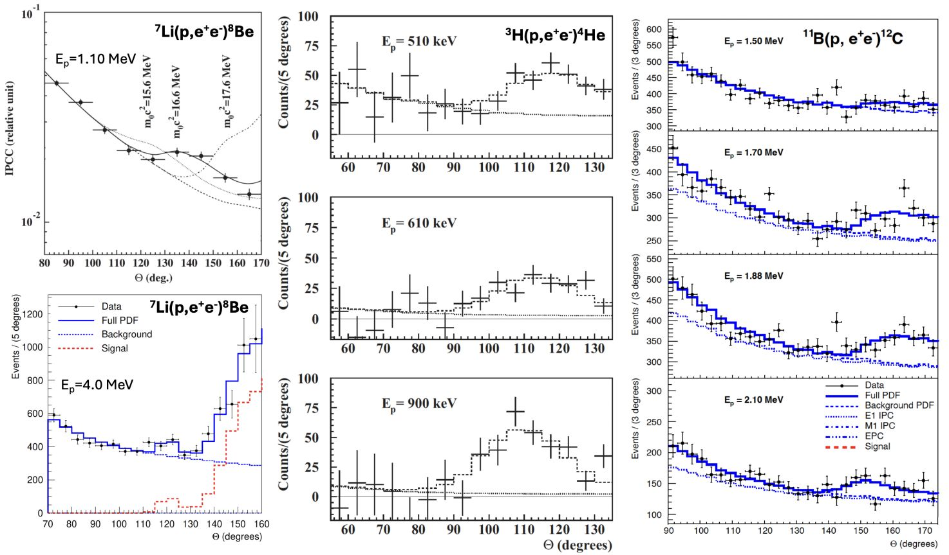
Motivation
A possible new boson at 17 MeV?
ATOMKI, 2016: an excess of e⁺e⁻ pairs at large opening angle, in three nuclear transitions
Consistent with a new particle: X17, ~17 MeV, decaying to e⁺e⁻
Can we make an independent measurement?
The same ⁴He* state, generated with neutrons + ³He?
A.J. Krasznahorkay et al., PRL 116, 042501 (2016) · PRC 104, 044003 (2021) · PRC 106, L061601 (2022)
3 / 27
D. Neff · n_TOF Italy Meeting · 15 October 2026

Slide 4
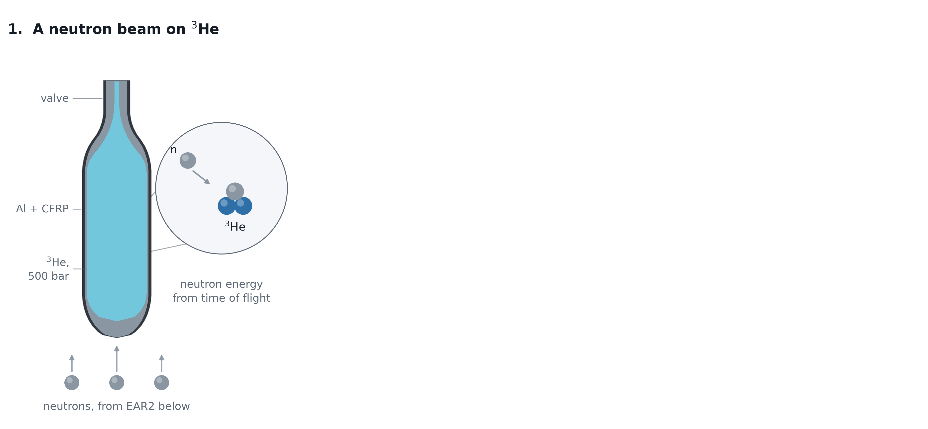
Motivation
Capture on ³He and how X17 could come out
4.1 / 27
D. Neff · n_TOF Italy Meeting · 15 October 2026

Slide 5
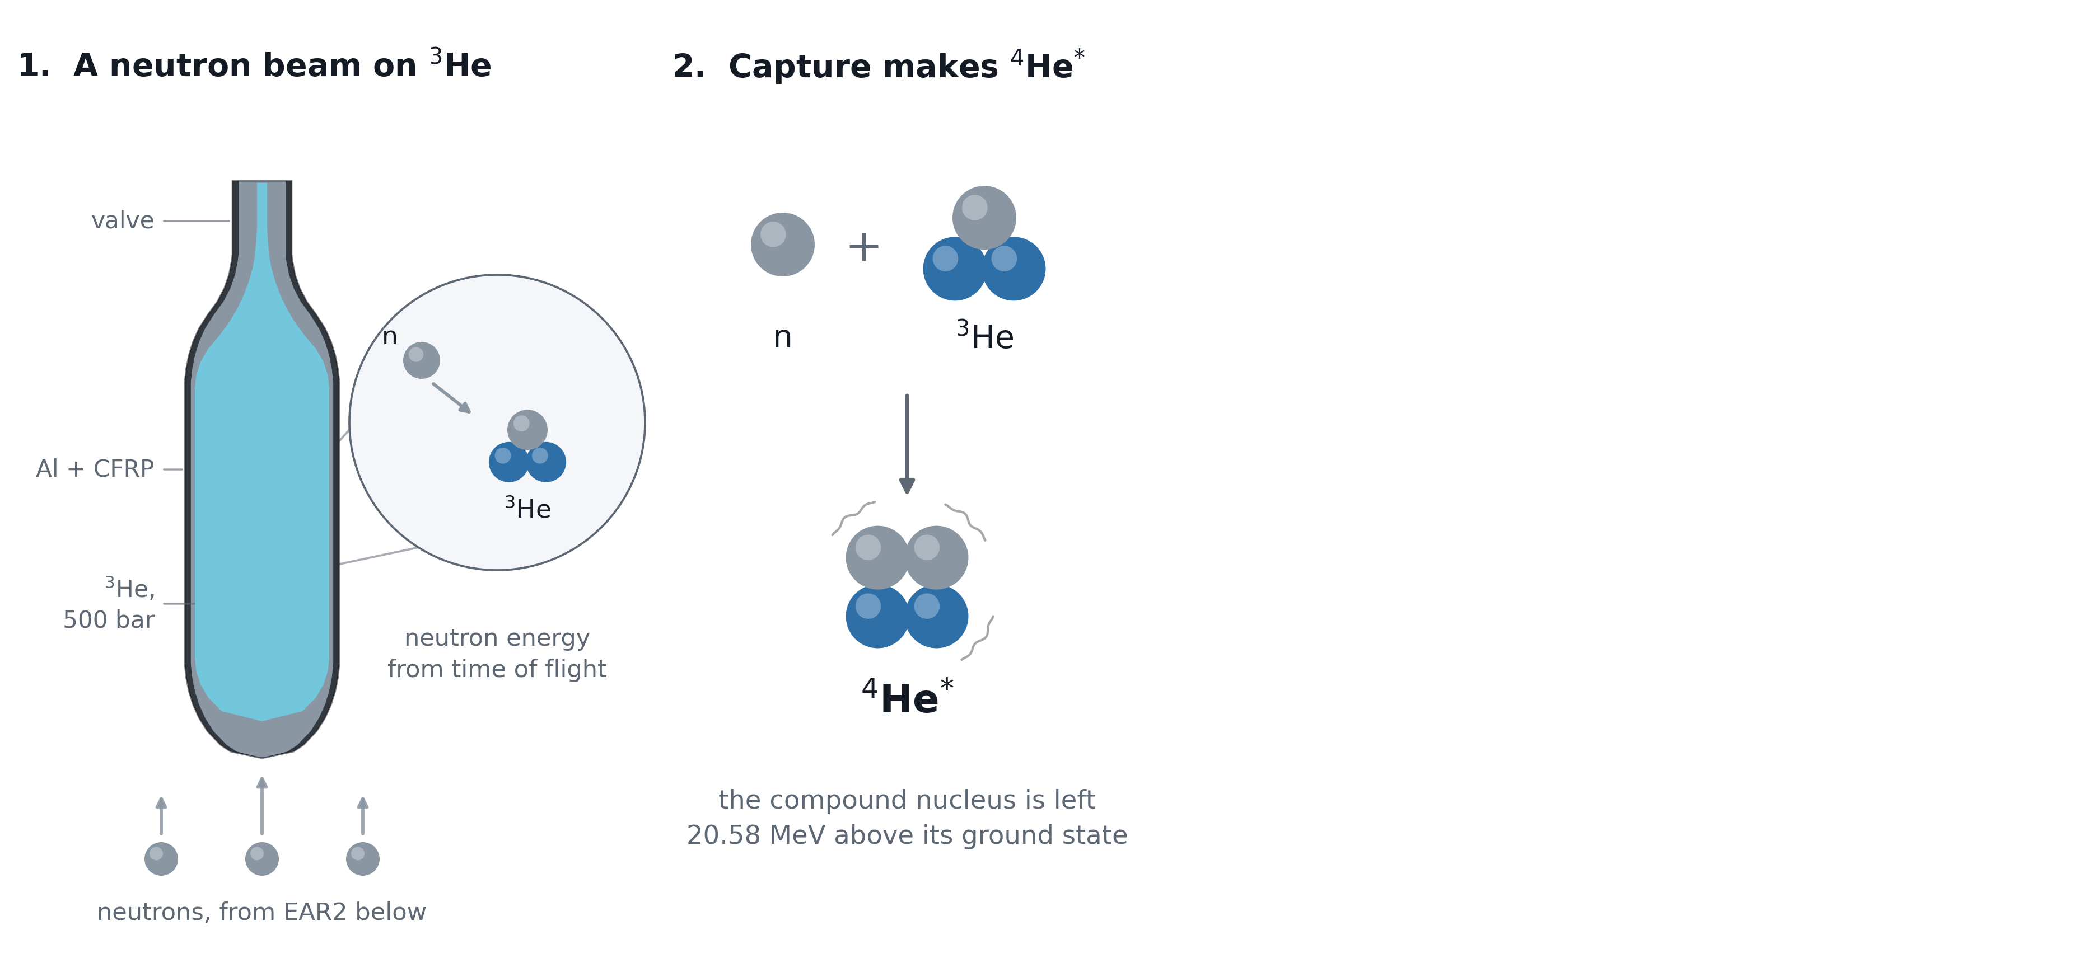
Motivation
Capture on ³He and how X17 could come out
4.2 / 27
D. Neff · n_TOF Italy Meeting · 15 October 2026

Slide 6
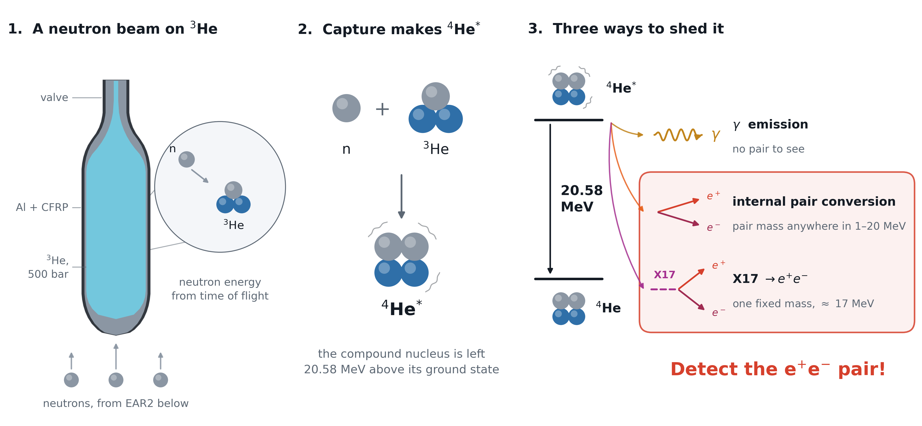
Motivation
Capture on ³He and how X17 could come out
?
4.3 / 27
D. Neff · n_TOF Italy Meeting · 15 October 2026

Slide 7
Motivation
The opening angle observable -- X17 moves slow
5.1 / 27
D. Neff · n_TOF Italy Meeting · 15 October 2026

Slide 8
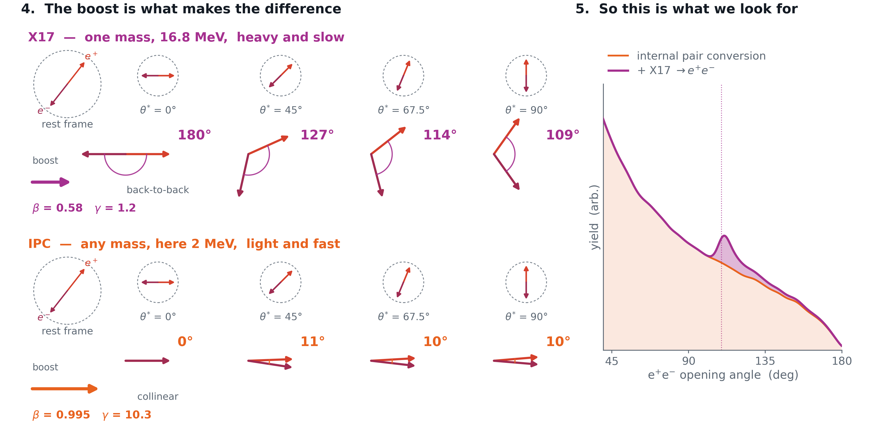
Motivation
The opening angle observable -- X17 moves slow
5.2 / 27
D. Neff · n_TOF Italy Meeting · 15 October 2026

Slide 9
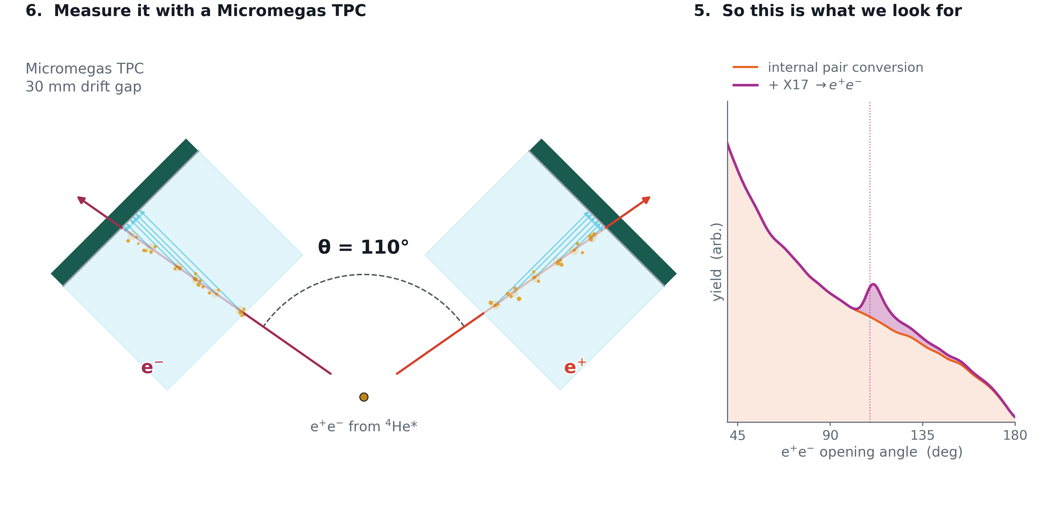
Motivation
The opening angle observable -- X17 moves slow
5.3 / 27
D. Neff · n_TOF Italy Meeting · 15 October 2026

Slide 10
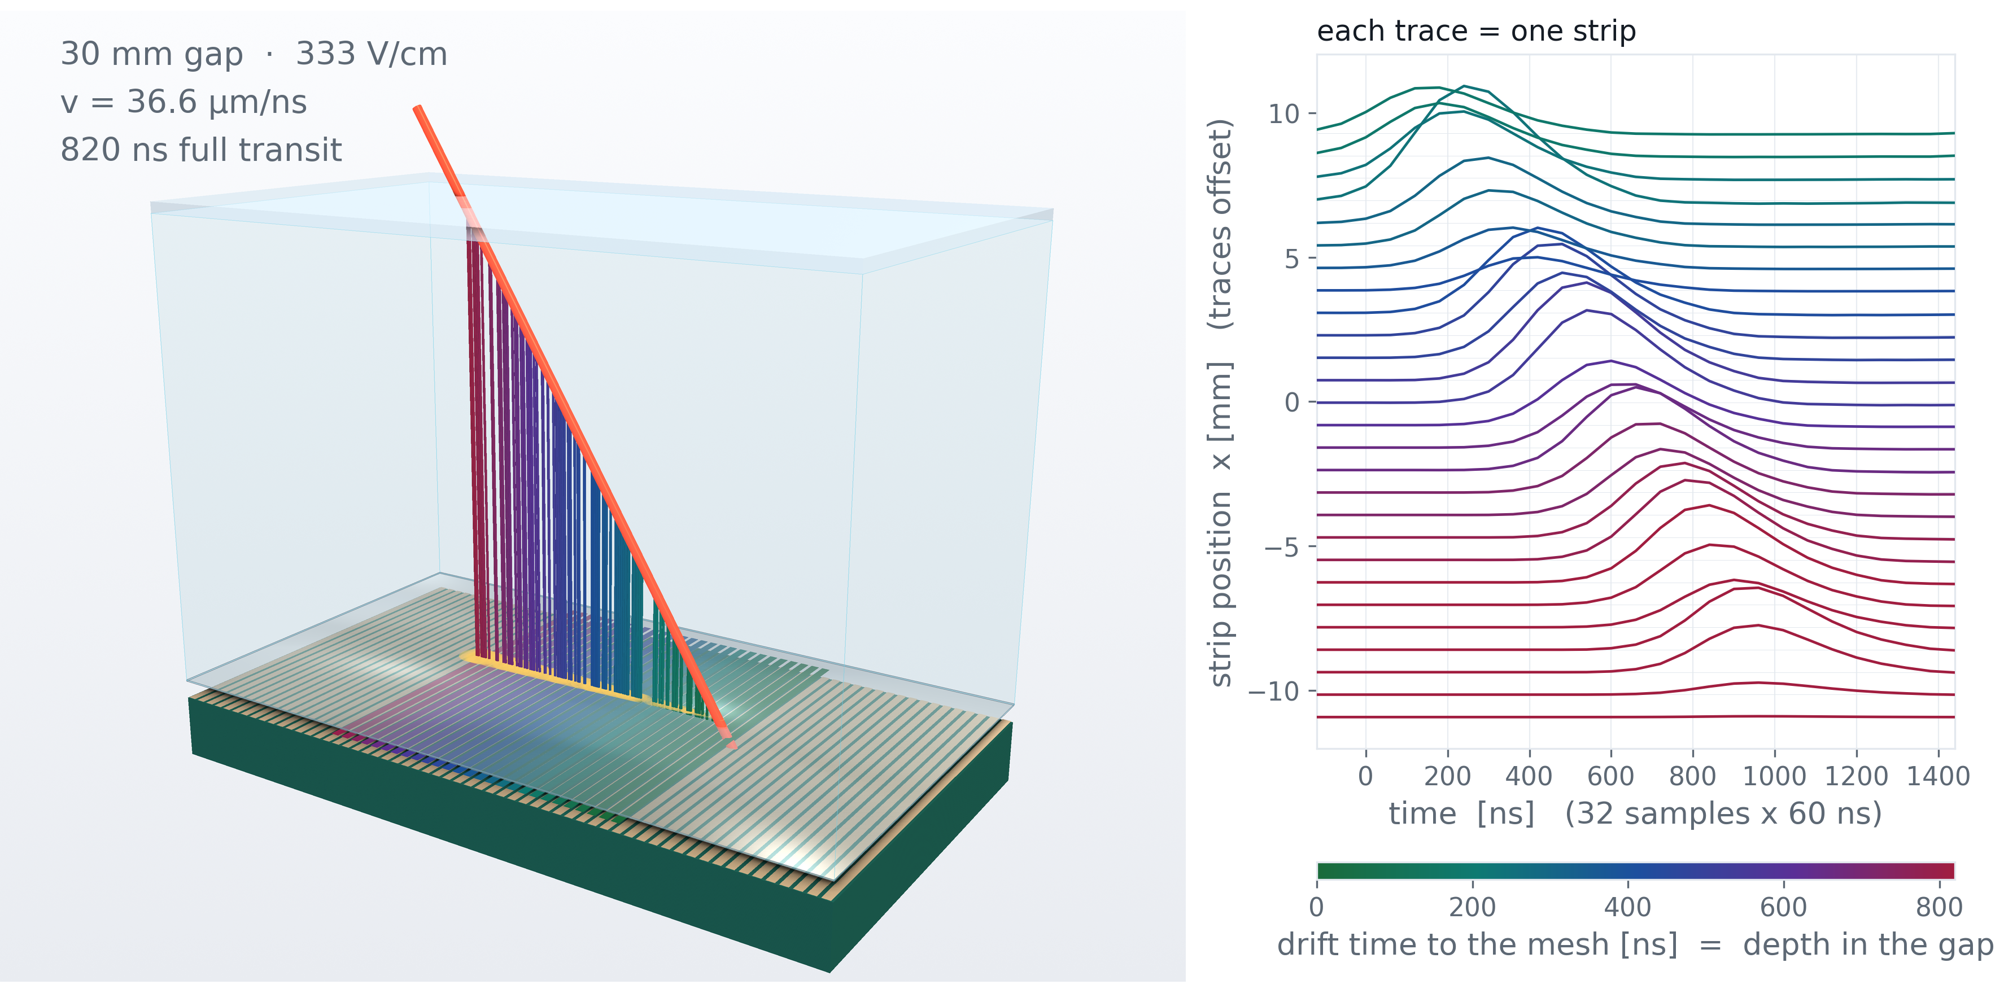
Designed & built at CEA Saclay by
Micromegas TPC · Saclay
Stéphan Aune
TPC operation
Simulated event
6 / 27
D. Neff · n_TOF Italy Meeting · 15 October 2026

Slide 11
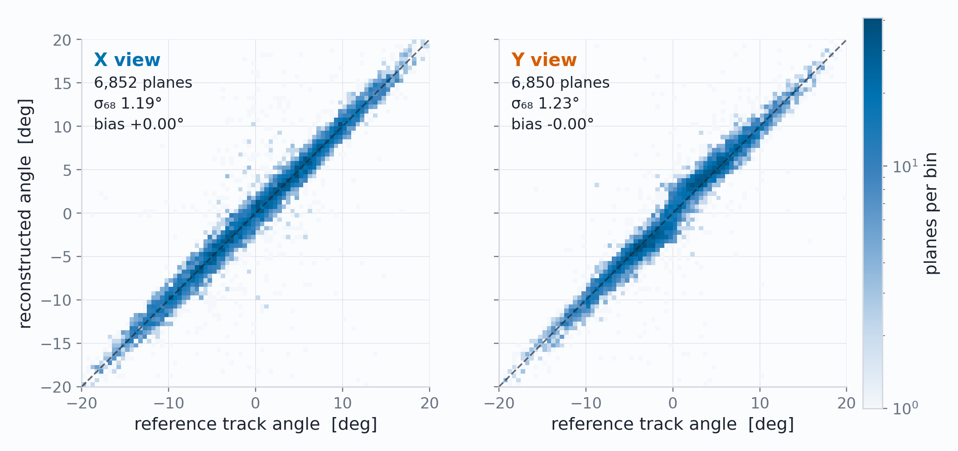
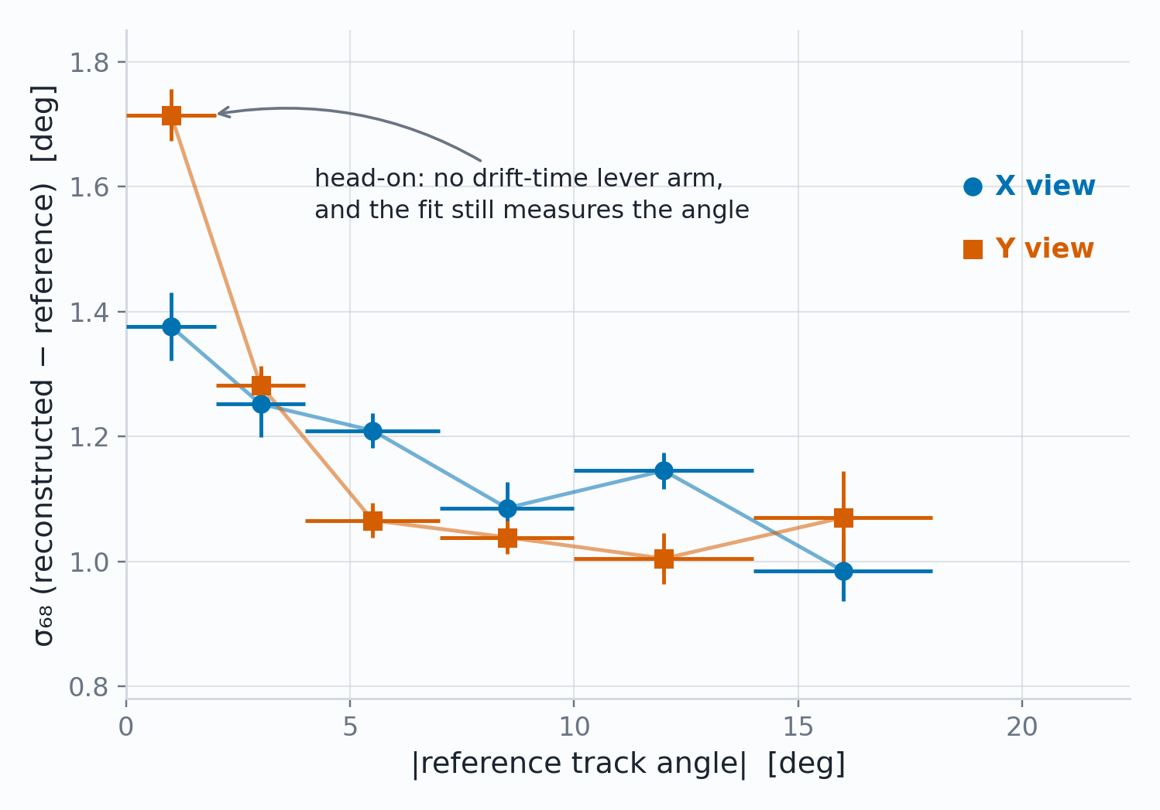
Work in progress
Characterization
Adequate angular, spatial and temporal resolution
Reconstructed against reference, per plane
Head on tracks reasonable and angled tracks approach 1°
1.19 / 1.23°
180 µm
33 ns
angle per plane, X / Y (σ₆₈), bias < 0.1°
position at normal incidence, ±0.035 mm conservatively
plane-to-plane timing, ≈ 1.1 mm of drift
7 / 27
D. Neff · n_TOF Italy Meeting · 15 October 2026

Slide 12
02
The EAR2 Setup
An apparatus capable of detecting X17
D. Neff · n_TOF Italy Meeting · 15 October 2026

Slide 13
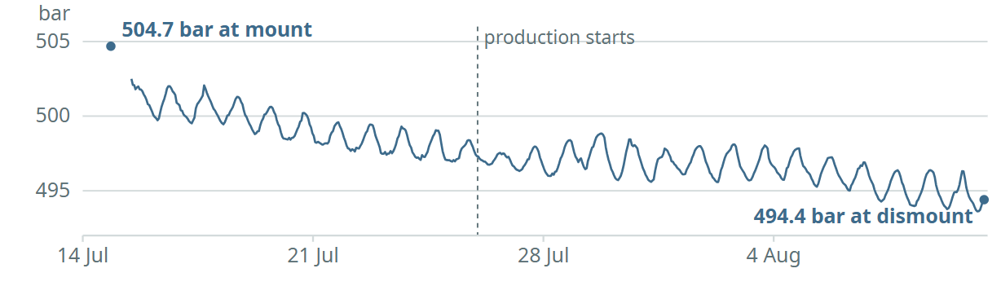
X17 search at n_TOF · Experimental setup
The vessel, as built: 500 bar of ³He in the beam
500 bar ³He
Ø20 mm bore,
40 mm long
0.6 mm Al
vessel
500 bar of ³He in as thin a capsule as we can build — least scattering on the way out, most interaction on the way in.
Ø20 mm bore, 40 mm of gas, domed both ends —
walls of 0.6 mm Al + 0.9 mm CFRP.
0.9 mm CFRP
overwrap
EAR2 neutron beam,
from below
8.1 / 27
D. Neff · n_TOF Italy Meeting · 15 October 2026

Slide 14
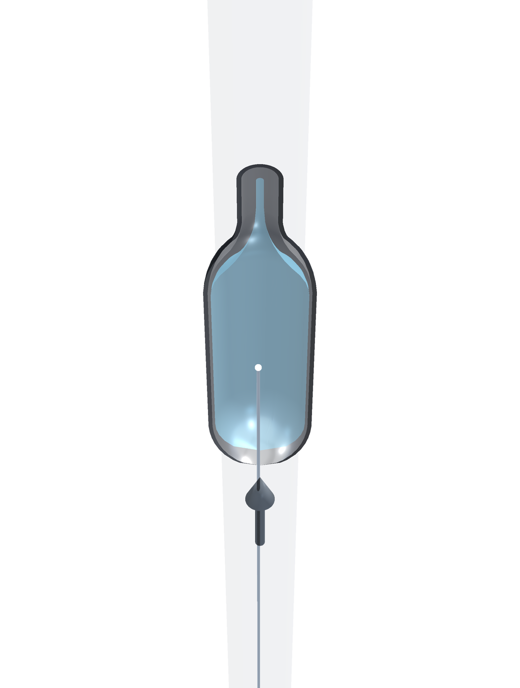
X17 search at n_TOF · Experimental setup
A neutron arrives
500 bar of ³He in as thin a capsule as we can build — least scattering on the way out, most interaction on the way in.
The neutron beam arrives from below and interacts in the ³He gas volume.
8.2 / 27
D. Neff · n_TOF Italy Meeting · 15 October 2026

Slide 15
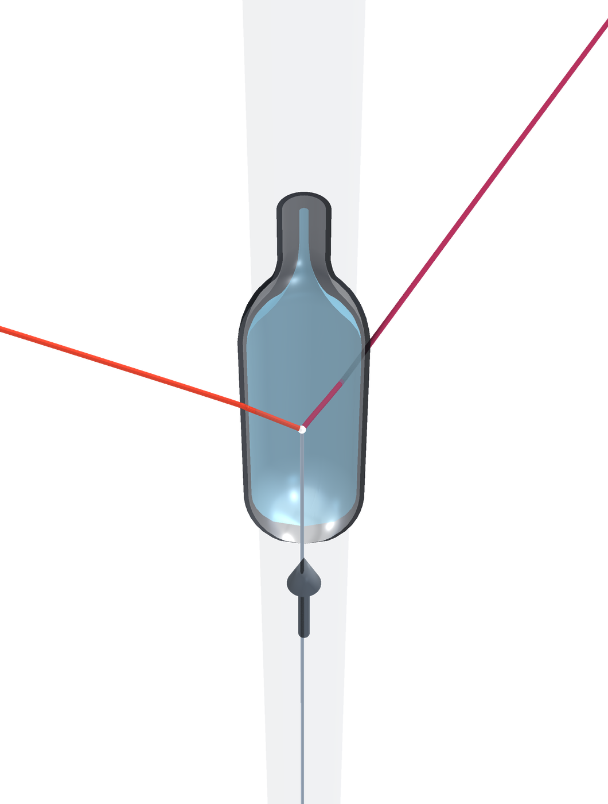
X17 search at n_TOF · Experimental setup
…and a pair leaves
500 bar of ³He in as thin a capsule as we can build — least scattering on the way out, most interaction on the way in.
The neutron beam arrives from below and interacts in the ³He gas volume.
Some probability of internal pair conversion — or of X17 → e⁺e⁻ — leaving the capsule, with some scattering in its wall.
e⁻
e⁺
neutron
beam
8.3 / 27
D. Neff · n_TOF Italy Meeting · 15 October 2026

Slide 16
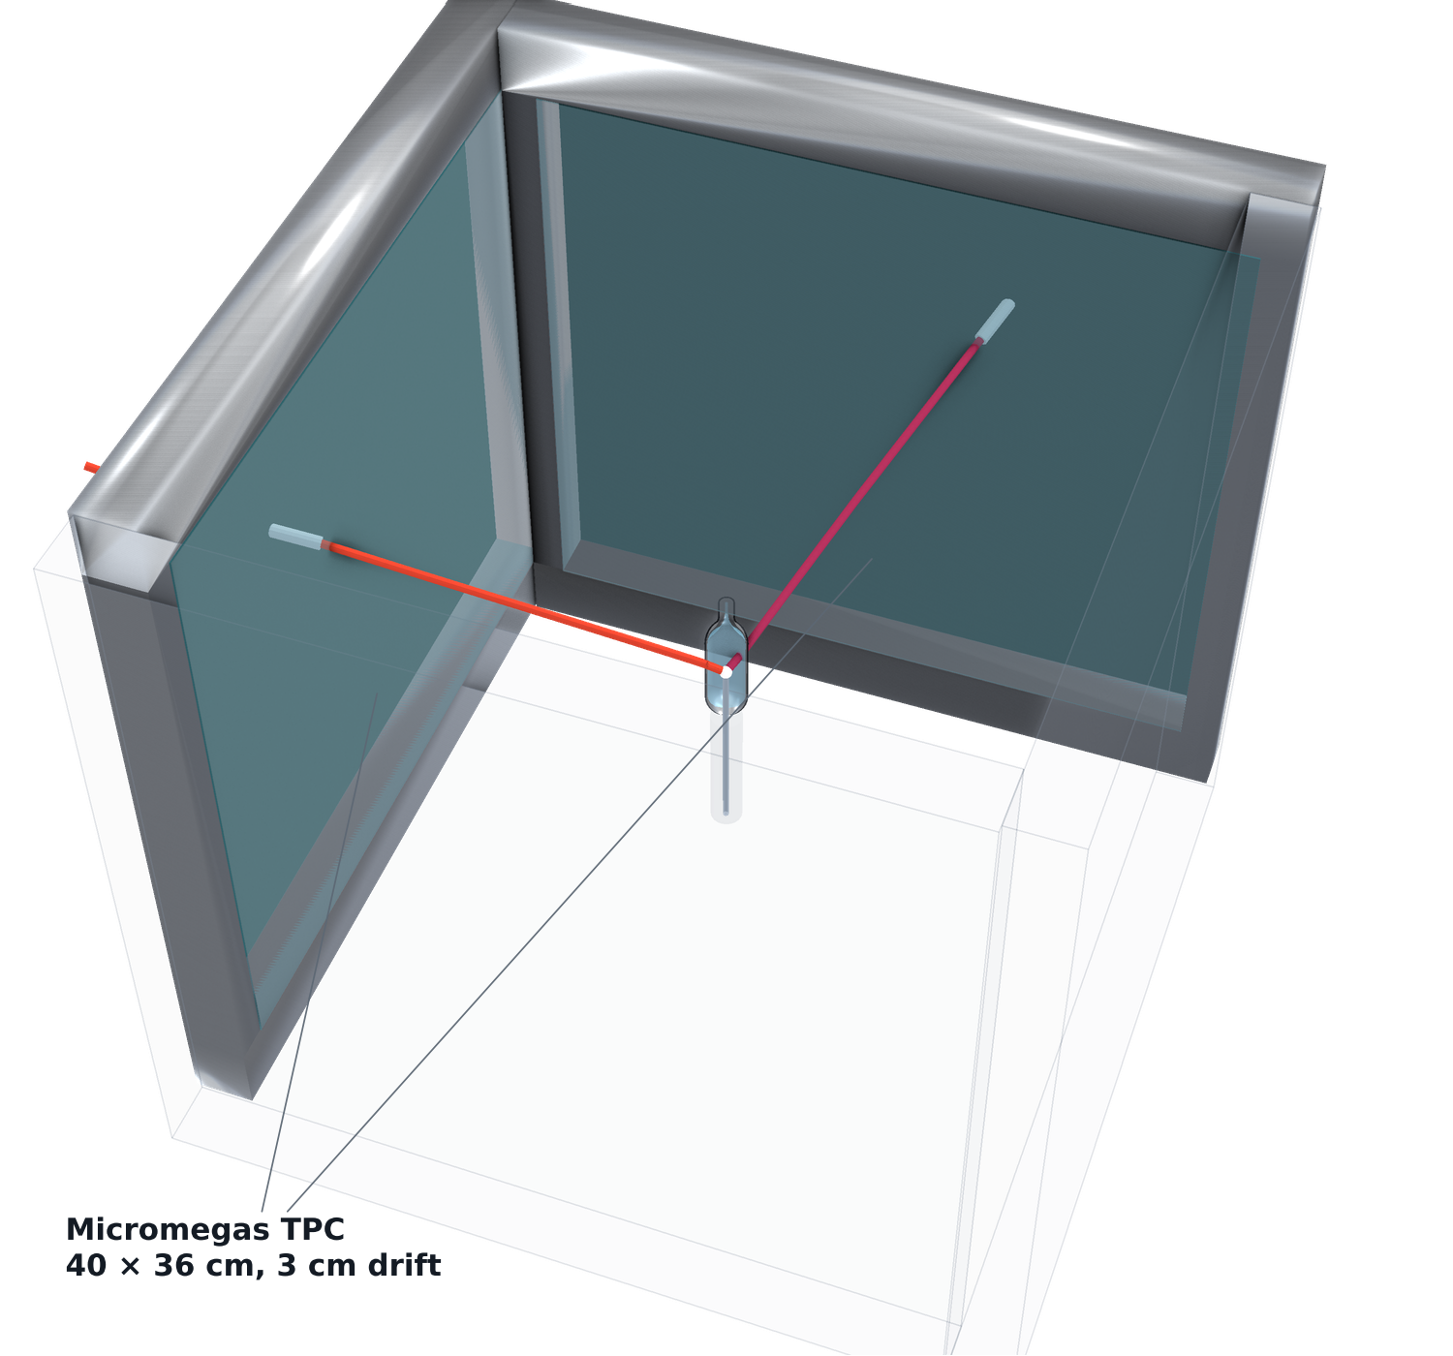
X17 search at n_TOF · Experimental setup
Now build something that can catch them
Reduce material budget until the track angles have been recorded with four Micromegas TPCs
8.4 / 27
D. Neff · n_TOF Italy Meeting · 15 October 2026

Slide 17
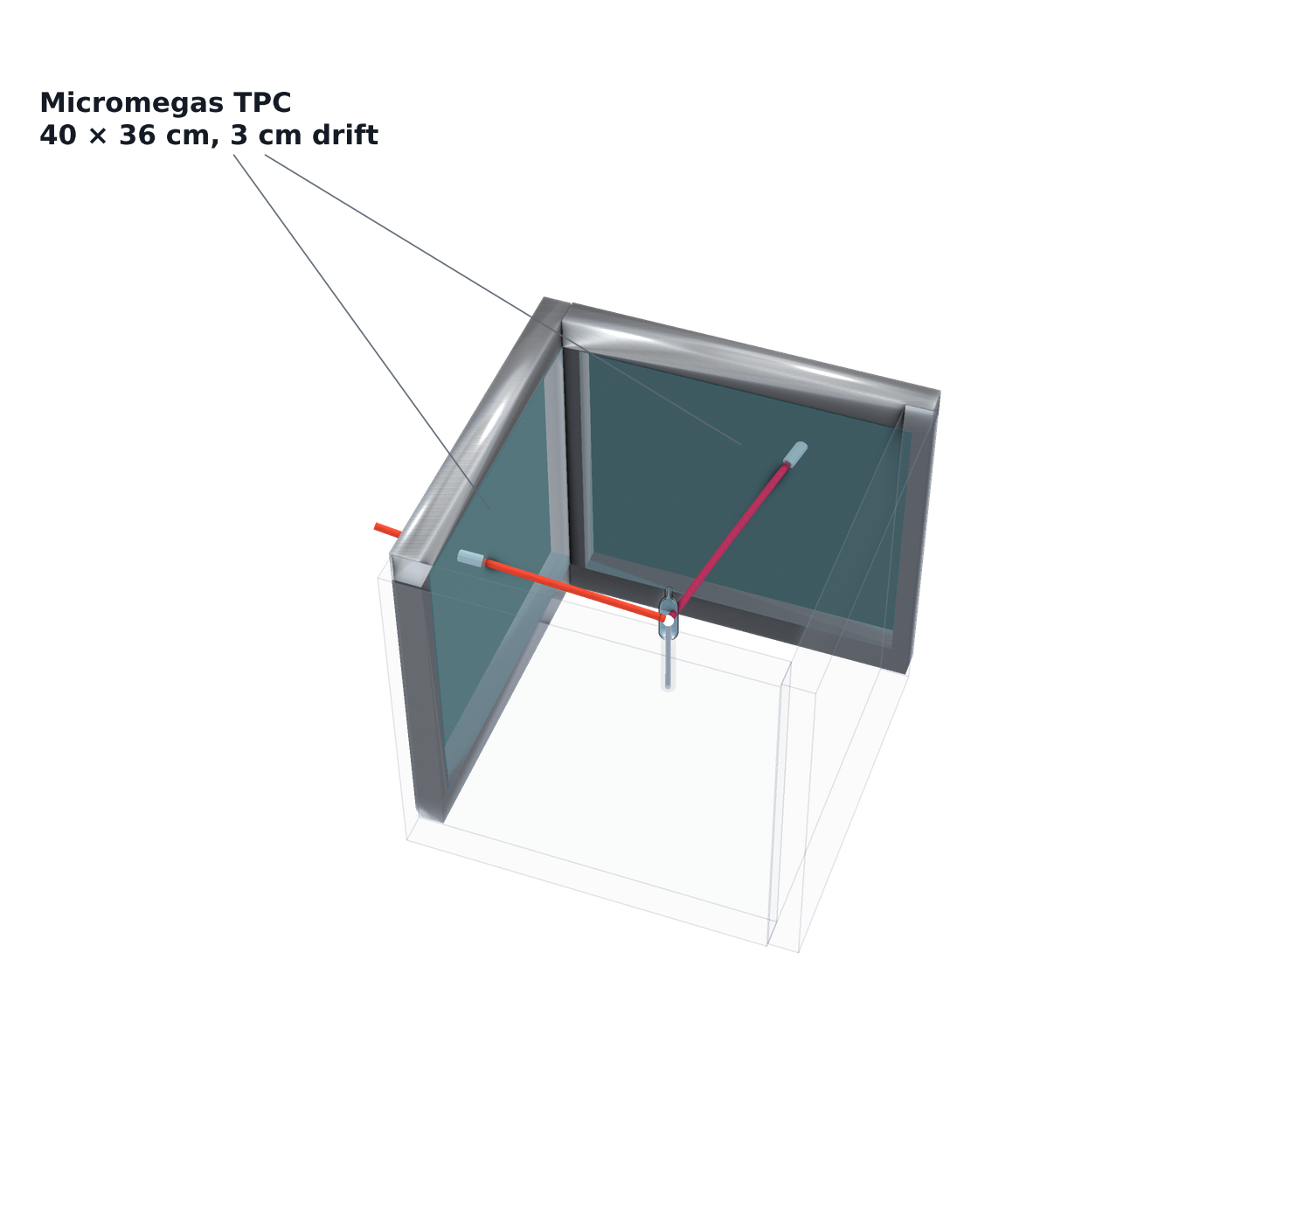
X17 search at n_TOF · Experimental setup
+ four Micromegas TPCs
Reduce material budget until the track angles have been recorded with four Micromegas TPCs
Need an external trigger for these trackers
8.5 / 27
D. Neff · n_TOF Italy Meeting · 15 October 2026

Slide 18
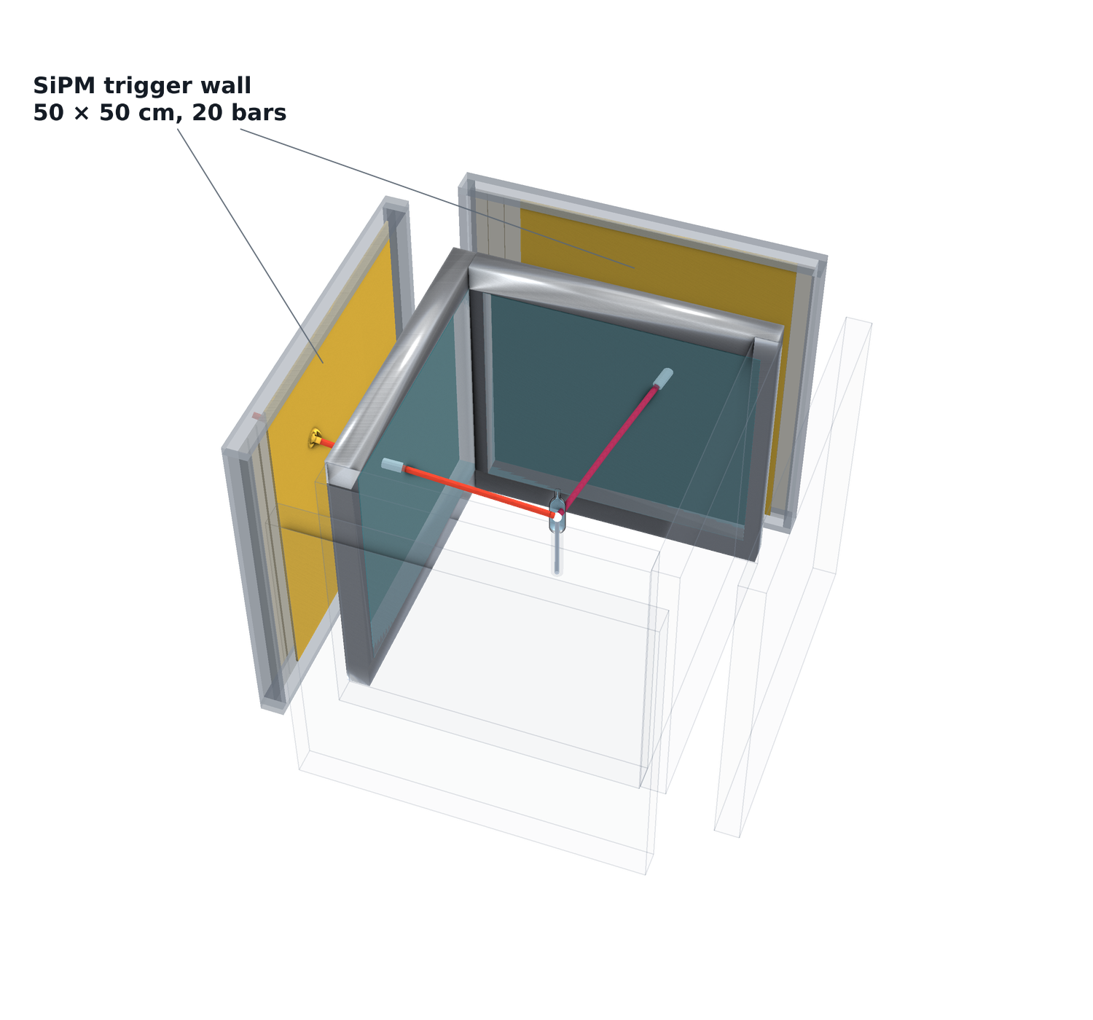
X17 search at n_TOF · Experimental setup
+ the SiPM trigger wall
Reduce material budget until the track angles have been recorded with four Micromegas TPCs
Need an external trigger for these trackers
Thin vertical scintillator bars readout by SiPMs: register the hit without stopping the electron or the positron. Precise timing.
8.6 / 27
D. Neff · n_TOF Italy Meeting · 15 October 2026

Slide 19
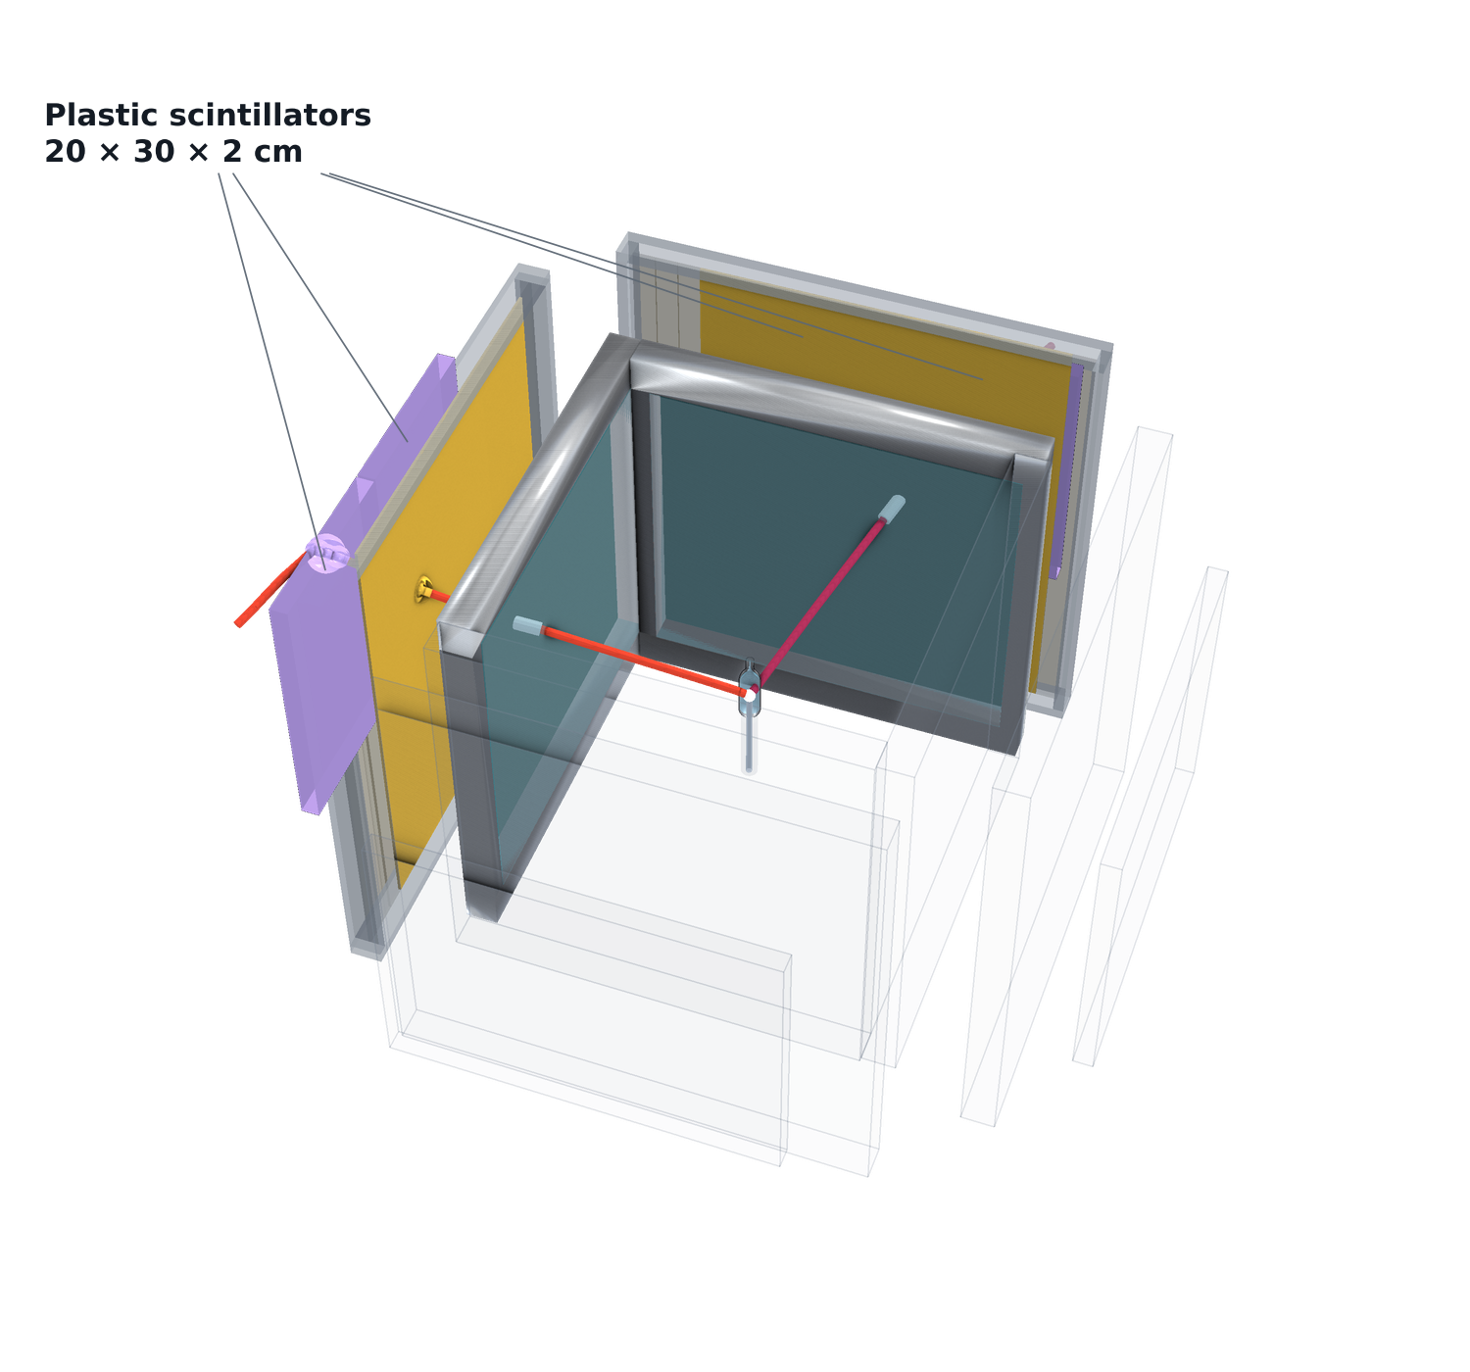
X17 search at n_TOF · Experimental setup
+ the plastic scintillators
Reduce material budget until the track angles have been recorded with four Micromegas TPCs
Need an external trigger for these trackers
Thin vertical scintillator bars readout by SiPMs: register the hit without stopping the electron or the positron. Precise timing.
2cm thick plastic scintillators complete the coincidence with the trigger wall.
8.7 / 27
D. Neff · n_TOF Italy Meeting · 15 October 2026

Slide 20
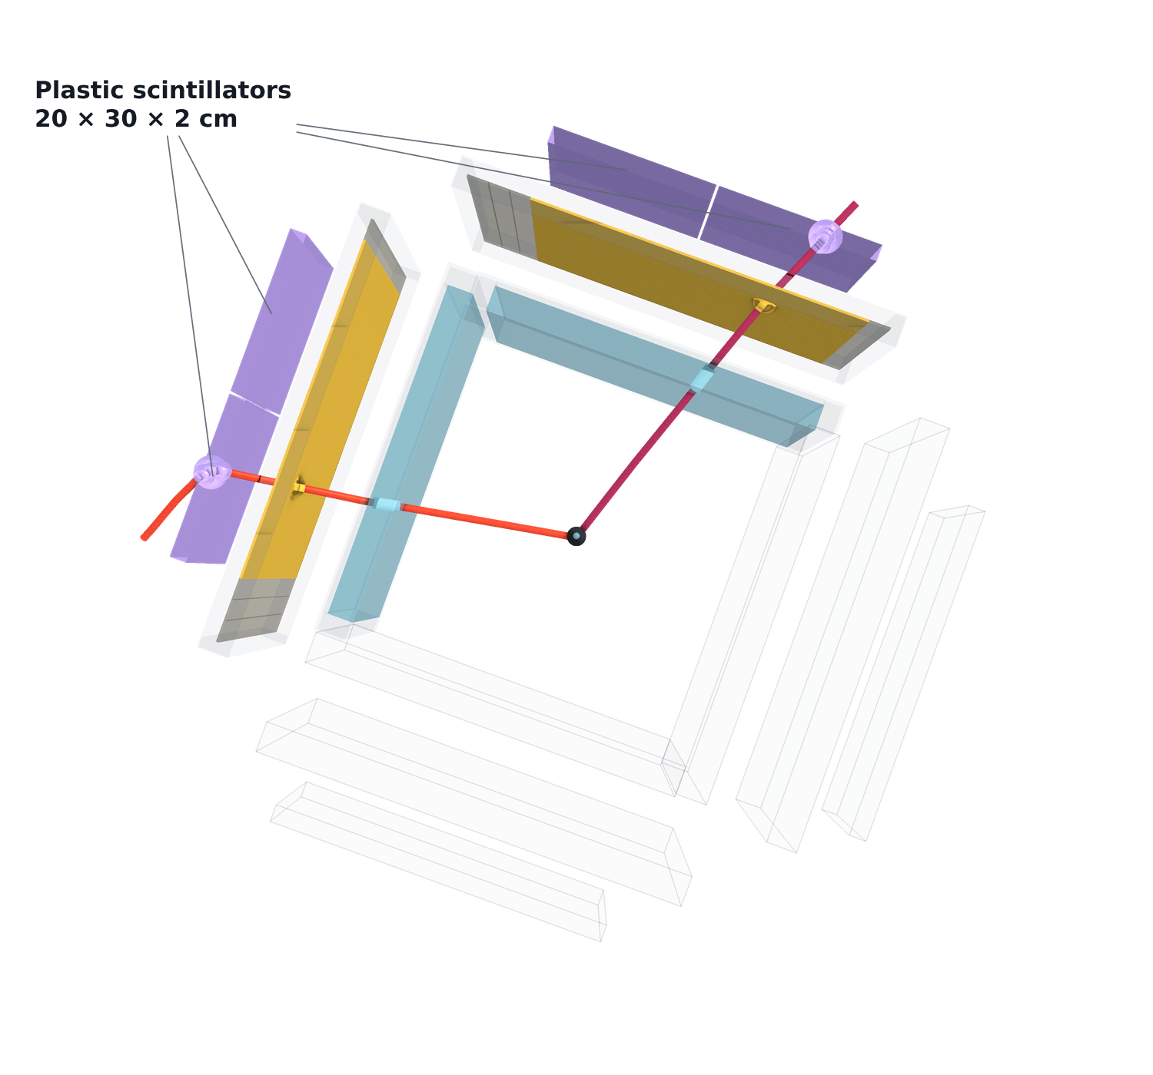
X17 search at n_TOF · Experimental setup
The same event from above — where the pair goes
Reduce material budget until the track angles have been recorded with four Micromegas TPCs
Need an external trigger for these trackers
Thin vertical scintillator bars readout by SiPMs: register the hit without stopping the electron or the positron. Precise timing.
2cm thick plastic scintillators complete the coincidence with the trigger wall.
Also provides stopping for calorimetry
8.8 / 27
D. Neff · n_TOF Italy Meeting · 15 October 2026

Slide 21
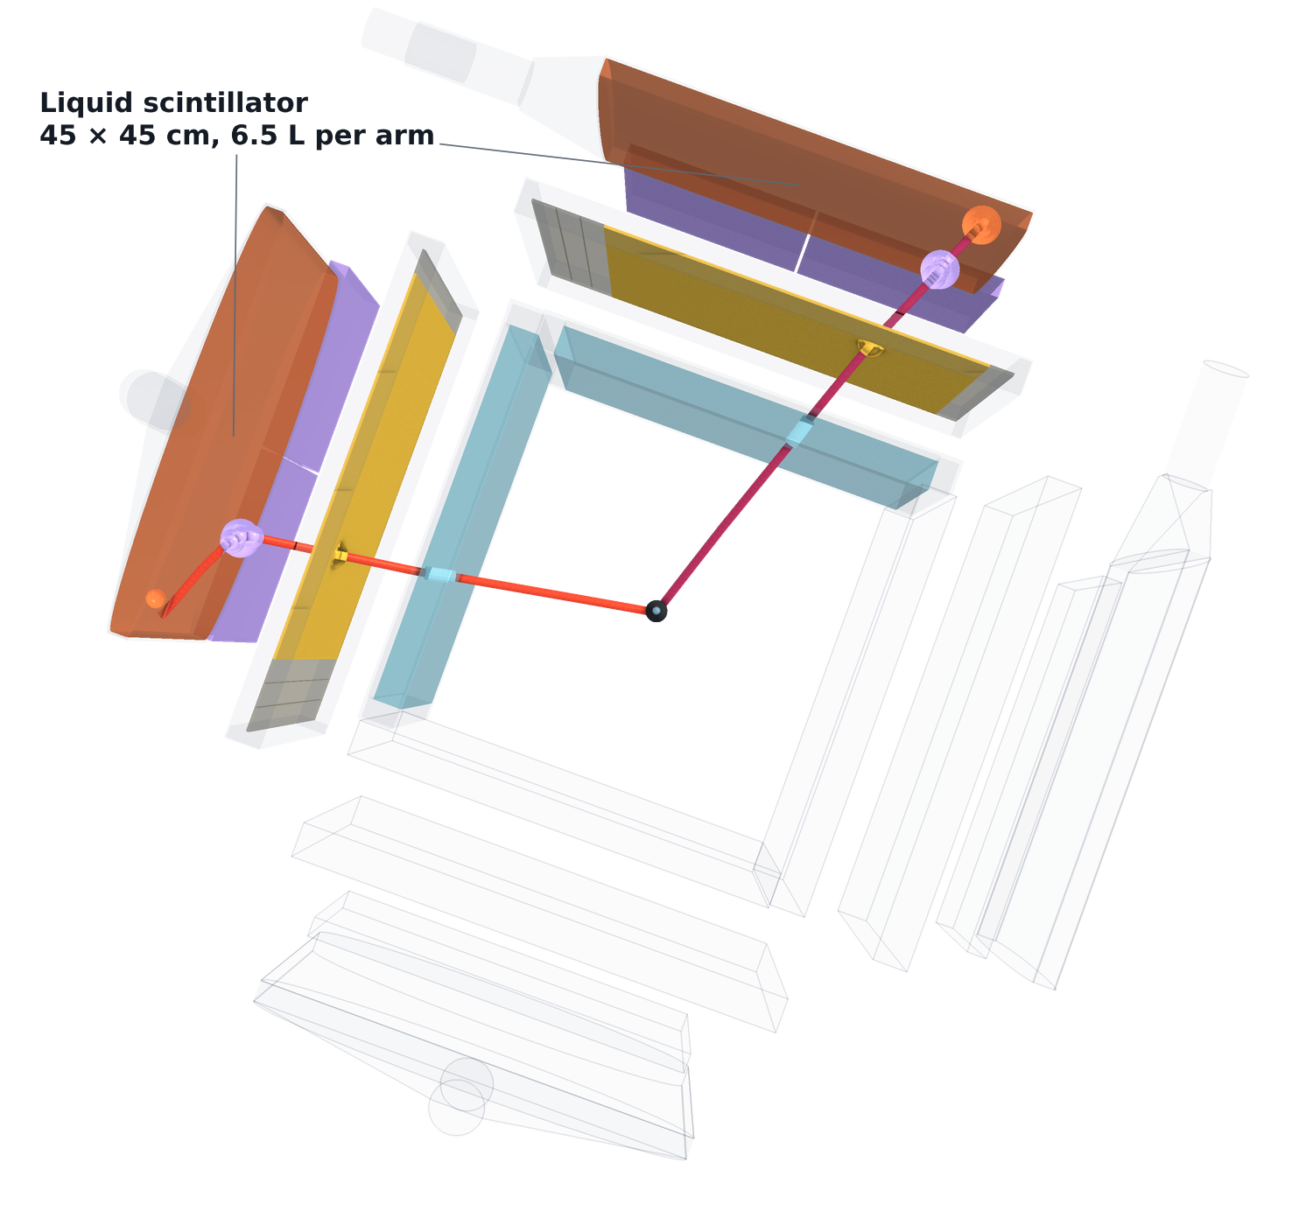
X17 search at n_TOF · Experimental setup
+ liquid-scintillator calorimetry — the full setup
Reduce material budget until the track angles have been recorded with four Micromegas TPCs
Need an external trigger for these trackers
Thin vertical scintillator bars readout by SiPMs: register the hit without stopping the electron or the positron. Precise timing.
2cm thick plastic scintillators complete the coincidence with the trigger wall.
Also provides stopping for calorimetry
Add 2cm of liquid scintillator to stop the pair completely
8.9 / 27
D. Neff · n_TOF Italy Meeting · 15 October 2026

Slide 22
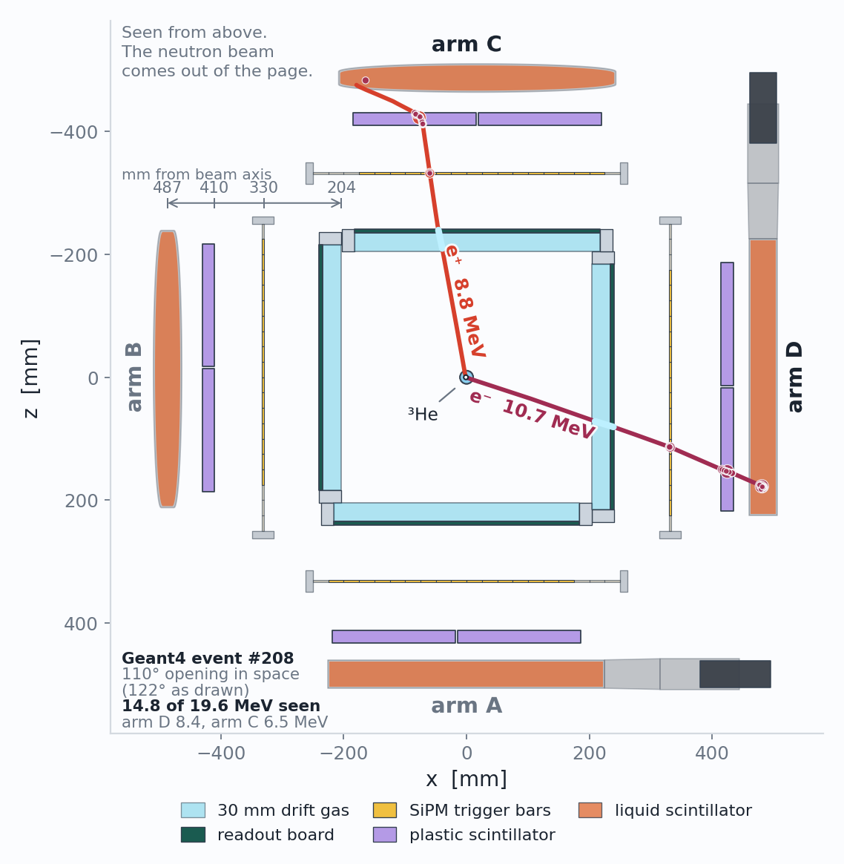
X17 search at n_TOF · Experimental setup
The same setup from above
Opening angle from the Micromegas, before anything else touches the pair.
Trigger and timing from the wall and the plastics.
Calorimetry from the full scintillator stack.
9 / 27
D. Neff · n_TOF Italy Meeting · 15 October 2026

Slide 23
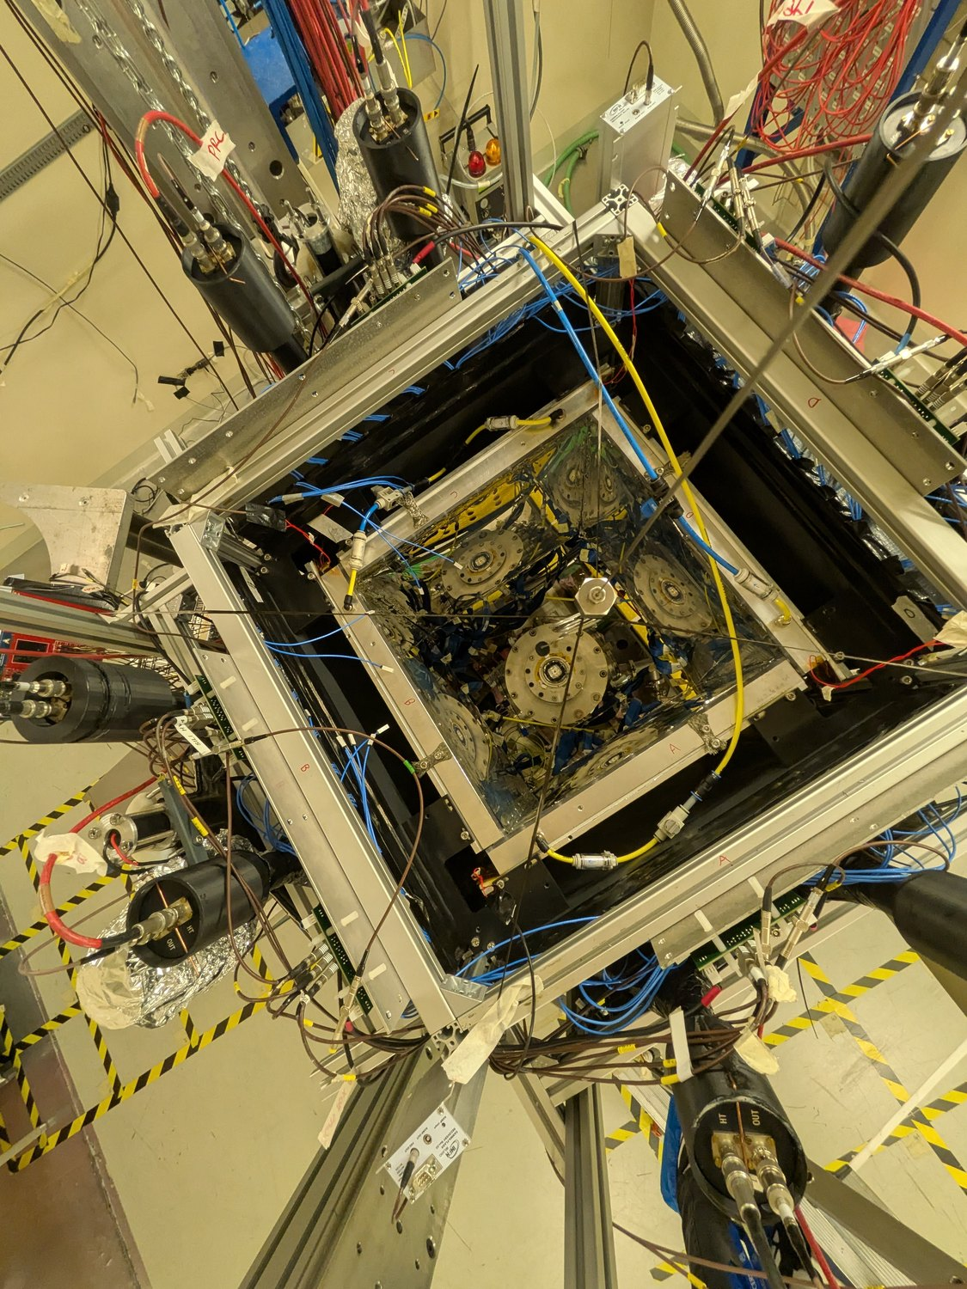
X17 search at n_TOF · Experimental setup
A look at the actual experiment – ran this July+August
Looking down into the station · n_TOF EAR2, 10 August 2026
10.1 / 27
D. Neff · n_TOF Italy Meeting · 15 October 2026

Slide 24
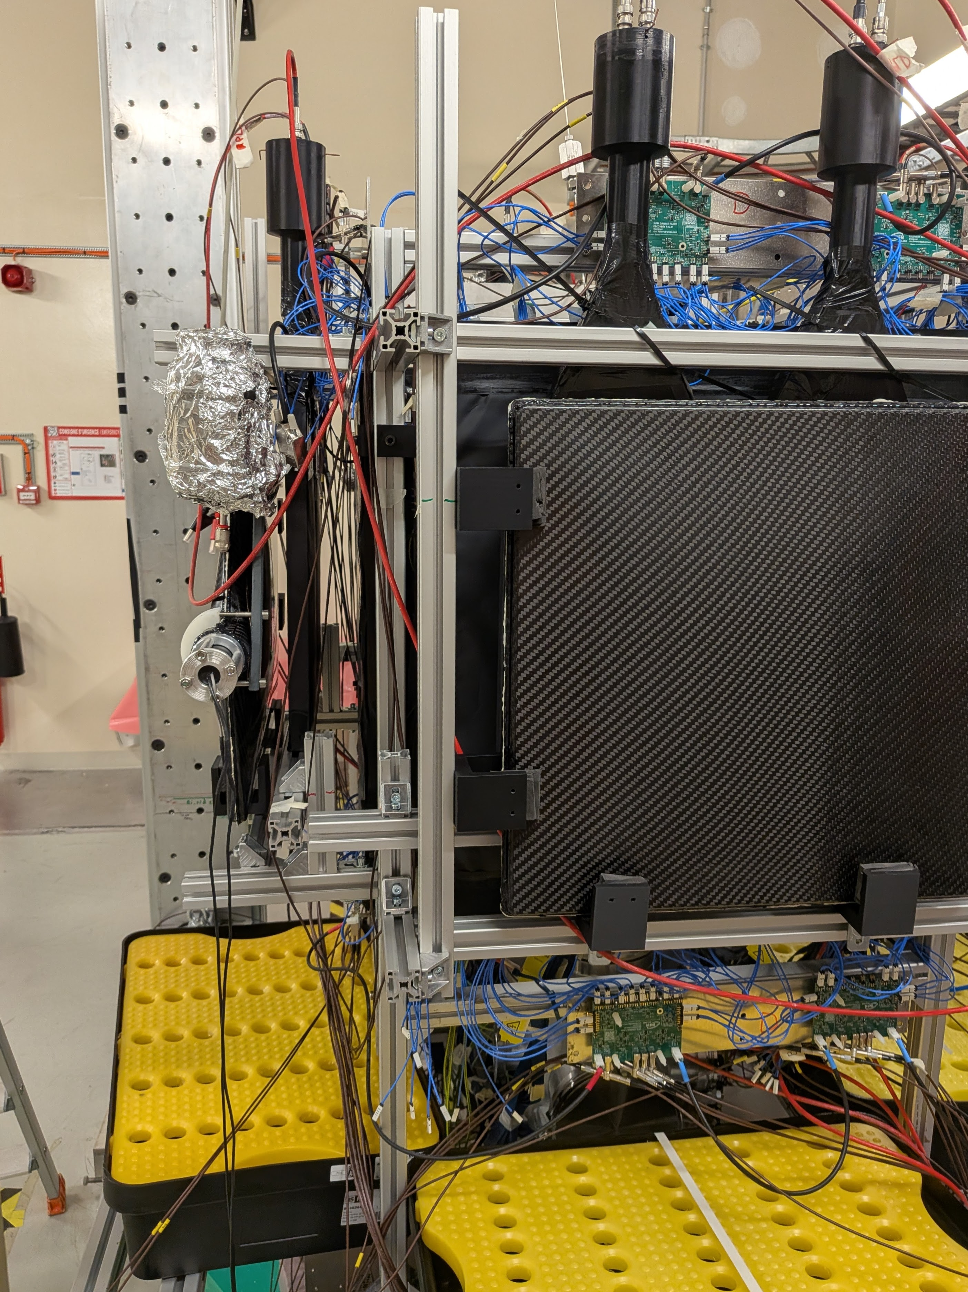
X17 search at n_TOF · Experimental setup
A look at the actual experiment – ran this July+August
Looking down into the station · n_TOF EAR2, 10 August 2026
One arm, from outside · n_TOF EAR2, 10 August 2026
10.2 / 27
D. Neff · n_TOF Italy Meeting · 15 October 2026

Slide 25
03
Plan A: the MeV neutrons
Where the X17 rate is, and why we could not reach it
D. Neff · n_TOF Italy Meeting · 15 October 2026

Slide 26
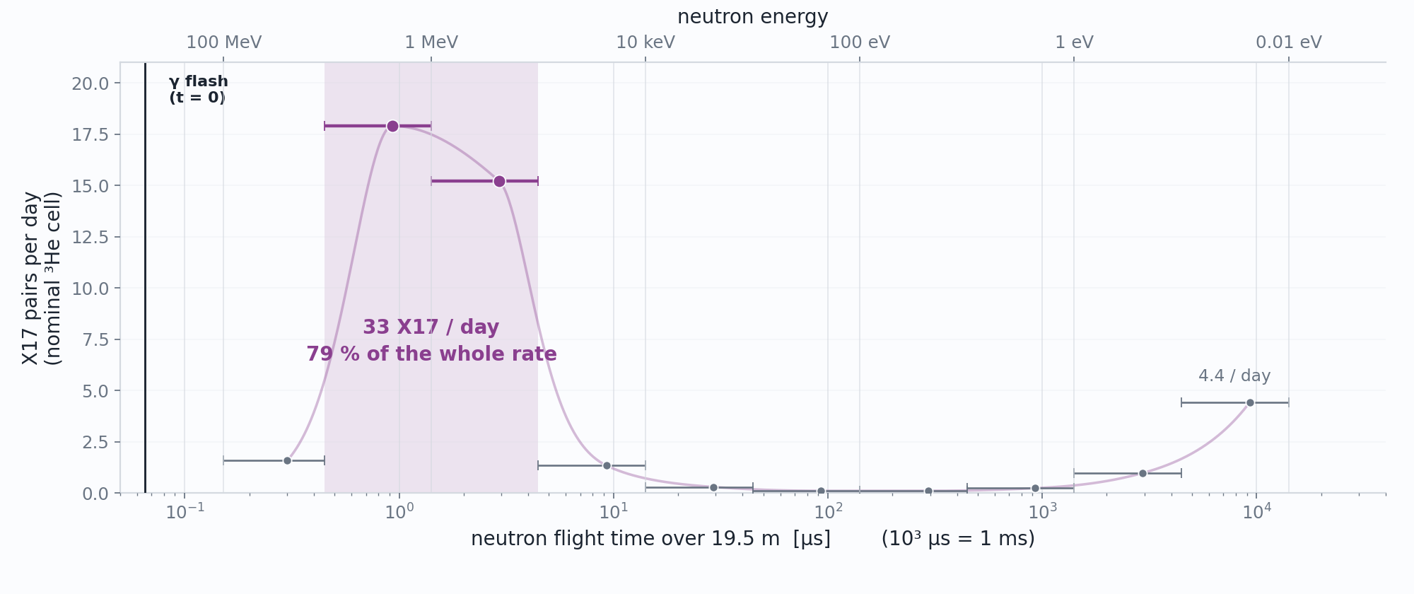
Status · What we came for
Almost all of the X17 rate is in the MeV
11.1 / 27
D. Neff · n_TOF Italy Meeting · 15 October 2026

Slide 27
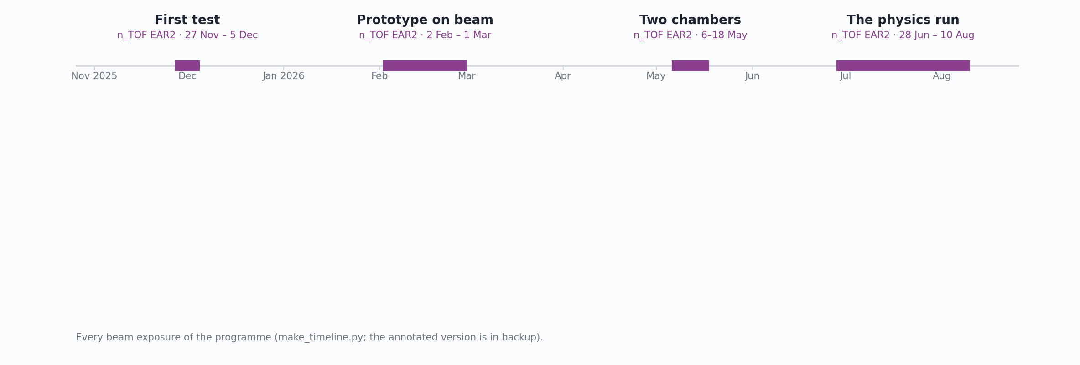
Status · What we came for
Almost all of the X17 rate is in the MeV
11.2 / 27
D. Neff · n_TOF Italy Meeting · 15 October 2026

Slide 28
Status · The environment
Problem: DREAM DAQ Can’t Handle Gamma Flash
DREAM — Dead-timeless Read-out Electronics ASIC for Micromegas, developed at CEA Saclay and built for the CLAS12 Micromegas vertex tracker.
512 channels per front-end unit (8 ASICs × 64); two units per chamber, 1,024 channels for each MX17.
Every channel: a charge-sensitive preamplifier and shaper, full scale switchable 50–600 fC, into a switched-capacitor analogue memory.
Sampled here at 20 ns, digitized on an external trigger.
12.1 / 27
D. Neff · n_TOF Italy Meeting · 15 October 2026

Slide 29
Status · The environment
Problem: DREAM DAQ Can’t Handle Gamma Flash
One flash, the 24 hottest strips
DREAM — Dead-timeless Read-out Electronics ASIC for Micromegas, developed at CEA Saclay and built for the CLAS12 Micromegas vertex tracker.
512 channels per front-end unit (8 ASICs × 64); two units per chamber, 1,024 channels for each MX17.
Every channel: a charge-sensitive preamplifier and shaper, full scale switchable 50–600 fC, into a switched-capacitor analogue memory.
Sampled here at 20 ns, digitized on an external trigger.
February 2026, the first prototype on beam: saturated — and saturated in a way that hides itself. The ADC rails to +4095, drops to 0, and settles onto a flat baseline within ~3 µs.
12.2 / 27
D. Neff · n_TOF Italy Meeting · 15 October 2026

Slide 30
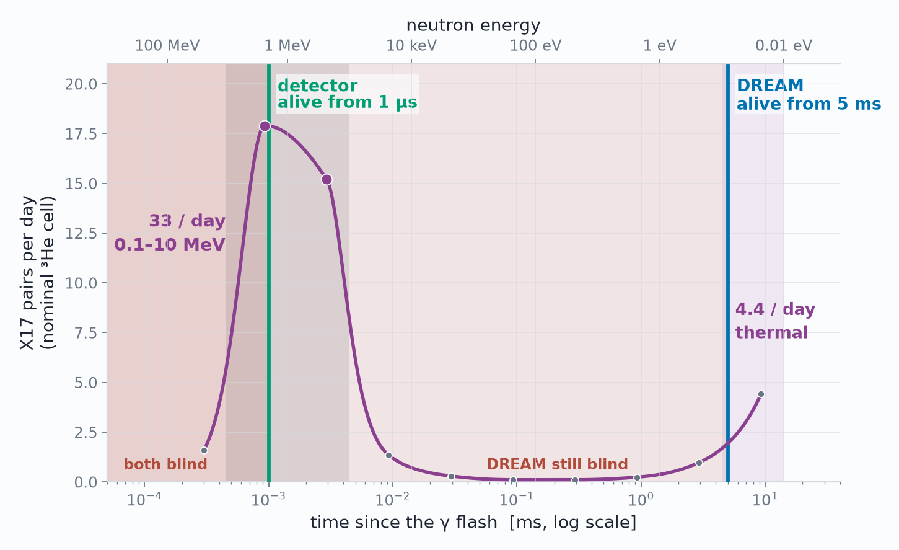
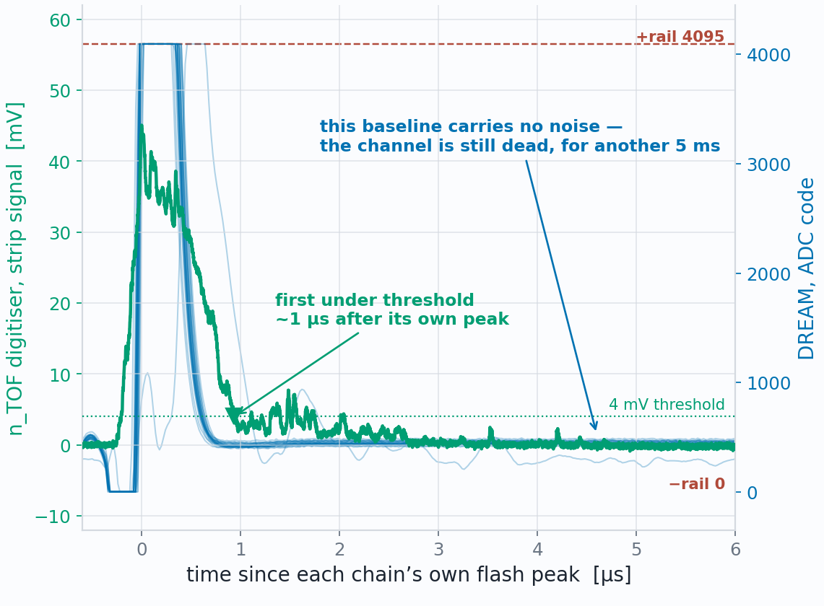
Status · The environment
The detector is fine. The DREAM DAQ is not.
When each DAQ is usable again
The same flash, seen by both DAQ
aligned on their own peaks
13 / 27
D. Neff · n_TOF Italy Meeting · 15 October 2026

Slide 31
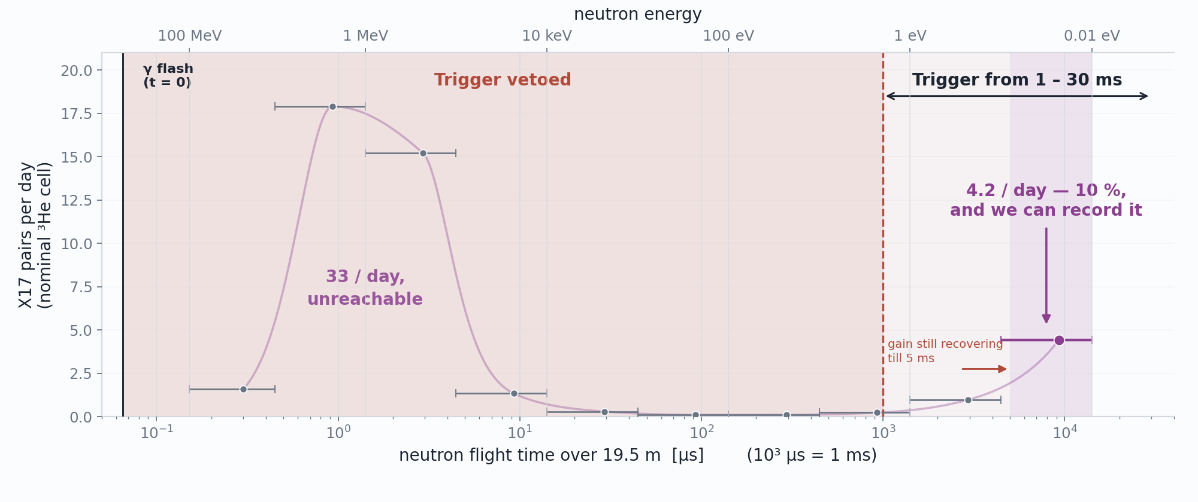
Status · What we could measure
Plan A → Plan B : Make the measurement at thermal
14.1 / 27
D. Neff · n_TOF Italy Meeting · 15 October 2026

Slide 32
Status · What we could measure
Plan A → Plan B : Make the measurement at thermal
Nothing we tried could recover high energy measurement before July.
Let’s take the statistics hit and measure at thermal
14.2 / 27
D. Neff · n_TOF Italy Meeting · 15 October 2026

Slide 33
04
Plan B: the Problem with Thermals
What we learned from Geant4 before and during the run
D. Neff · n_TOF Italy Meeting · 15 October 2026

Slide 34
Status · What we could measure
Problem: (n, p) dominates!
16 / 27
D. Neff · n_TOF Italy Meeting · 15 October 2026

Slide 35
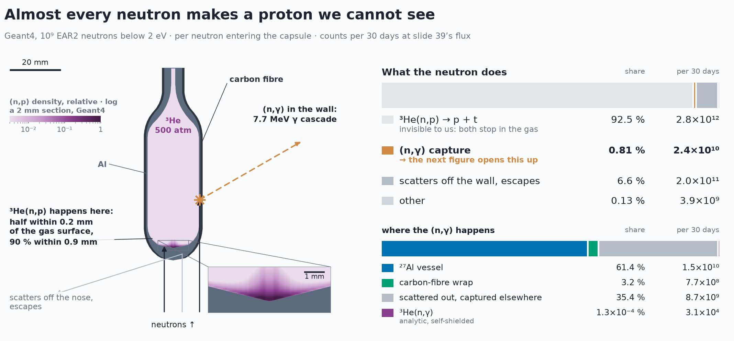
Status · What we could measure
Self-shielded: (n, p) takes the neutrons
Plan B also fails
Plan C: measure what we can
17 / 27
D. Neff · n_TOF Italy Meeting · 15 October 2026

Slide 36
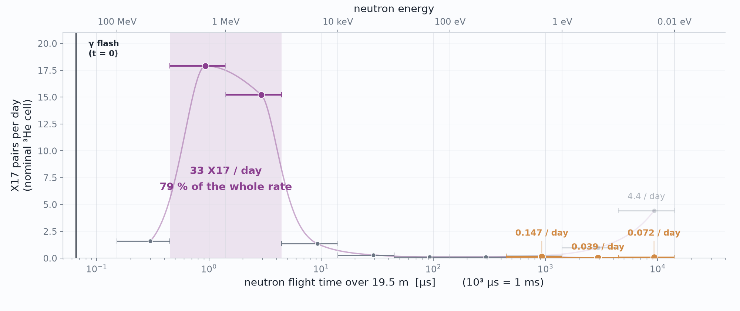
Status · What we could measure
What self-shielding leaves of the thermal X17 rate
Thermal window (0.01–0.1 eV)
4.4 → 0.07 X17 / day
self-shielding: ×60 fewer
Whole campaign, 436k pulses:
≈ 100 → ≈ 2 X17 made, before acceptance
18 / 27
D. Neff · n_TOF Italy Meeting · 15 October 2026

Slide 37
05
Plan C: the Aluminum Spectrum
Not X17, but the e⁺e⁻ pairs the capsule does make
D. Neff · n_TOF Italy Meeting · 15 October 2026

Slide 38
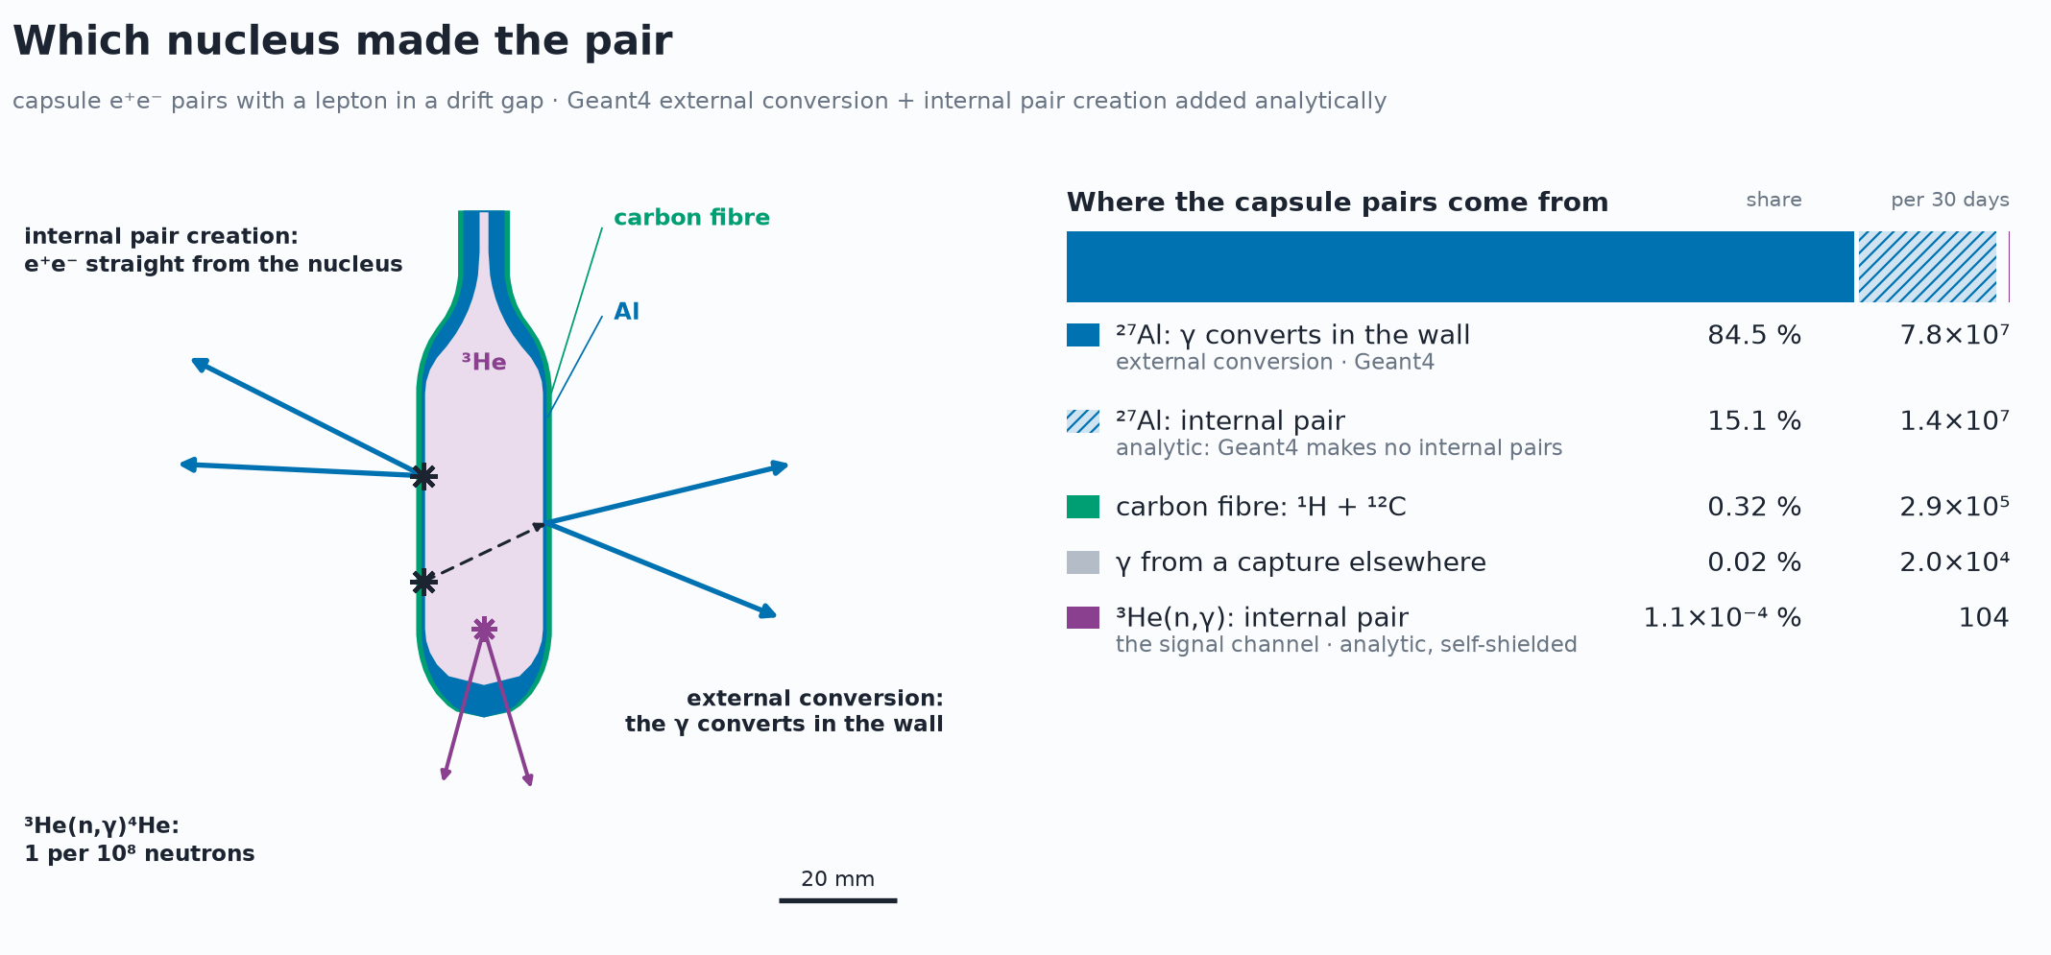
Plan C · What we expect
Plan C: the aluminum pair spectrum at thermals
No X17 here — not even ³He IPC
But ≈ 10⁸ ²⁷Al e⁺e⁻ pairs / 30 days
A demonstrator: if we can find these pairs, the same setup should work for X17 in future
20 / 27
D. Neff · n_TOF Italy Meeting · 15 October 2026

Slide 39
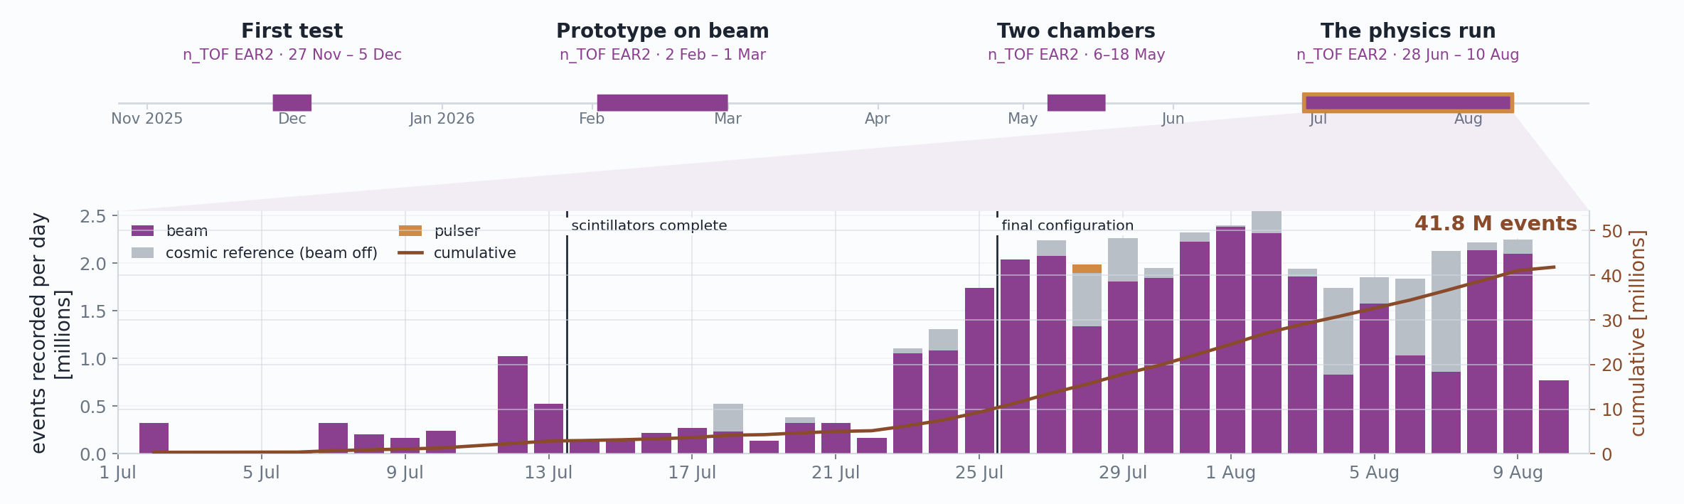
Status
Experiment timeline and statistics
41.8 M
17.9 TB
436,373
events recorded — 35.9 M on beam, 5.8 M cosmic reference
on EOS, across 162 runs / 2,705 sub-runs
beam pulses on target over 44 days
21 / 27
D. Neff · n_TOF Italy Meeting · 15 October 2026

Slide 40
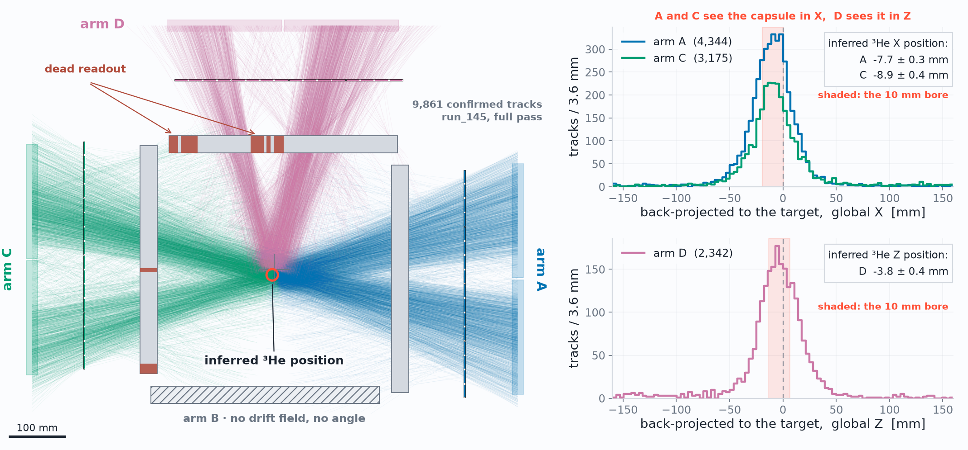
Work in progress
Status · Early Reconstruction Results
Two opposing arms, seen from above – image of capsule
Capsule ~1 cm
off-center in x
22.1 / 27
D. Neff · n_TOF Italy Meeting · 15 October 2026

Slide 41
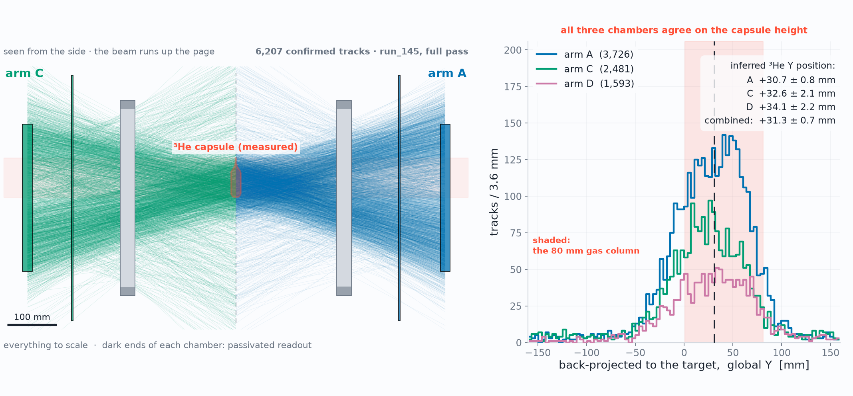
Work in progress
Status · Early Reconstruction Results
Two opposing arms, seen from above – image of capsule
Capsule ~3 cm
high in y
22.2 / 27
D. Neff · n_TOF Italy Meeting · 15 October 2026

Slide 42
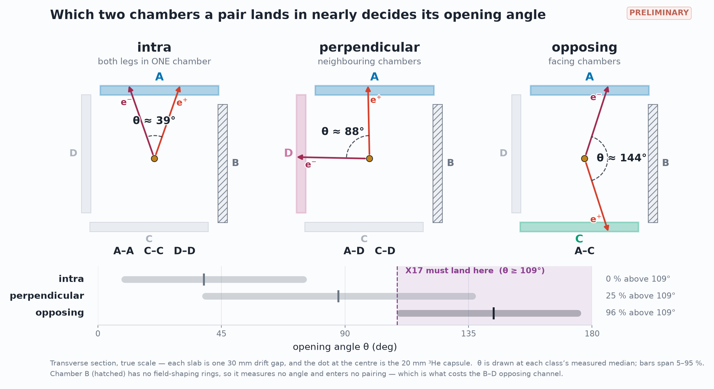
Work in progress
Ongoing · Pair analysis
Now: sorting the pairs by where their legs land
23 / 27
D. Neff · n_TOF Italy Meeting · 15 October 2026

Slide 43
Plan C · What we found
The Al pairs are soft: few trigger, poor pointing
11 % vs 82 %
33 mm vs 9 mm
~3,700
of Al vs X17 leptons reach the trigger
vertex miss per leg: Al vs X17 (scattering)
correlated double tracks in the data
Not a total loss: the double tracks are there, and they are the hardest two-track case to test on
24 / 27
D. Neff · n_TOF Italy Meeting · 15 October 2026
Notes:
The Al conversion pairs from the capsule are much softer than X17 legs: ~2 MeV at the drift gap against 4-16 MeV. Consequences:
- Trigger: per lepton reaching a gap, 11 % of Al legs reach the plastic at trigger level (>= 2.5 MeV) against 82 % of X17 legs; 2.6 % vs 57 % reach the liquid. An Al pair can fire the trigger itself 7.7 % of the time (X17 pair: 45 %). Most recorded Al pairs ride on a Compton electron trigger from the same capture (76 % of trigger legs).
- Pointing: p*beta*theta = 0.40 MeV rad; a median 2 MeV leg bends ~9 deg and misses the true vertex by 33 mm (X17 ~10 MeV: 2.3 deg, 9 mm). Same-chamber e+e- pass a DCA<30 mm vertex test at 2.3 % with perfect tracks, the event-mixed chance rate is 3.0 %.
- Still statistics: a rate-independent second same-chamber track in 0.15 % (A) / 0.16 % (C) of events after 12 ms: ~2,051 (A) + ~1,660 (C) correlated pairs; Geant4 says ~75-78 % of such pairs are one photon's e+e-. Opening angle (A) chi2 6.6/6 for Geant4 e+e- vs 26/6 for unrelated tracks. Rate = 0.13 (A) / 0.12 (C) of Geant4 x digitised reconstruction: pair-specific, the singles agree to ~20 %. Open.
Source: status deck for 15 Oct, dylan-neff.web.cern.ch/notes/x17-status-2026-10-15.html (slides 4, 5, 8, 9, 10, 11); sept26_prelim_analysis/leg_penetration.py, make_status_oct15_deck.py, SAME_CHAMBER_PAIRS.md. is2_v2 re-pass, capsule-focus k, run_69 onward.

Slide 44
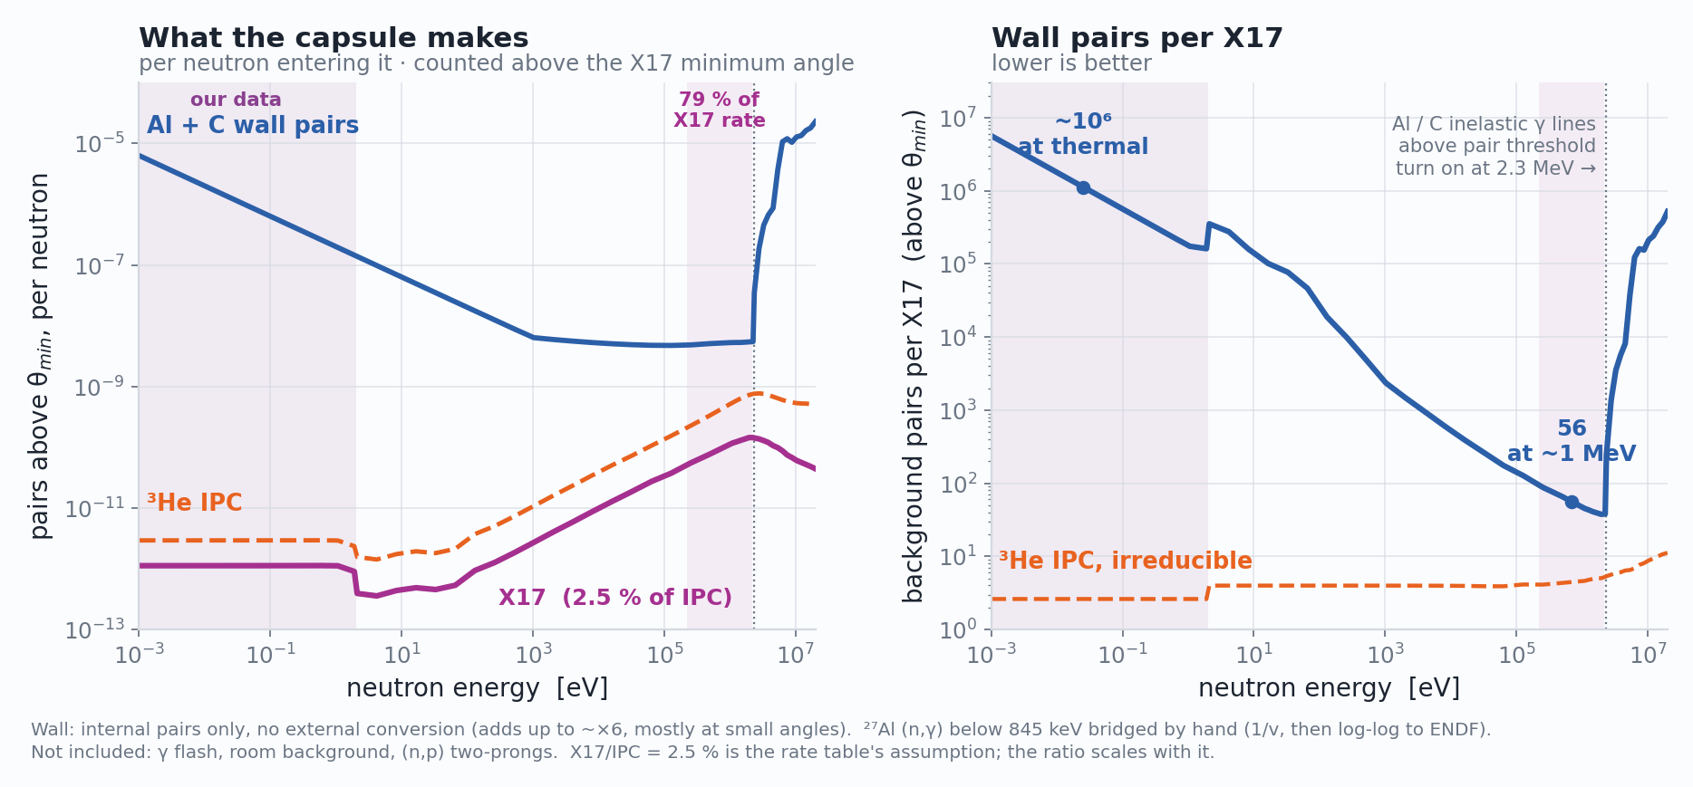
OUTLOOK · Back to PLAN A
Plan A after LS3: still potential at MeV energies
Find a DAQ fix for the γ flash
Potential after LS3: measure at 0.1–2 MeV
Background per X17: ~50 at MeV vs ~10⁶ at thermal → + separate on opening angle
Time to better simulate the environment
Al + C wall internal pairs only. X17/IPC = 2.5 % is the rate table's assumption; the ratio scales with it.
25 / 27
D. Neff · n_TOF Italy Meeting · 15 October 2026

Slide 45
Outlook · LNL Legnaro
Next: repeat the ATOMKI measurement at LNL
 | n_TOF EAR2 2026 | LNL AN2000 / CN
Reaction | n + ³He → ⁴He* → ⁴He e⁺e⁻ | ⁷Li + p → ⁸Be* → ⁸Be e⁺e⁻
Beam | white neutron beam, meV – MeV | DC protons at one energy, E_p ≈ 1.1 MeV
New: big plastics
ATOMKI’s own reaction, already measured (ATOMKI 2016, Hanoi 2024): an independent re-measurement
n_TOF: 20×30 bars
LNL: 75×75 plates
×7 trigger acceptance
3σ in ~1 day, not ~17
≈ €93k (budgetary)
Other options, n + ³He
ILL PF1B: cold beam, ~7× short in a 50-day cycle
GANIL-NFS: fast n, sub-2 MeV flux unmeasured
Demokritos: tandem MeV neutrons, first look
26 / 27
D. Neff · n_TOF Italy Meeting · 15 October 2026
Notes:
LNL: 7Li(p,e+e-)8Be at the 18.15 MeV resonance, the ATOMKI 2016 reaction, energy and target thickness (Li2O 300 ug/cm2, E_p = 1.04-1.10 MeV, 1 uA on the AN2000; ~4 uA on the CN). An exact re-measurement with an independent detector: the MX17 apparatus from n_TOF (Micromegas tracking points each lepton back to the target and rejects cosmics).
Why it is a cleaner problem than n_TOF: no neutrons below E_p = 1.88 MeV, so no capture background; one proton energy fixes the X17 edge at 133-139 deg; a 1.5 um film instead of a 500 bar capsule (sigma68 4.6 deg vs 14.5 deg).
Numbers (Geant4 of the full apparatus, calibrated n_TOF-anchored response, MM 15 deg + TOF, theta x |y| x E_sum fit with the background shape free, R = 5.8e-6, m = 16.7 MeV): of ~920 X17 produced per day at 1 uA, 17/day selected with the n_TOF stack as built and 135/day with big plastics (x7.8). 3 sigma at the ATOMKI ratio: 17 d as built (needs a repaired liquid scintillator) vs 1.0 d with big plastics; 5 sigma 2.8 d.
The limit is signal/background, not statistics: one week at 1 uA with big plastics is ~750 X17 on ~10,700 IPC pairs in 130-172 deg. The energy split |y| takes S/B from 8 % to 19 %; the 3D fit measures the background shape in the signal-free parts of the plane. Open: scattering in the real LNL beam pipe and target chamber (3 sigma 1.0 -> 2.5 -> 6.8 d for sigma68 4.5 -> 9 -> 14 deg); bench-test a plate as a calorimeter.
Big plastics: one 75x75x5 cm plate per arm replaces the two 20x30x2 cm bars and the liquid. Pairs triggered 3.3 % -> 23.2 % (x7.1). Price (trigger_scint/costs.py, budgetary, no labour/VAT): polystyrene plates EUR 93k (54-142k), ~EUR 121k with the SiPM readout; PVT EUR 136k.
Bar chart (make_lnl_plots.py): n_TOF Plan A = 33 X17/day produced at 0.1-10 MeV in the nominal 500 atm cell (mpgd26/data/x17_rate_3He.txt, X17/IPC = 2.5e-2, the Athens Plan A number), x 2.3 % both legs triggered for the n_TOF kinematics = 0.8/day. LNL = 920/day produced at R = 5.8e-6, 1 uA, x pair_tag 3.3 % (n_TOF stack) / 23 % (big plastics) = 30 / 213 per day. Each is "at the claimed strength" for its own nucleus, not the same coupling. Linear significance curves: Z = 3 sqrt(t / days_3sigma).
Other facilities (x17_facility_search): ILL PF1B, cold beam, Geant4 done: one 50-day cycle reaches X17/IPC(M1) ~1.2e-2 at 3 sigma, ~7x short of the ATOMKI 8Be level. GANIL/SPIRAL-2 NFS: fast neutrons 1-40 MeV, the sub-2 MeV flux the physics wants is unmeasured. NCSR Demokritos: quasi-monoenergetic MeV neutrons from the tandem, first look only.
Sources: x17_facility_search/lnl/FEASIBILITY_SIM.md, lnl/out/talk/numbers.json, lnl/out/syst/figures/syst_spectra.png; dylan-neff.web.cern.ch/notes/lnl-x17-feasibility.html (slides 3, 6, 8, 10).

Slide 46
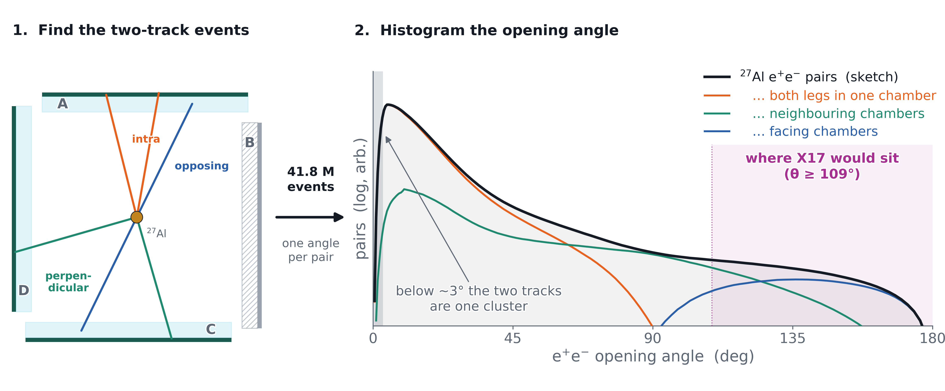
Summary
Conclusions
Plan A, MeV (79 % of the X17 rate): blocked by the DAQ, not the detector
Plan B, thermal: ³He self-shields, expectation is no X17 recorded during the campaign
Plan C, ²⁷Al pairs: 41.8 M events, good capsule image: a demonstrator for X17
Now: analysing the pair data
Illustration only — not a realistic spectrum
27 / 27
D. Neff · n_TOF Italy Meeting · 15 October 2026

Slide 47
Acknowledgements
Thank you!
n_TOF local team — for making the measurement happen in EAR2, and the whole n_TOF collaboration
CERN GDD & MPT — for their indispensable support that enabled the measurement
EUROLABS — for the funding that made this experiment possible
CEA Saclay & Bulk Lab — for help building the detectors and supplying the DAQ
Illustration only — not a realistic spectrum
Questions?
D. Neff · n_TOF Italy Meeting · 15 October 2026

Slide 48
Backup
D. Neff · n_TOF Italy Meeting · 15 October 2026

Slide 49
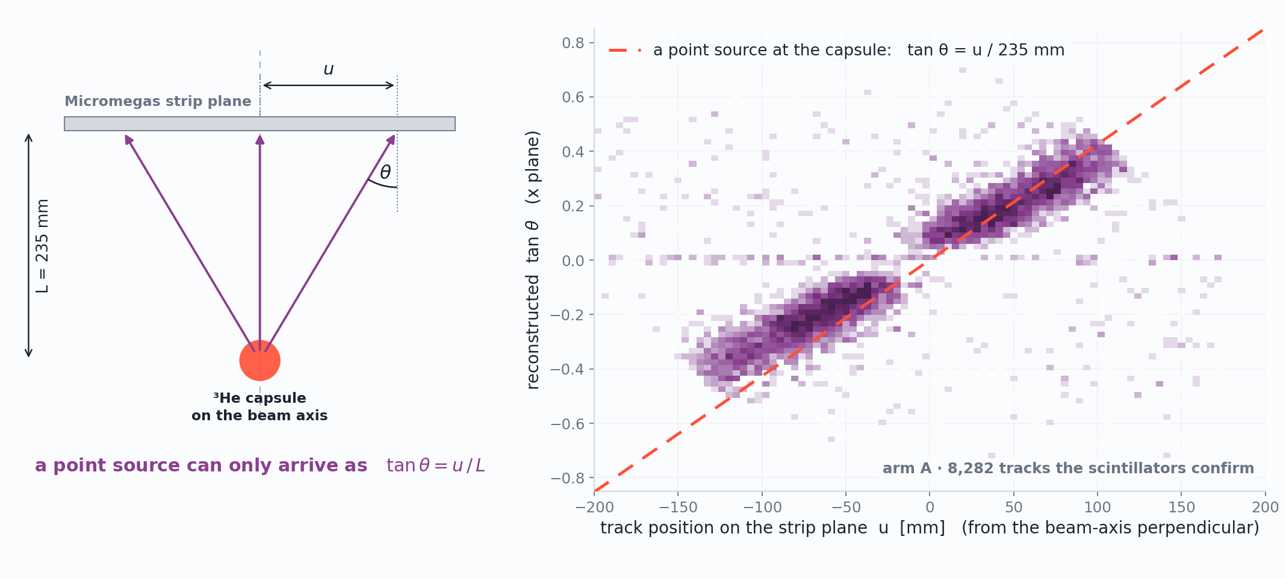
Work in progress
Status · Early Reconstruction Results
The angle a track arrives with says where it came from
Correlation implies that tracks point back to capsule
B1
D. Neff · n_TOF Italy Meeting · 15 October 2026

Slide 50
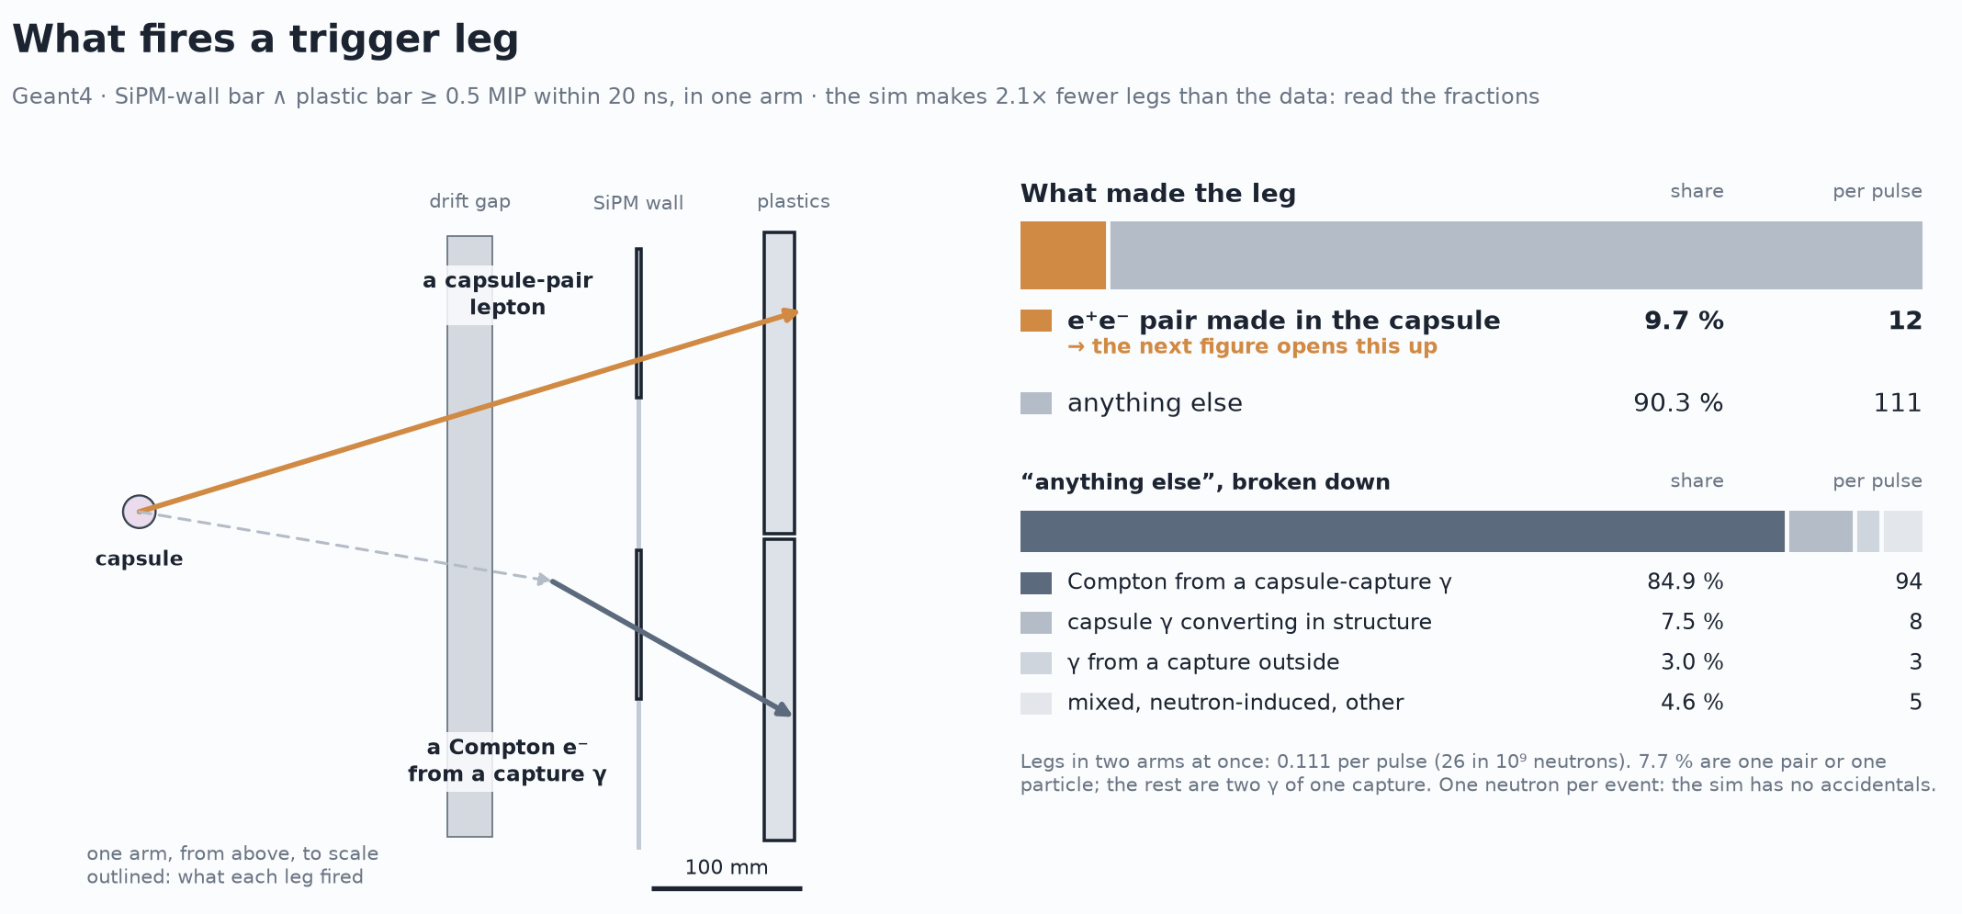
Status · What we could measure
What we expect at thermals -- aluminum
B2
D. Neff · n_TOF Italy Meeting · 15 October 2026

Slide 51
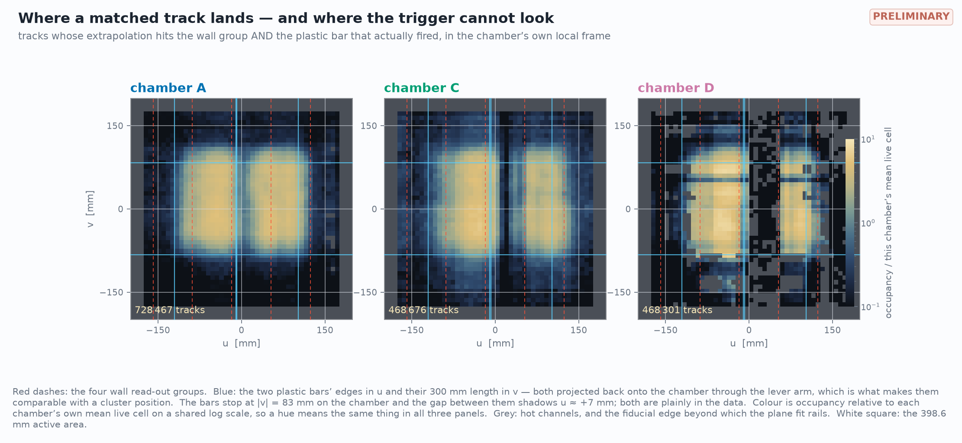
Work in progress
Status · Early Reconstruction Results
The angle a track arrives with says where it came from
B3
D. Neff · n_TOF Italy Meeting · 15 October 2026

Slide 52
Status · The environment
Every volt of gain costs milliseconds of beam
15.1 / 27
D. Neff · n_TOF Italy Meeting · 15 October 2026

Slide 53
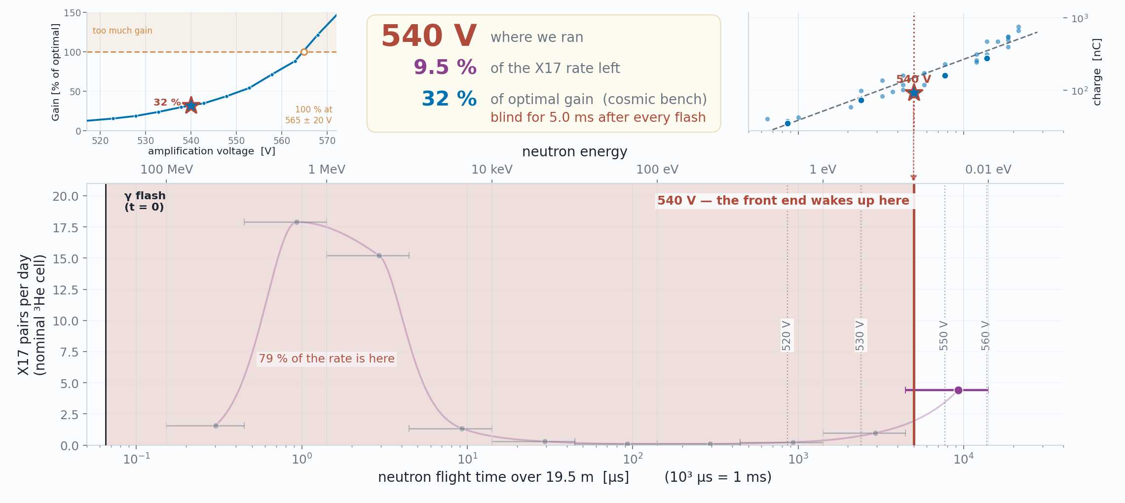
WHAT WE RAN WITH
Status · The environment
Every volt of gain costs milliseconds of beam
15.2 / 27
D. Neff · n_TOF Italy Meeting · 15 October 2026

Slide 54
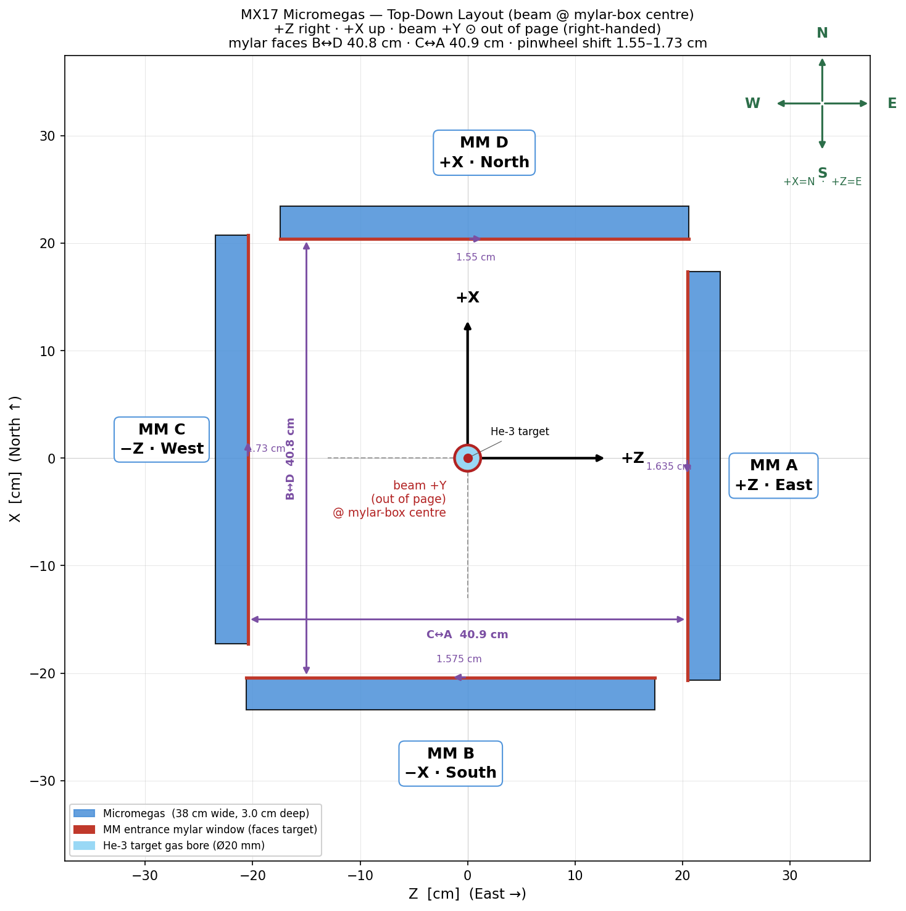
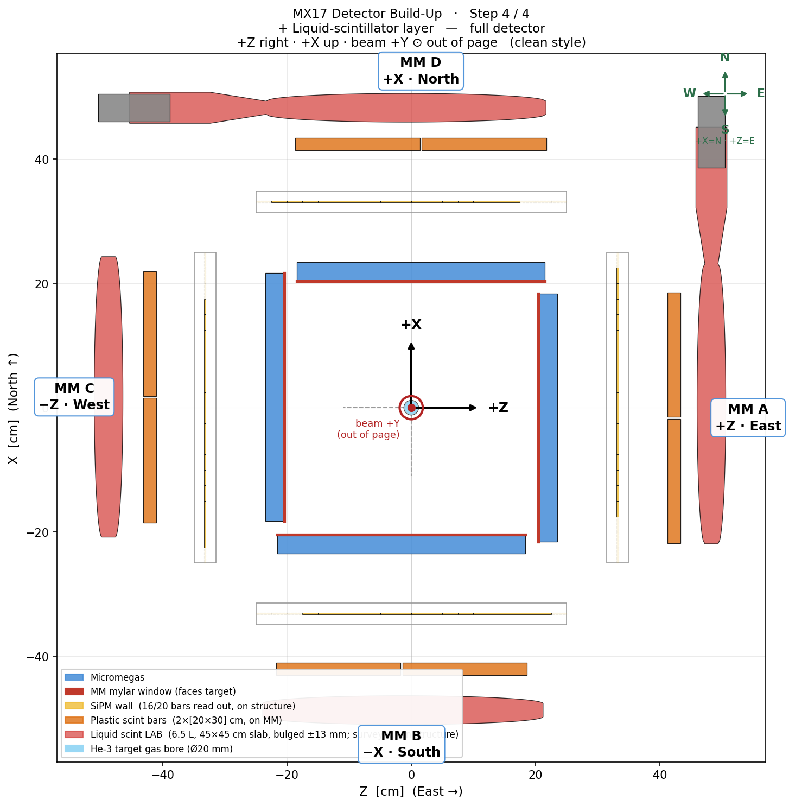
Backup · Experimental setup
The setup to scale: top-down, and layer by layer
Pinwheel, to scale: opposing mylar faces 408.0 mm (B↔D) and 409.0 mm (C↔A)
The full stack in section — every layer depth from the mylar front face
Same geometry as the 3-D build-up, drawn as a measured section rather than a render: distances 2026-07-15, per-arm gaps and vessel placements 2026-07-17/18. The intermediate build states (+SiPM, +plastics) are setup_2_sipm.png / setup_3_plastic.png in assets/img/.
B4
D. Neff · n_TOF Italy Meeting · 15 October 2026

Slide 55
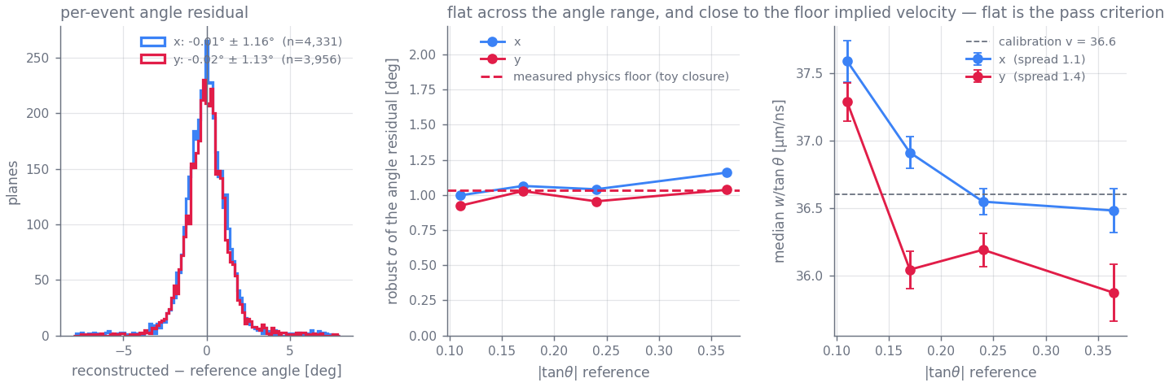
Backup · Reconstruction
The ~1° per-event scatter is physics, not fitting
The closure test | waveforms generated from the calibrated model with known tracks — real geometries, real charge profiles, real noise, real clipping — then fitted back. One knob: per-depth-bin transverse jitter of the charge centroid
jitter 0 | σ_{θ} 0.02° — electronics noise contributes essentially nothing
0.15 mm | 0.55°
0.30 mm | 1.05° — the scale diffusion + a few effective electrons per 2 mm of track + δ-rays actually give; reproduces the data exactly
0.50 mm | 1.77°
errors honest? | pull width 1.16 (X) / 1.13 (Y) — ~15 % optimistic, and χ²/dof genuinely ranks which fits to distrust
Full run, 6,852 / 6,850 reference-matched events, reference never in any fit: σ_{θ} = 1.16° / 1.13°, bias < 0.1°, flat across the angle range and sitting on the measured floor (middle, dashed); implied v flat to ~1.4 µm/ns (right)
So the per-event fit is extracting essentially all the information the detector geometry physically has — gains beyond ~1° come from ensemble averaging, not better fitters, which is why the reported errors carry a physics floor added in quadrature and the optimiser tolerances are deliberately loose. Ablations agree: dropping any single model refinement moves per-event σ by < 0.05°; what the refinements buy is ensemble physicality (implied-v flatness), the thing that cannot be tuned. Doc Part VII §41–43.
B5
D. Neff · n_TOF Italy Meeting · 15 October 2026

Slide 56
Backup · Characterization
The fleet, and what limits each chamber
det3 / det2 | Healthy. 100% of crossings fire; the whole residue is a 2.4–3.2% discharge coincidence and a 4.0–4.3% near-miss tail.
det6 / det7 | Discharge-limited — 22.3% / 37.4% of firing events are >50-strip discharges. Both ran at resist 495 V, above their measured optima (~480 / ~440 V): this is a chosen operating point, not a ceiling.
det4 | Gain-limited, and it is not blind: it produces a signal on 95.8% of crossings, but on 38.3% too few strips fire to form a valid X+Y point. Independently confirmed at the SPS: 62% of its area does not amplify.
Position core σ | 0.43–0.46 mm on det2/det3/det6, 0.56/0.62 mm on det4/det7 (radial) — on the good chambers the M3 reference contributes only ~10–20% of the variance.
det3
93.3%
det2
92.0%
det6
74.9%
det7
57.0%
det4
41.6%
Reconstructed within 5 mm of the M3 reference track (χ²<1.0 & NClus=4). One high-statistics sub-run per chamber, 3.7k–12.3k reference muons, waveform-first reconstruction, 2026-08-13 reprocessing.
Superseded 2026-07-14 values were 92.9 / 91.3 / 57.8 / 43.1 / 20.7%. The last three chambers gain 14–21 points from the matched-filter reprocessing of the raw waveforms — low-amplitude hits the previous analyzer never admitted — plus a further 0.4–4 points from reconstructing position from the waveforms instead of the strip hit times.
B6
D. Neff · n_TOF Italy Meeting · 15 October 2026

Slide 57
Backup · Operating in it
What we record, and when
Reconstructed tracks on beam data, joined event-by-event to the n_TOF scintillator stream. The turn-on at 1 ms is the DREAM gate, not the reconstruction; the bulk of everything we record sits in the first ~10 ms — the same interval the recovery map says the chambers are only partly alive in. That overlap is the experiment's central operational problem, stated in data.
B7
D. Neff · n_TOF Italy Meeting · 15 October 2026

Slide 58
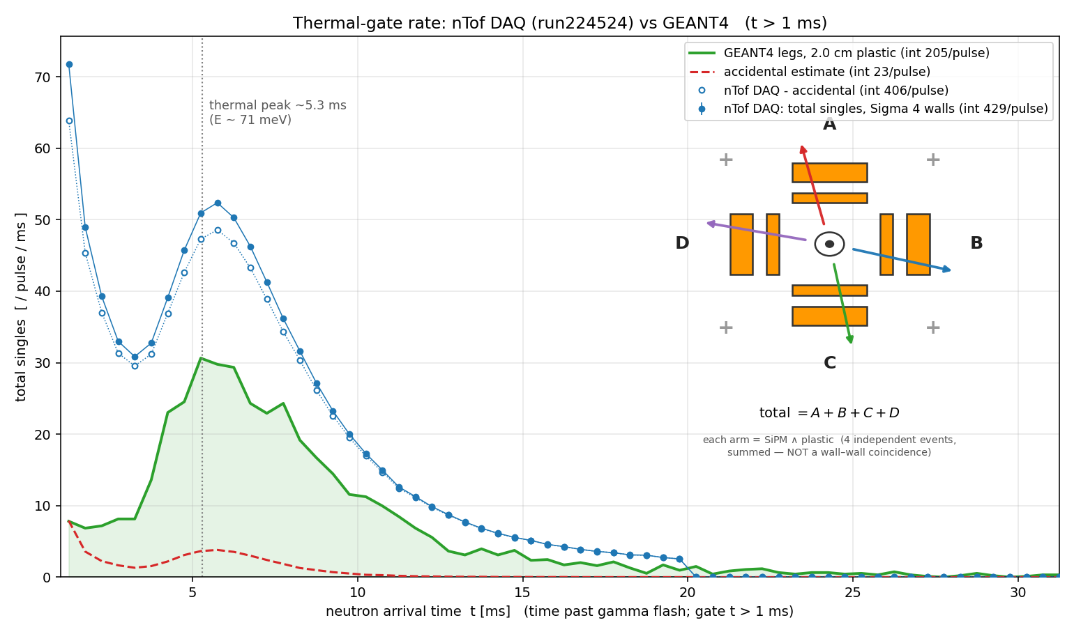
Backup · Operating in it
The trigger lives in the thermal window — by design
Capture loves slow neutrons, and slow neutrons are late. Over ~20 m of flight path the thermal flux peaks at 5.3 ms — recorded, and reproduced by Geant4 in shape.
The trigger: per arm, the SiPM wall (any of 4 segments over ½ MIP) AND a plastic bar over 0.90 MIP, within 20 ns — a charged leg crossing the stack, not a γ.
Simulation says 96 % of those trigger legs are ²⁷Al-capture γs converting in the capsule wall — the trigger is dominated by the background the analysis has to beat.
Recorded trigger rate vs neutron arrival time, against Geant4 — the 5.3 ms thermal peak reproduces; the normalisation runs 2.1× high (per wall 1.1–2.6×), under investigation
B8
D. Neff · n_TOF Italy Meeting · 15 October 2026

Slide 59
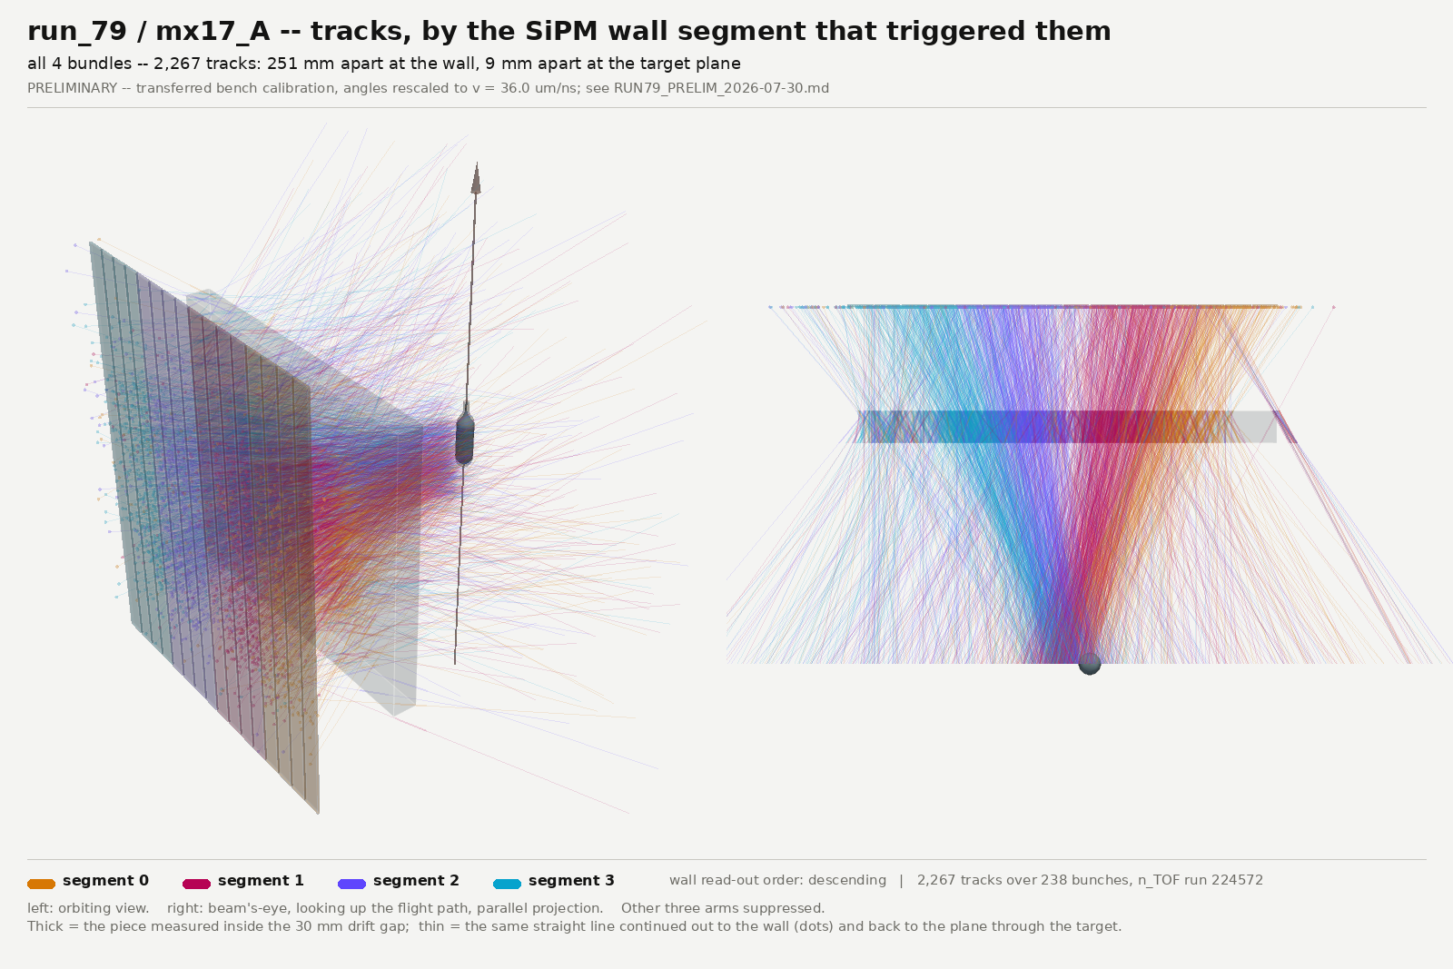
Backup · Reconstruction
The tracks point back at the capsule
Waveform-first reconstruction on beam data, coloured by which SiPM wall segment fired — external position truth on a 100 mm granularity, on a lever arm the chamber knows nothing about. The four bundles are 251 mm apart at the wall and 9 mm apart at the target plane; shuffling the segment labels collapses that to 28 mm and 3.2 mm. Ensemble statement — the waist is a convergence of medians, not a per-track pointing resolution.
B9
D. Neff · n_TOF Italy Meeting · 15 October 2026

Slide 60
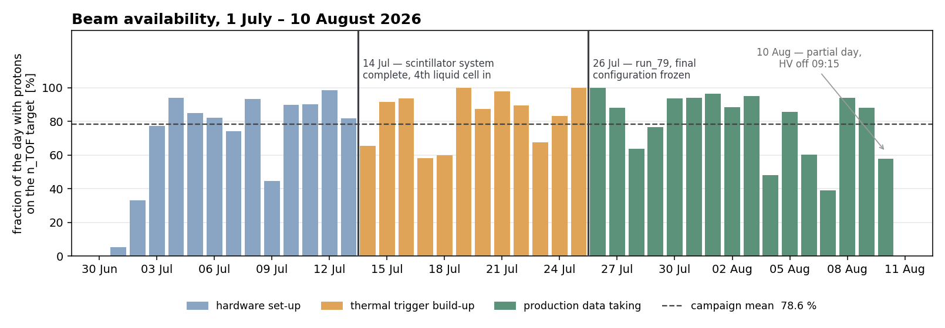
Backup · The campaign
Beam availability, day by day
Fraction of each day with protons on the n_TOF target, from the one-minute classification of the last beam-current transformer before the target (FTN.BCT477). Campaign mean 78.6 %; the 21.4 % without beam is the usual mix of PS supercycle sharing and machine stops — the logger’s attribution between the two is not reliable, so only the total is quoted. Colours are the three campaign phases; 10 August is a partial day (HV off 09:15).
B10
D. Neff · n_TOF Italy Meeting · 15 October 2026

Slide 61
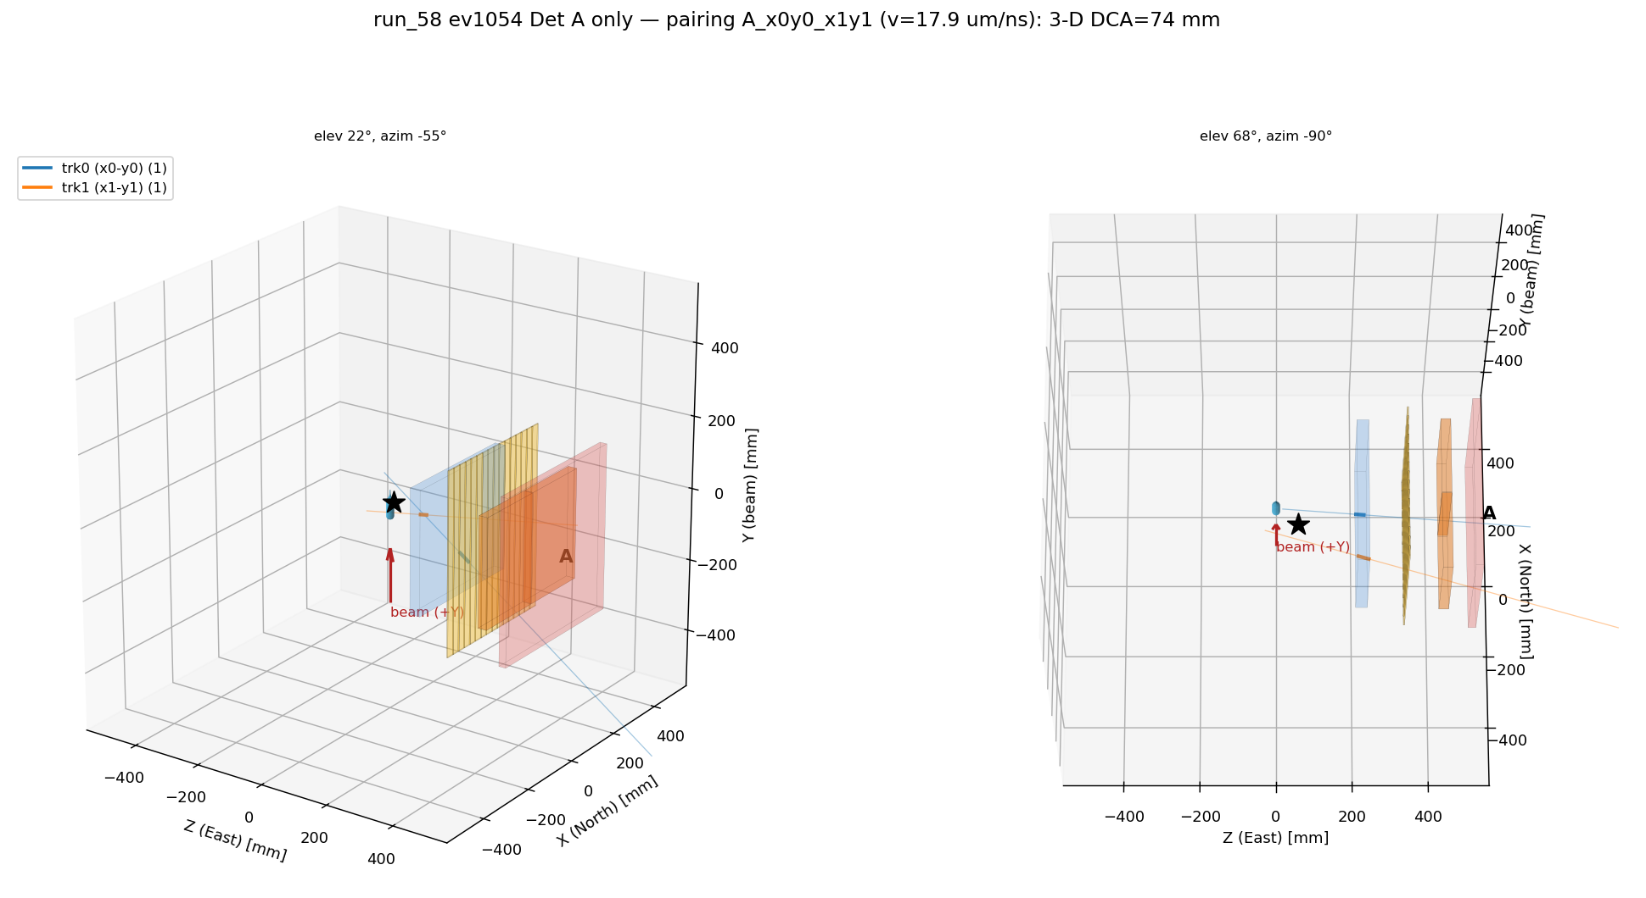
Backup · Outlook
Next: from single tracks to pairs
What a signal is: two tracks in different arms, opening angle kinematically confined above 109°, total pair energy 19.6 MeV (slide 4). Everything in this talk exists to make that measurable.
The reconstruction is ready for the easy half: the forward fit now returns every candidate track, not just the winner — single-track output bit-identical, candidates shipped alongside. Two tracks merged closer than ~12 mm still fit as one bad-χ² compromise: the two-track forward model is the one designed-but-unbuilt piece.
The dataset is final and the search is offline: 41.8 M events on EOS, with the trigger dominated by Al-capture pairs — an enormous calibration sample for exactly this topology.
The bar the tracker has to clear: the Al background separates on total pair energy, which asks for σ(p)/p ≲ 30 % per lepton from scattering or range — the open MPGD question to leave the room with.
A real two-track event in one chamber (July scan run) — two track-grade lines in both planes, paired into 3-D. A demonstration, not a measurement: hits-basis, and the X↔Y pairing is two-fold ambiguous
B11
D. Neff · n_TOF Italy Meeting · 15 October 2026

Slide 62
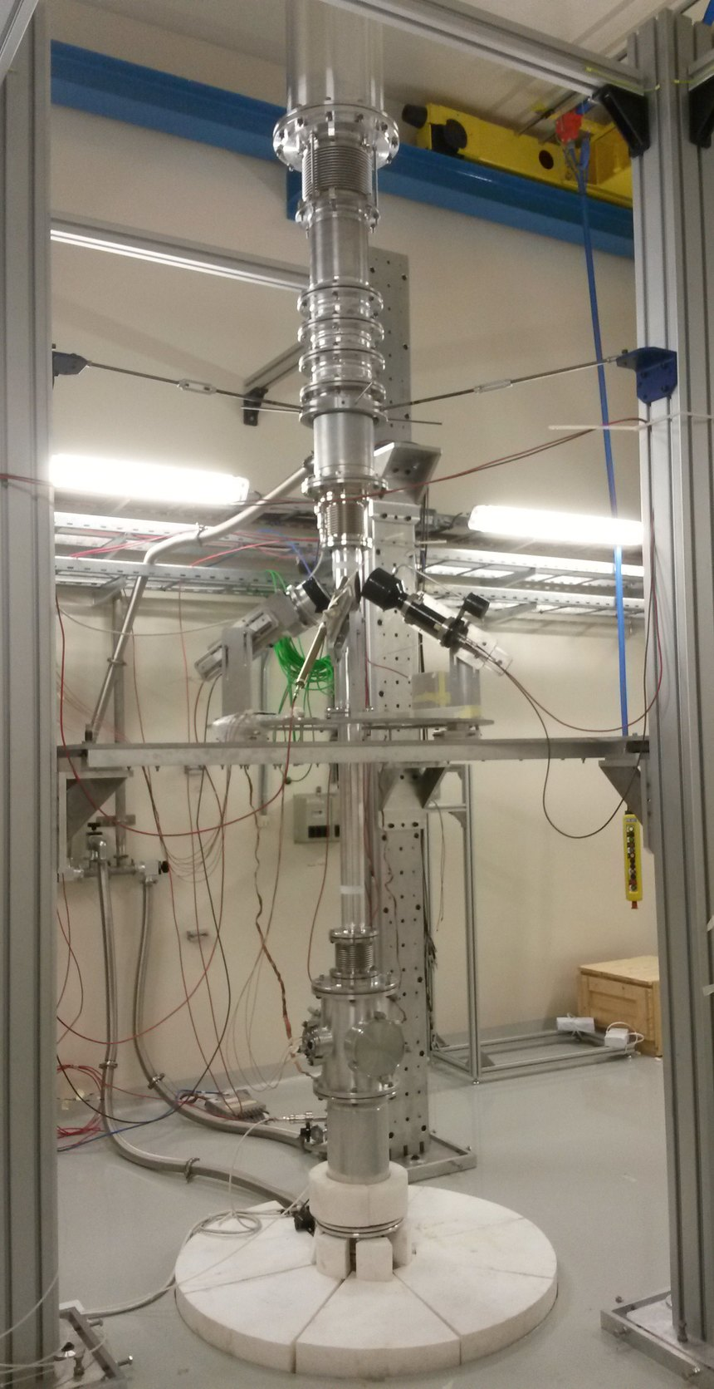
Motivation
n_TOF EAR2: a vertical neutron beam line at CERN
20 GeV/c PS protons hit a lead spallation target
The EAR2 hall — © CERN
In-house render · Weiß (2015), Pavon-Rodriguez (2025)
B12
D. Neff · n_TOF Italy Meeting · 15 October 2026

Slide 63
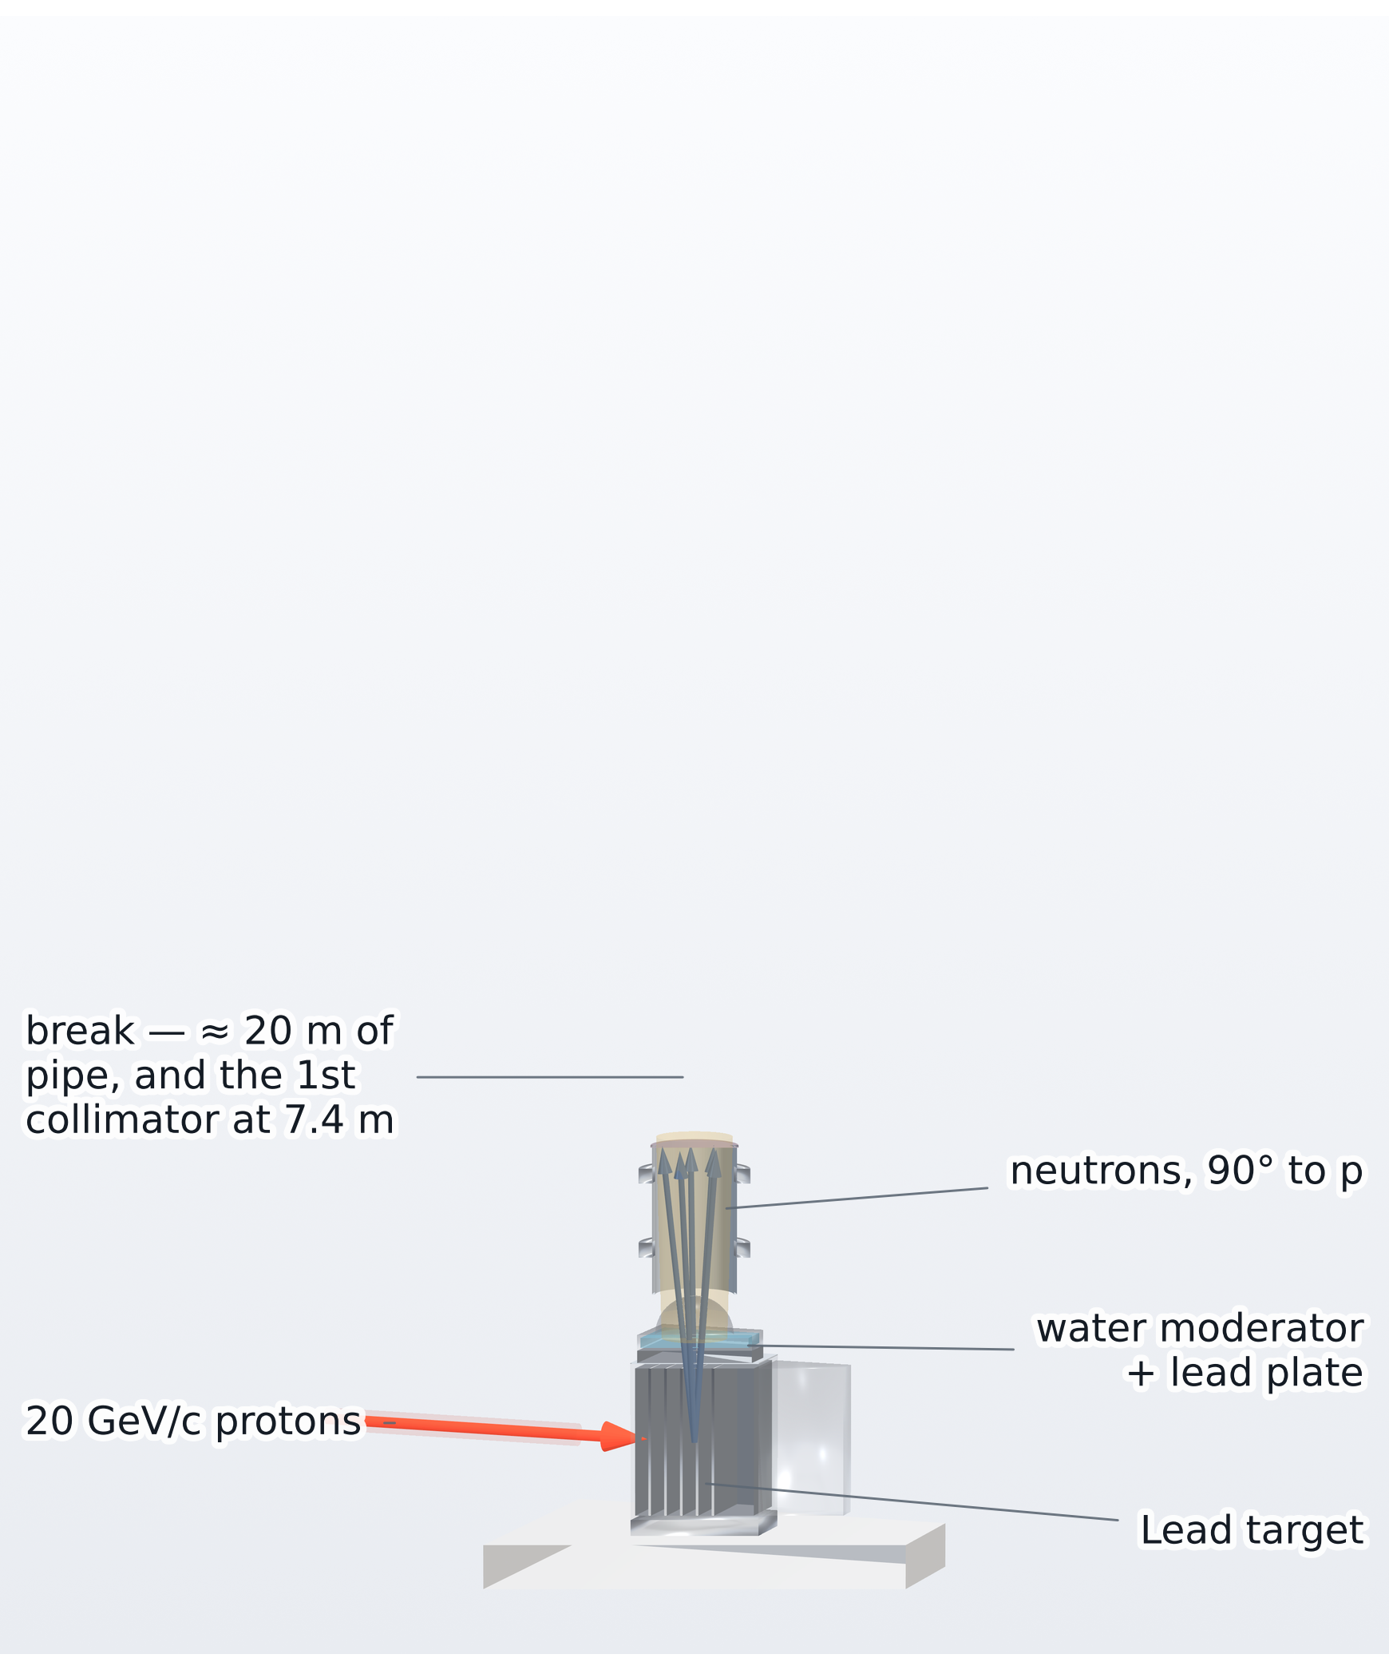
Motivation
n_TOF EAR2: a vertical neutron beam line at CERN
20 GeV/c PS protons hit a lead spallation target
Neutrons ejected at 90° climb ~20 m to EAR2
The EAR2 hall — © CERN
In-house render · Weiß (2015), Pavon-Rodriguez (2025)
B13
D. Neff · n_TOF Italy Meeting · 15 October 2026

Slide 64
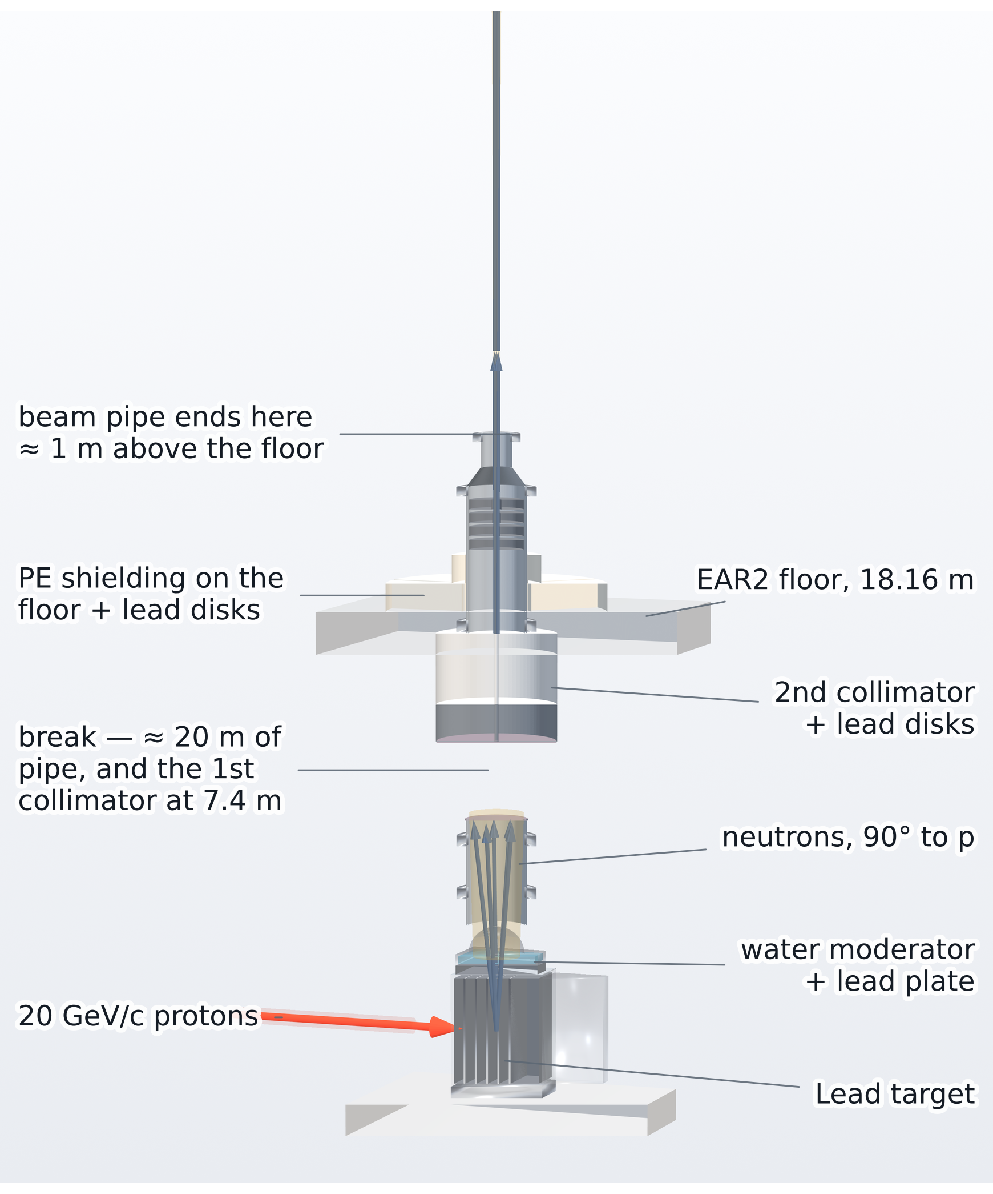
Motivation
n_TOF EAR2: a vertical neutron beam line at CERN
20 GeV/c PS protons hit a lead spallation target
Neutrons ejected at 90° climb ~20 m to EAR2
Collimated to a ≈3 cm pencil
The pipe ends: the beam crosses the hall in air
The EAR2 hall — © CERN
In-house render · Weiß (2015), Pavon-Rodriguez (2025)
B14
D. Neff · n_TOF Italy Meeting · 15 October 2026

Slide 65
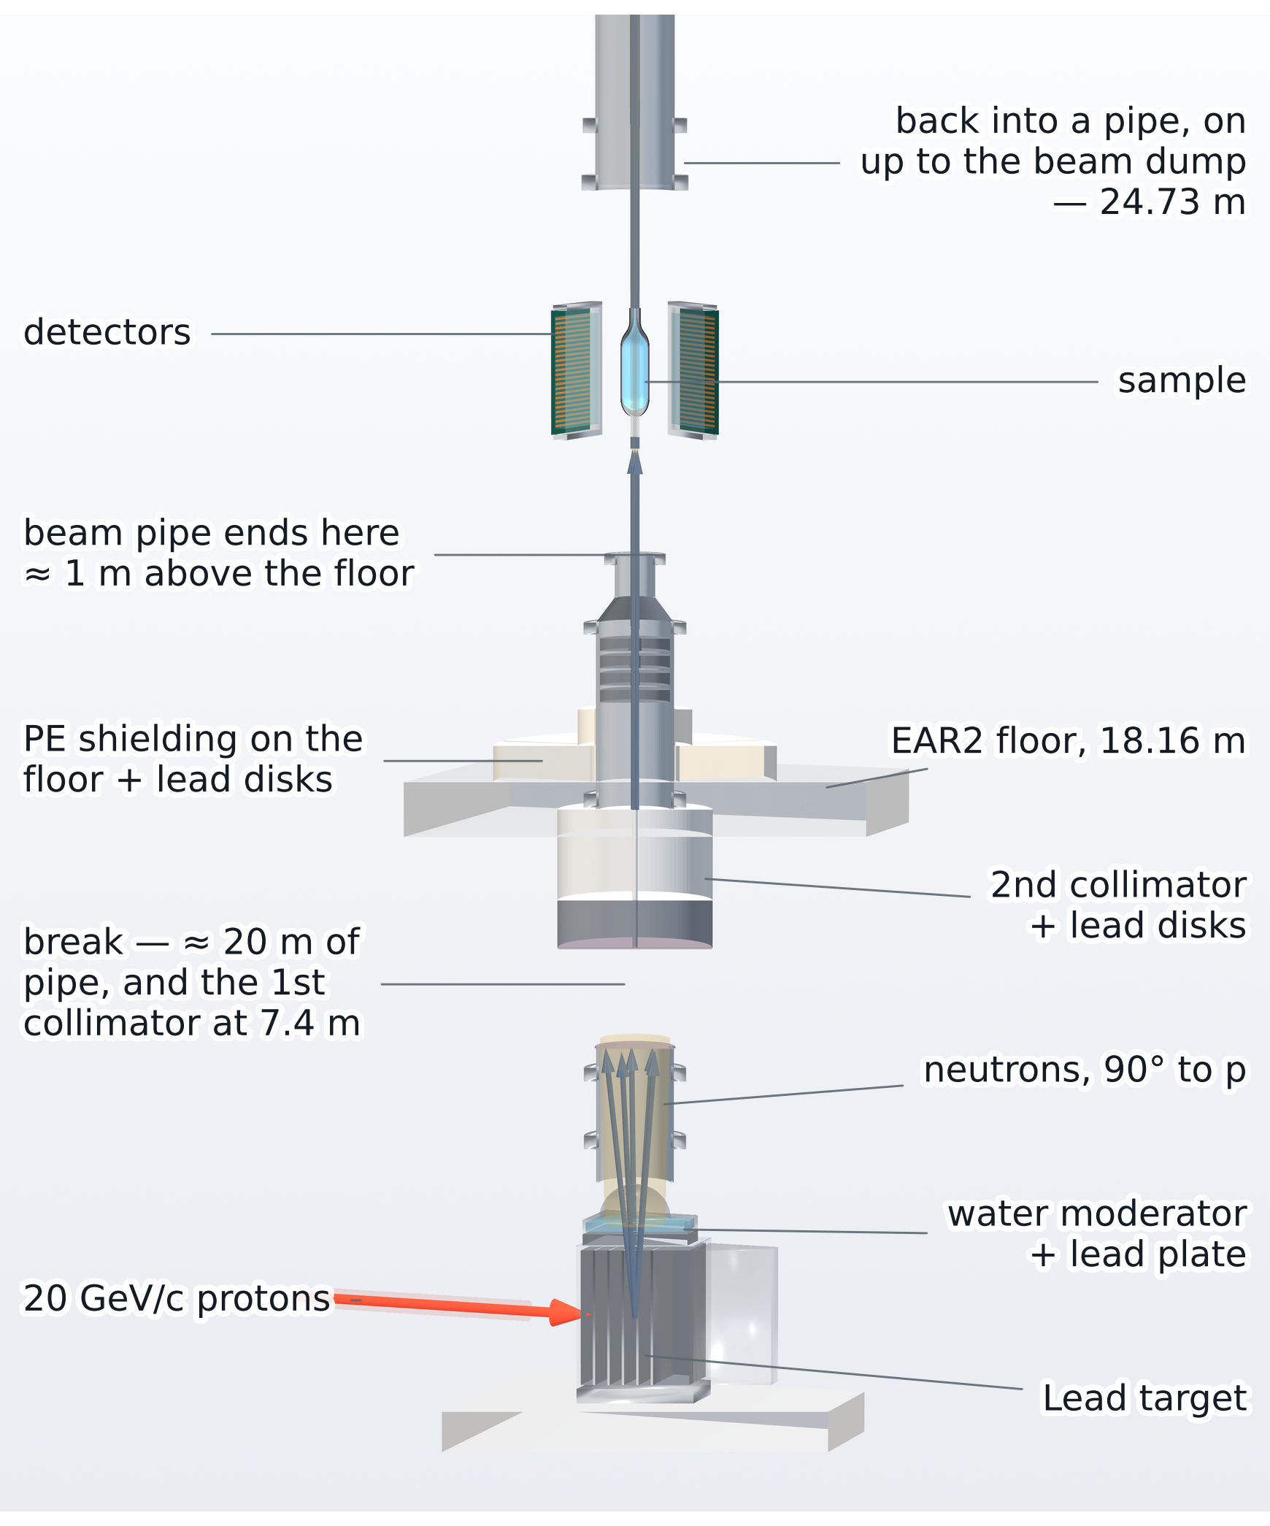
Motivation
n_TOF EAR2: a vertical neutron beam line at CERN
20 GeV/c PS protons hit a lead spallation target
Neutrons ejected at 90° climb ~20 m to EAR2
Collimated to a ≈3 cm pencil
The pipe ends: the beam crosses the hall in air
Measurement station sits in that open beam
The highest instantaneous flux at n_TOF
The EAR2 hall — © CERN
In-house render · Weiß (2015), Pavon-Rodriguez (2025)
B15
D. Neff · n_TOF Italy Meeting · 15 October 2026

Slide 66
The Micromegas Compact TPC
A large-area resistive-strip detector, built to measure the opening angle of the pair.
D. Neff · n_TOF Italy Meeting · 15 October 2026

Slide 67
Designed & built at CEA Saclay by
Micromegas TPC · Saclay
Stéphan Aune
The Micromegas compact TPC design
One chamber, exploded along the drift axis
a 44 × 34 mm window at the real pitch
MX17 readout board, four layers peeled back
25 × 25 mm of the 470 mm board
B16
D. Neff · n_TOF Italy Meeting · 15 October 2026

Slide 68
Designed & built at CEA Saclay by
Micromegas TPC · Saclay
Stéphan Aune
TPC operation
Simulated event
B17
D. Neff · n_TOF Italy Meeting · 15 October 2026

Slide 69

Method inspired by T2K ND280
Attié et al., NIM A 1056 (2023) 168534
Work in progress
Micromegas TPC · Reconstruction
Resistive strips spread and delay charge
What happens on the resistive layer
Charge spreads through the resistive strips
A neighbor’s copy arrives late and dispersed
B18
D. Neff · n_TOF Italy Meeting · 15 October 2026

Slide 70

Method inspired by T2K ND280
Attié et al., NIM A 1056 (2023) 168534
Work in progress
Micromegas TPC · Reconstruction
Resistive strips spread and delay charge
What happens on the resistive layer
Charge spreads through the resistive strips
A neighbor’s copy arrives late and dispersed
B19
D. Neff · n_TOF Italy Meeting · 15 October 2026

Slide 71


Method inspired by T2K ND280
Attié et al., NIM A 1056 (2023) 168534
Work in progress
Micromegas TPC · Reconstruction
The forward fit: assume a track and predict every waveform
Three numbers are searched:
Mesh arrival position and time (p₀, t₀) and transverse speed (w)
v_{drift} enters once at the end: tan θ = w / v_{drift}
Four consecutive strips of one real muon event
B20
D. Neff · n_TOF Italy Meeting · 15 October 2026

Slide 72

Work in progress
Micromegas TPC · Reconstruction
One muon through the forward fit
B21
D. Neff · n_TOF Italy Meeting · 15 October 2026

Slide 73
Characterization
How well the chamber actually performs,
measured with cosmic muons.
D. Neff · n_TOF Italy Meeting · 15 October 2026

Slide 74

Characterization
Characterization on the Saclay cosmic bench
A cosmic muon fires the scintillators at the top and bottom of the stack.
Four reference Micromegas reconstruct its track; the two MX17 detectors under test sit in between.
B22
D. Neff · n_TOF Italy Meeting · 15 October 2026

Slide 75

Characterization
Characterization on the Saclay cosmic bench
60 × 60 cm trigger scintillators, top and bottom
A cosmic muon fires the scintillators at the top and bottom of the stack.
Four reference Micromegas reconstruct its track; the two MX17 detectors under test sit in between.
B23
D. Neff · n_TOF Italy Meeting · 15 October 2026

Slide 76

Characterization
Characterization on the Saclay cosmic bench
60 × 60 cm trigger scintillators, top and bottom
50 × 50 cm Micromegas reference trackers, four of them
A cosmic muon fires the scintillators at the top and bottom of the stack.
Four reference Micromegas reconstruct its track; the two MX17 detectors under test sit in between.
B24
D. Neff · n_TOF Italy Meeting · 15 October 2026

Slide 77

Characterization
Characterization on the Saclay cosmic bench
60 × 60 cm trigger scintillators, top and bottom
50 × 50 cm Micromegas reference trackers, four of them
A cosmic muon fires the scintillators at the top and bottom of the stack.
Four reference Micromegas reconstruct its track; the two MX17 detectors under test sit in between.
40 × 40 cm TPC chambers — the ones being characterized
B25
D. Neff · n_TOF Italy Meeting · 15 October 2026

Slide 78
Characterization
Characterization on the Saclay cosmic bench
60 × 60 cm trigger scintillators, top and bottom
50 × 50 cm Micromegas reference trackers, four of them
A cosmic muon fires the scintillators at the top and bottom of the stack.
Four reference Micromegas reconstruct its track; the two MX17 detectors under test sit in between.
40 × 40 cm TPC chambers — the ones being characterized
Cosmic muons — two slots measured at once, against the same reference
B26
D. Neff · n_TOF Italy Meeting · 15 October 2026

Slide 79


Work in progress
Characterization
Efficiency: 93% on the best chamber
Where every crossing muon goes
Flat across the chamber face
a circle swept over the face, 500 µm at a time
Reconstructed within 5 mm
93.1% 20,428
the efficiency
Detected, point >5 mm off
4.2% 913
the near-miss tail†
Discharged during the muon
2.6% 563
many strips fire uncorrelated with muon
Fired, no valid X+Y point
0.2% 46
Silent — no signal at all
0.01% 3
genuine blindness
WHY 0.45 mm
Reference trackers resolve to ~500 µm
B27
D. Neff · n_TOF Italy Meeting · 15 October 2026

Slide 80
Work in progress
Characterization
Adequate angular, spatial and temporal resolution
Reconstructed against reference, per plane
Head on tracks reasonable and angled tracks approach 1°
1.19 / 1.23°
180 µm
33 ns
angle per plane, X / Y (σ₆₈), bias < 0.1°
position at normal incidence, ±0.035 mm conservatively
plane-to-plane timing, ≈ 1.1 mm of drift
B28
D. Neff · n_TOF Italy Meeting · 15 October 2026

Slide 81
Backup · Plan A
Could plan A still work? Wall pairs per X17, by neutron energy
The Al + C wall makes ~10⁶ pairs per X17 at thermal energies but only ~50 at 0.1–2 MeV, where 79 % of the X17 rate sits — until the Al/C inelastic lines open at 2.3 MeV. X17/IPC = 2.5 % is the rate table's assumption; the ratio scales with it.
B29
D. Neff · n_TOF Italy Meeting · 15 October 2026

Slide 82
Cut for the 15-minute version
D. Neff · n_TOF Italy Meeting · 15 October 2026

Slide 83
Outline
1
The X17 particle and the n_TOF channel
2
Micromegas TPC detectors
3
X17 search at n_TOF —
experimental setup
4
Experiment Summary and Early Results
D. Neff · n_TOF Italy Meeting · 15 October 2026
2 / 18

Slide 84
The Micromegas Compact TPC
A large-area resistive-strip detector, built to measure the opening angle of the pair.
D. Neff · n_TOF Italy Meeting · 15 October 2026

Slide 85

Status · The environment
Every volt of gain costs milliseconds of beam
D. Neff · n_TOF Italy Meeting · 15 October 2026
14.2 / 18

Slide 86

Status · The environment
Every volt of gain costs milliseconds of beam
D. Neff · n_TOF Italy Meeting · 15 October 2026
14.3 / 18

Slide 87

Status · The environment
Every volt of gain costs milliseconds of beam
D. Neff · n_TOF Italy Meeting · 15 October 2026
14.4 / 18

Slide 88
Status · The environment
Every volt of gain costs milliseconds of beam
D. Neff · n_TOF Italy Meeting · 15 October 2026
14.5 / 18

Slide 89
Measurement Status
What the campaign actually recorded, and the problems we faced.
D. Neff · n_TOF Italy Meeting · 15 October 2026

Slide 90
Status
Experiment timeline and statistics
D. Neff · n_TOF Italy Meeting · 15 October 2026
10.1 / 18

Slide 91
Status · What we could measure
What we expect at thermals -- aluminum
Realized in July after running Geant4 simulation that 3He self-shields at thermal energies and actually aluminum capture will dominate e+e- production.
Unfortunately, we don’t expect to see X17 or even 3He IPC, but aluminum gamma → pair conversion
Show the simulation of where our expected e+e- come from at thermal energies. Mostly aluminum
Show 3He branching ratio vs neutron energy
Show e+e- source breakdown
D. Neff · n_TOF Italy Meeting · 15 October 2026
15 / 18

Slide 92

Work in progress
Status · Early Reconstruction Results
The angle a track arrives with says where it came from
D. Neff · n_TOF Italy Meeting · 15 October 2026
16.1 / 18

Slide 93

Summary
Summary and where we go from here
Constructed Micromegas TPCs which measure track angle to ~1°
2026 X17 campaign at n_TOF EAR2 complete: 41.8 M events, 17.9 TB, 44 days
Thermal window recorded
Next steps for the analysis
D. Neff · n_TOF Italy Meeting · 15 October 2026
18.1 / 18

Slide 94
Summary
Summary and where we go from here
Constructed Micromegas TPCs which measure track angle to ~1°
2026 X17 campaign at n_TOF EAR2 complete: 41.8 M events, 17.9 TB, 44 days
Thermal window recorded
Next steps for the analysis
Thank you! Questions?
D. Neff · n_TOF Italy Meeting · 15 October 2026
18.2 / 18

Slide 95
Work in progress
Status · Early Reconstruction Results
The angle a track arrives with says where it came from
D. Neff · n_TOF Italy Meeting · 15 October 2026
16.1 / 18

