Slide 1
SiPM Wall MIP Calibration from Wall–Plastic Coincidences
n_TOF EAR2 X17 — run 224404 (first beam data, July 15)
Dylan Neff — July 17, 2026

Slide 2
Data & selection
Official processed file, run 224404: 3792 bunches (1471 dedicated), ~300M hits
Per-channel ADC→mV from DAQ settings (≈0.0305 mV/count)
SiPM walls delivered NO data for 46% of beam-on bunches (643–2212) — plastics unaffected; hardware cause TBD with DAQ crew
All results: post-recovery bunches, hits >0.1 ms after γ-flash (highest coincidence purity)

Slide 3
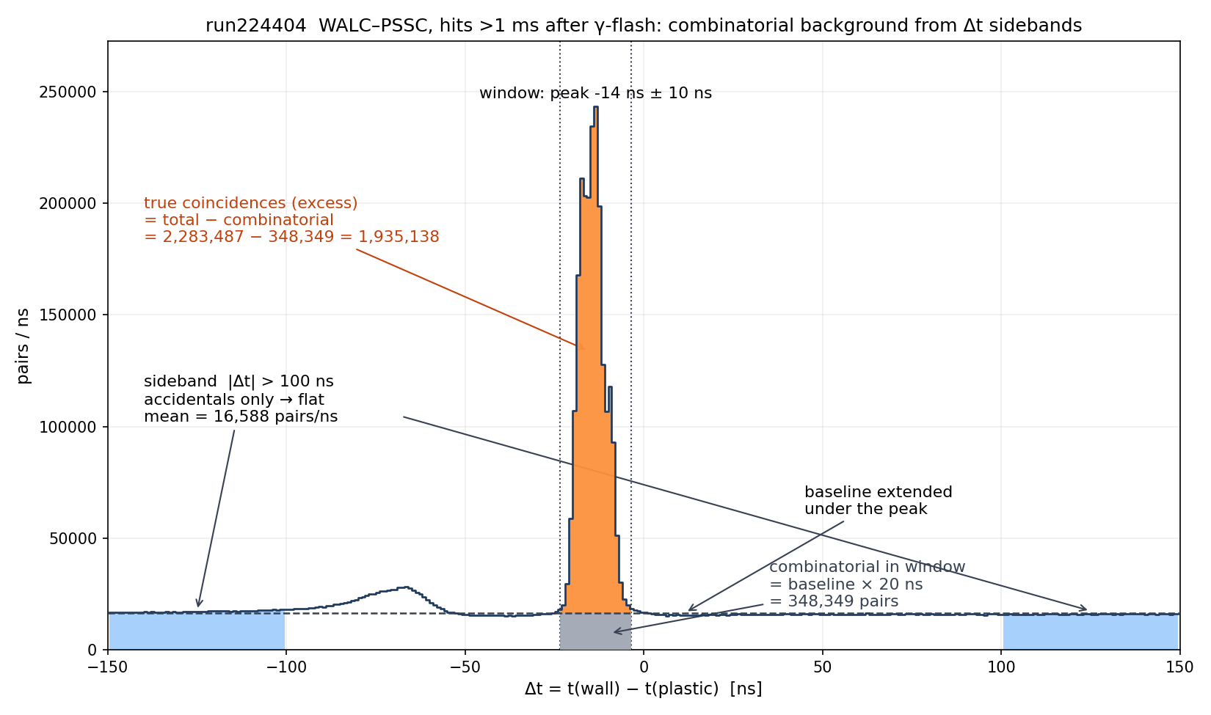
Method: coincidences with sideband subtraction

Slide 4
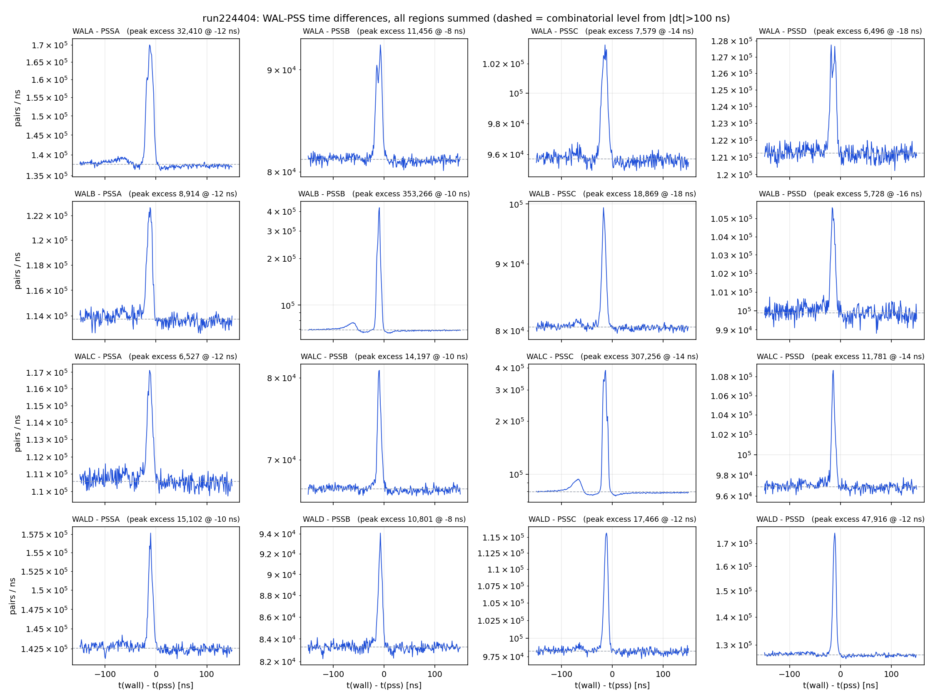
Every arm pairs wall ↔ plastic cleanly
Peaks at −8 to −18 ns, rms 1.5–3.5 ns; per-channel offsets now a stored calibration (calib/time_offsets_run224404.json).

Slide 5
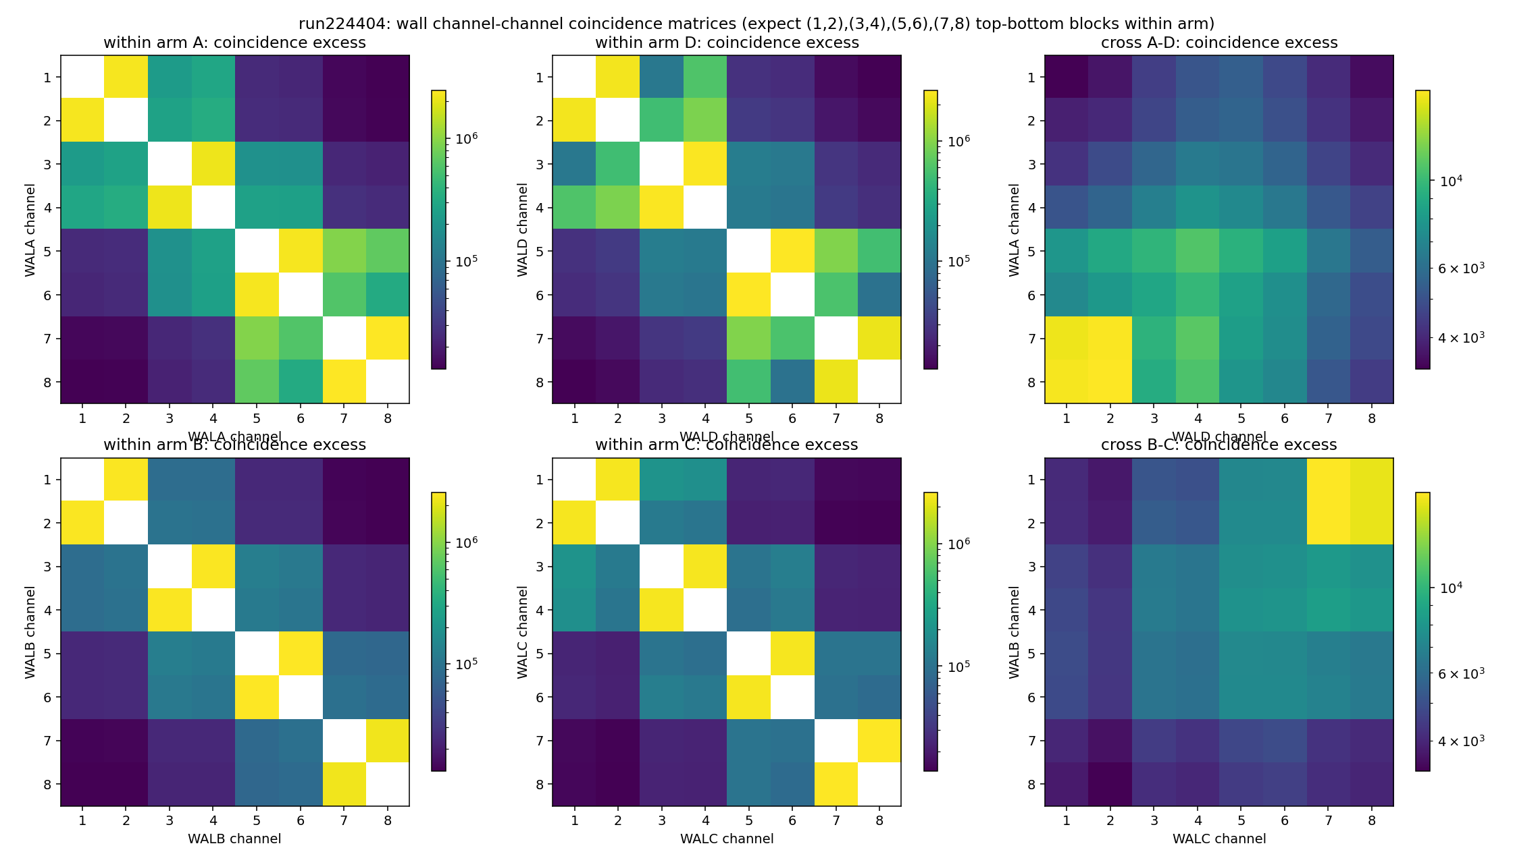
Geometry confirmed in data
Top/bottom blocks (1,2)(3,4)(5,6)(7,8) per 4-bar group; groups ordered left→right across the two bars. Corner hotspots ⇒ A–D and B–C are ADJACENT arms. Odd=top is an assumption — need cabling sheet.

Slide 6
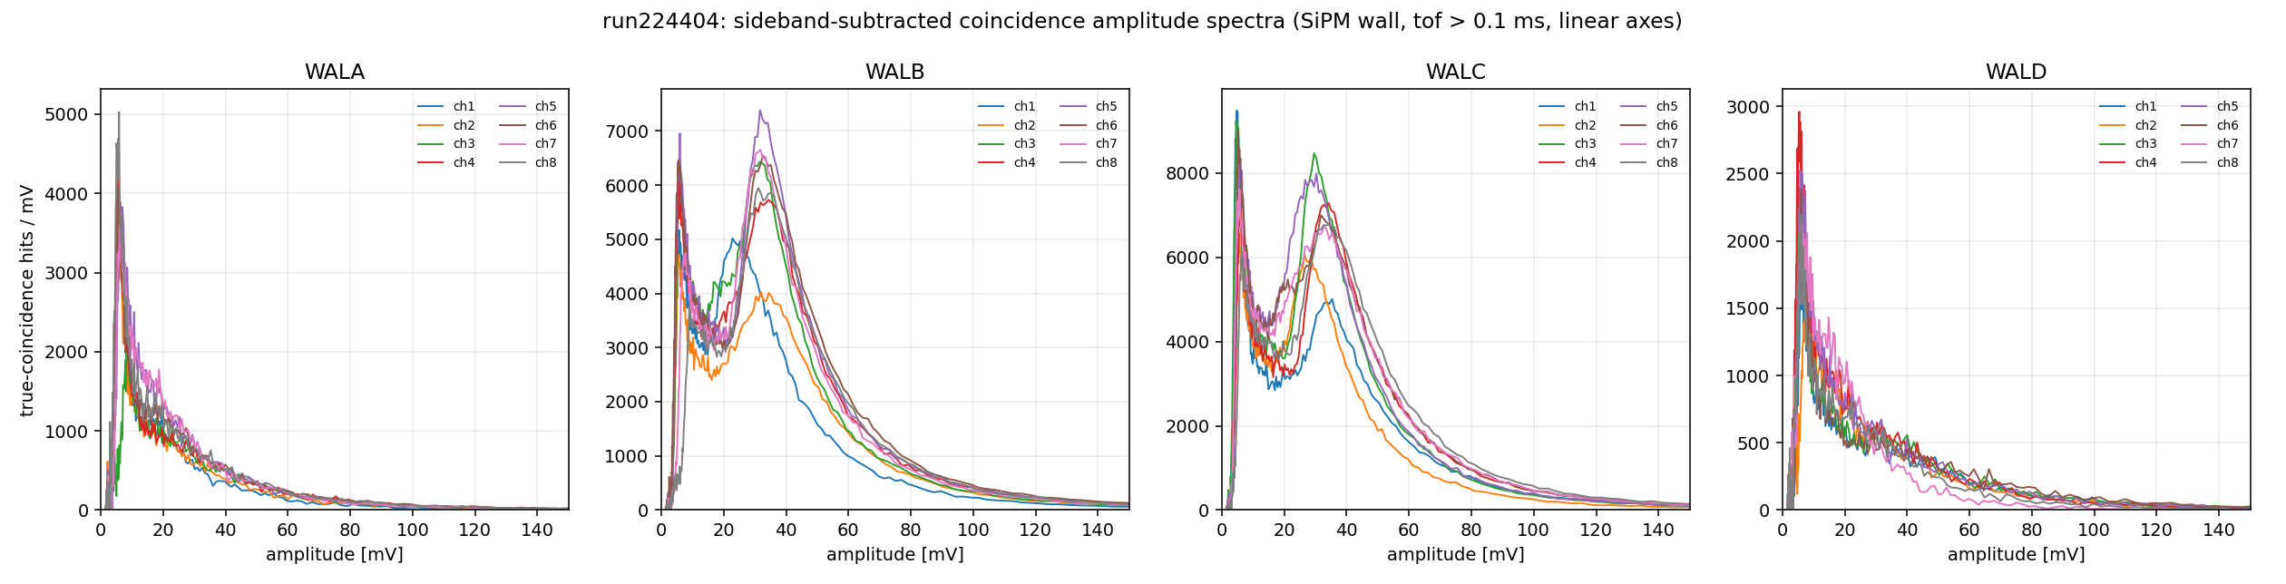
Headline: SiPM-wall MIP peaks on arms B and C
Sideband-subtracted coincidence spectra. B/C: clean MIP peaks, 29–39 mV, all 16 channels ⇒ per-channel calibration. A/D: no MIP population (later slides).

Slide 7
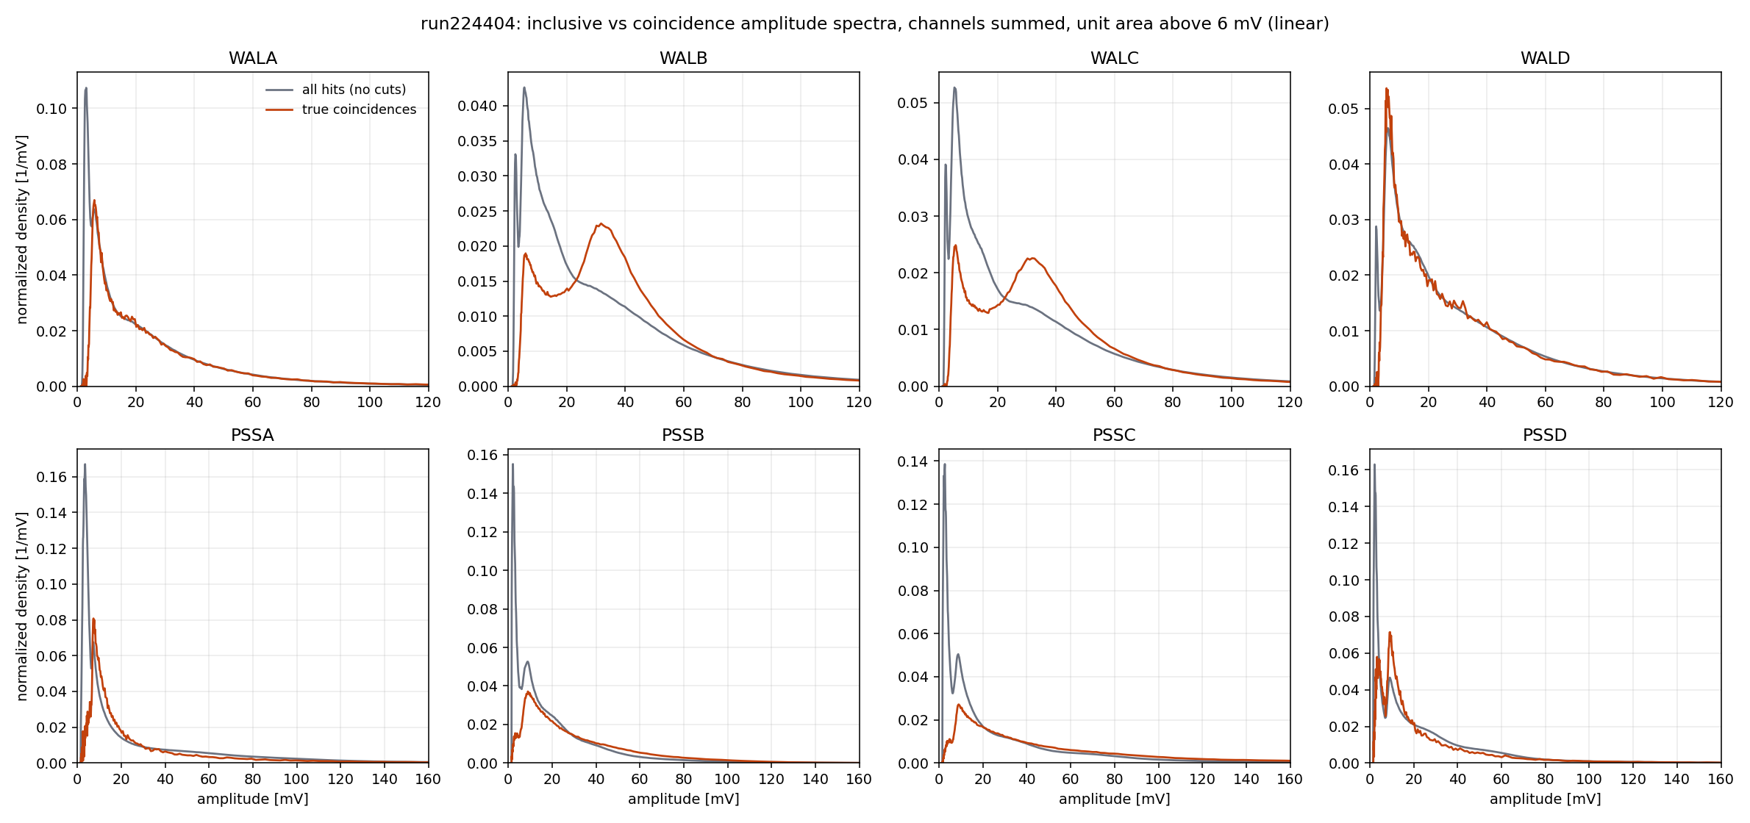
Coincidence selection performs exactly as intended (B/C)
Physics note: the plastic is at the BACK of the stack ⇒ the coincidence is a through-going (MIP) selection for the wall, but only a hit selection for the plastic — plastic spectra are NOT MIP spectra.

Slide 8
The A/D problem — cause still open
A/D: 6–8× fewer true coincidences; coincident spectrum just traces the inclusive shape — no MIP bump
Hypotheses: plastic response misses MIPs / wall SiPM gain low / geometry, absorption or flux composition
Inclusive plastic medians agree within ±30% across all 8 PMTs (DL highest) ⇒ large plastic-gain deficit unlikely
Wall-only top–bottom check (backup slide): SiPM response healthy on all four arms — MIP-scale deposits present everywhere
but top & bottom view the SAME bars, so a single gamma/Compton deposit also fires both ends — this does NOT prove a through-going flux, nor pin the blame on the plastic
Discriminating follow-ups: pre-flash cosmic sample (guaranteed through-going muons), LIQ readout, plastic HV scan

Slide 9
Plastic PMT relative gains & HV suggestions
PMT | HV [V] | med_inc [mV] | rel. gain | V (equalize) | V (2×)
PSSA1 (AL) | 1325 | 10.4 | 0.74 | 1384 | 1528
PSSA2 (AR) | 1275 | 13.2 | 0.93 | 1288 | 1422
PSSB1 (BL) | 1325 | 13.1 | 0.93 | 1339 | 1478
PSSB2 (BR) | 1300 | 14.9 | 1.05 | 1290 | 1425
PSSC1 (CL) | 1300 | 14.5 | 1.03 | 1295 | 1429
PSSC2 (CR) | 1300 | 15.3 | 1.08 | 1285 | 1419
PSSD1 (DL) | 1300 | 17.8 | 1.26 | 1258 | 1389
PSSD2 (DR) | 1300 | 14.9 | 1.06 | 1290 | 1424
G ∝ V^7 assumed — request a 2-point HV scan to calibrate before trusting shifts >25 V.

Slide 10
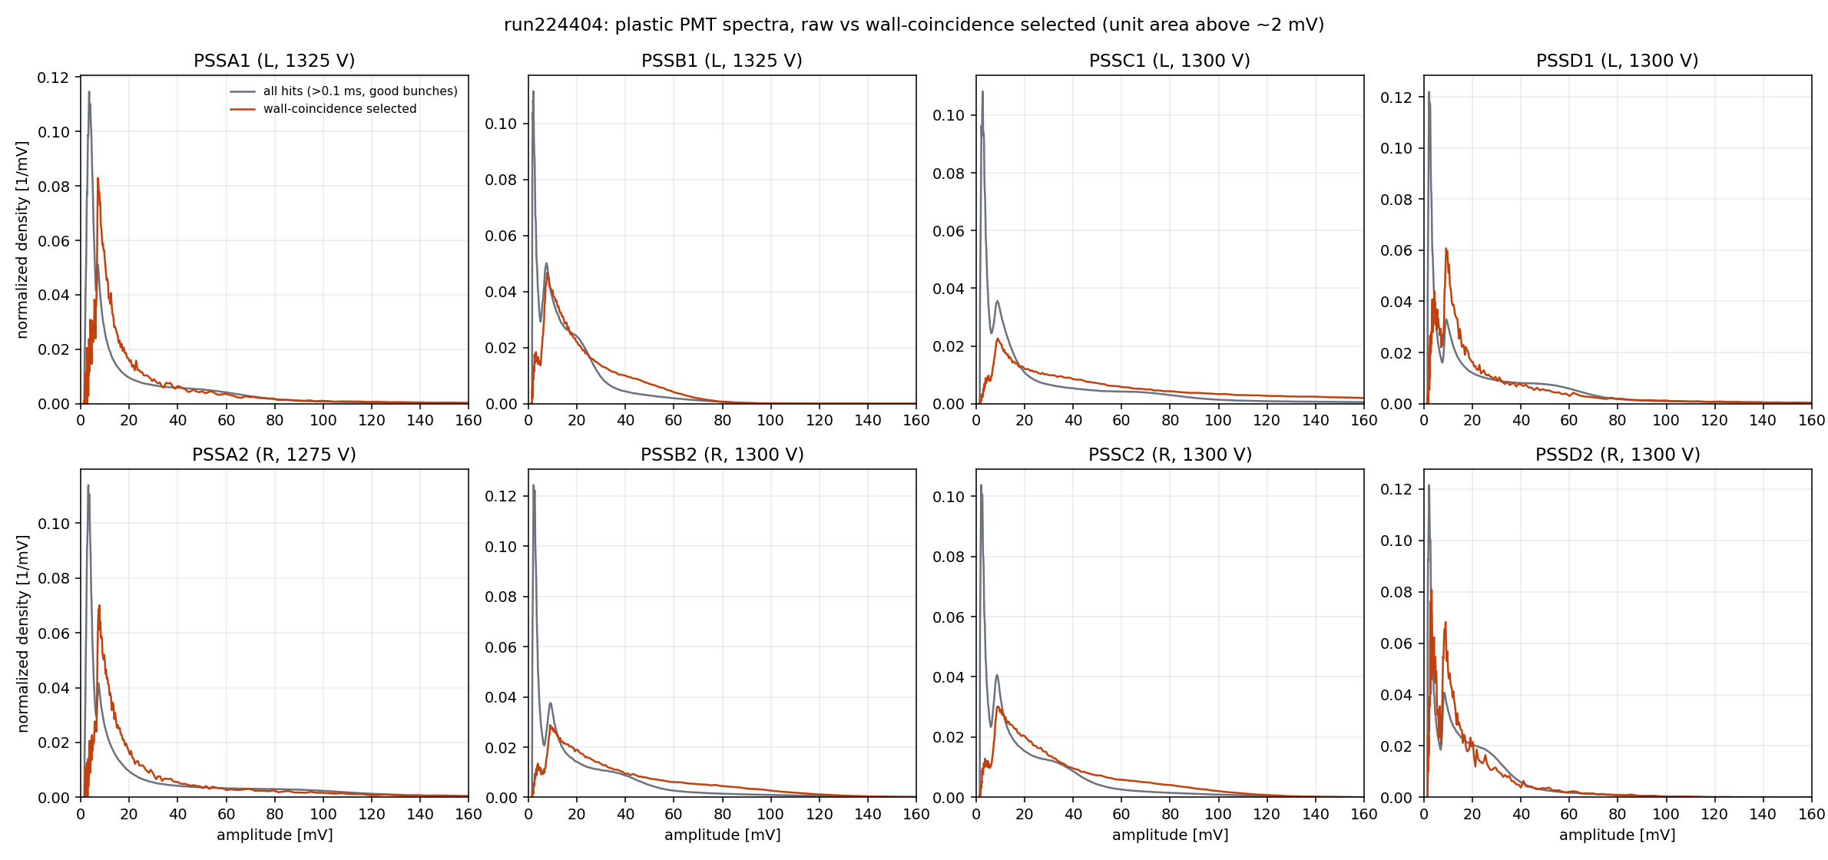
Raw vs coincidence-selected plastic spectra (per PMT)

Slide 11
Requests
READ OUT THE LIQUID SCINTILLATORS (behind the plastic on A/D): wall+LIQ coincidence requires passage through the plastic ⇒ true plastic MIP calibration. Only LIQA/LIQD cabled, no data
Plastic HV scan (2 points) → apply gain equalization
Cabling confirmations: top/bottom card assignment; which 4 of 20 wall bars unread; physical arm positions A–D; stack config per arm
DAQ follow-up on the SiPM-wall outage (bunches 643–2212)

Slide 12
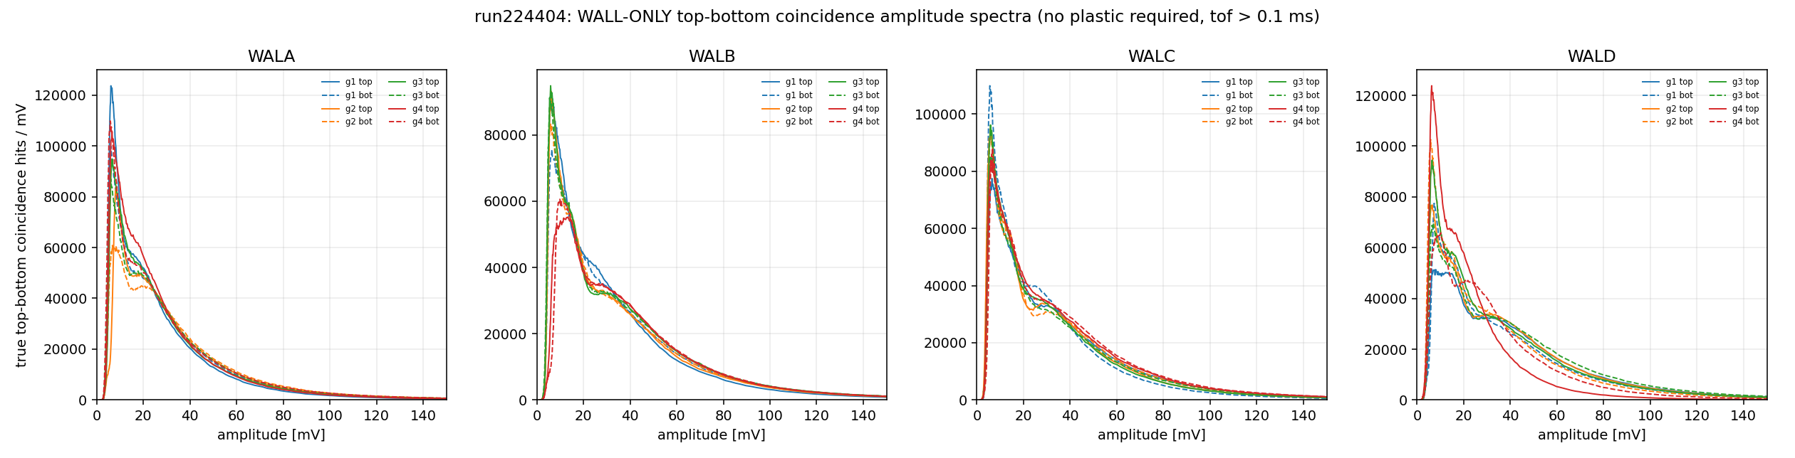
Backup: wall-only top–bottom coincidences
Top & bottom SiPMs read the SAME 4-bar group, so any real energy deposit (through-going MIP, stopping e±, or a gamma Compton-scattering in the bars) lights both ends in tight coincidence — this removes noise, not physics backgrounds. What it shows: SiPM response and gain are healthy on all four arms (MIP-scale bump 25–40 mV everywhere), and it provides an amplitude landmark for all 32 channels. What it cannot show: whether particles traverse onward to the back plastic — so the A/D coincidence deficit remains unattributed (plastic response, absorption between wall and plastic, or flux composition).

Slide 13
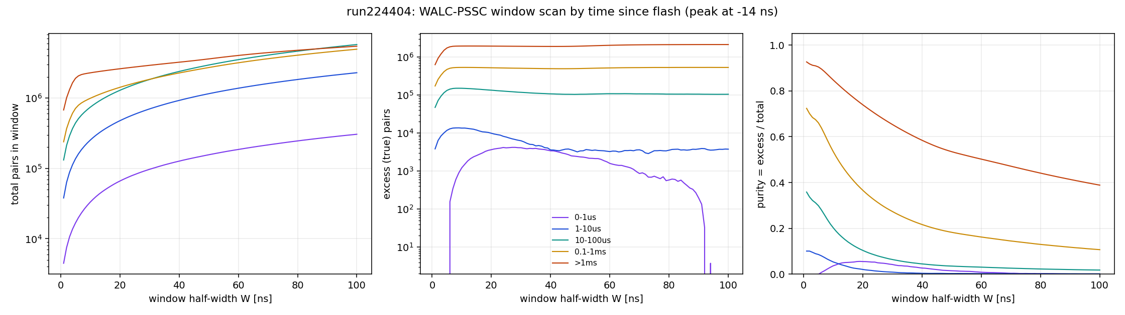
Backup: window scan & purity

Slide 14
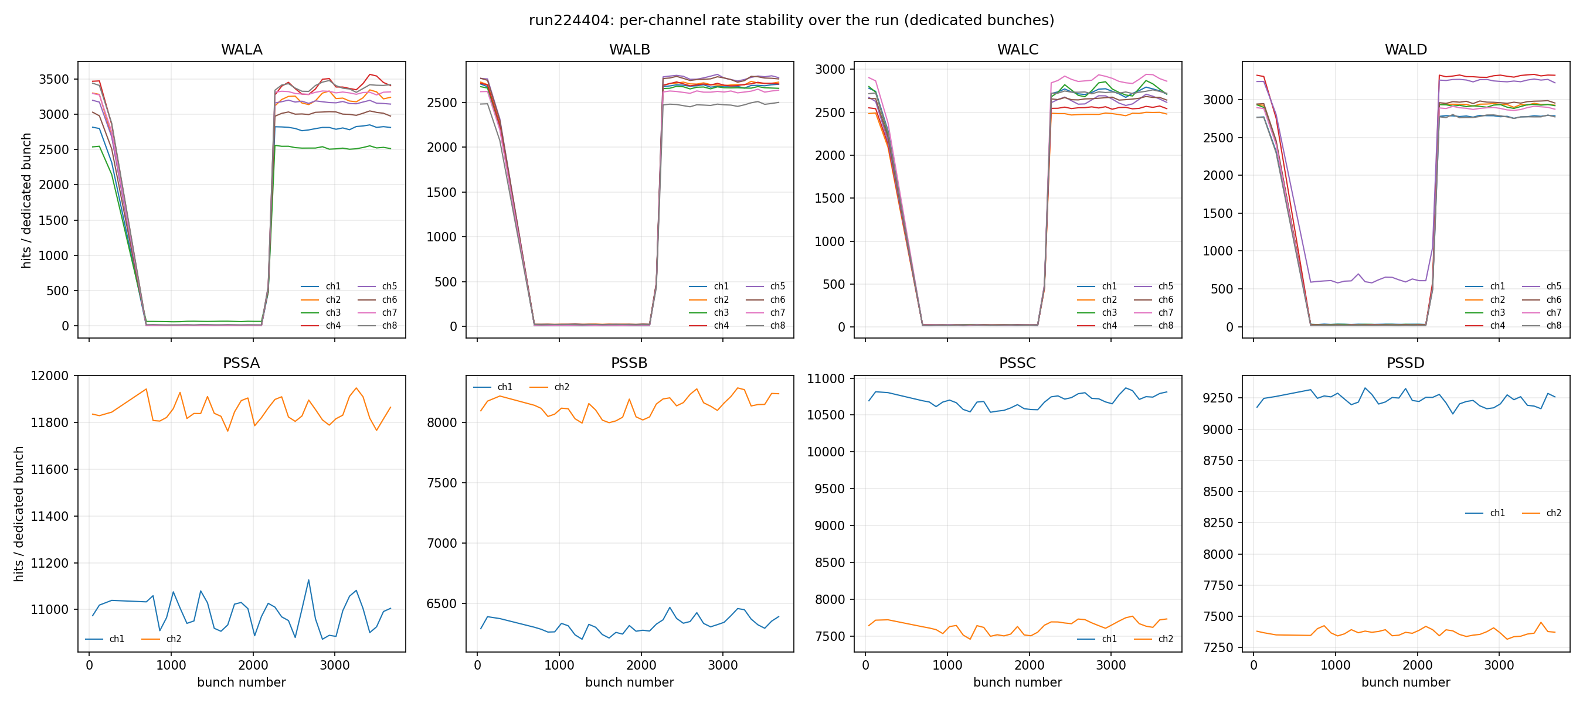
Backup: rate stability (wall outage)

