Slide 1
Angular Reaktiva frameworks för MVC

Slide 2
Dagens agenda
Översikt
JavaScript & TypeScript
Node Package Manager (npm)
Components
Bygg!
Services
Injectables
Bygg!
Modules
Bygg!
Directives
Bygg!
Webpack
Linting
Arkitektur

Slide 3
Angular
Vad är det och vad ska jag ha det till?

Slide 4
Data!

Slide 5
Routing
API Anrop
Arkitektur

Slide 6
Historia
AngularJS
Angular2
Angular

Slide 7
TypeScript
Superset av JavaScript

Slide 8
Compilera till JS (ES5)
let, const => var
Classer
Exempel: http://www.typescriptlang.org/play/

Slide 9
VERSION???
Just nu: 2.5

Slide 10
NpmJs
Hantera paket för din app
Laddar ner beroenden
Gör din app lättinstallerad
Försiktig!
Tips: Yarn

Slide 11
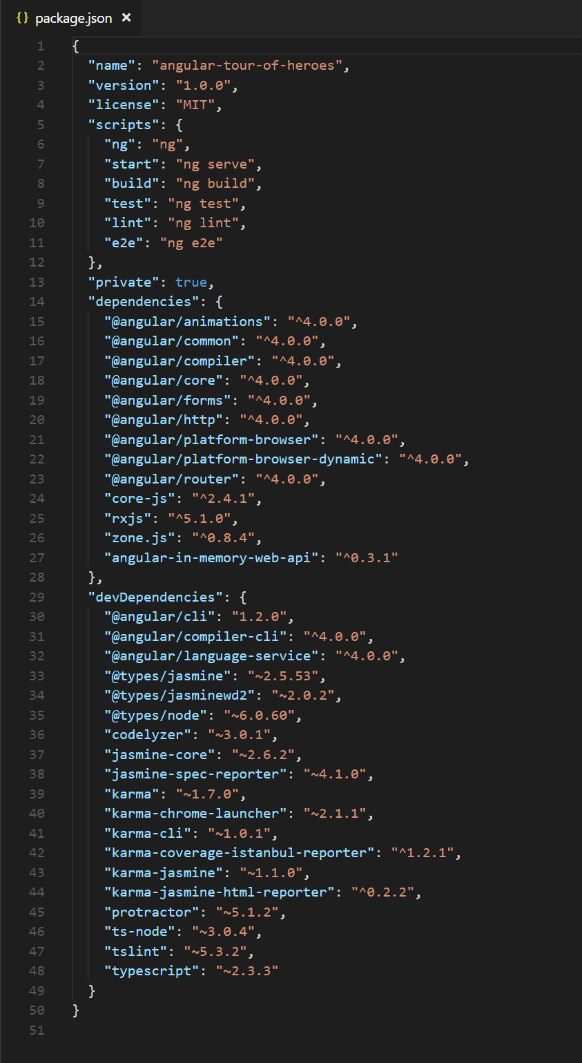
package.json

Slide 12
Fire up!
Git clone
Npm start
Npm install
Npm start

Slide 13
@Components
Import { } from …
selector
Html template
Class med vår logik!

Slide 14
Använd componenten
<min-komponent></min-komponent>

Slide 15
@Module (del 1)
Importera component(en) för att…
Declare(a) component(en)!
Nu borde vi se resultat

Slide 16
Decorators
Helps you explain to the app what to do
@Decorator()
class MinKlassComponent { }

Slide 17
Services
Bra för affärslogik
Kan användas av fler än en komponent
En komponent kan använda flera services

Slide 18
@Injectable
Låter oss använda klasser (services) i komponenter, utan att de direkt har refererats av vyn

Slide 19
Inject
constructor(heroService: HeroService) {

Slide 20
En duktig programerare skriver kod som fungerar. En mästare skriver kod duktiga programerare förstår.

Slide 21
Big concept
Bring the attention of your audience over a key concept using icons or illustrations

Slide 22
You can also split your content
White
Is the color of milk and fresh snow, the color produced by the combination of all the colors of the visible spectrum.
Black
Is the color of coal, ebony, and of outer space. It is the darkest color, the result of the absence of or complete absorption of light.

Slide 23
In two or three columns
Yellow
Is the color of gold, butter and ripe lemons. In the spectrum of visible light, yellow is found between green and orange.
Blue
Is the colour of the clear sky and the deep sea. It is located between violet and green on the optical spectrum.
Red
Is the color of blood, and because of this it has historically been associated with sacrifice, danger and courage.

Slide 24
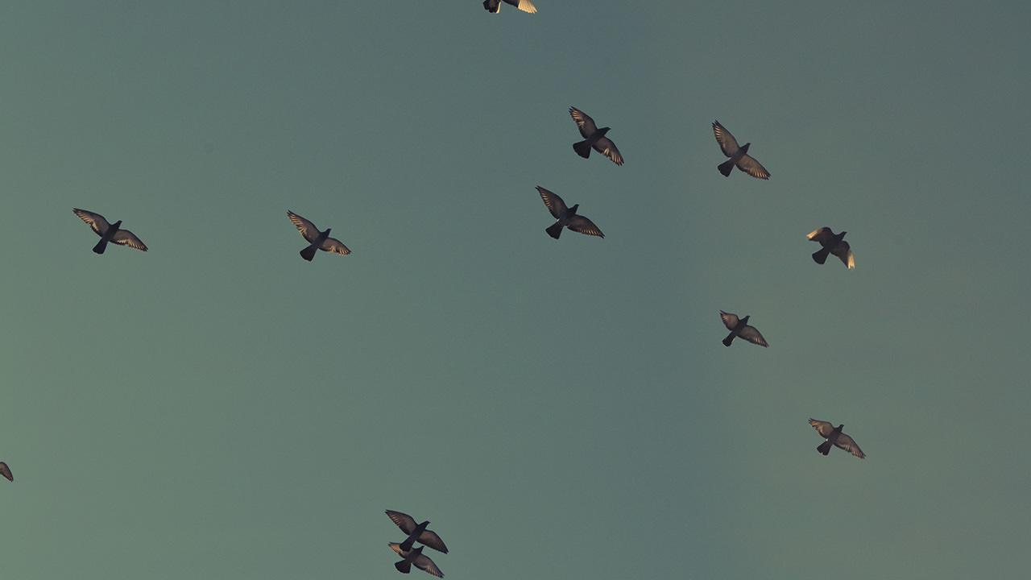
A picture is worth a thousand words
A complex idea can be conveyed with just a single still image, namely making it possible to absorb large amounts of data quickly.

Slide 25
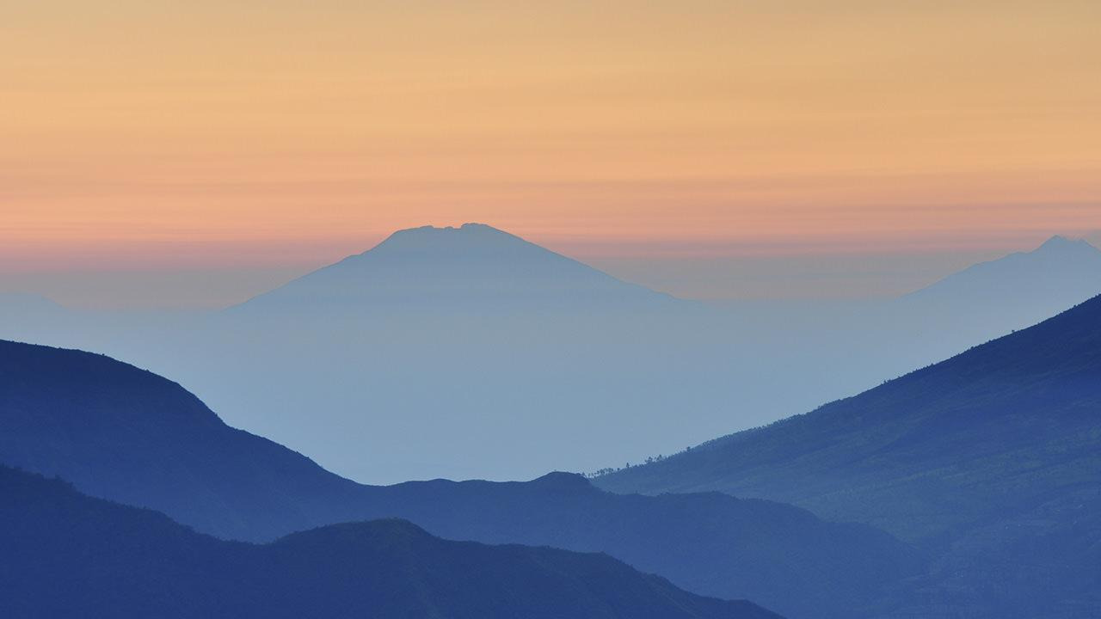
Want big impact?
Use big image.

Slide 26
Use charts to explain your ideas
White
Gray
Black

Slide 27
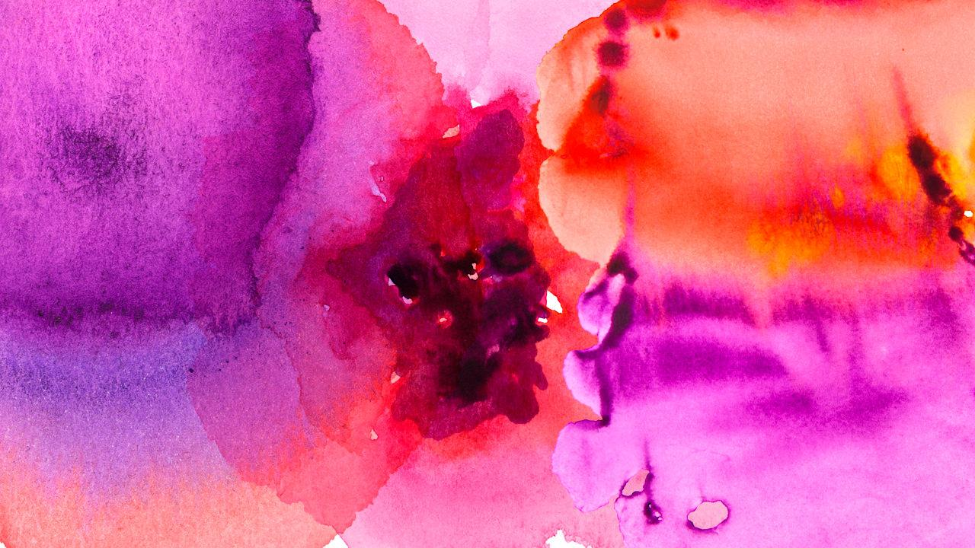
And tables to compare data
 | A | B | C
Yellow | 10 | 20 | 7
Blue | 30 | 15 | 10
Orange | 5 | 24 | 16

Slide 28
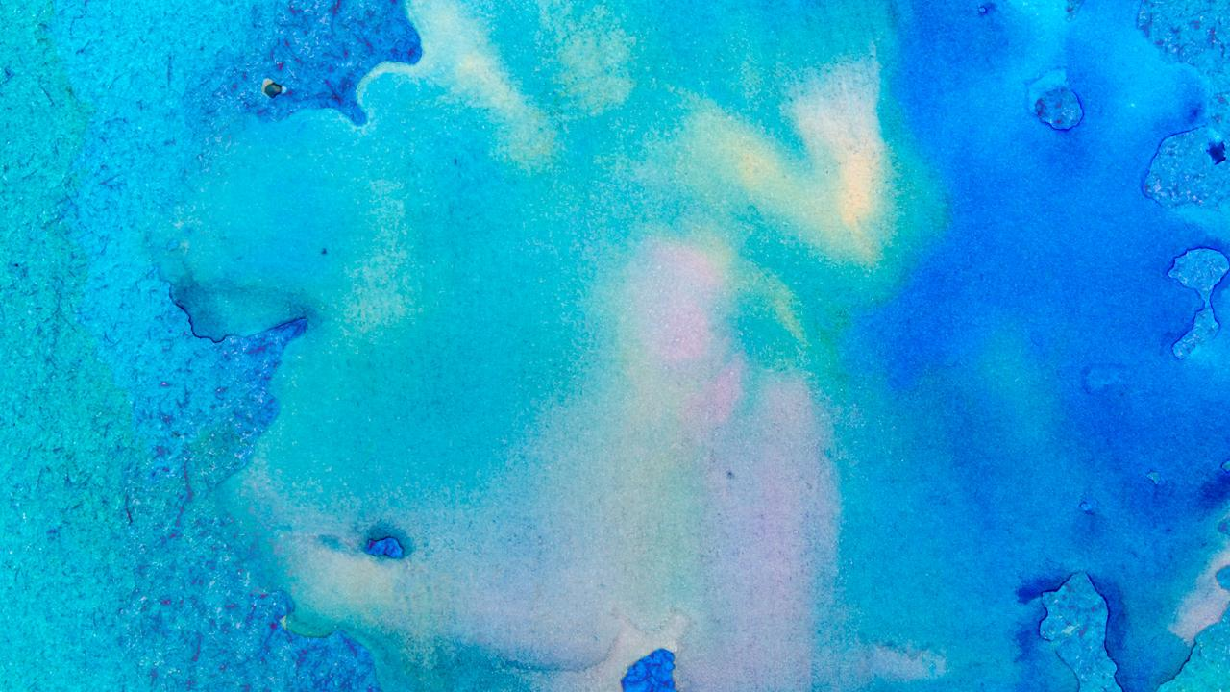
Maps
our office

Slide 29
89,526,124
Whoa! That’s a big number, aren’t you proud?

Slide 30
Let’s review some concepts
Yellow
Is the color of gold, butter and ripe lemons. In the spectrum of visible light, yellow is found between green and orange.
Blue
Is the colour of the clear sky and the deep sea. It is located between violet and green on the optical spectrum.
Red
Is the color of blood, and because of this it has historically been associated with sacrifice, danger and courage.
Yellow
Is the color of gold, butter and ripe lemons. In the spectrum of visible light, yellow is found between green and orange.
Blue
Is the colour of the clear sky and the deep sea. It is located between violet and green on the optical spectrum.
Red
Is the color of blood, and because of this it has historically been associated with sacrifice, danger and courage.

Slide 31
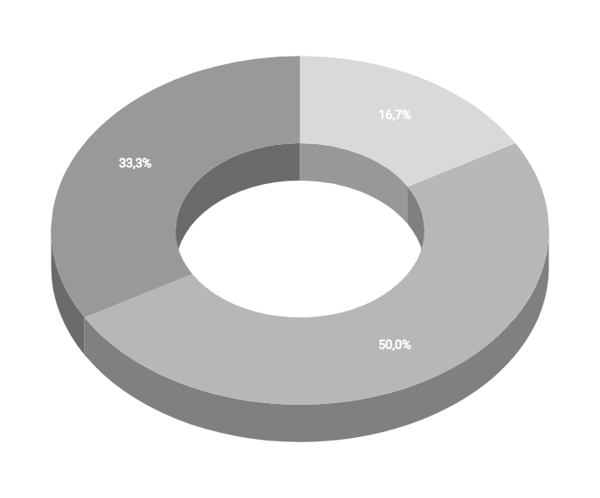
You can insert graphs from Google Sheets

Slide 32
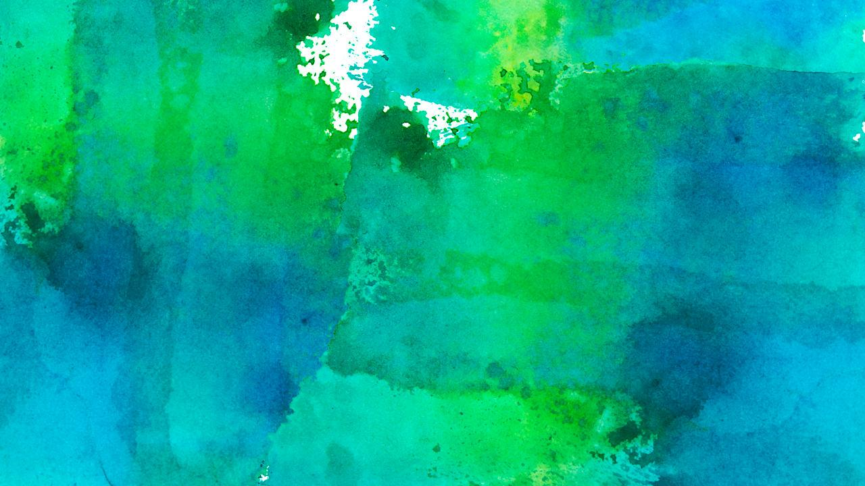
Android project
Show and explain your web, app or software projects using these gadget templates.
Place your screenshot here

Slide 33
iPhone project
Show and explain your web, app or software projects using these gadget templates.
Place your screenshot here

Slide 34
Tablet project
Show and explain your web, app or software projects using these gadget templates.
Place your screenshot here

Slide 35
Desktop project
Show and explain your web, app or software projects using these gadget templates.
Place your screenshot here

Slide 36
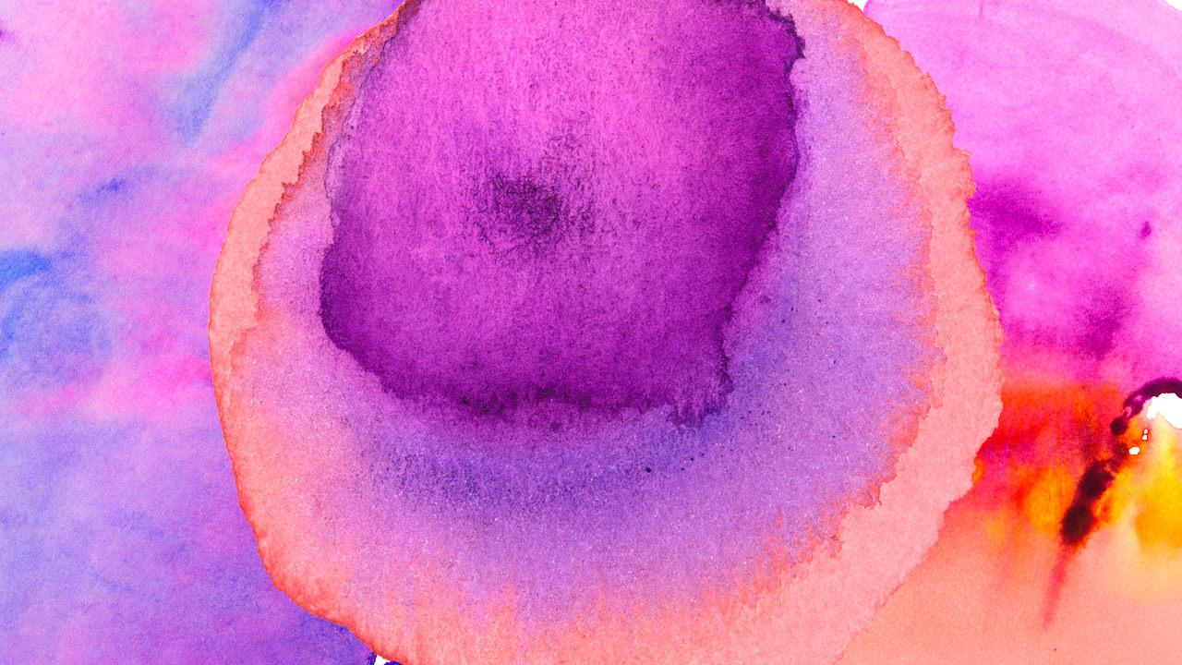
Thanks!
Any questions?
You can find me at:
@username
user@mail.me

Slide 37
Credits
Special thanks to all the people who made and released these awesome resources for free:
Presentation template by SlidesCarnival
Photographs by Unsplash
Watercolor textures by GraphicBurguer

Slide 38
Presentation design
This presentation uses the following typographies and colors:
Titles: Lato Thin
Body copy: Lato Light
You can download the fonts on this page:
http://www.latofonts.com/lato-free-fonts/
You don’t need to keep this slide in your presentation. It’s only here to serve you as a design guide if you need to create new slides or download the fonts to edit the presentation in PowerPoint®

Slide 39
SlidesCarnival icons are editable shapes.
This means that you can:
Resize them without losing quality.
Change fill color and opacity.
Isn’t that nice? :)
Examples:

Slide 40
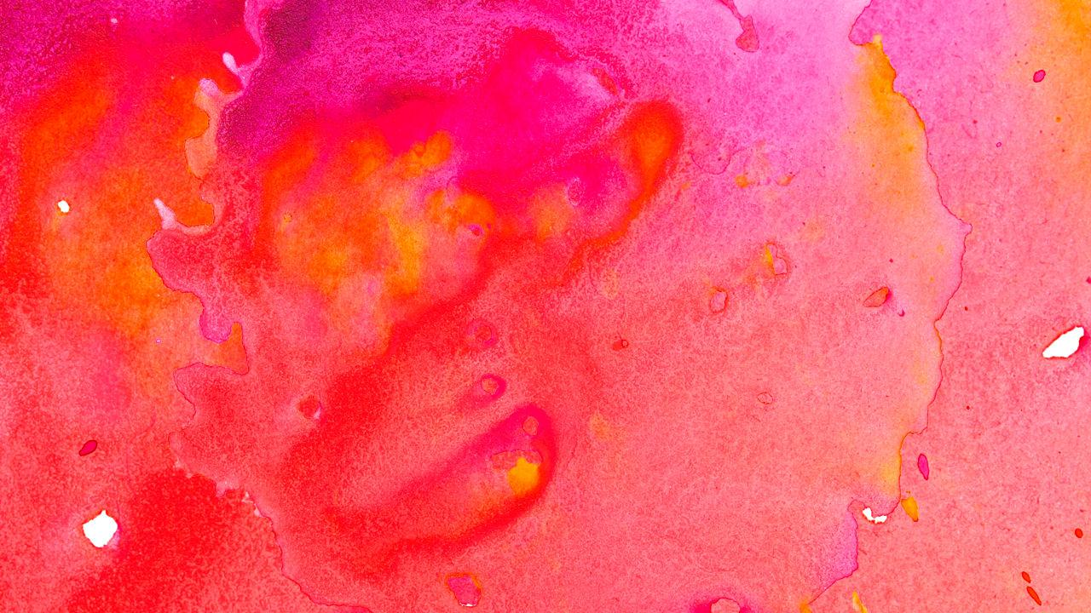
😉
Now you can use any emoji as an icon!
And of course it resizes without losing quality and you can change the color.
How? Follow Google instructions https://twitter.com/googledocs/status/730087240156643328
✋👆👉👍👤👦👧👨👩👪💃🏃💑❤😂😉😋😒😭👶😸🐟🍒🍔💣📌📖🔨🎃🎈🎨🏈🏰🌏🔌🔑 and many more...

