Slide 1
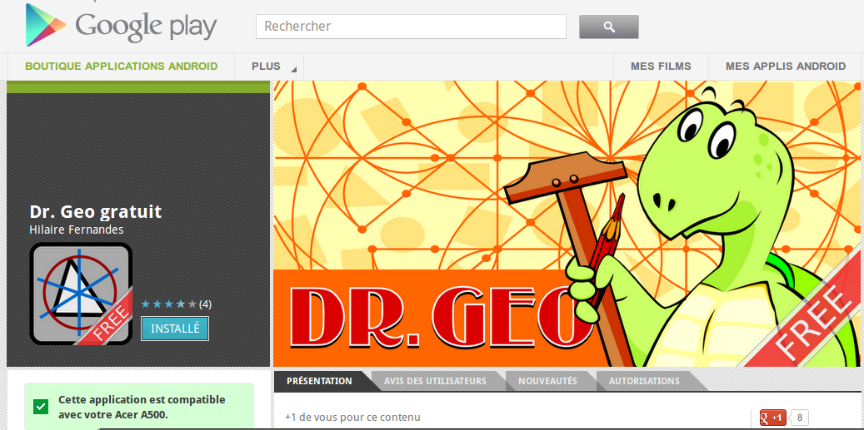
Dr. Geo

Slide 2

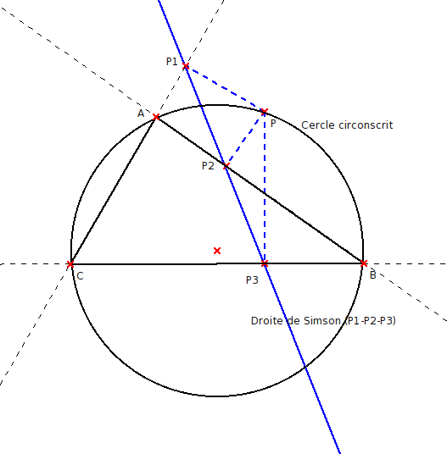
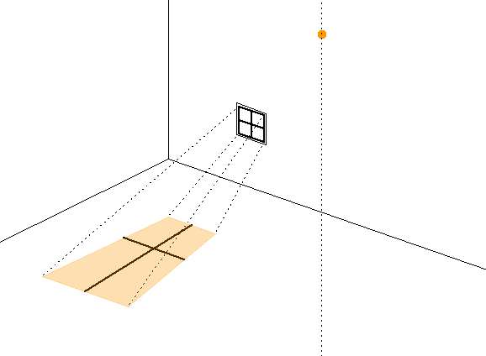
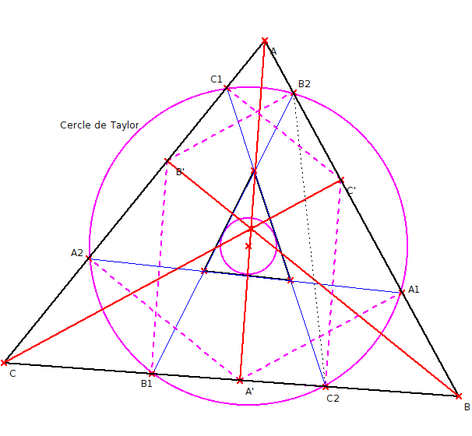
Interactive
Geometry

Slide 3
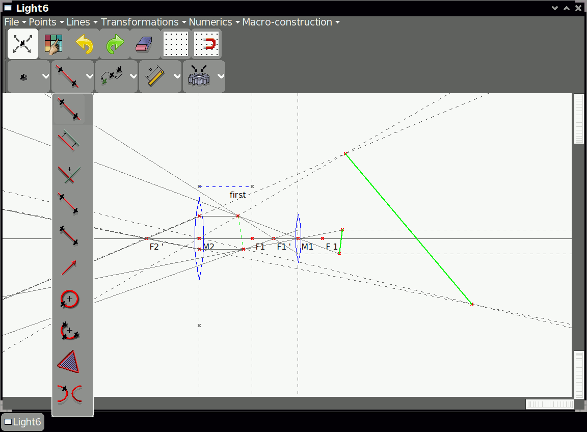
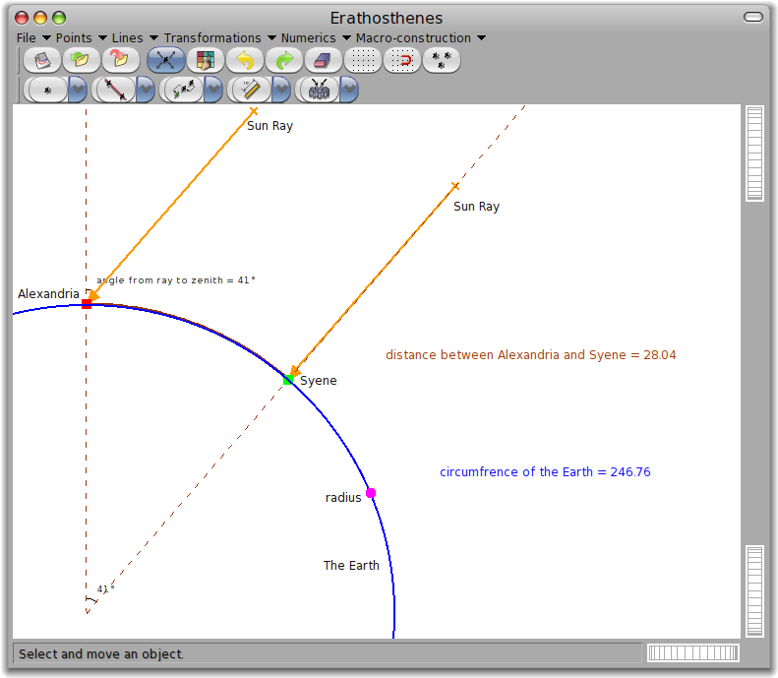
Develop once with Pharo
Deploy everywhere*
* with SqueakVM : GNU/Linux, Mac OSX, Windows, XO Sugar, Android, iPad

