Slide 1

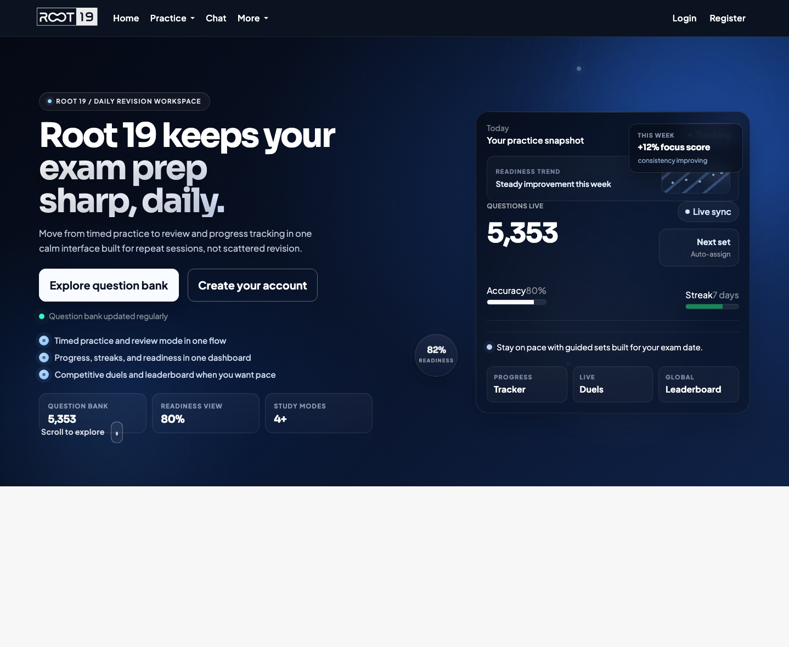
ROOT 19 / FEATURE SHOWCASE
Homepage + product framing
Study, compete, review, and operate from one revision workspace.
This deck maps the real feature surface of the Django app in this repo: learner workflows, competition, community tooling, external APIs, and the staff controls that keep the system running.
Question bank
Practice studio
Duels + leaderboard
API + staff ops
Community chat
Learner flow
Community
Operations
6
3
8+
bank, practice, saved, stats, progress, auth
chat, pings, question sharing
moderation, bugs, API keys, themes
ROOT 19 / Feature Showcase
01

Slide 2
PLATFORM MAP
All major features at a glance
Root 19 is not just a question page. It is a full revision surface with learner, competitive, community, integration, and staff layers.
1
Discover
2
Practice
3
Review
4
Track
Session + subtopic filters
Answer-first question UI
Bookmarks + stars feed Saved Studio
Stats dashboard, streaks, avg time
Random fallback when filters are blank
Timer, progress, reveal, report, share
Saved queue stays in the same answer flow
Per-session progress checklists
5
Compete
6
Connect
7
Build
8
Operate
Party-code duels on fixed question sets
Community chat, replies, image attachments
Question APIs with API keys
Question moderation, bug triage, password reset, chat lock
Subtopic import + image/CDN fields
Leaderboard plus weekly champion theme rewards
Question sharing and user pings
Theme access, notices, API key management
ROOT 19 / Feature Showcase
02

Slide 3
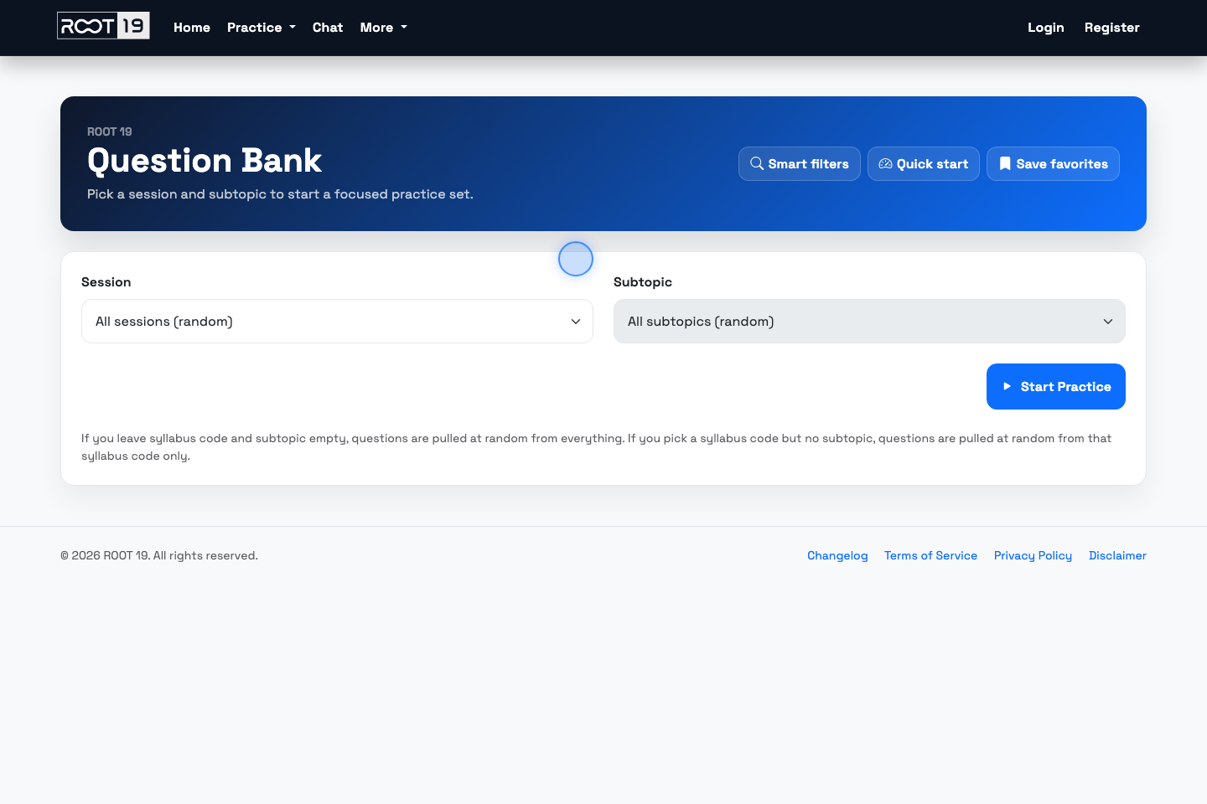
QUESTION SELECTION
Question Bank turns the archive into a fast entry point.
The page is intentionally simple: choose a session, fetch matching subtopics dynamically, and launch straight into a filtered practice set.
What this page does
Loads session options from the live question table and labels them by subject.
Calls `/get-subtopics/` only after a session is selected, so the second filter stays relevant.
Supports random behavior at two levels: everything, or random within one chosen session.
Can surface a staff-controlled notice banner directly above the filters.
/question-bank/ -> /practice-questions/?session_code=...&subtopic=...
ROOT 19 / Feature Showcase
03

Slide 4
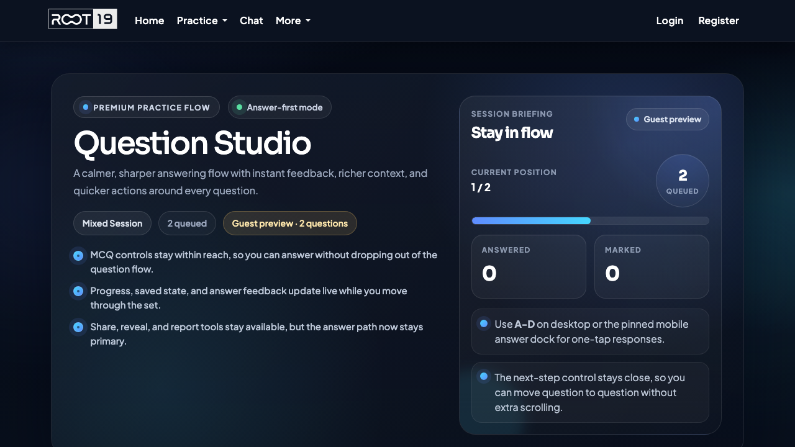
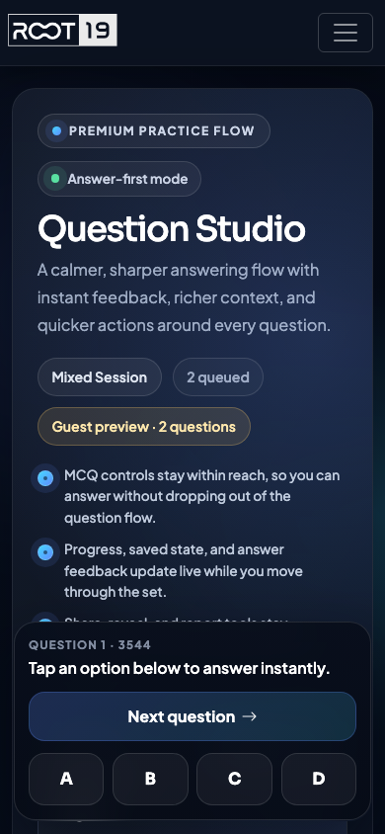
PRACTICE STUDIO
The practice flow is the core product surface.
It removes clutter, keeps answering front and center, and leaves the support actions close by instead of burying them in separate pages.
Mobile dock
Behaviors
Guest users get a two-question preview before login prompts appear.
Answer feedback is instant and stays visible while the learner moves forward.
Actions include star, save, reveal, send to chat, and report answer issues.
Keyboard support mirrors the touch controls for faster desktop drilling.
Queue gate
2
guest preview questions
ROOT 19 / Feature Showcase
04

Slide 5
RETENTION + PROGRESS
Saved review, stats, checklists, and streaks keep learners coming back.
The product stores interaction state per user and per question, then reuses it across dashboards instead of trapping it inside one page.
Personal dashboard
Saved Studio
24 queued
Focus zones
Top subtopics by attempts show where the learner is spending time and how accurate they are there.
Attempts
Accuracy
Avg
Streak
Starred and bookmarked questions reappear in the same answer-first layout for focused revision.
184
82%
46s
7d
all time
correct out of solved
per attempt
5 solves/day threshold
Motion
Question 3544
Star
Save
Motion
Electric fields
Progress checklist
625 / Physics
Question 3545
Star
Save
Waves
Motion
completed
Thermal physics
Electric fields
completed
Thermal physics
Question 3546
Star
Save
Thermal physics
in progress
Electric fields
Recent rows also preserve whether the question was correct, solved, bookmarked, or starred.
Waves
in progress
recent attempts
ROOT 19 / Feature Showcase
05

Slide 6
COMPETITION + MOTIVATION
Duels and leaderboards add pace without breaking the study model.
Competition is implemented as a parallel surface, not a separate product: the same question archive powers it, and the same users earn the recognition.
Duels hub
party codes
Leaderboard + champion themes
Top problem solvers can see themselves in the global table, while the weekly best accuracy performer is auto-awarded champion theme access.
Create duel
Match rules
Pick a question scope, choose 1-20 questions, then generate a code for an opponent.
Both players get the same ordered questions.
Status polling moves the duel from pending to active.
#1
Areeba
#2
Winner = most correct; time is the tie-break when both submit.
#3
625 / Physics
5 questions
214
Ibrahim
Nandini
solved
201
F3G9KD
196
solved
solved
Weekly top accuracy unlocks champion mode:
Gold
Emerald
Sapphire
ROOT 19 / Feature Showcase
06

Slide 7
COMMUNITY + SUPPORT
Chat, pings, question sharing, and bug reporting close the loop.
Learners can ask for help inside the product instead of leaving it, while support tools make it easy to report friction when something breaks.
Community chat
notifications
Report a bug
Structured form collects title, description, reproduction steps, severity, contact email, and an optional screenshot upload.
Areeba
Reply
Ping
Can someone sanity-check the motion question I just shared?
User help paths
Chat governance
Ibrahim
I think the answer is B because the acceleration stays constant.
Password reset requests can be queued for staff approval.
Staff can globally lock chat behind a password gate for non-admin users when moderation needs tighten.
Change password is available from the signed-in menu.
Nandini
Image attached
Pinged the group and attached the screenshot.
Legal and changelog pages round out the support surface.
chat lock
staff delete controls
question shared from practice
ROOT 19 / Feature Showcase
07

Slide 8
API + INTEGRATIONS
A documented API lets other sites consume the question archive.
The app exposes question listing, question detail, and subtopic import endpoints behind managed API keys and multiple auth header styles.
Sample request
Filters + response shape
Key management + image delivery
1 curl -H "X-API-Key: r19_xxx" \ 2 "https://app.root19.com/api/questions/?subject=Physics&session=May/June&limit=10&include_image_base64=0"
subject / session_code
Staff can create limited or unlimited keys, track usage, reset counts, and regenerate compromised credentials.
session / year / paper / variant
subtopic / question_type / answer
q search / limit / offset / order_by / sort
include_image_base64 switch
limited keys
usage count
X-API-Key header
Bearer token
URL api_key
active / inactive
Exposed endpoints
Question images can also be served from Supabase Storage, with `image_url` and `image_link` helping clients avoid large inline payloads.
GET /api/questions/ -> paginated archive search with normalized helper fields
Normalized helper fields also include `image_link`, `image_src`, `question`, and `subject`.
GET /api/questions/<question_id>/ and GET /api/subtopics/ -> detail + import workflows
ROOT 19 / Feature Showcase
08

Slide 9
STAFF CONTROL CENTER
Operational tools are unusually broad for a study app.
The admin surface covers content quality, support queues, theming access, chat governance, and external integrations.
Question tester
Question reports
Bug reports
Password requests
Search by ID or extracted text, preview the image, and validate submitted answers.
Review answer disputes, compare suggested vs live answers, and resolve moderation states.
Triage severity-tagged reports, screenshots, statuses, and reopen/close flows.
Approve reset requests and jump directly into the reset tool for the target email.
Theme access
Question notice
API key panel
Chat lock
Grant or revoke champion themes and preview who receives weekly recognition.
Publish a banner on the question bank when there is a service or content notice.
Generate, regenerate, deactivate, or reset usage on external integration keys.
Gate community chat behind a staff-controlled password without removing the feature entirely.
The result is a codebase with both learner-facing polish and production-minded guardrails.
moderation
support
governance
ops
ROOT 19 / Feature Showcase
09

Slide 10
SUMMARY
Root 19 already behaves like a full revision platform.
Its strongest story is the continuity between surfaces: discover questions, practice in a focused screen, save what matters, track performance, compete with others, and back it all with real operational tooling.
Learner flow
Social + pace
Question Bank, Practice Studio, Saved Studio, progress checklists, stats dashboards, streaks.
Community chat, question sharing, user pings, duels, leaderboard, champion themes.
Developer surface
Operational maturity
Managed API keys, question endpoints, subtopic import, normalized image fields, CDN-friendly responses.
Question moderation, bug triage, password reset workflow, notices, theme access, chat locking.
Showcase takeaway: the repo supports a polished presentation for students, plus the backstage tooling needed to run it seriously.
ROOT 19 / Feature Showcase
10

