Slide 1
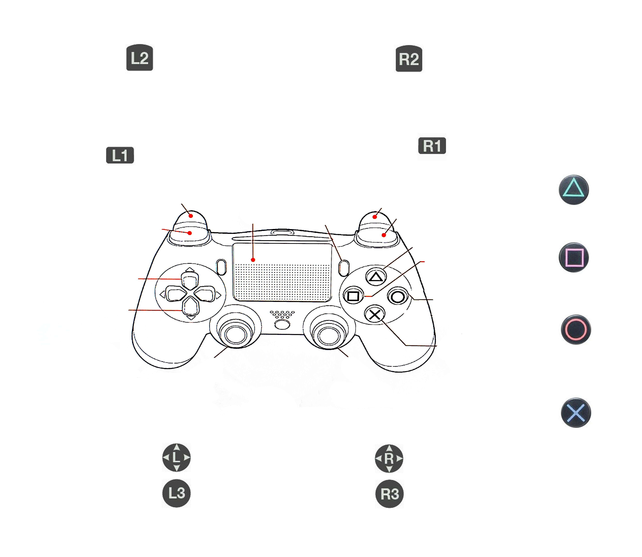
Passive
Stand
Lock State
Trot
Crawl
Pronk
Squiggle
X-Y control/
Roll-Pitch Control
Z-Control/
Roll-Pitch Control

