Slide 1
Variational Inference to Helmoholtz Machines
Varun Sharma
27/08/2024
Gen AI Journal Club

Slide 2
Outline of Talk
Recap of Variational Inference
Learning a generative model for a complex unknown observation
Helmholtz Machine
Recognition vs generative models
Importance of (Variational Free) Energy in variational inference

Slide 3
Machine Learning as Probabilistic Modeling
Probabilistic Modeling:
model of data generative process using probability distributions
goal is to infer the hidden structure (latent variables z) from observed data x.
Joint Distribution:
p(x,z) describes how both observed data x and latent variables z are related.
Posterior Distribution:
ultimate goal is to compute posterior distribution p(z∣x)
tells us about the latent variables given the observed data.
Challenge:
p(z∣x) is often intractable due to high-dimensional integrals
leads us to methods like Markov Chain Monte Carlo (MCMC) and Variational Inference (VI)

Slide 4
How to think about fitting a function: from deterministic to probabilistic models
say you have a training set X = [x₁, x₂,..,xₘ]ᵗ of m examples.
Deterministic machine learning approach:
fit a function f_{θ}(X) that by minimizing a loss function wrt to θ [i.e. moving through parameter/function space]
we minimise a loss ℒ(θ, X) = ln p(X| θ) to find one specific solution θ
Probabilistic (Bayesian inference) machine learning approach:
find a way to determine p(θ|X): the posterior distribution of the parameters θ of an underlying generative model, given the training set X
“Given the observed training samples (X) which parameters (θ) are most likely to have generated those samples X”
Key idea 1: the training process is fundamentally following a path on a manifold of parameters in a subset of function space (specified by the architecture of the model)
Key idea 2: you can think of a probability distribution (likelihood) over the space of parameters that would have generated our training samples → ‘uncertainty’ about the generating parameters

Slide 5
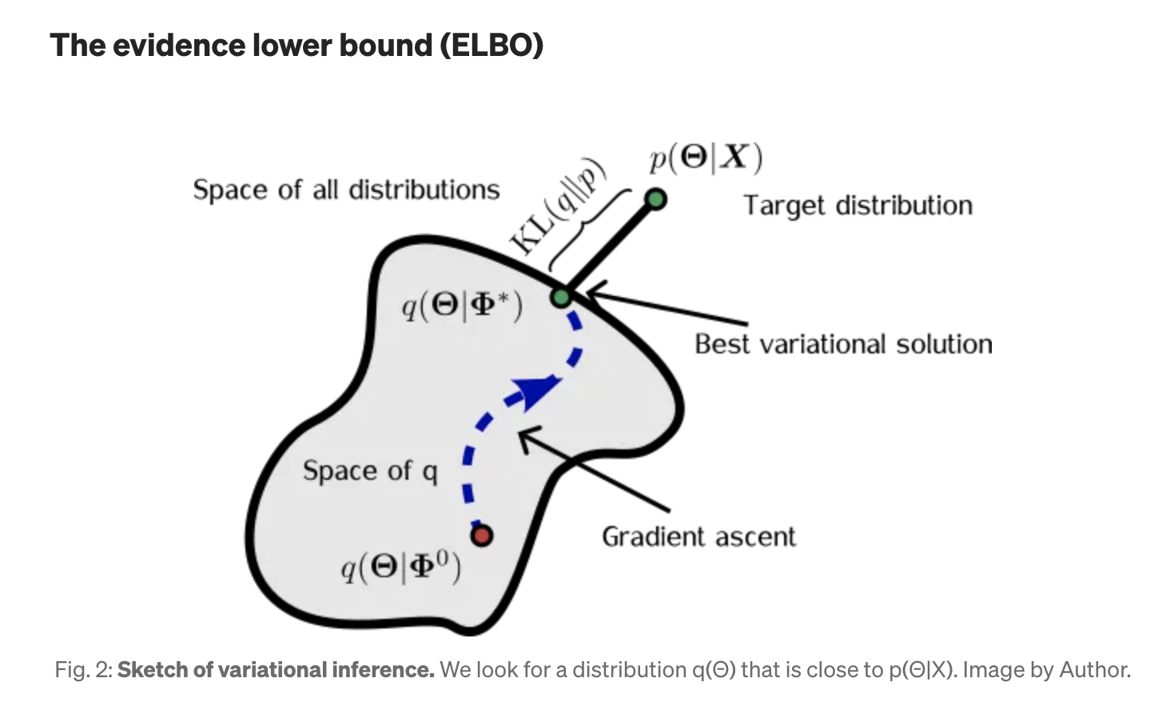
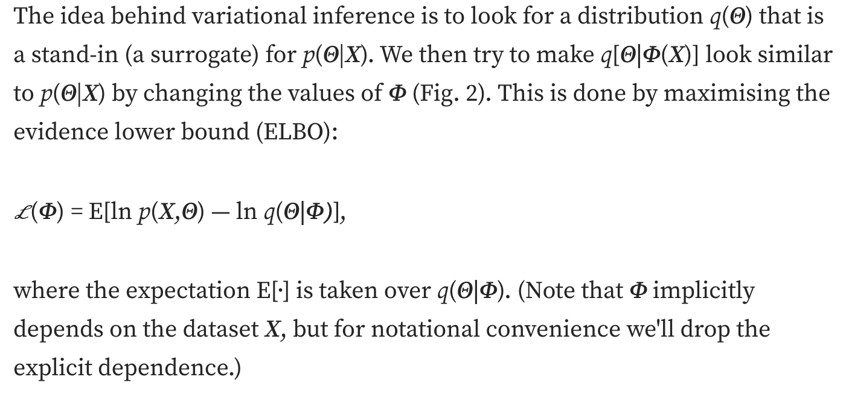
Variational Inference…an intuition

Slide 6
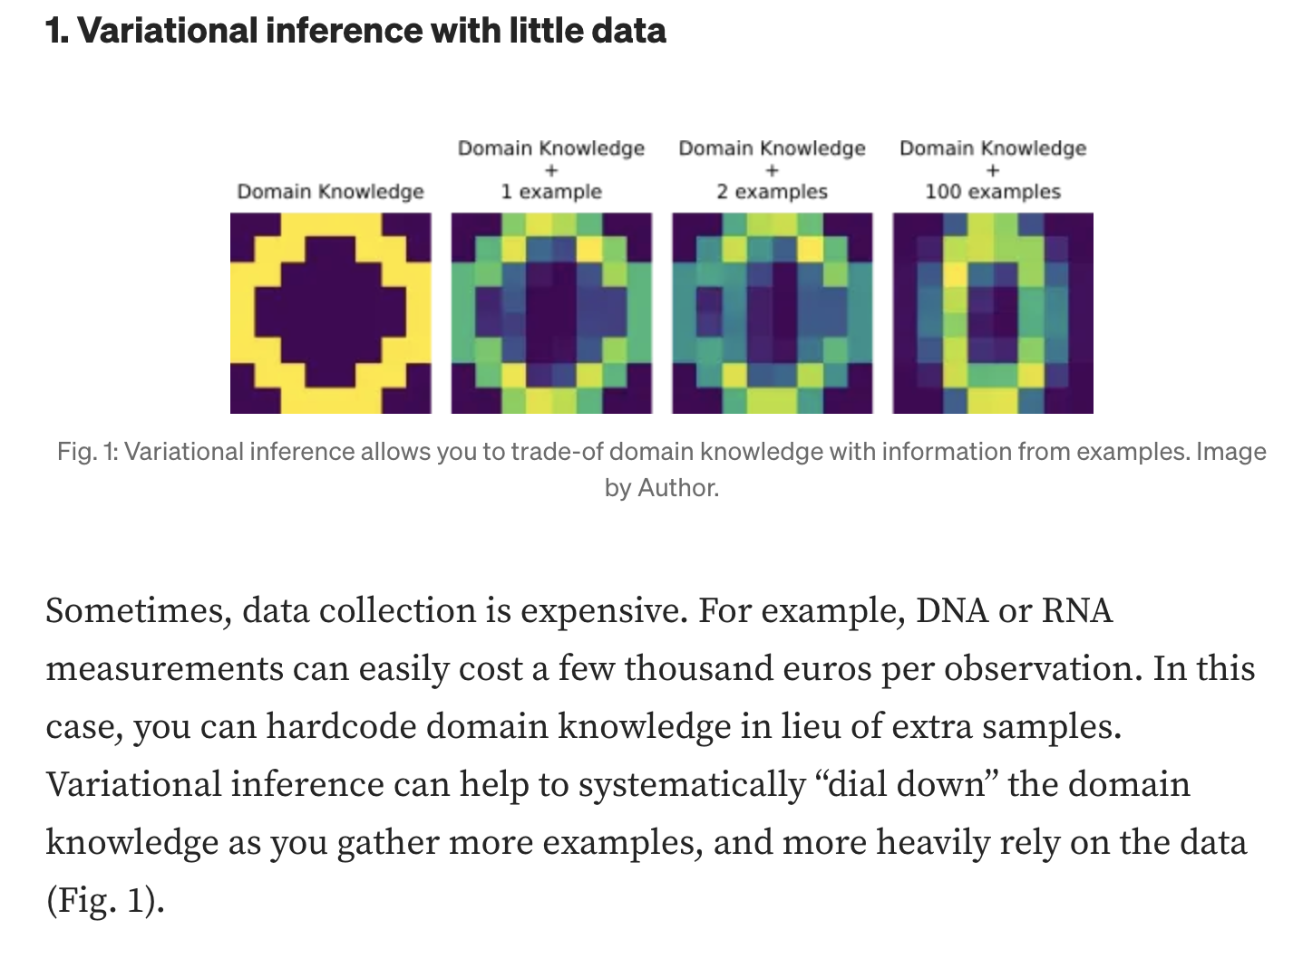
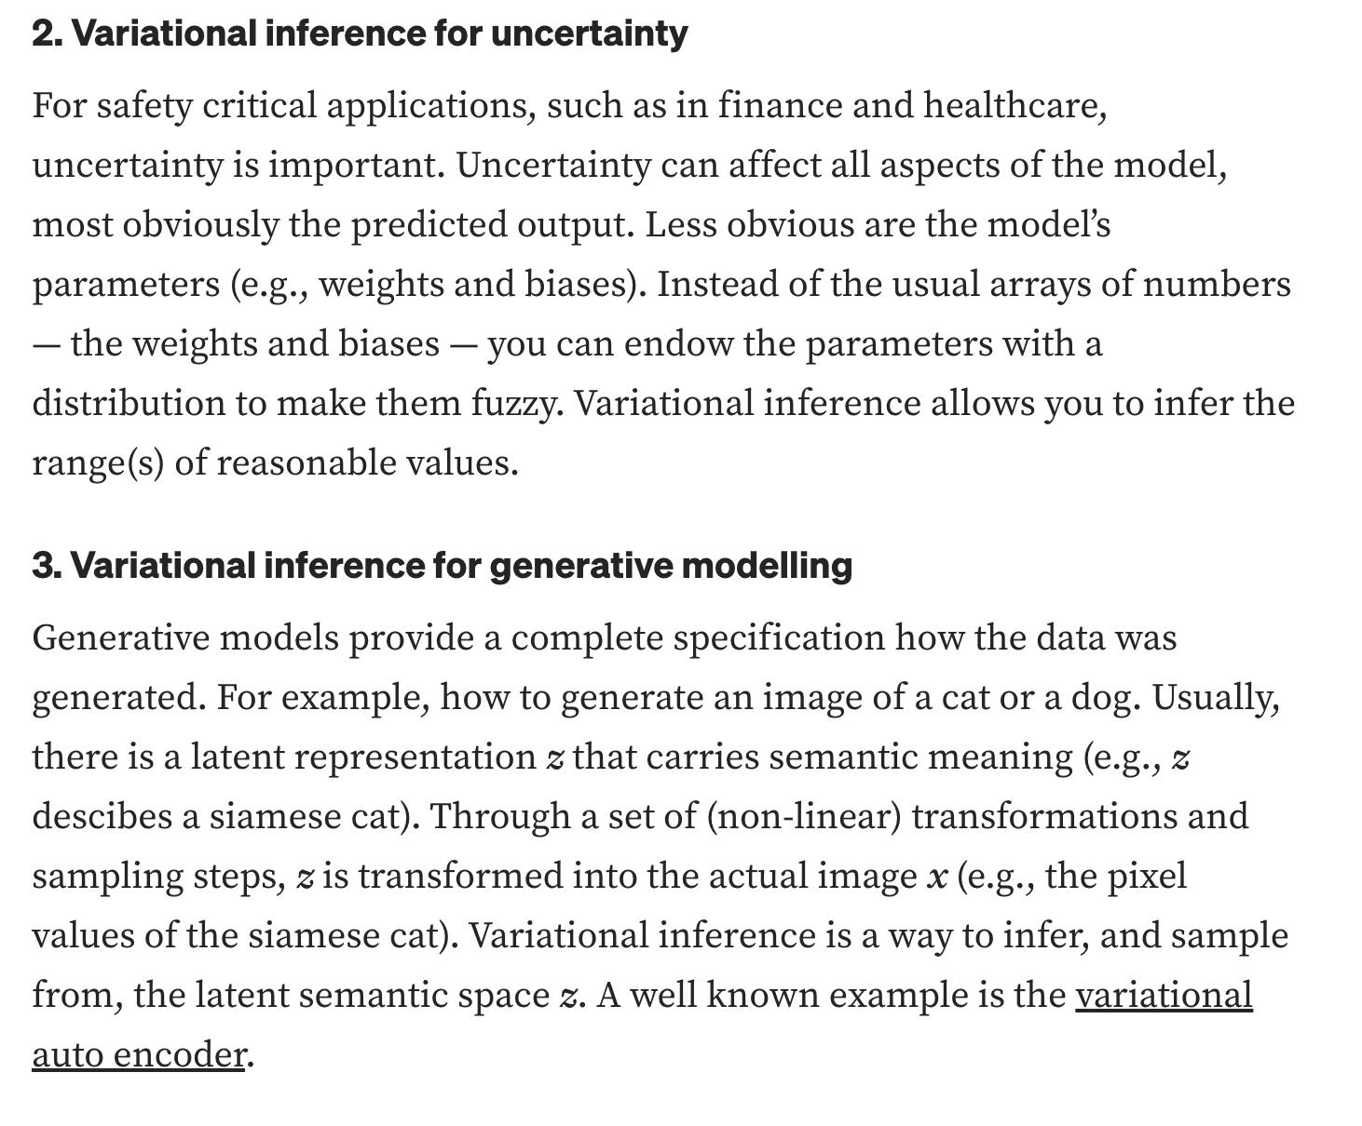
3 key advantages of Variational Inference (VI)

Slide 7
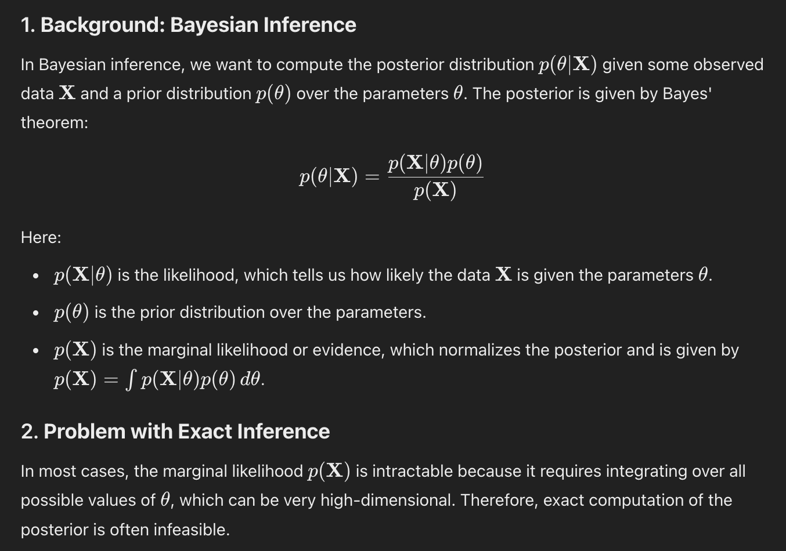
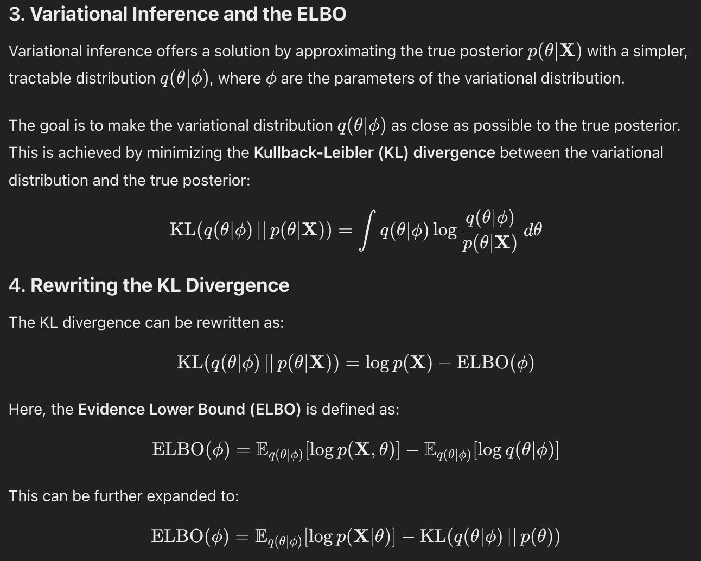
ELBO (evidence lower bound)

Slide 8
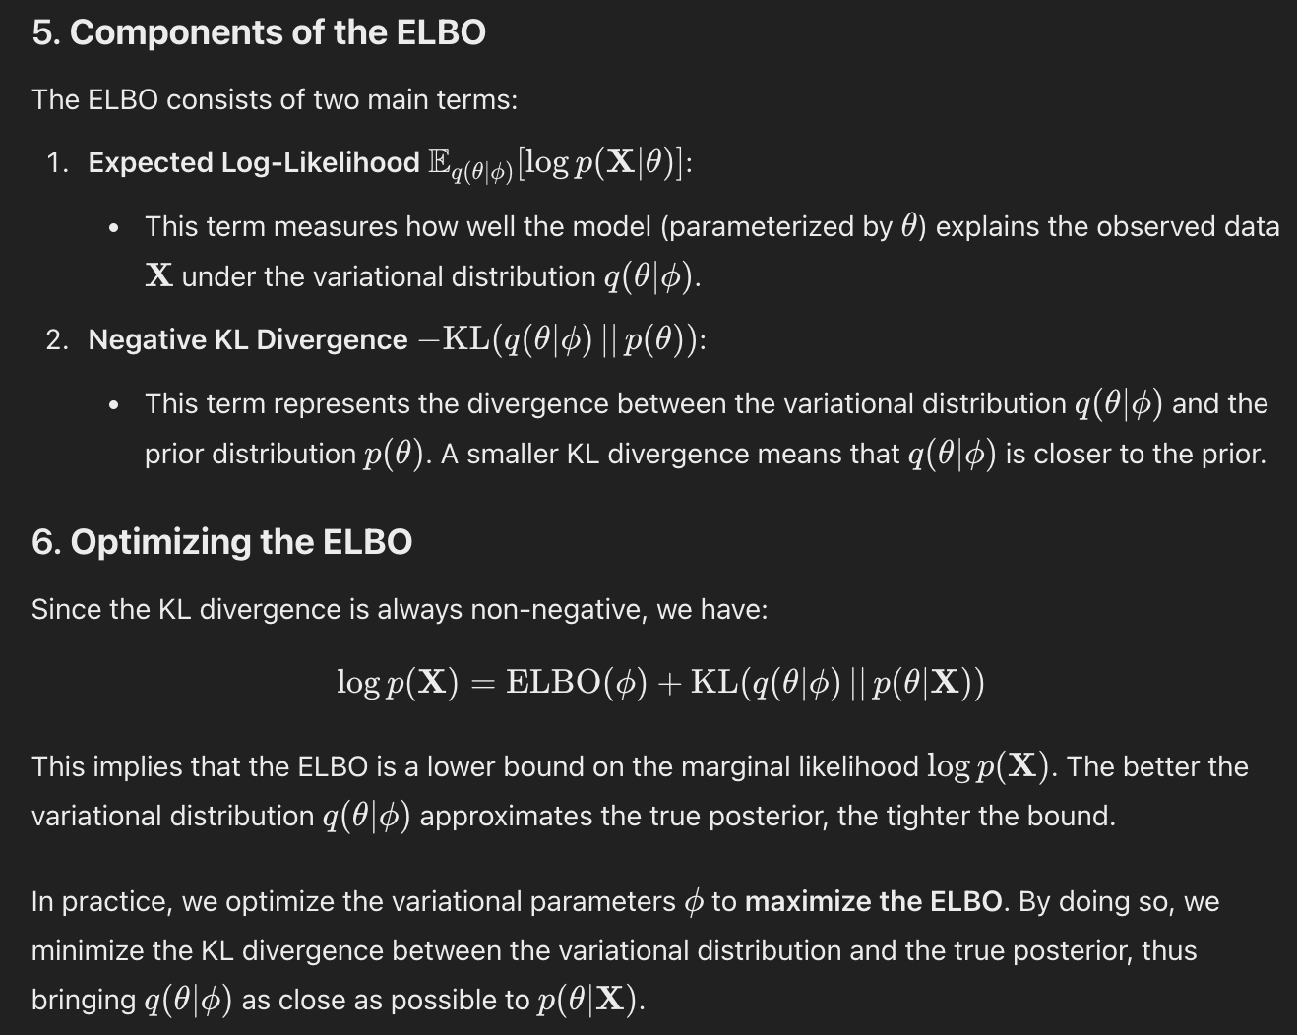
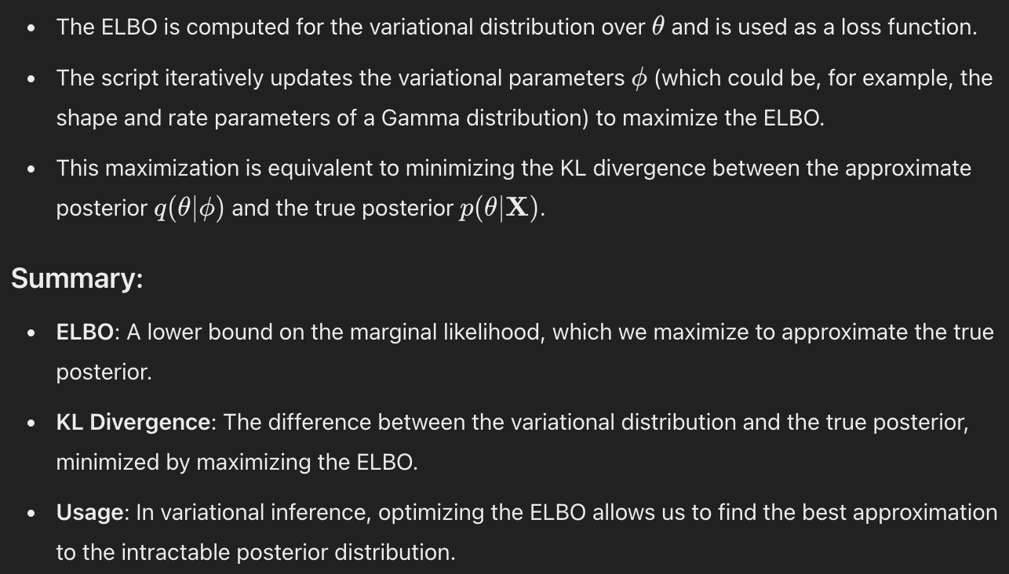
ELBO (evidence lower bound)

Slide 9
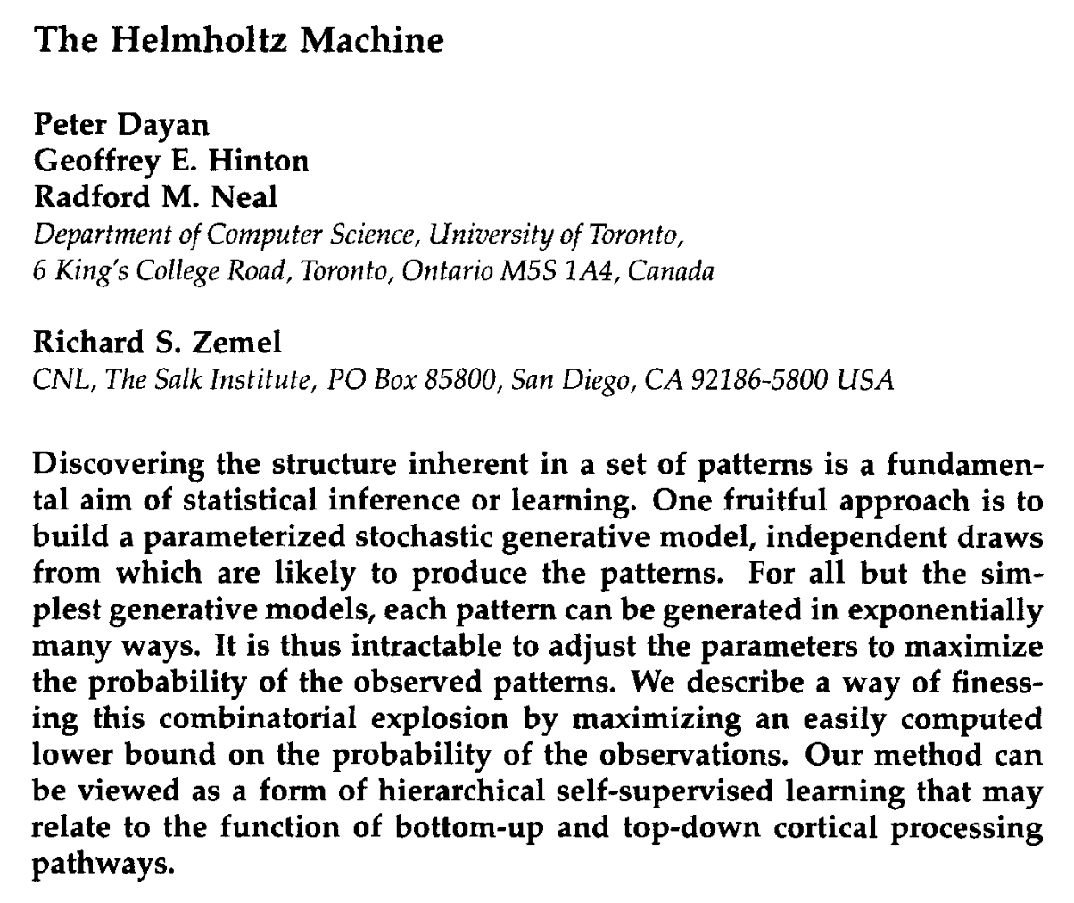
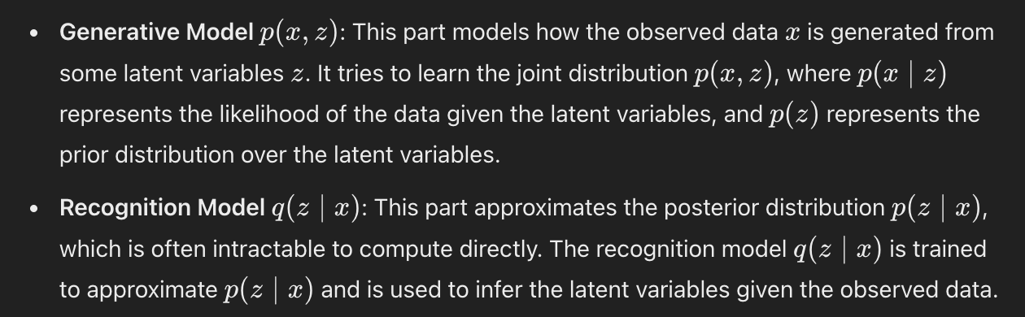

Slide 10
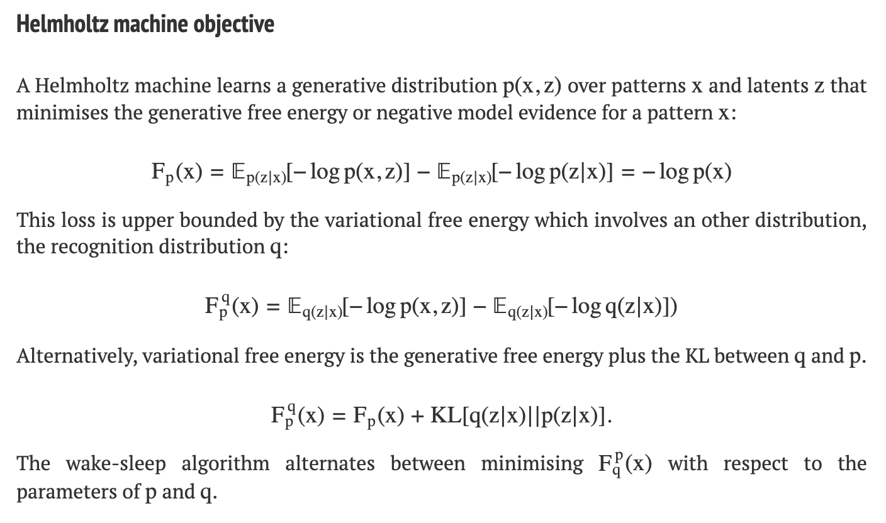
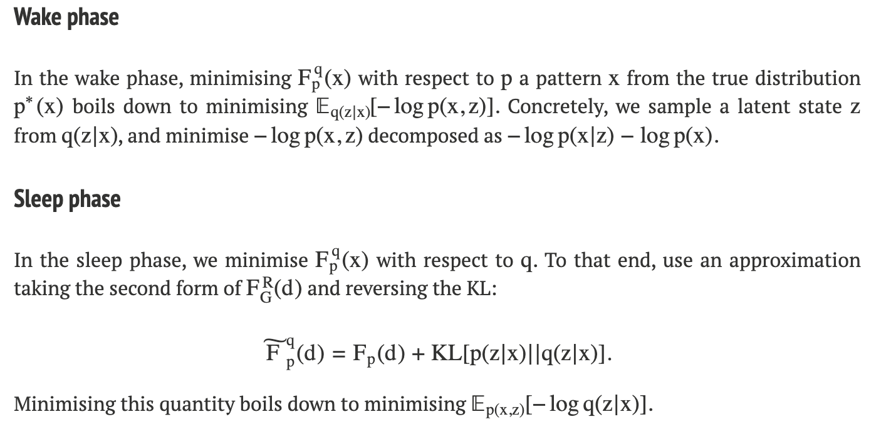

Slide 11
Key Insights
At the heart of Variational Inference is the minimization of Variational Free Energy which is directly tied into “maximizing model evidence” or “minimizing model surprise”
The exact algorithmic implementation can take on different flavors (i.e. Helmholtz Machine/Wake-sleep, VAEs, diffusion models) but they can all be framed in essence as trying to model a complex posterior distribution with a simpler and easier to sample variational distribution
Wake-sleep was directly inspired by biological plausibility (only local update rules) of neurons, which VAEs do away with to enable end to end training, but at its core this sets the stage as viewing probabilistic modeling as approximate Bayesian variational inference

Slide 12











We’ll go through this paper carefully. The chapters I really struggled with are circled in red below.

Slide 13
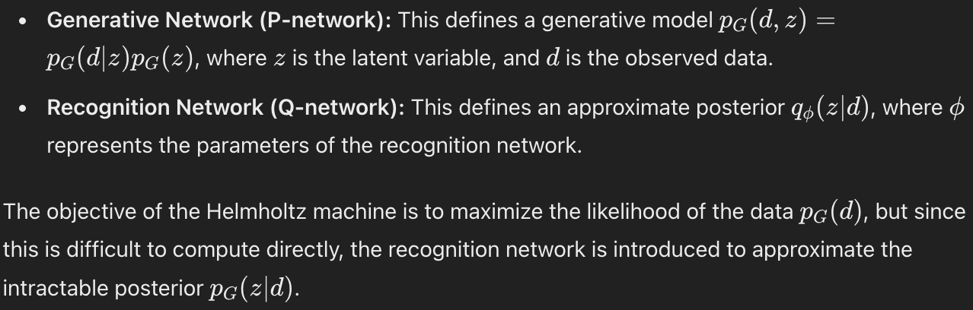
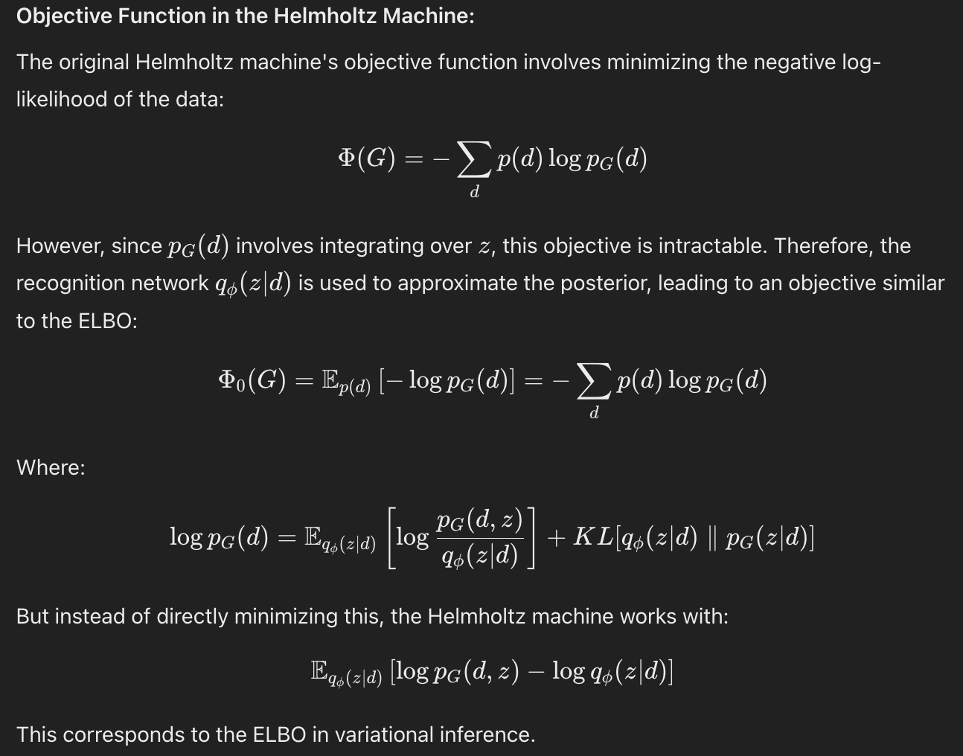
High level summary of Helmholtz Machine

Slide 14
Major discussion points
How to really solidify understanding about the mechanics of Variational Free Energy minimization vs. ELBO maximization vs. minimizing KL divergence between q and p posteriors for VI (Helmholtz vs. VAE)
The diffusion model seems quite similar in some ways (forward and reverse processes resemble recognition and generative models). What is the explicit relationship?
Prospective: All of these ideas underlie Karl Friston’s Free Energy Principle and the idea of all agents acting as approximate Bayesian machines that attempt to model the hidden external variables that project onto their sensory states…Helmholtz Machines clearly inspire this and may follow more biologically plausible update rules rather than backprop
Prospective: What about the issue that with overparameterized neural networks, many weight configurations execute the same function? This seems to violate the idea of moving on a statistical manifold of function parameterizations where each point in function space is a unique function (i.e. the divergence/distance between two points should be zero if it is the same point, but if two points execute the same function but are different points, then what happens here?)

Slide 15
Appendix

