Slide 1
Diffusion Schrödinger Bridge with Applications to Score-Based Generative Modeling
De Bortoli et al., 2023, Neurips
Understanding the Intersection of Schrödinger Bridges, Diffusion Processes, and Generative Models…

Slide 2
Take-home messages
Core contributions of the paper:
Introduces Diffusion Schrödinger Bridge (DSB) as a principled framework combining Schrödinger bridges and score-based generative models.
Provides an efficient approximation to Iterative Proportional Fitting (IPF).
Seems to produce better quality results than SBMs in practice?
More efficient at inference time than SBMs.
Why should we care?
Standard diffusion models require thousands of steps, making training and inference computationally expensive! The DSB introduced here should provide a much more efficient generative model.
Prior methods for Schrodinger bridges focuses on uniqueness and were quite abstract without algorithmic implementations.
We might want to set the prior distribution to something that isn’t Gaussian… ? E.g., We might want to map between distributions using unpaired samples (image style transfer)
DSB integrates diffusion and Schrödinger Bridge theory to achieve principled and practical generative modeling.

Slide 3
Take-home messages
Before we start, if I was to (crudely) over-simplify the DSB method as best possible…
(i) We just take a diffusion model where we sample from a forward process to create noised samples and then learn a backward process through some neural network that can remove the noise.
(ii) We then take another diffusion model where we sample from the backward process which takes us from a latent space sample to a ‘less noisy’ sample. We then use this as a sample to learn a forward process that can re-add the noise.
(iii) We then iteratively repeat (i) and (ii) until we get a final convergence. These iterative procedure provides consistency with the data and prior distributions. The forward and backward processes become more ‘aligned’.
However, they use some tricks so as not to need to train a whole diffusion model on each iteration…..

Slide 4
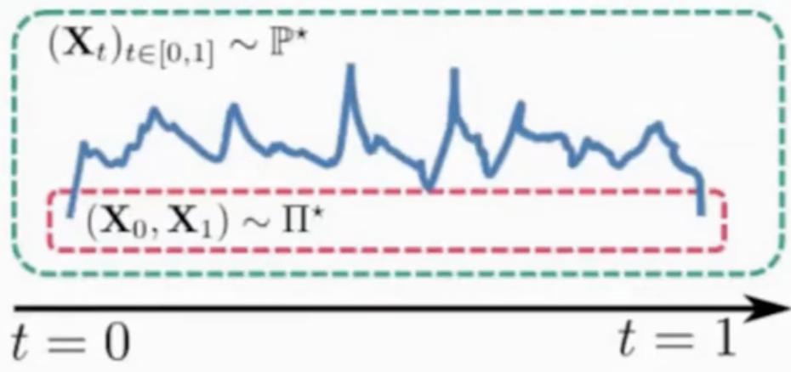
What is a Schrodinger bridge?
*A path measure is a probability distribution over entire trajectories/paths of a stochastic process, describing the likelihood of different sequences of states over time.
Problem Statement: Given two distributions π₀​ (initial) and π₁ (final), find a stochastic process P (path measure*) that:
starts with π₀​ and ends at π₁
**minimizes the relative entropy between P and a reference process Q.
The desired process, which transforms π₀​ into π1​
Brownian motion or another diffusion process
**Note that without (ii) we get the static schrodinger bridge formulation which ignores intermediate dynamics and is thus similar to optimal transport
Schrödinger Bridges can be viewed as a generalization of optimal transport with entropic regularization:
1. Optimal transport minimizes a cost (e.g., Wasserstein distance) for moving mass between π₀​ and π₁​.
2. Schrödinger Bridges add stochasticity (via the reference process Q) and minimize a probabilistic cost.
A Schrödinger Bridge (SB) is a stochastic process that provides a probabilistic interpolation between two probability distributions, π₀​ and π₁, while minimizing a cost (KL divergence?) subject to constraints.

Slide 5
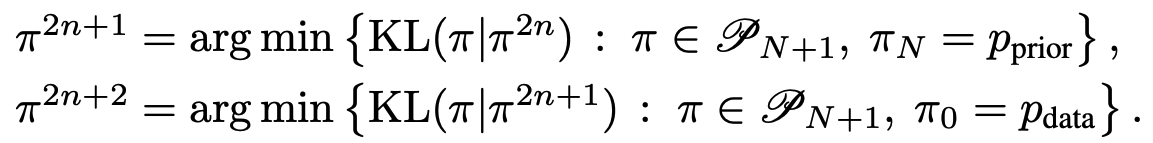
How is an SB solved?
This is my constraint that I need to satisfy!
Iterative Proportional Fitting (IPF).
1. Start with a reference process Q.
2. Alternate backward and forward updates (many times).
3. Reach convergence.
Brownian motion or another diffusion process
Initially this would be the Brownian motion
Odd iteration
Find a new path measure π that is as close as possible (in terms of KL divergence) to the forward path measure π^{2n ​}from the previous step.
Finding optimal path measure for backward process
Ensure that π^{2n+1​} such that its final-time marginal matches p_{prior}
Even iteration
Find a new path measure π that is as close as possible (in terms of KL divergence) to the forward path measure π_{2n+1 ​}from the previous step.
Finding optimal path measure for forward process
Ensure that π^{2n+2​} such that its final-time marginal matches p_{data}
Prior solutions to IPF:
Solvable by updating joint density p (shown in appendix D2)
Requires approximating the potentials (that transform reference process to desired process)
Theoretically feasible but computationally prohibitive for high-dimensional problems due to the complexity of solving forward and backward PDEs or sampling-based approximations.

Slide 6
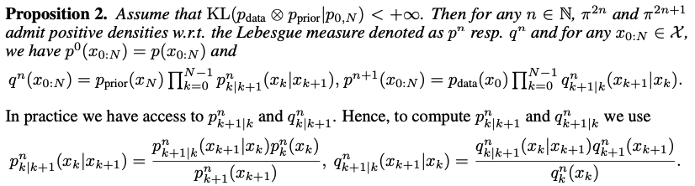
Linking forward and backward processes
Forward process
Backward process
Reverse time probability density at iteration n.
Anchors reverse process at t=N
Forward process p is used to transition back in time
forward time probability density at iteration n+1.
Anchors forward process at data
Backward process to transition forward in time
Just like a standard noising…
What are they saying?
Start with a reference process (gives us a baseline measure π^{2n​}= p(x_{0:N})) which was constrained at the data dist.
Now we use this p^{n} to construct a new backward measure π^{n}=q^{n+1​}. We do this by starting with the known prior distribution at time N and “propagating it backward” using transition probabilities derived from p^{n}.
Then we use this q^{n} to construct a new forward measure π^{2n+2}=p^{n+1}. We do this by starting with the known pdata at time 0 and “propagating it forward” using transition probabilities derived from q^{n}. The result is p^{n+1}(x_{0:N}), a new forward path measure that matches p_{data} at time 0 and is now also more consistent with the backward constraints introduced by q^{n}.
Repeats steps 2 and 3 till convergence….
We need to flip the transition directions using Bayes rule!

Slide 7
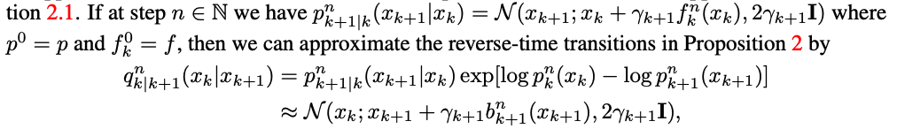
Gaussian approximation of transitions
The authors use a gaussian approximation:
The backward (and forward) transitions can be approximated by a Gaussian with some backward (forward) drift term.
Approximating these functions using score matching would be expensive…
i.e., we would need to fit a diffusion model on every iteration…

Slide 8
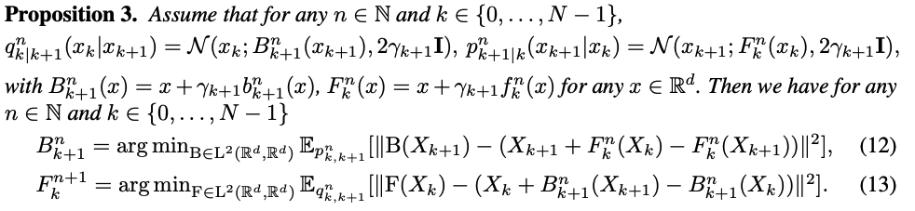
Iterative mean matching proportional fitting
They reduce the iterations to a set of least-squares regression problems:
Iteratively update B^{n}(k,x) and F^{n}(k,x) by minimizing a discrepancy between the two processes in terms of their dynamics.
1. To find b_{n}​, you adjust it so that the backward increments match those implied by the current forward measure.
2. To find f_{n+1​}, you adjust it so that the forward increments match those implied by the updated backward measure.
They frame is as an optimisation problem.
Instead of explicitly computing gradients of densities, one now just needs samples and can learn these functions F_{n}​ and B_{n}​ through empirical risk minimization, typically using neural networks to parameterize these functions.
Predicts X_{k​} from X_{k+1.}
Forward drift acts as our ‘ground truth’ transition from X_{k​} from X_{k+1.}

Slide 9
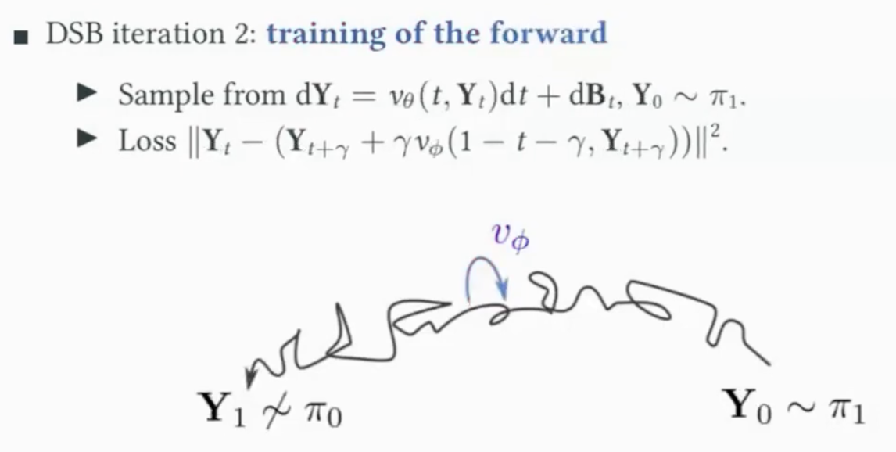
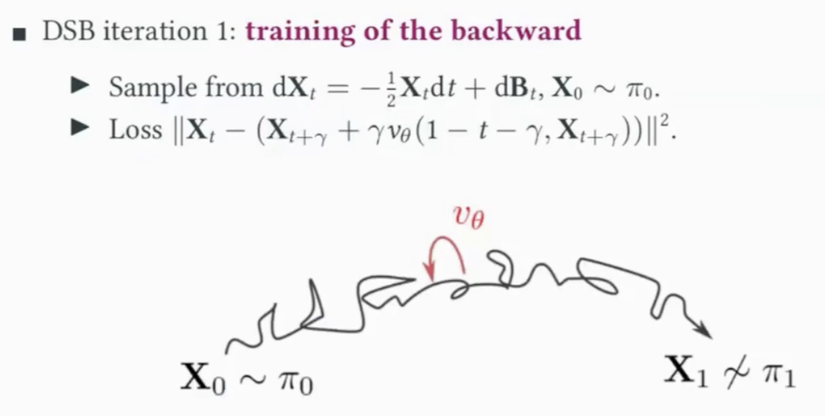
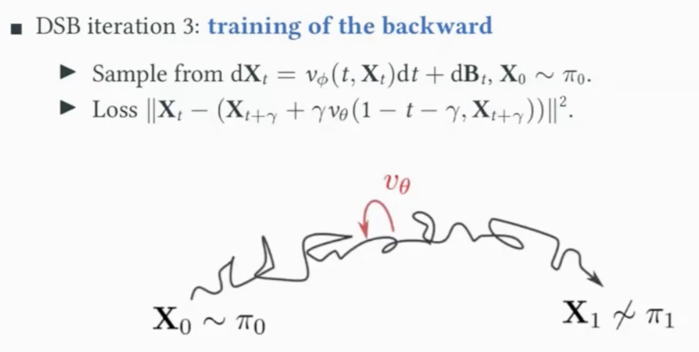
Algorithm
Create a sample from backward process (start with prior distribution and remove noise) and then learn to add the noise with forward process
Create a sample from forward process (e.g. add noise to image) and then learn to remove the noise with backward process.
We are iterating the ‘training’ of two diffusion models: backward and forward!
The first iteration is then like a standard diffusion model with fixed Brownian motion in the forward process.
Create a sample from forward process and then further learn to remove the noise with backward process.

Slide 10
Diffusion Schrodinger bridge
Let’s compare SBM and DSB side by side…
Score based model
Fit a single model once.
Fixed forward dynamics (e.g., Gaussian noise schedules).
Neural network sθ​(x,t) predicts the score function ∇_{x​}logp_{t}​(x).
Diffusion schrodinger bridge
Iteratively fit models (until convergence)
Forward dynamics f_{θ}(x,t) are learned to match π₀→π₁​
Backward dynamics g_{ϕ}(x,t) are learned to match π₁→π₀

