Slide 1
Wake-sleep algorithm
Hinton et al., 1995, Science

Slide 2
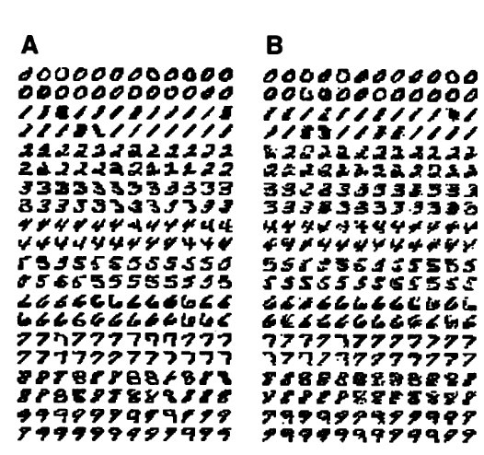
Objective
data
generated
Unsupervised learning of data
Generative model
Local updates (no back-prop)
ASK! (I might be wrong)
Hopping between paper & presentation

Slide 3
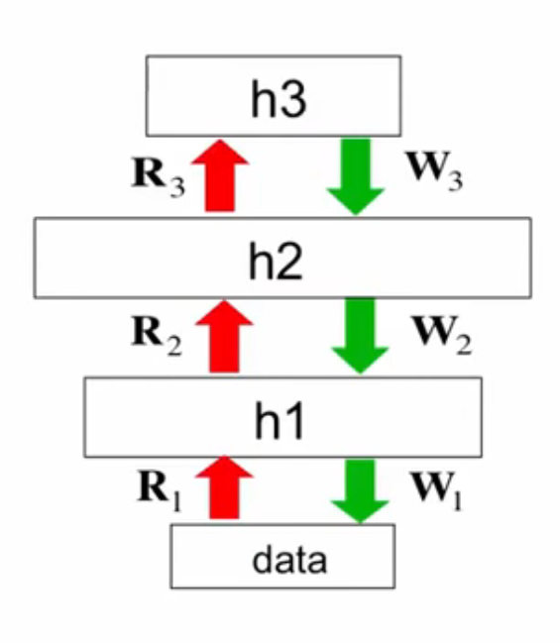
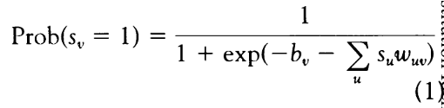
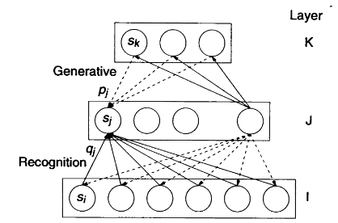
Core idea
Alternating update steps (wake-sleep)
Wake: use recognition, update generation
Sleep: use generation, update recognition
Sample new data starting from layer K
Optimize with information-theory
Minimize the information required to "transmit" data
Representation 'cost' (knowing generative weights)
Difference to real input
data
R: Recognition weights
W: Generation weigths
Sigmoid believe network (stochastic, binary states)

Slide 4

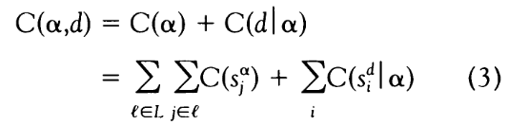

Wake
Infer latents (recognition)
2. Update generative weights

Slide 5

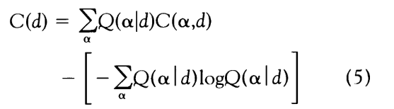
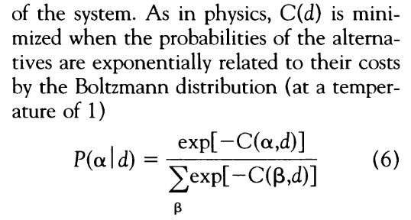

Sleep
Generate data (fantasize)
min_{α}
2. Update recognition weights
Optimize recognition weights across*all possible representations*
Entropy
MAGIC IN BETWEEN

Slide 6
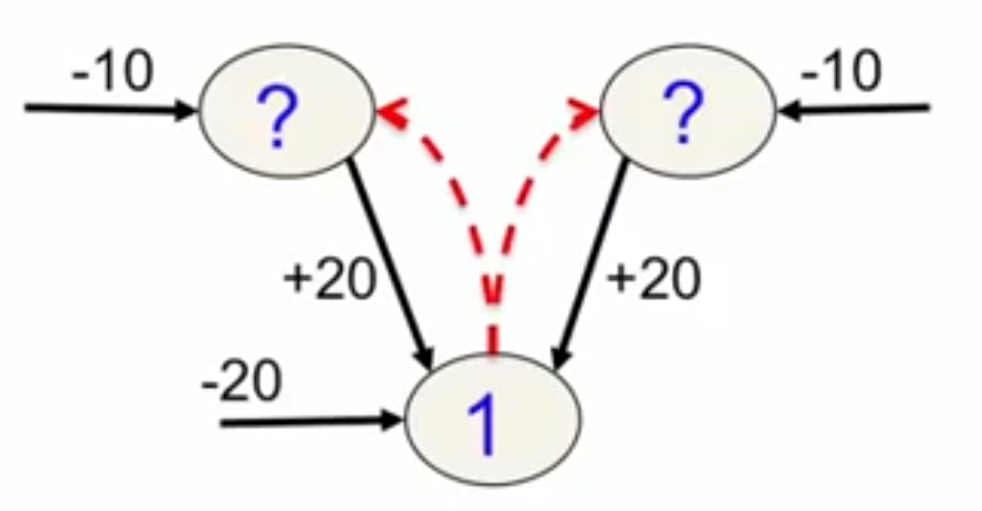
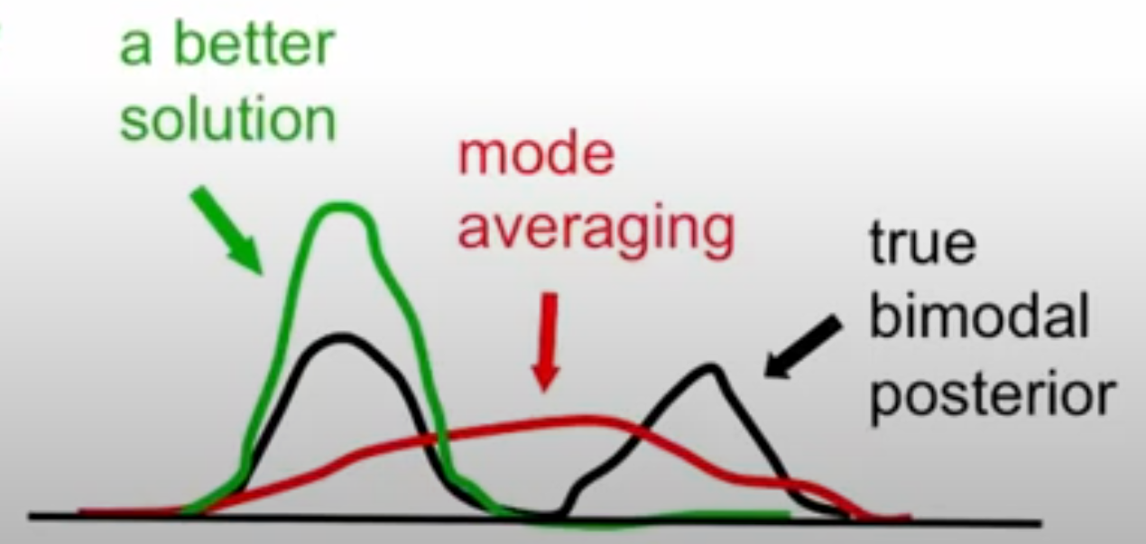
Caveats: Mode averaging
Sleep (generative) phase
Not a fatal flaw, because wake-phase training partially avoids such situations

Slide 7

Take-home
data
generated
Simple idea -> effective data generation
Mathematically grounded
Many ideas of today's generational networks are 30 years old

