Slide 1
NeuralODEs (round 2)
GenAI reading group, 9/10/2024

Slide 2
Agenda
Background - matrix multiplication, neural networks as function composition, backprop
NeuralODEs the naive way
Lagrangian optimisation
NeuralODEs the right way
Backprop the NeuralODE way

Slide 3

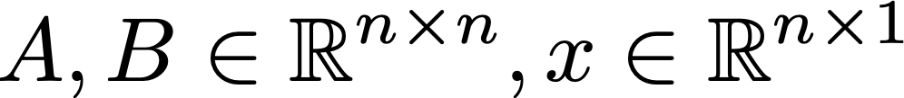
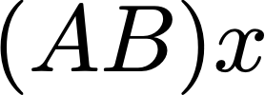
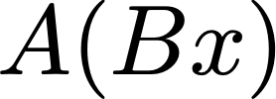
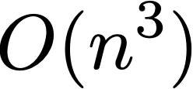
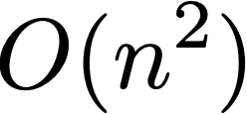
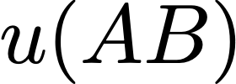
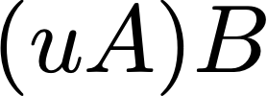
Matrix multiplication
We want to do , where
Which one is easier, or ?
Note is harder, , than , which is
Which is harder or ?
So, for column-wise multiplication we should multiply from right to left, for row-wise multiplication, we should multiply from left to right.

Slide 4

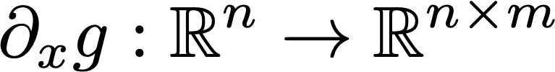








Neural networks as function compositions
In NNs, we study functions and Jakobians .
Represent a NN as a composition (outputting a scalar loss)
Forward pass: (multiply right to left, domain fixed)
Backward pass:
Chain rule
(multiply left to right, image fixed)

Slide 5
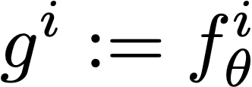
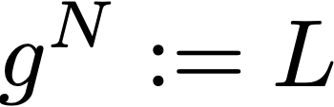
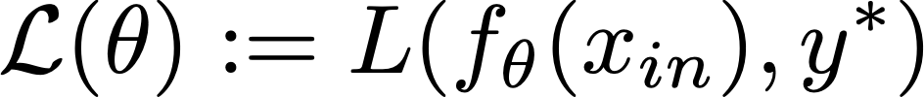







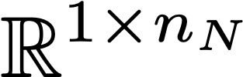












Backprop
Assume function, , , where is the ‘loss’
We seek to optimise , where is the ground truth
We need the gradient
Easy : we know
Needs more work:

Slide 6
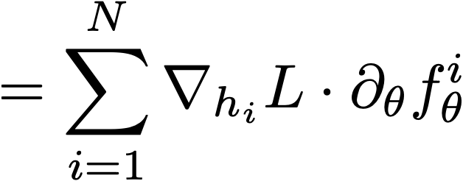
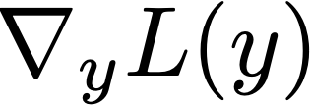


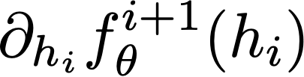

Backprop
Where , left to right
Algorithm
Forward pass to obtain
Find
For i from N to 1, find by multiplying by
Compute , and accumulate

Slide 7



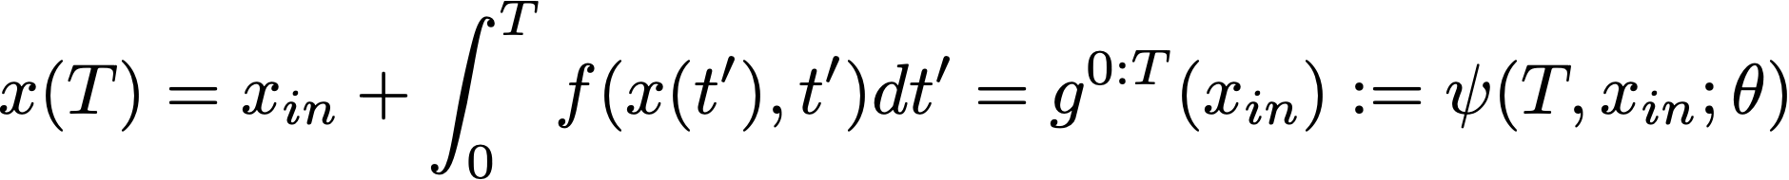

NeuralODEs recap
Usual NNs
NeuralODE
Layer index
Flow map

Slide 8






NeuralODEs the (direct) naive way
Idea: Let . Then, , , where .
Issue: is difficult to compute and we do not need it, we need !

Slide 9


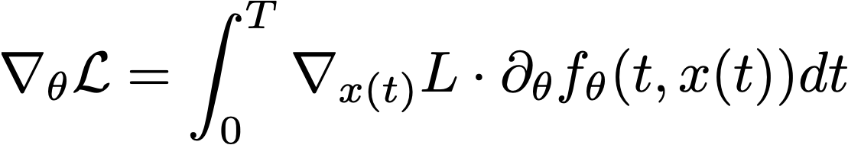



Another way of expressing the gradient of loss
Discrete NNs
Leap of faith
Continuous NNs (NeuralODE)

Slide 10
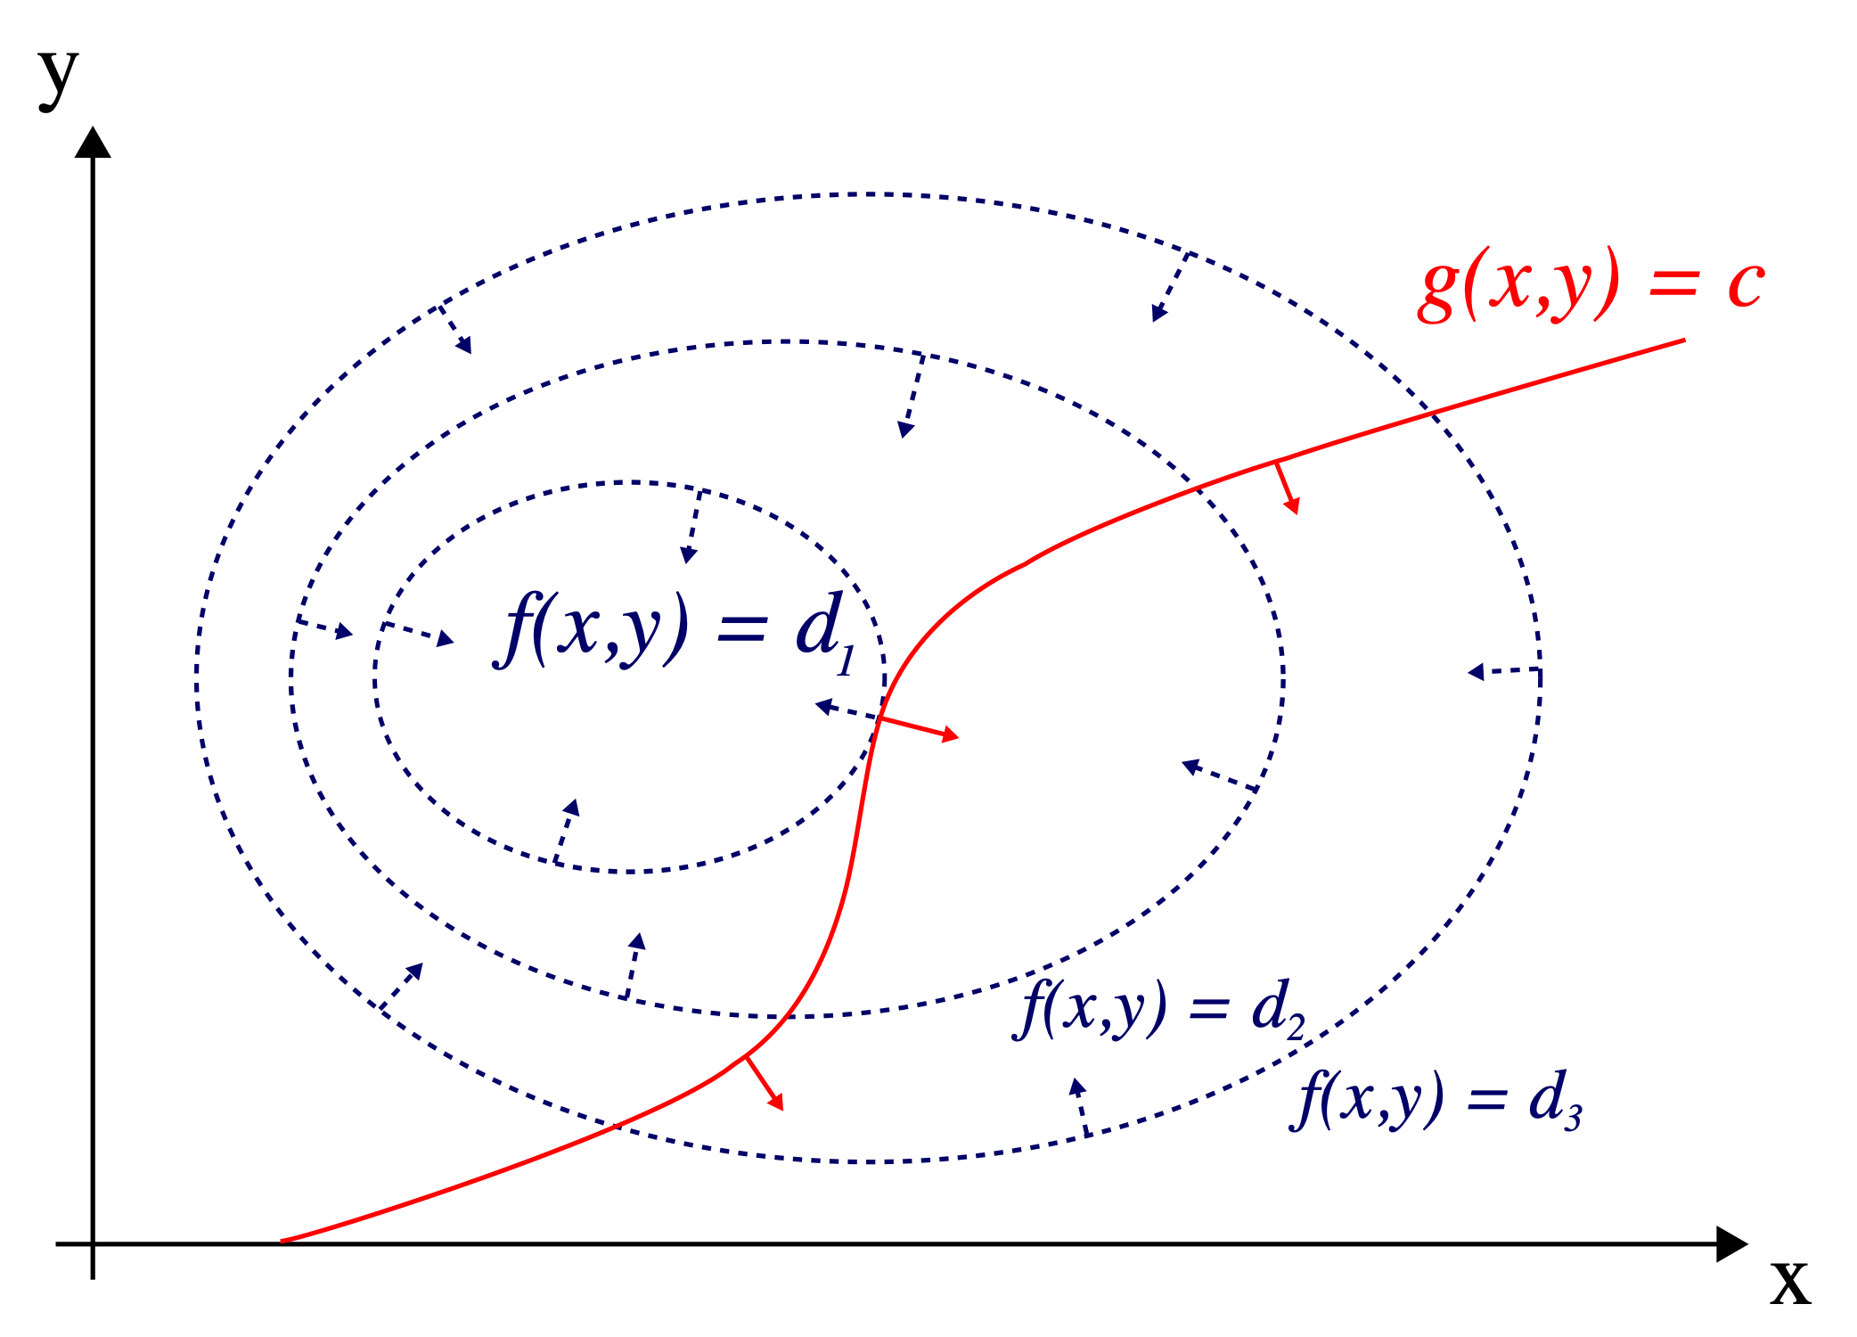
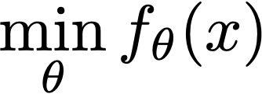

Lagrangian optimisation
The constrained optimisation problem
Is equivalent to finding the stationary points of
Which is equivalent to
Primal
Dual

Slide 11
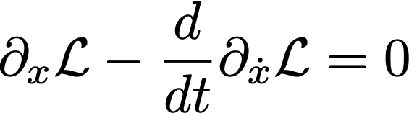
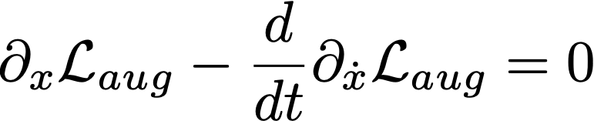
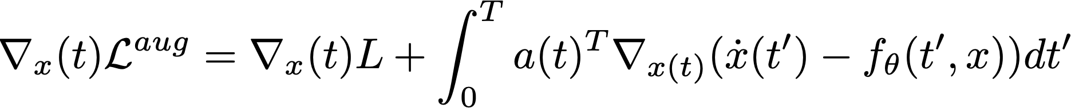
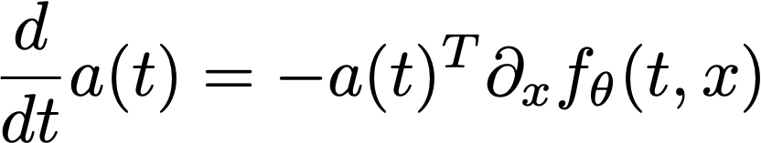


NeuralODEs the right way (dual problem)
Action functional
The stationary points are found via the Euler-Lagrange equations
Verify (first KKT condition)

Slide 12


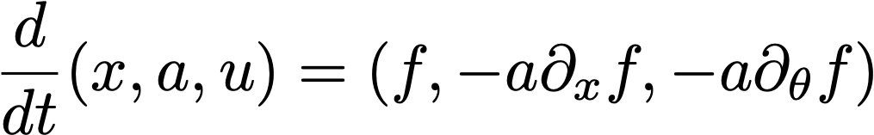
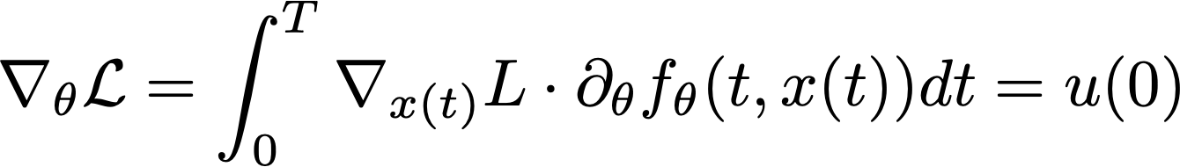
Backprop - the NeuralODE way
Usual backprop algorithm
NeuralODE backprop
Forward pass: solve , but only store
Solve , backwards.
Solve
Forward pass to obtain
Find
For i from N to 1, find by multiplying by
Compute

Slide 13
Key ideas
Find gradient of loss function in an efficient way - only take gradient against last function, which is a vector not a matrix
Long compositions in discrete space become flow maps of a differential equation in the continuous case
Use duality to solve the problem efficiently and avoid storing intermediate values

