Slide 1
Two Perspectives on Stochastic RWs
Diffusion models v.s. Score function

Slide 2
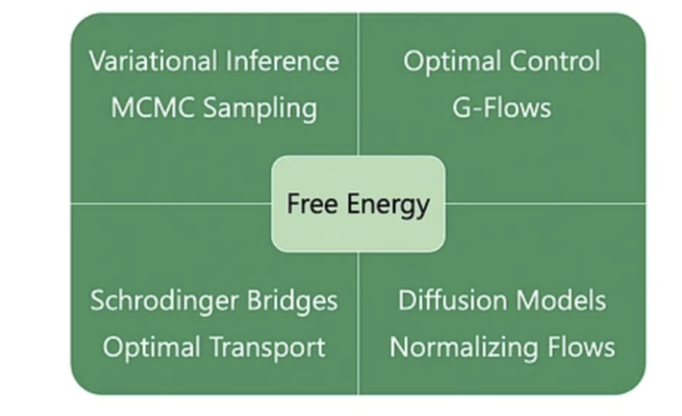

Slide 3
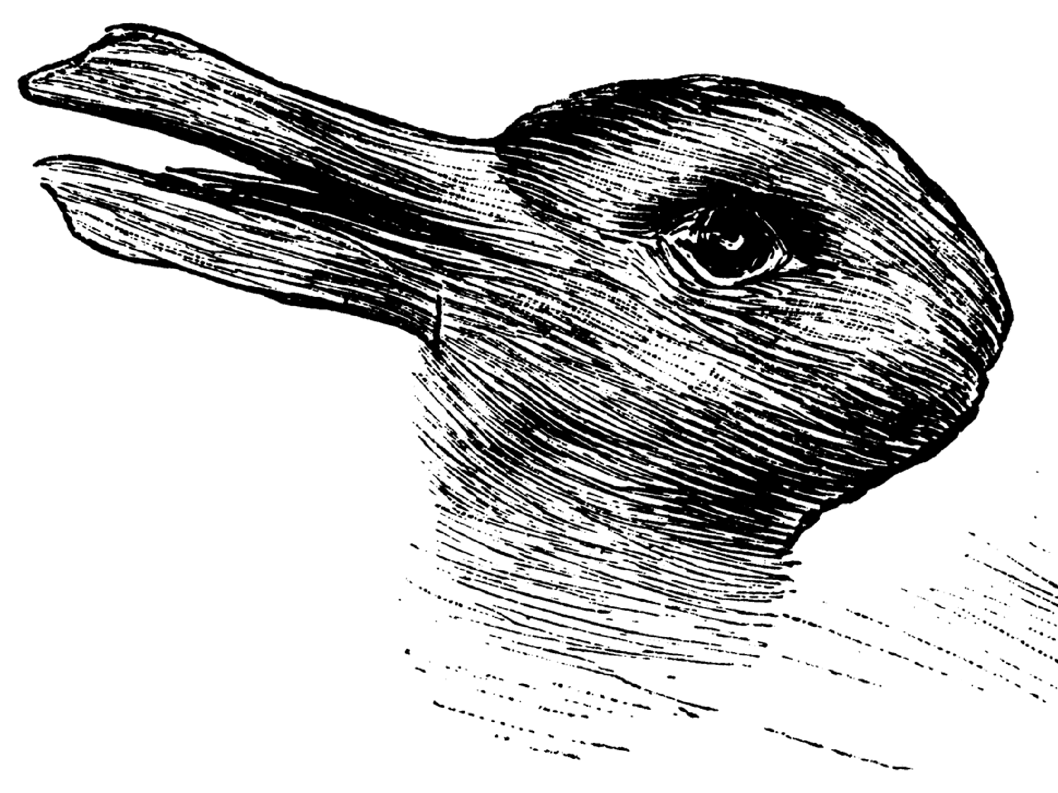
Annoying Things about Probability Distributions
Scoring
Sampling

Slide 4
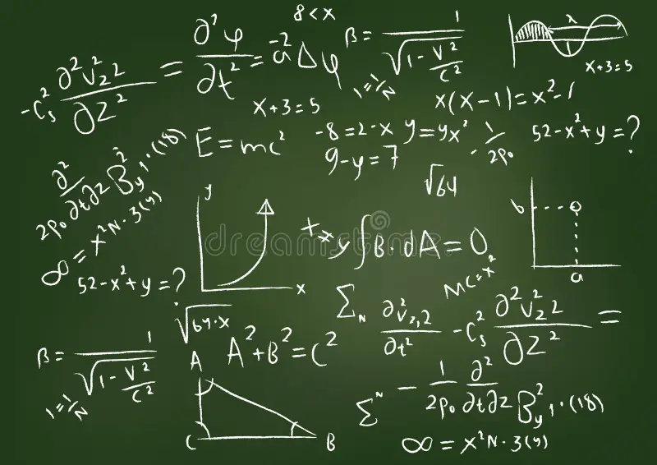
Too Many Equations! Which ones matter?

Slide 5
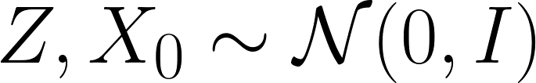
This one.
This is simple, flexible recipe for generating a probability distribution.
Take out the noise term - becomes a (discretized) ODE/Normalizing Flow
Take out the drift term - (discrete) brownian motion!
Take out the X_t term - it's basically a noisy RNN

Slide 7
This one.
This is simple, flexible recipe for generating a probability distribution.
Adds Stability c.f. RNNs v.s. ResNets
Trainability (actually shapes the resulting distribution)
Stochasticity

Slide 8
Can Generate Good(-ish) Distributions
Unlike all those ingredients separately, it can actually model complex datasets like image data quite well.
…if we pick train the model to pick f correctly,

Slide 9
Any ideas on how to train it?
Two things to notice about it.
It's a discretization of an SDE
(and we can analyze the corresponding Fokker-Plank)
Leads to Score function learning.
It's a Markov Chain
(and can be the inverse of another, simpler markov chain)
Leads to Diffusion models.

Slide 10
Variational Inference Recap

Slide 11
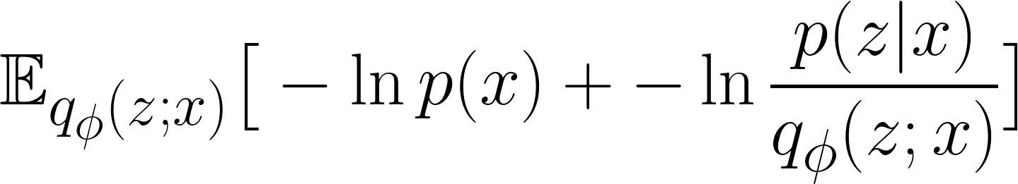
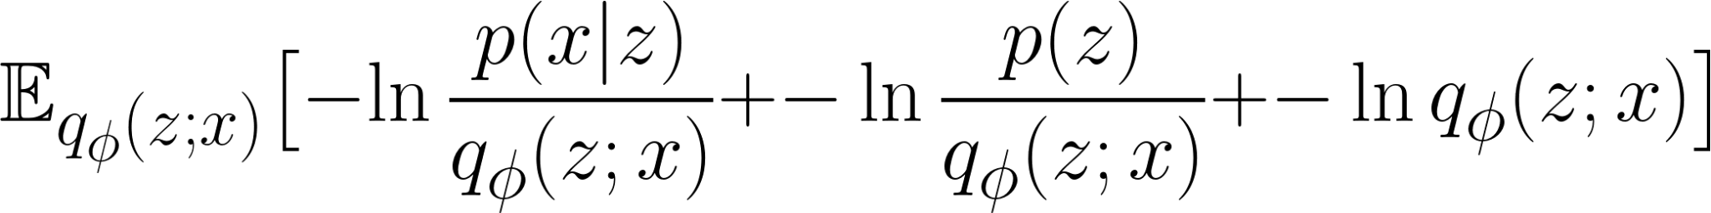
Variational Inference Recap
=

Slide 12
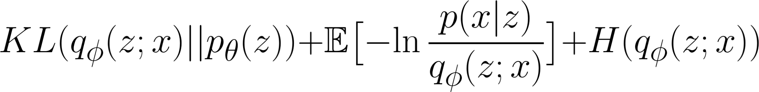
The Core of Variational Inference
=

Slide 13
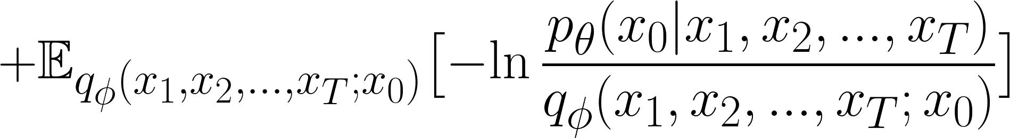
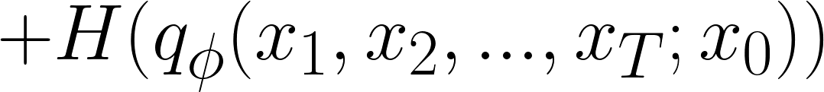
In the Case of a Diffusion Model
=

Slide 14


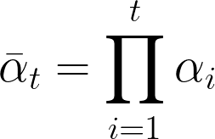

The Actual Insight of the Paper

Slide 16
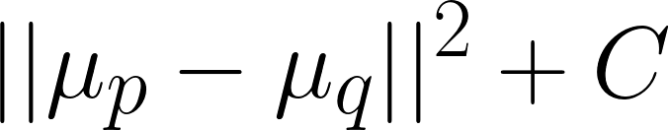
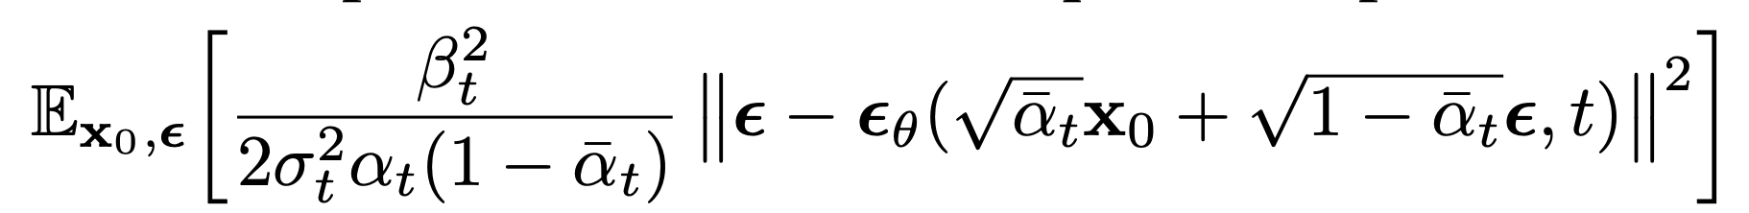
The Actual Insight of the Paper

Slide 17
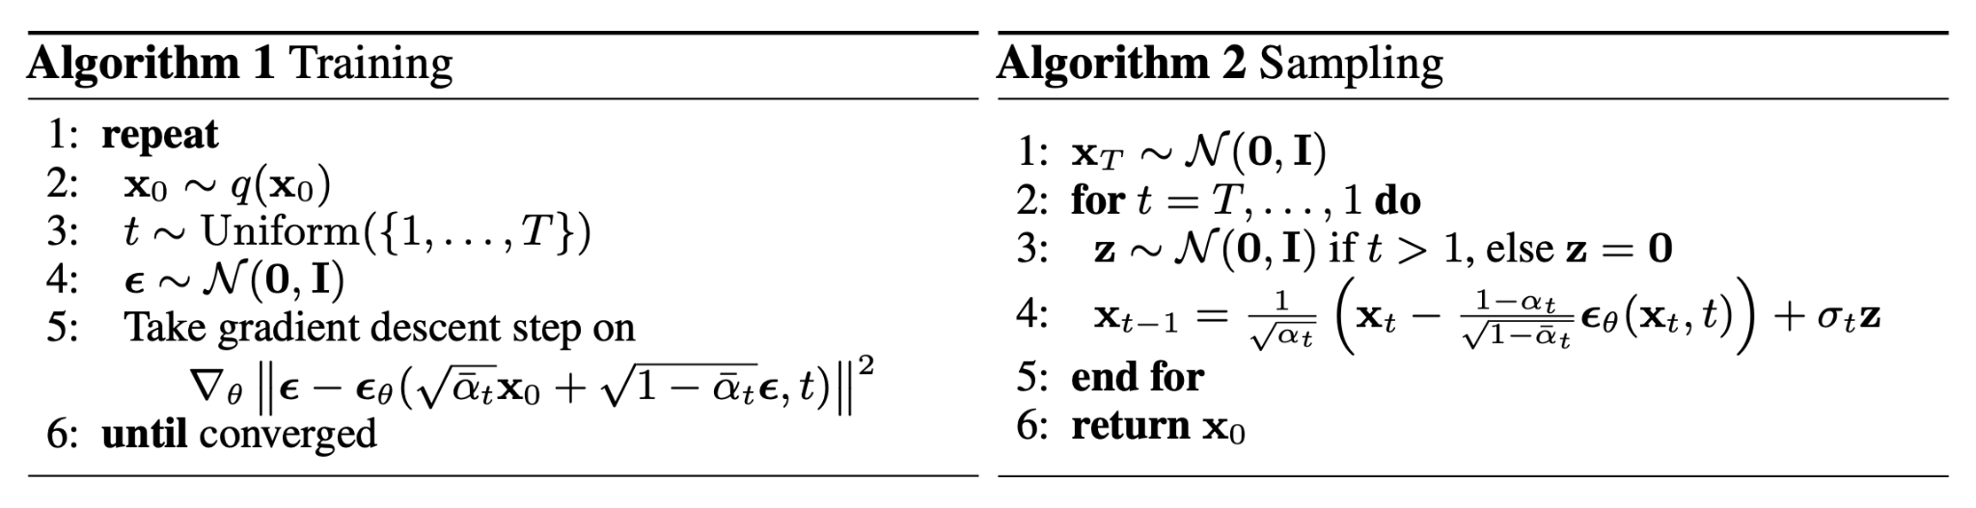
Sampling With an SDE

Slide 18
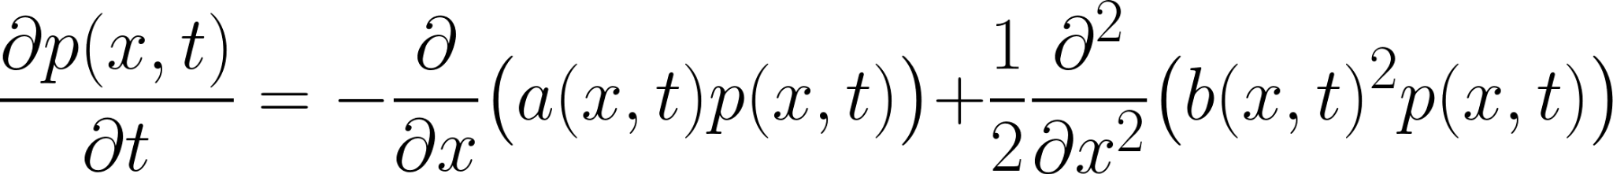
Fokker Plank to Guide Choice of SDEs

Slide 19
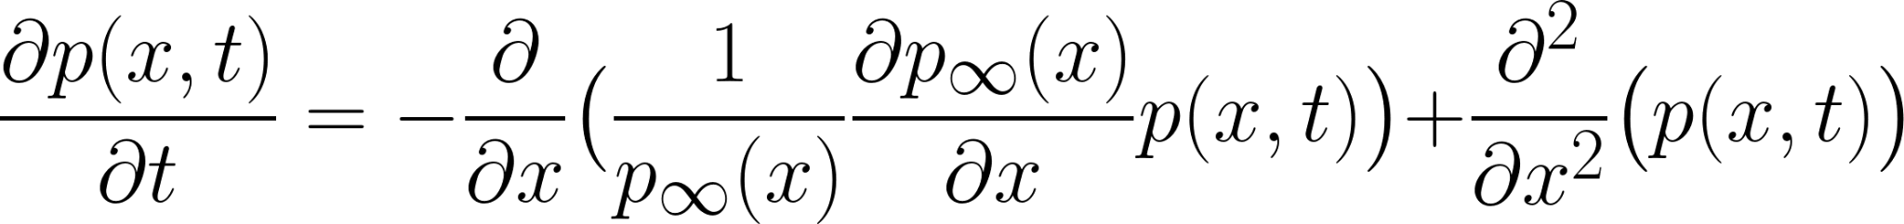


Fokker Plank to Guide Choice of SDEs
if

