Slide 1
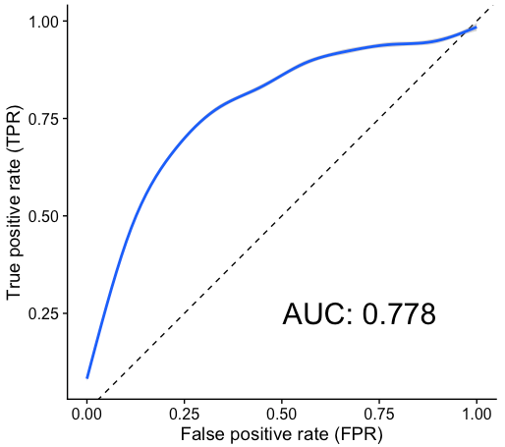
A
Notes:
Figure 2. Univariate time-series feature classification results.

