Slide 1
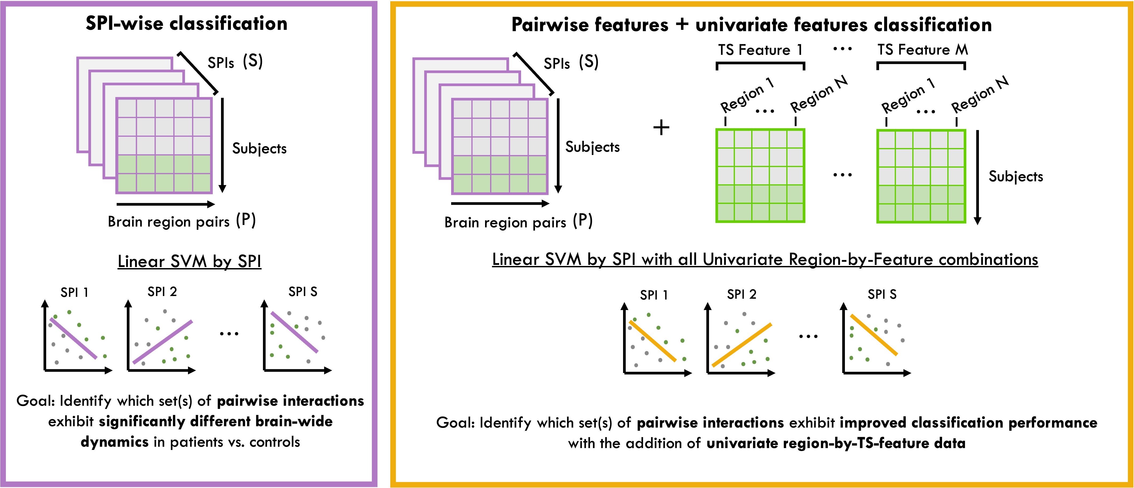
Figure S2
A
B
Notes:
Figure S4. Pairwise classification framework. Number of unique directed brain-region pairs (P) is 2,256 for ASD and 6,636 for Schizophrenia.

Slide 2
SPI-wise classification
Pairwise features + univariate features classification
(S)
(S)
TS Feature 1
…
TS Feature M
SPIs
SPIs
Region 1
Region 1
…
Region N
…
Region N
+
Subjects
Subjects
…
Subjects
(P)
(P)
Brain region pairs
Brain region pairs
Linear SVM by SPI
Linear SVM by SPI with all Univariate Region-by-Feature combinations
SPI 1
SPI 2
SPI S
SPI 1
SPI 2
SPI S
…
…
Goal: Identify which set(s) of pairwise interactions exhibit significantly different brain-wide dynamics in patients vs. controls
Goal: Identify which set(s) of pairwise interactions exhibit improved classification performance with the addition of univariate region-by-TS-feature data

